Slide 1

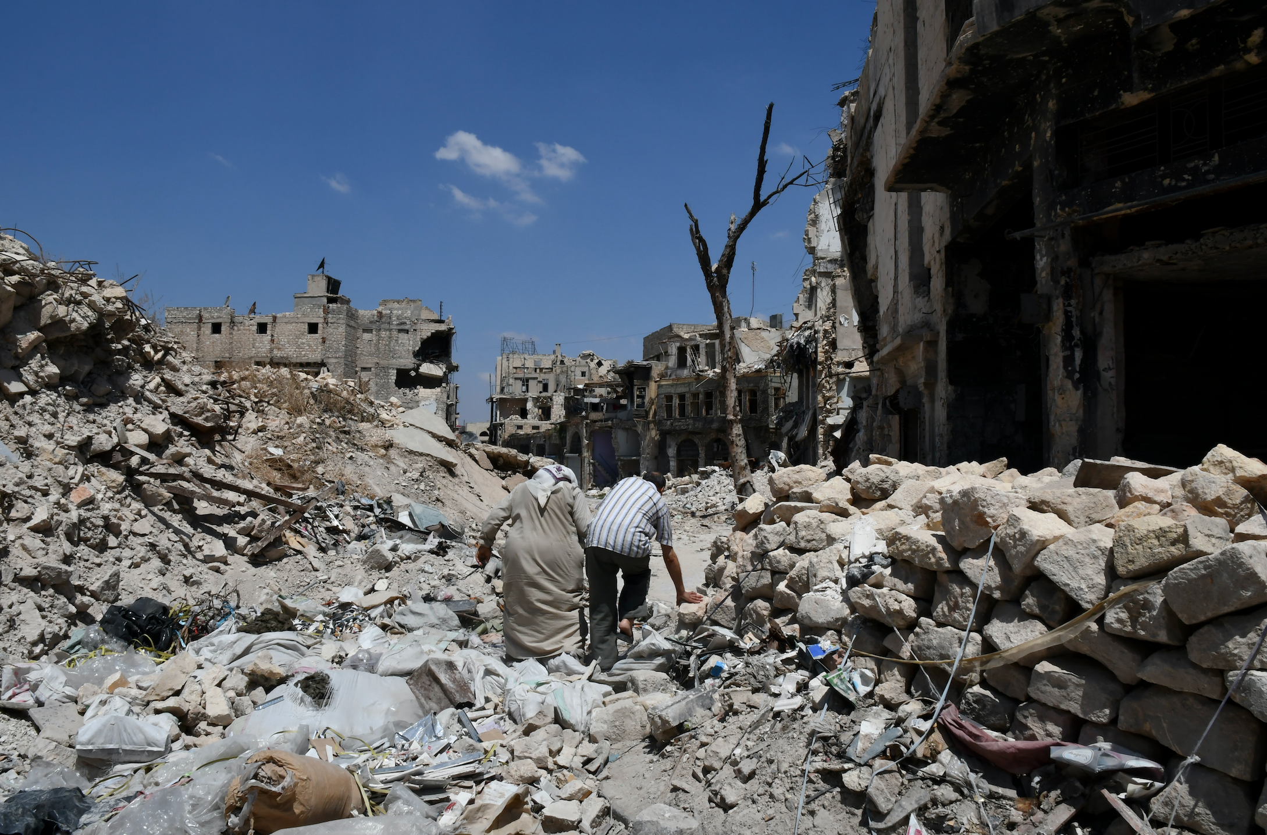
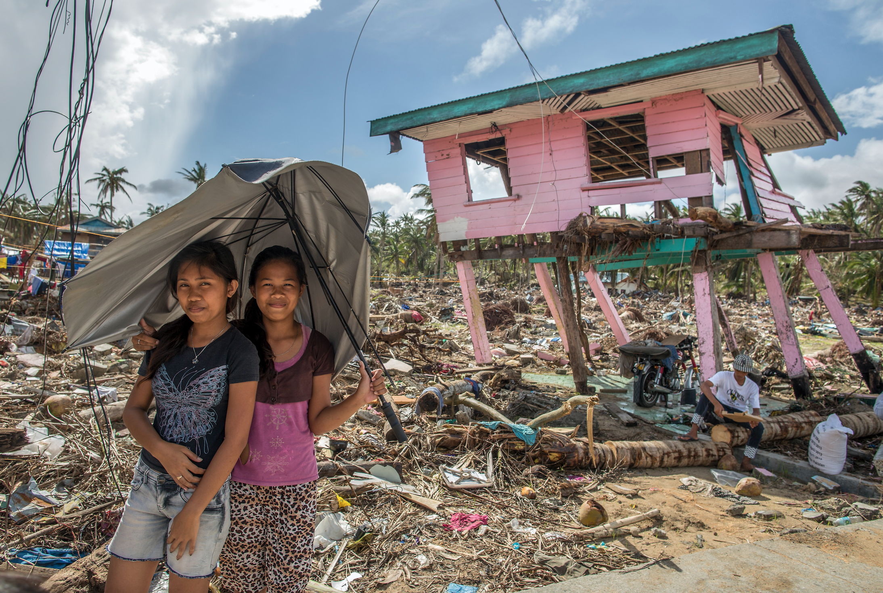
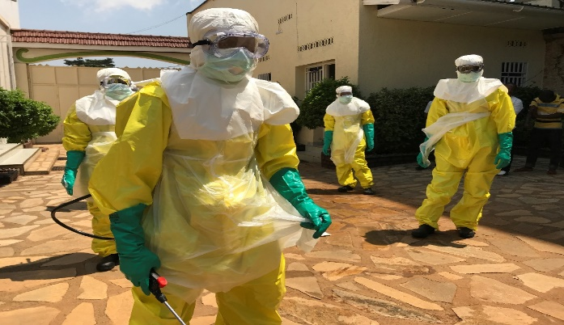
Setting the Scene
Eva Pilipp, ©ICRC
Olivier Matthys ©ICRC
LESKINEN, Hanna © ICRC
H.E.L.P. course
Monica Arpagaus, ICRC

Slide 2
Objectives
Be able to
explain how people, communities and services may be affected by different types of crisis situations
identify needs that should be met during humanitarian crises in order to maintain and/or improve the health of people affected by the crisis situation
describe main causes of excess morbidity and mortality during crisis situations and explain at what level humanitarian interventions take place to counter these
explain the relationship between health, health systems, health services, public health and social determinants of health
explain core principles, standards and norms in humanitarian action
H.E.L.P. course

Slide 3
H.E.L.P. course
Types of crisis - context and consequences
Groups | Video | Country | Time | Production
1 | Courage under fire | South-Sudan | 1:40 | ICRC
2-3 | Earthquake “Kirtipur” | Nepal | 3:00 | Sagarmatha TV
4 | Suffering escalates as winter looms | Syria | 1:18 | ICRC
  Group work, 15 minutes
  Discuss how the lives of the people and their communities are affected by the crisis
  List the problems that they are faced with
Notes:
Three movies, representing three types of situations/ contexts:
South Sudan: armed conflict, low income country, mainly rural, limited infrastructure, high prevalence of infectious diseases,…..
Syria: Armed conflict, middle level income country, important urban areas....
Nepal: Natural disaster / earthquake.....
Each group discusses one of the movies

Slide 4
Courage under fire –South Sudan
H.E.L.P. course

Slide 5
Earthquake “Kirtipur”, Nepal
H.E.L.P. course
Notes:
This video is not sub-titled -> it is meant as observation (people from Nepal / India understand what is being saif). Cut the movie after about 1.30 – 2 minutes

Slide 6
Syria – Winter looms
H.E.L.P. course

Slide 7




H.E.L.P. course
Crisis typology
Natural disasters
e.g. geophysical, meteorological, hydrological, geomorphological, biological, extra-terrestrial (meteorites)
Natural hazards impacted by humans
e.g. landslides during heavy rainfall due to deforestation, political systems that turn droughts into famines
Crises caused by humans (man-made)
e.g. armed conflict
Disease outbreaks /epidemics
e.g. Ebola, SARS, cholera
Source: https://www.cred.be/
Notes:
There is actually no such thing as a natural disaster, but disasters often follow natural hazards
Different types of crises are interlinked, e.g. earthquake in a conflict zone, ebola outbreak in DRC
With increased urbanization on all continents, crises have shifted from rural to urban settings which asks for an adaptation of the humanitarian interventions

Slide 8


H.E.L.P. course
Crisis typology
Another distinction:
Progressive evolution
Sudden onset
Notes:
Natural disasters with an immediate impact, e.g. earthquake, volcanic eruption, hurricane, floods
Natural disasters with a progressive impact, e.g. drought

Slide 9
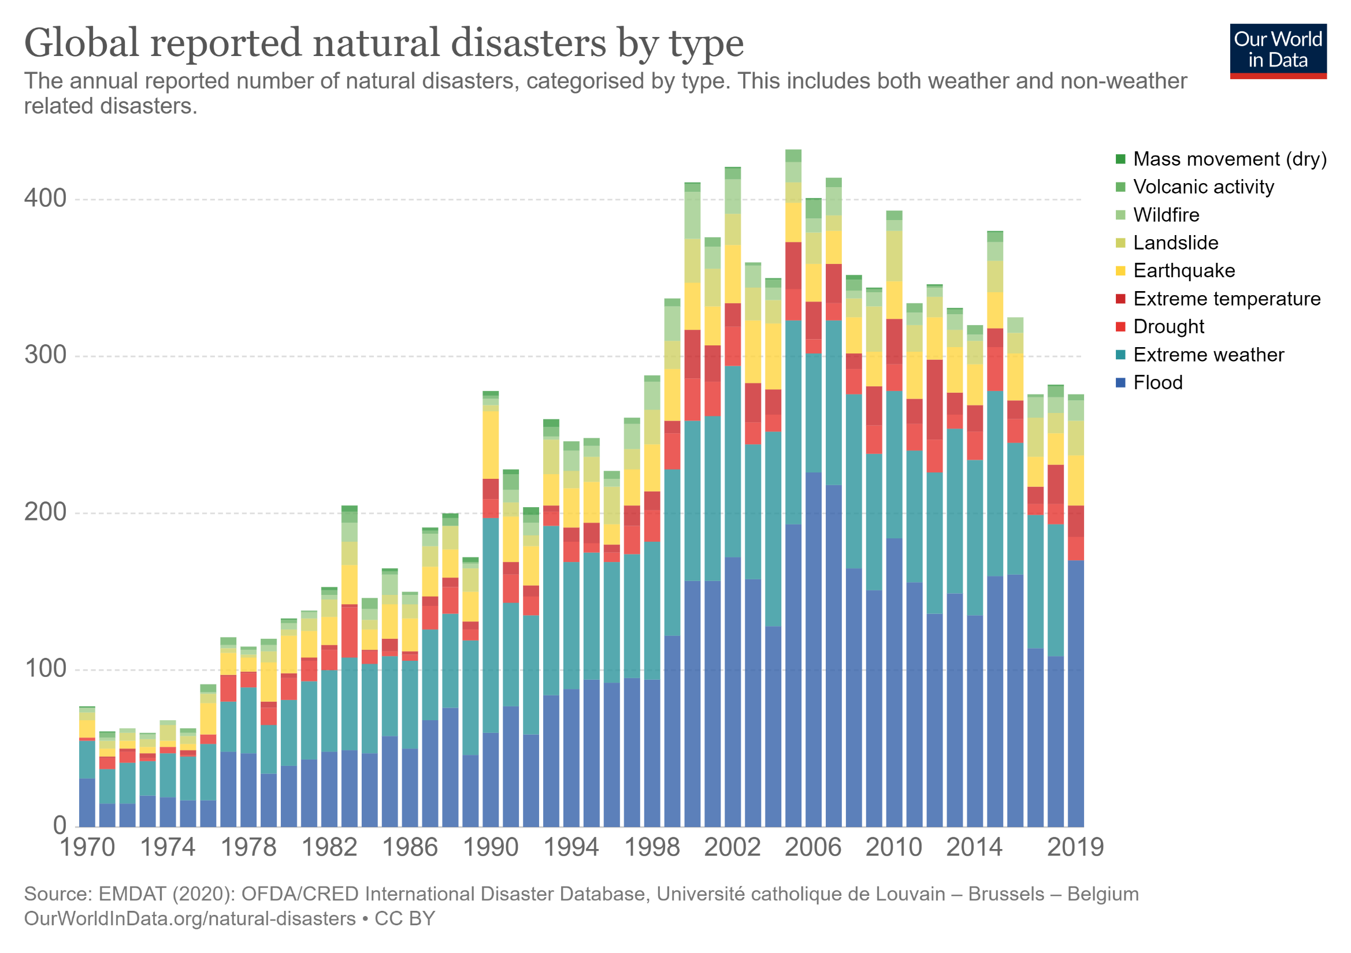
H.E.L.P. course
https://ourworldindata.org/grapher/natural-disasters-by-type

Slide 10
H.E.L.P. course
Global trends for forcibly displaced people – end 2018
Source: UNHCR – mid year global trends study
Notes:
Could also look at changes over time or DRC case study? See here: https://www.unhcr.org/globaltrends2017/

Slide 11
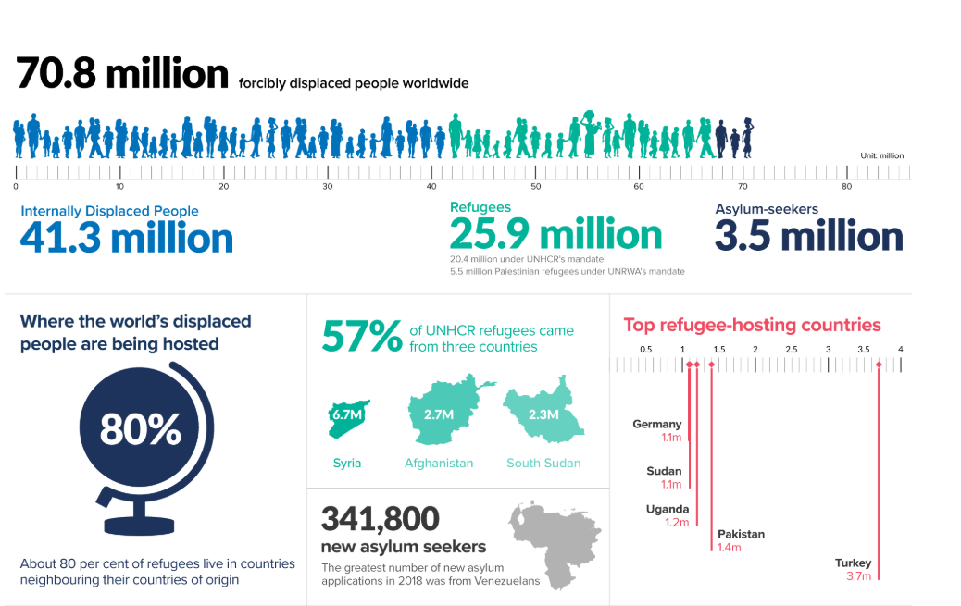
Global Trends for Forcibly Displaced People – 2018
H.E.L.P. course
Notes:
70.8 million forcibly displaced persons end 2018 up from 65.6 million mid year
25.9 million refugees end 2018 up from 22.5 million mid year
CHILDREN: In 2018, every second refugee was a child, many (111,000) alone and without their families.
TODDLERS: Uganda reported 2,800 refugee children aged five or below alone or separated from their families.
URBAN PHENOMENON: As a refugee, you are more likely to live in a town or city (61 per cent) than in a rural area or camp.
RICH & POOR: High income countries on average host 2.7 refugees per 1000 of population; Middle and low-income countries on average host 5.8; Poorest countries host a third of all refugees worldwide.
WHEREABOUTS: About 80 per cent of refugees live in countries neighbouring their countries of origin.
DURATION: Nearly 4 in every 5 refugees are in displacement situations that have lasted for at least five years. One in 5 have been in displacement situations that have lasted 20 years or more.
NEW ASYLUM SEEKERS: The greatest number of new asylum applications in 2018 was from Venezuelans (341,800).
LIKELIHOOD: The proportion of humanity who are refugees, asylum seekers, or internally displaced is now 1 in 108; Ten years ago it was 1 in 160.

Slide 12
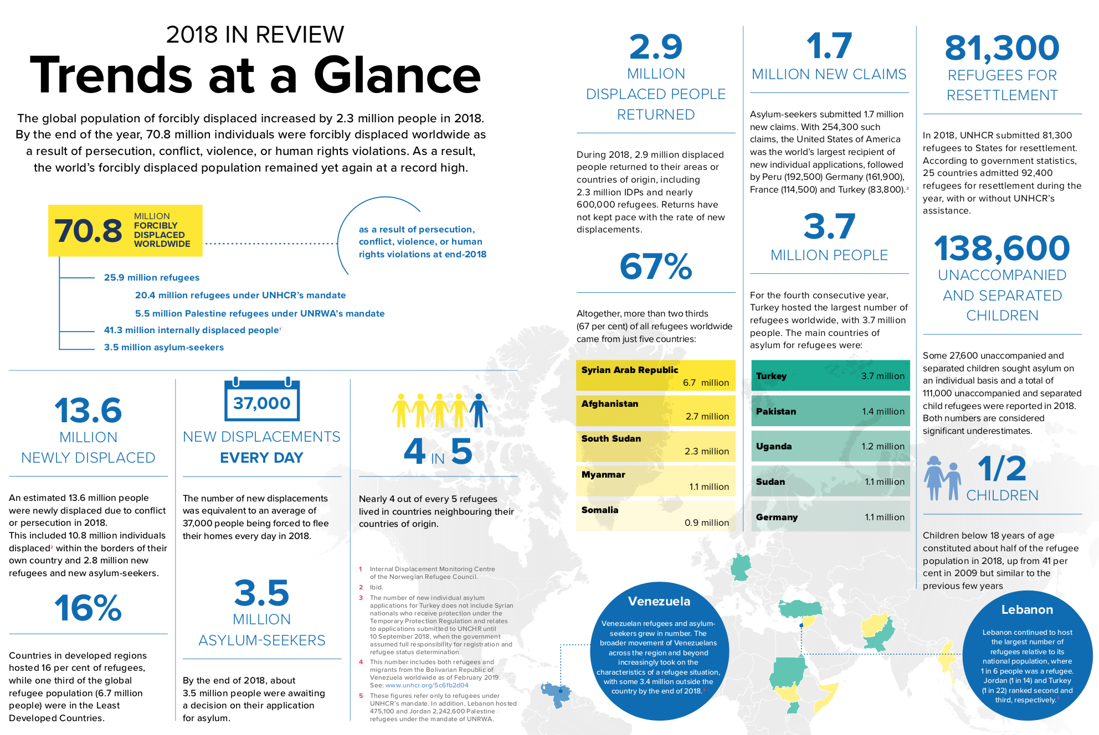
Notes:
CHILDREN: In 2018, every second refugee was a child, many (111,000) alone and without their families.
TODDLERS: Uganda reported 2,800 refugee children aged five or below alone or separated from their families.
URBAN PHENOMENON: As a refugee, you are more likely to live in a town or city (61 per cent) than in a rural area or camp.
RICH & POOR: High income countries on average host 2.7 refugees per 1000 of population; Middle and low-income countries on average host 5.8; Poorest countries host a third of all refugees worldwide.
WHEREABOUTS: About 80 per cent of refugees live in countries neighbouring their countries of origin.
DURATION: Nearly 4 in every 5 refugees are in displacement situations that have lasted for at least five years. One in 5 have been in displacement situations that have lasted 20 years or more.
NEW ASYLUM SEEKERS: The greatest number of new asylum applications in 2018 was from Venezuelans (341,800).
LIKELIHOOD: The proportion of humanity who are refugees, asylum seekers, or internally displaced is now 1 in 108; Ten years ago it was 1 in 160.

Slide 13
H.E.L.P. course
Main differences between natural disasters and armed conflict:
For the affected population
For the response
??

Slide 14
Specific aspects of armed conflict
H.E.L.P. course
Violence that impacts the integrity of people and communities
  Translates in cases of torture, disappearances, forced displacement, separation of families, ethnic cleansing, etc.
Constraints associated with the armed violence that prevents affected people from getting the services they need
  E.g. dis/non-functioning of systems, inability to access available services, security constraints or restrictions being put on humanitarian interventions, etc.
Notes:
In armed conflict the social fabric is torn apart. The society that you are used to is gone, the family that you are used to is gone. Friends are torn apart.

Slide 15
H.E.L.P. course
Main differences -response
Armed conflicts tend to have a slower onset and last much longer than natural disasters (except drought)
The context for the response is very different
Natural disasters
Wide spread panic, looting and violence are myths
Local population is not paralyzed but actively helping neighbors
The local authorities are on the side of the affected population
Armed conflict
Insecurity –Violence is the issue
Local governments are often part of the problems and/or are not in charge
Civil-military relation is critical but controversial

Slide 16
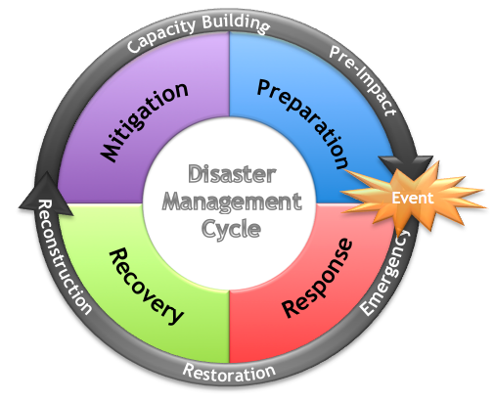
H.E.L.P. course
Disaster management cycle
Notes:
The H.E.L.P. course focusses mainly on acute and protracted crises but these cannot be considered in isolation from the other steps of the disaster management cycle.

Slide 17
H.E.L.P. course
Crisis and needs
Response capacity
Essential needs covered
Post-crisis
Essential needs are covered in a sustainable manner but it still remains fragile.
Essential needs are being covered, but at risk of no longer being addressed
Pre-crisis
Acute crisis
Protracted crisis
Essential needs are insufficiently covered, and acute crisis could resume.
Some essential needs are no longer covered
Time

Slide 18
H.E.L.P. course
When do we speak about
- A disaster
- An emergency
??

Slide 19
H.E.L.P. course
Disaster - definition
A serious disruption of the functioning of a community or a society involving widespread human, material, economic or environmental losses and impacts that exceeds the ability of the affected community or society to cope using its own resources and therefore requires urgent action.
  We use the word ”disaster” to refer to natural disasters as well as to conflict, slow- and rapid-onset situations, rural and urban environments and complex political emergencies in all countries.
  The term thus covers natural and man-made disasters and conflicts and encompasses related terms such as “crisis” and “emergency”.
Source: The Sphere Handbook Glossary, 2018

Slide 20
H.E.L.P. course
Emergency - definition
A sudden and usually unforeseen event that calls for immediate measures to minimize its adverse consequences.
      Source: WHO glossary of humanitarian terms, 2008
Notes:
http://www.who.int/hac/about/definitions/en/
WHO - Glossary of humanitarian terms

Slide 21
H.E.L.P. course
??
When is a crisis considered a significant public health emergency

Slide 22


H.E.L.P. course
Significant public health emergency
Crude mortality rate of a given population is at least two times greater than its ‘normal’ baseline
Under five mortality rate
When baseline un-known or of doubtful validity aim often stated as U5MR > 2.0 /10’000 / day
When baseline un-known or of doubtful validity aim for regional established thresholds. CMR > 1.0 /10’000 /day still widely used as threshold but questionable
More sensitive than CMR
Source: SPHERE, UNHCR
Notes:
CRM is one of the most widely used indicators in the humanitarian sector when assessing the severity of a health crisis within a given population. For UNHCR (also MSF, CDC) the ‘’normal’’ baseline corresponds to the baseline mortality prior to displacement, or to the population in the host country, while SPHERE considers it to be the baseline rate documented for the population prior to the disaster. ”. It is only when “the baseline rate is unknown or of doubtful validity” that either using the global 1/10,000/day emergency threshold or the regional thresholds calculated for Sub-Saharan Africa, Middle-East and other regions is recommended. Note that the threshold of a CMR of 1/10’000/day corresponds to the double the average mortality rate recorded in Africa in the mid-1980s and that since then, the average mortality rate in Sub-Saharan African has been halved (from 0.45 to 0.25/10,000/day, according to the World Bank) while the worldwide average mortality scale has significantly fallen to 0.21/10,000/day. Hence, the 1/10,000/day emergency threshold currently corresponds to four times the average mortality rate in Sub-Saharan Africa and five times the global average.
SPHERE proposes currently for contexts as assumed specific baseline:
Sub-Saharan Africa CMR 0.44 U5MR 1.14
Latin America CMR 0.16 U5MR 0.16
South Asia CMR 0.25 U5MR 0.59
Eastern Europe CMR 0.30 U5MR 0.20
Unknown Baseline CMR 0.50 U5MR 1.00

Slide 23
Common vs specific health needs
H.E.L.P. course
  What are common needs of people to maintain or enhance health?
  What specific needs may people have due to their sex, age, certain illnesses, disability, belonging to a certain group in society, …..?
? ?

Slide 24





H.E.L.P. course
Common needs to maintain/enhance health
  Personal security/safety, violence prevention
  Nutrition and household economy
  Water, Sanitation, Environmental health and Shelter
  Preventive and curative health care
  Contact with loved ones & Social links

Slide 25
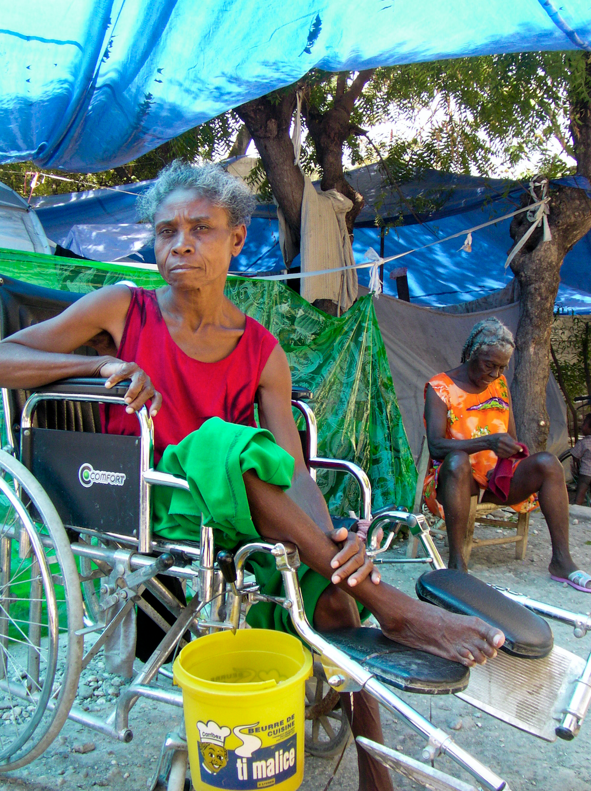
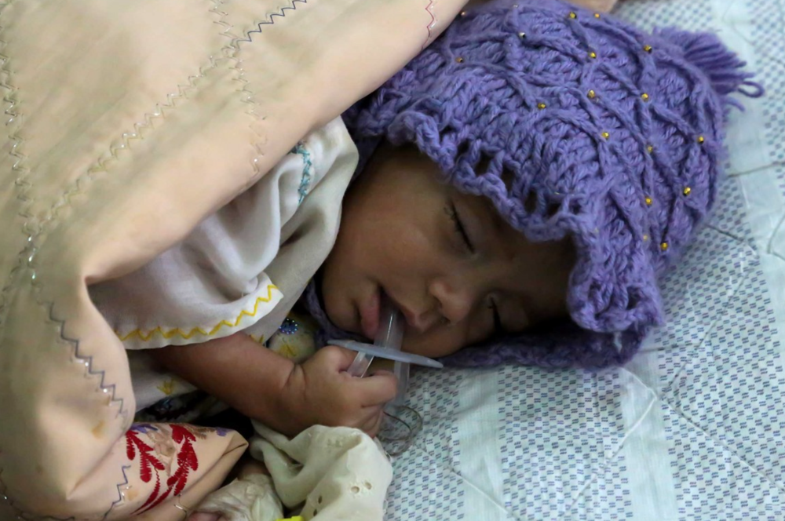
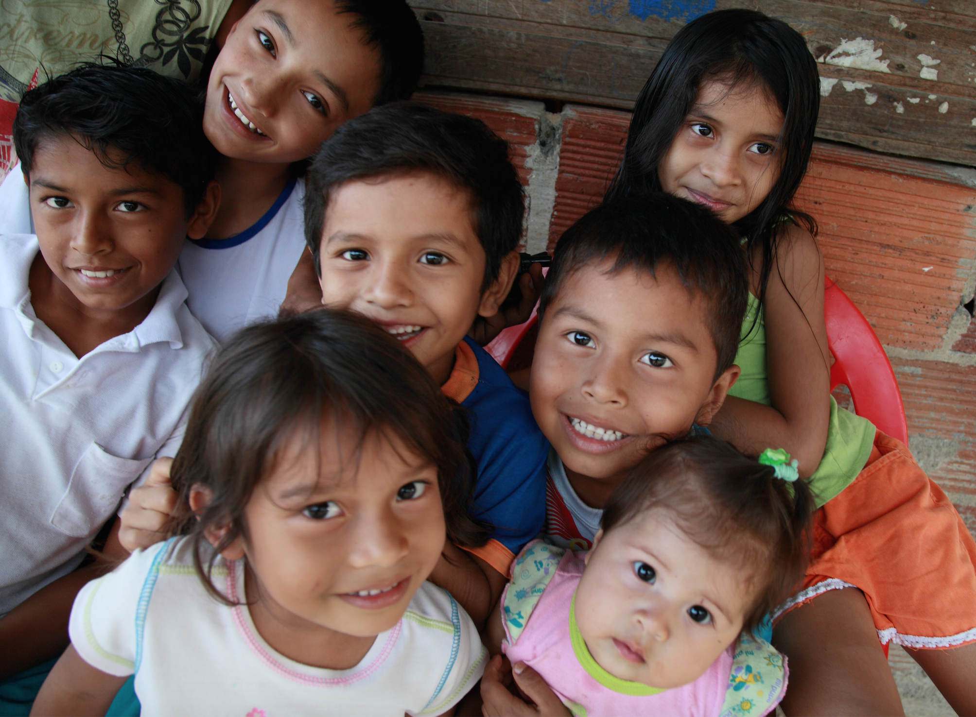
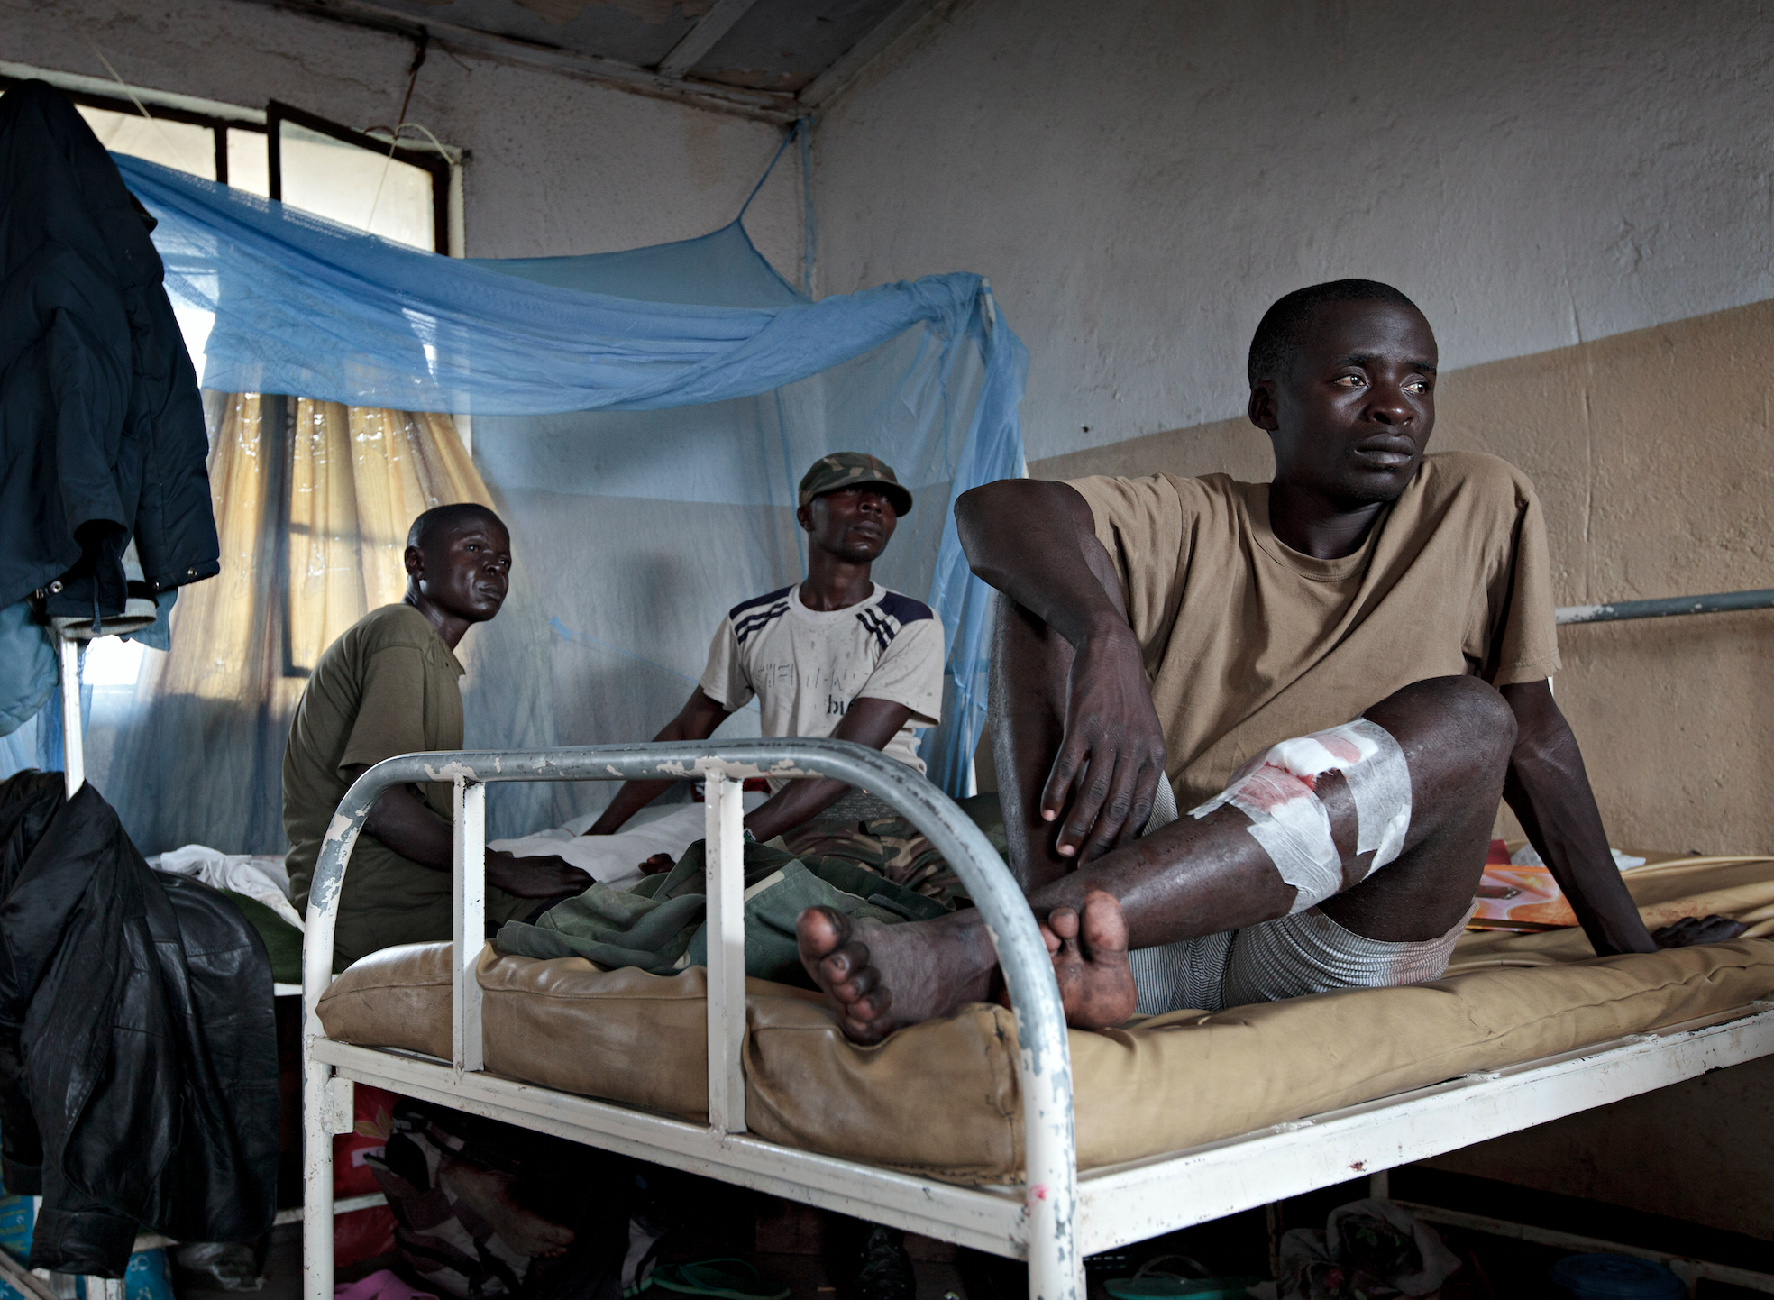
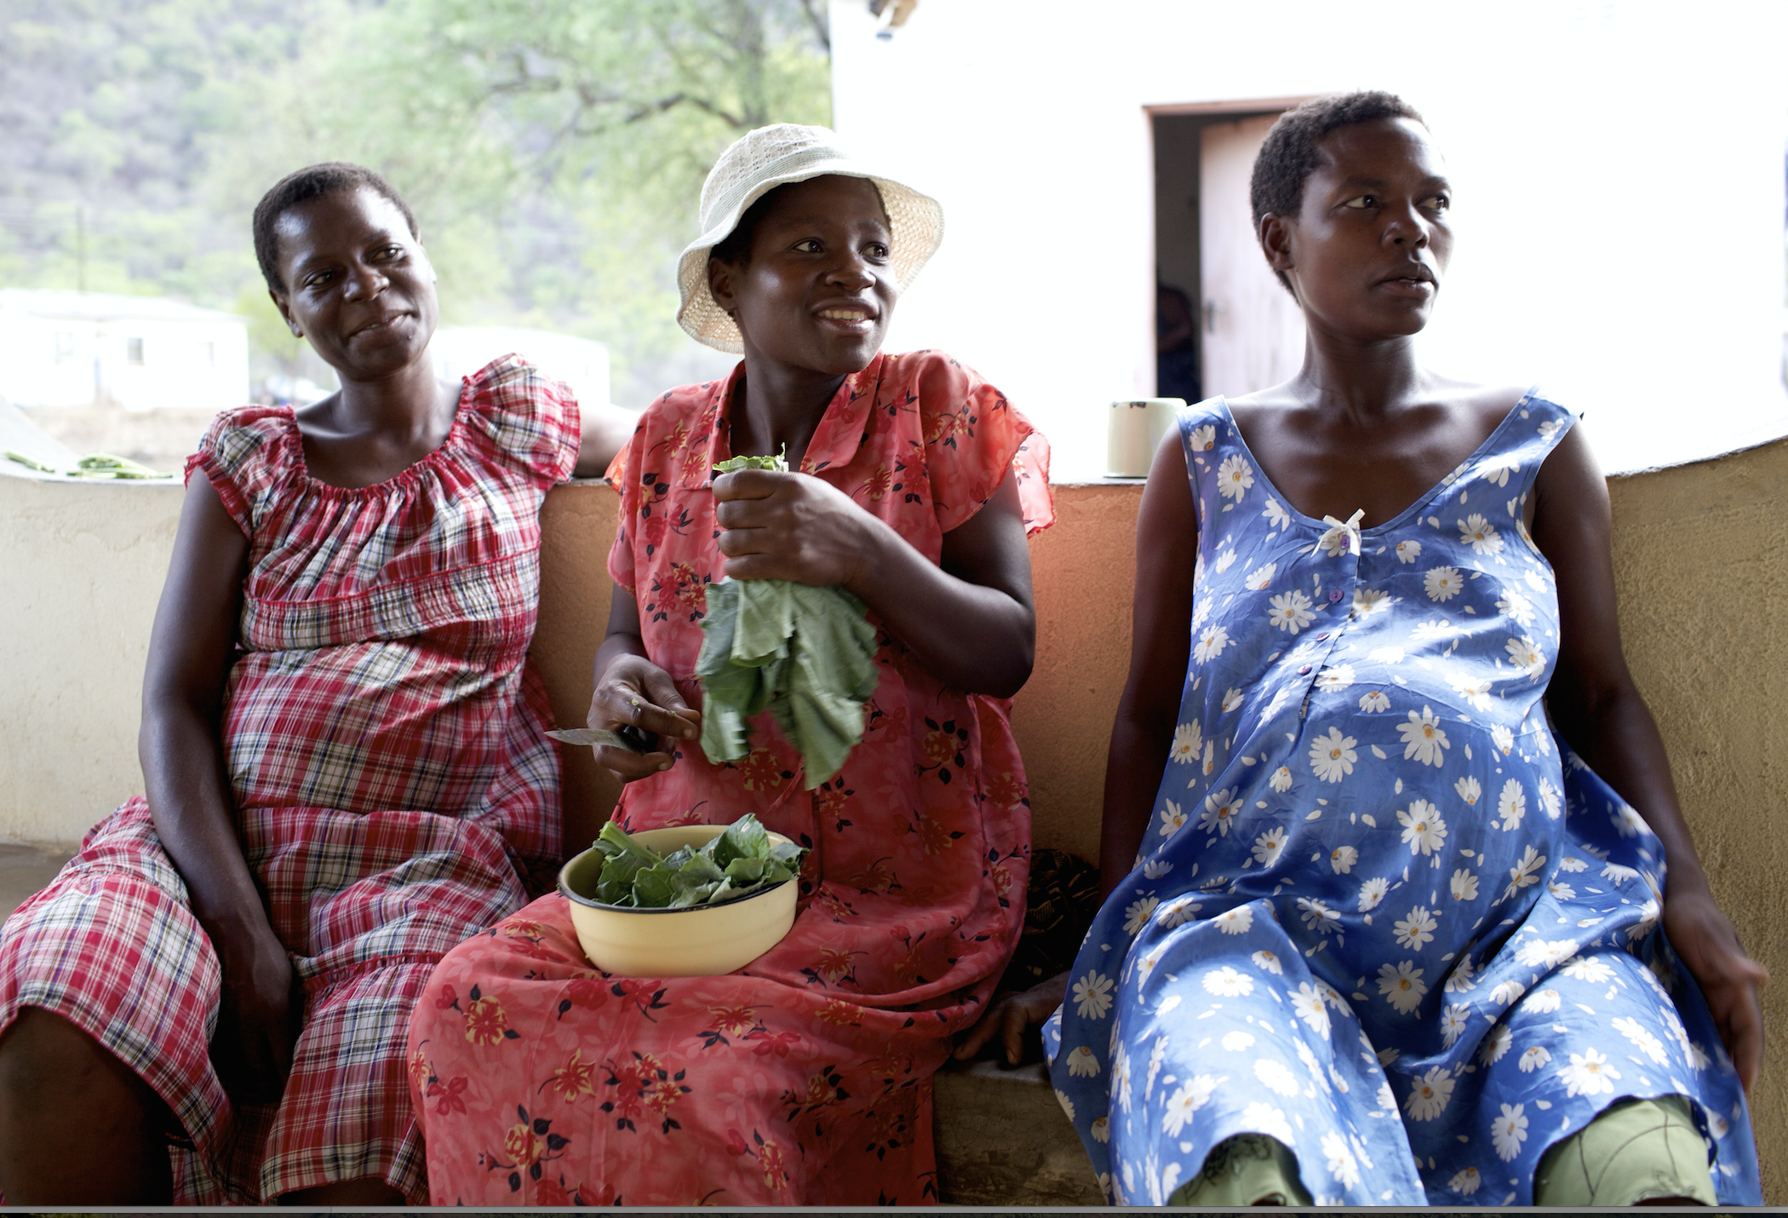
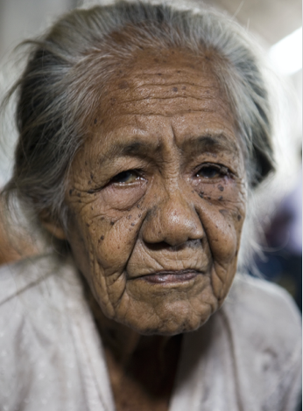
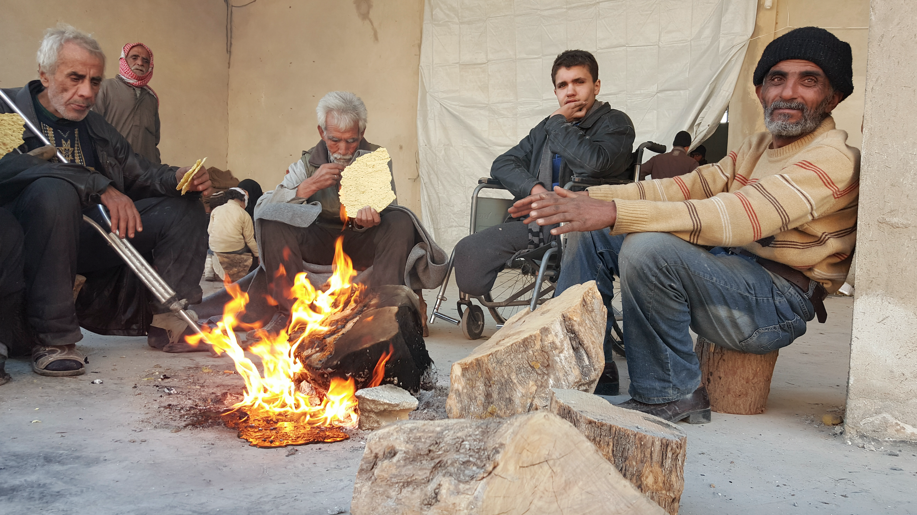
Specific needs
H.E.L.P. course
For instance:
Related to age
  new-born, infant, children <5, adolescent, elderly
Inherent to sex
  Pregnant & lactating mothers
Related to an event
  Survivors of sexual violence and torture, wounded fighters/civilians
Related to certain illnesses
  NCDs, psychiatric disorders
Related to disability
Dead bodies
Thomas Glas, ©ICRC
Jessica Barry, ©ICRC
Boris Heger, ©ICRC
Alvaro Ybarra Zavala,©ICRC
Olivier Moeckli, ©ICRC
Sana Tarabishi, ©ICRC
Jason Tanner, ©ICRC
Notes:
Infant: a child aged 0-11 completed months (may be referred to as 0 - <12 months or 0- <1 year). An older infant means a child from the age of 6 months up to 11 completed months of age (Source: Infant)
Young men may have have a specific protection need due to forced recruitment by armed groups (child soldiers)

Slide 26
Health Pyramid
Curative health care
Preventive health care
Nutrition and Food Security
Water, Sanitation,
Hygiene, Environment
Security
H.E.L.P. course
Notes:
Health services –top of the health pyramid. In addition to preventative and curative care there is also rehabilitation and palliative care
Health – health sector – health services
Health sector; MoH + all structures focusing on health care provision; includes legal aspects and monitoring
Health services: regularly services –health promotion, preventive, curative, palliative, rehabilitation.
Provision for / in case of emergencies: normal cases, additional cases, …. , risk managemet
Health emergency preparedness

Slide 27
H.E.L.P. course
Balance needs and capacities /services
Needs of affected people
Capacities /
services

Slide 28
H.E.L.P. course
Imbalance during crisis situations
Capacities / Services
Needs of affected people
Health crisis
Needs increase due to:
Population movement
Increased morbidity
New needs, e.g. weapon wounded
Etc.
Capacity of people /services deteriorates:
Lack of resources
Lack of staff (insecurity)
Disorganization of services
Destruction of health structures
Etc.

Slide 29
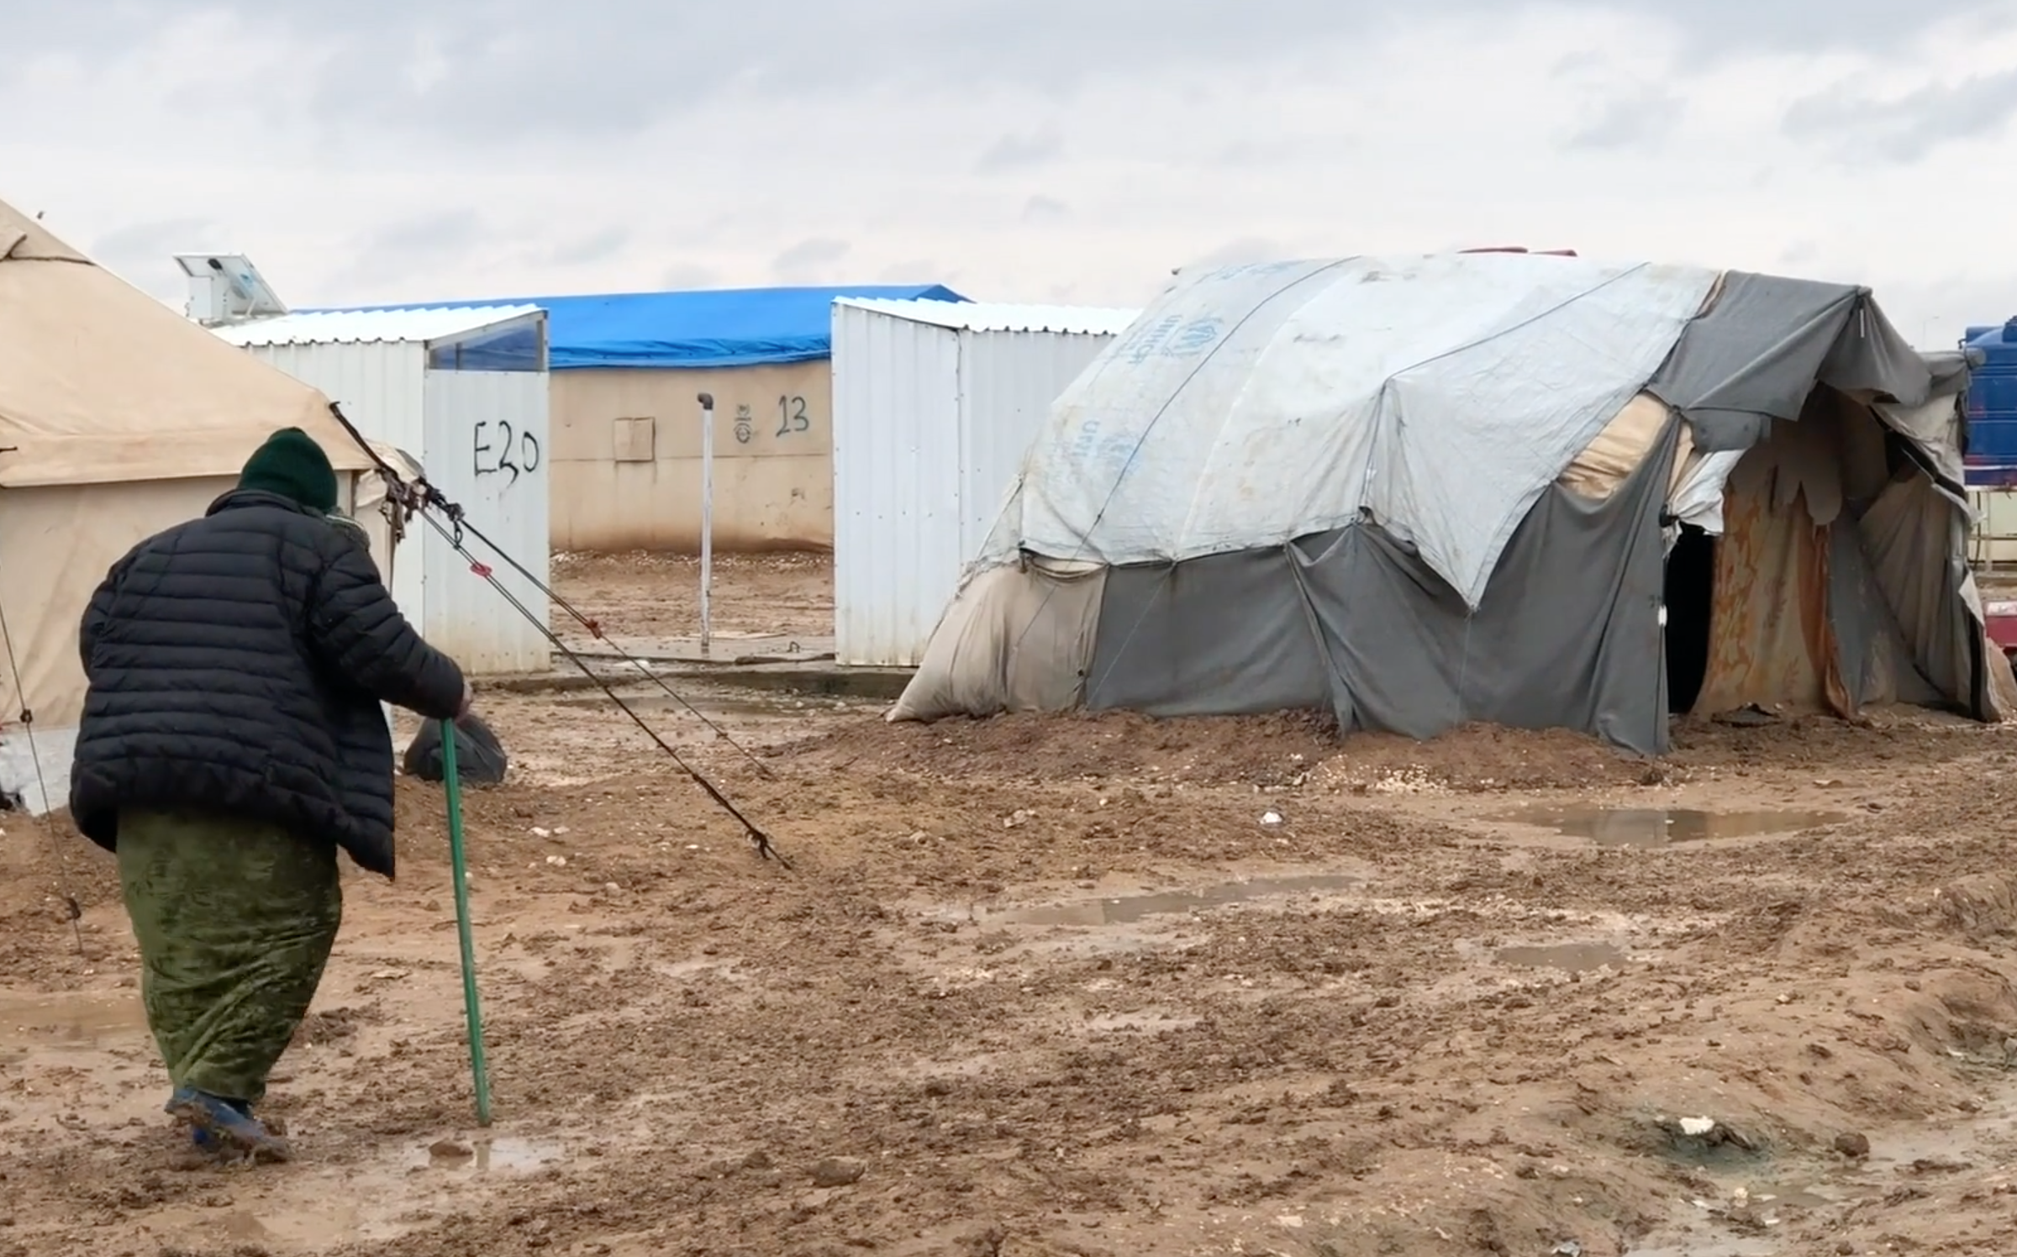
Needs vs capacities
H.E.L.P. course
Certain people may have more problems to meet basic needs for health and survival, e.g.
  IDPs, refugees, migrants, host populations, residents crisis area
  Ethnic or religious groups, casts
  Poor people
  Infants, Elderly
  Female headed households
  Disabled people
  People deprived of freedom
  Un-accompanied children, ……..
How do we make the invisible visible?
Ali Yousef, ©ICRC
Notes:
Picture caption: Sana'a, physical rehabilitation center. Abdo Qaed, 60 years old, was two year old when he realized that he could not play with friends because of his amputated leg.

Slide 30
H.E.L.P. course
Community Resources
Capacity
Vulnerability
Resilience
A combination of all the strengths and resources available within a community, society or organization that can reduce the level of risk, or the effects of a disaster.
The conditions determined by physical, social, economic and environmental factors or processes, which increase the susceptibility of a community to the impact of hazards.
The capacity of a system, community or society potentially exposed to hazards to resist, adapt, and recover from hazard events, and to restore an acceptable level of functioning and structure.
Notes:
Capacity is always present. It may include physical means, institutional abilities, societal infrastructure as well as human skills or collective attributes such as leadership and management
Vulnerability is always present and becomes more visible when a crisis occurs. Some people may be disproportionately affected by disruption of their physical environment and social support mechanisms during a crisis because of discrimination or neglect in their society.
Resilience is an active process and means to “resile from” or “spring back” after a shock. The resilience of a social system is determined by the degree to which the system has the necessary resources and is capable of organizing itself

Slide 31
H.E.L.P. course
Public health impact of selected crisis situations
Group work: 5 minutes
Estimate effect according to the following categories: Rare, few/small, moderate, common, many
Effect | Armed conflicts | Earthquakes | High winds | Floods | Flash floods/ tsunamis
Deaths
Severe injuries
Increased risk of communicable diseases
Food scarcity
Major population displacements

Slide 32
H.E.L.P. course
Public health impact of selected crisis situations
Effect | Armed conflicts | Earthquakes |  |  | Flash floods/ tsunamis
Deaths
Severe injuries
Increased risk of communicable diseases
Food scarcity
Major population displacements
High winds
Floods
Many Many Few Few Many
Varies Many Moderate Few Few
High Varies* Small Varies* Varies*
Common Rare Rare Varies Common
Common Rare Rare Common Varies
May occur in heavily damaged urban areas
*Depends on post-crisis/disaster displacement and living conditions of the population
Source: PAHO. SPHERE

Slide 33
Demographic and epidemiological settings
H.E.L.P. course
Type of setting | Demographic profile | Epidemiological profile
Low-income/very poor | High maternal and infant mortality and death rates, low life expectancy (<55 y) | Most disease and death due to infectious diseases, children and pregnant women particularly affected
Lower-middle income / Higher-middle income | Improving maternal and infant mortality and death rates, life expectancy 55-75 y | Pockets of high infectious disease burden subsist; NCDs increasingly dominant. Large within-country inequalities
High-income | Low maternal and infant mortality and deaths rates, life expectancy >75 y | Most diseases and deaths due to NCDs
Source: HPN network paper No 61
Notes:
Context gives some indication about disease patterns to be expected
The demographic transition is about decreasing mortality rate, with at a later stage a decreasing fertility rate which results in a shift in the population pyramid (aging population increases compared to the young)
The epidemiological transition is about changing patterns in diseases and mortality in a population (communicable diseases <-> non-communicable diseases).
Examples for types of settings:
Tropical and/or very poor: Sub-Saharan Africa, except South Africa, Haiti, rural/remote parts of Central and South America, Afghanistan, Nepal, Cambodia, ……..
Transition: South Africa, North Africa and Middle East, China, ……
Industrialized: North America, Europe, Japan, Australia, ……

Slide 34
Risk factors excess morbidity and mortality
H.E.L.P. course
Individual work: 5 minutes:
Take 1-2 of the Post-Its and place it in the appropriate column on the white board, i.e.
    1. Background variables
2. Intermediate factors
3. Proximate factors
4. Health outcome
Notes:
Distribute the post-its with the different determinants to the groups. Each individual group member places a number of these in the four groups: 1. Background variables, 2. Intermediate factors, 3. Proximate factors, 4. Health outcome

Slide 35
Determinant factors for health and survival
H.E.L.P. course
Background variables
Intermediate factors
Proximate factors
Health outcome
Armed conflict
Natural disaster
Displacement
Food insecurity
Breakdown of services
Extreme poverty
Political instability
Inequalities
Economic stagnation
Environmental vulnerability
Diseases
Poor water, sanitation, hygiene conditions
Food
Lack of and/or delayed treatment
Overcrowding
Trauma
Wounds
Developmental retardation
Outbreaks
Malnutrition
Ethnic rivalry
Arms proliferation
Climate
Seismic risk
Abusive relationship
Psychological and physical stress
Access/utilization to health services
Vaccination
Inadequate shelter
Violence
High exposure to disease vectors
Based on HPN, network paper 61

Slide 36
H.E.L.P. course
What is:
Health
Health system
Health care services
Public health
Determinants of health
??
Why do we use a public health approach during crises situations?
Notes:
Health – health sector – health services
Health sector; MoH + all strucutres focusing on health care provision; includes legal aspects and monitoring
Health services: regularly services –health promotion, preventive, curative, palliative, rehabilitation.
Provision for / in case of emergencies: normal cases, additional cases, …. , risk managemet

Slide 37
What is Health?
H.E.L.P. course
Physical
Mental
Social
Health is a state of complete physical, social and mental well-being, and not merely the absence of disease or infirmity.
WHO constitution of 1948

Slide 38
Definitions
Health - Health is a state of complete physical, social and mental well-being and not merely the absence of disease or infirmity.
Health System - All the activities whose primary intended purpose is to promote, restore and/or maintain health.
Health Service - Any service aimed at contributing to improved health or to the diagnosis, treatment and rehabilitation of sick people.
Public Health - An organized effort by society, primarily through its public institutions, to improve, promote, protect and restore the health of the population through collective action.
Determinants of health - The social and economic environment, the physical environment, and the person’s individual characteristics and behaviors.
H.E.L.P. course

Slide 39
H.E.L.P. course
Health System
Nutrition
Essential
medicines
Water
Hospital
Health
education
HIS
Control
of CDs
Medical
care
Rehabilitation
Sanitation
Management
of epidemics
Prevention
Food
Coordinated
activities
Etc…
Health

Slide 40
H.E.L.P. course
Health system for a civilian population
Some key elements:
Food &
Nutrition
Environmental
Hygiene
Preventive
Care
Screening &
Testing
Medical
Care
Mental Health Care
Referrals
Water
Food
Production
Water
Source
Growth Monitoring
Medical / Paediatrics
Support to Schools
Referral Policy
Shelter
Vaccination
Commercial Network
Water
Treatment
STI control
Surgery /
Obstetrics
Support to Social Networks
Ambulance service
Energy
Blood Test
Food
Availability
Water
Storage
Human Waste Disposal
Reproductive health
Other
Specialized
Care
Support to social security
Imaging
Food
Accessibility
Water
Distribution
Solid Waste Disposal
Insecticide
Treated Net
Malaria Rapid Test
Out-Patient
Care
Restoring family links
Food
Consumption
Water
Consumption.
Vitamin deficiencies
Pregnancy Test
In-Patient
Care
Individual Psychological Support
Vector Control
Biological
Utilization
Used-Water
Disposal
Hygiene
Promotion
Health
Education
Blood Pressure Test
Treatment Protocols
Psychiatric Care
Notes:
https://collab.ext.icrc.org/sites/TS_ASSIST/_layouts/15/WopiFrame.aspx?sourcedoc=/sites/TS_ASSIST/activities/HEALTH/PHC/00_To_Start_This_PHC_Database/RBM_Cycle/PHC%20as%20multi%20cells%20representation.docx&action=default >> Stephane suggested this one to go one step further

Slide 41
H.E.L.P. course
Actors in humanitarian interventions
??
Main actors involved in humanitarian interventions: who are they?
How can they be grouped?

Slide 42

Actors in humanitarian interventions
H.E.L.P. course
UN agencies, e.g. UNHCR, WFP, WHO, UNICEF, OCHA
Affected civilian population
Red Cross and Red Crescent Movement (ICRC, IFRC, National Societies)
National and local authorities
Actors implicated in the political management of conflicts, e.g. UN security council, States involved in negotiations
National and international NGOs
Arms carriers, e.g. national armed forces, opposition groups, international armed forces , peace keeping forces
Private sector
Diaspora groups
Religious institutions
Donors
The media

Slide 43
H.E.L.P. course
Organizational entities for which aid provision is their primary mandate
Military
forces
Diaspora groups
The international Red cross and Red Crescent Movement
Donors
International
NGOs
Groups that play a critical role in humanitarian response but humanitarian action is not their core function
Host governments
Affected communities
UN humanitarian agencies
Humanitarian arms of regional intergovernmental organisations
National NGOs
Religious institutions
Private- sector
entities
Source: ALNAP, State of the Humanitarian System, 2015

Slide 44
Four core humanitarian principles
H.E.L.P. course
Humanity | Impartiality | Neutrality | Independence
Endeavour to prevent and alleviate human suffering wherever it may be found. The purpose is to protect life and health and to ensure respect for the human being. | No discrimination as to nationality, race, religious beliefs, class or political opinions. It endeavours to relieve the suffering of individuals, being guided solely by their needs, and to give priority to the most urgent cases of distress. | Humanitarian actors may not take sides in hostilities or engage at any time in controversies of a political, racial, religious or ideological nature. | Humanitarian action must be autonomous from the political, economic, military or other objectives that any actor may hold with regard to areas where humanitarian action is being implemented.

Slide 45
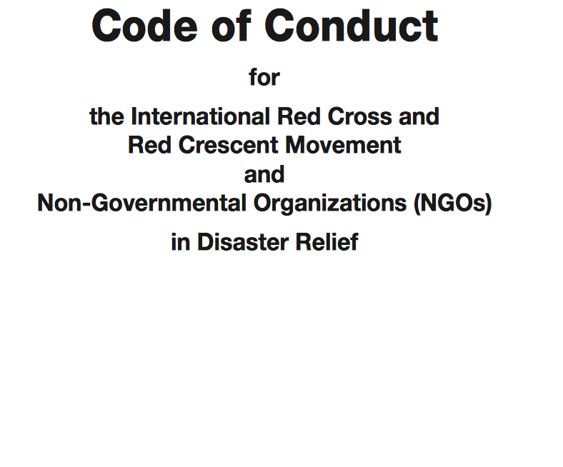
H.E.L.P. course
Standards in humanitarian interventions
Examples:
Notes:
The Code of Conduct for the International Red Cross and Red Crescent Movement and Non-Governmental Organizations (NGOs) in Disaster Relief is the ethical code for humanitarians. It affirms the four fundamental principles and adds six other important principles, to which we are all committed.

Slide 46
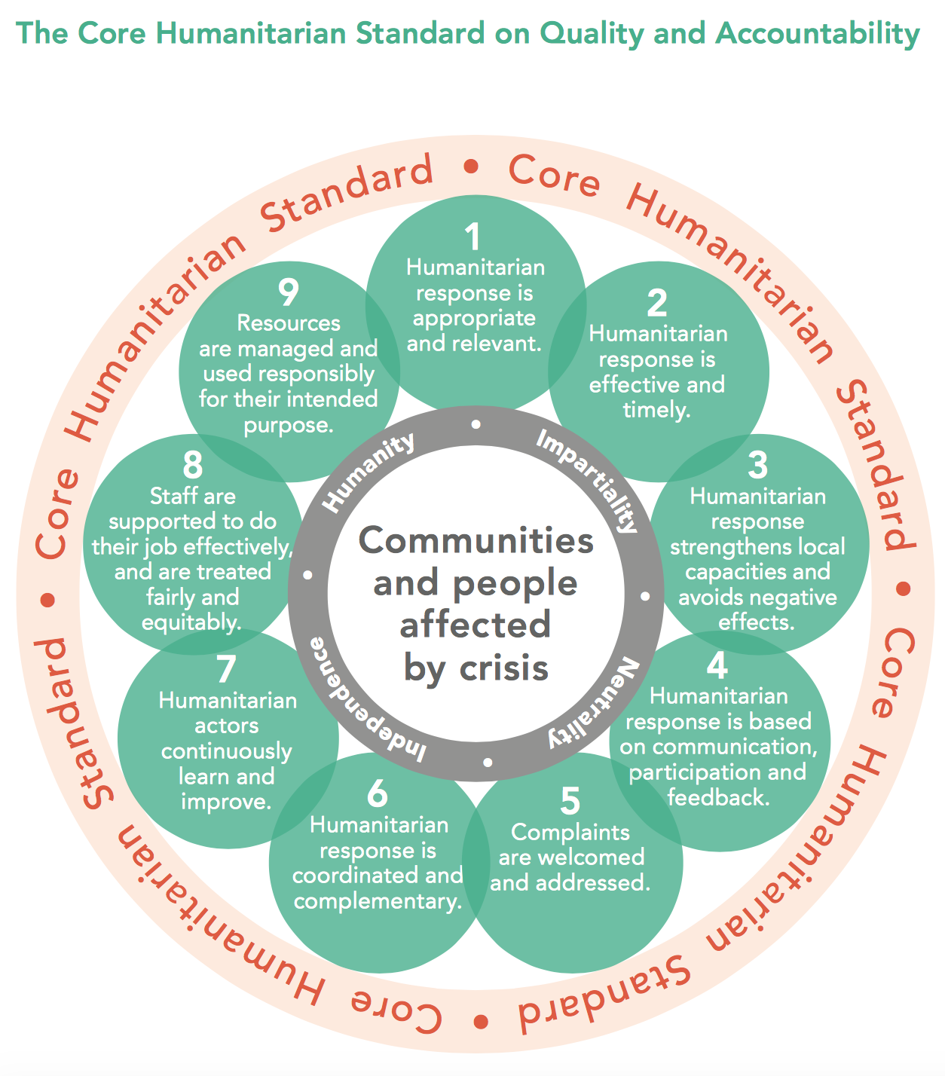

H.E.L.P. course
Standards in humanitarian interventions
Examples:
Notes:
Quality and accountability are not a luxury!
Sphere project -> The Sphere Handbook: Humanitarian Charter and Minimum Standards in Humanitarian Response
Core Humanitarian Standard on Quality and Accountability (CHS). The CHS represents the harmonization of already existing standards. It brings together key elements of: the Sphere Core Standards, the 2010 HAP Standard, the People in Aid Code of Conduct, the Quality COMPAS method developed by Groupe URD, the Red Cross/Red Crescent and NGO Code of Conduct, the IASC Commitments on Accountability to affected people/populations and the OECD DAC Criteria for evaluating development and humanitarian assistance.
There are also for instance national and international professional standards, such as the ones for medical doctors and other medical practitioners, nursing competency standards in primary health care, the classification and minimum standards for foreign medical teams in sudden onset disasters. Other examples include the Professional standards for protection work and Standards on data protection in humanitarian action,…….
The Code of Conduct, SPHERE and the Core humanitarin Standard on Qulait and Accountability are three examples for standards in humanitarian interventions.

Slide 47
Core Humanitarian Standards (CHS)
H.E.L.P. course
The CHS harmonizes already existing standards. It brings together key elements of:
  The Sphere Core Standards
  The 2010 HAP Standard
  The People in Aid Code of Conduct
  The Quality COMPAS method (Groupe URD)
  The Red Cross/Red Crescent and NGO Code of Conduct
  The IASC Commitments on Accountability to affected people/populations
  The OECD DAC Criteria for evaluating development and humanitarian assistance
Notes:
It is the result of an initiative jointly undertaken by HAP, People In Aid and the Sphere Project (Joint Standards Initiative — JSI) whose aim was to achieve greater coherence among humanitarian standards. The JSI process began in December 2011 and ended in July 2013. As a result, the boards of HAP, People In Aid and the Sphere Project agreed to develop a Core Humanitarian Standard based on their existing standards. Later on, the Groupe URD joined the development of the CHS, which was launched in December 2014.
The content of the Sphere Core Standards is generally well represented in the CHS, with a greater emphasis on accountability and more prominence given to organisations’ support to and management of their aid workers. The CHS also includes new elements not previously addressed by Sphere Core Standards such as budget monitoring (CHS 9.3) and consultation with affected populations on complaints mechanisms (CHS5.2).

