Slide 1
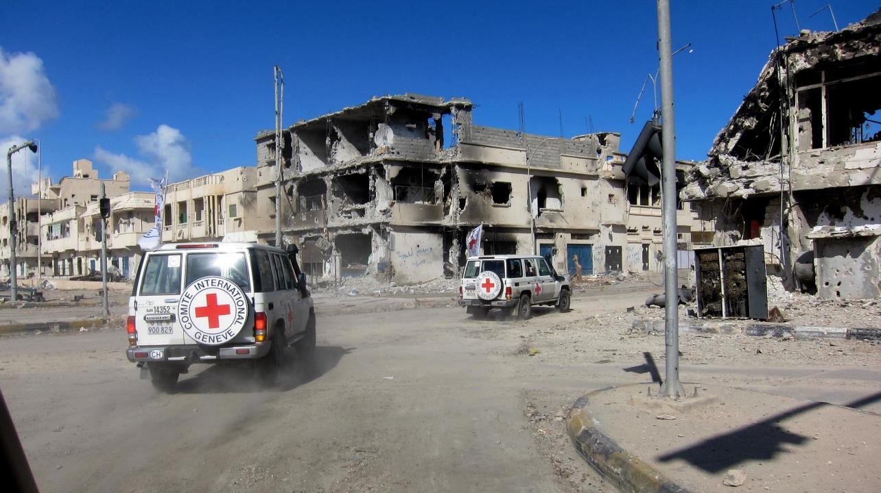
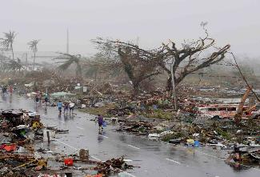
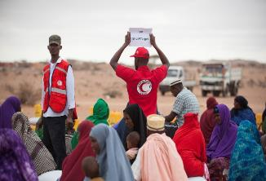
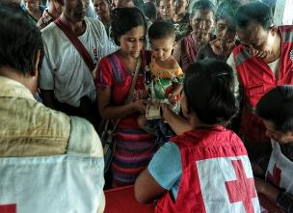
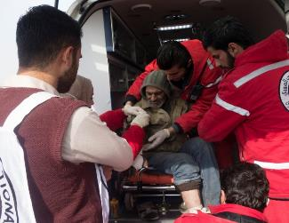
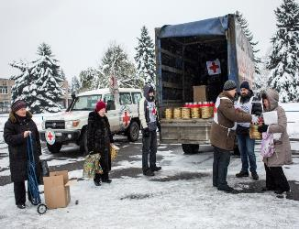
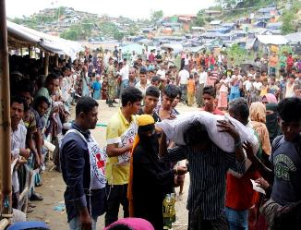
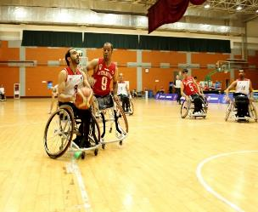
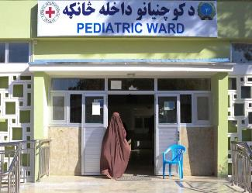
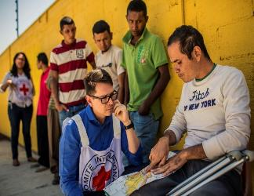
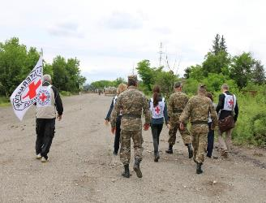
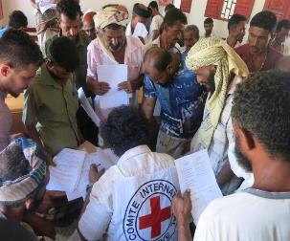
Staff security
Logo organization facilitator(s)
H.E.L.P. course
These learning material have been developed by
the ICRC Security and Crisis Management Support Unit
Name + organization facilitator(s)

Slide 2
Objectives
Be able to
identify, assess and mitigate risks you may face in their environment
  explain the basics of security risk assessment and describe its different steps, i.e. risk identification, assessment, mitigation and evaluation
  explain the use of the 7 pillars of security and how these can help in the own environment
H.E.L.P. course

Slide 3
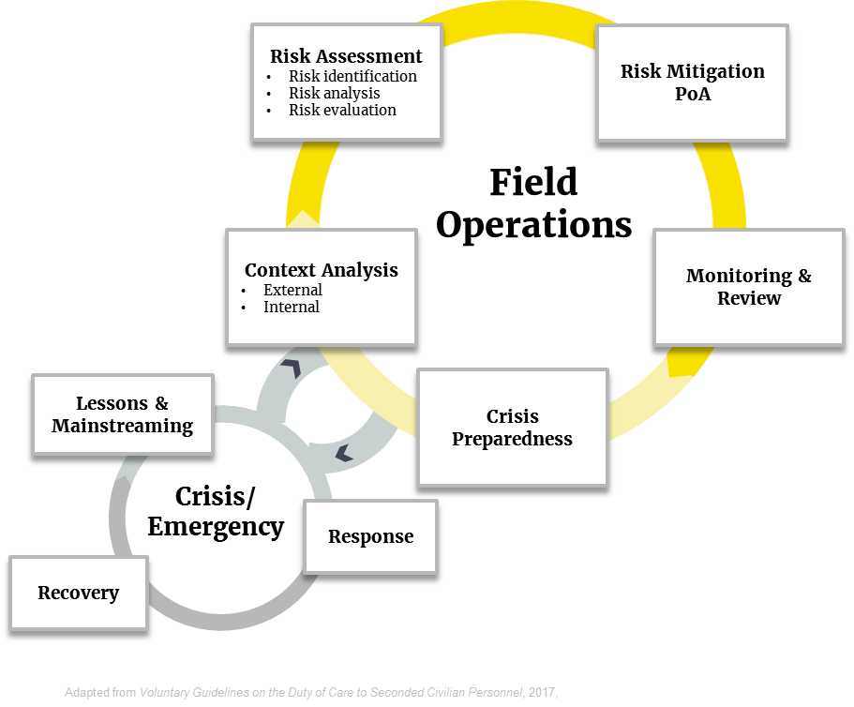
Security and Crisis Risk Management
H.E.L.P. course
Notes:
In this table, you can see the whole Security Assessment and Mitigation Cycle, and how it links to Crisis and Emergencies. In this session, we are going to focus on Risk Assessment and Risk Mitigation PoAs.

Slide 4
Risk Assessment
H.E.L.P. course
Notes:
The first part of the presentation focuses on how to understand Risks. This is the key factor if you want to make sure you have the proper mitigation measures.

Slide 5
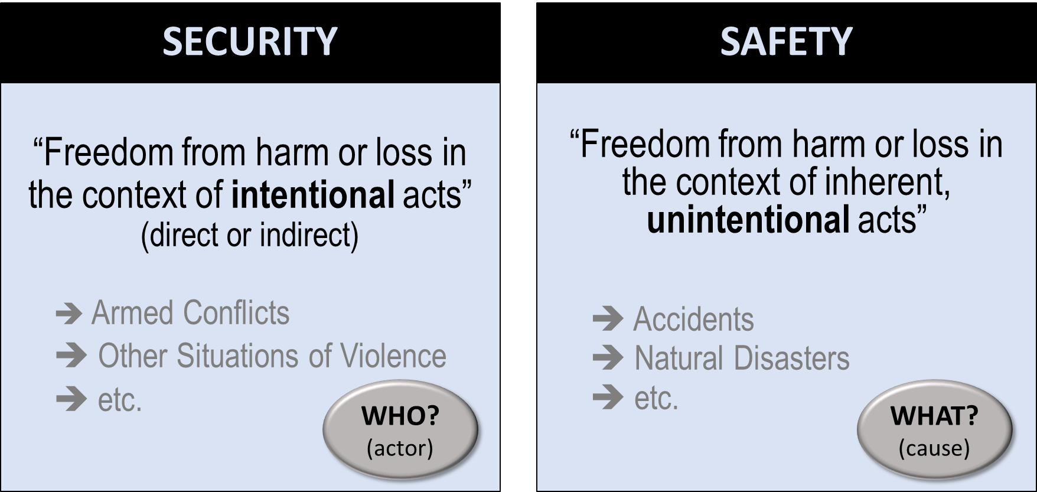
H.E.L.P. course
Notes:
First, a few definition. Distinction between Security and Safety, and between Risk and Incidents.

Slide 6
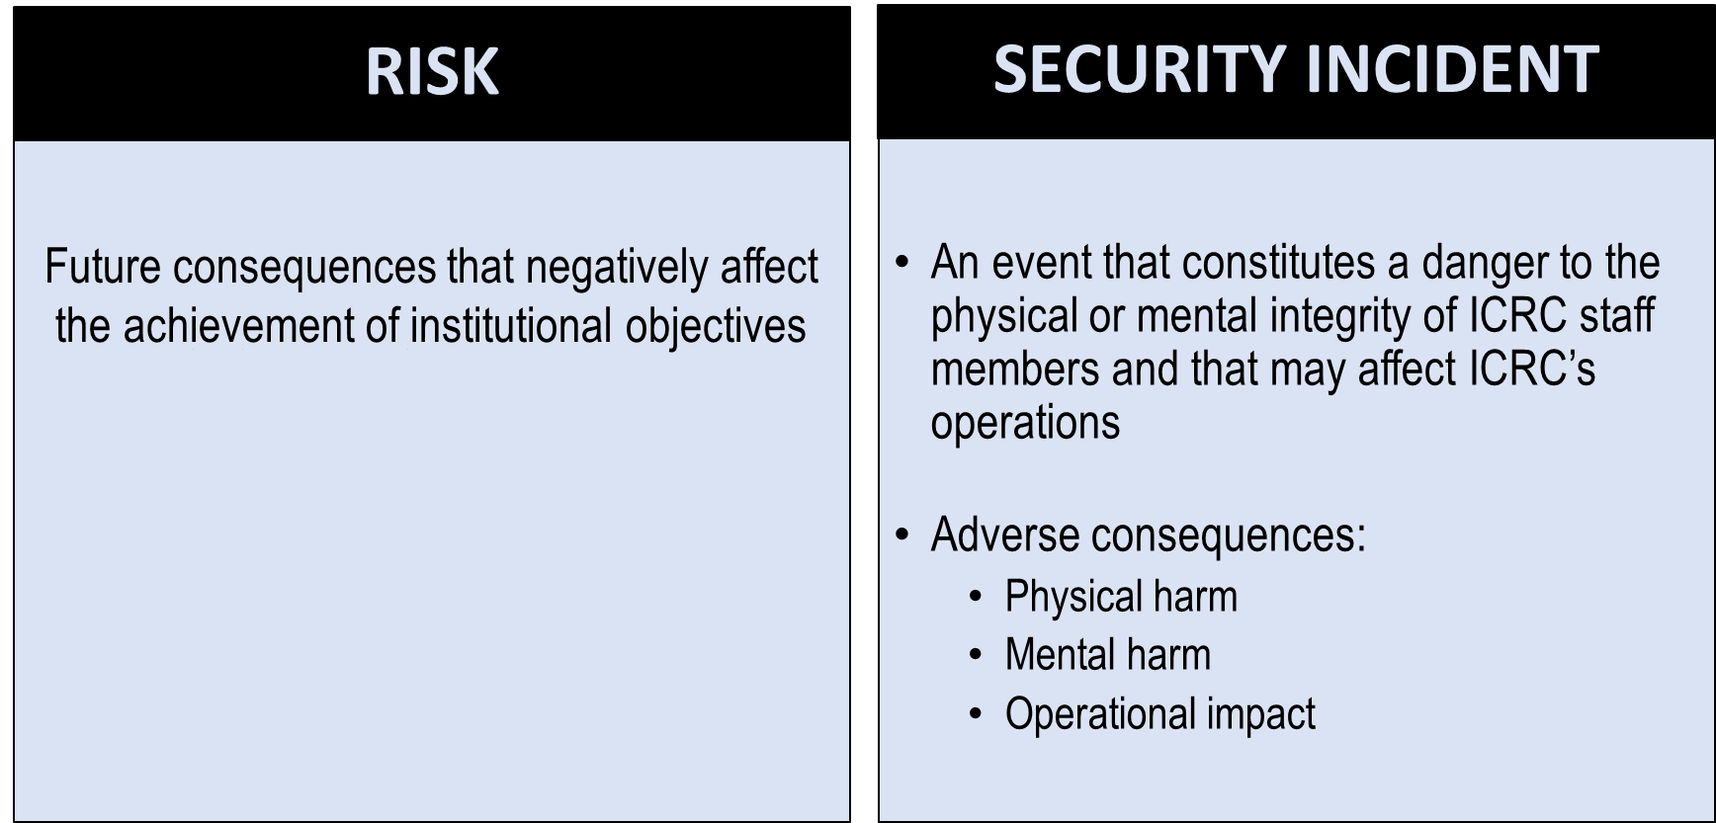
H.E.L.P. course
Notes:
Risk is the future, security incidents is the past. If you properly do risk mitigation, you could imagine security incidents as disappearing.

Slide 7
Establishing the CONTEXT
COMMUNICATION and CONSULTATION
Risk Assessment
Risk Identification
Risk analysis
Risk evaluation
Monitoring & Review
2. Risk Analysis
3. Risk Evaluation
Risk Mitigation
H.E.L.P. course
Risk Mitigation
Notes:
This is based on ISO 31 000, an industry standard. It is applied, in this case, to security. All agencies use this type of analysis in one form or another.

Slide 8

Key methodological aspects
Collective task
Dynamic process
Reducing uncertainties
H.E.L.P. course

Slide 9
Establishing the context
Planning & Monitoring Tools
Situational review (site specific)
  External factors
    Political, religious, cultural and economic indicators
    Natural & man-made environments
  Internal factors
    Composition of staff, level and adequacy of training, programs or planned activities
H.E.L.P. course

Slide 10
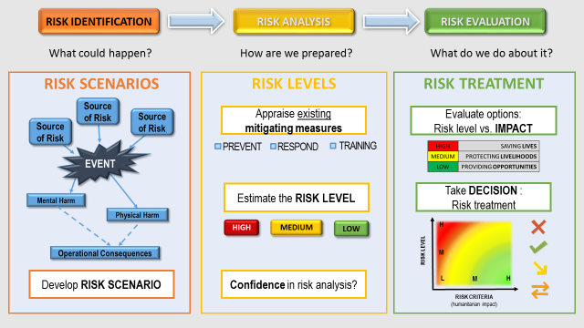
Risk Assessment Main Steps
H.E.L.P. course

Slide 11
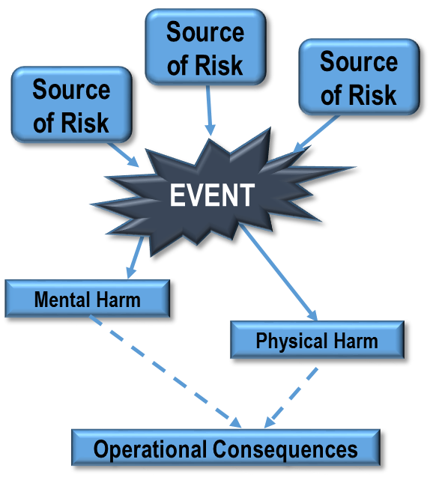
RISK IDENTIFICATION
A risk event is a potential security or safety incident.
Ex: “An ICRC staff/team is harmed by …”.
The description of a risk event can be
broad and general.
Sources of risk are the actors or causes
that could be behind a risk event (“Who? or What? could make the event happen?”).
The description of sources of risk needs to
be as specific as possible.
A scenario is a combination of possible
events (e.g. shelling, abduction, etc.) and
the sources behind these events
(e.g. criminals, specific armed group, etc.) that could have negative consequences for staff to which ICRC has a Duty of Care.
What could happen?
RISK SCENARIOS
H.E.L.P. course
Develop RISK SCENARIO

Slide 12
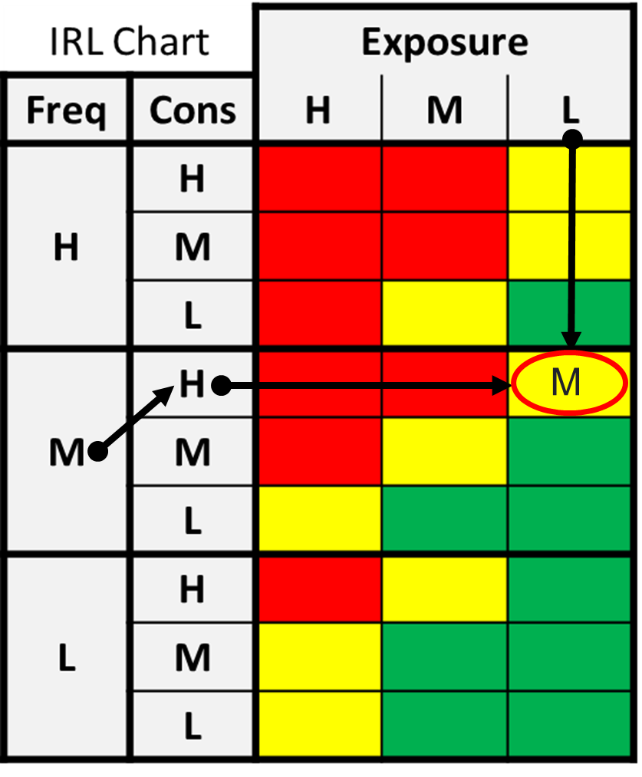
RISK IDENTIFICATION
Example:
Risk Event | ICRC staff is victim of ….. Being caught in IED explosion IEDs placed on Government buildings Targeting political actors
Sources of Risk | Who or What could cause harm? Angry tribal groups
Identified Risk Level | MEDIUM
Risk Assessment
1. Risk Identification
Monitoring & Review
2. Risk Analysis
2. Risk Analysis
3. Risk Evaluation
3. Risk Evaluation
Risk Mitigation
H.E.L.P. course

Slide 13



RISK ANALYSIS
How effective are internal and external mitigation measures?
Not Effective
Low
H.E.L.P. course
Somewhat
Medium
Very
High

Slide 14
RISK ANALYSIS
How are we prepared?
RISK LEVELS
Minimum Security Requirement & other institutional policies
Example:
Security Rules & Briefing
Code of Conduct
Premises’ Safe Areas
Premises’ Access Control
Road Safety Measures
Fire Safety Measures
Earthquake Mitigation Measures
Post-rape kits
3M anti-blast film on glass panels
Movement & Field Trip Procedures, etc.
Appraise existing
mitigating measures
PREVENT
RESPOND
TRAINING
Estimate the RISK LEVEL
HIGH
MEDIUM
LOW
H.E.L.P. course
Confidence in risk analysis?

Slide 15
RISK MITIGATION
How do we implement
the risk treatment decision?
Develop a plan of action
for mitigating measures
(WHO does WHAT and by WHEN?)
Types of risk mitigation measures
PREVENTION
RESPONSE
Training
H.E.L.P. course
Implement the plan
(update security rules, revise SOP, CP)

Slide 16
Watch the Staff Security Video (SSRM Individual) (movie 1)
H.E.L.P. course

Slide 17
Group work
Solferinia Video (Movie 2)
Identify of the main risks seen in the video, and rate these High - Medium – Low
H.E.L.P. course
Notes:
Watch the Solferina Video

Slide 18
Risk Mitigation:
The Seven Pillars of Security
Security
Acceptance
Identification
Information
Security
Rules
Telecommunication
Personality
Protective Measures
H.E.L.P. course

Slide 19
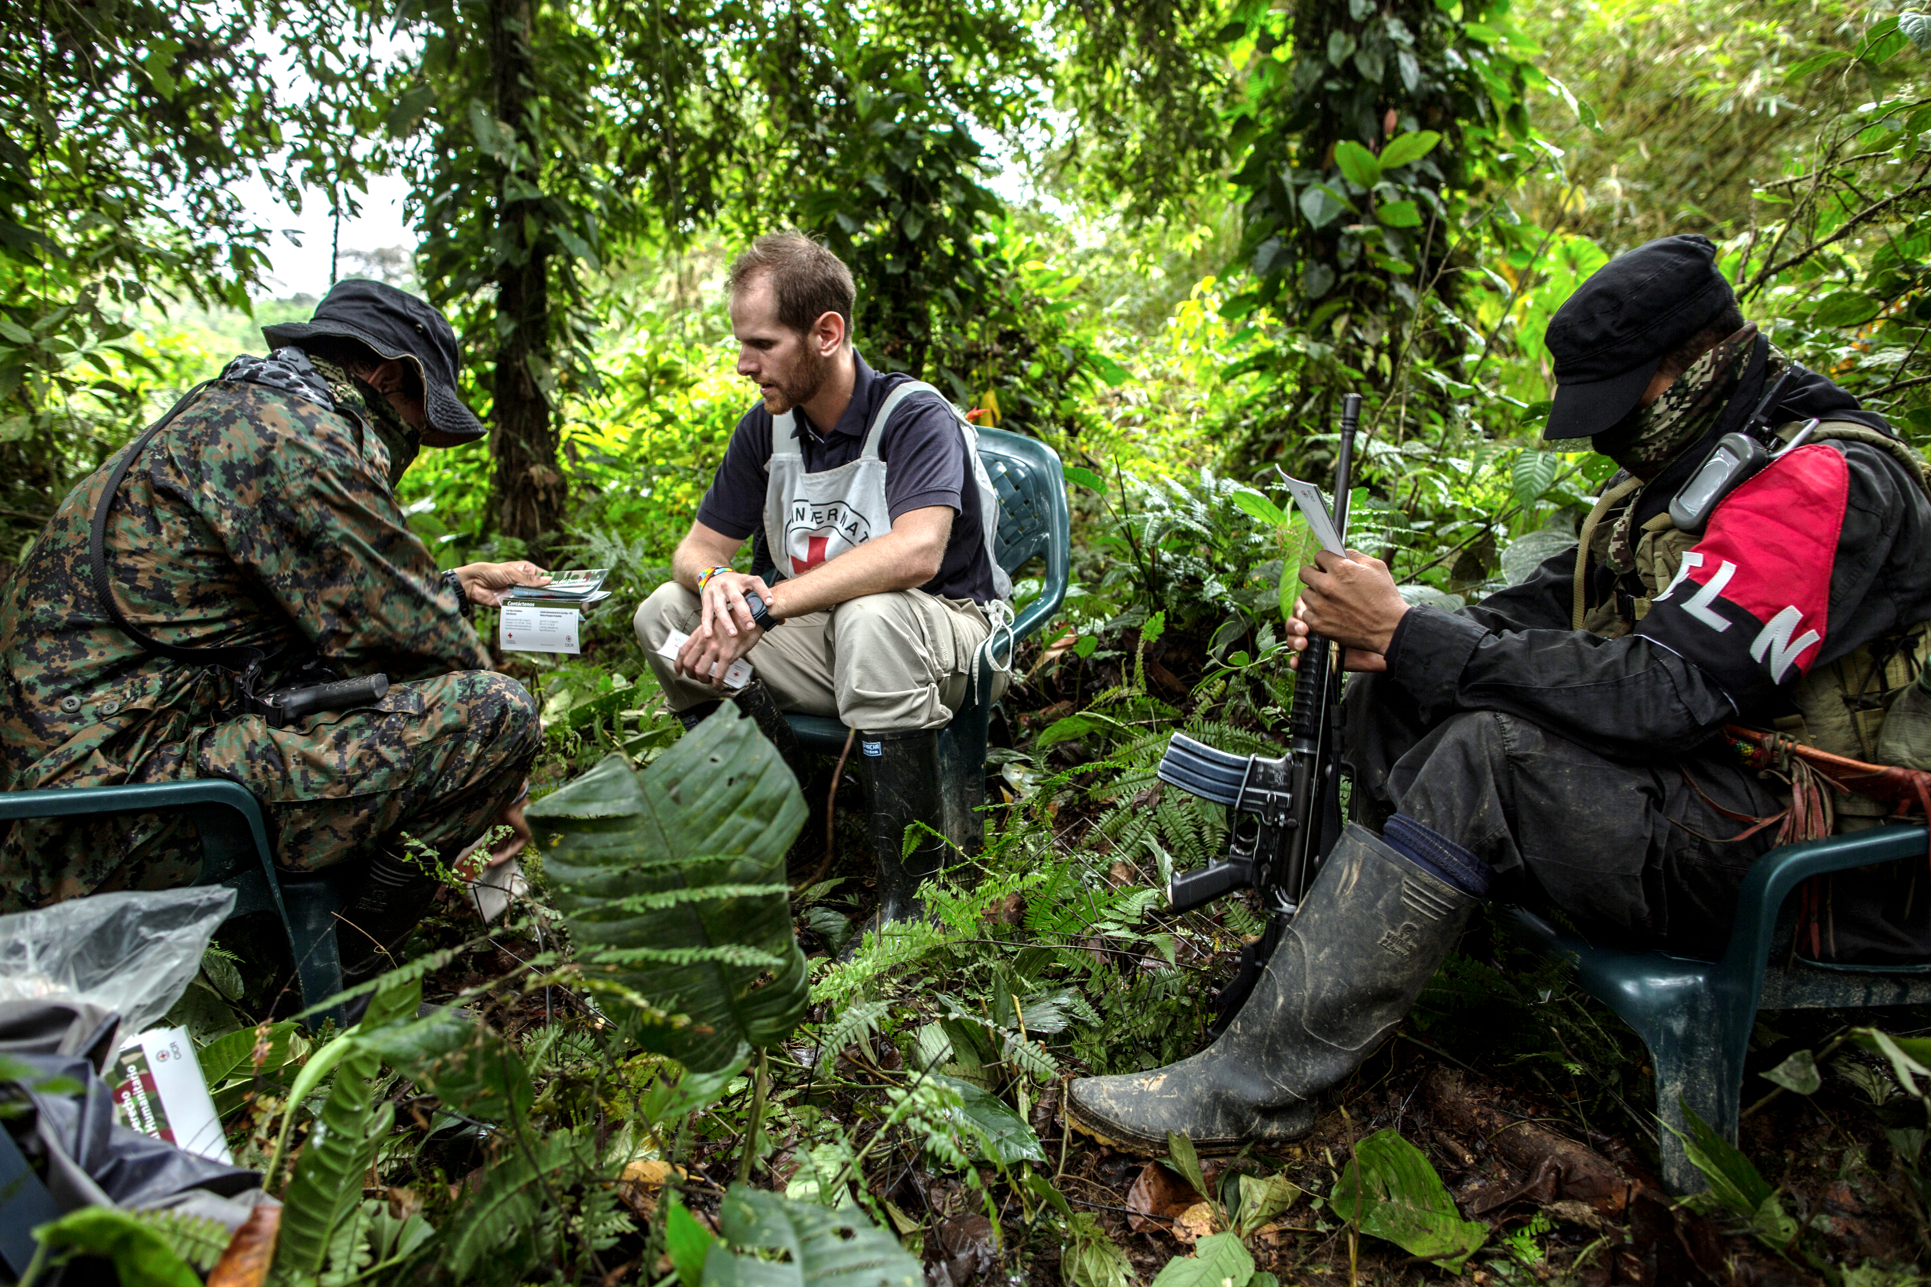
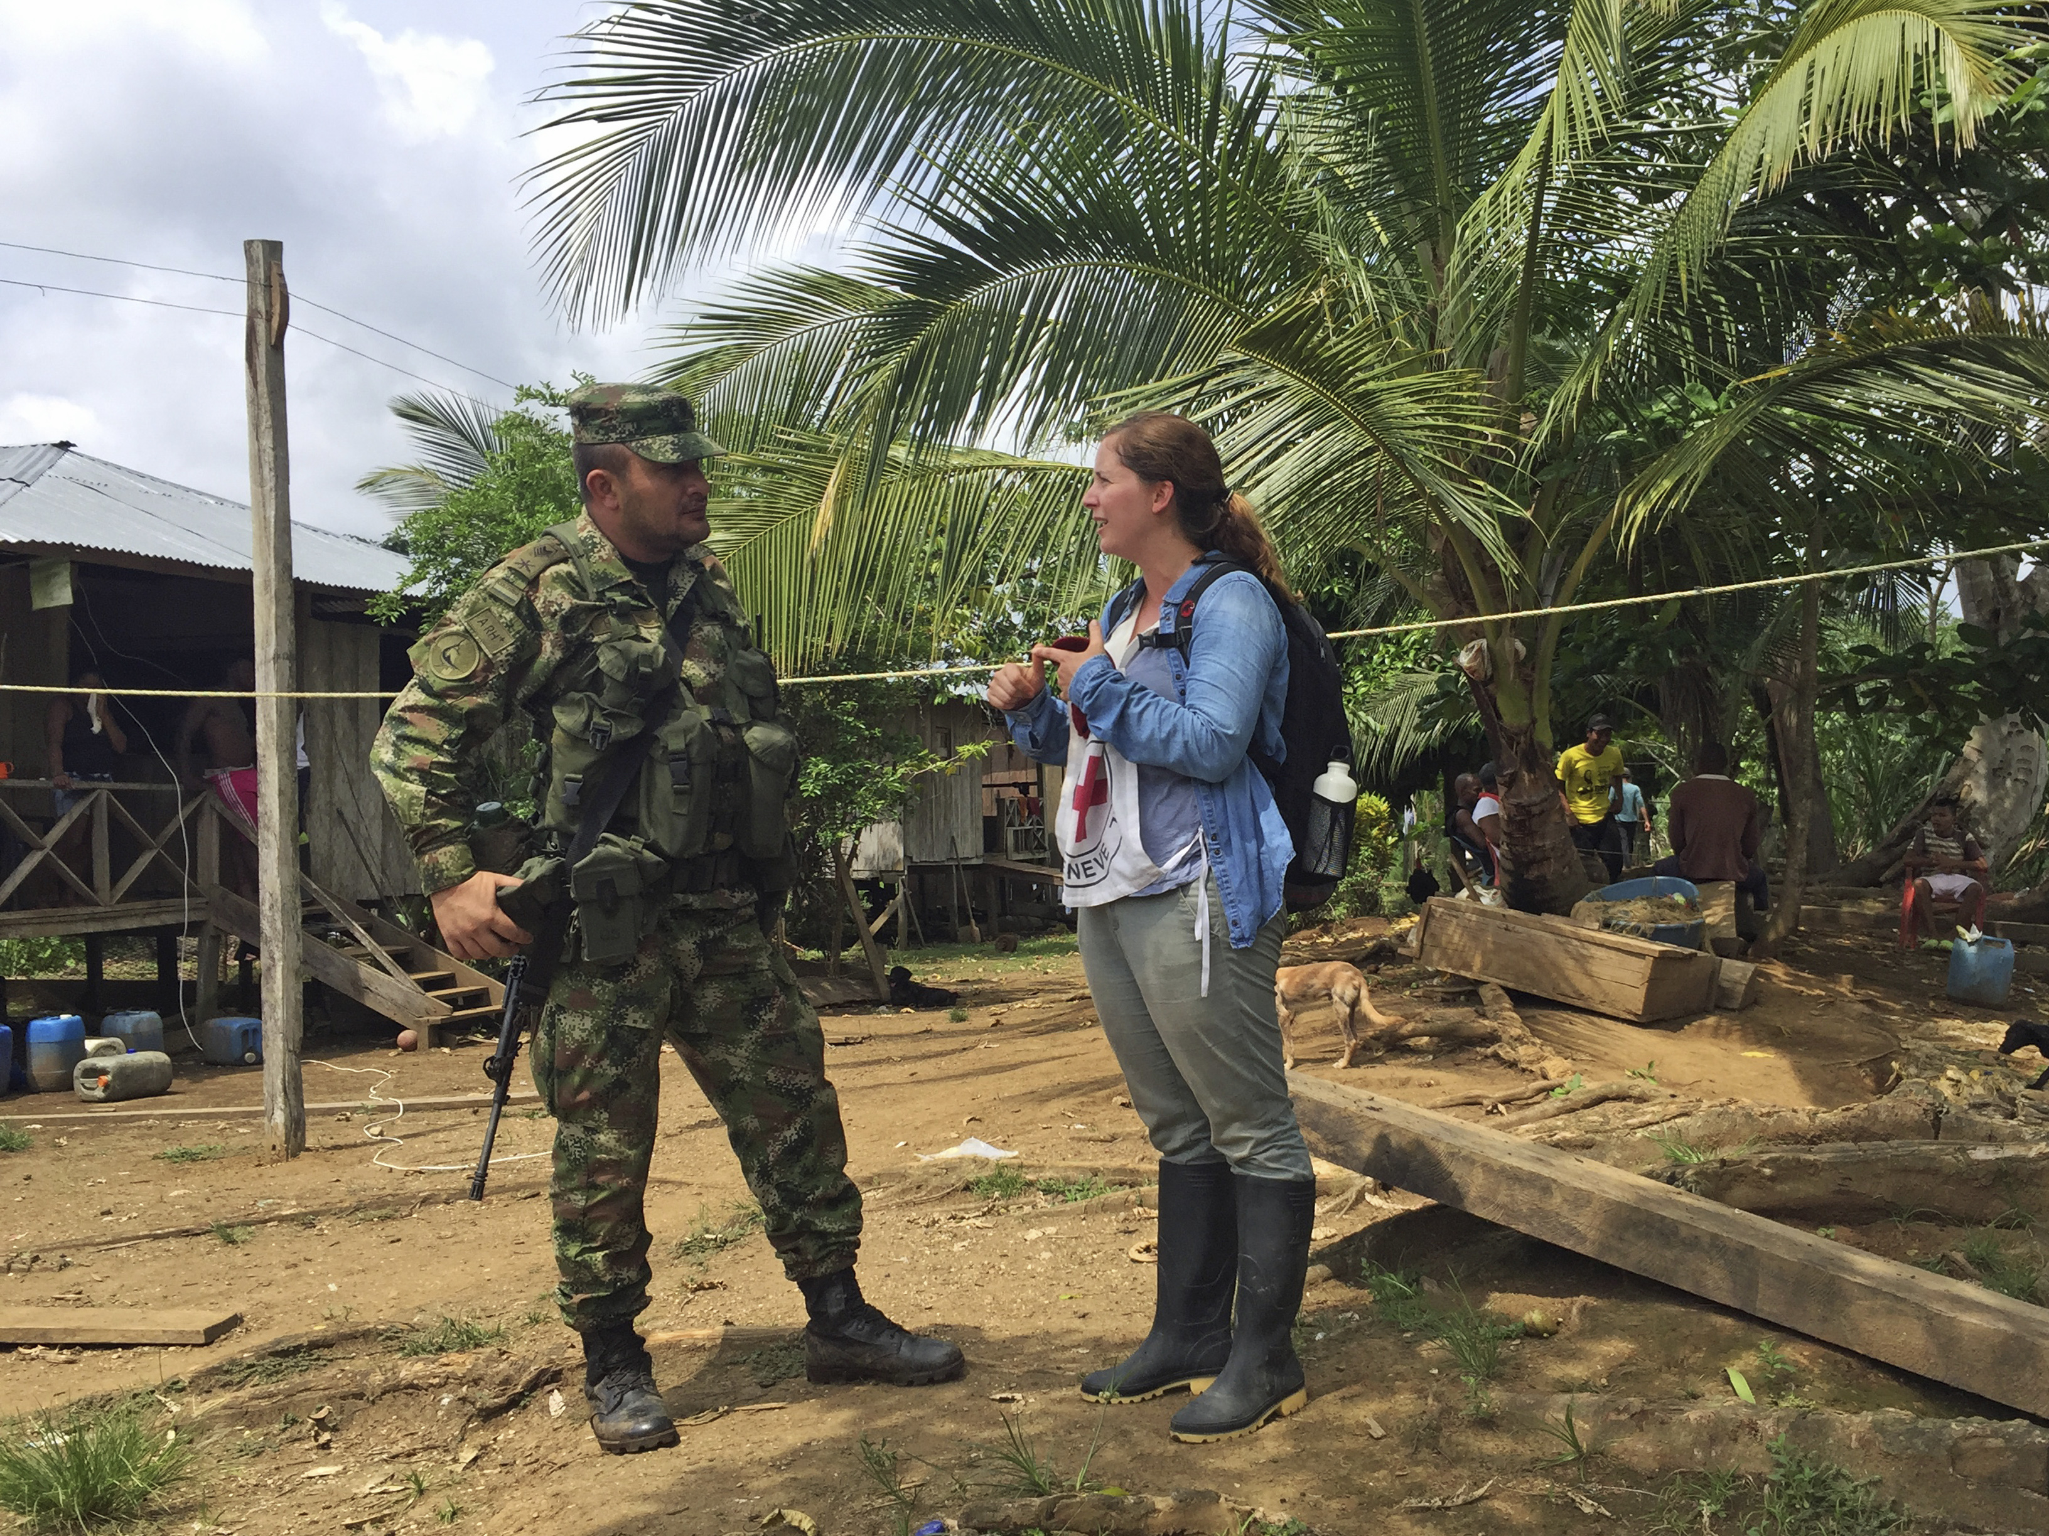
Example of risk mitigation approach: Acceptance
H.E.L.P. course

Slide 20
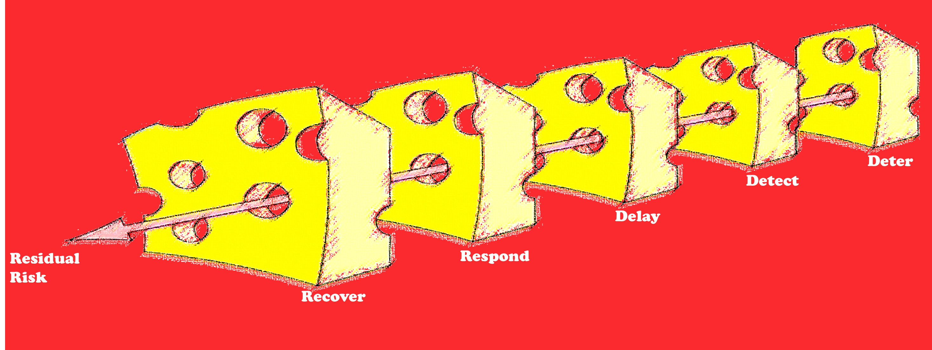
Example of risk mitigation approach: Protective measures
H.E.L.P. course

Slide 21
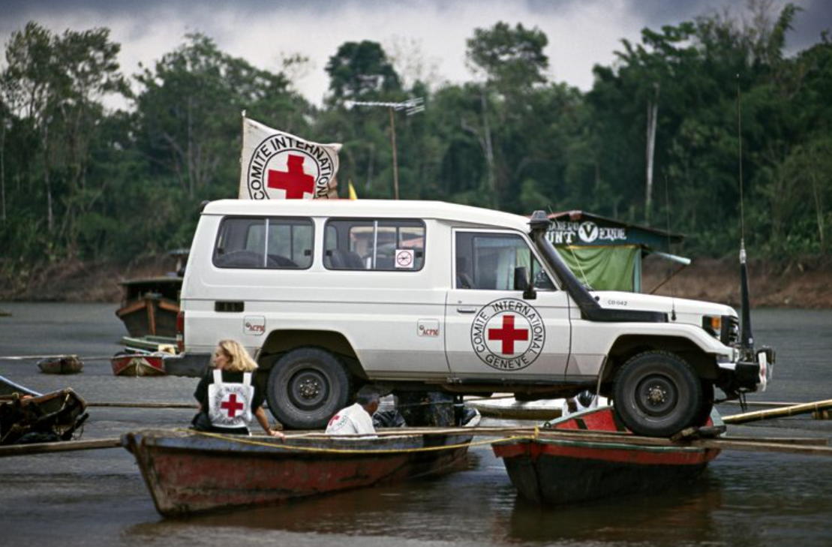
Example of risk mitigation approach: Identification
H.E.L.P. course

Slide 22
Group work
Each group takes two pillars:
  Discuss these, and see how to use these in the Solferinia world
H.E.L.P. course

Slide 23
AND CRISIS ?
H.E.L.P. course

Slide 24
Security and Crisis Risk Management
H.E.L.P. course

