Slide 1
Logo organization(s) facilitators(s)
Multidisciplinary response to violence: Sexual violence
H.E.L.P. course
These learning materials have been developed by Coline Rapneau, Sophie Sutrich and
Elizabeth Mc Guinness (ICRC)
Name(s) and organization facilitator(s)

Slide 2
Objectives
Be able to
explain the nature of sexual violence in acute and protracted crises
explain the consequences of sexual violence and the needs of victims of SV and, the challenges of addressing these needs
discuss how you can contribute to a comprehensive approach to address sexual violence in acute and protracted crises
H.E.L.P. course

Slide 3
Video
H.E.L.P. course

Slide 4
Definition of sexual violence
Sexual Violence
An act of a sexual nature imposed by force, threat of force or coercion
Occurs against women, men, boys and girls
Encompasses: Rape, sexual slavery, forced pregnancy, forced sterilization, etc. but also other forms of sexual violence of comparable gravity (instruments on genitals, forced to watch other being raped, etc.)
H.E.L.P. course
Notes:
Doesn’t need to be any struggle or explicit NO from the victim. The threat of force or coercion can be caused by fear of violence, psychological oppression or abuse of power; it can also be caused by the coercive environment that prevent the person to give his/her genuine consent
In armed conflict and places of detention, it is such a coercive environment that the lack of consent is inherent and automatic
In addition to being victims, women, men, boys and girls, can also be perpetrators of SV
Or any other forms of sexual violence of a comparable gravity (ICC Statute definition)

Slide 5
International legal framework
Rape & other forms of SV are absolutely prohibited
Under International Human Rights Law (IHRL) at all times
Under International Humanitarian Law (IHL) in both international & non-international armed conflicts
H.E.L.P. course

Slide 6
Sexual violence as international crime
SV that amounts to serious violations of IHL entails individual criminal responsibility and must be prosecuted
Rape and SV in armed conflict
Are a War Crime
Can constitute Crimes against Humanity, Genocide
Other crimes: Torture
H.E.L.P. course
Notes:
Humanitarian emergencies are time periods of instability which increase the vulnerabilities of affected population and leaves them at risk
it is not because there is not evidence that there is no incidence
Rape never occurs by accident

Slide 7
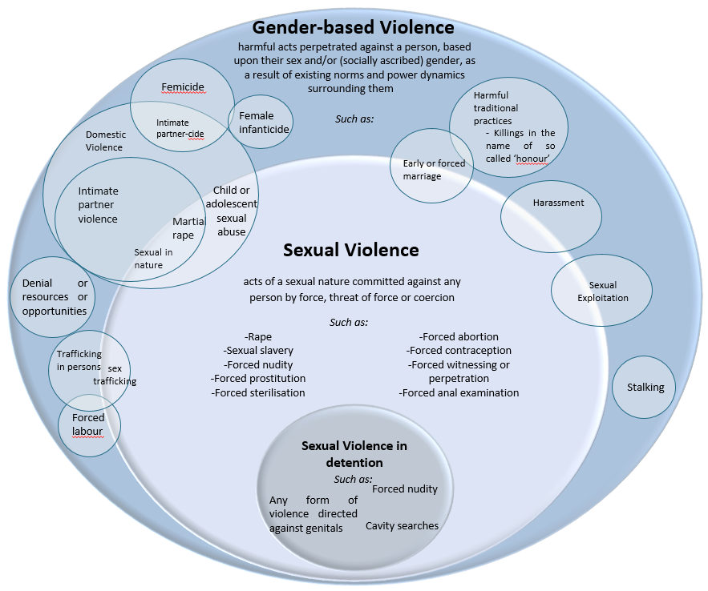
H.E.L.P. course
Figure 1.2

Slide 8
Movie
H.E.L.P. course
Notes:
The movie is embedded in the slide

Slide 9
The few documented cases of sexual violence are likely reflective of its prevalence within the conflict
Y/N
H.E.L.P. course

Slide 10
Facts About Sexual Violence
Sexual violence in humanitarian crisis
Often widespread
Remains under reported in many contexts
Never occurs in isolation
Preventable (importance of preventive measures)
H.E.L.P. course
Notes:
Humanitarian emergencies are time periods of instability which increase the vulnerabilities of affected population and leaves them at risk
it is not because there is not evidence that there is no incidence
Rape never occurs by accident

Slide 11
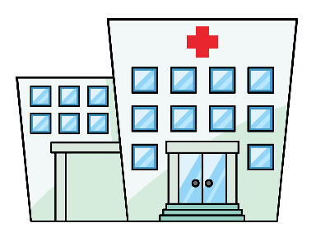
The ‘grey-zone’ between prevalence & incidence and reporting & disclosure:
Violence reported;
Administrative or service-based data – captured through police, judiciary, health or social services or civil society
Actual prevalence or incidence;
Likely never to be known
Violence disclosed;
Survey data
Official statistics
H.E.L.P. course
Notes:
Many victim/survivors of sexual and other forms of gender-based violence will never report or disclose their experience(s) - at least not through formal channels (See Fiche 1.2 on Barriers to Accessing Services). The likelihood of reporting or disclosing violence, and thereby obtaining an accurate picture of prevalence or incidence, can depend on a confluence of factors including, how sexual violence is understood in society, the surrounding legal environment, the trust (or lack thereof) placed in institutions or service-providers, even the competence of who’s recording the answers or asking the questions.
While survey data is the closest proxy to prevalence that can be gathered, even something as seemingly simple as the way questions are worded can drastically alter results. This speaks to the complexity of interpreting trends in data, whether once-off or over time.
For example, if a country displays a higher incidence of violence from one year to the next, this does not automatically infer that violence has increased. Changes in reporting could mean changes in dynamics of violence or, in dynamics of reporting
Likely, there will always be a degree of disparity between the true prevalence/incidence of sexual violence and the extent to which it is captured through either survey data or reporting to service providers (what’s known as either ‘administrative data’ or ‘service-based data’) (See FIG 1.2. ). Simply put, when it comes to data on sexual violence, every picture we have is always only partial.
Where services are non-existent, or ill-equipped to handle cases appropriately, and/or sexual violence remains heavily stigmatized however, estimations of prevalence will be both harder to obtain and even less accurate. This is because persons who experience sexual violence will be even less likely to come forward for well-founded fear of negative repercussions. Armed conflict and insecurity, add an additional layer of complexity, in that whatever capacity state institutions and other actors had to address said violence before the onset of a crisis, is further diminished.

Slide 12
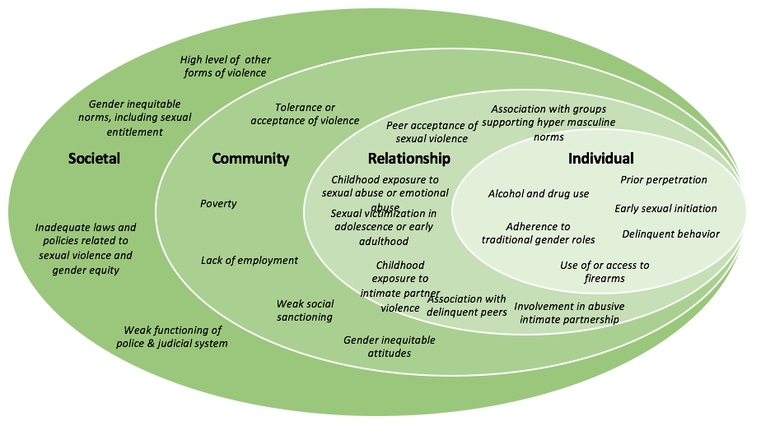
Risk factors for Rape Perpetration
H.E.L.P. course
As identified within: Brookmeyer et al. (2012), Jewkes (2012), Sexual Violence Research Institute, and CDC, National Centre for Injury Prevention and Control, Division of Violence Prevention (2019).
*Factors listed were found relevant to risk of perpetration across sources cited, however evidence thresholds varied within.

Slide 13
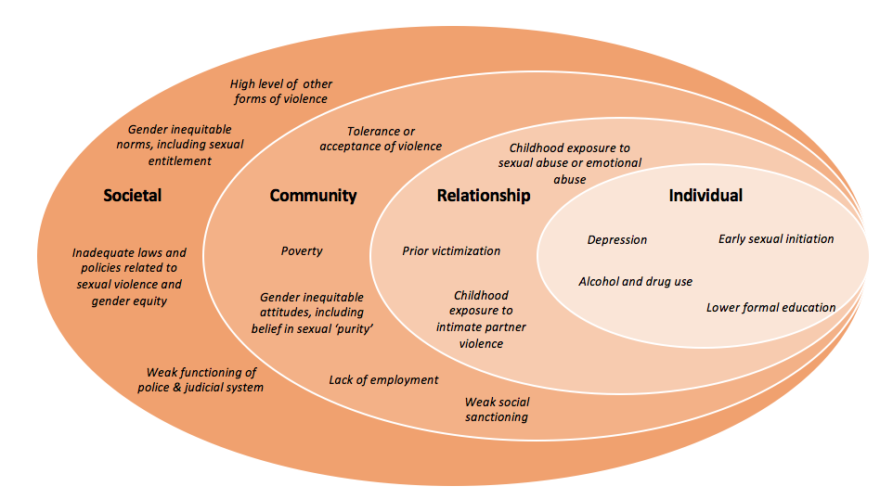
Risk factors for Sexual Violence Victimisation
H.E.L.P. course
As identified within: Brookmeyer et al. (2012), Jewkes (2012), Sexual Violence Research Institute, and CDC, National Centre for Injury Prevention and Control, Division of Violence Prevention (2019).

Slide 14
Sexual violence as a gendered phenomenon
Linked to, and stems from, harmful social practices based on perceptions of gender and the power dynamics surrounding them.
H.E.L.P. course
Notes:
SV is a gendered phenomenon in that it is linked to, and stems from, harmful social practices based on perceptions of gender and the power dynamics surrounding them.
Adopting a gender analysis is useful in that it requires us to examine the power differrentials on which SV is propagated and through which it manifests.
We see gender dynamics at play in complex and interwoven ways within….
Motives for committing SV- Perpetrators often play off gender norms when committing of SV (even if unconsciously), for example prominent males within communities may be targeted as a means of dominating the adversary by symbolically ‘feminizing’ them e.g. putting a man in what is usually thought to be a woman’s place. Similarly as women are often understood to represent the cornerstones of community e.g. as mothers, those ‘responsible’ for reproduction etc. (itself a product of embedded gender relations), they are also often targeted with aim to weaken community ties, emasculate men in the community through their perceived failure to serve as protectorates etc. Both examples are often employed as means to humiliate and demoralize the communities concerned.
Ways in which SV is carried out- Similar to the above, perpetrators of SV will often employ understandings of gender as a means to compound its intended impact e.g. forcing male detainees to strip and perform degrading acts in front of female guards or other prisoners (with the purpose of being further emasculated).
Vulnerability to SV- Persons of different genders will be vulnerable to SV in different way. LGBTI persons, for instance, may be particularly vulnerable to SV given perceived transgressions of norms relating to gender expression and/or sexual orientation.
Ability to access care and services – Again, persons of different genders will face different challenges as a result. As one example, men often encounter major difficulties in disclosing incidence of violence, thus accessing care, precisely due to the belief that they cannot constitute a victim of SV (hereafter VSV), as a result of norms surrounding masculinity.

Slide 15
Motives for committing acts of sexual violence
Toxic combination between desire to exert power, dominance & abuse of authority
Gratification of asserting power & inflicting suffering
Accepted practice
Tactic of war
Opportunistic
H.E.L.P. course
Notes:
Tactic: to displace a population, punish it - ex: all wives of military in CAR were raped in a certain place just because they were wives of soldiers

Slide 17
Video
H.E.L.P. course

Slide 18
??
What consequences do we see reflected within the case study?
H.E.L.P. course

Slide 19
Vicarious trauma from collective memory
Loss of subsistence due to breakdown of community functioning
Community
Tearing of community ties
Perception of shame associated with SV, potential ostracization from community, being forced to chose between family members and community, forced to relocate for fear of reprisal
Guilt or self-blame for not having been able to intervene, distress, vicarious trauma as a result of being forced to witness assaults
Family
Injury, contracting of sexually transmitted disease,
infection, infertility,
pregnancy, unsafe abortion, self-harm, honour killing etc.
Distress, self-blame, depression, PTSD, eating disorders, suicidal ideation, anxiety, fear of reprisal, insomnia etc.
Stigmatization, ostracization, rejection, abonnement from spouse, family or community, forced to relocate for fear of reprisal
Loss of means of subsistence- often resulting from physical, psychological or social impacts
Mandatory reporting requirements, being forced to marry the perpetrator, subjected to lengthy legal processes, risk of re-traumatization
Individual
H.E.L.P. course
Physical
Psychological
Social
Economic
Legal

Slide 20
Physical Medical Care
Clinical management of rape Emergency contraception
Post-exposure prophylaxis >72 hrs
Reconstructive surgery
Safe abortion, in line with national law
Medical
Psychological and Psychiatric Support
Information
Information
Psychological
Information on services & rights
Individual sessions
Group therapy
Social activities
Victim/
Survivor
Economic
Do no harm
Protection
Livelihood Support
Social
Legal
Protection
Cash-based transfer
Micro-economic initiatives
Vocational training
Safe-housing
Relocation
Safety planning
H.E.L.P. course
Social Support
Acceptance by the community
Family mediation
Legal Support
Legal representation
Forensic procedures

Slide 21
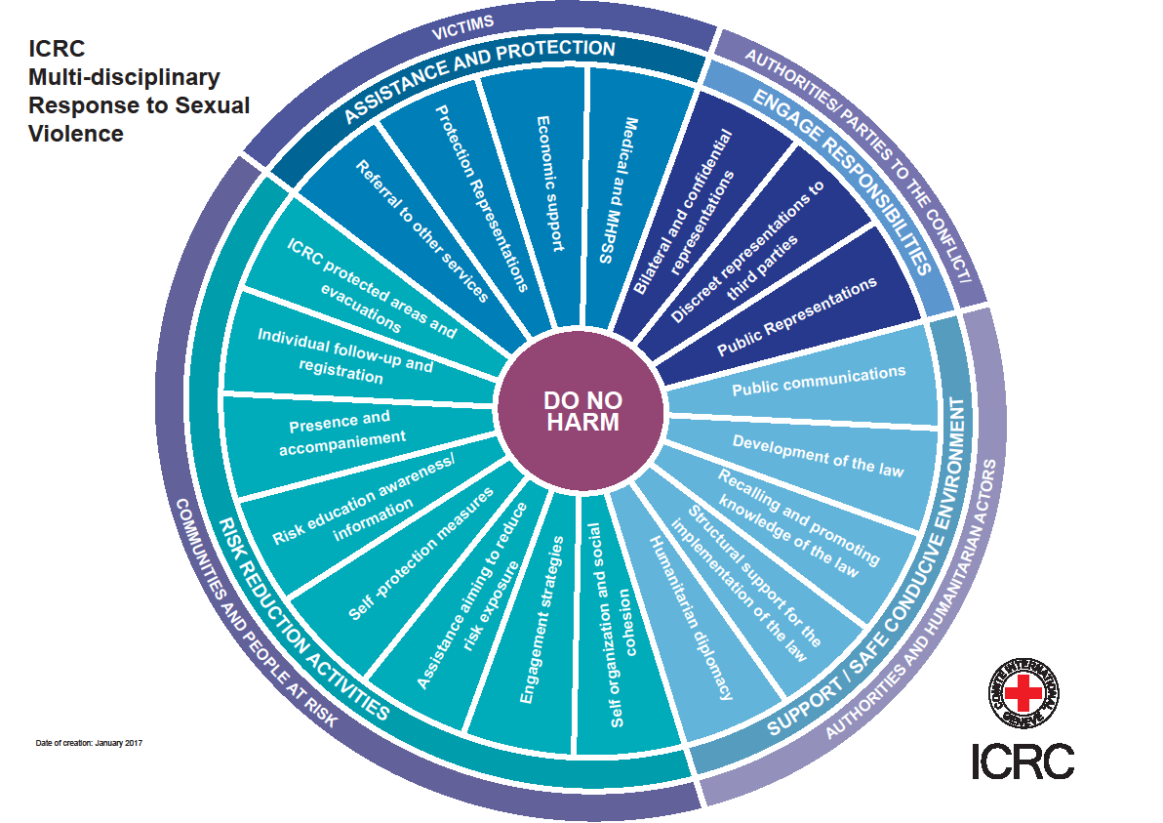
H.E.L.P. course

Slide 22
Role of the health sector
Respond to sexual violence
Provide clinical care & mental health and psychosocial support
Collect forensic evidence
Refer for further crisis intervention and support, such as risk assessment & safety planning
H.E.L.P. course
Prevent sexual violence, challenge stigmatisation, in cooperation with other sectors

Slide 23
HEALTH: Importance of a multi-layered, multi-disciplinary approach
Multi-layered approach: individual, community, and environment (policies, systems)
Integrated Care: not specifically targeted to victims of SV
Multi-disciplinary care: Primary health Care, Hospital Care, MHPSS, Nutrition and livelihood support, Protection
H.E.L.P. course
Participation of affected population: people centric-approach tailored to needs and context
Notes:
Multi-layered: it is necessary to evaluate and tend to the needs of individuals (e.g. medical, MHPSS needs), communities (trauma, stigma, access to care) and at the advocacy level influence decisions to reduce risk, improve protection and enhance access
Integrated Care: programs aimed solely at VV can further enhance stigmatization of victims

Slide 24
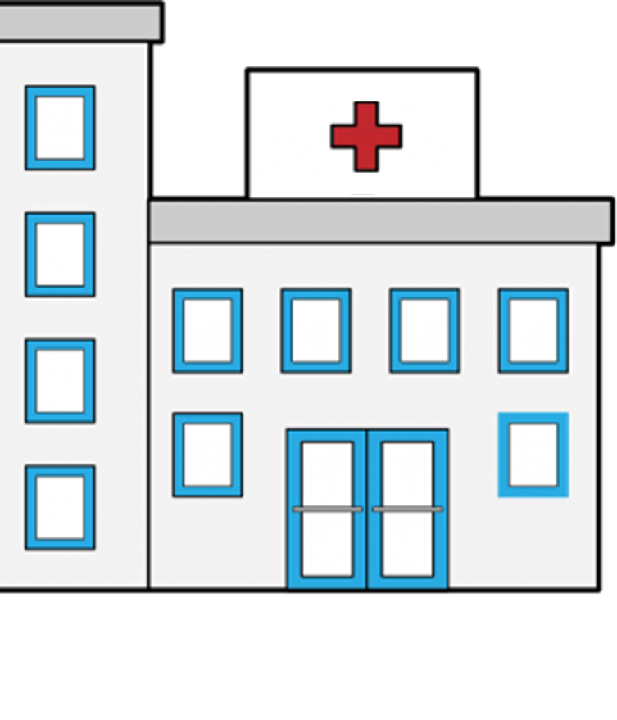
??
What can stop a victim / survivor from accessing care
Fear of identification ⇒ retaliation, stigmatization, rejection, isolation, re-victimisation etc.
Internalised stigma/shame
Inability to afford transport and/or treatment
Lack of awareness of potential health consequences
Safety risks because of long distance travel to health services
H.E.L.P. course
Insecure environment (checkpoints, fighting, shelling, etc.)
Lack of physical accessibility for persons with disabilities

Slide 25
Lack of both male and female health staff
Lack of written protocol for clinical management of rape
Lack of adequate equipment and medical supplies
Lack of safety and
confidentiality
Lack of referral to MHPSS
Lack of training for first-line responders
Practise of invasive procedures
Lack of staff trained in forensic examination in one facility
Victim-blaming attitudes
Criminalisation or restrictions on access to abortion
H.E.L.P. course
Existence of laws restricting use of emergency contraception
Lack of trained interpreters
Notes:
Supplies include:
Consent forms;
Medical chart with pictograms for documentation of injury;
Filing cabinet or storage space with lock;
Info pamphlets for follow on care;

Slide 26
Inadequate medico-legal structure: lack of procedures for processing or storing of evidence
Lack of confidentiality → risk of reprisal
Legal structure unaligned with international standards;
Fear of detention
Lack of documentation needed to report; irregular migration status
Fear of further violence
H.E.L.P. course
Existence of mandatory reporting requirements (in law or practice)
Lack of recognition of potential survivors; existence of laws creating repercussions for survivors themselves
Notes:
Criminalization/ legal considerations
Lack of recognition of potential victim/survivor-survivors within legal structure (e.g. do not recognize men/boys as potential victims).
Existence of anti-homosexuality laws, impact upon male victim/survivor/survivors in particular:
Female victim/survivor/ survivors of sexual violence accused of adultery (“zina”)
Risk of administrative detention (to protect against killings in the name of so called ‘honour’)
Existence of clauses exonerating perpetrators who marry the victim/survivor
Irregular migration status → lack of access to justice in the first place

Slide 27
Ethical and safety concerns
The Four Principles of a victim-survivor centered response:
Respect for agency, well-being & individual choice
Ensuring concerns for safety at the fore
Non-discrimination (impartiality) in support
Ensuring confidentiality is maintained at all times
H.E.L.P. course
Notes:
Ask:
An example of how each can be breached within provision of medical response:
Respect – pushing a survivor to pursue a particular avenue of care – e.g. forensic documentation

Slide 28
At the individual level, a victim/survivor centred response
Means: | Which helps: | As opposed to:
Respecting the agency & choices of each individual (even if we would disagree ourselves) | A victim/survivor to regain a sense of control | Telling a survivor what to do, attempting to influence their decisions or offering personal opinions, and/or treating them as if incapable of making decisions.
Providing information on all available services toward informed consent | A victim/survivor to make decisions best suited to their situation and deal with outcomes/consequences as a result | Providing only partial information, or withholding of certain details, in support of a particular agenda, bias, or belief.
Interacting in a non-judgemental manner at all times (including on circumstances surrounding an incident of violence, choices made subsequently, and any expression of those for future) | A victim/survivor to feel supported, and more likely to continue seeking care | Making value judgements about their experience, circumstances, which may stem from and be reinforced by induvial/societal bias
Providing support/ service without discrimination as to each individual | Uphold the principle of impartiality If individual belongs to a marginalised group or community, other members may be encouraged to come forward in future | Only treating (or giving preference to) persons from certain groups.
H.E.L.P. course

Slide 29
Assessment of health services
Availability
Acceptability
AAAQ
H.E.L.P. course
Quality
Accessibility
Notes:
NB. Basics of the AAAQ framework are discussed during the module Health Care Service earlier in the H.E.L.P. course
Accessibility
Can care be accessed without police involvement (e.g. mandatory reporting)?
Do police or other security forces or armed group mediate access to facility?
Can care be accessed without payment or specific documentation?
Is transportation covered?
Is the location physically accessible?
Is it accessible to persons with disabilities?
What are the entry points for accessing CMR? E.g. maternity ward, emergency ward, focal point, ‘code-word’ etc.
Are entry points inclusive of different groups of survivors? E.g. if maternity ward, this may exclude men, girls or un-married women etc.
Acceptability
Is the staff /organization accepted by the community? (It is recommended to ask the population about their perception of the organization)
Are they associated with another organization (both governmental and non-governmental)?
Does the staff belong to a certain ethnic, religious or other grouping?
Awareness (this is still another point)
Community is aware of facility and what types of services can be offered there?
Are certain groups likely to perceive the service as not applicable to them?
Capacity to refer
Are staff trained to provide referral to MHPSS (if not included), safety or protection services in a confidential manner?

Slide 30
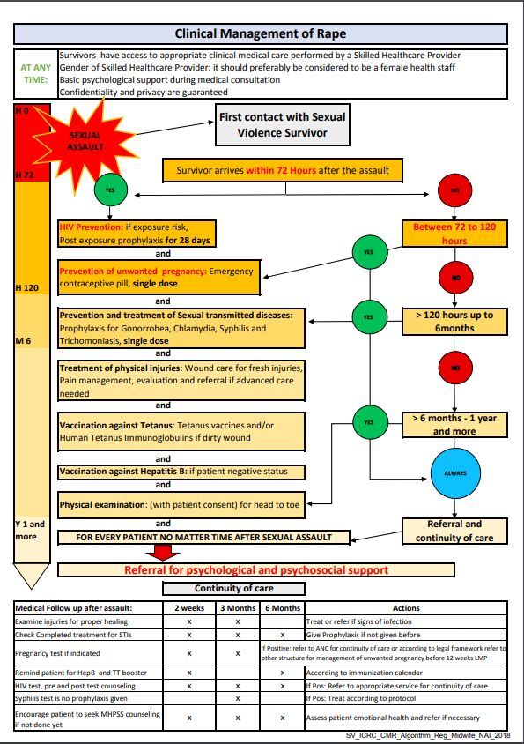
H.E.L.P. course

Slide 31
Clinical management of rape survivors in crisis situations and low income settings -> out? –see next slide
Clinical management of rape survivors in emergency and low-resource settings:
!
Avoid asking questions that indicate blame e.g. why were you in X place alone? What were you wearing at the time of assault? Did you attempt to fight back? Etc.
1. Preparation to offer medical care
2. Preparation of VSV for examination
3. Taking of history
All medical personnel should be aware of the following;
4. Collection of forensic evidence
Legal requirements with regard to reporting cases of SV to police; if mandatory reporting laws in place, the VSV must be notified beforehand in order to inform their decision on whether/not to proceed with care.
National and, if applicable, local protocols for testing of forensic materials (necessary to avoid collecting evidence that cannot be processed etc.).
Legal requirements regarding testimonial in court and accountability to justice system
Relevant information for legal referrals
5. Performing of physical examination
6. Prescribing treatment
7. Counselling the VSV
8. Follow up care
*Based on WHO/ UNHCR (2004), Clinical Management of Rape Survivors- revised ed.
Notes:
All medical personnel should be aware of the legal considerations in their context that are mentioned here

Slide 32
Clinical management of rape survivors
Clinical management of rape survivors in emergency and low-resource settings:
Avoid asking questions that indicate blame e.g. why were you in X place alone? What were you wearing at the time of assault? Did you attempt to fight back? Etc.
!
As health professional, be aware of
Legal requirements with regard to reporting cases of SV to police; if mandatory reporting laws in place, the VSV must be notified beforehand in order to inform their decision on whether/not to proceed with care.
National and, if applicable, local protocols for testing of forensic materials (necessary to avoid collecting evidence that cannot be processed etc.).
Legal requirements regarding testimonial in court and accountability to justice system
Relevant information for legal referrals
H.E.L.P. course
*Based on WHO/ UNHCR (2004), Clinical Management of Rape Survivors- revised ed.

Slide 33
Minimum requirements for clinical management of sexual violence in low-resources settings
Protocol
Written medical protocol for clinical management of rape in language of provider*
Appropriate staff
Trained (local) health care professionals (on call 24 hours/day)* For female survivors, a female health care provider speaking the same language is optimal If this is not possible, a female health worker (or companion) should be in the room during the examination*
Furniture/setting
Room (private, quiet, accessible, with access to a toilet or latrine)*
Examination table*
Light, preferably fixed (a torch may be threatening for children)*
Access to an autoclave to sterilise equipment*
Supplies
Speculum* (preferably plastic, disposable, only adult sizes)
Tape measure for measuring the size of bruises, lacerations, etc*.
Paper bags for collection of evidence*
Paper tape for sealing and labelling containers/bags*
Supplies for universal precautions (gloves, box for safe disposal of contaminated and sharp materials, soap)*
Resuscitation equipment*
Sterile medical instruments (kit) for repair of tears, and suture material*
Needles, syringes*
Cover (gown, cloth, sheet) to cover the survivor during the examination*
Sanitary supplies (pads or local cloths)*
H.E.L.P. course

Slide 34
Minimum requirements for clinical management of sexual violence in low-resources settings
Drugs
For treatment of STIs as per country protocol*
For post-exposure prophylaxis of HIV transmission (PEP)
Emergency contraceptive pills and/or copper-bearing intrauterine device (IUD)*
For pain relief* (e.g. paracetamol)
Local anaesthetic for suturing*
Antibiotics for wound care*
Administrative supplies
Medical chart with pictograms*
Consent forms*
Information pamphlets for post-rape care (for survivor)* sensitively designed
Safe, locked filing space to keep records confidential*
H.E.L.P. course

Slide 35
Collecting forensic evidence of Sexual Violence See notes AVR -> next 2 slides
The primary purpose of an examination of a VSV, is to access what kind of medical care should be provided.
Forensic examination (abridged) *:
!
VSV should be given option of being examined by a person of their chosen gender (if applicable), and/or to be accompanied by someone they trust. The same applies towards interrupters, if applicable.
VSVs should never be pressured into undergoing forensic examination. The role of the medical practitioner is to inform not advise.
Description of steps comprising examination, reassurance of VSV that they are in control of the process and can stop at any time
Remember: The injury incurred does not automatically speak to the gravity of violence experienced.
Many cases of sexual violence will have no clinical findings; it is not the role of the examiner to determine whether or not SV took place.
!
Performance of physical and genital examination (note: different procedures depending on if VSV presents pre or post 72hrs of incident)
Description of incident should be recorded in words of VSV
VSV should be given the option to review medical script and remove any detail they are uncomfortable with being shared
!
When documenting evidence or asking for clarification on specific details: avoid using words such as ‘alleged,’ ‘suspected,’ or those that otherwise indicate suspicion or disbelief in the person’s narrative.
H.E.L.P. course
Medical certificates should only be shared with human rights bodies, upon consent and with identifying information removed
*Based on WHO/ UNHCR (2004), Clinical Management of Rape Survivors- revised ed. Step 4.

Slide 36
Collecting forensic evidence of sexual violence -see
!
Primary purpose of an examination of a VSV is to assess what kind of medical care should be provided.
VSVs should never be pressured into undergoing forensic examination. The role of the medical practitioner is to inform not advise.
Remember: The injury incurred does not automatically speak to the gravity of violence experienced.
Many cases of sexual violence will have no clinical findings; it is not the role of the examiner to determine whether or not SV took place.
When documenting evidence or asking for clarification on specific details: avoid using words such as ‘alleged,’ ‘suspected,’ or those that otherwise indicate suspicion or disbelief in the person’s narrative.
!
!
!
H.E.L.P. course
!

Slide 37
Collecting forensic evidence of sexual violence see
!
VSV should be given the option of being examined by a person of their chosen gender (if applicable), and/or to be accompanied by someone they trust.
Description of steps comprising examination, reassurance of VSV that they are in control of the process and can stop at any time
Performance of physical and genital examination (Note: different procedures depending on whether VSV presents pre or post 72hrs of incident)
Description of incident should be recorded in the words of VSV
VSV should be given the option to review medical script and remove any detail they are uncomfortable with being shared
Medical certificates should only be shared with human rights bodies, upon consent and with identifying information removed
!
!
!
!
H.E.L.P. course
!
Based on WHO/ UNHCR (2004), Clinical Management of Rape Survivors- revised ed. Step 4.

Slide 38
What might be the problem with situating an entry point for access to clinical management of sexual violence within a maternity ward?
??
H.E.L.P. course

Slide 39
??
What ethical safety concerns must be considered when conducting community awareness raising for health services on sexual violence?
H.E.L.P. course
Notes:
Provide information to community leaders, women’s groups,
men, adolescents
Use different media (radio, posters, leaflets, sessions at
outpatient clinic) to disseminate your message
Information on prevention of SV and where to get care
Give correct information on available services (i.e. PEP
prevents transmission of HIV - it is not treatment of AIDS)
Emphasize: seek care at earliest opportunity: within 72 hrs
Develop talking points to ensure all staff deliver the same
Message
Context- language
Discreet
Creative placement
Imaging

Slide 40
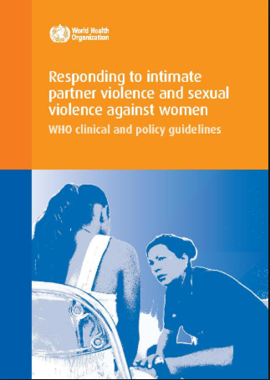
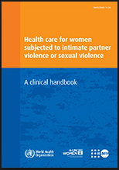
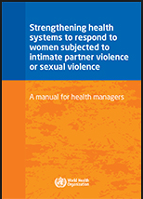
Resources
WHO, 2014: Health care for women subjected to intimate partner violence or sexual violence: a clinical handbook
WHO, 2004: Clinical Management of Rape Survivors: Developing Protocols for work with Refugees and Internally Displaced Persons
WHO, 2013 Responding to Intimate Partner Violence and Sexual Violence Against Women: WHO Clinical and Policy Guidelines
WHO, 2017:Strenghtening Health Systems to Respond to Women Subjected to Intimate Partner Violence or Sexual Violence: a manual for health managers
H.E.L.P. course

Slide 41
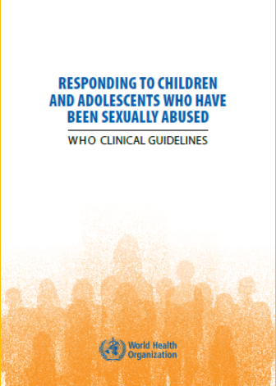
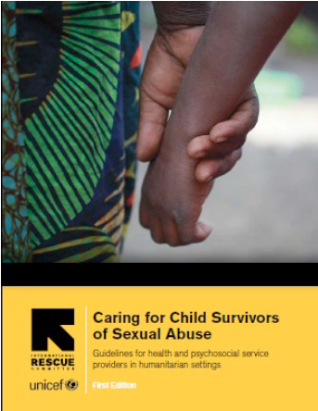
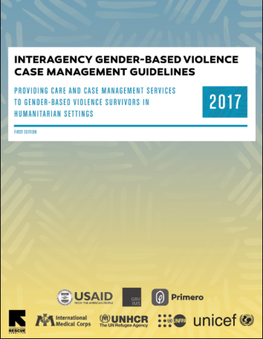
Resources
MOSAIC, CMR for Male Survivors of Sexual Assault
MOSAIC, Toolkit for understanding issues of SOGI
WHO, Responding to Children and Adolescents who Have Been Sexually Abused
H.E.L.P. course
2017, Interagency GBV Case Management Guidelines
IRC, Caring for Child Survivors of Sexual Abuse

Slide 42
A woman takes part in a basket-weaving workshop as part of a multidisciplinary project within the Wau Protection of Civilians camp, encompassing components of livelihood support, protection and mental health and psycho-social support. Wau, South Sudan, 2017.
H.E.L.P. course
Questions?

Slide 43
The following slides were part of the module sexual and reproductive health in the Hawaii 2019 H.E.L.P. course (MISP section) Facilitated by Ribka Amsalu, Senior Advisor, Emergency Health department of Global Health, Save the Children USA
Sexual Violence
Prevent sexual violence and respond
to needs of survivors

Slide 44
GBV
SEXUAL VIOLENCE
ATTEMPTED
RAPE
RAPE
- is an umbrella term for any harm that is perpetrated against a person’s will that results from power inequities that are based on gender roles
- may be physical, sexual, psychological, economic or socio-cultural – sexual threats, humiliation, assault, domestic violence, etc
- is any non-consented action of a sexual nature, including rape, attempted rape, sexual exploitation and sexual abuse
- is a subset of the broader category of gender-based violence (GBV)
- is an act of non-consensual sexual intercourse
- involves the use of force, threat of force, and/or coercion
- Any penetration is considered rape.
Efforts to rape someone which do not result in penetration are considered attempted rape.
Notes:
Let’s review a few terms before discussing sexual violence and GBV further. Survivors of sexual violence can be of any sex, gender, or age

Slide 45
Sexual violence
Sexual Violence
MISP priority interventions focus specifically on:
Prevention of sexual violence (multi-sectoral)
Providing clinical and psychosocial care for survivors
Raising community awareness of the services available and prevention measures

Slide 46
Sexual violence: Prevention
Sexual Violence
Consultation with community
Multi-sectoral task force for prevention of sexual violence
Risk mapping
Firewood, water patrols
Lighting
Secure sanitation and bathing
Community awareness campaigns
Code of conduct for humanitarian workers in place and enforced
“the girls need more privacy in the evacuation centers, there is no privacy to change clothes and it is really hard to take a bath in rest rooms as there is no privacy” a girl, in Estancia, Philippines . SOWM report 2014

Slide 47
Sexual violence: care for survivors
Sexual Violence
Post-exposure prophylaxis (PEP)
Emergency contraception (EC, IUDs)
Care of wounds and prevention of tetanus
Presumptive treatment of STIs
Prevention of hepatitis B
Prevention of Human Papilloma Virus (HPV)
Collecting forensic evidence
Linking survivors with other services such as psychosocial services
Notes:
A health care provider may be the first or only person a survivor ever approaches and the quality of the care provided can have short and long-term impacts on the well-being of the survivor and the survivor’s willingness to disclose. Therefore, all health providers (including those who are not working in facilities equipped to provide clinical care for survivors of sexual violence) must be prepared to provide the first-line of support, which includes empathetic listening and validation, identifying the survivor’s immediate emotional, psychological, and physical needs, and identifying available support services.
Only providers explicitly trained and supervised in the collection of forensic evidence should undertake the collection of other samples of forensic evidence
It is the role of the health provider to document the exam and the findings consistent with the survivor’s description of what happened, but it is not the role of the provider to establish whether, legally, a rape happened
If a microscope is available and no more than 5 days have passed since the incident, a trained health provider or laboratory worker can examine wet-mount slides for the presence of sperm
The importance of seeking immediate medical care following sexual violence:
No later than 72 hours for prevention of HIV
No later than 120 hours for prevention of pregnancy
Progestin-only ECPs (delay or prevent ovulation )
400 mg of cefixime plus 1 g of azithromycin orally will be sufficient presumptive treatment for gonorrhea, chlamydial infection, and incubating syphilis
PEP must be initiated as soon as possible and no later than 72 hours following exposure and continued for 28 days. Offer counseling and testing for HIV in the first 2 weeks after the incident.
Age
Treatment
Adults and adolescents. Backbone regimen: Tenofovir (TDF) + Lamivudine (3TC) or Emtricitabine (FTC). Recommended third drug: Lopinavir/ritonavir (LPV/r) or Atazanavir/ritonavir (ATV/r) . Where available Raltegravir (RAL), Darunavir + ritonavir (DRV/r), or Efavirenz (EFV) can be considered as alternative options for the third drug
Children 10 years and younger. Backbone regimen: Zidovudine (AZT) + Lamivudine (3TC). Alternative regimen: Abacavir ABC + Lamivudine (3TC) or Tenofovir (TDF) + Lamivudine (3TC) or Emtricitabine (FTC). Recommended third drug: Lopinavir/ritonavir (LPV/r) is recommended as third drug for HIV PEP in children) . An age-appropriate alternative regimen can be identified among Atazanavir/ritonavir (ATV/r), Raltegravir (RAL), Darunavir + ritonavir (DRV), Efavirenz (EFV) and Nevirapine (NVP)
.
Provide hepatitis B vaccine within 14 days of the assault unless the survivor is fully vaccinated. A total of 3 doses are needed, the second dose 4 weeks after the first, and the third dose 8 weeks after the second dose.
Consider providing the HPV vaccine to any age 26 or younger, unless the survivor has been fully vaccinated. In most cases, a total of 3 doses need to be given over a 6-month period.
Where relevant, discuss adherence to STI prophylaxis or treatment including PEP and hepatitis B vaccination (additional doses at 1 month and 6 months), HIV testing at 3 months and 6 months, and pregnancy status and options

Slide 48
Why are incidents of sexual violence often not reported?
Sexual Violence
Fear of retribution,
Shame, stigma,
Powerlessness,
Lack of support,
Unreliability of public services,
Lack of trust in the health services
Lack of confidentiality
Unfamiliarity with the services.

Slide 49
We keep in our heart
Sexual Violence
https://data2.unhcr.org/es/documents/download/60864

Slide 50
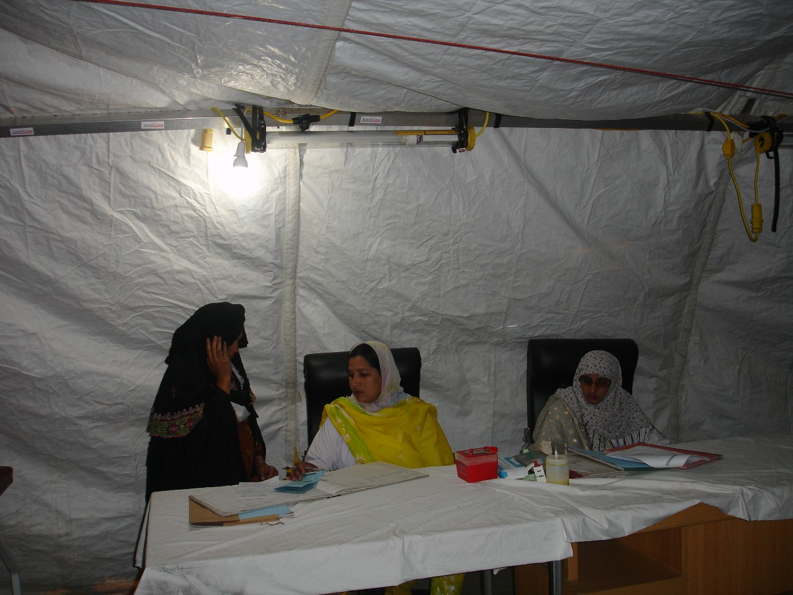

Slide 51
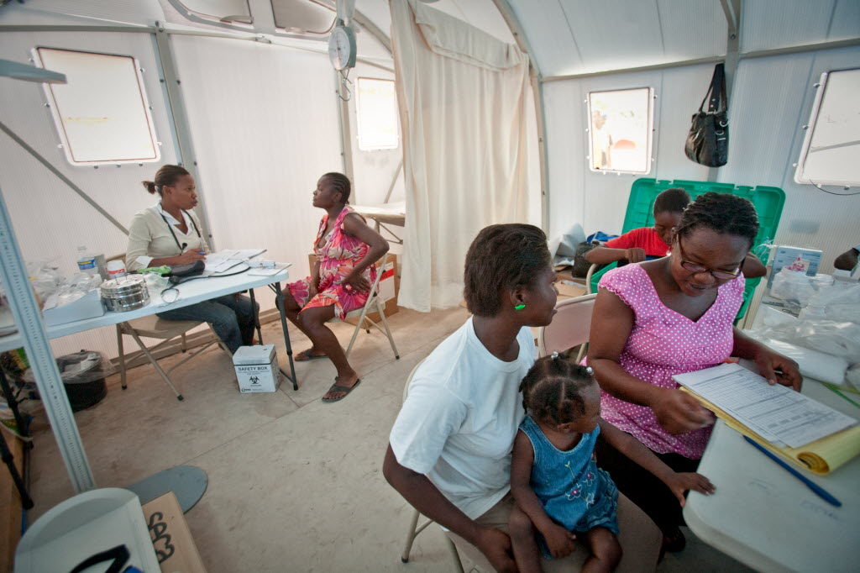
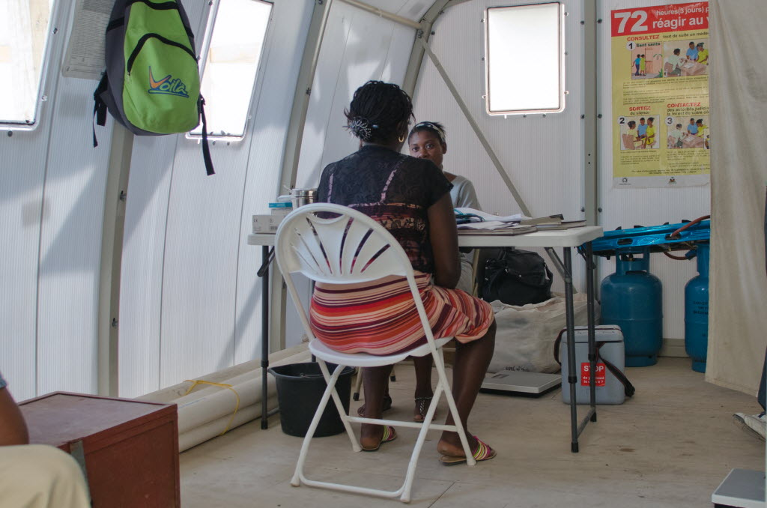
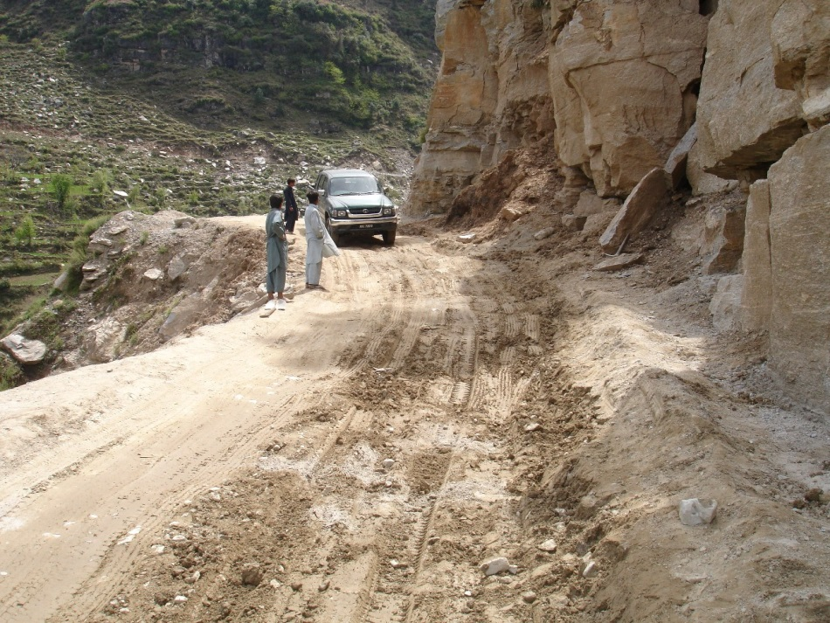

Slide 53
Sexual Violence
Programmatic Considerations
Survivor centered - prevention and response
Multi-sectoral
Community - meaningfully engaged
Train health and other sector staff
Equip heath facilities with necessary supplies
Privacy and confidentiality
Individualized approach to care
Document and course-correct, prevention and response.

Slide 54
Questions / Comments?

