Slide 1
Humanitarian Protection
H.E.L.P. Course 2022
Notes:
Pre-learning material for the session:
Enhancing protection for civilians in armed conflict and other situations of violence. Introduction: Understanding Protection (p.9 – 10)
Professional standards for protection work. Chapter 1: Overarching principles in protection work (p.21-32) and Chapter 5: Promoting complementarity (p.91-101)
Notes for facilitators:
F2F session roll-out: 90 mins.
Presentation of objectives and methodology 5’
Concept of protection 10’
Identification of protection concerns and addressing protection needs – case study: work in groups 20’ + restitution 10’ + feedback and exchange 30’
Ways in which protection and health interventions are intertwined – 15’

Slide 2
Objectives
Learners are able to
explain the concept of protection and identify some of the main protection concerns of people affected by conflict and other situations of violence
identify ways to address protection needs
describe ways in which protection and health interventions are intertwined
H.E.L.P. course
Notes:
Every actor sees protection from a particular perspective depending on their mandate. In this session we’ll talk about protection in the ICRC in settings of armed conflict and OSV
To reach protection outcomes we need a multidisciplinary approach, which includes the health perspective
Methodology of the session

Slide 3
What is Protection?
Activities to ensure the respect for the rights of individuals in accordance with the relevant bodies of law (international humanitarian law, human rights law, refugee law…)
Reduction of risks, also by decreasing the vulnerability of persons and the strenghthening of their capacities
Notes:
Protection from abuses and violations caused by the behavior of arms carriers and others in conflicts and violence
Responsibility of State authorities and non-State actors where relevant to protect people by ensuring their safety, well-being and dignity.
E.g. violence attacks against medical personnel, ill-treatment, being forced to participate in conflict, depriving access to health care and other essential services, access to humanitarian aid, etc. Beyond health related issues, family separation, disappearance, forced displacement, attacks against civilians and civilian objects, etc
ICRC definition + Inter-Agency Standing Committee
To address protection needs: to influence the behavior of those responsible, together with reducing the risks of affected people.
Prot activities addressed to authorities and arms carriers + activities addressed to communities and persons at risk

Slide 4
Case study
Rebel forces gained a large part of the territory and ruled it with a brutal regime for more than 10 years. Recently, through a vicious war that entailed enormous harm to both sides, the government managed to retake the land.
Many people, supposedly supporters of the rebel regime, are in the custody of the government and depend on them to cover all their basic needs (housing, food, health, education, ...).
The men of fighting age are deprived of their liberty with no possibility to contact their families. The others, mainly women and children, are in IDP camps in a dire situation and prevented by the Government, for security reasons, to return to their communities of origin. Even if they were free to do so, they could not return, as the communities would never accept the women, perceived as collaborators, nor “the children of the rebel”.
H.E.L.P. course
Notes:
Work in groups, flipcharts

Slide 5
Group work
What protection concerns and risks do you think people face in this situation?
Define as many actions as possible to address them

Slide 6
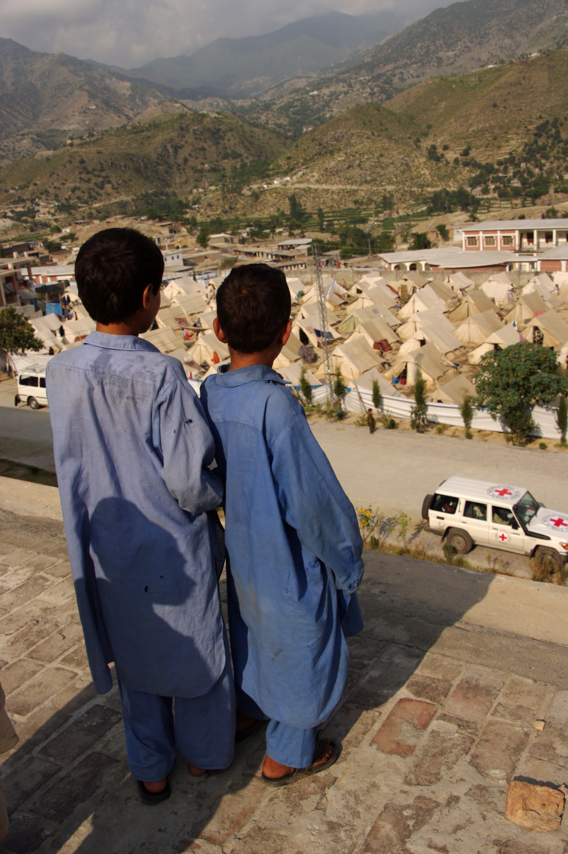
Addressing protection needs
H.E.L.P. course
Notes:
To assess protection needs: understand who has been affected by what, how, the severity of impact, how people are coping, stakeholders involved…
See the protection risk, as the exposure to the source of the threat (violation, abuse…), the specific vulnerability of the individual, community, services or systems (e.g. health system) to that threat, as well as the capacities to face it. Threats, vulnerabilities and capacities are interrelated and in constant evolution. Interventions addressing one of the elements will affect the rest.
Individuals and populations at risk are also actors of their own protection (agency). It is essential to understand concerns from their perspective and engage with them for the identification of needs and solutions.
To plan possible interventions, see actors with a responsibility to protect and other stakeholders who may have an influence on the behaviour or in the reduction of the risks.
Regarding legal responsibilities, different bodies of law set the specific responsibilities of authorities and other actors. Authorities at all levels of government are primary duty bearers: Authorities (State, non-State) have the primary responsibility to protect and uphold the rights of people within their territory or control. [Link to module on Legal framework].
Given the variety of protection actors involved, efforts should be made to ensure that methods and approaches are complementary to obtain protection outcomes. The roles, activities and capacities of others must be taken into account for building synergies. (Link to module Setting the scene and actors in humanitarian interventions/coordination)

Slide 7
Levels of protection interventions
to prevent or put a stop to the abuse, and alleviate the immediate effects
Environment
Building
Responsive
Action
to foster a political, social, cultural, institutional and legislative environment that respect the rights of individuals
Remedial
Action
H.E.L.P. course
Violation
Abuse
to restore people’s dignity after the abuse

Slide 8
Examples of protection interventions
Int. standards into national legislation
Public campaigns on needs
Access to support for victims/survivors
Support/creating systems to facilitate family contact
Awareness raising in communities of origin
Environment
Building
Environment
Building
Public reports (others)
Mobilization other actors
Responsive
Action
Responsive
Action
Judicial guarantees
Remedial
Action
Remedial
Action
H.E.L.P. course
Violation
Abuse
Violation
Abuse
Confidential dialogue
Clarify fate of missing persons and support families
Strengthening resilience of people at risk
Notes:
Possibilities in the case study:
Stakeholders: Government forces, Rebels, community leaders, religious leaders, Embassies, NGO and Civil society organizations, UNHCR, OHCHR, the ICRC, Red Cross/Red Crescent National Society, etc. (To be complemented by participants based on their own experiences)
Only a few examples:
Responsive action: Activity undertaken to prevent abuse, put a stop to it, and/or alleviate its immediate effects.
Potential examples case study:
Men deprived of their liberty: ICRC engages in a confidential dialogue with Government authorities re. arbitrary deprivation of liberty, torture and other forms of ill-treatment, enforced disappearance, contact with families, conditions of detention, etc); HRW publish a report on the treatment of detainees and their living conditions; activities to restore family links; etc
Women and children in the camps: ICRC engages in a confidential dialogue with Government authorities regarding protection from acts of vengeance and exploitation, discrimination, denial of access to basic services, sexual violence, lack of education for children, registration, lack of freedom of movement…; supporting authorities capacity to register affected people; mobilization of other actors to address urgent gaps; provide assistance to cover essential needs; providing information about existing or potential resources to women and support the exchange of information among them; access to health and psychosocial support for survivors of sexual violence, etc
Remedial action: Action taken to restore people’s dignity and to ensure adequate living conditions after a pattern of abuse.
Eg case study:
Men deprived of their liberty: supporting authorities through rehabilitation to improve conditions in places of detention; mobilize other actors to support authorities on judicial guarantees; help creating a system to facilitate contact of detainees with their families; supporting the families who have no news on the fate and whereabout of their loved ones and collect individual cases to be searched in the prison system, etc
Women and children in the camps: supporting authorites through donations and rehabilitations to resume services without discrimination (water supply, shelter, healthcare, education…); capacity building on relevant standards for camp authorities, protocols and guidelines for an effective protection; Red Cross restore the family links with the outside world; support referral systems, etc
Environment building: Efforts to foster a political, social, cultural, institutional and legislative environment that enables or encourages the authorities to respect their obligations and the rights of individuals.
Eg case study:
Men deprived of their liberty: integration of international standards in national legislation (Mandela’s rules…), etc
Women and children in the camps: raise awareness among communities of origin and other potential communities of the situation of these families through campaigns, etc; humanitarian mediation with communities of origin; influencing community leaders to accept their members; etc
Be aware of humanitarian environment and how the role and working modalities of different actors (authorities and others) complement each other in the protection of people.

Slide 9
Which role would you play in the protection of people
and
how do you see protection work contributing to Health?
H.E.L.P. course
Notes:
In which ways health interventions may contribute in protection outcomes and how protection interventions can improve health objectives?

Slide 10
ICRC Protection Material
Notes:
Key resources on Protection in www.icrc.org

