Slide 1
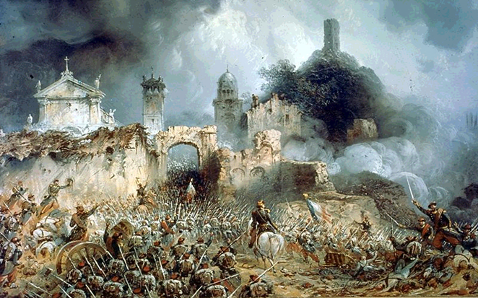
Logo organization(s) facilitators(s)
Legal Framework
H.E.L.P. course
These learning materials have been developed by:
Alexandra Ortiz, Kelisiana Thynne and
Anne Quintin, ICRC
Name + organization facilitator(s)

Slide 2
Objectives
Be able to:
distinguish different situations of violence and identify the main IHL instruments applicable to each of these
explain what human rights are, who has the obligation to respect and protect them and who the intended beneficiaries are
explain the difference between IHRL and IHL in terms of scope of application
explain the distinction between refugees, displaced persons and migrants, and the main rules applicable to each category
explain the most relevant rules of IHL
explain the responsibilities of health-care personnel working in crisis situations and the main rules linked to the care and protection of wounded and sick, and the protection of health-care personnel and health services overall
explain the protective and indicative use of the Red Cross, Red Crescent and Red Crystal emblems
explain the purpose and scope of the International Health Regulations
H.E.L.P. course

Slide 3
I. What is IHL, IHRL and refugee law?
Statement 1: “International humanitarian law overrides human rights law and refugee law during armed conflict”
Y/N
H.E.L.P. course
Notes:
Answer: No – human rights law and refugee law continue to apply during armed conflict. IHL only applies during armed conflict.
If there is any contradiction between HR and IHL during an armed conflict, IHL will apply – Advisory opinion of the ICJ on the legality of the threat or use of nuclear weapons.
Unlikely to be many cases of contradiction between the two bodies of law

Slide 4
International criminal law
Environmental law
International humanitarian law
Law on dispute settlement
Refugee law
Human rights law
H.E.L.P. course
Law of state responsibility
Notes:
These laws all apply in times of armed conflict and IHL is just one of many laws applying – so any time you hear the phrase “legal vacuum” this is not the case – IHL may not apply to all situations, but some other law is definitely going to.

Slide 5
Overview: International Humanitarian Law
A branch of public international law;
Established by custom or treaty;
Applicable in time of armed conflict;
protects persons who are not, or no longer, participating in the hostilities, as well as certain places and objects;
restricts the rights of the warring parties to use the methods and means of warfare of their choice;
H.E.L.P. course

Slide 6
II- Sources of IHL
Statement 2: “Civilian and military medical facilities can display the Red Cross or Red Crescent emblem during an international armed conflict”
Where do you go to find the answer to this?
Y/N
H.E.L.P. course
Notes:
You find the answer in Geneva Convention I articles 19 and 42 and 44
The answer is yes, with the permission of the military authorities
They already have protection as hospitals – the emblem just is a reminder that they have this protection

Slide 7
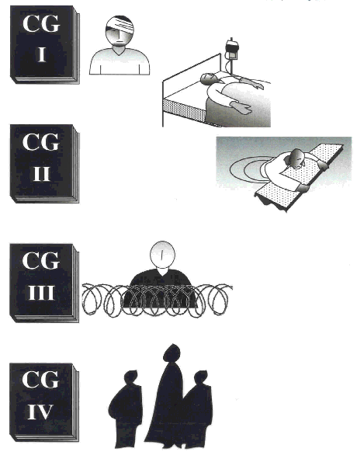
Geneva Conventions of 1949
Wounded and Sick (Land)
Wounded, Sick and Shipwrecked (Sea)
Prisoners of War
H.E.L.P. course
Civilian Persons (in the power of the enemy)

Slide 8
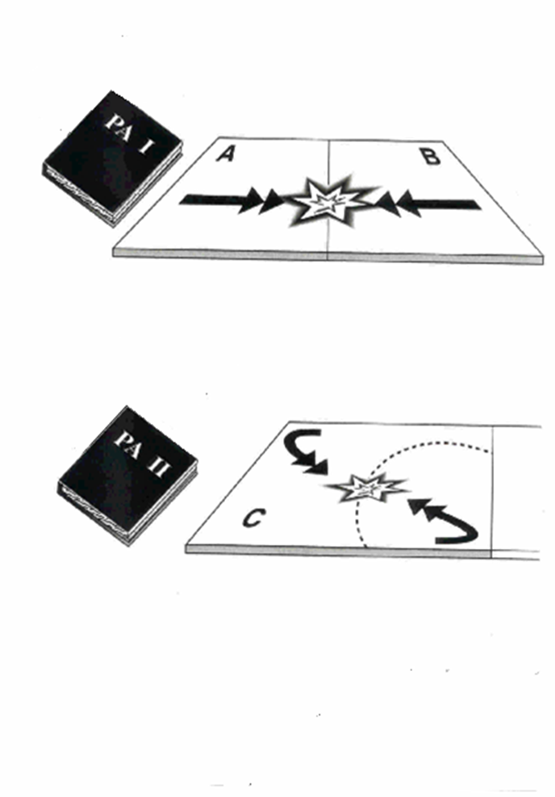
Additional Protocols of 1977 and 2005
International Armed Conflicts (IAC)
Non International Armed Conflicts (NIAC)
H.E.L.P. course
Additional Distinctive Emblem
Notes:
The Red Crystal was adopted in 2005 as an alternative protective and indicative emblem to the cross and crescent. It is only used by Israel when it operates overseas and it was established to give Israel an emblem so that the Palestinian Red Crescent could also be recognised under the principle of neutrality.

Slide 9
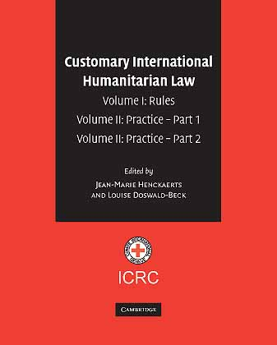
Customary International Humanitarian Law
161 rules identified:
13 only applicable in international armed conflicts (IAC)
2 only applicable in non international armed conflicts (NIAC)
146 rules applicable in both IAC and NIAC
H.E.L.P. course
Notes:
13 only applicable in international armed conflicts (POWs and occupation generally)
Rule 3 definition of combatants
Rule 41 return of cultural property in occupied territory
Rule 44. Due Regard for the Natural Environment in Military Operations??
Rule 45. Causing Serious Damage to the Natural Environment??
Rule 49. War Booty
Rule 51 protection of property in occupation
Rule 82. Recording of the Placement of Landmines??
Rule 106 protection of POWs
Rule 107 spies
Rule 108 mercenaries
Rule 114. Return of the Remains and personal Effects of the Dead
Rule 145 reprisals
Rule 146 reprisals against protected persons
Rule 147 reprisals against protected objects
Rule 23 Location of military objectives outside densely populated areas?
Rule 24. Removal of Civilians and Civilian Objects from the Vicinity of Military Objectives?
Only applicable in NIAC:
Rule 148 reprisals in NIAC
Rule 159. Amnesty
3 have different formulations in IAC and NIAC:
Rule 4 Definition of armed forces
Rule 128. Release and Return of Persons Deprived of Their Liberty
Rule 129. The Act of Displacement

Slide 10
What is international human rights law?
Environmental law
Protects the rights of individuals from the State
Human rights are universal - they belong to everybody in the world.
Human rights are inalienable - they cannot be taken away from people.
Human rights are indivisible and interdependent – all the different human rights are important for human beings to flourish and participate in society.
Law on dispute setement
H.E.L.P. course

Slide 11
IHRL -Key instruments
International:
International Covenant on Civil and Political Rights (1966)
International Covenant on Economic, Social and Cultural Rights (1966)
Convention on the Elimination of All Forms of Discrimination against Women (1979)
Convention against Torture and Other Cruel, Inhuman or Degrading Treatment or Punishment (1984)
Convention on the Rights of the Child (1989)
International Convention on the Protection of the Rights of All Migrant Workers and Members of their Families (1999)
International Convention for the Protection of All Persons from Enforced Disappearance (2006)
Convention on the Rights of Persons with Disabilities (2006)
Regional:
European Convention on Human Rights (1950)
American Convention on Human Rights (1969)
African Charter on Human and Peoples’ Rights (1981)
H.E.L.P. course

Slide 12
General scope of application IHL/HRL
IHL | IHRL
Protection of individuals | Protection of individuals
Only in time of armed conflict | Applies at all times
Binding on States & non-state armed groups | Only binding on States
Extraterritorial application inherent | Extraterritorial application controversial
No derogation | Some derogation in emergencies
H.E.L.P. course
Notes:
Apart from general commonality of general rationale protection of individuals, differences important
Ad 2) IHRL applies at all times while IHL only in AC
That means:
clear that in OSV (short of armed conflict) only HRL applicable (thus must refer to HR norms on problems like UoF, detention, protection of health-care providers in OSV
- The invocation of IHRL by the ICRC since 2008.
From a fundamentally IHL driven discourse, to more comfort with IHRL.
Other situations of violence
The Arab spring
Others, including the detention framework.
b) But even if AC, not everything that happens on territory where AC ongoing is automatically governed by IHL
e.g. violent demos unrelated to AC, actions of party to AC
Detention unrelated to AC (ordinary criminal detention)
c) still, sometimes very difficult to neatly separate what is linked to AC and what is not, esp. with regard to UoF see later Part II
e.g. Yemen interventions in 2011 where both IHL and HRL mentioned, more on that later; of course domestic law may also be referred to, if conversation on international legal framework difficult for whatever reason, to the extent that domestic law consistent with international norms
– introduction to riot control
Situations where it is complex to determine to legal framework
Intro to factual circumstances
Intro to legal framework
Distinction between Gaza and WB?? To be continued…
d) Cases where IHL and HRL in AC not in conflict but where they can mutually reinforce each other, see later Part II
e.g. non-refoulement, basic needs and conditions in detention (sufficient food, water, ventilation etc. for detainees)
Ad 3 and 4) whenever we invoke HRL, 2 additional hurdles to be overcome, compared to IHL:
3) Who is bound? Only State, controversy over NSAGs; ICRC: limited exception: de facto HRL responsibilities if NSAGs de facto semblance with government (rarely such stable control)
The invocation of IHRL with non-state actors – TNC 2011
ICRC has a fairly restrictive approach to the invocation of IHRL with NSAGs
TNC 2011 – Request to the ICRC for a legal framework for detention
ICRC’s intervention: Premised on IHL; internment, detention related to conflict
But – One reference to IHRL to accommodate detention unrelated to conflict
- And, in any event, the TNC was near to being a state!
4) Extraterritorial application: under HRL controversial, bound up with interpretation of notion of jurisdiction
Famous example Art.2 ICCPR
Each state Party to the present Covenant undertakes to respect and to ensure to all individuals within its territory and subject to its jurisdiction the rights recognized in the present Covenant
-) On this basis especially, taking this literally, US and Israel deny, as a matter of law, the extraterritorial application of HRL (but possible to apply sometimes as a matter of policy)
-) However, otherwise, well recognized that some extraterritorial application possible:
effective control over territory (occupation)
effective control over persons (detention)
limits: especially on battlefield (especially airstrikes)
5) Derogations: possible under HR but not under IHL, not automatic, State needs to proactively declare derogation in an emergency threatening the life of the nation, prototype of situation of emergency AC but could also be OSV!
Only so far as not being inconsistent with other international obligations (esp. IHL): for instance could make room for preventive security detention without promptly affording possibility to challenge internment before a judge
Some rights not possible to derogate from: prohibition of torture, right to life (except for narrow exception under ECHR)
Derogation vs lex specialis – Is Derogation necessary where IHL applies
GCIII PoW, GCIV PC: Little doubt that there is no requirement to derogate (ECHR).
For NIAC, however, this is an area of the law where there is certainly some ambiguity
Afghanistan from 2002 (NIAC) – the U.S. and others were engaging in a form of IHL-based NIAC internment – No question of derogation.
By 2012, Afghanistan was considering its own internment regime – uproar in relation to this framework vs IHRL (can you derogate right to fair trial – not for DS).
ECHR – Irish cases: Derogation must be necessary, and accompanied by safeguards (e.g. detention commission that can order release, access to family et al).
Complex issue – and relationship to question of using internment in lieu of criminal proceedings.
6) Enforcement by individuals: because of notion of rights on international level, possibility to enforce rights (effective remedy and possibility to obtain redress for harm suffered for violations) before international HR courts & bodies against States; individuals have also done so for alleged violations of HRL in armed conflict (complaints mechanisms under universal HR treaties like ICCPR-HRC; CAT-CAT Committee; regional courts like ECtHR, American Commission & Court of HR)
-Also: State reporting under HR treaties
-In addition: political mechanisms, Charter-based HR system with HRC: UPR (where States examine HR compliance of each other); UN Special Rapporteurs and WG, both thematic and country specific submitting regular reports; also Commissions of inquiry established for fact-finding and analysis of violations
IHL rarely uses language of rights (right of families to know fate of relatives) normally formulated in terms of obligations of the parties
Existing compliance mechanisms like Protecting Powers, Enquiry Procedure, International Humanitarian Fact-Finding Commission, Meeting of States parties under API rarely, if every used; only applicable in international armed conflicts; both states party to conflict must consent to their use; in practice: mostly us but limits inherent in our preferred working method of confidentiality

Slide 13
Refugee law
1951 Refugee Convention and 1967 Protocol, a person who:
“owing to a well-founded fear of being persecuted for reasons of race, religion, nationality, membership of a particular social group or political opinion, is outside the country of his nationality, and is unable to, or owing to such fear, is unwilling to avail himself of the protection of that country.”
Need a refugee status determination (otherwise asylum seeker)
Some practical human rights based steps for individual states to implement
H.E.L.P. course
Notes:
Short introduction only in order to understand the legal meaning (and hence applicable protection) of the various categories, and make sure that the terms are used correctly · Discuss the distinction between refugees, internally displaced persons, and migrants · Definition of refugee as a legal status · Existing international and regional instruments - Geneva Convention on the definition of the status of refugees (1951) - OAU Convention Governing the Specific Aspects of Refugee Problems in Africa (1969) - (non-binding) UN Guiding Principles on IDPs - (IDPs) Kampala Convention

Slide 14
Internally Displaced Persons (IDPs)
IDPS: internally displaced persons are persons or groups of persons who have been forced or obliged to flee or to leave their homes or places of habitual residence, in particular as a result of or in order to avoid the effects of armed conflict, situations of generalized violence, violations of human rights or natural or human-made disasters, and who have not crossed an internationally recognized state border.
Guiding Principles on IDPs, Kampala Convention of the AU on IDPs
H.E.L.P. course
Notes:
The Guiding principles on IDPs set out some steps that must be taken (noting non-binding document but many provisions reflect IHL and IHRL) to protect IDPs and ensure that they can return home when it is safe

Slide 15
III. Classification of conflicts
Statement 3: “When a State fires rockets into the territory of another State, this is necessarily an international armed conflict”
Y/N
H.E.L.P. course
Notes:
Yes – an international armed conflict starts when there is resort to force or attack on the territorial integrity of another country by a third state. There is no intensity criteria for an international armed conflict.
Any difference arising between two States and leading to the intervention of armed forces is an armed conflict within the meaning of Article 2, even if one of the Parties denies the existence of a state of war. It makes no difference how long the conflict lasts, or how much slaughter takes place. … If there is only at single wounded person as a result of the conflict, the Convention will have been applied as soon as he has been collected and tended … and his identity notified to the Power on which he depends: Pictet Commentary on GCI

Slide 16
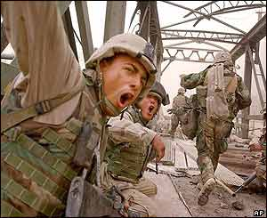
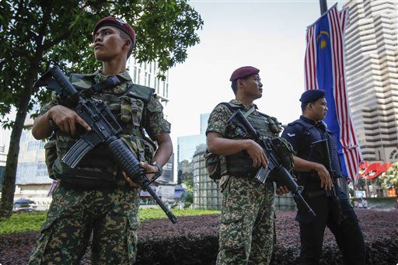
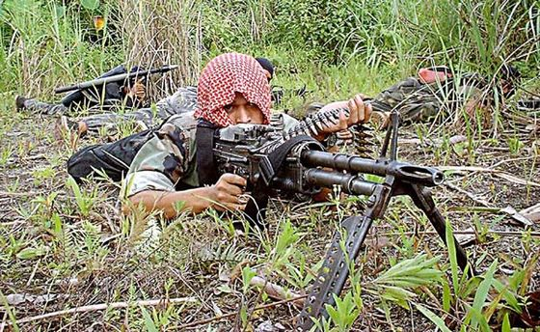
What is an “armed conflict”?
H.E.L.P. course
Notes:
Riots/security to NIAC to IAC (pictures are Malaysia during CT operations, riots (unspecified country), Philippines NIAC, Iraq 2003 (IAC)

Slide 17
Legal frameworks applicable to situations of violence
IHL
IHL
IHL
IHRL
IHRL
IHRL
IHRL
IHRL
National
law
National
law
National
law
National
law
National
law
H.E.L.P. course
Armed conflict
OSV
NIAC
IAC
Notes:
No legal vacuum – law always exists to deal with situations

Slide 18
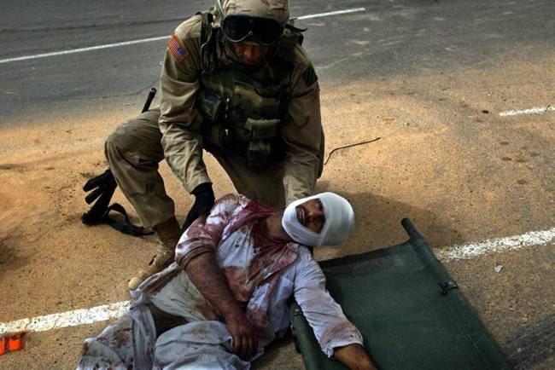
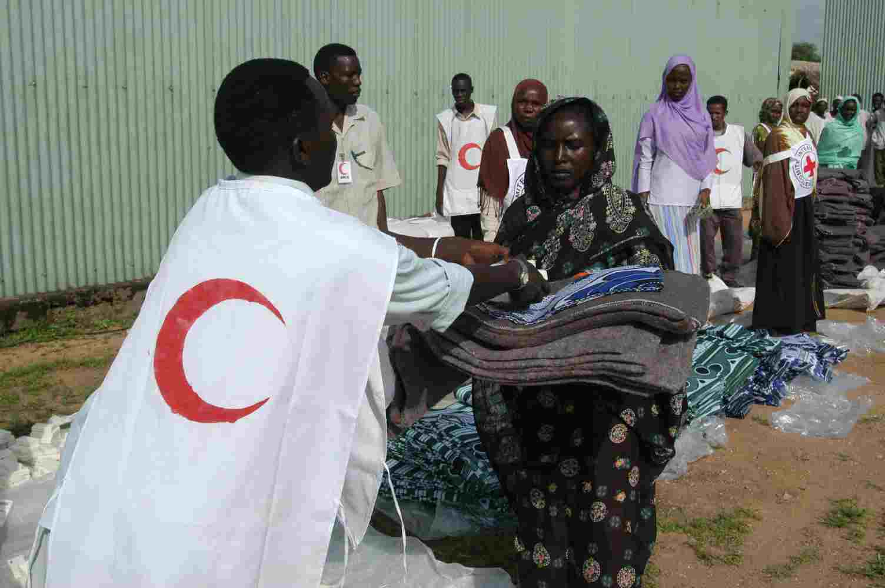
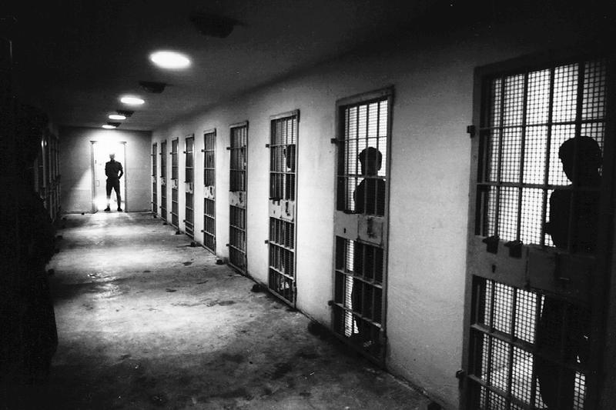
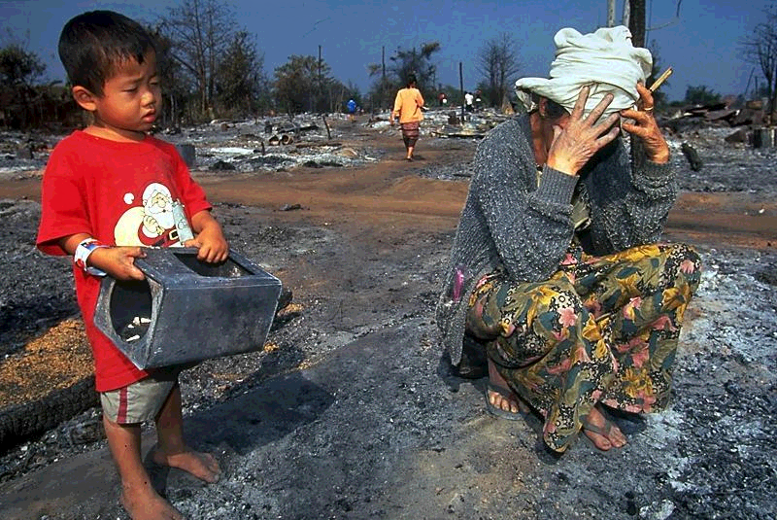
Protection of persons not taking part, or no longer taking part, in hostilities
H.E.L.P. course
Notes:
Main part of the legal session · Rules related to the conduct of hostilities:
Principle of distinction:
- Wounded and sick soldiers, humanitarian workers, detainees, civilians should all be protected

Slide 19
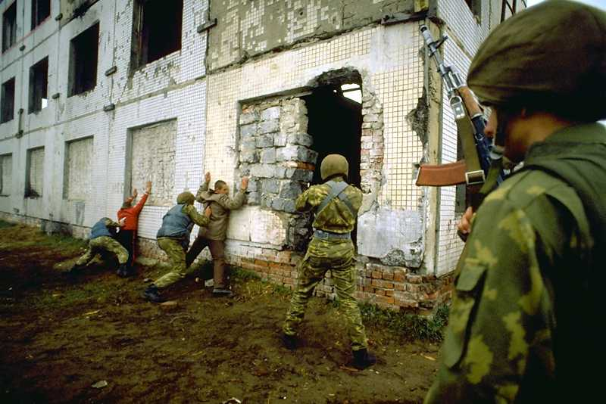
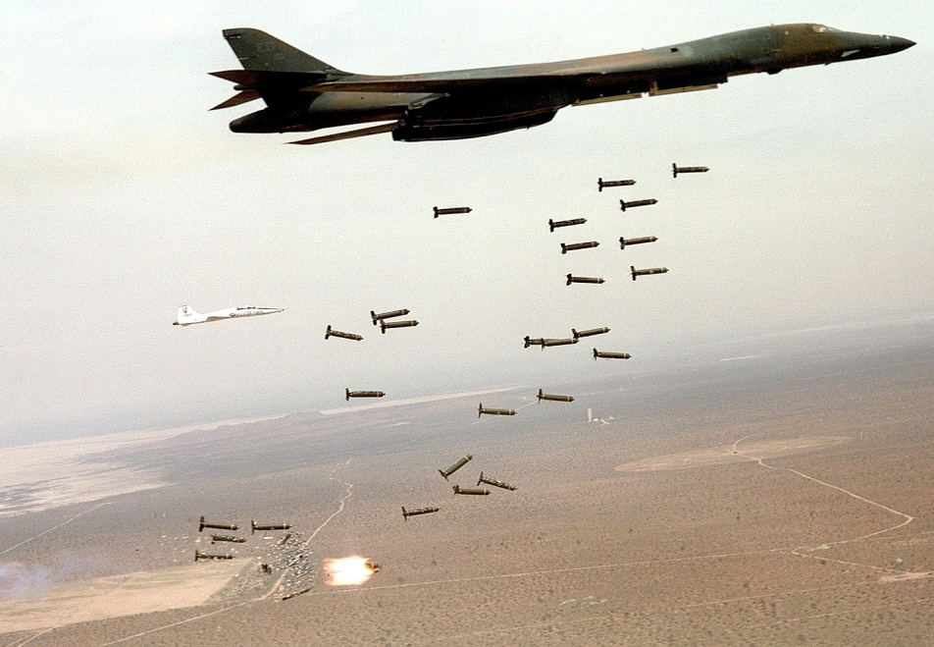
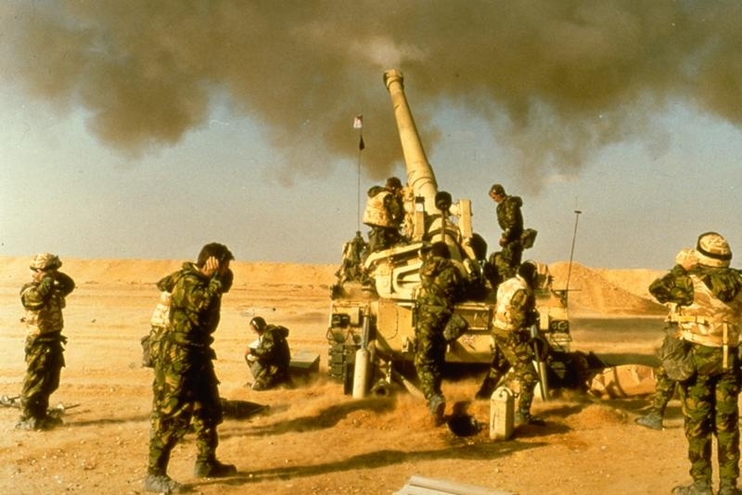
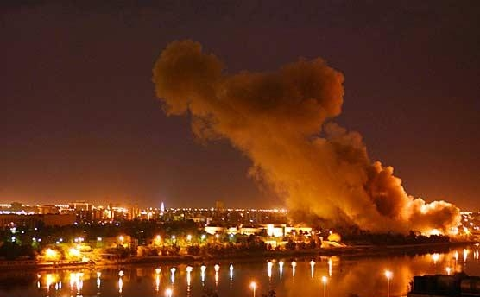
Limitations on means and methods of warfare
H.E.L.P. course
Notes:
Principles of distinction, proportionality, precautions - Main rules related to means and methods of warfare
(e.g. prohibition of indiscriminate attacks,
prohibition of superfluous injury and unnecessary suffering, new weapons review, specifically prohibited methods of warfare, etc.) ·
First picture:
Rules related to the protected of persons in the hands of party to the conflict (e.g. humane treatment, rules applicable to detention, etc.)
Second picture; cluster munitions – indiscriminate effects in attack
Third: precautions in attack
Fourth: necessity of not having military bases in civilian areas and the flip side, principle of proportionality and ensuring that civilians are not indirectly attacked

Slide 20
Examples – Does IHL apply?
Heavy fighting has taken place between Colombian government troops and opposition FARC guerillas, as part of hostilities that have been going on for years and with large casualties. In the most recent attack, more than 60 members FARC and government troops have been killed.
Y/N
H.E.L.P. course
Notes:
Yes – heavy fighting, armed groups, armed attack:
criteria for NIAC: intensity of conflict and organisation of the armed groups (Tadic decision ICTY)
Organised forces:
Indicative factors:
the existence of a command structure and disciplinary rules and mechanisms within the group
the ability of the group to gain access to weapons, other military equipment, recruits and military training
its ability to plan, coordinate and carry out military operations, including troop movements and logistics
its ability to define a unified military strategy and use military tactics;
its ability to speak with one voice and negotiate and conclude agreements
Intensity of the conflict
Indicative factors:
the number, duration and intensity of individual confrontations
the type of weapons and other military equipment used
the number of persons and type of forces taking part in the fighting
the number of casualties
the extent of material destruction
the number of civilians fleeing combat zones
…

Slide 21
Examples – Does IHL apply?
Y/N
A young man is killed during a clash between his gang and the national police in a slum area in Cité Soleil, Haiti.
H.E.L.P. course
Notes:
No – police, not military, riot – APII says that internal disturbances, riots etc are not subject to IHL

Slide 22
IV- Wounded and sick
Statement 4: “It is permitted to attack a hospital which members of the enemy are using for military purposes, even if this hospital is still caring for wounded and sick patients”
Y/N
H.E.L.P. course
Notes:
Yes – as long as precautions are taken article 21 GCI
of medical personnel (including refraining from participating in hostilities, care without discrimination, etc.) · Protection of medical services and cases of loss of protection for medical services Main part of the legal session Link to other course modules, e.g. Violence against health care and Humanitarian protection · Protection of (military and civilian) wounded and sick: respect, protect, care (including evacuation and equal treatment) · Protection of medical personnel: - On the battlefield: may not be attacked, may perform medical duties in conformity with medical ethics, etc. - Once in enemy hands: repatriation or employment caring for POWs - Under control of the enemy: right to perform medical duties, etc. - Duties

Slide 23
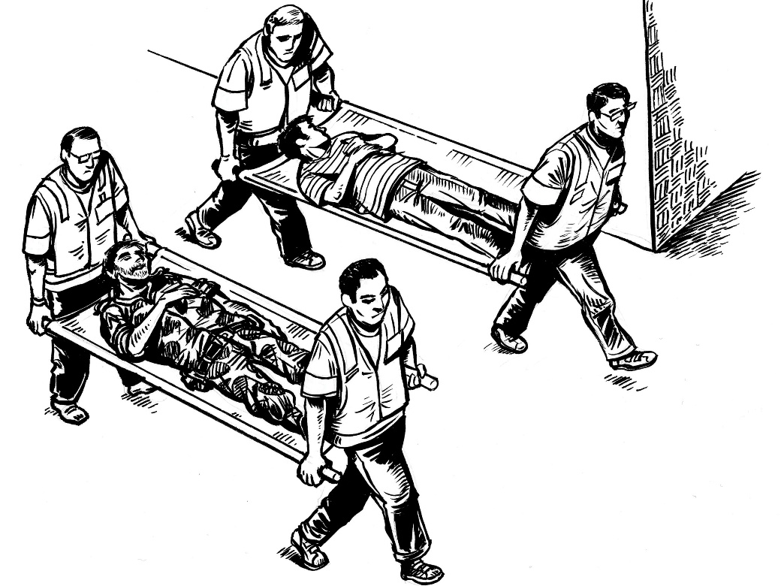
IHL definition of wounded and sick
➪ The wounded and sick:
- require medical care
- civilian or military
- refrain from any hostile act
H.E.L.P. course
Notes:
Additional Protocol I - Art 8. Terminology
For the purposes of this Protocol:
"Wounded" and "sick" mean persons, whether military or civilian, who, because of trauma, disease or other physical or mental disorder or disability, are in need of medical assistance or care and who refrain from any act of hostility. These terms also cover maternity cases, new-born babies and other persons who may be in need of immediate medical assistance or care, such as the infirm or expectant mothers, and who refrain from any act of hostility;
-Requirement of medical care:
-no threshold of severity of medical condition;
-includes persons that would not usually be considered wounded or sick, like expectant mothers, new-born babies
-refrain from any act of hostility: a soldier who keeps firing not protected even if wounded

Slide 24
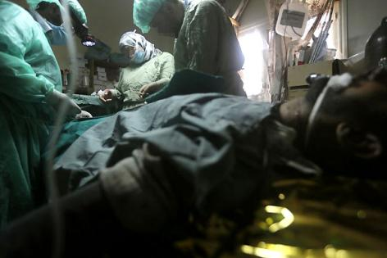
IHL obligations towards wounded and sick
Humane treatment
Respect
Protect
Collect
Care
H.E.L.P. course
Notes:
Picture: Al-Qusayr, Homs governorate. A wounded man is operated on in a field hospital.
In times of armed conflicts, under IHL, the wounded and sick enjoy a general right to be:
respected (not to be subject to, for instance, killing or ill-treating them)
protected (to be assisted, including protected against third parties)
collected (subject to what is possible in terms of security conditions and capacities, but without delay)
cared for (similarly subject to what is possible in terms of security conditions and capacities, but with least possible delay)
For each of this categories, states and non-state parties to the conflict and health-care personnel have corresponding obligations and responsibilities.
Under IHRL, we find corresponding State obligations which apply also in emergencies other than armed conflicts, principally under angle of respecting & protecting patient’s access to HC services
See commentary to GC I, art. 12:
“It is not sufficient to respect the wounded. They require ' care, ' If a soldier, who is ' hors de combat, ' is respected and [p.137] protected against injury of any kind, but is at the same time left to struggle alone against the effects of his wound or his sickness, he runs a great risk of succumbing. There is therefore a positive, as well as a negative, obligation: the wounded and sick must be given such medical care as their condition requires. This fundamental principle has remained unchanged since 1864”

Slide 25
CARE: All possible measures shall be taken to provide medical care to the wounded and sick.
On a non-discriminatory basis
As far as practical
With the minimum delay
Means also permitting others, including civilians or impartial humanitarian organizations to assist with care
H.E.L.P. course
Notes:
Picture: Tskhinvali, Georgia, 20 August 2008. Patients had to be moved to the basement of this hospital after the building was partly destroyed.
Under IHL, all parties to armed conflicts have the basic obligation to provide the wounded and sick with medical care and attention as far as practicable and with the least possible delay. Medical care and attention must be provided without any adverse distinction based on grounds other than medical ones [Common Art. 3 (2) GC I-IV; Art. 12 GCI; Art. 12 GCII; Art. 10 (2) API; Art. 7 (2) APII; ICRC Customary IHL Study, rule 110].
The law of occupation contains broader obligations to preserve the existing public health-care system in occupied territories. Thus, the occupying power must ensure the medical supplies of the population of an occupied territory, as well as ensure and maintain, with the cooperation of national and local authorities, the medical and hospital establishments and services, public health and hygiene in the occupied territory [Arts. 55, 56 GCIV].
Though IHL allows parties to the conflict to provide care “as far as practicable” and thus to take into account the resources available to them and existing security conditions, a lack of resources does not justify inaction. Even in cases where resources are extremely limited, parties to the conflict must use their best efforts to ensure medical care to the wounded and sick. This includes permitting impartial humanitarian organizations to provide such care. Consent to their work must not refused arbitrarily.
As actors directly involved in providing health-care to the wounded and sick, health-care personnel have the responsibility to ensure that such obligations are implemented and have the right to demand that the authorities assist them in carrying out their work.
In particular, in all circumstances, they have to:
treat the wounded and sick humanely;
not abandon the wounded and sick;
advocate and provide effective and impartial care for the wounded and sick without any adverse distinction

Slide 26
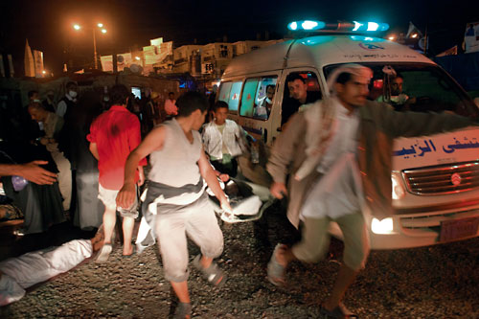
All possible measures shall be taken to search for, collect and evacuate the wounded and sick
Without discrimination
Without delay
Permit others to assist in those tasks
H.E.L.P. course
Notes:
Under IHL, whenever circumstances permit, and particularly after fighting, all parties to armed conflicts must, without delay, take all possible measures to search for, collect and evacuate the wounded and sick without adverse distinction [Art. 15 (1) GCI; Art. 18 GCII; Art. 8 APII; Rule 109, Customary IHL Study]. Again, they must use their best efforts to do so, taking into account prevailing security conditions and existing capacities.
Health-care personnel have the responsibility to make sure that such obligation is implemented and have thus the right to remind authorities of their obligation to search for and collect the wounded and sick and to ensure their access to health care without discrimination.

Slide 27
Quick quiz on protection of HC professionals at large:
Government forces discover that a wanted insurgent has been wounded in battle and is being treated in a civilian hospital. The forces enter the hospital and attempt to arrest the insurgent. The hospital staff attempt to explain that the insurgent is in need of additional medical treatment and cannot be taken out of the hospital, but to no avail. On the contrary, they are threatened with punishment if they do not comply with the order of arrest.
The insurgent may be arrested, but must continue to receive adequate medical care. Health-care personnel must not be compelled to refrain from acts required by ethical principles of health care.
The insurgent may not be arrested because the wounded and sick may not be subjected to interrogation or deprivation of liberty.
H.E.L.P. course
The insurgent may not be arrested because Government authorities cannot enter hospitals.
Notes:
Right answer: a.

Slide 28
Nobody engaged in health care activities shall be hindered in the performance of their exclusive medical tasks; shall not be harassed for the simple fact of assisting the wounded and sick.
The parties shall not arbitrarily interfere
No punishment for acting within medical ethics
HC professionals shall not be compelled to perform activities contrary to medical ethics
H.E.L.P. course
Notes:
Under IHL, the obligation to respect medical personnel who are performing their exclusively medical function also entails an obligation on parties to the conflict not to arbitrarily interfere with their work so as to allow them to treat the wounded and sick [Commentaries on Arts. 19, 24, 35 GCI, pp. 196, 220, 280; Commentary on Arts. 12, 21 API, pp. 166, 250; Commentary on Art. 11 APII, p. 1433].
Parties to the conflict shall not molest or punish any person engaged in medical activities (NB: scope broader than “medical personnel”) performing activities compatible with medical ethics, nor shall they compel them to perform activities contrary to medical ethics or to refrain from performing acts required by medical ethics [Art. 18 (3) GCI; Art. 16 (1) (2) API; Art. 10 (1) (2) APII].
A related issue concerns the question whether medical personnel may be compelled to provide to a party to a conflict information that goes beyond the health condition of the wounded and sick strictly speaking, such as information on the activities, connections, position or simply the existence of the wounded [Commentary on Art. 16 API, p. 206, para. 682].
The rules contained in API and APII provide that, while generally, the confidentiality of patient information shall be protected from denunciation to authorities, medical personnel, especially towards their own authorities, as parties to a conflict may make protection from such denunciation subject to national law [Art. 16 (3) of API specifies for IACs that in relation to both its own authorities and authorities of the adverse party, medical personnel may be compelled to reveal this type of information in the case of communicable diseases. This case is not explicitly mentioned in the corresponding provision of Art. 10 (3) of APII applicable to NIACs regulated by APII, since such exceptions are usually enshrined in national legislation. See Commentary on Art. 10 (3) APII, p. 1428, para. 4702].

Slide 29
Specific protection of medical personnel, facilities and transports
Notion of « assignment » by competent authority of party to a conflict for medical purposes
dedication to medical purposes must be pre-determined by such authority;
linked with ability to control who & what is entitled to use the protective emblems of the red cross, red crescent and red crystal
can be civilian or military
H.E.L.P. course
Notes:
Medical personnel" means those persons assigned, by a Party to the conflict, exclusively to the medical purposes enumerated under e) or to the administration of medical units or to the operation or administration of medical transports. Such assignments may be either permanent or
temporary. The term includes in IAC:
i) medical personnel of a Party to the conflict, whether military or civilian, including those described in the First and Second Conventions, and those assigned to civil defence organizations;
ii) medical personnel of national Red Cross (Red Crescent, Red Lion and Sun) Societies and other national voluntary aid societies duly recognized and authorized by a Party to the conflict;
iii) medical personnel or medical units or medical transports described in Article 9, paragraph 2.
In NIAC:
-same as under Art. 8 (c) (i) API;
-medical personnel of Red Cross/Red Crescent organizations recognized and authorized by parties to the conflict;
-medical personnel of other aid societies recognized and authorized by a party to the conflict and located within the territory the conflict is taking place
Thus, restriction to local medical personnel!
-can be members of AF; members of NSAGs; NS staff duly recognized and authorized by party to conflict; staff of other NGOs under same conditions as NS
-assigment: means that not any doctor is automatically protected as medical personnel in the sense of IHL but his dedication to medical purposes must be pre-determined; linked with ability to control who is entitled to use the protective emblems of the red cross, red crescent and red crystal which in term should make it visible to opposing party to conflict who is protected as such!
[…]
Incidentally, scope of Art. 16 API and Art. 10 APII is broader than the term «medical personnel», as it covers all persons engaged in medical activities, whether or not assigned by a party to the conflict!
Definition of health care personnel according to the ICRC broader than technical definition of “medical personnel” under IHL:
All those working in the area of health care. This includes:
People with professional HC qualifications, e.g. doctors, nurses, paramedics, physiotherapists, pharmacists;
health-care personnel, whether working in HC facilities, in ambulances, as ambulance drivers, administrators of hospitals or in the community in their professional capacity;
Red Cross and Red Crescent staff involved in the delivery of health care, including volunteers;
Personnel of health-oriented NGOs or international organizations;
military health-care personnel

Slide 30
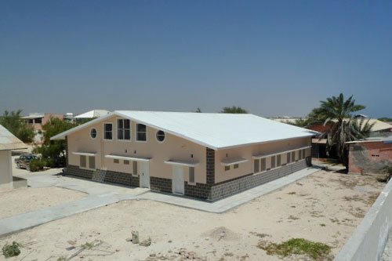
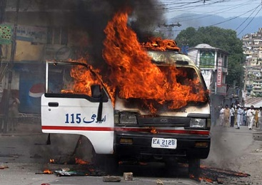
RESPECT: Medical transports and facilities shall not be object of attack or subject to other forceful interferences.
H.E.L.P. course 2019
Notes:
Pictures: Pakistan, 12 April 2010. An ambulance is set ablaze by angry protesters in Abbottabad, located in the North West Frontier Province. Keysaney hospital, Mogadishu, Somalia
Under IHL, the basic obligation to respect the wounded and sick entails, in particular, not to attack, kill, ill-treat or harm them in any way [Art. 12 GCI; Art. 12 GCII; Art. 16 GC IV; Art. 10 API; Art. 7 APII; Commentary on Art. 10 API, para. 446].
From the basic obligations in relation to the wounded and sick flow the specific IHL protections of medical personnel, units and transports. Medical personnel, units and transports, pursuing their exclusively humanitarian task, whether military or civilian, may not be attacked or harmed, unless they commit, outside their humanitarian functions, acts harmful to the enemy [Rules 25, 28, 29, Customary IHL Study; Arts. 19 (1), 24-26, 35 GCI; Arts. 23, 36 GCII; Arts. 18, 20, 21 GCIV; Arts. 12 (1), 15, 21 API; Arts. 9, 11 (1) APII].
Thus, wounded and sick are protected as civilians or wounded combatants or fighters, in particular from attack because of the fact of abstaining from hostile acts. To ensure their safety and protection, health care facilities and transports are also considered as protected targets and may not be object of attack.
Medical units, such as hospitals and other facilities that have been set up for medical purposes, must be respected and protected in all circumstances. Medical units may not be attacked and their functioning not unduly impeded. Parties to an armed conflict must take measures to protect medical units from attacks, such as ensuring, whenever possible, that they are not situated in the vicinity of military objectives.
Health-care facilities include hospitals, laboratories, clinics, first-aid posts, blood transfusion centres, and the medical and pharmaceutical stores of these facilities. Violence includes bombing, shelling, looting, forced entry impeding their functioning, shooting into, encircling or other forceful interference with the running of health-care facilities (such as depriving them of electricity and water).
Medical transports include ambulances, medical ships or aircraft, whether civilian or military; and vehicles transporting medical supplies or equipment. Violence includes attacks on, theft of and interference with medical vehicles.
Under IHL, the obligation to respect medical personnel, units and transports, performing their exclusively medical function, which means that their functioning may not be unduly interfered with, entails that the passage of medical personnel and supplies must not be arbitrarily prevented [Commentary on Art. 12 API, p. 166, para. 517]. (The same may be argued on the basis of the obligation to take all possible measures to search for, collect and evacuate W&S without delay. This includes permitting humanitarian organizations to carry out such tasks, and consent must not be withheld arbitrarily in this regard)
DIFFERENCE to norms on humanitarian access/assistance more broadly b/c of entitled beneficiaries that include wounded fighters & not only civilians!
Forceful entry into medical units: not per se prohibited but need to make sure that least possible interference with medical care; continuity of care must be preserved
Like all other obligations in relation to health-care personnel and infrastructure, this obligation derives from the fundamental obligations to respect, protect and care for the wounded and sick [Commentary on Art. 12 GCI, p. 134].

Slide 31
Quick quiz:
A group of armed insurgents sets up a medical facility near the front lines to treat its wounded. In the basement of the facility, the insurgents store weapons to be sent to the frontlines. A red cross is placed on the roof of the facility. Government soldiers attacked the facility, after having issued a warning with an appropriate time-limit for compliance to the non-state armed group, which remained unheeded.
The Government has violated IHL because even though the weapons are in a medical facility, they were not going to be used there.
The Government has not violated IHL because non-state armed group facilities cannot qualify as medical facilities protected under IHL.
.
H.E.L.P. course
The Government has not violated IHL because even though the weapons were not going to be used there, their mere storage alone is sufficient to deprive the medical facility of protection from attack
Notes:
Right answer: c.

Slide 32
… such protection can be lost by committing ‘acts harmful to the enemy’:
Using medical facilities, or transports…
to shelter healthy combatants
to store arms or ammunition
as military observation posts
as a shield for military action
to carry or use weapons for non-defensive purposes
to transport healthy troops, arms or munitions
to collect or transmit military intelligence
H.E.L.P. course
Notes:
Medical personnel, units and transports retain their protected status as long as they are exclusively devoted to the care of the wounded and the sick and are not used to advance military goals, that means used to commit “acts harmful to the enemy” [the notion is contained in AP I, art 13 and in CIHL, see Rule 25]. Examples of "acts harmful to the enemy" include:
the use of medical units to shelter able-bodied combatants;
the use of medical facilities to store arms or ammunition;
the use of medical facilities as military observation posts or as a shield for military action;
the use of medical units to launch military attacks;
firing weapon for non-defensive purposes;
the transport of healthy troops, arms or munitions;
the collection or transmission of military intelligence;
the presence of armed combatants inside a medical facility for other than medical reasons;
[Commentary on Art. 21 GCI, pp. 200-201; Commentary on Rule 28 and 29, Customary IHL Study, p. 97 and p. 102].
A warning and reasonable time limit must be given before an attack is launched. An attack must also respect the principles
of distinction and proportionality because of the highly likely presence of wounded and sick inside such medical units or transports.
If medical transports fall into the hands of an adverse party, that party becomes responsible for ensuring that the wounded and sick in their charge are cared for.
Finally, parties to an armed conflict who use medical units or transports with the intent of leading the opposing parties to believe they are protected, while using them to launch attacks or carry out other acts harmful to the enemy, leading to killing, wounding or capture, commit acts of perfidy. If such an act of perfidy results in death or injury to individuals belonging to an adverse party, it constitutes a war crime.

Slide 33
Exceptions to loss of protection:
Medical personnel may…
Carry light individual weapons for self-defence or for the protection of their patients;
Be escorted by combatants;
Retain patients’ small arms and ammunitions before handing them to the authorities.
H.E.L.P. course
Notes:
However, certain acts are not considered to fall within this exception, for example: carrying light individual weapons for self-defence or defence of the wounded and sick; the presence of, or escort by, military personnel; and the possession of small arms and ammunition taken from the wounded and sick and not yet handed over to the proper authority [Art. 22 GCI; Art. 13 API; Commentaries on Rules 25, 29, Customary IHL Study, pp. 85, 102].
Health-care personnel, to retain their protection under IHL and not to put into danger the protected status of the wounded and sick and of their colleagues, should:
avoid taking part in any act of hostility;
not take undue risks while discharging their duties.

Slide 34
PROTECT: Positive measures shall be taken to protect medical personnel & objects from attacks and to avoid forceful interference, even by third parties, with their work & functioning.
Support and assistance by the authorities
H.E.L.P. course
Notes:
Picture: Somalia. After being attacked, Mohammed Yusuf, director of the Medina Hospital in Mogadishu, is now guarded 24 hours a day.
-interesting example of protecting medical personnel under threat!
It is clear from this case that protection also implies an obligation to take positive measures to protect medical personnel & medical units from attacks and to avoid forceful interference with the running of health-care facilities.
Such measures include the following precautions:
Ensuring, where possible, that medical units are not situated in the vicinity of military objectives;
avoiding forced armed entry with the intent or effect of hindering continued functioning of health-care delivery and taking measures to ensure it does not happen;
ensuring that they are not deprived of essential supplies, electricity and water.
Under IHL, the obligation of parties to a conflict to protect the wounded and sick, medical personnel, units and transports means that they are also bound to ensure that they are respected by third persons and to take measures to assist such personnel, units and transports in the performance of their functions. This requires, for instance, removing the wounded and sick from the scene of combat and sheltering them, or to ensuring the delivery of medical supplies by providing a vehicle [Commentaries on Arts. 19, 24, 35 GCI, pp. 196, 220, 280; Commentary on Arts. 12, 21 API, pp. 166, 250; Commentary on Arts. 9, 11 APII, pp. 1421, 1433].
In particular, the wounded and sick must be protected against ill-treatment and pillage of their personal property [Art. 15 GCI; Art. 18 GCII; Art. 16 GCIV; Art. 8 APII; Rule 111, Customary IHL Study].

Slide 35
Quick quiz:
A non-governmental organization attempts to enter into an agreement with the Government to operate a field hospital in the country. The government, which knows the NGO to be corrupt and incompetent, declines the offer and prohibits the NGO from operating in the area. The NGO, citing its purely humanitarian interests, enters, sets up and begins to operate its field hospital anyway. In order to protect itself against direct attack, the NGO places a red crescent emblem on the walls and roof of the hospital, which is used exclusively for medical purposes.
The use of the emblem violates IHL because the Government did not give the NGO permission to operate.
The hospital and its personnel are not specially protected as a medical unit & personnel, but are still protected as a civilian object and as civilians.
H.E.L.P. course
The NGO's use of the emblem does not violate IHL and the facility should enjoy specific protection as a medical facility because a party to the conflict cannot stand in the way of a humanitarian organization who wants to provide medical treatment.
Notes:
Right answer a
No permission to use emblem – violation of IHL and national law
The hospital might also be illegal under national law
However this does not mean that the hospital can come under attack – it remains protected from attack as long as it does not become a military objective
Debate whether there is an obligation to facilitate all humanitarian assistance and therefore it would be unreasonable to not allow the hospital to function

Slide 36
 | Relevant IHL rules: A Summary
Care | Taking all possible measures to provide medical care
Collect | Taking all possible measures to search for, collect and evacuate the wounded and sick
Protect | Ensuring that protected persons and objects are not attacked Protecting against undue interferences Preventing and repressing misuses of the emblems
Respect | No attacks or other harm inflicted on W&S, medical personnel & objects No other forceful undue interference with medical care Respecting health-care personnel’s medical duties and ethics
Humane Treatment | Respecting the autonomy and dignity of the individual Maintaining confidentiality
H.E.L.P. course

Slide 37
V- The Use of the Emblems
 | PROTECTIVE USE | INDICATIVE USE
For what purpose? | Making specific protection under IHL visible | Link to the Movement
What features? | Large and visible | Comparatively small
Who can use it? | Persons falling within IHL definitions of medical personnel, units & transports of: Armed forces/NSAGs Authorised NS Authorised NGOs Authorised hospitals + ICRC and Int. Fed. of RC/RC National Societies | National Red Cross and Red Crescent societies; Authorized ambulances and first-aid stations operated by third parties + The ICRC and the Int. Fed. Of RC/RC National Societies.
H.E.L.P. course
Notes:
Medical personnel: In times of armed conflict, medical personnel should wear armlets and carry identity cards displaying the emblem.
Medical units and transports: In times of armed conflict, parties should use the emblem to clearly mark their medical units and transports on the ground, at sea and in the air.
Under IHL, the protective use of the emblem constitutes the visible sign of protection in armed conflicts.
The authorized users of the protected emblems are: medical services of armed forces and sufficiently organized armed groups; medical personnel units and transports of NS that have been duly recognized and authorized by their governments to assist the medical services of the armed forces, when they are employed exclusively for the same purposes as the latter and are subject to military laws and regulations; civilian hospitals (public or private) that are recognized as such by the State authorities and authorized to display the emblem; in occupied territory and in zones of military operations, persons engaged in the operation and administration of such civilian hospitals (and also in the search for, removal and transport of and provision of care for wounded and sick civilians, the infirm and maternity cases); civilian medical personnel in occupied territories and where fighting takes place or is likely to take place; civilian medical units and transports, as defined under AP I, recognized by the competent authorities and authorized by them to display the emblem; other recognized and authorized voluntary aid societies, subject to the same conditions as those for national Red Cross and Red Crescent societies. The ICRC and the International Federation of Red Cross and Red Crescent Societies may use the emblem for protective purposes in armed conflicts without further restrictions [See Arts. 39-44, GC I; Arts. 22-23, 26-28, 34-37, 39, 41-44, GC II; Arts. 18(1)(4), AP I; Art. 12, APII; Art. 2, APIII].
In contrast, the indicative use is intended to show that persons or objects are linked to the Red Cross and Red Crescent Movement [Art. 44 GCI; Art. 1, Regulations on the Use of the Emblem of the Red Cross and Red Crescent by the National Societies, last revised November 1991].
The authorized users are: national Red Cross and Red Crescent societies; ambulances and first-aid stations operated by third parties, when exclusively assigned to provide free treatment to the wounded and sick, as an exceptional measure, on condition that the emblem is used in conformity with national legislation and that the national Red Cross and Red Crescent society has expressly authorized such use [See Art. 44 (2) GCI; Art. 44 (4) GCI]. The ICRC and the International Federation of Red Cross and Red Crescent Societies may use the emblem for indicative purposes with no restriction [See Art. 44 (3) GCI].
While the protective emblem must be identifiable from as far as possible, and may be as large as necessary to ensure recognition [Arts. 39-44 GCI; Art. 18 API; Art. 6, Regulations on the Use of the Emblem of the Red Cross or the Red Crescent by the National Societies, adopted by the 20th International Conference of the Red Cross and the Red Crescent, Vienna, 1965, and revised by the Council of Delegates, Budapest, 1991], the indicative emblem shall be comparatively small in size and may not be placed on armlets or on the roofs of buildings [Art. 44 (2) GCI; Arts. 4, 16, Regulations on the Use of the Emblem].
It bears emphasis that the emblem as such does not confer protection; it is applicable IHL that confers protection on the wounded and sick, and health care personnel and infrastructure. It follows also that no obligation to bear a distinctive emblem but practically, visibility of protection reduced if no emblem carried (problematic in some recent armed conflicts where adversaries perceive the red cross or red crescent as an easy target).
The distinction between the two types of use is necessary to avoid any confusion as to who is entitled to bear the visible sign of protection in armed conflicts [Art. 44 (2) GCI].
Attacking buildings, material, medical units and transports or personnel displaying the distinctive emblems in conformity with international law is a war crime.

Slide 38
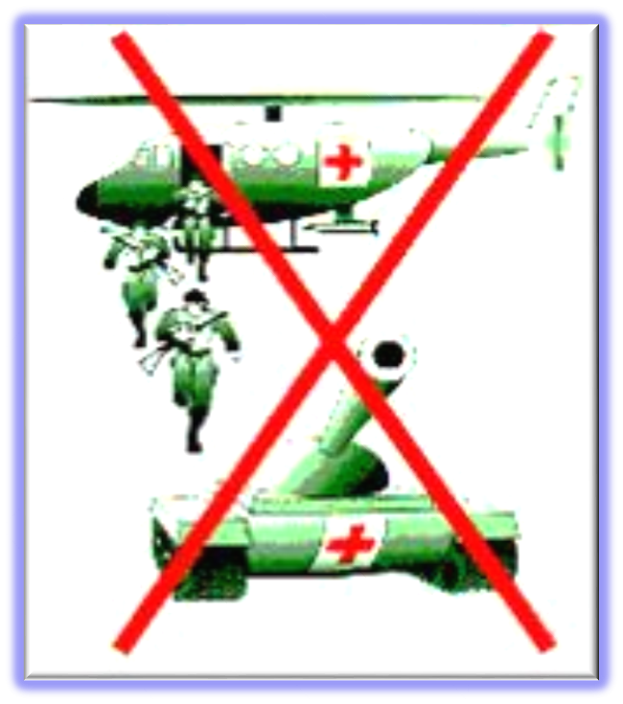
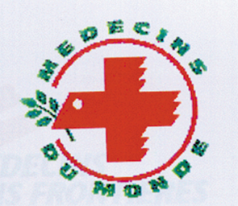
All necessary measures, including adopting national legislation, shall be taken by competent authorities to prevent and repress misuses:
Imitation
Improper and unlawful use
Perfidy
H.E.L.P. course
Notes:
The responsibility for authorizing the use of the red cross, red crescent and red crystal emblems, and for suppressing misuse and abuse, rests with the State, which must regulate their use in accordance with the terms of the Geneva Conventions and their Additional Protocols.
All necessary measures, including adopting national legislation, shall be taken by competent authorities to prevent and repress misuses [Art. 54 GCI; Art. 12 APII; Art. 6 APIII], including:
Imitations: The use of a sign which, owing to its shape and/or colour, may be confused with the emblem.
Improper use: The use of the emblem by people usually authorized to do so, but in a manner inconsistent with IHL provisions on its use; or by entities or persons not entitled to do so (commercial enterprises, pharmacists, private doctors, NGOs, ordinary individuals, etc.) or for purposes that are inconsistent with the Fundamental Principles of the Movement [See Art. 38 API].
Perfidious use: The use of the emblem during an armed conflict to invite the confidence of the adversary to lead him/her to believe that one is protected in order to kill, injure or capture him/her [See Art. 37 API}. Killing or wounding an adversary by resort to perfidy constitutes a war crime in both international and non-international armed conflicts [See Arts. 8 (2) (b) (xi), 8 (2) (e) (xi) ICC Statute].

Slide 39
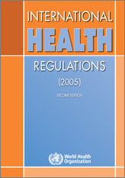
International health regulations (IHR)
In response to the exponential increase in international travel and trade, and emergence and reemergence of international disease threats and other health risks, 196 countries across the globe, including all member states of the World Health Organization, have agreed to implement the International Health Regulations (2005)
This binding instrument of international law entered into force on 15 June 2007.
H.E.L.P. course

Slide 40
Purpose and scope of IHR
The IHR define their purpose and scope as
"to prevent, protect against, control and provide a public health response to the international spread of disease in ways that are commensurate with and restricted to public health risks, and which avoid unnecessary interference with international traffic and trade."
The IHR
outline the minimum requirements for functional public health systems that allow countries to quickly detect and respond to disease outbreaks in their communities (10 steps for implementing IHR)
Annex 2 is an instrument that directs States to notify WHO of events that may constitute a PHEIC
H.E.L.P. course
Notes:
Implementing IHR -10 steps
Know the IHR; purpose, scope, principles and concepts
Update National Legislation
Recognize shared realities and the need for collective defenses
Monitor and report on IHR implementation progress
Notify, report, consult and inform WHO
Understand WHO’s role in international event detection, joint assessment and response
Participate in the PHEIC determination and WHO recommendations-making processes (PHEIC = public health emergency of international concern)
Strengthen national surveillance and response capacities
Increase public health security at ports airports and ground crossings
Use and disseminate IHR health documents at points of entry

Slide 41
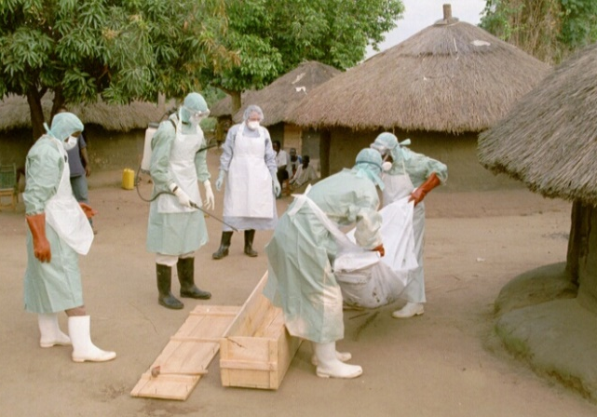
Core capacity requirements
Countries must have capacities to ‘’detect, report and respond’’ to risks in general and to those at international ports, airport, and land crossings
Capacities for assessment and notification include
to assess all reports of urgent events within 48 hours; and
to notify WHO immediately (within 24 h of assessing a PHEIC) through the National IHR Focal Point
H.E.L.P. course
Notes:
PHEIC = Public Health Emergency of International Concern (see next slide)

Slide 42
Public health emergency of international concern (PHEIC)
An extraordinary event that may constitute a public health risk to other countries through international spread of diseases and many require an international coordinated response
The role of countries is to assess the magnitude and potential risk involved with and event and WHOs’ role is to make the decision
The Director-General of the WHO determines if the event is a PHEIC
H.E.L.P. course

Slide 43
Public health emergency of international concern (PHEIC)
Since the revised IHR were put into place in 2007, 6 PHEICs have been declared by WHO:
H1N1 influenza (2009)
Polio (2014)
Ebola (2014)
Zika virus (2016)
Ebola (2019)
Coronavirus (2020)
Several diseases always need to be reported to the WHO:
Severe acute respiratory tract syndrome (SARS),
Smallpox
New influenza viruses
Wild-type polio
Ebola
H.E.L.P. course

Slide 44
References / useful links
How to find IHL treaties?
https://ihl-databases.icrc.org/ihl
How to find customary law?
https://ihl-databases.icrc.org/customary-ihl/eng/docs/home
Health regulations
https://www.who.int/ihr/publications/9789241580496/en/
H.E.L.P. course

