Slide 1

Mental Health and Psychosocial Support for Populations Affected by Crisis
H.E.L.P. course
List the Presenters

Slide 2
Objectives
Be able to
Explain the importance of addressing mental health and psychosocial needs of affected populations during acute and protracted crises
Describe the elements of an MHPSS assessment
Discuss an appropriate program response with focus on prevention, treatment and care for people with mental health and psychosocial needs during an acute and/or protracted crisis
H.E.L.P. course
Notes:
In this session we expect to be able to:
explain the importance of addressing mental health and psychosocial needs of affected populations during acute and protracted crises
describe the elements of a MHPSS assessment
discuss an appropriate programmatic response with focus on prevention, treatment and care for people with mental health and psychosocial needs during an acute and/or protracted crisis

Slide 3
WHO definition of Mental Health
A state of well-being in which every individual realizes his or her own potential, can cope with the normal stresses of life, can work productively and fruitfully, and is able to make a contribution to her or his community
H.E.L.P. course
No Health without Mental Health
Notes:
The definition of Mental Health, as described by the WHO, consists of an state of well-being in which every individual realizes his or her own potential, can cope with the normal stresses of life, can work productively and fruitfully, and is able to make a contribution to her or his community.
In the Mental Health community, accepting that Mental Health is an integral part of any person’s general health and well being, we categorically say: “There is No Health without Mental Health”

Slide 4
Global Burden of Disease 2004
% of DALY’s for mental and substance use disorders
Worldwide: 14%
Eastern Mediterranean Region: 12%
% of YLD 19 %
  Severe Disabled: 2.9%
  Moderate Disabled: 12.4%
Moderate and Severe Disabled:
  Children 0-14 year 5 %
  Adults 15-59 year 15 %
  Elderly >60 year 46 %
H.E.L.P. course
Notes:
The burden of mental disorders in global populations has been described for many different health diseases and conditions. The “burden” takes into consideration early/premature mortality due to a specific disease or risk factor as well as the amount of years that a health condition or risk factor makes a person live with disability. It is important to mention here that different diseases impact different on a person’s level of disability. And it is important to remember too that mental disorders tend to cause a very high level of functional impairment and disability.
When those burden measures are calculated as DALYS (Disability adjusted life years) and YLD (years lived with disability), we observe that a great proportion of the disease burden is caused by mental and substance use disorders. We know that globally, 1/5 of the burden of diseases is due to mental and substance abuse disorders. Depression is the leading cause of disability worldwide.
So, coming back to populations affected by crisis situations, we already know that there will be a pre-existing burden of mental health conditions on them and the crisis (acute or protracted) will bring an added load of stressors to that burden!

Slide 5
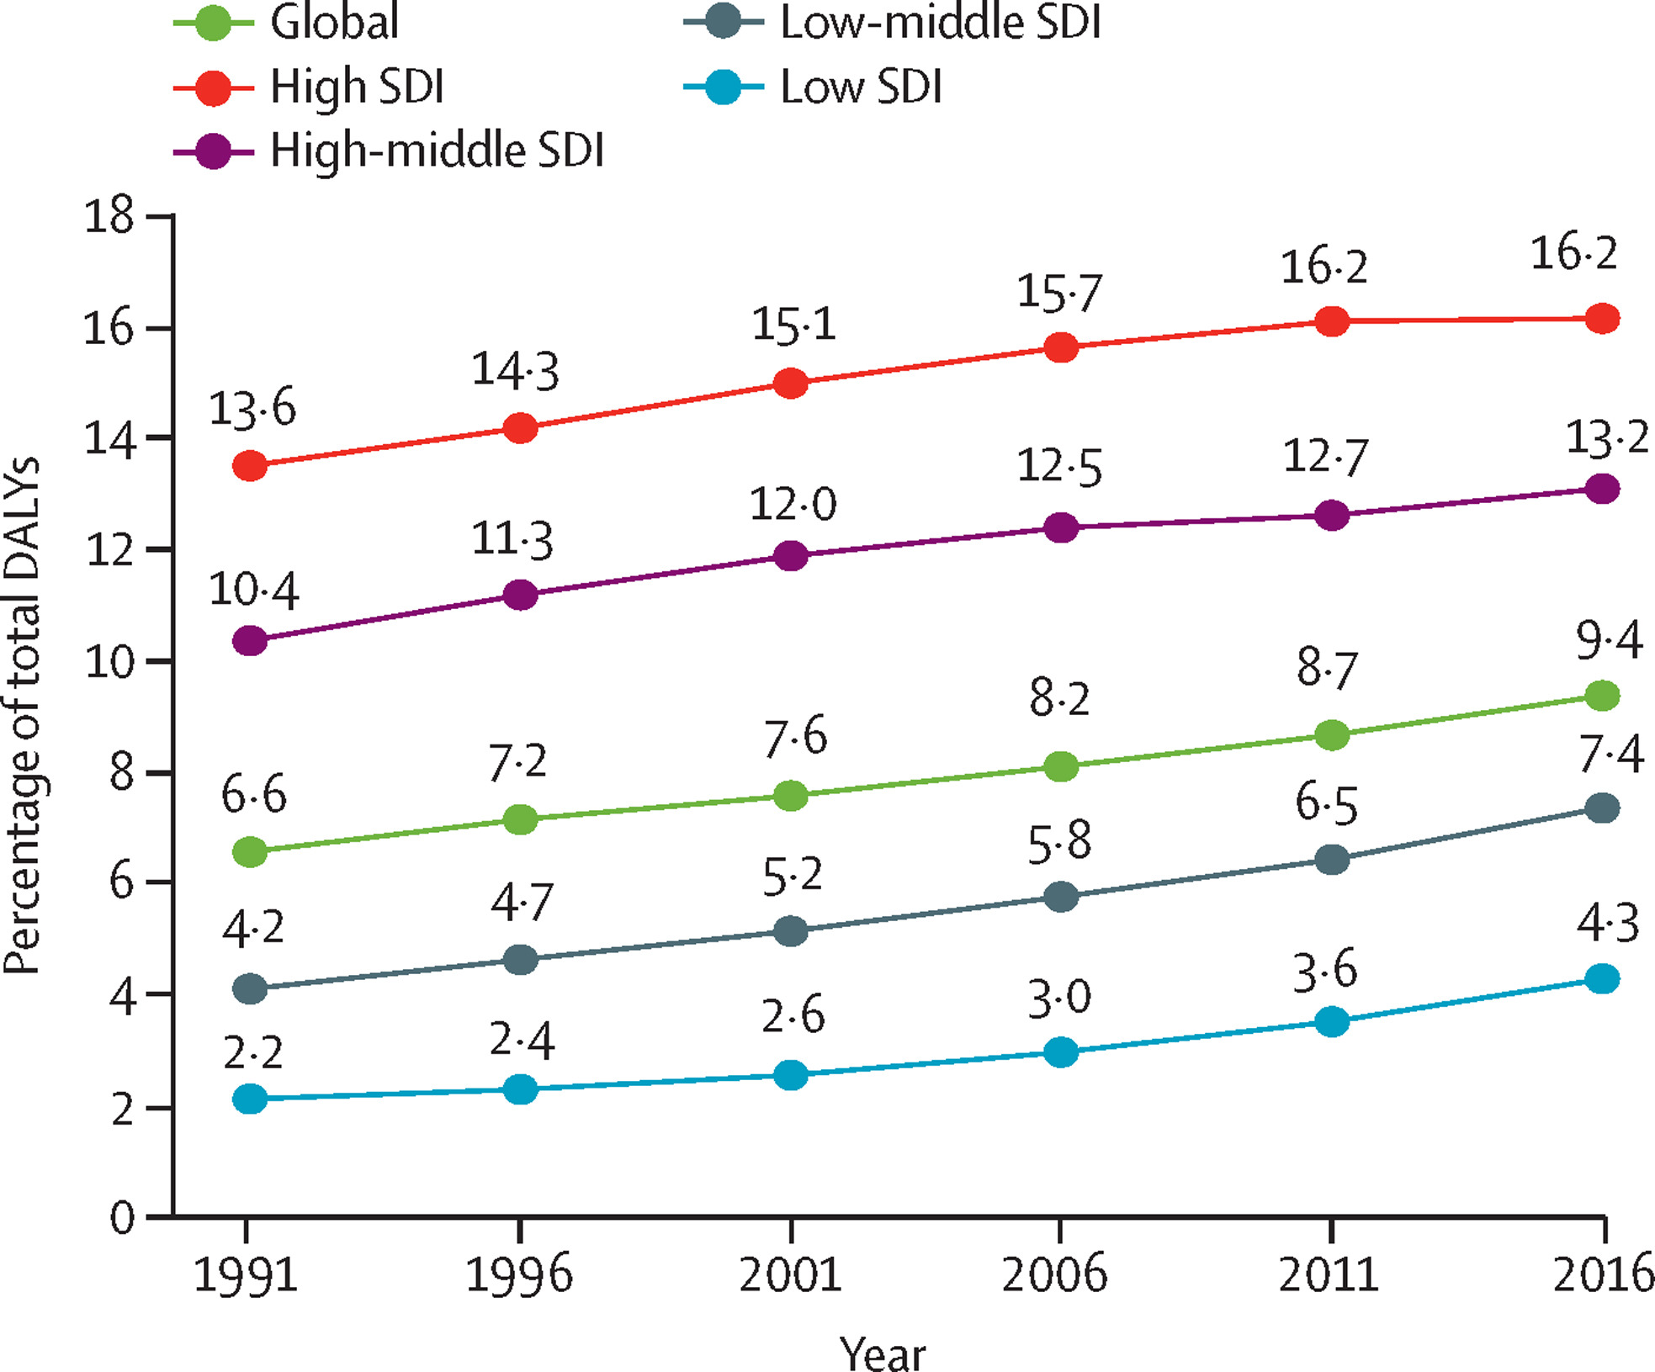
2018 Rising Burden of MH, Substance Use Disorders, Suicide, Alzheimer’s and other dementias by Sociodemographic Development (SDI)
The Lancet
Volume 392, Issue 10157, Pages 1553-1598 (October 2018)
Notes:
Lower SDI have more communicable diseases and lower life expectancy, thus burden of Alzheimer’s and dementia which usually happens later in life, is lower. However interesting to note is the steady rise of MH burden (disability and premature mortality) globally

Slide 6
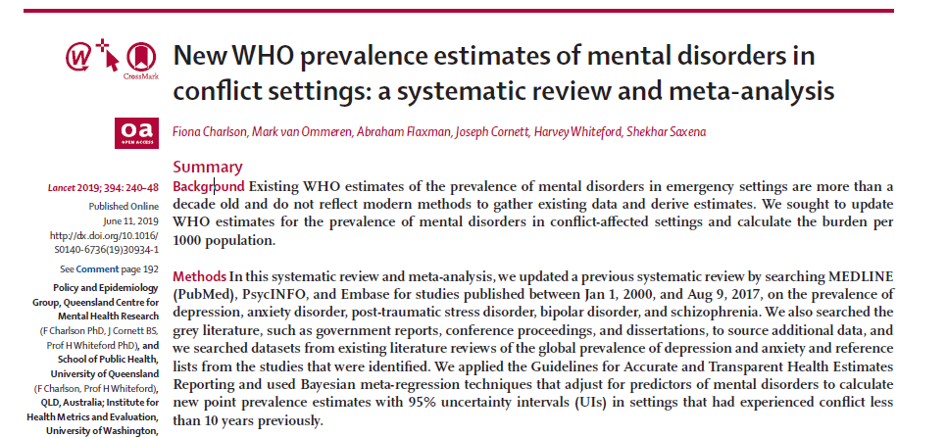
H.E.L.P. course
Notes:
This slide and the next show you the most recent prevalence estimates from WHO on key mental disorders in conflict settings. They are a systematic review of all the available studies and update a previous systematic review on the same topic.

Slide 7
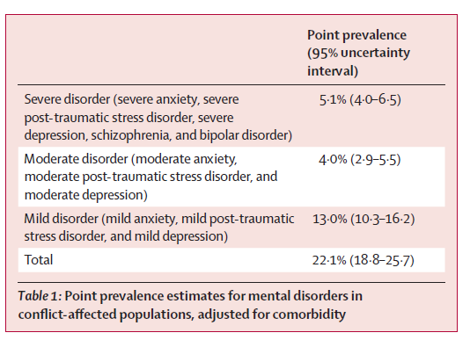
Prevalence of mental disorders is 22.1% at any point in time in the conflict-affected populations assessed.
H.E.L.P. course
Charlson, F, et al. New WHO prevalence estimates of mental disorders in conflict settings: a systematic review and meta-analysis. Lancet. June 2019.
Notes:
As you can see here, it is estimated that 1 in 5 people present a mental disorder in an area affected by a conflict. This can be due to pre-existing conditions or conditions induced or influenced by stressors caused by the conflict. It is also important to highlight that it is estimated that 5% present with a severe mental disorder which severely impacts functionality and leads to very high levels of disability.
When we put together moderated and severe mental disorders, we can observe that around 1 in 10 people will present them.
Anxiety disorders (including PTSD) encompass the majority of mental disorders (some studies put it at a prevalence of 21.7%. Depression has a prevalence of around 10%, with 3% of those accounting for moderate and severe depression.
Here it is important to highlight the importance of understanding the presence and prevalence of different mental health conditions, and to take this into consideration when developing MHPSS programs, and especially when coordinating action with different actors in the humanitarian response.

Slide 8
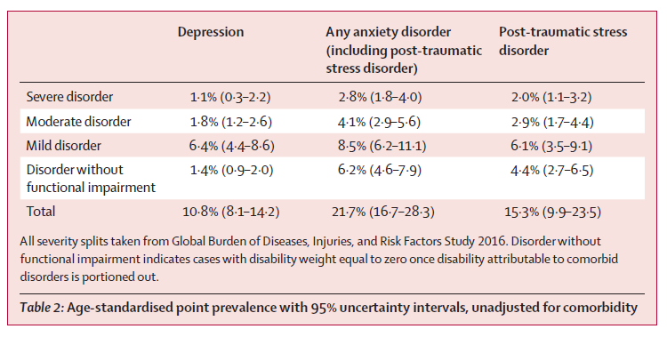
H.E.L.P. course
Charlson, F, et al. New WHO prevalence estimates of mental disorders in conflict settings: a systematic review and meta-analysis. Lancet. June 2019.
Notes:
The table here also show that any anxiety disorders have a prevalence of 21.7% which includes 15.3% prevalence of people with PTSD. Depression has a prevalence of around 10%, with 3% of those accounting for moderate and severe depression.
Here it is important to highlight the importance of understanding the presence and prevalence of different mental health conditions, and to take this into consideration when developing MHPSS programs, and especially when coordinating action with different actors in the humanitarian response.

Slide 9
Mental Health Prevalence in Detention
 | General population | Detention places
Anxiety | 15% | 16-76%
Depression | 11% | 10-72%
Schizophrenia | 0.5% | 3-20%
Drugs | 5.0% | 30-76%
Total | 10% mild 2-3% severe | 55-90%
H.E.L.P. course
Conclusion: There are not many inmates who do NOT have mental issues
(Countries: Belgium, USA, UK, Brazil, Chile, Mexico, China, Iran, Nigeria)
Notes:
It is many times forgotten, but here it is important to bring to your attention the needs of a specific group of the population that have in general a higher than expected prevalence of mental disorders and tend to be neglected in the humanitarian response. Different studies have shown the increased prevalence of mental disorders of people in places of detention. This is due to many factors, that we do not have time to further discuss here. Unfortunatelly, mental health care for those populations tend to be insufficient in areas of low resources.

Slide 10
Needs in Crisis Situations
Pre-existing problems
  Social problems
  Psychological (incl. psychiatric) problems
Crisis-induced problems
  Social problems
  Psychological (incl. psychiatric) problems
    Psychological problems may involve realistic appraisal (no mental disorder) or distortions (possible mental disorder)
H.E.L.P. course
Notes:
The MHPSS needs in populations affected by crisis tend to be composed by an accumulation of factors.
Populations affected bring their pre-existing social, psychological and psychiatric problems as for example poverty, social conflicts as well as the pre existing levels of distress and mental disorders.
The crisis increases the number and magnitude of stressors as it is common to have violence, loss, disappearances and other situations that can cause a huge burden on people’s mental health and psychosocial well being.

Slide 11
Classification of Mental and Behavioral Disorders (ICD-10) -> 300 !!!
0. Psychiatric disorders due to organic reasons (Dementia, etc.)
Drug abuse and dependence
Schizophrenia
Affective (Depression, Bipolar Disorder)
Neurotic, trauma and psychosomatic disorders (Anxiety, OCD, PTSD, etc.)
Issues due to somatic disorder (Eating Disorder, Sleeping, etc.)
Personality and Behaviour disorders
Intellectual Disability
Developmental Disorders (Autism)
Child and adolescent specific disorders (ADHD, etc.)
H.E.L.P. course
Notes:
The international classification of mental disorders has a description of many mental health conditions that can affect the health of people and that can impair their functionality and capacity to live fulfilling lives. In crisis situations, priorities need to be made on key conditions to be address where health staff can be trained to diagnose and treat with psychological and psychopharmachological approaches combined.

Slide 12
Most Commonly Experienced Symptoms
  Psychosomatic Symptoms
  Sleep-related problems
  Appetite-related problems
  Emotional problems: Depression, desire to die, anxiety, etc.
  Repetitive thoughts
  Substance Misuse
  PTSD Symptoms (flashbacks, avoidance)
  Children (enuresis, aggression, fear)
H.E.L.P. course
Notes:
Psychosomatic Symptoms
Sleep-related problems
Appetite-related problems
Emotional problems: Depression, desire to die, anxiety, etc.
Repetitive thoughts
Substance Misuse
PTSD
These are the most common symptoms of distress that people experience after experience violent events. Depending on the frequency and magnitude they appear, functionality can be impaired and people will benefit from psychological support.
With children be aware signs and symptoms may be different from adults

Slide 13
What are consequences arising from mental health issues
??
Effects on social and family life
Effect of stigma on access to services
Economic burden: direct / indirect
H.E.L.P. course
Notes:
Mental health and psychosocial problems impact goes beyond personal. People affected produce less and might spend more to reach care.
Other affected are afraid to disclose their problems and feel recognized or ostracized. That blocks their access to effective treatment and care.
Without treatment, the family and even communities can be affected as isolation, anger, lack of communication can affect the social capital of entire communities.

Slide 14
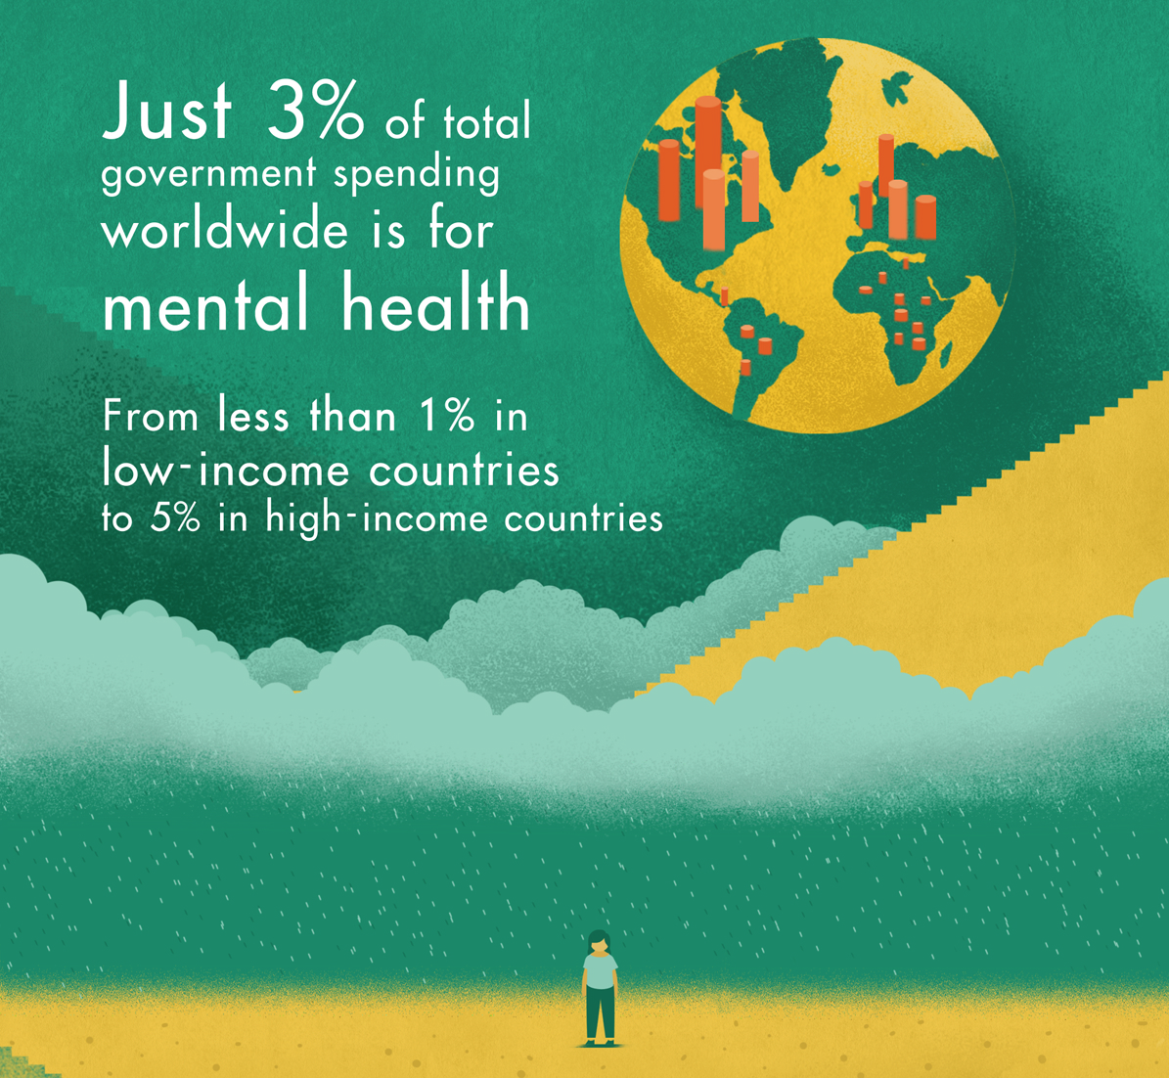
H.E.L.P. course
Notes:
Mental health is one of the most neglected areas of Public Health
40% of countries have no MH policy
> 30% of countries no MH programmes
> 50% of MH legislations drafted over 20 years ago and do not incorporate recent developments on human rights for people with psychosocial disabilities
Eventually costs for not treating MH disorders are higher than treatment

Slide 15
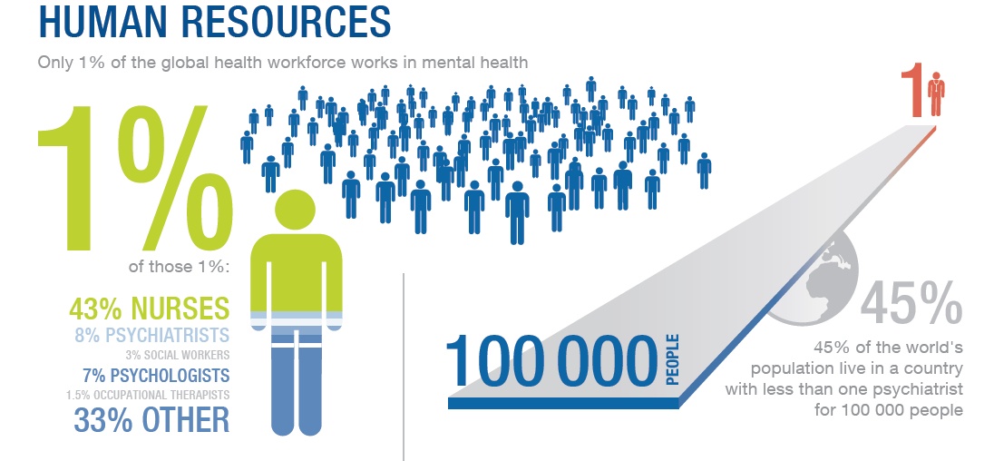
H.E.L.P. course
Notes:
There is scarcity of specialized human resources and that is why the ICRC asks for the strengthening of the MHPSS workforce in areas affected by armed conflicts. 45% of the countries have less than 1 psychiatrist for 100,000 people. The existing workforce is insufficient to address the MH burden and in areas affected by crisis, generally, the few professionals that exist, also leave in order to protect themselves and their families. It is necessary to train and continuously supervise non MHPSS specialists to take over classical MH roles.

Slide 16

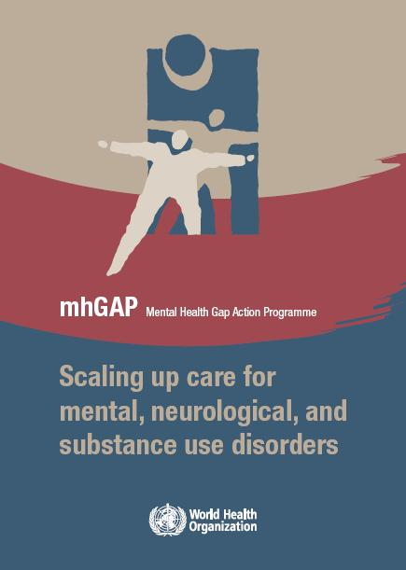
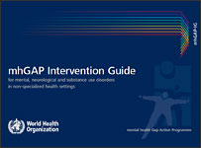
mhGAP
H.E.L.P. course
2001
2010
Notes:
The MhGap program is a WHO package on scaling up MH care for priority MH conditions in non specialised settings. It is composed of different guidelines that address psychological and psychopharmacological approaches by non specialists. A specific version for humanitarian settings has been developed.
Components of mhGAP Package are:
Operations to scale up by district managers
Manualized psychological interventions
Building capacity of non-specialists
Clinical decision making tools for non-specialists

Slide 17
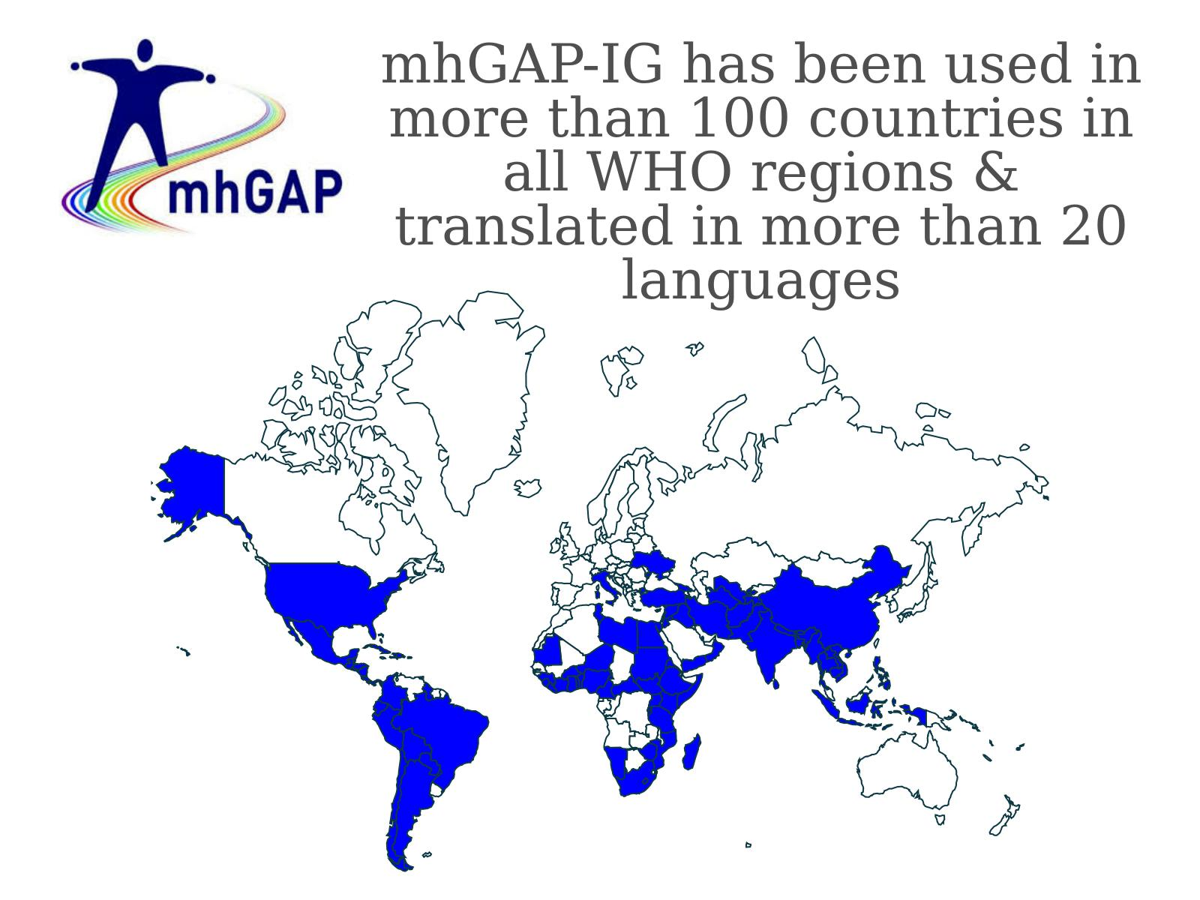
Notes:
The MhGap has been used in more than 100 countries in all Regions of the world. It has been adapted to many different languages.

Slide 18
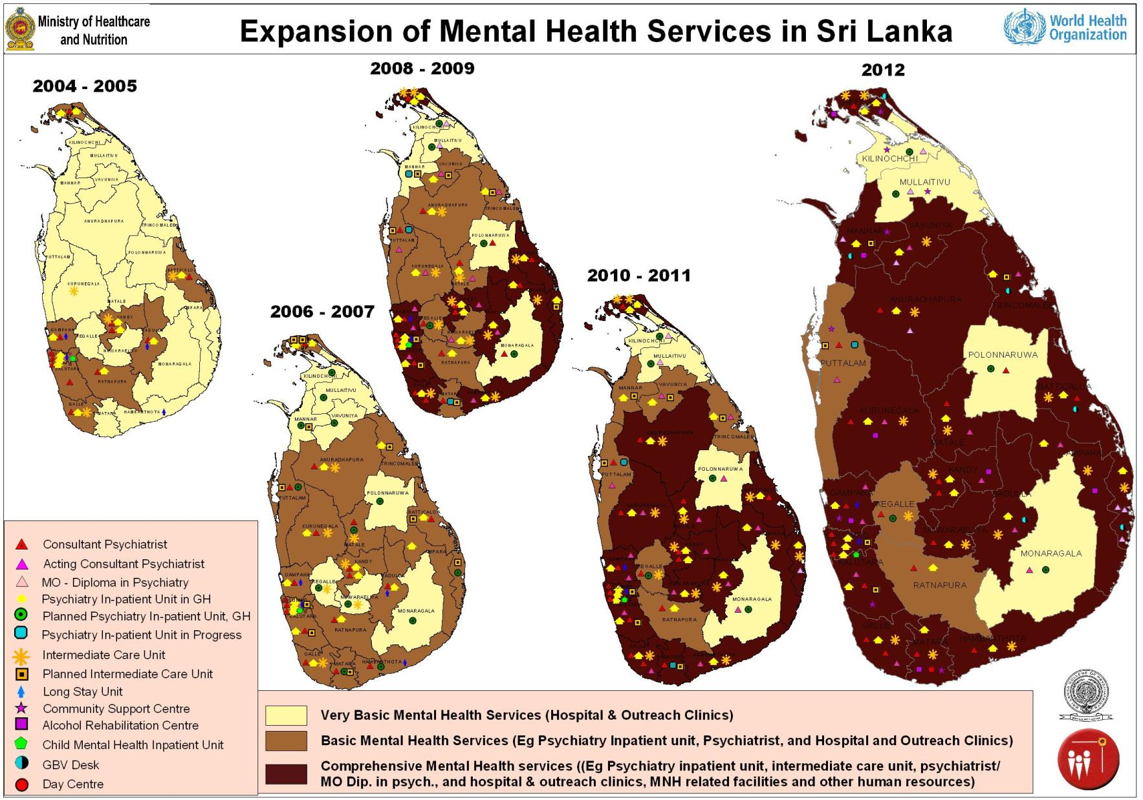
Notes:
Sri Lanka has made significant strides towards the development of efficient, comprehensive, and integrated community-based mental health services.
As of 2011, 20 out of 26 health districts (77%) had functioning acute inpatient units within general hospital settings, compared with 10 out of 26 (38%) before the tsunami.
In addition, the country had 16 fully functional intermediate stay rehabilitation units, compared with five units in 2004.
Nearly 30 community support centres have been established, promoting community involvement and education.

Slide 19
2013-2020 WHO MH Plan of Action
Strengthen effective leadership and governance for mental health
Provide comprehensive, integrated and responsive mental health and social care services in community-based settings
Implement strategies for promotion and prevention in mental health
Strengthen information systems, evidence and research for mental health
H.E.L.P. course
Notes:
The 2013-2020 WHO MH Plan of action has now been extended up to 2030. The priorities are:
Strengthen effective leadership and governance for mental health
Provide comprehensive, integrated and responsive mental health and social care services in community-based settings
Implement strategies for promotion and prevention in mental health
Strengthen information systems, evidence and research for mental health
Priorities have attached indicators and targets.

Slide 20
Intervention Pyramid (Adapted from IASC 2007)
Examples:
Clinical mental health care (whether by PHC staff or by mental health professionals)
Clinical
services
Basic emotional and practical
support to selected individuals or families
Focused psychosocial supports
Activating social networks
Supportive child-friendly
spaces
Community and family supports
Strengthening community and family supports
H.E.L.P. course
Advocacy for good humanitarian practice: basic services that are safe, socially appropriate
and that protect dignity
Basic services and security
Social considerations in basic services and security
Notes:
20
This slide is adapted with permission from the IASC Guidelines on Mental Health and Psychosocial Support (IASC, 2007).
The pyramid provides a description of the different levels of support that need to be provided to populations in crisis situations.
At the base we have social considerations that are transdisciplinary and if well addressed can prevent that further MHPSS problems appear. As an example here we have the construction of toilets in places that do not expose people to risk of further violence (e.g. women to sexual violence)
One level higher, we have activities that aim to promote social support and cohesion, that activate social networks and that bring a sense of normalcy. As an example we have child friendly spaces where children can have the opportunity to distract, play, interect and stay in a protected environment.
One level higher we have activities that provide basic emotional support by addressing people’s key psychological or psychosocial necessities. As an example here we have psychological first aid or basic psychological support provided to immediate victims of violence.
And on the highest level, meaning, the smallest part of the affected population will be in need of it, we have clinical services that aim to diagnose and treat psychological or mental health conditions. That can be done by specialists or trained and supervised generalists as nurses, doctors or clinical officers.
The different levels of the pyramid reflect the different amount of the population that would need those services.
Having said that, all levels have the same importance and are complementary.
No organization can provide all.
Partnerships and complementarity is needed in order to provide comprehensive care that can address comprehensively the different levels.

Slide 21
IASC Guidelines: Inclusive framework: mental health and psychosocial support covers both
Composite definition
protecting or promoting psychosocial well-being
and/or
preventing or treating mental disorder.
MH PS
H.E.L.P. course
Notes:
As described before, the IASC guidelines provides a comprehensive framework where protecting or promoting psychosocial well-being
and/or preventing or treating mental disorder is included in complementary ways.

Slide 22
Traditional usage of the term psychosocial support varies with sector
Health sector staff: non-biological interventions for people with mental disorder (e.g. CBT)
Protection, social & community services: any non-clinical support for any person with/without disorder (e.g. child friendly spaces)
Lack of common language confusion
H.E.L.P. course
Notes:
Traditional usage of the term psychosocial support varies with sector.
In the Health sector staff: non-biological interventions for people with mental disorder (e.g. CBT)
Protection, social & community services: any non-clinical support for any person with/without disorder (e.g. child friendly spaces)
Therefore, it is important to describe what one means when using such terminology in order to avoid confusion.
More important than that is to clearly describe the observed needs and what activities will be implemented in order to respond to the observed needs.

Slide 23
Mental health - Psychosocial -ICRC
Mental health is used to denote psychological well-being. Mental health interventions aim to improve psychological well-being by reducing levels of psychological distress, improving daily functioning and ensuring effective coping strategies.
Psychosocial is used to describe the interconnection between the individual (i.e. a person’s ‘psyche’) and their environment, interpersonal relationships, community and/or culture (i.e. their social context). Psychosocial support is essential for maintaining good physical and mental health and provides an important coping mechanism for people during difficult times.
H.E.L.P. course
Lack of common language confusion
Notes:
Traditional usage of the term psychosocial support varies with sector.
In the Health sector staff: non-biological interventions for people with mental disorder (e.g. CBT)
Protection, social & community services: any non-clinical support for any person with/without disorder (e.g. child friendly spaces)
Therefore, it is important to describe what one means when using such terminology in order to avoid confusion.
More important than that is to clearly describe the observed needs and what activities will be implemented in order to respond to the observed needs.
In the ICRC, as an example:
Mental health is used to denote psychological well-being. Mental health interventions aim to improve psychological well-being by reducing levels of psychological distress, improving daily functioning and ensuring effective coping strategies.
Psychosocial is used to describe the interconnection between the individual (i.e. a person’s ‘psyche’) and their environment, interpersonal relationships, community and/or culture (i.e. their social context). Psychosocial support is essential for maintaining good physical and mental health and provides an important coping mechanism for people during difficult times.
As mentioned before, those are always complementary approaches.

Slide 24
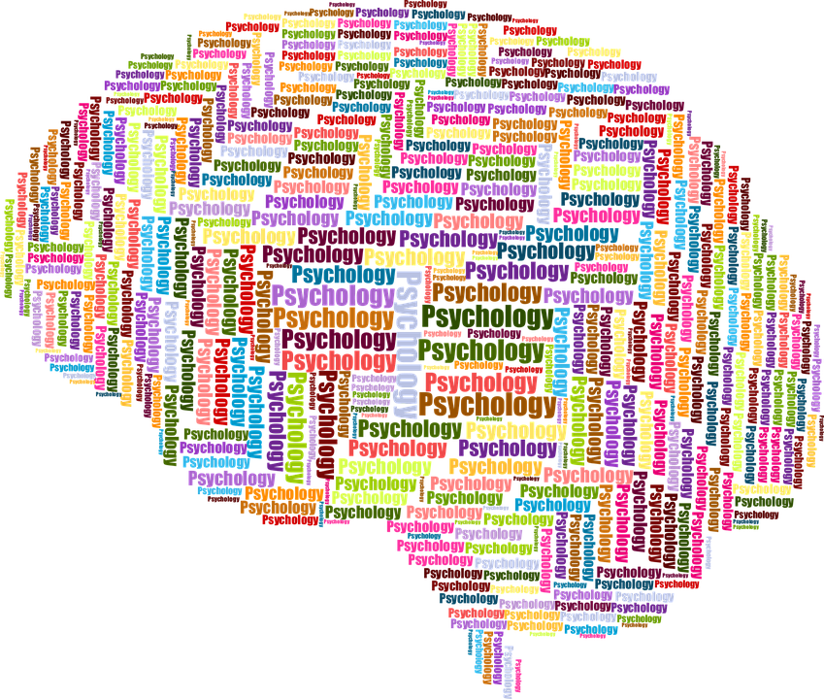

ICRC MHPSS Indicators
Functionality
Distress Reduction (questionnaires)
Coping
H.E.L.P. course
Notes:
In the ICRC, MHPSS activities prioritize the improvement of individuals affected by violence in the different types of MHPSS programs.
In order to regularly monitor the improvement, measures as functionality, distress and coping are used in the follow up of patients under psychological support. That allows clinicians and program manages to make the necessary adaptations and draw lessons learned for programmatic improvement.

Slide 25
ICRC MHPSS Programs
MHPSS for victims of violence
MHPSS for families of missing persons
MHPSS for helpers
MHPSS for people deprived of liberty and former detainees
MHPSS for the hospitalized weapon wounded and people with physical disabilities
MHPSS in Emergencies
H.E.L.P. course
Notes:
The ICRC MHPSS types of activities are divided according to the support provided to specific target populations.
MHPSS for victims of violence (at community or health centers) and it can include children and victims of sexual violence
MHPSS for families of missing persons
MHPSS for helpers
MHPSS for people deprived of liberty and former detainees
MHPSS for the hospitalized weapon wounded and people with physical disabilities
MHPSS in Emergencies

Slide 26
Some MHPSS Interventions
Training
Referral
Psycho-education
Group support Interventions
Family support Interventions
School support Interventions
Psychological First Aid
Community awareness sessions
H.E.L.P. course
Notes:
Psychosocial interventions constitute the backbone of any MHPSS response and include a range of social activities designed to foster psychological improvement, such as sharing experiences, fostering social support, awareness-raising and psychoeducation.

Slide 27
MHPSS Activities
  Community awareness and support sessions
  Individual and group support sessions
  Psychological and Psychiatric consultations
H.E.L.P. course
Notes:
The MHPSS activities are developed in order to cover gaps on MHPSS care that are identified after needs based assessments. Those assessments and the programs that result of it are done in partnership with community and local organizations after the authorization provided by local and/or national authorities.
The MHPSS activities can be implemented as:
MHPSS Community awareness and support sessions (being this PS)
MHPSS Individual and group support sessions (being this PS)
Psychological and Psychiatric consultations (these being MH interventions)

Slide 28
Psychological First Aid
Humane, supportive and practical assistance to those who recently suffered exposure to serious stressors. It involves:
  Non-intrusive, practical care and support
  Assessing needs and concerns
  Helping people to address basic needs (food, water)
  Listening, but not pressuring people to talk
  Comforting people and helping them to feel calm
  Helping people connect to information, services and social supports
  Protecting people from further harm
Notes:
What is Psychological First Aid?
Humane, supportive and practical assistance to fellow human beings who recently suffered exposure to serious stressors, and involves:
Non-intrusive, practical care and support
Assessing needs and concerns
Helping people to address basic needs (food, water)
Listening, but not pressuring people to talk
Comforting people and helping them to feel calm
Helping people connect to information, services and social supports
Protecting people from further harm

Slide 29
What Psychological First Aid is NOT?
It is NOT something only professionals can do
It is NOT professional counselling
It is NOT “psychological debriefing”
  No detailed discussion of the distressing event
It is NOT asking people to analyze what happened or put time and events in order
Although PFA involves being available to listen to people’s stories, it is NOT pressuring people to tell you their feelings or reactions to an event
H.E.L.P. course
Notes:
-In contrast to psychological debriefing: PFA does NOT necessarily involve a detailed discussion of the event that caused the distress.
It is known that Psychological debriefing can be potentially harmful and has to be avoided!

Slide 30
Recommendations for Implementation
Needs Assessment
  Assess needs of patients
  Assess the capacities of medical personnel
  Assess HR needs & capacities (MHPSS national/international staff /Psychologist)
  Assess cultural aspects
Monitoring & Evaluation
  Questionnaires:
    Impact Event Scale
    Center for Epidemiologic Studies Depression Test
    Patient Specific Functional Scale Test…etc.
H.E.L.P. course
Notes:
The needs assessment is the starting point for any MHPSS activity which includes a comprehensive situational analysis.
The key points of the needs assessment are:
Assess the existing knowledge via collection of data and information already available
Assess needs of beneficiaries
Assess the capacities of health personnel
Assess HR needs and capacities (MHPSS national, international staff and MHPSS professionals if available. )
Assess the local cultural aspects
Programs also need to include monitoring and evaluation mechanisms:
Questionnaires can be used to monitor the improvement of beneficiaries under care or the improvement of the capacities of professionals trained in MHPSS service delivery.
Local adaptation and validation of questionnaires is a MUST!

Slide 31
ASSESSMENT
H.E.L.P. course
Participative and Coordinated
Notes:
And here you have examples of international guidelines produced by international organizations that can guide you in performing assessments of MHPSS needs and resources in crisis situations.

Slide 32
Coordinating Mental Health and Psychosocial Support (MHPSS) –Cluster system
Government leader /UN Humanitarian Coordinator
Inter-sector Coordination Group
Health Cluster
Protection cluster
(with Child protection
Sub-cluster)
Education and other
Clusters
MHPSS Cross-sector Technical Working Group (with focal points in each of the sectors and with
accountability in sectors). MHPSS activities within the cluster system where relevant in Appeal chapters under
health, protection and education, rather than in a separate Appeal chapter
Notes:
It is important to be aware and involved of existing coordinating mechanisms on MHPSS in crisis situations. The local WHO or UN office will be able to provide the necessary directions.
There is in general a MHPSS working group and MHPSS participates in other groups as Health, Protection and Education.

Slide 33

Crisis Situations as Opportunities for MH Development
Media interest
Interest of decision-makers (e.g. government leaders, heads of humanitarian agencies)
Decision-makers willing to consider options beyond the status quo
Notes:
While the challenges related to mental health care are considerable, emergencies also present unique opportunities for better care of all people with mental health needs.
Following disasters, the media often focus on the plight of surviving people, including their psychological responses to the stressors they face.
In some countries, government leaders and heads of nongovernmental organizations express – for the first time – serious concern about their nation’s mental health.
Within this context, decision-makers often become willing to allocate resources towards mental health and to consider options beyond the status quo.
Collectively, these factors create the possibility of introducing and implementing more sustainable mental health services that can help people during the emergency and continue to help them in the long term.

Slide 34

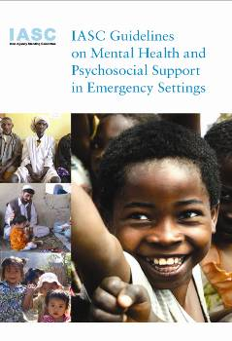
IASC (2007, 2010) Sphere (version 2018) PFA (2011)
Some Current Guidelines
H.E.L.P. course
Notes:
Here the IASC guidelines, mentioned before:
a multi-sectoral, inter-agency (UN-NGO) framework
that enables coordination,
that identifies useful practices,
that flags harmful practices
that clarifies how different approaches to mental health and psychosocial support complement one another.
The Sphere handbook with key intervention on MHPSS also included.
And the guidelines on Psychological First Aid.

Slide 35
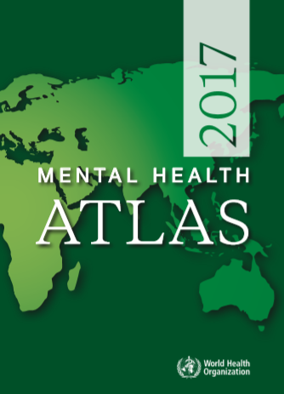
WHO’s Mental Health Atlas
Comprehensive resource on global information on mental health and an important tool for developing and planning mental health services within countries and regions.
Country-Specific Resources include:
Mental health…
Policies;
Plans;
Financing;
Care delivery;
Human resources;
Medicines; and,
Information systems
H.E.L.P. course
Notes:
The WHO also regularly produces a compilation of MH information and indicators on UN Member States. Please check for information on existing resources.

Slide 36


The EQUIP Project
The EQUIP project aims to ensure the quality and effectiveness of brief psychological interventions that are delivered by people who are not mental health specialists and the expansion of the use of these interventions in communities who need them around the world.
Video Link:
https://www.youtube.com/watch?v=bMiVP_YKBpI&feature=youtu.be
Notes:
The EQUIP Project, from the WHO aims to ensure the quality and effectiveness of brief psychological interventions that are delivered by people who are not mental health specialists and the expansion of the use of these interventions in communities who need them around the world. Please check the WHO website for more information. There is an increased amount of psychological interventions that can be delivered by trained and supervised non MHPSS specialists. Those can be helpful to help people overcome the high levels of distress they face in situations of crisis. The evidence for their effectiveness is well documented in the scientific literature.

Slide 37
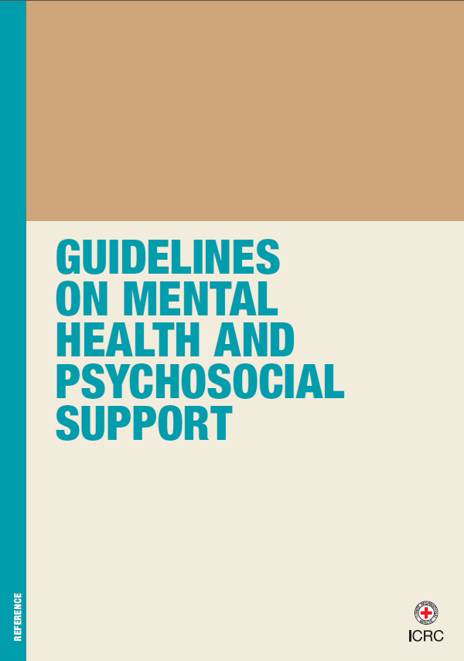
The ICRC’s MHPSS response does not necessarily follow diagnoses but instead is led by and focuses on symptoms and functionality.
H.E.L.P. course
Notes:
The ICRC MHPSS guidelines provide guidance on assessing the needs, developing programs, monitoring and evaluating MHPSS programs for populations affected by armed conflicts and other situations of violence.
The ICRC’s MHPSS response does not necessarily follows standard diagnostic approaches but instead is led by and focuses on symptoms and functionality. More information can also be acquired in the ICRC website at www.icrc.org

Slide 38
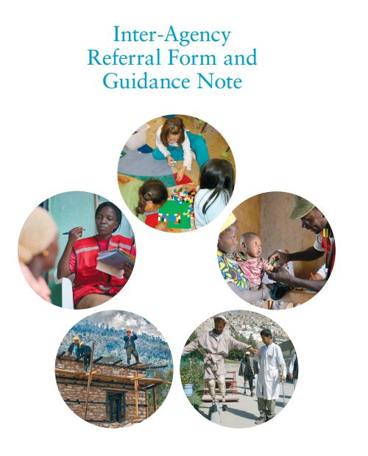
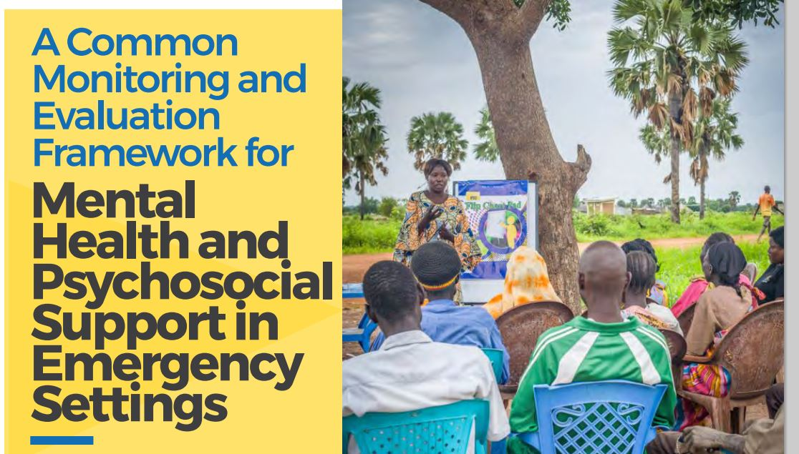
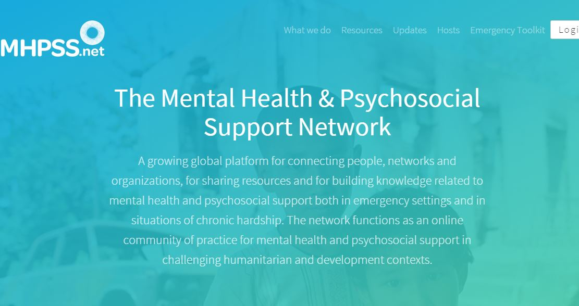
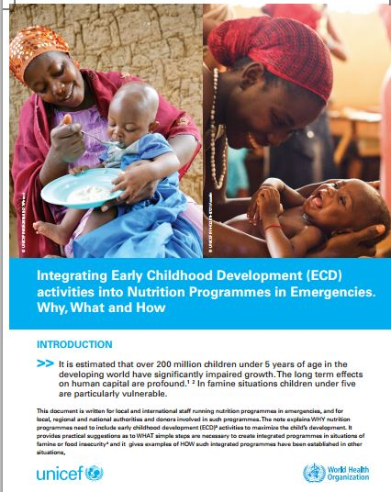
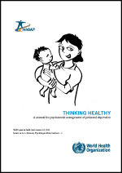
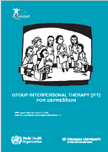
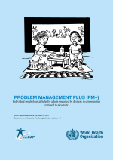
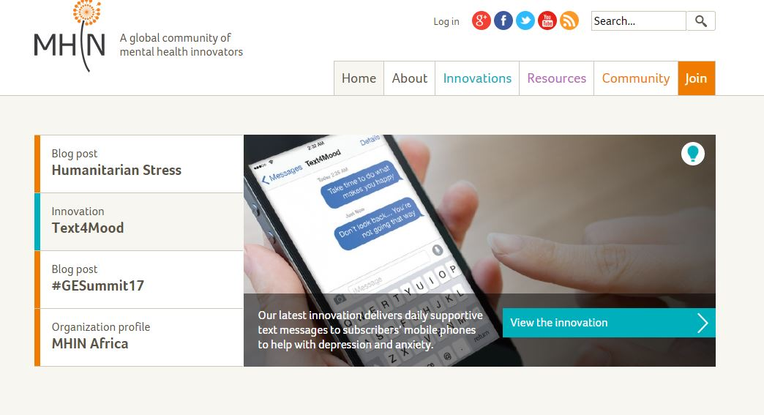
And many more…….
H.E.L.P. course
…………………..
Notes:
There is more and more material that can be of help in developing MHPSS approaches and programs in crisis situations. Please consult the UN agencies or the ICRC in the place where you work.

Slide 39
Thank you very much!
H.E.L.P. course

Slide 40
Group Work
Read background
Based on background, outline assessment questions
Outline possible MHPSS interventions
H.E.L.P. course
H.E.L.P. course
Notes:
Each groups discusses one of these three crises

