Slide 1
Introduction to Mass Casualty Management….
Logo institution facilitator
H.E.L.P. course
Facilitator(s) name(s) and organization(s)
These learning materials have been developed by
Thomas Wilp, ICRC

Slide 2
Objectives
Be able to
explain the need for and benefits of a systematic, structured and pre-established approach to mass casualty incidents (MCIs)
describe the general principles of mass casualty management (MCM), including those for triage, and what might be hurdles to overcome
H.E.L.P. course

Slide 3



Mass Casualty Management (MCM)
What does the term “Mass Casualty” mean?
What is a Mass Casualty Incident (MCI)?
What is Mass Casualty Management?
H.E.L.P. course
Notes:
Discuss what a Mass Casualty (any incident in which emergency medical services resources, such as personnel and equipment, are overwhelmed by the number and severity of casualties) is and what the differences between a Mass Casualty Incident (MCI) and a Mass Casualty Management approach are….
It has to include more than one patient, and in many jurisdictions, it is generally defined as at least three
MCI = (WHO) An incident which generates more patients at one time than locally available resources can manage using routine procedures. It requires exceptional emergency arrangements and additional or extraordinary assistance. i.e. imbalance between needs and services
Mass casualty management: (WHO) A coherent and interrelated set of established procedures, policies, and plans that contribute to the shared objectives of optimizing the baseline capacity to deal with patient populations expected in a mass casualty incident, and efﬁciently increasing this capacity during the response to a mass casualty incident.

Slide 4
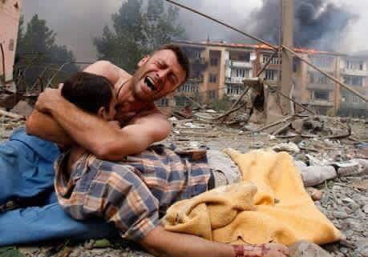
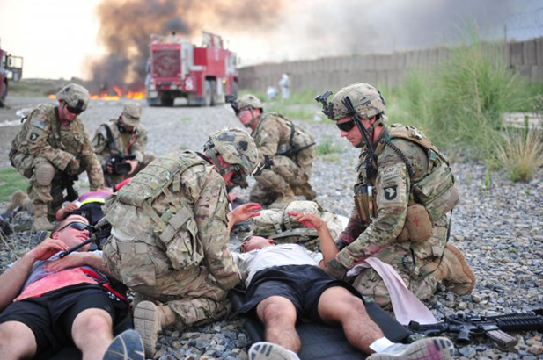
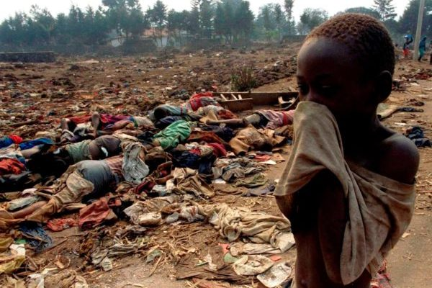
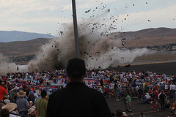
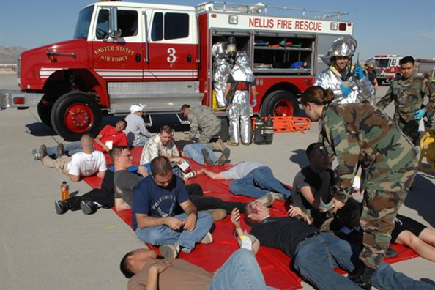
Introduction to Mass Casualty Management….
H.E.L.P. course
Prepare for the worst
& hope for the best….
Notes:
There are different situations that may cause mass casualties, for instance,
Certain natural disasters (earthquake, cyclone, floods, landslides, …),
Road / air collisions, subway derailment, ….
Accidental or intentional explosions and fires
During armed conflict, specific safety & security concerns have to be taken into consideration.
CBRN (chemical, biological, radiological and nuclear) incidents create a different set of issues for mass casualty management

Slide 5
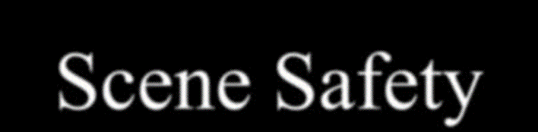
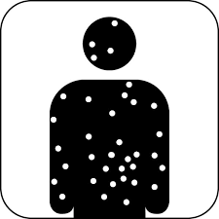
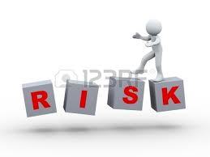
H.E.L.P. course

Slide 6
Different actors in the prehospital medical field...
  Bystanders…
  Relatives/ friends…
  Workmates…
  Community members…
  First responders, first aiders…
  Army… or any other armed groups…
  Police… or other security forces…
  Fire Service… or community based equivalent…
  Civil defense… or community “services”…
  Ambulance Service…
  Others (Railway, Aviation…etc.)
H.E.L.P. course

Slide 7
Different approaches in pre-hospital care…..
THE TWO MAIN APPROACHES IN PREHOSPITAL EMERGENCY MEDICAL CARE ARE:
1. Basic approach
A so called "scoop and run" method is used most commonly to deal with accident victims…
This approach does not require specific technical ability from the rescuers…
In a mass casualty situation this approach will result in the transfer of the problem from the incident site to the hospital, overwhelming and disrupting the care capacity of the health facility…
H.E.L.P. course

Slide 8
Different approaches in pre-hospital care…..
2. Mass casualty management approach
Mass casualty management includes pre-established procedures for resource mobilization…
Management in the field and the responding hospitals…
It is based on specific training of various level of responders…
Incorporates links between the actors through a command post…
It acknowledges the need for a multi organizational approach…
H.E.L.P. course

Slide 9
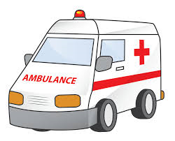
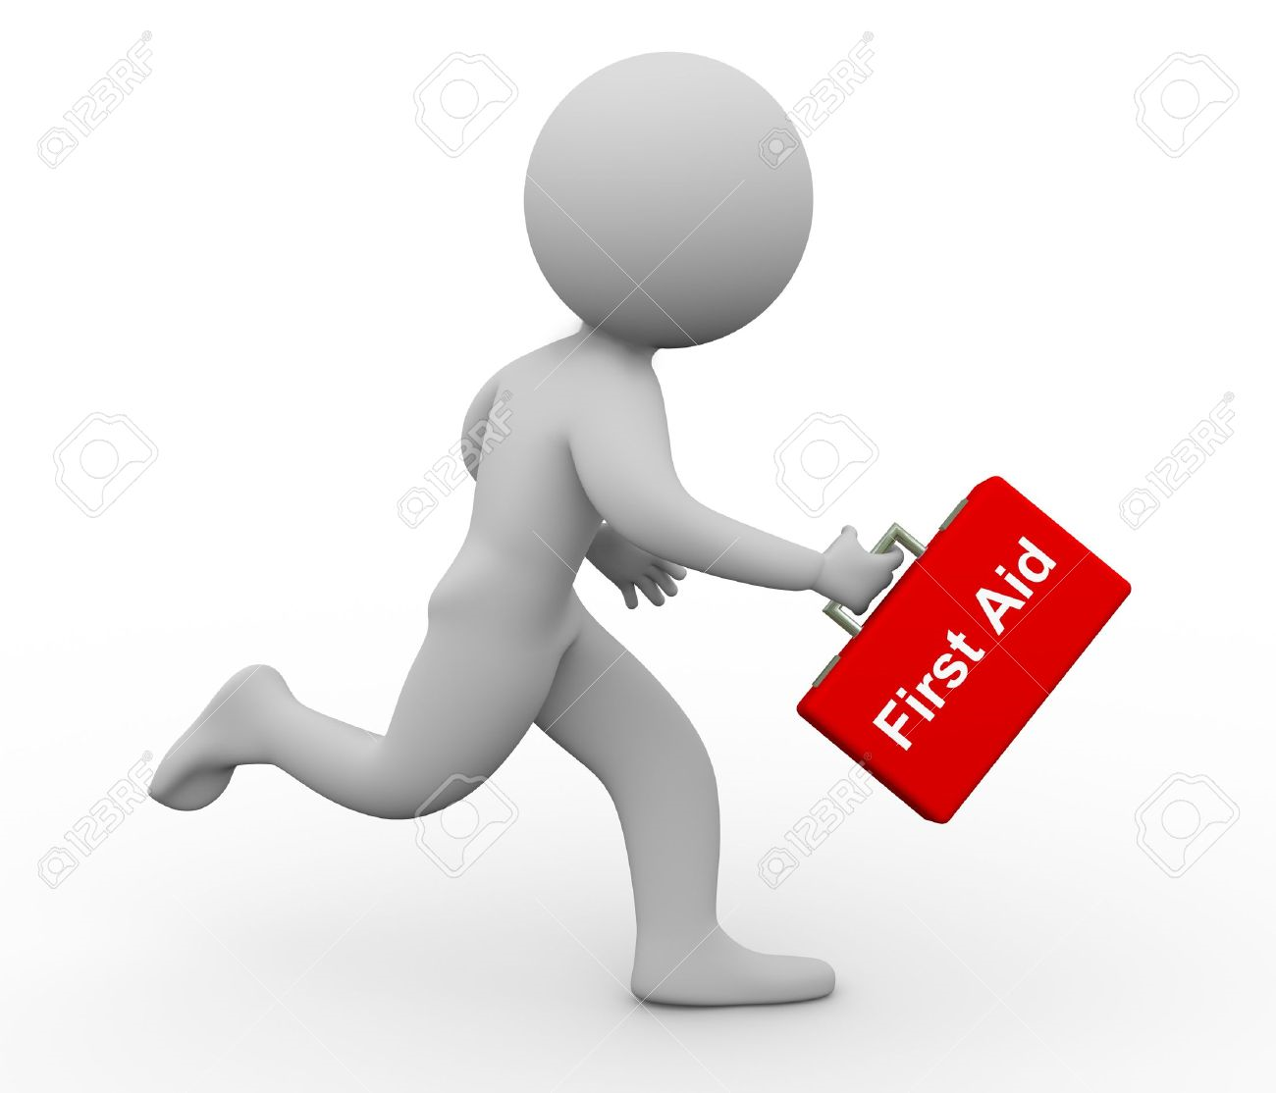

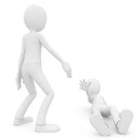
Why Mass Casualty Management (MCM)?
Management of victims of a mass casualty event, aimed at minimizing loss of life ….
H.E.L.P. course

Slide 10

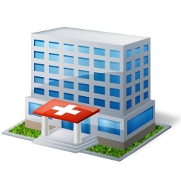

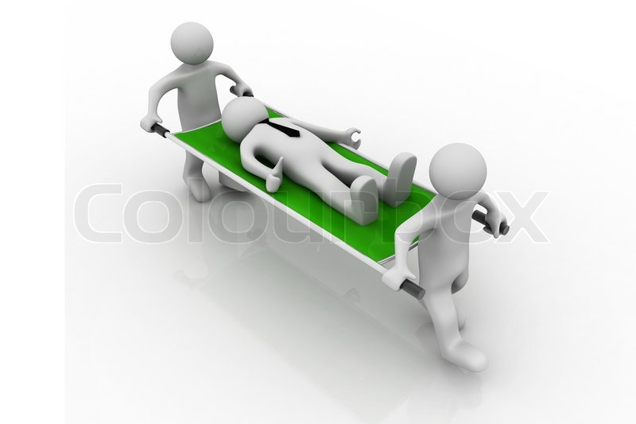
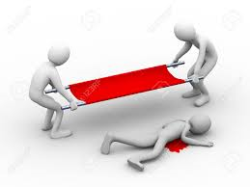
Do you remember
Basic approach
SCOOP
and
RUN
H.E.L.P. course

Slide 11


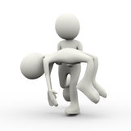
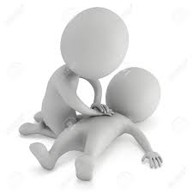
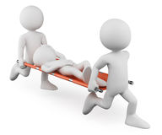
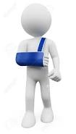


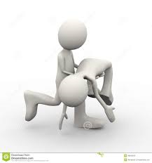
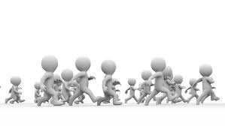
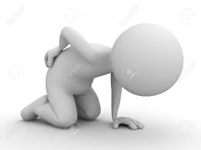

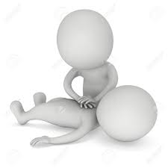



….YOU WILL JUST SHIFT THE PROBLEM!
H.E.L.P. course
Notes:
In a mass casualty situation this approach will result in the transfer of the problem from the incident site to the hospital, overwhelming and disrupting the care capacity of the health facilities…

Slide 12




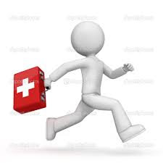


Back to the scene….
What does this picture tell you
??
H.E.L.P. course

Slide 13
Back to the scene….
What does this picture tell you
??
H.E.L.P. course

Slide 14
Mass Casualty Management
THE NEED TO SWITCH….
From individual emergency
patient care….
…to emergency medical care of several (mass/ multi) casualties…
H.E.L.P. course

Slide 15
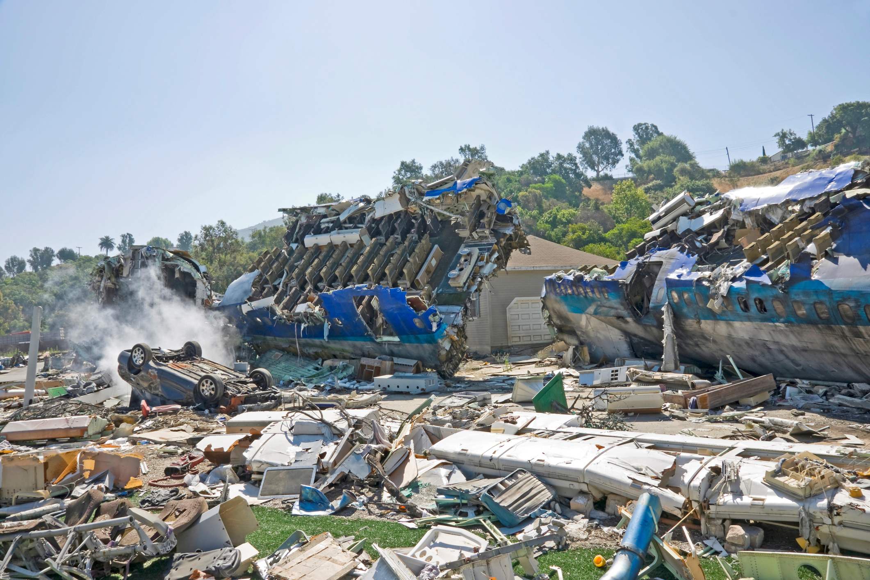
A Mass Casualty Management System
Is developed in order to:
Maximize the use of the existing resources…
Establish a coordinated multi−sectoral rescue chain…
Promptly and efficiently bring disrupted emergency and health care services back to routine operation…
H.E.L.P. course

Slide 16
A Mass Casualty Management System
Requires:
A group of units, organizations and sectors which work jointly, through institutionalized procedures...
Pre-established procedures and protocols…
(command & control, communication, resource mobilization…)
Multi−sectoral preparation and response…
Strong pre−planned and tested coordination…
H.E.L.P. course

Slide 17
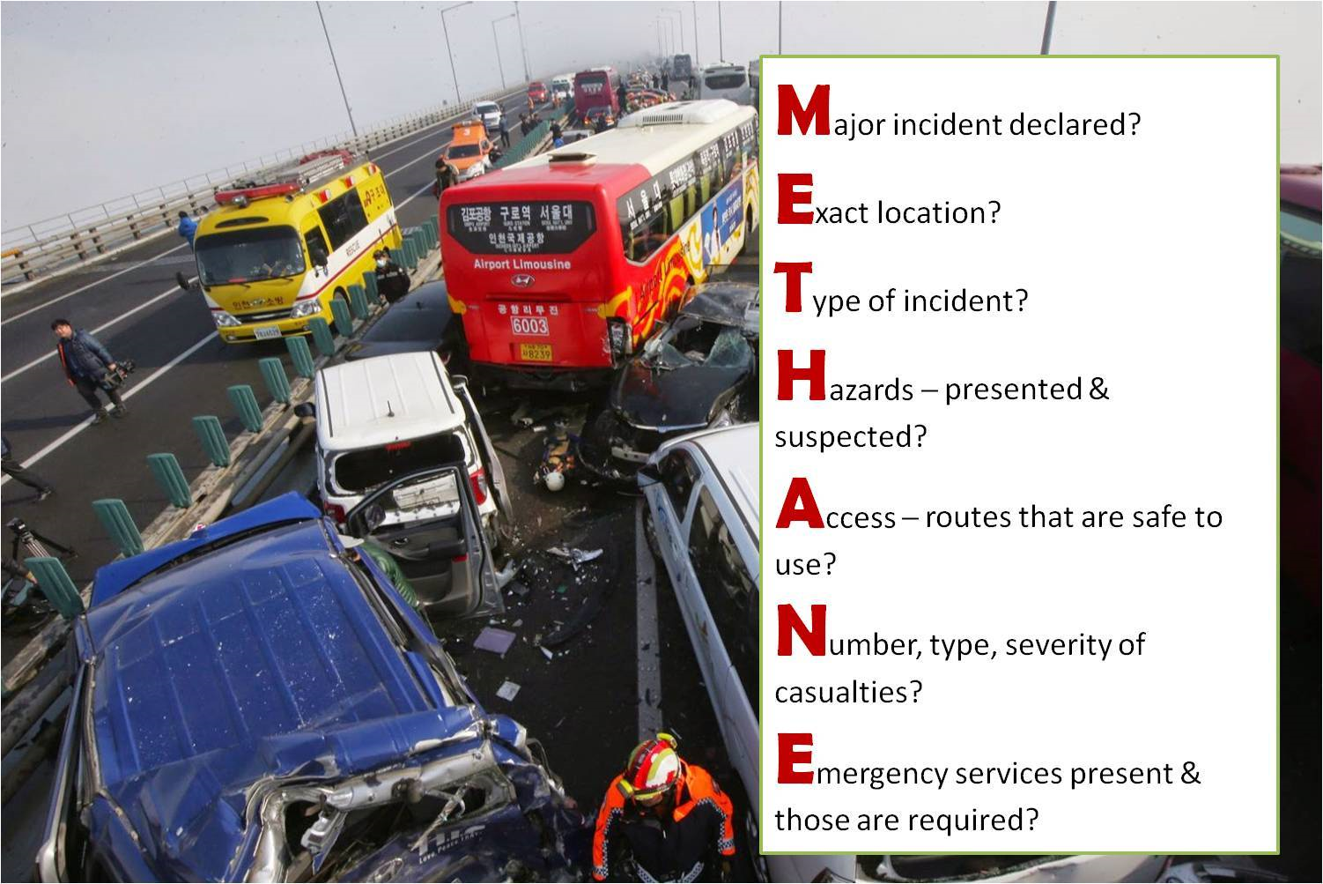
Protocol example…
H.E.L.P. course
Notes:
A member of the emergency services can declare a major incident using the METHANE prompt if they consider criteria within the above definition have been met, noting that a major incident for one emergency service does not automatically constitute a collective major incident. If doubt exists, personnel (and hospitals) can be placed on stand-by.
The advantage of such a message structure is that both receiver and transmitter are aware of the sequence reducing the chance that a vital portion of the message will be missed on either side.

Slide 18





Rescue chain
The Rescue Chain, the essence of the Mass Casualty Management System
Several actors: military, police, ambulance service, hospitals, civil defense, fire service, transport services, other actors like Red Cross /Red Crescent National Societies, and communications…
Starts at the disaster site…
Includes transfer of victims to medical care point (FAP/ (A)MP)…
Prehospital Triage
Regulated evacuation for example via ambulance (incl. traffic control),
and ends in hospital ED (hospital disaster response plan)
H.E.L.P. course

Slide 19
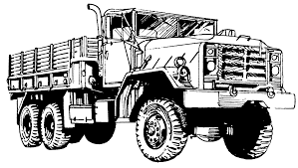

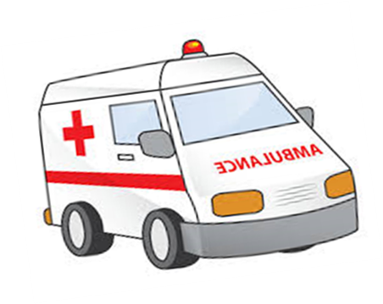


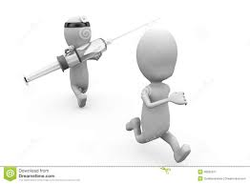
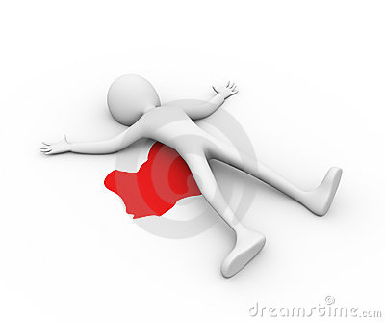
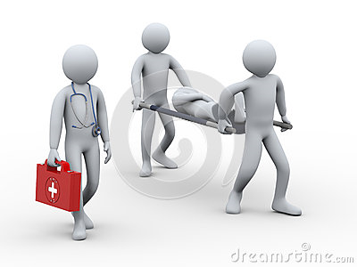

Rescue chain
Command post
IMPACT ZONE
TRIAGE
STABILIZATION
EVACUATION
MEDICAL POINT
EVACUATION &
TRAFFIC CONTROL
Search
Rescue
(First Aid)
H.E.L.P. course
Emergency Department (ED)

Slide 20

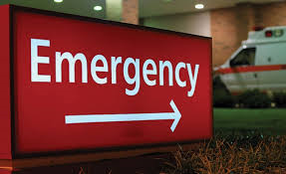
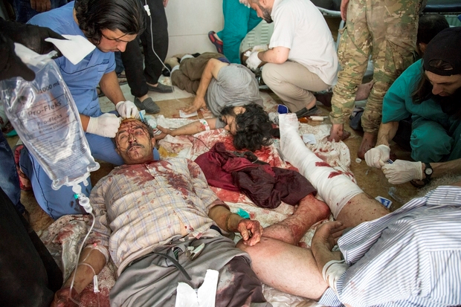
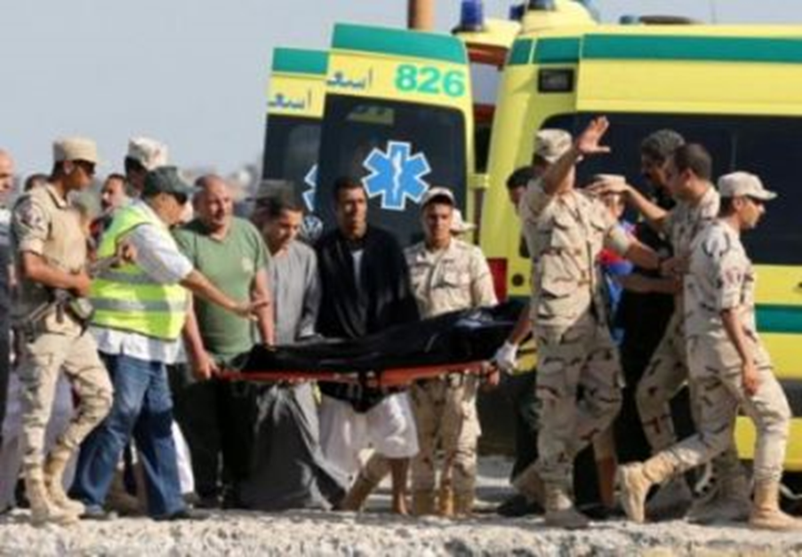
Rescue chain
The implementation of this Rescue Chain requires the existence of:
An efficient ED or receiving hospital department…
A basic common communication system ..
Coordination between all actors who are involved…
H.E.L.P. course

Slide 21
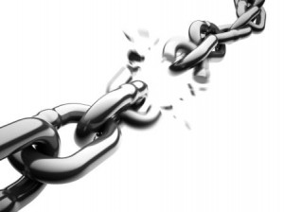
Rescue chain
A chain is only as strong as its weakest link…..
H.E.L.P. course

Slide 22

From Medical Post to Hospital ED…
Purpose
Reduce loss of life by providing, asap, effective care for all the victims…
Due to limited resources and lack of space, a health care facility can in general not provide adequate housing and effective treatment for victims of a mass casualty event alternative solutions must be proposed…
Distributing victims among various health institutions is a viable alternative…
H.E.L.P. course

Slide 23

From Medical Post to Hospital ED…
When the distance is too far, or transport resources too few, the transfer of victims to an adapted health care facility will involve delay, and……..
delay puts the victims at greater risk!
Victims must receive the best stabilization, allowing them to tolerate delayed arrival at the hospital!
Field care should be provided by the highest medically qualified actor at the scene
H.E.L.P. course

Slide 24




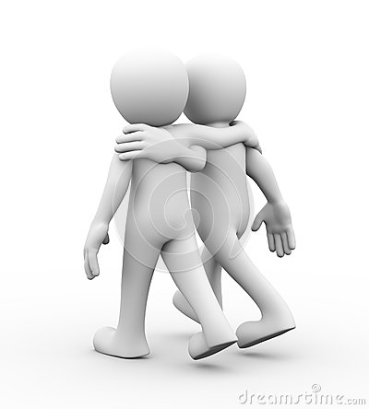
IMPACT ZONE
Deceased
Not injured
survivors
COLLECTING POINT
First TRIAGE
H.E.L.P. course
MEDICAL POINT (FIRST AID - AMP)
…..next TRIAGE……

Slide 25
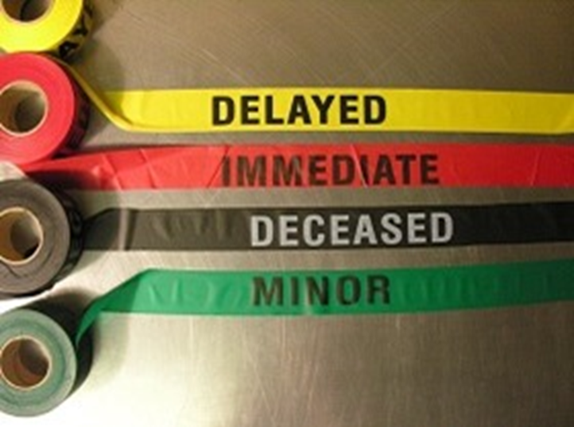
H.E.L.P. course

Slide 26
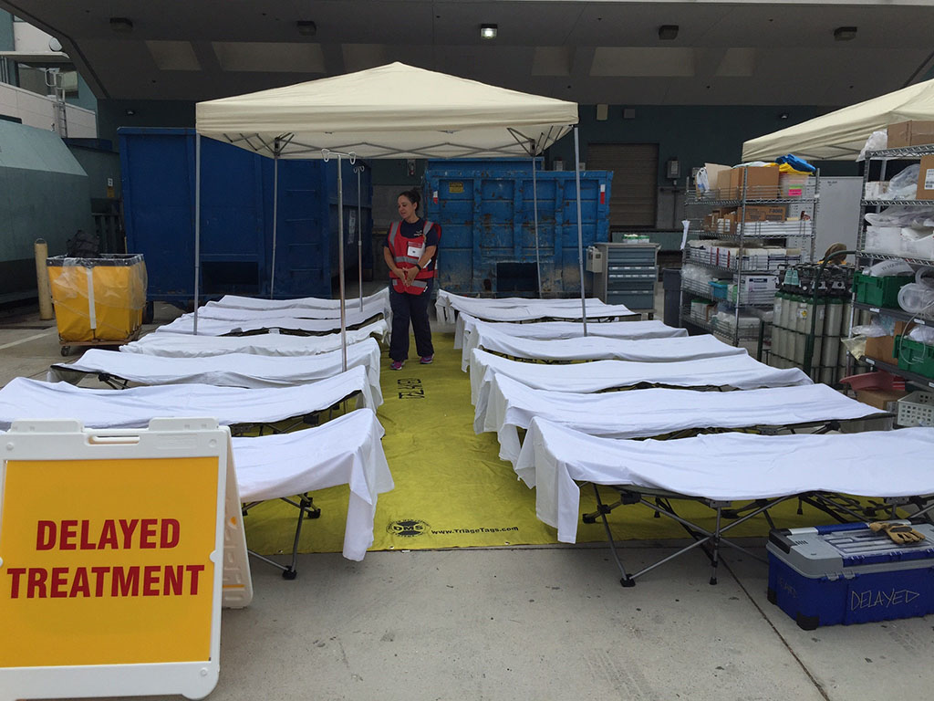
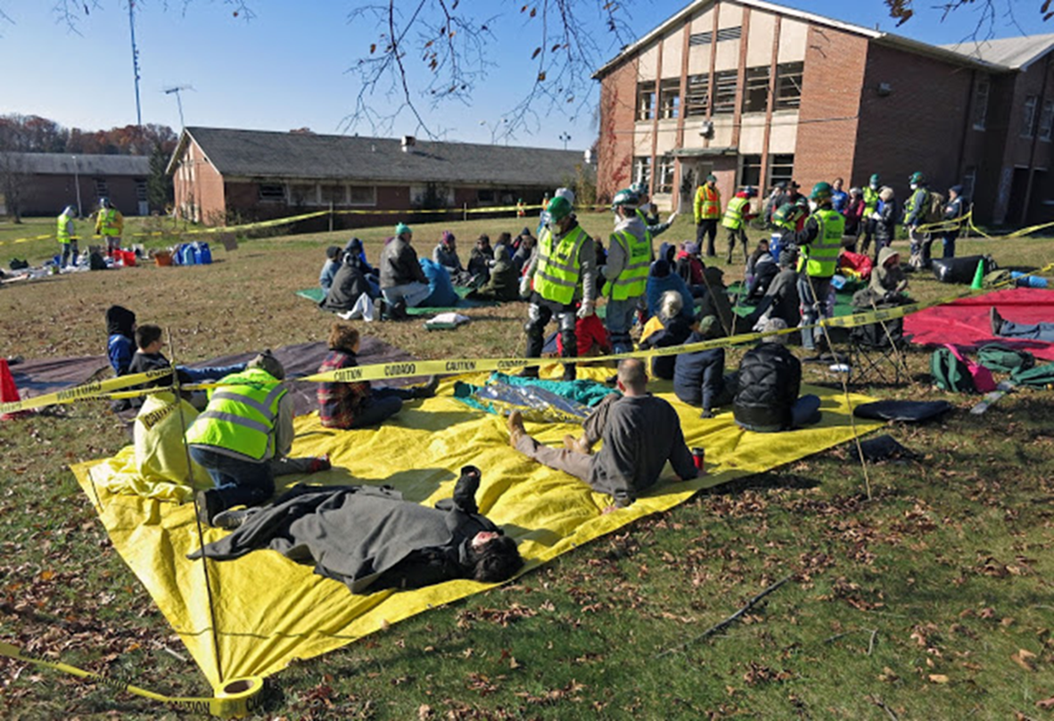
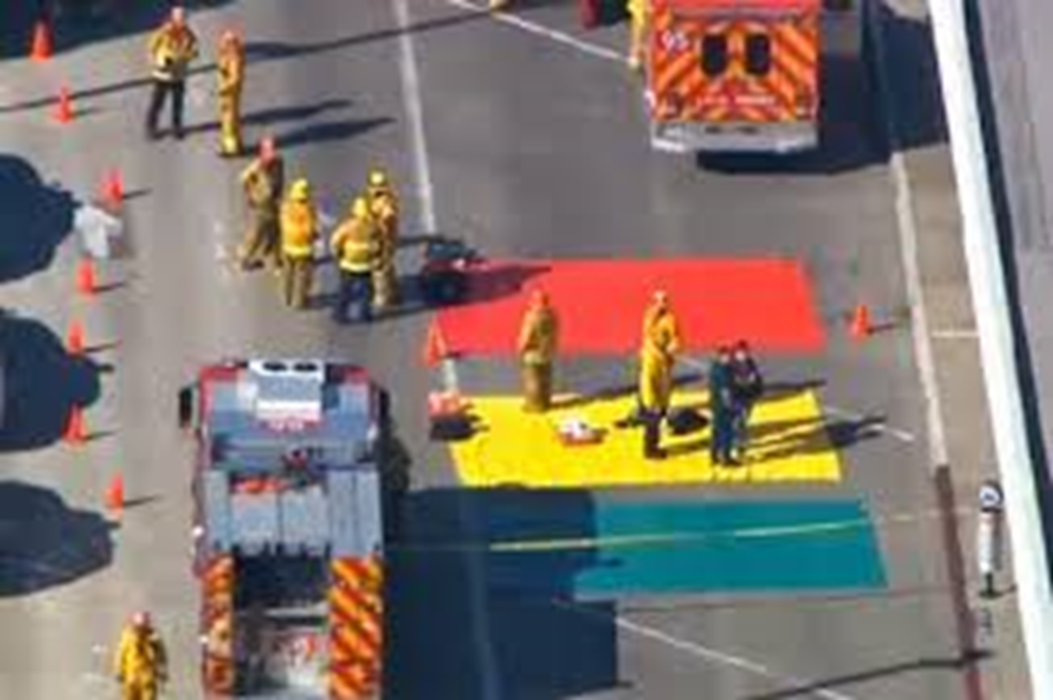
TRIAGE-Example
H.E.L.P. course

Slide 27
Location of the Medical Point
The Medical Point should be established within walking distance of the impact zone:
  In a safe area…
  With direct access to the evacuation road…
  At a short distance from the Command Post…
  In a communication zone (to other actors)…
H.E.L.P. course

Slide 28
Location of the Medical Point
Sometimes, e.g. where hazardous materials are present, the (A)MP will be placed further away….
But it should remain as close as safely possible to the impact zone...
In such a situation, transport of victims from the impact zone to the (A)MP will require a different organization (e.g. RCRC, taxi, tuck-tuck)
When weather conditions allow, the (A)MP can be in the open but it is preferable to locate it in a building or under a tent….
H.E.L.P. course

Slide 29
Role of the (A) Medical Point
Main objective: to provide effective stabilization and first aid for the victims.
Medical triage will take place at the entrance of the (A)MP to identify victims who will benefit from immediate attention
Through stabilization and first aid, (A)MP staff should try to move as many patients as possible from the red to yellow category.
The final role of the (A)MP is to organize patient transfer to adequate health care facilities (hospitals).
H.E.L.P. course

Slide 30



Are you lost?
…or ready for a small exercise?
H.E.L.P. course

Slide 31
H.E.L.P. course
Notes:
This is an example for a civilian mass casualty incident. A freight train colliding with a passenger train on an open track. Participants receive the attached scene layout to work on…. TASK: Try to establish a coordinated approach to this mass casualty incident within your group…

Slide 32
Case study: Mass Casualty Incident (MCI)
Group work
Decide on where you are in the world.
Try to organize the scene according to your context 10 min
H.E.L.P. course
Notes:
This is an example for a civilian mass casualty incident. A freight train colliding with a passenger train on an open track. Participants receive the attached scene layout to work on…. TASK: Try to establish a coordinated approach to this mass casualty incident within your group…

Slide 33
H.E.L.P. course
Notes:
It makes sense to work with different levels of command and coordination…. The direct patient care, extraction, triage, treat etc. are coordinated by bronze commanders…Operational/Bronze Command -Bronze or operational areas are usually at the site of the incident. Within a Silver area, there can be any number of Bronze areas or sectors. Each sector will represent a focus of activity and may require its own Forward Commander. Tactical/Silver Command -The outer cordon encloses the area of responsibility of the incident commanders. This is the Silver or tactical area. The commanders at an incident are in overall command of the scene, allocating resources to the Operational Commanders, planning and coordinating the overall response and obtaining additional resources as necessary. For a conventional man-made incident (for example, train crash or terrorist bomb) there is only one Silver area. For widespread public disorder or a natural occurrence (for example, an earthquake with major structural collapse) there may be two or more discreet major incidents, each regarded as a Silver area.Bronze: operational zone
Silver: tactical zone
Gold: strategic zone

Slide 34
H.E.L.P. course
Notes:
Three tiers of command are recognized:
Operational (previously known as bronze) and
Tactical (silver) are located at the scene.
Strategic (previously called gold) support is provided distant to the scene often at regional police headquarters.
Strategic/Gold Command For a ‘routine’ major incident, there is only one Gold Command. However, in incidents that cross police force or county boundaries there is a probability that there will be a multiagency Gold Command established in each domain. On these occasions it may be decided to establish regional or national coordination. A Strategic Commander’s purpose is to establish a framework of policy within which a tactical command can work, thus providing support to the tactical command and determining plans for the return to a state of normality once the incident is brought under control. The Gold area is a theoretical boundary beyond the scene, representing a level of senior command that will decide on the resources to assist the scene.

Slide 35
H.E.L.P. course
Notes:
A one way approach to the incident side (clearly coordinate IN and OUT) are the first decision to be made…..Next step could be a clear parking order an regulation, otherwise streets get blocked by police, ambulance and fire trucks in just a few minutes… Other coordinated posts like a joined command post (ambulance, military, fire, police…) Incident Command Post (ICP) can be established…. Other would be Vehicle Operation Center (VOC)….

Slide 36
H.E.L.P. course
Notes:
ICP = incident command centre
VOC = vehicle operating cente

Slide 37
Ethical Challenges in Mass Casualty Situations?
- ETHICS in TRIAGE -
What about Governors, Majors, military Commanders or other high authorities in a mass casualty situations (TRIAGE situation)?
What about an injured “attacker” (for example a shooter) who is triage priority one vs. a pregnant woman that he severely (but not life threatening) injured?
??
H.E.L.P. course

Slide 38
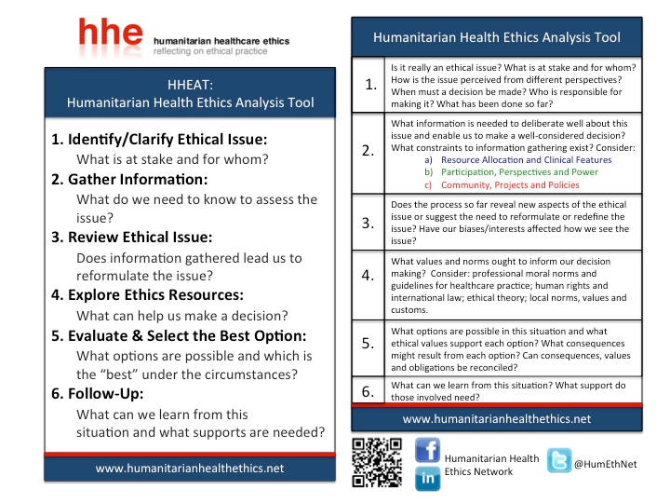
H.E.L.P. course

Slide 39
Fundamental values that impact the TRIAGE process…
Values of human life and dignity…
Triage decisions should not discriminate against certain groups…
Triage must be done without regard to rank, age, race, social worth, income or any other distinction other than emergency medical need…
H.E.L.P. course

Slide 40
Ethical Challenges in Mass Casualty Situations?
- ETHICS in TRIAGE -
In a crisis or a mass casualty situation there is a switch from standard medical ethics (with the primary focus on individual autonomy) to ethics of public health (with a primary focus on health of communities)
The overarching aim is to minimize morbidity and mortality
DOING THE BEST FOR THE MOST……
H.E.L.P. course

Slide 41
Mass Casualty Management - Hospital
EMERGENCY DEPARTMENT - MASS CASUALTY PLAN
As before, a mass casualty refers to a large number of casualties, or people injured and in need of medical assistance, produced in a short period of time.
A mass casualty incident (MCI) refers to any event that produces a large number of casualties, beyond the hospital’s usual capacity, that disrupts the daily hospital routine requiring additional resources to manage the influx of casualties (…at any time and without warning!)
Good preparation and a detailed plan will save lives
H.E.L.P. course

Slide 42
Mass Casualty Management -Hospital
The management of a mass casualty incident (MCI) should be adapted to the local situation: staff skills, transportation, communication, supplies, and equipment…
Each hospital must develop their own MCM plan based on their resources and local situation…
Each department must develop their own plan and practice it regularly.
For the emergency department (ED) it is important that the MCM plan follows the daily routine as much as possible, in order to avoid confusion. This concept is called preparedness by design. By standardizing routine emergency activities teams work more efficiently, providing a better outcome for the patients.
H.E.L.P. course

Slide 43
Hospital – Mass casualty management plan
Communication
Crowd control and security
Pre-hospital MCM plan
Pre-hospital communication
Media
Families
Volunteers
….
H.E.L.P. course

Slide 44
Action Cards…
JOB TITLE | DUTIES DURING MASS CASUALTY SITUATIONS
ED Director | →Make list of essential personnel & phone numbers, prior to MCI →Assign job cards and delegate duties to MD staff →Declares mass casualty situation and implementation of ED plan →Stay in constant communication with relevant authorities to anticipate any new arrivals of casualties →Oversees the implementation of the overall plan in the ED →Liaise with all departments of the hospital to prepare for transfer of patients from the ED →Deactivate the ED MCM plan at the end of the emergency →Lead the debriefing with key staff at the end of the emergency
JOB TITLE | DUTIES DURING MASS CASUALTY SITUATIONS
Hospital Project Manager (Administration) | →Contact all available and essential staff to report to the hospital, when the MCI is declared →Ensure staff receive adequate breaks, food, and water →Make sure all patients have ICRC identification tag and documentation before leaving the triage point
JOB TITLE | DUTIES DURING MASS CASUALTY SITUATIONS
ED Head Nurse | →Assign job cards and delegate duties to nursing staff, hospital staff, and volunteers →When MCM plan is initiated transfer all previous patients to other departments or discharge →Obtain current bed statues with updates on the number of ED beds available →Communicate bed status with essential personnel (ED Director) →Complete the bed status form →Provide patient information to the families via the nurse in charge of the family area →Ensure adequate supply of materials, drug, and equipment in ED →Support and adequately maintain staff in the triage and ED →Liaise with other department Head Nurses and Nursing Director to assist in patient flow →After MCI evaluate ED process
JOB TITLE | DUTIES DURING MASS CASUALTY SITUATIONS
Physician or RN In-Charge of Walking Patients | →Performs secondary triage of each walking patient →Completes triage assessment for each patient → Re-assess and re-triage patients if their condition changes →Transfer patients to another unit or discharge them home
H.E.L.P. course

Slide 45
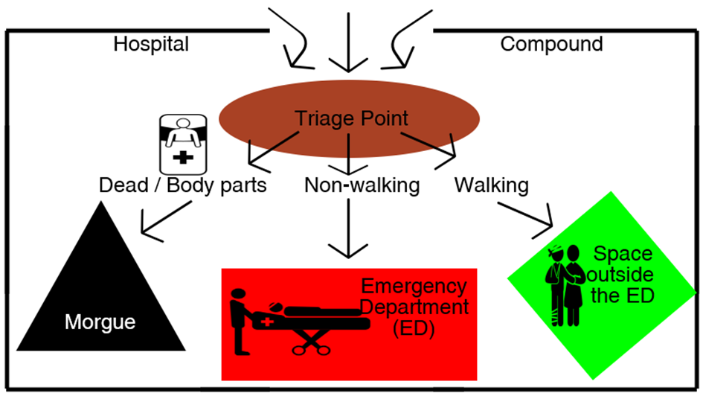
Hospital -Triage
H.E.L.P. course

Slide 46
H.E.L.P. course

Slide 47
Components of a mass casualty plan
Multi-agency approach
Roles & responsibilities (decision makers, triage leader, liaison with others)
Pre-established communication and coordination system
Resource mobilisation
Equipment and consumables
Triage protocols to prioritize salvageable patients for treatment and ration resources
Hospital networking; Cooperation between Civilian and Military services
Crowd control (cultural elements: often difficult)
Media
Staff safety and well-being
Training and rehearsal of the mass casualty plan
H.E.L.P. course
Notes:
There must be a pre-established communication system between the emergency services and pre-hospital services but also the community and hospital. Keep in mind that prehospital services can vary from well-staffed and equipped teams to First Aid volunteers
Triage: Do the best for the most

Slide 48
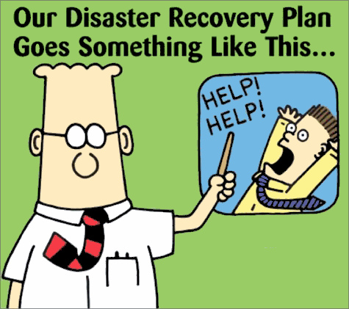
Mass casualty management plan
A mass casualty management plan needs to undergo periodic assessment and evaluation whether the plan addresses all issues….
H.E.L.P. course

Slide 49

Questions
H.E.L.P. course

