Slide 1
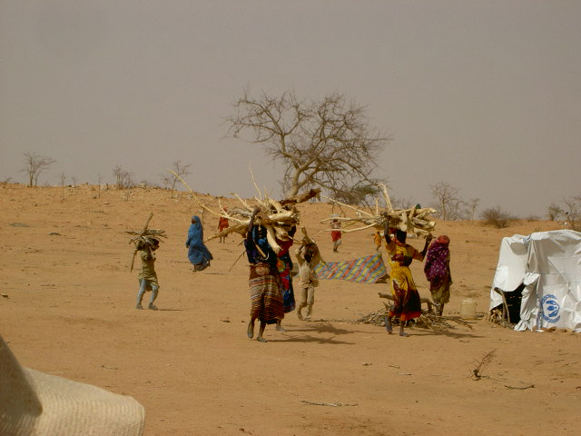
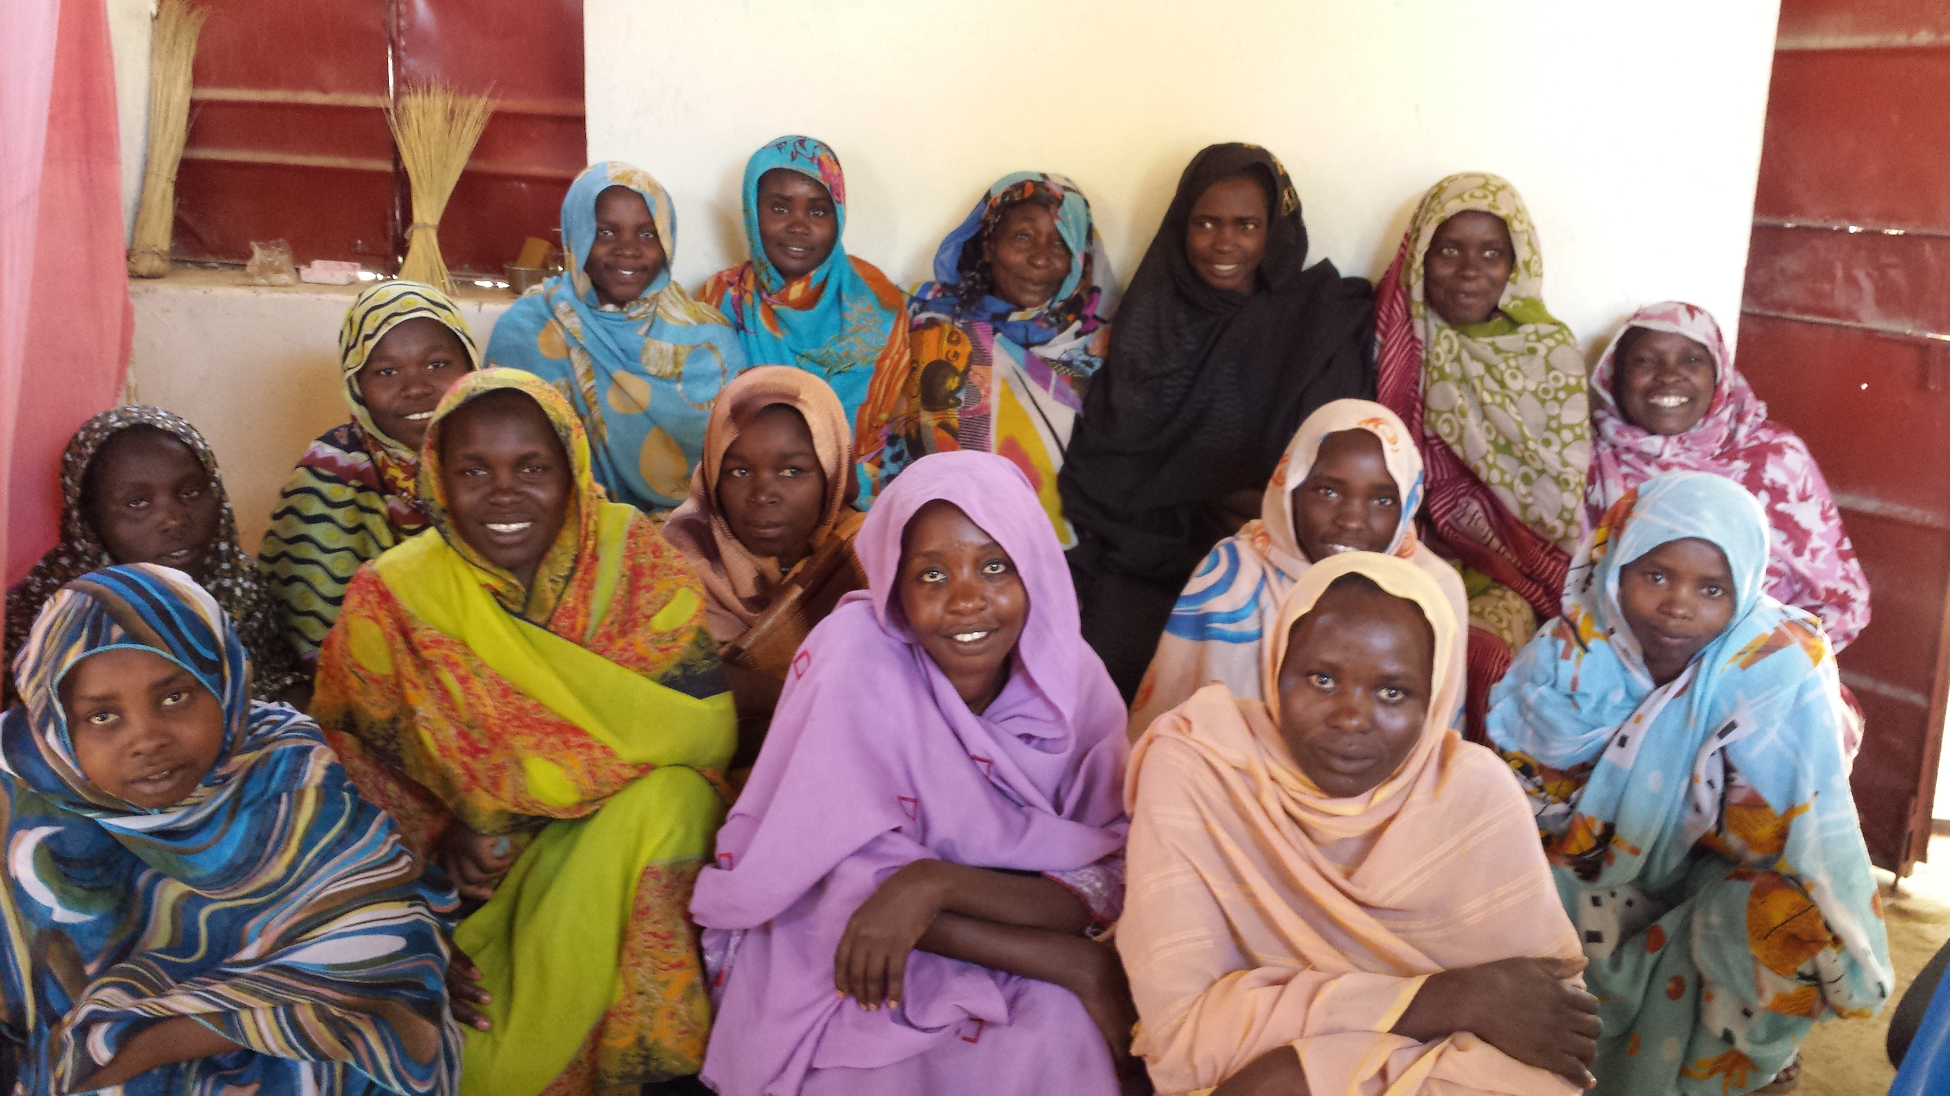
Logo organization(s) facilitator(s)
Sexual and Reproductive Health in Crises
Minimum Initial Service Package (MISP)
Name(s) and organization facilitator(s)

Slide 2
Objectives
Be able to:
Explain why Reproductive Health (RH) is important in humanitarian settings and the magnitude of RH health needs during times of crises
Explain what may happen when RH needs are not adequately covered
Explain what the MISP is, its components and how to effectively implement the MISP
Apply the core concepts of the MISP in preparedness and response planning

Slide 3
Childbirth on board MSF Mediterranean Search and Rescue Ship, Dignity I; October 2015
https://www.youtube.com/watch?v=P9higAW_KAw

Slide 4
Reproductive Health
Is a state of complete physical, mental and social well-being and not merely the absence of disease or infirmity, in all matters relating to the reproductive system and to its functions and processes.
It implies that people are able to have a satisfying and safe sex life and that they have the capability to reproduce and the freedom to decide if, when and how often to do so.
(Cairo, ICPD Programme of Action, paragraph 7.2)

Slide 5
Continuum of SRH during Stable Times
Community and Outreach
Adolescence and pre-Pregnancy
Pregnancy
Birth
Postnatal Mother
Motherhood
Postnatal Baby
Infancy and Childhood
Health Facilities

Slide 6
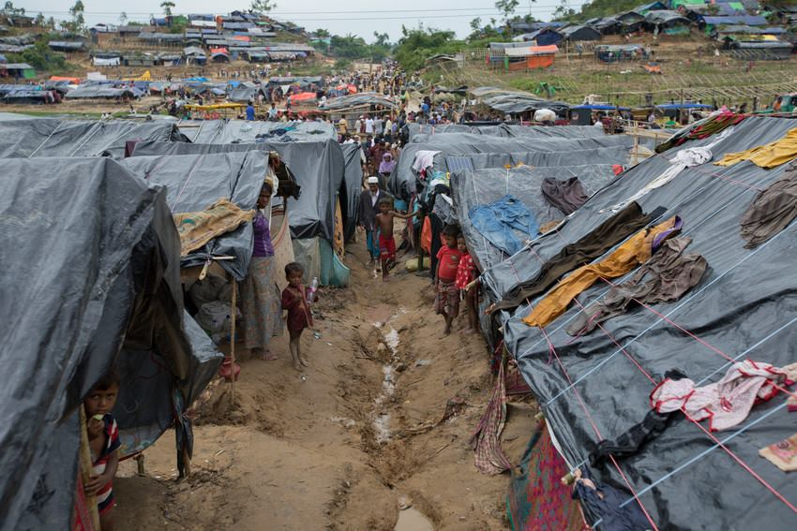
SRH in crisis situations
In 2018, a staggering 136 million people needed aid, of whom an estimated 34 million were women of reproductive age (25%); of those, 5 million women were pregnant (IMAP, 2018)
Of preventable maternal deaths, 60% take place in settings of conflict, fragility, displacement and natural disasters

Slide 7
During Crises: Women and Girls = Increased Risk
Anywhere from 4-16% of Women in Reproductive Age (WRA) will be pregnant at any given time. 15% of these will experience life-threatening complications due to pregnancy
Increased risk of HIV transmission
Loss of protocols / compromised universal precautions
No access to condoms
No safe blood supply
Increased risk of unplanned pregnancy and STI
Lack of access to routine Family Planning
High population density
Increased risk of sexual violence as civil society is destabilized
Displacement often means lack of security

Slide 8
Health Delivery Suffers During Crises
No access to comprehensive Obstetric Care = unplanned pregnancies, unsafe abortions, maternal death
General lack of health services, qualified health personnel
General lack of transportation: childbirth occurs on roadsides during population movements
Community support systems and protection mechanisms break down
Humanitarian crises exacerbate gender inequalities: women, girls and other vulnerable groups tend to have lowest access to response systems

Slide 9
As a Result There is a Higher Risk Of:
Sexual violence and rape
Early, child, and forced marriage
Human Trafficking
Cases of STI and HIV
Unintended pregnancy
Unsafe abortion
Complications during pregnancy and delivery
Unsafe childbirth
Maternal death
Notes:
As a matter of fact we know that RH needs often even increase during crisis.
For instance
The absence of law and order, commonly seen in refugee situations, may, together with men‘s loss of power and status and the loss of income for women who find themselves as the sole responsible for the household, lead to sexual violence, rape, sexual abuse, and involuntary prostitution. This may lead to an increase in the sexual tranmission of HIV and STIs
Also in crises there often is an increase in demands on the health systems, but insufficient supplies to assure universal precautions against the tranmission of HIV. Furthermore, the system of provision of safe blood supplies usually breaks down, whereas there may be a greater need of bloodtransfusions, particularly in complex emergencies.
Lack of FP may lead to unwanted pregnancies and increase the risks associated with that, such as complications of unsafe abortions.

Slide 10
What is Comprehensive SRH Care Services ?
??
Safe motherhood: abortion care, ANC, delivery, new-born, PNC
Family Planning
STI and HIV prevention and management
GBV prevention and management
Gynaecology: infertility, fistula, cervical and breast cancer screening/treatment
Urology: infertility, male sexual dysfunction, male reproductive cancer screening/treatment
Active discouragement of harmful practices: FGM, early marriage, safe abortions…

Slide 11
It is Imperative:
Appropriate and timely SRH Services are prioritized and made available in the immediate humanitarian response
Minimum Initial Service Package (MISP) was developed for reproductive health in emergencies by The Inter-agency Working Group on Reproductive Health in Crises (IAWG: works to expand and strengthen access to sexual and reproductive health services in humanitarian crises
Join IAWG! http://iawg.net/

Slide 12
What is the MISP ?
??
Minimum
Initial
Service
Package
basic, limited reproductive health
for use in emergency, without site-specific needs assessment
services to be delivered to the population
supplies (e.g. RH kit) and activities
coordination and planning
Notes:
I think we alll agree that, after the first needs of a population in crises are seen to: water, shelter and food, we have to provide basic public health and PHC services. The IAWG argues that a minimum of RH services should be part of these health care measures in the early emergency.
A set of priority SRH activities to be implemented at the onset of a crisis
Defines which SRH services are most important in preventing morbidity and mortality
Minimum initial response

Slide 13
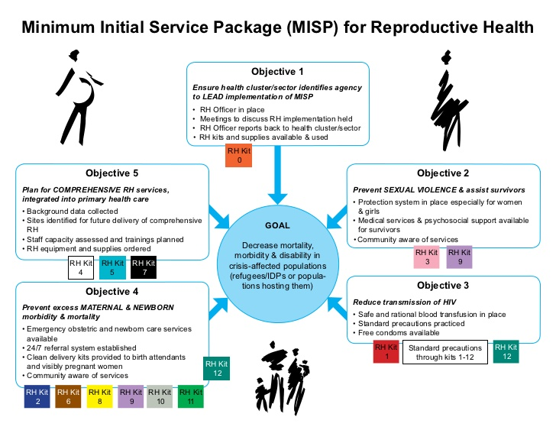

Slide 14
How is the MISP Implemented?
The MISP is a set of priority SRH activities to be implemented at the onset of a humanitarian crisis
Ideally implementation should take place within 48 hours
Planning and preparedness is critical
The MISP can be implemented without an in-depth SRH needs assessment
The identified SRH interventions are life-saving
The MISP represents a minimum set of activities
Humanitarian stakeholders should transition to comprehensive SRH services as soon as possible (possibly within 3 months)
Notes:
The Minimum Initial Service Package (MISP) is perhaps the most recognized part of the IAFM.
The MISP has been widely adopted by governments and is the standard within the humanitarian sector. The priority activities of the MISP are included in the Sphere Minimum Standards in Humanitarian Response.

Slide 15
The continuum of an emergency
Emergency
Post-emergency
Destabilizing Event
Durable
Solutions
Comprehensive
SRH services
Comprehensive
SRH services
Emergency Preparedness
H.E.L.P. course
MISP
Loss of essential services
Restoration of essential services
Relative stability
Return to normality

Slide 16
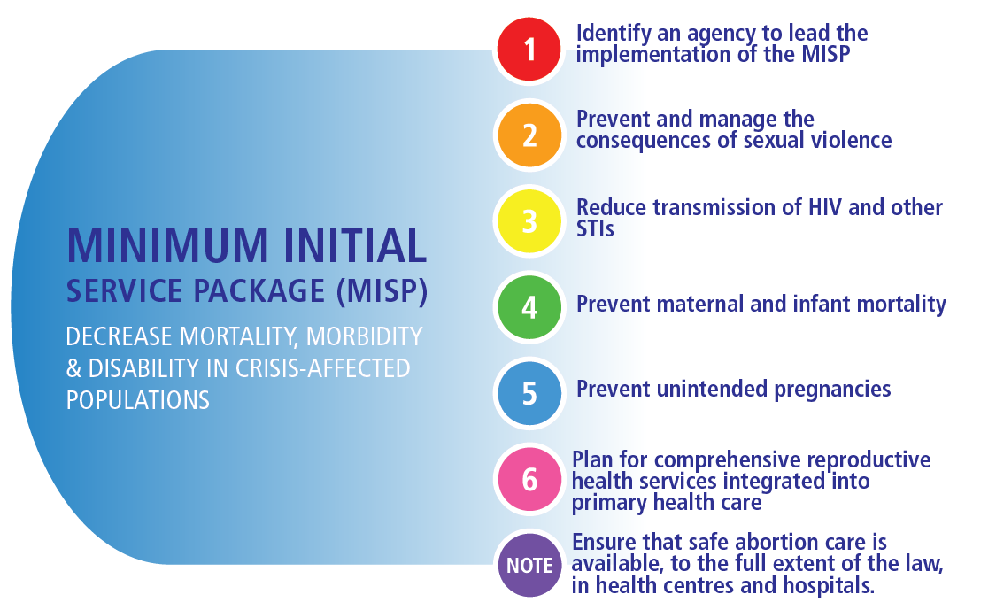

Slide 17
Sexual violence in crisis situations
‘During the armed conflict in Bangladesh in 1971, it is estimated 200,000 civilian women and girls were victims of rape’ (Human Rights Watch)
According to a survey JAMA published in 2010, 30% of women and 22% of men from eastern DRC reported they had been subject to conflict-related sexual violence.
Often widespread
Remains invisible in many contexts
“Reverse Burden of Proof”

Slide 18
Sexual Violence: Immediately Life-Threatening
Crisis
Recovering
Post-Crisis
MISP: Minimum Response
Prevent: coordinate mechanisms to prevent Sexual Violence
Respond: clinical care & referral for survivors
Respond: confidential & safe spaces
Restore comprehensive services AS SOON AS POSSIBLE

Slide 19
What are Some Risk Factors in Crisis Settings for Spread of STI and HIV?
??
HIV prevalence
Reduced access to prevention, treatment, and care services
The level of interaction between displaced and surrounding populations
The location and extent of isolation of the displaced population
Poverty
Sexual violence
Sex-work
Presence of armed forces
Reduced access to resources and services
Increased substance abuse
Poor quality of services ( “better than nothing” )
Modified from Spiegel PB. HIV/AIDS among Conflict-affected and Displaced Populations: Dispelling Myths and Taking Action. Disasters 2004;28(3):322-39.

Slide 20
HIV and Other STI
Crisis
Recovering
Post-Crisis
MISP: Minimum Response
Safe & rational blood transfusion
Standard Precautions
Condoms
ARVs
PEP
Cotrimoxazole prophylaxis
Syndromic diagnosis & treatment of STIs
Restore comprehensive services AS SOON AS POSSIBLE

Slide 21
Importance of Maternal and Newborn Health in Crisis Situations
About 4% of a displaced population is pregnant at any given time
About 15% of pregnant women will have life threatening complications
“It is a fact largely ignored that 60% of preventable maternal deaths and 53% of newborn and under-5 deaths now take place in zones of conflict and displacement.” Horton, Lancet May 2016
500 women and girls die in crisis settings every day from complications due to pregnancy and childbirth.
Most maternal and newborn deaths occur around the time of labour, delivery, and the immediate post-partum period
Notes:
The fourth objective is dedicated to maternal and newborn health. The importance of ensuring provision of life-saving MNH interventions at the outset of an emergency cannot be underestimated. Globally, the countries with the highest maternal mortality ratios are almost all defined as conflict-affected, post-conflict, or fragile. Approximately 4% of a displaced population is pregnant at any given time and one in six pregnant women in emergencies will have life threatening complications. Notably, in the 2018 version of the MISP there is greater emphasis on activities to decrease newborn morbidity and mortality.
More than 60 percent of all maternal deaths occur in emergency and fragile context settings. It means that more than 500 women and girls die in emergency settings every day from complications due to pregnancy and childbirth.
500 women who needed to give birth in a safe environment.
Most of those complications can be prevented or managed
500 women that we can save every day by prioritizing SRH services
Sexual and gender-based violence also increases in such settings, with devastating and sometimes deadly consequences.
The unprecedented frequency, intensity and scope of humanitarian emergencies in the past year has dramatically amplified these risks for millions of women and girls
We need to prioritize life-saving high impact strategies at the onset of an emergency, and we also need to be able to scale up services. The average length of displacement is now around 17 years (conflicts in Somalia and Afghanistan, for example are in their third and fourth decades, respectively. We have entire generations, born and raised in camps and other displacement settings).

Slide 22
Major Causes of Maternal and Newborn Death
Every Woman Every Child 2015

Slide 23
The 3 Delays
In decision to seek care
In reaching health facility
In receiving appropriate treatment
Can’t predict or prevent complications… … but can prevent deaths by reducing DELAYS

Slide 24
Maternal and Newborn Health
Crisis
Recovering
Post-Crisis
MISP: Minimum Response
Availability and accessibility of EmONC
24/7 referral system
Post-Abortion Care
Supplies for clean delivery and immediate newborn care
Restore comprehensive services AS SOON AS POSSIBLE
Notes:
Link MISP to major causes of maternal and newborn death

Slide 25
Factors Influencing Risk of Unintended Pregnancy in Crisis Situations

Slide 26
Prevent Unintended Pregnancies
Crisis
Recovering
Post-Crisis
MISP: Minimum Response
Ensure availability of a wide range of contraceptive methods at primary health care facilities to meet demand
Provide information
Ensure community is aware of availability
Restore comprehensive services AS SOON AS POSSIBLE

Slide 27
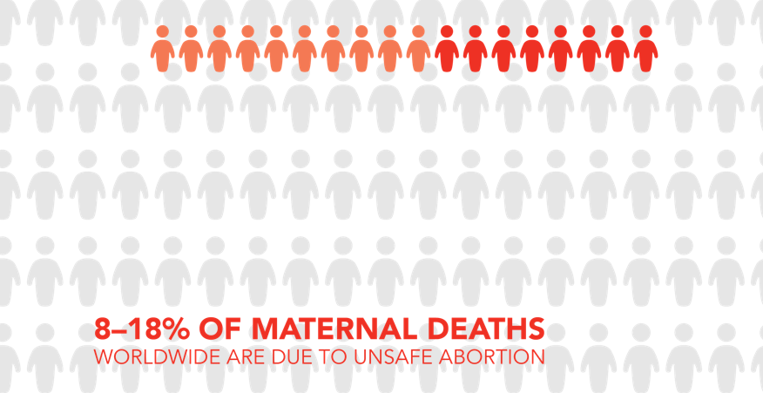
Safe Abortion Care in Humanitarian Crises
IPAS: Overview of Unsafe Abortion

Slide 28
Safe Abortion Care in Humanitarian Crises
Safe abortion care saves lives
There IS a need for safe abortion care in humanitarian settings
Abortion care is simple
Many donors do fund abortion care
Abortion is illegal only in very few countries
Note:
It is important to ensure that safe abortion care is available, to the full extent of the law, in health centres and hospital facilities
Notes:
This could be expanded out- based on IPAS

Slide 29
What is needed to implement MISP
??
Leadership and coordination
Community Engagement
Multi-sectoral collaboration, e.g. health, protection, logistics
Infra-structure
Expertise: sufficient quantity & quality
Supplies and commodities
Funding
Monitoring and evaluation

Slide 30
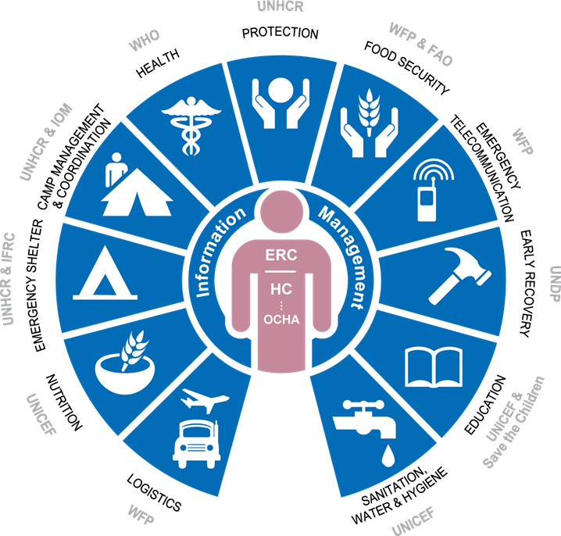
What is Needed to Implement MISP?
Multi-sector collaboration

Slide 31
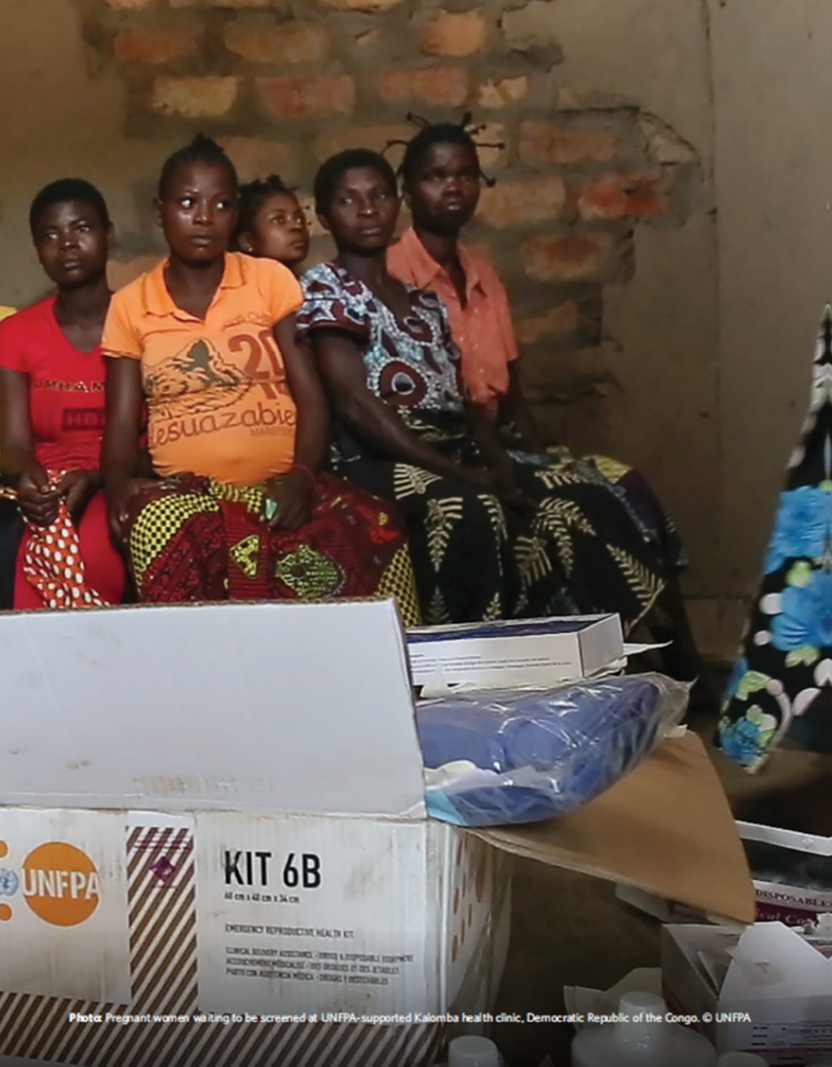
What is Needed to Implement MISP?
Funding:
The MISP saves lives so qualifies for Central Emergency Response Funding (CERF)
Donors willing to support a Ministry of Health MISP implementation
Budget advocacy and integration
To support rebuilding stronger services as the crisis situation stabilises

Slide 32
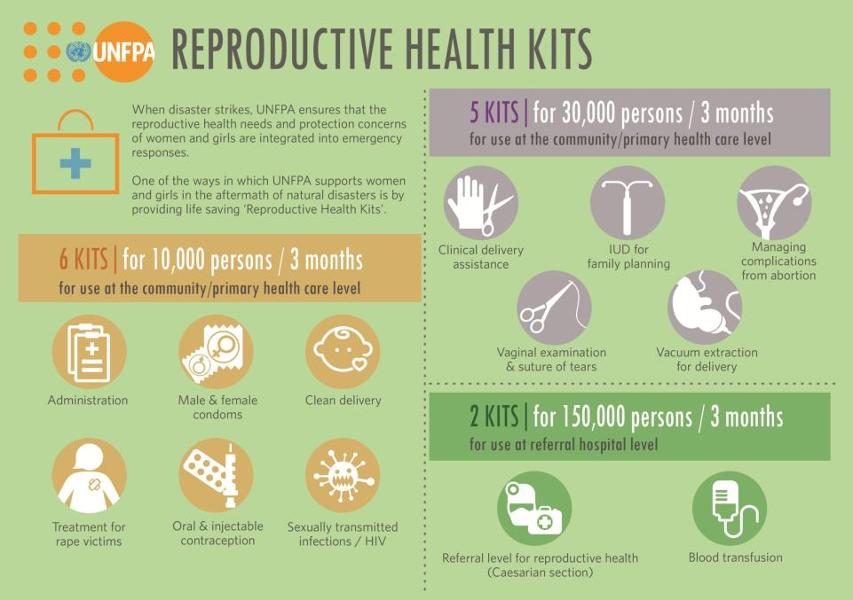
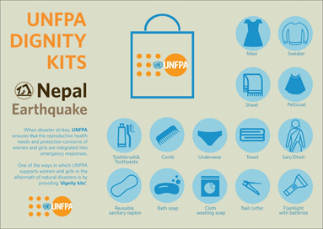
What is Needed to Implement MISP?
Supplies and commodities from the onset of the crisis
In-country supplies and commodities
Pre-positioned supplies and commodities
Inter-Agency Emergency Health Kit (IEHK)
Inter-Agency Reproductive Health Kits (IARH Kits)

Slide 33
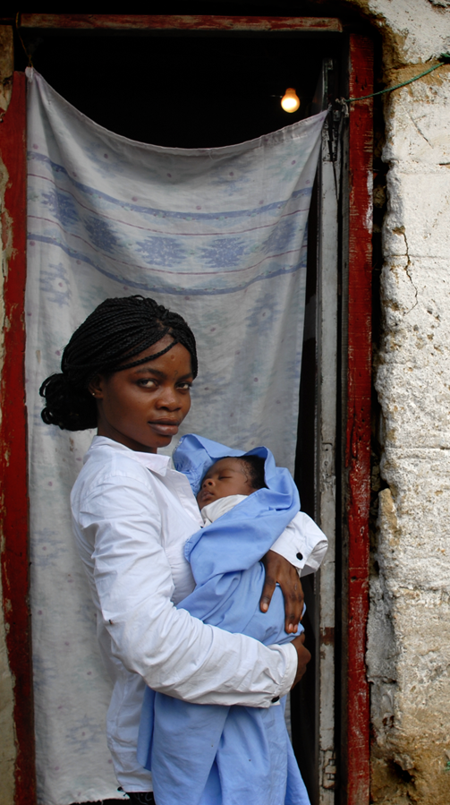
What is Needed to Implement MISP?
Monitoring and evaluation
MISP checklist
Onset basic data collected, analyzed rapidly
Services established routine monitoring
Gaps and overlaps discussed within the SRH coordination meetings and with health sector/cluster
Notes:
Community accountability?

Slide 34
“Standard“ Population
Adult males 20%
Women of reproductive age (WRA) 25%
Crude birth rate 4%
Number of pregnant women
Number of deliveries
Complicated abortions/pregnancy 20%
Vaginal tears/delivery 15%
Caesarean sections/delivery 5%
WRA who are raped 2%
WRA using contraception 15%
Oral contraception 30%
Injectables 65%
IUD 5%
Notes:
The supplies in the kit are calculated for a „standard“ population, and it is based on the following assumptions.

Slide 35
Inter-Agency RH kits
Kits
0
1 A & B
2 A & B
3
4
5
Community and Primary Health Care Level
10 000 pop
Training and administration
Condoms (male & female)
Clean delivery - home
Post-rape care
Oral and injectable contraception
STI drugs
6 A & B
7
8
9
10
Health centre or hospital level (BEmONC)
30 000 pop
Delivery - midwife
IUD insertion
Complications of abortion
Suture of cervical and vaginal tears
Vacuum extraction
Referral Hospital level (CEmONC)
150 000 pop
11 A &B
12
Obstetric Surgery
Blood transfusion
Kits contain supplies for 3 months
Notes:
There are 12 kits, divided into 3 „blocks“ each targetting another level of health service delivery (health post, health centre and referral hospital). Each of these levels have a different population coverage. Supplies are calculated for the first 3 months, after which further supplies should be ordered based on monthly consumption, through the ususal supply systems of the ministry or organization implementing the services.
Re-ordering kits is not encouraged, unless absolutely necessary. Kits are meant to implement services where none exist at all.
The first block contains 6 subkits and is designed for

Slide 36
RH Kit Challenges
Appropriate ordering
In-country distribution plan
In-country transport
In-country warehousing
Coordinating with local partners (MoH, NGOs, UN)
Customs clearance
Cold chain
Monitor distribution and use of supplies
Move from “push” to “pull” supply systems and comprehensive RH commodity security

Slide 37
MISP: No Need for Assessment!
What you need to know:
How many people are affected?
Where are they?
Where are the health services?
Can health facilities still function?
Are health services accessible?
What local resources are available?
What external resources needed?
Any information on the pre-existing SRH situation is a plus
Notes:
For rapid assessment, the question is what do I need to know now. What are the short term immediate life saving measures that will make a difference? What is the best way to get it? We need to be intelligent. Its not simply a matter of doing something. Its doing the right something, and not making things worse. What are some of the objectives of doing a rapid health assessment?
These questions are essentially the same if your emergency is in Sri Lanka, Afghanistan or Thailand. As Oleg said, don’t collect information if you are not going to use it. So what will we use this information for? As Agostino says we need to be intelligent. Its not doing something its doing the right something, and not making things worse.

Slide 38
Group Work
Based on the following scenarios
Syria
Philippines
15 Minutes

Slide 39
Syria Response

Slide 40
Syria
More than 8 years of conflict (March 2011 - present)
Over half the population has been displaced and over 13 million are in need of humanitarian assistance
An estimated 6 million Internally Displaced
UN OCHA: “In the absence of a political solution to the conflict, intense and widespread hostilities are likely to persist.”
Restricted access and humanitarian space
Estimated characteristics of affected population
Total affected population (OCHA) | 13.5 million
Women of reproductive age | 3.4 million
Notes:
Syria is in its seventh year of major conflict.
13.5 million people have been directly affected according to the UN Office for the Coordination of Humanitarian Affairs and 5 million have fled the country.
Population peaked at 20.7 million in 2010 (currently about 18.5 million, had been growing by about half a million per year)
4.6 million people are living in besieged or hard to reach places.
There is no end in sight for the conflict without a political resolution.
Millions of women of reproductive age are among those affected and their reproductive health needs have not disappeared, particularly for the several hundred thousand currently pregnant women.
The nearly 50,000 pregnancies that will end in miscarriage or unsafe abortion in the next nine months speak to the need to ensuring access to post-abortion care services.
Crude birth rate: 32 (World Bank, 2015)
MMR: 385 (WHO, 2015)
CPR: 20% (DHS, 2013)

Slide 41
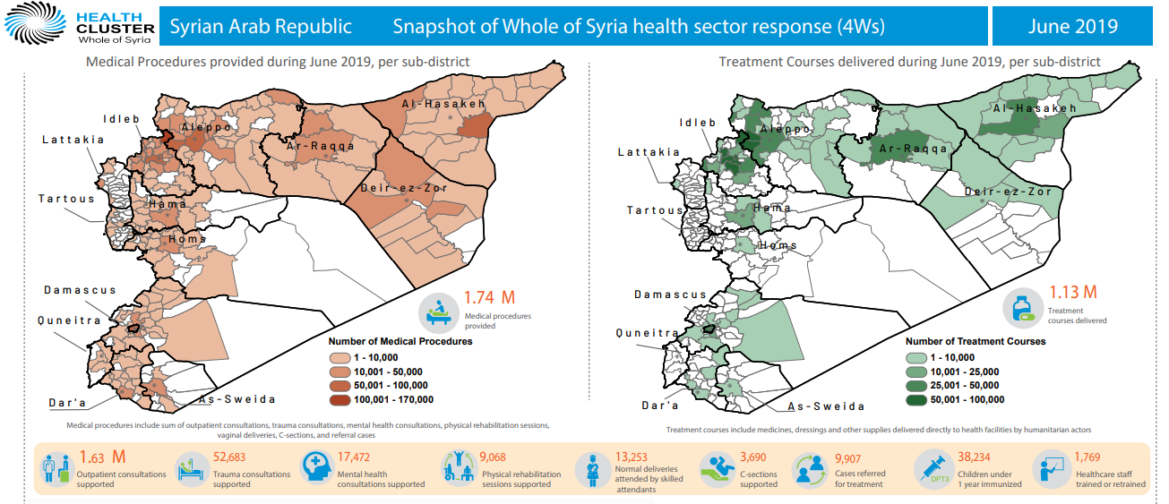

Slide 42
Group work –Program strategy
Your organization is working or providing support to two hospitals in Idlib governorate in NW Syria. There is ongoing active armed conflict. Cross-border travel from Turkey to Syria is restricted and unpredictable.
What are the 3-5 challenges you foresee for sexual and reproductive health programming in North West Syria?
What are the key data points, strategies or indicators you will use to monitor program performance?
Preposition RH supplies for the two hospitals for a year period, assuming population size of 200,000 people
XX minutes

Slide 43
Philippines Typhoon Preparedness and Response

Slide 44
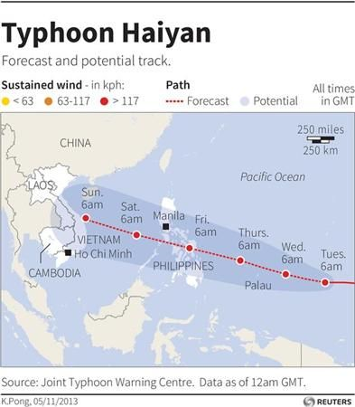
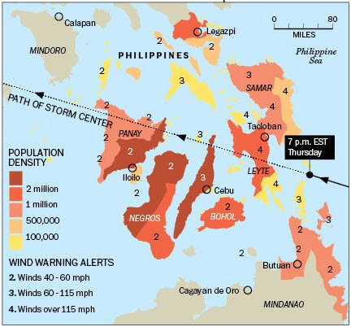
A super typhoon has surface winds that sustain speeds of more than 240 kph for at least a minute (U.S. National Oceanic and Atmospheric Administration)
https://www.bing.com/videos/search?q=super+typhoon+haiyan+video&view=detail&mid=3182A8B888C1414BB3A53182A8B888C1414BB3A5&FORM=VIRE

Slide 45
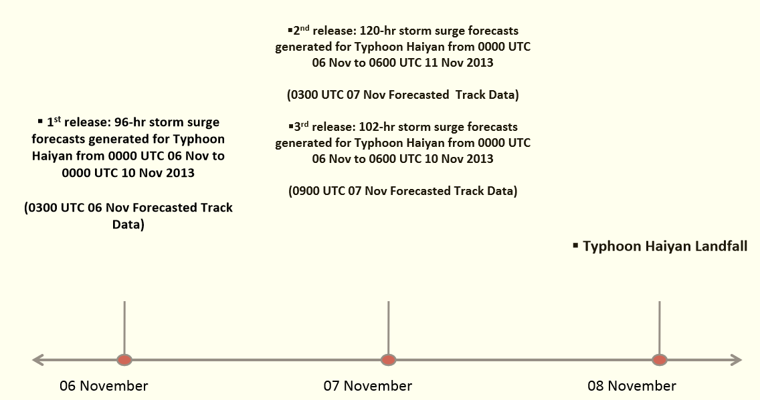

Slide 46
Groupwork -SRH Preparedness Plan
You are invited by the Department of Health to provide reproductive health technical advice.
What are 3 reproductive health specific disaster preparedness activities you will recommend?
List two reproductive health considerations in selection of evacuation centers/shelters?
List three key information that you will recommend to be shared with the community pre and after the disaster?
Will you preposition supplies? And if yes, which reproductive health kits will you preposition?
XX minutes

Slide 47
Global Efforts to Prioritize SRH in Humanitarian Settings
1979, Convention on the Elimination of All Forms of Discrimination Against Women, (CEDAW)
1994 International Conference on Population and Development (ICPD), Cairo
1995, Platform for Action, Fourth World Conference on Women, Beijing
United Nations Security Council Resolutions 1325, 1820, 1888, 1889
Reports of UN Special Rapporteurs on (1) Violence Against Women and (2) Right to Health
Inter-Agency Working Group on Reproductive Health in Crises (IAWG)
Notes:
Formal recognition that SRH is a priority in humanitarian settings has taken place over the last two decades.
Of course, the 1994 International Conference on Population and Development was a seminal moment as reproductive health became recognized as a human right. This set the stage for global recognition that, like all other human rights, this right applies to refugees, internally displaced persons, and others living in humanitarian settings. To realize this right, affected populations must have access to comprehensive SRH information and services so they are free to make informed choices about their health and well-being.
A series of United Nations Security Council resolutions have also recognized the importance of sexual and reproductive health and rights in conflict and conflict-affected settings, and addressing the gravity of sexual violence in armed conflict. The UN Security Council Resolutions 1325, 1820, 1888, and 1889 on Women, Peace, and Security affirm the unique needs, perspectives, and contributions of women and girls in conflict settings. The Security Council has recognized sexual and reproductive health, with Resolution 1889 explicitly referencing the need to ensure women and girls’ access to SRH services and reproductive rights to achieve better socioeconomic conditions in post-conflict situations.
But one of the most important efforts was the creation of the Inter-Agency Working Group on Reproductive Health in Crises (IAWG).

Slide 48
Lessons Learnt From the Field
Identify a strong and respected coordinator
Transparent collaboration facilitates implementation!
Prevention of SV requires a concerted effort, sensitivity and staff preparation
People use condoms during an emergency
Women want contraception during crisis situations
Clean delivery kits provide essential supplies for deliveries outside health facilities
Logistics preparedness is essential for prompt use of RH kits
Satisfactory implementation requires pre-planning
Onsite technical assistance for MISP implementation helps translate training into practice
“Do not wait for a crisis situation to address the MISP”
Notes:
The MISP and the RH kit have been implemented more or less successfully in many emergency settings around the world since 1996. There were quite a lot of evaluation, part of a big review in 2004 and 2014 but also in specific emergencies.
Some of the lessons learned are summarised here.

Slide 49
Key Messages
SRH needs continue and increase during humanitarian crises
Promptly meeting the SRH needs of women and girls in emergencies saves lives
The MISP is a set of life-saving activities that must be implemented with 48 hours of the onset of an emergency
The MISP is an inter-agency standard which ensures basic SRH services in crises
Transitioning to comprehensive SRH services as soon as possible is a priority

