Slide 1
Logo(s) institution(s) facilitator(s)
Addressing the needs of persons with non communicable diseases (NCD) in humanitarian crises
H.E.L.P. course
Name + organization facilitator(s)
These learning materials were prepared by
Hyo-Jeong Kim, WHO
Sigiriya Aebischer Perone, ICRC & Geneva University hospitals (HUG)

Slide 2
Objectives
Be able to
explain the importance of addressing the needs of people with non-communicable diseases (NCDs) in acute and protracted crises and the challenges to ensure their treatment and care
identify an appropriate response to treatment and care needs of people with NCDs during an acute and /or protracted crisis
H.E.L.P. course

Slide 3
What are the key characteristics of NCDs, and differences with communicable diseases?
??
H.E.L.P. course

Slide 4
What is an NCD?
Individual work, 3 minutes
Individually write on a post it note diseases included in NCDs and stick it on the flip chart
H.E.L.P. course

Slide 5
H.E.L.P. course 2019

Slide 6
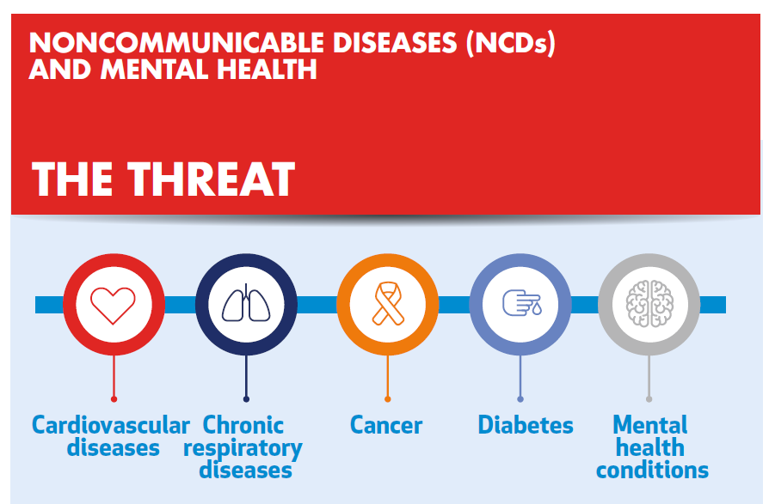
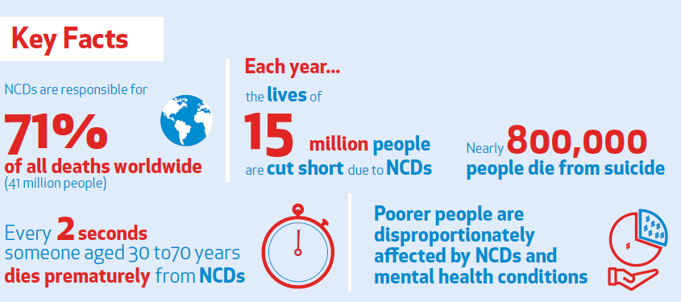
Burden of disease
H.E.L.P. course
Notes:
38 million deaths (68%) mainly due to cardiovascular diseases, diabetes, chronic respiratory diseases and cancer
Nearly ¾ in low and middle income countries

Slide 7
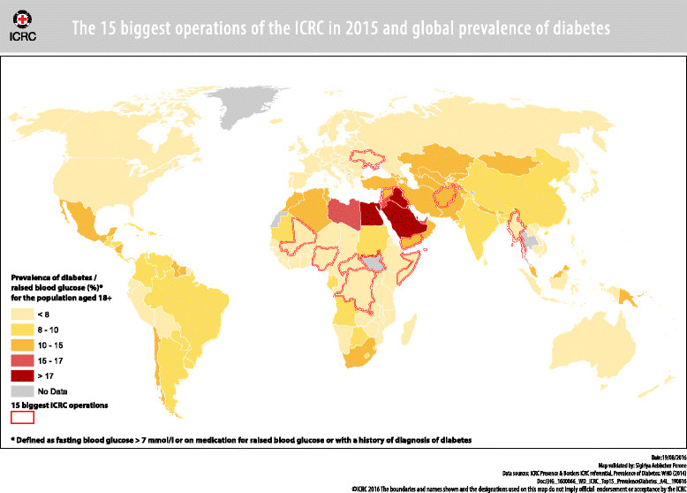
NCDs and humanitarian emergencies
H.E.L.P. course
Notes:
15 biggest operations of the ICRC in 2015 and global prevalence of diabetes

Slide 8
??
Why is it important to address NCDs in acute and protracted crisis?
H.E.L.P. course

Slide 9
NCDs in crisis situations
Prevalence of NCDs for refugees from Middle East ranges from 9-50% and for those from Africa and Asia 1-30% (Amara & Aljunid,2014)
50% of Syrian refugee households in Jordan reported a member with a NCD
85% of Syrian refugees with NCDs sought care (Doocy et al, 2015)
Of the Syrian refuges over 60 years in Lebanon:
60% Hypertension
47% Diabetes
30% Heart disease
11% Lung disease
6% Renal disease
74% dependent on humanitarian assistance (Strong et al, 2015)
In 2012, 46% of all adult deaths in Syria were attributable to NCDs (Collins et al, 2017)
H.E.L.P. course
Benjamin J. Ryan, Asia-Pacific Center for Security; H.E.L.P. course 2018

Slide 10
NCDs in crisis situations
Hurricane Katrina (USA 2005): 33% of people exhibited symptoms of NCD exacerbation when arriving in a shelter (Evans 2010)
Cancer related deaths 19% increase in:
Hurricane Iniki (Hawaii 1992) – in the 12 months after (Hendrickson 1997
Florida (2004) –during the weeks after four hurricanes (McKenney 2011)
Cancer treatment services decreased by 33% one year after Hurricane Katrina (USA 2005) (Brown 2008)
Diabetes related deaths accounted for 5% of excess deaths –Florida 2004 (four hurricanes) (Brown 2008)
In three months after the 2011 Great East Japan Earthquake, mortality for people of 60 years on dialysis increased by 41%, cardiovascular diseases 33% and heart diseases 37% (Uchimura et al 2014)
H.E.L.P. course
Benjamin J. Ryan, Asia-Pacific Center for Security H.E.L.P. course 2018

Slide 11
Why are NCDs important?
Basic health need
Changing burden of disease on affected population
Pre-existing health problems exacerbated
Double burden of disease
Traditional focus on communicable disease
H.E.L.P. course
Demaio et al 2013, Hayman KG 2015, Besançon et al 2015, Spiegel et al 2010

Slide 12
NCDs = chronic conditions, continuum of care challenges in fragile environments
H.E.L.P. course
Non communicable diseases in emergencies WHO/NMH/16.2
Notes:
Continuous care over time (lifelong)
Often require ongoing treatment with medicine, medical technology or appliance
Can have acute complications
Can reduce people’s ability to cope with emergencies
Necessitate coordination of care, follow-up between different providers and settings
May be associated with the need of palliative care
Often only 1 patient encounter
Challenges related to access due to security, safety issues
Lifelong treatment
Adherence to treatment and change of medication

Slide 13
Continuity is key…
Continuity of prevention and care is essential for NCD management, but how to ensure this in a humanitarian context?
General Population
At risk, e.g. overweight, obese
At risk, high blood pressure
Undiagnosed NCD
NCD related complication
Death
Person with an NCD
H.E.L.P. course
Without NCD | With NCD
D. Beran
Notes:
Palliative care

Slide 14
What type of assessments would you need to conduct?
??
Where would you find the information, and what type of information would you need?
H.E.L.P. course

Slide 15
Assessment for NCDs
Sources of data
Primary data sources
Secondary data sources
Types of data
Health sector data
Non-health sector data
Areas of focus
Burden of disease
Capacities (including task shifting)
H.E.L.P. course

Slide 16
??
Why do you need to prioritize, and how can you prioritize?
Why is this necessary for NCD management in humanitarian settings?
H.E.L.P. course

Slide 17
Prioritization Criteria
Suggested to agree on a list of prioritization criteria for health activities/projects together with health partners.
This allows partners to agree on context specific criteria to prioritize activities and areas of work in the response
Why?
Focus on key identified needs
Guides allocation of resources
H.E.L.P. course

Slide 18
Example of prioritization criteria: Strategic Response Plan (SRP))
Most life-saving
Time critical
Critical Enabling
H.E.L.P. course
Notes:
Interventions during acute crises
Patients with acute condition s that need immediate care and / or rapid referral
Patients that can progress to rapid deterioration or complications if proper care is not provided in a timely manner
Patients with stable conditions and without symptoms , who primarily need continuation of treatment
Interventions during protracted crises: As for acute crisis plus extend care to patients with NCDs not covered in the acute phase and to prevention.

Slide 19
Other prioritisation criteria
Available resources
Crisis context
Evidence of need and gaps: Disease profile
Thresholds and indicators
H.E.L.P. course

Slide 20
Prioritization Criteria
Context
Conflict setting, both internal and international
Different health issues identified among the displaced population, including low immunization rate, NCDs (esp. diabetes),
Number of displaced population expected to grow, especially of women and children
You are convinced management of NCDs is of critical concern within this context and would like to include NCD management as part of the health cluster response plan. However, the HCT is not convinced and would liked further justification.
Group work, 20 minutes
Discuss how to justify management of NCDs as a priority in the humanitarian response plan.
H.E.L.P. course
Notes:
Check against model actually used!!!!!

Slide 21
Ethical implications
??
What are some of the ethical dilemmas you may face when prioritizing interventions on NCDs?
H.E.L.P. course

Slide 22
Different ethical questions
Screening
Haemodialysis
Referral vs no-referral, and links with palliative care
Beyond the three (COPD; Hypertension; Diabetes) – cancer, rheumatism /pain management etc.?
Ensuring quality of care, including access to quality drugs
Patient adherence to treatment, including issues around selection of drugs
Patient data management
H.E.L.P. course
Notes:
Yes/no carrying out active case finding: To be considered only for high risk patients in order to improve their management
Importance of confidentiality of personal data (e.g. people known with certain NCDs may not be accepted easily for relocation to a 3rd country

Slide 23
Different ethical questions
Screening
Haemodialysis
Group work:
In groups A & C, you will discuss why screening (Group A) or hemodialysis (Group C) needs to be done.
In groups B & D you will discuss why these should not be done.
You will have 10 minutes to prepare.
After, there will be a 10 minutes debate on each topic.
H.E.L.P. course

Slide 24
Prevention vs Management
VS
General approach to NCDs in non-humanitarian settings focuses primarily on changing life style and preventing having an NCD condition and/or preventing exacerbation of NCD conditions
In humanitarian settings the focus is primarily on managing NCDs, but prevention should not be forgotten and is sometimes possible, especially in protracted emergency settings
H.E.L.P. course

Slide 25
H.E.L.P. course
Notes:
Movie that shows the Non-Communicable Diseases Framework -> click at the lower part of the slide

Slide 26
Minimal package
Integrated into health system
Diagnostic tools
Treatment, medicines
Patient education
Patient follow-up
Referral system
Monitoring
Advocacy, mobilisation
H.E.L.P. course
Notes:
Diagnostic tools: clinical/biological cf WHO NCD kit
Treatment: basic drugs and devices (cf WHO), supply chain, contingency stock protocols (country > WHO/MSF…)
Patient education selfmanagement prevention of complications nutrition, physical activity, orthotic devices adherence
Patient follow-up referral system, knowledge of existing structures medical file: for patient / health structure
Referral system
Data collection follow-up, monitoring
Advocacy funding. National level, international organisations, private…

Slide 27
3 crisis types, 3 crisis contexts
Armed conflict <–> Middle East region
Disease outbreak: Ebola <–> Africa region
Natural disaster <-> Western Pacific region
Group work 30 minutes
Form 3 groups, list answers specific to the identified challenges of the context, use the 10 questions to guide your intervention
H.E.L.P. course

Slide 28
Questions to inform the intervention: Question 1-5
What are the existing capacities of the local health system?
Which NCDs to address?
Who is the target population?
What kind of interventions to ensure continuum and continuity of care?
Which algorithms or guidelines to use?
H.E.L.P. course
Aebischer Perone S. et al 2017

Slide 29
Question 6-10
What medications to integrate in the basic essential drug list?
What are the ethical implications?
How to ensure accountability to patients?
How to monitor interventions?
What to do beyond provision of health services for “classical” NCDs?
H.E.L.P. course
Aebischer Perone S. et al 2017

Slide 30
Country affected by a crisis due to armed conflict Middle East
10 top causes of death before conflict: ischemic heart disease (leading cause of death), stroke, DM accounting for > 50% of mortality
Probability of dying between 30 and 70 from the 4 main NCDs 24% (9% in CH)
Health structures: destruction, looted, inaccessible, remaining absorb caseload 2-3x > capacity
Shortage in HR (4.5 doctors/10’000); shortage in medicines
State not able to sustain health system
H.E.L.P. course

Slide 31
Country affected by a crisis due to armed conflict Middle East
Population: host population, refugees, IDPs
90% IDP outside camps, depend on health system
Government: salary cuts and delay in pay
MoH: no NCD department, strategy, monitoring & surveillance
PHC: newly graduated doctors
Referral for NCDs to specialized clinics
H.E.L.P. course
Notes:
Syria 7.5 mio displaced, 4 mio need of care
30 mobile clinics, ambulances
Health facilities: medical supplies
NCD action plan

Slide 32
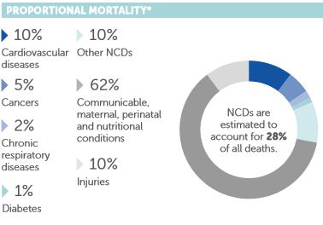
Country affected by Ebola –Africa
10 top causes of death: Acute communicable diseases (30%), Stroke (4%), Tuberculosis (4%), HIV/AIDS (3%),
Probability of dying between 30 and 70 from the 4 main NCDs 20% (9% in CH)
Prevalence of HTA 22%, DM 4%
Weak health system
Shortage in HR < 3/10’000
H.E.L.P. course
Notes:
Higher risk of developing NCDs in Africa region: Brazzaville, 19 December 2016 – With millions of people in Africa predicted to die from non-communicable diseases (NCDs) by 2020, the World Health Organization (WHO), African Region has supported countries to carry out surveys to identify the main causes of this rising trend.
According to a report released by the Organization, that consolidates available data, these impending threats can be predicted because most adults in Africa have at least one risk factor that increases their chances of developing a life-threatening NCD, including heart disease, cancer, type 2 diabetes and chronic obstructive lung disease.
The ECHO report proposes a range of recommendations for governments aimed at reversing the rising trend of children aged under 5 years becoming overweight and obese. At least 41 million children in this age group are obese or overweight, with the greatest rise in the number of children being obese or overweight coming from low- and middle-income countries.

Slide 33
Country affected by Ebola -Africa
Shortage in medicines: 3/10 essential NCD medicines available
Shortage in diagnostic tools: 2/6 available
Risk of closed border during outbreak
Fear of population getting infected, lack of trust
H.E.L.P. course
Notes:
Risk communication

Slide 34
Confirmed and probable Ebola virus disease cases by week of illness onset by health zone. Data as of 30 April 2019*, WHO
H.E.L.P. course

Slide 35
Country affected by a natural disaster Western Pacific
NCDs are the leading causes of death and disability in the Region, responsible for 80% of all deaths
10 top causes of death: ischemic heart disease (leading cause of death)(15.4%), stroke (11.1%), DM (5.9%) accounting for 45% of mortality
Probability of dying between 30 and 70 from the 4 main NCDs 28% (9% in CH)
H.E.L.P. course

Slide 36
Country affected by a natural disaster Western Pacific
Wide spread devastation
Power interruptions, landslides and flash floods
Major roads blocked by trees, and impassable
International airline flights cancelled. Some airports also closed
Disruption of access to and delivery of essential interventions, including medicines
H.E.L.P. course
Notes:
Temporary health facilities, tents
Deployment of health professionals close by
Stockpiling of medicines, colour coded food packs according to patients conditions
Transfer out of patient for secondary care – medevac
Emergency kits of medicines, support from other municipalities
Simplified guidelines
Deployment of PEN:
training health providers,
providing essential tech
Emergency kits in region
Number of consultations: high BP, asthma, diabetes

Slide 37
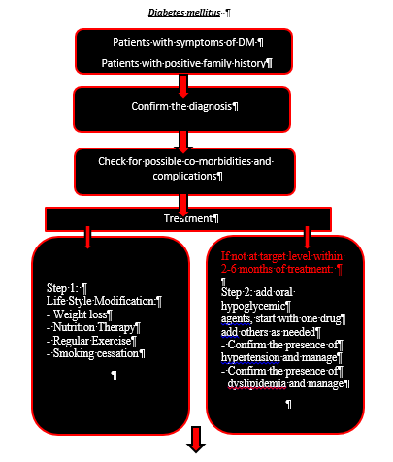
Country affected by a crisis due to armed conflict Middle East
Mobile clinics, ambulances, organising transport
Health facilities (all levels of care):
Medical supplies, devices (IEHK)
Essential medicines – supplies patient/facility
Cold chain
Follow-up? Patient file
Training, task shifting/sharing
NCD action plan: simplified guidelines
Community
H.E.L.P. course
Iraq MoH, WHO

Slide 38
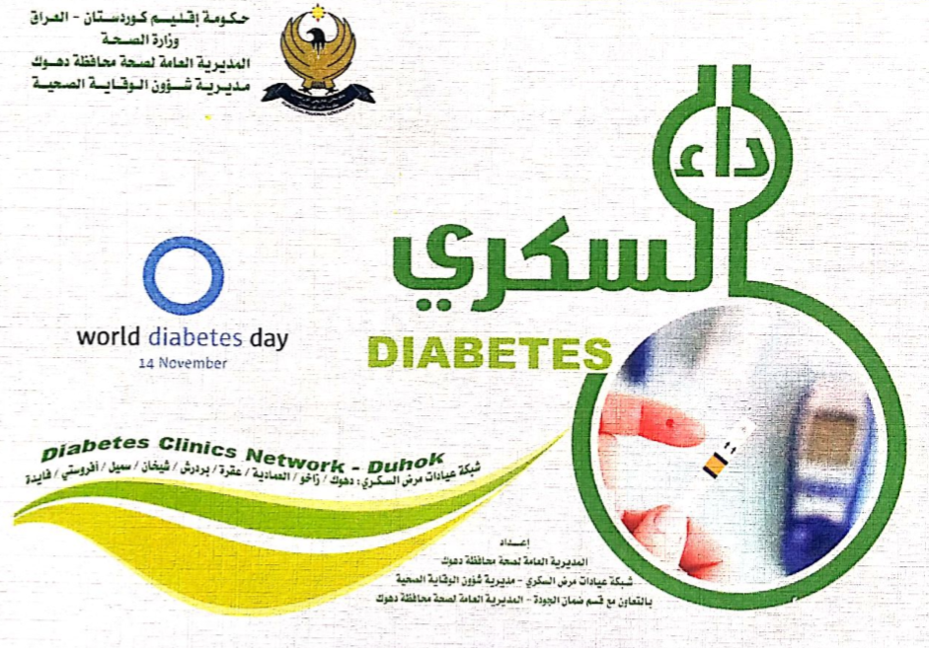
H.E.L.P. course

Slide 39
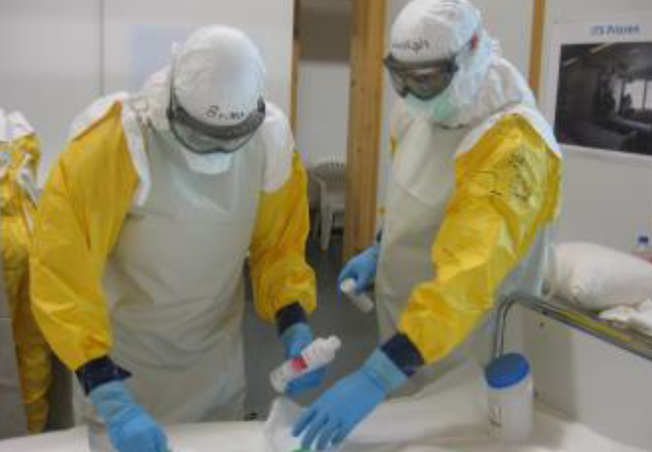
Country affected by Ebola -Africa
Prevention and control
Reducing the risk of wildlife-to-human transmission
Reducing the risk of human-to-human transmission
Reducing the risk of possible sexual transmission
Outbreak containment measures
H.E.L.P. course
Notes:
Reducing the risk of wildlife-to-human transmission from contact with infected fruit bats or monkeys/apes and the consumption of their raw meat. Animals should be handled with gloves and other appropriate protective clothing. Animal products (blood and meat) should be thoroughly cooked before consumption.
Reducing the risk of human-to-human transmission from direct or close contact with people with Ebola symptoms, particularly with their bodily fluids. Gloves and appropriate personal protective equipment should be worn when taking care of ill patients at home. Regular hand washing is required after visiting patients in hospital, as well as after taking care of patients at home.
Reducing the risk of possible sexual transmission, based on further analysis of ongoing research and consideration by the WHO Advisory Group on the Ebola Virus Disease Response, WHO recommends that male survivors of Ebola virus disease practice safe sex and hygiene for 12 months from onset of symptoms or until their semen tests negative twice for Ebola virus. Contact with body fluids should be avoided and washing with soap and water is recommended. WHO does not recommend isolation of male or female convalescent patients whose blood has been tested negative for Ebola virus.
Outbreak containment measures, including prompt and safe burial of the dead, identifying people who may have been in contact with someone infected with Ebola and monitoring their health for 21 days, the importance of separating the healthy from the sick to prevent further spread, and the importance of good hygiene and maintaining a clean environment.

Slide 40
Country affected by Ebola - Africa
Preparedness: triage, HR, infrastructure, medicines, diagnostic tools prepositioning, stock, referral
Test contingency plan
Inform authorities about contingency plan (security, crowd control)
Community awareness raising
Communication: TV, radio
Contingency package for stable patients, train on self-management
Training of community health workers, follow-up, triage
Ideally phone consultations
H.E.L.P. course

Slide 41
Country affected by Ebola -Africa
Systematic screening, infection prevention and control measures
Protective equipment for health staff
Combined care for HIV/AIDS or TB and other chronic conditions
Gain of efficiency of services
Multidisciplinary approach
Same skills for lifelong treatment of HIV/AIDS and diabetic care
H.E.L.P. course
Bulletin of the World Health Organization 2007;85:880–885.

Slide 42
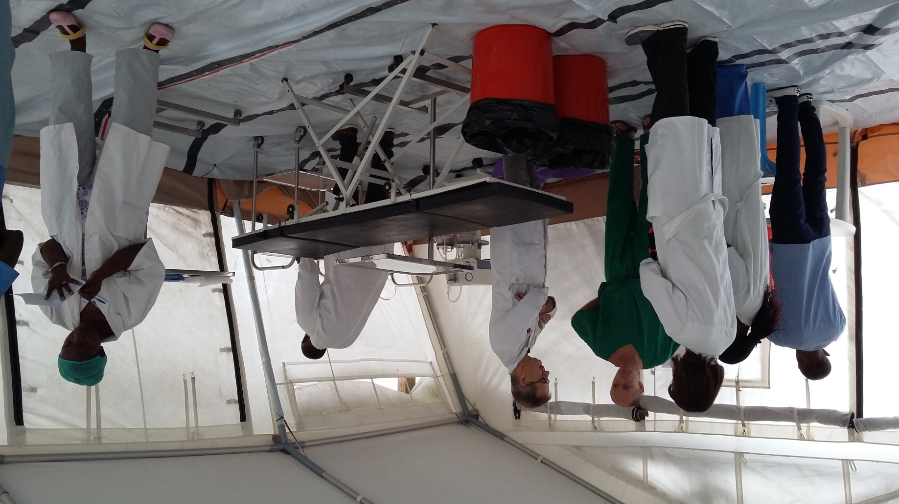
Ebola –Africa region Setting up a controlled ER/OT with specific SOP
ICRC pictures
Exit patient
Waiting/awaking area
H.E.L.P. course
Entry staff
Dressing staff
Dressing - undressing area
Entry Patient
ER
OT
Exit staff
Decon
Undressing Staff
Notes:
Describing the need for a separate ER with specific procedures in order to confine contamination

Slide 43
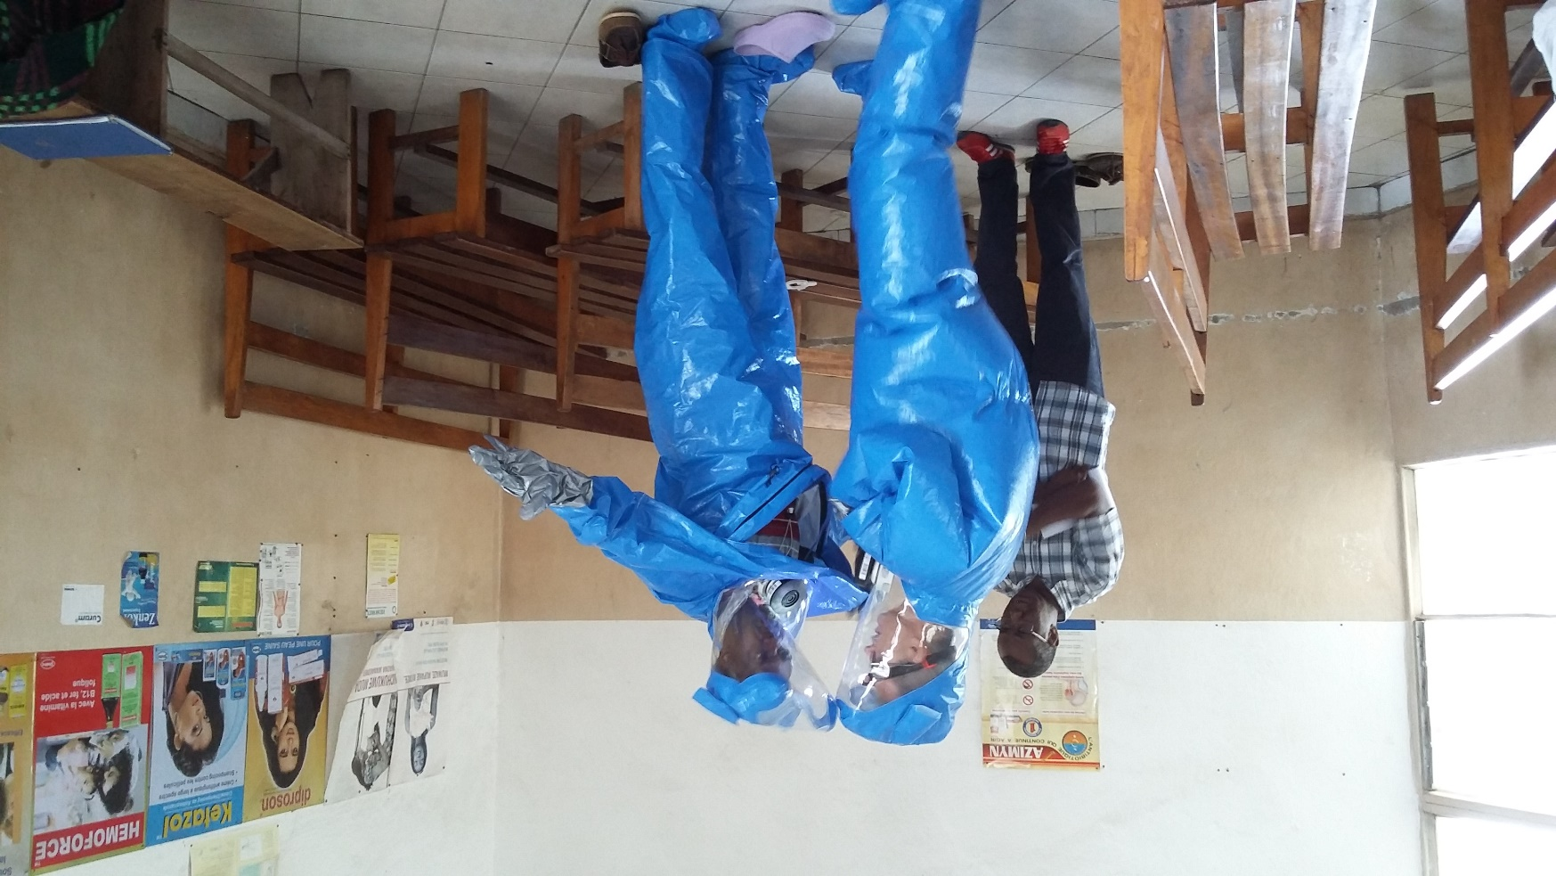
Protective personal equipment (PPE) training and buddy check
H.E.L.P. course
© ICRC
Notes:
Training for the essential staff

Slide 44
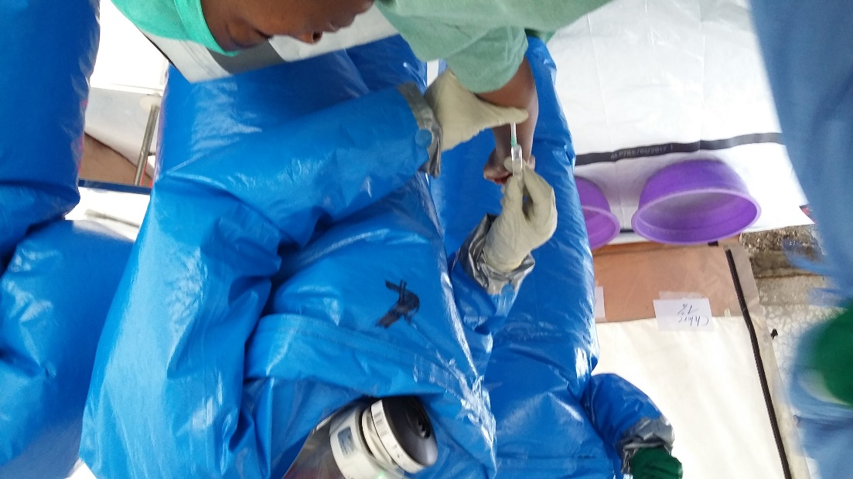
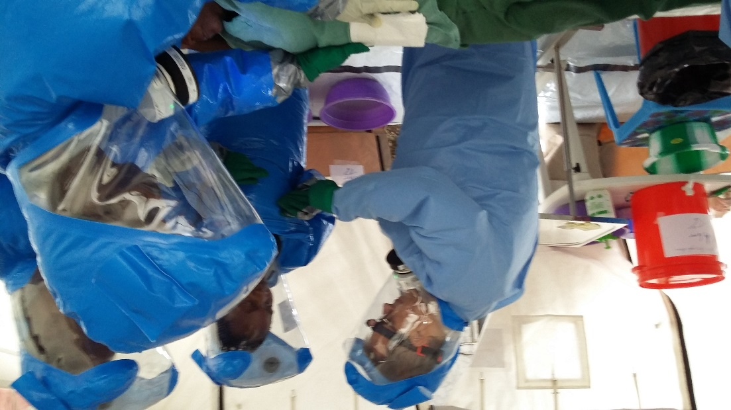
Adapting to do normal work in PPE
ICRC pictures
H.E.L.P. course
The SOPs and PPE allow to save a life while waiting for EBV confirmation
Notes:
Team practicing in the ER as if it was a normal day

Slide 45
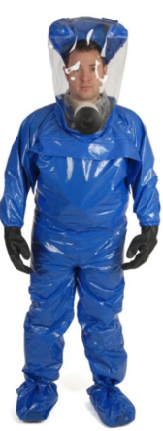
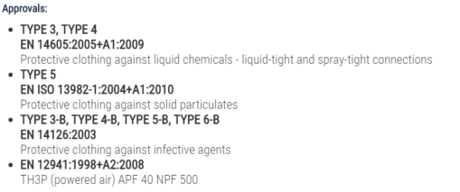
Challenges whilst responding to during and ebola outbreak
ICRC lessons learn from challenges in previous deployments:
Export/End user licensing
Use of glasses or scarfs
Need for better vision and eye contact with victims
Need to be able to perform precise actions
Need for better communication
H.E.L.P. course
Notes:
Technical requirements needed reduce the choice in equipment, export licensing should not be an additional limitation

Slide 46
Controlling infection in health-care settings
Health-care workers should always take standard precautions when caring for patients, regardless of their presumed diagnosis. These include basic hand hygiene, respiratory hygiene, use of personal protective equipment (to block splashes or other contact with infected materials), safe injection practices and safe burial practices.
Health-care workers caring for patients with suspected or confirmed Ebola virus should apply extra infection control measures to prevent contact with the patient’s blood and body fluids and contaminated surfaces or materials such as clothing and bedding. When in close contact (within 1 meter) of patients with EBV, health-care workers should wear face protection (a face shield or a medical mask and goggles), a clean, non-sterile long-sleeved gown, and gloves (sterile gloves for some procedures).
H.E.L.P. course

Slide 47
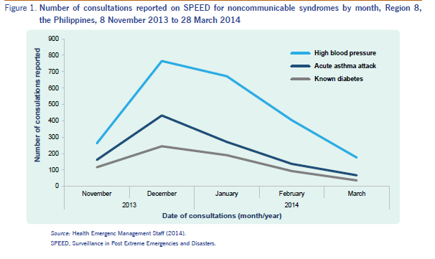
Country affected by a natural disaster Western Pacific
Temporary health facilities, tents
Deployment of health professionals close by
Stockpiling of medicines, colour coded food packs according to patients conditions
Transfer out of patient for secondary care – medevac
Emergency kits of medicines, support from other municipalities
Simplified guidelines
Deployment of PEN:
training health providers,
providing essential tech
Emergency kits in region
H.E.L.P. course

Slide 48
Country affected by a natural disaster Western Pacific
Preparation for natural disasters critical: kit ready, water proof, copies of medical info, early evacuation
Abrupt change in dietary intake leading to severe hypo and hyperglycemia
Trucking supplies; syringes, insulin; mobilization of volunteers to bring supplies to shelters
Connection with Facetime to answer questions of persons in shelters
Resources in different languages
Need of switching insulin documents, reviewed by ADA August 2018 (diabetesdisasterresponse.org)
Whatsapp and text version
Connecting with Association of family physicians
H.E.L.P. course

Slide 49
Emergency preparedness
H.E.L.P. course
Allweiss P., Albright A. Diabetes, disasters and decisions. 2011. www.futuremedicine.com

Slide 50
Emergency preparedness
H.E.L.P. course
Diabetes Disaster Response Coalition 2018

Slide 51
Items for DM emergency kit
H.E.L.P. course
Allweiss P., Albright A. Diabetes, disasters and decisions. 2011. www.futuremedicine.com

Slide 52
Food emergency kit for persons with DM
One large box of unopened crackers (saltines)
One jar of peanut butter
One small box of powdered milk (or milk that does not need refrigeration)
One gallon of water per day per person for at least 1 week
Two packages of cheese and crackers or one jar of soft cheese
One package dry, unsweetened cereal or single serving boxes
Six cans of sugar-free soda
Six pack of canned fruit juice or sports drink
Cans of tuna, salmon, chicken and nuts
Can opener
H.E.L.P. course
Allweiss P., Albright A. Diabetes, disasters and decisions. 2011. www.futuremedicine.com

Slide 53
Conclusion / Guiding principles
Ideally integrated into existing health system
Diagnostic tools
Treatment, medicines
Patient education
Patient follow-up
Referral system
Monitoring
Advocacy, mobilisation
H.E.L.P. course

Slide 54
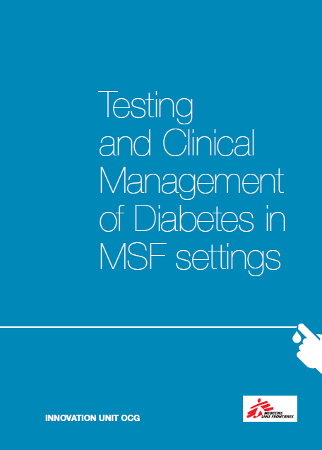
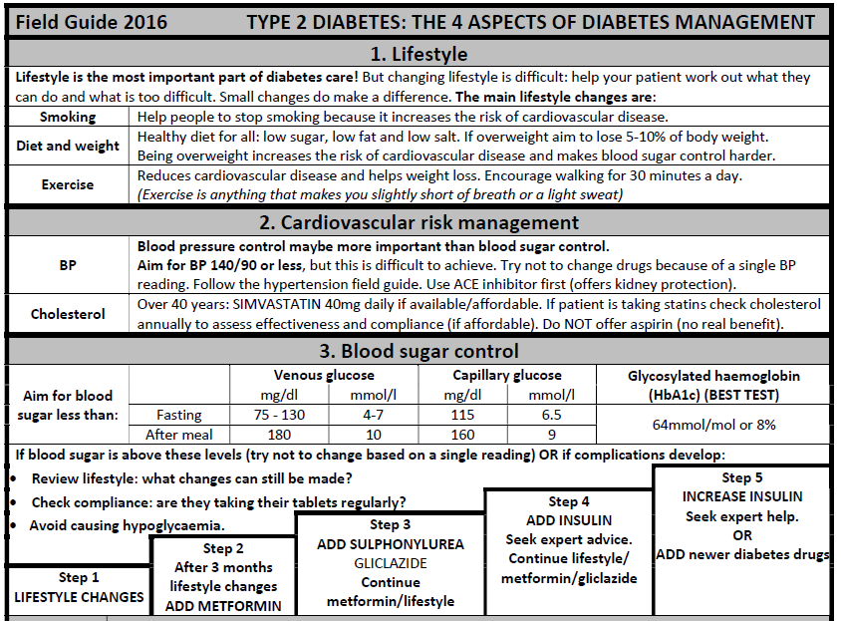
Protocols MoH, PEN, PCI, MSF
H.E.L.P. course

Slide 55
Follow-up
H.E.L.P. course

Slide 56
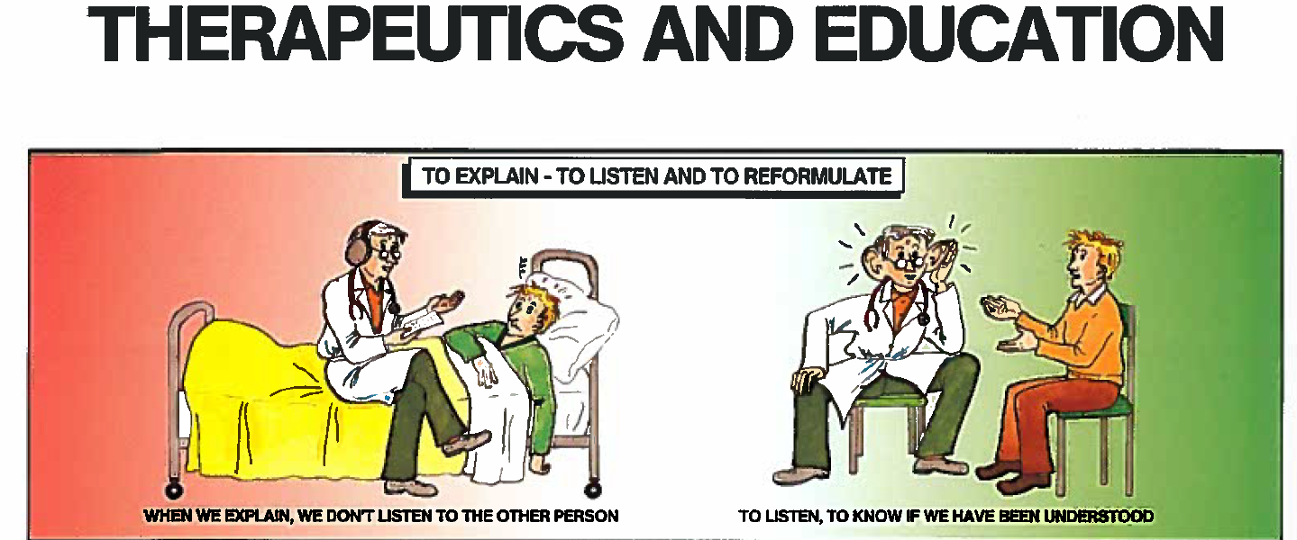
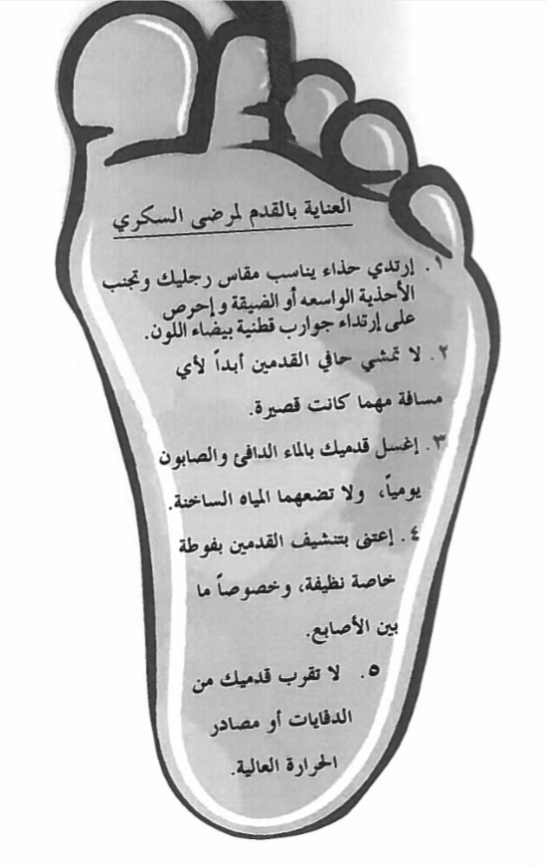
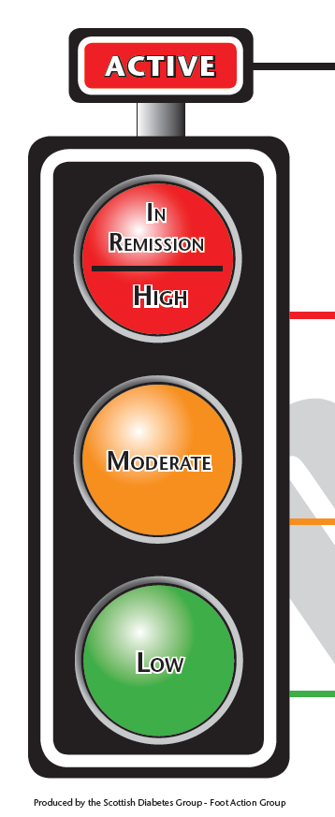
H.E.L.P. course

Slide 57
Multiple actors – continuity, coordination
Local authorities /Ministry of health
(RC/RC)
(NGOs)
H.E.L.P. course
Private sector
Physician associations
Patient associations
Etc.…..

Slide 58
Conclusions / Guiding principles
NCDs contribute heavily to morbidity and mortality in crisis settings
Assessment and prioritization of NCDs in acute and protracted crises is critical to ensure the issue is fully addressed
NCDs are a complex and complicated issue, that requires attention in the following aspects in operations:
Choice of type and level of intervention
Access to services, medication, and referral
Patient registration, follow up
HR training and task shifting
It is important to consider ethical dilemmas linked to NCDs
H.E.L.P. course

Slide 59
References
Demaio A, Jamieson J, de Courten M, Tellier S. Non-communicable diseases in emergencies: A call for action-PLOS Currents Disasters 2013
ICRC. Non communicable diseases in health interventions, guiding principles, ICRC 2012
Mendis S et al. Gaps in capacity in primary care in low resource settings for implementation of essential non-communicable disease interventions. International J of hypertension 2012
Aebischer Perone S, Beran D. Modifying the Interagency Emergency Health Kit to include treatment for non-communicable diseases in natural disasters and complex emergencies: the missing clinical, operational and humanitarian perspectives. BMJ Global Health. 2017, 2(1), e000287.
UNIATF UN interagency task-force on the prevention and control of non-communicable diseases. Non communicable diseases in emergencies. WHO/NMH/NVI16.2
H.E.L.P. course

Slide 60
References
Ruby A, Knight A, Perel P, Blanchet K, Roberts B. The effectiveness of interventions for non-communicable diseases in humanitarian crises: A systematic review. PLOS ONE Sept 25, 2015
Sphere Project. Sphere handbook. Geneva: 2011: Essential health services – non communicable diseases
Spiegel PB, Checchi F, Colombo S, Paik E. Health-care needs of people affected by conflict: future trends and changing frameworks. Lancet 2010:375:341-45
Aebischer Perone S, Martinez E, du Mortier S, Rossi R, Pahud M, Urbaniak V, Chappuis F, Hagon O, Jacquerioz Bausch F, Beran D. Non-communicable diseases in humanitarian settings: ten essential questions. Conflict and Health 2017, 11:17
H.E.L.P. course

