Slide 1
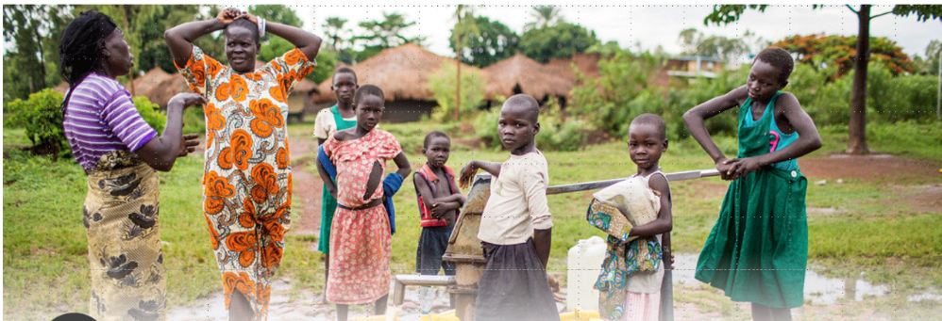
Logo organization(s) facilitator(s)
Communicable diseases:
Diarrhoeal diseases; cholera
H.E.L.P. course
Name(s) + organization(s) facilitator(s)
These learning materials were developed by
Kate Alberti, WHO Cholera Team

Slide 2
Objectives
To be able to
explain the importance of diarrheal diseases during crisis situations and describe causal factors
identify an appropriate response to control cholera in acute and protracted crisis situations
H.E.L.P. course

Slide 3
Diarrhoeal diseases
Affect people of all ages; children however the most vulnerable
Globally 1.7 billion cases of childhood diarrhoeal diseases every year
Malnourished people and those with impaired immunity at high risk of life threatening diarrhoea
Leading cause of malnutrition in children under five
Globally 2nd cause of death in children under five: ≈ 525’000/ year
May represent up to 40% of consultations in IDP camps
H.E.L.P. course
Notes:
In refugee camps in Syria, Jordan and Iraq, diarrhoeal diseases were the 2nd cause of consultation for children under the age of five –Source: UNHCR quarter 1-3, 2013
For information the leading cause of death in children under 5 is pneumonia.

Slide 4
??
How do we define diarrhoea
The passage of three or more loose or liquid stools per day (or more frequent passages than is normal for the individual). Frequent passing of formed stools is not diarrhoea, nor is the passing of loose, ‘’pasty’’ stools by breastfed babies
It is usually a symptom of an infection in the intestinal tract, which can be caused by a variety of organisms
H.E.L.P. course
Notes:
This is a hidden slide -> I propose to remain it like this

Slide 5
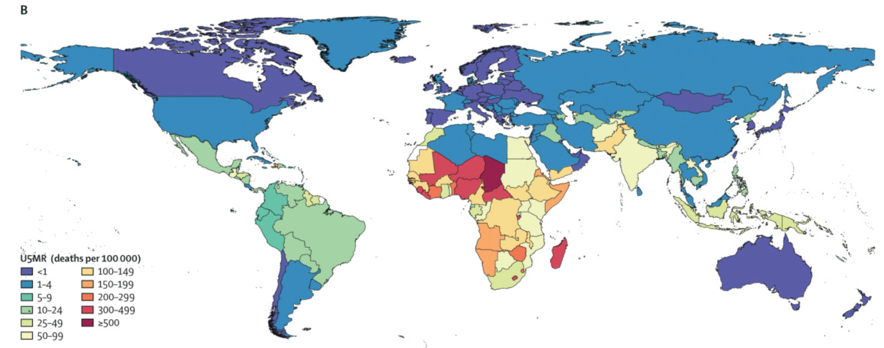
Diarrhoeal diseases: U5MR (death per 100’000), 2016
H.E.L.P. course
Source: The Lancet Infectious diseases, Volume 18, Issue 11, p 1211-1228, Nov. 01 2018
Notes:
Diarrhoeal diseases affect people of all ages throughout the world. Children however, are the most vulnerable; diarrhoea is the second leading cause of death worldwide in children under five years old,
Note: The information above is correct, but it needs to be in context that this is the baseline, therefore if an crisis occurs in these countries diarrhoeal disease will represent a large proportion of consultations.

Slide 6
Diarrhoeal diseases
??
What is the route of transmission:
Faecal oral
??
What is the main threat for people with diarrhoea:
Dehydration
H.E.L.P. course
Notes:
This slide is meant as a quick reminder for the participants, not to go in detail as faecal oral transmission was discussed during the module Public Health Engineering

Slide 7
Examples of the spectrum of diarrheal diseases include
Bacterial
Campylobacter
Cholera
ETEC
Shigellosis
Viral
Rotavirus
Noroviruses
Parasitic
Amoebic dysentery
Cryptosporidium
Giardia
H.E.L.P. course
??
Which two are the most frequent
Which two require specifically attention
Notes:
It is not the idea to spend much time on this slide but rather to show the variety of diarrhoeal diseases before moving on the focus of this module, cholera outbreaks. So, I would suggest the below:
Leading causes are Rotavirus and ETEC
It is important to note that in crisis settings, there are numerous aetiologies for the diarrhoeal disease that will be seen in both outpatient and inpatient treatment facilities. Rotavirus is prevalent in children in many of these settings.
We will focus the rest of this session on cholera as it is causes the most epidemics.
Although there have been large epidemics of Shigella dysenterae 1 in the past, including in Goma in 1994, none have been reported now for more than a decade.

Slide 8
Three clinical types of diarrhoea
Acute watery diarrhoea | Last several hours or days, and includes cholera
Acute bloody diarrhoea | Also called dysentery
Persistent diarrhoea | Last 14 days or longer
H.E.L.P. course
Notes:
This is a hidden slide -> I propose to remain it like this

Slide 9
Diarrhoeal Disease of Epidemic Potential:
Cholera
H.E.L.P. course
Notes:
The rest of the module will focus on cholera as you are most likely to be asked to be part of or lead a response to a cholera epidemic.

Slide 10
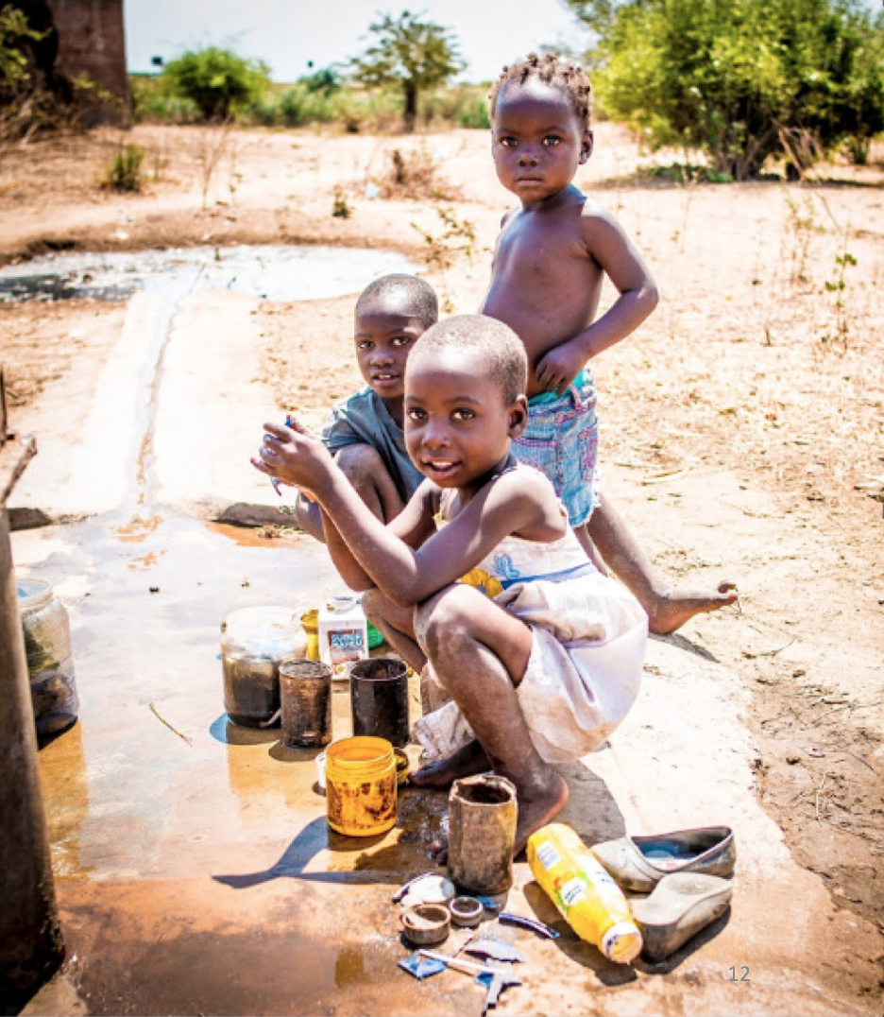
Cholera kills an estimated 95 000 people per year and sickens more than 2.9 million
H.E.L.P. course

Slide 11
H.E.L.P. course
Notes:
It may be interesting to ask what these are and why they are used.
They are cholera beds that are used with a plastic bucket under the hole (as seen on the right) and usually a second plastic bucket near the head of the patient. These are for stool and vomit. Patients with severe forms of cholera pass large volumes of fluid (as much as 10 to 20 litres of fluid per day) and are frequently too weak to walk to the toilet.
In a previous course a participant commented that there are no curtains between the beds for privacy. This is a good comment and can open a short discussion on the need to have separate rooms/facilities for men and women and the need to, as much as possible, maintain dignity.

Slide 12
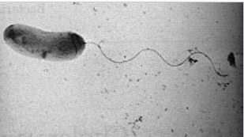
Cholera
A bacterial infection caused by toxigenic Vibrio cholerae O1 or O139
Transmitted by faecal-oral route
Incubation period 1-5 days
Causes acute watery diarrhoea and sometimes vomiting
Severe forms lead to severe dehydration and potentially death within hours if untreated
Can cause large epidemics with a major impact on communities
H.E.L.P. course

Slide 13
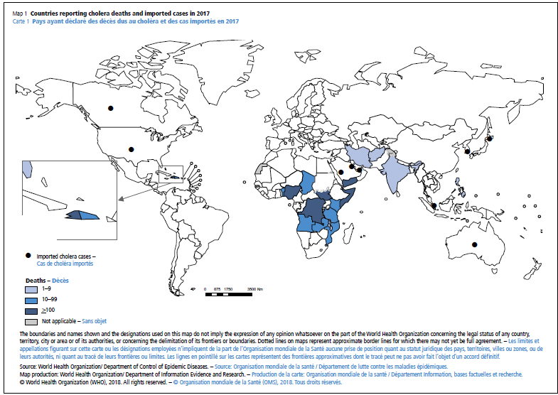
H.E.L.P. course
Source: WHO Weekly Epidemiological Record, 21 September 2018
Notes:
The map of cholera is essentially a map of poverty and lack of access to clean water and adequate sanitation.
Other factors that contribute to cholera deaths include delayed seeking of treatment and lack of access to health care (often in remote/rural) areas.
In addition, several of the countries where cholera deaths are reported are countries affected by armed conflict and / or floods. This adds a layer of complexity for the cholera control. A cholera outbreak may become a crisis within an already ongoing crisis.
Most countries in Europe and North America had cholera epidemics in the past, but access to clean water and sanitation systems means cholera epidemics are now a thing of the past, even when cases are imported, there is no spread of the disease.
Indicate countries is which major outbreaks of cholera have taken place in the last year(s)
It may be interesting to point out that not all countries report cholera. There have been issues in the past that lead to countries to not report cholera or to severely underreport for political and/or economic reasons. For example, some countries have refused to import products such as shrimp or cut flowers from countries reporting cholera. This type of refusal has had major economic impacts on the exporting country and they therefore stopped reporting cholera for many years. Participants may know examples of this. Recently however, a number of countries who have not reported cholera for many years are again reporting cholera (Ethiopia and Sudan both reported cholera in 2018).

Slide 14
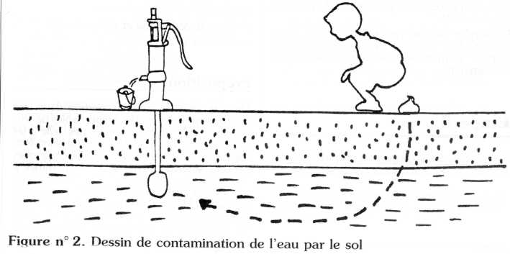
Methods of control are well known
H.E.L.P. course
Source: Belec M, Hentgen V, Jauréguiberry S. Maladies du péril fécal et leur prévention. Développement et Santé. n°148,149, 150, août, octobre, décembre 2000
Notes:
The simple explanation is stop feces infected with V. cholerae from being ingested by humans.

Slide 15
F-Diagram for water, sanitation and hygiene interventions
Fluids
Fingers
Reservoir
Faeces
Food
New Host
Flies
Secondary barrier
Primary barrier
Field
H.E.L.P. course
Sanitation
Water Quality
Hygiene
Notes:
You saw this diagram earlier in the course the Public Health Engineering module. It is applicable for cholera control showing both where transmission can occur and also how to stop the transmission.
You can clearly see the importance of having adequate sanitation, proper hygiene practices and adequate quantity and quality of water to ensure health benefits.

Slide 16
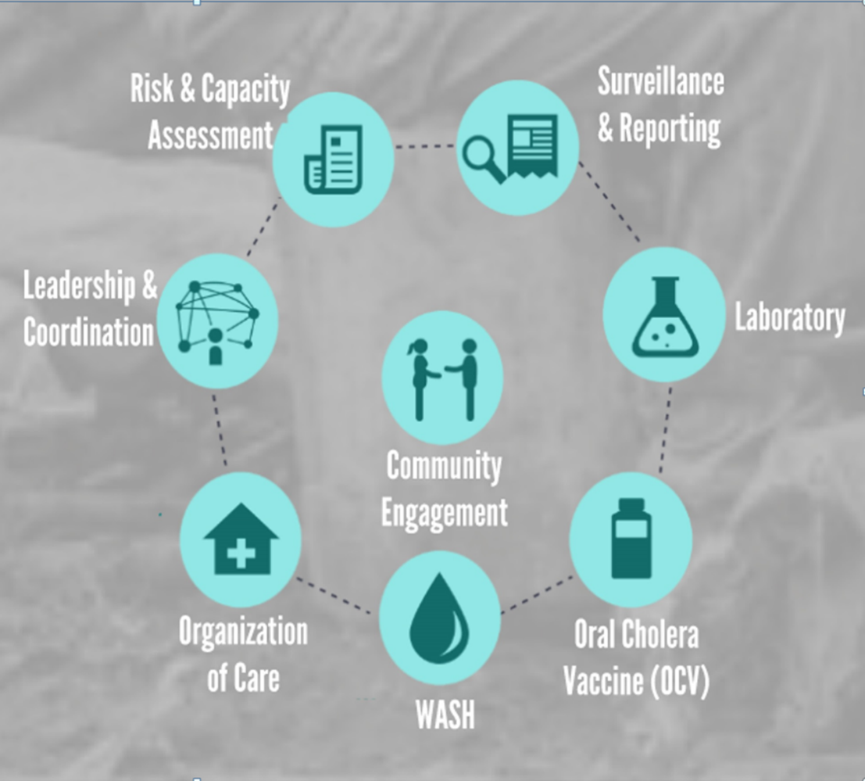
Cholera control is multi-sectorial
H.E.L.P. course
Notes:
Cholera control must be multisectoral with all of the above components. It is important that a multisectoral coordination mechanism be put into place as soon as possible.

Slide 17
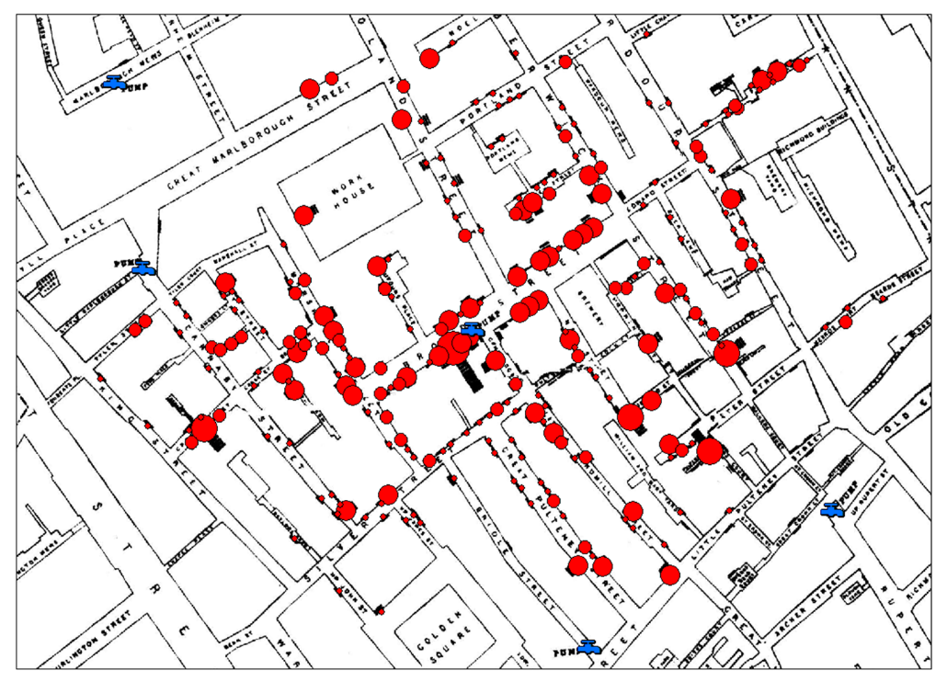
Surveillance
Cholera is often part of surveillance for diseases of epidemic potential (EWARS)
Time, place, person
Data must be shared with all sectors in order to orient activities in a timely manner
Collect data on and analyse by residence of patients whenever possible
H.E.L.P. course
Notes:
Surveillance was discussed earlier during the course, so I won’t go over it again. However, the last two points here are key. All sectors need detailed epidemiological data analysis in order to target their actions to control and prevent cholera. For example, water, sanitation and hygiene actions may be targeted to the household level in which case household level information should be shared on a daily basis. In other contexts, neigbourhood analysis may be sufficient. It is important to establish systems to share data with all sectors on a daily basis.
Some people may recognize this map as one of the John Snow maps from the cholera epidemic that hit London in 1854. John Snow is considered the first epidemiologist, but was in fact an anesthetist. He was however very concerned about the repeated cholera epidemics in the city and was convinced that cholera was spread not by the bad air coming off the river Thames as was commonly believed at the time (miasma theory), but rather that it was spread by contaminated water. He added the location of water pumps (from different water companies) to this map of the deaths in the Soho district of London. This map, amongst other analyses, helped convince people of the link between the water and cholera.
Many of you will have recognised this map and known its historic important. However, we regularly forget or neglect to make and share maps of the provence of cases (where the patient is from, not where they were treated). Maps should be prioritised, they can be very useful to orient control activities.
When possible, active case finding should be implemented. However contact tracing is not part of cholera control activities. Transmission is not person to person.

Slide 18
Case definition
In an area where a cholera outbreak has not yet been declared, any person aged 2 years or older presenting with acute watery diarrhoea and severe dehydration or dying from acute watery diarrhoea.
In areas where a cholera outbreak has been declared, any person presenting with or dying from acute watery diarrhoea.
H.E.L.P. course
Notes:
If there is time, it may be worth asking about this second case definition. Why is it so sensitive.
It is important to remind participants that probably 80% of cholera patients do not show classical symptoms of cholera. In addition, treatment is rehydration – it will do no harm and will benefit any dehydrated patient whatever the aetiology.

Slide 19
Diagnosis
Confirmation by culture or PCR
Culture also for antibiotic sensitivity testing
Once the outbreak is confirmed, diagnosis is clinical
Periodic culture during outbreaks is sufficient
Rapid Diagnostic Tests are available and are useful for outbreak investigation, but are not for individual diagnosis
Preparedness should include transport media (Cary Blair) and laboratory supplies if necessary
H.E.L.P. course
Notes:
It may be worth reminding participants that control activities can begin based on clinical suspicion and should not wait for culture confirmation.

Slide 20
Symptoms
Of all the individuals infected with toxigenic V. cholerae O1 or O139 only approximately 20% will have symptoms for which they will require treatment
Acute watery diarrhoea (sometimes rice watery stool)
May have vomiting
Dehydration
H.E.L.P. course
Notes:
All patients will have diarrhoea, many will vomit.
Fever is not usually present, but could be a symptom of a concurrent infection.

Slide 21
Treatment
Of those requiring treatment approximately 70-80% can be treated with standard ORS
The remaining 20-30% with severe dehydration will require IV rehydration, Ringer’s lactate is recommended
Antibiotics reduce the duration and severity of symptoms and are only recommended for patients with severe dehydration
Zinc for children
Regular food as soon as possible
H.E.L.P. course
Notes:
This slide is necessary for the exercise in Slide 26.
Patients will recover without antibiotics.

Slide 22
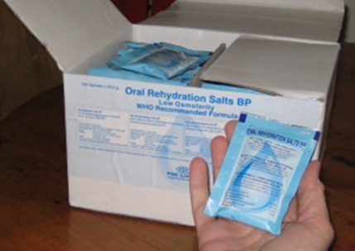
Oral Rehydration
Solution (ORS)
Low osmolarity ORS = standard ORS for all patients
Standard ORS is used to treat children with severe acute malnutrition and cholera
H.E.L.P. course
Notes:
ORS is sufficient to treat most patients with cholera and access to ORS is a priority. ORS should be available as close to the patient as possible. This can be achieved both through existing programmes such as community health worker programmes as well as specific structures called oral rehydration points.
The original formulation of ORS was designed for cholera – it was designed to balance the stool outputs which is very high in sodium. The current ‘low osmolarity’ formulation is lower in sodium, but is still adequate for cholera.
It is also important to note that although malnourished children with diarrhoea are usually given a special rehydration solution called ReSoMal that is lower in sodium, due to the high sodium level in cholera stool, normal/regular ORS is given to children with cholera.

Slide 23
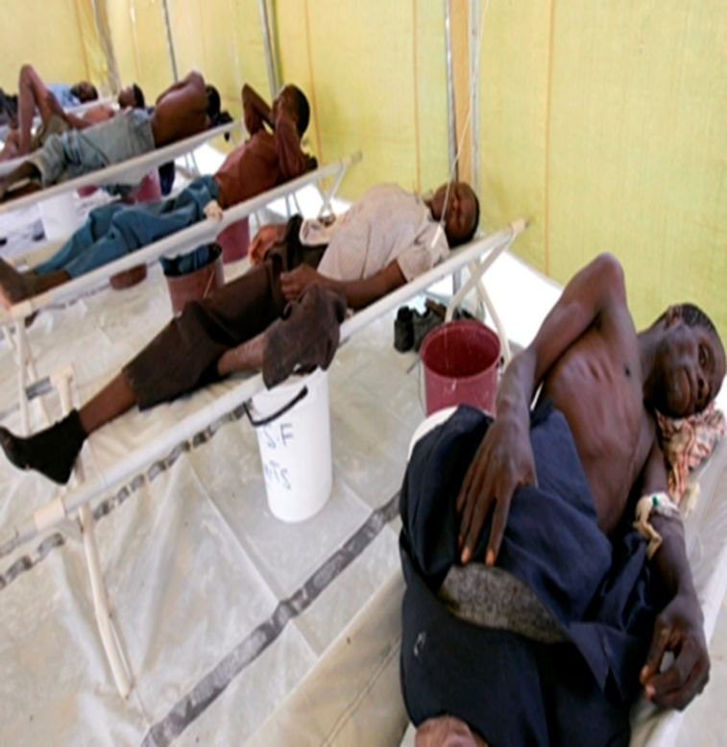
Treatment structures
Patients with cholera should be isolated from other patients to reduce transmission
These can be part of an existing structure or an independent structure
Decentralisation of care is important to provide rapid access to treatment
Oral rehydration points are a core part of the treatment network
H.E.L.P. course
Notes:
The in patient treatment centres are usually referred to as cholera treatment centres (CTCs).
By convention, large structures are referred to as cholera treatment centres (CTCs) and smaller ones of up to 10 to 15 beds are referred to as cholera treatment units or CTUs.
If there is space and patients isolation and infection prevention and control can be assured, patients can be treated in specific wards of hospitals or specific treatment centres in the grounds of health facilities. In larger outbreaks, large tent based treatment structures of up to 150 beds may be set up temporarily in spaces such as football fields.
In addition to the structures themselves, it is also important to think about how patients will reach the treatment structures. In some contexts emergeny phone lines are set up and an ambulance service provided. Whatever the type of transport, the vehicle should be disinfected at the treatment structure before being used again.

Slide 24
Some key numbers for planning
Estimated attack rates:
Rural : 0.1 to 2.0%
Urban in slums or in IDP or refugee camps: 1 to 5%
Proportion severe cases : 20 - 30%
Average IV Ringer Lactate use per patient with severe dehydration: 10 litres
Average number of ORS packets per patient: 8 to 10
Average length of stay for hospitalized patients : 2 to 3 days
Estimate that 30% of patients are seen during an epidemic peak
of 1 to 2 weeks
H.E.L.P. course
Notes:
Show this slide during the exercise/group work (slide 26)

Slide 25
Key considerations for WaSH
Adequate access to clean water and sanitation accompanied with protective hygiene measures are the cornerstones of prevention
Hygiene messaging must match the means available
WaSH in treatment structures is also a priority to reduce the spread of cholera
Both community and targeted strategies are currently used
Teams require epidemiological data to target interventions
H.E.L.P. course
Notes:
Although we frequently think of infection prevention and control in specific cholera treatment structures, patients may not always present immediately to a cholera treatment centre and infection, prevention and control in all health care structures is important.

Slide 26
Exercise /group work
You are working in a newly established IDP camp of 50’000 people. Although your WASH colleague are working hard, the Sphere Standards for WASH have not been met. The area is endemic for cholera. Epidemics usually occur during the rainy season which is expected in 2 months. As part of the preparedness planning, you have been asked to make a medical order.
What will you do?
How many total patients would you expect?
How many patients with severe dehydration would you expect?
How many packets of ORS should you order?
How many liters of IV should you order?
How many beds would you need to treat the patients with severe dehydration?
Would you include vaccination?
H.E.L.P. course
Notes:
In a camp the AR can be between 1 and 5%. Some groups may choose to calculate using the highest expected number in order to plan for the worst case scenario. Others may choose to calculate using both 1% and 5% in order to have a range and others may use the middle, 2.5%. These are all reasonable options, each group should just explain why they made their choice. It is important to note that all of the material in a cholera kit can be used to treat other conditions.
Example using 5%:
Total patients = 50 000 x 0.05 or 2500 patients
Of these approximately 30% will have severe dehydration or 750 patients
The usual estimate is 8 to 10l of ORS for ALL patients so highest estimate 25 000 1l sachets. Be aware that in some countries, the sachets used in maternal child health programmes are for 0.5l. This is important information for health promotion.
Litres of IV fluid = 750 (the patients with severe dehydration) x 10l or 7500l. Remember that although patients will continue to have diarrhoea, much of the ongoing losses will be replaced using ORS. In addition, 10l of IV fluid is sufficient to rehydrate a 100 kg individual with severe dehydration. Many patients will weigh less (children for example) and will require less IV fluid. The estimate of10l per patient is based on field experience.
Note the 10l per patient with severe dehydration is for the full course of treatement, not per day (this was a question in a previous session).
The 750 patients with severe dehydration will not all present on the same day. We usually estimate that 1/3 of the patients will present during the peak week (250 patients). We assume equal distribution over the week (250/7) or 36 patients. The usual length of stay is 3 days. So 36 x 3 or 108 beds.
It is worth discussing that this is for planning purposes only. The 108 beds to not need to be built immediately, but it gives a good idea of the space that may be needed. For example, it may be sufficient to build a centre with 20 beds immediately, but to ensure that there is enough space to expand to 100 beds. Or identify a second site etc. In a camp if there is enough space, all the hospitalized patients can usually be treated in one Cholera treatment centre (CTC), but there should be decentralized oral rehydration points (ORPs).

Slide 27
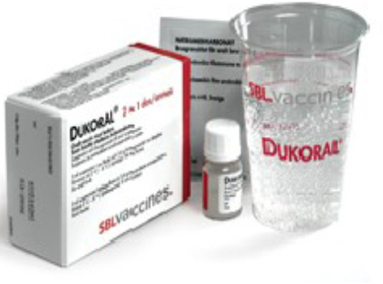
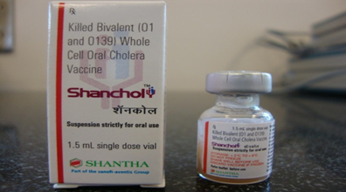
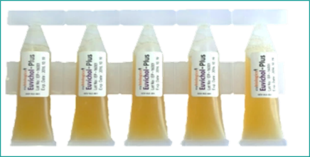
Oral cholera vaccine (OCV)
First oral cholera vaccine (OCV), Dukoral® prequalified by WHO in 2001, now used for travellers
Shanchol™ prequalified in 2011
Euvichol® prequalified in 2015, Euvichol plus in 2017 (new packaging)
Shanchol™ prequalified for Controlled Temperature Chain (CTC) use in 2018 (use outside the cold chain for last stage of delivery)
New WHO position paper published in August 2017
H.E.L.P. course
Notes:
Dukoral – this is an effective vaccine, but it is both expensive and is administered with a buffer solution that is made up with 150 ml of clean water. This is logistically challenging so it is usually not used in the field.
The vaccines that are available via a global stockpile are Shanchol and Euvichol plus. These two vaccines are essentially the same vaccine, but produced by two different manufacturers. Both vaccines are packed as individual doses with each individual given a single dose which is usually delivered during a mass campaign.

Slide 28
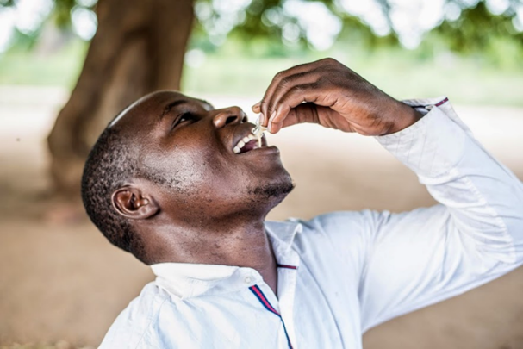
OCV properties and protection
Shanchol™ and Euvichol® are 2 dose killed whole cell oral cholera vaccine, given a minimum of 2 weeks apart
1 dose provides approximately 6 months protection
2 doses approximately 70% effective for at least 3 years; there is additional herd protection. Less effective in children under 5
Target population all people 1 year and over
Recommendation to keep in cold chain 2-8°C
Vaccine safe, few side effects reported
H.E.L.P. course
Notes:
There are three usual contexts for vaccine use:
Prevention of cholera in humanitarian contexts with a high risk of an epidemic (e.g. population movement, cholera endemic area, poor access to clean water and sanitation)
2) Containment of ongoing epidemics
3) Prevention in areas with endemic cholera/repeated outbreaks

Slide 29
Timeline for OCV mass vaccination
1st dose
campaign
Minimum 2 weeks between
doses, up to 6 months
2nd dose
campaign
Extended immunity
to at least 3 years
H.E.L.P. course
+ 7 to 10 days
Build up immunity
Notes:
There should be a minimum of 2 weeks between the delivery of doses for each individual. This delay can be up to 6 months.
It takes 7 to 10 days for individual immunity to build.

Slide 30
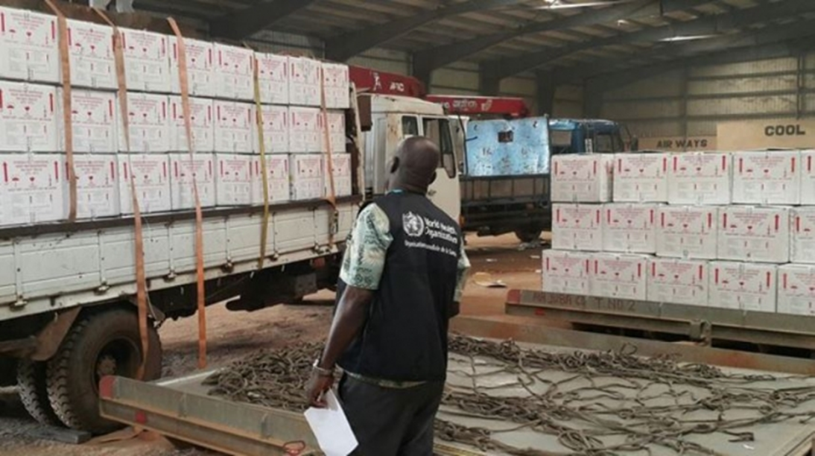
Logistics: voluminous vaccine requiring significant storage
H.E.L.P. course
Notes:
Shancol is more voluminous than Euvichol plus.

Slide 31
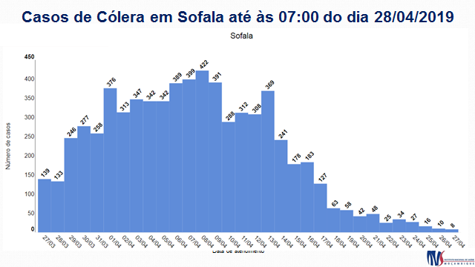
Cholera cases reported in 27 March to 27 April 2019, Sofala province, Mozambique
Other interventions
Daily reporting of surveillance data, including mapping
Case management, including decentralized oral rehydration points (ORPs)
Provision of clean water, including targeting most affected neighbourhoods
Hygiene promotion
Vaccination campaign
Notes:
This is an example of vaccine use from Mozambique. Beira in Mozambique is endemic for cholera. Following Cyclone Idai and the consequent flooding in March 2019, there was a large outbreak along with all the other elements of a post cyclone disaster. In addition to all the other cholera control measures including strengthening surveillance, coordination (including data sharing), treatment of patients, increasing access to clean water, hygiene promotion a mass OCV campaign was also added.
More than 800 000 people were vaccinated in 6 days.
For background, the vaccine was accessed from the Global Stockpile via the International Coordinating Group (ICG), emergency mechanism. The cost of vaccine and operational costs for the delivery of vaccine from the Global Stockpile are covered by the GAVI alliance.

Slide 32
Core components of cholera control
Decrease mortality
Early case detection
Increase access to health care
Adequate care, including nutrition
Reduce the burden
Access to safe water
Adequate sanitation
Community engagement
Isolation and infection control in health structures (including dead body management)
Food safety and hand washing
H.E.L.P. course
Vaccination
Community Engagement

Slide 33
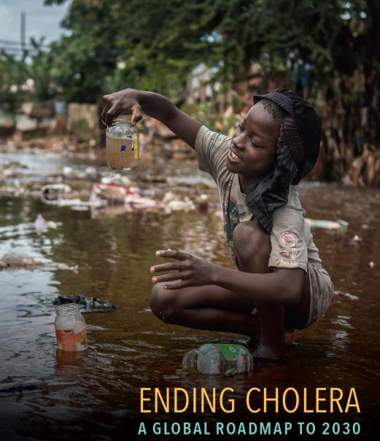
Ending Cholera: A Global Roadmap to 2030
Launched in 2017 by the Global Task Force on Cholera Control (GTFCC) and endorsed by the World health assembly in 2018
Objectives to eliminate cholera as a public health threat in at least 20 countries and to reduce cholera deaths by 90% by 2030
H.E.L.P. course
Notes:
While this whole course focuses on acute and protracted crisis siutations, it is important to introduce the participants to Ending Cholera: A global roadmap to 2030 – a global strategy to reduce cholera. The strategy was launched by the Global Task Force on Cholera Control, a global multisectoral partnership of NGOs, UN agencies, academic institutions, donors etc. The global objectives of the Roadmap are to reduce cholera deaths by 90% and to eliminate cholera as a public health issue it at least 20 countries by 2030. Cholera is preventable and we must do more to prevent cholera transmission and not wait to react when there is an outbreak which has been the traditional attitude. In some countries we have known where cholera will come and more or less when it will come and instead of preventing it, have waiting for the cases to appear to react.
The Roadmap was endorsed by member states at the 2018 World Health Assembly.
The Roadmap is built around 3 axes.

Slide 34
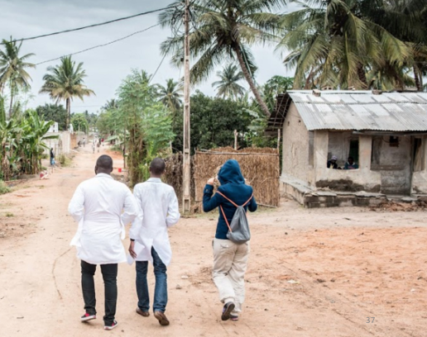
Strategic Axis 1:
Early detection & immediate response
Early detection and rapid response to ensure immediate containment of outbreaks
H.E.L.P. course
Notes:
There will still be cholera outbreaks – in some countries, especially those in conflict working on long term access to water and sanitation is difficult. However, we all know that the earlier epidemics are detected, the more rapidly they can be controlled and the fewer cases and deaths there will be.
In addition, large outbreaks can be a catalyst. A large high profile outbreak can raise government awareness of cholera and be a catalyst for long term control. This has been seen a number of times including in Zambia and Zimbabwe.

Slide 35
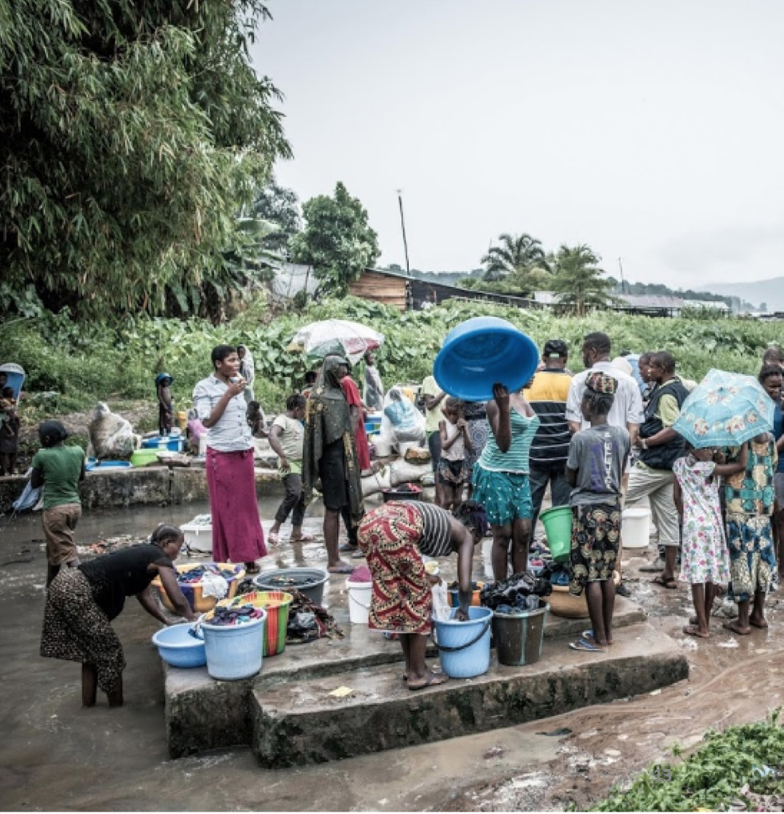
Strategic Axis 2:
Hotspot approach
Most cases of cholera happen in highly endemic area –called ‘’hotspots’’ –where outbreaks of cholera occur regularly
Priority to long term development in these areas, in line with the Sustainable Development Goals
H.E.L.P. course
Notes:
The second strategy is about prevention and the ‘hotspot’ approach is a key to this. We used to think of countries as endemic which makes knowing where to target difficult. However, more recent analysis showed that cholera within one country usually affects specific areas, which we call hotspots. Cholera may also spread from there areas to other less frequently affected areas. These hotspots are an indicator of poor water, hygiene and sanitation. If there is cholera, the population have not yet reached the millenium development goal standard for access to water and sanitation and is far behind the goals of the sustainable development goals. Identifying hotspots helps a country target those who are being left behind. In most countries in Africa, these hotspots represent about 5% of the national population.

Slide 36
Strategic Axis 3:
GTFCC as an effective coordination mechanism
Partnership at local
and global levels
H.E.L.P. course
Technical support
Resource Mobilization
Notes:
The final axis of the strategy consists of advocacy, resource mobilization and provision of technical support. The core of the Roadmap is governments developing their own multisectoral, multi year national plans and this axis is about supporting that process.

Slide 37
From preparedness and response to
prevention and control
Treating patients alone has limited impact on transmission
…… and long-term WaSH
… and OCV with WaSH
H.E.L.P. course
Cholera Treatment Centers, cholera kits, emergency WaSH
Bridging emergency and development
Notes:
This course is health focused, so this final slide attempts to show how treatment remains essential, but that there is also a need to build upon that with OCV and WASH and targeting the WASH objectives of the sustainable development goals.

Slide 38
Useful Links
WHO cholera factsheet: who.int/news-room/fact-sheets/detail/cholera
WHO Cholera page including the Ending Cholera Roadmap and the 2017 OCV Position Paper: www.who.int/cholera
Cholera Kits and Calculation Tool: who.int/cholera/kit/en
GTFCC site including technical notes: who.int/cholera/Task_force/en
Video Intro to the Cholera Kit calculation tool: openwho.org/courses/cholera-kits
Training materials: www.gtfcc.org
UNICEF Cholera Tookit: www.unicef.org/cholera
WHA resolution 2018: http://apps.who.int/gb/ebwha/pdf_files/WHA71/A71_R4-en.pdf
H.E.L.P. course
Notes:
Fact sheet.

Slide 39
H.E.L.P. course

