Slide 1

Malaria Prevention and Control
Dr Stefan Hoyer (hoyers@who.int)
High Burden High Impact Unit (HBI)
WHO Global Malaria Programme GMP
H.E.L.P. course

Slide 2
Outline
Presentation – 15 minutes
  Factors influencing malaria epidemiology transmission
  Interventions and strategies against malaria
  Malaria control within a humanitarian emergency response
Q & A – 5 minutes
Group exercise – 10 minutes
H.E.L.P. course
WHO Global Malaria Programme

Slide 3
Malaria: An ecosystem between three biological entities
Human host
Over 3 billion people are at risk
Vectors
Anopheles mosquitoes
70 out of over 500 species can transmit malaria
30 – 40 species are of major importance
Malaria Parasites
Plasmodium falciparum
Plasmodium vivax
Plasmodium malariae
Plasmodium ovale
Eco-
System
Malaria
H.E.L.P. course
Suitable environments
Physical (Temp. Alt.)
Biological, environmental
Socio-economic
WHO Global Malaria Programme

Slide 4
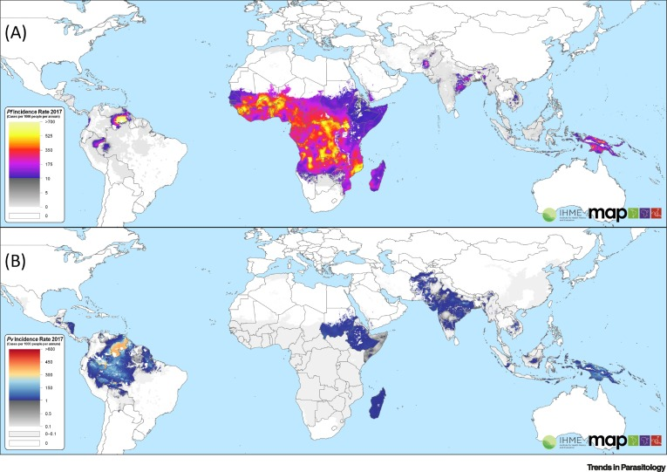
Global Distribution of Malaria Disease Burden
(A P. falciparum, B: P vivax)
H.E.L.P. course
WHO Global Malaria Programme

Slide 5
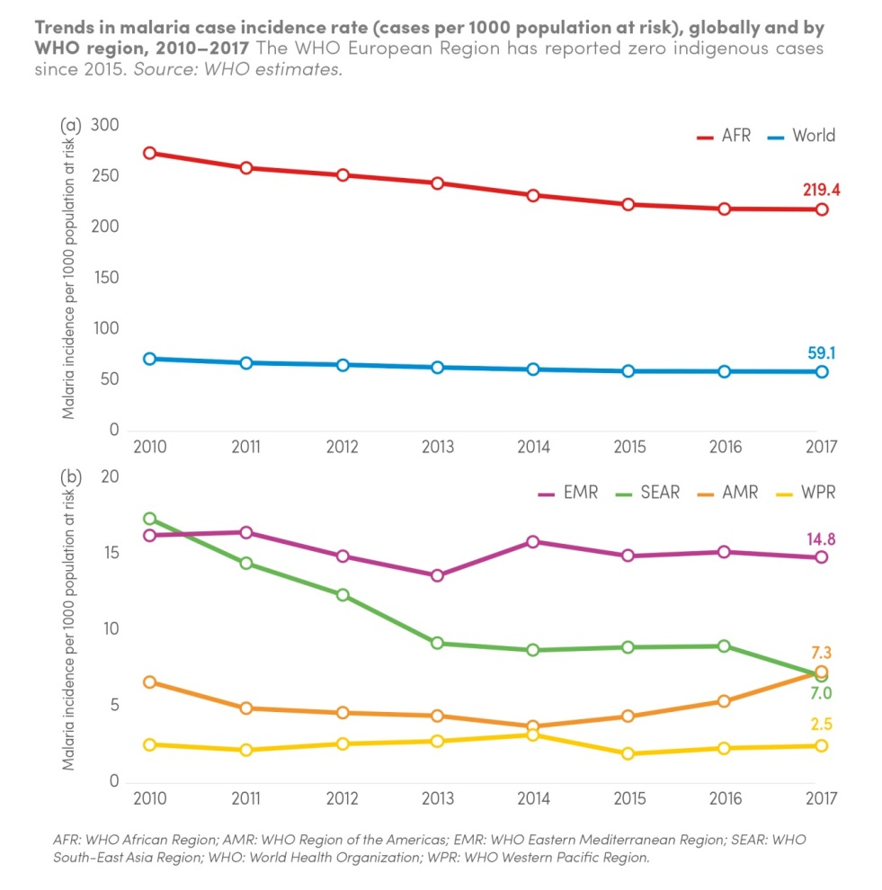
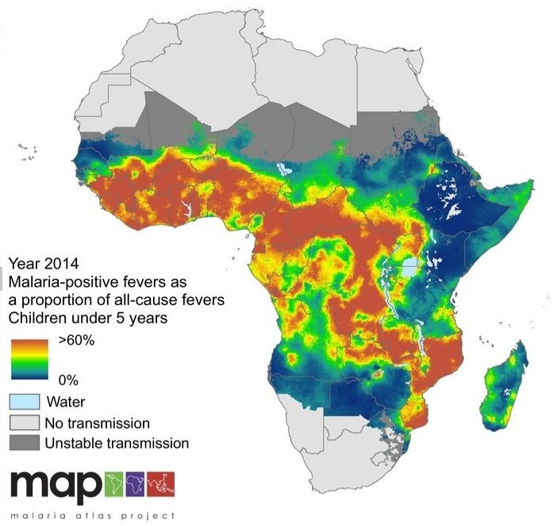
Malaria distribution is uneven due to multiple factors
H.E.L.P. course
Annual Parasite Incidence, India, 2018
WHO Global Malaria Programme

Slide 6
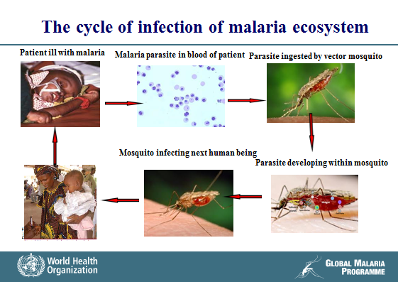
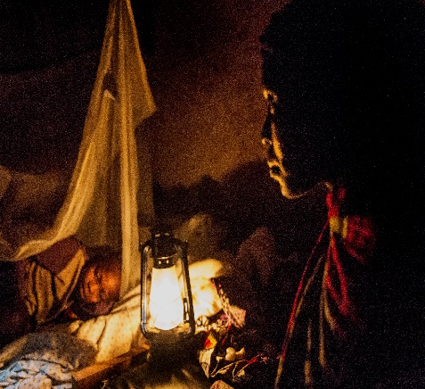
H.E.L.P. course
WHO Global Malaria Programme

Slide 7
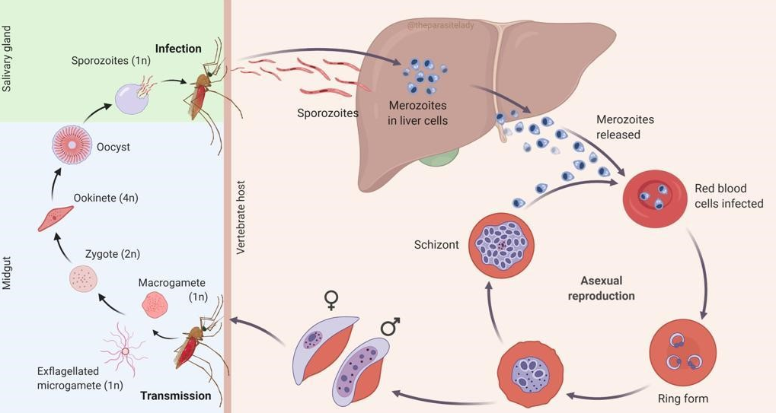
Biological stages of malaria transmission:
Suitable environments
Physical
Socio-economic
H.E.L.P. course
WHO Global Malaria Programme

Slide 8
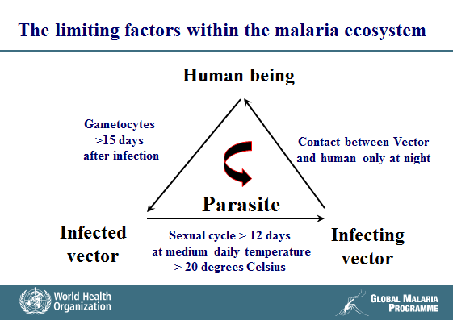
H.E.L.P. course

Slide 9
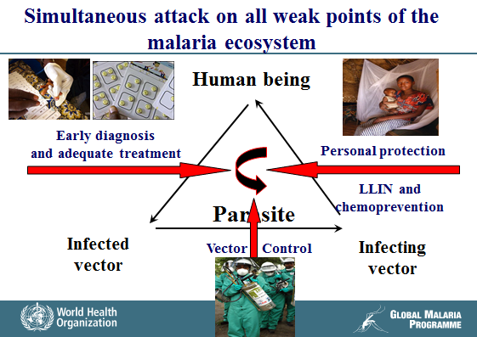
H.E.L.P. course

Slide 10
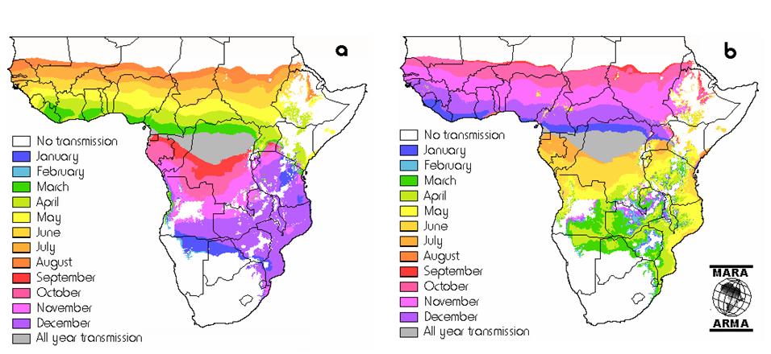
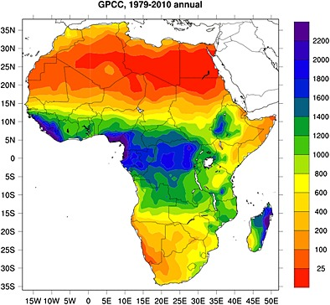
Highest risk groups for malaria morbidity and mortality depends on duration and intensity of transmission resulting in partial immunity
a) First month of malaria transmission b) Last month of malaria transmission Annual rainfall in Africa ml/year
H.E.L.P. course
WHO Global Malaria Programme

Slide 11
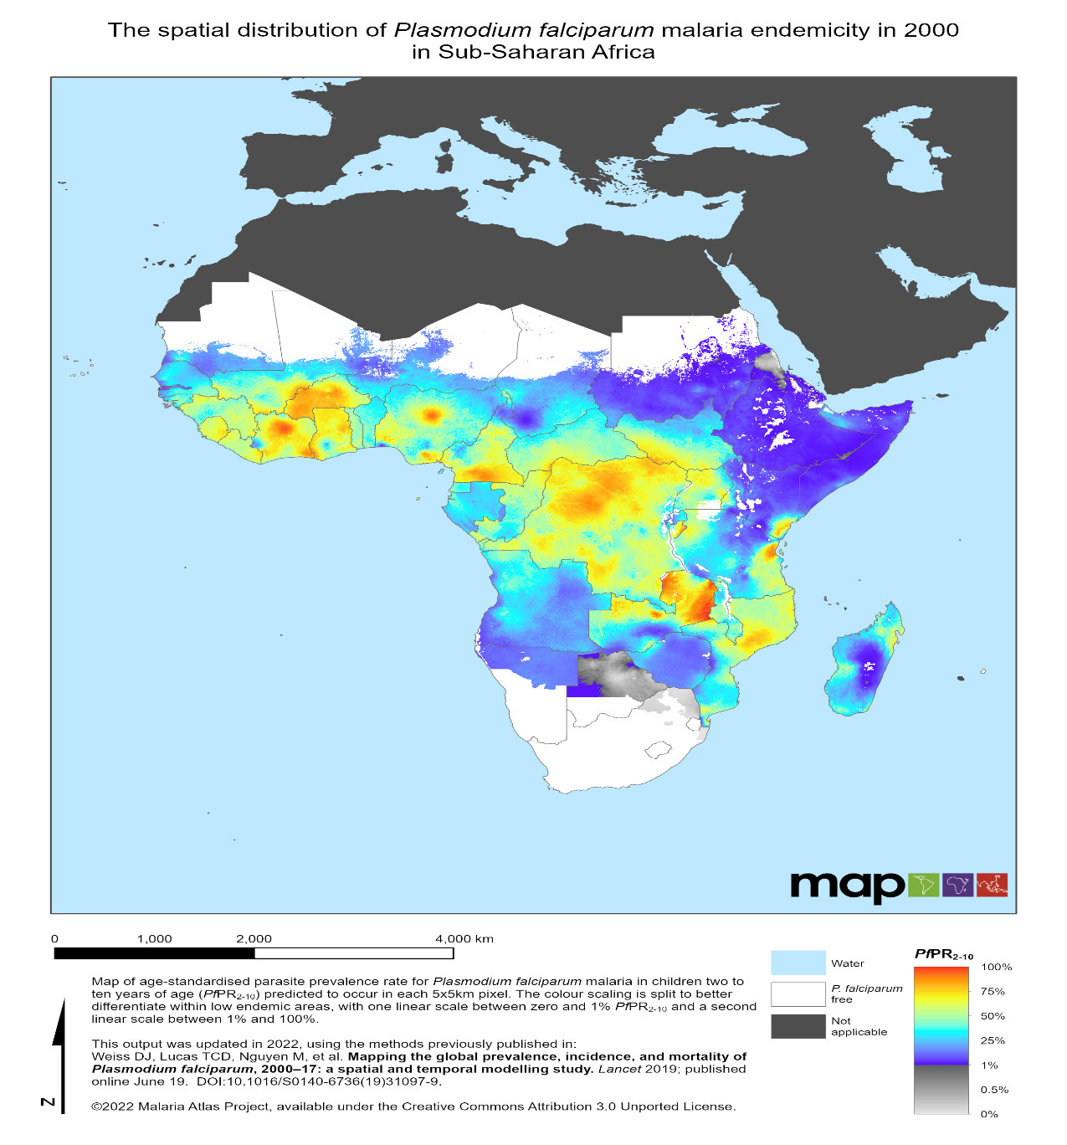
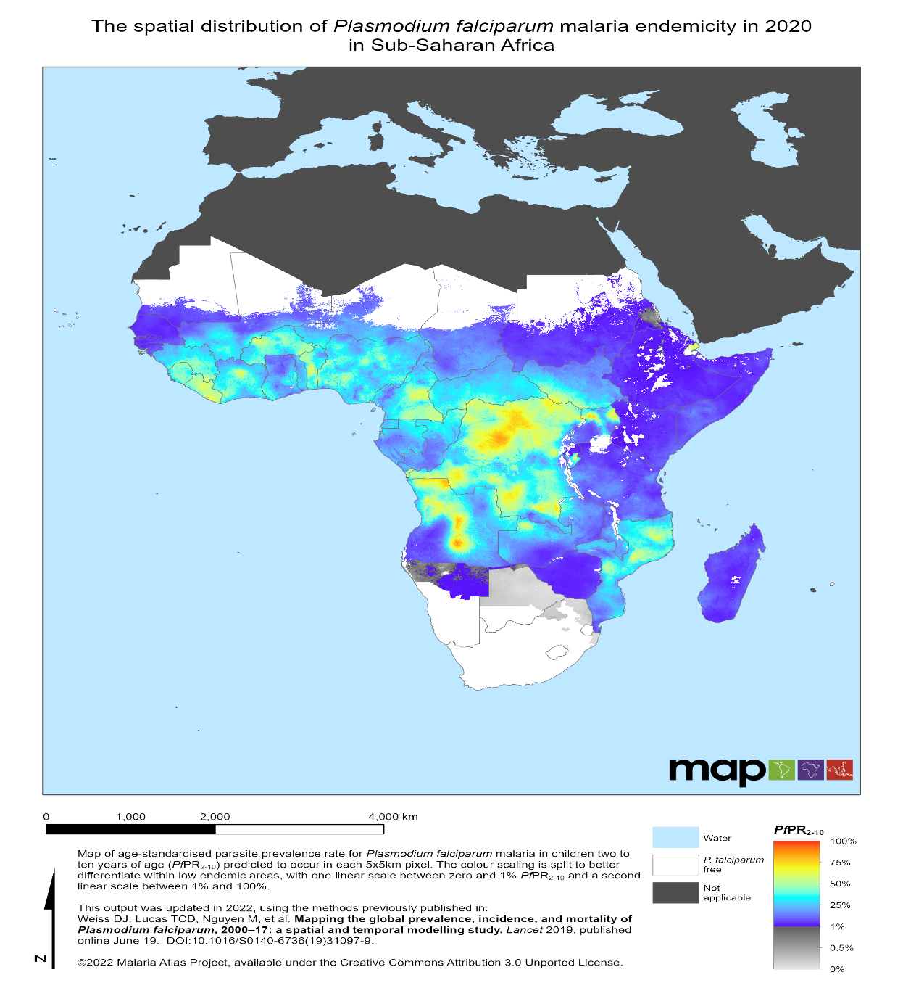
Due to acquired immunity by exposure hisk groups for malaria morbidity and mortality in high transmission areas are children and pregnant women. Low transmission are epidemic prone
H.E.L.P. course
WHO Global Malaria Programme

Slide 12
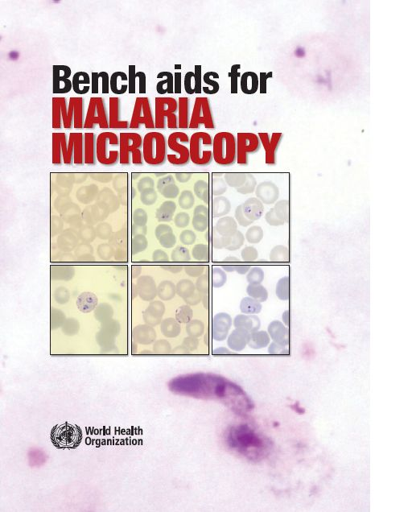
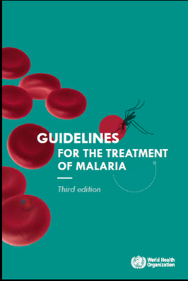
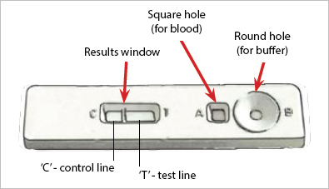
Malaria Control Interventions and strategies
Diagnosis
  Microscopy
  Rapid diagnostic test
Treatment of uncomplicated malaria
  Artemisinin-based combination
  therapy (ACT) for P. falciparum
  Chloroquine for non-falciparum malaria
Prevention of relapse (P. vivax and P. ovale)
  Primaquine
Reducing transmissibility of P. falciparum infections
  Primaquine
H.E.L.P. course
WHO Global Malaria Programme

Slide 13
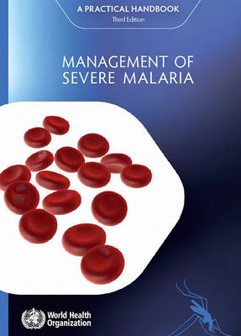
Malaria control Interventions and strategies
Treatment of severe malaria:
  Artesunate iv.
  Artemether im.
  Quinine
  Treatment of medical complications
    Hypogycemia
    Coma
    Kidney failure
    Respiratory failure due to pulmonary oedema
    Shoc
Pre-referral treatment:
  Rectal artesunate
H.E.L.P. course
WHO Global Malaria Programme

Slide 14
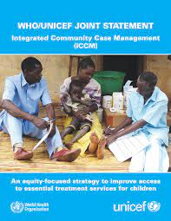
Interventions and strategies
Integrated Community Case Management (iCCM)
Differential diagnosis of fevers and treatment of:
  Malaria
  Pneumonia
  Diarrhoeas
By trained community health workers at village level
H.E.L.P. course
WHO Global Malaria Programme

Slide 15
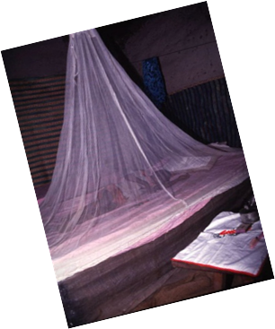
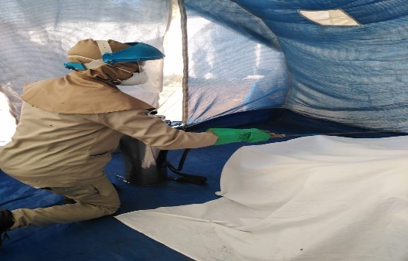
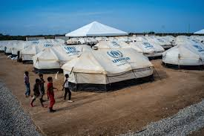
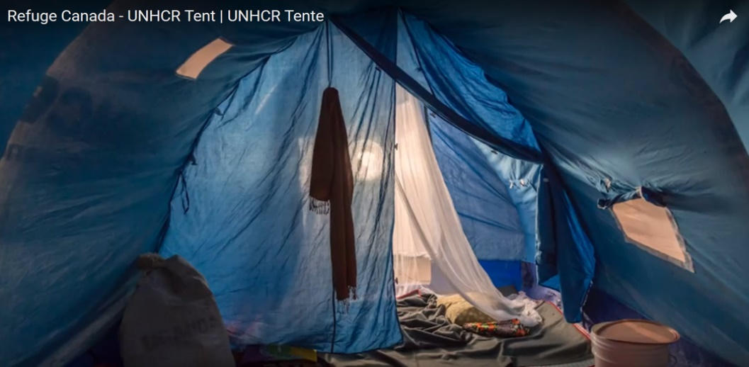
Malaria Control Interventions and strategies
Vector control
  Indoor residual spraying
  Long lasting insecticidal nets (LLINs)
  Larval source management (LSM)
H.E.L.P. course
WHO Global Malaria Programme

Slide 16
Interventions and strategies
Chemo-Prevention of malaria
  Intermittent preventive treatment of infants (IPTi) Integrated into EPI
  Intermittent preventive treatment in pregnancy (IPTp) Integrated into ANC
  Seasonal malaria chemoprevention (SMC) Targeting children < 5
  Mass drug administration (MDA)
  Emergency intervention
H.E.L.P. course
WHO Global Malaria Programme

Slide 17
Mass drug administration (MDA)
WHO recommends MDA to:
Stop malaria epidemics
Rapidly reduce malaria mortality and morbidity in complex emergencies in which the health system has broken down including in Ebola-affected areas
Eliminate Pf in the Greater Mekong subregion in reduce the risk for spread of multi-drug resistance,
To interrupt transmission of falciparum malaria in areas approaching elimination,
H.E.L.P. course
Global Malaria programme

Slide 18
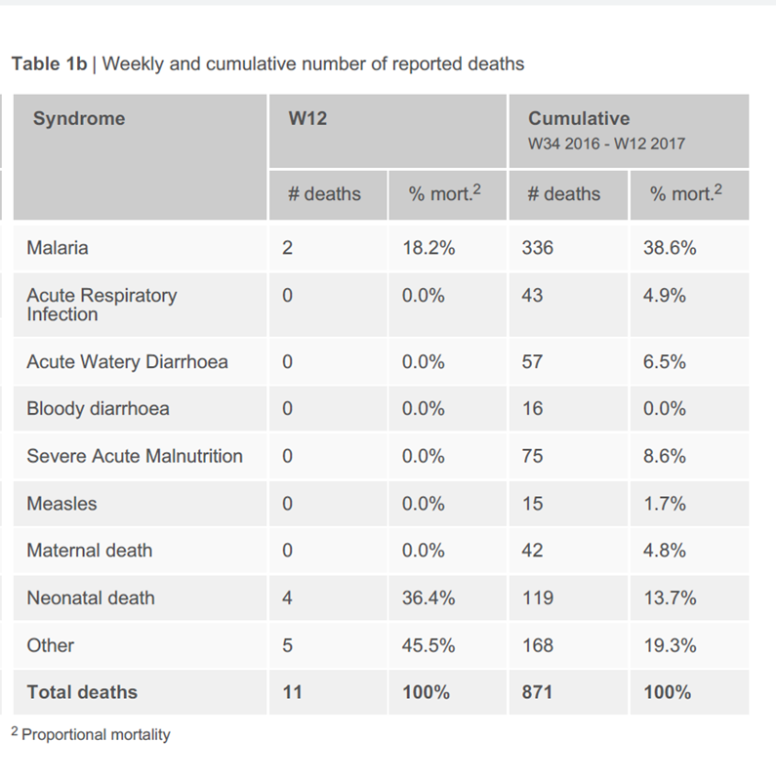
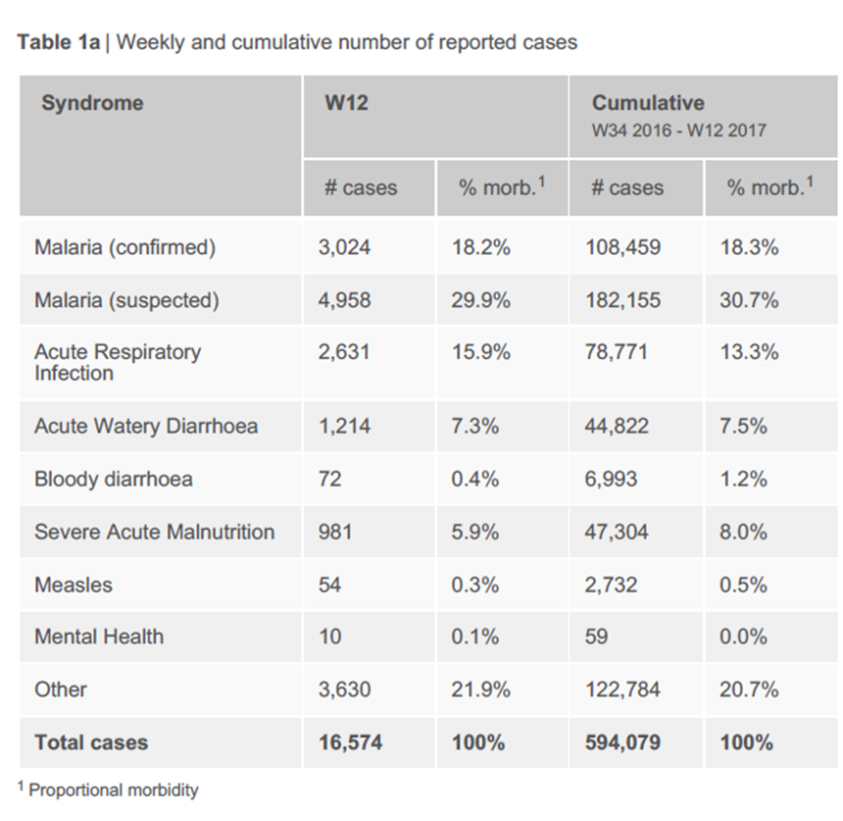
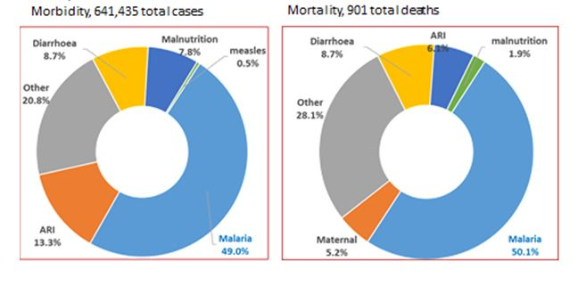
Malaria in humanitarian emergencies
Countries with ongoing emergencies in 2019
Malaria is a major public health problem during humanitarian emergencies in endemic countries. The data shown below are the causes of morbidity and mortality among IDPs in Borno State, Nigeria.
H.E.L.P. course
WHO Global Malaria Programme

Slide 19
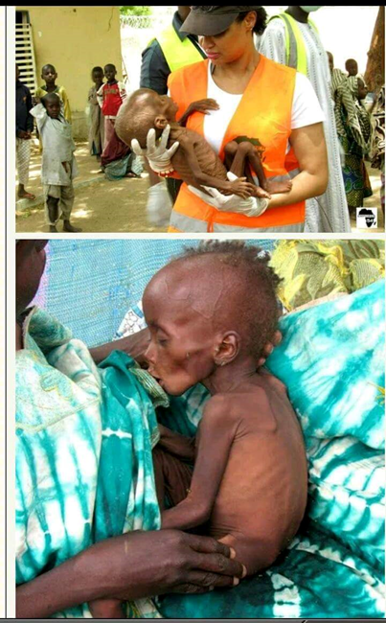
Example of successful emergency response through MDA
Situation in Borno Sate, Nigeria 2017
Example how the widespread acute malnutrition combined with malaria and no access to treatment cana exacerbate malaria mortality
Maximum all cause child mortality levels in Borno, Nigeria up to 8.4:
Emergency threshold = 2 child deaths < age of 5 /10'000 population/day
Successful WHO Emergency response:
Monthly age-targeted mass drug administration during high transmission season
H.E.L.P. course
WHO Global Malaria Programme

Slide 20
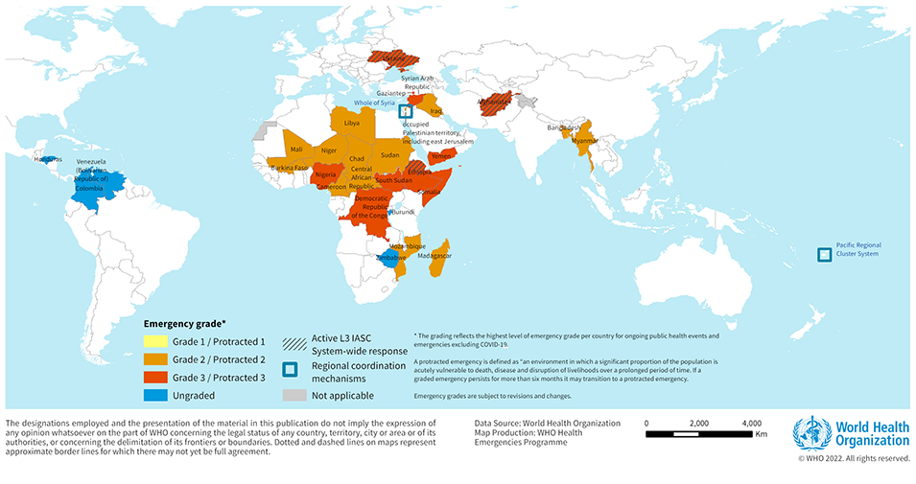
Assessing malaria risk within a humanitarian emergency
1) Is there malaria transmission in the emergency affected area?
H.E.L.P. course
WHO Global Malaria Programme

Slide 21
2) Is there high or low malaria transmission in the emergency area?
(i.e Which age groups are at highest risk of malaria morbidity and mortality)
H.E.L.P. course
WHO Global Malaria Programme

Slide 22
3) When does the next high transmission rainy season start?
a) First month of malaria transmission b) Last month of malaria transmission
H.E.L.P. course
WHO Global Malaria Programme

Slide 23
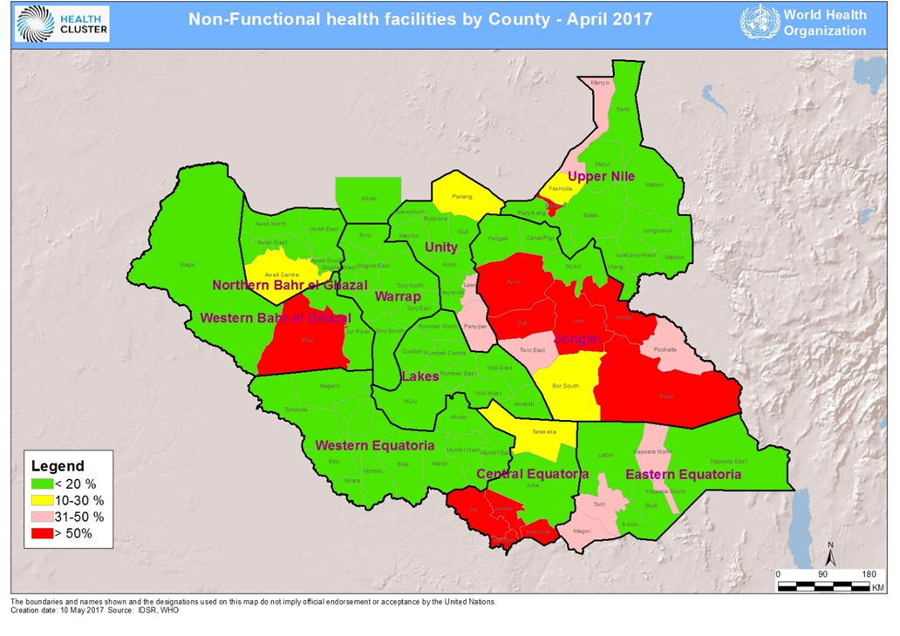
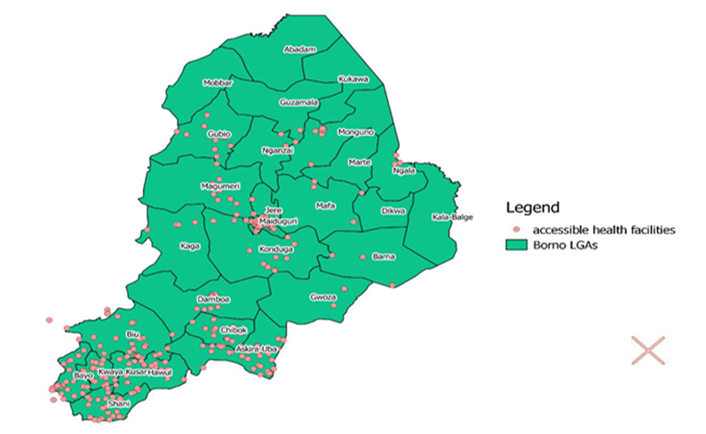
4) How good is access to malaria case management in emergency area
a) Map of access to heath facilities in South Sudan and b) Boku Haram-affected Borno State Nigeria
H.E.L.P. course
WHO Global Malaria Programme

Slide 24
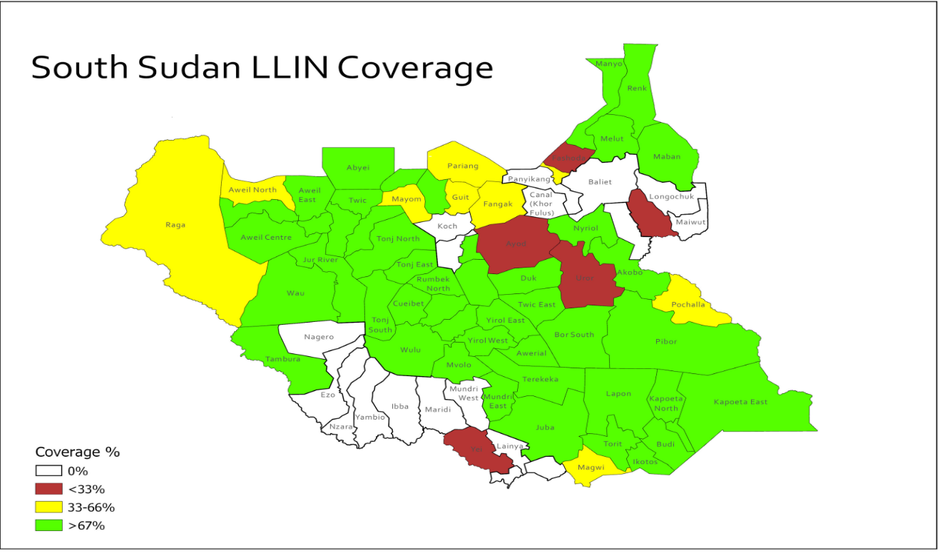
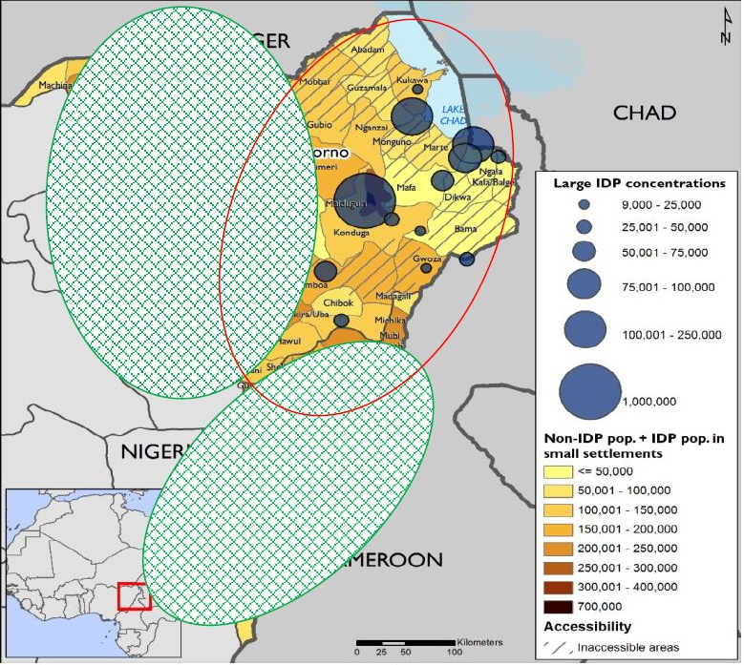
5) What is the remaining vector control coverage in the emergency area?
a) Map of access to heath facilities in South Sudan and b) Boku Haram-affected Borno State Nigeria
H.E.L.P. course
WHO Global Malaria Programme

Slide 25
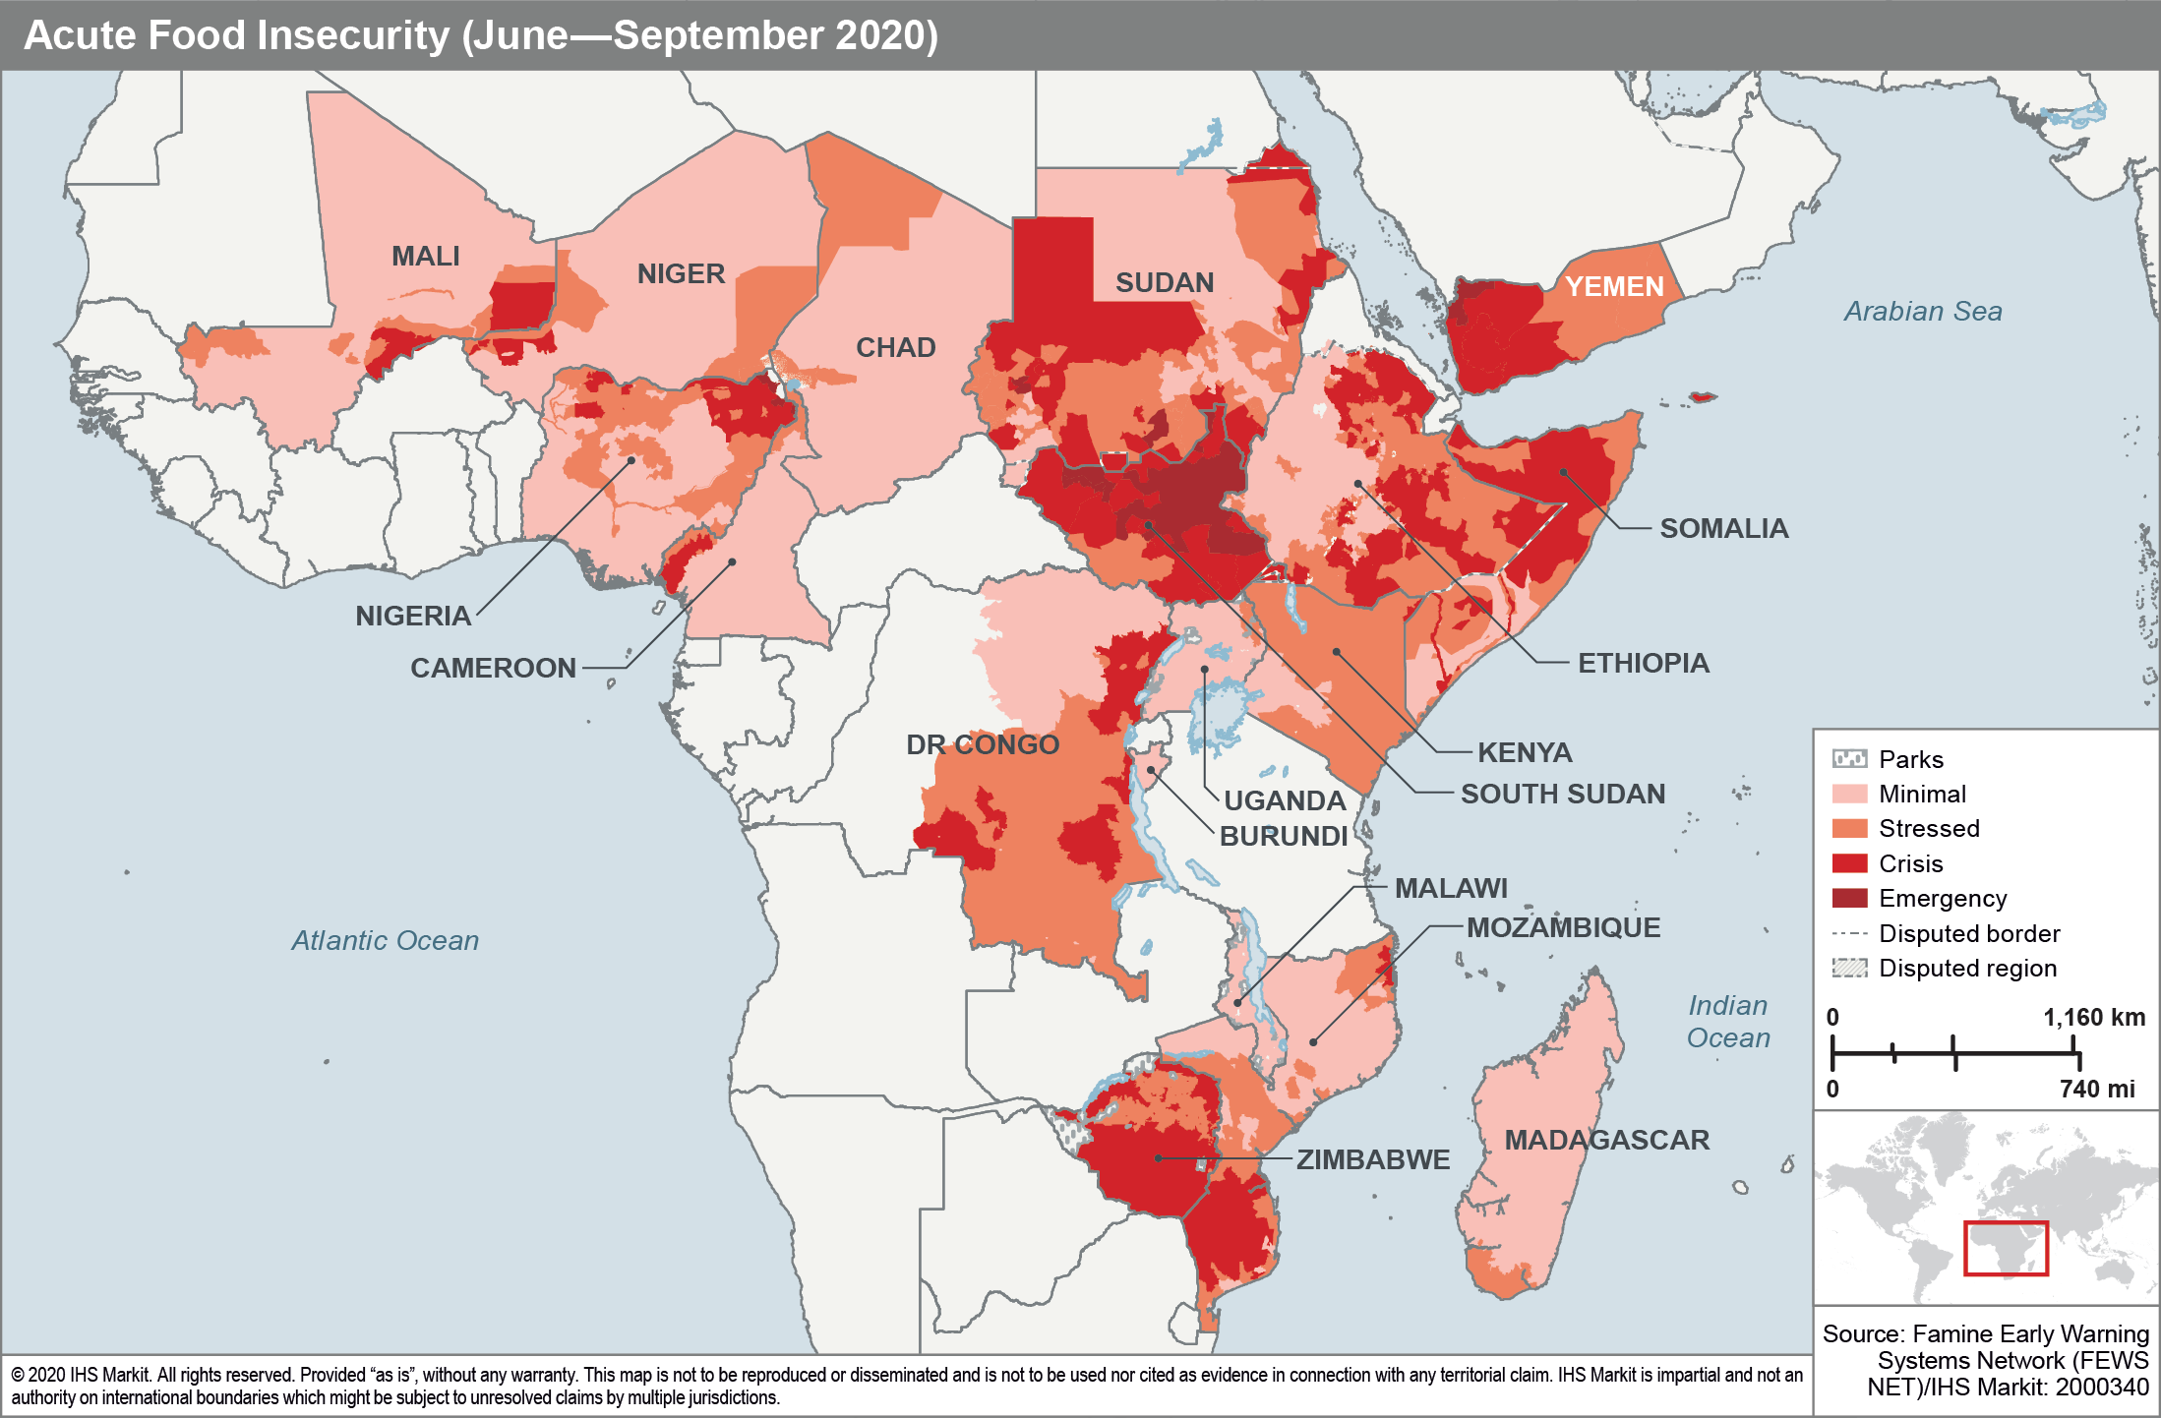
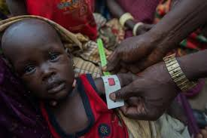
Are there comorbities that could massively increase all cause child mortality?
(Severe acute malnutrition, measles, cholera)
H.E.L.P. course
WHO Global Malaria Programme

Slide 26
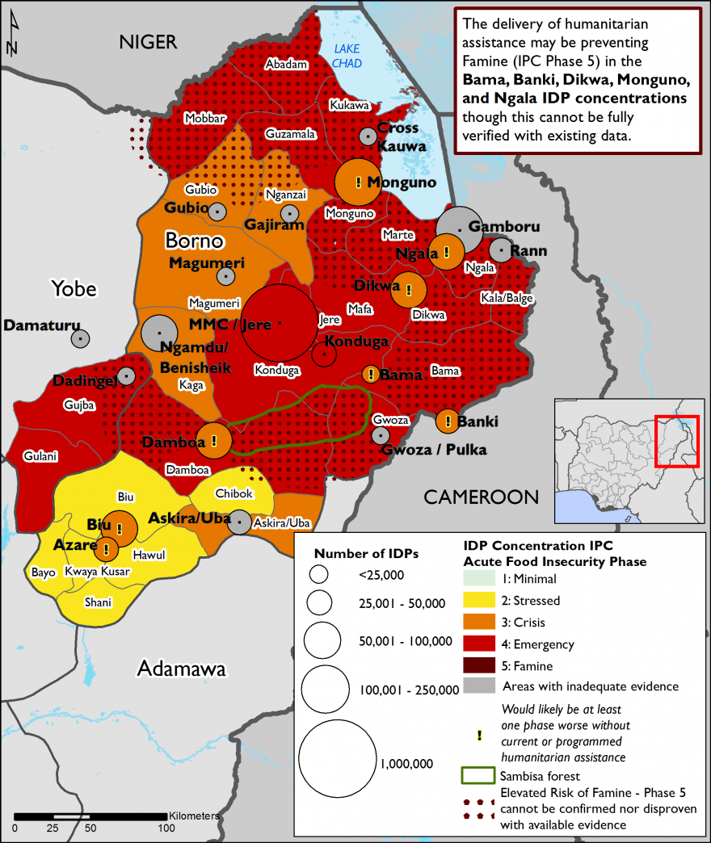
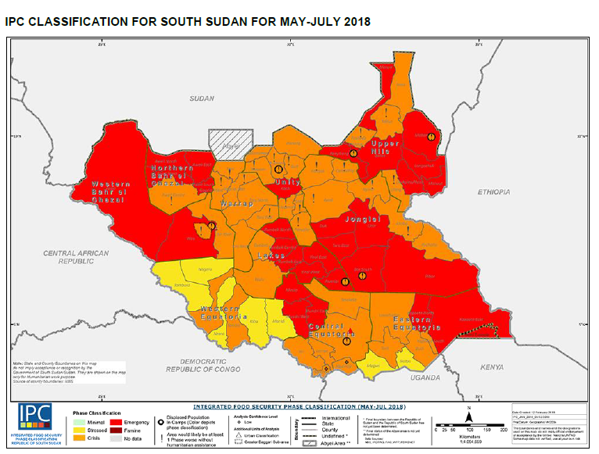
6) Two examples of malnutrition combined with malaria exacerbating mortality
a) IPC map of South Sudan
H.E.L.P. course
WHO Global Malaria Programme

Slide 27
7) Result targeting those at highest risk of exacerbated malaria mortality
Prioritization and Quantification of High-Risk Populations for Malaria Mortality South Sudan 2017
Quantification of High-Risk Population | 40,080 | 258,453 | 191,446 | 484,042
Percent of Total Population | 0.4% | 2% | 2% | 4%
Level of PRIORITY | 1st PRIORITY | 2nd PRIORITY | 3rd PRIORITY | 4th PRIORITY
Prioritisation by: i High-Risk age group, Access to ii health facilities iii vector control iv Malnutrition IPC scale | Pop <5 years No health facility access, No vector control IPC 5 areas | Pop <5 years No health facility access No vector control IPC 4 | Pop <5 years No health facility access but LLIN coverage IPC 4 areas | Pop <5 Limited health facility access ( > 5 km distance) LLIN coverage IPC 4 areas
H.E.L.P. course
WHO Global Malaria Programme

Slide 28
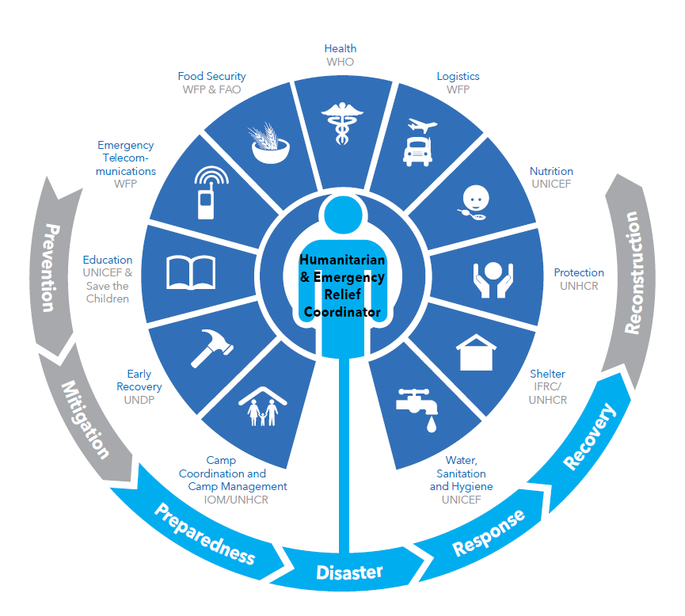
Humantarian emergencies also provide extraordinary opportunities for collaboration and integration of malaria control activities into the emergency response operation
Humanitarian assets on the ground:
387 UN staff (120 international and 267 national
32 NGO partners 108 additional international and 1,141 additional national staff
2.8 million receiving food aid 50%
430’000 emergency shelter
55 Mobile Health and Nutrition Teams (MHNTs) in 57 Woredas. total of 11603 Out-Patient Department (OPD) consolations.
Oral Cholera Vaccination (OCV) campaign targets 2 million IDP and host communities
Measles campaign for <5s
Provision of essential medical supplies
68,301 persons have been vaccinated against COVID-19 – (3 percent IDPs and 7 percent health care workers).
WASH response for 561,000 IDPs
USD 154’000’000 available
H.E.L.P. course
WHO Global Malaria Programme

Slide 29
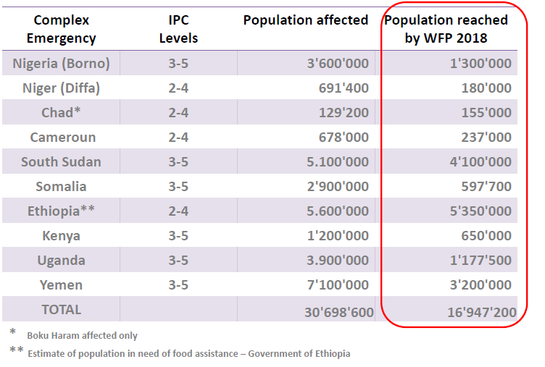
Example: Potential of intensified collaboration with WFP
Highlighting potential to going to scale through new partnerships

Slide 30
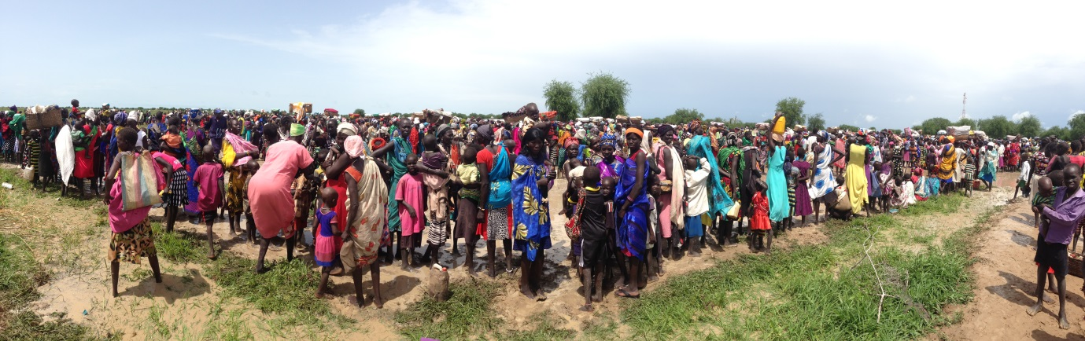
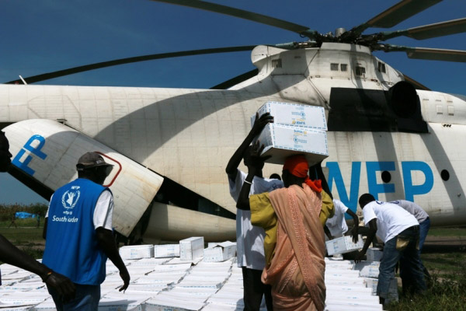
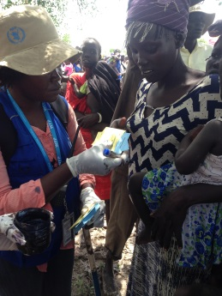
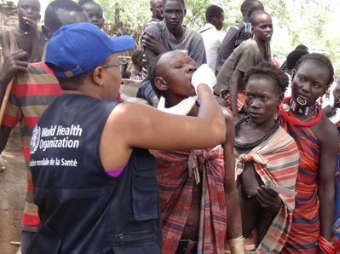
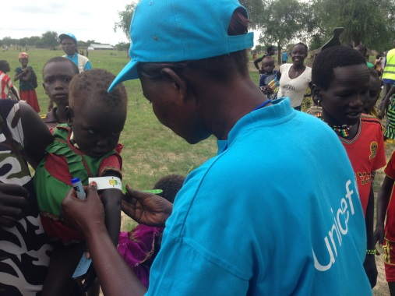
Integrating health, nutrition and logistics cluster activities
Notes:
Notes:

Slide 31
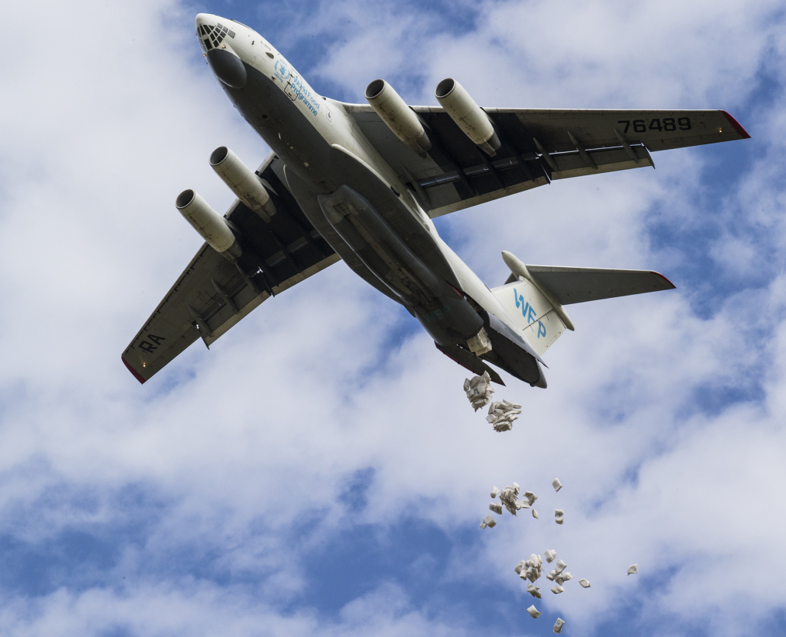
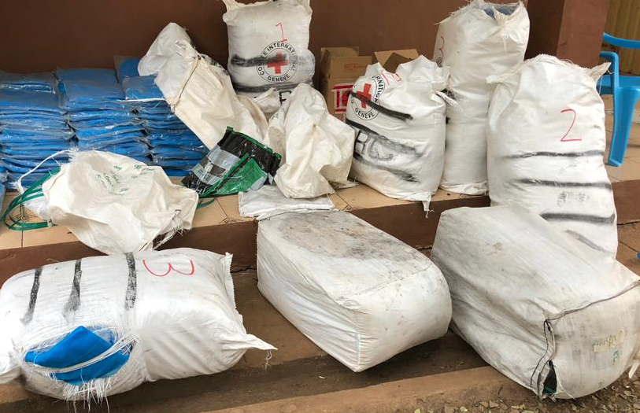
New best practices need to be documented and published
Recent example:
First air drop pilot test of LLIN bales in Maiwut, South Sudan 28/02/18

Slide 32
For more info:
www.who.int/malaria/en/
H.E.L.P. course
WHO Global Malaria Programme

Slide 33
H.E.L.P. course
WHO Global Malaria Programme

Slide 34
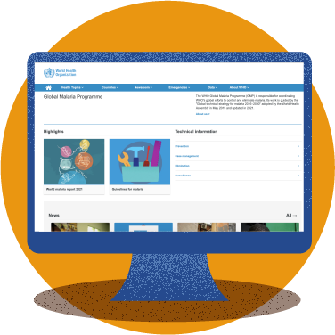
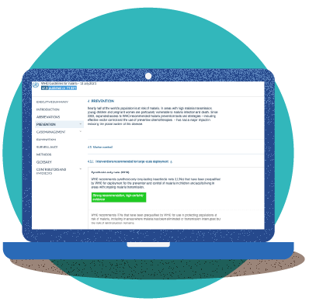
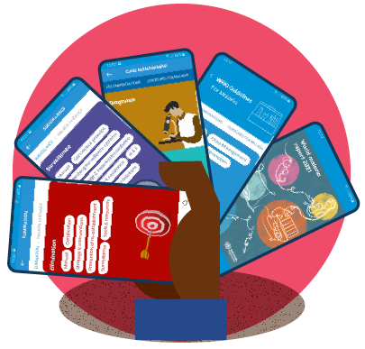

How to access WHO malaria guidance
1
WHO Global Malaria Programme website
2
3
WHO Malaria Toolkit app
MAGICapp

Slide 35
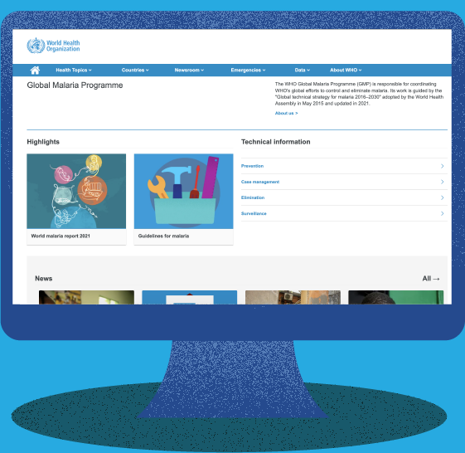
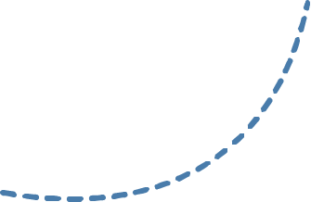
Ways to access WHO malaria guidance
1
The WHO Global Malaria Programme website is the main gateway through which national malaria programmes and partners can access the most up-to-date malaria guidance.
The new consolidated WHO Guidelines for malaria bring together all current WHO recommendations on malaria in one easy-to-navigate web-based platform.
They are a living resource that will be updated periodically as new evidence becomes available.

Slide 36
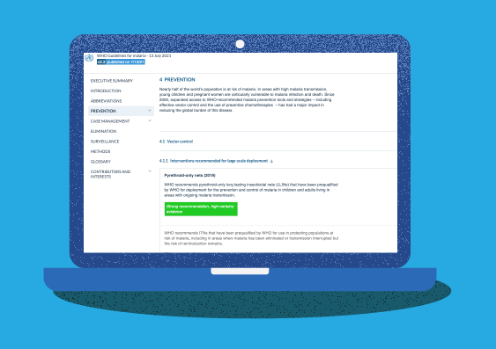
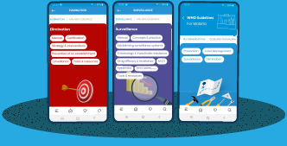
Ways to access WHO malaria guidance
WHO’s malaria guidance can also be found on 2 digital platforms:
2
3
Through MAGICApp, you can access a consolidated set of all WHO malaria guidance, including:
All WHO recommendations can also be accessed through an easy-to-navigate mobile "Malaria Toolkit app".
The app is available for iOS devices and Android devices.
In addition to the WHO recommendations, it provides the latest data and trends from the World malaria report.
All official WHO recommendations
Operational manuals
Handbooks
Frameworks
And links to other resources

Slide 37



Group exercise: Assessing and responding to the malaria component of the Grade 3 –level humanitarian emergency in Tigray
H.E.L.P. course
Malaria transmission areas lie below 2000 m or 6500 ft
WHO Global Malaria Programme

Slide 38

High malaria transmission in west, malaria epidemic prone centre
H.E.L.P. course
WHO Global Malaria Programme

Slide 39

At least 2’000’000 internally displaced person (IDP) fled from west to centre and from southern Eastern Tigray
H.E.L.P. course
WHO Global Malaria Programme

Slide 40

750’000 IDPs crammed around malaria-epidemic prone areas of Shire
H.E.L.P. course
WHO Global Malaria Programme

Slide 41




Most extreme food insecurity situation since 1984
Birhan Woldu
The «Face of famine» 1984
H.E.L.P. course
WHO Global Malaria Programme

Slide 42
Is there a malaria risk of so where and when for whom and what can be done about it?
Questions concerning malaria response:
What age groups are at risk of malaria outbreaks in Shire (below 2000 m)?
What is the malaria epidemic risk among IDPs in Mekele at 2300 m altitude?
When would malaria epidemics risk to break out if the rainy season lasts from September to November?
What would be the fastest measure to supress malaria epidemics in IDP camps?
What could be done to improve case management in a war zone with dysfunctional health facilities?
What can be done to establish vector control in IDP camps?
Who can malaria control efforts collaborate and integrate with ?
Size of the problem in 2021
5.6 million in need of urgent humanitarian assistance (Total pop.)
1,645,944 IDPs are in Tigray Region in 264 sites,
350’000 in confirmed state of famine (IPC5)
At least 70% of health facilities dysfunctional due to looting (MSF)
1288 cases of gender-based violence
Inaccessibility remains for more than 50% of the region due to continued fighting
H.E.L.P. course
WHO Global Malaria Programme

