Slide 1
Dengue prevention and control
Dr Raman Velayudhan
Head
Veterinary Public Health, Vector Control and Environment unit (VVE)
Dept of Control of Neglected Tropical Diseases, WHO, Geneva

Slide 2
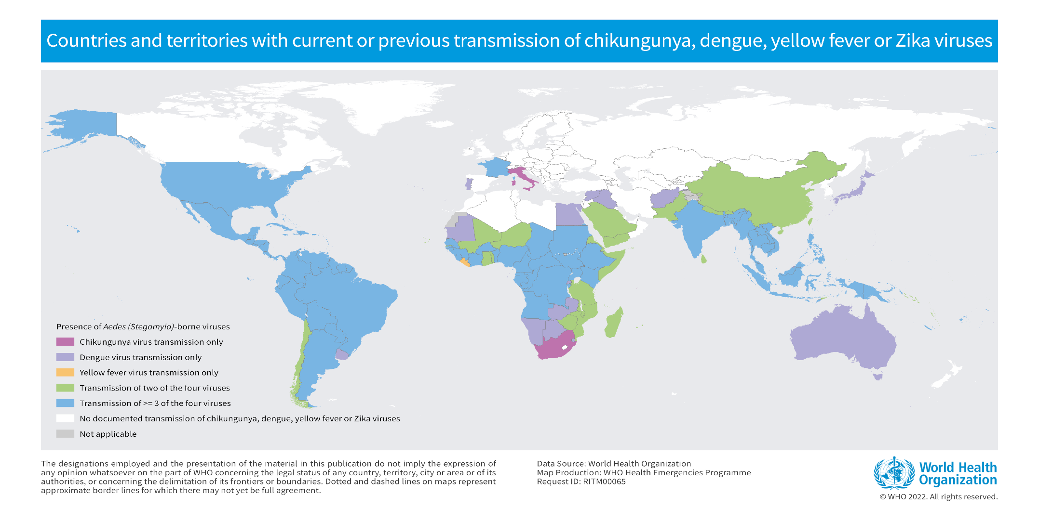
Countries reporting cases of Aedes- (Stegomya)-borne diseases

Slide 3
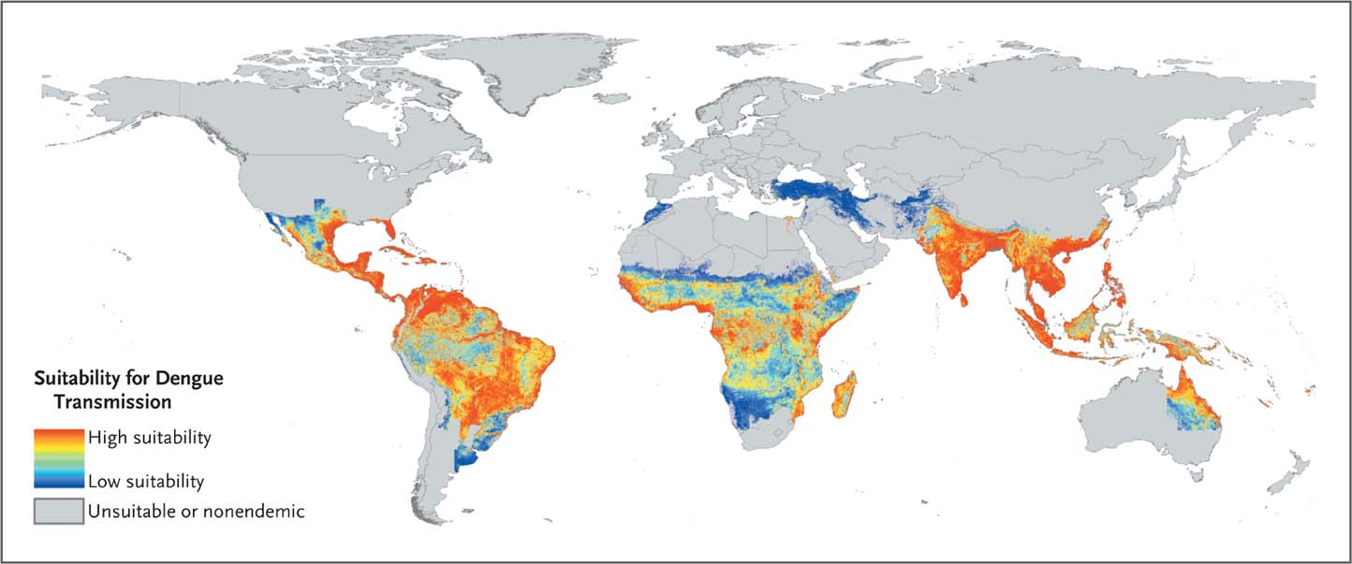
Global Dengue Risk 2012.
Simmons CP et al. N Engl J Med 2012;366:1423-1432
Notes:
Figure 1 Global Dengue Risk. Determination of the risk status was based on combined reports from the World Health Organization, the Centers for Disease Control and Prevention, Gideon online, ProMED, DengueMap, Eurosurveillance, and published literature. Risk exclusions were made on the basis of a biologic model of temperature suitability and areas of excessive aridity defined according to the GlobCover “bare areas” land-cover classification. Within areas at risk, environmental suitability for dengue transmission was modeled with the use of a boosted regression-tree algorithm that took into account 8342 confirmed point-occurrence records, random background pseudo-absences (artificially generated absences), and a suite of 18 environmental and climatic covariates and sources of data (Bhatt S, Gething PW, Brady O, and Hay S: personal communication). (For additional details on the method and sources of data, see the Supplementary Appendix, available with the full text of this article at NEJM.org.)

Slide 4
Dengue: introduction 1
Dengue is a mosquito-borne viral infection, transmitted by females of the species Aedes aegypti and Ae. albopictus
Dengue is found in tropical and sub-tropical climates worldwide, mostly in urban and semi-urban areas. Number of early cases may exceed 400 million out of a population of 4 billion living in areas at risk
Four distinct serotypes of the dengue virus can cause infection.
  Recovery from infection by one provides lifelong immunity against it, while cross-immunity to the other serotypes is partial and temporary.
  Subsequent infections by other serotypes increase the risk of developing severe dengue

Slide 5
Dengue: introduction 2
Infection usually causes flu-like illness, but occasionally develops into a potentially lethal complication called severe dengue
Over 80% of cases are asymptomatic
There is no specific treatment for dengue/severe dengue, but early detection and access to proper medical care lowers fatality rates from 20% to below 1%
Public health control depends largely on vector control

Slide 8
1) Global Malaria Report 2020
2) http://www.pdvi.org/about_dengue/GBD.asp and Brady et.al. PLoS Negl Trop Dis 2012; 6: e1760
 | Malaria 1 | Dengue WHO RECENT 2
Population at risk | 3.2 billion | 2.5 billion | 3.9 billion
Endemic countries | 87 | >100 | 129
Infections /year | 229 million | 50-100 million | 390 million
Severe Cases | 3 million? | 2.1 million
Deaths/ year | 409,000 | 20,000 | 40,000

Slide 9
DRAFT The global strategy for dengue prevention and control (2021-2030)
Goal: To reduce the burden of dengue
Objectives:
To reduce dengue mortality to ZERO
To reduce dengue morbidity by at least 25% by 2030
Technical element 1: Diagnosis and case management
Technical element 2:
Integrated surveillance and outbreak preparedness
Technical element 3:
Sustainable vector control
Technical element 4: Future vaccine implementation
Technical element 5:
Basic operational and implementation research
Enabling factors for effective implementation of the global strategy:
Advocacy and resource mobilization;
Partnership, coordination and collaboration;
Communication to achieve behavioral outcomes;
Capacity building; and
Monitoring and evaluation

Slide 10
Dengue: management
No specific treatment exists
Drinking plenty of fluids avoids dehydration from vomiting and high fever. Dehydration can be suspected in case of:
  Decreased urination
  Dry mouth or lips
  Lethargy or confusion
Paracetamol/acetaminophen can be used to alleviate pain and reduce fever. Pain relievers that can increase bleeding complications should be avoided (aspirin, ibuprofen)
Health staff should know and be able to detect warning signs
Severe dengue requires supportive care in a health facility:
  Intravenous fluid and electrolyte replacement
  Transfusion

Slide 11
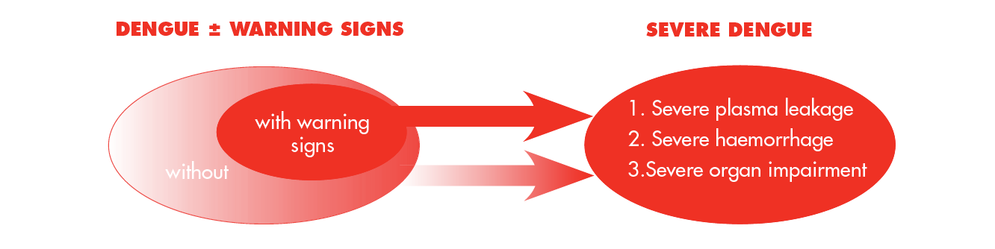
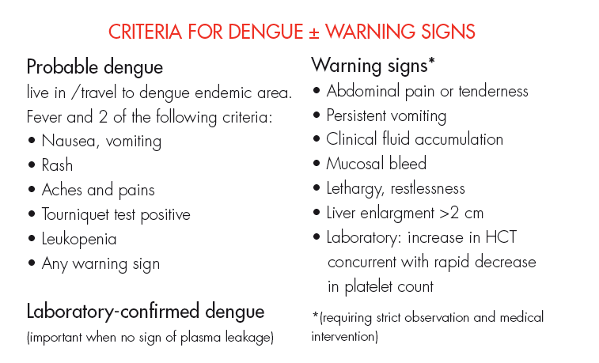
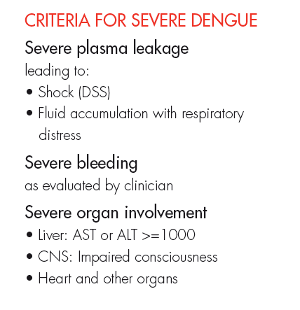
Dengue: clinical presentation

Slide 12
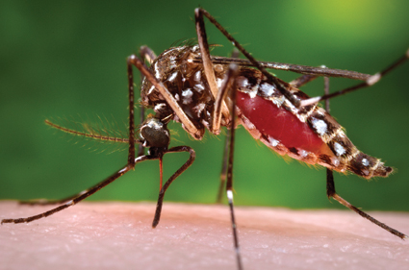
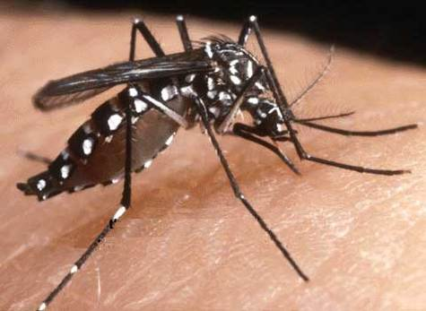
Urban Arbovirus Vectors
aegypti
A. albopictus
Originated in sub-Saharan Africa, spread throughout the tropics centuries ago
Originated in Asia, spread to the Americas, Africa and Europe beginning in 1985
Kraemer, M.U., et al., 2015. The global distribution of the arbovirus vectors Aedes aegypti and Ae. albopictus. Elife 4.

Slide 13
Comparison of vectors
Factors | Aedes aegypti | Aedes albopictus
Climatic conditions | Tropical and subtropical | Tropical and Temperate (Hibernation)
Habitat | Urban centres | Urban and Rural
Feeding pattern | Multiple blood meal | Single blood meal
Feeding preference | Humans (Anthropophilic) | Opportunistic feeder
Feeding place | Inside houses | Inside and outside homes
Breeding sites | Artificial water containers | Tree holes, axils, other natural stagnant water
Eggs | Withstands desiccation | Withstands desiccation
Flight range | 400-500 metres | same
Susceptibility to viruses | High - Moderate | Low to moderate

Slide 14

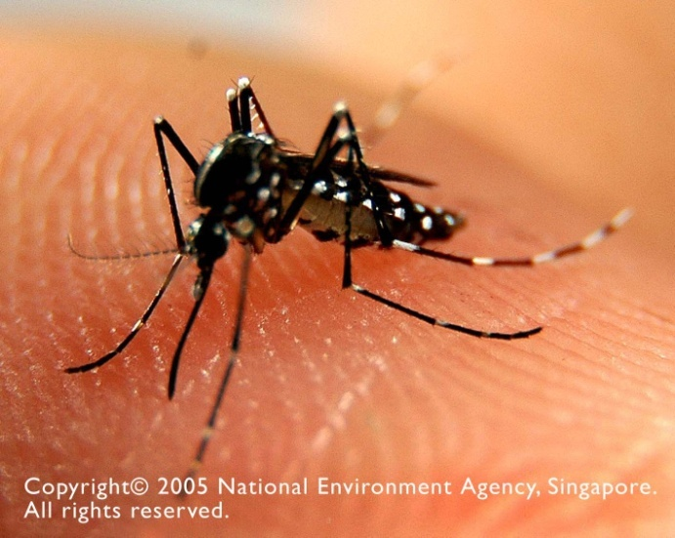
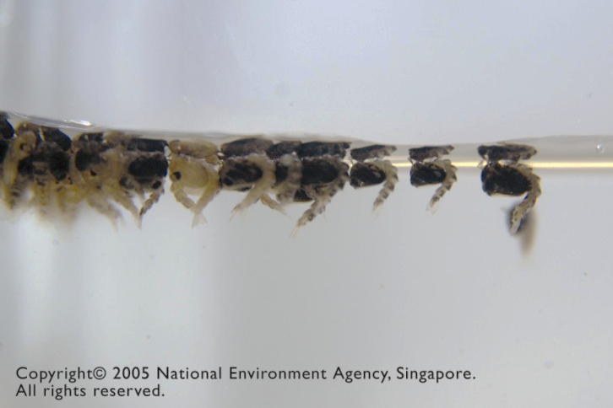
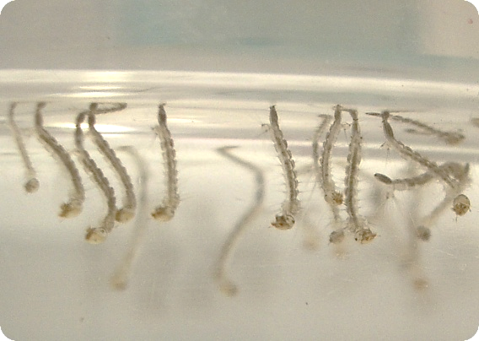
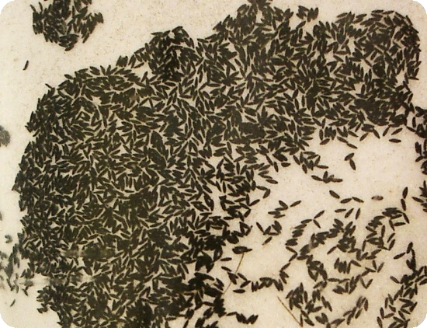
Life cycle of Aedes Mosquito
1-2 days
Pupae
Larvae
Eggs
4-5 days
2-3 days
Stagnant water

Slide 15
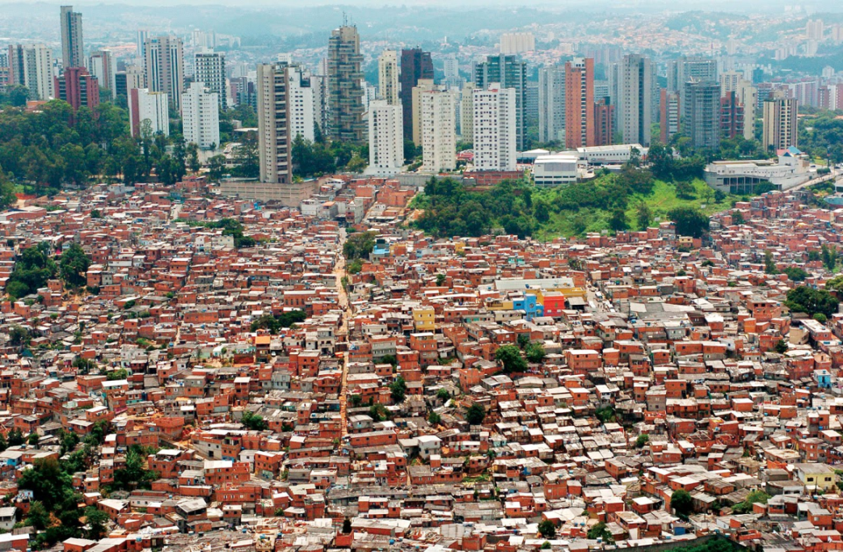
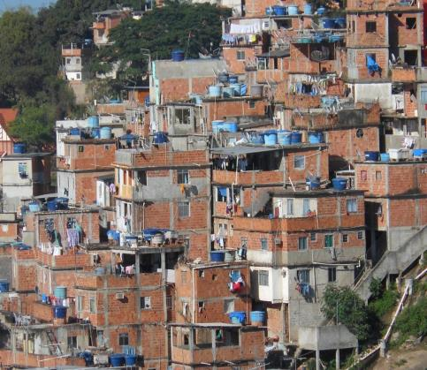
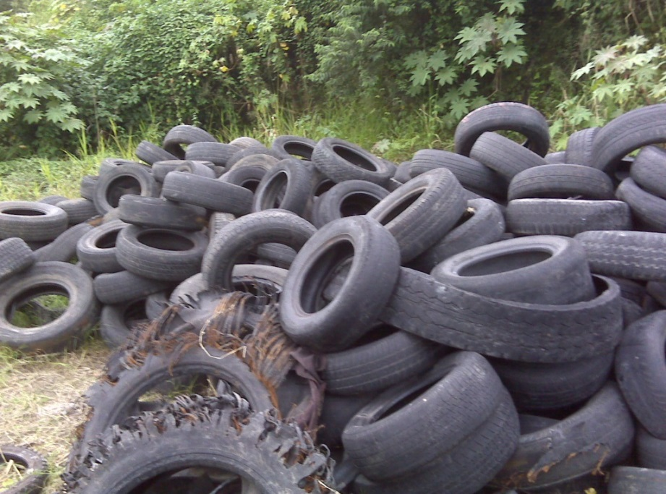
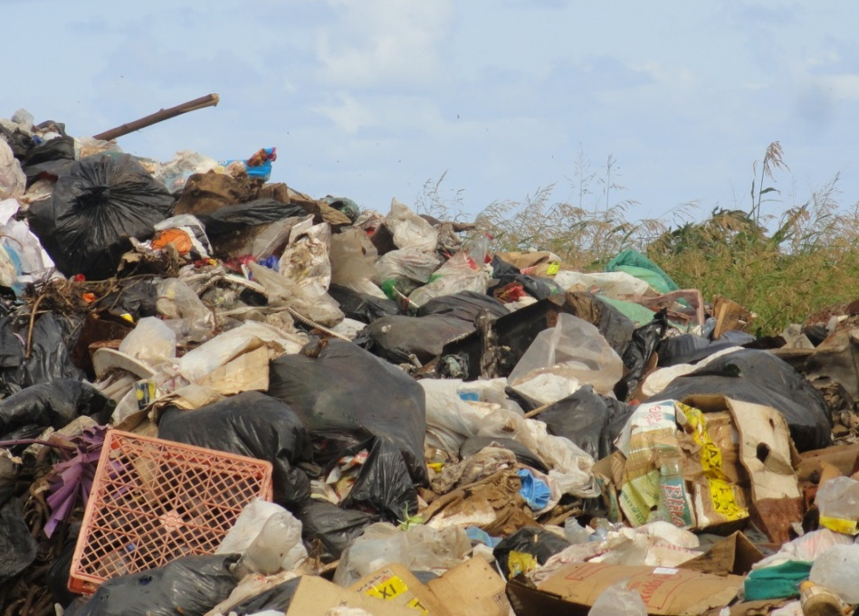
Global spread of Aedes mosquitos
Slide courtesy Dengue Unit PAHO/WHO

Slide 16
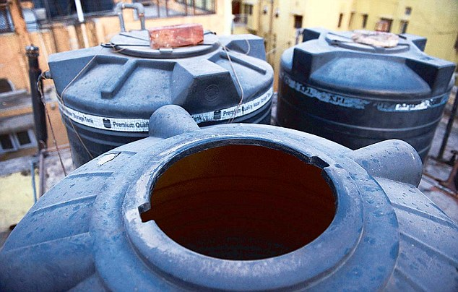
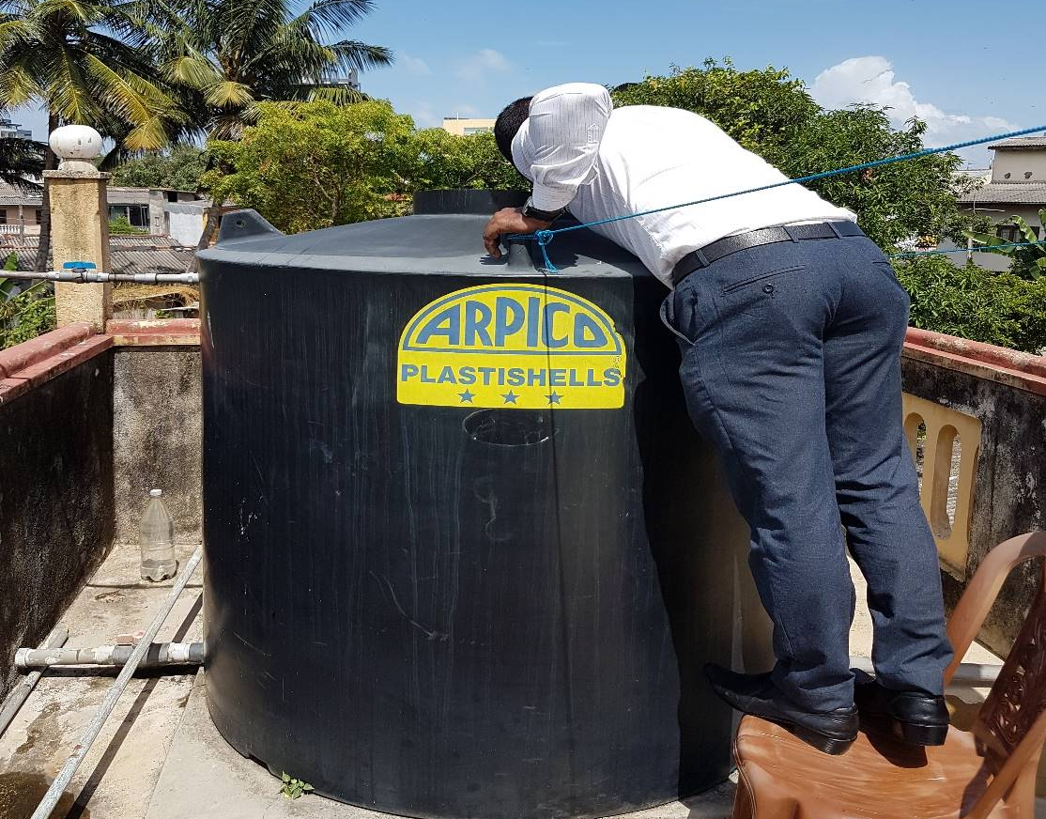
Aedes Breeding Sites
Over Head tanks

Slide 17
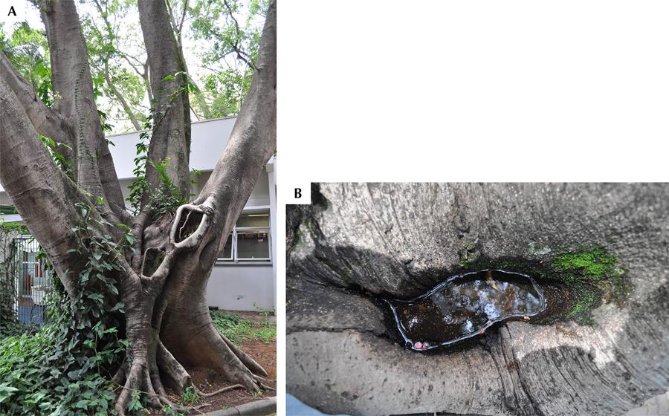
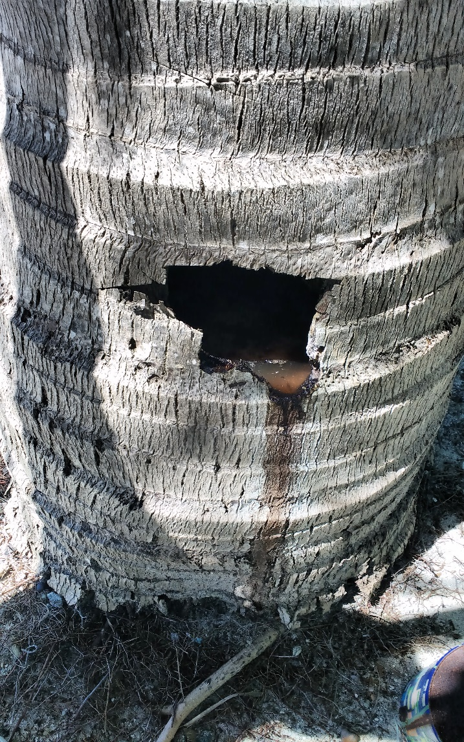
Aedes Breeding Sites
Tree Holes

Slide 18
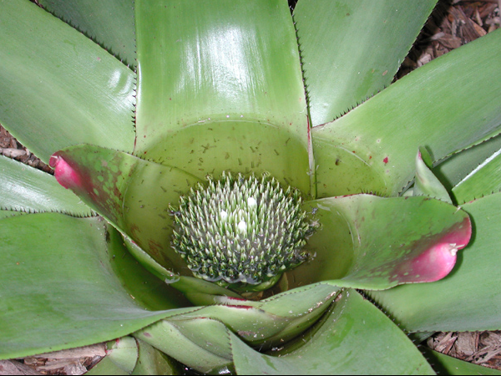
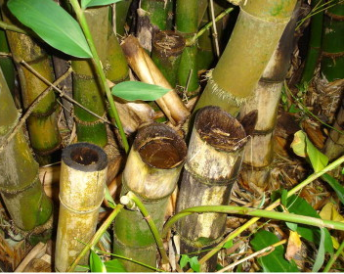
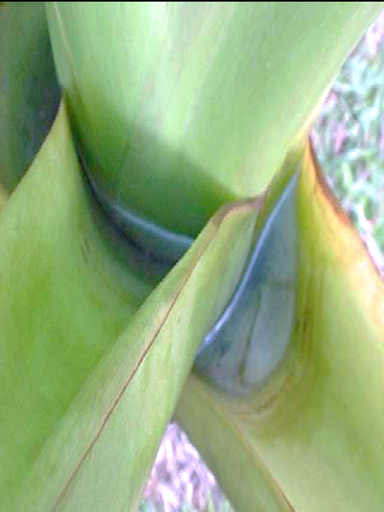
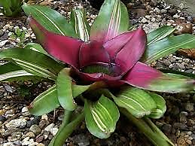
Aedes Breeding Sites
Plants

Slide 19
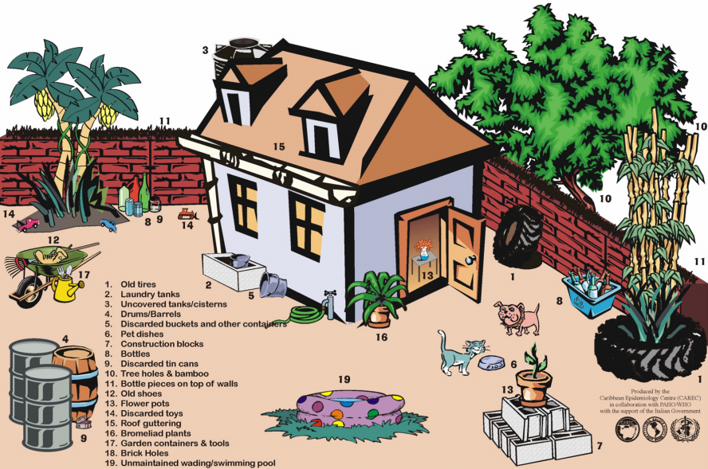

Slide 20
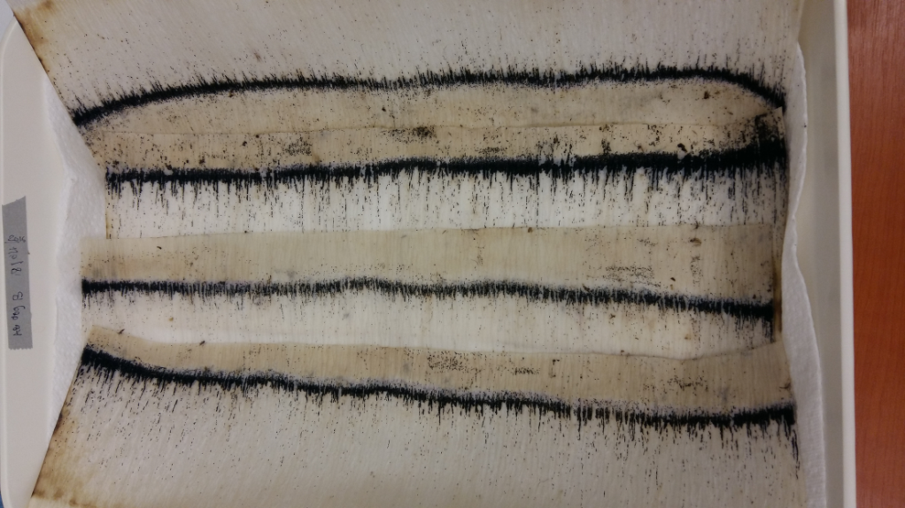
Eggs
Aedes eggs can withstand desiccation and remain dry for many months.
Control options
Scrubbing
Bleaching

Slide 21
Larval Control
Chemical control
  Organophosphates
  Pyrethroids
  Spinosad
  Insect Growth Regulators
Biological control
  Fishes
  Copepods
Biocides –Bacillus thuringiensis var israelensis
Environmental Control

Slide 22
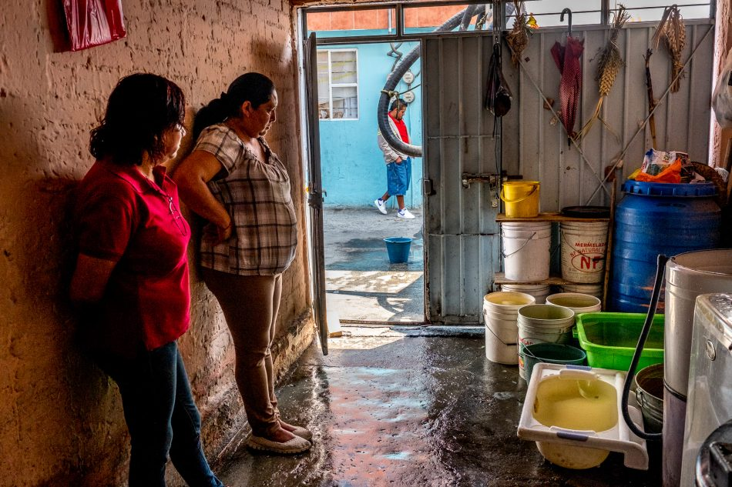
Water storage practices – major issue

Slide 23
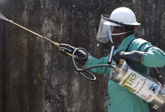
Indoor Residual Spraying (IRS)
Or Perifocal spraying for Aedes control

Slide 24
Perifocal Spraying:-
To reduce the survival of vectors entering the houses
Not effective if the vector rests outdoors and bites outdoors
The chemical should be effective through out the transmission season
Residual action depends on the surface and climatic condition
  Less re-plastering of sprayable surface.
It also depends on the structure of the house (large windows and doors hinder effectiveness)

Slide 25
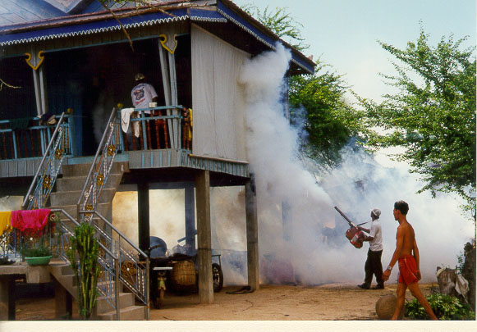
Space spraying with portable thermal fogger
for emergency adulticiding

Slide 26
Conditions for space spraying
To be used as an emergency measure
Precise location to be sprayed
Based on distribution of case house(s)
Type of vector (Aedes aegypti vs Aedes albopictus or both)
Adequate trained staff and supervisors
Availability of protective cloth and accessories
Health information and communication back up
Spraying to be done early morning or late evening

Slide 27
Vector Control Conclusions & Implications
Use locally adapted & derived vector control to fight dengue. Success will require enhanced intersectorial & interdisciplinary interaction & strong community engagement (GVCR).
Know your vector & its local ecology. The primary DENV vector is Ae. aegypti. It prefers to rest & blood feed indoors. Thus, adulticides targeting Ae. aegypti should focus on indoor areas using residual insecticides.
Know the insecticide susceptibility of the local vector population.
Most space sprays (both aerial & ground) are relatively ineffective in controlling dengue, unless they are repeatedly delivered inside homes. Non-residual thermal fog or ULV spray outdoors is generally ineffective because it misses indoor resting Ae. aegypti & kill for a short time. Repeated indoor applications are needed.
Targeted indoor residual spray (TIRS) shows promise for reducing dengue. TIRS is labor intensive & intrusive. Can be ineffective if mosquitoes are resistant or if coverage is poor.
Adulticiding should not be done in isolation. Adulticiding should be part of an integrated vector management plan, in partnership with a larval control program involving source reduction &/or larvicides.
Future dengue control programs will require a combination of tools & strategies. Insecticide-based interventions in combination with vaccines & non-insecticide-based vector control; e.g., source reduction, management of the built environment & Wolbachia.

Slide 28
Prevention and control of dengue during COVID-19 pandemic
Community involvement:
Mobilize community support for prevention of COVID-19 and dengue (ensuring physical distancing measures introduced for COVID-19 prevention).
Simple materials on information, education and communication through the media (including social media) for both diseases where possible.
Households should be encouraged to eliminate mosquito breeding sources; in accordance with physical distancing and hand hygiene measures.
In areas where schools and colleges have resumed classes, special sessions should be devoted to raising awareness of COVID-19 and dengue..
Notes:
Highly productive mosquito breeding sites such as water storage containers (drums, overhead tanks, mud pots, etc.) should be targeted for prevention of breeding; other breeding sites such as roof gutters and other water holding containers should also be cleaned periodically.
Local teams know how to tailor information effectively; sometimes national campaigns and messages are not as effective as local initiatives.
Media campaigns can continue for dengue prevention and control of Aedes mosquito breeding

Slide 29
Dengue - A disease for the 21st century
Uncertain distribution and burden
As malaria declines, dengue, Chikungunya and Zika rises
Impact of Environmental changes
Silent expansion and cryptic breeding of the vector
Two vectors transmitting more than 4 diseases

Slide 30
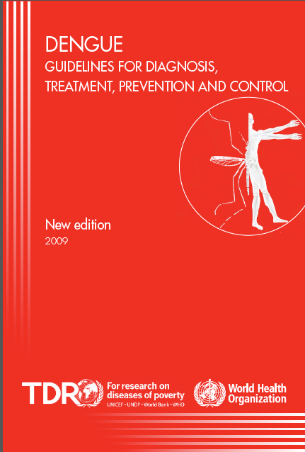
WHO guidelines
https://www.who.int/neglected_diseases/resources/9789241547871/en/
Under revision for each chapter
Applicable to other arboviruses
Norms and standards (GRC review)

Slide 31
Exercise
A major earthquake struck the Western province of Solomon Islands in 2015. Large number of houses were damaged and the population were accommodated in camps on a soccer pitch. Dengue cases were reported /prevalent in these islands.
What are the major health challenges
When do you anticipate outbreaks of vector borne diseases
What are the control measures to be instituted.

