Slide 1
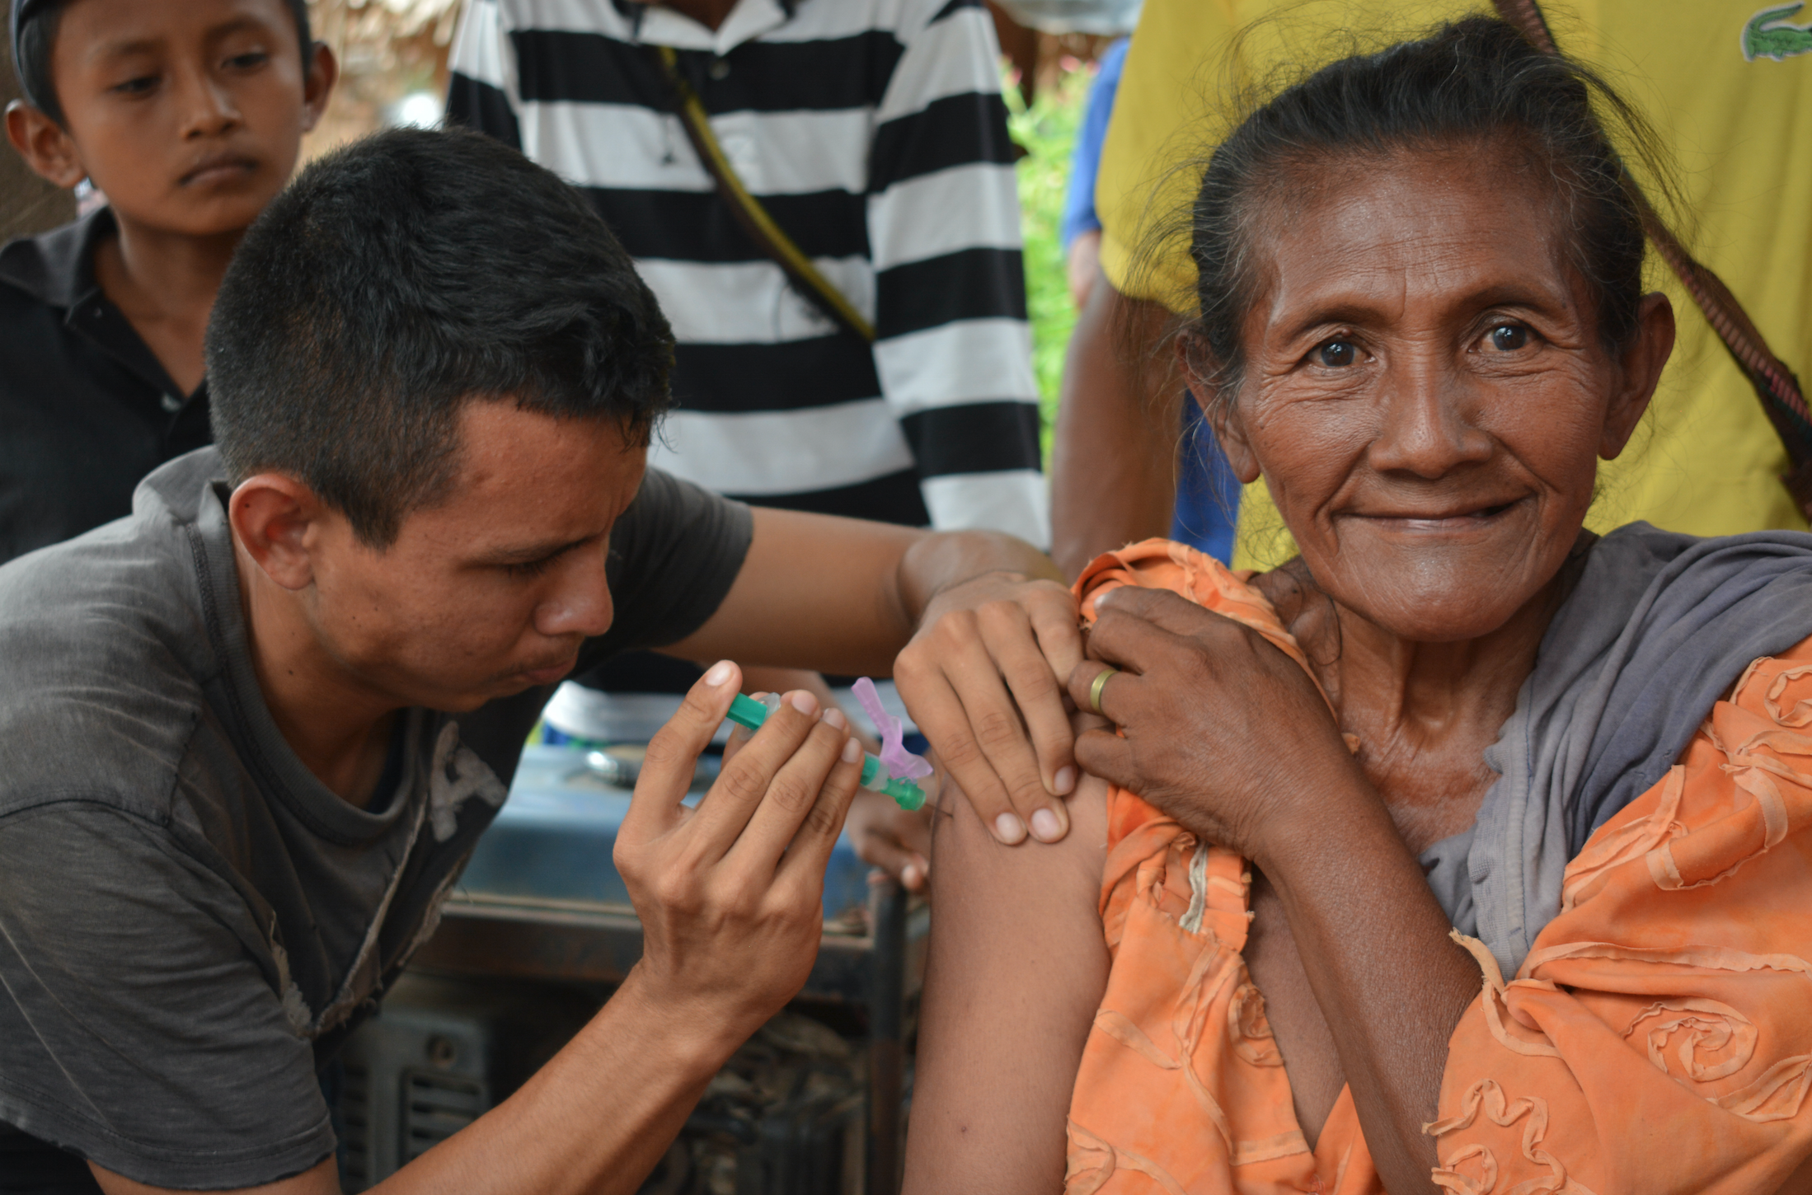
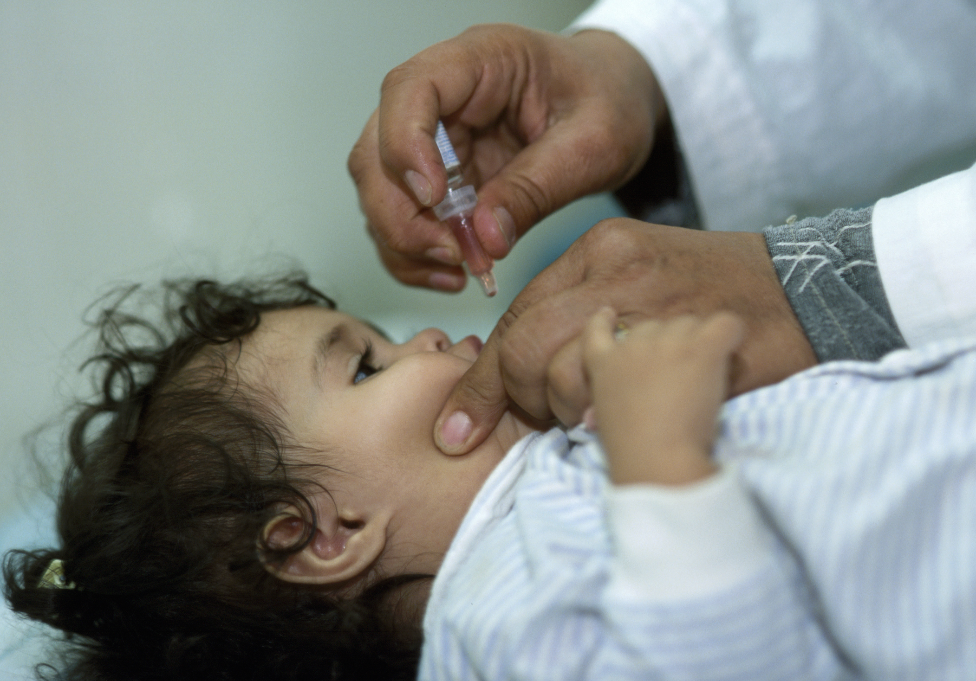
Logo(s) organization(s) facilitator(s)
Communicable diseases:
Vaccine-preventable diseases
Andreina Ludovic, ©ICRC
Christopher Black, ©IFRC
Facilitator name(s) + organization(s)
These learning materials were developed by
Rodolfo Rossi, ICRC, and Gabriel Alcoba, Tropical & Humanitarian Medicine Division, Geneva University Hospitals (HUG) /Médecins Sans Frontières (MSF)

Slide 2
Objectives
Be able to:
identify priority diseases for preventive and /or re-active vaccination during acute and protracted crises (EPI / outside EPI)
explain how they prioritize population groups for vaccination of selected diseases at times of limited vaccine availability
explain points to consider when planning the implementation of a vaccination programme / campaign

Slide 3
Group work –Introduction
Priority diseases for vaccination in two contexts:
The Lebanon refugee crisis
South Sudan: internal armed conflict

Slide 4
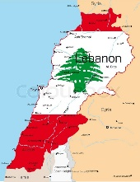
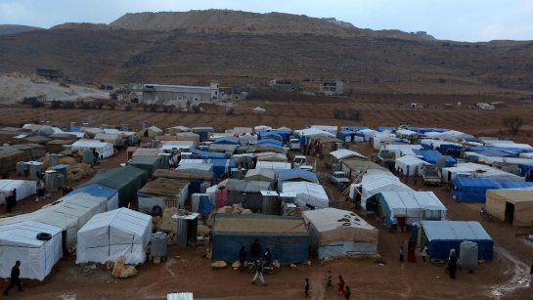
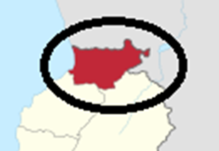
Context 1: the Lebanese refugees crisis
Real scenario
>1 M Syrian + ~400K Palestinian refugees (6M people living in 10K Km2)
Double burden of diseases
Lebanese MoPH overwhelmed
Highly privatized health system not investing in preventive services
Low uptake of vaccination services for both Lebanese & Syrians
Akkar governorate: limited availability of PHC services + high population density & movements
Reports of measles, mumps and polio outbreaks

Slide 5
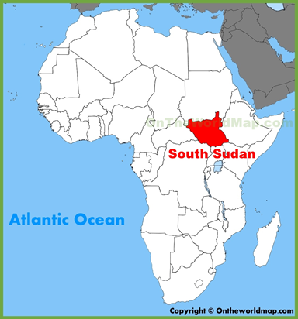
Context 2: South Sudan internal conflict (since 2013)
Fighting → influx 80’000 displaced in small town of 20’000 people
You are working in a MoH hospital during the malaria season (50% admissions for malaria)
Hospital is overloaded: Beds occupancy suddenly 150% (160 beds)
15 cases of suspected measles in a district of 200,000 pop inhabitants.
No confirmation is possible as the laboratory is not rapidly available. Serology is sent to Uganda but it needs 1 week.
Mostly children affected. Death of 1 malnourished child and 1 pregnant woman with fever and rash.
Real scenario
Total population 13 million (M)
1 M live as refugees in neighbouring countries
2-3 M are displaced by war, disease, hunger

Slide 6
Group work 1
2-3 of the groups focus on Lebanon, the other 2-3 on South Sudan
Task:
What are the top three diseases, in order of priority, that you propose for vaccination in your context. Explain the reasons for your choice.
Time allocated: 10 minutes

Slide 7
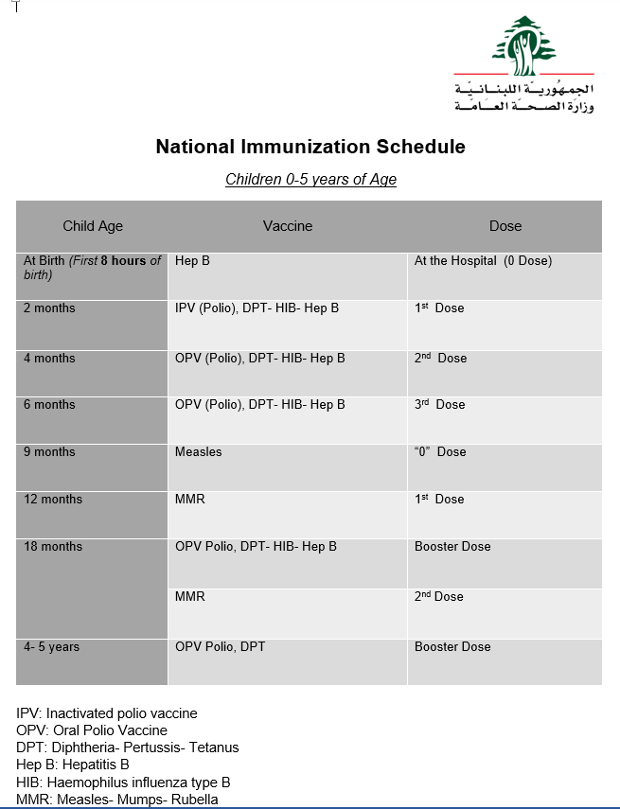
Lebanese EPI Vaccination calendar (2015)
Notes:
Ask the groups whether they have look at the country’s EPI Vaccination calendar

Slide 8
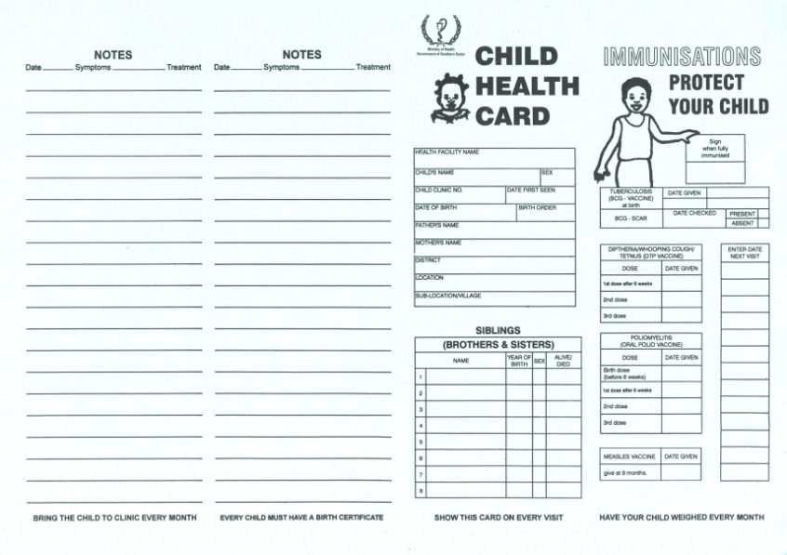
South Sudanese -EPI vaccination calendar

Slide 9
Priority should be given based on the following criteria / Key elements for deciding priority are
  Case Fatality Rate (CFR): n of deaths due to the disease/total cases of the same disease
  Basic Reproductive Number (R0) & mode of transmission (potential for outbreak) – R0: the average number of new (secondary) cases produced by one case

Slide 10
Case fatality rate (ratio), CFR
CFR of some vaccine-preventable diseases
Measles: 2-6% and >10% in case of malnutrition or HIV in LMIC
Diphtheria: 1-10%
Tetanus: 6-68%
Polio 2-5% with
  but added disability
Rubella <0.1%
  but foetal-morbidity
Pertussis: 1%
Ebola > 50% (25-90%)
Proportion of deaths among the cases over the course of the disease
Rather constant for 1 disease in 1 same context;
Varies with:
- Age
- Risk factors/exposure
- Level of care

Slide 11
Case fatality rate (ratio), CFR
Is Case Fatality the only criteria to decide that a disease is the Nº 1 priority?
Which could be other criteria?
  Burden: Incidence and duration
  Transmission (Measles)
  Disability and socio-economic impact (Polio, Cholera, Meningitis…)
  Panic (Ebola, plague)
Most aid organizations prioritize diseases based on:
  CFR + rate of complications
  Incidence in vulnerable populations
  Transmission
  Cost, impact, co-morbidities

Slide 12
Disease | Transmission | Serial interval (range) | R0 | Heard immunity threshold (%)
Measles | Airborne | 7-16 days | 12-18 | 83-94
Pertussis | Airborne droplet | 5-35 days | 12-17 | 92-94
Diphtheria | Saliva | 2-30 days | 6-7 | 85
Polio | Faecal-oral route | 2-45 days | 2-4*, 8-14▵ | Variable
Rubella | Airborne droplet | 7-28 days | 6-7 | 83-85
Mumps | Airborne droplet | 8-32 days | 4-7 | 75-86
Malaria | Vector-borne | 20 days | 5-100 | 80-99
Cholera | Faecal-oral route | Variable | Variable | Variable
Influenza | Airborne droplet | 2-4 days | 2-4 | 50-75
Ebola (2014 outbreak) | Body fluids | 6-24 days | 2 | 50%
Tuberculosis | Airborne | Months-Years | - | -
* Population with good hygiene; ▵ Population with poor hygiene
-> Priority diseases from an epidemiological perspective: 1. Measles, 2. Pertussis, 3. Diphtheria

Slide 13
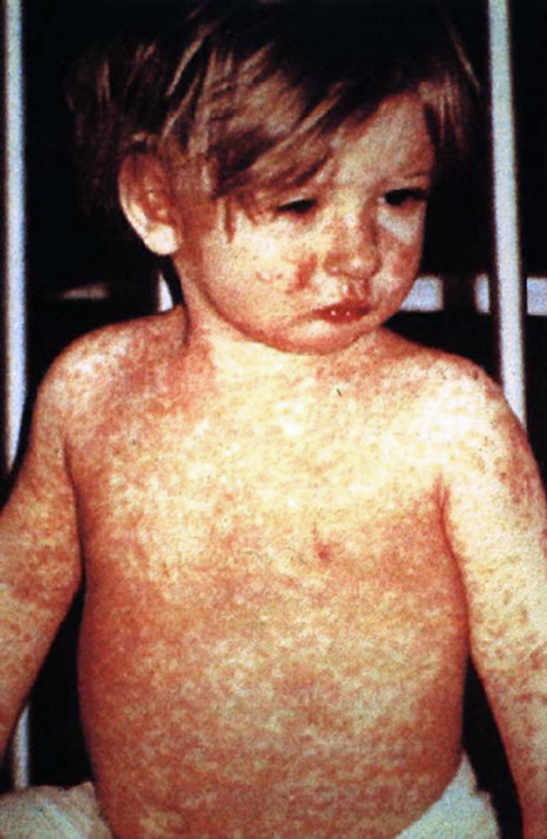
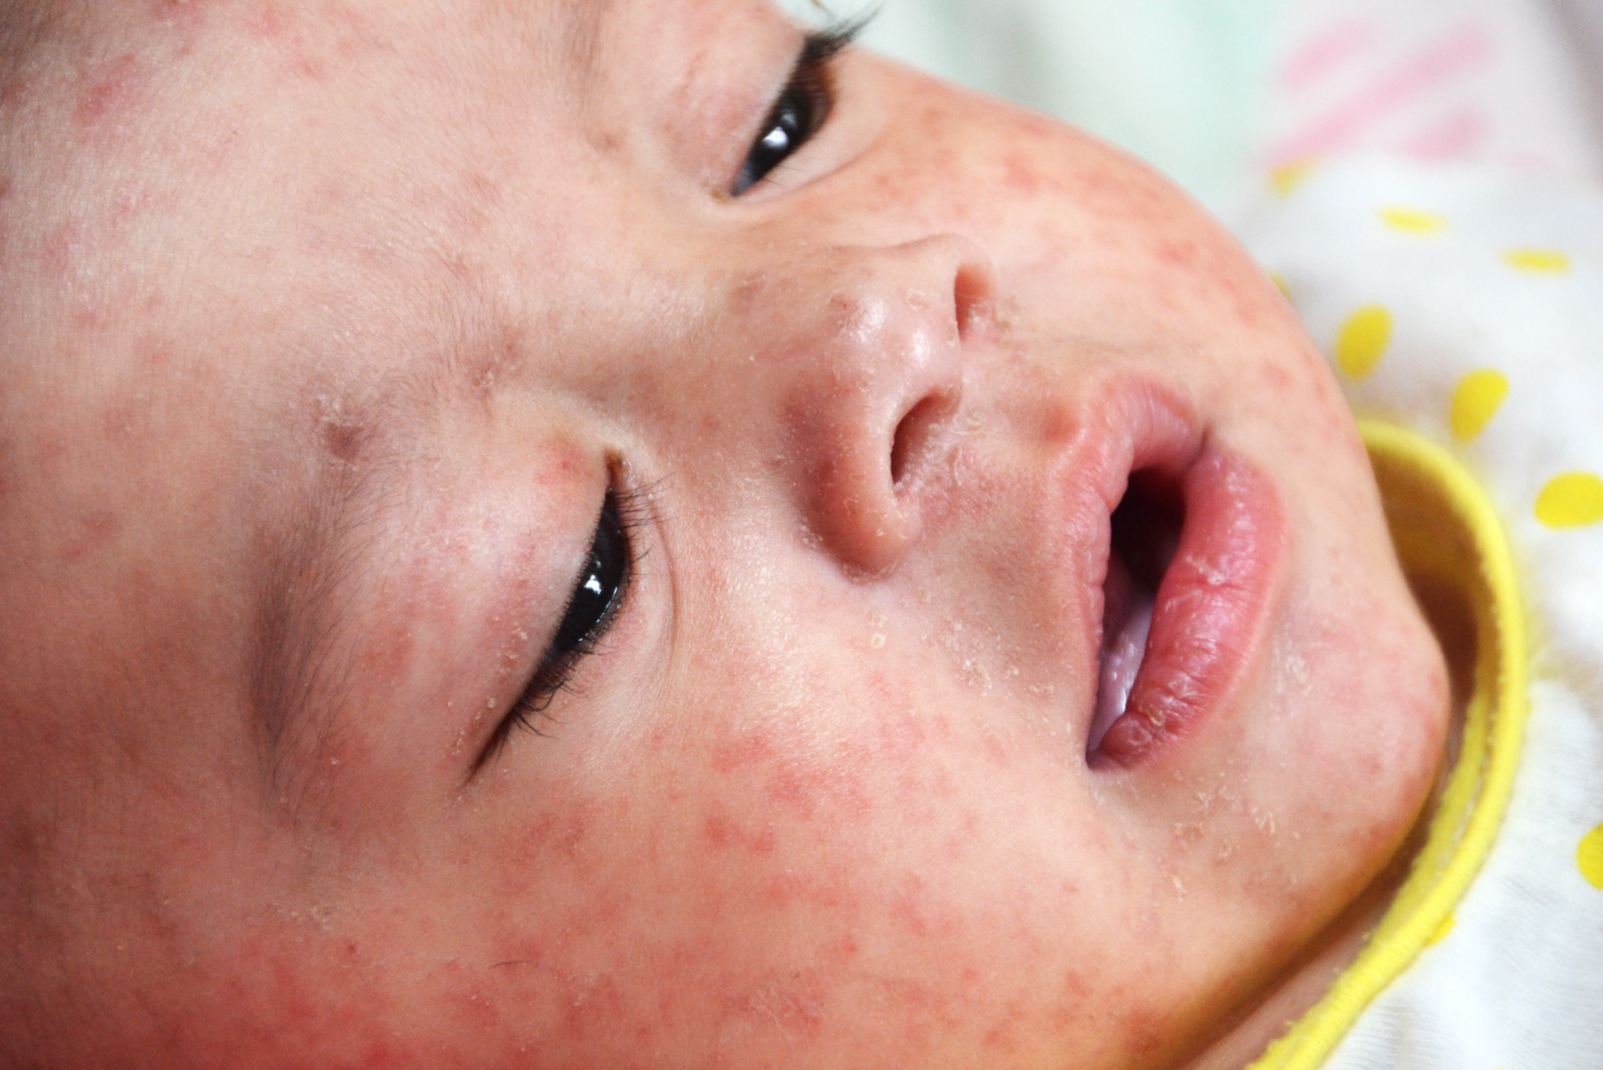
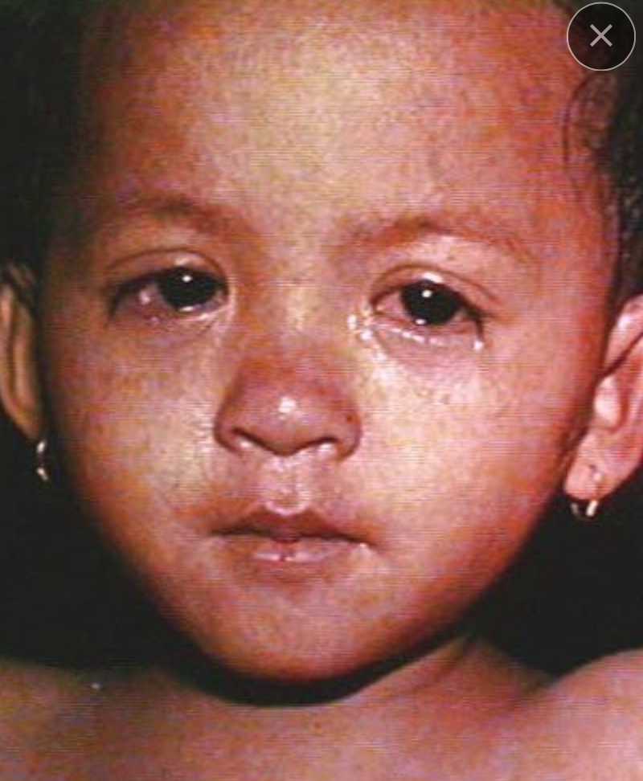
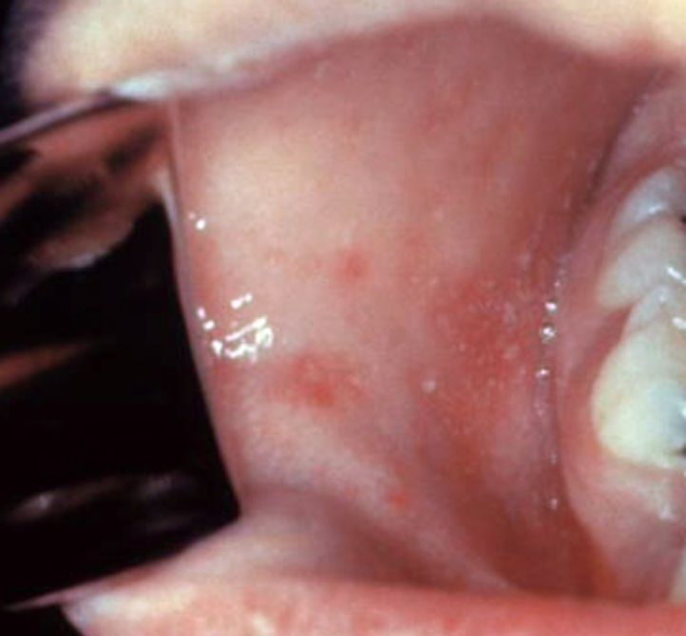
Measles
Baby with measles
Child with a classic measles rash
after four days (with fever, cold,
cough, conjunctivitis).
Eyes of child with measles
Koplik spots
Sources: www CDC

Slide 14
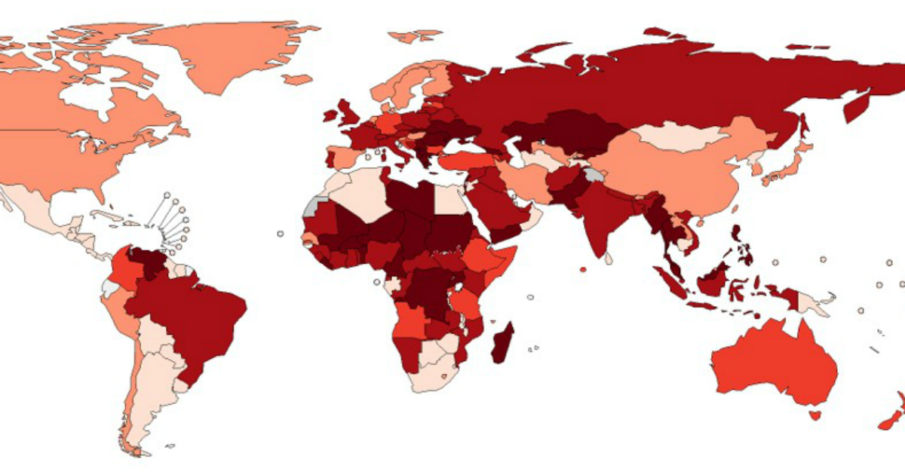
April 2019: Provisional data about reported measles cases in the world
Reported measles cases rose by 300% in 1st quarter 2019 compared to same period 2018
Outbreaks include Ethiopia, DRC, Georgia, Kazakhstan, Kyrgyzstan, Madagascar, Myanmar, Philippines, Sudan, Thailand and Ukraine, causing many deaths – mostly among young children.
Over recent months, spikes in case numbers also occurred in countries with high overall vaccination coverage, e.g. USA, Israel, Thailand, Tunisia (fast spread among clusters of unvaccinated people.
https://www.who.int/immunization/newsroom/measles-data-2019/en/

Slide 15
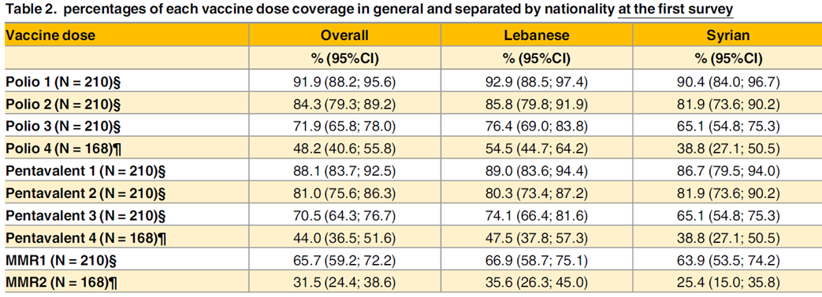
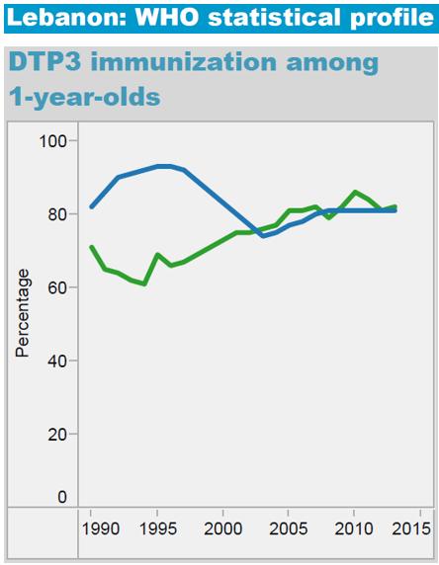
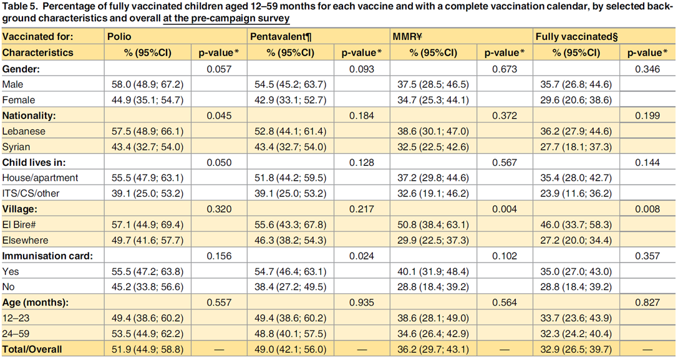
Lebanon vaccination coverage: official/routine reports vs surveys
Tables from Lebanon (2015): https://doi.org/10.1371/journal.pone.0168145
Notes:
Source table: https://journals.plos.org/plosone/article?id=10.1371/journal.pone.0168145
Vaccination Coverage Cluster Surveys in Middle Dreib – Akkar, Lebanon: Comparison of Vaccination Coverage in Children Aged 12-59 Months Pre- and Post-Vaccination Campaign
Rodolfo Rossi, Ramia Assaad, Arianna Rebeschini, Randa Hamadeh
Published: December 19, 2016

Slide 16
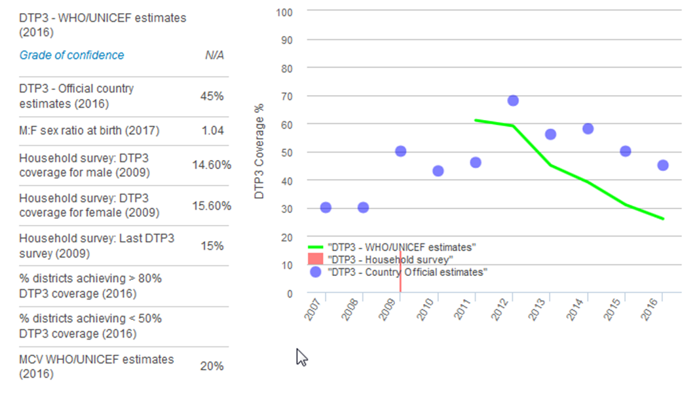
South Sudan
Use of basic drinking water services (%) |  | 2015 | 50
 |  |  | 60
 |  |  | 48
Use of basic sanitation services (%) |  | 2015 | 10
 |  |  | 28
 |  |  | 6
2016 Immunization coverage (%) | BCG |  | 37
 | DTP1^{β} |  | 35
 | DTP3^{β} |  | 26
 | polio3 |  | 31
 | Measles1 |  | 20
 | Measles2 |  | 0
 | HepB3 |  | 26
 | Hib3 |  | 26
 | Rota |  | 0
 | PCV3 |  | 0
 | Protection at birth (PAB) against tetanus ^{λ} |  | 75
Extremely alarming coverage indicators (source UNICEF 2017)
Which disease will be priority 1?

Slide 17
Vaccination exists for the following diseases
Tuberculosis (BCG)
Measles
Mumps
Rubella
Polio
Diphtheria
Tetanus
Pertussis
Hepatitis B
Haemophilus influenza B
Pneumococcus
Meningococcus
Influenza
6 basic EPI vaccinations during 1st year of life in many African countries:
BCG
DPT 1-2-3
Polio 1-2-3
Measles or MMR
Specific conditions
Hepatitis A
Yellow fever
Typhoid fever
Japanese encephalitis
Cholera
Rotavirus
Rabies
Human papilloma virus (HPV)
Experimental stage
Malaria (experimental)
Dengue (failure)
Ebola (new, seems effective)
MMR
DPT*
Hexavalent*
Pentavalent*
*Combinations depend on brands & country programs

Slide 18
Group work 2
For your context (Lebanon, South Sudan):
Define your target population (age /other factors) for a catch-up vaccination campaign.
List points to consider when planning for a vaccination programme /campaign
Which challenges may you be faced with during the programme / campaign?
Time allocated: 15 minutes

Slide 19
Target population for a vaccination programme and
campaign
Routine vaccination - catch up campaign - in case of a disease outbreak
Standard age groups according to national vaccination calendar
Susceptibility
  Non / partly-immune populations
Vulnerability
  Per-se vulnerable to the disease
  External factors due to crisis situation
  Higher risk of complications / death
Areas with low vaccination coverage (herd immunity threshold)
Geographic area(s) for prioritisation (need to put a limit)
  Rural - camps – urban: Densely populated areas
  Estimated population and obstacles, e.g. logistics, security

Slide 20
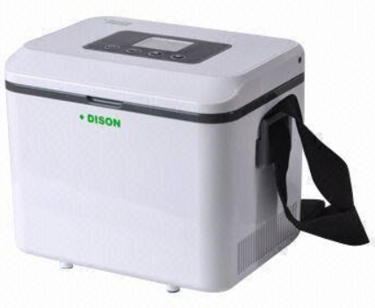
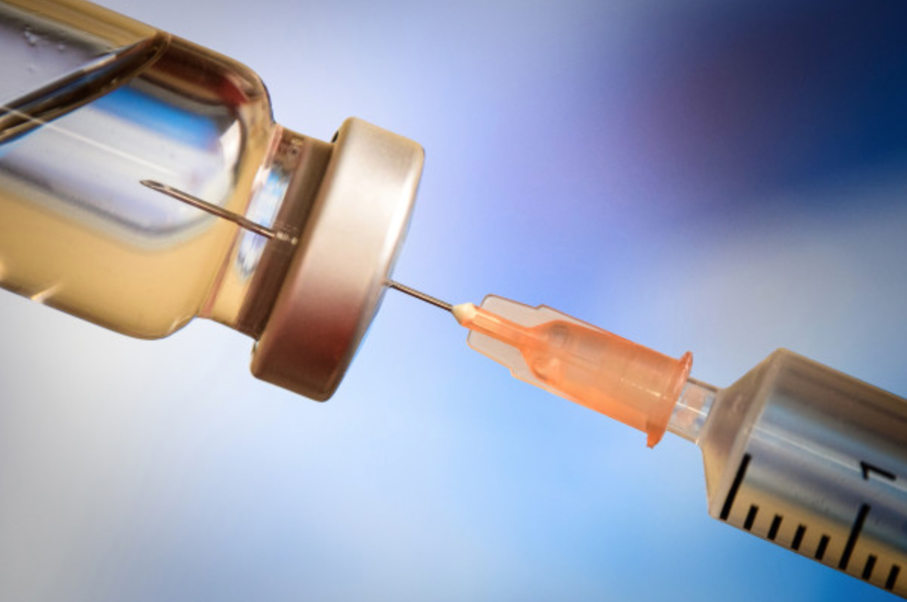
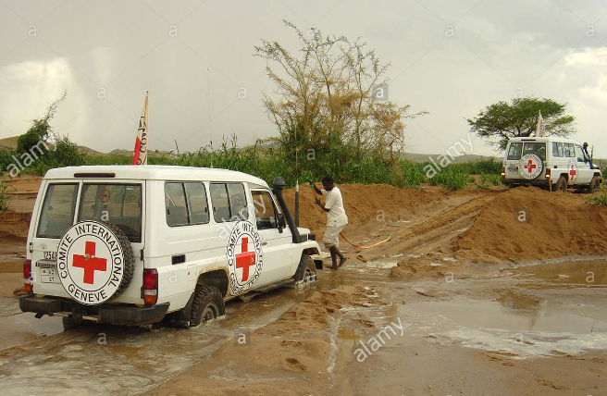
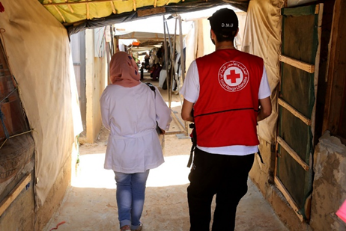


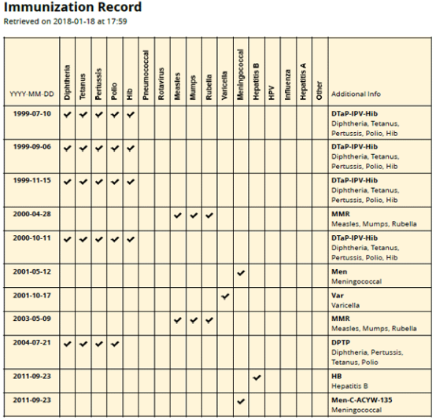
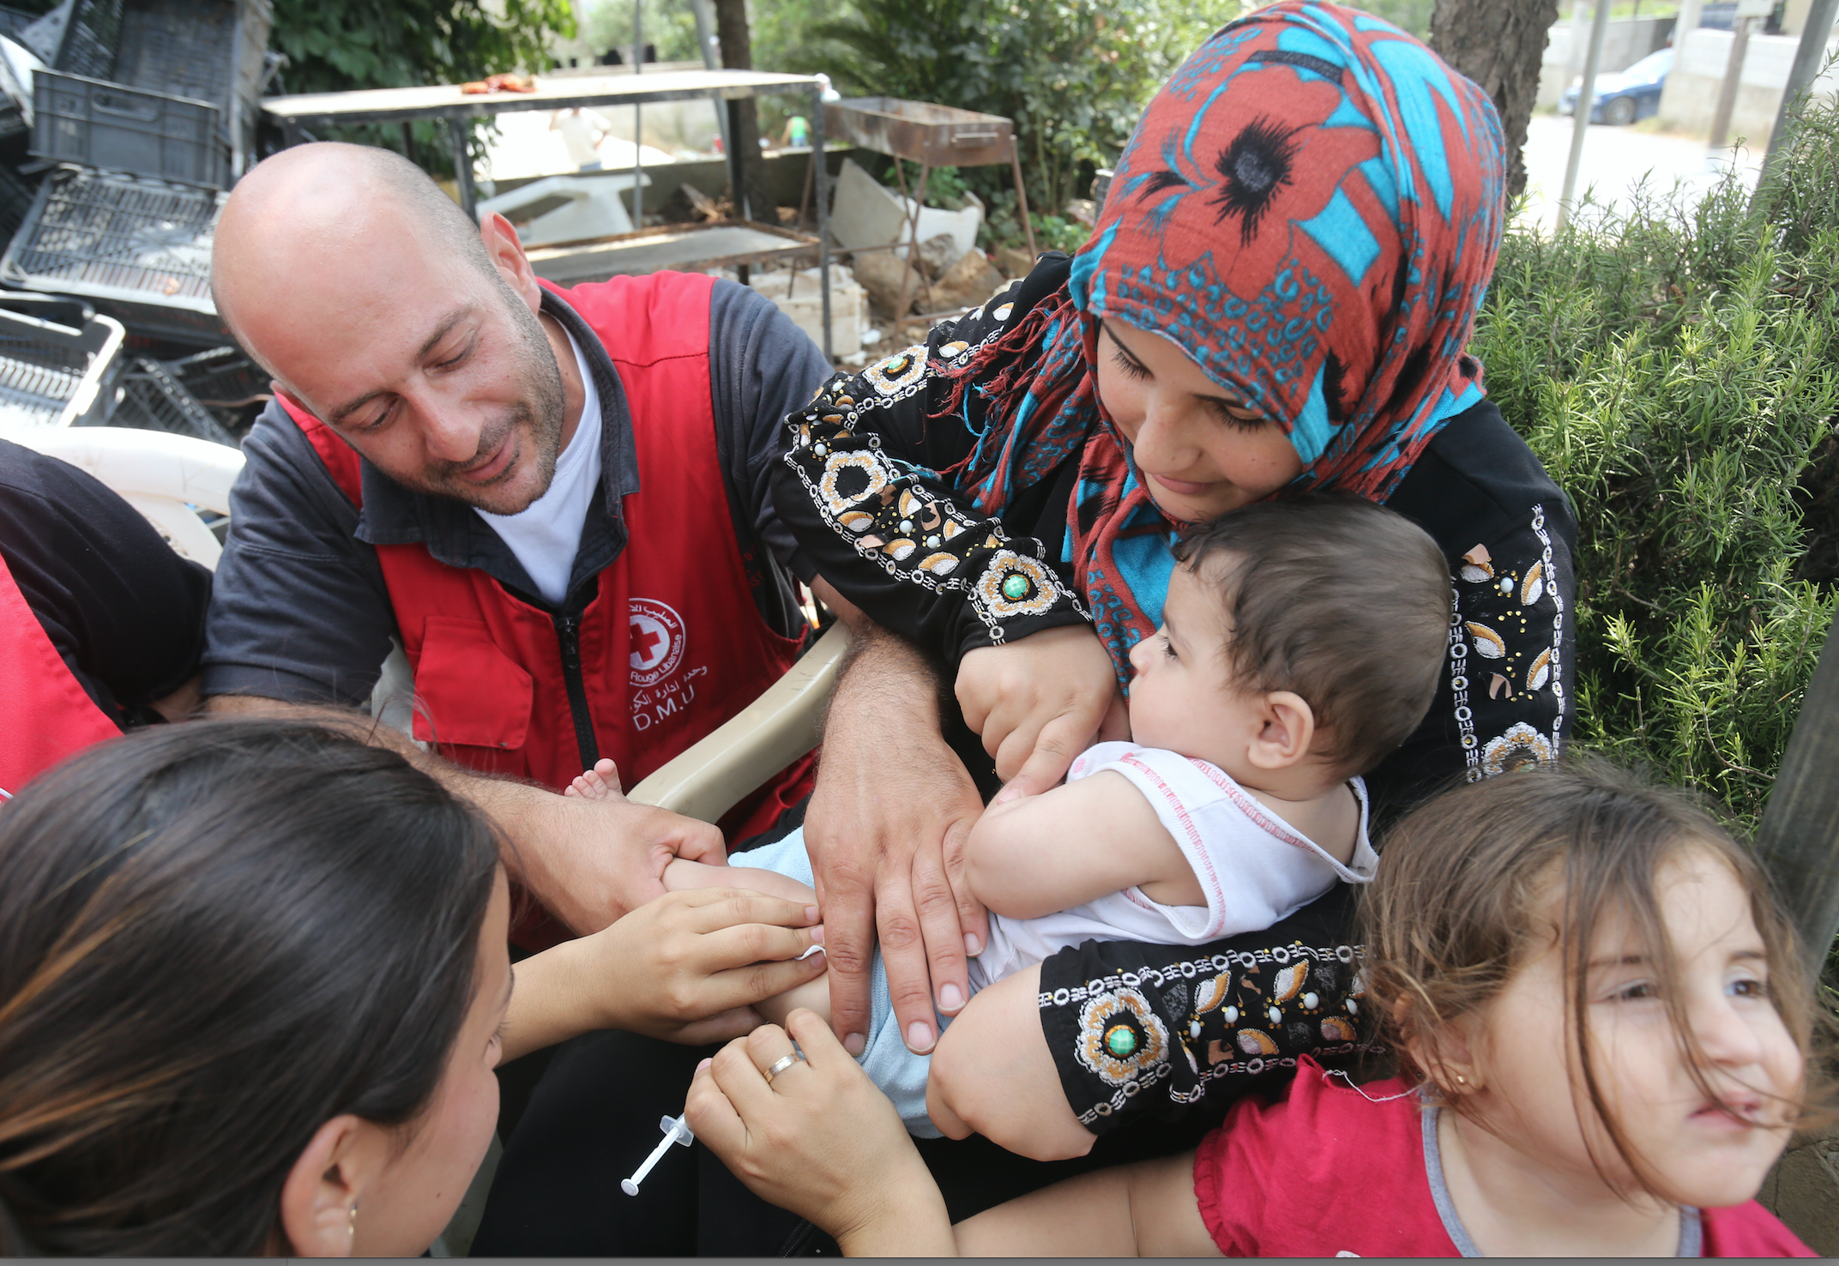
Points to consider (campaign)
Vaccines /other supplies
Personnel; Assign ad-hoc staff during a vaccination campaign
Set-up special vaccination sites
Consider alternatives to reach groups with low vaccination coverage (e.g. door to door)
Logistical support, e.g. cold chain, transportation, fuel
Information & social mobilization
Selective vs non-selective vaccination
Vaccination recording /reporting
Financing
Leadership and coordination

Slide 21
Take constraints into account
  Supply time for vaccines and other supplies
  Staff availability (right mix)
  Logistical capacity
  When limited, it will be better in the case of an (imminent) outbreak to start the campaign quickly, targeting priority areas, rather than wait for the means for a larger scale operation that will be too late.
  Acceptability (NB. Spread of vaccine misinformation; Managing adverse effects of immunization (AEFI) -> have a plan ready to deal with this!!)
  Accessibility: Road network, distance, population density
  Special events (holidays, elections, food distribution, etc.)
  Security

Slide 22
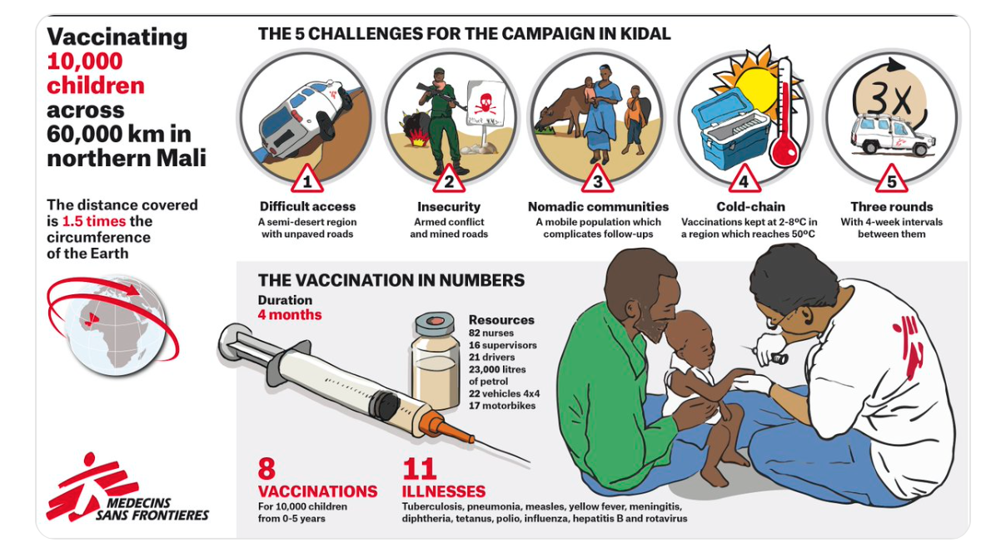

Slide 23
Wrap-up -1
From a clinical and epidemiological perspective, the priority target for vaccination is based on a combination of:
  Case-fatality ratio (CFR) & burden of disease
  Basic reproductive rate (Ro)
  Mode of transmission (air/droplets is most dangerous, also water / vectors)

Slide 24
Wrap-up -2
Measles: Vaccinate! often No1 priority because incidence (rate) + transmissibility (R0) + CFR (lethality) are all HIGH. “It’s not IF measles will happen, but WHEN it will happen” in many crisis situations (routine vaccination & cold-chain break down).
Meningitis, Cholera, Diphtheria, Yellow fever: Outbreaks are often local, some very important, vaccination is essential
  Cholera : rehydration, water-sanitation and hygiene are crucial
Rubella : low CFR but good to combine with measles and mumps (MMR)
Malaria : case management and vector-control (vaccine not very effective)

Slide 25
Wrap-up -3
Organizing a vaccination programme and/or campaign:
Careful formulation and planning is needed before starting a routine vaccination programme or vaccination campaign
Take opportunities and constraints into account
Information, social mobilization and coordination are essential

Slide 26
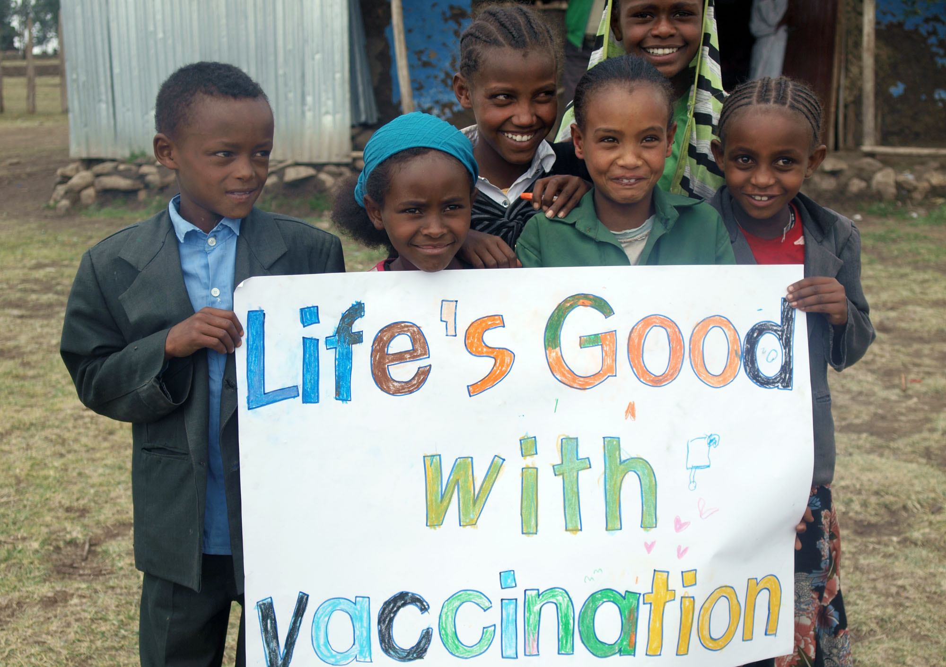
Any questions?

Slide 27
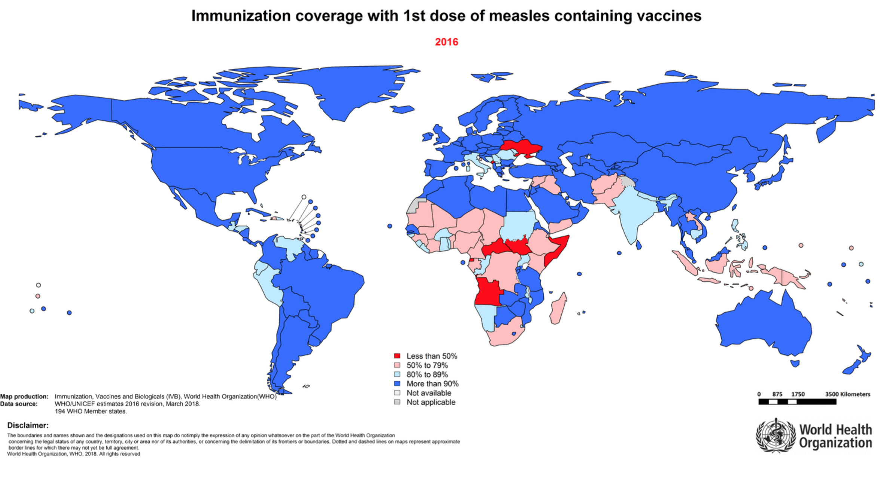

Slide 28
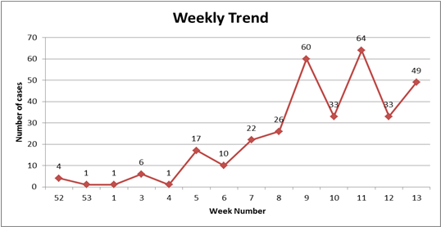
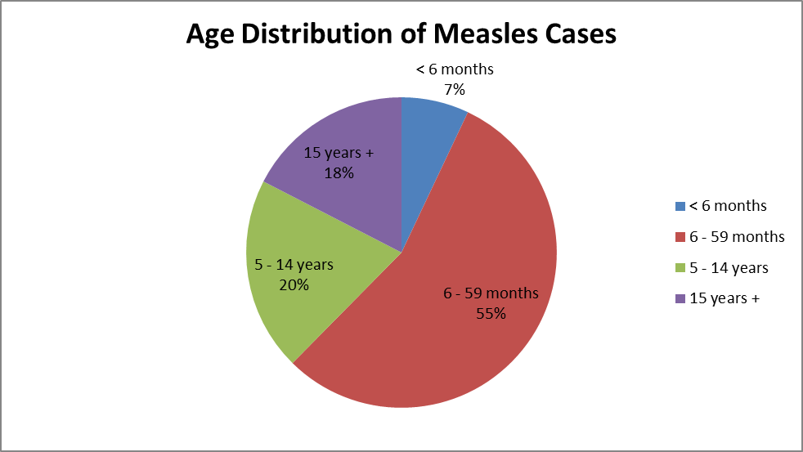
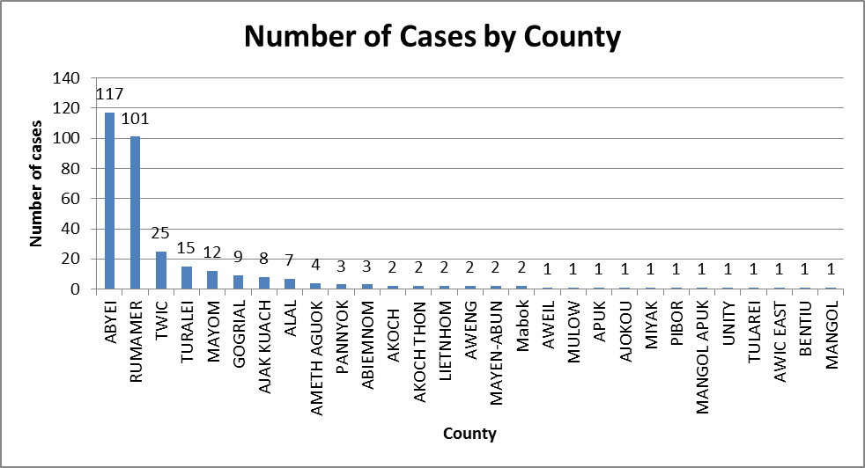
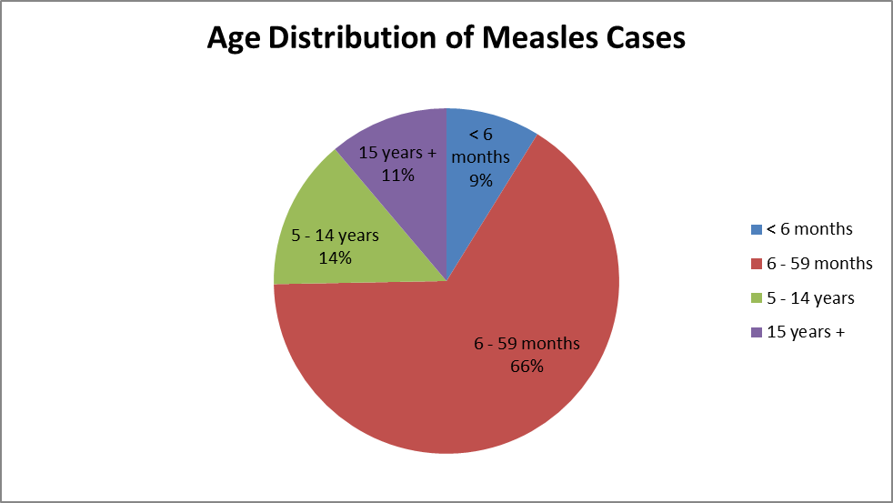
Analysis South Sudan measles
MSF, GOAL, IOM, UNICEF, WHO:
21,500 people vaccinated
in 7 days
All cases
(327)
National view by province/county
Hospitalized
=
+children<5yrs
Source : MSF & WHO

Slide 29

ALGORITHM FOR THE DIAGNOSIS OF MEASLES
Generalized febrile rash
+
cough or nasal discharge or conjunctivitis
Probable measles case
Other diagnosis
At least one major complication or risk factor
Unable to breastfeed/ eat or drink
Convulsions, impaired consciousness
Severe oral lesions
severe pneumonia
Croup /stridor
Dehydration/shock
Corneal damage
Malnutrition (SAM or MAM)
Pregnant women
Newborns < 2 months
Complicated (severe) case
INPATIENT
NO major complications
Pneumonia without severe signs
Acute otitis media
Purulent conjunctivitis
Diarrhea without dehydration
Oral candidiasis that does not interfere with eating
Uncomplicated case
OUTPATIENT

Slide 30
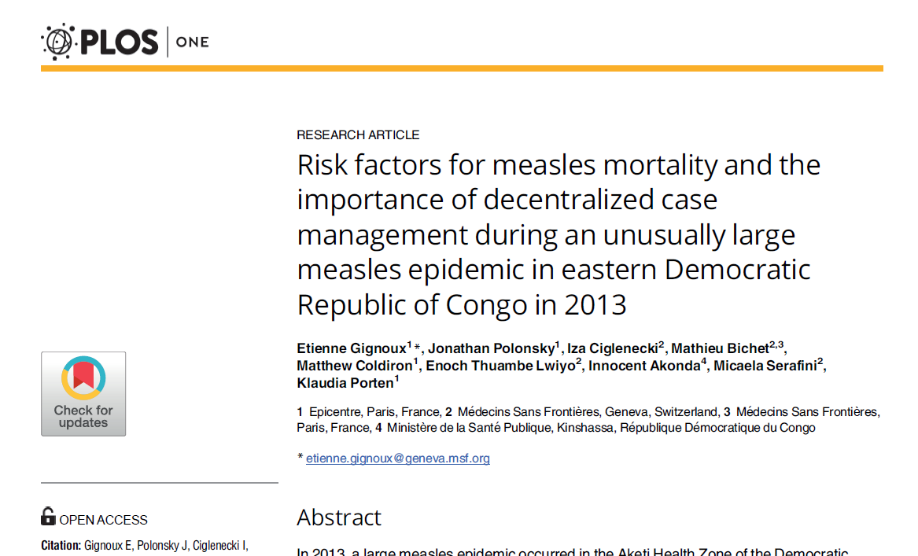
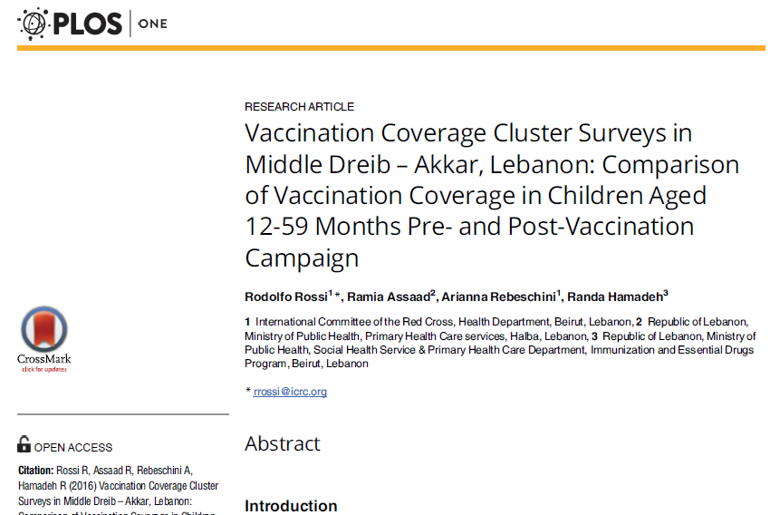
10.1371/journal.pone.0194276
https://doi.org/10.1371/journal.pone.0168145

Slide 31
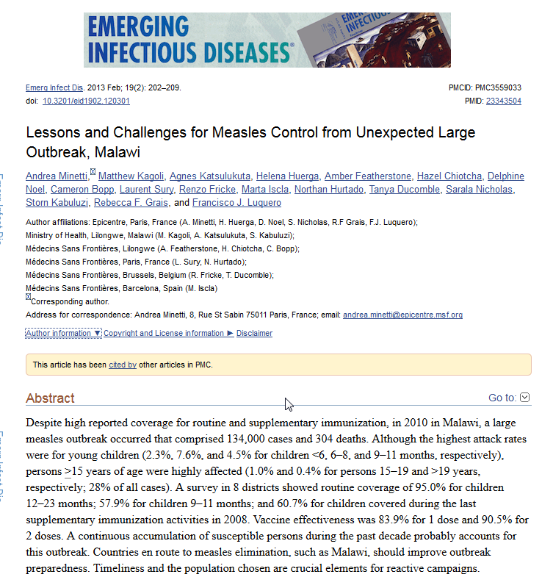
10.3201/eid1902.120301

