Slide 1
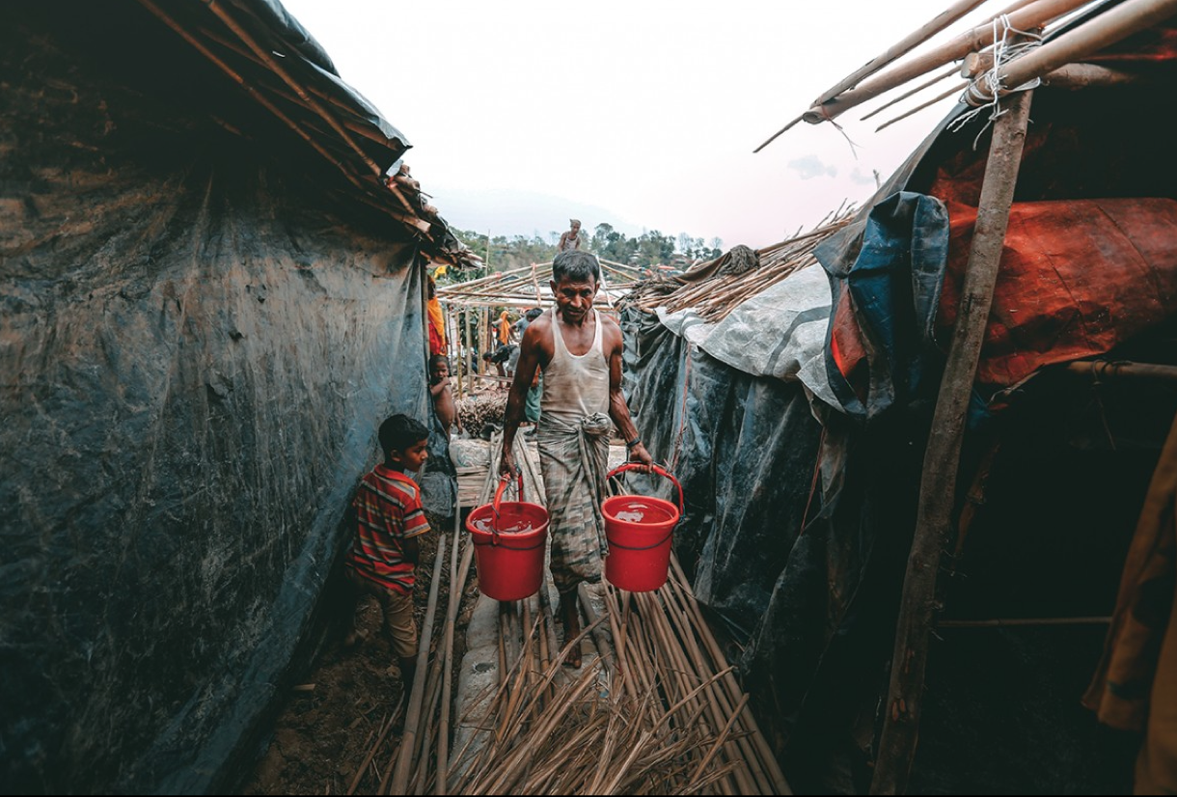
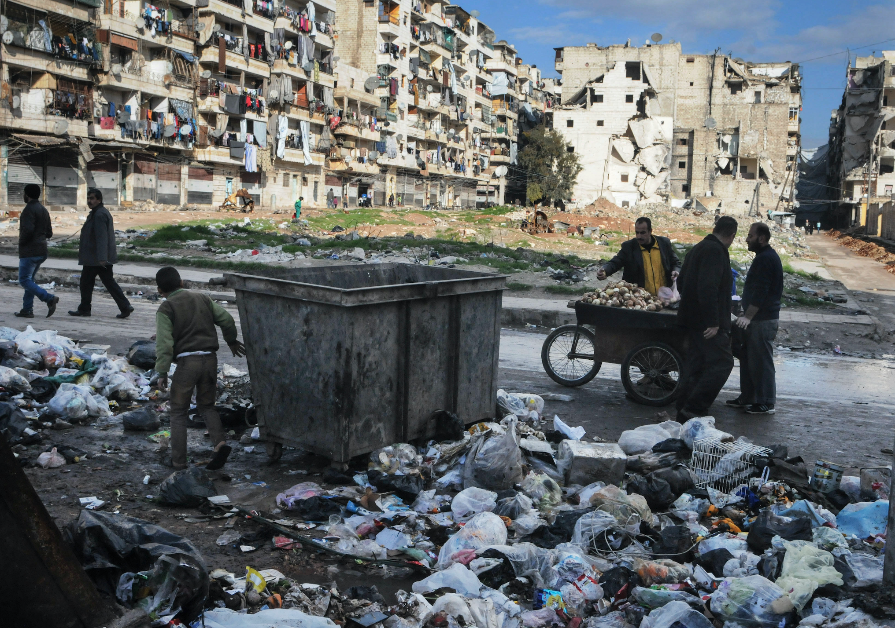
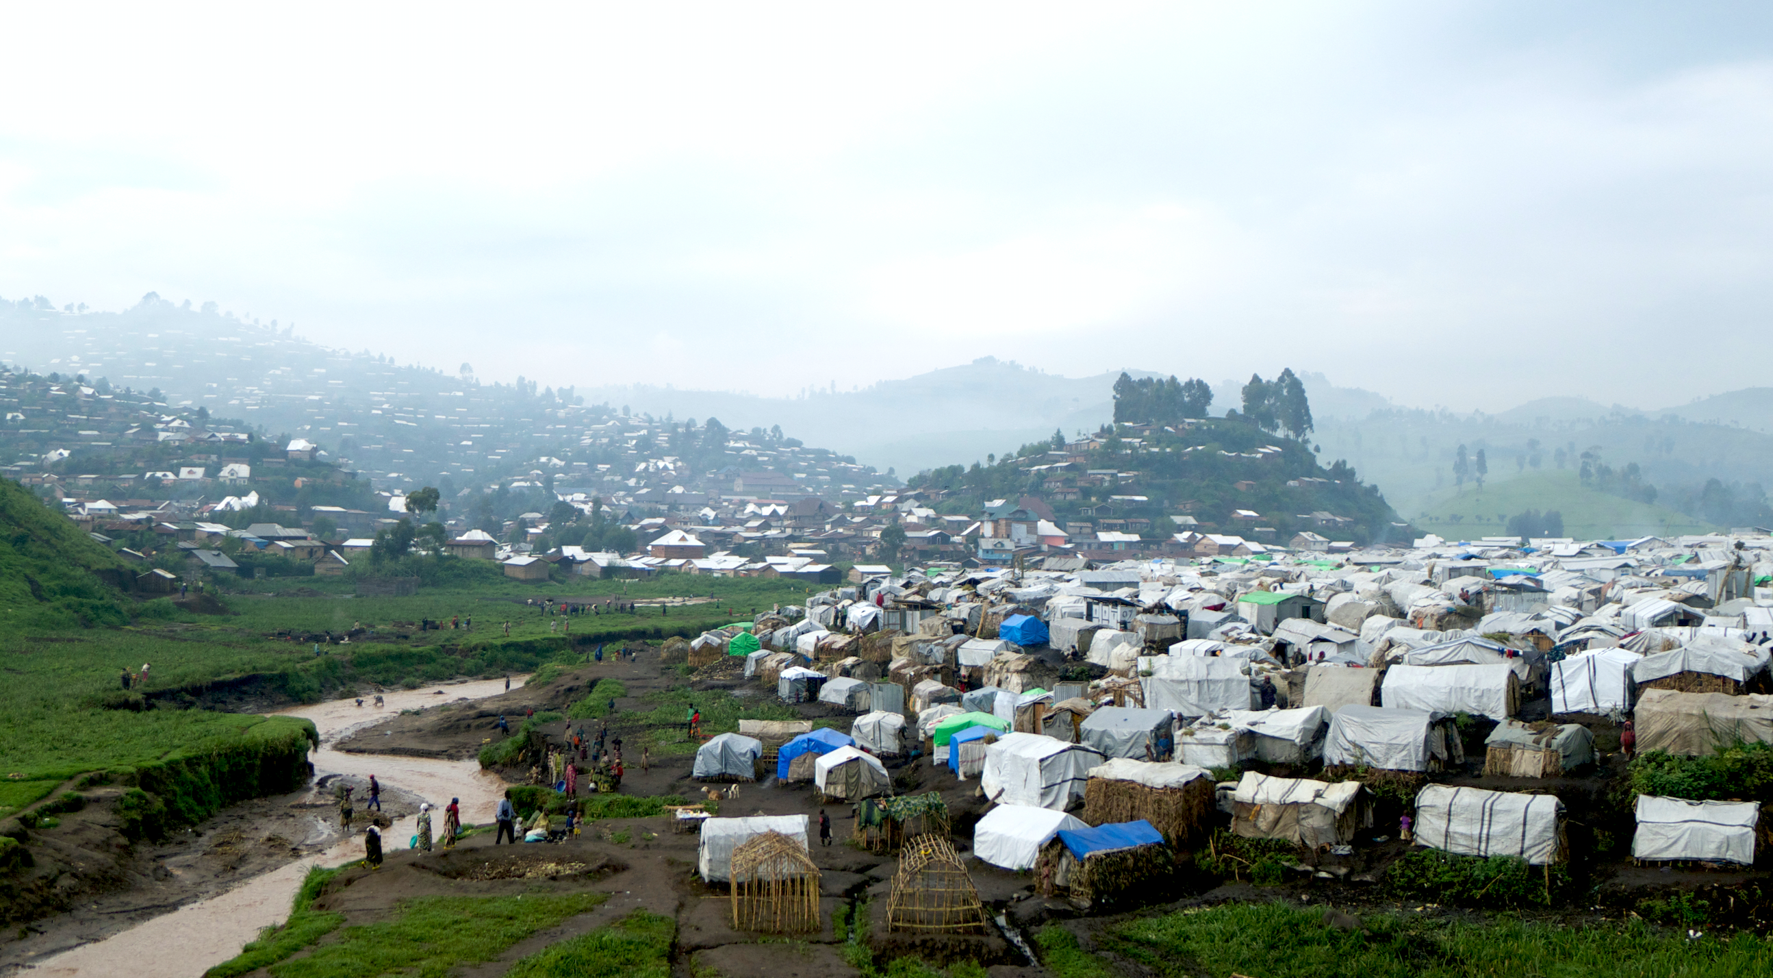
Communicable Diseases
Outbreak Investigation and Control
Logo organization(s) facilitator(s)
Cox’s Bazar; Sheikh Mehedi Morshed, ©ICRC
Syria 2015; Teun Voeten, ©ICRC
DRC, 2013; Roberto Forin, ©ICRC
Name and organization facilitator(s)
These learning materials have been developed by Anne Perrocheau, WHO
Notes:
Photos:
Left: Cox’s Bazar, Cox’s Bazar; Sheikh Mehedi Morshed, ©ICRC
Middle: Outskirts of Aleppo, Syria, 2015. Teun Voeten; ©ICRC
Right: DRC, 2013; Roberto Forin, ©ICRC

Slide 2

Objectives
Be able to:
Explain the approach to disease outbreak investigations and justify the most adequate control measures in an acute or protracted crisis situation
  Explain the indicators describing an outbreak
  Describe the main steps of an outbreak investigation
  Describe different types of control measures used in crisis situations

Slide 3
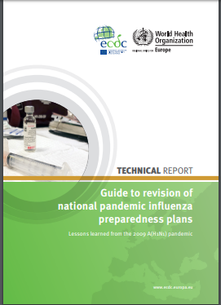
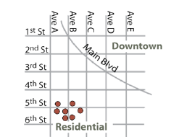
Definitions
Outbreak
Epidemic
Cluster
Pandemic
Increase in number of cases expected in a given
area among specific groups of people over a particular period of time period
Cases grouped in time or place
May not represent an increase
Epidemic that has spread over several countries or continents. Usually affecting a large number of people

Slide 4
Case study : Investigating an Outbreak in Seewhat in 2018
Small country of 6 millions inhabitants
Capital Treetown
Protracted humanitarian crisis in North for 2 years with 2 million inhabitants
Armed conflict with displaced population and non accessible areas
High child malnutrition rate
Cholera, Hepatitis E outbreaks
Tropical climate, rainy season starting

Slide 5
Tuesday April 25 2017 12:00 AM:
In your office in Treetown, Capital of Seewhat
You receive a call from your colleague working in Delmare District, Northern Seewhat:
  8 deaths reported at the district Hospital in Bluetown, capital of Delmare district (15’000 inhabitants), since yesterday evening.
  More patients still arriving in the hospital, some dead on arrival, others OK but some died afterwards.
  Patients are very weak, confused, complaining of abdominal pain. Some are vomiting.
  The majority of them have participated in a funeral ceremony of a religious leader last Friday night.
  Everybody is afraid of Ebola and panic is spreading in the community.
  Doctors have no diagnosis

Slide 6
Based on Case Study
Group Work
What is the minimum information you need to assess the situation?
List the questions you should ask
5 Minutes

Slide 7
Lists
  WHO was attacked by the disease
  How many cases and deaths
  Age, sex
  Describe all clinical signs and symptoms
  WHERE did the cases arise
  Which setting: displaced camp, rural area, town, remote area
  Where do the patients come from? Extent of the outbreak
  Epidemiological profile of the area
  WHAT
  Cause of death of the buried man? Date of the death?
  Is there a suspected product that could cause the disease?

Slide 8
Lists Continued
  HOW
  Are there links between cases? (family, classroom, work, trip,…)
  What happened at the funeral?
  How many persons attended the funeral?
  RESPONSE CAPACITY
  What is the hospital and laboratory capacity?
  Is there material for infection control on site?
  What do you need first?
PERCEPTION
  What is the local team feeling about the situation?
  Other information ?

Slide 9
Based on the Case Study
Group Work
What is your immediate recommendation to support your field staff?
5 Minutes

Slide 10
Immediate Recommendations
Implement Measures for Prevention and Control of Infection (PCI)
  Apply standard precautions for all patients
  Isolate patients from the rest of the patients in the hospital
    Organise an isolation sector
    Verify the availability and use of Personal Protective Equipment
    Limit the contacts of the patients with their family
Implement safe burial procedures

Slide 11
What Do You Recommend?
??
Alert the Ministry of Health?
Leave the country?
Alert health partners in the county?
Organize crisis meeting in the capital inviting Delmare team to join?
Organize a mission to Delmare urgently?
Provide a list of the laboratory investigations to conduct?

Slide 12
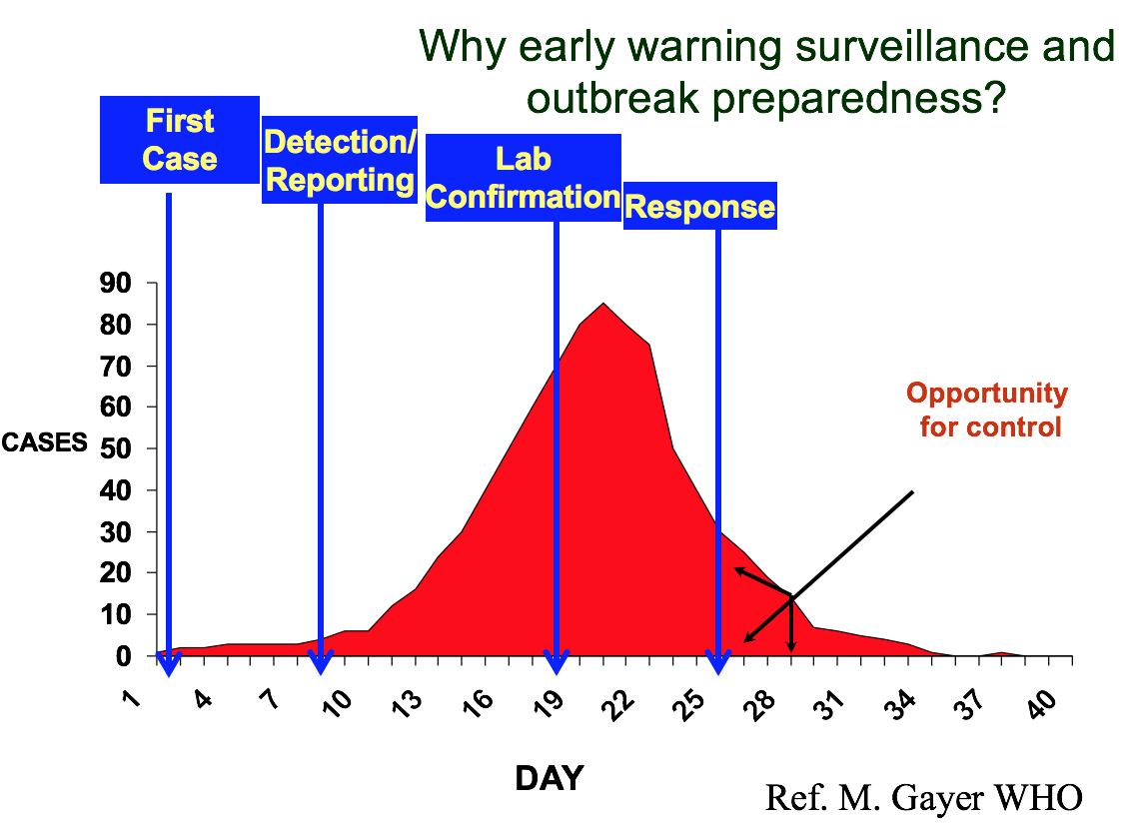
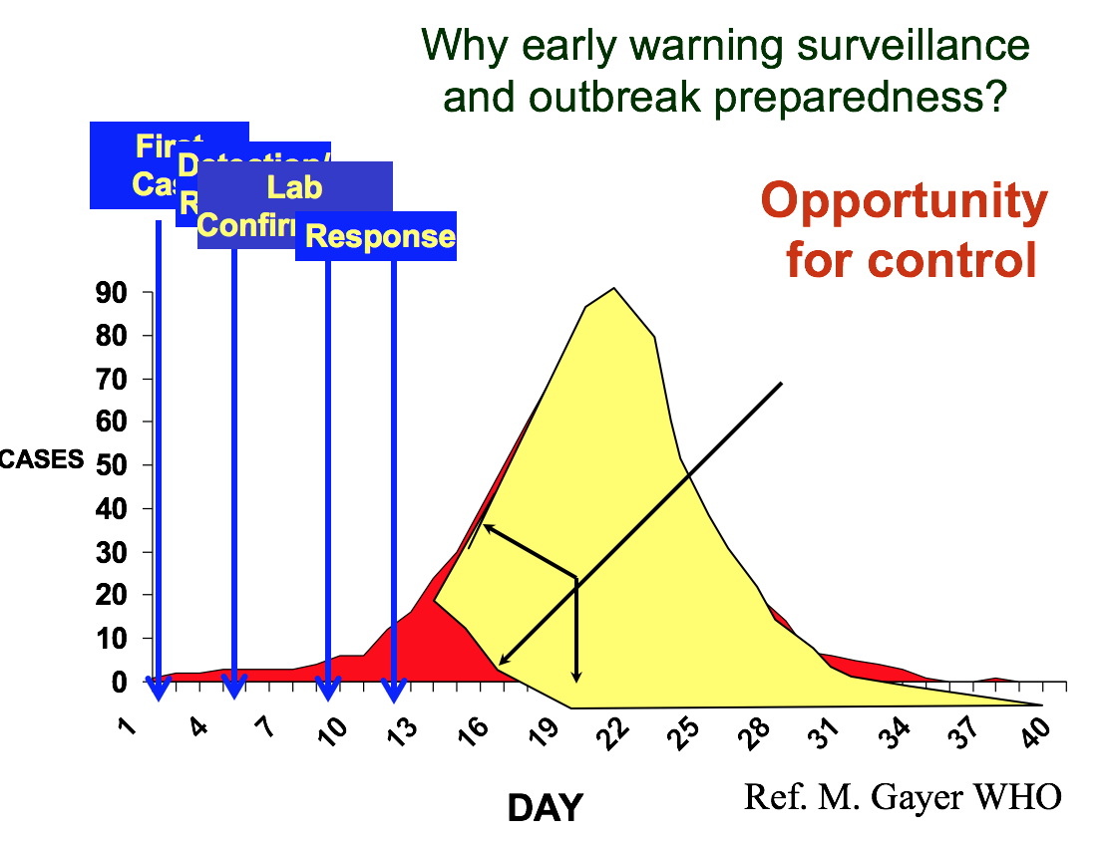
Why Conduct an Investigation?
Confirm the possible outbreak
Limit mortality and morbidity
Stop the spread of the outbreak
Protect those at risk
Communicate
Document
Advance and share knowledge

Slide 13
Based on the Case Study
Is this an outbreak?
What is your answer based on?
??

Slide 14

10 Steps of an Outbreak Investigation
Establish the existence of an outbreak
Confirm the diagnosis
Establish a case definition
Count the cases
Describe the outbreak by Person, Place and Time
Formulate and test hypotheses
Implement prevention and control measures
Monitor the outbreak and re-assess strategies
Perform environmental and laboratory investigations
Communicate findings

Slide 15

STEP 1 : Confirm the outbreak
Rule-out a pseudo outbreak
Consider other reasons for an increase in cases
Compare observed vs expected number of cases
Use rates to make comparisons
Reporting procedures
Case definitions
Awareness among reporters
Habits of reporters (referral bias)
Diagnostic tests
Size of population…

Slide 16
STEP 2 : Confirm the Diagnosis
Biological samples
    From every patient, post mortem samples
    Follow up: inform patients of results
    Link patient information and sample: unique ID
Specimen adequate to confirm hypothesis
Adequate sampling, storage conditions and transport media
Where no lab capacity: use clinical and epidemiological criteria

Slide 17
Continuation Outbreak : 26 April, Bluetown
More patients admitted during the night
Death on arrival continuing
Some patients escaped from the hospital, others hid in the community
The family of the deceased is not affected: intentional poisoning suspected by community
Panic and military forces needed to control the population

Slide 18
Based on the Case Study
Group Work
You are a field epidemiologist in charge of the investigation
List your tasks for the next hours
5 Minutes

Slide 19
Tasks for the Next Hours
Map the area
Diagnosis: line-list with clinical signs
Provide a case definition
Organise contact tracing of funeral attendees: name, address, telephone number
Start the active case finding: visiting houses
Plus: Ensure PCI measures in place, availability of isolation beds and drugs
Notes:
Prevention and Control of Infection (PCI)

Slide 20
STEP 3: Provide a Case Definition
To
  Collect all cases (not a diagnosis method)
  Ensure consistency in the cases collected, regardless of the data collector
  Classify a posteriori the cases as suspect, probable and confirmed

Slide 21




Elements of the Case Definition
Criteria
  Clinical signs
  Biological signs
  Paramedical parameters
Limits
  Time
  Place
  Persons
Do not include potential risk factors in a case definition

Slide 22
Case Classification
Classifications for Measles Case Definition
  Possible (suspected)
    Any febrile illness accompanied by rash
  Probable
    A case that meets the clinical case definition, does not have diagnostic laboratory findings and is not linked by a person, place or time to a confirmed case
  Confirmed
    A case that is laboratory confirmed or that meets the clinical case definition and is epidemiologically linked to a confirmed case.
    A laboratory-confirmed case does not need to meet the clinical case definition.

Slide 23
Characteristics of a Case Definition
Precise
Objective
Operational
Logical
Sensitive
Specific
POOLSS

Slide 24
Characteristics case definition: Precise
Not Precise | Precise
Fever | Temperature higher than 38°C (axillary)
Diarrhoea | More than 2 liquid stools per 24 hours
Jaundice | Yellow coloration of the conjunctiva or the skin
Elevated white cells | More than 5000 white cells per mm3
Notes:
To avoid interpretation of every person
Need to decide threshold

Slide 25
Characteristics case definition: Objective
Subjective | Objective
Fatigue, asthenie | Incapacity to conduct daily activities, work
Haemorrhagic signs | Observed bleeding from nose, mouth, mucosa Presence of blood in urine, stool, vomit
Loss of appetite | No or limited food intake during last days

Slide 26
Characteristics case definition: Operational
Should be easy to understand and can be applied by
  Non medical workers
  Non specialists
Should be applicable at the field level
Should be adapted to field diagnosis capacity

Slide 27
Characteristics case definition: Logical
Case definition | Presence of Signs and Symptoms | Patient inclusion
A and B | A B A + B | No No yes
A or B | A B A + B | Yes Yes Yes

Slide 28

Sensitivity – Specificity
Case Definition | Sensitivity | Specificity
A or B or C | +++ | -
A and (B or C) | ++ | +
(A and B) or C | + | ++
A and B and C | - | +++
Specificity
Sensitivity
Notes:
Questions to review to define the level of sensitivity of a case definition:.
What is the rate of apparent and inapparentes infections for this disease?
What are the pathognomoniques signs of the disease?
What are the lab technics validate and easy to implement and reliable for this disease?
Do we need to indentify every case in this investigation?
Ex Heaptits E in Chad in 2016-17, no treatment, no vaccine

Slide 29
Case study: Which Signs Would You Include in the Case Definition?
Signs and symptoms | cases
General weakness | 19
Abdominal pain | 15
Headache | 17
Vomiting | 14
Confusion, agitation | 11
Diarrhea | 9
Respiratory signs | 5
Purpura/Ecchymosis | 6
Fever | 1
Chest pain | 5

Slide 30

STEP 4: Count the cases
Identify Additional Cases
  Active surveillance: search of cases
    in the community
    hospital /health centres
    hospital registers
  Enhanced passive surveillance
Enhanced
surveillance

Slide 31
Continuation Outbreak: New inputs from the investigation
Active case search revealed a total of 22 patients admitted in the community or found retrospectively in the hospital register (1 admitted April 22)
Most patients are friends, cousins, relatives.
A cluster of two cases occurred in another province : husband was the disk-jockey at the funeral and his wife who did not attend the funeral. Her death occurred 24 hours after him with the same clinical symptoms.
A total of 110 persons attended the funeral

Slide 32
What does the new and crucial information tell you?
??
Is it a sexually transmissible disease?
Is it an infectious disease responsible for secondary cases?
Is it a highly transmissible disease?
Is it a virulent disease?

Slide 33
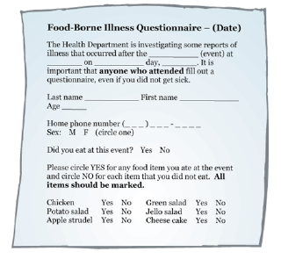
STEP 5: Conduct Descriptive Epidemiology
Describe the outbreak: person, place and time
Collect the data :
  Case investigation form
  Line-list
Clean and validate the data
Organise the data
=> WHO Outbreak toolkit for case definition, case investigation forms, line-list

Slide 34
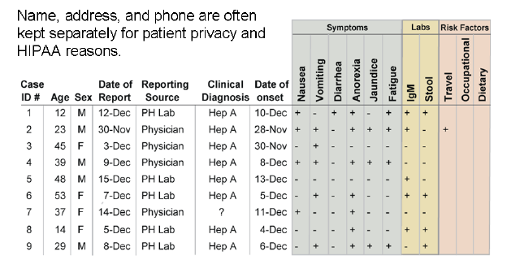

Organize the information
Create line-list with selected variables of interest
Name, address, and phone number are kept separately for patient privacy and confidentiality

Slide 35

Descriptive Epidemiology: Person
Define population at risk
Age
Gender
Occupation
Social features
Medical history
Travel history

Slide 36
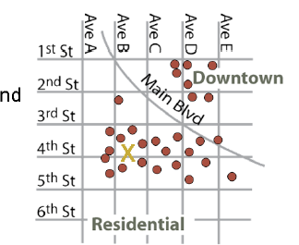
Descriptive Epidemiology: Place
Geographical extent of outbreak
Identify clusters, patterns, and clues
Define potential common exposures
  Point source
  Water supply
  Aerosol transmission/wind currents
  Food distribution
  Other factors related to location

Slide 37
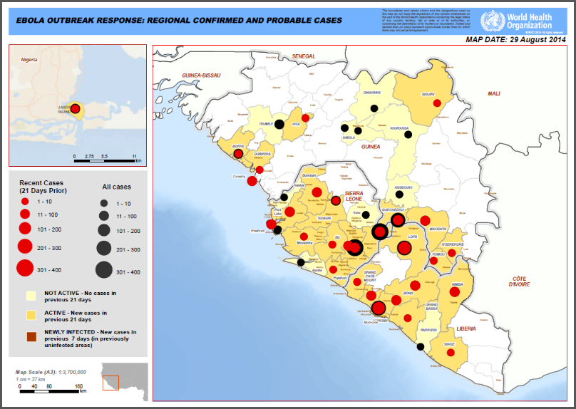
Geographic distribution
Ebola MSF outbreak Budibudyo Uga
Ebola MSF Uganda 2007

Slide 38
Descriptive Epidemiology: Time
The epi curve displays the distribution of cases over time
  Estimates magnitude and time trend
  Determines incubation period
  Helps predict course of epidemic
  Suggests the type of transmission or source of infection
Notes:
Most commonly per date of onset of the disease
If not available per date of admission or contact with health facility

Slide 39
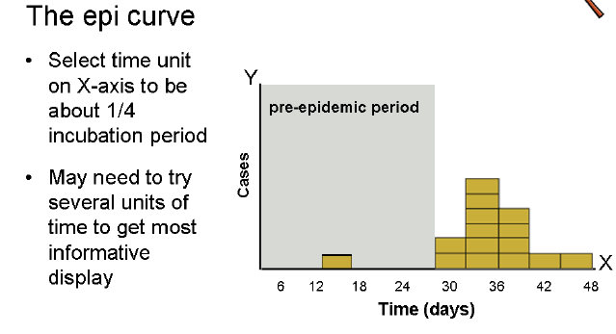
How to Create an Epi Curve

Slide 40

Reproductive number
R0 = Reproductive number: how many persons one case can infect.
Serial interval: time between onset of signs of patient 1 to onset of signs of patient 2 with 1 being the source of infection of 2.
Video: Contagion, 2011
https://www.youtube.com/watch?v=VrATMF_FB9M
Notes:
CONTAGION" - Bande Annonce Officielle. We have to go back to the source and find a solution to this disaster. A Film by: Steven Soderbergh With: Marion Cotillard, Matt Damon, Jude Law, Bryan Cranston, Gwyneth Paltrow, Kate Winslet, Laurence Fishburne. Accustomed to thriller with Ocean's Eleven, Soderbergh returns with a whole new story: a devastating pandemic explodes on a global scale ...

Slide 41
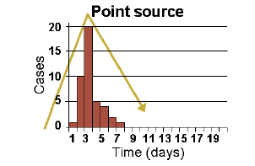
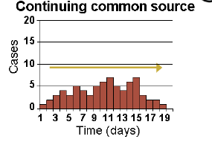
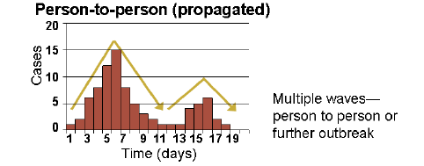
Classic Epi Curves
Notes:
Unique and temporary source
Continuing common source

Slide 42
Examples of Classic Epi-curves
Point source
Continuous source
cases
cases
time: hours
time: days
Person-to-person source
Intermittent source
cases
cases
time: weeks
time: days
Notes:
Shows the start and end of an outbreak and peaks.
Can be presented in days or hours for food borne outbreaks
In crisis situations usually presented in epidemiological weeks.
The epicurve of a point source outbreak has a maximal peak and lasts one incubation period. A good example is a contaminated meal.
A continuous source outbreak (like a contaminated drinking water source), has one or more peaks and lasts more than one incubation period.
A propagated or person-to-person outbreak has multiple peaks separated by approximately one incubation period.
An intermittent source outbreak, such as a food sold over a long time (almonds and SE PT30), has multiple small peaks with no relation to the incubation period.

Slide 43
What is the Incubation Period?
??
Funeral

Slide 44
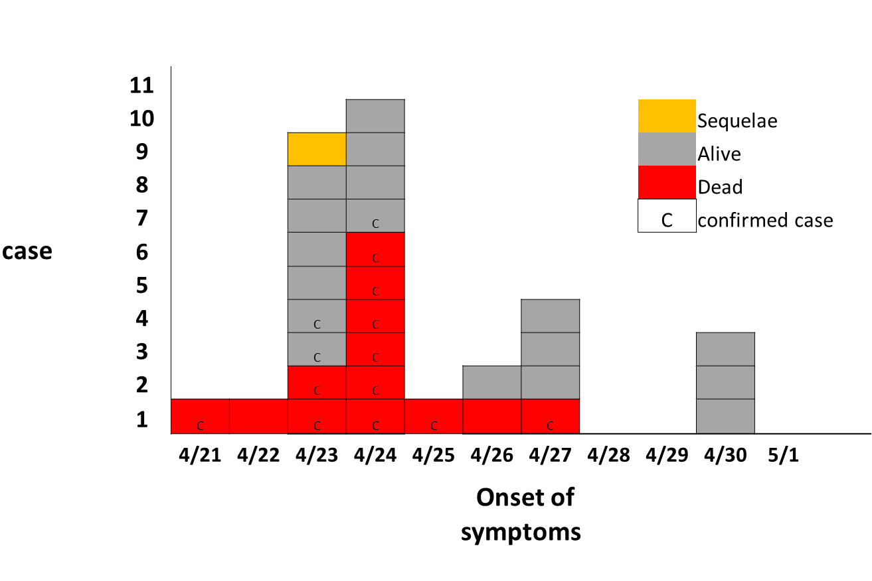
What is the incubation period?
??
Funeral
Notes:
Globally From April 23 to 30, 31 cases identified, confirmed 14, suspected 17.
26 Cases were admitted in local hospital, 3 visited the hospital as outpatient and 2 were identified through active case searching and treated at home
Search for epidemiological link between cases revealed that 19 patients mentioned one to three direct link with other patients. A total of 11 interconnections chains are reported : 2 are mother and child, 2 are aunt and nephew, 2 are neighbors, 2 are boy and girl friends, 6 friends and 7 others who shared the same table and bedroom during the wake, 2 are friends sharing one meal day prior the disease. Four patients (Three teenagers and one young adult patients) are included in three clusters.

Slide 45
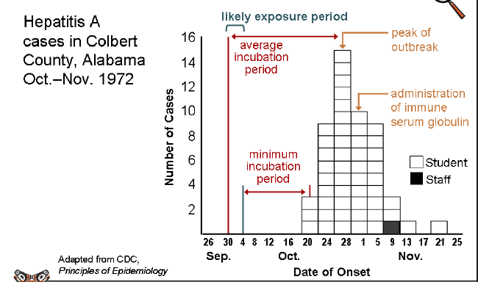

Epi Curve Example

Slide 46
What transmission pattern is the epidemic curve is revealing?
??
Funeral
Point source
Inter-human transmission
Continuing common source

Slide 47
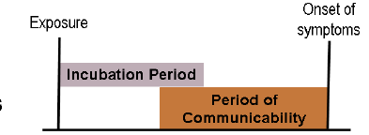
STEP 6: Formulate and test hypothesis
Requires knowledge of diseases
  Mode of transmission
  Incubation period
  Communicability period
  Clinical manifestations
  Unusual risk factors
Open-ended conversations
Scrutinize outliers

Slide 48
Case study: Description Time Place Persons
22 cases occurred between April 23 and 27
Case fatality rate: 42%
Majority of deaths occurred 24-48 hours after onset of disease
Age
  Range: 10-62 years old
  Median age: 23 years old
  68% between 10 and 29 years old
  Most affected age group (67% of cases) was between 10-25 years. No cases were reported from 0-9 years and above 55 years.
Sex ratio M/F = 0.82
Occupation for 18 cases: 13 students, 2 business persons, 1 housewife, 1 mason, 1 teacher
Majority of patients are young adults and teenagers. Mainly students. The index case is a teacher at one of the two schools.

Slide 49
Case Study Hypothesis
Group Work
What are the hypotheses of disease, transmission patterns and potential sources?
5 Minutes

Slide 50

6. Test Hypotheses
Analytical epidemiology
  Compare groups with different characteristics
  Test significant associations with risk factors
  or exposures
  Search for the causes of and factors contributing to disease

Slide 51



Analytical Epidemiology
Different methods (study design) for comparing groups : Two study designs
COHORT STUDIES
Well defined groups of exposed and non-exposed individuals
Track and compare disease (or outcome) among exposed and non-exposed individuals
CASE-CONTROL STUDIES
Compare individuals with a disease to those without the disease
Examine differences in exposures or risk factors
With Disease Without disease
Exposed Non exposed
Exposure/risk factors
Outcome

Slide 52

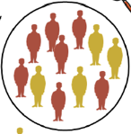
Selecting an Appropriate Study Design
Different methods (study design) for comparing groups : Two study designs
COHORT STUDIES
Outbreak in small, well defined population
Typically foodborne disease outbreaks affecting attendees at an event and therefore can all be easily identified
CASE-CONTROL STUDIES
When population at risk is not well defined
Choosing appropriate controls is crucial
Notes:
COHORT STUDIES
Well defined groups of exposed and non-exposed individuals
Track and compare disease (or outcome) among exposed and non-exposed individuals
CASE-CONTROL STUDIES
Compare individuals with a disease to those without the disease
Examine differences in exposures or risk factors

Slide 53
Case study: Hypothesis
In order to test your hypothesis would you recommend a case control or cohort study ? Justify your answer
??

Slide 54

STEP 7: Implement Control and Prevention Measures
Control inter-human transmission
  Early detection of new cases
    Active follow up of exposed persons: Contact tracing
    Community awareness to identify and treat sick
  Isolate patients and non infected persons
    Active case finding in community
    Implement isolation or quarantine: measles, TB, SARS
    Information and education of patients families
  Cases management
    CPI
    Less patients => lower risk of contagion (public health perspective)
    If positive outcome in hospital, patients will seek treatment
  Implement safe burial procedures (Ebola dependant)

Slide 55
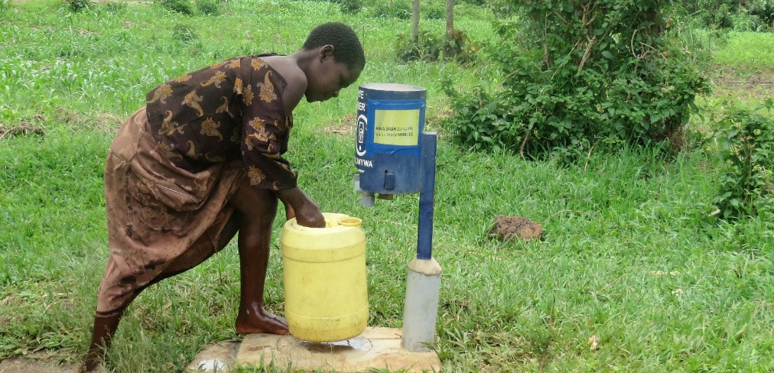
Implement Control and Prevention Measures
Control infectious agent
  Identify the source
  Control the source:
    Halt distribution of product, recall product
    Eliminate environmental source
    Chlorinate drinking water (cholera, shigella)
    Avoid contact with animal infected tissue or fluids
  Control reservoir/vector:
    Mosquito control (malaria, WNV, dengue, chikungunya),
    Animal control (rabies, plague)

Slide 56
Implement Control and Prevention Measures
Protect the susceptible hosts
  Immunize:
      Response to infection: rabies
      Response to the epidemic: Hepatitis, meningococcal meningitis, varicella, influenza
      Prevention of risk: measles, cholera, meningitis
  Chemoprophylaxis of family contact
      Diphtheria
      Meningococcal infection
      Pulmonary plague
      HIV

Slide 57
STEP 8: Monitor Outbreak and Reassess Strategies
Refine hypothesis if necessary
  Have other potential explanations been overlooked?
Sequential case-control studies
  Narrow down exposures to identify risk factor

Slide 58
STEP 9: Perform Environmental and Laboratory Investigations
Environmental investigations
  Food, water sources, buildings, materials, or environmental surfaces
  Provide information about:
    Exposure to agent
    Contamination during food preparation, or manufacturing
    Exposure during recreational activities
    Document contaminated environment
    Do trace back investigations

Slide 59

Laboratory Investigations
Clinical lab serving hospitals and health care facilities:
  Perform diagnostic testing of patient samples
Local, state, and federal public health labs:
  Test water, soil, dust, food, and clinical specimens
  Conduct confirmatory diagnostic and forensic testing and
  molecular fingerprinting
    Identify agent and subtype
    Link cases with sources by strain identification
Both types of labs can report cases
  Samples collected during investigation go to PH labs

Slide 60
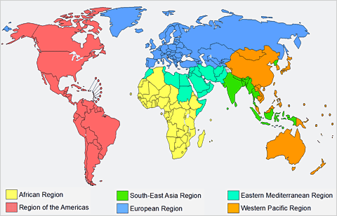
Laboratory investigation
Virology
Paris
Vienna
Bacteriology
Lyon
Histopathology
Atlanta
Food investigations
Monrovia
Toxicology
Johannesburg
Notes:
Bacteriology
Liberia National Referent Laboratory : Ebola (26/04)
CDC Atlanta (7 patients samples, 1/05)
WHO collaborative centre for Viral Haemorrhagic Fever in Lyon (3 patients samples)
WHO Referent Lab for meningococci, Pasteur Institute Paris (3 samples, 10/05)
CDC Monrovia : 18 patients (11/05)
National health Institute for Communicable Disease in South Africa (13/05/17) 22 samples as control quality)
Food investigations:
From house of cases: powdered milk, sugar, cake, pepper, seasoning, fresh garlic, salt, raw eggs, mayonnaise, butter, flour, can of sardine, cooking soda, salt.
Drinks: Soft drink cans, Tea, water samples,
Toxics: : 3 urines samples tested for presence of metals and organophosphates pesticides

Slide 61
STEP 10: Communicate Findings
Provide ongoing current and accurate information to:
  Staff within your team and agency
  Other health agencies
  Local and state health departments, national health department, other health services for specific population (e.g. Indian)
  Health care providers and facilities
  The public : media, schools, business

Slide 62
Communicate with the Public
Establish reliable communication
Be prepared and anticipate questions
Control rumors: ensure correct information is publicized
Don’t over reassure: Acknowledge what you don’t know
Assign a credible spokesperson

Slide 63
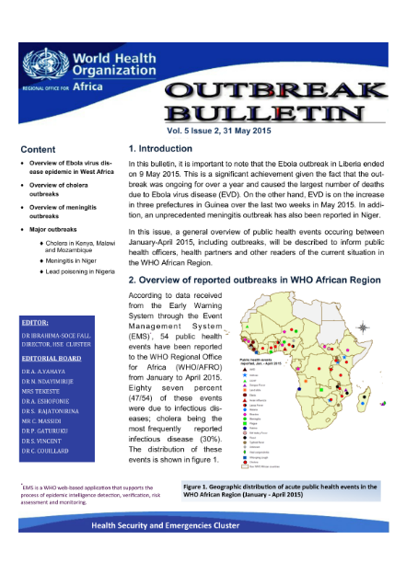

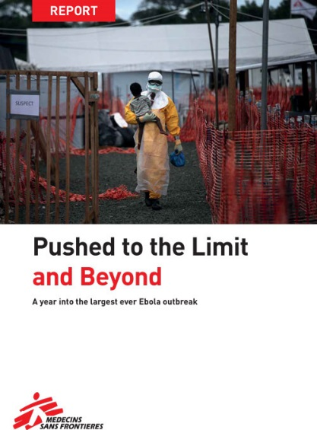
Write it up and disseminate
Important to include all the steps and lessons learnt
Disseminate
Notes:
Don’t need to be followed in detail but do provide an outline

Slide 64


A Cluster of Unexplained Deaths in Sinoe County Liberia
Rapid response
team
NmC
Case review, medical observations, autopsies
Case management, contact follow up,
Biological samples, food-drink samples, case control study
Alert
Funeral in Teah town,
Sinoe county
21 | 22 | 23 | 24 | 25 | 26 | 27 | 28 | 29 | 30 | 1 | 2 | 3 | 4 | 5 | 6 | 7 | 8
April
May
14 cases
8 deaths
20 cases, 11 deaths in Sinoe
1 death in Montserrado county
1 death in
Grand Bassa
county
Last case admitted
Notes:
April 25 :14 cases with 8 deaths of an unexplained illness in Greenville city reported to NIPH Monrovia.
All patients attended a funeral on the night of the 21st of april until the 22 .
The deceased was a religious leader who died one month before his funeral. The body was frozen at Monrovia morgue. Because he was well known the family prepared a funeral with the community and everybody could attend the funeral.
April 25- 27: 20 cases with 11 deaths
Attendance to a Funeral of religious leader April 21-22 with more than 200 participants from different counties.
Main symptoms: general weakness, headaches, vomiting, abdominal pain and mental disorders.
On Tuesday, 25th April 2017 at 10:30 GMT, Sinoe County Health Team (SCHT) notified the National Public Health institute of Liberia (NPHIL) and the Ministry of Health (MoH) of a cluster of unexplained health event involving 14 cases with 8 deaths in Greenville City, Sinoe. From the 25th to 27th April, the number of cases increased to 20 with 11 deaths reported (Case fatality rate is 55%). The first case identified in Montserrado County was a person who reportedly attended the
funeral in Sinoe County. This case was initially admitted at a clinic and subsequently referred to a hospital with signs and symptoms of headache, fever, diarrhea mental confusion and convulsion and died this afternoon in Monrovia.
Main symptoms: general weakness, headaches, vomiting, abdominal pain and mental disorders.
Rapid Emergency Team from Monrovia on site April 26
Priority: Ruling out Ebola disease
The medical investigation
Case review, interviews,
Direct observations of patients, autopsies
Collection of biological samples
The epidemiological investigation
Case definition
Active case finding
Questionnaire for systematic data collection
Contact tracing
Case control study

Slide 65

Thank you for your attention
Questions?

