Slide 1
Logo organization(s) facilitator(s)
Communicable diseases
Challenges in crisis settings
H.E.L.P. course
The learning materials have been developed
by Dr. Anne Perrocheau, WHO
Name(s) and organization facilitator(s)

Slide 2
Objectives
Be able to
List the common communicable diseases associated with humanitarian crises
Identify the risk factors that contribute to an increased incidence of communicable diseases
Identify control measures for communicable diseases and challenges for implementation
H.E.L.P. course
Notes:
Identify communicable disease prevalent in acute or protracted crisis situation and criteria for prioritizing interventions
Define and describe the common communicable diseases associated with humanitarian crisis (type, transmission, prevention, priority criteria)
Differentiate endemic versus epidemic prone diseases and associated control measures in acute or protracted crisis situation
Vaccination strategy per disease
Control measures per type of disease
List the main challenges for the control of communicable disease during crisis situation (environment, population, disease, detection and response capacity)

Slide 3
Communicable diseases in crisis settings
Major cause of death
conflict-affected settings
in displaced populations in low income countries.
Death rates among refugees and displaced persons significantly above the baseline have been recorded
Over three quarters of these deaths may be due to infectious diseases
Often in conjunction with malnutrition
Children under five have the worst mortality rates
H.E.L.P. Course

Slide 4
Infection and communicable diseases
H.E.L.P. course

Slide 5
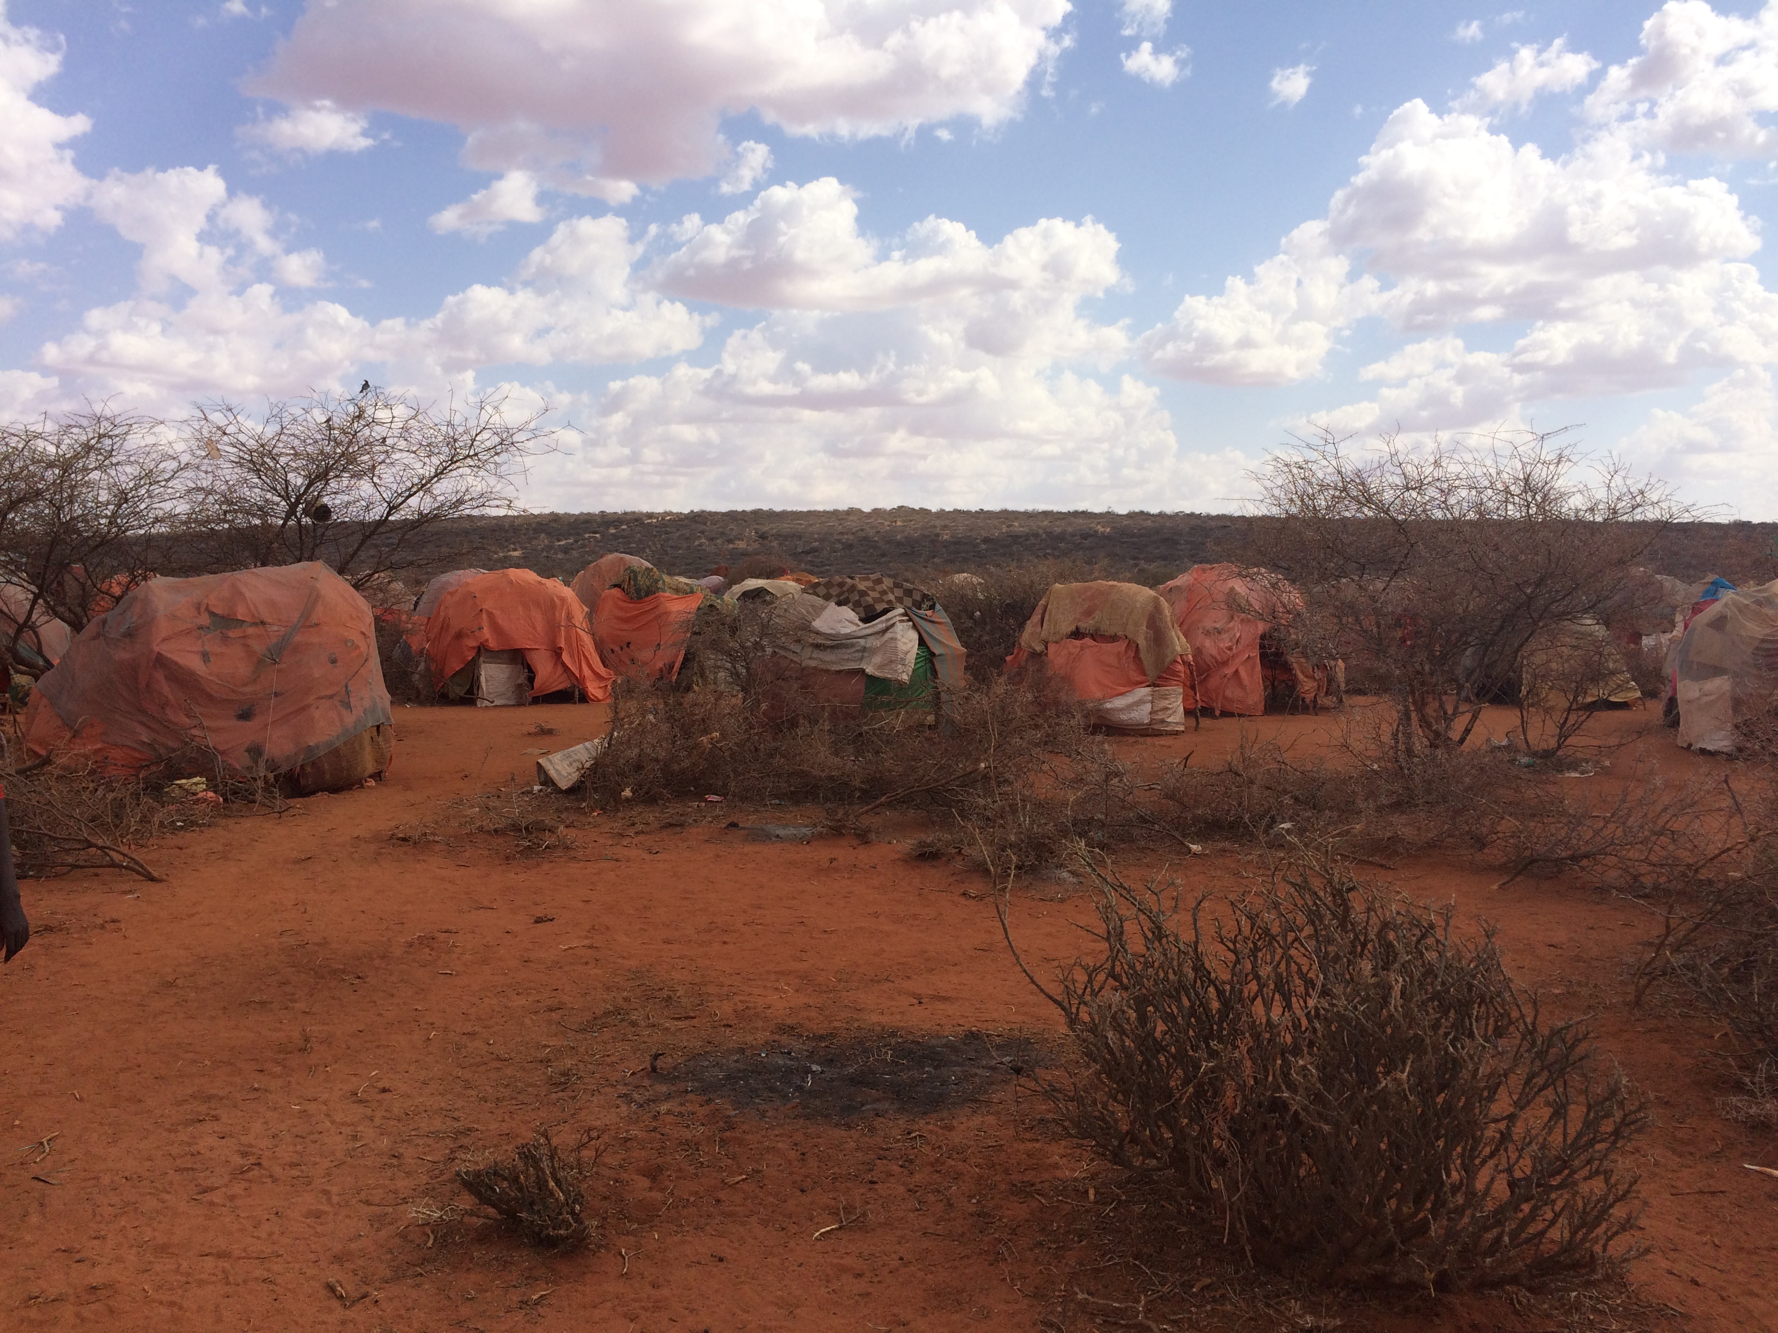
Ethiopia: Somali region, Sept. 2017
Group Work
Prolonged drought for two years
Most camels died
More than 200,000 displaced in camps and settlements
High infantile malnutrition rate
From your experience, what are the communicable disease threats for the displaced population
H.E.L.P. course
10 minutes

Slide 6
Answer 1
Traditionally the threats in crisis situations:
Diarrhea
Cholera
Measles
Meningitis
Malaria
Respiratory infections
Lice and scabies
Other communicable disease reported in last 3 years in crisis affected populations:
Diphtheria
Hepatitis E
Polio
Monkey pox
H.E.L.P. course

Slide 7
Definition of communicable disease
A communicable disease is transmitted to human host via an infectious agent (a pathogenic micro-organism) directly or through some intermediate host called a vector.
Source: WHO
H.E.L.P. course

Slide 9
Chain of infection
2. Route of transmission from host to host
3. Host suceptibility
1. Infectious agent
H.E.L.P. course
Notes:
Environmental facotrs can interfer on any of those links

Slide 10
Infectious agent – Classification
2. Route of transmission from host to host
3. Host suceptibility
1. Infectious agent
Bacteria
Cholera, meningitis, typhoid, leptospirosis, shigellosis, tetanus, diphtheria, pertussis, salmonellosis,
Virus
Measles, poliomyelitis, rabies, yellow fever, dengue, monkey pox, Ebola, Marburg, HIV, hepatitis A, E, C,..
Prions
Mad cow disease
Helminths (worms)
Ascaris, filariasis,, larva migrans, tenia,…
Mycosis (fungus)
Candidiasis, cryptococcosis
Protozoa (parasites)
Malaria, trypanosomiasis, amebiasis, schistosomiasis
H.E.L.P. course

Slide 11
Sources of infection
2. Route of transmission from host to host
3. Host suceptibility
1. Infectious agent
Human
Animal ( zoonosis)
Water
Food
Dust /air
H.E.L.P. course

Slide 12
What are the main infectious disease sources
??
Disease
Source
Cholera
Measles
Hepatitis E
Rabies
Shigelloses
Acute Respiratory Diseases
Contaminated drinking water
Sick contact
Contaminated water, food
Infected animals (not reservoir)
Contaminated water
Infected contact
H.E.L.P. course

Slide 13
Mode of transmission
2. Route of transmission from host to host
3. Host suceptibility
1. Infectious agent
Contact transmission
Direct-contact
Indirect contact : body fluids, infected tissues
Droplets spread
Common vehicle transmission: water, food
Air transmission
Vector bites
H.E.L.P. course
Notes:
Essential to know to limit the spread of the disease
One agent might have several routes. Rabies : bite of infected dog and from infected bats via airborn transmission
contact transmission
Direct contact : Touching, biting, kissing, sexual intercourse HIV, rabies, syphilis, ebola
Indirect contact : Vehicle born : inanimate materials, biological products: zoonosis
droplets spray onto conjunctiva, mucous membranes of eyes, nose, mouth (1 m or less). Flu, measles, meningitis
Common vehicle : Common vehicle: one agent transmissted to several host from a single inanimate source : water, food, …cholera , salmonellose,
Air born :
microbial aerosols of microorganism penetrating into the alveoli. Can remain in the air for long period of time. carbon anthrax legionelosis
alos droplet nuclei (evaporation of fluid from droplets)
Vector born : mechanical: puncture drops product that itch , while itching the host allows the contact with his blood and agent enter into blood stream.
biological malaria, dengue, chikungunya, plague,
Dust: fungus spores
Rabies; what type of transmission is ti? Dog bite to human: direct contact
Human to human
Droplets: Flu, Measle, meningococcal disease, diphtheria
Direct contact: Ebola, syphilis
Animal to human:
Direct contact: Ebola, zoonotic flu
Contact with excreta: Leptospirosis
Vector borne: Nipah fever, Malaria, Dengue, Plague
Water born : Hepatitis E, cholera, Poliomyelittis
Food born : Hepatitis A, Salmonellose, E. Coli ET, ET SHU

Slide 14
Same disease, big difference
Measles in France, 2019: 1184 cases, 112 severe forms, 1 death
Complication rate = 9%
CFR = 0,2%
http://invs.santepubliquefrance.fr/Dossiers-thematiques/Maladies-infectieuses/Maladies-a-prevention-vaccinale/Rougeole/Points-d-actualites/Bulletin-epidemiologique-rougeole.-Donnees-de-surveillance-au-22-mai-2019
Measles in Chad, 2019: 9000 cases, 1677 severe forms, 68 deaths
Complication rate = 18%
CFR = 0,7%
https://www.msf.ch/nos-actualites/articles/au-tchad-lepidemie-rougeole-nest-pas-encore-maitrisee
??
H.E.L.P. course
Which factors can explain the observed differences?

Slide 15
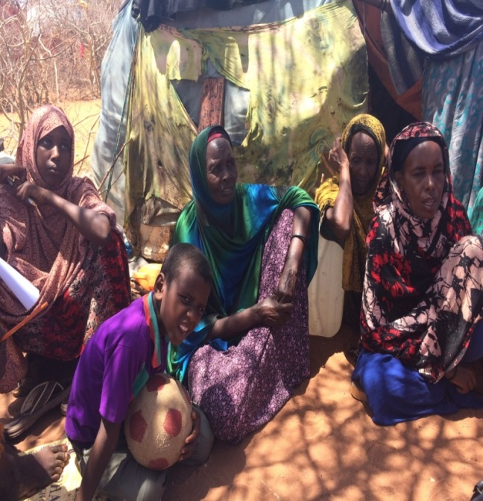
Host susceptibility
2. Route of transmission from host to host
3. Host suceptibility
1. Infectious agent
Age and gender
Extreme ages
Women post partum and pregnant
Nutritional and physiological status
Digestive parasitosis in children
Malnutrition; low protein; dehydration
Health Status
Previous or concurrent diseases e.g. malaria
Prior Immunologic experience
Stress
Impacts immunity
H.E.L.P. course
Notes:
Immunologic experience: vaccination, prior infection raising immunity, co-morbidities, introduction of new pathogen (malaria, measles, cholera)

Slide 16
Factors impacting transmission of communicable diseases
Environment
Disease
Response capacity
H.E.L.P. course
Notes:
Environment factors
Influence any of the three major links in the chain of transmission so as to promote or limit the development of infection

Slide 17
??
How can the environment impact the incidence and the spread of communicable diseases
H.E.L.P. course

Slide 18
Answer
2. Route of transmission from host to host
3. Host susceptibility
1. Infectious agent
Host vulnerability
Transmission
Reservoir/source
H.E.L.P. course

Slide 19
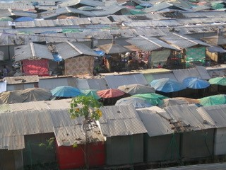
Living conditions
Overcrowding
Low level of personal hygiene
Inadequate quantity of water, poor quality
Lack of adequate sanitation
Food insecurity
H.E.L.P. course
Notes:
Low level of personal hygiene -> lack of soap

Slide 20
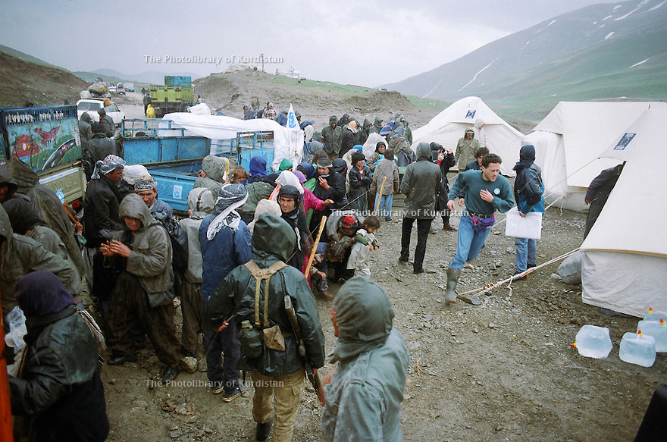
Physical factors
Cold
Heat
Rainfall
Humidity
Velocity of air currents
H.E.L.P. course
Notes:
Physical factors affect both host defences and viability of infectious agent
Velocity of air currents -> e.g. hurricanes, tornados; earthquakes, tsunamis

Slide 21
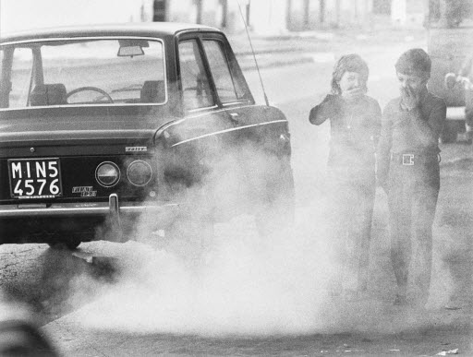
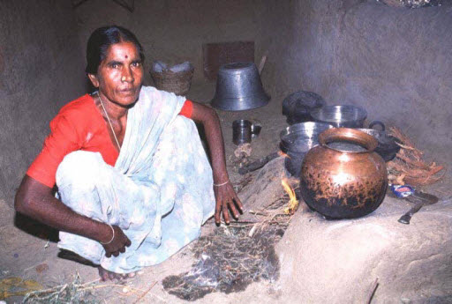
Pollution
Respiratory diseases
Skin toxicity
Contaminated water
H.E.L.P. course
Notes:
In house pollution is the worst, smoke from inhouse fires
Refugees camps are settled in none adequate areas: mud, but also environmental polution

Slide 22
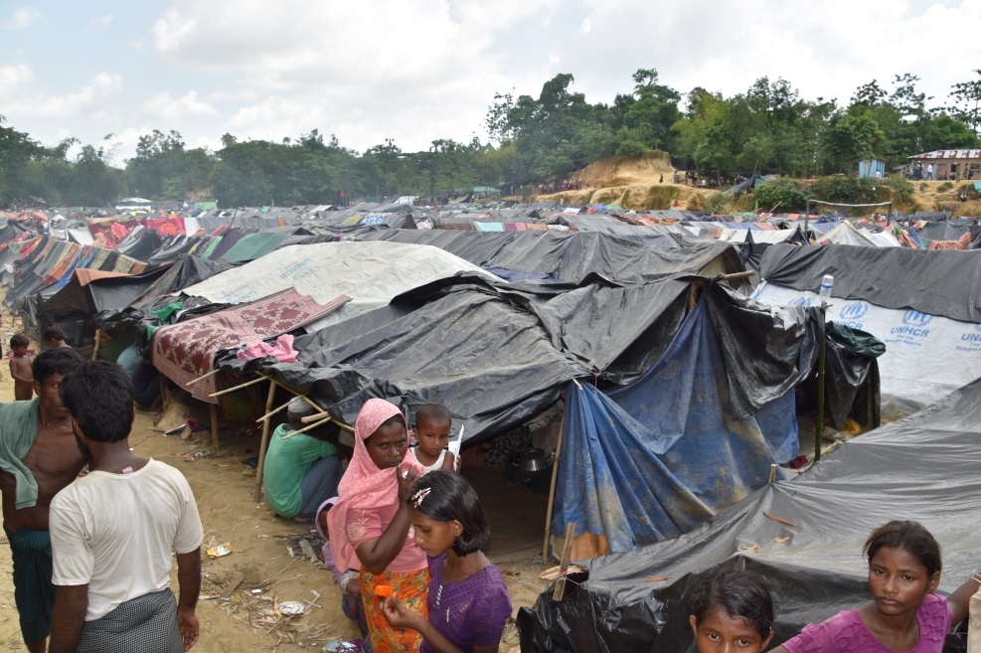
Biological factors
Attraction of rodents and pests inside houses
Availability of food sources for other host reservoirs and vectors
Waste disposal
Increased vector breeding
H.E.L.P. course
Notes:
Link climate change with vector breeding

Slide 23
Other factors
High percentage of children
Disruption of social structure
Sexual and gender based violence
Limited access to preventive or curative services
H.E.L.P. course

Slide 24
Common diseases in CRISES
H.E.L.P. course

Slide 25
??
Which one(s) describes epidemic and endemic disease?
Present permanently prior to the refugees, displaced arrival
Spread from one person to another
High number of cases reported in a short period of time.
H.E.L.P. course

Slide 26
Endemic versus epidemic diseases
Endemic disease
Epidemic disease
Habitual presence within a given geographic area or a population group
Hyper endemic: all ages and high prevalence rate
Cases with frequency clearly in excess of normal expectancy
Number of cases varies according to the infectious agent, size and type of population exposed, previous experience or lack of exposure to the disease, time and place of occurrence.
H.E.L.P. course
Notes:
Endemic: malaria; AURI
Hyperendemic: cold, cholera

Slide 27
Communicable diseases in crisis settings
 | Outbreak-prone | Seasonal | Emergencies | Mass gatherings | Zoonotic | Air-borne | Vector-borne | Water-borne | Rodent-borne
Anthrax
Chikungunya
Cholera (water diarrhea)
Crimean-Congo haemorrhagic fever
Dengue
Diphtheria
Ebola virus disease
Hantavirus
Hendra virus infection
Hepatitis E
Influenza (pandemic, seasonal, zoonotic)
Lassa fever
Leptospirosis
Malaria
Marburg virus disease
Measles
Meningitis
MERS-Cov
Monkeypox
Nipah virus infection
Plague
Poliomyelitis
Rickettsia (murine typhus)
Rift Valley fever
Severe acute respiratory syndrome (SARS)
Shigellosis (bloody diarrhea)
Smallpox
Tularaemia
Typhoid fever
West Nile fever
Yellow fever
Zika virus disease
Any public health event of international or national concern (infectious, zoonotic, food borne, chemical, radio nuclear, or due to unknown condition
H.E.L.P. course

Slide 28
Communicable diseases in crisis situations
Major epidemic potential
Other
Cholera
Measles
Meningococcal meningitis
Bacillary Dysentery
Diphtheria
Hepatitis A and E
Malaria
Typhus
Yellow fever
Trypanosomiasis
Leishmaniasis
Leptospirosis
Viral hemorrhagic fever
Relapsing fever
Typhoid
H.E.L.P. course
Notes:
80% of cholera, meningitis, measles cases in fragile/conflict-affected/vulnerable countries
The big common recurrent ones that require mass response
Cholera
Measles
Meningitis
Cholera and measles will discussed in more details in the coming days (Module Vaccine preventable diseases, module Dirrhoeal diseases / cholera)

Slide 29
Other potential important communicable diseases
Sexually transmitted diseases
Scabies
Louse borne relapsing fever
HIV
Hepatitis C
Various parasitic diseases
H.E.L.P. course
Notes:
Don’t forget in protracted crises the chronic contagious diseases present in the population e.g. guinea worm,

Slide 30
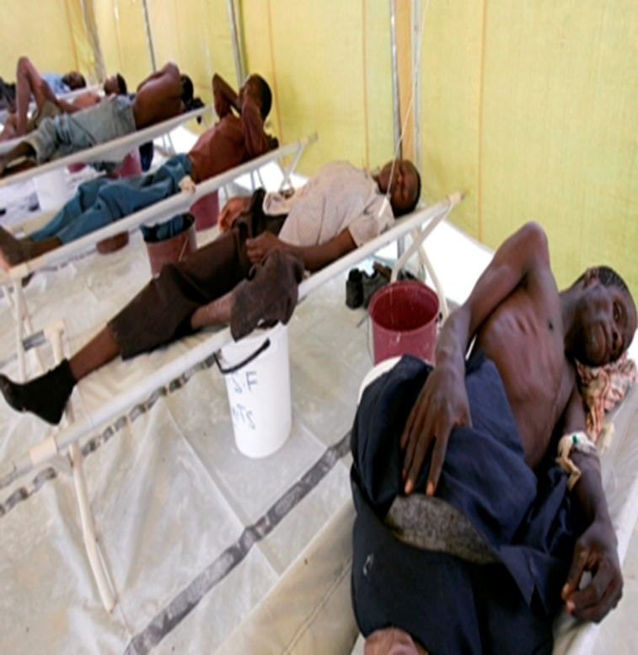
Cholera
The most feared major outbreak
Waterborne except where population concentrations are very high
May result in major loss of lives
If system is not prepared
If treatment is inadequate
Seasonal variation—disease of the rainy season
H.E.L.P. course
Notes:
Currently Yemen, Zimbawe

Slide 31
Expect cholera
Endemic to the area
Introduced
Population movements, conflict, displaced persons
Poverty
Some recent outbreaks
Yemen 1 million cases
Zimbabwe
Sierra Leone
H.E.L.P. course

Slide 32
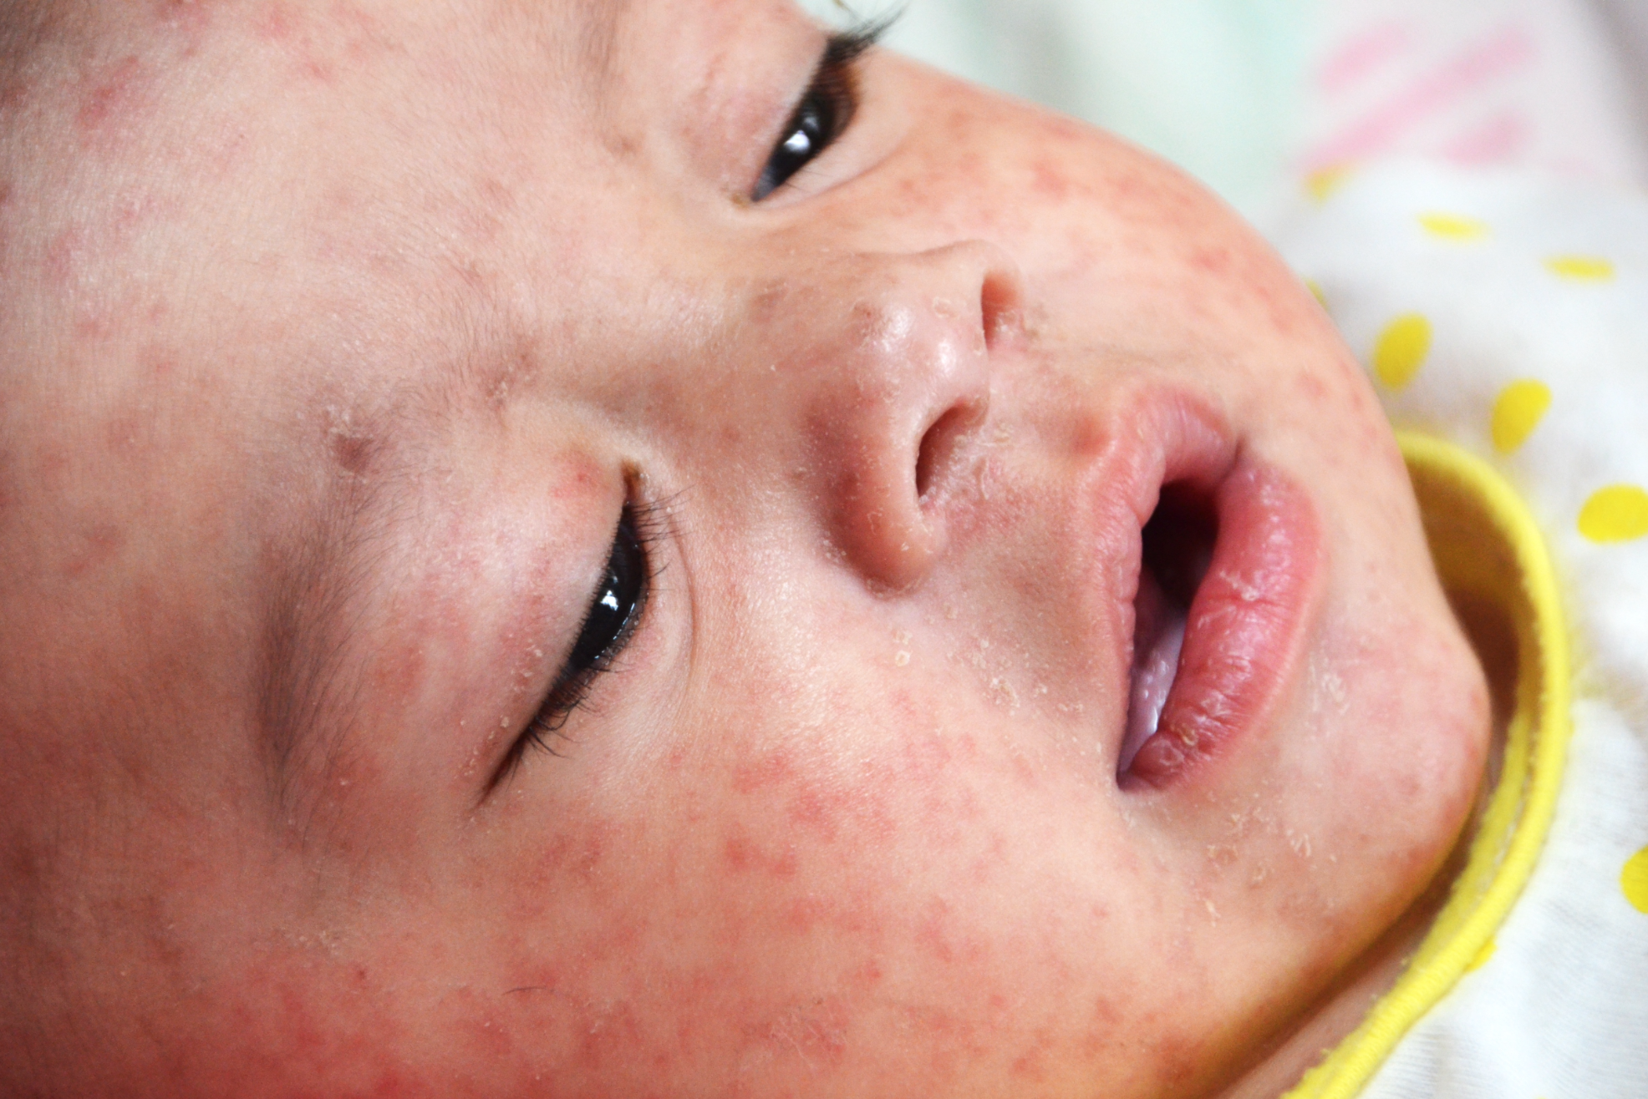
Measles
High mortality in children: Case fatality rates may run to 30% in crises
Malnourished children
Death due to respiratory complications
Highly infectious; a major risk in crowded settlements
Low age of infection in developing countries
Risk begins at 5-6 months of age
>30% of children infected by age 1 year
Effective EPI programs have greatly reduced risks
H.E.L.P. course
Notes:
Syria,

Slide 33
Displacement and measles
Often immunization coverage is low in displaced populations
Overcrowding promotes spread
Poor nutritional status increases risk of complications
Measles a major cause of weight loss — may take 3-4 months to recover
Measles is often followed by other diseases
Vitamin A deficiency associated with increased CFR and corneal changes which may lead to blindness
H.E.L.P. course

Slide 34
Meningitis
Epidemic meningitis Neisseria meningitides (Group A before, now group C)
Also Haemophilus influenzae and S. pneumonia
Common in Africa (meningitis belt)
Particularly in the dry dusty times - epidemic breaks with rains
Droplet spread
Increased transmission in crowded situations
H.E.L.P. course
Notes:
Nigeria 2018 C

Slide 35
Bacillary dysentery
Usually Shigella, but can be other organisms
Can be rapidly spreading infection of up 1/3rd of a population
Transmission: water, food and person-to-person
Highly contagious, only small inoculum required
Outbreak can be explosive
Incubation period 1-3 days
Bloody diarrhea, abdominal and rectal pains
H.E.L.P. course
Notes:
AWD common with cholera, major shigella outbreaks have not recently reported

Slide 36
Malaria
Malaria is common in many displaced populations
In Africa malaria leading cause of death among displaced populations
4 species of Plasmodium:
“Benign”: P. vivax, P. malariae, P. ovale, P. Knowlesi
“Malignant”: P. falciparum
H.E.L.P. course

Slide 37
Control of Malaria
One of most common causes of fever in endemic areas
Many persons self-treat
Repeated infections in childhood give partial immunity
Usually acquired age 3-5 year old
Before this age severe complications common
Complicated malaria
H.E.L.P. course

Slide 38
Sexually transmitted disease
Major risk in many crises—particularly with population displacement
Risk for GBV and transactional/survival sex
Pre-existing levels of STIs—Including HIV determine risks
Changes in sexual behavior with displacements
Reduced access to health care
Sexual and reproductive health is evolving—sex happens
H.E.L.P. course
Notes:
Over time, the need to address sexual and reproductive health issues in crisis situations has been more and more acknowledged and funding for these programmes is increasing

Slide 39
Tuberculosis risks in crisis situations
Major cause of mortality in long term crises
TB is a major in risk crisis situations
Overcrowded populations
Limited access to correct diagnosis and continuous treatment
National TB control programmes overwhelmed in crisis situations; cannot provide consistent supply of drugs
Treatment-completed ratios of <40% not uncommon
Poor nutritional status of population predisposes
H.E.L.P. course
Notes:
Prevalence of pulmonary TB
Situation urgent if prevalence >1% of the population
In many displaced populations TB prevalence is >4%
Tibetan refugees in central India: incidence 1,055/100,000 vs.109/100,000 for India

Slide 40
Communicable diseases are most common in children
Majority of child illnesses in crisis situations are caused by one of six conditions:
Measles
Malaria
Complicated by malnutrition
Diarrheal diseases
Upper respiratory infections
Lice and scabies
The majority of deaths from communicable diseases is in children; most in the <5 years and usually <2 years
H.E.L.P. course

Slide 41
Managing child health
H.E.L.P. course
Clinical care and immunization efforts closely linked
Child health and nutritional monitoring intertwined
Standard diagnostic and treatment algorithms reflecting host community standards

Slide 42
Other challenges
High Risk Pathogens
MERS, SARS, (pandemic) Influenza
Localized: e.g. Typhoid fever, Diphtheria
Environment control required: e.g. Dengue, Chikungunya, Zika
Endemic diseases
Emerging diseases
H.E.L.P. course

Slide 43
Control of communicable disease during crisis situations
H.E.L.P. course

Slide 44
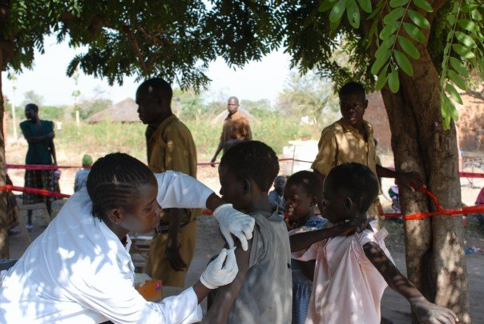
Prevention
Definition: identifying and reducing the risks of disease
Primary
Secondary
Tertiary
H.E.L.P. course

Slide 45
Primary prevention
Intervention before disease occurs
Vaccination
Health education: altering risky behaviors (poor eating habits, hand washing, tobacco use)
Banning substances known to be associated with a disease or health condition
Infection control – vector control, standard precautions in health care settings
H.E.L.P. course

Slide 46
Secondary prevention
Trying to detect a disease early and prevent it from getting worse
Screening, e.g.
Regular blood pressure testing
Mammography
HIV testing
Health surveillance and early warning systems (EWAR)
H.E.L.P. course

Slide 47
Tertiary prevention
Managing disease post-diagnosis to slow or stop disease progress
Primary and referral health care services for case management – standard diagnostic and treatment protocols
Trying to improve quality of life and reduce symptoms of a disease already present.
Mass treatment centers targeting outbreak
H.E.L.P. course

Slide 48
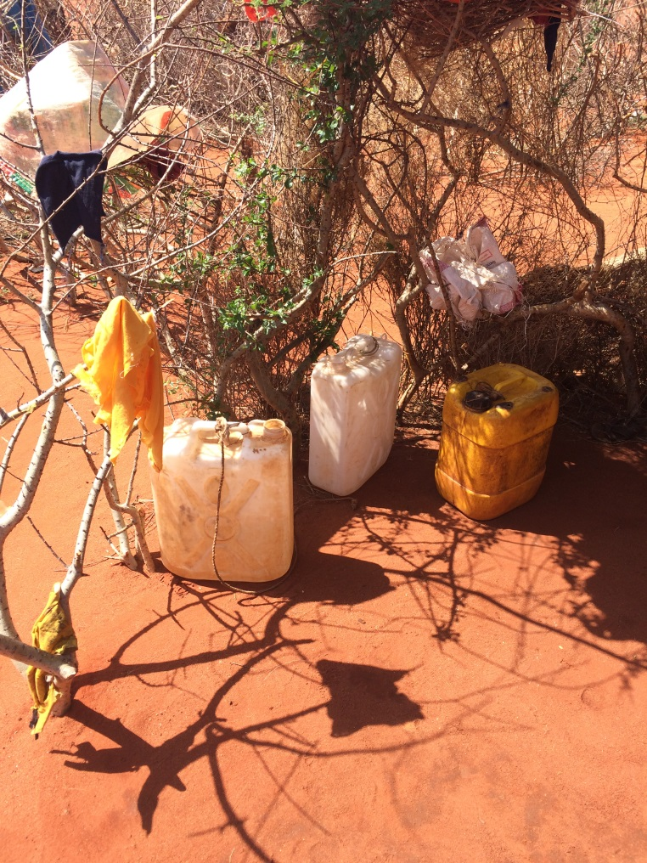
Ethiopia: Somali region, Sept. 2017 - Q 2
Group Work: 10 Minutes
What preventive measures would you instigate to address the risk for CD?
H.E.L.P. course

Slide 49
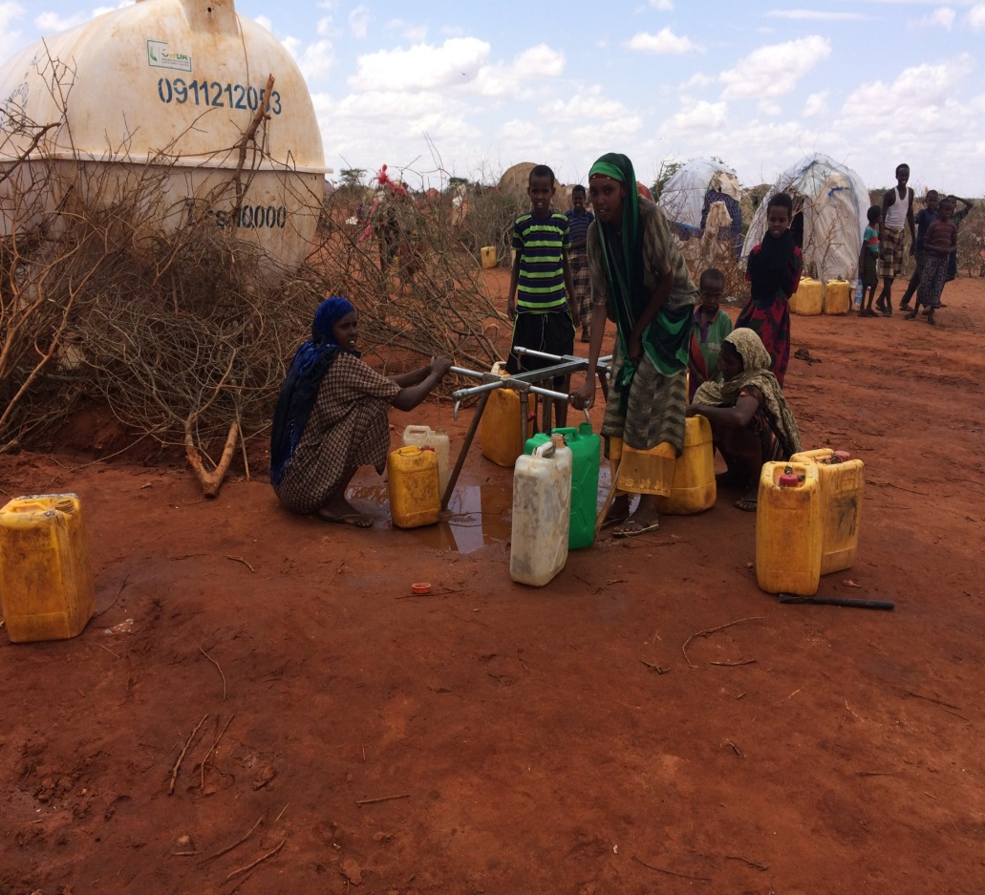
Answers
Water trucking
Measles vaccination
NFI distribution
Health Education
Secure water sources
H.E.L.P. course
Source: M Gayer WHO

Slide 50
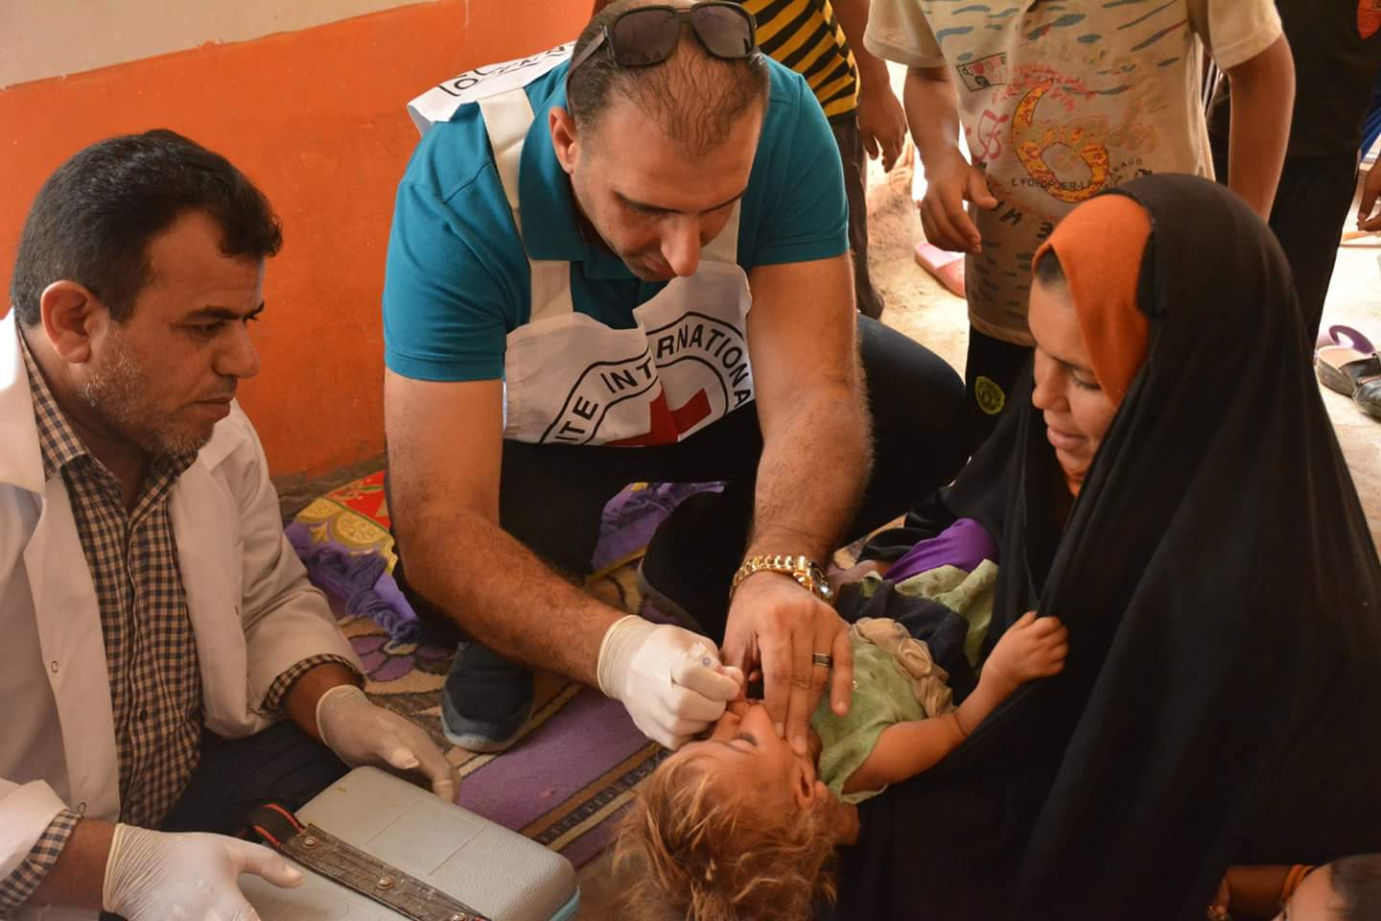
Preventive public health measures – Primary prevention
Safe water
Vaccination against measles
Routine EPI, MUAC
Infection control
Vector control
Secure water sources /environmental sanitation/waste disposal
H.E.L.P. course

Slide 51
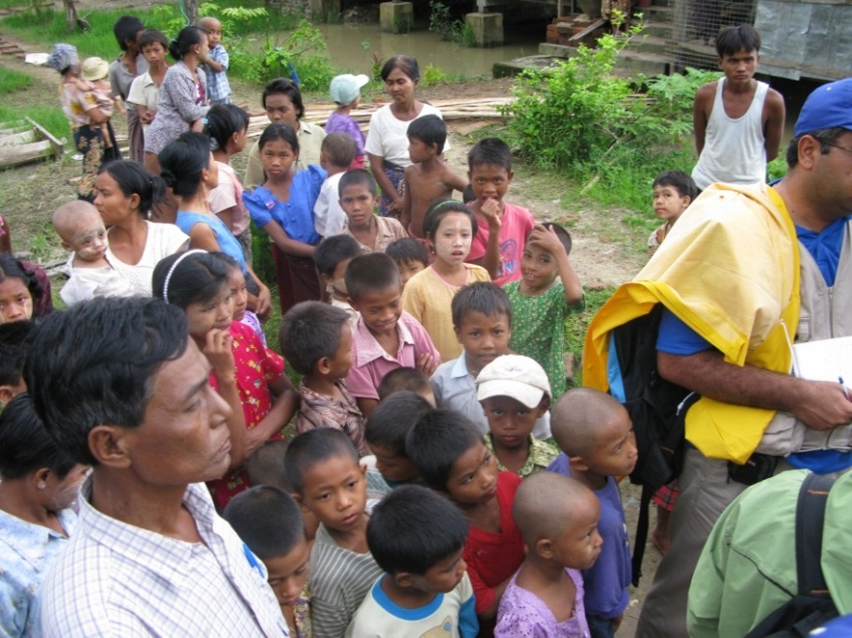
Secondary prevention – Rapid detection of events
Disseminating adequate information
Health education
Social mobilization
Community network
Surveillance as appropriate: active, passive, sentinel sites
Early warning and response system
Creating public awareness—providing reassurance
H.E.L.P. course
Notes:
Surveillance / early warning and response system for epidemic detection and control
Health education and social mobilization - community health care workers sensitized & trained to identify main diseases or problems and disseminate health messages.
Vector control
Environmental sanitation/waste disposal

Slide 52
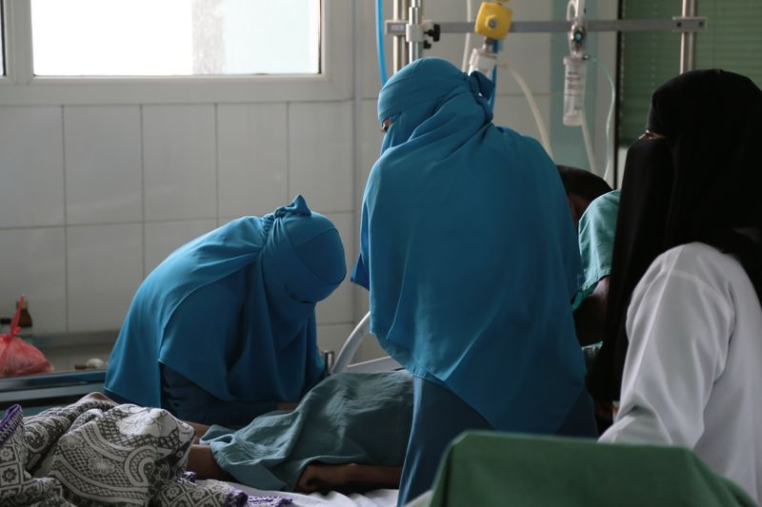
Tertiary prevention - Case management
Ensuring access to correct treatment
Access to health care
Availability of health care, health workers
Care seeking behaviour
Drug provision for main diseases
Physical rehabilitation
Surveys
H.E.L.P. course

Slide 53
Conclusions
Prevention has more impact than reaction, e.g.
Early warning and alert systems are essential
Vaccination, vector control
Good knowledge of local epidemiology is required
Pay attention to risk factors
Endemic diseases are less visible but may be major killers
Communicable diseases are common in displaced populations
Avoid outbreaks
A variety of control measures are available
In crises, children are more at risk for communicable diseases
H.E.L.P. course

Slide 54
Questions? Comments?
Thank you for your attention
H.E.L.P. course

