Slide 1
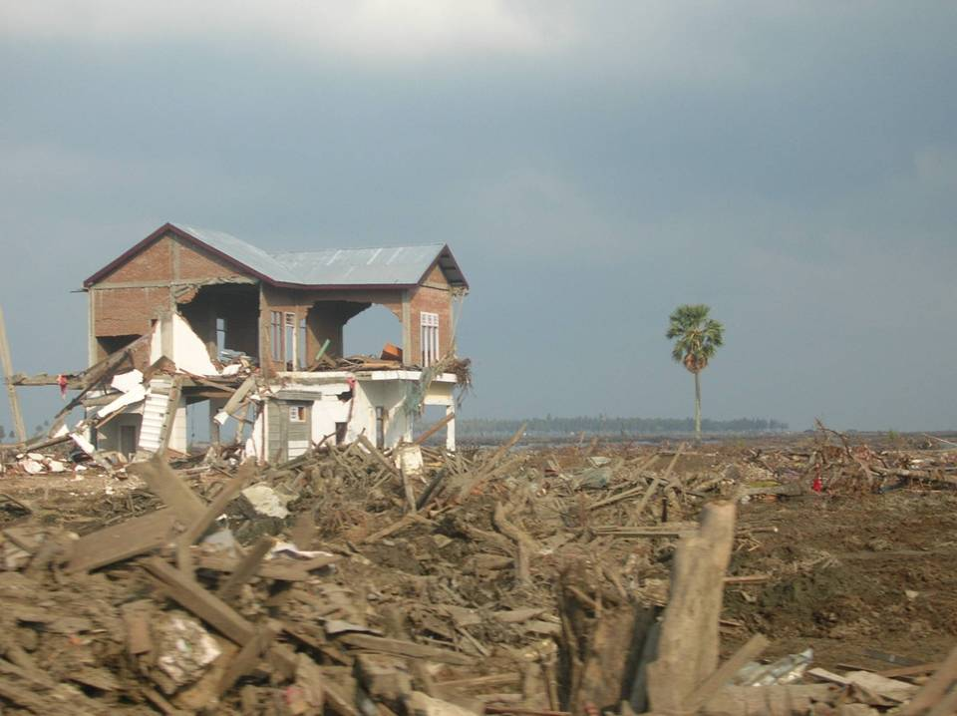
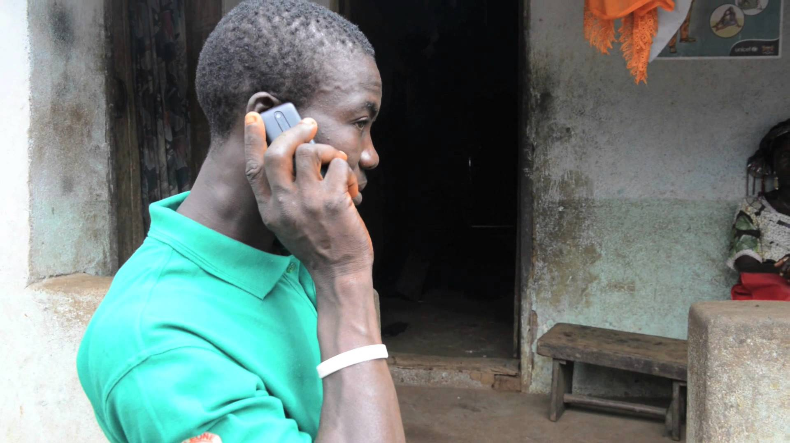
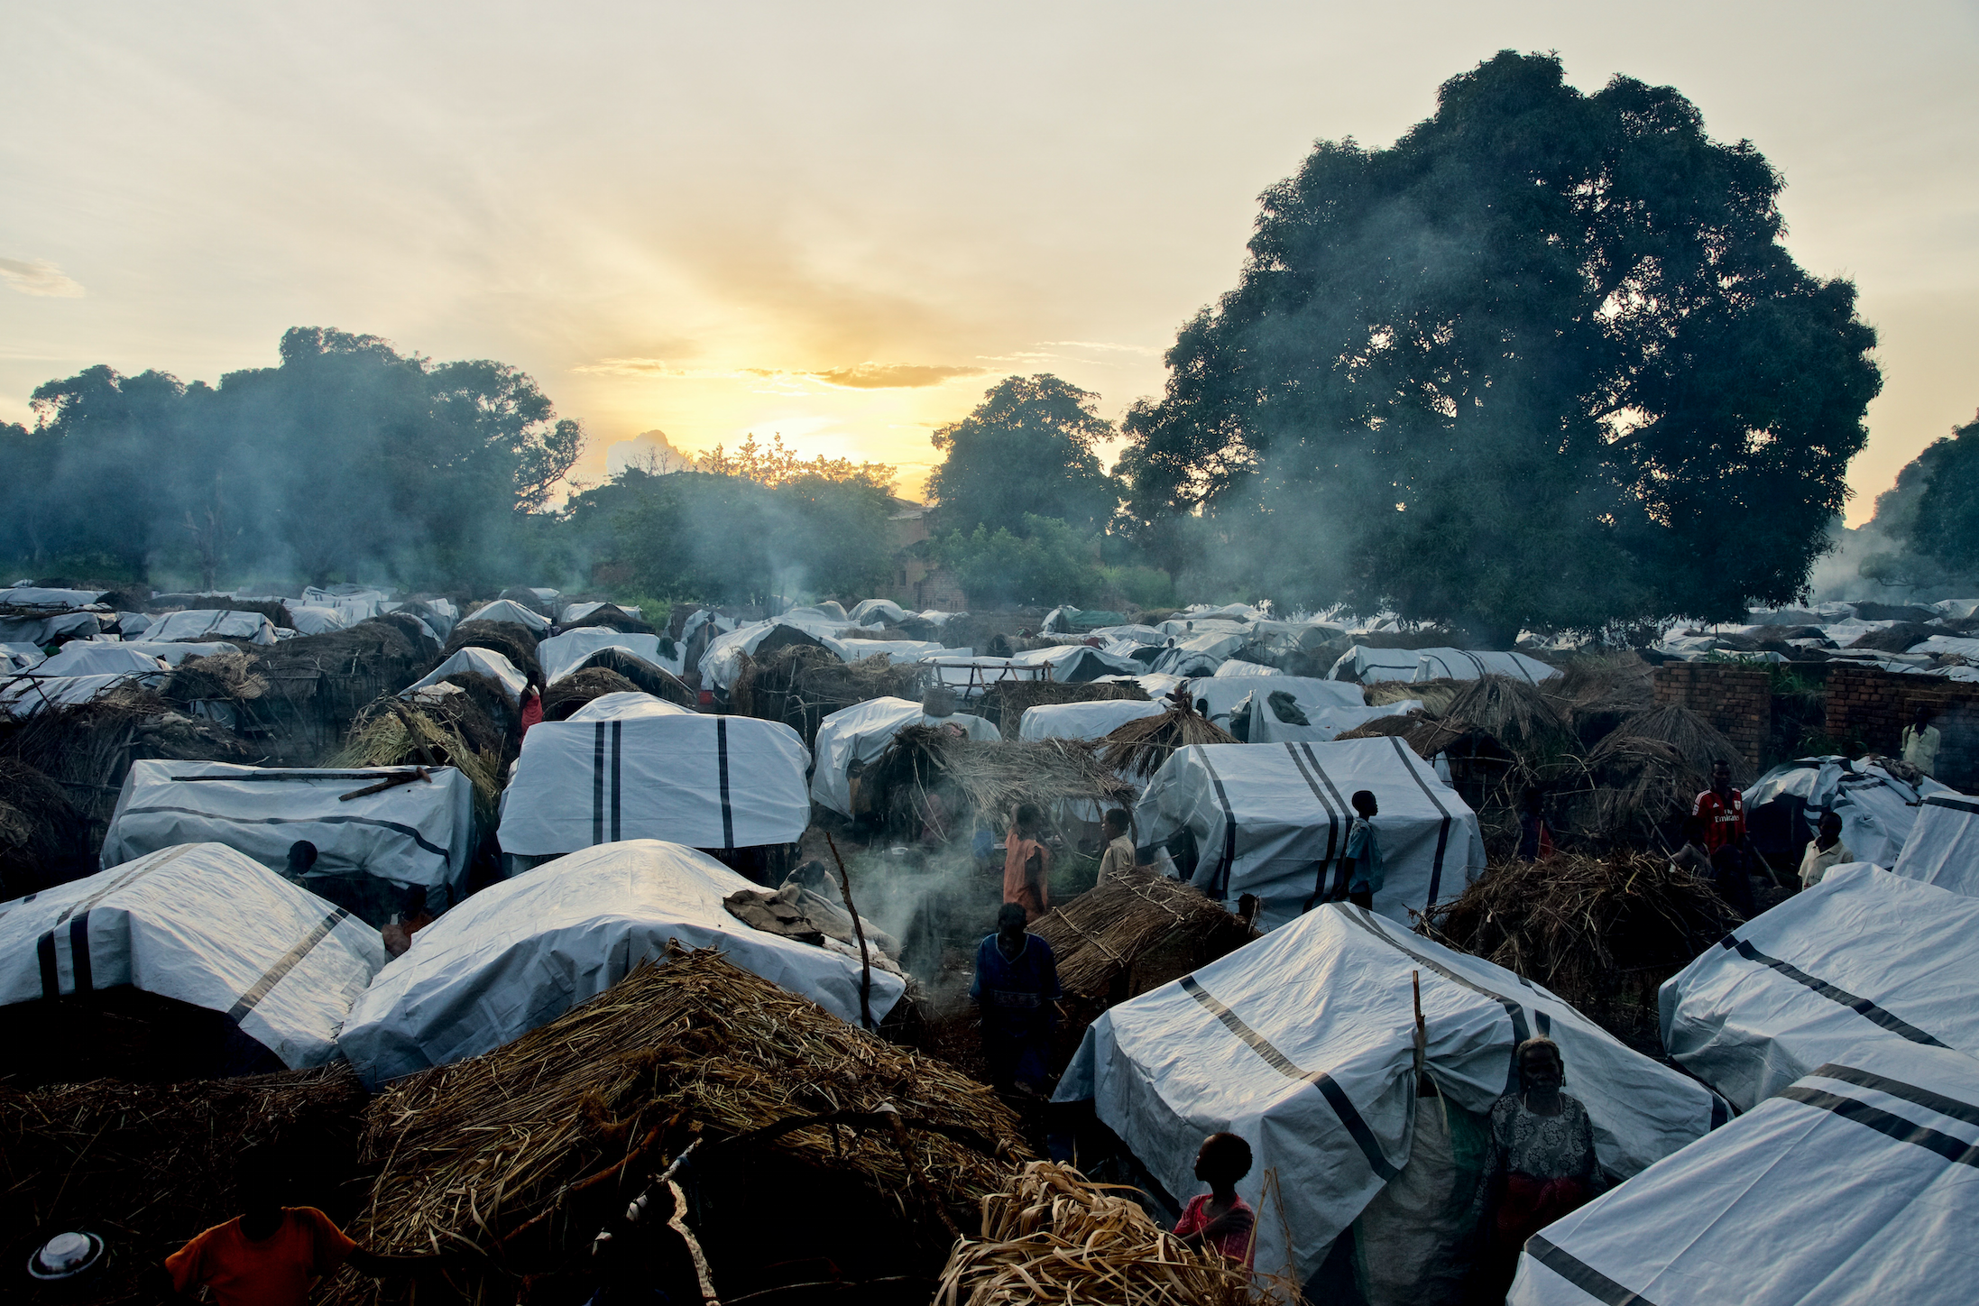
Logo organization(s) facilitator(s)
Health Surveillance and Early Warning Systems
H.E.L.P. course
These learning materials were developed with inputs from
Tony Stewart, Tambri Housen, Anne Golaz,
Gilbert Burnham and Antje van Roeden
Name and organization facilitator(s)
Notes:
Toni Stewart, Australian National University
Tambri Housen, Australian National University
Anne Golaz, CERAH Geneva
Gilbert Burnham, John Hopkins University, Bloomberg School of PH
Antje van Roeden, ICRC

Slide 2
Objectives
Be able to
participate in setting-up and implementing a functional health surveillance system in an acute and / or protracted crisis situation
explain the purpose and intended use of health surveillance in crisis situations
identify diseases/health problems to be included in a health surveillance and early warning system
explain the practical aspects and main features of a health surveillance system in a crises situation
H.E.L.P. course

Slide 3
Public health surveillance
An ongoing, systematic collection, analysis and interpretation of health-related data essential to the planning, implementation, and evaluation of public health practice
Source: WHO
Continuous process
Closely integrated with the timely dissemination of those data to those who need to know.
The final link in the surveillance cycle is the use of these data for appropriate disease prevention and control
H.E.L.P. course
Notes:
In the module Programme Cycle Management, we discussed the definition of monitoring (A continuous and systematic process of collecting, measuring, recording, analysing and communicating information intended to aid management) and identified different types of monitoring (situation monitoring/ongoing assessment, activity/process monitoring, results monitoring, other types, e.g. financial monitoring). We also looked into the difference between monitoring and evaluation, and gave an introduction to indicators
Public health surveillance is one of the types of monitoring. It is of key importance in crisis situations

Slide 4
The Surveillance Cycle
Data collection
Dissemination & Public health action
Data cleaning
Data analysis
H.E.L.P. course
Interpretation

Slide 5
Who usually conducts disease surveillance?
Ministry of Health
Provincial Health Level
National Feedback & Policy
Data analysis should take place at all levels to enable timely action.
District Health Level
Health facilities (health centers, hospitals, labs)
Results
Results
H.E.L.P. course
Adapted from Hari Purnomo (University of Gadja Mada)

Slide 6
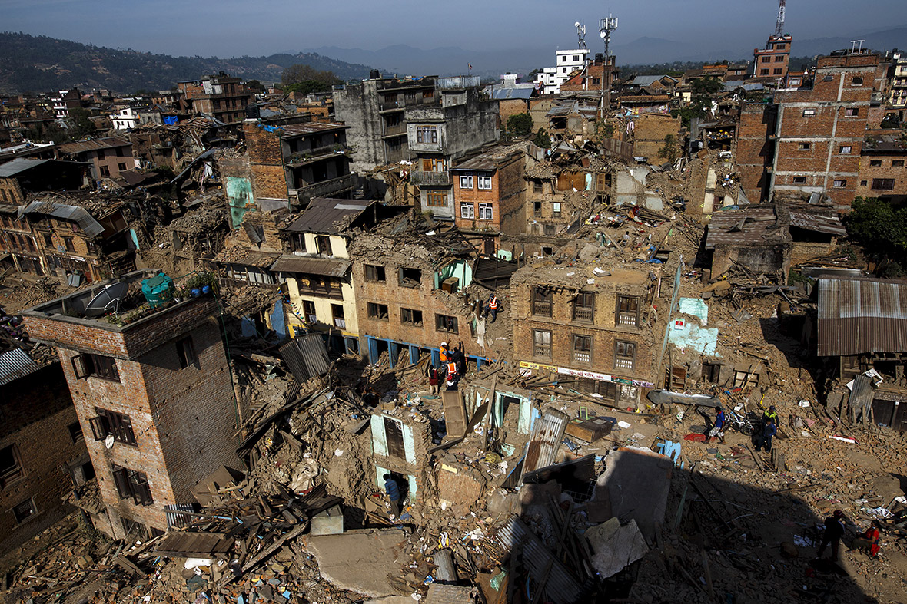
Purpose of PHS in crisis situations
H.E.L.P. course
Reduce Mortality and Morbidity in a population
Photo credit: http://d.ibtimes.co.uk/en/full/1437494/nepal-earthquake.jpg
Notes:
What are some of the purposes for PH Surveillance?
Can you provide examples?

Slide 7
Role of health surveillance in crises
Timely detection of health events threatening public health (outbreaks)
Monitor health trends for appropriate public health action
Monitor programme performance
Monitor workload at health facilities to optimise allocation of resources
H.E.L.P. course
Notes:
What is the difference between health surveillance and other data collection activities?

Slide 8
Why is health surveillance imperative in acute and protracted crises?
High vulnerability of affected populations to risks of epidemics, malnutrition and other acute health problems
Sudden changes that can occur (in the population and health conditions)
Need for data on which to base information about the situation and potential need for interventions
H.E.L.P. course
Notes:
In crisis situations there is often displacement of large numbers of people with an increased risk of transmission of communicable diseases, inadequate nutrition and shelter, unsafe water, poor sanitation and a lack of services

Slide 9
Types of health surveillance
??
Passive surveillance
Regular reporting of disease data by all services that see patients and are part of a reporting network. It involves passive notification and reports are generated and sent by local staff
There is no active search for cases.
Active surveillance
involves visiting health facilities, talking to health-care providers and reviewing medical records to identify suspected cases of disease under surveillance
What is the difference between Passive and Active health surveillance
H.E.L.P. course
Source: WHO
Notes:
Passive surveillance: examples are infectious diseases, injuries, cancers, antibiotic resistance, behavioral risk factors (BRFSS)
Active surveillance : examples are disease targeted for eradication /elimination, during an outbreak investigation

Slide 10
Surveillance network
??
Comprehensive
All health facilities in the region participate
More expensive
Higher requirement for supervision
Sentinel
Only a few selected health facilities (aim for good quality, geographic spread)
Less expensive
Sufficient to show trends
May detect outbreaks late
What is the difference between Exhaustive and Sentinel surveillance
H.E.L.P. course
Source: WHO

Slide 11
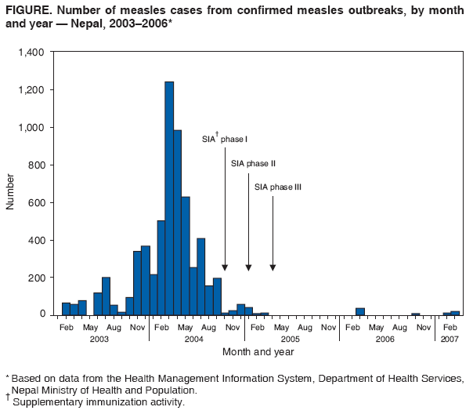
H.E.L.P. course
Notes:
11

Slide 12
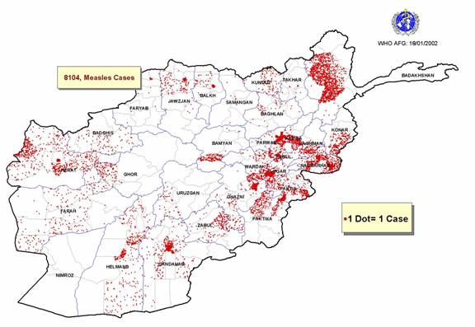
Sentinel surveillance –Measles cases from 328 WHO sentinel sites in Afghanistan, January-December 2001
A sentinel system deliberately involves only a limited network of carefully selected reporting sites
H.E.L.P. course
Notes:
12

Slide 13
Group work: three crises
Indian Ocean Tsunami
Refugee influx South Sudan
Diphtheria in Cox Bazar
H.E.L.P. course
H.E.L.P. course
Each of the groups will look at one of these crises
Notes:
Each groups discusses one of these three crises

Slide 14
Crisis 1: Indian Ocean Tsunami (2004)
H.E.L.P. course

Slide 15
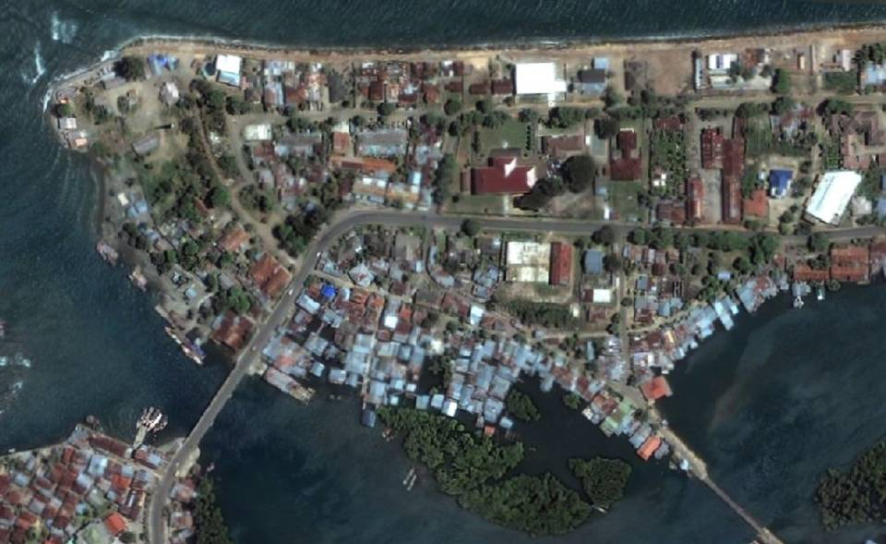
H.E.L.P. course

Slide 16
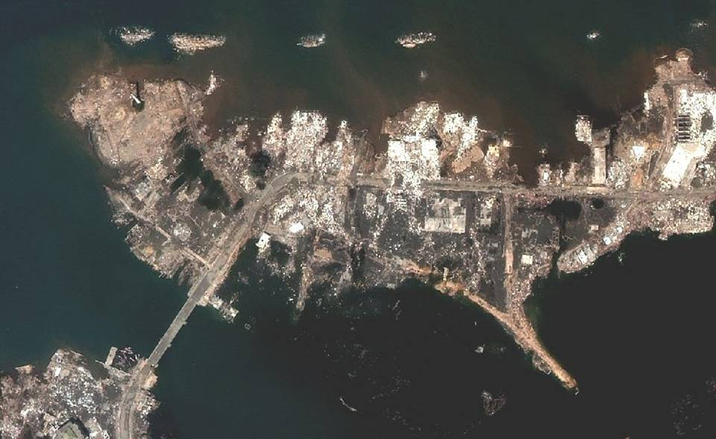
H.E.L.P. course

Slide 17
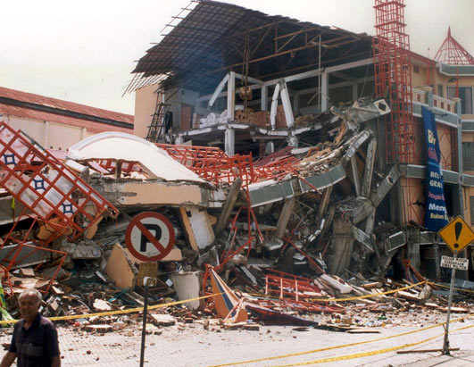
Crisis 1: Indian Ocean Tsunami -Scale of Disaster
More than 300,000 deaths throughout Asia
Estimated figures Indonesia’s Aceh province
220,000 people killed
126,000 buried
94,000 missing
440,000 people displaced
600,000 livelihoods affected
H.E.L.P. course

Slide 18
Crisis 1:Indian Ocean Tsunami - Operational challenges
Unprecedented scale of death and destruction
Near simultaneous impact in 10 countries
Continuing seismic activity
Access and support to remote communities
Ongoing military conflicts
Scale of planning and coordination required
H.E.L.P. course

Slide 19
Crisis 1: Indian Ocean Tsunami Effect on Health Sector
Health Workers dead or missing; many more unable to report to work
Hospitals and health centres destroyed or damaged
Provincial health office, public health lab, central stores and vaccine stores destroyed
Health training facilities destroyed
Transport and communications severely disrupted
H.E.L.P. course
Notes:
Points that can be highlighted after the participants have given their group work feedback
Timeliness and communication:
Daily meetings initially
Brief
Two way exchange of information
Encouragement to participate / report
In Banda Aceh:
Surveillance helped to prioritise areas for measles mass immunisation when outbreaks occurred
Large number of wounded on 26th of December: majority received little to no wound care -> First case of tetanus 7 days after -> health worker education, clinical protocol, surveillance, prevention
It is a good moment here to make a reference to the HeRaMS -Health Resources Availability Mapping System)
HeRAMS is a global health information management tool (for mapping, collection, collation and analysis of information on health resources and services) that aims to provide timely, relevant and reliable information for decision-making. It is used to guide interventions at the primary and secondary care levels, measure gaps and improve resource planning, ensure that actions are evidence-based, and enhance the coordination and accountability of WHO and other health sector partners.

Slide 20
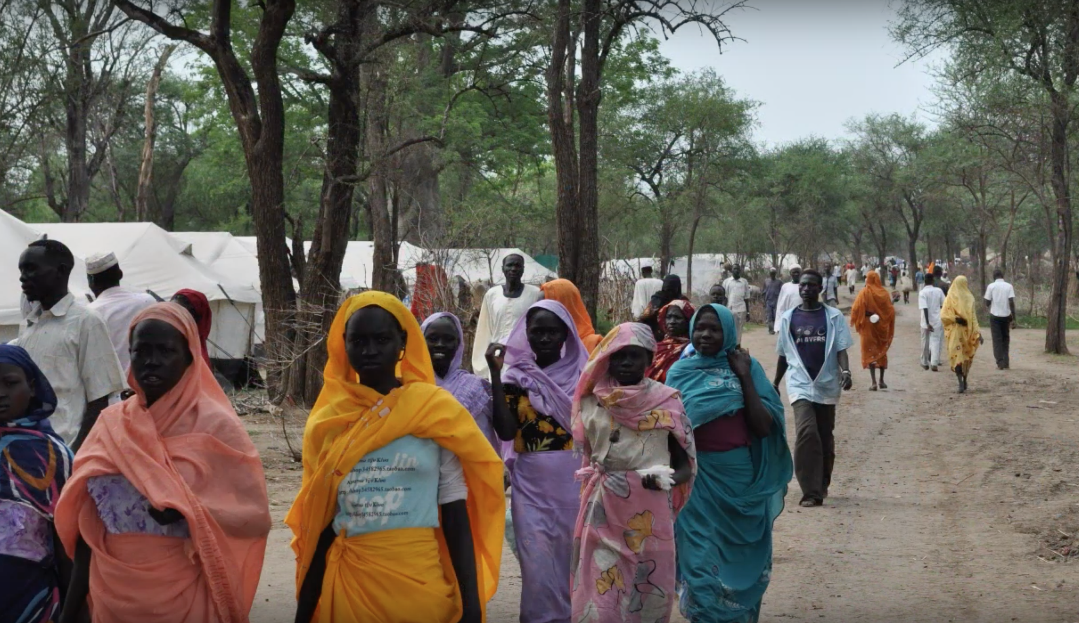
Crisis 2: Refugee influx South Sudan 2012
> 170’000 refugees crossed from Sudan, to escape conflict and food insecurity
Many walked for weeks and arrived weakened
4 camps, Yusul Batil camp 35’000 people
Huge needs across all sectors
Local services limited
Rainy season started; cold nights
Access roads are disintegrating
Humanitarian response struggling to provide basic conditions
H.E.L.P. course
Notes:
Photo: Yusuf Batil camp 2012
Situation August 2012 –sources of information MSF and UNHCR

Slide 21
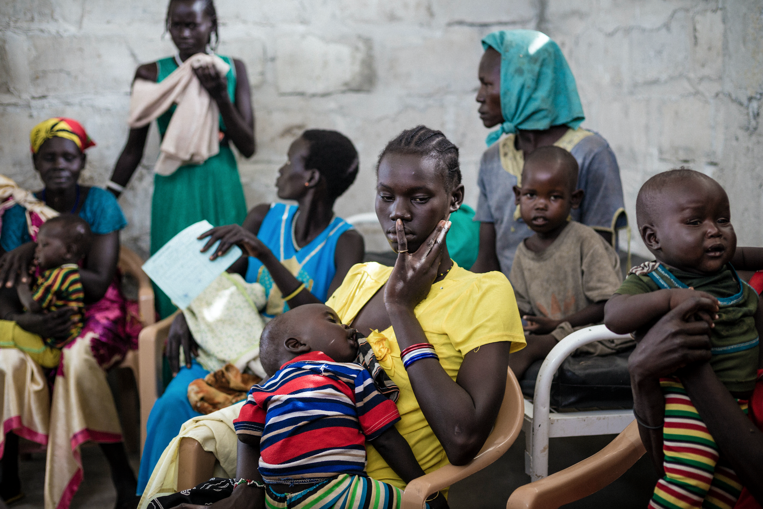
Crisis 2: Refugee influx, South Sudan (2012)
CMR: 4 deaths per day /10’000
58% of reported deaths children <5y old
25% of reported deaths > 50y old
Main cause of death reported diarrhoea
25% <5 y old malnourished; 10.1% severely
Since start rainy season consultation for respiratory tract infections tripled
H.E.L.P. course
Notes:
South Sudan –Photo Alyona Solenka, Copyright ICRC

Slide 22
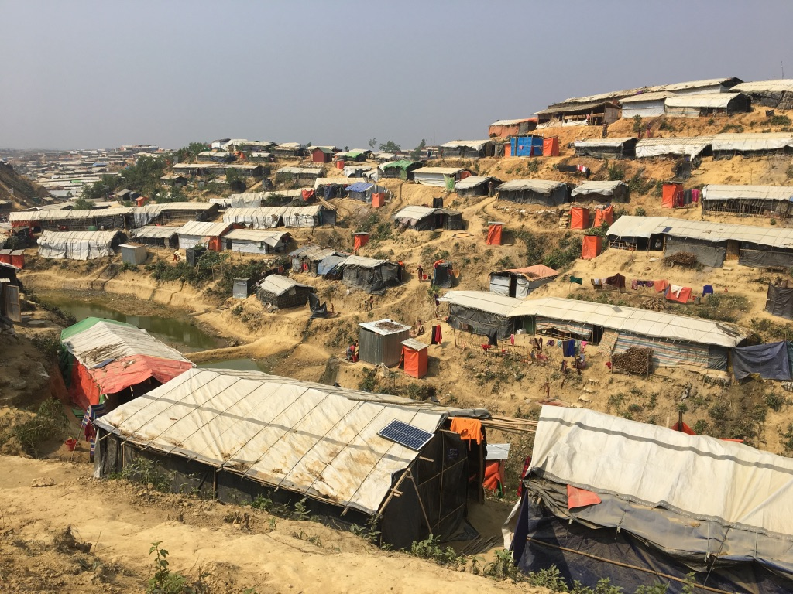
Crisis 3: Diphtheria Cox Bazar – Bangladesh Rohingya Camp
One of the fastest and largest mass displacement of the last 25 years
12 camps /settlements
> 900’000 refugees
79’000 with host communities
Mega camp: 602’000 people
Estimated total population: 1.3 million
H.E.L.P. course

Slide 23
Crisis 3: Diphtheria Cox Bazar– Bangladesh Rohingya Camp
H.E.L.P. course

Slide 24
Crisis 3: Diphtheria Cox Bazar -Initial signal and context
Suspected diphtheria cases in Nov 2017 among Rohingya refugees in the camps and surrounding host community
Lack of laboratory facilities for confirmation
Concurrent outbreaks/background of other epidemic prone illnesses
1 hospital, already overwhelmed
MSF, Red Cross and IOM have established field hospitals, all suspect cases to 1 facility
H.E.L.P. course
Notes:
Points that can be highlighted after the participants have given their group work feedback
Components of the Cox Bazar diphtheria response included:
Surveillance/case definitions
Community awareness (schools)
Referral systems/transport
Clinical care including allocation of Diphtheria Anti-Toxin
Contact tracing
Vaccination

Slide 25
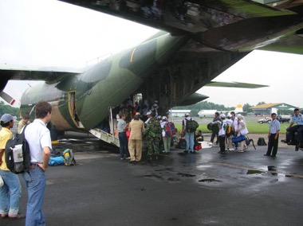
Group work Time allocated: 20 minutes
Your team has been dispatched to one of these crises and been assigned to take responsibility for disease surveillance
How would you implement a surveillance system?
What diseases would you prioritize in your surveillance system?
Design a form to collect data (one page)
How will you interface with other responders: Government, clinical care providers, community based programmes, etc.
H.E.L.P. course

Slide 26
Some key points for disease surveillance data
Which diseases are endemic in the affected area?
What seasonal events should you consider?
Which of the communicable diseases has outbreak potential
Which diseases are associated with high mortality
What are the immunisation rates?
Case definitions
H.E.L.P. course
Notes:
Case definitions are discussed more in details during the next module: Outbreak investigation and response

Slide 27
Communicable diseases typical under surveillance in a country
Syphilis
Gonorrhoea
Pneumonia
Neonatal tetanus
Tuberculosis
Aids
Viral hepatitis
Influenza
Meningitis
Malaria
Which of these has outbreak potential?
Which should be under surveillance during the acute phase of this crisis?
Cholera
Diarrhoea
Typhoid fever
Leprosy
Tetanus
Dengue fever
Diphtheria
Measles
AFP
H.E.L.P. course
Notes:
From our case study
If you were looking at a displaced /refugee population, you would have to consider diseases endemic in the area where they have come from also

Slide 28
Priority diseases for surveillance in crises
Cholera
Diarrhoea
Typhoid fever
Leprosy
Tetanus
Dengue fever
Diphtheria?
Measles
AFP
Febrile illness
Syphilis
Gonorrhoea
Pneumonia
Neonatal tetanus
Tuberculosis
Aids
Viral hepatitis
Acute respiratory illness
Meningitis
Malaria
H.E.L.P. course

Slide 29
Cox Bazar
H.E.L.P. course

Slide 30
Cox Bazar
H.E.L.P. course

Slide 31
Principles of health surveillance in crises
Identify health events with associated high morbidity and mortality (communicable) –early warning
Limit data to what can be acted upon (10-12 max)
Use existing systems in place; extend the systems if necessary
Keep it simple and acceptable
Frequency of data reporting
Training, clear tasks and responsibilities
Quick feedback loop
Flexible
H.E.L.P. course
Notes:
Only health events with associated high mortality and morbidity (communicability)
Limited to what can be acted upon (effectively prevented or treated)
Think about what works in this setting for timeliness
Frequency of data reporting (daily, weekly, monthly)

Slide 32
The Surveillance Cycle
Data collection
Dissemination & Public health action
Data cleaning
Data analysis
Interpretation
H.E.L.P. course
Notes:
Data collection –
What is the overarching goal – what are the specific objectives required to meet that overarching goal
What data do we want to collect, why?
What are the definitions of the data to be collected.
How are we going to use each of the data collected
Will the system give us what we need
Who will collect the data
How will it be collected
When will it be collected
From whom will it be collected – who is the target population
Where do we implement the system
How will the data be transmitted to the people performing the analysis

Slide 33
Data collection and reporting
Establish a working case definition for each disease
In crises, sensitivity above all (better to have false alerts than to miss outbreaks)
Syndromic surveillance for diseases of epidemic potential
Reporting form
Initial: age (<5 and ≥5), sex, disease, location (residence, health structure), reporter
Clearly allocate roles and responsibilities at all points along the surveillance cycle
Register ONLY ONE (most important) diagnosis per patient
Count only new cases not follow-ups
Define frequency and method of reporting
Daily/weekly reporting in the acute crisis phase, Weekly when situation stabilizes, Immediately if highly contagious disease; Feedback on the same basis
Report zero (0) for no case of death or diseases/syndromes listed on the form
H.E.L.P. course
Notes:
Syndromic based rather than diseases, e.g. acute respiratory tract infections, diarrhoeas, fever
Reporting: Weekly ; In the case of an outbreak – daily
NB: Case definitions, including sensitivity and specificity are discussed during the module ‘’Outbreak investigation and control’’

Slide 34
Ex. Suggested case definitions and alert thresholds
Disease | Case definition and information | Alert criteria
Suspected measles | Fever≥38ºC AND generalized maculopapular rash (non-vesicular) AND ONE of the following: cough or runny nose (coryza) or red eyes (conjunctivitis) | One case
Acute jaundice syndrome | Acute onset of jaundice (yellowing of whites of eyes or skin or dark urine AND severe illness with or without fever AND the absence of any know precipitating factors | Five or more cases in on location Or Double the weekly average number of cases seen in the previous 3 weeks for a particular location
Suspected cholera /AWD | Any person ≥5 years with severe dehydration or death caused by acute diarrhoea (three or more abnormally loose or fluid stools in the past 24 hours) During a cholera epidemic, any person ≥2 years with acute diarrhoea (three or more abnormally loose or fluid stools in the past 24 hours), with or without dehydration | One case
H.E.L.P. course
Source: WHO
Notes:
34

Slide 35
Syndromic surveillance
Is surveillance using health-related data that precede diagnosis and signal a sufficient probability of a case or an outbreak to warrant further public health response
(source: CDC)
Examples: Fever of unknown origin
Diarrheal syndrome
Acute jaundice syndrome
H.E.L.P. course
Notes:
Syndromic surveillance provides information at an earlier stage than laboratory confirmation and therefore has the potential to inform timely actions to reduce the impact of disease in a community.

Slide 36
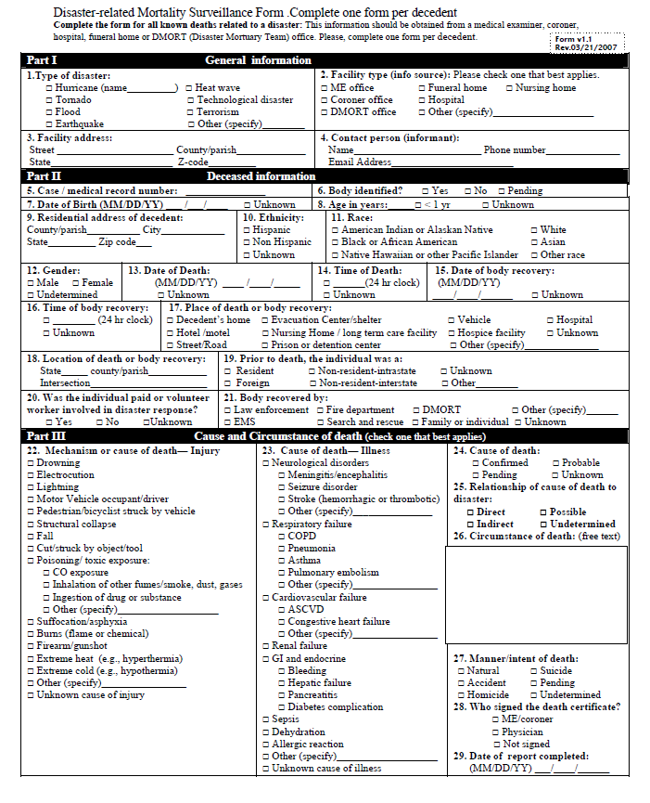
??
H.E.L.P. course
Notes:
This is an example of surveillance data collected in a normal / stable situation (MoH).

Slide 37
H.E.L.P. course
Notes:
During a crisis situations: Keep it simple! Only key relevant points to be included
Reporting:
paper forms in a box
texting,
call from surveillance team
When the situation stabilizes, the surveillance system will change and mature with time in most contexts especially as improved diagnostic methods are (re)introduced.

Slide 38
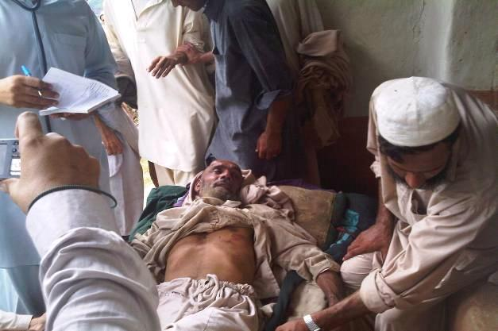
Health surveillance data in crisis situations
Demographic data
Mortality
Morbidity
Basic needs
Programme coverage indicators
H.E.L.P. course
Photo credit:http://www.who.int/features/galleries/photo9large_20100819.jpg?ua=1
Notes:
Picture of mobile medical team in Buner district after the floods

Slide 39
Estimating the number of affected people
Sources / methods:
Information from country authorities, community leaders, UNHCR, other agencies, repeated sample surveys
Census, Comprehensive count
Dadaab refugee camp survey, Garissa Region, Kenya
Counting people fleeing when they cross the border
Rohingya fleeing from Myanmar to Bangladesh, 2018
Overflight/areal photography to count households, complemented by other estimates of household size
Goma 1994
Mapping: Estimate the settlement area in m², complemented by an assessment of population density at different points
Count of services: Count N° of services provided to a target population (e.g. N° of vaccinations given to <5y) -> estimate total population using the target population count as percentage
H.E.L.P. course
Notes:
For info: This slide was discussed during the module ‘’Data collection, analysis and sharing’’ in the first week of the course -> reference can be made to this here

Slide 40
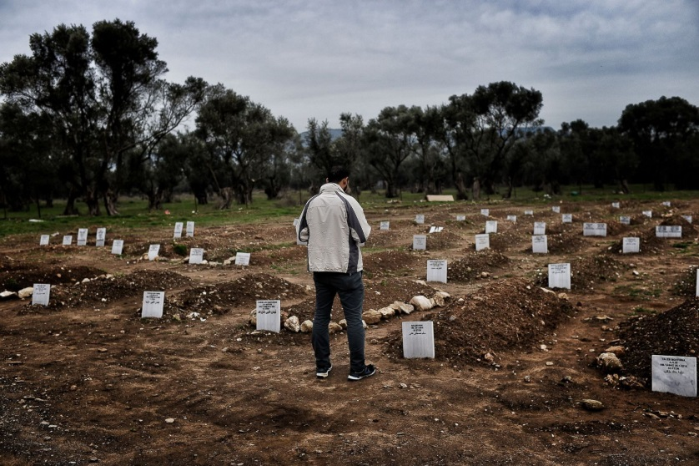
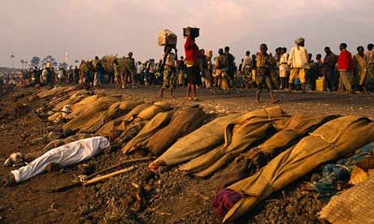
Mortality surveillance
Source
Hospital
Body collectors
Cemetery – ‘grave watchers’
Burial shroud distribution
Camp administrators
Community – home visitors, leaders
Drones, over flying
Report
Crude mortality rate
U5MR
Cause specific mortality rate
Cemetery inside Syrian refugee camp, Lesbos, Greece
H.E.L.P. course
Goma 1994 –Source: The Guardian
Notes:
Photo on top: Cemetery inside a Syrian refugee camp in Lesbos, Greece
In the module ‘’Data collection, analysis and sharing’’ examples are discussed about estimating the number of affected people (denominator)

Slide 41
Ex. Mortality surveillance in Goma, Zaire -1994
Number of deaths in camps obtained from 3 sources:
Daily counts of bodies collected by trucks and tallies of bodies buried in mass graves
Health facility-based surveillance, first sentinel sites, then comprehensive August 14
Population-based surveillance: surveys or community health workers (CHWs)
H.E.L.P. course
Notes:
Data of UNHCR for the period 18 July to 08 August show 4’330 deaths reported versus 45’535 bodies being collected. Nb. UNHCR paid the body collectors per body
This is a reminder that much illness and many death occur outside health facilities –and a reminder of the use of passive and active surveillance

Slide 42
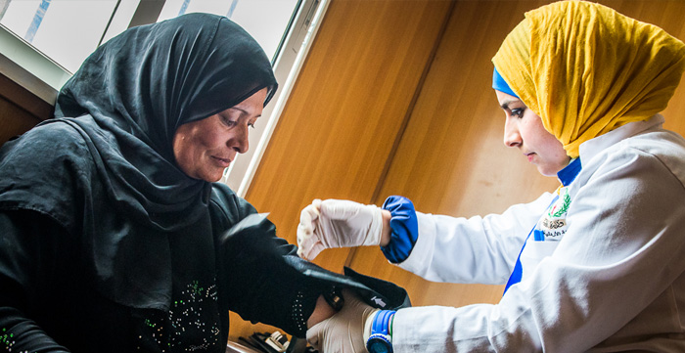
Morbidity (disease) Surveillance
Have a valid case definition
Be aware of seasonal patterns
Be flexible
Insist on negative reporting
Health centres/clinics
Hospitals
Laboratory
Health visitors (usually only in an outbreak – active case finding)
Indicators
Incident rate
Attack rate
Case fatality rates
H.E.L.P. course
Notes:
Photo: Zatari refugee camp Jordan
Case definition sensitivity and specificity are discussed during the module ‘’outbreak investigation and control’’

Slide 43
Health surveillance in acute crisis situations
Large numbers of people affected, high population density, inadequate food, water, sanitation and shelter, and lack of infrastructure
Increased risk of transmission of infectious diseases and other health conditions such as malnutrition
Epidemic prone diseases are a major risk for morbidity and mortality
National routine surveillance system may be underperforming, disrupted or non-existent
Overwhelmed by the crisis to adequately meet surveillance information: timeliness and data quality
H.E.L.P. course
-> Early warning alert and response system (EWARS) to fill the gap

Slide 44
Early warning and response system /network EWARS / EWARN
A health surveillance system to rapidly detect and promptly respond to signals that might indicate outbreaks and clusters of epidemic-prone diseases
Addition to, not a substitute for the national surveillance system
should not continue to operate in parallel when the crisis over
Two main components
Immediate alert: signals early stage of outbreak
Weekly reporting: data aggregated by health facilities
H.E.L.P. course
Notes:
44

Slide 45
EWARS/EWARN
Weekly reporting
.………
Immediate alert notification
Central EWARN Coordinator
….…..……………..………..
Intermediate district and provincial EWARN reporting levels
Intermediate district and provincial reporting levels
H.E.L.P. course
Reporting health facilities in surveillance network
(clinics, hospitals, labs)
Community informants
General public
Media rumours
Source: EWAR guideline
Notes:
45
Source EWAR guideline

Slide 46
Ex. Syria EWARS –types of alert reporting
Type A alert Of immediate notification | Type B alerts Of Weekly reporting
Acute watery diarrhoea (suspected cholera) AFP (suspected poliomyelitis) Suspected measles Unusual cluster of health events Unusual cluster of deaths Acute bloody diarrhoea (suspected shigellosis) in camps | Other acute diarrhoea Acute bloody diarrhoea (suspected shigellosis) not in camps Acute jaundice syndrome (Hepatis A & E) Influenza like illness (ILI) Severe acute respiratory illness (SARI) Suspected meningitis Suspected typhoid fever Cutaneous leishmaniasis It depends on trend analysis of aggregated data from selected health facilities (sentinel surveillance)
H.E.L.P. course

Slide 47
Some existing tools for EWAR
Name (ownership) | Advantages and disadvantages | Description and use setting | Objectives of tool | Implementation where?
ARGUS (WHO) | Takes into account IDSR surveillance objectives and procedures. SMS transmission. In-country server and data storage. Free and open source software. No line listing features. No laboratory surveillance integration. | Surveillance and alerting tool supporting implementation of IDSR. | Implement the Integrated Disease Surveillance and Response (IDSR) technical guidelines | Pilot in CAR by MSF. Pilot in Togo. Upcoming pilots in Malawi and Nigeria.
eDEWS (Live solutions) | Submits routine surveillance data from mobile phones and provides automated feedback to the phone. Difficult to customize. Modification requires IT support. No built-in analysis. No laboratory surveillance integration. | Surveillance, early warning and weekly report generation. | Minimize morbidity and mortality due to communicable diseases through detection of potential outbreaks at their earliest possible stage. | March 2013 (Yemen) WHO/CO Pakistan (1996)
EWARS (WHO) | Simple, robust and cost-effective. Rapidly deployable in areas where no other system is available. Requires further development regarding fully offline analysis integration and laboratory surveillance. Non-hierarchical validation process. | For emergency settings. Multi user level surveillance, alerting and response tool including situation reporting, M&E. | To rapidly detect disease outbreaks and respond timely. | African Region Western Pacific Region Ethiopia, Fiji, Nigeria, South Sudan and Tschad (all 2016). 10 priority countries de-fined: Somalia, CAR, Afghanistan, South Sudan, Yemen, Iraq, Sudan, Congo DR, Myanmar, Mali, Syria.
SPEED | Simple to deploy , cost-effective, but used in Philippine national context only. Not feasible for weekly reporting, but weekly aggregation can be done. No laboratory surveillance integrated | Multi-syndromic field data collection and early warning tool in emergency. Complementary to PIDSR routine surveillance system | Early detection of unusual increases or occurrences in CD+ CD and health conditions, Monitor health trends, enable identification of appropriate response in extreme emergencies or disasters. | Philippines
H.E.L.P. course

Slide 48
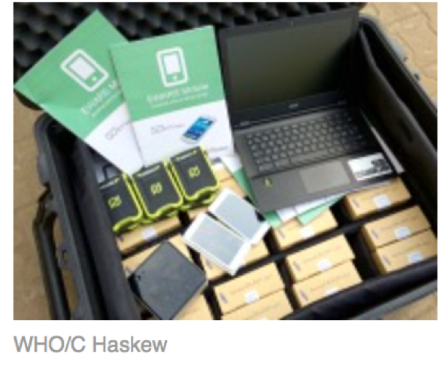
EWARS in a box
The box contains 60 mobile phones, laptops and a local server to collect, report and manage disease data. A solar generator and solar chargers allow the phones and laptops to function without 24-hours electricity. A single kit costs approximately USD 15’000 and can support surveillance for 50 fixed or mobile clinics serving roughly 500’000 people
H.E.L.P. course
Source: www.who.int
https://www.youtube.com/watch?v=jW7o0JVi9vg
WHO movie 2016 – 5’
Notes:
When participants are interested, they can watch the WHO movie about EWARS in a box -> www link youtube

Slide 49
Health surveillance: Challenges
Tip of the iceberg
Incomplete reporting
Diagnostic quality
Underestimation of true incidence due to low health care access / utilization
Health workers’ demotivation (e.g. due to poor feedback loop)
Changes in the surveillance system (e.g. changes in case definitions)
Mobile population
Unknown / changing denominators
Biases
H.E.L.P. course
Notes:
49
Unknown / changing denominators: e.g. Goma Kibumba camp 1994 at first estimated population 250’000 – 350’000; after aerial photography: 180’000
NB. Programmes implemented on the basis of incomplete data can do harm and can waste resources.

Slide 50
Take home: Surveillance in crisis situations
How is the population likely to change?
What are the current/future risks?
Which diseases/syndromes should be in the system?
What are the case definitions?
What information will be collected?
Who will collect information?
How will data be collated/analyzed?
What is the frequency/method of reporting?
How will it be used and fed back to stakeholders?
H.E.L.P. course

Slide 51
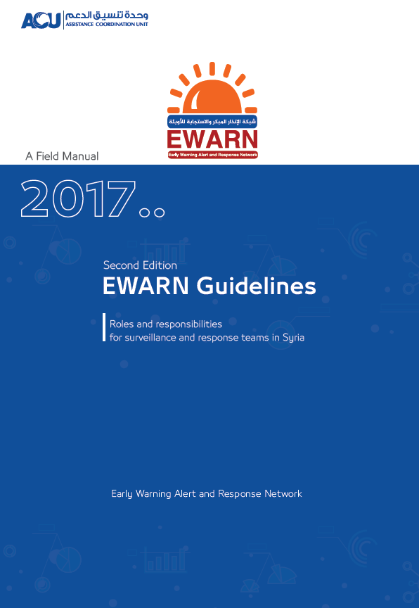
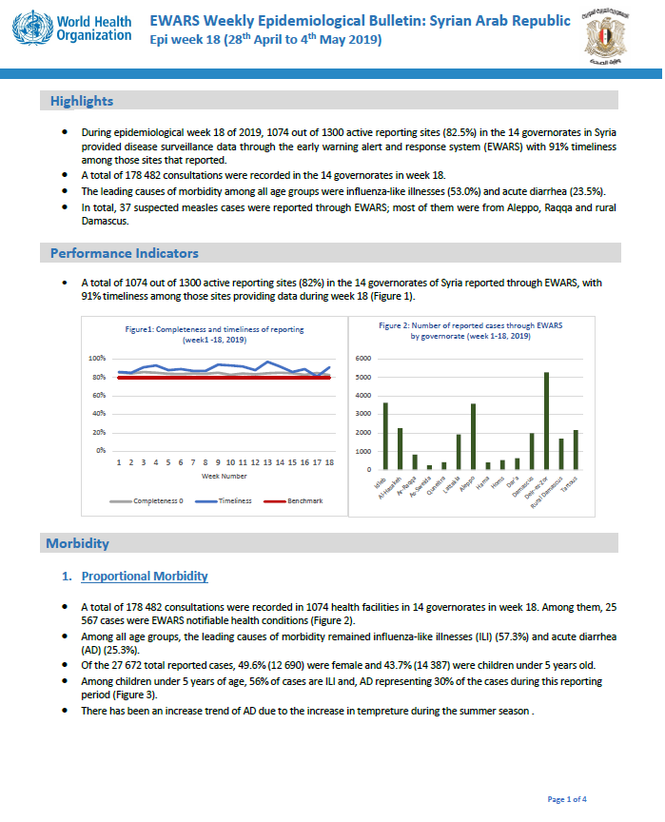
References
EWAR weekly reports (WHO), e.g
H.E.L.P. course

Slide 52
Further reading
Stone, Erin et al. “Community Event-Based Surveillance for Ebola Virus Disease in Sierra Leone: Implementation of a National-Level System During a Crisis.” PLoS Currents 8 (2016): ecurrents.outbreaks.d119c71125b5cce312b9700d744c56d8. PMC. Web. 20 Feb. 2017
Mariner, Jeffrey C. et al. “Experiences in Participatory Surveillance and Community-Based Reporting Systems for H5N1 Highly Pathogenic Avian Influenza: A Case Study Approach.” Ecohealth 11.1 (2014): 22–35. PMC. Web. 20 Feb. 2017
Sarah Bowden, et al. ‘’Implementation and utilization of community-based mortality surveillance: A case study from Chad.’’ Conflict and health 2012, 6: 11
Francesco Checchi et al. ‘’Evaluation of the Disease Early Warning system in crisis-affected areas of Pakistan. Final report 2011. WHO – LSHTM
Oleg O. Bilukha et al. ‘’Fatal and non-fatal injuries due to intentional explosions in Nepal, 2008-2011: analysis of surveillance data’’. Conflict and health 2013, 7: 5

