Slide 1
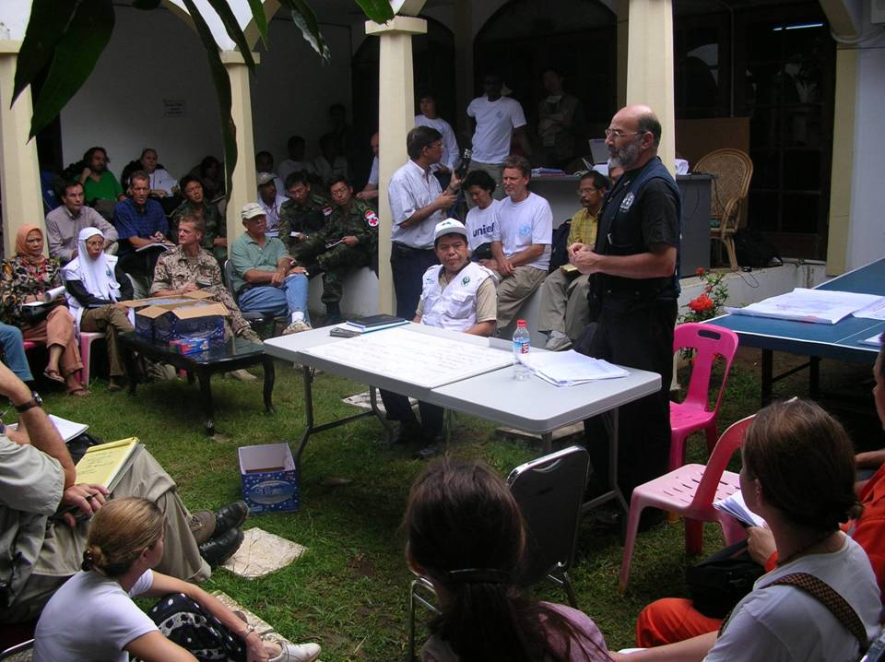
Logo organization(s) facilitator(s)
Actors in Humanitarian Interventions / Coordination
These learning materials have been developed by
Antje van Roeden and Stephane du Mortier (ICRC)
Name(s) and organization facilitator(s)

Slide 2
Objectives
Be able to
identify similarities and differences between actors involved in humanitarian interventions
identify your role and responsibilities within the prevailing coordination system in an acute / protracted crisis

Slide 3
Actors in humanitarian interventions
Main actors in involved in humanitarian interventions: who are they?
How can they be grouped?
??
Notes:
This slide is used during the module Setting the Scene: Q/A in plenary -> see next slide

Slide 4

Actors humanitarian interventions
Affected civilian population
UN agencies, e.g. UNHCR, WFP, WHO, UNICEF, OCHA
Red Cross and Red Crescent Movement (ICRC, IFRC, National Societies)
National and local authorities
Actors implicated in the political management of conflicts, e.g. UN security council, States involved in negotiations
International and national NGOs
Diaspora groups
Arms carriers, e.g. national armed forces, opposition groups, international armed forces , peace keeping forces
Private sector
Donors
Religious institutions
The media
Notes:
The learners have identified different stakeholders during the module ‘Setting the Scene’ -> this slide was shown after this

Slide 5
H.E.L.P. course
Organizational entities for which aid provision is their primary mandate
Military
forces
Diaspora groups
The international Red cross and Red Crescent Movement
Donors
International
NGOs
Groups that play a critical role in humanitarian response but humanitarian action is not their core function
Host governments
Affected communities
UN humanitarian agencies
Humanitarian arms of regional intergovernmental organisations
National NGOs
Religious institutions
Private- sector
entities
Source: ALNAP, State of the Humanitarian System, 2015
Notes:
This slide has been discussed during the module ‘Setting the Scene’

Slide 6
Stakeholder analysis
Mission
Expertise & Resources
Mandate
Actor
Policies
&
Procedures
Legal framework
Principles for action
Strategies
NB: Affected populations are a stakeholder
Source: Pierre Perrin –Guerre et Santé Publique, 2017
Notes:
This is one way of looking at the different stakeholders
Bring out examples for some of these elements, e.g.
-Mandate + legal framework: ICRC has an mandate that has been given to the institution by the States signatory to the Geneva conventions. NGOs have generally chosen themselves a mission
-Legal framework: ICRC –international humanitarian law; UNHCR –refugee law;
-Expertise: UNICEF, UNFPA – MSF, HelpAged.
-Principles for action / strategies: For the ICRC confidentiality is one of key principles while Amnesty International choses to speak out
Etc.
You will use this framework to look more in-depth into some of the stakeholders / the organizations that will be present here for the panel discussion later in the week

Slide 7

Stakeholder analysis
This map is developed for:
What does (s)he Think and feel?
What really counts
Major pre-occupations
Worries, aspirations
What does (s)he See ?
Environment
Friend
What the market offers
What does (s)he Hear ?
What influences her/him
What does (s)he Say ?
Attitude in public
Appearance
What does (s)he Know ?
Technically
Health system, security situation
Authorities, Red Cross, NGOs
Community
What does (s)he Do ?
Behaviour towards others
Affected populations
Health authorities and system
NGOs, Red Cross
What does (s)he Want ?
Priority needs
Previous achievements
H.E.L.P. course
Pain
Fears
Frustrations
Obstacles
Strengths
Expertise, experience
Successes
Lessons learnt
Gain
Wants / needs
Dreams / hopes

Slide 8
Spectrum of coordination
3. Cooperative coordination
4. Collaborative activities
2.Communication
5. Merger
1. Complete autonomy
Source: Background paper ALNAP 30th Annual Meeting, 2015
Notes:
Communication stage: Stakeholders /Organizations sharing information with one another, with no specific requirement to take the exchanged information into account in their own work.
Cooperative coordination: Can involve a variety of activities, from agreeing to follow common guidelines/standards to gathering information through joint assessments or evaluations, moving the location of programmes, or changing their content to reduce gaps and duplications. These activities generally concern the ‘where’, ‘what’ and ‘how’ of humanitarian response, although they normally focus on one or two of these areas and do not attempt to regulate or affect all three. Still leaves actors with a high degree of autonomy
Collaborative activities are formalised, and generally involves organisations aligning strategies and work plans so that, while maintaining their own independence, they carry out activities together.
Of course, there are limitations to any attempt to categorise relationships that are diverse and continuously evolving. These three categories represent ‘ideal types’; the reality is messier

Slide 9
Examples of coordination mechanism
National / Regional specific coordination mechanisms
Cluster Approach (Result of UN Humanitarian Reform, 2005
OCHA
  Part of the UN Secretariat responsible for bringing humanitarian actors to ensure a coherent approach to emergencies
  Three types of pooled funds managed by OCHA: CERF, CHFs, and ERFs
IASC (Inter-Agency Standing Committee)
  Forum for coordination, policy development and decision-making involving key UN and non-UN humanitarian partners
ICVA (International council of voluntary agencies)
Agreements between WHO and UNICEF for a variety of health problems (diarrhoeal diseases, malnutrition, ….)
Seville agreement (1997),
  Framework for cooperation for the international RC/RC Movement
Notes:
CERF = Central Emergency Response Fund
CHFs = Common Humanitarian Response Funds
ERFs = Common Humanitarian response funds
Seville agreement –lead role = assignment of specific areas of competence to each component whatever the situation, e.g. the Federation Secretariat has a lead role in the development of national societies, whereas ICRC has a specific role in the dissemination of IHL. Lead agency: means that in a specific situation one of the components is given responsibility of directing and coordinating all the Movement’s international relief activities

Slide 10
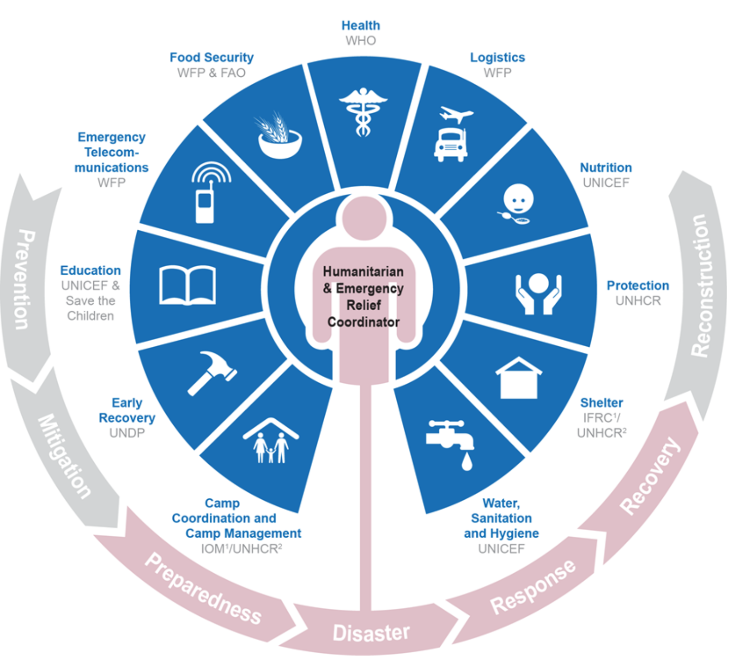
Cluster approach
Notes:
‘’The UN Humanitarian Reform of 2005 introduced new elements to improve capacity, predictability, accountability, leadership and partnership. The most visible aspects of the reform is the creation of the Cluster Approach. Clusters are groups of humanitarian organizations (UN / non-UN) working in the main sector of humanitarian action, e.g. shelter and health’’ Source: OCHA website. There are in total 11 clusters
Not all organizations fall under the cluster lead, e.g. ICRC, MSF

Slide 11
Panel discussion Date: ……..
Purpose: To bring out similarities and differences between the actors, how they work together and what coordination mechanisms are in use.
Represented in the panel are names organizations/institutions (4-5)
Groupwork
Preparation by you using the stakeholder analysis framework 1
You have 2 minutes to present the organization /institution before the panel discussion starts
Notes:
Each group does a web search to find information about one of the organizations /institutions included in the panel

