Slide 1
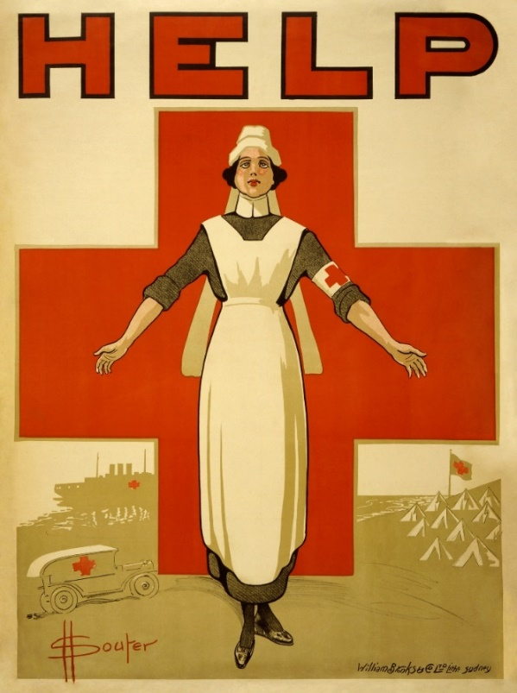
Communication with media, through social media, with affected populations
Logo organization(s) facilitator(s)
H.E.L.P. course
These learning materials have been developed by Pascal Jequier, Richelle Esquerra and Tina Bouffet
Facilitator’s name(s) + organization(s)

Slide 2
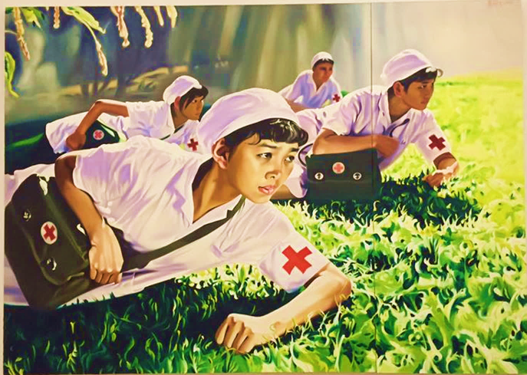
Objectives
Be able to
examine the opportunities and risks of sharing information publicly
discuss the relevance and benefits of active community engagement in acute and protracted crisis situations
H.E.L.P. course

Slide 3
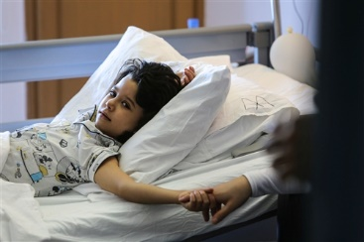
The role of the media in humanitarian crisis
WHY is it important to communicate publicly?
Lebanon, 2014:
Tripoli, Weapon Traumatology Training Center.
A six-year-old girl holds on to her mother's hand as she recovers from surgery.
Copyright: ICRC
H.E.L.P. course

Slide 4
Today’s environment
Interconnected world
Instant sharing of information→ who is a trusted source?
Power of images
Competition for headlines, digital media, social media
Public scrutiny→ pressure for transparency, accountability
H.E.L.P. course 2019

Slide 5
Current environment
Speed
Global
Infobesity
Trust
Echo-chambers – info bubbles
Transparency
Accountability
Disintermediation
Feeling hopeless
Social recognition
H.E.L.P. course
Notes:
Non essential, only if time allowed

Slide 6
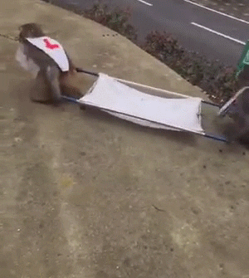
Current environment
TRUST PROFESSIONALS
Accountability
H.E.L.P. course
Notes:
Optional: Non essential, only if time allowed

Slide 7

What is your role?
What should you do as a health professional?
YOU
LEADERSHIP
Policies of your own organisation
COMMUNICATORS Support from your colleagues from the communication unit
AFFECTED PEOPLE that you serve
PATIENTS
JOURNALISTS
Media and social media
??​
H.E.L.P. course
Notes:
Working for a humanitarian organisation involves(d) knowing how to navigate within these 4 dimensions:
Above : Each organisation has got its own core values and policies, it is important for you to understand them and live them.
On the left side: Under the guidance of your fellow colleagues communicators, you are encouraged to be an ambassador and to communicate on your own capacity (being active on social media for example or even being interviewed by media because you are a credible source of information).
On the right side: You receive a professional support from your fellow colleagues communicators to help you having impact.
As health specialist, you have a role to play in providing relevant updated information and data to your communication colleagues.
Below: You communicate and engage with the people and communities you serve (Community engagement).

Slide 8
Your experience with Media
Share your own experiences with the media, i.e. when approached by journalists, etc.
Group work
Brainstorm about the pros and cons of communicating publicly as health professionals about what you do (through media interviews, Tweets, Facebook, Instagram, etc.)
10 minutes
H.E.L.P. course

Slide 9
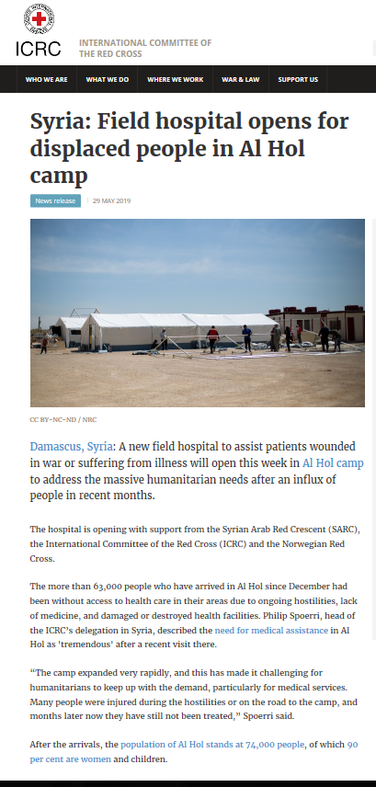
Press release
Syria: Field hospital opens for displaced people in Al Hol camp
News release
29 May 2019
H.E.L.P. course
Notes:
Communication product on Health : Example of a Press release

Slide 10
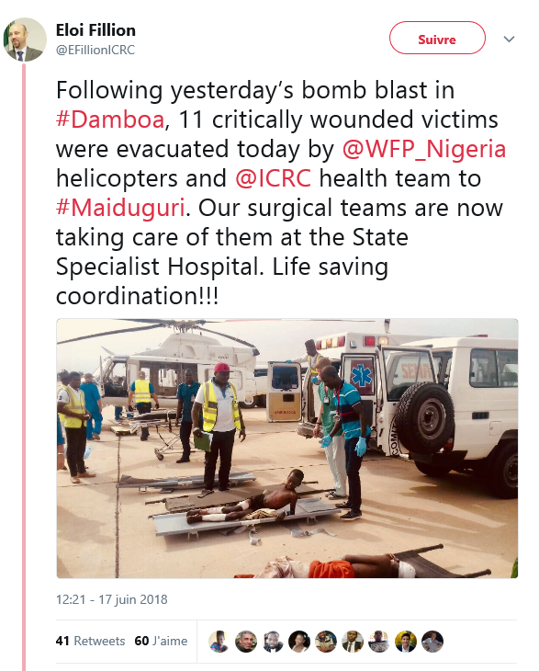

Tweet from the field
H.E.L.P. course
Notes:
Communication product on Health : Example of a Tweet written by the ICRC Head of Delegation in Nigeria just after a Medevac

Slide 11
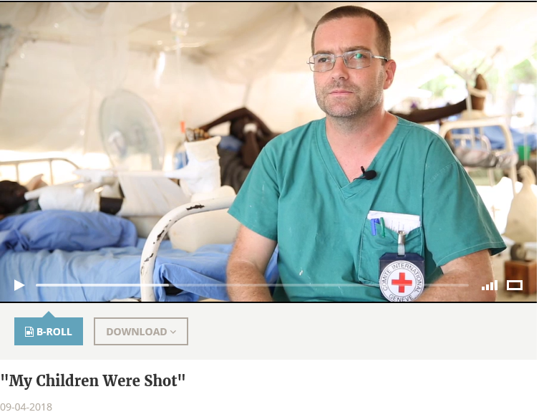
Video from the field
  “What you see a lot is bullet wounds, big injuries, mostly in the legs,” said Guido Serge Verslout, an ICRC physiotherapist based in Ganyliel.
  “Most of the wounds…were already infected…We had to do a lot of debridement to clean the wounds, heal the fractures.”
H.E.L.P. course
Video Newsroom - South Sudan – ICRC website
Notes:
Communication product on Health : Example of a Video with a testimony of an ICRC physiotherapist working in the field in South Sudan

Slide 12
Humanitarian Crisis and Public communication
Group work
What can be the positive and negative outcomes of a large media coverage of a humanitarian crisis?
What does it change ? What may be the consequences ?
2. Identify reasons why your organization should communicate publicly
3. Give examples of potentially sensitive data/information that may cause problems if a humanitarian organization communicates publicly
15 minutes
-> Benefits & risks need to be considered
H.E.L.P. course
Notes:
Question 3 has a link to the module ‘’Data collection, analysis and sharing’’ earlier in the course, during which we touch on the so called ‘’data dilemma’’

Slide 13
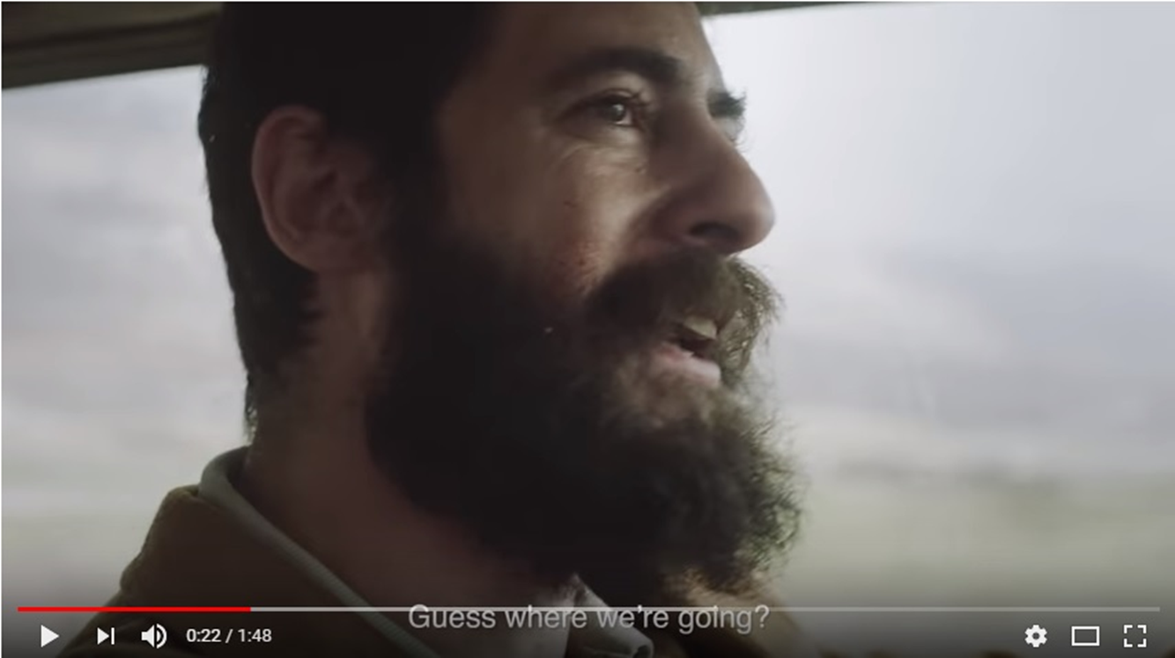
Why is it important to communicate?
Communication is critical for:
  access,
  security,
  acceptance,
  support, including financial
Need to
  raise awareness,
  influence,
  mobilize,
  call for action !
Management of perception and reputation:
Response to manipulation, propaganda, controversies
H.E.L.P. course
https://www.icrc.org/en
Notes:
The Video is part of a Health Care in Danger campaign

Slide 14
Example: ICRC communication policy/Doctrine 7:
Why 4 Goals
Build trust in the ICRC to facilitate its humanitarian action
Enhance the International Red Cross and Red Crescent Movement’s public profile
Communicate to influence behaviour and policies
Empower people through information
5. Focus on people and the laws protecting them
6. Broaden the ICRC's public support base
7. Incorporate communication in all ICRC strategies
8. Communicate for impact and ethically
What
H.E.L.P. course
To whom
How to
Notes:
Only for an ICRC audience

Slide 15
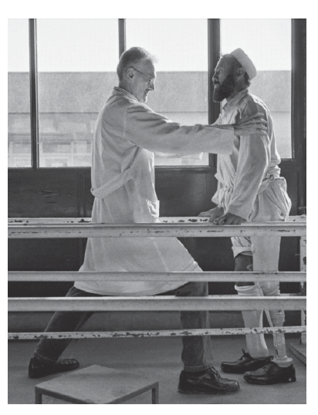
Power of images and emotion
‘Through the experience of covering wars, I’ve come to realize that nothing in society exists in a vacuum, that solutions begin with shared awareness, that consciousness evolves into a sense of conscience, and that once our collective conscience becomes engaged, solutions – though they may take time and resources and a lot of hard work – become not only possible but inevitable.’
Alberto Cairo in Afghanistan
Photo by James Nachtwey
H.E.L.P. course
Notes:
Not essential, can be skipped if not enough time.
Used to explain that images have a strong impact and have always been used to communicate
Humanity, empathy; always put people at the center of the story
Respect dignity and privacy; always portray people in a dignified manner.

Slide 16
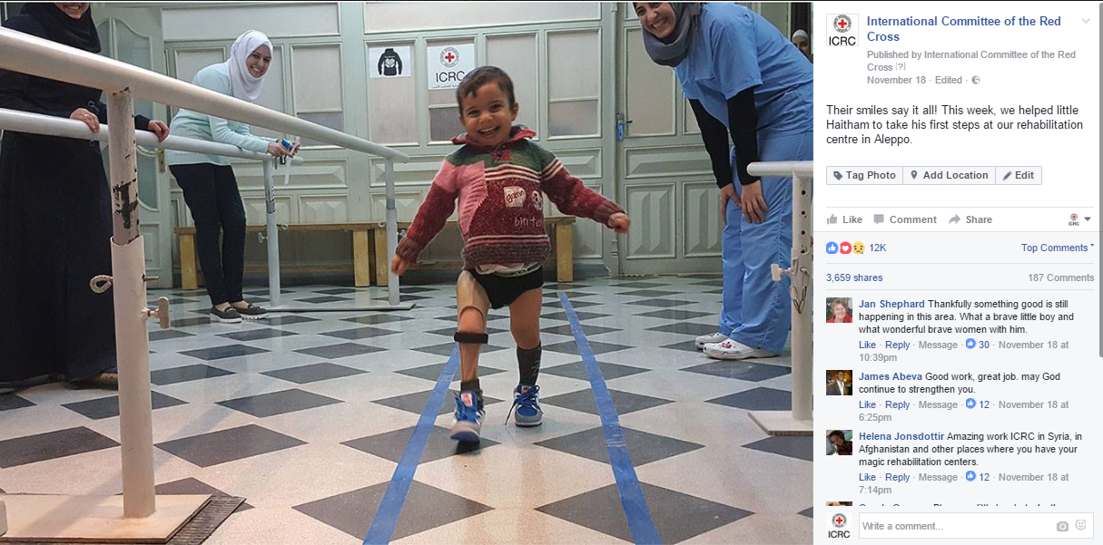
Digital content in a nutshell:
People want to share stories that mean something
H.E.L.P. course
Notes:
Social Media allow to engage in two ways communication with a larger audience. Joyful human stories raise a lot of interest.
Humanity, empathy; always put people at the center of the story
Respect dignity and privacy; always portray people in a dignified manner.

Slide 17
Health care in danger, Syria 2016
H.E.L.P. course
Notes:
Optional: Just in case, to illustrate an example in Syria in 2016

Slide 18
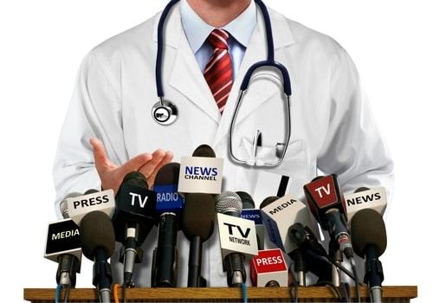
Health staff interacting with the media
Why you?
??​
H.E.L.P. course
Notes:
Pause. Give enough time for the participants to have a self reflection about it, before giving some elements of response with the next slide

Slide 19
Why you?
You have a story to tell:
→proximity with the people
You are the voice of the expert:
→trusted source of information, credibility
H.E.L.P. course
Notes:
Explain why media and fellow colleagues communicators need Health Staff to give interviews for example

Slide 20
Interacting with the media
Example from the field
https://www.youtube.com/watch?v=vrCo0ygcLNE
Yemen 2015: interview with general surgeon
An ICRC surgical team sails by boat from Djibouti to Aden in Yemen, to help treat people wounded due to the recent conflict.
Marco Baldan, the general surgeon, talks about the difficulties the team will face delivering urgently needed medical assistance in Yemen. Also on board are Elin Oddsdottir, operating theatre nurse, Ana Lufinha, anaesthesiologist and Birgitte Gundersen, post-op nurse.
H.E.L.P. course
Notes:
Just in case as additional resource: Another example of a video with an interview of an ICRC surgeon

Slide 21

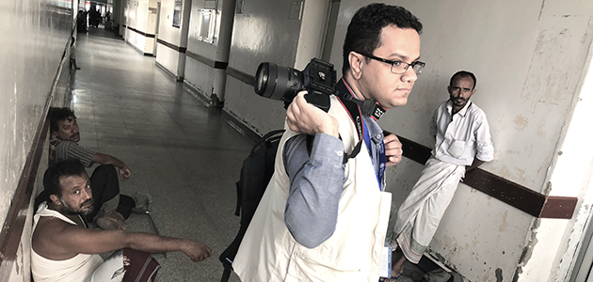
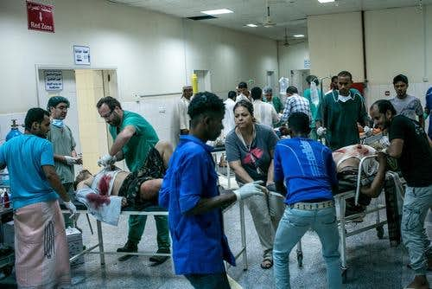
Interacting with media
Group work
You are working in a hospital which has just been shelled. Patients have been wounded and part of the building has been destroyed.
This serious incident raises attention. People start to film with their smartphones, patients and hospital staff are interviewed all around, journalists are calling.
What should you do in this confused situation?
H.E.L.P. course
5 minutes
Notes:
The responses are coming on the next two slides

Slide 22
Know your priorities
Patients come first BUT you need also to find time for communications (with the media, communities, etc.)
Coordinate with the communication staff of your organization
Be aware of the media policy / communication plan of your organization.
Know who is the contact person for media/public communication, or choose someone who will act as a focal point for the media.
Size media opportunities to address key messages and call for action whenever it is feasible!
H.E.L.P. course
Notes:
Elements of responses for the exercise: Interacting with Media

Slide 23
Principled & ethical communication
Always portray people in a dignified manner
Protect their privacy
Respect their well being
Do no harm, best interest of the affected people
Informed consent: Ask for permission before taking pictures, filming, interviewing, thoroughly inform the person(s) about the use of the material
H.E.L.P. course
Notes:
Elements of responses for the exercise: Interacting with Media

Slide 24
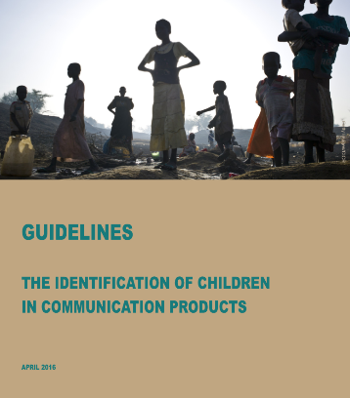
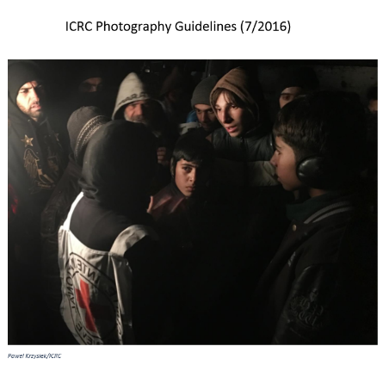

Guidelines
Many organizations have adopted guidelines when it comes to taking photos, publishing information on social media, identifying children in photos, etc.
H.E.L.P. course
Notes:
These are resources available for those who want to learn more about it

Slide 25
Tips for interviews with Media
Preparation is key: know your audience, your priorities and your messages.
Try to get some info about the angle and objective of the reporting. Avoid off-the-record interviews.
Use key messages, speaking points, or press lines to manage difficult questions.
Humanity, empathy; always put people at the center of the story, give some context.
Respect dignity and privacy; always portray people in a dignified manner.
Be cautious when using figures, check them thoroughly.
Avoid assigning responsibilities, pointing fingers. No denunciation.
Be to the point.
Respect medical ethics.
Follow the Guidelines (social media, image, data protection, etc.) and coordinate with Communication specialists.
H.E.L.P. course
Notes:
Elements to take in considerations whenever anybody is requested for an interview.

Slide 26
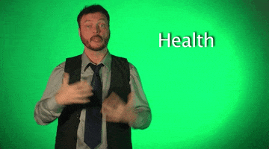
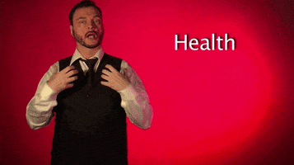
Interview with Media
Preparation is key !
Coordinate with communication specialists
Know your :
  priorities
  audience
  key messages
H.E.L.P. course
Notes:
Take away – Key learning points for interviews
Know your audience: The two memes illustrate the word “Health” in the language sign

Slide 27
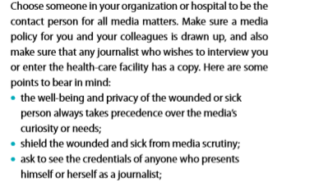
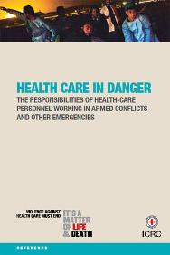
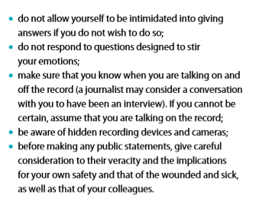
Guidance: Some points to guide you when dealing with the media are given below.
H.E.L.P. course
Notes:
Optional: In complement to the tips for interviews with Media, the brochure “Health Care in Danger, the responsibilities of health- care personnel” has got an interesting chapter : Media p. 94 & 95. This document is available on line in PDF

Slide 28
What is information as aid?
What is two-way communication?
??​
H.E.L.P. course

Slide 29
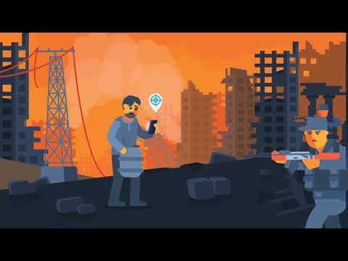
Video
Engaging with people affected by conflict and violence
H.E.L.P. course
https://www.youtube.com/watch?v=pEzeRGgH0lQ
Notes:
Click on this link to show the video : https://www.youtube.com/watch?v=pEzeRGgH0lQ

Slide 30
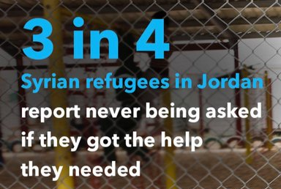
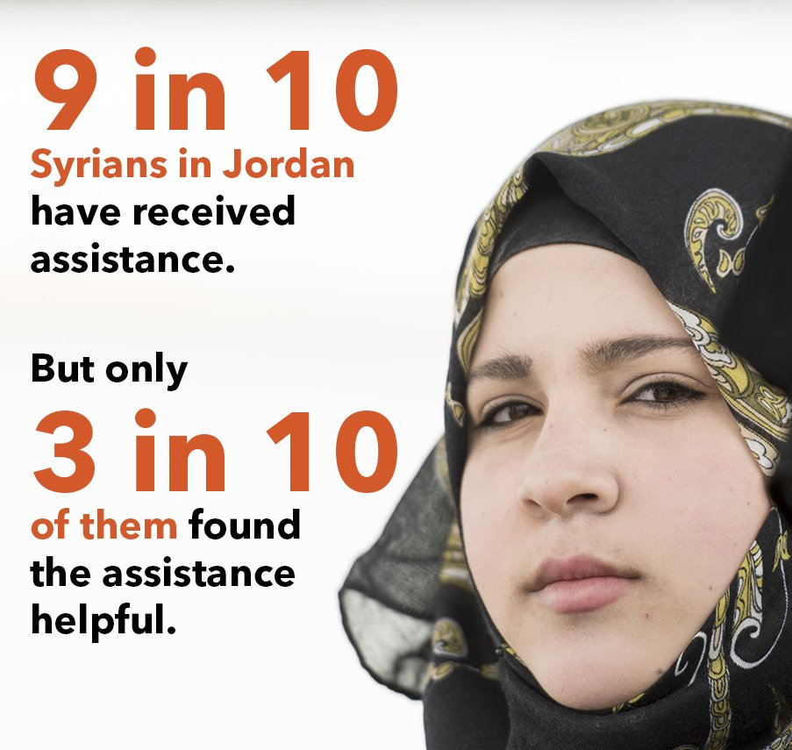
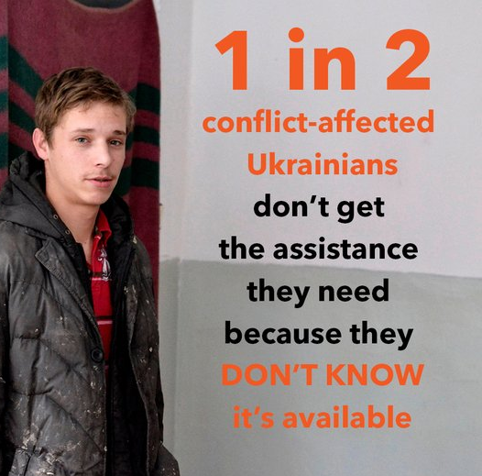
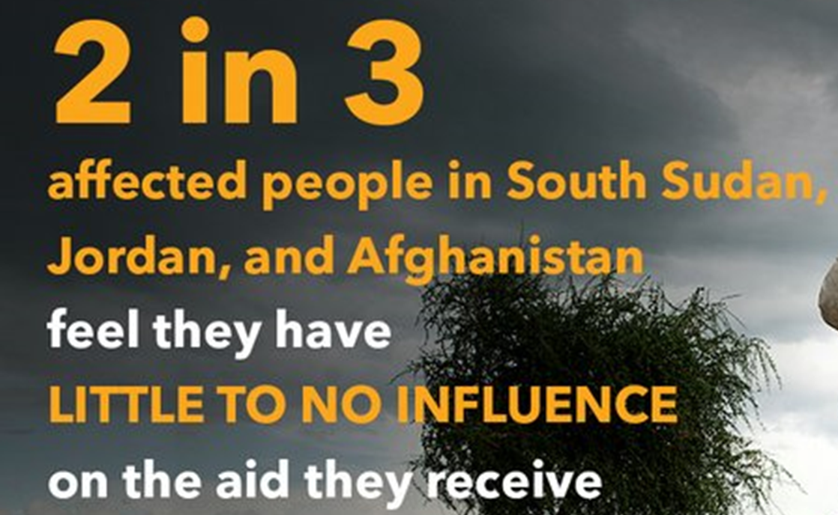
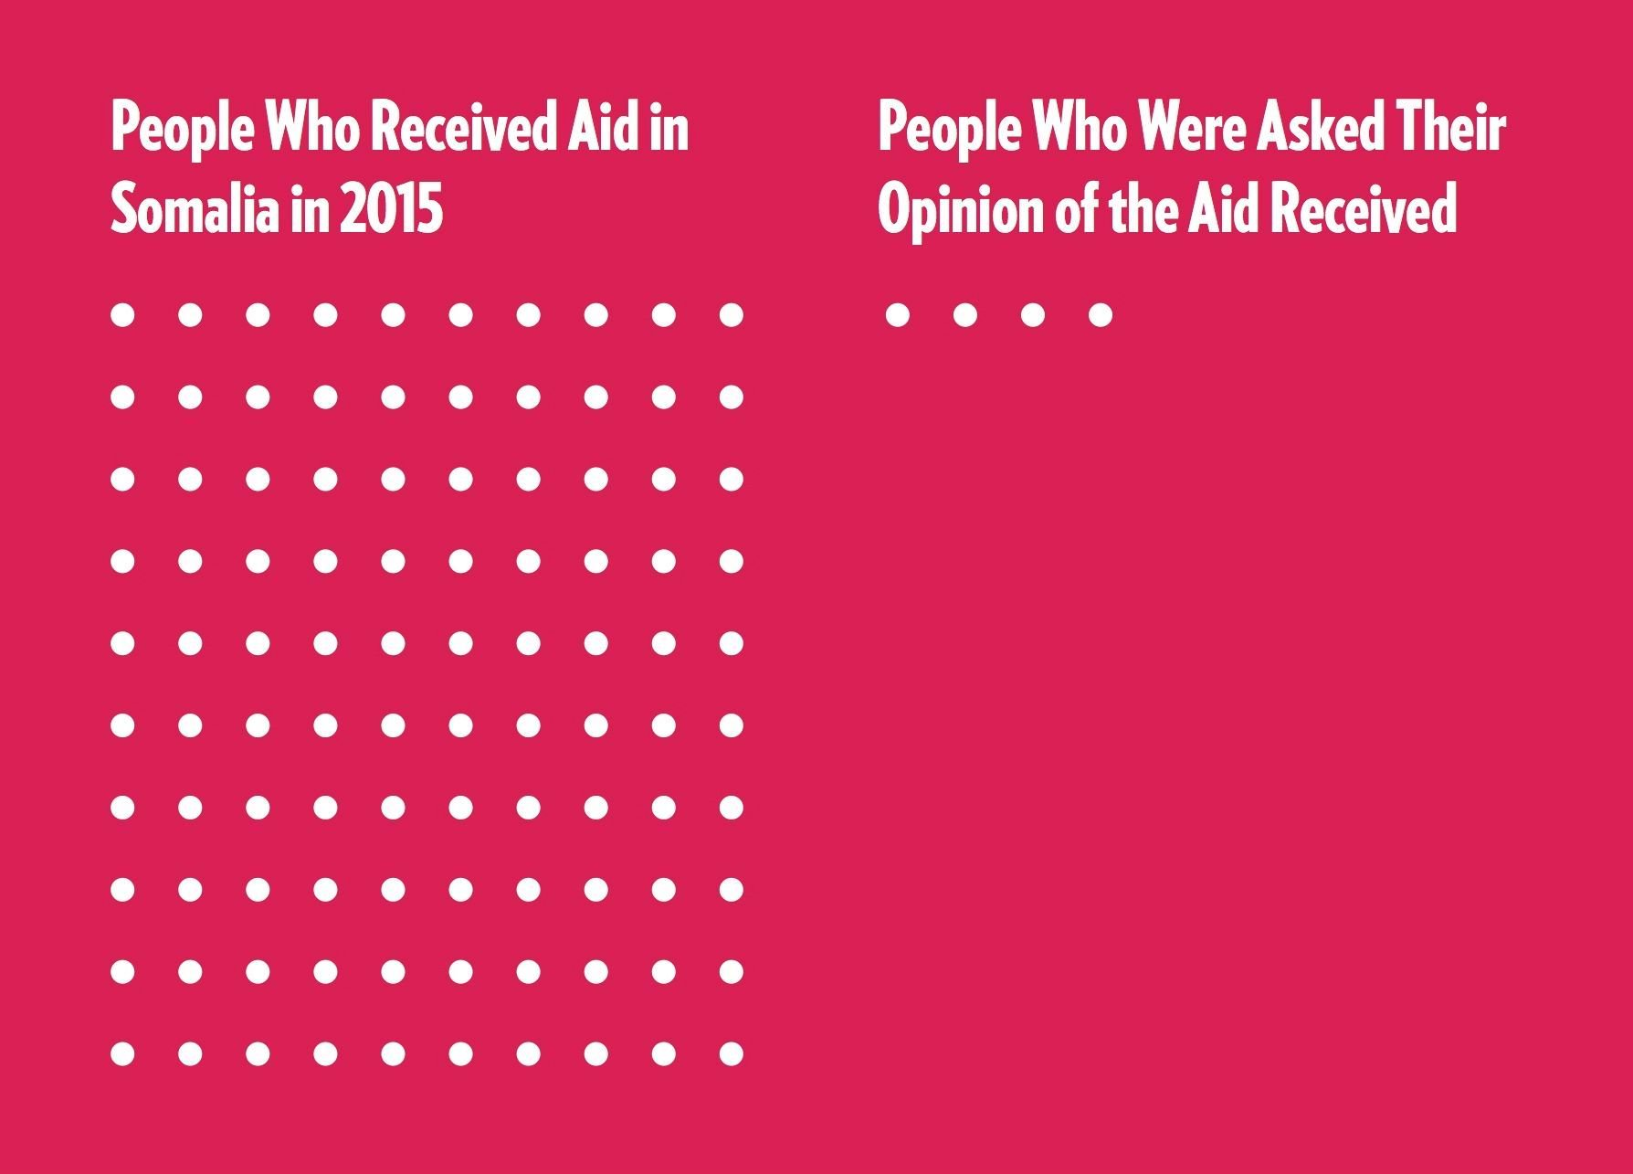
H.E.L.P. course
Notes:
SOURCE: World Humanitarian Summit – COMMUNITY CONSULATIONS
https://consultations.worldhumanitariansummit.org/bitcache/069aa44b39f84506ac6e6712fd2ce4fccde2cf9b?vid=579670&disposition=inline&op=view
In preparation for the World Humanitarian Summit (WHS), the WHS secretariat commissioned Ipsos to conduct community consultations with crisis-affected communities in multiple focus countries. The countries chosen for the consultations were Afghanistan, Guinea, South Sudan, Syria, and Ukraine, representing a diverse range of geographic regions, humanitarian contexts, and actors.

Slide 31
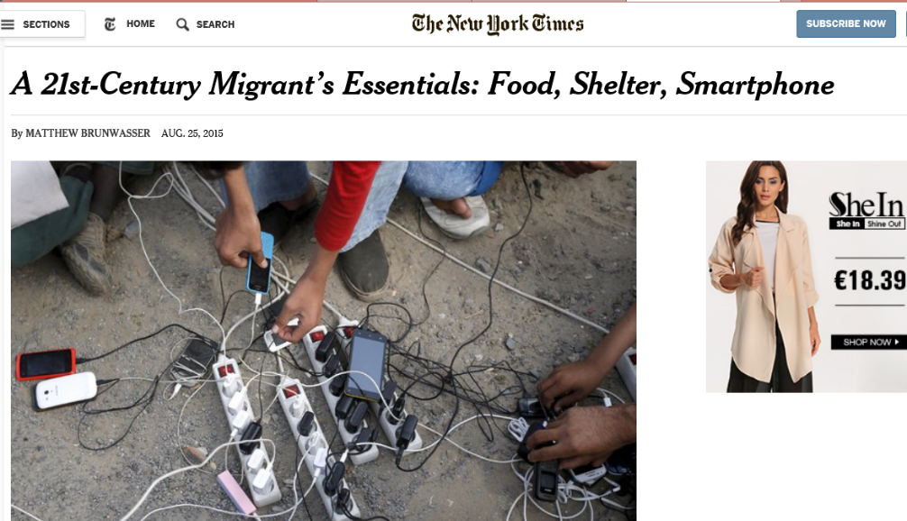
INFO-as-Aid:
Examples from the field
H.E.L.P. course
Notes:
Access to information is a right and is just as vital as food and shelter.
While improving the institutional approach to engaging with and being accountable to affected people (AAP) is an ethical responsibility, the need to adapt and improve our AAP approach is also dictated by a changing humanitarian landscape:
Changing humanitarian landscape and technological disruption – for example, people may not need our satellite phones. They may have their own mobile phones and their most immediate need may be energy to charge their phones and connectivity to get online.
People’s increasing and more visible demand for interaction, transparency and accountability from governments, the media and also organisations like us.
The complexity of today’s armed conflicts and the sensitivity and insecurity characterizing the contexts in which humanitarian organizations operate force us to adapt and consider new approaches and ways of working. At the same time, new technologies, allowing people around the world to better organize their own response and engage more effectively with each other, governments, media and humanitarian organisations, have changed people’s ability to voice their needs and expectations. This connectivity further empowers affected people to demand greater interaction, transparency and accountability from all stakeholders, including the ICRC. This means that institutionally, and within the specific contextual limitations, we need to become more accessible and responsive to affected people.

Slide 32
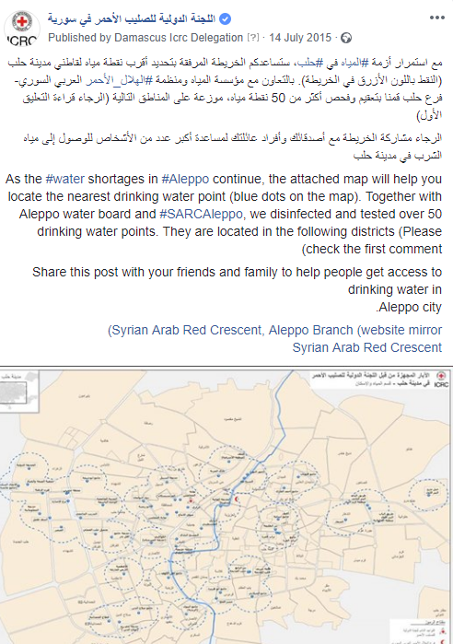
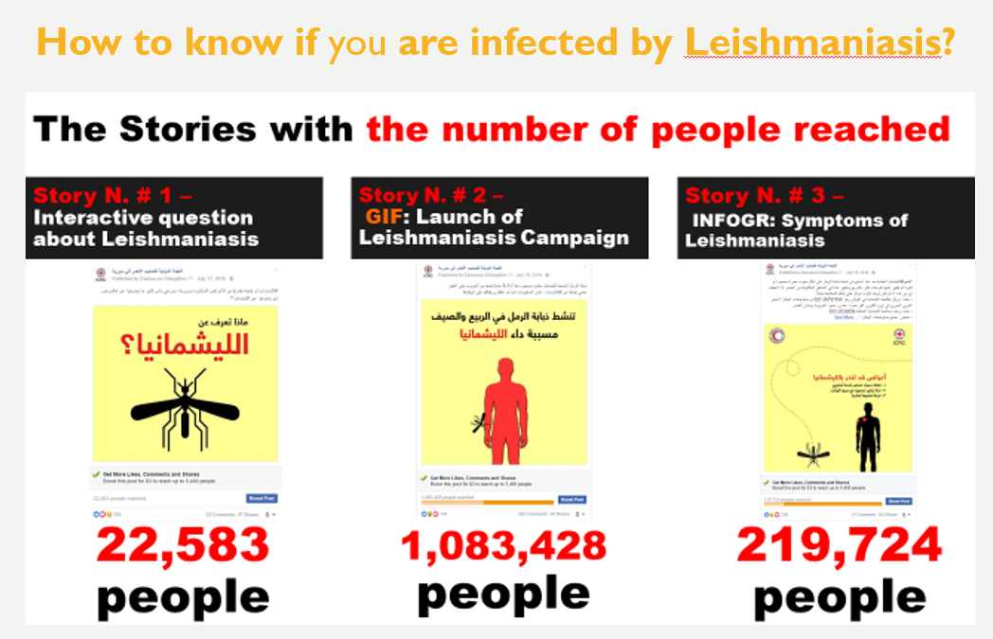
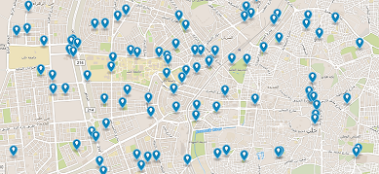
InFO-as-AID:
Examples from the field -Syria
H.E.L.P. course
Notes:
Info-as-Aid
Water points in Aleppo, Syria. Map geolocating the nearest drinking water points. Shared through social media, feedback from the communities helped correct locations if needed.
Leishmaniasis campaign. Using social media to raise awareness about the disease, the symptoms to look out for and where to get treated.

Slide 33
COMMUNITY ENGAGEMENT
Accountability to affected people
“Community engagement is the process of, and commitment to, providing life-saving, useful and actionable information to communities (information-as-aid). It is also the process of using and/or establishing two-way communication channels to listen to community needs, concerns, feedback and complaints ensuring that the community can actively participate and guide ICRC’s humanitarian action.”
Source: ICRC
  Guiding Principle on Community Engagement (2016)
  Based on External Communication Doctrine (Doctrine 7) (2015)
  Principle 4: Empowering people through information
H.E.L.P. course
Notes:
ICRC’s “official” definition – note we are dividing it in two parts:
Provision of information-as-a-aid
Two way communication for listening and feedback
Community engagement can critically help the ICRC to better understand the environment in which operates as well as improve its acceptance, proximity and access to communities, and its reputation.
Community engagement is an attitude, a key component to programming - not a distinct nor a ‘new’ activity - that puts communities at the center of protection and assistance activities.

Slide 34
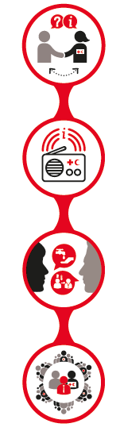
The 4 components of community engagement
Participation and feedback
Communicate clearly to communities about who we are and what we are doing. Provide opportunities for participation and listen, respond and act on feedback, questions and complaints.
Information as aid
Share timely, actionable and potentially life saving information with communities quickly, efficiently and at scale.
Behaviour and social change communication
Understand people’s behaviours and use innovative and participatory communication approaches to support communities adopt safer and healthier practices.
Evidence-based advocacy
Support communities to speak out about the issues that affect them - or speak up on their behalf if that’s not possible - to influence decision-makers to take action.
H.E.L.P. course

Slide 35
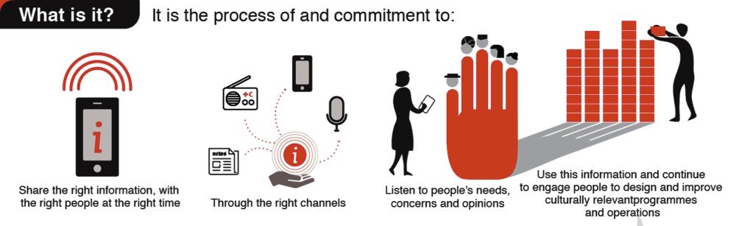
In a nutshell…
H.E.L.P. course

Slide 36
Why is community engagement important?
??​
H.E.L.P. course

Slide 37




Mapping & managing expectations
Perceptions: How much is your organization trusted? How easily accessible are we?
Satisfaction: Are people satisfied with the quality of our work?
Listening & feedback: Do people feel that they are being listened to?
Information needs: Are people informed about vital services?
H.E.L.P. course 2019
Notes:
Why? To better know and measure people’s perceptions and expectations of the ICRC, with a view to building trust and acceptance, enabling better access and security, and improving operational effectiveness and accountability to the affected populations

Slide 38
Community engagement is important because:
Leads to better, more effective programming and operations
Builds trust and acceptance
Manages feedback and complaints
Helps to save lives
Empowers people and builds community resilience
Supports positive behaviour and social change
Recognises community as experts and partners
Supports do no harm programming
Helps manage community expectations
H.E.L.P. course
Notes:
This is the answer to why community engagement is important

Slide 39
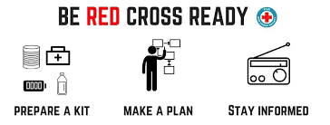
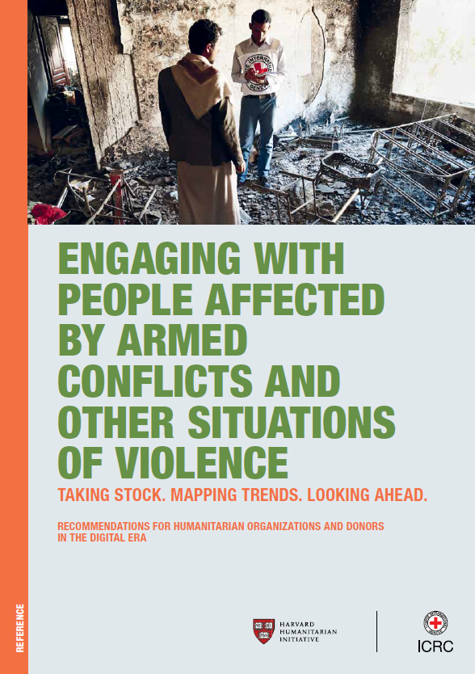

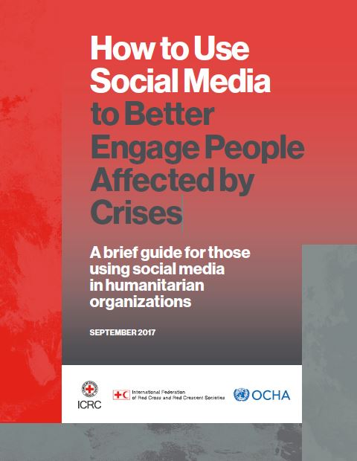
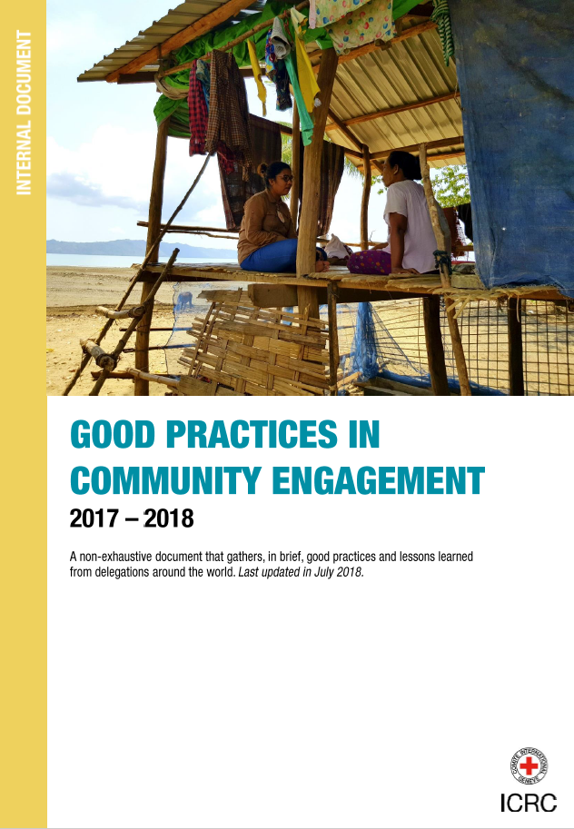
Publications available
H.E.L.P. course
Notes:
All these publications are available on the ICRC website

Slide 40
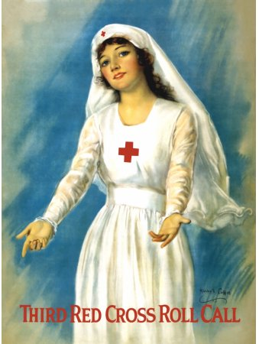

Thank you for your attention and participation!
Remember…
How we listen
and what we say
helps what we do!
H.E.L.P. course
Notes:
Communication is about 80 % listening and 20 % broadcasting !
Communication aims at facilitating and reinforcing the impact of the humanitarian action.

