Slide 1
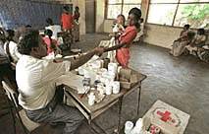
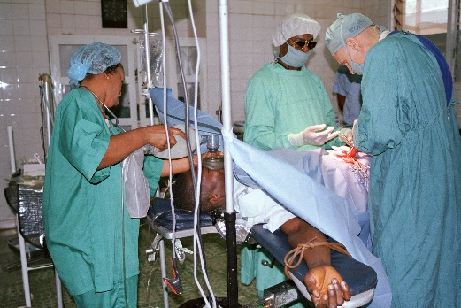
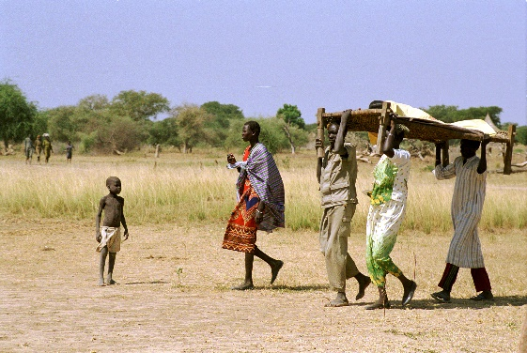
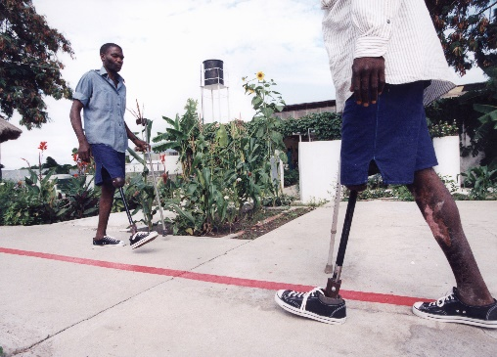
Logo organization facilitator(s)
Health Care Services
H.E.L.P. course
Name + organization facilitator(s)
These learning materials have been developed by
Dirk Horemans (WHO), Ben Lane (WHO) and Antje van Roeden (ICRC)

Slide 2
Objectives
Be able to
assess to what extent the health services in acute and protracted crisis situations are able to meet the needs of the population, and identify an appropriate response when there is an imbalance between the needs and the services
examine people’s health care seeking behaviour and explain what barriers there may to access health services
H.E.L.P. course

Slide 3
Health Pyramid
Curative health care
Preventive health care
Nutrition and Food Security
Water, Sanitation,
Hygiene, Environment
Security
H.E.L.P. course
Notes:
Health services –top of the health pyramid. In addition to preventative and curative care there is also rehabilitation and palliative care
Health – health sector – health services
Health sector; MoH + all structures focusing on health care provision; includes legal aspects and monitoring
Health services: regularly services –health promotion, preventive, curative, palliative, rehabilitation.
Provision for / in case of emergencies: normal cases, additional cases, …. , risk managemet
Health emergency preparedness

Slide 4
Curative Services without Public Health Measures
Health services
Diarrhea
Malnutrition
Malaria
Pneumonia
Scabies
Intestinal parasites
Diabetes
Hypertension
Tuberculosis
Insufficient water
Polluted water
Inadequate diet
Unhealthy environment
Overcrowding
Insecurity
Heat or cold
Poor air quality
Diseases
Circumstances
H.E.L.P. course
Disease Returns
Notes:
We should keep in mind that treating diseases without considering other public health measures will mean that people get into a vicious circle.
E.g. diarrhoeal diseases -> going back home to an environment with poor water and sanitation -> back in the clinic with diarrhoea.

Slide 5
Health services in your country
Group work
Discuss how the health system is organized in your country or the country that you work in
Where do people go when they are ill? Who provides health care and what are their competences? How are the services organised? Who is in charge? What coordination mechanism exists between providers? How does the referral system work? Where do pregnant women go for ante-natal care /delivery? To what extent are medicines and other medical supplies/tests available? Who pays for what? Who is in charge of the HIS?
Bring out differences between your countries
Time before presenting your results in plenary is 10 minutes
H.E.L.P. course
Notes:
This exercise is meant to bring out the difference between countries from the users perspective.

Slide 6
The Health Pyramid
Major
Hospitals /
Specialized Care
3rd level of care: Referral hospitals
Referral
2nd level of care: District hospitals
Level 1 hospitals
Health centres
1st level of care: Primary health care facilities
H.E.L.P. course
Health posts
Community
Notes:
There are different institutions at different levels.
Also called service delivery platforms.
The levels may vary per context.
Some of these platforms may be mobile (both in crisis and non-crisis situations).
Crisis-specific service delivery platforms?

Slide 7
The ‘’Package of health services’’
Defines the services to be provided in a specific setting
Many countries have a National Package of Health Services -Minimal, Complementary, Basic or Essential Package
Based on disease burden and health service needs (and resource availability)
Defines services by delivery platform, including referral system
Reference for costing, planning, resource allocation, training and monitoring
International guidance: DCP3, EUHC, HPP, MISP, SPHERE
Sometimes only aspirational, sometimes an entitlement “Benefit Package”
Defining Priority Health Service Package for emergency settings (Ongoing GHC work)
H.E.L.P. course
Notes:
An example. DCP3 = disease control priorities,
Costed packages of health services
UHC intervention menu
Population and individual health services

Slide 8
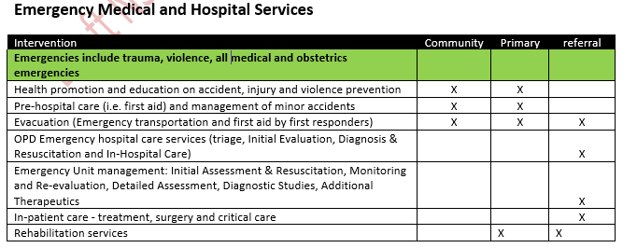
“Essential Package of Health Services” -example (Extract from Nigeria National Health Strategic Plan)
H.E.L.P. course
Notes:
This slide shows the example: Nigeria
Focusses on pre-hospital care

Slide 9
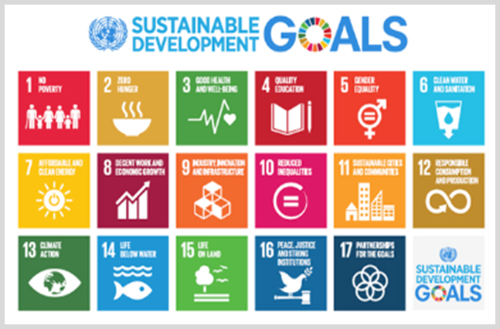
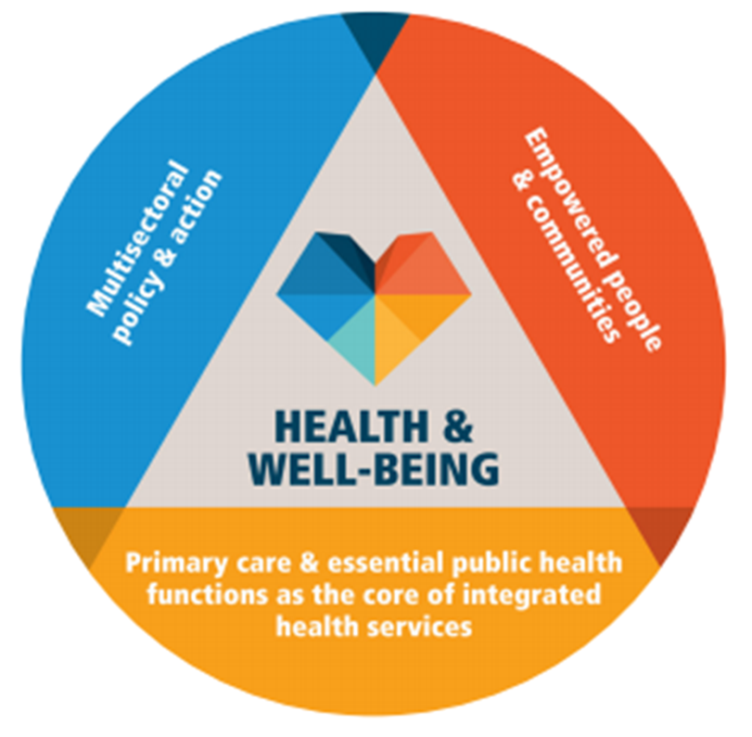
Universal Health Coverage (SDG 3.8)
, access to quality essential health-care services and access to safe, effective, quality and affordable essential medicines and vaccines for all, including financial risk protection.
Primary health Care
PHC is a whole-of-society approach to health that aims equitably to maximize the level and distribution of health and well-being by focusing on people’s needs and preferences (both as individuals and communities) as early as possible along the continuum and as close as feasible to people’s everyday environment.
Three inter-related and synergistic components:
1. Meeting people’s health needs through comprehensive promotive, protective, preventive, curative, rehabilitative, and palliative care throughout the life course, through primary care and through public health;
2. Systematically addressing the broader determinants of health (including social, economic and environmental factors) through evidence-informed policies and actions across all sectors;
3. Empowering individuals, families, and communities to optimize their health, as advocates, as co-developers, and as self-carers and caregivers.
https://www.who.int/docs/default-source/primary-health/vision.pdf?sfvrsn=c3119034_2
H.E.L.P. course
Notes:
PHC is a whole-of-society approach to health that aims equitably to maximize the level and distribution of health and well-being by focusing on people’s needs and preferences (both as individuals and communities) as early as possible along the continuum from health promotion and disease prevention to treatment, rehabilitation and palliative care, and as close as feasible to people’s everyday environment.
PHC has three inter-related and synergistic components:
1. Meeting people’s health needs through comprehensive promotive, protective, preventive, curative, rehabilitative, and palliative care throughout the life course, strategically prioritizing key health care services aimed at individuals and families through primary care and the population through public health functions as the central elements of integrated health services;
2. Systematically addressing the broader determinants of health (including social, economic and environmental factors, as well as individual characteristics and behaviour) through evidence-informed policies and actions across all sectors; and
3. Empowering individuals, families, and communities to optimize their health, as advocates for policies that promote and protect health and well-being, as co-developers of health and social services, and as self-carers and caregivers.

Slide 10
Health Needs and Health Services
Resources for a hospital
Conditions requiring a hospital
Resources for a health center
Conditions requiring a health center
Health resources for home treatment
Conditions treatable at home
H.E.L.P. course
Notes:
There are many conditions that can easily be treated at home (e.g. common cold, headache, scratch)
Others require care at the health center level (e.g. malaria, pneumonia, hypertension, diabetes)
And than there are those that will need hospital care (e.g. complicated delivery /CS, other types of surgery, severe malaria, heart attacks, …….)
The resources needed for treatment increase with the level of the services -> lowest at the level of home treatment -> health center -> hospital

Slide 11
Health Services in Crisis Situations
Resources for a hospital
Conditions requiring a hospital
Conditions requiring a health center
Resources for a health center
Conditions treatable at home
Health resources for home treatment
H.E.L.P. course
Needs at all levels increase
Service capacity often shrinks
Notes:
Increased morbidity and mortality during crisis situations is often increased due to the fact that the existing system is not able to maintain the routine essential services

Slide 12
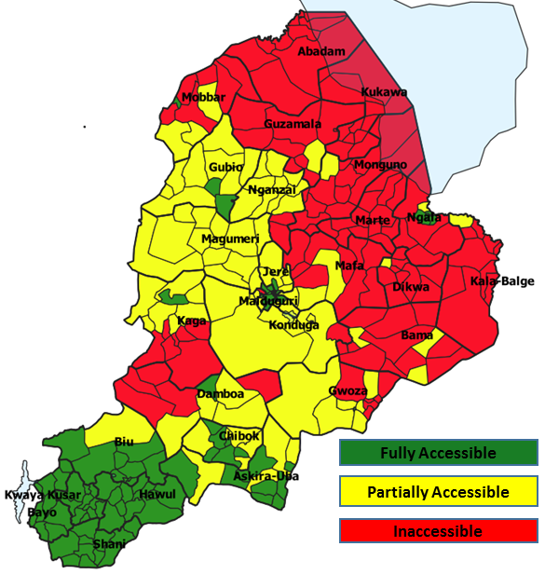
Humanitarian settings adapted “Essential Packages of Health Services”
(MAP WITH PARTIAL AND EVOLVING INFORMATION)
Defining context specific packages at district level
Access and security
Functionality of facilities (infrastructure, HWF, resources, ….)
Available/functional service delivery platforms
Population
Disease burden
Existing national EPHS
Needs
H.E.L.P. course
Notes:
Examples Nigeria: WITH PARTIAL INFO MAP of the country
Monitoring of areas of accessibility and security and active programing:

Slide 13
What do you need
to ensure appropriate health care services
can be provided?
??
H.E.L.P. course
Notes:
Question in plenary -> bring out different elements -> the next slide gives an overview of the needs to ensure that appropriate health services can be provided

Slide 14
Building blocks for health services
Health facilities/Infrastructure
Health workforce (competencies, quantity, mix)
Equipment
Medical and non-medical supplies (provision + supply line; essential drug)
Financing
Service delivery (process, quality -international standards)
Health information management system
Leadership, governance
Coordination
Communities
Based on the WHO’s Framework for a System Approach
H.E.L.P. course
Notes:
This is an analytical framework. You can look at this for the whole health system in a country/area but also for individual services/projects

Slide 15
Governance and Leadership
The first responsibility lies with the national authorities
In times of a crisis, national authorities may not have the capacity to manage everything on their own and may be supported by international agencies and community based organizations
H.E.L.P. course

Slide 16
Coordination
The humanitarian response in crisis situations is often marked by chaos and duplication and gaps in services
The Cluster system was created in 2005 to bring those who intervene during humanitarian crisis together by sector to strengthen inter-agency coordination and enhance the desired impact, e.g. Health Cluster with WHO as lead agency
H.E.L.P. course
Notes:
In crisis situations, coordination takes an even stronger place than in non-crisis situations.
The Cluster approach is discussed as part of the module Actors in Humanitarian Interventions / Coordination -> normally before the Health Services module.
Note that the Clusters not activiated during all crises (e.g. not during natural disasters in Indonesia in 2019)
Cluster + cluster lead -e.g. health c-WHO, nutrition c-UNICEF, wash c-UNICEF, shelter c–IFRC/UNHCR, Food security c–WFP & FAO, Logistics c -WFP, Camp coordination & Camp Management c-UNHCR & IOM, Protection c -UNHCR, Emergency tele comm c -WFP Education c- UNICEF/SCF, Early recovery c -UNDP etc. Learners have been asked to explore the cluster system as pre-session work (preparation for H.E.L.P. session on actors in humanitarian interventions/ Coordination

Slide 17
Health Services
HEALTH WORK FORCE
LEADERSHIP, GOVERNANCE
III
HEALTH FACILITIES INFRASTRUCTURE
FINANCING
(NON-)MEDICAL SUPPLIES
HMIS
The impact of armed conflicts
II
EQUIPMENT
COMMUNITIES
H.E.L.P. course
I
SERVICE DELIVERY
COORDINATION
Large Scale Humanitarian Impact
Notes:
When we assess the different levels of health care in a context and the different building blocks needed for proper functioning of these services, you can bring these different elemets together and see where constraints/problems are that affect the provision of good quality services.
In case of a major crisis, for instance during an armed conflict, the system may collapse (almost) completely.

Slide 18
Essential Health Services in crisis situations
Package of services for your environment
Interests of individual patients may conflict with those of public health
At a moment in time/over time
Influenced by:
Demographic pattern
Epidemiological pattern /Burden of disease
Pre-existing health care services in the context
Crisis situation
H.E.L.P. course
Notes:
Refer to the platforms and that we are now moving to crisis/disaster situations. Essential health services in crisis situations refer to service delivery planning and maintenance.

Slide 19
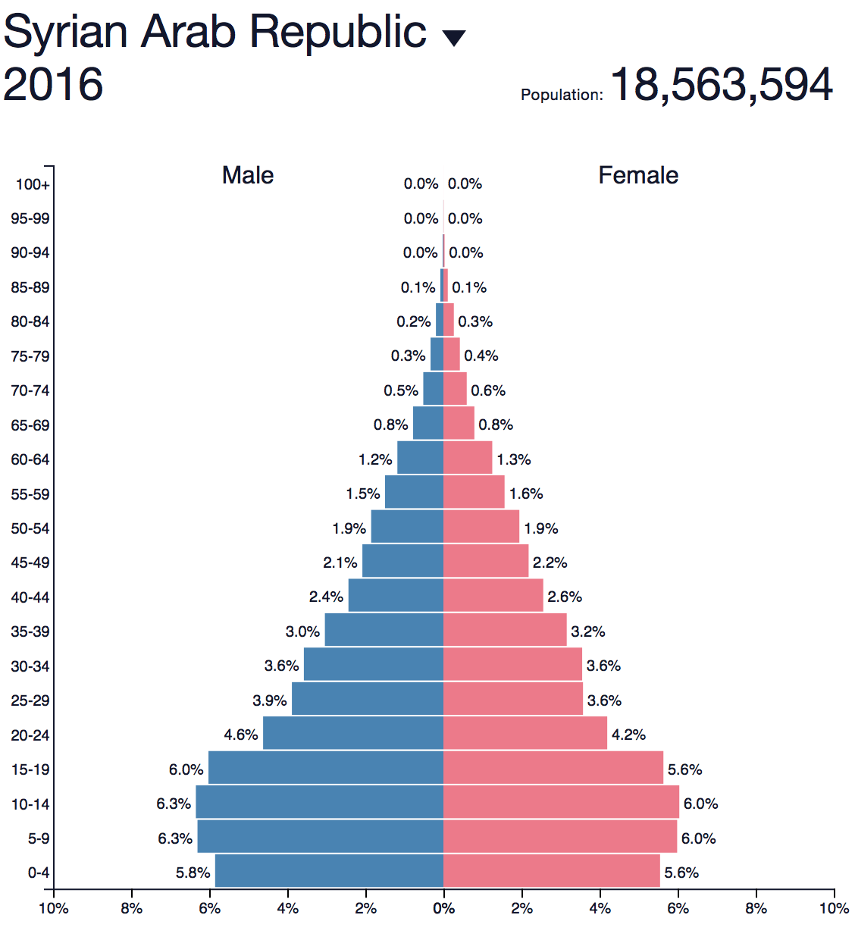
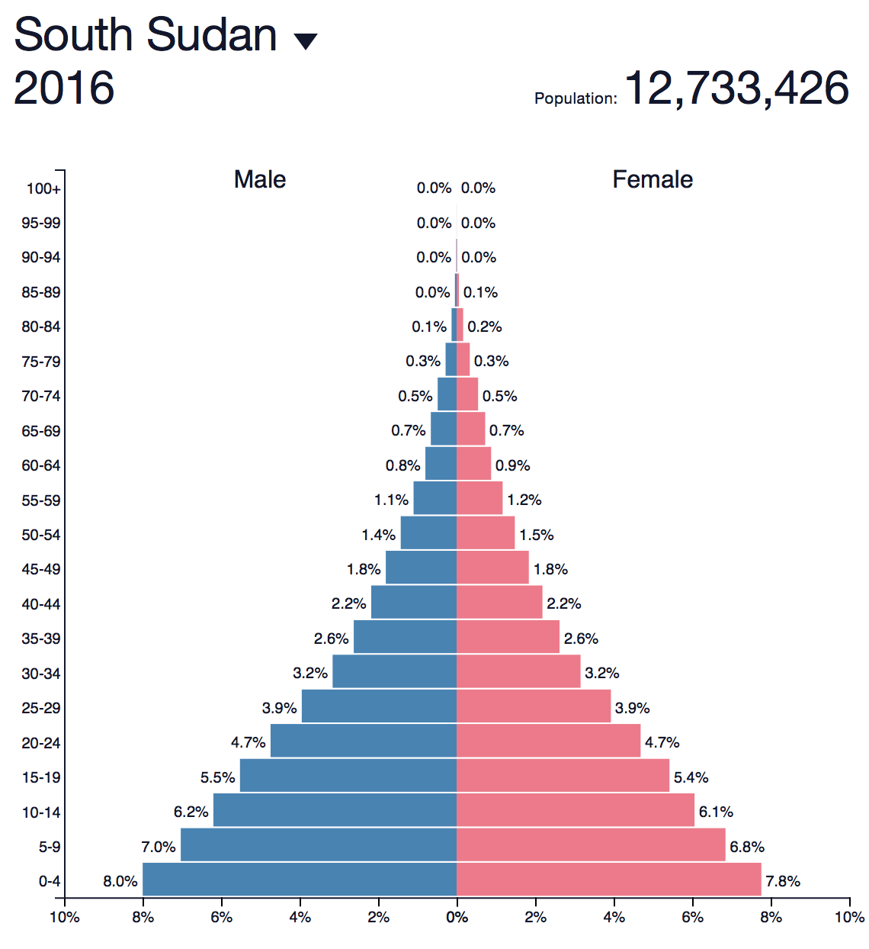
Population pyramid
H.E.L.P. course
Notes:
Secondary data give you already first information about the population in a country, e.g. In South Sudan the proportion of children is high while in Syria there is a higher proportion of elderly.
This will have an influence on the health interventions / services that are needed.
Syria Boys: 0-4 y 5.8% ; 5-9 y 6.3% ; 10-14 y 6.3% -> 18.4%
Syria refugees in Lebanon–boys: 0-4 year = 10%, 5-9 y = 8.6%, 10-14 y = 6.2% -> 24.8%
South Sudan boys: 0-4 y 8%; 5-9 y 7%; 10-14 y 6.2% = 21.2%
In high fertility populations the number of children <5y to may be 15% and <18y between 40-45%; young children require a disproportional share of health services

Slide 20
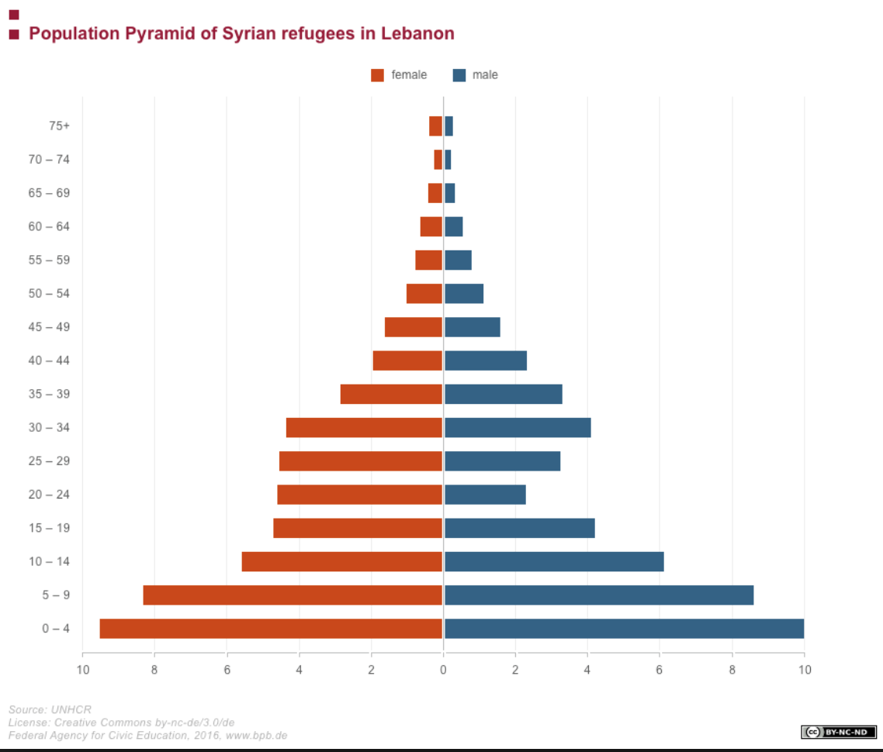
H.E.L.P. course
Notes:
The population pyramid of the Syrian refugees in Lebanon in 2016 showed a gap for the (young) adult men. When you take the total camp population to get an indication of the services that are needed this may have an influence, e.g. the proportion of women at child bearing age will be higher than expected whn you only look at the total population.

Slide 21
WHO – NCD country profile 2014
South Sudan:
Population 10 838 000
Income group: Low
Syrian Arabic Republic
Population 21 890 000
Income group: Low middle
H.E.L.P. course
Notes:
On the WHO website, you find information about diseases. This example brings out different points, e.g. 56.1% of the population in Syria lived in urban settings, while for South Sudan this was 18%. The mortality data show that in South Sudan 9% of deaths were attributed to cardiovascular diseases while in Syria this was 28 %. The main causes of mortality for Syria were due to injuries (48%) while in South Sudan the highest proportion of deaths was caused by communicable diseases, maternal and perinatal and nutritional conditions (63%). This gives you a first indication about the situation.

Slide 22
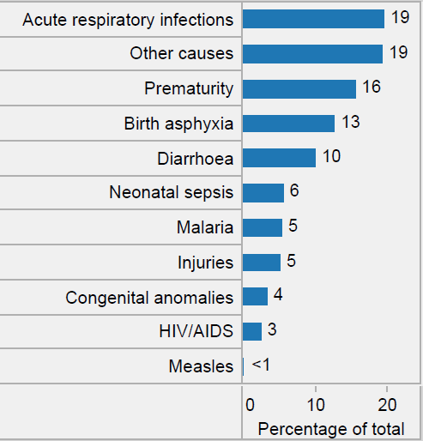
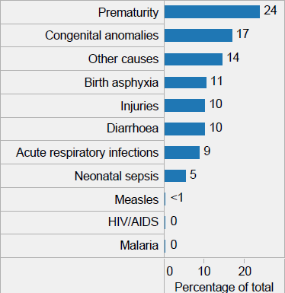
Proportional Causes of Death in Children <5
South Sudan
Syria
2016
H.E.L.P. course

Slide 23
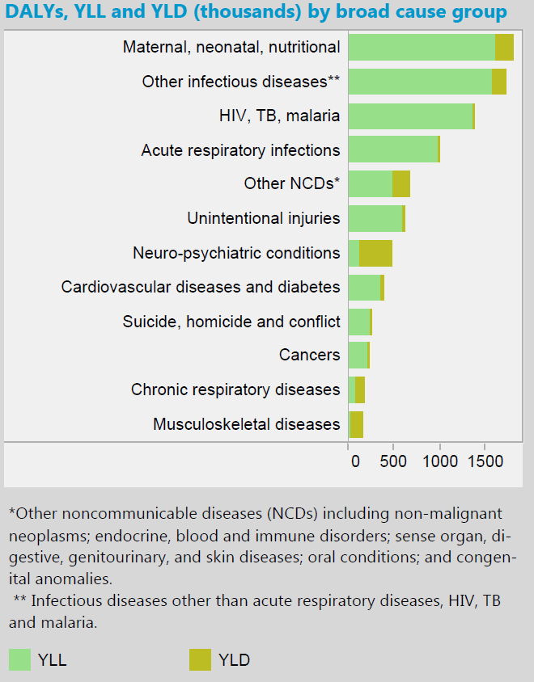
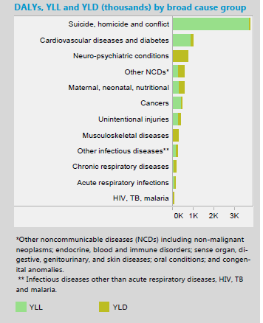
Disease Burden Comparison
South Sudan
Syria
2016
H.E.L.P. course
Notes:
DALYs for a disease or health condition are calculated as the sum of the Years of Life Lost (YLL) due to premature mortality in the population and the Years Lost due to Disability (YLD) for people living with the health condition or its consequences: Calculation: DALY = YLL + YLD
NB horizontal: scale not same for both countries

Slide 24
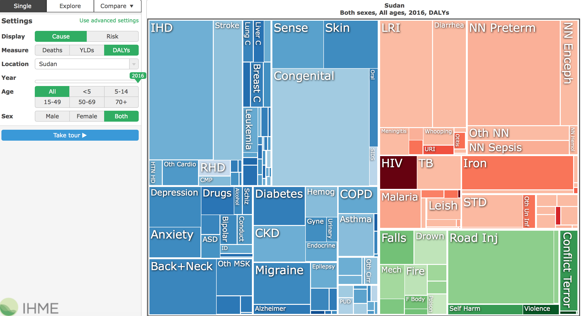
H.E.L.P. course
Source: Institute for Health Metrics and Evaluation
Notes:
You find here information about the cause specific DALYS lost for the total population (all age groups, men and women) in Sudan in 2016.
DALYs for a disease or health condition are calculated as the sum of the Years of Life Lost (YLL) due to premature mortality in the population and the Years Lost due to Disability (YLD) for people living with the health condition or its consequences: Calculation: DALY = YLL + YLD
NB horizontal: scale not same for both countries

Slide 25
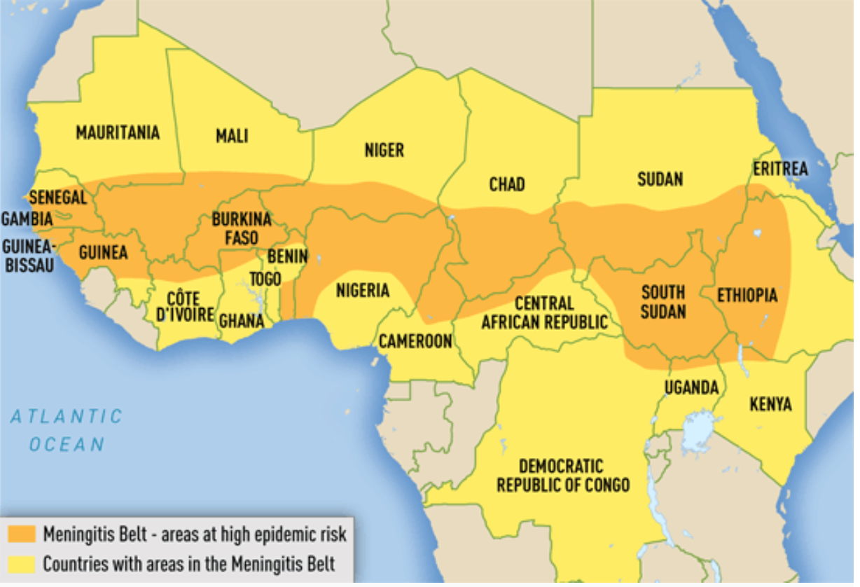
Meningitis belt Africa
H.E.L.P. course
Notes:
For certain diseases, the burden varies per region in the world. An example of this is meningococcal meningitis which is observed worldwide but the highest burden of the disease is in the meningitis belt of sub-Saharan Africa, stretching from Senegal in the west to Ethiopia in the east.
Around 30 000 cases are still reported each year from that area (source WHO), a point to consider from the onset of a crisis in this region.

Slide 26
Public health impact of selected crisis situations
Effect | Armed conflicts | Earthquakes | Floods | Flash floods/ tsunamis
Deaths
Severe injuries
Increased risk of communicable diseases
Food scarcity
Major population displacements
Many
Many
Few
Many
Varies
Many
Few
Few
High
Varies*
Varies*
Varies*
Common
Rare
Varies
Common
Rare (may occur in heavily damaged urban areas)
H.E.L.P. course
Common
Common
Varies
*Depends on post-crisis/disaster displacement and living conditions of the population
Source: Pan American Health Organization, 2000
Notes:
As we discussed already during the module ‘Setting the Scene’, certain crisis types result in other health impacts than others. Do you remember?

Slide 27
??
Which health issues
are key in crisis situations
H.E.L.P. course
Notes:
Discuss in plenary -> see next slide which gives a brief summary

Slide 28
Common key Health Issues in Crisis Situations
Communicable diseases
Measles, diarrheas, respiratory tract infections, skin infections, malaria, HIV
Non-communicable diseases
Cardiovascular, respiratory, diabetes, cancers, ….
Mental health, psychiatric diseases
Child health (IMCI)
Sexual and Reproductive health, including sexual violence
Injury
Fractures, weapon wounded, ……
Disability
Acute malnutrition and micro-nutrient deficiencies
H.E.L.P. course
Notes:
Keep in mind the type of crisis and where you are. Generally you will see an increased prevalence /worsening of diseases that are present in the context, compounded by problems that are directly linked to the crisis
Important that national prioritized diseases and health programmes are addressed
Avoid vertical disease programme approaches which undermine harmonization and efficiency of health services provision
This can be achieved through packages of services which integrate the different health services provided under the disease programmes

Slide 29
What is Needed and How Much?
Influenced by a variety of things:
Demographic pyramid, e.g. proportion of children
Population health status
Epidemiological pattern, e.g. endemic diseases, diseases with epidemic potential, wounds, disability, stress
Type of crisis
Health seeking behavior / health service utilization
H.E.L.P. course

Slide 30
How many medical consultations
How many hospital admissions
What would be the rough estimate per day
??
H.E.L.P. course
Notes:
Question in plenary -> get out answers from the participants.
Data show that the average Nbr. of out-patient consultation per year in the general population vary: Colombia 1.7, Netherlands 8, South Korea 16 (WHO).
The following slide gives an overview of the rough calculations that can be made -> see speaking notes there for explanation how it comes to the 1% - 1% ….

Slide 31
Rough quantification of daily medical needs
Population
1%
1%
1% of population needs out-patient consultation
1% of those who consult need hospitalization
H.E.L.P. course
Based on a consultation rate of 4 / person / year
Notes:
2008/9: 2 studies refugee camps -> average utilization out-patient 2.2 consultations/y (variation –Africa 1.8, Asia 3.5; women > men). Other studies similar -> can derive roughly %: putting at 4 consultation /y in acute crisis -> 10’000 people: 40’000 consultations/y -> divide by 400 days -> 100/day -> 100/10'000 = 1%. Is high based estimate -> will decrease when situation stabilizes and preventive measures have positive effect on morbidity. Hospital admission rate: rough estimate 40/1000 / year, or 1/10.000 day -> corresponds to 1% of daily consultation. When estimate average length of hospitalization 10 days need for one hospital bed for 1000 people. Depending on situation distribution workload per service will vary (kids, WW, .......). Source: Pierre Perrin: Santé Publique et Sécurité Humaine dans les Conflits Armée (2015)

Slide 32
Estimate daily requirements 10’000 persons
100 medical consultations
1 in-patient admission
With average hospital stay of 10 days -> 10 hospital beds
A doctor or other person consulting can rarely see more that 50 patients/day and maintain quality of diagnosis and treatment
When estimating staffing requirement, don’t forget that staff need time off and training time
H.E.L.P. course

Slide 33
Group work
A low income country has received an influx of 25’000 refugees in one of the districts and the numbers are still increasing. Most are clustered in two areas around the main city
The existing health care services are unable to cope with the extra work load. Therefore, the decision has been made by your organization to set up three additional primary care facilities and a community health workers network.
How will you meet the needs for the health work force expansion, i.e.
Professional staff in the primary care facility
The community health workers
3 groups look into the professional staff, 2 at the CHWs -> see questions
Time allocated: 20 minutes
H.E.L.P. course
Notes:
Explain the exercise and put the next slide in view when the participants are doing the groupwork, so that they are clear about their tasks
Where possible, support existing services (infra-structure, expertise, resources; re-open services that were closed).
When services overwhelmed, part of population no access to existing services, security reasons, ........
When additional/new services needed, ensure these are integrated in the existing health system (e.g. professional norms and standards, sharing data, not draining staff existing services). Fixed vs mobile services. Ensure minimal standards for foreign medical team are met.

Slide 34
Community health workers
What will be their function?
What medical conditions will they be allowed to treat?
How many CHW will you need? How will they be selected? Will they receive a salary?
What training will you provide and how will this be done?
How will they be supervised and by whom?
What would be their relationship with the primary care facility?
Professional staff in the three health care facilities
What would be your staff requirements to attend these out-patients
Which health staff mix do you need to provide the defined essential package of services
How many from each type? What qualifications should they have?
How will they be recruited and retained?
What about hiring refugee health workers? What are some possible implications?
H.E.L.P. course

Slide 35
How to go about medical supplies
Which drugs do you need?
How do you ensure quality of drugs?
Will you import?
How will you distribute (push-pull)?
??
H.E.L.P. course
Notes:
Should meet the essential package of health services; those linked to the national prescription guidelines; local
Pre-qualified drugs (good manufacturing licenses); good storage; be aware of the risk that good drugs may be replaced by sub-standard or fake drugs
Depends on availability, quality assurance and cost + import licenses
Acute crisis: push with existing kits -> move to supplies adapted health centre case mix: (line items) = pull

Slide 36
Medical supplies –kits for acute crisis situations
Examples:
Interagency Emergency Health Kit 2015 for 10’000 people/3 months
Non-communicable diseases kit 2016 for 10’000 people/3 months
Severe malnutrition with Medical Complications kit for 50 children (< 5 y)
Cholera kits
Reproductive health kits
First aid kit, War Wounded kit
Is a push system, when situation more stabilized -> change to a pull system
H.E.L.P. course
Notes:
There may be an essential medicine package in the country. Country specific supplies will be linked to the specific situation. Where possible these should be used. At global level work is done for these medical kits (MISP, NCDs). Certain content kits is not accepted by countries, e.g. Greece considers content not up to standard (e.g. for palliative care), anti-psychotic drugs in NCD kit may cause problems, malaria tablets in kits in zones where the disease is not present -> authorities may ask to remove items. Leaflets that come with the kits may not be in your national language and some drugs may be un-know.

Slide 37
Continuum of care
H.E.L.P. course
Farzana movie 3.27 minutes
Notes:
Note that the movie is embedded in the slide
Also available separate on the H.E.L.P. course facilitators’ platform and through https://www.icrc.org/en/document/afghanistan-healing-wounds-war

Slide 38
??
What does continuum of care mean
in the example of Farzana
H.E.L.P. course
Notes:
Farzana: pre-hospital care -> hospital care /amputation -> physical rehabilitation.
Over time, Farzana will need replacement / adaptations of her prosthesis
She may need psychological support
There may be a moment that she gets a problem with her stump which may require an intervention
Socio-economic integration is essential too.

Slide 39
The Health Care Pyramid
Major
Hospitals /
Specialized Care
3rd level of care: Referral hospitals
Referral
2nd level of care: District hospitals
Level 1 hospitals
Health centres
1st level of care: Primary health care facilities
H.E.L.P. course
Health posts
Community

Slide 40
Continuum of care
Levels of care
H.E.L.P. course
Time
Notes:
Continuum of care implies a continuum over time and between different levels of health care
Examples: diabetes, paraplegia, tuberculosis, pregnancy……
When long term consequences are not considered this may be ‘’costly’’, e.g. no proper antenatal care may result in a disabled child or maternal death, a not properly managed diabetes may result in ulcers -> amputation.

Slide 41
Continuum of Care
Linked to an integrated system that assures a person secure and timely access to effective, comprehensive and impartial health services with a functioning referral and counter-referral system
Implies knowing the needs of the beneficiary for each step of the resolution of an episode of illness
Requires a good understanding of the services in place, especially health ones, to recognize the gaps
H.E.L.P. course
Notes:
NB. Don’t forget to make the invisible people visible

Slide 42
What may be reasons why people would not use existing health services
Can you distinguish different groups of reasons?
??
H.E.L.P. course

Slide 43
AAAQ Framework
Availability | Health facilities, goods and services must be available in sufficient quantity
Accessibility | Health services must be accessible to everyone without discrimination
Acceptability | Health services must be respectful of medical ethics, culturally appropriate and gender sensitive
Quality | Health services must be scientifically and medically appropriate and of good quality
H.E.L.P. course
Source: General Comment No. 14 of the Committee on Economic, Social and Cultural Rights
Notes:
This is one approach that you could use to group these.
Committee on Economic, Social and Cultural Rights (CESCR) General Comment
No. 14: The Right to the Highest Attainable Standard of Health
Accessibility –different factors, e.g. cultural, affordability, geographic, security, ……

Slide 44
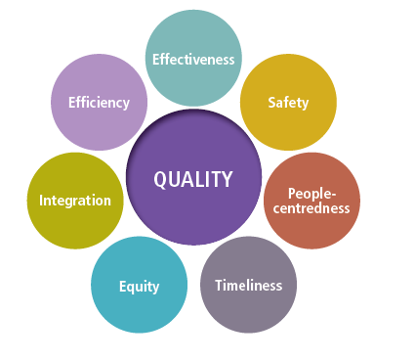
Quality of Care in emergency settings
“Quality” does NOT stand for “Luxurious”
QOC is multi-dimensional with 4 priority dimensions selected for FCV emergency settings
Just as Access, QoC cannot be overlooked in crisis situations
H.E.L.P. course
Notes:
FCV = fragile, conflict and violence

Slide 45
Quality of Care in emergency settings
1) Patient Safety - Minimize the Harm from health care practices
Annual global number of medical incidents 43 Million
Infection prevention and control, handwashing, facility-WASH
Medication safety, Safe surgery
Medical Incident register
2) Effectiveness - Getting the basics right
Existence of clinical guidelines and adherence; Qualified and competent staff; Clinical quality monitoring systems
3) People centeredness
Culturally acceptable (gender of professionals, abortion, “Caring” approach
Patient – clinician communication; language
Collect and use patient experience
4) Equity
Different population groups (socio-economic, age, gender, ethnic, religious, ….)
Displaced persons >< local host community
H.E.L.P. course
Notes:
Globally, poor-quality health care causes harm to human health, with between 5.7 and 8.4 million deaths occurring annually in low- and middle-income countries due to inadequate care. It can be expected that this applies even more so to countries affected by extreme adversity. Resilient health services require quality as a foundation. The success and value of UHC depends on its ability to provide quality services to all people, everywhere. National Academies of Sciences, Engineering and Medicine. 2018. Crossing the Global Quality Chasm: Improving Health Care Worldwide. Washington, DC: The National Academies Press. Doi: https://doi.org/10.17226/XXXXX.
Hospital infections affect 14 out of every 100 patients admitted, much higher in LMIC, no data on emergency settings
“Access to an improved water source within 500m” 58% of facilities in AFRO (23 country sample), probably much worse in FCVs

Slide 46
H.E.L.P. course
Quality of care in health emergencies
What is happening in the area?
Establishment of Quality Improvement Task Team within the Global Health Cluster
Primary care facility quality assessment tool for humanitarian settings.
Rapid deployment /emergency medical teams (EMTs) investment in quality assurance
H.E.L.P. course
Notes:
Health cluster partners recognized the importance of quality of care in humanitarian settings -> Establishment of Quality Improvement Task Team (QITT) was established in March 2019.
A variety of humanitarian actors are investing in quality of care tools (tools to assess quality issues and to improve quality); WHO with health cluster partners are in a in process of developing a standardized tool for these assessment (Currently focusing on primary level)
Pre-qualification criteria for deployment teams + international recognized certification; https://www.who.int/hac/techguidance/preparedness/emergency_medical_teams/en/

Slide 47
Questions
H.E.L.P. course

