Slide 1
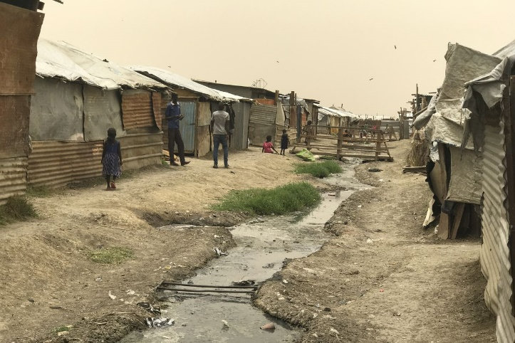
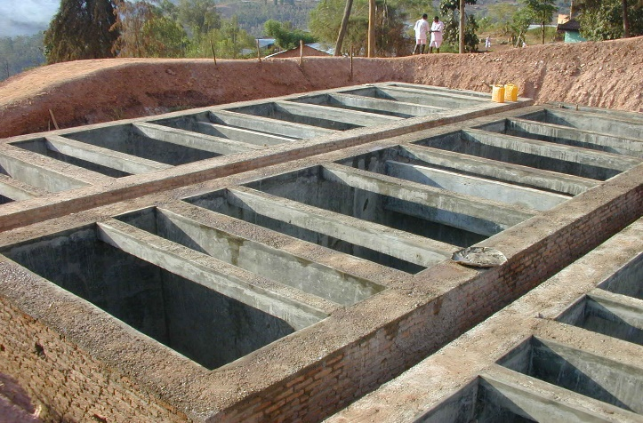
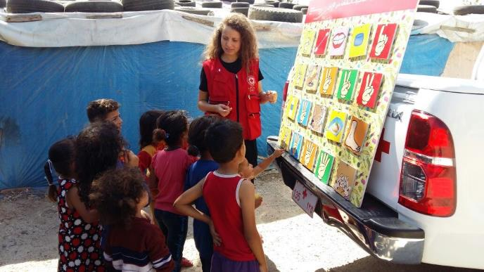
Logo organization(s) facilitator(s)
Sanitation
H.E.L.P. course
These learning materials have been developed by colleagues of the ICRC Water and Habitat team
Name and organization facilitator(s)

Slide 2
Objectives
Be able to
analyse excreta waste management
analyse solid waste management
analyse medical waste management
explain challenges of changing behaviour through hygiene /health promotion
explain the principles and key steps of vector control measures

Slide 3
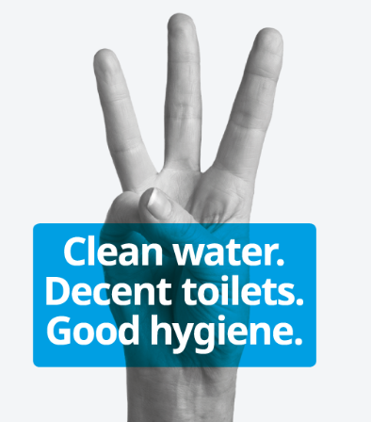
Environmental Sanitation
Transmission cycle
Hygiene promotion
Excreta disposal
Solid waste disposal
Medical waste disposal
Vector control
https://www.wateraid.org/uk/

Slide 4
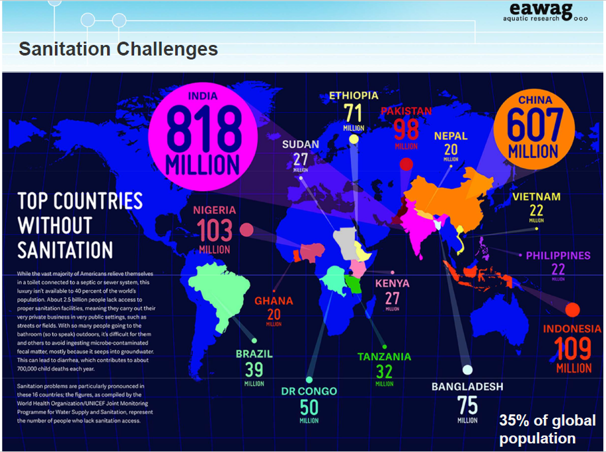

Slide 5
Why do we care so much about excreta?
?

Slide 6
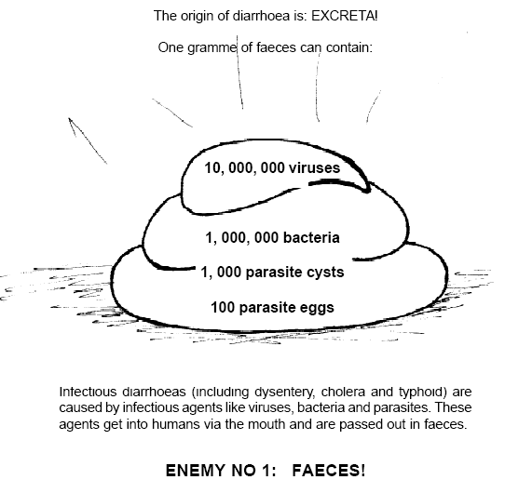
Excreta
Daily Production (Weight)
  60 g./p/day (dry)
  150-300 g./p/day (wet)

Slide 7
Environmental Sanitation
Sensitization & Hygiene Promotion
Sanitation systems & services
Human waste
Garbage
Liquid waste
+Pathogens
Population
Environment
Water, Energy, Food
Materials, Housing,
Vectors
+Pathogens
Notes:
Environmental Sanitation has two main pillars of intervention:
1.) In order to assure good hygiene practices and the correct use of sanitation systems the population is targeted with Sensitization and Hygiene Promotion Programs
2.) In order to reduce the risk of contamination of the environment and infection of populations, the waste products need to be collected, treated and disposed correctly. For this, various sanitation systems have to be put in place, including infrastructure and services (see later).

Slide 8
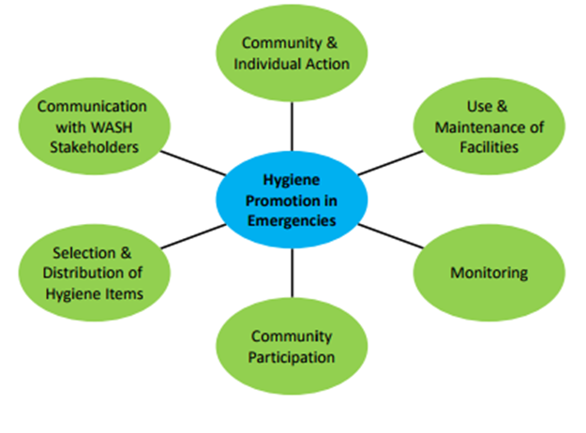
Hygiene Promotion
Hygiene promotion is a planned, systematic approach to enable people to take action to prevent or mitigate water, sanitation, and hygiene related diseases

Slide 9
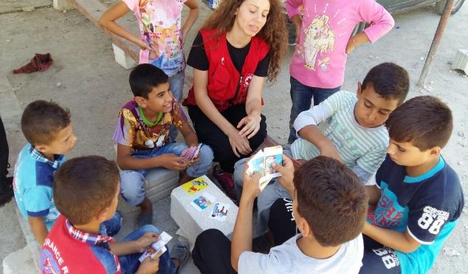
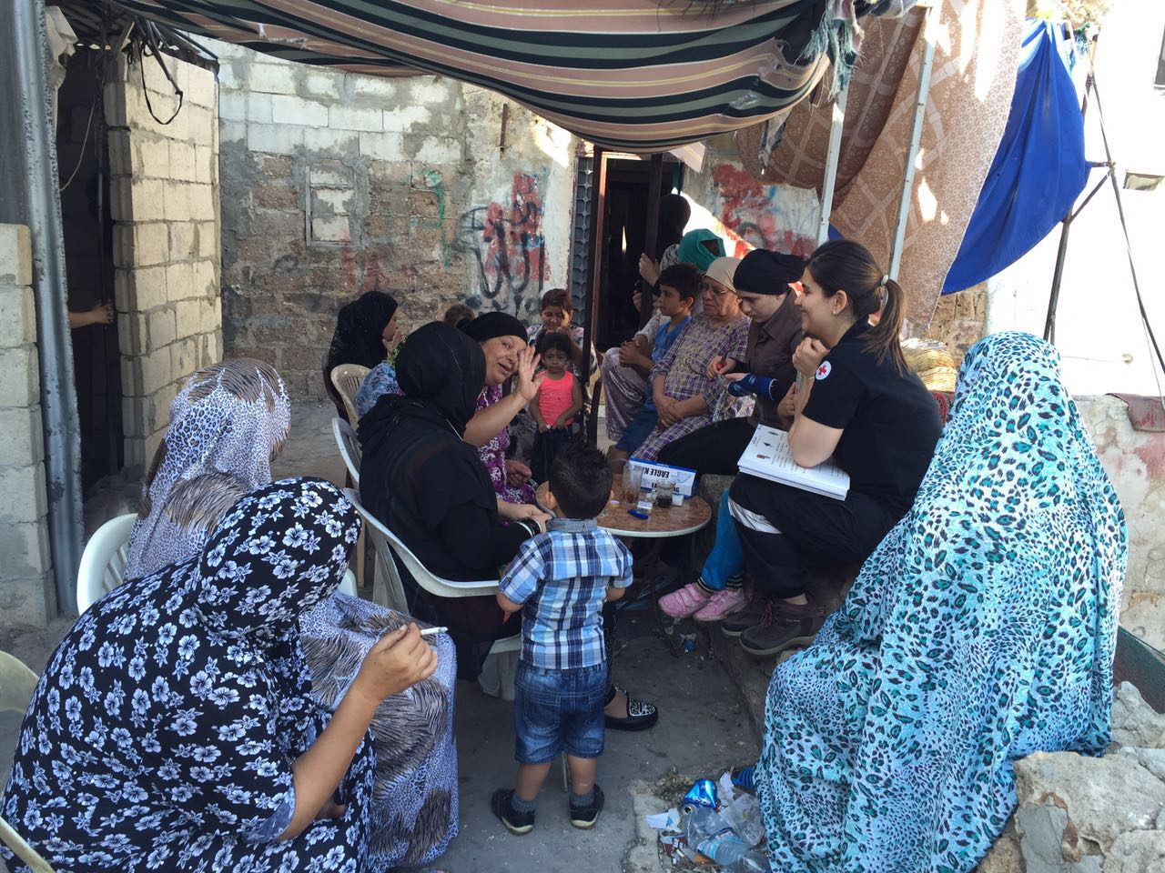
Hygiene Promotion Methodologies
PHAST Adaptations
CLTS
Child-to-Child Approach
PHASE Program
Nali Kali Methods
Notes:
Hygiene promotion is a planned approach that aims to reduce the incidence of poor hygiene practices and conditions that pose the greatest risk to the health of children, women and men
PHAST: Participatory Hygiene and Sanitation Transformation, A participatory approach for the control of diarrhoeal diseases, WHO; 7 steps:
Step 1: Problem identification (community stories, health problems in our community
Step 2: Problem analysis: (mapping of water and sanitation in our community, good and bad hygiene behaviours, investigating community practices, how diseases spread)
Step 3: Planning solutions (blocking the spread of disease, selecting the barriers, tasks of men and women in the community)
Step 4: Selecting options (Choosing sanitation improvements, choosing improved hygiene behaviours, taking time for questions)
Step 5: Planning for new facilities and behavior change (Planning for change, planning who does what, identifying what might go wrong)
Step 6: Planning for monitoring and evaluation (preparing to check our progress)
Step 7: Participatory evaluation (checking our progress)
CLTS: Community-led Total sanitation: Community driven method using natural human reflexes of disgust and shame to encourage households and communities to go open defecation free (ODF). Using certification and celebration of ODF families and communities to encourage others to follow their example.
Child-to child approach: Approach to health education of primary school age children, 1978 activity oriented teaching; developmental needs, nutrition, contagious illnesses and aspect of environment, adopted by UNICEF, Oxfam etc.
PHASE program: Reduce diarrhea diseases among school children; Personal Hygiene and Sanitation Education is helping to reduce diarrhea-related disease by encouraging school children to wash their hands.
Nali Kali Methods: Joyful learning, strategy adopted creative learning practices to help retain children in school and bring in those not attending school. Child competencies were pegged to a learning ladder and the learning process was organised into milestones providing every child the opportunity to assess his or her own progress. The initiative has helped improve enrolment, particularly of girls in parts of India since 1995 and supported by UNICEF. Learning through multi-sensory stimulation, play learning, peer guidance, own pace etc.

Slide 10
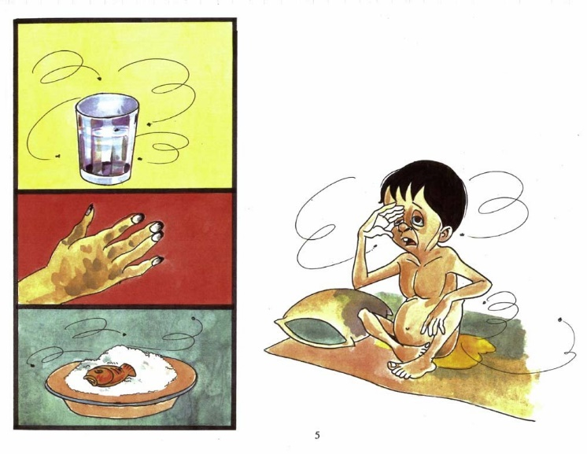
What principals have to be respected when designing and implementing a hygiene promotion campaign?
?

Slide 11
Principle of Hygiene Promotion
Target a small number of risk practices
Target specific audiences
Identify motives for behavior change
Hygiene messages need to be positive
Identify appropriate channels of communication
Decide on a cost-effective mix of communication channels
Allocate enough resources and time. Hygiene promotion requires careful planning, execution, monitoring and evaluation
Notes:
Participatory approach

Slide 12
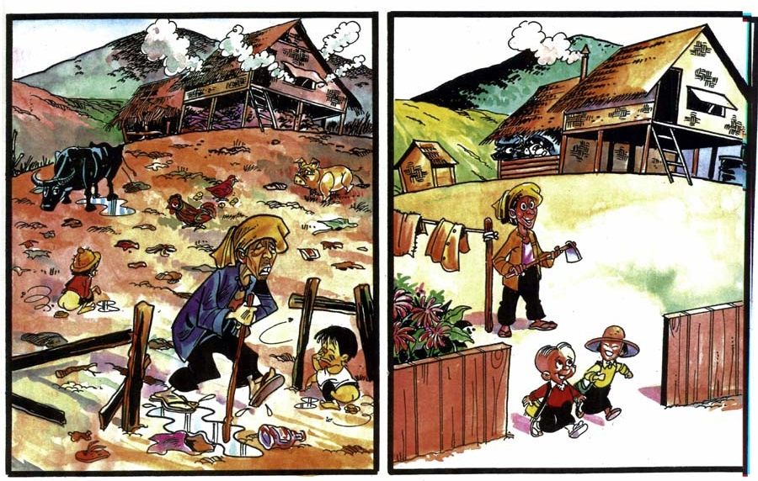

Slide 13
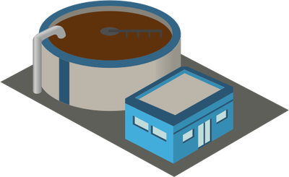

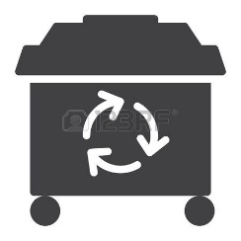
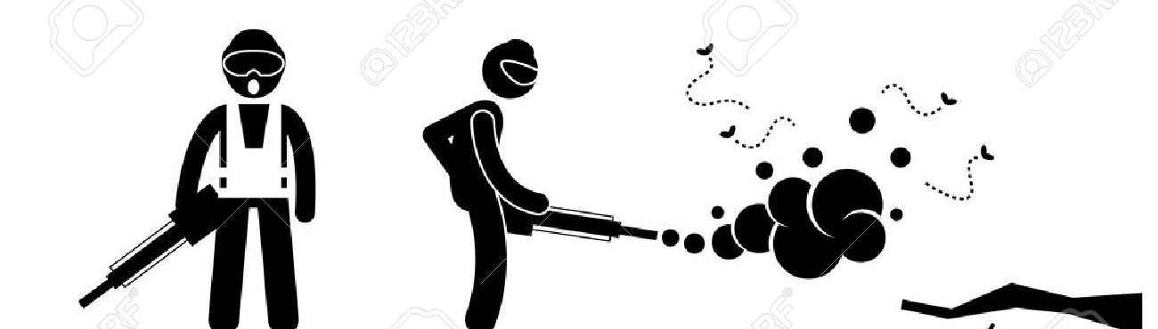
Sanitation Systems and Services
Wastewater collection, treatment, disposal
Solid Waste Management
Vector control

Slide 14
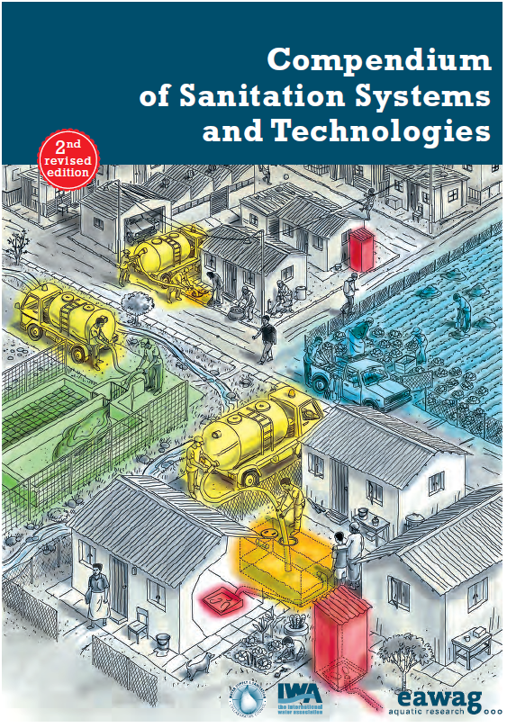
Fecal and Wastewater management
User Interface
Storage
Conveyance
Treatment
Disposal or Reuse
https://www.eawag.ch/fileadmin/Domain1/Abteilungen/sandec/schwerpunkte/sesp/CLUES/Compendium_2nd_pdfs/Compendium_2nd_Ed_Lowres_1p.pdf
Notes:
There are many different sanitation technologies and usually a number of technologies have to be combined into a system to safely dispose of waste water products.
Sanitation systems are usually composed of 5 consecutive components (some can be combined), including:
User Interface for extraction of waste products (e.g. latrine)
Storage (e.g. septic tank)
Conveyance (e.g. sewage truck)
Treatment (e.g. waste stabilization pond system)
Disposal or Reuse (e.g. composting, discharge)
Remember:
Not all technologies can be combined! In order to understand and check which options are available for each component and which technologies can be combined, you can consult the EAWAG Compendium.
Sanitation systems should be designed to safely collect, treat and dispose all waste products, including excreta, urine, flushwater, greywater etc.
Sanitation systems should always be adapted to the local context!

Slide 15
List and classify means to evacuate excreta
?

Slide 16
Classification of Waste Water Disposal Systems
SITE
(In situ)
(Ex situ)
Defecation area
Pit latrines
Twin pit latrines
VIP latrines
Compost latrines
Bucket latrines
Flying toilet
Pour flush toilet
Septic tank + Soakaway
Conventional sewage and treatment system
(Dry)
METHODS
(Wet)
Notes:
Not exhaustif: compost latrines, EcoSan for example

Slide 17
List selection criteria for choosing a sanitation technology
?

Slide 18
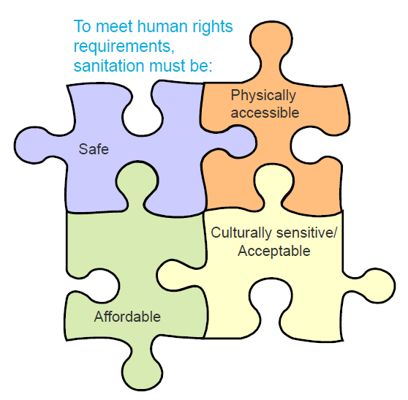
Criteria for Choice of Technology
Technical feasibility
  Water requirement
  Ease and speed of construction
  Number of users
  Cost, available space
  Ease of maintenance
  Cleansing method
  Emptying methods available
  Soil (stable, permeable)
  Distance from water sources (> 30 m.)
  Distance from water table (> 1.5 m.)
  Avoiding odor
  Safety
  Easy access
Acceptability
  Awareness of health benefits
  Strong social organization
  Willingness to switch from traditional system
  Cultural acceptability: sexual, religious
Notes:
Consider all Criteria for decision, TECHNICAL AND CULTURAL !

Slide 19
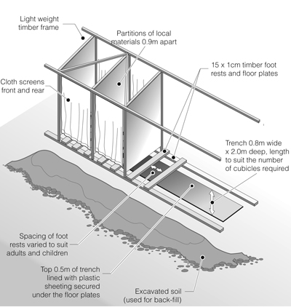
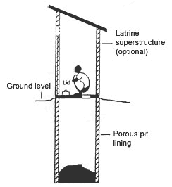
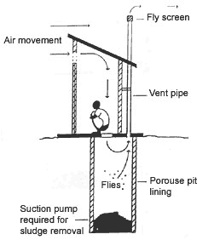
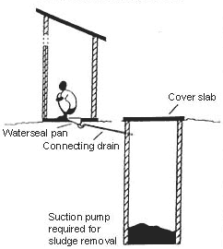
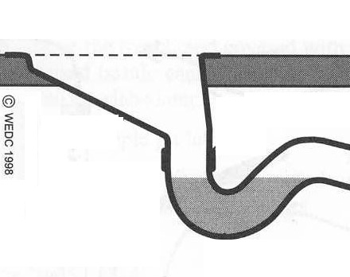
Types of Latrines
http://www.wateraid.org.uk/site/in_depth/technology_notes/303.asp
Notes:
Trench latrines for the beginning of an emergency
Pit latrine
Ventilated Improved Pit (VIP) latrine
Poor flush toilet (with syphon). Consider water availability and anal cleansing material.

Slide 20
Septic Tank
The purpose of a septic tank is to dissolve solid matter, thus facilitating its sedimentation and bacterial degradation.
The processes that occur in a septic tank:
  sedimentation
  the formation of scum
  digestion and solidification of sludge
  stabilization of liquids

Slide 21
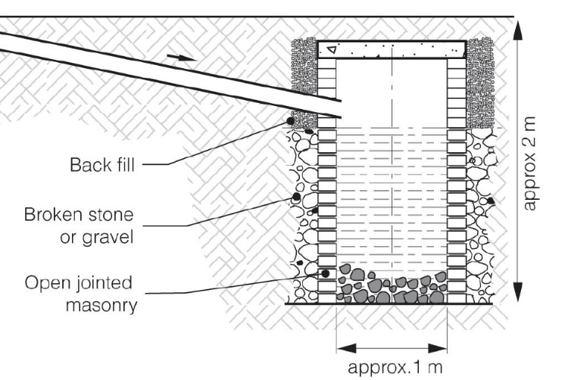
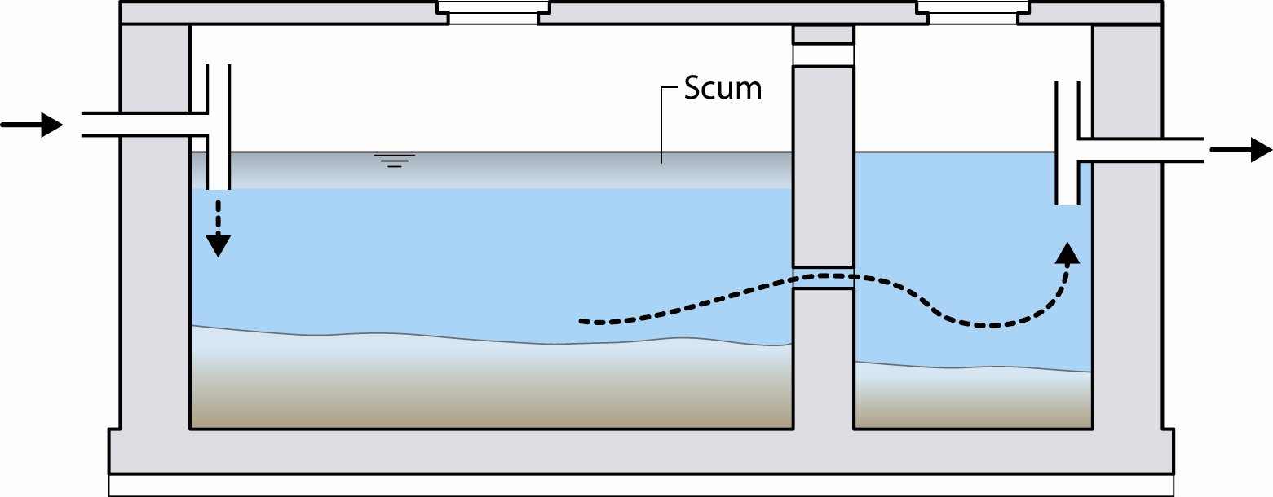
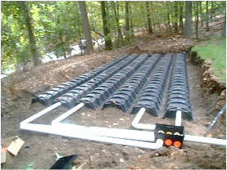
Disposal of Effluent
Soak away Pit
Infiltration Trenches
Notes:
After treatment (septic tank or other systems) we still have to safely dispose the effluent.
In the picture, we have a soak away pit and trenches
The choice of disposal system will depend on the effectiveness of the treatment

Slide 22
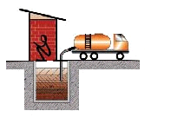
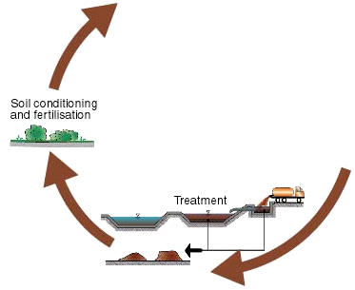
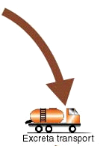
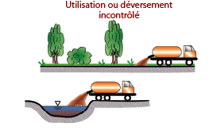
Sewage Disposal – Common Issues
Correct reuse as resource
!
!
No uncontrolled waste disposal
!
Safe disposal
Uncontrolled
disposal
or
reuse
Notes:
The most common approach for sewage collection in developing countries is the emptying of latrine pits and septic tanks by sewage trucks.
Unfortunately, in many cases the sewage is dumped irregularly causing a risk to the public.
If sewage is delivered to waste water treatment plants (WWTP), they are often overloaded, not maintained or not operated correctly. This means, waste water is not correctly treated and discharged into the environment, which puts the again public at risk.
Furthermore, discharging waste water into the environment is also a loss of a potential resource. Feces can be recycled as fertilizer and compost if processed correctly.

Slide 23
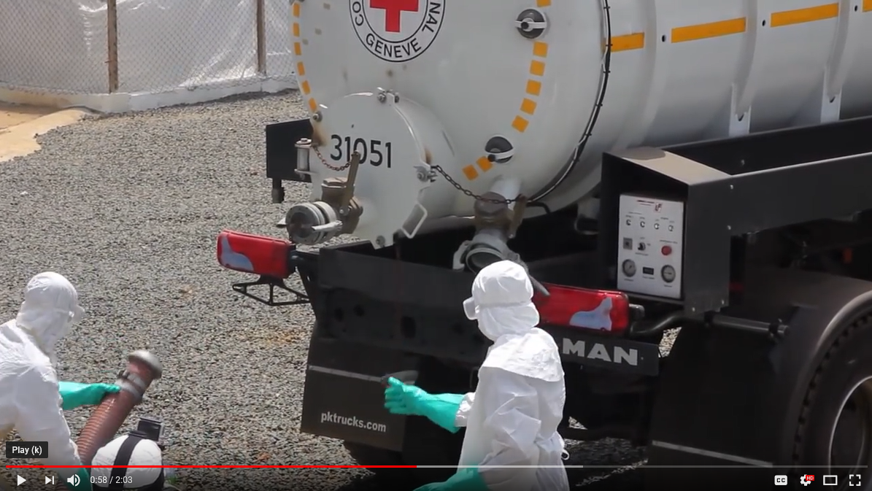
Video
Safe disposing of wastewater in Ebola emergency
https://www.youtube.com/watch?v=nFwfoSOe3Yc
https://www.youtube.com/watch?v=nFwfoSOe3Yc

Slide 24
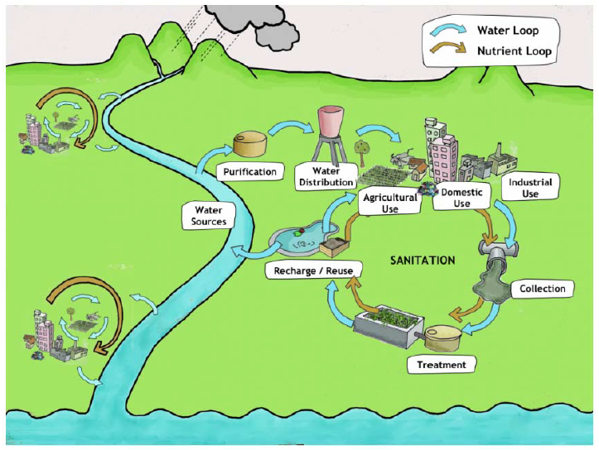
IWRM- Integrated Water Resources Management
Notes:
Water and waste water, with all its products, should be planned in an integrated manner, to assure risks are mitigated and the products are recycled safely. Ideally, this should be a system of closed cycles.

Slide 25
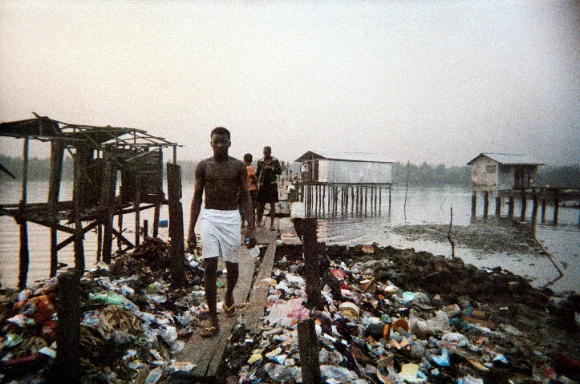
Solid Waste management
Main Health Concerns
Attraction of vectors
Increase in insects counts
Bacteria transmission through flies to food
Potential pollution to surrounding soil and water
Bad smell and visual pollution

Slide 26
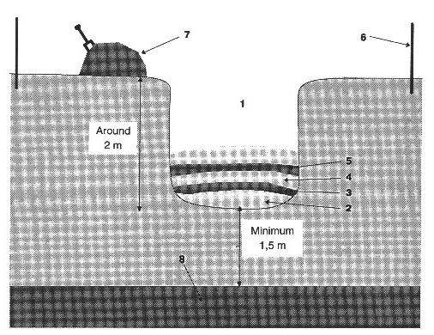
Solid Waste management
Appropriate solutions for collection, transport, treatment (if possible) and disposal have to be found.
In an emergency situation, the best option for disposal are often refuse pits (household level) or refuse trenches (on communal level).
Important:
keep >1.5m to groundwater-level
cover with soil-layer every day
fence the pit properly
inform, train and equip population

Slide 27
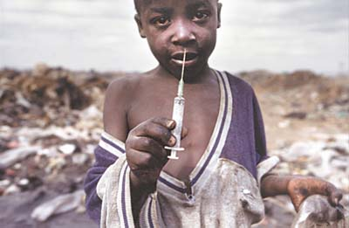
Medical Waste Disposal

Slide 28
What types of medical waste do you know?
?

Slide 29
Composition of Medical Waste

Slide 30
Principals of Medical Waste Management
First steps should always be Prevention and Reduction:
by using the least toxic products
by segregation of waste
Segregation:
Sorting wastes is always the responsibility of the person producing it.
Sorting must take place as close as possible from where it has been produced.
Notes:
Use these principles as guidelines when designing a Medical Waste Management system. This allows to reduce medical waste and the risks related to it.
*/ Prevent:
-For Example: Opting for the least toxic products. Many medical Equipment, such as intravenous bags, artery catheters, blood bags, dialysis bags and tubing contain Polyvinyl Chloride (PVC) plastic. Incinerated, they produce CHLORINATED DIOXINS which are extremely potent, toxic substances. Alternative, PVC free-products, exist in the market. Their choice would prevent a mayor problem.
-Another example: The use of digital X-ray imagery would prevent the problem of the disposal of toxic development liquid.
*/ Reduce:
-The segregation of medical waste from other type of wastes can dramatically reduce the quantity of waste to be handled as medical waste. No need to treat kitchen waste as infectious! Sorting wastes is always the responsibility of the person producing it. Sorting must take place as close as possible from where it has been produced.
*/ Reuse:
Reusable Sharp Container developed by MSF. It is safe in protecting medical operators from accidental puncture, and it can even be built with local materials, but more importantly, it prevents the use of whatsoever treatment (usually incineration) to safely dispose of the needles it contains. Its contents is dropped in a dedicated pit, and kept out of reach from any risk.

Slide 31
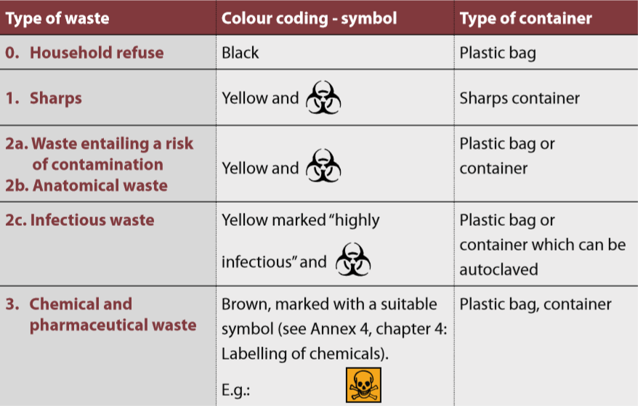
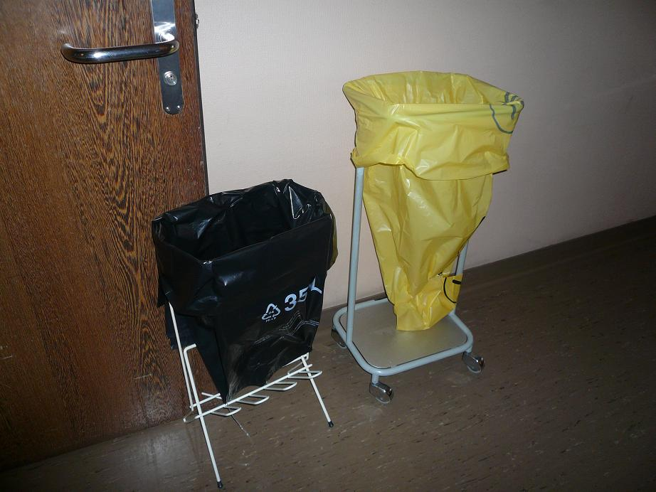
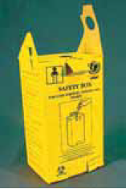
Segregation and Coding
Household
refuse
Infectious &
contaminated
waste
Sharps Container
Sharp Container
Coding recommendations (WHO – UNEP/SBC 2005)

Slide 32
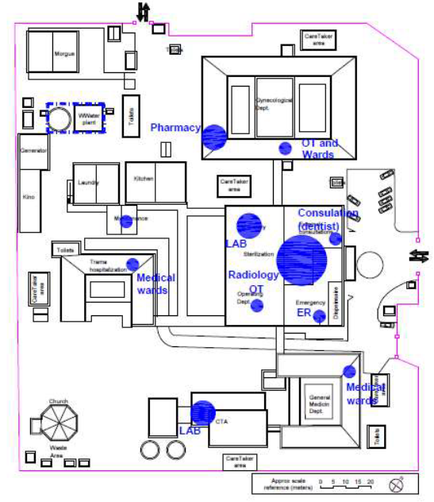
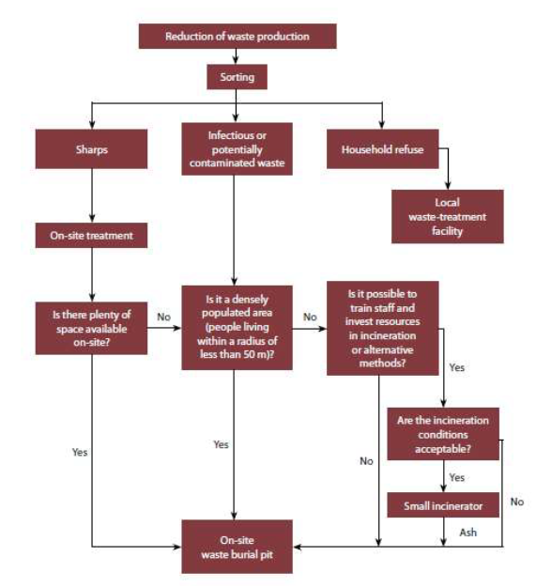
Waste Management System
Assess categories and quantities of wastes
Mapping (what? How much? Where?)
Discuss different technologies & management systems
Consider solutions for all stages of medical waste
Define/consult Decision Trees
1. Segregation
2. Temporary Storage
3. Transport
4. Treatment and
5. Final Disposal
Notes:
Decision Trees: different organizations and institutions (e.g. WHO…) have developed decision trees that should provide guidance in medical waste managment. They are always specific to defined situations and contexts and should not be generalized.
Essential criteria for the selection of a medical waste management system are:
• Regulations
• Existing facilities
• Space availability
• Neighborhood
• Financial resources
• Human resources

Slide 33
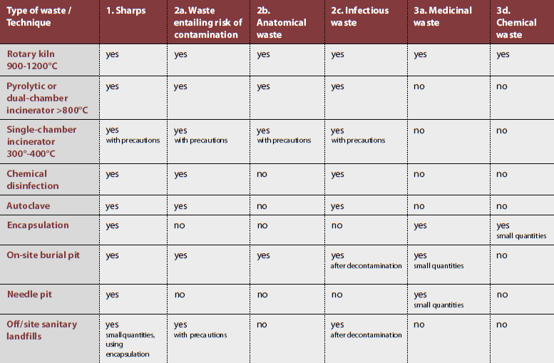
Treatment and Disposal Options
Notes:
Incineration: Incinerators with operation temperatures of over 1’000°C are usually costly and only worth installing on centralized level. There are also simple incinerator models for treating small
quantities of medical waste. Some are available on the market (expensive, maintenance intensive and electricity dependent!), and others can to be built with local materials on the spot according to relatively simple plans. E.g. the De Montfort incinerators (approx. 1,000 CHF) with temperatures of up to 800°C.
Chemical Disinfection: Suitable mainly for treating liquid infectious wastes such as blood, urine, faeces or hospital sewage. Solid medical waste can be chemically disinfected, but
they must first be shredded. This practice poses a number of safety problems, and the wastes are only disinfected on the surface. Thermal disinfection must be preferred over chemical disinfection for reasons of effectiveness and for ecological reasons.
Needle Disposal: For safety reasons, the ICRC does not recommend that needles are extracted or destroyed. Some appliances run on electricity and cannot be used widely in ICRC contexts. Alternatives: 1.) Shredders: They are often built into closed chemical or thermal disinfection systems as the products still require disinfection. Should be considered whenever needles and syringes are available in large quantities. However, is also electricity dependent and usually costly 2.) Encapsulation: see below. 3.) Direct to landfill (option of last resort; see below).
Encapsulation: It involves filling containers with waste, adding an immobilizing material, and sealing the containers. The containers are sealed and disposed of in a sanitary landfill or waste burial pit. Encapsulation of sharps or unwanted vaccines could is generally not considered to be a long-term solution, but can be envisaged in temporary settings, such as camps or vaccination campaigns.
Landfill or waste burial pit: only be used as a last resort and with the necessary precaution. Ideally, the pit should be lined with low-permeability material such as clay to prevent the pollution of shallow groundwater and should be fenced in so as to prevent scavenger access. Health-care wastes must be buried immediately under a layer of soil after each unloading operation. It is suggested that lime be spread on the waste for added health protection (in the event of an epidemic, for example) or to eliminate odour. The pit should be sealed once it has been filled.

Slide 34
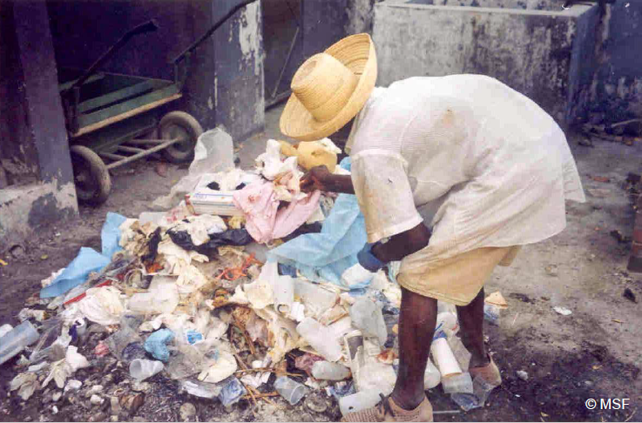
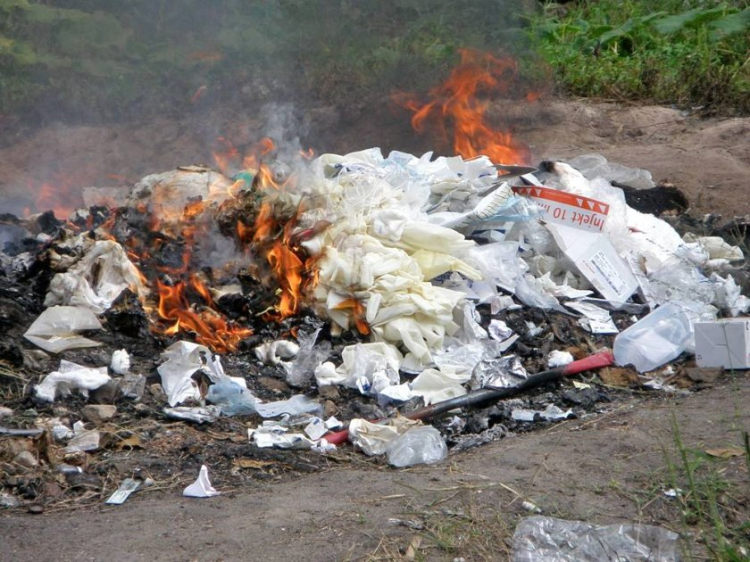
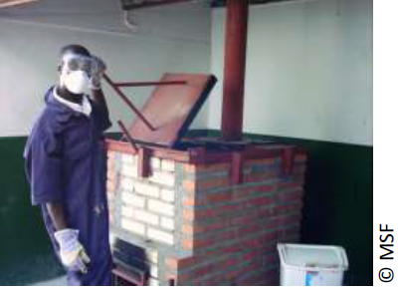
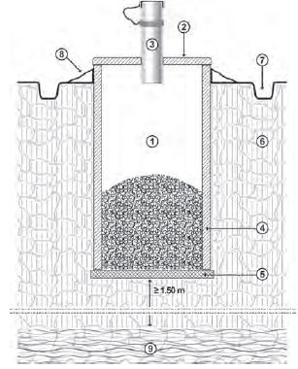
Treatment and Disposal
Avoid dumping of wastes !
Identify appropriate solutions for all different waste products, also including sharps and hazardous liquids
If no other solutions are feasible, use waste burial pits (separate pits for sharps, organic and soft waste; follow instructions)
Notes:
Liquid Wastes: sewage system should not be used to dispose of hazardous chemical or pharmceutical waste, not even when diluting. They should be deactivated & recycled by a specialized firm.
Hazardous bilogical waste (eg. Blood reserves) should be disinfected by autoclave, chemical treatment or incineration, or in the worste case disposed of in a waste burial pit.
Waste Burial Pit: see http://refbooks.msf.org/msf_docs/en/public_health/public_health_en.pdf

Slide 35
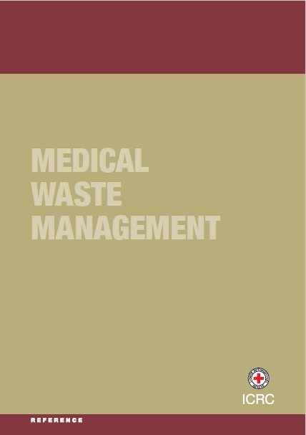
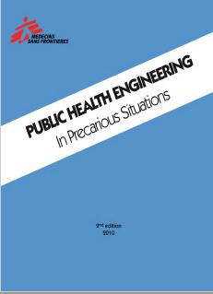
Reference Docs on Medical Waste Mngt
https://www.icrc.org/en/doc/assets/files/publications/icrc-002-4032.pdf
http://refbooks.msf.org/msf_docs/en/public_health/public_health_en.pdf

Slide 36
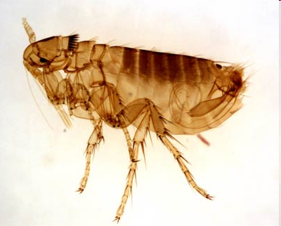
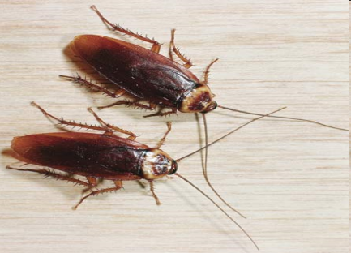
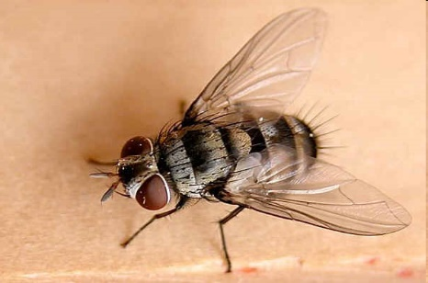
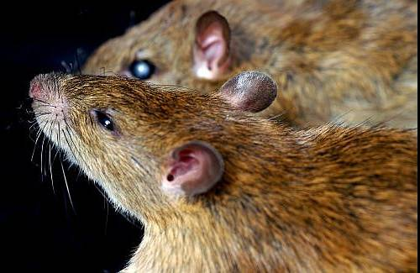
Vector Control
Definition: arthropods or animals that are capable of carrying disease pathogens from an animal, human, etc. (reservoir) to another.
Objective: To reduce the transmission of specific communicable diseases by directly or indirectly destroying (or containing) the carriers vectors concerned
Notes:
A vector carries and transmit infectious pathogens from a reservoir to another host. The reservoir can be a animal, human or environment on which the infectious agent depends to survive.
The pathogens can be transmitted either mechanically to another host. It means that that the vector transmits the pathogens by transporting them on their body.
For instance, a flies landing on a faeces with pathogens, will then transmit these pathogens to another human by landing in its eye or in the salad that he eats..
The pathogens can also be transmitted after biological transformation. In that case, the vector is involved in the life cycle of the pathogen which mature through the vector such as malaria.
In the transmission of vector-borne diseases; Infections can occur via biting (Malaria transmitting mosquitoes) , via skin penetration (eg. Scabies transmitting mites) or ingestion (eg. Food contaminated by flies)

Slide 37
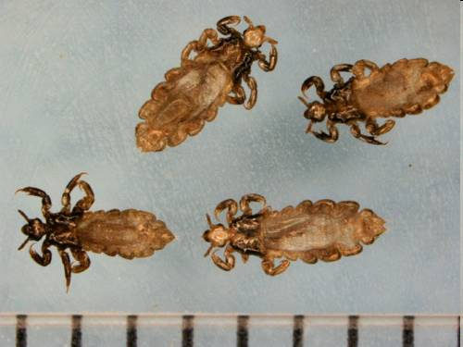

Vector Control
It is highly important to know the life-cycle of vectors in order to define the most appropriate control.
In addition to transmitting diseases, some vectors may also be considered as a nuisance because of their painful bites, e.g. mosquitoes, biting flies, fleas, and lice.
Notes:
To speak about the main vectors like lice (typhus, relapsing fever), bedbugs (comfort), fleas (plague for the rat’s fleas, murine typhus), houseflies (to be compared to a A380 for of bacteria), mites (scabies), rats, cockroaches (associated with filth), and of course mosquitoes and the different types.
To fight a vector, we have to know its habitus (take the example with the difference of habitus between anopheles and Aedes)

Slide 38
What types of vector control measures do you know?
?

Slide 39
Diseases transmitted through Vectors
Vector | Diseases transmitted
Mosquitos Anopheles Aedes Culex | Malaria, filariasis Yellow fever, dengue, chikungunya, zika Japanese encephalitis
Flies | Trachoma; may mechanically transport other pathogens (cholera, dysentery)
Sand flies | Leishmaniasis
Lice | Typhus, relapsing fever
Rats | Leptospirosis
Fleas | Plague, typhus
Ticks | Rickettsia, tularaemia, Lyme disease, tick-borne encephalitis
Mites | Scabies
Bed bugs | Nuisance
Triatomine bugs | Chagas diseases; other pathogens by mechanical transport
Tsetse flies | African trypanosomiasis
H.E.L.P. course

Slide 40
Vectors Control Measures
Any vector-control programme must aim to:
make the environment unfavourable for the development and survival of the vector, thus minimizing the number of vectors.
prevent the different forms taken by each vector during its cycle of development from reaching the adult stage by destroying eggs, larvae, etc.
promote passive protective measures (screening and mosquito nets) and prevent the persons from contacts with environments where transmission can occur. Insecticides should be used only as a last resort as it is better to:
encourage good personal and environmental hygiene
Notes:
Vector control measures should be taken in epidemic zone, in epidemic prone contexts or where there is high presence of vectors.
Principal vector control strategies usually aims at:
Reducing vector breeding sites;
Reducing vector population density;
Reduce the risk of human-vector contacts;
→ In other words, reducing the creation of the hazard, its transport and the exposure of people to the hazard.
Categories of vector control measures may be classified in 4 types:
Environmental control to alter breeding sites, such as draining or filling sites or also to ensure proper waste management
There is also mechanical control. For instance using nets against mosquitos, covering food against flies or using traps to catch rodents
Biological management consists of using living organisms or product against the different form of the vector, such as fish that eat larvae
Finally chemical control for personal protection such spray use as mosquito repellant or insecticides for environmental control. However, it is usually recommended to use Insecticides as a last resort. Indeed, it is more effective and less costly to collect and remove refuse regularly than to depend upon insecticides to combat flies or rat poison to eliminate rodents. In addition, while using pesticide it is important to ensure that staff, communities and the local environment are adequately protected, and avoid creating chemical resistance to the substances used

Slide 41


Priorities
Improve general sanitation
Disposal of excreta, waste water and solid waste
Careful storage of food and water
Intensify personal protection
Initiate appropriate chemical control methods

Slide 42
Diseases, Vectors and Control
Vector | Disease | Effectiveness of available Vector Control Measures
Anopheles mosquitos | Malaria | Poor
Culex and aedes mosquitos | Filariasis and viral diseases | Poor
Blackflies | Onchocerciasis | Good
Tsetse flies | African tryphanosomiasis | Good
Aedes mosquitos | Yellow fever | Poor
Sandflies | Leishmaniasis | Good
Triatomid bugs | Chagas disease | Good
Body lice | Relapsing fever and typhus | Moderate
Rats | Leptospirosis | Moderate
Mite | Scrub typhus | Good
Itch mite | Scabies | Good

Slide 43

Video
https://www.youtube.com/watch?v=yOJ_lNO8cuU

Slide 44
Wrap-up: Sanitation
Public Health Engineering covers both, the design of sanitation infrastructure and services, and the sensitization and education of the population.
Sanitation systems are composed of a set of compatible technologies that together allow to collect, store, treat and safely dispose of all waste-water products. Systems should always be adapted to the local context.
Sorting hazardous wastes at the source is the most efficient method to limit its risks. Appropriate solutions also need to be put in place for the storage, transport, treatment and disposal of the segregated waste products.
Generally, the most efficient vectors control measures are to improve hygiene conditions, correctly dispose of waste products, protect food and water storage and intensify personal protection.

Slide 45


Further Info:
Control of communicable
diseases manual (WHO:2004)
Controlling and preventing
disease (WEDC:2003)

Slide 46

Further Info:

