Slide 1
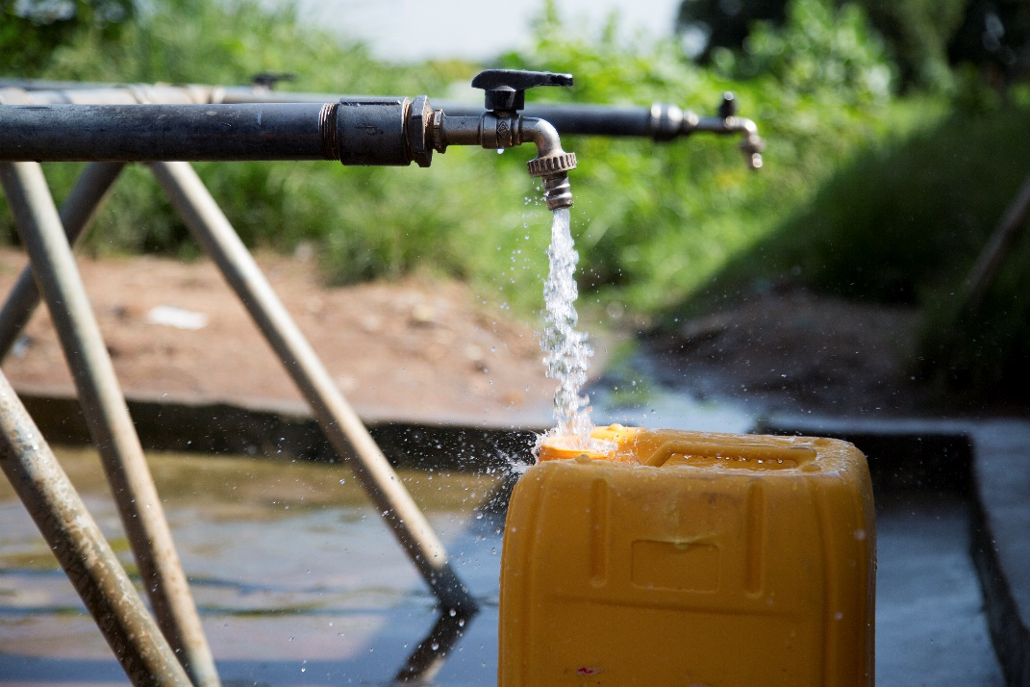
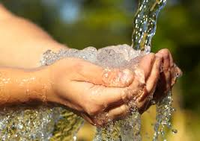
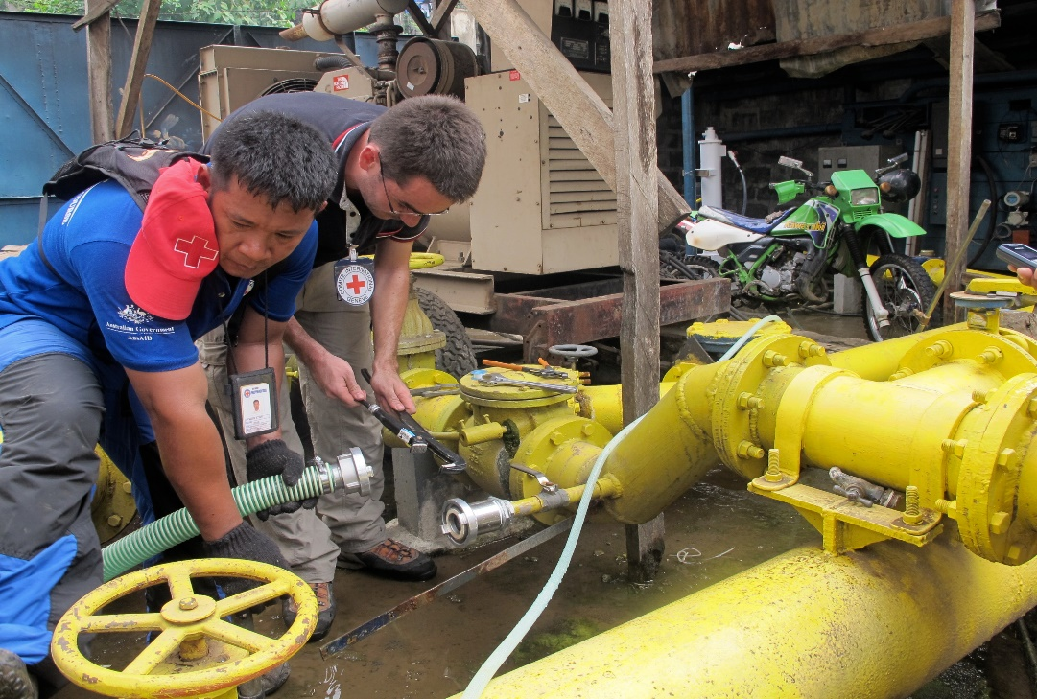
Logo organization(s) facilitator(s)
Water and Health
H.E.L.P. course
Name and organization facilitator(s)
These learning materials have been developed by colleagues of the ICRC Water and Habitat team
Notes:
During this session, we will introduce you to the topic of public health engineering and see how engineers can have a significant impact to reduce the mortality and morbidity encountered in many humanitarian contexts. You will learn about the link between health and Water, Sanitation and Hygiene, so-called WASH activities.
Engineers in humanitarian assistance should have a good understanding on how communicable diseases are transmitted. This is why you will be introduced to different environmental transmission pathways of diseases and you see some measures to be taken to prevent the spread of some diseases.

Slide 2
Objectives
Be able to
explain water quality and quantity requirements
compare different water sources and contamination risk
recommend a water treatment process based on basic quality indicators
analyse the different steps from water source to distribution

Slide 3
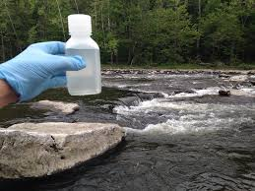
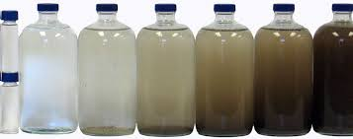
Water Quality Criteria
Microbiological quality is a primary concern in humanitarian settings
→E-Coli /100ml = 0
Some chemicals can also be harmful in long or immediate exposure
→ Nitrate, Arsenic, Fluoride etc.
Organoleptic criteria play an important role in acceptance of water
→ Turbidity ≤ 5NTU
Notes:
Three main criteria are used in WHO guidelines to assess if water is fit for human consumption:
the microbiological quality. It is usually the primary concern in humanitarian contexts, because the presence of some pathogens can cause an acute effect on a large number of people in short term. Therefore, a bad microbial quality represents a high risk of epidemic.
There are thousands of different pathogens, so in order to assess the microbiological quality, we use an indicator of the presence of fecal contamination, the Escherichia coli (E-coli). Iit does not demonstrate the presence of pathogenic organism, although there is a strong suspicion.
Some chemical components occurring in the water supply can also be harmful, they are usually a health concern after a long exposure. The principal exception is nitrate. Chemical contamination can be man-made due to industrial or agricultural activities for instance, but some contaminants can also naturally occurred in the ground. At a global scale, fluoride and arsenic are the most significant chemicals, each affecting perhaps millions of people. However, many other chemicals can be important contaminants of drinking-water under specific local conditions.
Organoleptic criteria are related on how water looked, smell and taste. It is not necessarily because a glass of water is not fully transparent or smell or taste slightly that water is harmful, but organoleptic criteria play an important in the acceptance of the product by the consumer. In a emergency, if people do not trust water quality, they may change to alternative sources which are less safe.
but organoleptic criteria play an important in the acceptance of the product by the consumer. In a emergency, if people do not trust water quality, they may change to alternative sources which are less safe

Slide 4
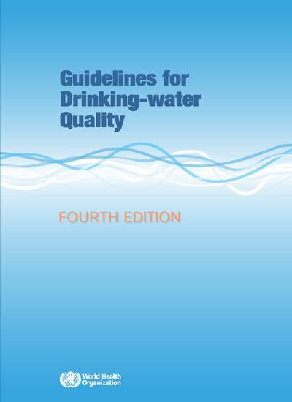
Water Quality Standards
WHO produces international norms on water quality and human health in the form of guidelines that are used as the basis for regulation and standard setting world-wide
https://www.who.int/water_sanitation_health/publications/drinking-water-quality-guidelines-4-including-1st-addendum/en/
Notes:
In any cases, you must ensure that the quality of water supplied complies with national water quality regulations in the country where you are working. In the absences of recognised national standards, you can refer to the values and recommendations contained in WHO Water Quality Guidelines. These guidelines are available for free in the Internet

Slide 5
??
What are the limitations of water quality tests?

Slide 6
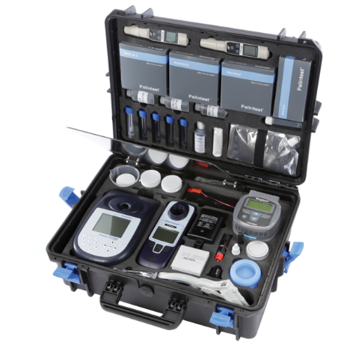
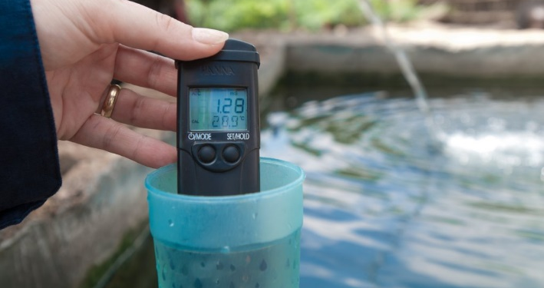
Limitations of Water Quality Analysis
It is just a snapshot
Not all parameters are easy to measure
Reliability of laboratories
→ Complementary investigations required
http://www.who.int/wsportal/wsp/en/
Mobile Water Laboratory
Notes:
However be careful with water analysis:
It is only a snapshot which gives single results at a given time and given location. Some parameters can vary strongly: for instance in some contexts turbidity & fecal pollution occurs more often in rainy season
• Some microbial and chemical parameters can be easily measured in the field with specifically designed portable laboratory and equipment, however not all the parameters can be measured like that. Some analysis require specific equipment in laboratory. Also, laboratories are not always reliable.
This is why Complementary investigations are requiered. Local knowledge, including medical information is very valuable. As well as a Good understanding of water resources, through hydrogeological studies for instance
– Finally, sanitary survey and assessment of rsik of contamination are needed.
For further information, you can refer to WHO Water Safety Plans (WSP) which are quite comprehensive

Slide 7
??
From a public health perspective, what are the main uses of water?

Slide 8
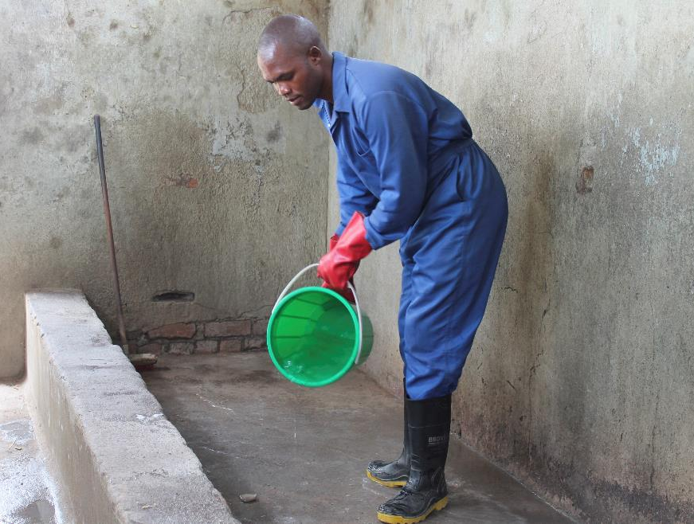
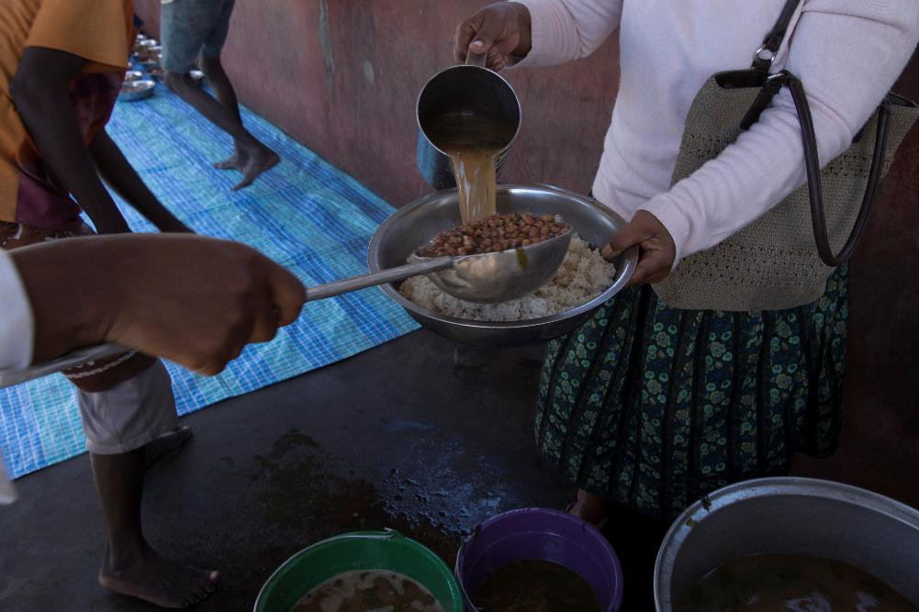
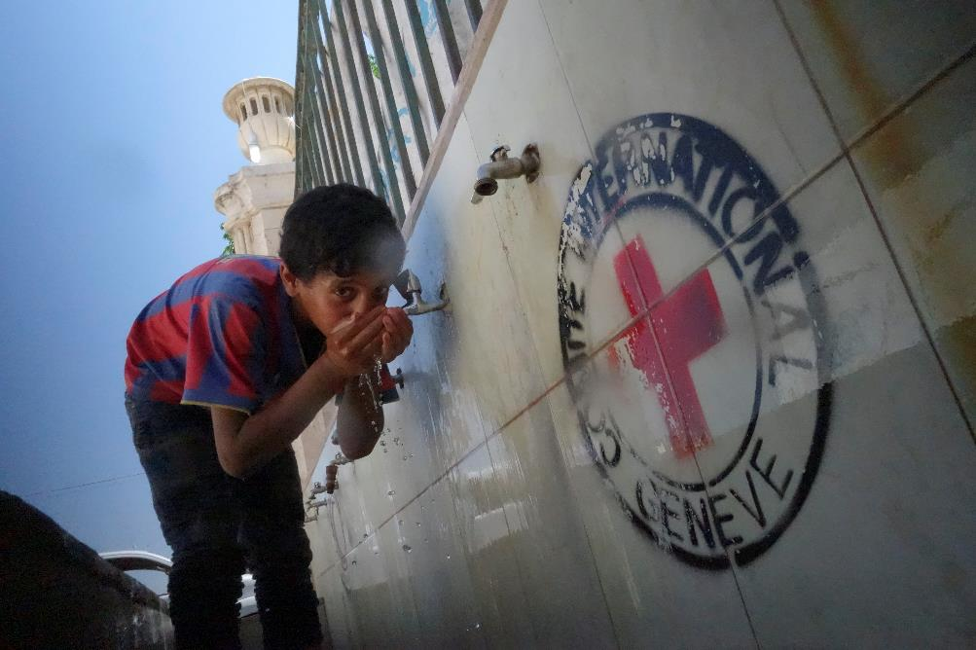
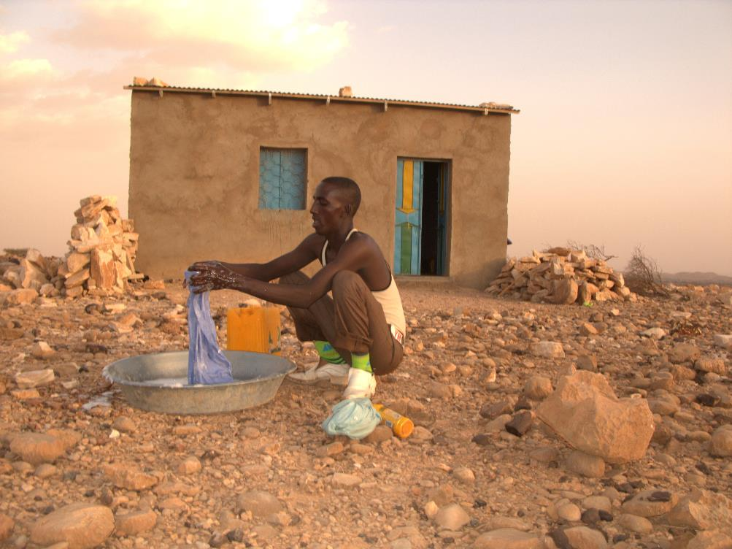
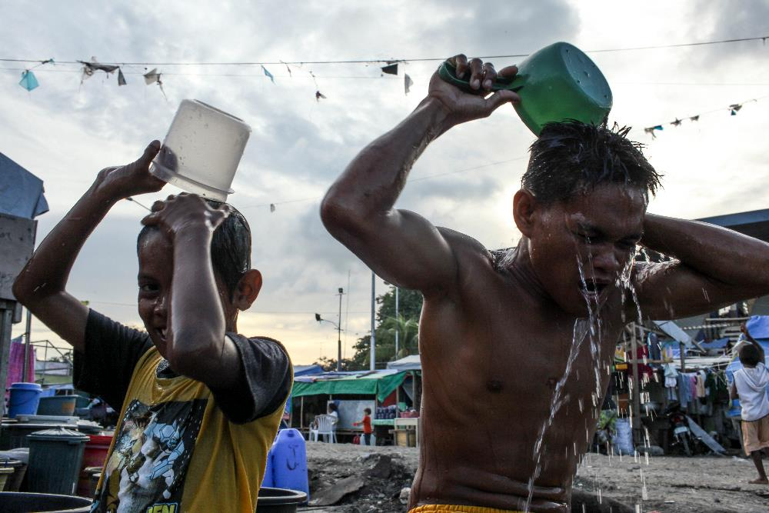
Different uses of water
Cooking
Cleaning
Drinking
Laundry
Showering
Notes:
If we focus on public health aspects, water is needed for:
Drinking
Cooking
Washing clothes
Cleaning building
Waste disposal (sanitation)
Personal washing

Slide 9
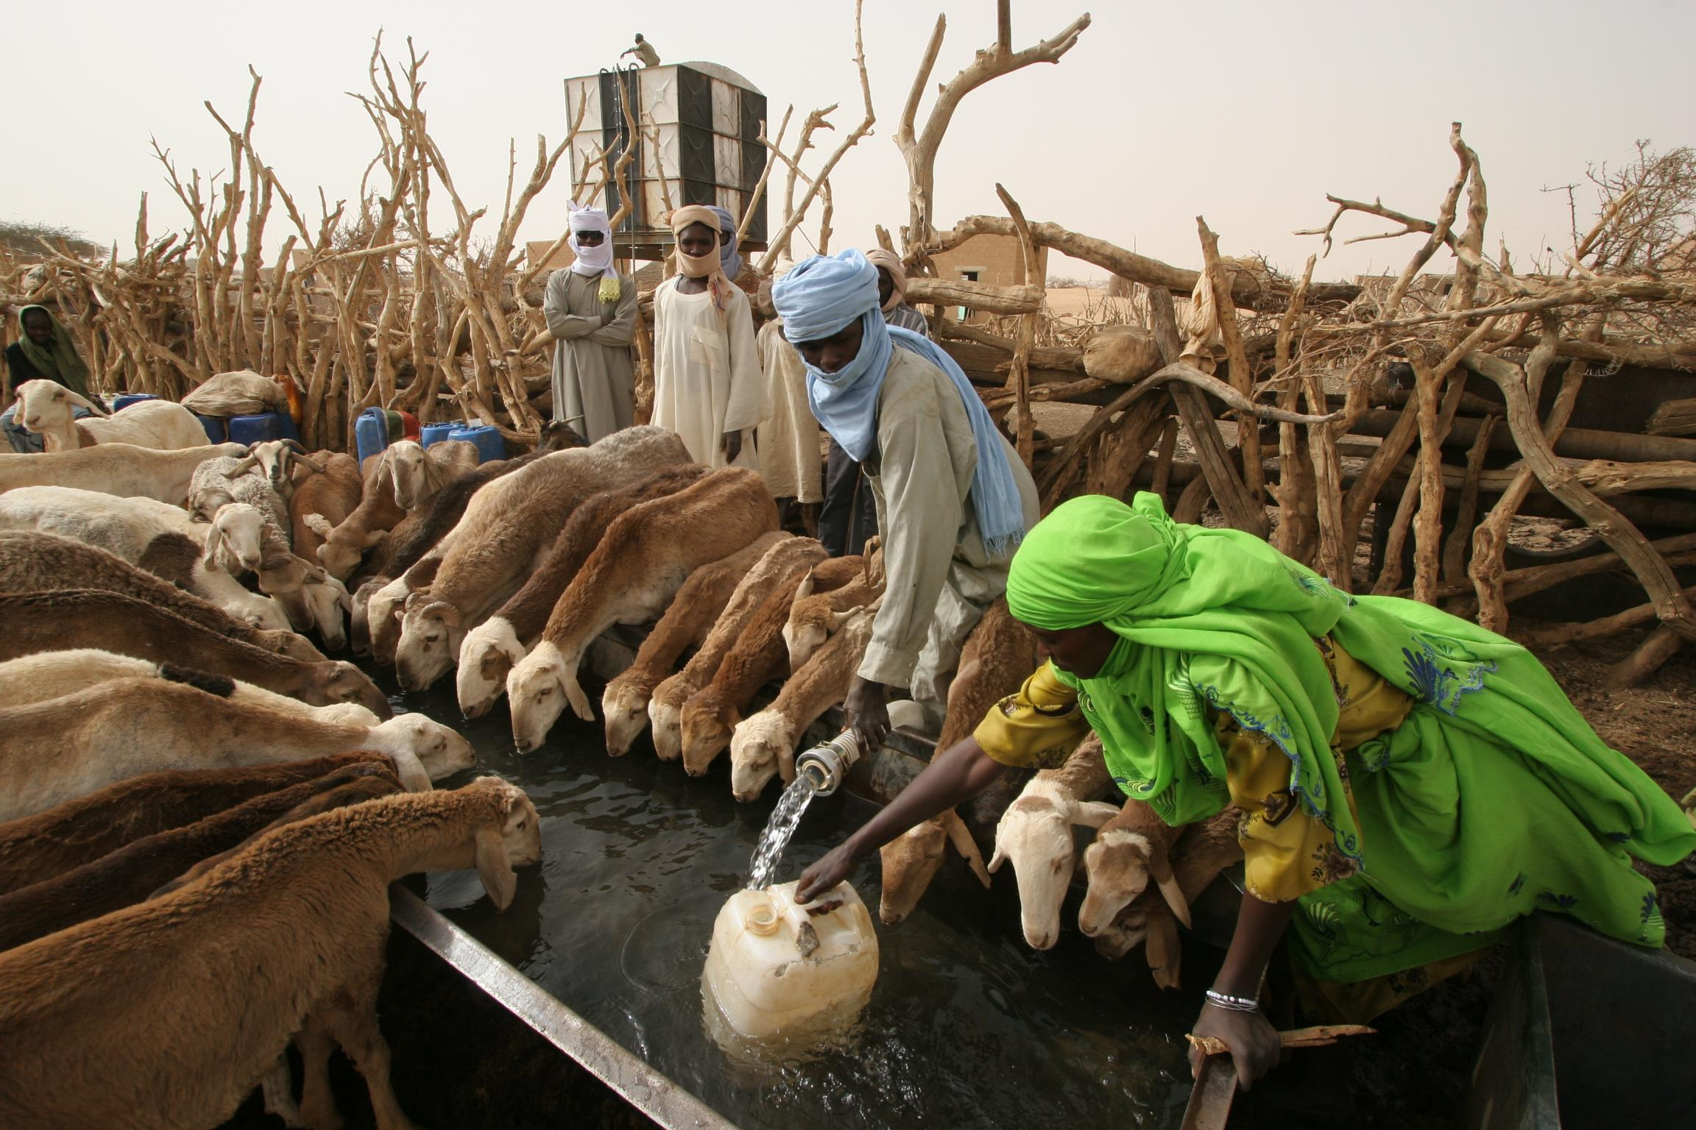
Other uses of water
Notes:
Water is also needed for many other purposes:
Adequate quantity of water can also be crucial to ensure livelihood. Providing water to livestock (as here in Darfur, Sudan) or irrigating plantations allows many people to earn their livelihood and supplies food to the population
Availability of water is also vital for some cultural and religious practices
The list of water uses can be very long and competition for water between these different uses and users exist. It should be taken into account in the assessment of water needs.

Slide 10
??
What are the minimum standards for water quantities?

Slide 11
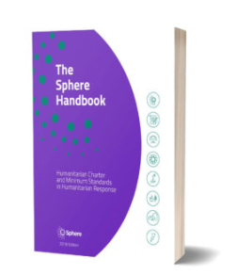
Minimum standards for water quantity
Survival needs: water intake (drinking and food) | 2.5-3 liters/day | Depends on the climate and individual physiology
Basic hygiene practices | 2-6 liters/day | Depends on social and cultural norms
Basic cooking needs | 3-6 liters/day | Depends on food type and social and cultural norms
Sphere standards, 2018
https://handbook.spherestandards.org/en/sphere/#ch006
Notes:
The Sphere movement was started in 1997 by a group of humanitarian professionals aiming to improve the quality of humanitarian work during disaster response.
Initially developed by non-governmental organizations, along with the Red Cross and Red Crescent Movement, the Sphere standards have become a primary reference tool for national and international NGOs, volunteers, UN agencies, governments, donors, the private sector, and many others
*/ According to the Sphere project standards, in humanitarian assistance at least 15 ldp is required for basic survival water needs. It includes:
3 lpd for drinking
6 lpd for basic hygiene practices
6 lpd for cooking
BE CAREFUL! These figures should be considered as a minimum for survival during a very acute emergency and not as a satisfactory situation.

Slide 12
Impact of water quantity on health
Service level | Needs met | Level of health concern
No access ( <5 l/c/d) | Consumption: cannot be assured Hygiene: hardly possible | Very High
Basic access (< 20 l/c/d) | Consumption: should be assured Hygiene: handwashing and basic food hygiene possible; laundry and bathing difficult | High
Intermediate access (about 50 l/c/d) | Consumption: assured Hygiene: handwashing and food hygiene assured; laundry and bathing should be assured | Low
Optimal access (> 100 l/c/d) | Consumption: all needs met Hygiene: all needs should be met | Very low
Notes:
*/ Indeed, priority should be given to quantity while respecting quality in order to tackle water washed diseases that are due to the lack of water for hygiene purposes.
If you look at the figures from the WHO, we see that with 20l/c/d, you should be able to assure drinking, cooking and very basic hygiene needs. However, it would be difficult to ensure laundry and bathing and other hygiene needs. As such, the level of health concern remains high due to the risk of spread of infectious diseases.
In order to lower this risk to less concerning levels, at lest 50 l/c/d would be needed according to WHO

Slide 13
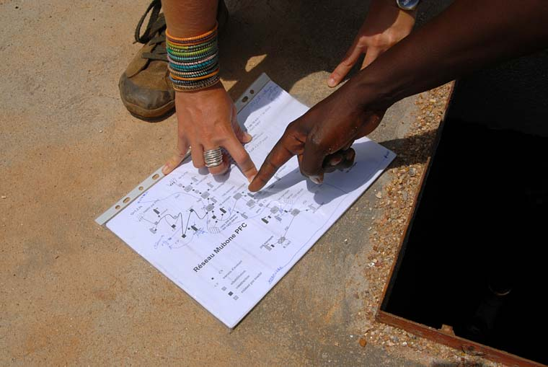
Access to water
Aspects to be considered:
Security
Social/Cultural
Physical
Economical
Time/Distance
Notes:
*/ Providing adequate quantity of water at a water point does not guarantee that people will have access to it.
As part of the assessment of water needs, we have also to look at the various obstacles to this access,
- Is it safe to access to it, can we access freely at any time
Does everyone have access to it? Especially the most vulnerable. Is the water point accessible to everyone. For instance, does a disable person can access to it
Is it affordable the poorest
Finally, time to get to the water point is also very important

Slide 14
??
How to assess time required to get water?

Slide 15
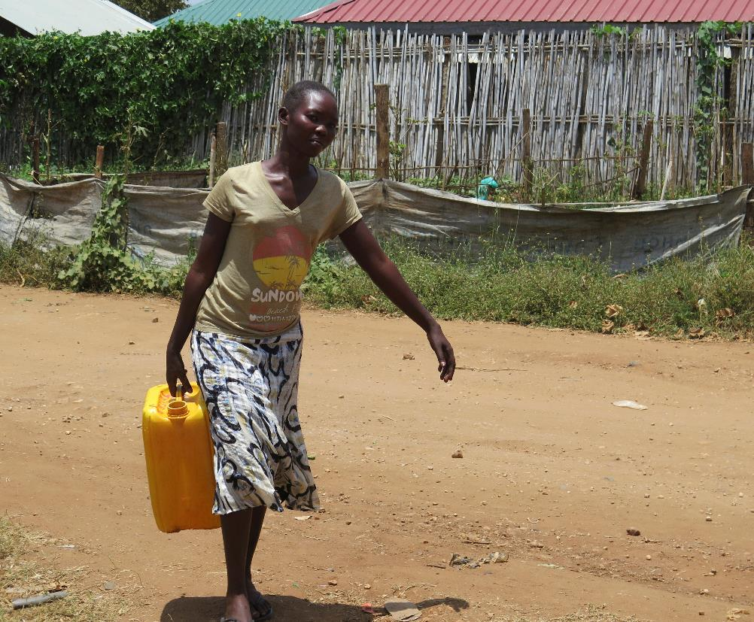
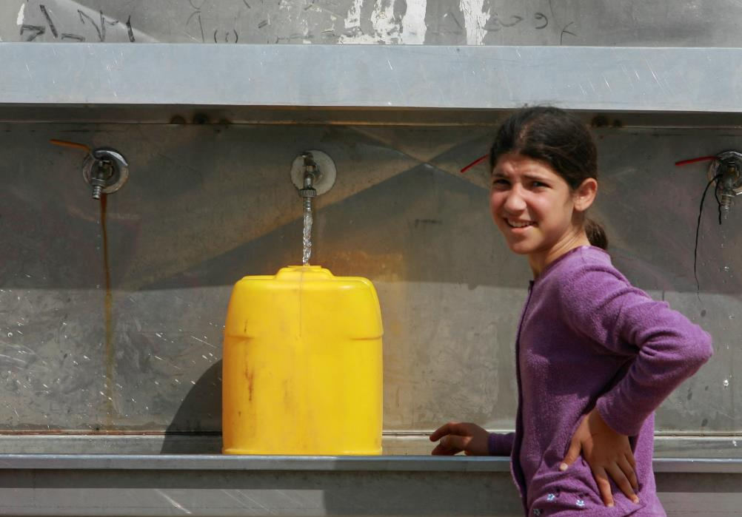
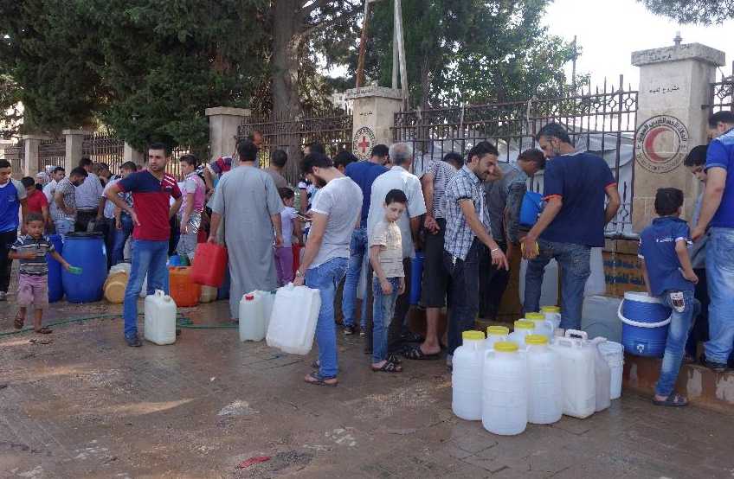
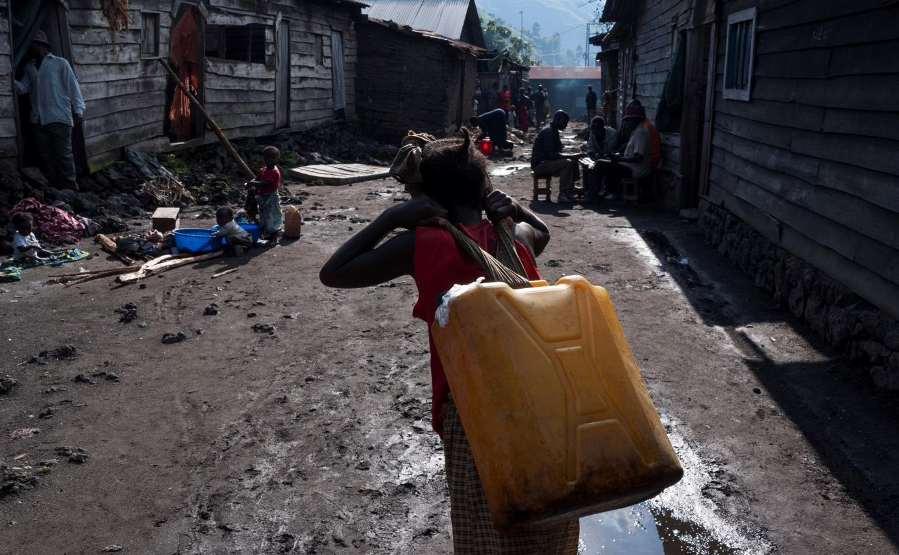
Time to collect water depends on:
Distance
Flowrate
Queing
Container
Notes:
*/ Time to collect water depends on:
Time to get to the water point and back which mainly depends on the distance
Time to wait at the water point which can be very long when there is not enough water points and people have to queue
The size and type of the container. Some are easier to carry than others.
The flow-rate of the water point can make the water collection a lengthy expedition

Slide 16
Time to collect water and Consumption:
Round trip walking distance | Range of consumption (l/c/d)
>1000m | 5 – 10
500-1000m | 10 – 15
Stand post<250m | 20 – 50
Yard tap | 20 – 80
Single house tap | 30 - 60
Multi house taps | 70 -250
Smet and Wijk (WEDC:2002)
Notes:
*/ As shown in this graph, there is a relationship between the distance of the water point and the water consumption. However, the relationship is not linear!
People who have easy access to water at home (e.g. via multiple taps) were shown to consume large quantities of water (usually >100 l/c/d).
If water can be collected from a water point that is less than 100m from home within less than 5min, consumption is still relatively high (e.g. 50l/c/d)
However, if people have to walk 100 to 1000m to the water point or it takes you between 5 to 30 min, the water consumption has show to drop to about 15-20l/c/d. Interestingly, that quantity doesn’t change much within that range of time and distance. This quantity is still not optimal to maintain a good hygiene and has shown to have a negative impact on health.
When people have to walk longer time than 30min (in total) or distances above 500m (one-way), the quantity of water drops below acceptable levels. Personal hygiene is hardly possible anymore which results in a serious risk to health.

Slide 17
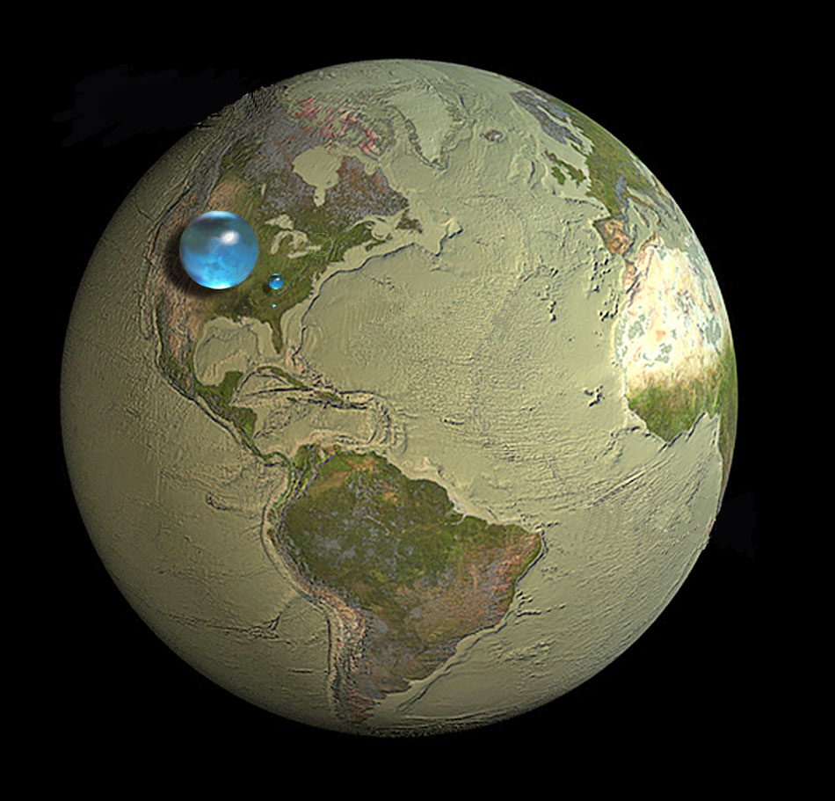
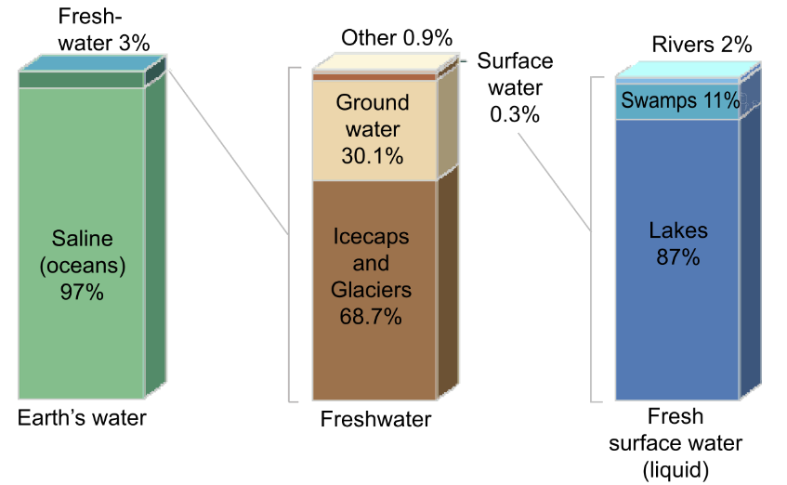
World Water Resources
Notes:
Fresh water is a tiny part of world water (middle sphere), but most of it is not accessible to living things (ice, underground)
Easily accessible water is found in lakes, ponds, rivers : small sphere of 60 km of diameter. Water for 7.5 billion human beings (drinking water, irrigation, animals, industries) + all other living organisms !
Oceans cover 71% of Earth's surface and contain 97.2% of the volume of water of our planet.
97.2% salt water and 2.8% freshwater.
Nearly 70% of that fresh water is frozen in the icecaps of Antarctica and Greenland; most of the remainder is present as soil moisture, or lies in deep underground aquifers as groundwater not accessible to human use.
< 1% of the world's fresh water (~0.007% of all water on earth) is accessible for direct human uses

Slide 18
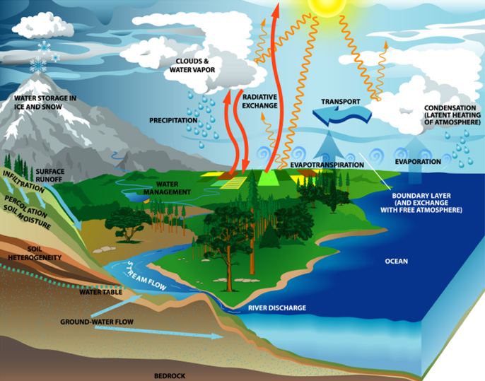
The Water Cycle
The water cycle describes the continuous movement of water
  on
  above
  below
the surface of the Earth
(http://www.usgcrp.gov/usgcrp/images/ocp2003/ocpfy2003-fig5-1.htm)
Notes:
Water also exists in different forms: including mineralized (salt-) water, “sweet” water, snow, ice, vapour etc.
The different forms of water can be “transformed” into others

Slide 19
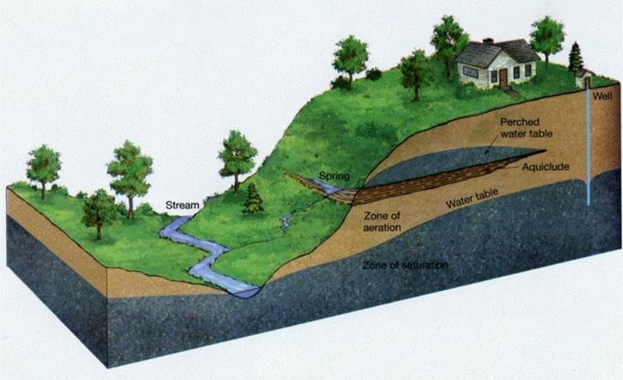
Different Water Sources:
→ Surface Water:
  river, lake, sea
→ Groundwater:
Spring,
Shallow well,
borehole
Rain Water

Slide 20
Group work
What are the pros and cons of different water sources
(i.e. rainwater, surface water, salt water, natural spring,
shallow well and borehole)
Time allocated 10 minutes
Notes:
Rainwater: often cheap solution, as little infrastructure needed. However treatment of water is needed. Depends on rain availability, quantity and pattern (seasonal)
surface water (lake, rivers): needs always treatment. Requires pumping, stockage and distribution.
salt water: requires desalination of water which is very power consuming and costly. Rarely a viable option.
natural spring: good option if available. Requires initial investment into spring catchment, pipeline and storage, but has low running costs (no pumps or electricity needed thanks to gravity flow).
Open shallow well: relatively cheap and simple, but water is usually contaminated and thus not really safe for consumption. Household treatment needed.
Borehole: requires pumping but is usually safe for consumptions (no treatment unless for large populations). High initial investment i.e. if deep borehole.

Slide 21
Criteria for selecting a water source
Water quantity
      Immediate capacity
      Reliability over time
Water quality
      present water quality
      risk of contamination
Technical & financial feasibility
      Requirements to develop and install a technological solution
      Requirements to operate and maintain it
Accessibility and Acceptance
      physical access and security
      social and cultural
Notes:
How do we select a water source? First check which sources are available at all. Then, for each available source, we consider four major criteria:
Water quantity – what is the yield of the water source and how does it relate to the demand? Is the source intermittent or strongly affected by seasonality? The minimum yield of the water source should still be greater than the demand. If this is not the case, combination of several sources cover demand should be considered. Sufficient storage capacity might help to improve reliability of supply.
Water Quality: is the water likely to be contaminated? What type of contamination (biological, chemical, physical)? Some parameters, i.e. turbidity, taste, color can be easily tested on site. Chemical and biological require a laboratory. The treatment of water requires both initial and running costs, especially if there is a specific chemical contaminant (e.g. iron). Therefore sources that don’t require treatment, like springs and deep boreholes are often an interesting option.
Technical and financial feasibility: Some sources might be available but are not viable for practical or financial reasons. E.g. distance of spring is far and would require a huge initial investment. The same is the case if the ground-water is very deep and a borehole would be costly to drill and operate. Sometimes the lack of grid-electricity or lack of competence can also render a project unrealistic.
The Accessibility and Acceptance: If for example a borehole is in an insecure area, it will be difficult to operate and maintain it.

Slide 22
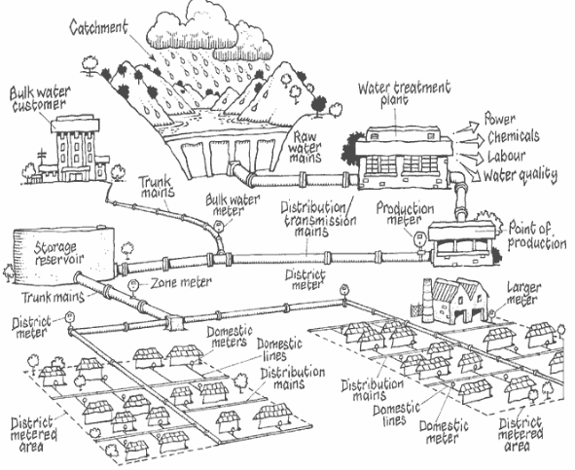
Water Supply Systems (WSS):
References: Queensland Environmental Protection Agency and Wide Bay Water Corporation (2004): Managing and Reducing Losses from Water Distribution

Slide 23
Group work
How to provide these different settlements with water?
What would be possible solutions?
Time allocated 10 minutes

Slide 24
Spring
in the mountains
River
Aquifer
Aquifer
Notes:
A village in the mountains
A city and a village in the plains
A village next to the river
The plain has a deep aquifer while in proximity to the river there is a shallow alluvial aquifer

Slide 25
Spring catchment, tank & pipeline
Tank
Tank
WTP
Hand-dug well /rain-water collection, Household storage & treatment
Well,
Handpump &
Jerry cans
River
Aquifer
Aquifer
Aquifer
Notes:
What could be possible water supply system providing these four settlements? (discussing possibilities, just for the exercise!)
Lets see – there is a pure spring in the mountains. We protect the spring, and deliver water by gravity to the village nearby (distance reasonable, so limited costs).
We build an intake on the river down in the valley, pump water up to the drinking water treatment plant (WTP). Treated water is pumped further and stored at the tank, from where it is further distributed to the town through a distribution system.
In the village further down the valley, people collect water at the protected well with a handpump. They carry water in jerry cans home.
A local NGO has distributed the household filters to treat water at home in this village next to the river. Few households also collect rainwater from their roofs and store it in rainwater tanks.
All these different types of water supply systems have different scale. However, they have all the same steps:
Water source – spring, well, surface or groundwater,
water intake structure – be it either a protected river intake, spring catchment, dugwell or rainwater gutter
abstraction technology – such as hand pump or motorized pump
water treatment – if it is required
water transport – either through a network or with jerry cans
and water storage (rainwater tanks) or treatment (HWTS) at the user level.
Most water supply systems can be structured along these 6 functional groups.

Slide 26
Source
Intake
Abstraction
Treatment
Distribution & transport
User safety
Roof collection
Clarification
Filtration methods
Coagulation/ sedimentation
Jerry cans
Storage
Safe storage
< 1000 L
> 1000L
Rain water
Gravity
Rain catchment
Vendors
Spring
Manual pumps
Household treatment
Ceramic
Membranes
Chlorination
Boiling
Biosand
UV
Sodis
Subsurface storage dam
Disinfection
Chlorination
UV
Ozone
Slow sand filter
Ultrafiltration
Pasterization
Kiosks
Groundwater
Protected spring intake
Motorized pumps
Distribution networks
Surface water
Protected dugwell
Chemicals
F & As
Storage tanks
Brackish & sea water
Borehole
GAC
NF/RO
Chemicals
F filters
As filters
River intake
Sea
RO
MD
Sea intake
Notes:
The technologies from each functional group perform specific tasks of the water supply system and can be linked between each other to show possible combinations. It is not always necessary that water passes through all functional groups to reach the consumer. In some systems treatment is excluded due to high quality of source water, or water is supplied by gravity and no pumping is needed. However, water always moves from left to right through the functional groups or from top down within the group.

Slide 27
Source
Intake
Abstraction
Treatment
Distribution & transport
User safety
Clarification
Filtration methods
Coagulation/ sedimentation
Roof collection
Clarification
Filtration methods
Coagulation/ sedimentation
Jerry cans
Storage
Safe storage
< 1000 L
> 1000L
Rain water
Gravity
Rain catchment
Vendors
Spring
Manual pumps
Household treatment
Ceramic
Membranes
Chlorination
Boiling
Biosand
UV
Sodis
Subsurface storage dam
Disinfection
Chlorination
UV
Ozone
Slow sand filtr
Ultrafiltration
Pasterization
Kiosks
Groundwater
Protected spring intake
Motorized pumps
Distribution networks
Surface water
Protected dugwell
Chemicals
F & As
Storage tanks
Brackish & sea water
Borehole
GAC
NF/RO
Chemicals
F filters
As filters
River intake
Sea
RO
MD
Sea intake
Notes:
Here you see an example for a centralized or a semi-centralized system supplying and treating surface water. Surface water is collected at a protected or unprotected river or lake intake, is delivered with means of gravity or motorized pumping to the tretament plant. There it is clarified and disinfected and either is being sold at a water kiosk or fed into the distribution network. Safe water storage at home might be needed to cover for interruptions.

Slide 28
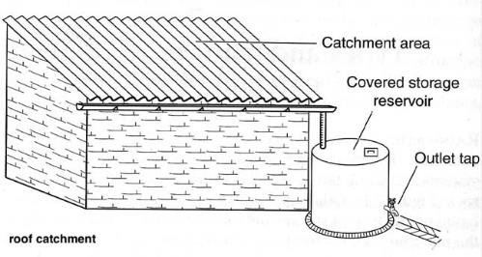
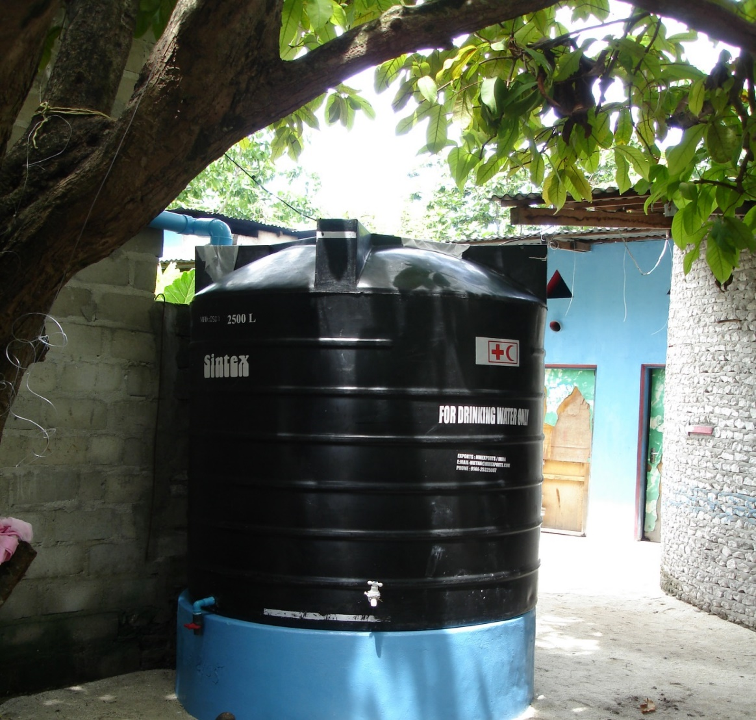
Rain Water Collection
Mainly used household level
Not for large scale water supply
Normally requires complementary source
Characteristics:
Good quality (depends on storage)
Adequate installation
Limit to available quantity
Depend on climate conditions
High user maintenance

Slide 29
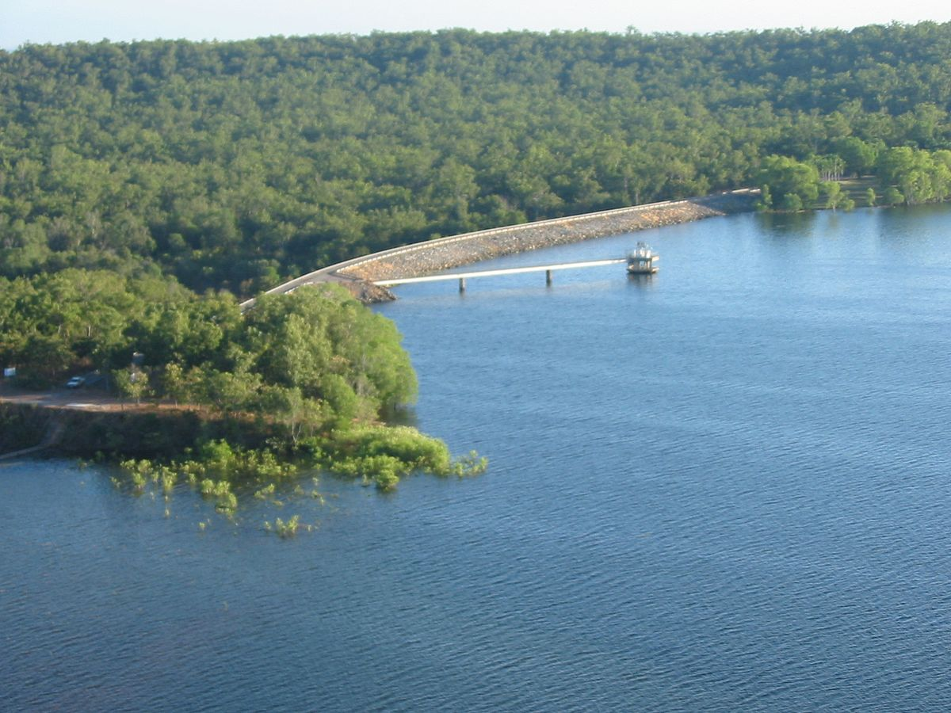
Surface Water
Rivers, stream
Lakes, lagoons, dams
Characteristics:
Always requires treatment
Usually large volumes available
Notes:
Surface water is often a good option, as usually large quantities can be extracted. However, the water requires treatment and pumping, which comes with running costs.
Sea water (mineralized/salty) is also a surface water but is rarely a reasonable option as a source of water. Desalination is too costly and only used if there is no alternative.

Slide 30
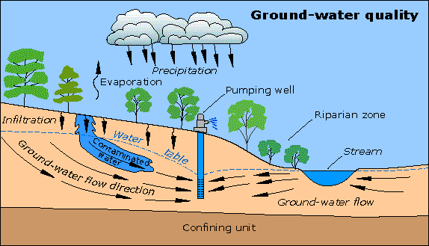
Ground Water
Ground water:
Spring catchments
Shallow well: Hand-dug-well
Deep well: Boreholes
Characteristics:
Excellent quality (usually)
Extraction can imply high costs
Can be contaminated (e.g. by nearby latrine)
Risk of salt water intrusion if nearby coast
Notes:
If there is no contamination, ground water does not require treatment, which reduces costs. The deeper the borehole or well the more costly the investment and running costs.
It important to test the groundwater for contamination, which can come from many sources, as for example from nearby latrines or septic tanks but also from leaking well apron. Saltwater intrusion is a common phenomenon in proximity to sea-costs. Open hand-dug-wells have to be considered contaminated and unsafe.

Slide 31
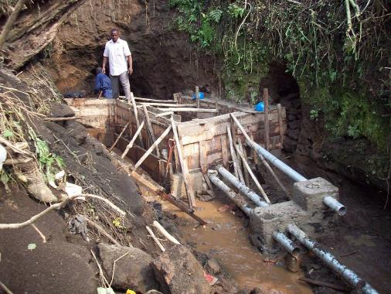
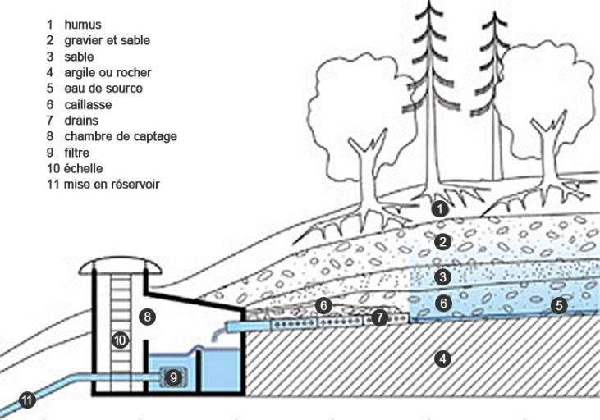
Spring Catchment
Characteristics:
Excellent quality (usually). Only initial investment, low running costs
Notes:
Using natural spring water is a good option if available.
It requires an initial investment for the spring catchment (to prevent contamination
of intake), pipeline and storage, but then has low running costs
(no pumps or electricity needed thanks to gravity flow). Usually, no treatment is required.

Slide 32
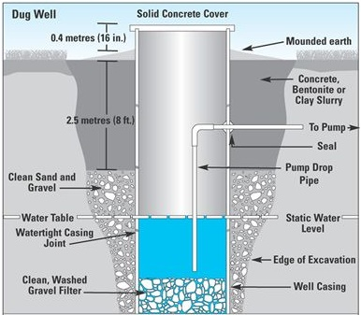
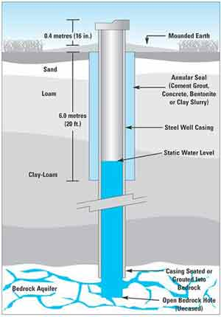
Wells
Dug-well
Borehole
Notes:
The two methods to extract water from an underground aquifer is by digging a well or by drilling a borehole. Dug-wells are usually limited to max. 40-50m depth, while boreholes can reach much deeper (hundreds of meters). However, the deeper the borehole the costlier.

Slide 33
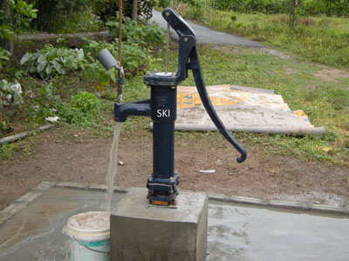
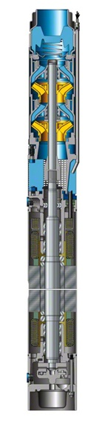
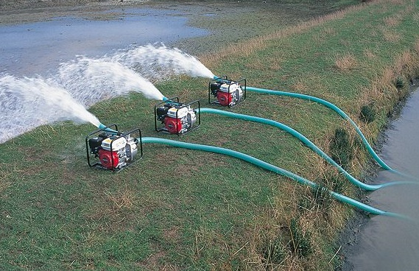
Pumping
Hand Pump
  Depth of water (usually max. 50m)
  Low productivity: Number of beneficiaries max. 250 persons (Spheres)
  Simple to use and repair but still needs maintenance & supervision
Motorized Pump
  High productivity possible
  Fuel/energy need means higher operation costs and dependency on supplies
  Maintenance requires more skills
  Availability of spare parts?

Slide 34
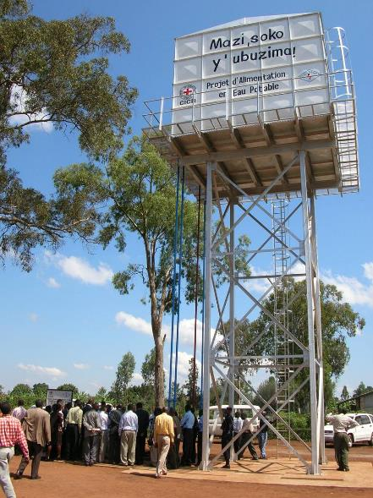
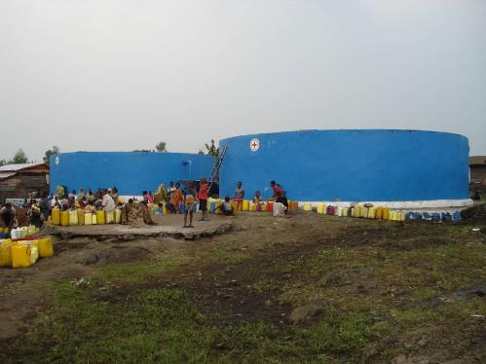
Water Storage
Ground Storage Water Tanks
Elevated Water Tank

Slide 35
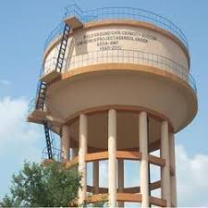
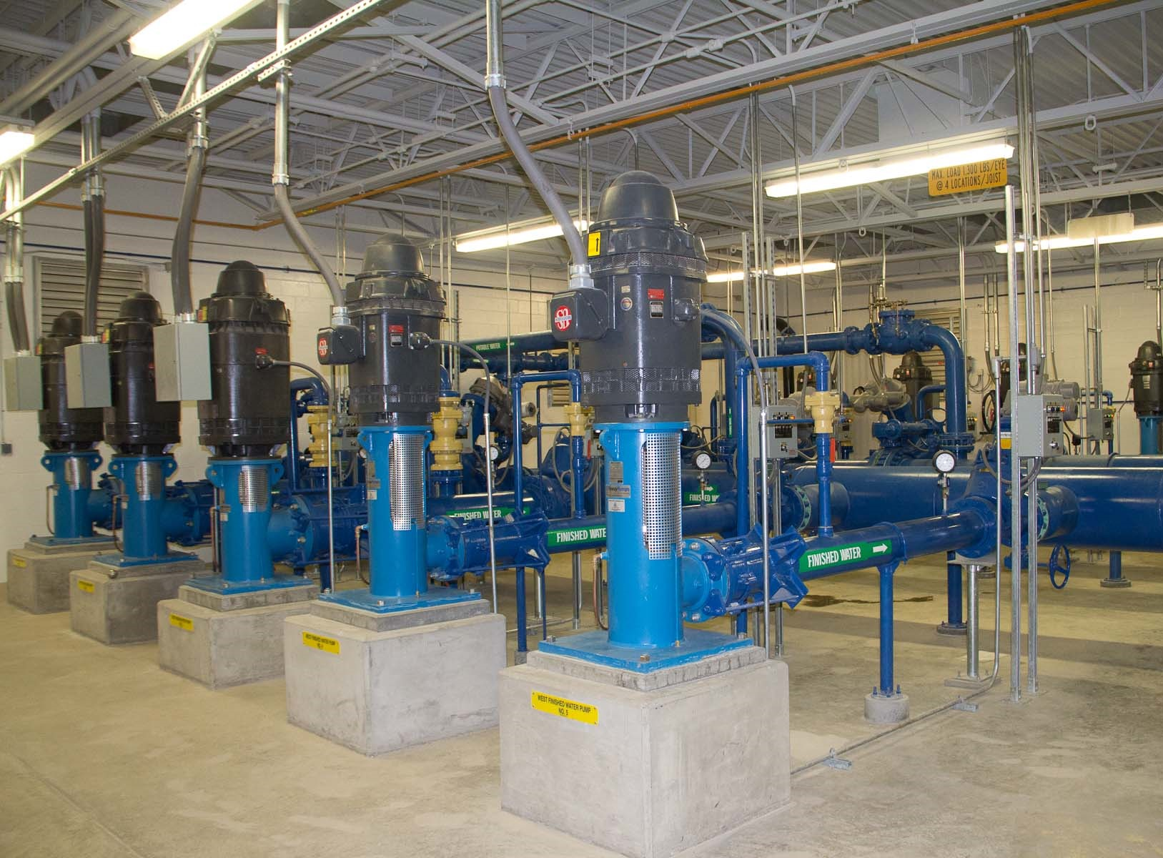
Water Distribution
By gravity
By booster pumps

Slide 36
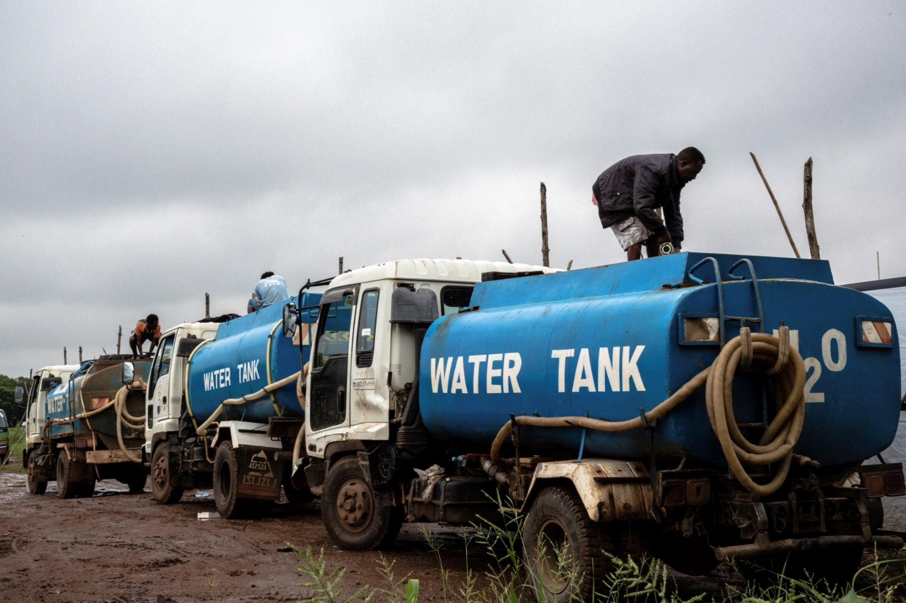
Water Trucking
High costs
High organizational effort
Choose appropriate means of transport
Risk of recontamination
  → Shock chlorinate tanks and chlorinate water
Use trucks only to transport water – not to distribute it!
→ Avoid water trucking if possible !
Notes:
Water tankering is still used in remote rural settings without access to adequate water sources, urban and peri-urban areas wihout distribution networks or as an emergency water supply when other adequate water sources are not available. In all cases – it is expensive, not easy to organize and should be avoided whenever possible. If water is not chlorinated, water quality is likely to deteriorate during transport. And tankering of water from contamined water sources can support spreading of deseases in large areas within a very short time. Thus chlorination of tankered water as well as shock chlorination of the tankers, especially in times of disease outbreaks is highly recommended. Since the tank volume and the type of water source are known and the water is well mixed during transport, chlorination of tankered water is rather easy.

Slide 37
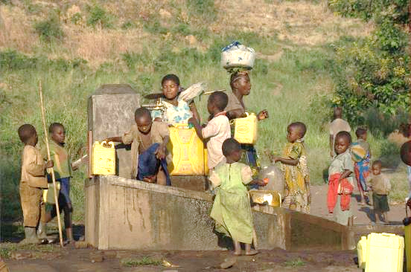
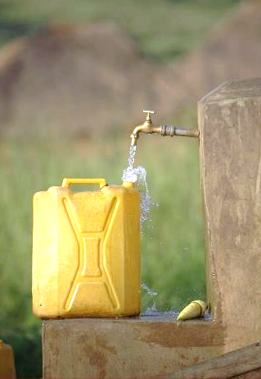
Distribution points and storage at household level
Notes:
Transport of water in jerry cans is a reality for many rural and urban families. Depending on the location of the water source, it requires often a lot of time which can be used for other activities. In areas where water sources are located at longer distances, other water distribution options should be considered first. Transport of jerry cans filled with safe water to home by water kiosk providers can be costly but in general adequate option in case water and jerry cans are disinfected and safely sealed. Usually this is not the case and deterioration of water quality can be expected during transport and use. Chlorination of jerry cans at the point of water collection can be an option to improve the situation.

Slide 38
??
What are the typical stages of water treatment?

Slide 39
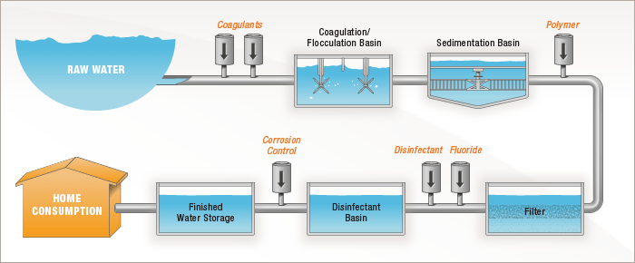
Main Stages of Water Treatment
Pre-treat
clarification
disinfection
filtration
Notes:
Pre-tretament: e.g. Screen, gritting, greases traps, ventillation (to remove iron)
Clarification: The purpose of clarification is to remove as much as possible
particulate material. The conventional treatment sytsems usually apply
coagulation/flucclation combined with sedimentation or filtration.
Filtration: Rapid sand filtration without coagulation is used as well on large
centrazied drinking water tretament plants or community supplies.
In community supplies, roughing filtration has been used successfully as
efficient and low maintenance pre-treatment.
Disinfection: Usually via chlorine or ozon

Slide 40
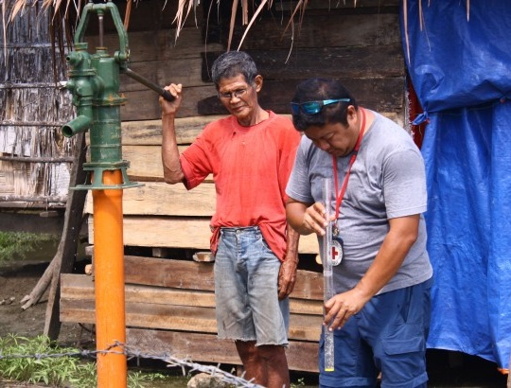
Water Turbidity
Turbidity characterizes a cloudy condition in water caused by particles in suspension (organic residences, clays, microscopic organisms etc.)
Sphere recommends turbidity below 5 NTU (Nephelometric Turbidity Unit) to enable effective chlorination.
To reduce turbidity in water, clarification by coagulation or flocculation is needed.

Slide 41
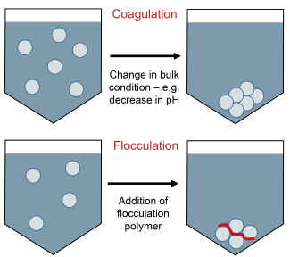
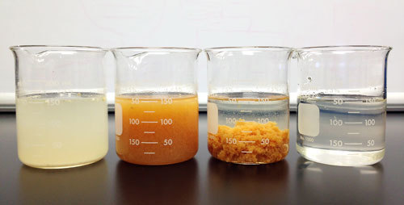
Clarification Stage
Coagulation:
The coagulant most commonly used is aluminum sulphate powder, which though not a very strong coagulant, does have the advantage that it can be air freighted easily and is quite commonly available in different parts of the world.
Flocculation:
Addition of Polymers can be efficient. However, it does have quite a narrow pH range, operating best between pH 6.5 and 7.5. Outside these limits its efficiency drops and the applied quantity has to be increased to compensate.

Slide 42
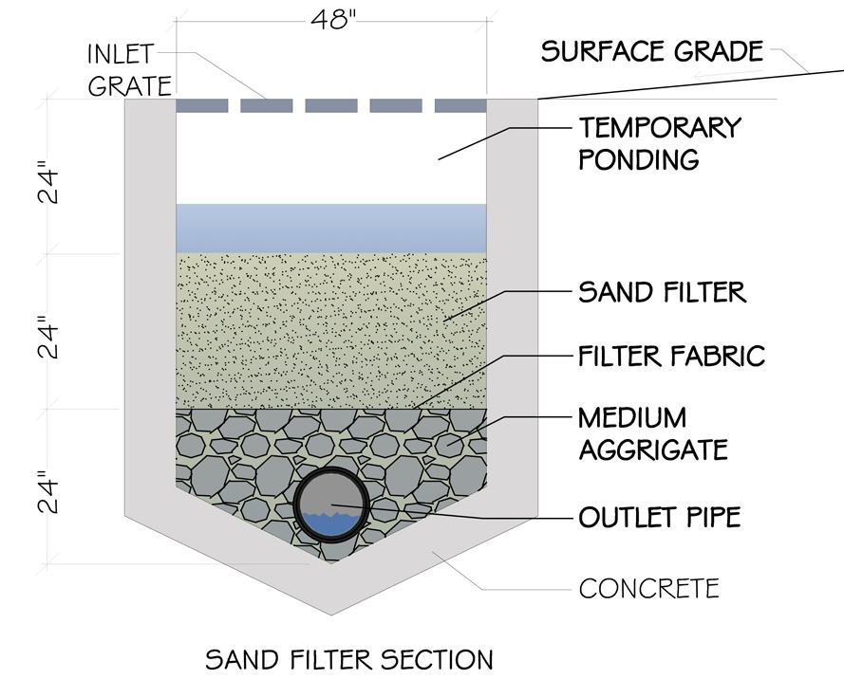
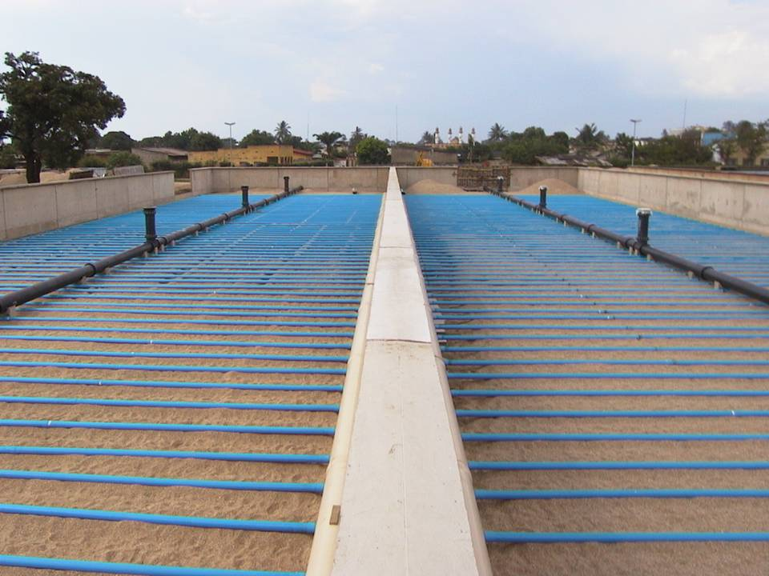
Filtration Stage
The process of filtration involves the flow of water through a granular bed, of sand or another suitable media, at a low speed. The media retains most solid matter while permitting the water to pass.

Slide 43
Filtration Stage
Microns (μm)
(log scale)
0.001
0.01
0.1
1.0
10
100
1000
Visualisation
Techniques
Scanning
Electron
Microscope
Light
Microscope
Visible to
Naked Eye
Size of entities
Hemo-
globin
Bacterias
Salts
Pseudomonas
diminuta
Polio virus
Pollens
Viruses
E.Coli
Red
blood
cells
Anti
biotics
Human
hair
Human plasma
Separation Process
Nanofiltration
Microfiltration
Reverse osmosis
Ultrafiltration
Sand filter

Slide 44
??
What are the different methods of Water Disinfection?

Slide 45
Methods of Water Disinfection
Boiling
Chemical Disinfection (i.e. chlorine, ozone)
UV-radiation (via sun or lamp)
Ultra- or Micro-Filtration (Ceramic filters)
In emergencies, chlorine is often the most practical option
Notes:
Boiling: A simple and effective method, but it’s very expensive and not efficient for large quantities. Used mainly at household level
Chemical Disinfection (i.e. chlorine, ozone): Relatively cheap and effective method, also for large quantities.
UV-radiation (via sun or lamp): possible method but needs good management. Often used in combination with other methods.
Micro-filtration (Ceramic filters): Also a simple method but relatiely slow. Filters have to be cleaned. Used mainly at household level. [Formally, filtration is not considered a disinfection, as it only removes, but doesn’t kill off the pathogens. It is still listed here as an alternative]
→ Chlorine is easy to use, generally available, cheap and quite effective. (pros and cons of chlorine are discussed in the following)

Slide 46
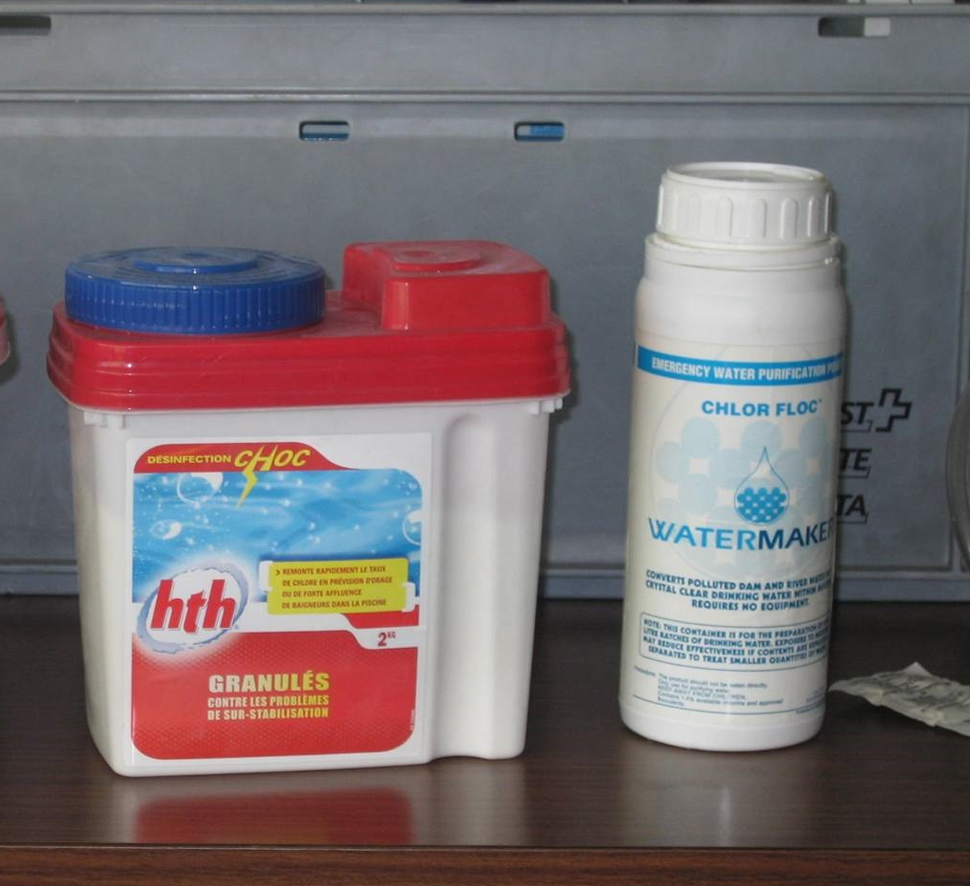
Different Forms of Chlorine
 | Chlorine Content | Form of product
Cl gas | 99% | Liquid gas or pressurized
Ca(ClO)2 (=HTH) | 60 à 70 | White Powder, Granules or Tablets
NaClO (bleach) | 15% max | Liquid solution
Notes:
Chlorine gas is only used for large scale water treatment as it requires complex
and expensive equipment.
Calcium hypochlorite (HTH) powder is the most commonly used type for bulk water
disinfection. High concentrated but still easy to use.
Sodium hypochlorite is often used for pools or for water disinfection at household level.
Widely available and less dangerous than HTH. But less concentrated, thus more quantity
needed.

Slide 47
Chlorine as Disinfectant
Advantages:
usually readily available and relatively cheap
it dissolves easily
residual chlorine remaining in treated water provides some protection against further contamination
it is effective against a wide range of pathogens (incl. bacteria and viruses)
can be produced locally
Disadvantages:
it is a powerful oxidizing agent which must be handled carefully – do not breathe Cl2 fumes
it does not effectively penetrate particulate matter
it can give an unpleasant taste when slightly overdosed, which could dissuade people from drinking safe water
its effectiveness against some pathogens –cysts, ova, viruses- requires higher chlorine concentrations and a longer contact time

Slide 48


Pool tester
Chlorine Disinfection
When chlorine is added to a water source, it purifies the water by reacting with organic matter, including bacteria and viruses. The amount of chlorine needed to do this is called the chlorine demand of the water.
Once the demand has been satisfied, any excess chlorine, above the level needed to satisfy the demand, remains as chlorine residual in the water.
The chlorine residual of a solution can easily be measured with a pool-tester kit
The amount of chlorine to be added to treat water is determined by measuring the chlorine residual of a sample series with different chlorine doses
The recommended residual chlorine level 30min. after treatment is 0.2-0.5 mg/l
Notes:
The jar-test is a series of test on

Slide 49




Emergency Water Treatment
Notes:
In Emergencies, we often use coagulation/flocculation combined with
sedimentation or filtration. Then the water is disinfected with chlorine.
Mobile equipment is often the most practical solution, as for example:
Mobile water treatment system (LMS), mounted on a trailer. Available
in 4-10 m3/h.
Flexible onion tanks (e.g. for coagulation and sedimentation) and flexible
bladder tanks or Oxfam tanks for storage.
Mobile water test kit for water analysis and to adjust the water
treatment methods.

Slide 50
Wrap-up: Water and Health
Water can be contaminated by biological, chemical or physical agents. If no national water quality standards apply, the WHO standards can be used as a reference.
Minimum water quantity should not drop below 15 l/p/d, even in emergencies. The time spent for water collection should not exceed 30min.
Water can be collected from different sources, including rain-, surface- and ground water. To select the most appropriate source factors like quality, quantity, technical feasibility, costs, accessibility and acceptance have to be considered.
Chlorination is the most appropriate disinfection method in emergencies. If turbidity is above 5NTU, the water should be clarified by coagulation or flocculation before chlorination.

