Slide 1
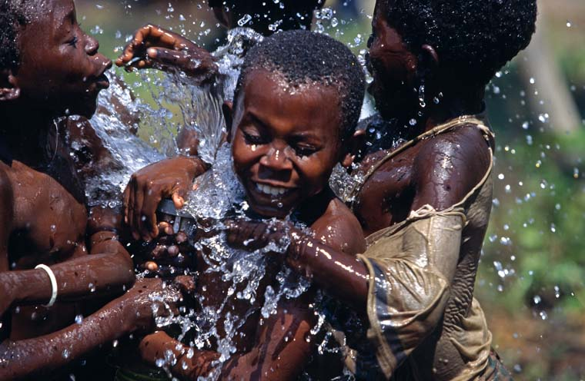
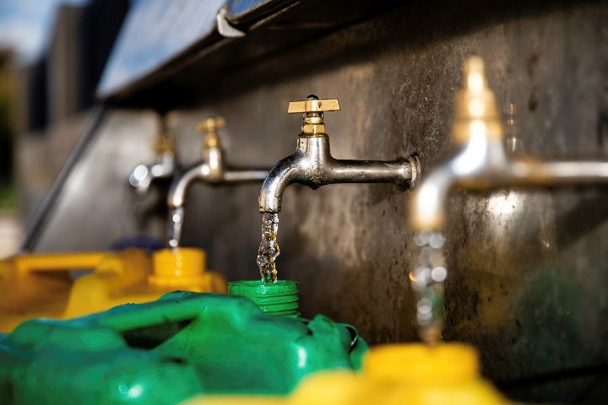
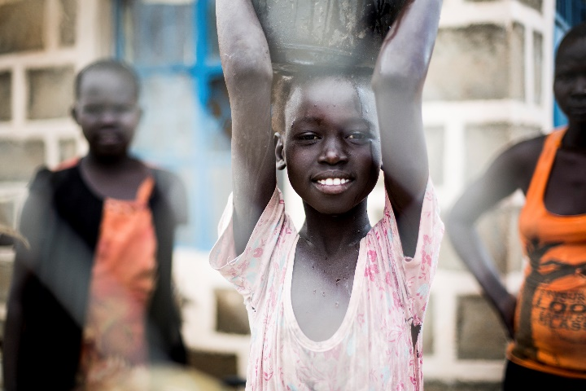
Logo organization(s) facilitator(s)
Public Health Engineering
These learning materials have been developed by colleagues of the ICRC Water and Habitat team
Name(s) and organization facilitator(s)
Notes:
During this session, we will introduce you to the topic of public health engineering and see how engineers can have a significant impact to reduce the mortality and morbidity encountered in many humanitarian contexts. You will learn about the link between Public Health and Water, Sanitation and Hygiene, so-called WASH activities.
Engineers in humanitarian assistance should have a good understanding on how communicable diseases are transmitted. This is why you will be introduced to different environmental transmission pathways of diseases and you see some measures to be taken to prevent the spread of some diseases.

Slide 2
Objectives
Be able to
describe the interaction between population, environment and health
illustrate public health engineering related activities within the wider health system
describe the levels of intervention in the field of water and habitat to tackle communicable diseases

Slide 3
Health pyramid
Curative health care
Preventive health care
Nutrition and Food Security
Water, Sanitation,
Hygiene, Environment
Security
H.E.L.P. course
Notes:
At the foundation of the pyramid there are two key building blocks: nutrition and public health engineering which usually in humanitarian contexts aim to provide an adequate drinking water supply, a proper excreta management, run off and waste water disposal, collection and disposal of refuse and medical waster and effective vector control interventions.
The idea behind the pyramid of health is that it makes no sense to manage health issues of vulnerable people only from the top– with “medical curative care” – if their immediate environment is the cause of their unhealthy state. Tackling the root of the problem, particularly for communicable disease, rather than only treating patients is more effective to reach out a large of population.
This approach was implemented in the eighties and well documented researches have shown that the provision of adequate food, clean water, sanitation and shelter activities were more effective than most medical programmes to tackle diarrhea and vector-borne diseases,
This is why this model advocates for public health engineering and nutrition activities to be done in close collaboration with medical activities in order to achieve a public health objective

Slide 4
Interaction between Population and Environment
Population
Environment
Notes:
In order to understand the role of the public health engineer, we have to look at the interaction between a population and its environment which can be schematized as a diagram showing,
*/ on one side, waste that a population discharges into the environment
*/and on the one side, the elements originating in the environment which are necessary to maintain a population’s life and health

Slide 5
What are the waste that a population discharges into the environment? What are the elements originating in the environment which are necessary to maintain a population’s life and health?
??

Slide 6
Interaction between Population and Environment
Human waste
Garbage
Liquid waste
Population
Environment
Water
Energy
Food
Materials / Housing
Vectors
Notes:
*/ waste that a population discharges into the environment (in the form of human excreta, garbage, and liquid waste).
*/ the elements originating in the environment which are necessary to maintain a population’s life and health (water, food, energy, raw materials for work, materials for building shelter) and also vector of diseases (such as rats or mosquitoes)

Slide 7
How do the interactions of populations with their environment change in the situation of crisis and displacement? What are the consequences in regards to public health?
??

Slide 8
Vicious Circle
Production of
human waste
Population
Environment
Vicious circle
Pathogens
Notes:
During many situations of displacement:
Populations away from their familiar habitat have difficulties to maintain their hygiene practices
Overcrowding increases the risk of disease transmission
The stress on public services is increased and can result in shortages or break-down of services (water systems, health centers, latrines, waste-water systems etc)
Waste products (e.g. faeces or solid waste) are no longer disposed off properly resulting in a contamination of the environment
Displaced populations don’t have the means to keep their environment clean and are exposed to pathogens
Malnutrition and inappropriate housing increases the vulnerability of displaced populations
Between these two poles a vicious circle may be created. Infectious diseases can be transmitted by direct contact within the population,
but also through the environment.
For example, if human waste are disposed inadequately in the environment, it can lead to a proliferation of pathogens contains in the faeces in the water for instance.
As a result, it might lead to an increase of incidence of diarrheal diseases within the population, which leads to an increase of the contamination of the environment and an increase number of pathogens and so on….. A vicious circle !

Slide 9
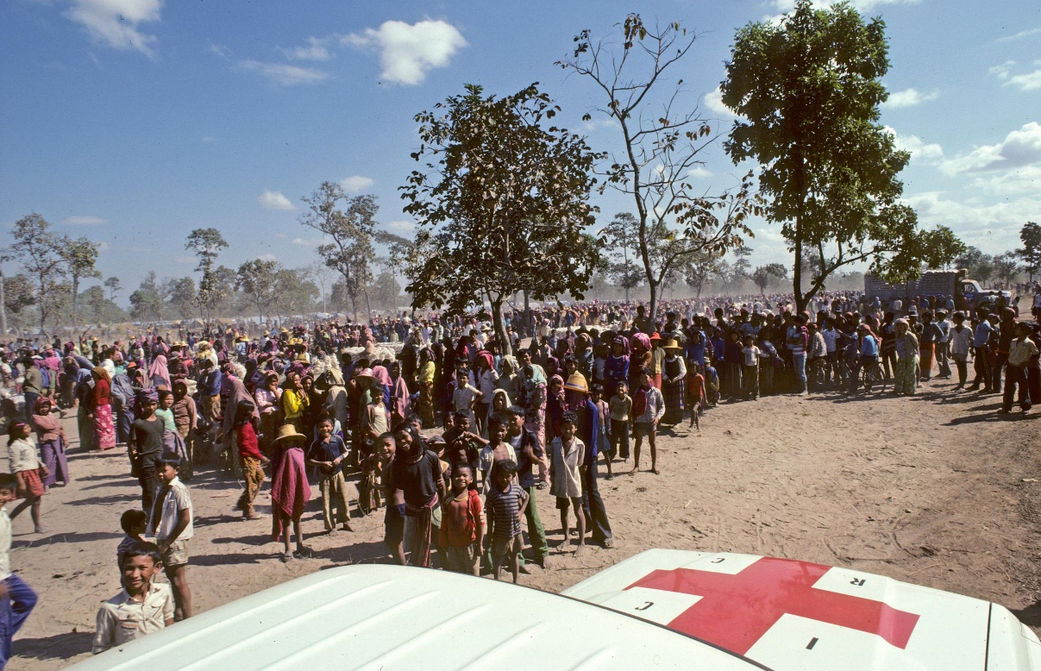
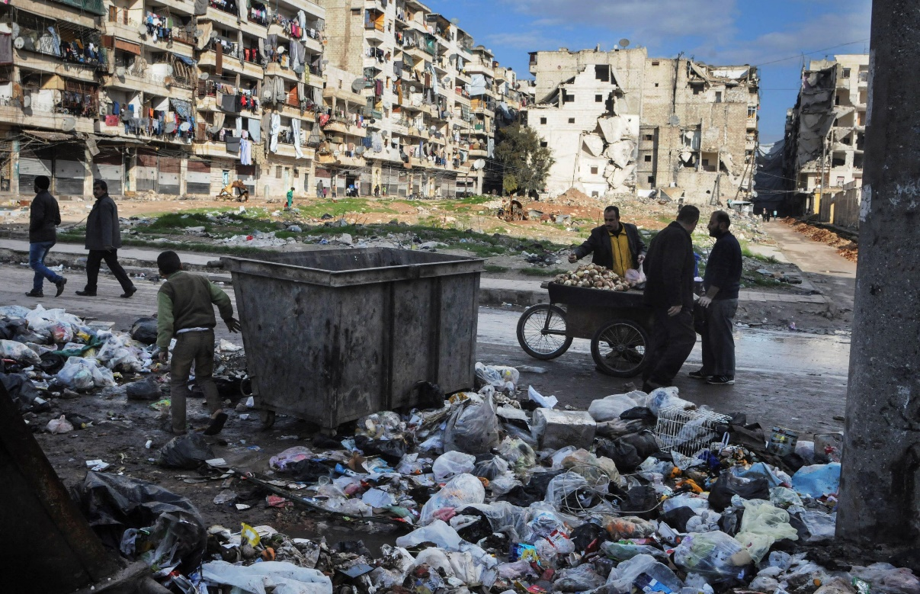
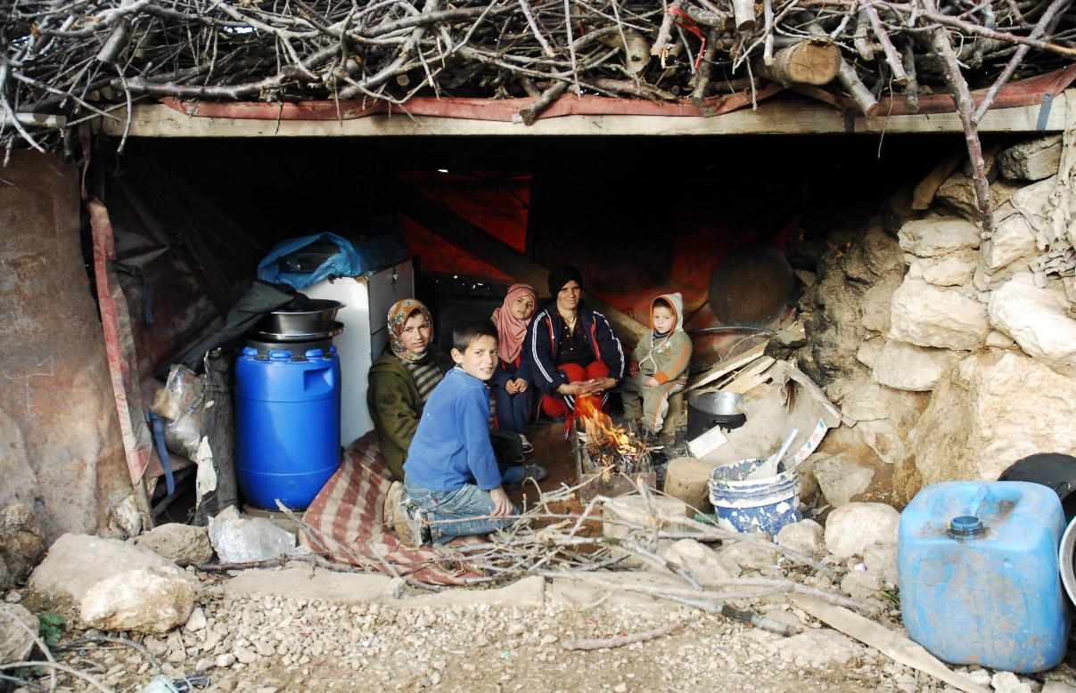
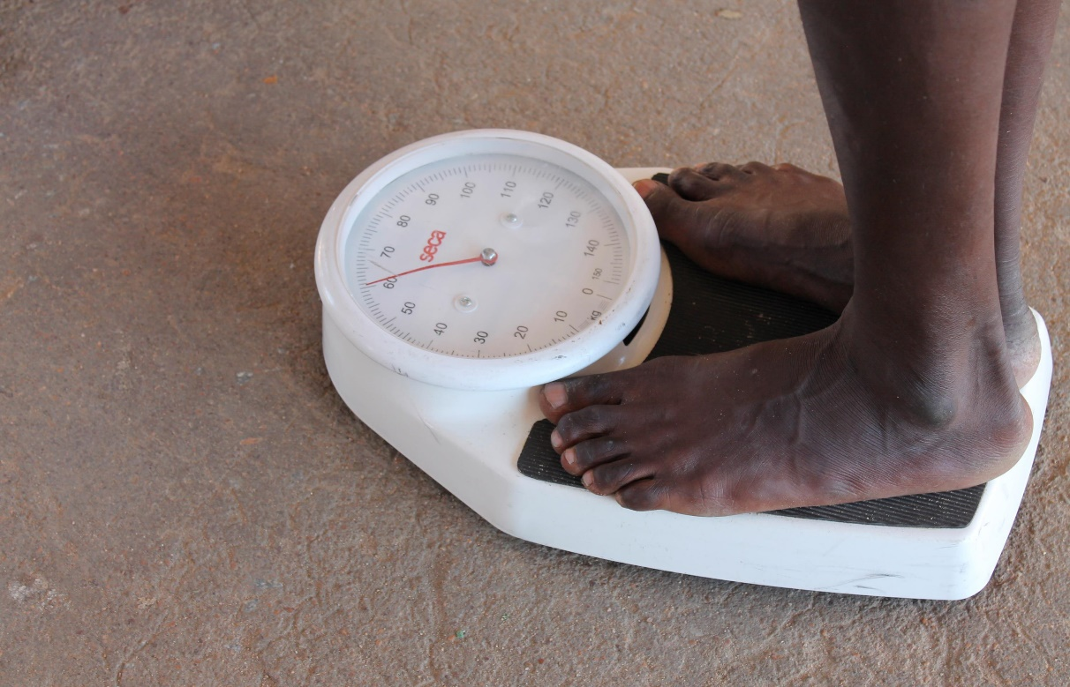
OVERCROWDING
LACK OF SERVICES
POOR HOUSING
POOR NUTRITION
Notes:
In a humanitarian context, the role of the public health engineer is crucial because population are particularly at risk of this vicious cycle.
Various factors aggravate the vulnerability of the population to infectious diseases:
\* Overcrowding
\* Deterioration of essential services and infrastructure, such as health care, water and sanitation systems, garbage collection.
\* Poor housing conditions in temporary settlement or damaged structures
\* Lower immunity due to malnutrition or lack of health care
.

Slide 10
Public Health Engineering Principles
Knowing the transmission cycle of diseases allows to design an appropriate response
→ Preventing
Creation of hazards
Transport of hazards
Exposure to hazards
→ Introduction of multiple barriers
Notes:
Public health engineering relies on this concept that certain hazards (infectious pathogens or chemicals) move through the environment and cause harms to human. Therefore, public health engineering measures focus on preventing the creation of hazards, its transport and the people from being exposed to it once encountered.
In the case of human waste mentioned early, we cannot avoid its creation, but the public engineer can reduce the spread of human waste in the environment by setting a proper sanitation system. He can also treat water and promote proper food hygiene practices to the reduce the exposure of people to faces contained in contaminated food or water.
Therefore, the role of the engineers is to put barriers at the creation, transport and exposure to hazards to improve health. Because one barrier rarely function at 100%, public health engineer should put multiple barriers.
In order to know where and when to put the barrier to stop the vicious cycle of the transmission of a disease, the public health engineer should have a good understanding of the transmission cycle of this disease
Depending on the organizations, this public health engineer is called, environmental health specialist, WASH specialist or Water & habitat, such as the ICRC.

Slide 11
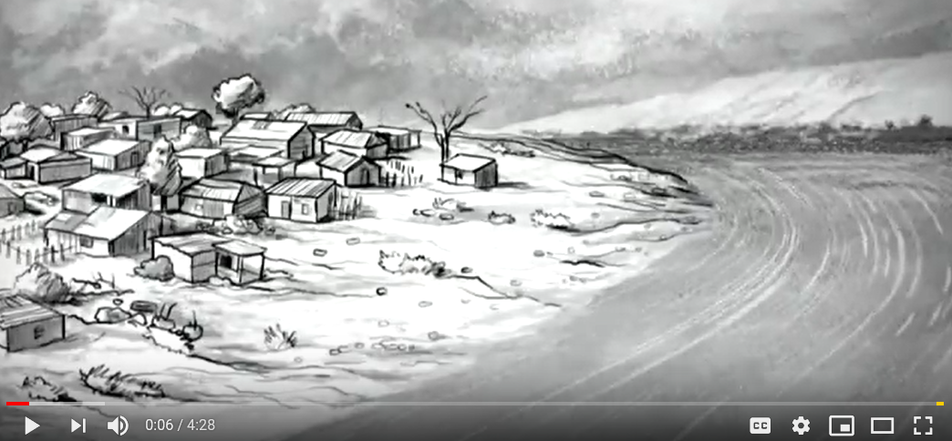
Video
THE HYSTORY OF CHOLERA
https://www.youtube.com/watch?v=jG1VNSCsP5Q
Notes:
Water-borne diseases are infections which can be transmitted through drinking water which contains the pathogen
Water-borne diseases include diarrheal diseases which is the second leading cause of death in children under five years old, and is responsible for killing more than half million of children every year. It also includes infectious hepatitis or polio. All these diseases are part of the so-called faecal-oral diseases. That is to say that Infection occuring when pathogens from the faeces of a sick person are ingested by somebody else. There are many different pathways, some direct and some indirect, for the faeces containing the pathogen to gain entry into the mouth..
The water-borne class is, for many, the most intuitive and comprises those diseases caused by the ingestion of pathogens in water. It is fundamentally concerned with water quality and safety. Chapter 4 of this volume provides an overview of the diverse viral, bacterial, protozoal and helminthic causes of water-borne disease. While water-borne disease can be manifest as, sometimes large, outbreaks, the ability of public health surveillance systems to detect such events, even in countries with advanced health information systems, is very low and in fact the majority of water-borne disease is not associated with identified outbreaks.

Slide 12
Disease Classification System
Bradley classification of water related hazards according to their transmission route:
Water-borne diseases
Water-washed diseases
Water-based diseases
Water-related diseases
Notes:
Unlike the conventional biological taxonomy which classifies diseases according to the nature of their pathogens, in Public health engineering, we prefer to classify infectious disease according to their environmental transmission pathways
In public health engineering, we often used the so-called Bradley classification to distinct fours types of water-related routes by which a diseases may be transmitted from one person to another.
Water-related disease’ is a diverse assemblage. The hazards or agents that are the direct cause of damage include bacteria, viruses, protozoa, helminthes, chemicals and personal physical factors. They may originate from human or animal excreta, industrial operations or be parts of natural or disturbed ecosystems. The sites of entry include ingestion but also inhalation/aspiration, wounds and perforation of mucous membranes and intact skin. The sites of damage – whether by pathogens or chemical toxins – include every organ of the body. The symptoms are diverse ranging from the acute (self-limiting diarrhoea) to the chronic (cancers, blindness and life-long infections) and recurring (malaria); and are both direct (caused by a pathogen or chemical) and indirect (such as an existing condition aggravated by the physiological effects of the water-related disease or through an intermediate state such as such as malnutrition caused or aggravated by water-related disease). Finally, epidemiological investigation identifies numerous underlying associated factors such as poverty, education, climate, demography, housing and use of basic services. Some of these may be judged to be ‘causal’ whereas others may be associated through a series of co-factors, and distinguishing among these is complex.

Slide 13
Water-Borne Diseases
The water-borne class comprises diseases caused by the ingestion of pathogens in water.
It is fundamentally concerned with water quality and safety
Examples:
Diarrheal diseases
Cholera, dysenteries
Infectious hepatitis
Polio
Notes:
Water-borne diseases are infections which can be transmitted through drinking water which contains the pathogen
Water-borne diseases include diarrheal diseases which is the second leading cause of death in children under five years old, and is responsible for killing more than half million of children every year. It also includes infectious hepatitis or polio. All these diseases are part of the so-called faecal-oral diseases. That is to say that Infection occuring when pathogens from the faeces of a sick person are ingested by somebody else. There are many different pathways, some direct and some indirect, for the faeces containing the pathogen to gain entry into the mouth..
The water-borne class is, for many, the most intuitive and comprises those diseases caused by the ingestion of pathogens in water. It is fundamentally concerned with water quality and safety. Chapter 4 of this volume provides an overview of the diverse viral, bacterial, protozoal and helminthic causes of water-borne disease. While water-borne disease can be manifest as, sometimes large, outbreaks, the ability of public health surveillance systems to detect such events, even in countries with advanced health information systems, is very low and in fact the majority of water-borne disease is not associated with identified outbreaks.

Slide 14
F-Diagram
Fluids
Fingers
Feces
Food
New Host
Flies
Field
https://www.youtube.com/watch?v=A5zgzLA8YaE
Notes:
The F-Driagram illustrates these main pathways. They are easily memorized as they all begin with the letter ‘f’: fluids
(such as drinking water), fingers. flies, fields (crops and soil) and food
The great majority of the agents of water-borne disease can also be transmitted by other means, all leading to ingestion. As such it overlaps with the concept of faecal–oral disease transmission

Slide 15
F-Diagram
Fluids
Fingers
Feces
Food
New Host
Flies
Sanitation
Field
Primary barriers
Notes:
Various sanitation measures represent primary barriers, as they prevent feces from entering the environment in a uncontrolled manner.
Examples: appropriate latrines and waste water systems

Slide 16
F-Diagram
Fluids
Fingers
Feces
Food
New Host
Flies
Secondary barrierss
Field
Sanitation
Primary barriers
Water Quality
Notes:
Water quality represents a secondary barrier, as it prevents contaminated environment (water) from contaminating food or infecting the host.
Examples: water treatment methods (like chlorination)

Slide 17
F-Diagram
Fluids
Fingers
Feces
Food
New Host
Flies
Secondary barriers
Field
Sanitation
Primary barriers
Water Quality
Hygiene
Notes:
Good Hygiene represent can both be a primary or secondary barrier.
Examples as primary barrier: stop open defecation and promote correct use latrines, washing hands after defecation
Examples as secondary barrier: washing hands before eating, store water correctly to avoid recontamination, protect food from flies etc.

Slide 18
Water-Washed Diseases
Caused by poor hygiene due to the lack of water
Three different ways of disease transmission
Examples:
Associated with the fecal-oral route (e.g. ascariasis)
Infections of the skin or eyes (e.g. trachoma)
Infections caused by lice (e.g. typhus)
Notes:
this class as comprising ‘infections that decrease as a result of increasing the volume of available water’ and also provide a formal operational definition: ‘water washed infections are those whose incidence or severity can be reduced by augmenting the availability of water without improving its quality’ (p162).
The second type of water-related diseases are water-washed diseases. Infections that are caused by pathogens whose transmission can be prevented by improving availability and quantity of water.
Good personal hygiene requires the availability and use of water for bathing, clothes washing and utensil washing. Therefore, the transmission mechanism is related to the quantity of water rather than water quality. There are three types of water-washed diseases:
The ones associated with the faecal-route with similar diseases to water-borne diseases
Infections of skin or eyes that are not related to the faecal oral routes, but also due to poor hygiene such as trachoma which is the leading infectious cause of blindness worldwide And infections carried by lice and which may be reduced by improving personal hygiene, such as typhus

Slide 19
Reduction of diarrheal diseases
Effects of different types of interventions:
Water quantity has an important impact on personal hygiene and can reduce the risk of disease transmission.
Intervention | Reduction
Water quality | 15%
Water quantity | 20%
Hygiene | 33%
Sanitation | 55%
A lack of water has been associated with water borne-, water washed- and vector borne- diseases.
Source: www.lboro.ac.uk/well/...briefs/52-water-quality-or-quantity.pdf
Notes:
Providing sufficient quantities of water is at least as important as providing good quality of water. The reason is that to maintain a good personal hygiene sufficient water is essential and that good hygiene has show to reduce the transmission of most water-associated diseases.

Slide 20
Water-Based Diseases
Caused by parasitic worms which live part of their life cycle in water
Transmission through ingestion or skin penetration
Examples: schistosomiasis, guinea worm
Notes:
The water-based disease class is concerned with those agents of disease that pass an obligatory part of their life cycle in water. Infection may be through ingestion – as is the case with dracunculiasis – which therefore overlaps with the water-borne class; or may be across the intact or damaged (abraded, wounded) skin (percutaneous) – as is the case with schistosomiasis and leptospirosis. These are normally disease agents with more-or-less complex life cycles. Chapter 5 describes the cause, transmission and prevention of schistosomiasis.
The third type of water related diseases is called water based. Here the pathogen spends part of its lifecycle in the water usually in a snail or another aquatic animal.
Pathogens usually enter the water from faeces and urine of infected persons. The pathogen is transmitted by ingestion or by penetration of the skin
The water-based diseases are all caused by parasitic worms. Not all parasitic worms are water-based but two of the most significant are: the Guinea worm and shistosomaisis

Slide 21
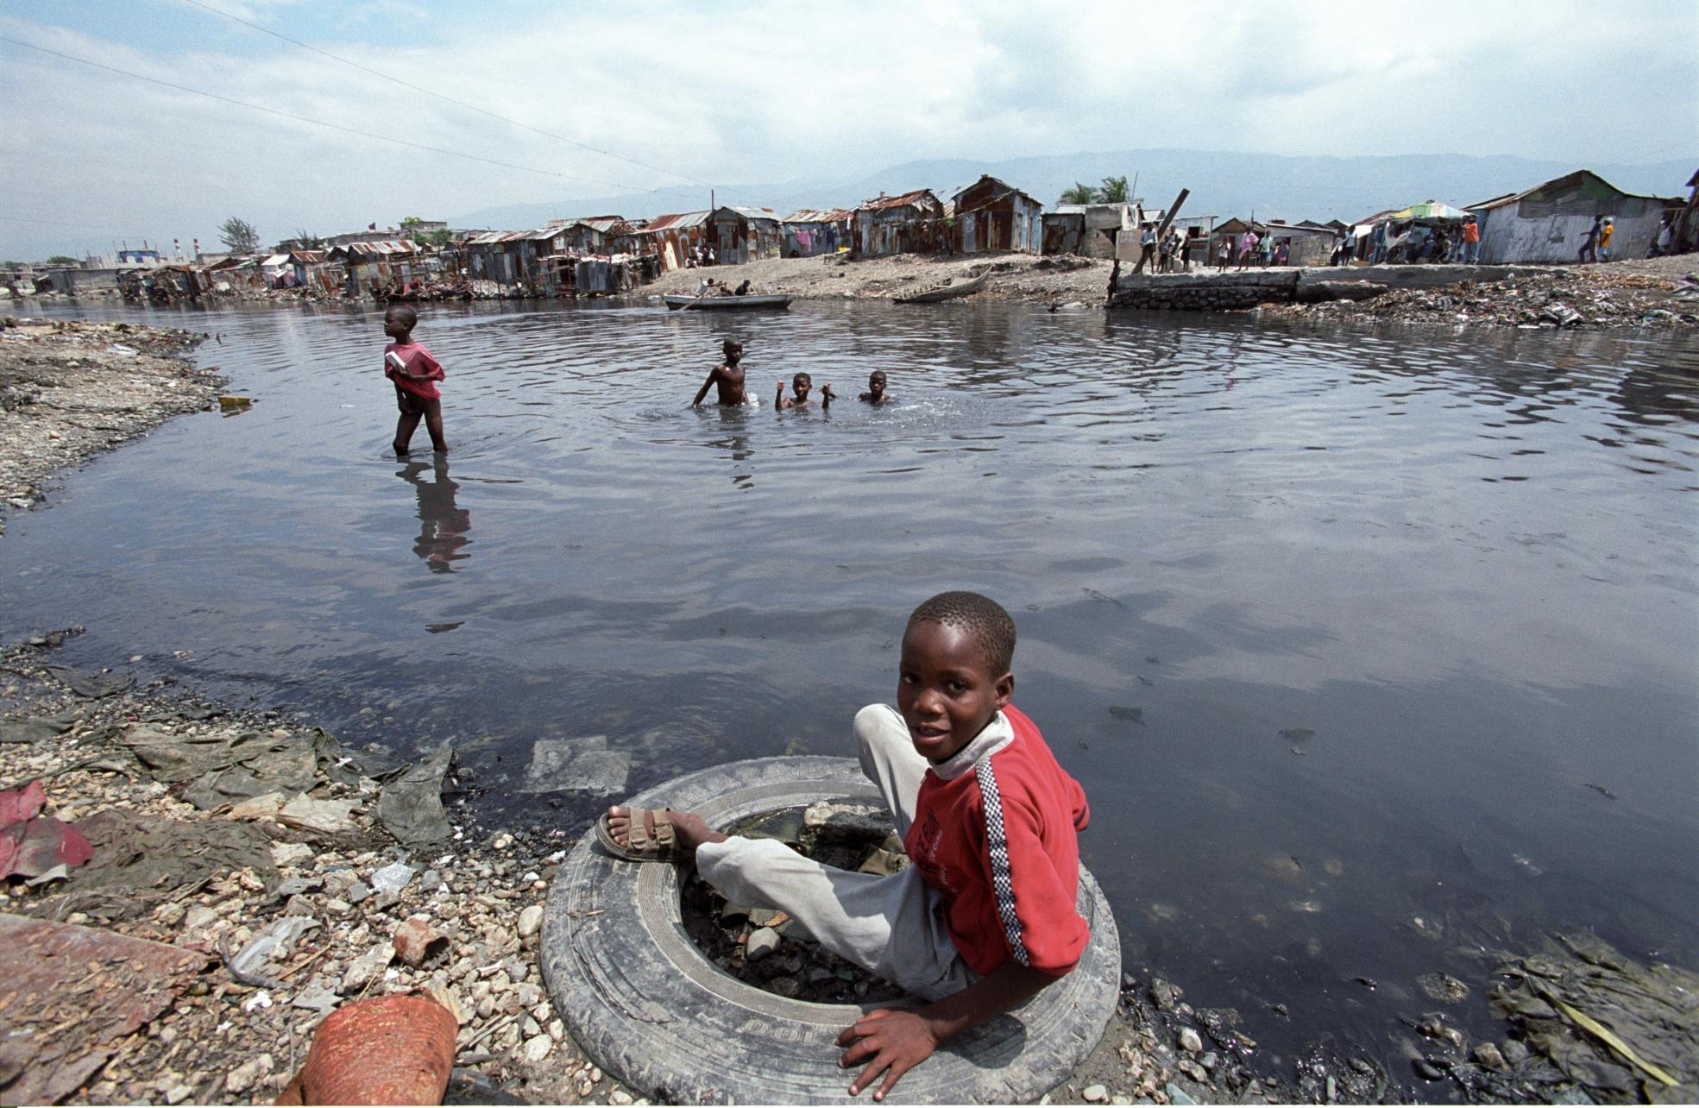
https://www.youtube.com/watch?v=lo1cRLdqKq4
Notes:
Schistosomiasis affects millions of people each year . People become infected when larval forms of the parasite – released by freshwater snails – penetrate the skin during contact with infested water (usually stagnant water). Play habits of school-aged children such as swimming or fishing in infested water make them especially vulnerable to infection.

Slide 22
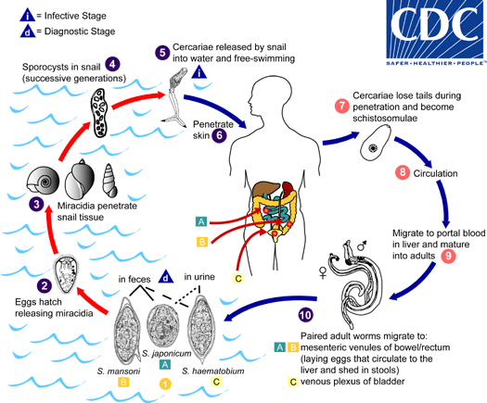

Slide 23
Water-Related Vector-borne Diseases
Caused by insects vectors which breed in or near water
Examples: Malaria, yellow fever, dengue, etc.
Notes:
Finally, the fourth route are diseases spread by insects which breed in water or bite near water.
Malaria, yellow fever and dengue are diseases transmitted by this transmission mechanism
The title of this class is largely self-explanatory. The disease agent itself may have no relationship itself with water; rather its insect vector either breeds in or bites near water bodies. The relationship to water is determined by the insect vector, with some preferring stagnant polluted waters and others preferring clean, fast moving waters. Globally malaria is the most important of this class, which also includes Bancroftian filariasis, onchocerciasis, dengue, yellow fever and other arboviral infections all of which are transmitted by insects with aquatic larvae. Tsetse flies, which transmit Gambian sleeping sickness, are found near rivers but do not breed in water. Chapter 6 of this volume describes the cause, transmission and prevention of some vector-borne diseases.

Slide 24
Group work
List key interventions to reduce the spread of diseases according to the transmission routes
Time before presenting your results in plenary is 15 minutes
H.E.L.P. course

Slide 25
Engineering Interventions
Notes:
Knowing the transmission routes for diseases help to identify key interventions to be done to reduce the spread of diseases.
For instance, to tackle water borne diseases, we need to improve water quality by treating water or preventing its contamination
For water-washed disease, we have to increase access and availability of water to ensure better hygiene
For water-based, it is difficult to treat infected water surface bodies, but we can prevent people from getting into contact with them.
For water related insect vector, we can apply some vector control measures that we will see further into details during this wekk.

Slide 26
Wrap-up: Public Health Engineering
In emergency situations, the personal hygiene practices and public services often break down, which can result in a spread of diseases: a vicious circle.
The work of a public health engineer is to insert multiple barriers to block disease transmission. This is done by sensitizing the public and by providing appropriate infrastructures and services. Most important barriers are related to: water supply, sanitation and hygiene promotion.
In order to formulate effective barriers, the transmission patterns of pathogens need to be known, be it water-borne, water-washed, water-based or vector-born diseases.
The provision of sufficient water quantities is essential to maintain a good hygiene. A good personal hygiene has shown to reduce the risk to contract most water-related diseases.

