Slide 1
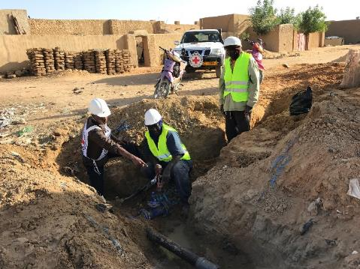
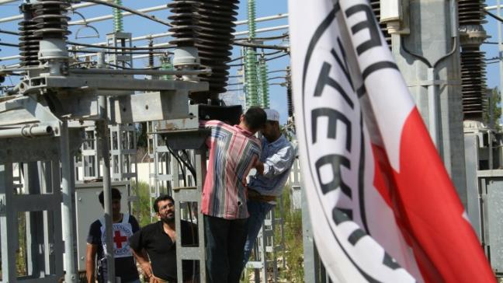
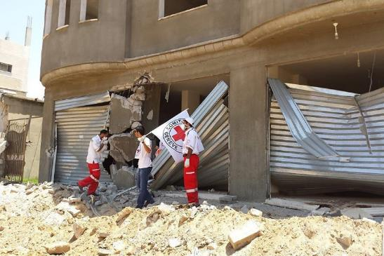
Logo organization(s) facilitator(s)
Public Health Engineering in Urban Contexts
These learning materials have been developed by colleagues of the ICRC Water and Habitat team
Name and organization facilitator(s)

Slide 2
Objectives
Be able to
explain the scope and magnitude of urbanization, and the characteristics and vulnerabilities of essential services in urban settings
discuss the challenges of humanitarian responses in urban settings
present and justify an appropriate response to essential services disruption in a specific setting

Slide 3
Public Health Engineering in Urban Contexts
Definitions
The Urban Challenge
Essential Public Services
Consequences of Protracted Crisis
Changing Approach

Slide 4
The Urban Challenge
?
What are the particular characteristics of conflicts in the urban context?

Slide 5
The Urban Challenge
Large populations affected
Big & complex infrastructure affected
Protracted nature of conflicts
Degradation of public services
Inappropriate humanitarian response in urban settings
Notes:
The world is getting more urban and the conflicts also. Some 50 million people worldwide are affected by armed conflicts in urban areas. In addition, it is also estimated than 80% of displaced people find refugee in urban areas. On top of that, there is a sharp increase of protracted conflicts all around the world resulting in an unprecedented level of humanitarian needs.
Protracted conflicts in urban area is a challenge for humanitarian response. Indeed, humanitarian approach has been mainly designed to address needs in camps or rural contexts. There is a lack of expertise and knowledge for urban settings. In addition, current funding mechanisms and programming, both mainly on yearly basis, are not adapted to respond to humanitarian crisis due to protracted armed conflicts.

Slide 6
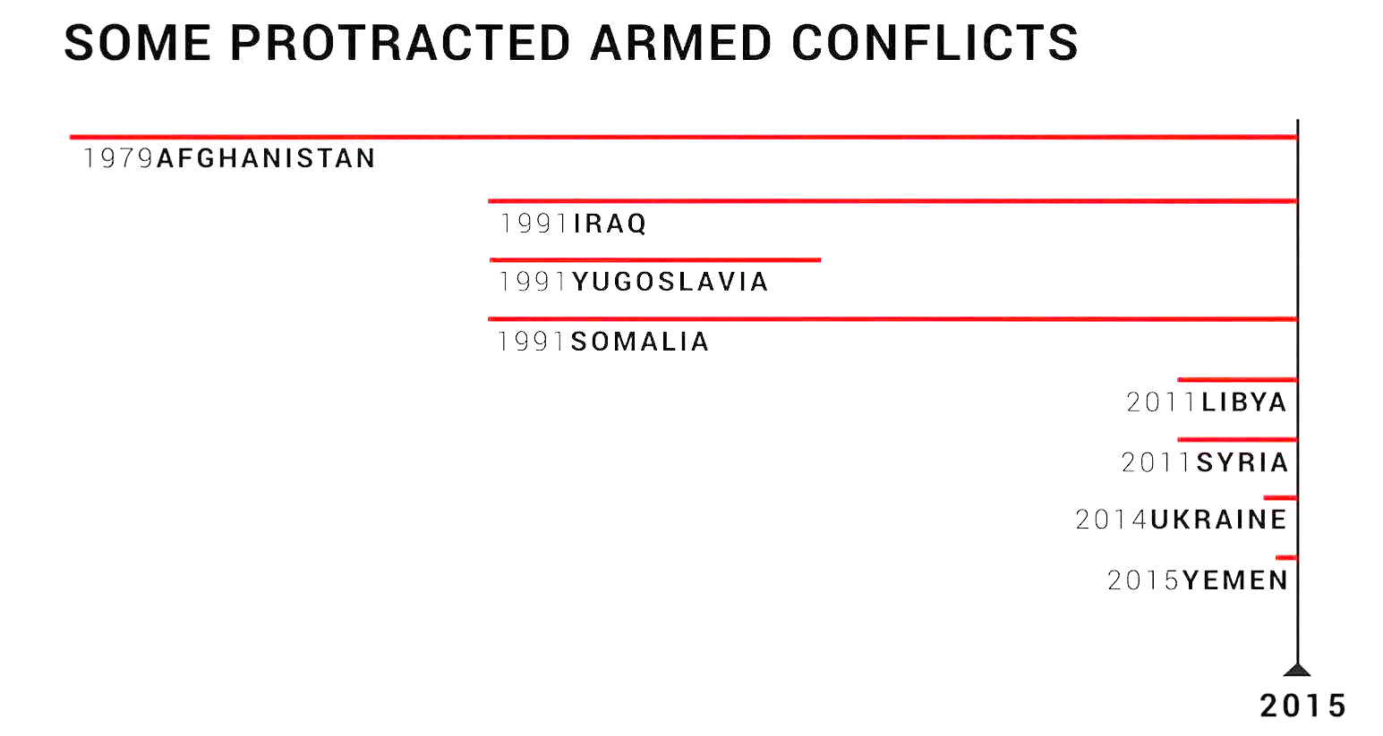
The Urban Challenge: Long Duration
Notes:
The average length of time the ICRC has been present in the countries hosting its ten largest operations is more than 36 years.

Slide 7
The Urban Challenge: Definition
Humanitarian Definition of the Urban Context:
“The area within which civilians vulnerable to disruptions in essential services reside and the network of components supporting those services.»
Notes:
Urban areas are undoubtedly complex and so is its definition… Tokyo and a village of 2’000 people in Angola are officially classified as “urban”
There is clearly no agreed definition of the term. Definitions of “urban” are normally based on population density and/or a geographic area defined by municipal authorities.
→ In this course, we adopt a different approach, we propose that for humanitarian action, Urban context should be defined as the area within which civilians vulnerable to disruptions in essential services reside and the network of components supporting those services.

Slide 8
The Urban Challenge
Video:
Facing urban Challenges
(Engl., 6:21)
https://www.icrc.org/en/document/water-and-habitat-facing-urban-challenges
Notes:
Humanitarian response in urban areas is major challenge of today’s humanitarian crisis. In order summarize this introduction on urban contexts, let’s watch the following animation that summarize key messages of this video and introduce you the topics of the next ones.

Slide 9
Essential Services: Critical Components
?
What are the three main components that all essential services require in order to function?

Slide 10
Essential Services: Critical Components
Provision of services is more than just infrastructure!
Notes:
Essential urban services are understood to be those services that are vital to ensure the subsistence of the civilian population, including electricity, health, water, wastewater treatment and solid waste disposal. All urban services require three elements in order to function: people (i.e. service provider staff, private-sector contractors and entrepreneurs), hardware (e.g. infrastructure, equipment, heavy machinery) and consumables (e.g. fuel, chlorine, medicines).
Disruption to an essential service occurs when the functions of any of the critical people, hardware or consumables are compromised. Short-term disruption to a service may not have a major impact on the survival of the civilian population, while its deterioration over the long term pose greater risks.
→ Challenge the understanding of the audience by demonstrating that humanitarian action (for a few humanitarian organizations at least) not only deals with the traditional emergency response, but also in parallel a medium to long term more structured support to municipal service providers.

Slide 11
Interconnected Services
Notes:
As shown this figure, critical components of essential services (e.g. electrical power plants, supply routes, water and wastewater treatment plants) are often located outside the city limits. Very distant active combat can thus have a dramatic effect on urban dwellers.

Slide 12
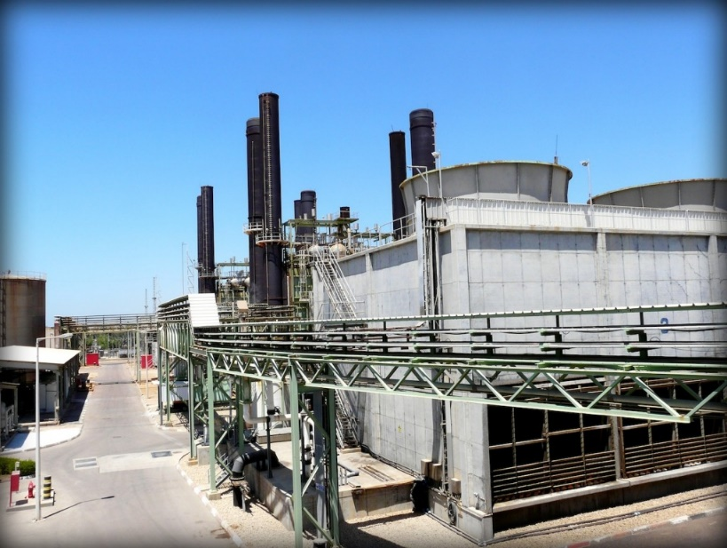
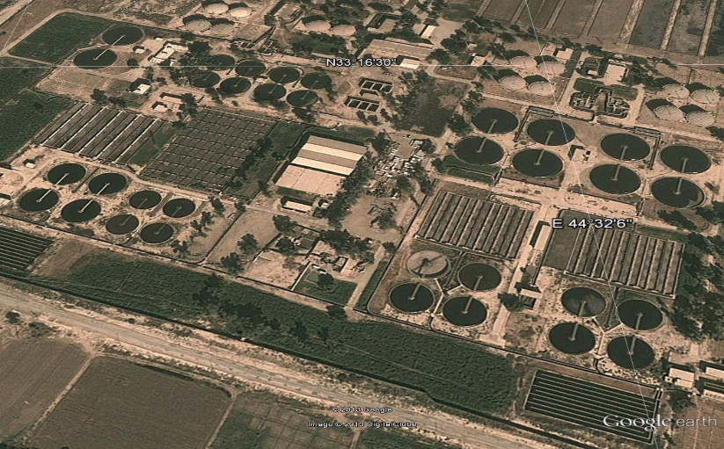
Vulnerabilities in Urban Areas
Residents’ high dependence on essential services
Essential services in urban areas are increasingly vulnerable, due to
Sophistication & complexity
Centralization and long, exposed supply lines
Interconnectivity of essential services
Large scale of service systems means also high impact when failing
Density and diversity of communities and governance structures (local authorities)
Thermic power plant, Gaza
Rustumiyah WWTP, Baghdad
Notes:
Urban areas are very complex entities characterized by a number of features which result in their residents being particularly exposed and vulnerable to armed conflicts:
The main vulnerability of people in urban contexts is their reliance on essential services. The services are beyond the technical capacity and the direct physical control of the residents. It affect the resilience of the inhabitants
These essential services consist of sophisticated, often centralized, large scale infrastructure which rely on the availability of specialist expertise, potentially fragile governance structures and complex logistic.
Many essential services depend on others to function. For example, the quality of health services is dependent on potable water and a reliable power supply, for example. Groundwater can also be contaminated by improperly maintained landfill sites. Most services also depend on electricity supply and the associated resources.
Another factor affecting the vulnerability is the scale. Because of the relatively large spatial scale of urban contexts, disruption to an essential service can have a large-scale impact. The destruction of a single power line can result in an electricity blackout across an entire neighborhood (comprising 200,000 people, for example).
Finally, densly populated urban areas are not only at greater risk from epidemics, the diversity of communities can also result in clashes along opposing political, sectarian or tribal lines or across municipal political borders as well as with authorities.

Slide 13
Armed Conflict in Urban Context: Impact
Video Animation:
Explosive weapons in populated areas: the consequences for civilians
(English 1:49)
https://www.icrc.org/en/document/explosive-weapons-populated-areas-consequences-civilians
Notes:
Humanitarian response in urban areas is major challenge of today’s humanitarian crisis. In order summarize this introduction on urban contexts, let’s watch the following animation that summarize key messages of this video and introduce you the topics of the next ones.

Slide 14
Essential Services: Types of Impact
?
What types of impact could result from the disruption of essential services?

Slide 15
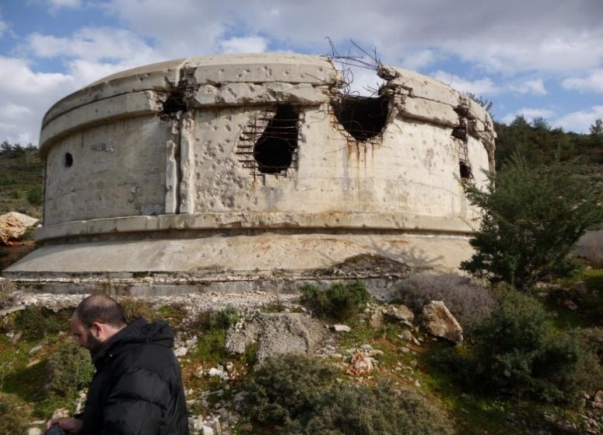
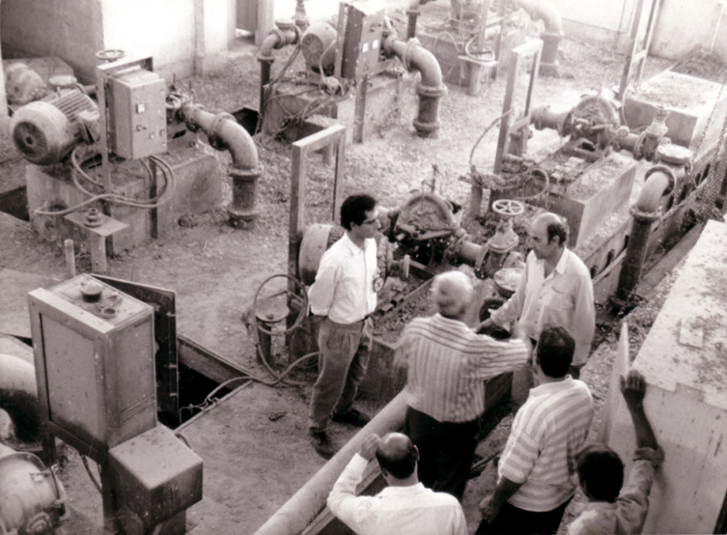
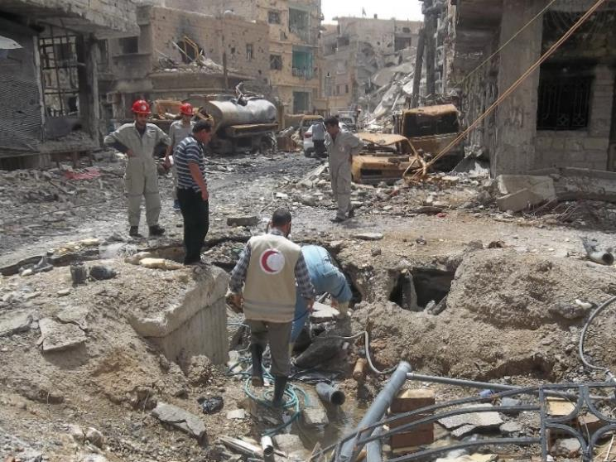
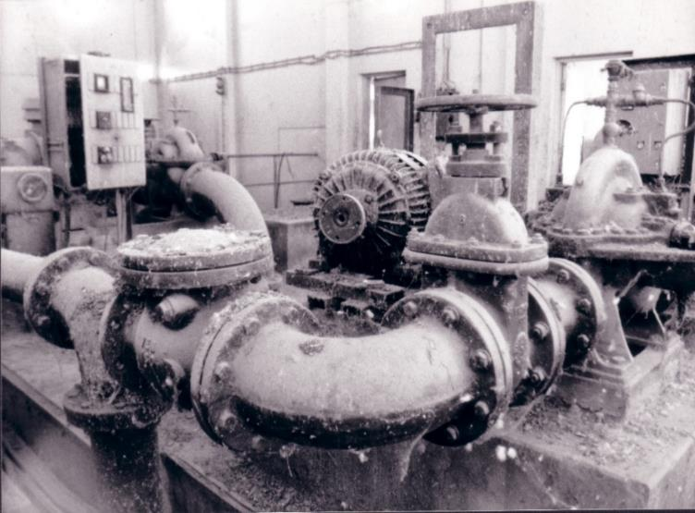
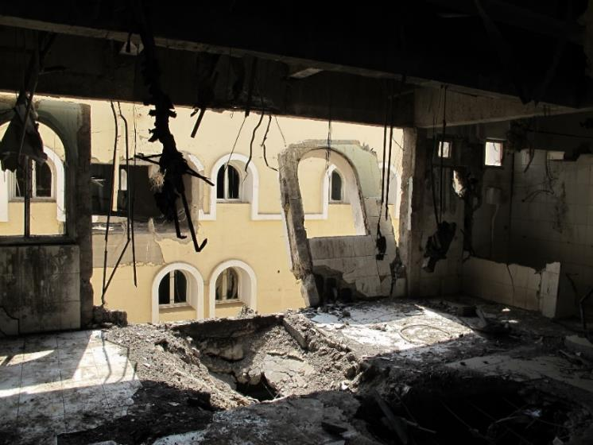
Types of Impact
DIRECT IMPACT
INDIRECT IMPACT
Direct Impact
Indirect Impact
Cumulative Impact
A combination of direct and indirect impacts lead to cumulative impact.
Notes:
Protracted conflicts have different types of impacts on urban essential services:
The direct impact which is the immediate and physical impact caused directly by armed conflict, such as damages to essential urban infrastructure,
And the indirect impact which derives from direct impact, affecting an associated component of a system, usually in the short to medium term. An example is the “brain drain” that occurs following attacks on staff.
→ These impacts can accumulate over time, resulting in cumulative impact, for example, in a lack of maintenance planning due to insufficient long-term staffing.
Let’s see more into details how theses different types of impacts affect the three critical elements of essential services

Slide 16
Impact on Hardware
Notes:
Destruction of or damage to infrastructure and equipment is an example of direct impact on hardware. However this pictures does not illustrate a direct impact, but an indirect one. Indeed, this pipe is leaking not because of explosive munitions, but due to the coping mechanisms of people affected. The inhabitants were no longer supplied by the main network and they made holes in the nearest pipes in order to have access to water. Sometimes coping mechanisms from inhabitants can result in negative effect on public health.

Slide 17
Impact on Hardware
Notes:
Another example of indirect impact on critical hardware is this water pumping station In that case, functional equipment were removed gradually by water utility staff to a more crucial part of the system to respond to an emergency. As a result, this water pumping was rendered completely inoperable. We call this phenomena cannibalization of critical hardware components.

Slide 18
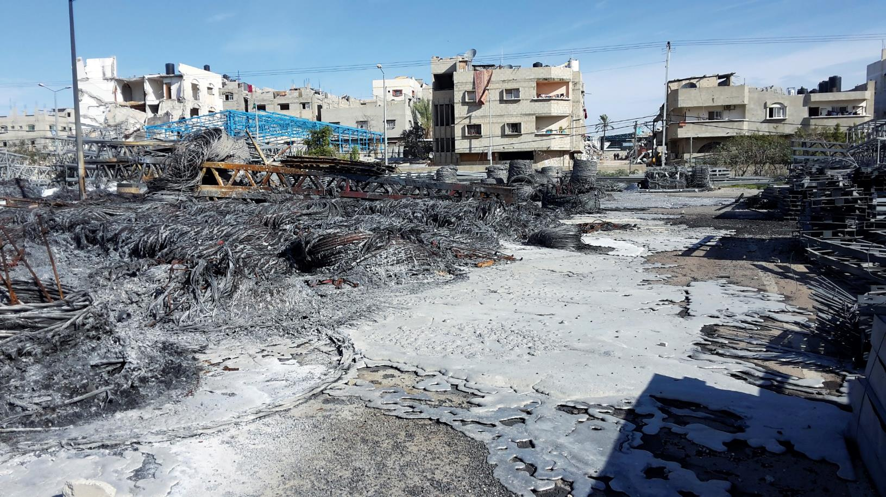
Impact on Consumables
Notes:
Direct impact on critical consumables is related primarily to their destruction such as in the picture of the destruction of a warehouse of an electrical utility following a bombing. As a result, the electrical company lost its capacity to react to breakdowns

Slide 19
Impact on Consumables
Notes:
Looting of water or electricity providers’ warehouses is a classic example of indirect impact on critical consumables as we can see here in the picture of a looted water treatment plant.

Slide 20
Impact on People
Notes:
One of the obvious direct impact on people is the casualties among essential staff due to the conflicts. As a result, there are fewer staff reporting to work and fewer staff willing to go the field to conduct routine operation and maintenance work.
Another direct impact on people is the poor or complete lack of access to a service component. Here an example of ICRC providing secured access to municipal workers in order to perform emergency repairs.
An indirect impact of on critical people occurs when armed conflict and sanctions (or embargoes) begin to affect a country’s economy. It often results in staff salaries being reduced or delayed. As a consequence, staff services then resign or loose motivation reducing the likelihood of routine operation and maintenance from being carried out

Slide 21
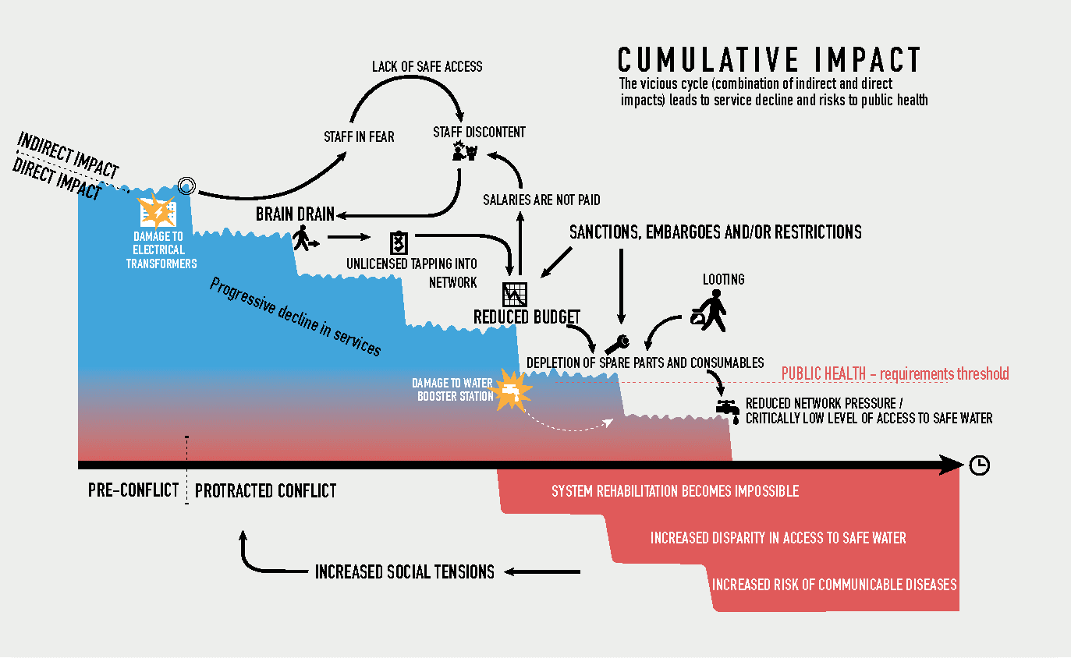
The Cumulative Impact
Notes:
Cumulative impact is the long-term deterioration in the performance of essential services through
incremental direct and indirect impacts on one or more of the critical components of essential services
Cumulative impact on essential services can be seen as a vicious cycle influenced by direct and indirect impacts. The accumulation ultimately affects public health and may contribute to the very conflict which created it. The cycle of impacts therefore lies within the cycles of conflict that characterize complex emergencies.

Slide 22
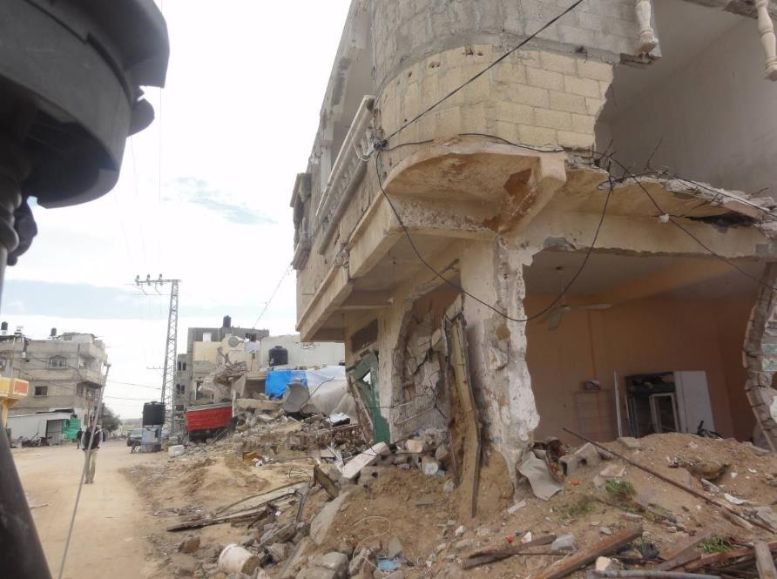
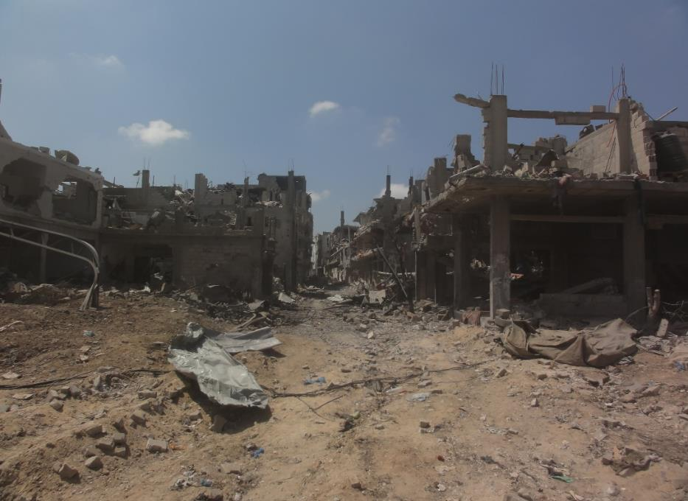
Humanitarian Consequences: Displacement
Destruction of residential areas and the erosion of public services can lead to population displacements, which again exacerbates stress on urban services and natural resources elsewhere.
Scale of destruction: Household Level
Scale of destruction: Neighborhood Level

Slide 23
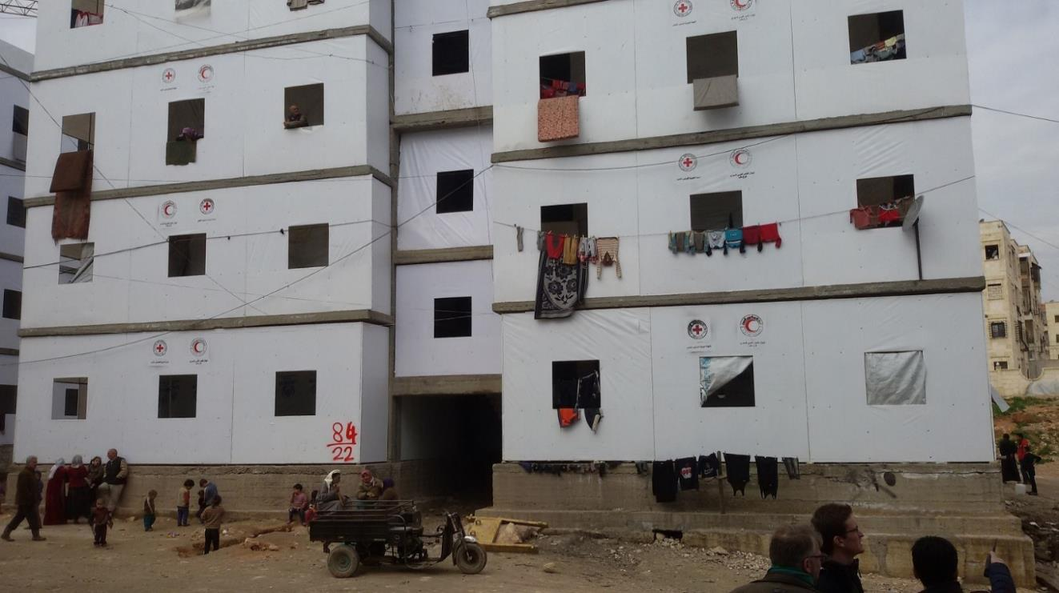
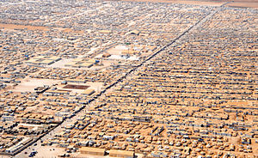
Humanitarian Consequences: Displacement
Displacement – to Host Communities
Displacement – to Communal Facilities
Displacement – to Camps
Notes:
The cumulative impact of protracted urban crises and the associated erosion of public services, often lead to displacement, be it to host communities, communal facilities or camps.

Slide 24
Humanitarian Consequences: Public Health
Notes:
The cumulative impact of protracted armed conflict on public health is much more difficult to track than its impact on the quality of coverage of any essential service.
Even a short disruption to the drinking water supply (as might be expected at the start of the hostilities) can greatly increase the probability of infection from diseases already present in the environment if the quality of the service was originally reliable.
As people’s immunity builds up with repeated disruptions to the water service, it is difficult to generalize the impact that any disruption would have on general health of the population.
However, the risk of a sustained increase in the incidence of endemics diseases is enhanced as the conflict drives more people and strains of illness into the city, particularly when the movements of people are coupled with poor general treatment of water and wastewater and incomplete immunization campaigns.

Slide 25
Humanitarian Consequences
Video Animation:
From ruins to rebuilding_ Helping Syrians regain hope for their future
(English 1:08)
https://www.icrc.org/en/document/ruins-syria-war-fighting-rebuild
Notes:
Humanitarian response in urban areas is major challenge of today’s humanitarian crisis. In order summarize this introduction on urban contexts, let’s watch the following animation that summarize key messages of this video and introduce you the topics of the next ones.
(SARC Homs Branch WATSAN Video)

Slide 26
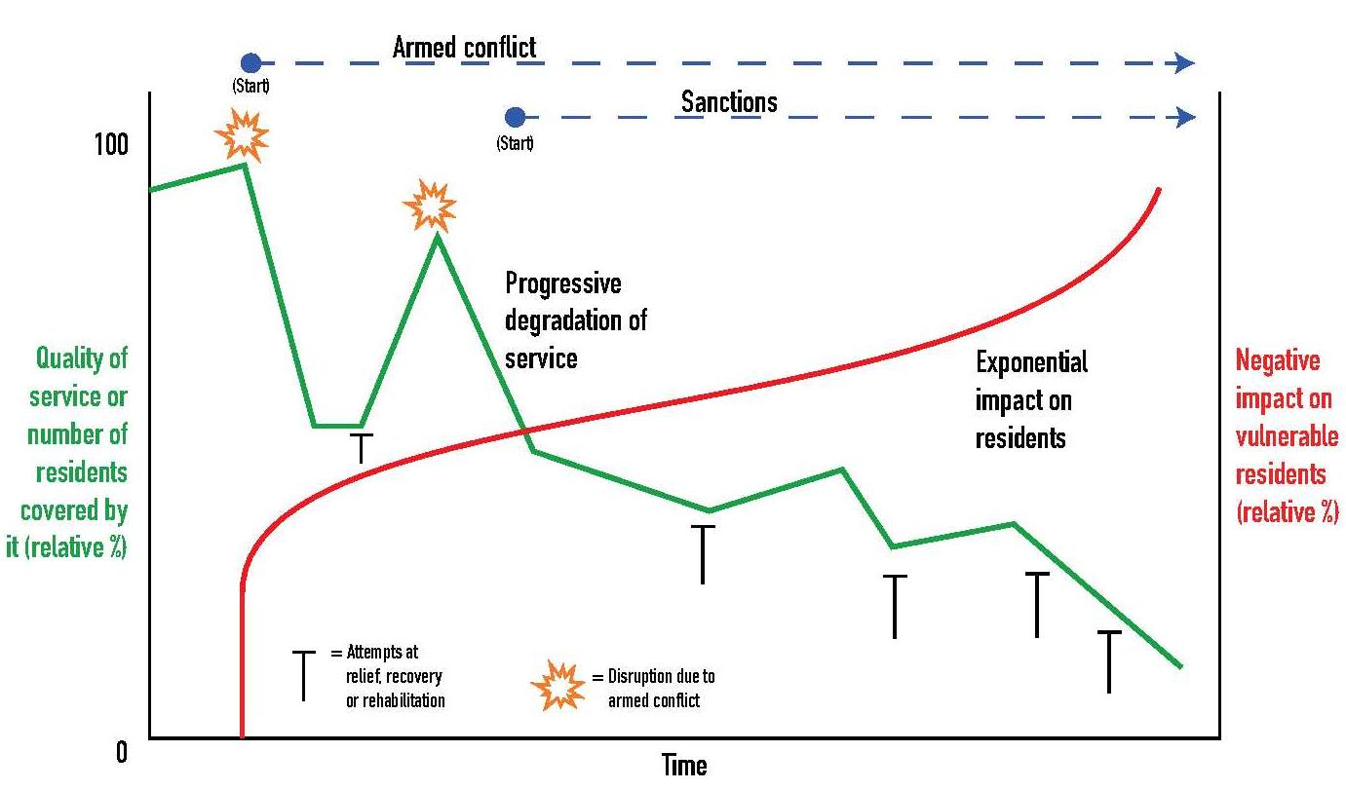
Humanitarian Consequences
Notes:
The challenge of maintaining essential services in urban contexts subject to protracted armed conflict is conceptualized here.
While the quality of the service decreases cumulatively over time, as a result of direct and indirect impacts, the impact on residents increases exponentially.
Unfortunately, the humanitarian approach is traditionally geared towards “simple” short-term interventions (fire-fighting approach), like e.g. water trucking, rather than sustainable rehabilitation. Reparation of large scale systems is often too costly and complex for humanitarian agencies and municipalities, especially if the systems have been eroded over time, through cumulative impacts.

Slide 27
Developing a better Approach
?
How should the approach be changed to respond better to the particular challenges of urban conflicts?
Notes:
We have seen the extent and nature of the impact of the deprivation of urban services during times of armed conflict. It is clear that there is need for a move from traditional assistance paradigms to one that takes into account of the longer-term realities and needs in urban areas affected by ongoing armed conflict.
→ How would you suggest a way forward to best meet the challenges and to ensure the right response in the right place at the right time. So the main objective is to discuss the relevance of humanitarian response to essential urban services disruption in protracted conflicts.

Slide 28
Urban Services during Armed Conflict:
Changing Approach
1.) Changing humanitarian practice from reactive to proactive:
Change to muli-year programming and funding
Strengthen long-term, structural support & collaboration with local actors and the local population (NIIHA)
2.) Reinforcing response capacity:
technical capacity and competences (e.g. power supply, wastewater, etc…)
reinforcing logistics capacity (including contracts)
3.) Addressing root causes as well as the consequences
Promoting respect of the IHL to prevent the use of weapons of mass destruction in the urban context (protection of essential infrastructure)
4.) Reviewing paradigm of emergency-rehabilitation-development spectrum.
collaboration and know-how exchange between humanitarian and development actors
Notes:
Donors should reconsider their funding schemes to ensure that they match the scale and duration of the challenge. Relief, rehabilitation and development efforts will be much more expensive and take far longer if humanitarian agencies in coordination with local service providers are unable to mitigate the consequences of indirect and cumulative effects. Twelve-month funding designed for disaster relief or very short conflicts are not adequate to stabilize or restore essential urban services in protracted armed conflicts. To appropriately address the complexity of essential urban services during protracted armed conflicts, larger budgets that cover a longer period are needed
Essential services rely on three critical components (people, hardware and consumables,). Experience tends to show that, of all the components of an essential service, “people” may be the most crucial. Effective partnerships with local authorities and service providers become indispensable in complex urban environments, much more than for rural areas where people can organize themselves around less sophisticated services.
It is widely accepted that including beneficiaries in the conception, implementation and management is vital to the effectiveness, as well as to the sustainability, of any intervention. However, “community involvement” in urban areas is very different from the common understanding based on rural experience. Working with local people to repair or rehabilitate essential services in urban contexts also poses some particular challenges. Humanitarian assistance should not focus only community based approach assistance. It is arguably more beneficial to restore water to an entire neighborhood (by repairing the transmission line), for example, than to assist household-level coping mechanisms.
International humanitarian law (IHL) offers a degree of protection. However, while IHL protects all service components from the direct impact of armed conflict, there are specific challenges arising from its interpretation and application in urban warfare, in particular the extent to which IHL provides protection against the indirect or cumulative impact of hostilities on essential services. The ICRC is actively seeking to address some of these challenges, in particular through its work on the use of explosive weapons in populated areas.
The distinctions between the stages of relief-rehabilitation-development response are not necessarily relevant in urban context. Multiple types of programme may be required simultaneously in the same city. For instance, in 2010 in Bagdad, ICRC interventions covered the full spectrum; for example, large hospital and wastewater infrastructure rehabilitation projects were established to support the government’s long-term development plans, alongside basic maintenance of existing health and water facilities (which could be labelled “reconstruction”) and water-trucking programmes to informal settlements of IDPs – typical “relief” activity.

Slide 29
Wrap-up: PHE in Urban Settings
Urban services require hardware, consumables and people to function properly.
Urban services are progressively vulnerable due their centralization, sophistication and inter-connectedness.
Since urban populations are often large and their habitants are particularly dependent on public services, the disruption of these can quickly result in large scale needs.
Protracted conflicts in urban contexts have direct and indirect impacts. The cumulative impact of them often results in the progressive, and sometimes irreversible, erosion of public services.
The resulting humanitarian consequences can be a deterioration of public health and displacement of large populations.
In order to respond to the particular challenges of protracted urban conflicts, the humanitarian approach needs to become more pro-active and long-term oriented. Also the promotion of IHL and the collaboration with development actors should be strengthened.

Slide 30
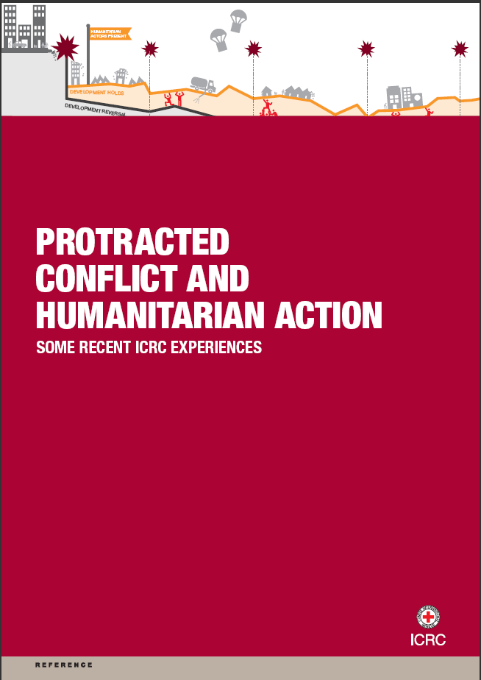
Reference Documents
More research to be done
A few examples:
Measuring impact
Epidemiological studies
Notes:
Finally, more research need to be conducted on the impact of disruptions to urban services on people’s lives over time. One priority area is the need to gain an understanding of how disruptions to services affect people’s livelihoods, food security, human security and health. Many humanitarian agencies have programmes targeting the direct impact of these disruptions but not the indirect or cumulative impact on the broader nexus of interrelated humanitarian issues of concern.

