Slide 1
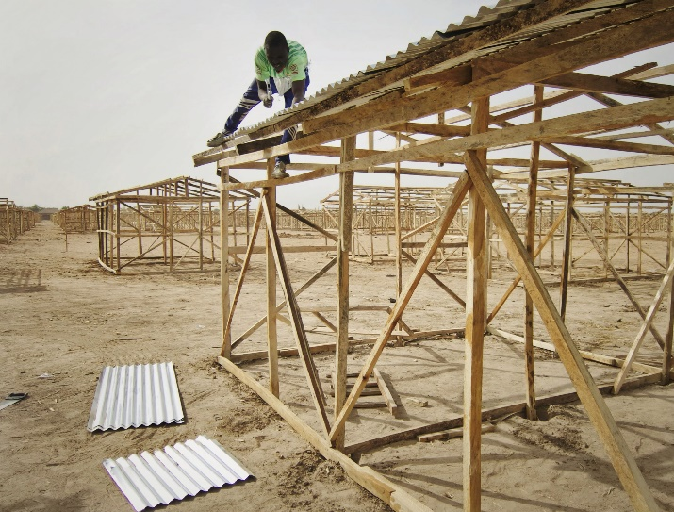
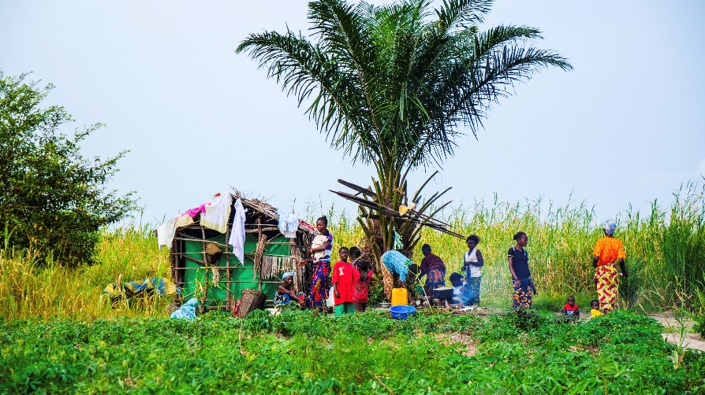
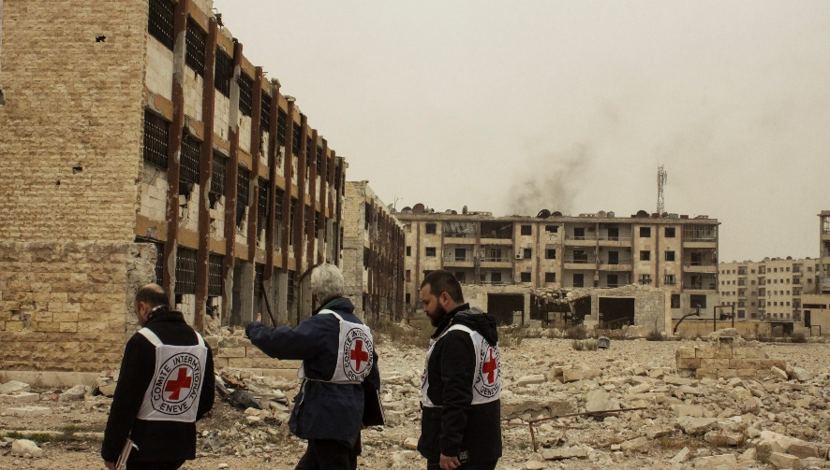
Logo organization(s) facilitator(s)
Shelter in Displacement
Name and organization facilitator(s)
These learning materials have been developed by colleagues of the ICRC Water and Habitat team
Notes:
During this session, we will introduce you to the topic of the impact of shelter on public health during situation of displacements
According to UNHCR, in 2017:
A total of 65.6 mio forcibly displaced persons (including refugees 22.5 mio and stateless perons 10 mio)

Slide 2
Objectives
Be able to
explain the unique displacement, resettlement, and sheltering challenges in responding to an acute or protracted crisis
describe shelter alternatives and problems associated with the resettlement of large populations
describe camp planning priorities and propose an adequate response in terms of essential services

Slide 3
?
What is an IDP?
Notes:
Exercise in group 10 min

Slide 4
Displaced Populations - Definitions
Internally Displaced Persons (IDPs) are persons or groups of persons who have been forced or obliged to flee or to leave their homes or places of habitual residence, in particular as a result of or in order to avoid the effects of armed conflict, situations of generalized violence, violations of human rights or natural or human-made disasters, and who have not crossed an internationally recognized state border. [UN Guiding Principles on Internal Displacement]
A Refugee is someone who, owing to well-founded fear of being persecuted for reasons of race, religion, nationality, membership of a particular social group or political opinion, is outside the country of his nationality and is unable or, owing to such fear, is unwilling to avail himself of the protection of that country; or who, not having a nationality and being outside the country of his former habitual residence, is unable or, owing to such fear, is unwilling to return to it. [UNHCR: 1951 Convention and its 1967 Protocol]
Notes:
Internally displaced people (IDPs) have not crossed a border to find safety. Unlike refugees, they are on the run at home.
Being a refugee entitles the person to a number of rights (UN refugee conventions), including the right not to be sent back to the country of origin (principle of non-refoulement).
IDPs stay within their own country and remain under the protection of its government, even if that government is the reason for their displacement.
According to UNHCR, there are presently about 25.9 Mio refugees and 41.3 Mio IDPs globally

Slide 5

Shelter means Protection
Protection against:
  Cold / Heat
  Rain / floods
  Wind / storms
  Loss of privacy/intimacy
  Theft/violence
  → Which can have multiple effects on health
Notes:
The conditions that characterize forced displacement can have a profound impact upon the health and well-being of individuals and communities.
Conflict, displacement and other violations of human rights, combined with lack of access to adequate shelter, sanitation, food and safe water, can seriously undermine people’s ability to prevent and respond to health-related risks in their environment.

Slide 6
?
What consequences on health can result from displacement, be it due to conflict or natural disaster?
Notes:
Exercise in group 10 min

Slide 7
Shelter: Impact on Health
PHYSICAL HEALTH
Physical health: Exposure to harsh weather conditions. Access to water and sanitation services as well as adequate conditions for personal care and nutrition
→ can result in death, respiratory infections and other diseases, nutritional insufficiencies, disability, injury or trauma
Mental health: Exposure to violence, separation from family members, and the loss of homes, livelihoods, lack of privacy & dignity
→ can give rise to post-traumatic stress disorders, psychosomatic illness, depression and anxiety, but also result in substance abuse, aggression and violence
Sexual and reproductive health: limited access to health care, erosion of traditional health practices, and exposure to violence, exploitation and abuse
→ can lead to a rise of maternal and infant mortality, still births, sterility, incontinence, sexually transmitted infections etc.
HEALTH STATUS OF DISPACED POPULATION
MENTAL
HEALTH
REPRODUCTIVE HEALTH

Slide 8
?
What types of transitional settlements do you know and what are the particular needs of their inhabitants?
Notes:
Exercise in group 10 min

Slide 9
Transitional Settlements: Different Types
Host families
Rural self-settlement
Collective centres
Urban self-settlement
Self-settled camps
Planned camp
Notes:
Host-Families: usually in houses, apartments or compounds of relatives or friends. (is usually the preferred and most common option for displaced populations!)
Displaced populions in host families tend to have a bit less needs, as they are integrated, have support by hosts, can profit from existing infrastructure and services. Nontheless, they have needs!
Also the host-population has needs, as their resources are often overstretched.
Urban Self-Settlement: renting or occupying buildings or apartments in cities
Population in cities are usually heavily dependent on public services (water, food, electricity, clinics etc) and their needs depend much on the availability of those services
Rural Self-Settlement: constructing of simple rural shelters or renting or occupying buildings or villages
Although there is usually a lack of public services, it is often easier in the rural environment to be self-sufficient if the surrounding nature can provide basic supplies (land, wood, water etc).
However, there are usually essential needs to be addressed, like water supply, sanitation and hygiene, shelter, medical services…
Self-Settled Camps: often improvised shelters erected on public spaces such as church or school compounds, football fields, stadiums etc. where displaced populations feel protected/safe
→ Often indiscriminate, improvised shelters, overcrowded, lacking sanitation and hygiene and other basic services
Collective Centers: usually in public buildings such as schools, churches, factories, usually allocated by authorities but often overpopulated
Usually dispose of some facilities and infrastructure incl. water, toilets, electricity, accommodation etc. but often insufficient. Need rehabilitation, extension, improving…
Planned Camps: Usually designed and allocated by authorities, often with support of humanitarian organizations.
If respecting guidelines and standards designed camps should provide a decent living to displaced populations.
Requires assistance until standards are met. Camps often grow due to more arrivals requiring more space, infrastructure and assistane.
Is often a secondary solution to resettle displaced for other informal sites.
However, is often not a favored solution by governments (difficult to dissolve, acceptance issues, conflict with local population) and at times complicated and time-consuming to negotiate

Slide 10
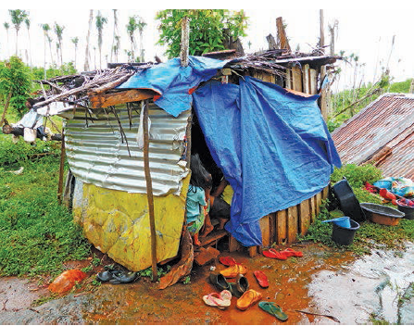
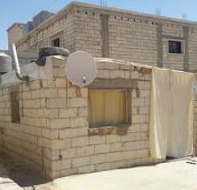
Transitional Settlements: single makeshift
Notes:
When displaced people cannot find refuge with host-families or communal center, makeshift shelters are usually the first type of transitional settlements to appear after a crisis.

Slide 11
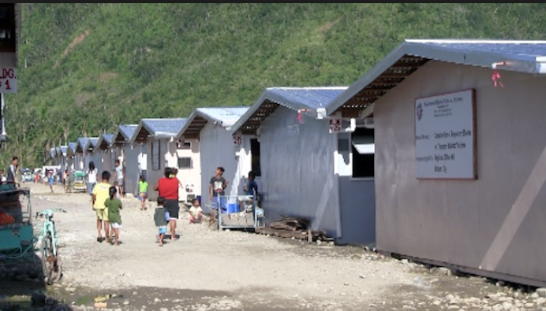
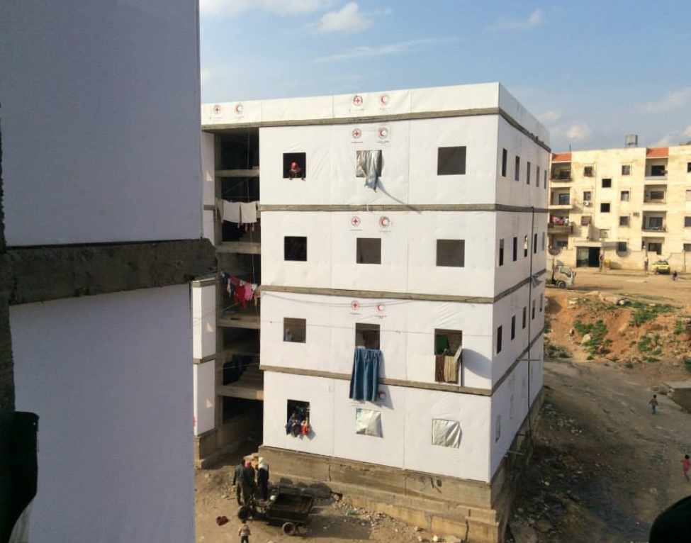
Transitional Settlements: Collective centres
Notes:
Communal centers (schools, churches etc.) or unoccupied buildings that are allocated to displaced people.

Slide 12
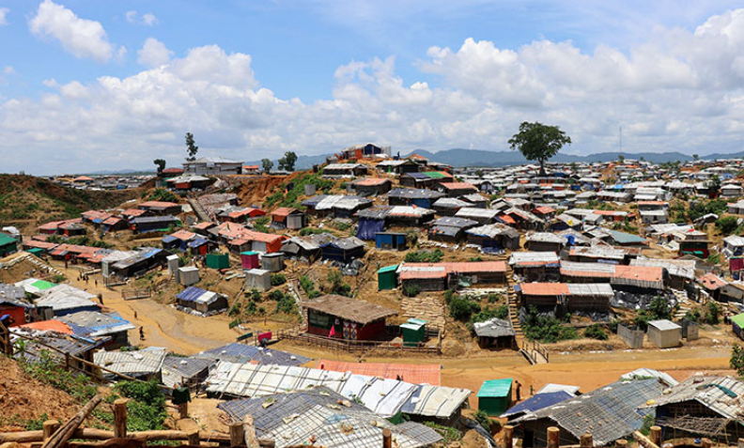
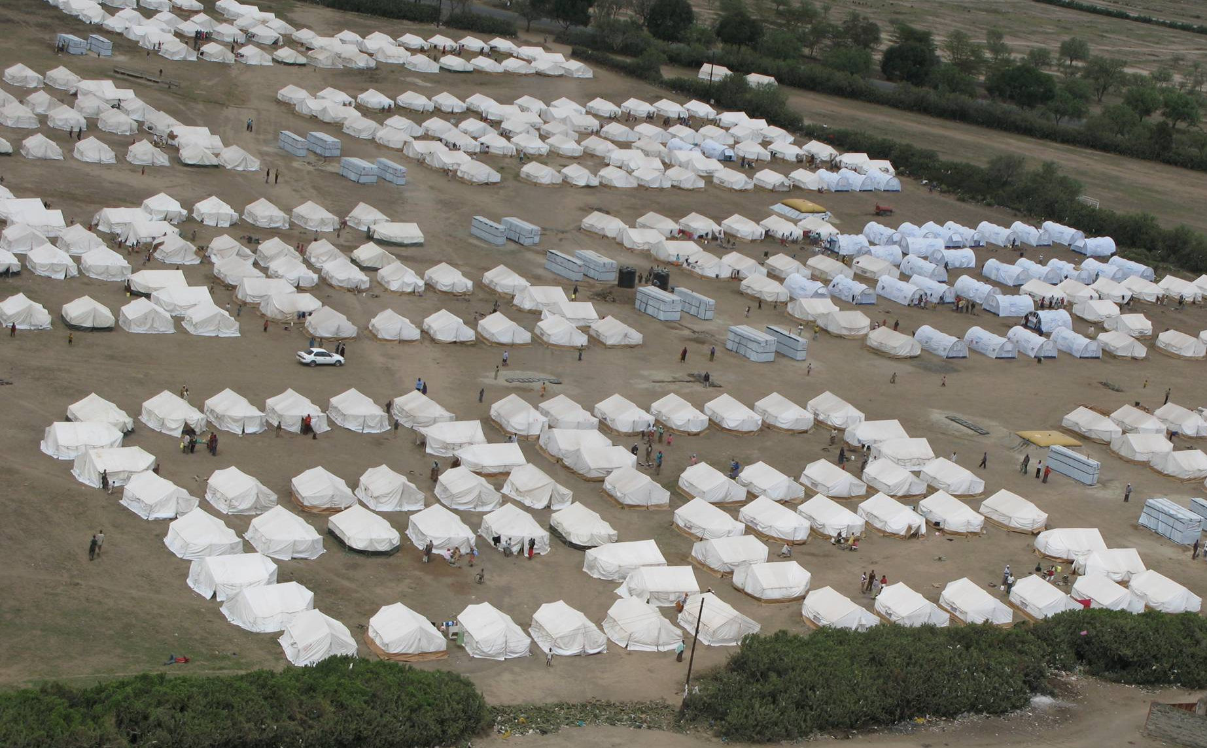
Transitional Settlements: Camps
Notes:
The informal, spontaneously established camps are more common and are usually the first to appear. The population density is often very high, the shelter quality bad and sanitary conditions are often appalling.
Formal camps are usually set up by governments and humanitarian actors, most of the time in a second phase, to transfer displaced populations from other more informal settlements and to accommodate new arrivals.

Slide 13
Transitional Settlements: options
Host families
Rural self-settlement
Collective centres
Urban self-settlement
Self-settled camps
Planned camp
Dispersed
Grouped
Notes:
Discuss:
How do you assist dispersed populations?
How do you assist grouped/concentrated populations?
In which type of settlements do you think it is easier to assist people? And why?

Slide 14
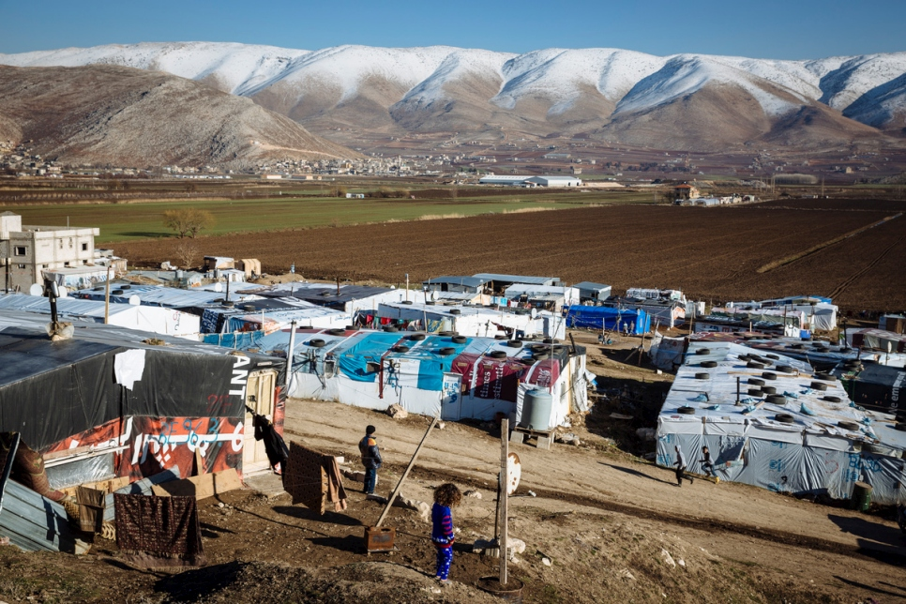
Hosting Communities
When assisting displaced populations in camps, we should also look at the needs of the
Host Communities who are sharing their resources!
Notes:
Irrespective of the displacement pattern, always assess also the needs of the hosting/neighboring communities, which are sharing their resources with the displaced populations and are often living in difficult conditions themselves.
Can avoid local conflicts between displaced persons and local ones, and also prevent aggression towards the assisting humanitarian actors.

Slide 15
Access to Services During Displacement
Food and non food items
Water, sanitation and hygiene
Shelter
Health care
Education
Livelihoods
Notes:
When we speak about access to services, Water & Habitat which is just a part of it.
Importance of the coordination between the different activities. Who does what, why and when.
When opening a camp, think long-term. Even though people like our hierarchy will tell you that the people will go back to their land very soon, the experience shows that it is the contrary. Think long-term and large.

Slide 16

Safe Environment and Protection
Identify and answer needs of vulnerable groups
Protection/
security
Registration
Notes:
Protection:
Protection is not just security. Protection can be against rape, favoritisme, discrimination, etc. Security must assure a secure enviromnent for the people. To protect them against the violence from which they fled. Responding to the health needs of a displaced population requires a multi-sectoral response that takes due account of the inter-linkages between health and protection (https://www.unhcr.org/4794b5d32.pdf)
Registration of all displaced persons living in a site is very important. It allows to know the population number, type of habitants but also facilitates the reunification of missing.
Vulnerable groups should be identified and their particular needs addressed. Eg. Elderly, handicapped, widows, children etc.

Slide 17



Essential Tasks in Camp management
Community involvement
Coordination
Information management
Use of natural resources and environment
Camp set-up
and closure
Notes:
Coordination

Slide 18
Transitional Settlements: Phases
Improvement of conditions in tents and makeshifts
EMERGENCY
6 MONTHS
TO 1 YEAR
Temporary houses (tarps, local materials)
Financial support
Collective Shelters
TEMPORARY
MAX 2 YEARS
Repair houses and apartments
Construct new houses
PERMANENT
MIN 9 YEARS
Notes:
There are a variety of approaches to provide shelter-assistance to displaced populations.
The choice of the appropriate approach has always to be adapted to the specific context and phase of crisis.
A stepwise approach can be considered, moving from more temporary-, to medium- and long-term solutions.

Slide 19
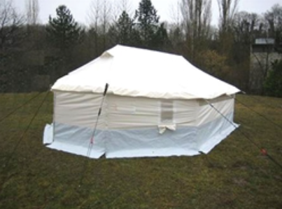
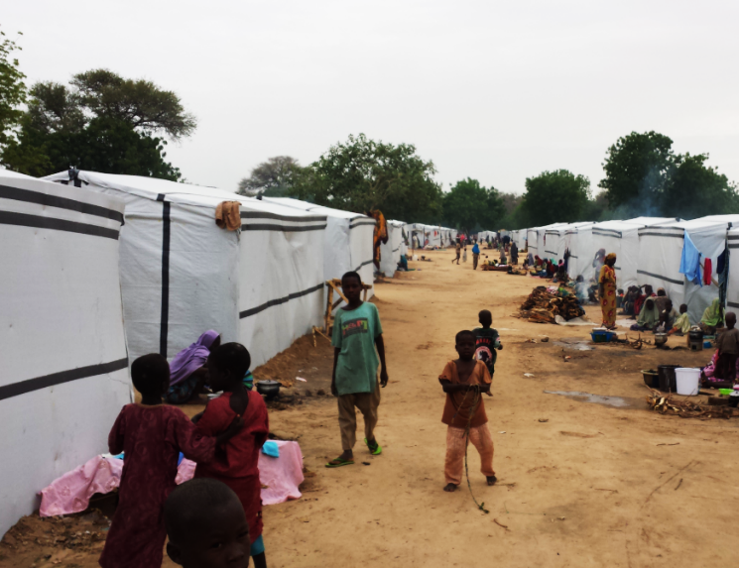
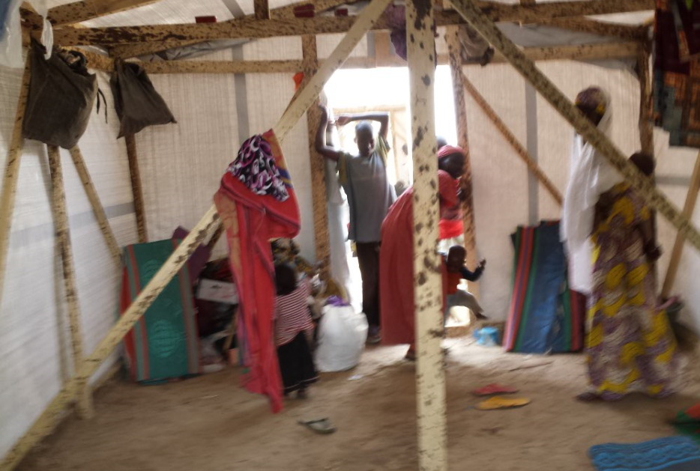
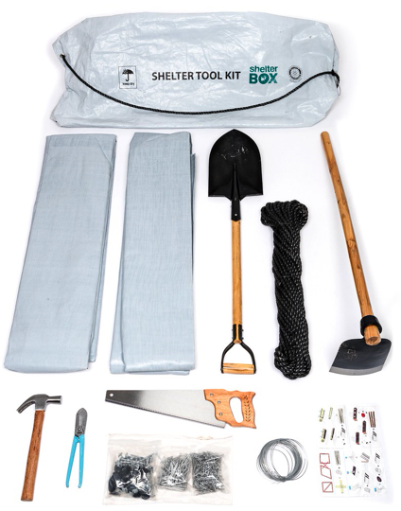
Emergency Shelter Options
Family Tents
Fabricated Shelters
Consider the best option, depending on time, resources, local customs and standards.
Don’t just distribute tents to beneficiaries without supervision, training and instructions.
Camps need to be planned and organized (see later, camp management)
Consider also the climate, maybe also a winterization kit is needed
Shelter Kits
19 m2 with possibility of winterization
Notes:
Options:
Tents (usually family tens of 16-18m2): fastest option if available. Still needs time (30-45min) and some training to erect.
Distribution of basic shelter kits, e.g. when site not accessible (material and tools with instructions for self-fabrication, or for improving existing shelters). Supervise if possible!
In situ fabricated shelters (usually made of timber and tarpaulin): needs timber and tarps. Quickly built but requires some training.
Rubbhalls and large tents: fast if available, but not recommended due loss of privacy and disruption of family/community structures.
Consider the best option, depending on material, skills, tools, time, budget, competences available and adapt to local customs and standards.
Avoid to distribute the tents to beneficiaries to set up by themselves. It will be completely disorganized, if teams are not trained and supervised.
Shelters need to be set up in an organized fashion and defined pattern (see later, camp management)
Consider also the climate. Tents used in desert for hot and dry climate will not fit for places with monsoon (waterproof). Distribute winterization kits for cold climate.

Slide 20
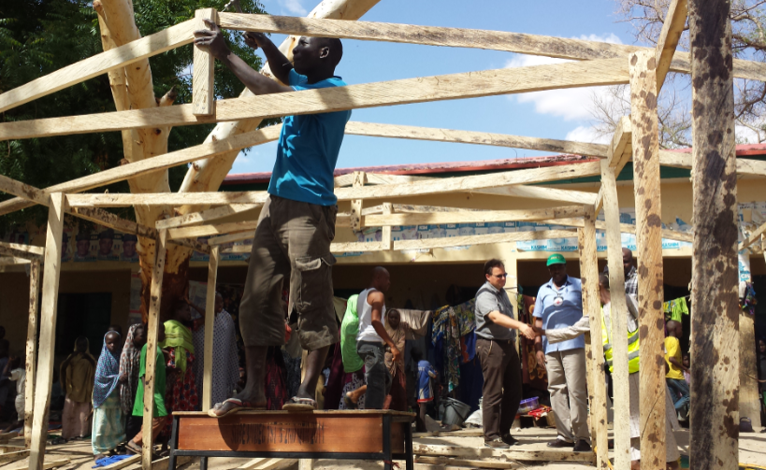
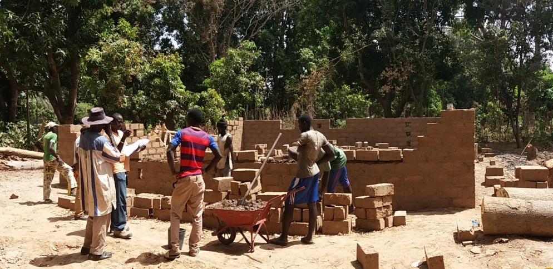
Shelter Assistance: Methods
Shelter assistance can be:
in cash (for construction, repairs or renting, if available rooms and functional market)
through vouchers (to buy construction material or services, if locally available)
in kind (providing building material and tools, needs skills, supervision and instructions)
through participatory construction works (e.g. cash for work, often incl. training)
contracted construction works (if contractors available and participation not realistic)
…or a combination of this.
Notes:
Discuss, which option may be more appropriate in which phase of a crisis and under which circumstances
Examples:
1.) temporary shelter construction in Nigeria 2015: paid teams of carpenters hiring local IDPs for support. Material provided by ICRC
2.) long-term houses in Casamance, Senegal 2017: Material provided by ICRC but work organized by communities through solidarity mechanisms

Slide 21
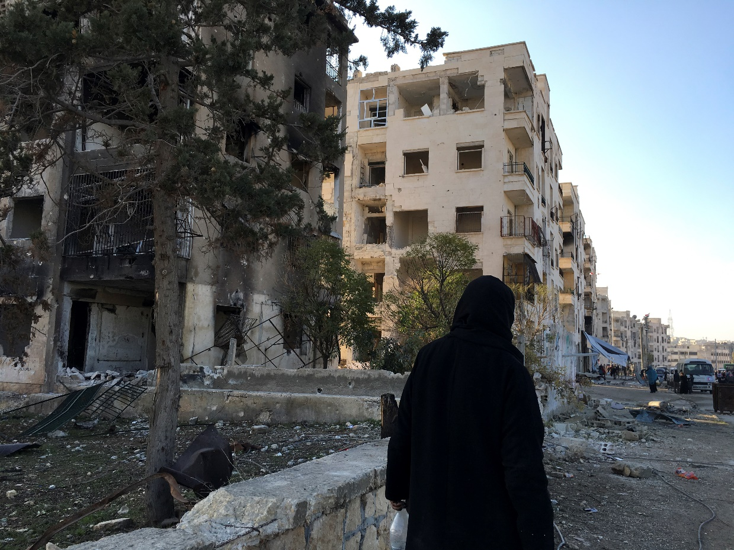
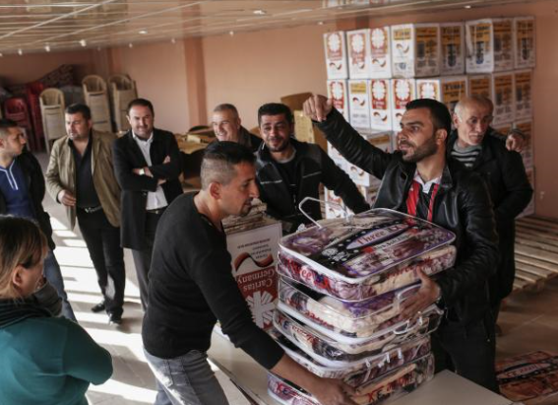
Emergency Shelter Support in Urban Setting
Depending on climate zone, → consider the provision of winterization kits
Notes:
Most of the time the displaced populations find a roof over their head, be it apartments or in other buildings. However, in some climate zones temperatures can drop very low and the population is not equipped for that. Central heating, if existent at all, are often not working due to lack of electricity or fuel supplies.
→ Consider the provision of winterization kits, like stove, fuel and plastic sheeting or emergency building material for insulation and basic repairs.

Slide 22
?
What are the essential criteria for the selection of a camp site?
Notes:
Exercice 10 min by group

Slide 23
Criteria for selection of a Camp Location
Political & Security Situation
Land tenure
Impact on local community, resources, environement
Necessary space (min 30 m2/person, including sanitation, common space)‏
Accessibility (roads, communication)
Proximity to existing essential and economic center
Water resource
Slope and drainage capacity
Soil type (avoid marshy or rocky soil)
Existing vegetation (shade, dust, fuel & environment)‏
Environmental health and natural hazards
Notes:
Give example:
Water if 10’000 persons, means 200’000 l per day, or 200 m3 or 20 water truck of 10 m3 per day
Same for the food, the need is between 5 and 6 tons per day.
Importance of the access
Space is very important. The 30 m2 per persons include all services but not private garden for families. If it is the case, one have to go for 45 m2 per persons.

Slide 24
Standards in Camp Layout
 | Sphere Project (2018) | UNHCR (2018)
Space required Minimum surface area of camp per person Minimum covered floor area per person Family tent 16 m² ? ? | 45 m², including garden 3.5 – 4.5 m² 4.6 - 3.6 p/tent | 30 m² + 15m² for garden 3.5 warm climates; 4.5-5.5 m² cold or urban 4.6 - 2.9 p/tent
Fire breaks Minimum dist. between buildings Minimum dist. between communities Minimum dist. between blocks | 2 m 6 m 15 m | 2 times structure height 3-4 times if highly flammable 30 m per built-up 300 m
Notes:
Importance of the area. Often people cannot imagine the space requirements of a camp.
For example: 10’000 people times 45 m2 (with garden) means 450’000 m2, which corresponds to approximately 65 football pitches, or one 18 holes golf course
To speak about Sphere projet standards. Web side www.shpereproject.com

Slide 25
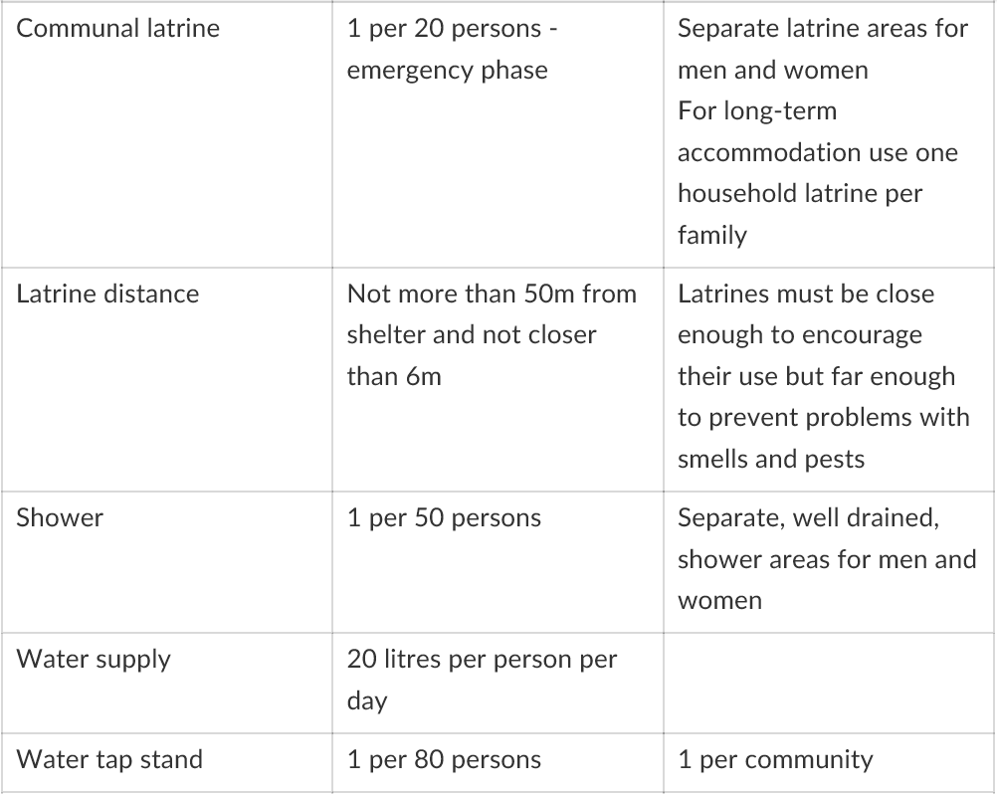
Standards in Camp Layout
Source: UNHCR emergency handbook, 20152018)
Notes:
Important to notice that the figures are indicators. It is important to reach and even overpass these but if, in the acute emergency phase it is too difficult to reach them, we have to deal with it. Quite often, one has one latrine for 50 persons, which is still better than nothing.

Slide 26
Standards in Camp Layout
Communal Latrine | 1 per 20 persons - Emergency phase | Separate latrine areas for men and women For long term accommodation use one latrine per household
Latrine distance | Not more than 50 m from shelter and not closer than 6 m | Latrines must be close enough to encourage their use but far enough to prevent problems of smells and pests
Shower | 1 per 50 persons | Separate, well drained, shower areas for men and women
Water supply | 20 litres /person /day
Water tap stand | 1 per 80 persons | 1 per community
Source: UNHCR emergency handbook, 20152018)
Notes:
Important to notice that the figures are indicators. It is important to reach and even overpass these but if, in the acute emergency phase it is too difficult to reach them, we have to deal with it. Quite often, one has one latrine for 50 persons, which is still better than nothing.

Slide 27
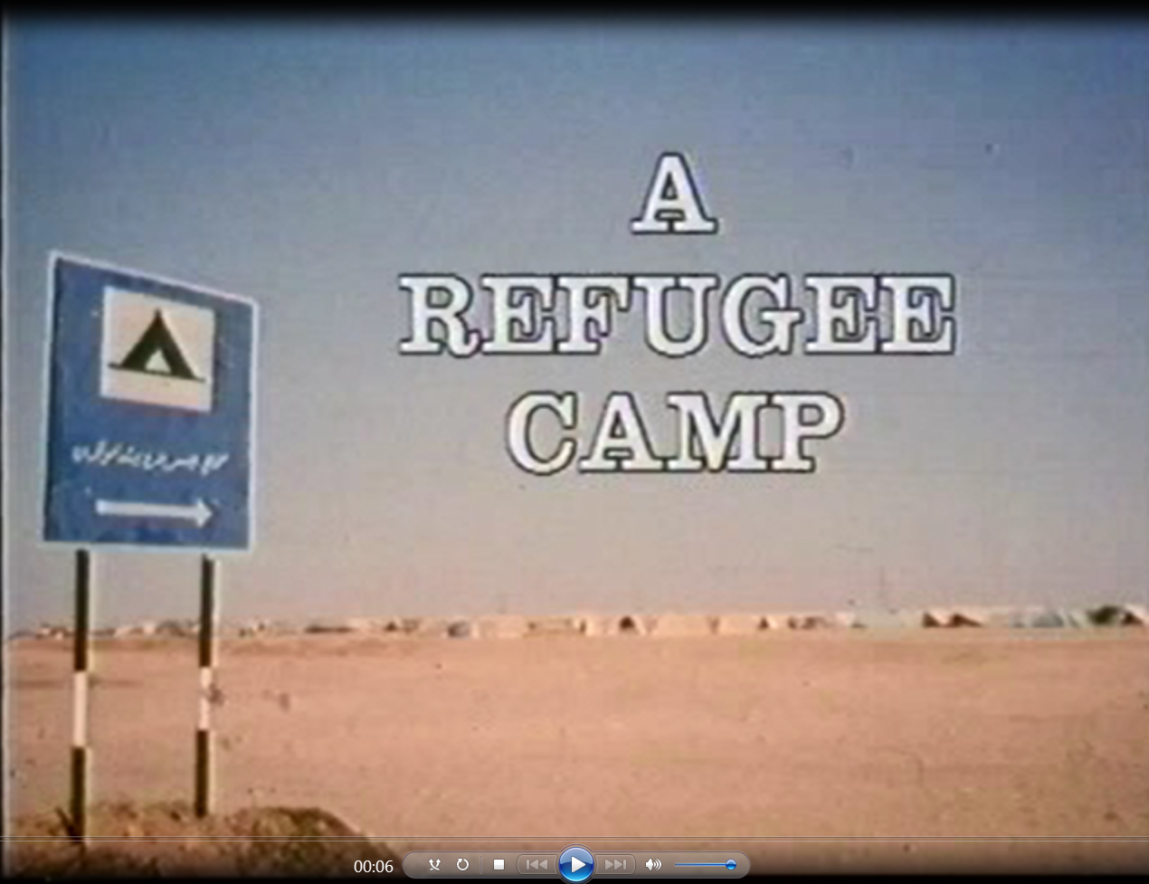
Video
Azraq, Jordan (1991)
Notes:
Movie 15’50 minutes

Slide 28
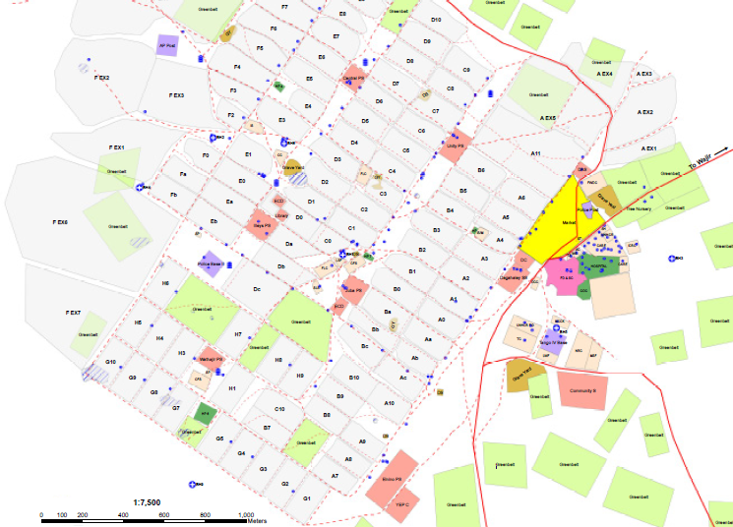
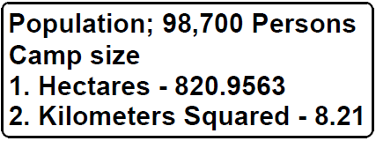
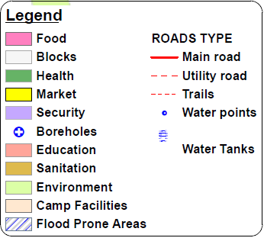

Preparing a Master Plan
Sources; UNHCR, LWF/DWS-Dadaab
Notes:
Example: Dagahaley Refugee Camp, Kenya 2013
Importance of designing a master plan with a vision on the number of people, the different communities hosted and the different services.
Use standards for space allocation, providing space for fire breaks, roads, sanitary facilities etc.
Organize camp in blocks and sectors, keeping communities together
Provide space for communal facilities like clinics, schools, markets, cooking areas, playgrounds, warehouse etc.
Consider space for expansion if more people arrive

Slide 29
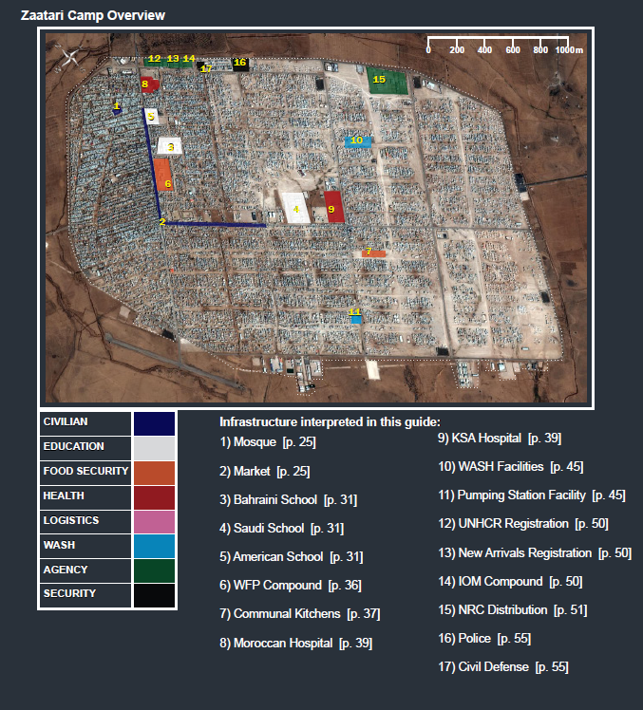
Preparing a Master Plan
Source: http://hhi.harvard.edu/publications/satellite-imagery-interpretation-guide-displaced-population-camps
Notes:
E.g. Zaatari Camp: Liberian refugees fleeing the war and settling in Gonama (Sierra Leone):
→ Satellite image are very usefull to plan. Easy to determine area and to make a simple outline of the planned camps. Use e.g. Google Earth, free and available can be already very useful for that. No need of a complicated and sophisticated software.

Slide 30
Size of a community unit
8m
4m
Space for 1 family plot = 64m2:
People per tent (16m² ~ 4-5pers)‏
Size of plot (type of tent)‏
  extra activities (garden, cattle)‏
  services (shower, latrines, water, garbage)
  ‏
Space for 1 community (grid-pattern):
50 to 100 people per community
10 to 16 family plots = 1 community
→ 1 community = 640-1024m2
16m²
4m
8m
2m
8m
40m
8m
8m
16m
40
e.g. 10 family plots, 640m2
Notes:
Importance to plan by cluster, sectors and blocks to stay organised.
Most probably the camp will grow up and new sectors built.

Slide 31
Design of Community Unit
8m
8m
Grid-Shaped
16m
40
40m
6m
4m
16m
U-Shaped
6m
40m
8m
8m
Square shaped
8m
24m
40
40m

Slide 32
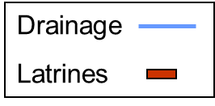
Design of Block
110m
180m
Example: 1 block with U-shaped communities
4x5 = 20 communities with 50pers. each. → 1'000 people on ~2 ha
(6m between communities for access, communal facilities etc.)

Slide 33
Design of Block
160m
180m
Example: 1 block with Square-shaped communities
4x4 = 20 communities with 50pers. each. → 960 people on ~3 ha
(6m between communities for access, communal facilities etc.)

Slide 34
Design of Sector
Block A
Block B
Block C
Block D
Water
H P
Mosc
Block E
250m to
350m
Kitchen
W H
Sport field
Distr. area
School
600m
Example: 1 Sector of 5 blocks ~5'000 people
→ Total size ~15 to 22 ha = 30 m2 per person

Slide 35
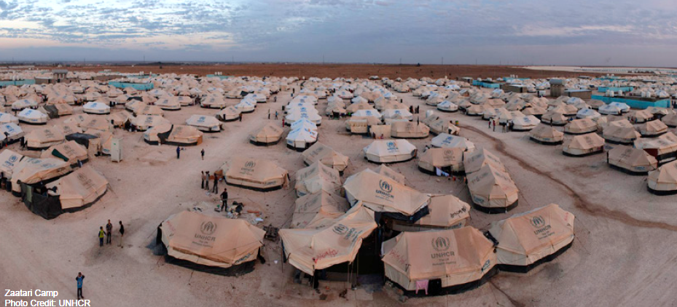
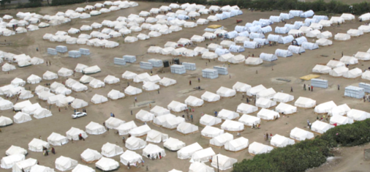
Camp Design- Examples

Slide 36
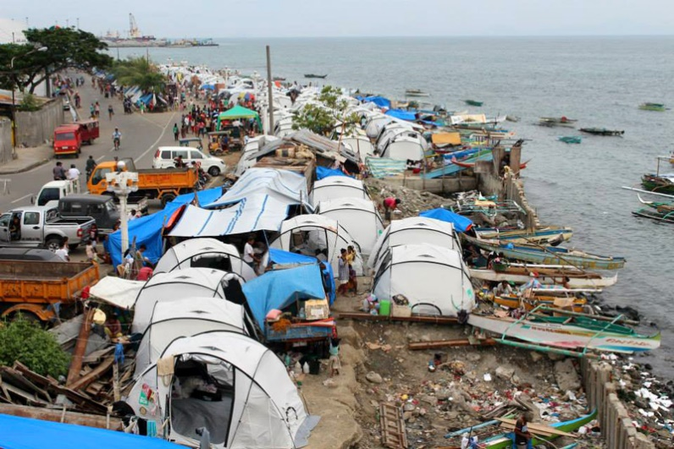
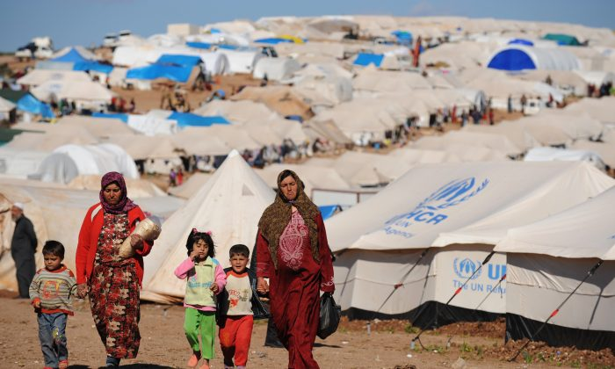
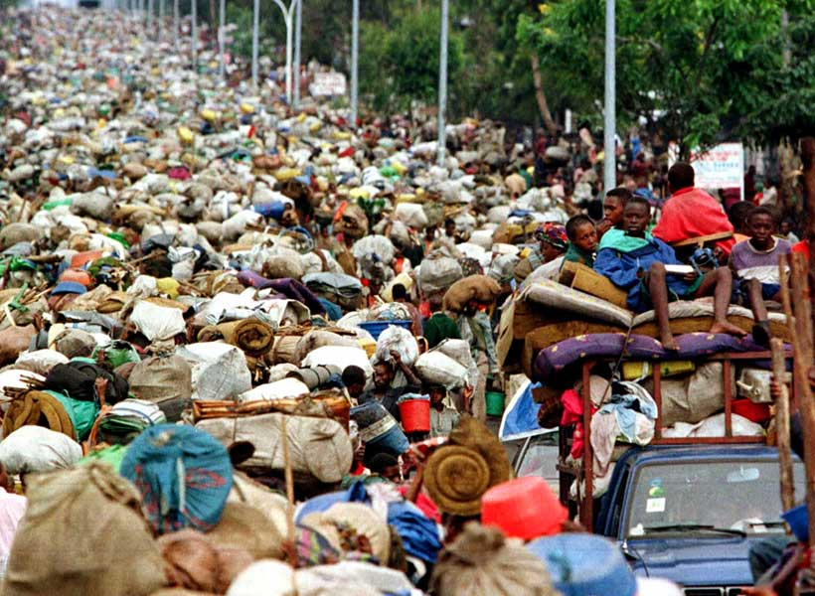
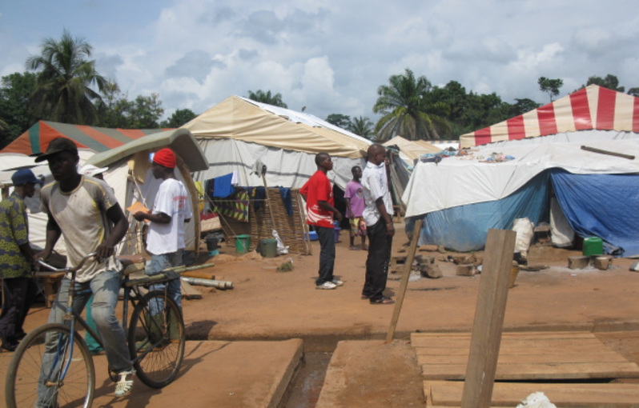
?
The reality... How to proceed when you find a transitional settlement that was created spontaneously without organization and that doesn’t comply with minimal standards?
Notes:
Discussion:
In reality, many of the transitional settlements are created spontaneously before any qualified authority or actor can interfere. Often, in order to assure appropriate living conditons and to provide minimal safety and essential services, camps have to be relocated or reorganised, meaning moving people, dismantling tents, etc. This can be very difficult but necessary in terms of access to services, fire safety, flooding zones, etc.
How do you go about it? What do you consider?

Slide 37
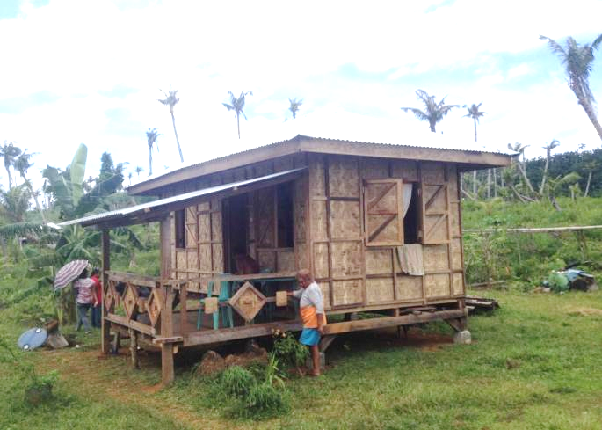
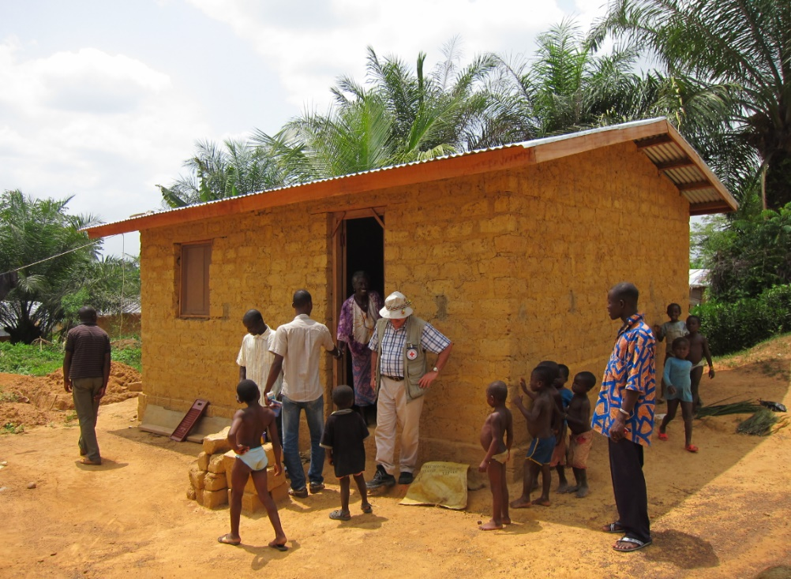
Shelter Programs for Returnees
Always adapt to local context: considering available material, skills, tools, time, budget and adapt to local customs and standards.
Use participatory approach if possible (e.g. cash for work, or ask for work/material contribution)
Use local material and techniques if available
Target especially most vulnerable (poor families, handicapped, women-head-of-households etc.)
Be transparent with the selection criteria
Avoid creating tensions between beneficiaries & non-beneficiaries & neighbors
Notes:
Construction of shelters for returnees, following conflict or natural disaster.
Examples:
Construction of shelters in the Philippines after destruction of houses by typhoon (2013 Typhoon Pablo – 3150 shelters , 2014 Typhoon Hayan – 4500 shelters)
→ using local wood and bamboo sheeting, training and paying local laborers with cash-for-work to cut wood, collect gravel, produce bamboo sheeting, do carpentry etc. targeting most vulnerable
Construction of >800 shelters in Ivory Coast (2011) after post-election crisis that resulted in burning and destruction of houses
→ Paying local population to fabricate cement-reinforced mud-bricks, providing timber and iron sheeting, paying local carpenters for construction, targeting most vulnerable

Slide 38
Wrap-up: Shelter in Displacement
An IDP is someone who is forced to flee his or her home but remains within his/her country. A refugee has left his country of origin or has no nationality; is protected under refugee law.
A lack of shelter can have multiple effects on physical-, mental- and reproductive health.
Displaced find refuge in different forms of transitional settlements, all having their particular challenges. The shelter assistance has to be adapted to the specific needs of their inhabitants.
Depending on the situation and phase of the crisis, a shelter assistance can be short-, mid- or long term. Best approaches can vary from provision of cash, vouchers or material to the payment of labor or entire construction works.
Shelter assistance programs should always be adapted to the local context and standards. If possible, use participative approaches, use local material and techniques and prioritize vulnerable populations.
Always consider also the needs of the host-communities, to avoid tensions and strengthen their capacity to support the displaced populations.
Camps have to be well designed and planned, considering site selection criteria and minimal standards. Assure sufficient space allocation for shelters, reads, security, services and possible extensions. Camps also need to be managed, all in coordination with communities and authorities.

Slide 39
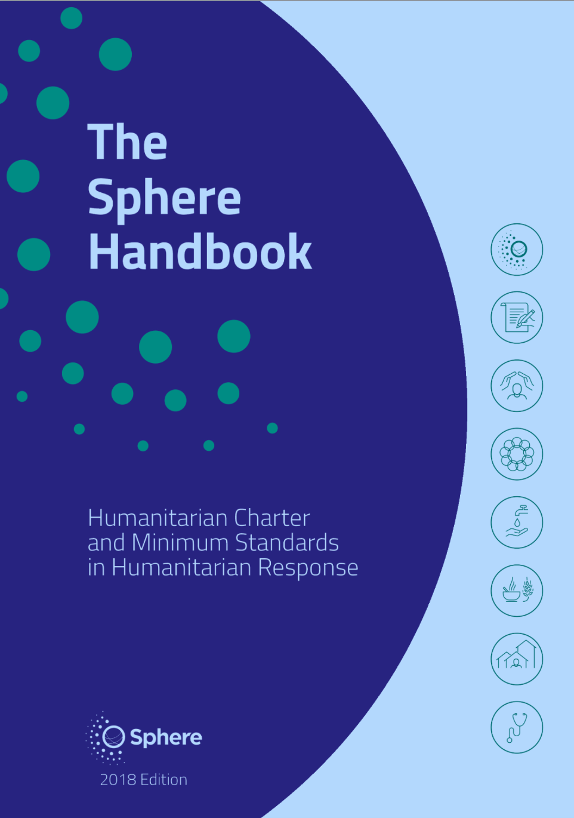
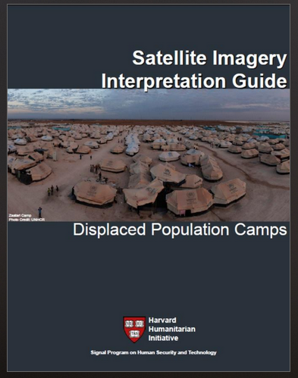
References

