Slide 1

Nutrition and food security programmes and strategies
Logo organization(s) facilitator(s)
H.E.L.P. course
These learning materials have been developed by:
Rachel Lozano, ICRC, Valérie Belchior-Bellino, ICRC,
Mija Ververs, John Hopkins University/CDC and
Nicole Niederberger, Terre des Hommes
Name(s) and organization facilitator(s)
Notes:
Prepare the video:
CALP video: https://www.youtube.com/watch?v=ZNUQ36xH9II

Slide 2
Objectives
Be able to
explain the concept at the basis of Nutrition-sensitive and Nutrition-specific interventions
illustrate ways to address the causes of malnutrition through Nutrition-sensitive interventions
illustrate ways to prevent and treat malnutrition through Nutrition-specific interventions
describe which types of food security and nutritional interventions can be implemented in different crisis situations
H.E.L.P. course

Slide 3
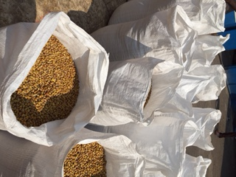
What types of food and nutrition programmes did you already see in acute and protracted crisis situations?
H.E.L.P. course

Slide 4
1. Relief Programmes
2. Nutrition Programmes
General Food Distribution
General
population
At Risk
Malnourished
H.E.L.P. course
4. Nutrition for sick patients
3. Preventive Programmes
Notes:
4

Slide 5
General food distribution (GFD)
When:
  Severe decline food availability + accessibility
  Food security level : 4 and 5
  ex: recent displacement → supply ↓, food price ↑
Objectives
  To cover basic food needs of the whole population
  To maintain + restore regular livelihood → prevent malnutrition and death
How
  Adequate quantity and quality (full, dry, cooked)
  Distribution equitable with local, governmental collaboration
H.E.L.P. course
Notes:
5

Slide 6
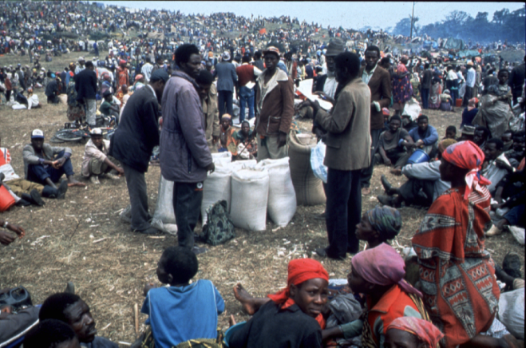
H.E.L.P. course

Slide 7
General distribution is
a ‘full’ ration
At least 2100 kcal/person/day
10-15% proteins, 30-35 % fats
ITEM
QUANTITY
C
ereal
400 gr
Beans
60 gr
Oil
25 gr
Cupercerals
50 gr
Sugar
15 gr
Salt
5 gr
TOTAL
555 gr
Ex: WFP Ration
2113 kcal
11% proteins
18% fats
H.E.L.P. course
Notes:
7
A food distribution when done like recommended by Un agencies, which is the best scenario can cover basic needs of the population.
A part of the population is forbidden… children below 5 years old need dense food rich in vitamines and minerales, which is not the case of a DFG ration.
CSB was added but not always given, not always known by the population, not always possible to be cooked, not always well cooked, often share in the family and at the end not useful for younger!
In an emergency situation, even before to have cases of malnutrition all vulnerable – children- start to loose weight. If at this time a proper food is given to children they will continue to lose weight and to enter in malnutrition.
For a 1 year old children → 70 cm, the median weight is 8.5 kg and the <70% weight is 6kg.
For a 6 months old infnat → 65 cm, the median weight is 7 kg and the < 70% is 5 kg!

Slide 8
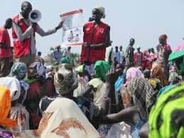
Education during the GFD
At the distribution point
To make sure the use of nutritional product is well understood
Radio spots, poster… before, after distribution
H.E.L.P. course
Notes:
Education:
Before the distribution in villages
At the distribution points
During monitoring
To ensure products
To avoid misused
With the most adapt approach
CSB given to goat, to

Slide 9

Communication on Super Cereal
H.E.L.P. course

Slide 10
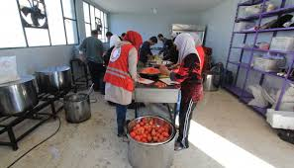
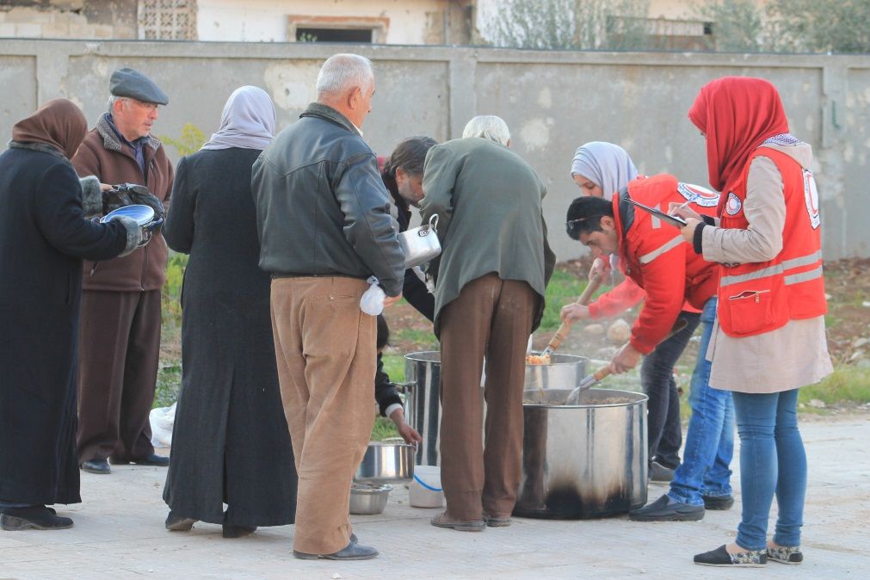
Cooked food distributions
No means to cook at HH level
No means to transport food
But
Increased cost for cooking and staffing
Hygiene control
H.E.L.P. course
Notes:
Only used when people do not have the means to cook for themselves: for example during heavy flooding, sudden movements of groups of people without any means to prepare or obtain food, large groups of children (or older people, mentally sick people) without skills (and capacity or means) to prepare or obtain food
Ex: Mogadishiu early 1990, specific population in orphanage or school. Prison population
Increases the price and logistic issue

Slide 11

In extreme emergencies:
BP5 or HEB
1 box / 1 person / 1 day Maximal period: a month
H.E.L.P. course
Notes:
Education:
Before the distribution in villages
At the distribution points
During monitoring
To ensure products
To avoid misused
With the most adapt approach
CSB given to goat, to

Slide 12
Monitoring of the GFD
Food basket monitoring at the end of the distribution or later at home to monitor:
  the quality of the food perceived by the beneficiaries
  the ration received
  timing of the distribution
Post distribution monitoring, to follow
  malnutrition trend
  food consumption
  coping mechanism
An accountability system should be set-up
In order to reduce or increase the GFD, design a more adapted approach
H.E.L.P. course

Slide 13
1. Relief Programmes
2. Nutrition Programmes
General Food Distribution
Targeted Food Distribution
General
population
At Risk
Malnourished
H.E.L.P. course
4. Nutrition for sick patients
3. Preventive Programmes
Notes:
13

Slide 14
Targeted Food Distribution (TFD)
When:
  ↓ access to food for vulnerable households
  Food security level (IPC): 3 and 4, may be 5 if no GFD
  Inadequate or ineffective GFD
Objectives
  To prevent deterioration of nutritional status
  ↑ food availability /accessibility rapidly
How
  A short term intervention (3 to 4 months max.)
  Minimum 500 kcal/person→ ration for all family members
  With strong lobby simultaneously
H.E.L.P. course
Notes:
14

Slide 15
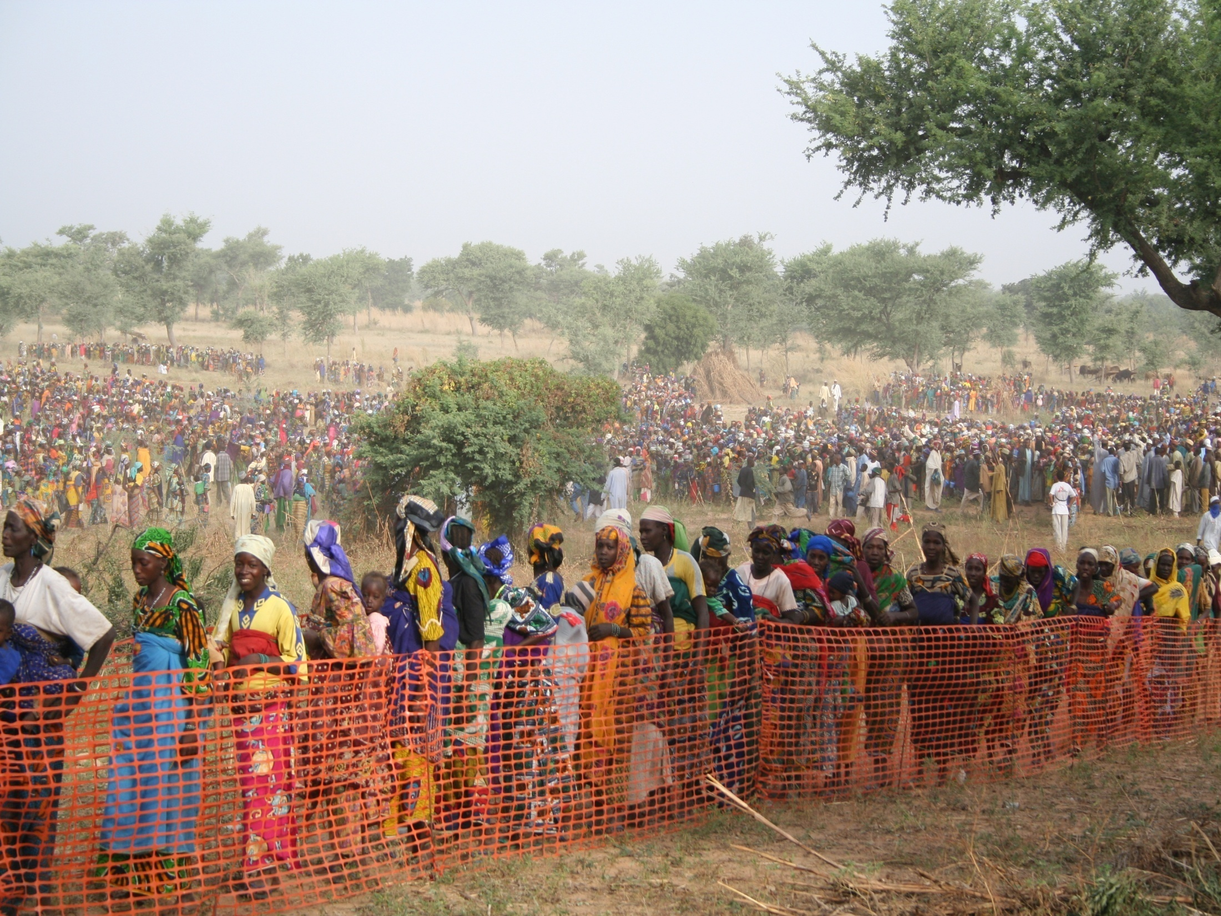
Part
3.b
TFD, Magaria, Niger 2005
H.E.L.P. course
Notes:
15

Slide 16
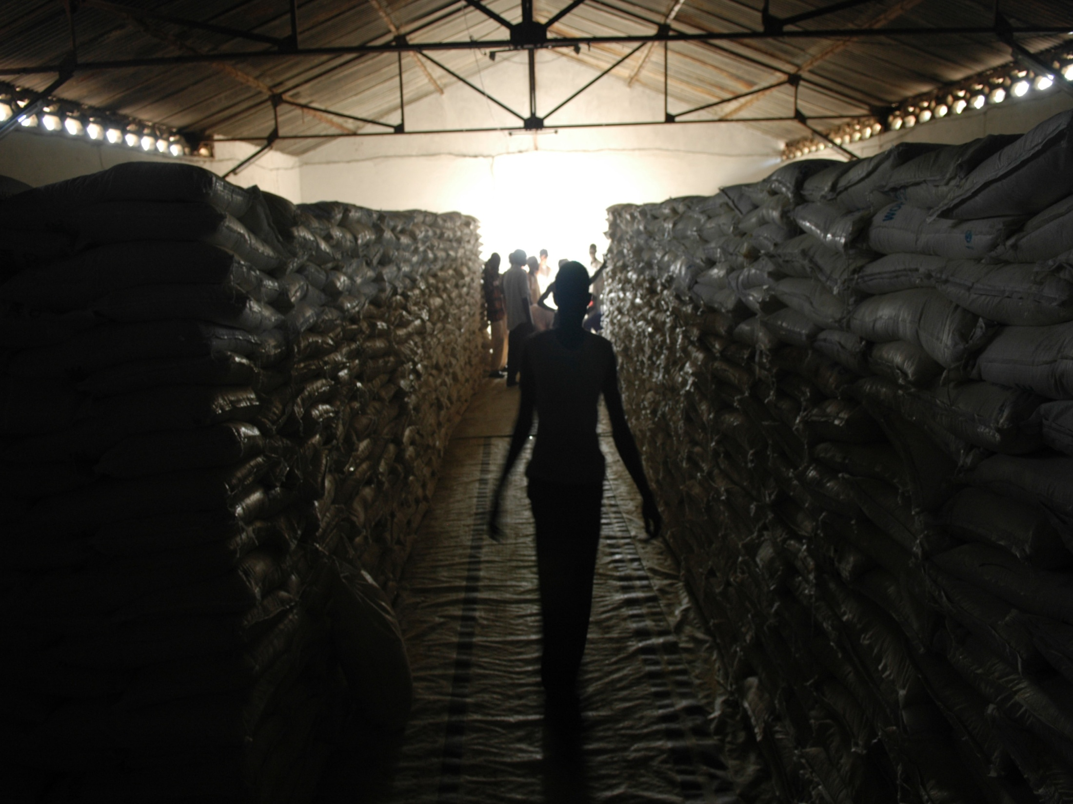
H.E.L.P. course
Large quantities of food
Notes:
16

Slide 17
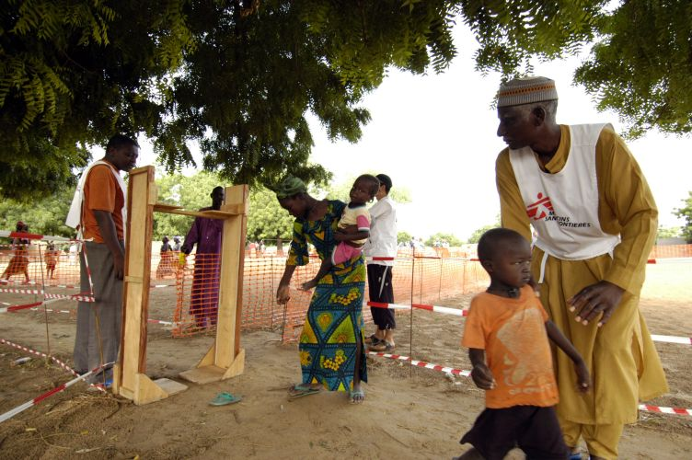
Mostly through < 5 years
H.E.L.P. course

Slide 18
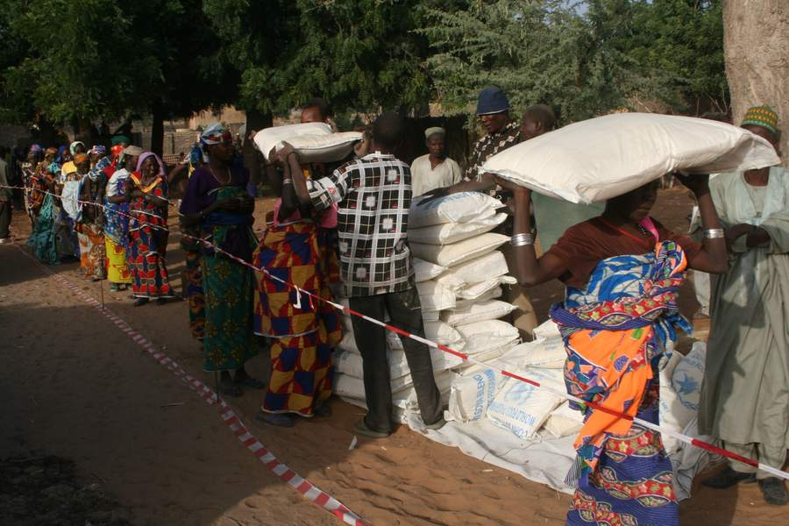
H.E.L.P. course

Slide 19
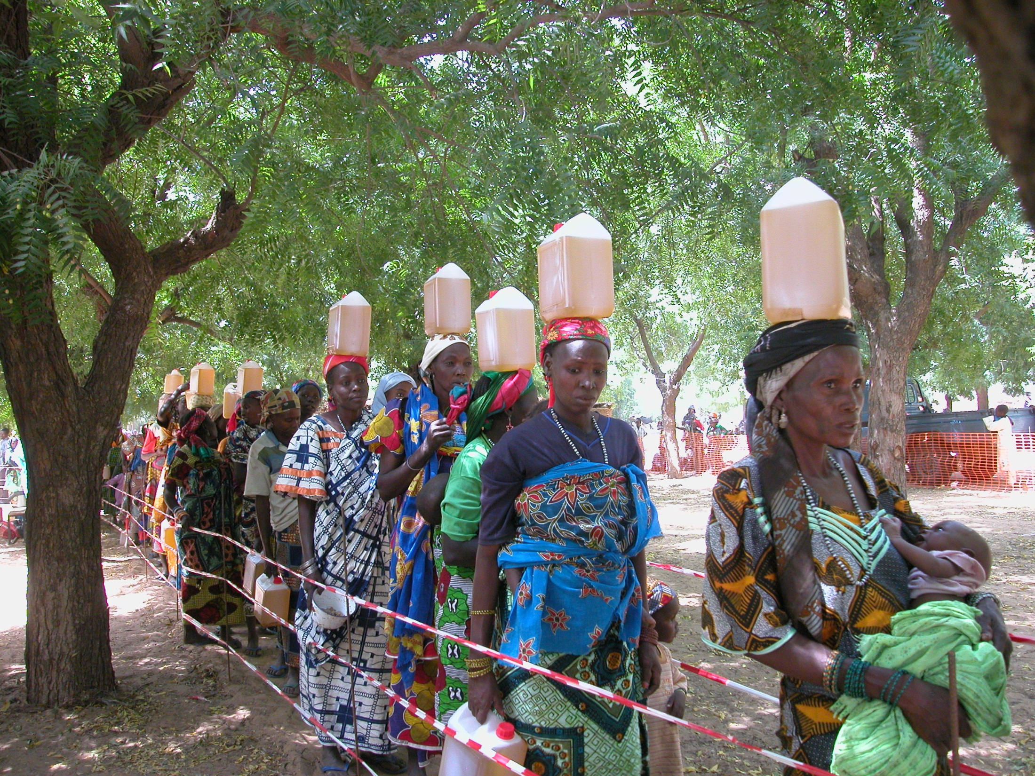
For the entire family
H.E.L.P. course
Notes:
19

Slide 20
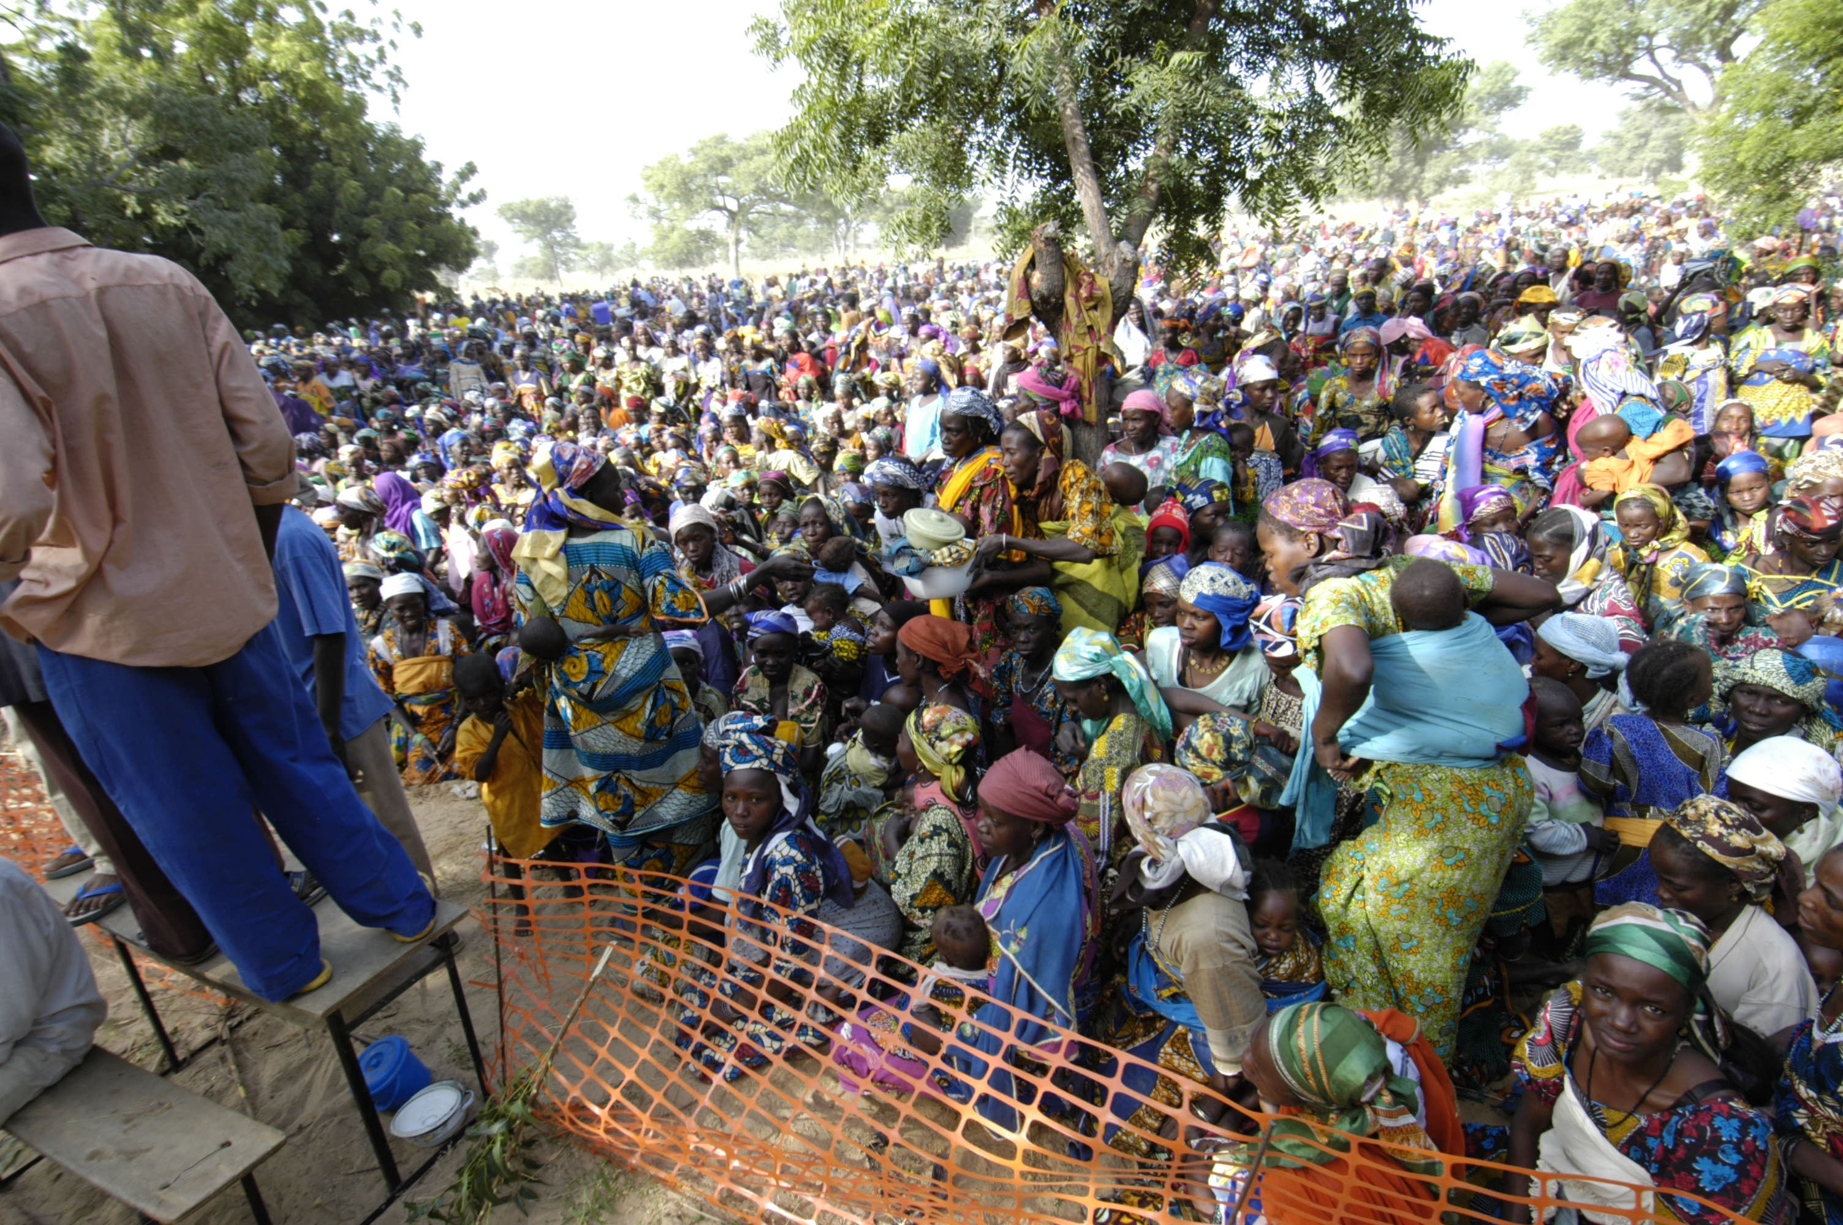
H.E.L.P. course
And crowd control!
Notes:
20
Now the questions are: “Should we use blanket distribution in other type of context?”
“Should we change the product given (CSB) to really prevent malnutrition and have best outcome?

Slide 21
Precautions for food Aid Operations
Political challenges
  A tool for manipulation or for controlling people
  should be efficient, impartial, equitable, transparent & accountable
Financial challenges
Food aid is extremely expensive
An in-depth Analysis of the situation permits to develop a range of arguments to donors
Logistical challenges
Food aid is a high priority in emergency settings to save life
should arrive (procurement&, transportation) and be distributed quickly
Human challenges
To be able to set up the operations (means)
To communicate with government, leaders, partners, donors, families…
H.E.L.P. course
Notes:
21

Slide 22
1. Relief Programmes
2. Nutrition Programmes
General Food Distribution
Targeted Food Distribution
Cash Transfer programmes
General
population
At Risk
Malnourished
H.E.L.P. course
4. Nutrition for sick patients
3. Preventive Programmes
Notes:
22

Slide 23
New approaches for GFD
Distribution of food vouchers or cash
  Favors the local economy
  Families consume food they like
  Easier for the logistics
But:
  Security issues
  Money not spend on food
  May cause food prices to increase
H.E.L.P. course

Slide 24
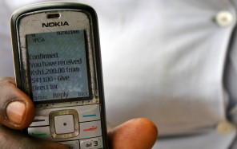
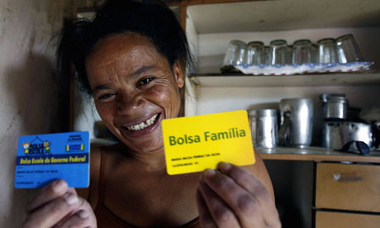
Cash transfers
Dignity in decision
Choice and diversity
Supports the local economy
Easier logistically – often faster
But…
May not be spent on food
Markets / minimum security requirements
CALP video: https://www.youtube.com/watch?v=ZNUQ36xH9II
H.E.L.P. course
Notes:
More and more trendy. Can be a problem to target the 1000 days (U2 not benefitting it because of individual choices or because market has not the items for U2. So program can be complemented each other.
Cash ultimately gives choice, people can meet their wide range of dietary needs – promotes fresh produce
Supports local economy – if signed an agreement with financial service provider in advance, can be extremely quick
Lots of concerns about risks – 10+ years of evidence shows risks can be mitigated. Of course need functioning markets and need to consider security – but cash is more discreet than in kind and often preferred by beneficiaries
Plenty of evidence that shows if people are food insecure, they spend money on food
Can give cash just for food, but normally is part of multi purpose cash grant (MPG) which is a cash grant given to meet basic needs, based on an expenditure basket of food, and other needs depending on context (clothes, shelter, water etc.)
Link vers vidéo You tube?
Ajouter : foire (ex RDC)

Slide 25
Vouchers
Value vouchers
  specific value – can buy any items sold by specified trader
Commodity vouchers
  restricted to specific commodities sold by specified trader
Supports the local economy
Some choice, but restrictions mean can be targeted only for food items
But…
Limits choice
Can be logistically complicated
Markets/minimum security requirements
H.E.L.P. course
Notes:
More and more the trend. Can be a problem to target the 1000 days (Under 2y old not benefitting from it because of individual choices or because the market has not the items for U2.
So, different kind of interventions can be complement each other.
Vouchers give more choice than GFD but less than cash – however vouchers allow it to be restricted only for food, or for specific food items. Supports local economy as contracts are signed with local traders
Lots of concerns about risks – 10+ years of evidence shows risks can be mitigated. Of course it need functioning markets and there is a need to consider security – but vouchers are more discreet than in kind (although cash even more discreet) and often preferred by beneficiaries

Slide 26
1. Relief Programmes
2. Nutrition Programmes
General Food Distribution
Targeted Food Distribution
Therapeutic Feeding programme
Supplementary Feeding Programme
Cash Transfer programmes
General
population
At Risk
Malnourished
H.E.L.P. course
4. Nutrition for sick patients
3. Preventive Programmes
Notes:
26

Slide 27
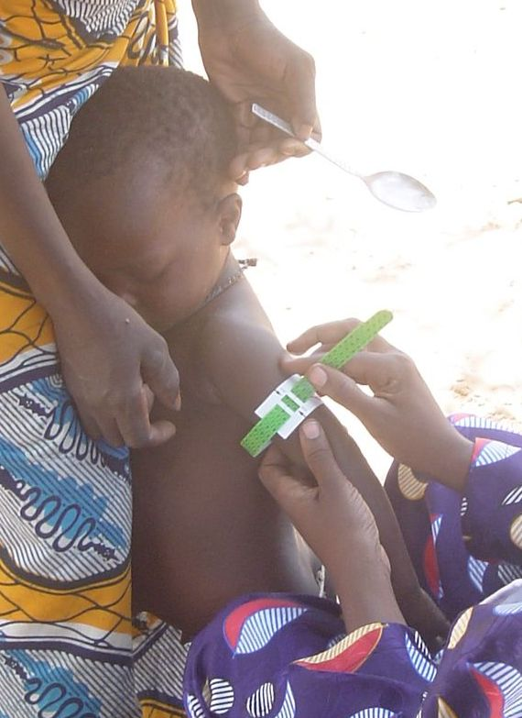
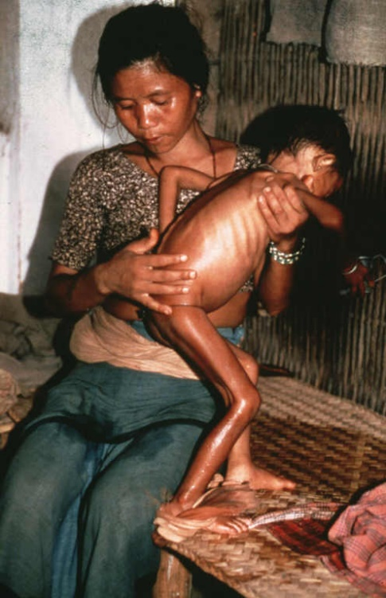
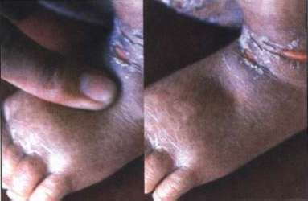
Reminder: Acute Malnutrition
Clinical ‘diagnosis’
Anthropometrical
‘diagnosis’
Weight
Height
W/H
High risk of
mortality
Acute Wasting
Marasmus
Marasmus
kwashiorkor
+
Oedema
Kwaskiorkor
+
MUAC
H.E.L.P. course
Notes:
27

Slide 28

Acute malnutrition
Severe acute malnutrition
With medical complications
Weight for height <-3 ZS
Or
MUAC <11.5 cm
Or
Bilateral pitting edema
and medical complications
Severe acute malnutrition
Without medical complications
Weight for height <-3 ZS
Or
MUAC <11.5 cm
Or
Bilateral pitting edema
and no medical complications
Moderate acute malnutrition
Weight for height ≥-3 ZS
and <-2 ZS
Or
MUAC ≥11.5 and <12.5 cm
H.E.L.P. course
Inpatient therapeutic care
Outpatient therapeutic care
Outpatient supplementary feeding
Notes:
CMAM
SAM definition : essentially anthropometric criteria
Complicated or not complicated: medical criteria
Reference in-patient / out patient
Specificities for Ttt for under 6 months: feeding and breastfeeding
**Children with MAM with medical complications are admitted to supplementary feeding but are referred for treatment of the medical complication as appropriate
Complications: anorexia or no appetite, intractable vomiting, convulsions, lethargy or not alert, unconsciousness, lower respiratory tract infection (LRTI), high fever, severe dehydration, severe anaemia, hypoglycaemia, or hypothermia

Slide 29
Therapeutic Feeding Programme (TFP)
When
  Target : All age groups
  In all food security situations
Objective
  To reduce mortality among severely malnourished individuals and to treat severe acute malnutrition (SAM) by providing intensive medical and nutritional cares
How
  Stabilization centre → Inpatient therapeutic feeding center (for complicated SAM)
  Out-patient treatment → Ambulatory therapeutic feeding center (for uncomplicated SAM)
H.E.L.P. course
Notes:
29

Slide 30
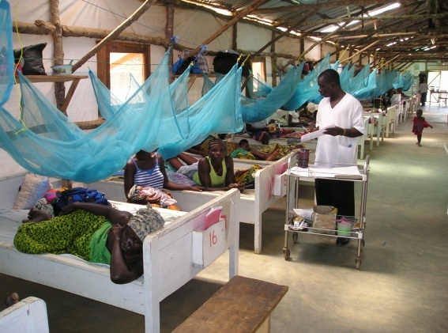
H.E.L.P. course

Slide 31
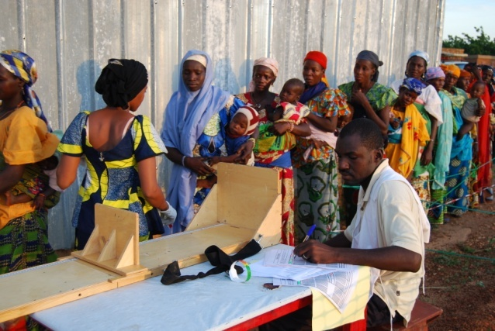
H.E.L.P. course

Slide 32
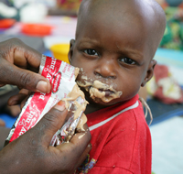
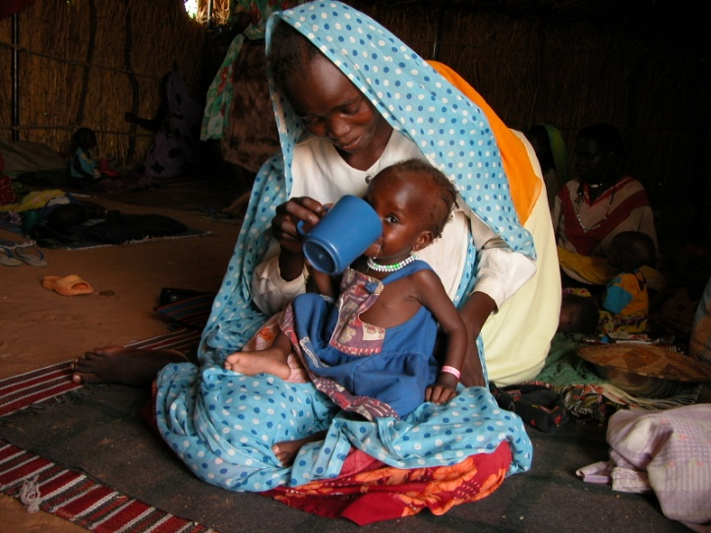
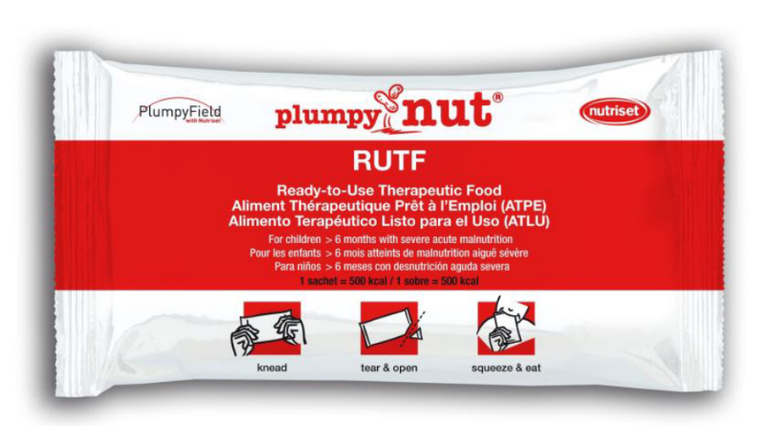

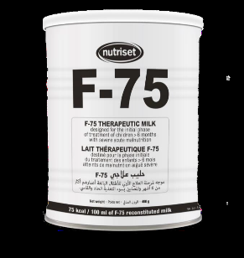
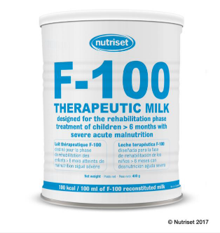
Products for SAM treatment
H.E.L.P. course

Slide 33
Supplementary Feeding Programme (SFP)
When
High prevalence and numbers of moderate malnutrition
Food insecurity level 3, 4 and 5
Objective
To treat moderate malnourished individuals and prevent severe malnutrition
How
SFP with a weekly (or every 2 weeks) dry ration (most used)→ Nutrition + medical care
Collective supplementary feeding with a monthly distribution → patients selected by MUAC, no medical follow up
H.E.L.P. course
Notes:
33

Slide 34
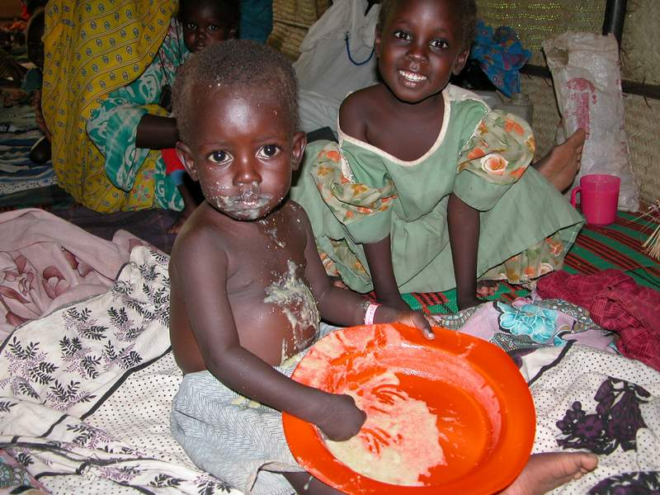
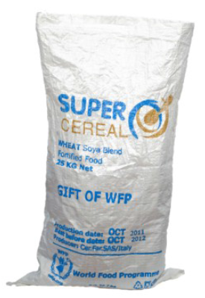
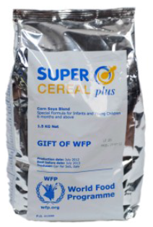
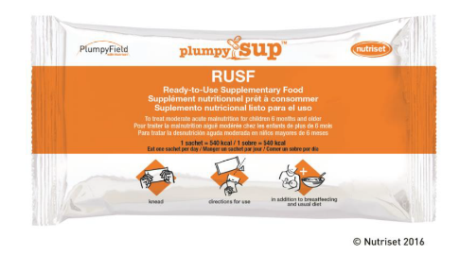

Products for MAM treatment
Blended flour : Supercereal type – to make a porridge
Ready to Use Supplementary Food
Local food
+ Systematic medical treatment
H.E.L.P. course

Slide 35
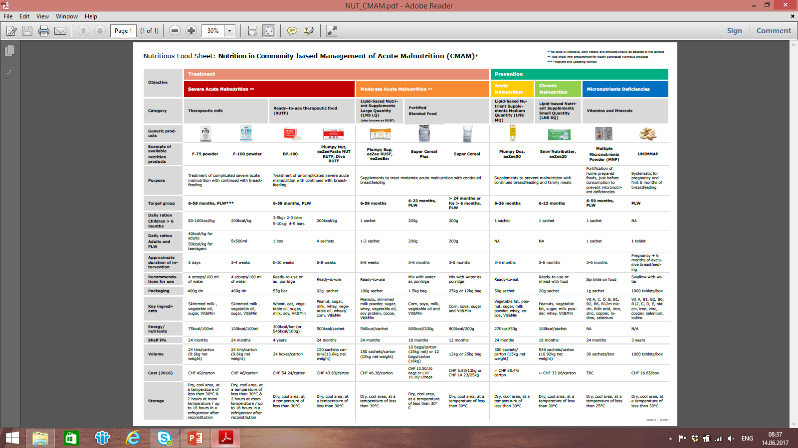
H.E.L.P. course

Slide 36
1. Relief Programmes
2. Nutrition Programmes
General Food Distribution
Targeted Food Distribution
Therapeutic Feeding programme
Supplementary Feeding Programme
Cash Transfer programmes
General
population
At Risk
Malnourished
H.E.L.P. course
Infant Feeding in emergencies
4. Nutrition for sick patients
3. Preventive Programmes
Notes:
36

Slide 37
Infant feeding in emergencies
Why:
Emergency could affect infant feeding due to the mother’s stress
Objective:
Prevention on morbidity, mortality and development of malnutrition among young infants
How:
Dedicated structure and staff who provide infant feeding advice, psychological support, nutrition screening and identification of acutely malnourished infants and mother
Can be included in existing mental health and psychosocial support programmes
H.E.L.P. course

Slide 38

The mother of our displaced family delivered a few days ago. It’s a boy, called Little Red. Because of the difficult conditions of the pregnancy, Little Red has a low birth weight and his mother is tired
??
What type of support/program would they need?
H.E.L.P. course
Notes:
A compléter

Slide 39
Preventative interventions | Proportion of U5 deaths prevented
Exclusive and continued breastfeeding until 1 year of age | 13%
Insecticide treated materials | 7%
Appropriate complementary feeding | 6%
Zinc | 5%
Clean delivery | 4%
Hib vaccine | 4%
Water, sanitation, hygiene | 3%
Antenatal steroids | 3%
Newborn temperature management | 2%
Vitamin A | 2%
Impact on mortality of a preventive intervention in children under five
H.E.L.P. course
Notes:
800’000 death annually could be avoided trough exclusive breastfeeding
We’ll come back to the programmatic intervention linked to that issue.
Hib vaccine = Meningitis vaccination
Even in non-emergency situations, breastfeeding and complementary feeding interventions combined will prevent 19% (i.e. 1 in 5) of deaths in children under 5 years.
Source:
Jones et al. How many child deaths can we prevent this year? Lancet 2003; 362: 65–71

Slide 40
1. Relief Programmes
2. Nutrition Programmes
General Food Distribution
Targeted Food Distribution
Therapeutic Feeding programme
Supplementary Feeding Programme
Cash Transfer programmes
General
population
At Risk
Malnourished
H.E.L.P. course
Infant Feeding in emergencies
4. Nutrition for sick patients
3. Preventive Programmes
Notes:
40

Slide 41
Nutrition for ill patients
Objective:
To support groups with specific needs
  HIV / Aids patients
  TB patients
  Inpatients at hospital
  Measles patients
  Malaria patients
  …
Interventions may vary for each group
H.E.L.P. course
Notes:
Wounded. Need to feed as well the patient where we run hospital services as nutrition status is an important determinant of health in these population.
Need of high quality protein food and high protein food.

Slide 42
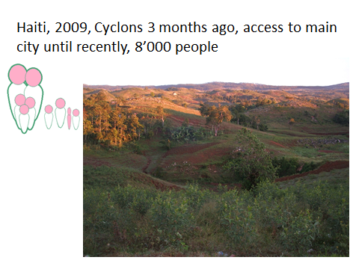
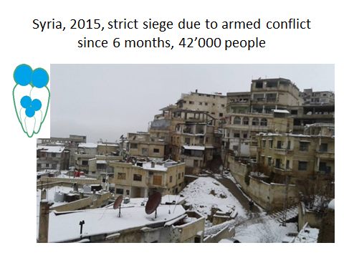
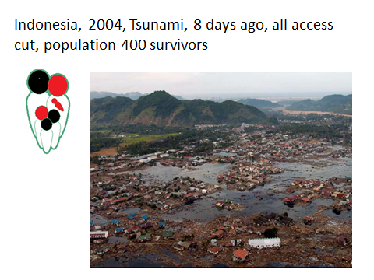
Based on the available information about the current situation of the community in which your families are hosted
List the priority programmes you would like to implement in nutrition and food security?
Argument your strategy and the choice of each programme
H.E.L.P. course
Notes:
Imagine you work for a large polyvalent NGO. One sentence
Haiti : To confirm the existence of nutritional crisis situation and to understand the causes of current nutritional crisis situation as well as existing resilience mechanism and expected evolution of crisis.
Syria: Providing quantitative assessment of malnutrition situation in under five and in general population and main causes for design of emergency assistance response in support to that population and support advocacy actions.
Indonesia: Identify the vulnerable groups and priority needs of surviving population related to nutritional risk factors.

Slide 43
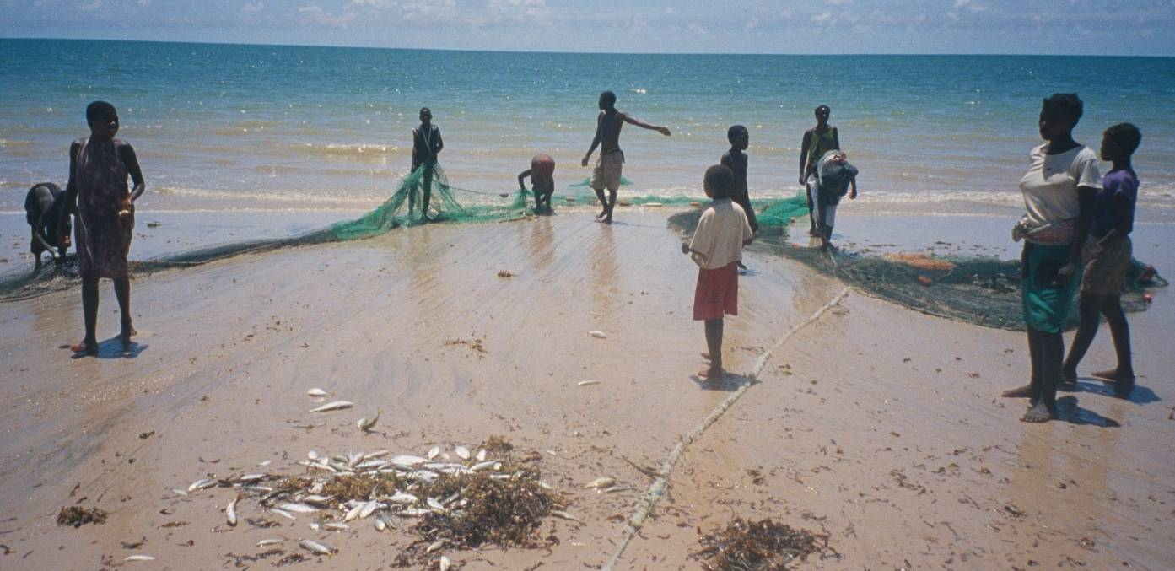
Livelihood support interventions
H.E.L.P. course
Notes:
Module 1 Part 1: minutes 1:28-4:26 or 6:08
http://agrilinks.org/training/nutrition-sensitive-agriculture
If time, intro nut sensitive / USAID video

Slide 44
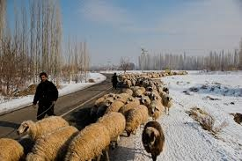
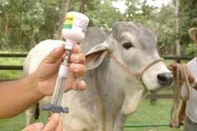
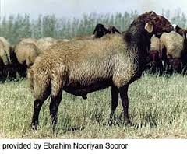
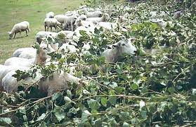
Livestock programmes
What is the relation between the provision of veterinary services and prevention of malnutrition?
H.E.L.P. course
Restocking or destocking of animals, veterinary services
fodder distributions…
Can be in kind, cash transfers or vouchers…
Notes:
Destocking is selling the animals, and provide them back ot the popualtion as meat

Slide 45

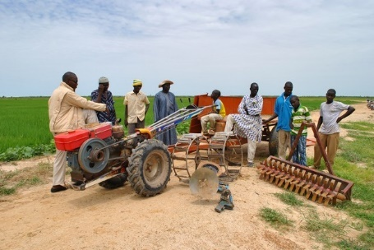
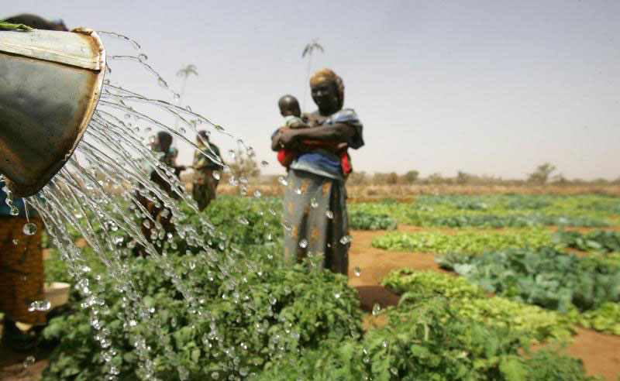
Seeds and tools programmes
Distribution of seeds and tools
Seeds multiplication, irrigation, agricultural machinery
Technical support on agricultural practices
Can be in kind, cash transfers or vouchers…
H.E.L.P. course

Slide 46
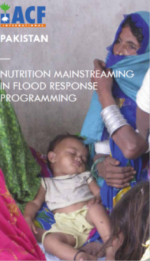

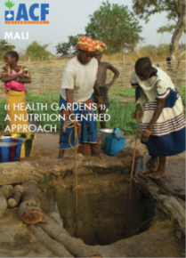
Examples of case studies
H.E.L.P. course
Notes:
In handouts

Slide 47
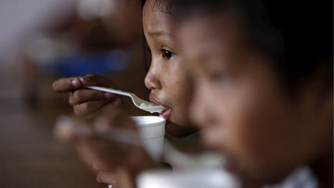
Thank your for
your participation
H.E.L.P. course

