Slide 1
Measuring malnutrition
Logo organization(s) facilitator(s)
H.E.L.P. course
These learning materials have been developed by:
Rachel Lozano, ICRC, Valérie Belchior-Bellino, ICRC,
Mija Ververs, John Hopkins University/CDC and
Nicole Niederberger, Terre des Hommes
Name(s) and organization facilitator(s)

Slide 2
Objectives
Be able to
identify the nutritional status in different age groups or biological groups, using anthropometry
H.E.L.P. course

Slide 3
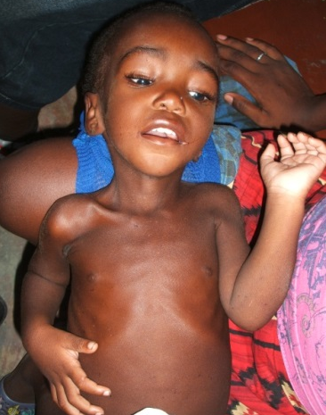
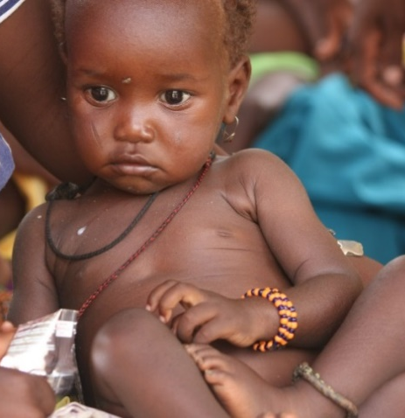
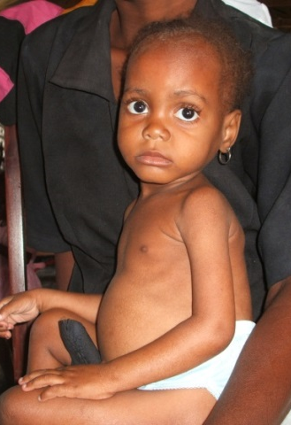
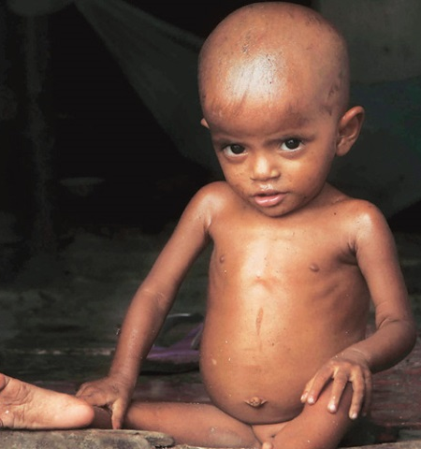
Why do we measure malnutrition?
To help identify
Malnourished from non malnourished,
Acute from chronic malnutrition, and
Severe from moderate forms of malnutrition
To enable:
Classification of nutritional status of individuals
Identifying prevalence of malnutrition in populations
H.E.L.P. course
Notes:
These are then
- related to age and sex
- compared with international reference standards
We’ll come back to prevalence in population in the assessment part of this course

Slide 4
How do we measure malnutrition?
H.E.L.P. course
Notes:
Ask whether the participants have experience with anthropometric measurement
The objective here is not to enable you to perform the measures, which needs training and exercise, but to give you an insight into the topic

Slide 5
How do we measure malnutrition?
Clinical signs
Anthropometry - Body measurements
Weight, Height
Mid-upper-arm circumference (called MUAC)
Oedema
And, comparison with international standards
H.E.L.P. course

Slide 6
In which age groups do we measure malnutrition?
Children from 6-59 months:
First and most hit by changes in nutritional risk factors => early indicator
Most at risk to die from malnutrition
Standardized methods available
Pregnant and lactating women
Increased risk factors and consequences for themselves and their child
Infants under 6 months
Other groups
H.E.L.P. course
Notes:
6-59 months is until their 5th birthday
Infants under six months: assessment requires additional clinical signs or follow up over time. Case management is also different from older children
All other population: for example elderly, detainees,

Slide 7
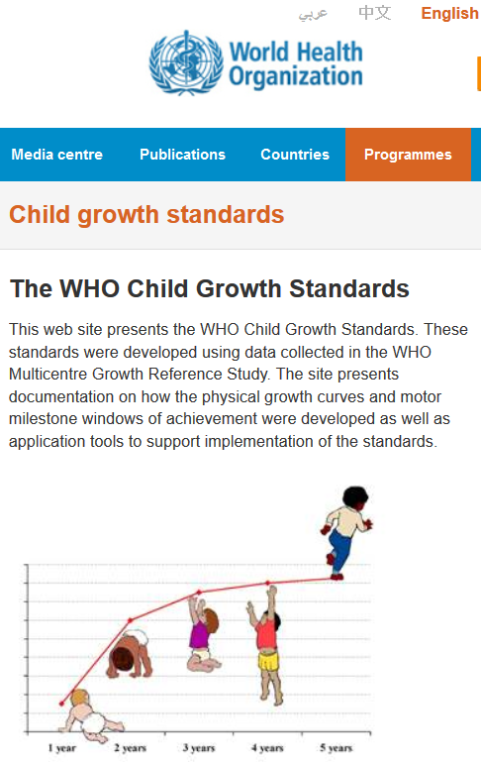
International standards for growth (WHO 2006) http://www.who.int/childgrowth/en/
WHO: “Multicenter Growth Reference Study (MGRS)’’took place between 1997 and 2003 to make new growth curve to follow infants and young children around the world.
Growth and development of around 8500 children from different countries and ethnic groups (Brazil, Ghana, India, Norway, Oman & USA). These children were breastfed.
We use 1 international standard reflecting the best growth for all healthy children from birth to 19 years old.
H.E.L.P. course

Slide 8
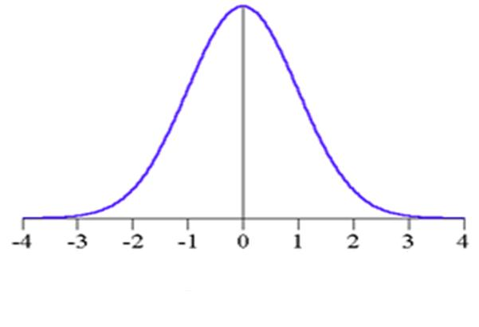
Expressing Indices: Z-Score
ET = 1
H.E.L.P. course
Notes:
Notes for facilitator:
See Annex 5.1 for an example explaining the concept of standard deviation.
Low standard deviation: your data is « close » to the median.
High standard deviation: your data is dispersed over a large interval.
Example:
We must separate two exam results of a class of 30 students; the marks of the first exam vary between 31 % and 98 % and those of the second between 82 % and 93 %. Given this range, the standard deviation will be higher for the results of the first exam.

Slide 9
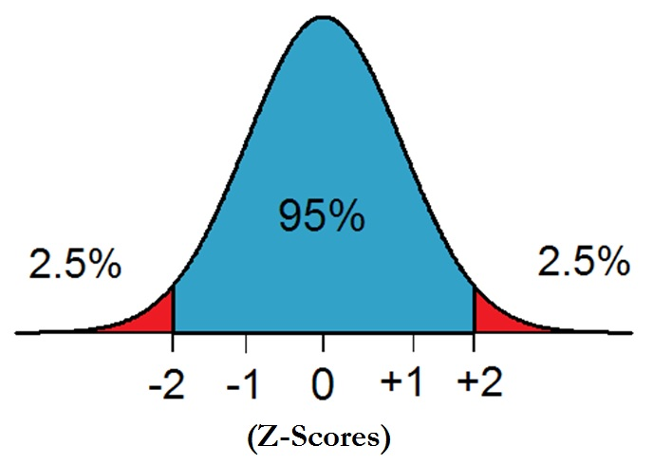
WHO Reference Population
H.E.L.P. course

Slide 10
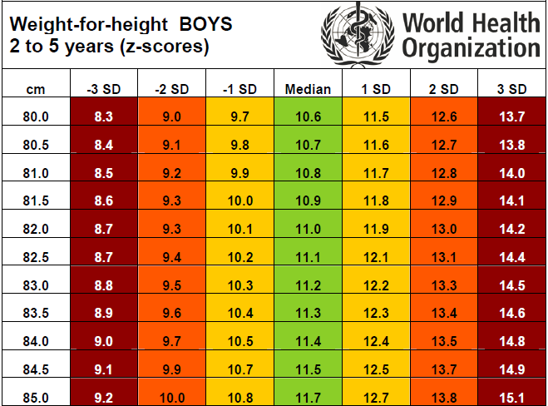
Example: WHO Z-score Table
H.E.L.P. course

Slide 11
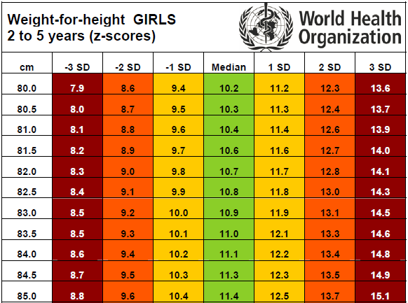
Example: WHO Z-score Table
H.E.L.P. course

Slide 12
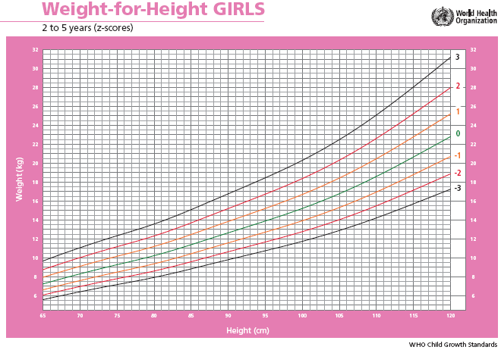
H.E.L.P. course

Slide 13
Children between 6 and 59m
Wasting/
marasmus or Kwashiorkor*
Acute
malnutrition
Weight-for-Height (WFH)
Oedema
MUAC
Stunting
(Shortness)
Chronic
malnutrition
Height-for-Age (HFA)
H.E.L.P. course

Slide 14
Cut-off points for acute malnutrition for children
Acute Malnutrition | Weight for height | MUAC
Moderate Acute Malnutrition MAM | ≥ - 3 and < - 2 Z-scores | ≥ 115 and < 125 mm
Severe Acute Malnutrition SAM | < - 3 Z-s or oedema | < 115 mm or oedema
Global Acute Malnutrition GAM = SAM+MAM | < - 2 Z-s or oedema | < 125 mm or oedema
H.E.L.P. course
Notes:
Explain something on Z-scores:
Z-Scores (average weight and SD (= standard deviation) : 1 z-score is 1 SD, 2 z-scores is 2 SD from the mean)
< 115 mm is a suitable criterion to identify severely malnourished children for treatment (amongst children with height of 65 cm - 110 cm i.e. 6-59 months) : predictor of the risk of death among these children
The 115 mm is a recent decision agreed upon worldwide amongst agencies and academic institutions as the mortality increases exponentially when a child has a MUAC < 115 mm (it is also high when MUAC is measured at 110, but this means that you will miss the ones with high mortality risk between 110 and 115mm).
See: WHO child growth standards and the identification of severe acute malnutrition in infants and children
A Joint Statement by the World Health Organization and the United Nations Children’s Fund, 2009
Cut-off points exist as well for chronic malnutrition

Slide 15
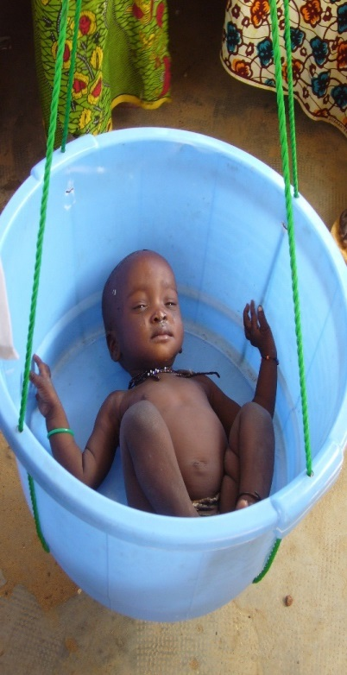
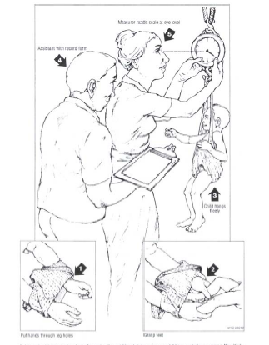
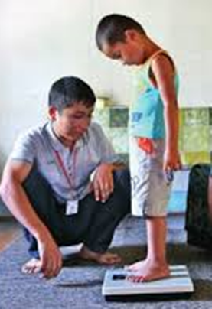
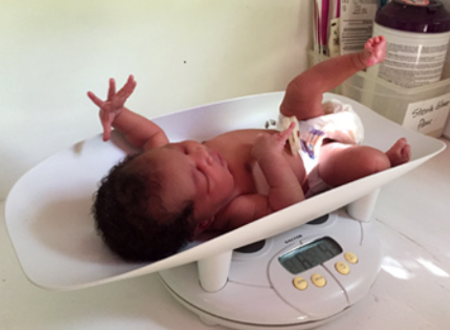
Weight
H.E.L.P. course
Notes:
For all these anthropometric measures, there are standard procedures and techniques to follow, in order to enable, as much as possible reproductibility of the measurment.
Needs a scale adapted to age
Limited or no clothing if possible (clima, cultural norms)

Slide 16
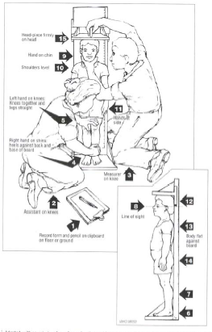
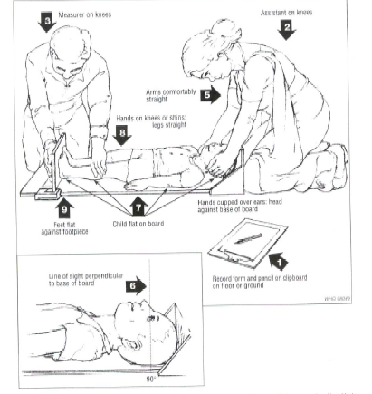
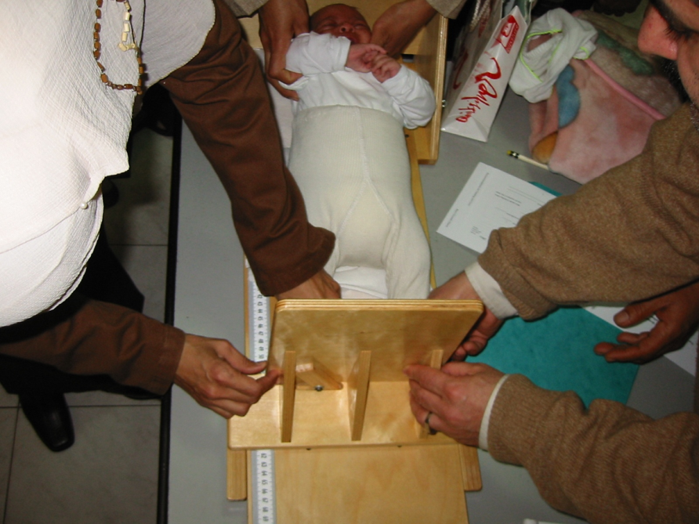
Height
H.E.L.P. course
Notes:
Measuring board adapted to age
Lying down under 2 years or 85 cm
Remove shoes

Slide 17
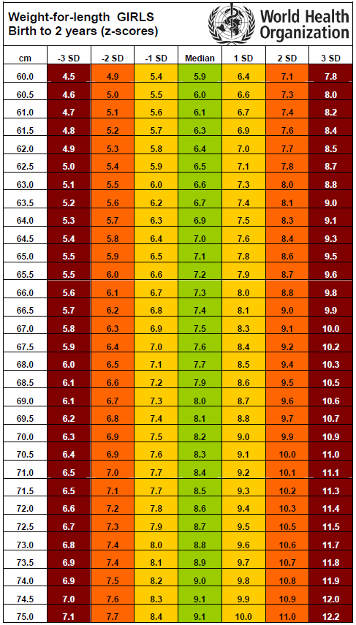
Weight for height/length
Little pink
Girl, 11 months
72.5 cm, 6.4 kg
H.E.L.P. course
Notes:
Is determined by using standard tables or graphs. Z score express the gap compared to the mean
WHO standards replaced the former NCHS standard
The WHO Multicentre Growth Reference Study (MGRS) was undertaken between 1997 and 2003 to generate new growth curves for assessing the growth and development of infants and young children around the world.
The MGRS collected primary growth data and related information from approximately 8500 children from widely different ethnic backgrounds and cultural settings (Brazil, Ghana, India, Norway, Oman and the USA).
The formula is observed measure – mean measure (for age/height) / mean measure - -1standard deviation.
Different tables exist for each age group and indicator.
Let’s do the exercise for little pink

Slide 18
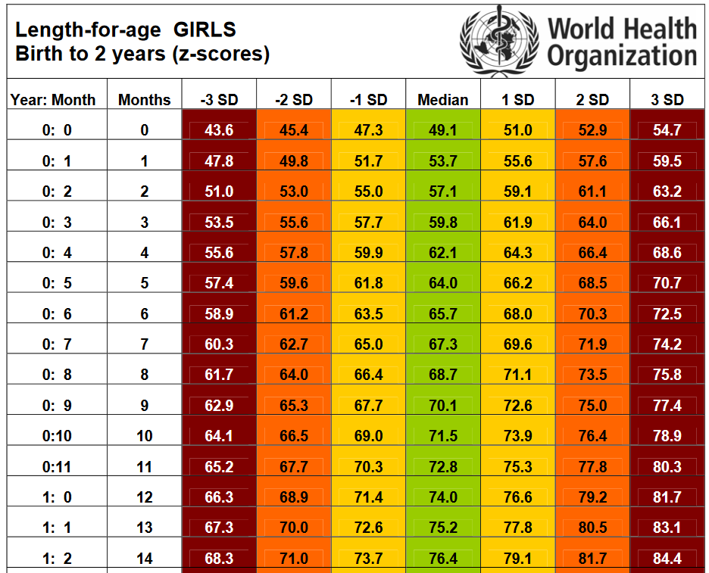
Height for age
Little pink
Girl, 11 months
72.5 cm, 6.4 kg
H.E.L.P. course
Notes:
Is determined by using standard tables or graphs. Z score express the gap compared to the mean
WHO standards replaced the former NCHS standard
The WHO Multicentre Growth Reference Study (MGRS) was undertaken between 1997 and 2003 to generate new growth curves for assessing the growth and development of infants and young children around the world.
The MGRS collected primary growth data and related information from approximately 8500 children from widely different ethnic backgrounds and cultural settings (Brazil, Ghana, India, Norway, Oman and the USA).
The formula is observed measure – mean measure (for age/height) / mean measure - -1standard deviation.
Different tables exist for each age group and indicator.
Let’s do the exercise for little pink

Slide 19
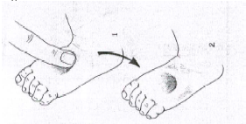
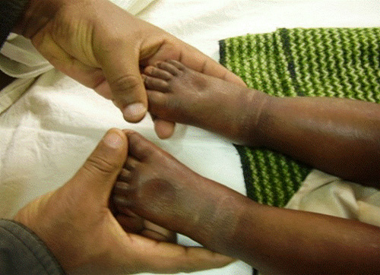
Oedema
H.E.L.P. course
Notes:
One crocodile, two crocodile, three crocodile
On both feets simultaneously
Nutritionnal oedema are bilateral, soft, ascendant, usually not painful.

Slide 20
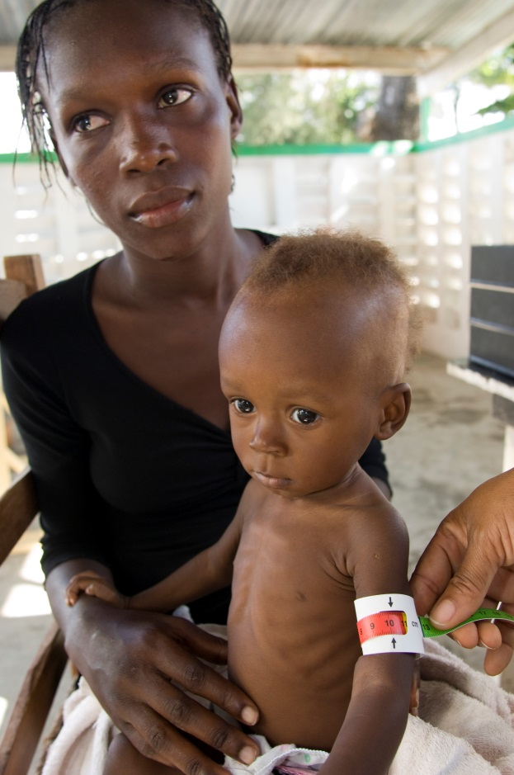
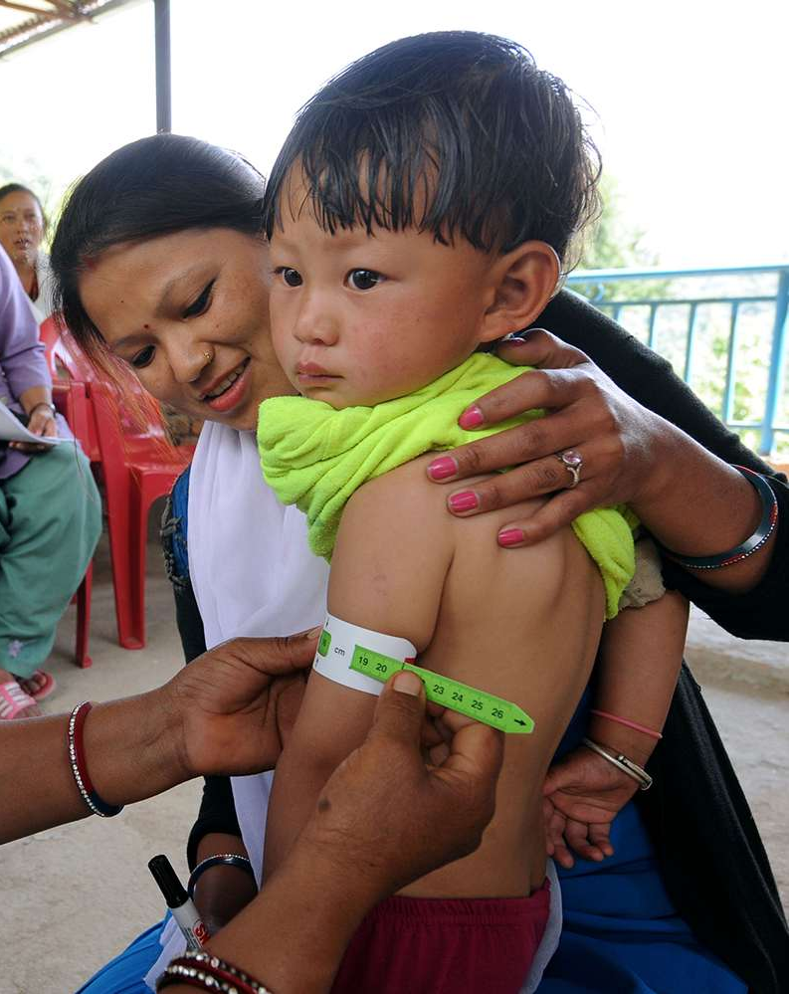
MUAC = Middle upper arm circumference
Little pink, 11 months
MUAC: Red, 113 mm
H.E.L.P. course
Notes:
Exercise water bottle
MUAC for children 65 cm - 110 cm or 6-59 months. Specific use instruction
MUAC value is closely related to mortality risk
Useful for rapid evaluation of nutritional situation and rapid assessment when you do not have time or material conditions to perform weight measurement. One can use a stick with two marks, at 65 and 110 cm to identify size group in case true age is not easily available

Slide 21
Which indicator is the best index in crisis situations?
MUAC
Little pink has a WH Z <-3 and a MUAC <115 mm.
Weight for height & MUAC are in children from 6 to 59 months the most used nutritional indexes because these reflect recent conditions.
Young children are generally the most nutritionally vulnerable.
Weight for height
Oedema
Height for Age
H.E.L.P. course

Slide 22
Pregnant and Lactating Women
Extremely important group
If they are malnourished their (unborn) child might be as well
If their survival is at risk, survival of their children is also at risk
Standard BMI cut-off points are not applicable
MUAC is the tool used to identify malnutrition: MUAC <230 mm for pregnant and Lactating women
Note: A lactating woman with a malnourished infant (< 6 months) should receive complementary feeding while her infant is enrolled in nutritional programmes
H.E.L.P. course
Notes:
For details on 210-230 mm
http://fex.ennonline.net/7/supplementation.aspx and various different sources : the table in this article might be of help how to choose your approach, depending on the context
Other relevant background information on this:
For pregnant women: various cut-off points are used by different agencies and NGOs. Until a SCN publication consensus is reached, MUAC < 230 mm (moderate risk) is recommended as stated in the SPHERE standards (SPHERE 2004). Since a MUAC < 230 mm has been shown to carry a risk of growth retardation of the foetus, using this cut-off point for admission into feeding programmes would allow addressing the problem of malnutrition in both mother and foetus by contributing to an improved birth outcome. In practice, MUAC < 210 mm is often used in emergency interventions. The choice should be made according to proportions of women falling under each category of MUAC and available resources.
Source: GUIDELINES FOR SELECTIVE FEEDING THE MANAGEMENT OF MALNUTRITION IN EMERGENCIES
May 2009 WFP and UNHCR

Slide 23
Infants under 6 months
We speak of “nutritionally vulnerable”
Weight for age
Bilateral oedema
MUAC
Admission criteria for treatment are different, can include assessment of weight gain over time and assessment of breastfeeding.
Treatment differs significantly also
H.E.L.P. course

Slide 24
Adolescents and adults
BMI (body mass index) is used, with specific cut-off depending on age
Weight (kg)
BMI (kg/ m²) = ---------------
Height (m²)
Nutritional oedema
MUAC
Low weight for age (WAZ) and Low weight for height (WHZ)
Corrections must be made for particular cases such as
elderly unable to stand upright and amputees
H.E.L.P. course 2019
Notes:
Adult:
BMI <16 = severely malnourished
BMI 16 – 16.9 = moderately malnourished
BMI 17-19 = at risk
Adult with bilateral oedema = severe acute malnutrition
And/or MUAC:
men
≥ 224 and <231 mm plus clinical signs = moderate
<224 mm = severe
women
≥ 214 and <221 mm plus clinical signs = moderate
<214 mm = severe
Standard cut off of MUAC are based on less solid evidence than in children and it is not routinely used
Adolescent
Recommended: combination of various indicators
BMI tends to over-estimate malnutrition in adolescents (Woodruff, 2000)
No agreement on MUAC. Not recommended
Include oedema!
WHO 2007 Reference for school aged children and adolescents (http://www.who.int/growthref/en/):
Weight-for height
BMI-for-age and height-for-age, for 5-19 years
Weight-for-age, for 5-10 years

Slide 25
You know now how to measure malnutrition in individuals
??
How do we obtain information about the scale of malnutrition in a population?
H.E.L.P. course
Notes:
Count the malnourished / by total target population
What are the possible sources of information?

Slide 26
Prevalence at a moment in time is a snapshot of the situation
Further information is missing
Trends over time: How does malnutrition evolve?
Is this current prevalence ‘normal’, e.g. occurs each year at this time of the year or is it exceptional?
H.E.L.P. course
Notes:
Anthropometric surveys give an estimate of the prevalence of malnutrition at the time when the survey was done, but give no indication if the findings are abnormal, or how the rate of malnutrition is likely to evolve in future, without which it is impossible to plan a response.
(Is the worst peak over? Will it still increase?)
(seasonality aspect of changing anthropometry in people)

Slide 27
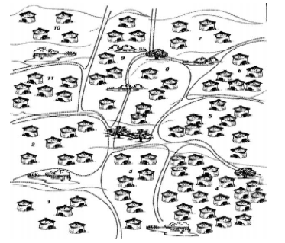
Ad-hoc screening
Rapid Assessments
Nutritional surveys
Surveillance systems (sentinel)
Existing health centres
Routine growth monitoring
Admission data of feeding programmes
Etc.
H.E.L.P. course 2019
Notes:
Example
Prevalence means: what proportion of malnourished people do we have at a certain point in a population
Pay attention on how data are collected: they may count existing cases (prevalence), or new cases (incident cases)

Slide 28
We can then match this prevalence data with standards and other factors
SAM and MAM
Acute Malnutrition level | Nutrition classifcation
<5% | Acceptable
5 - 9% | Situation is of concern
10 – 14% | Serious
≥ 15% | Critical
Aggravating Factors:
SAM <5yrs: >5%
Inadequate general food ration
CMR > 1/10,000/day
Epidemic of measles or whooping cough
High incidence of respiratory or diarrhoeal diseases
High levels of food and/or economic insecurity
High levels of chronic malnutrition or micronutrient deficiencies
H.E.L.P. course 2019

Slide 29
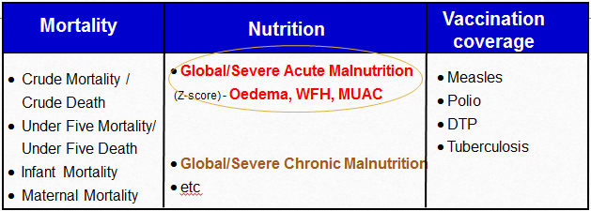
Common indicators used during crises
H.E.L.P. course 2019
Notes:
The assessment of a situation has to take into account all this indicators and triangulate these information for analysis

Slide 30
What do anthropometry of individuals and prevalence in the population not tell you?
??
Causes of malnutrition
H.E.L.P. course

Slide 31
We now have the first useful indications for nutritional assessment and will go in more detail into this in the next session
H.E.L.P. course

