Slide 1
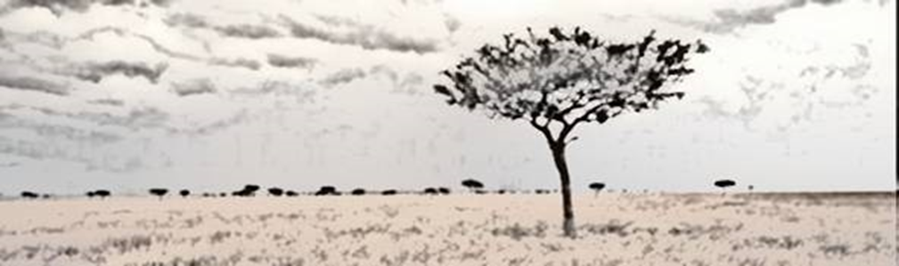
Nutrition and livelihood: Concepts
Logo organization(s) facilitators(s)
H.E.L.P. course
Name + organization facilitator(s)
These learning materials have been developed by:
Rachel Lozano, ICRC, Valérie Belchior-Bellino, ICRC,
Mija Ververs, John Hopkins University/CDC and
Nicole Niederberger, Terre des Hommes

Slide 2
Objectives
Be able to
describe the concepts of nutrition and food security
describe different livelihood strategies based on household assets
describe the basics of adequate nutrition for individuals and populations
H.E.L.P. course

Slide 3
Let’s imagine three families.
We will follow them during these two days
H.E.L.P: course
Notes:
Each group gets one family
We’ll follow these families during the nutrition and livelihood module
See Hand out

Slide 4
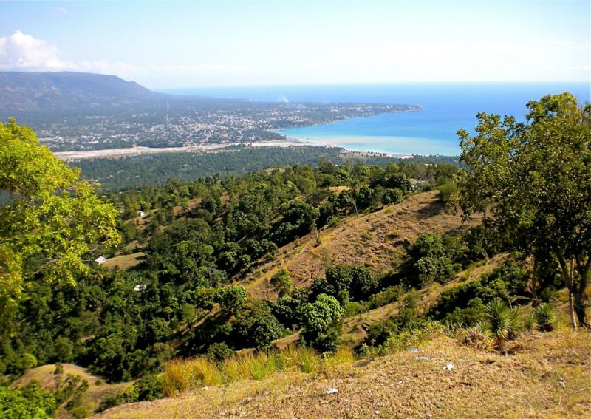




Haiti, 2008, a rural area in the south: The Pink family
H.E.L.P: course
Notes:
Low income country, modest farmer family. Parents and 7 children.

Slide 5

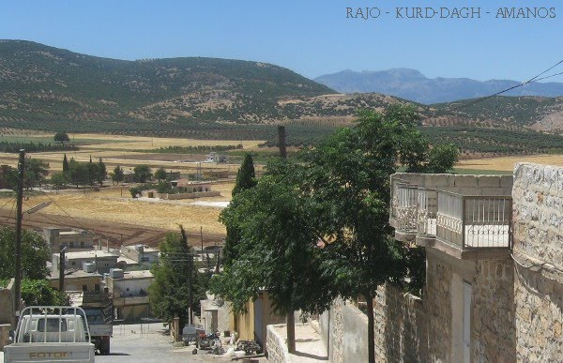
Syria, 2009, a little touristic town:
The Blue family
H.E.L.P: course
Notes:
Lower middle income country,
Follow a family with parents, grand mother (missing in the drawing), and 3 children (1, 2 and 4 years old). Father is a civil servant and works in a nearby place. They own an apartment.

Slide 6

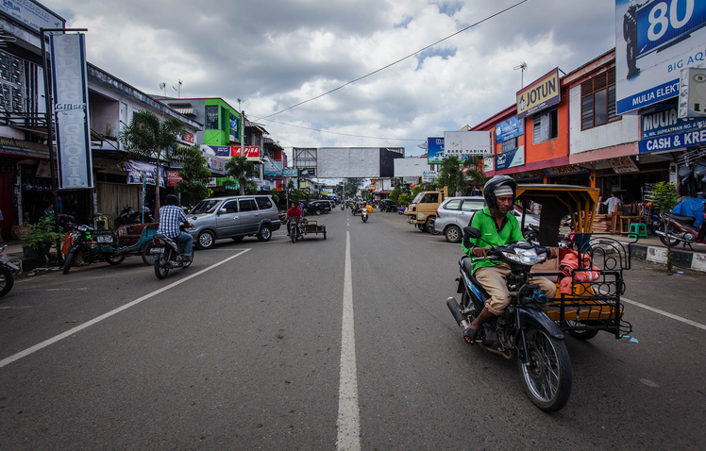
Indonesia, 2003, a costal town:
The Red family
H.E.L.P: course
Notes:
Lower middle income country, Costal area in the south of Banda Aceh, in Indonesia.
Family with 3 children, mother is pregnant, parents have a little house close to the sea and work occasionally in a small food store in the neighborhood.

Slide 7
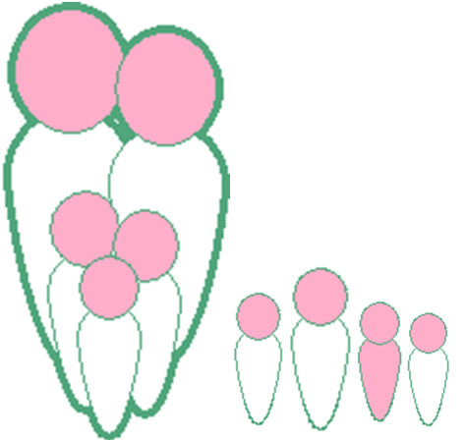
??
What do these families and all people need to live?
H.E.L.P: course
Notes:
Based on the responses. How can we detail those needs? (question-answer in plenary or in small groups -3 min)
Food
Education
Social life and network
Water and sanitation
Security
Health
Shelter and furniture

Slide 8
So, they need:
Food
Shelter &
furniture
Education
Health care
Social life
and friends
H.E.L.P: course
Security
Water &
sanitation
Notes:
The three families are all three represented by the family here.
Whatever context you live in, these basic needs are the same.

Slide 9
So, they need:
These are called essential needs
Food
Shelter &
furniture
Education
Health care
Social life
and friends
Security
H.E.L.P: course
Water &
sanitation
Notes:
Link with family needs

Slide 10
So they need:
Food
Shelter &
furniture
Education
Health care
Social life
and friends
Security
H.E.L.P: course
Water &
sanitation
Notes:
Let’s deepen our insight in one of these needs: food

Slide 11
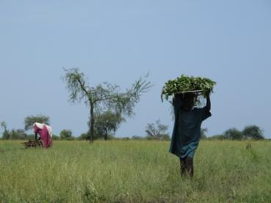
Food
In appropriate quantity
And adequate quality
H.E.L.P: course
South-Sudan, August 2013
Notes:
Everybody needs food
in adapted quantity → a child is eating less than an adult
In adapted quality → children needs animal source food to grow, women a good source of iron…

Slide 12
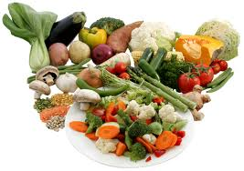
Quantity
Called Energy
Measured in Kilocalories (kcal)
Variation with age, growth, weight, pregnancy or lactation, physical activity, climate, diseases…
H.E.L.P: course
Notes:
Energy provided to the body per amount of nutrient
Food needs vary. Those variations are due to:
Age: an infant is eating less than his father nutrients to grow before 2 / 3 years
Body shape: large people eat more than the tin ones
Season: people eat more in cold environment or season the in hot ones → 100 kcal / degree
Activity level: farmers eat more when going to cultivate than office employee
Status: a pregnant women needs 285 Kcal more per day (in average), a lactating 500 kcal
Health: a sick child may refuse to eat. Some illness or injury increase the need for food (HIV, TB, Burns)

Slide 13
Daily energy requirements
Age
Males
Females
Average
group
(kcal/day)
(kcal/day)
(kcal/day)
% of pop.
0-4 yrs.
1320
1250
1290
12.37%
5-9
yrs.
1980
1730
1860
11.69%
10-14
yrs.
2370
2040
2210
10.53%
15-19
yrs.
2700
2120
2420
9.54%
20-59
yrs.
2460
1990
2230
48.63 %
60+
yrs.
2010
1780
1890
7.24 %
Pregnant
285
(extra)
2.4%
Lactating
500
(extra)
2.6%
AVERAGE DAILY REQUIREMENT:
2100 Kcal/person/day
H.E.L.P: course
Based on WHO technical Report No. 724 and UN Pop. Data, mid 1995
Notes:
PREGNANCY: 285 kcal extra is based on:
Food and Nutrition Needs in Emergencies, UNHCR, UNICEF, WFP and WHO, 2004.
And other articles.1st trim no extra needs in kcal, 2nd 350 and 3rd 500 kcal, average throughout pregnancy 285 kcal
The ICRC ration of 2’400 kcal / person / day is based on WHO 1: a male of 65 kg, a female of 55 kg with a moderate activity
The WFP ration of 2’100 Kcal / person / day is based on WHO 2: a male of 60 kg, a female of 52 Kg with light activity… may be the type of population in camps??

Slide 14
Macro-nutrients
Micro-nutrients
Protein
Minerals
Trace
elements
Carbohydrates
Vitamins
Fat
Essential for cell function
H.E.L.P: course
Provide energy
WATER
Notes:
Nutrients are divided in 2 types of nutrients
MACRONUTRIENTS**
MICRONUTRIENTS
Vitamins and minerals

Slide 15
Micro-nutrients
MINERALS
WATER SOLUBLE VITAMINES
Calcium
Sulphur
Magnesium
Iron
Vitamin B-1 (thiamine)
Sodium
Phosphorous
Pantothenic acid
Vitamin B-2 (Riboflavin)
Potassium
Folic acid
Vitamin B-12
Vitamin B6
B3 -Niacin
Vitamin C
TRACE ELEMENTS
Molybdenum
Boron
FAT SOLUBLE VITAMINES
Fluoride
Selenium
Cobalt
H.E.L.P: course
Vitamin A
Iodine
Zinc
Vitamin D
Copper
Vitamin E
Chromium
Manganese
Vitamin K
Silicon
Notes:
Those marked as Red are of a big public health concern worldwide.
Red bold are those most often seen in emergencies on large scale, often difficult to get sufficient in a diet in even ‘normal’ diets in developing countries.

Slide 16
Macro-nutrients
Proteins → 4 kcal per gram
Fat → 9 kcal per gram
Carbohydrates → 4 kcal per gram
Alcohol → 7 kcal per gram
Energy (kcal)
H.E.L.P: course
Notes:
PROTEINS 10 - 15 %
FAT 15 – 30 %
CARBODHYDRATES 55 – 75 % ; have as well specific roles and metabolism
They all provide energy but

Slide 17
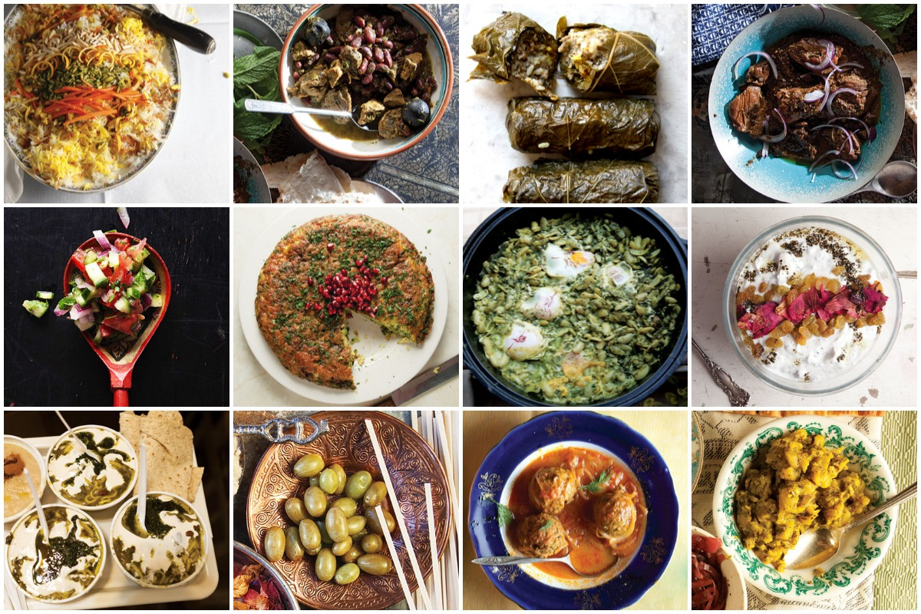
Similar to all human beings, our families do not feed on nutrients or kcal or percentages
but on a large variety of food
Remember…
H.E.L.P: course
Notes:
Depending on many, social, environnemental and cultural factors

Slide 18
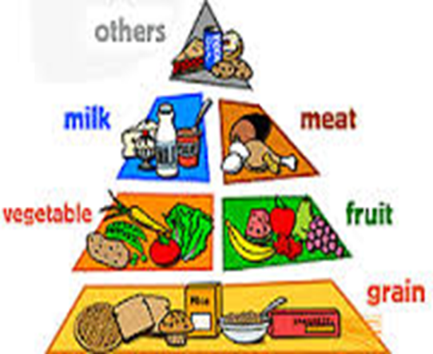
  Fat
  Proteins
  Vitamins & minerals
  Carbohydrates
H.E.L.P: course
Notes:
To have a balanced intake, Our requirement should be met with a diversified range of foods
The food diversity has been classified in 4 groups in a pyramid:
At the base: carbohydrates it’s what we need in biggest quantities
1st floor: fruits and vegetables
2nd floor: meat, milk, fish eggs
3rd floor: What we need in smaller quantity like oil

Slide 19
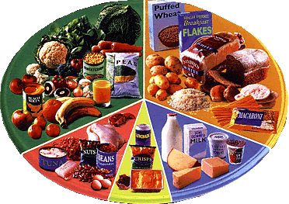
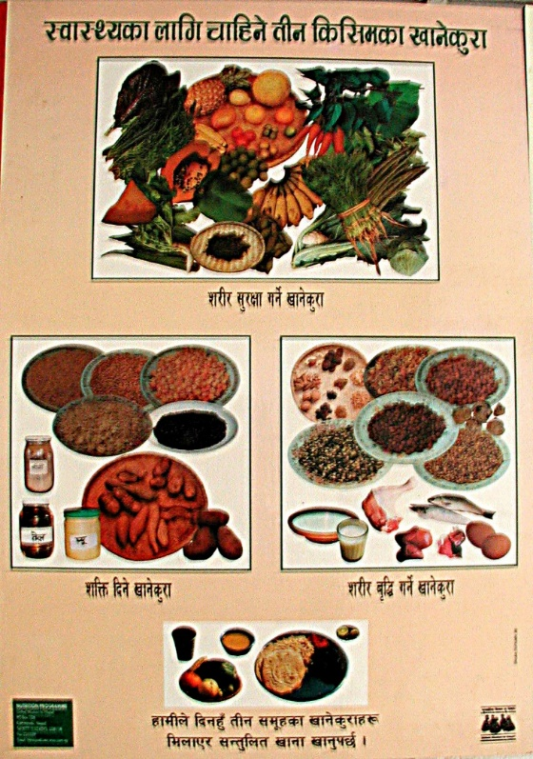
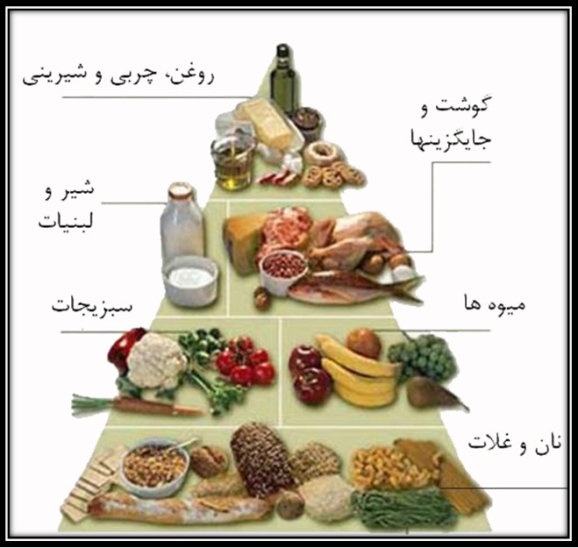
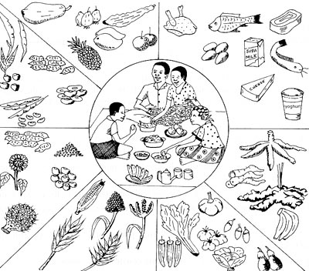
H.E.L.P: course
Notes:
This can be presented in many different ways, and adapted locally. A more boring, written one is proposed to you as a hard copy (hand out).
When we have access to the whole range of nutrients on a regular basis and in good quantities, this will contribute to a good nutritional status (we will see later that food alone is not sufficient to ensure a good nutritional status.

Slide 20
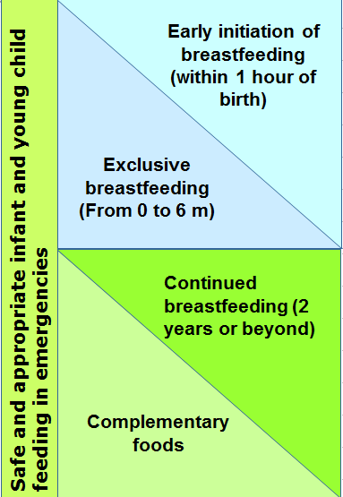
Recommendation for children under 24 months
Crucial role for health care system, aid agencies, community and government on individual choices and practices of mothers
International code of marketing of BMS adopted in 1981. Often poorly implemented.
H.E.L.P: course
Notes:
What are optimal IYCF recommendations?
Safe and appropriate IYCF practices are optimal practices to minimize morbidity and mortality:
Optimal IYCF recommendations are:
Early initiation of exclusive breastfeeding (EBF) – this means breastfeeding within 1 hour of birth
EBF for 6 months – exclusive breastfeeding means an infant receives only breastmilk, no other liquids or solids, not even water, with the exception of necessary vitamins, mineral supplements or medicines.
Continued breastfeeding to 2 years or beyond.
Complementary feeding encompasses continued breastfeeding, the introduction of complementary foods, and how that is done in the nutritional and developmental interests of the child.
BMS industry represents 44 billion US yearly worldwide, increasing 10% in some countries (e.g. China). And puts enormous means into marketing (10x more than breastfeeding promotion programmes in UK in 2012)

Slide 21
A good nutritional status is
A state in which the physical function of an individual is able to maintain adequate body performance processes such as growth, pregnancy, lactation, physical work, and resist and recover from disease
H.E.L.P: course

Slide 22
To cover their essential needs, our household has livelihood assets
Livelihood
Their capabilities, their assets, their income and the activities they require in order to make a living
H.E.L.P: course
Notes:
They have needs, but they also have assets

Slide 23
Livelihood Assets
PHYSICAL
FINANCIAL
NATURAL
HUMAN
H.E.L.P: course
POLITICAL
SOCIAL
Notes:
On a flip chart: Bring out the assets of this family, i.e.
Human assets
Physical condition: Health & nutritional status, ability to work, ability to move
Capacities: Skills & education
The human assets of a HH describe the people themselves, their condition and capacities.
HH’s human assets can be seen as the balance of productive human assets (labour force, good education, developed professional skills) on one side, versus the HH’s liabilities on the other side (poor physical condition, illiteracy, high number of dependents, chronically ill family member needing care etc.)
Key message: The impact of the human assets on a HHs livelihood can hardly be overestimated! Naturally, the human assets vary strongly between different HHs.
Social assets
Solidarity networks like the extended family, kinship structures, neighbours, religious groups as well as benefits through prestige and influence.
The social assets comprise solidarity mechanisms available to a HH that are beyond the HH (core family) but that remain at an informal (non-government) level. Such networks are particularly important after HHs face a shock.
Example: In many cases, displaced populations seek refuge in areas where they can expect solidarity from relatives or members of their ethnic group.
Political assets
Rights through citizenship, relations with the authorities
The political assets describe people’s relationship to political power structures and decision makers. Typical examples of this are favouritism and marginalization. In addition, there are the basic rights that come with citizenship – or the absence of these if people are for example refugees.
Natural assets
Natural resources like (public) land, water, wildlife, biodiversity, the atmosphere, solar energy etc.
These comprise the natural environment that is not privately owned and that, in principle, is accessible to everyone. The preservation and exploitation of these resources is usually regulated by formal or customary laws (regulations to protect water quality, the exploitation of timber, hunting etc.).
Physical assets
Basic goods and infrastructure at HH level. They are mostly related to living conditions and means of production
Physical assets can be divided into the following categories:
Basic (HH level) infrastructure related to: water, sanitation, transport, communication and energy
Housing / shelter
Non-food items: cooking, clothing, bedding etc.
Means of production: Livestock, tools and devices used for livelihood activities as well as privately owned land
HHs’ living conditions and capacity to produce food often depend on physical assets.
Financial assets
Savings, gold & jewellery, remittances, credit, scholarships, pensions
These are HHs direct “reserves” of cash. Income and salaries are not included in this because they are realized through livelihood activities and fall under the livelihood outcomes.
The financial assets are crucial because they provide flexibility as they can be easily converted into other assets.
For example, money can buy physical assets, it can develop the human assets through education or it can enhance the political capital through paying bribes.
A HH’s dependency ratio is the number of individuals aged under 15 or over 64 years, divided by the number of individuals aged 15 to 64 years. The higher the value, the heavier the burden for the HH.
The initial version of the SLF contained only five assets, the political assets were integrated at a later stage.
Infrastructure at HH level includes means of communication, transport, water etc.
Depending on the situation, livestock can be used either as means of production, savings or a social asset (for status & dowry)
Some versions of the SLF place privately owned agricultural land under “natural assets”. However, here the assumption is that this is a private means of production. The benefit of its use or the impact due to its loss will essentially affect the owners. For this reason, privately owned land is grouped together with the other means of production.

Slide 24
??
What livelihood assets may your family have?
H.E.L.P: course
Notes:
Q/A in plenary: Each group proposes 3 possible livelihood assets for their family (taken from the description given earlier or imagined). Guide so that the examples cover all the categories of the livelihood assets.

Slide 25
Livelihood strategies
Based on their own choices:
Will children go to school until university?
What type of house improvements will they decide?
What eating habits do they have?
What spending will they prioritize?
…
PHYSICAL
FINANCIAL
LIVELIHOOD
STRATEGIES
NATURAL
HUMAN
POLITICAL
SOCIAL
H.E.L.P: course
Notes:
Livelihood strategies – What people do for a living
The livelihood strategies of a household comprise the range of economic and social activities undertaken by its members. Often, members of a HH pursue several activities that can vary considerably throughout the year. Consequently, livelihood strategies are often complex and multifaceted. While diversified livelihood strategies have the advantage of making the best use of the available capacities to earn income or to produce food, this diversity also makes HHs less vulnerable to shocks.
In order to choose the right strategies, it is crucial that HHs dispose of complete and up-to date information on the economic context they are living in. Key message: Livelihood strategies are, in principle, based on people’s own choices.
EXAMPLE: Likely, farming has been for generations the main livelihood of our family of farmers. Distance from the capital has prevented family members to study in relatively better schools and to choose other paths (or to do farming by following improved practices). 2/3 of the yield (cassava and groundnuts) are used for self-consumption, 1/3 is sold. Cash will be used to by other food items, clothes, medicine etc. During the lean period, when the HH cannot count anymore on their harvest for self-consumption, other activities complement the main livelihood, such as collecting savage foods, ignam, firewood to be sold to get cash etc. Hunting and/or fishing might be more relevant during this period.

Slide 26
Livelihood outcomes
PHYSICAL
FINANCIAL
Education
Essential Expenditures
Income
NATURAL
HUMAN
LIVELIHOOD
STRATEGIES
Living Conditions
Health
Food Production
POLITICAL
SOCIAL
Food Consumption
Nutrition
H.E.L.P: course
Notes:
The assets and strategies will lead to livelihood outcomes
Nutritional status
The nutritional status is a key indicator for a person’s physical condition that will be discussed in a later section. It is a very useful outcome to monitor because it reflects directly people’s health and / or food consumption and it informs on
people’s ability to work.
Health
A person’s health is closely linked to their food intake, nutritional status and basic living conditions as well as to their behaviour (awareness, attitude, practices) and their access to quality health care. Good health in turn is essential for performing livelihood activities and achieving positive outcomes
Education & capacities
People’s capacities are crucial. If someone is uneducated and has poor skills, there is a strong risk that the person will only achieve poor livelihood outcomes.
The EcoSec core components
Those that are directly relevant for the economic security at HH level:
Food consumption
Food production
Income support; and
Basic living conditions.
It has been demonstrated that the poorer the household, the more of its resources are spent on food.

Slide 27
??
Based on the assets they have, our households will decide
on livelihood strategies
What could be possible livelihood strategies for your family
H.E.L.P: course
Notes:
Q/A in plenary. Each group to propose 3 potential livelihood strategies for their family (imagined; covering the different strategies)

Slide 28
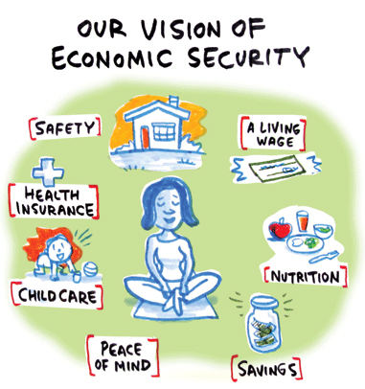
Thanks to their livelihood assets and strategies, our families live in a situation of economic security…
When a household or community is:
economically self-sufficient
can meet essential needs
H.E.L.P: course

Slide 29
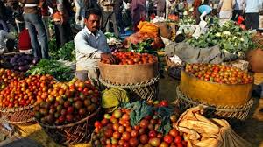
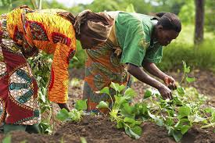
…and a situation of food security
Food security exists when all people, at all times, have physical and economic access to sufficient, safe and nutritious food that meets their dietary needs and food preferences for an
active and healthy
life
World Food Summit, 1996
H.E.L.P: course
Notes:
At the level of a HH, of a community or of a state

Slide 30
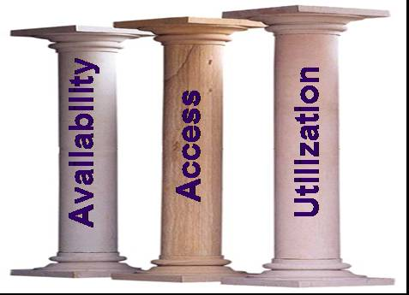
Food security has three pillars
Availability of food
Food production, food imports, etc.
Access to food
Household food production and reserves,
family income, solidarity mechanisms,
barter, etc.
Utilization of food
Health situation (diarrhoea, malaria,
AIDS), food storage and cooking
practices, fuel, age related needs, etc.
H.E.L.P: course
Notes:
Availability: Sufficient quantities of appropriate food are physically available.
Access - Income or other resources are adequate to obtain sufficient and appropriate food. The main focus here is on the economic access of households to food. Often forgotten but also relevant is access to preparation facilities: i.e. fuel, cooking utensils, etc. (for example: in flooded areas fuel to cook might be needed)
Utilization - Food is properly used (food processing and storage practices, adequate knowledge and application of nutrition and child care principles, and adequate health and sanitation services). Also includes biological use, which is linked to a person’s health.

Slide 31
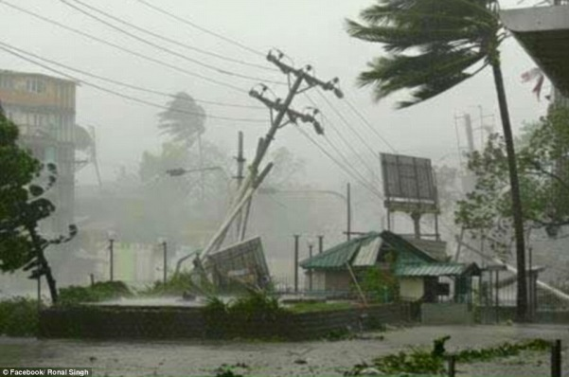
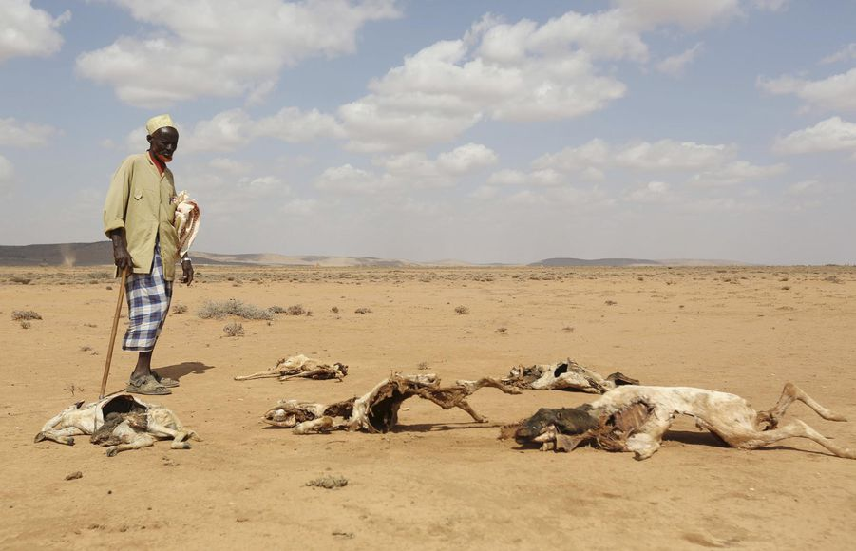
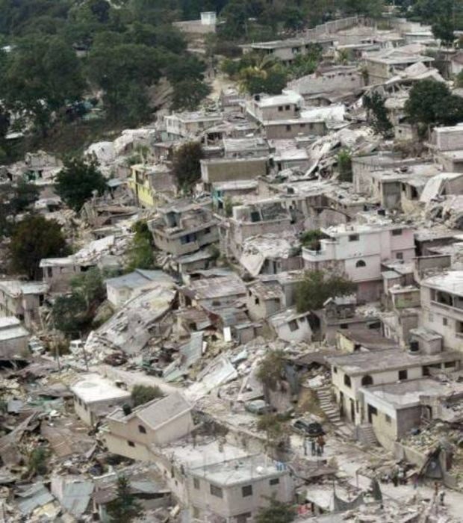
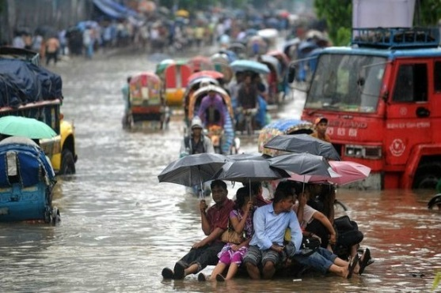
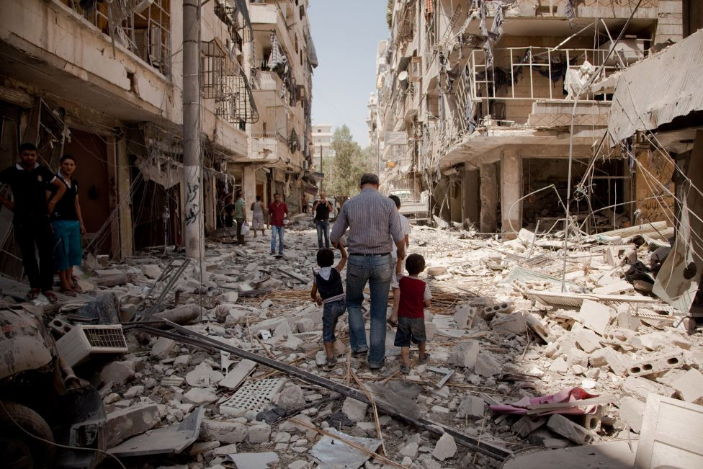
But then… things changed…
H.E.L.P: course
Notes:
This crisis may be of sudden onset or more gradual, may occur in a previously stable context or in a more vulnerable context. There may as well be several crises hitting the same population. This will affect economic and food security and nutrition determinants. Let’s see how.

