Slide 1
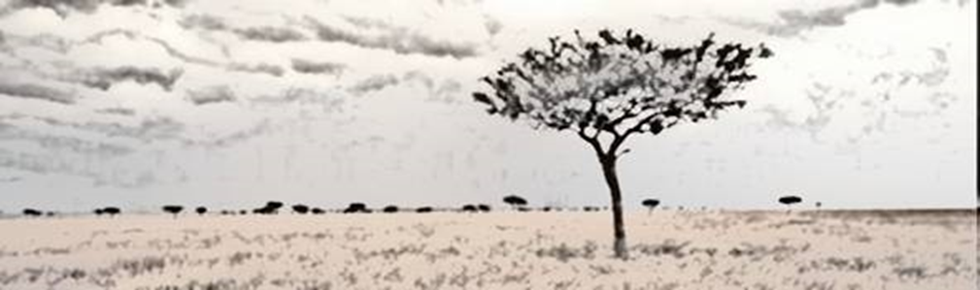
Nutrition and Livelihood in Humanitarian Crisis situations
Logo organization(s) facilitator(s)
H.E.L.P. course
These learning materials have been developed by:
Rachel Lozano, ICRC, Valérie Belchior-Bellino, ICRC,
Mija Ververs, John Hopkins University/CDC and
Nicole Niederberger, Terre des Hommes
Name(s) and organization facilitator(s)

Slide 2
Objectives
Be able to
identify population groups with higher risks of malnutrition and their specific needs
describe the stages of a crisis and different crisis settings
H.E.L.P. course

Slide 3
Coping mechanism
Education
PHYSICAL
FINANCIAL
Essential Expenditures
Income
NATURAL
HUMAN
LIVELIHOOD
STRATEGIES
Living Conditions
Health
Food Production
POLITICAL
SOCIAL
Food Consumption
Nutrition
H.E.L.P. course
Notes:
The assets and strategies will lead to livelihood outcomes
Nutritional status
The nutritional status is a key indicator for a person’s physical condition that will be discussed in a later section. It is a very useful outcome to monitor because it reflects directly people’s health and / or food consumption and it informs on people’s ability to work.
Health
A person’s health is closely linked to their food intake, nutritional status and basic living conditions as well as to their behaviour (awareness, attitude, practices) and their access to quality health care. Good health in turn is essential for performing livelihood activities and achieving positive outcomes.
Education & capacities
People’s capacities are crucial. If someone is uneducated and has poor skills, there is a strong risk that the person will only achieve poor livelihood outcomes.
The economic security core components
Those that are directly relevant for economic security at HH level:
Food consumption
Food production
Income support; and
Basic living conditions.
It has been demonstrated that the poorer the household, the more of its resources are spent on food.

Slide 4
Crisis process
Preliminary phase
Catch up phase
Acute phase or crisis
Adaptation
Use of reserves and defences
Consolidation
Functional degradation
Catch up
H.E.L.P. course
Decompensation
Reanimation
Death of the concerned system
Notes:
This process can take a few minutes (tsunami) or a much longer period (political crisis, drought) .

Slide 5
Coping Mechanisms
Examples of coping mechanisms:
Reduction of meals
Taking out loans
Gathering wild foods
Sending family members
for waged labour
Sale of productive tools
Sale of farm land
Prostitution
Are activities that people use as a means of getting through difficult times, brought on by events affecting their livelihood and way of living
Can be identified at community, household and individual levels
They may be harmful by permanently undermining the household’s food security or health, or be adaptive and reversible.
H.E.L.P. course
Notes:
Are coping strategies always ‘abnormal’ or damaging?
There are different stages of coping. Early coping strategies are not necessarily abnormal: They are reversible and cause no lasting damage. These may include collecting wild foods, selling nonessential assets or sending a family member to work elsewhere.
More drastic strategies may permanently undermine a household’s future food security. These may involve the sale of land, distress migration on the part of whole families, or intensive use of wood leading to deforestation.
Some coping strategies employed by women and girls, such as prostitution/commercial sex work, tend to expose them to sexual violence, physical harm and higher risk of HIV and other sexual transmitted diseases infection. Migration generally increases the risk of HIV transmission.
Coping strategies may also affect the environment, for example through over-exploitation of commonly-owned natural resources. It is important to protect and support food security before people begin using more damaging strategies, having exhausted all other means of coping.

Slide 6

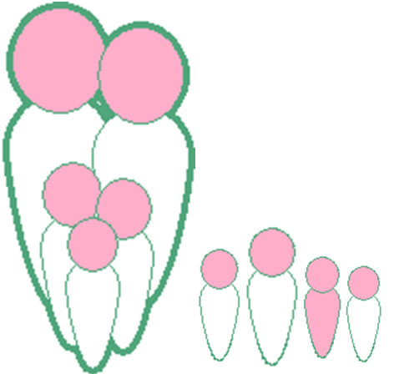

Here are our families
H.E.L.P. course

Slide 7
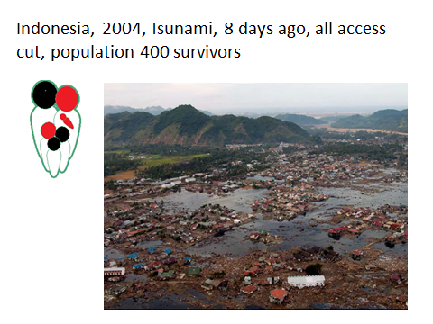
H.E.L.P. course
Notes:
Situation: Earthquake of a magnitude of 9.2 on the Richter scale followed by one of the deadliest tsunami of history. Affected several countries and millions of people.
Few contacts with survivors per radio communication, visual assessment of the whole coast using a helicopter, slow decrease of water level, assumption of very high number of deaths.
Were middle class inhabitants of a big village close to the sea
Father and two kids died during the events, the baby was born in between.

Slide 8
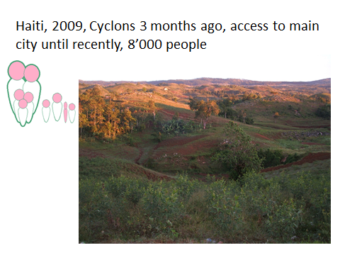
H.E.L.P. course
Notes:
Situation: South east Haiti, a place called Baie d’Orange. We were requested to make an assessment because «there is something wrong there». Cyclons 3 months ago (Fay, Gustave and Hannah)
access to main city of department cut because of road damage: «much more» cases of acute malnutition than usually.

Slide 9
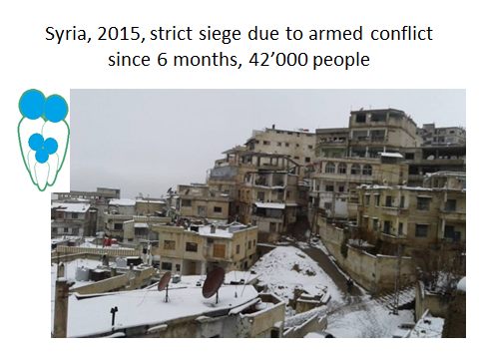
H.E.L.P. course
Notes:
Severe conflict situation since more than 4 years in a lower middle income country. Previously health and education system were functionning. Siege used as a warefare technique. No access possible since 5-6 months (no good nor people movement possible). Most information received through media and social media, few contact with healthcare providers, non quantified but alarming feedback on nutritional situation. Time available on site possibly very short.
Father was outside the area for his work when city was besieged and has no possibility to join them.

Slide 10
Whether a humanitarian crisis happens depends on:
Vulnerability and capacity, but also the type and magnitude of hazard
(HAZARD + VULNERABILITY)
----------------------------------------- = gravity of CRISIS
CAPACITY/RESSOURCES
H.E.L.P. course
Notes:
A disaster is a sudden or slow, calamitous event that seriously disrupts the functioning of a community or society and causes human, material, and economic or environmental losses that exceed the community’s or society’s ability to cope using its own resources. Though often caused by nature, disasters can have human origins
Means available to mitigate the effect of the haZard

Slide 11
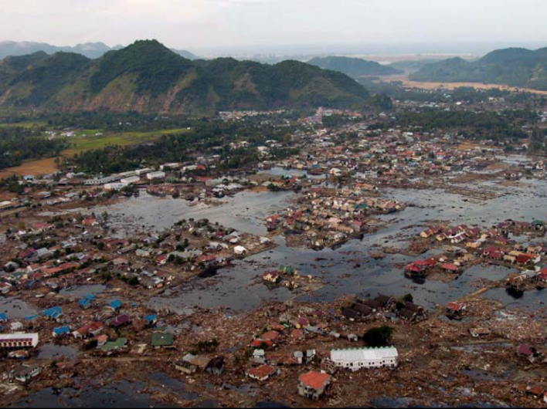

Indonesia, 2004, Tsunami, population 400 survivors
HAZARD + VULNERABILITY
----------------------------------------- = gravity of CRISIS
CAPACITY/RESSOURCES
Massive hazard, exposed costal area
Lower middle income country
Good human and material assets existing pre disaster
No preparedness
Available aid had to be shared among millions of people in several countries
H.E.L.P. course

Slide 12
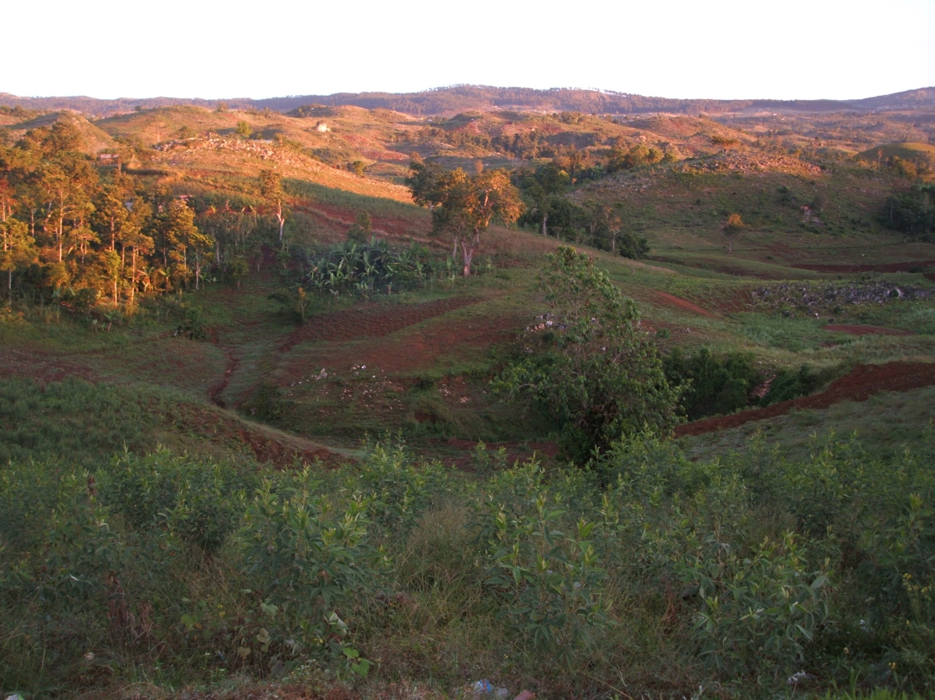
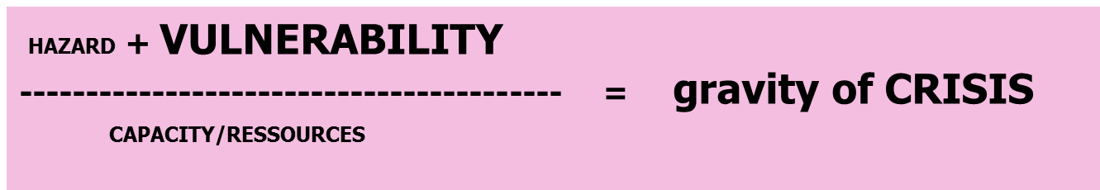

Haiti, 2009, Cyclone 3 months ago, access to main city cut until recently, 8’000 people
Medium scope of the hazard
Low income country
Poor family, borderline food security
No preparedness for disaster
No food stock
Little/ no external aid provided
H.E.L.P. course

Slide 13
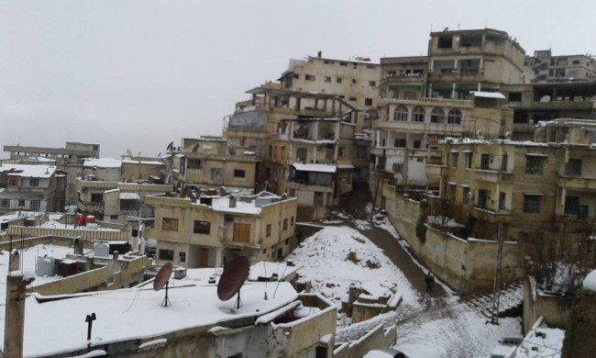
Syria, 2015, Besieged city due to armed conflict since 6 months, 42’000 people
HAZARD + VULNERABILITY
---------------------------------------- = Gravity of CRISIS
CAPACITY /RESOURCES
Lower middle income country
Solid governance, health and education system
Limited preparedness
Loss of essential human assets as a strategy to the conflict
H.E.L.P. course

Slide 14
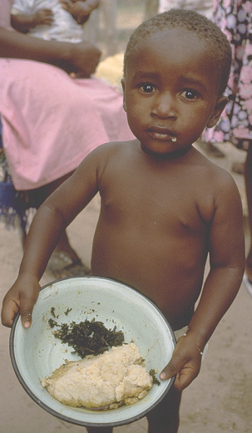
In crisis situations leading to food and economic insecurity.
Insufficient quantity and quality of food
Additional exposure to other nutritional risk factors
Risk of malnutrition
H.E.L.P. course
Notes:
Crisis often lead to worsening of the food consumption
What’s wrong with this ration?
Monotonous
Limited food groups: 4 or 5
Incomplete range of micronutrients
Often lacking adequate proteins
Causes of malnutirtion will be detailed duirng one of the next sessions

Slide 15
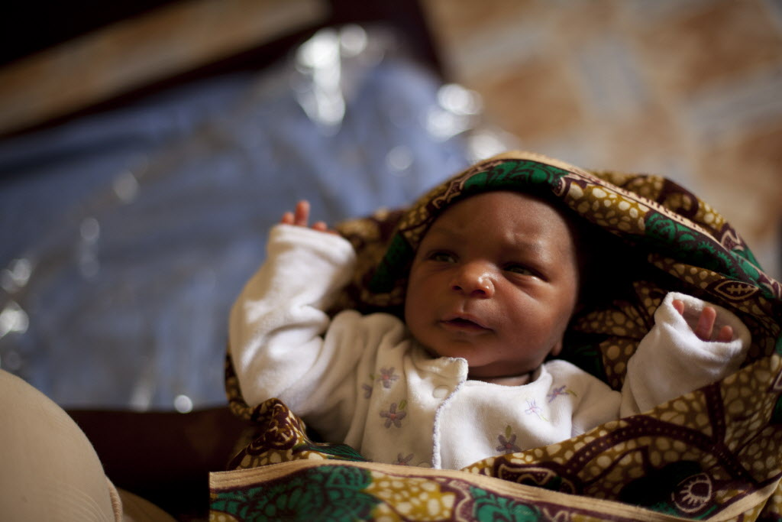
The particular case of infants and young children
H.E.L.P. course
Notes:
Published in 3 Lancet series in 2008, 2013 and 2016
Access is needed for as long as the child needs it, meaning minimum 6 months to one year.
Example: Syria: no access of the household and no availability on the market in besieged area.

Slide 16
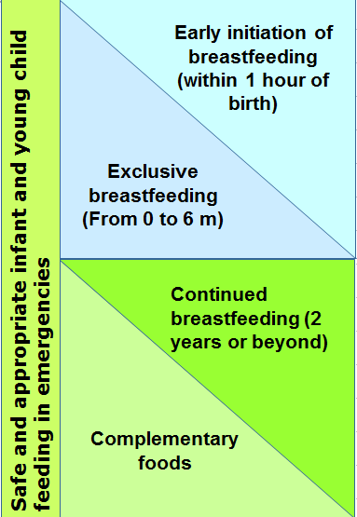
Recommendation for children under 24 months
Crucial role for health care system, aid agencies, community and government on individual choices and practices of mothers
International code of marketing of BMS adopted in 1981. Often poorly implemented.
H.E.L.P. course
Notes:
What are optimal IYCF recommendations?
Safe and appropriate IYCF practices are optimal practices to minimise morbidity and mortality:
Optimal IYCF recommendations are:
Early initiation of exclusive breastfeeding (EBF) – this means breastfeeding within 1 hour of birth
EBF for 6 months – exclusive breastfeeding means an infant receives only breastmilk, no other liquids or solids, not even water, with the exception of necessary vitamins, mineral supplements or medicines.
Continued breastfeeding to 2 years or beyond.
Complementary feeding encompasses continued breastfeeding, the introduction of complementary foods, and how that is done in the nutritional and developmental interests of the child.
BMS industry represents 44 billion yearly worldwide, increasing of 10% in some countries (China). And puts enormous means in marketing (10X more than breastfeeding promotion programs in UK 2012)

Slide 17
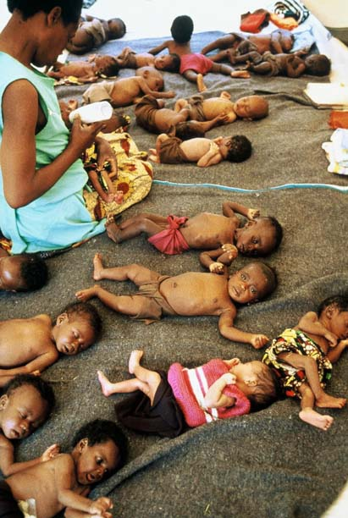
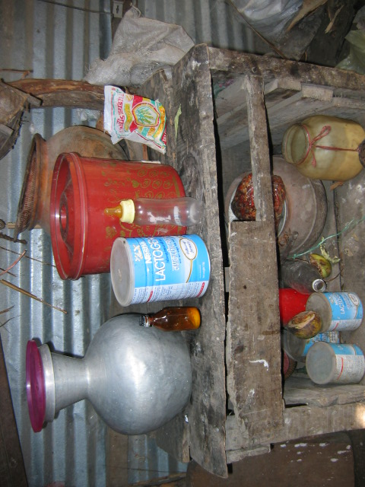
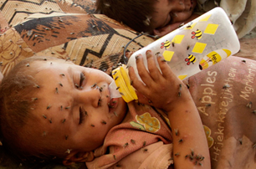
What is the problem in crisis situations?
While breastfed children <6 months are well protected, artificially fed infants are highly vulnerable
NO safe drinking water
NO safe preparation means
NO access to formula
H.E.L.P. course
Notes:
Published in 3 lancet series 2008, 2013 and 2016
Access is needed for as long as the child needs it, meaning minimum 6 months to one year.
Example: Syria: no access of the household and no availability on the market in besieged areas.

Slide 18
The particular case of infants and young children
Diversification in 6-23 months old can also be problematic
NO food of adequate consistency and quality
NO adequate frequency of meals
NO safe drinking water
NO safe preparation mean
Frequent illness (environment and child development related)
Increased risk of malnutrition and mortality
H.E.L.P. course
Notes:
Published in 3 lancet series 2008, 2013 and 2016
Children >6 months need sufficient nutritious food – Breast milk is no longer enough
Frequency (Ex. Chad refugee camp: 2 meals/day….)
Consistency
Quality – lack of nutritious foods; need for calcium, protein food products, etc. (transition BF-food problems)
Quantity – sharing… Inappropriate feeding: full grains (staple)
Not hygienically prepared or consume
Frequent illnesses (normal childhood diseases but also new ones due to disaster setting; >1 year: age of walking with more exposure to unhygienic environment)
Access is needed for as long as the child needs it, meaning minimum 6 months to one year.
Example: Syria: no access of the household and no availability on the market in besieged area.

Slide 19
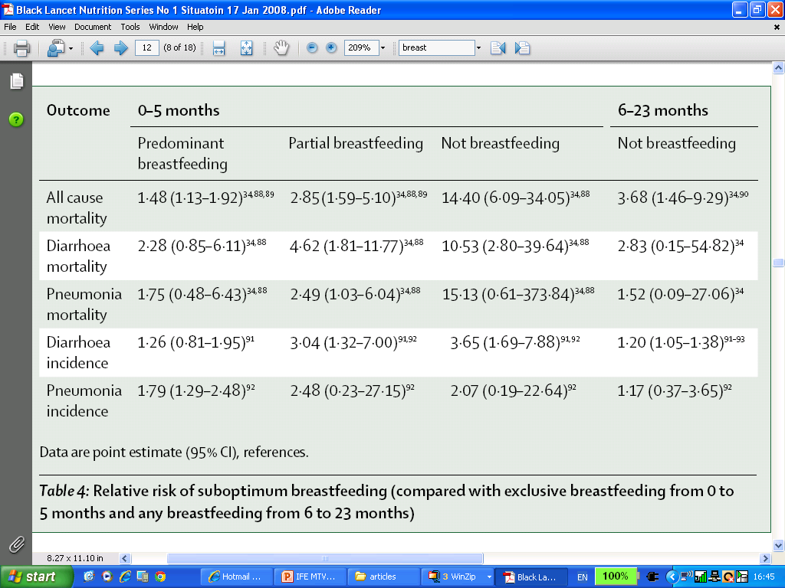
Loss of benefits of breastfeeding (immunological, nutritional, psycho- affective…)
And additional risks due to not breastfeeding (hygiene, supply, quality ,…)
H.E.L.P. course
Notes:
Black lancet

Slide 20
What could the impact of a crisis be on the food consumption of these families?
H.E.L.P. course
Notes:
In plenary:
Remember : hazard + vulnerability/ capacity
Coping mechanisms? Consequences at short term for those families?

Slide 21
In the next session, we will look at the causes of malnutrition
H.E.L.P. course

