Slide 1
Assessment of the nutritional situation in crisis situations
Logo organization(s) facilitator(s)
H.E.L.P. course
These learning materials have been developed by:
Rachel Lozano, ICRC, Valérie Belchior-Bellino, ICRC,
Mija Ververs, John Hopkins University/CDC and
Nicole Niederberger, Terre des Hommes
Name(s) and organization facilitator(s)

Slide 2
Objectives
Be able to
explain different types of assessment according to context, objectives and phase of an intervention
explain the objectives of a food security and nutritional assessment during a crisis and list the kind of data to be collected
describe the general steps of a food security / nutritional assessment
interpret the results of nutritional surveys and identify when acute malnutrition is a humanitarian concern
H.E.L.P. course

Slide 3
Mandate, mission and principles
Assess
& Analyze
Organizational management priorities
Affected Populations & Context
Evaluate
& Learn
Design /
Formulate& Plan
Monitor
Implement
& Monitor
H.E.L.P. course
Notes:
Do you still remember the programme cycle that you looked at during the module Programme Cycle Management on the first day? Keep the affected people / population at the centre
The cycle is not complete until the findings / results are shared with those responsible for follow-up and others ‘’who need to know’’
While many parameters cannot be controlled during crisis situations, in particular during armed conflict, humanitarian interventions should follow as much as possible a strict process that ensures that actions are carried out in a coherent manner.

Slide 4
Golden rule for Assessments:
A BAD ASSESSMENT generally leads to BAD programmes… that miss the intended target
H.E.L.P. course
Notes:
Providing seeds to pastoralist who do not own land
Starting health services in places where good quality health services exist already
Setting up a treatment unit for malnutrition where there is no or little malnutrition, or where people cannot access the structure
Starting a community based programme in places where the social links are too weak to support it

Slide 5
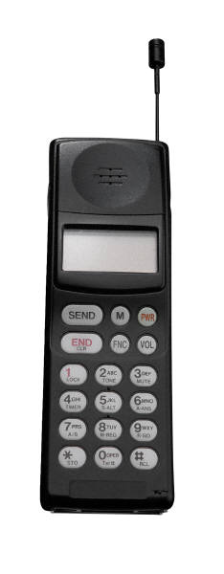
An example…
….We have an emergency here, there are 144 seriously malnourished people…..
H.E.L.P. course
Notes:
Can you start with a response based on this information?

Slide 6
144 malnourished over the last 3 months, or since one week?
144 out of a population of 100,000 or out of a population of 1,000?
144 malnourished children? Age groups? Elderly?
What type of malnutrition?
Mortality?
What are the causes of this situation?
Etc.
H.E.L.P. course

Slide 7
Rapid assessments Nutritional surveys Nutrition surveillance
??
What are the differences in data types, methods, information outputs and use of the information of these three?
H.E.L.P. course

Slide 8
 | Rapid assessment | Nutritional survey | Nutrition surveillance
 | Cross sectional snapshot | Cross sectional snapshot | Continuous /Ongoing Longitudinal trends
Methods | Secondary sources Purposive sampling Rapid appraisal methods, e.g. observation | Probability sample Survey instruments | Systematic, standardized data collection Facility or population based Sentinel or all
Data type | Qualitative | Quantitative | Quantitative
Information outputs | Identification of main problems, risks and gaps | Identification of scope and severity of the crisis Evaluate existing programme | Identification of scope and severity of the crisis
Use of the information | Initial crisis response strategy Initial project proposal | Determine the need for adaptation of interventions Advocacy, Accountability | Determine the need for adaptation of interventions Early warning and response
H.E.L.P. course

Slide 9
SMART Methodology
www.smartmethodology.org
H.E.L.P. course

Slide 10
Definition of SMART:
SMART is a simplified and standardized cross-sectional survey method used to gain an understanding of the severity and magnitude of a situation in ALL types of contexts, including humanitarian crises and situations with displaced persons.
SMART key indicators:
Nutritional status (GAM prevalence)
Mortality (death rates: CMR / U5MR)
H.E.L.P. course
Notes:
For info: SMART is also been touched upon during the modules ‘Setting the Scene’ and ‘Introduction to field epidemiology in crisis situations’. In both the focus is on the crude mortality rate (CRM) and under-five mortality rate (U5MR) and thresholds defined linked to these

Slide 11
Preliminary Steps
Assess the need for a nutritional survey
Formulate clearly the purpose and intended use
Formulate clear objectives
Decide which indicators to include
Formulate questions
Decide between exhaustive survey and sampling
Assign roles: Who does what
H.E.L.P. course
Notes:
We will focus during this session more in detail on some of these steps

Slide 12
1. Establish the need for a nutritional survey
Consider:
Is there a problem: food security, political/economic breakdown, environmental (incl. climate)?
Will the survey respond to questions that you seek to answer?
Will the results be important for decision making? Will they help you adopt specific programmes/interventions?
Is there data already available?
H.E.L.P. course
H.E.L.P. course

Slide 13
Examples of Secondary data sources
Multiple Indicator Cluster Survey (MICS)
Demographic and Health Survey (DHS)
NGO reports, RCRC. Which ones?
UN reports. Which ones?
Nutrition cluster
Annual reports
CFSVA (Comprehensive Food Security and Vulnerability Analysis), food security surveys
Early warning systems
Websites: early warning sites, such as Fewsnet, IPC
Relief Web
Government documents, for example data on demographics, infrastructure, health, nutrition and agriculture
Official statistics
Project evaluations
Reports from research organizations
Joint assessment mission reports
Thematic experts
Media information
H.E.L.P. course
Notes:
HDDS : Household dietary diversity score
FCS: food consumption score
EFLS: emergency food security and livelihood
Role of the media…

Slide 14
2. Purpose and use of nutritional surveys
Assess whether a nutritional emergency or risk of it exists
Estimate severity and scope
Likely evolution and impact of crisis on health & nutritional status
Assess the need for a (new) intervention
Evaluate an existing intervention (Baseline needed!)
Operational management, advocacy, accountability, fundraising

Slide 15
3. Formulate the objectives
Objectives:
More specific statements of what you seek to answer through the survey
WHAT: Specific health indicators to be measured
WHO: Target groups
WHERE: Geographic area
WHEN: Timeframe
H.E.L.P. course

Slide 16
Are these objectives clear? If not, what is missing?
??
Assess anemia
Study children less than 5 years of age in refugee camps in Tanzania
Estimate the current prevalence of anemia in refugee camps in Tanzania
Estimate the current prevalence of anemia among children less than 5 years of age
Estimate the current prevalence of anemia among children less than 5 years of age who live in refugee camps in Kibondo District, Tanzania
H.E.L.P. course

Slide 17
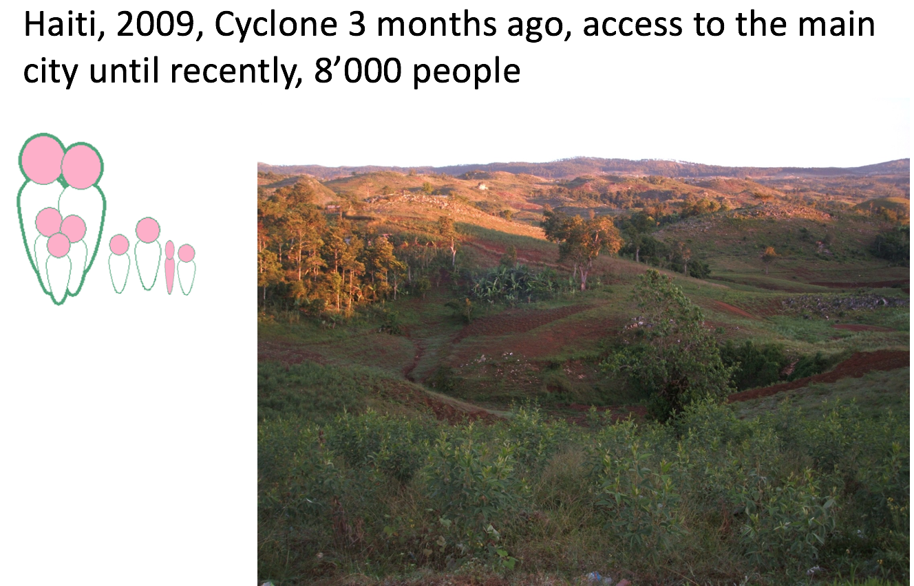
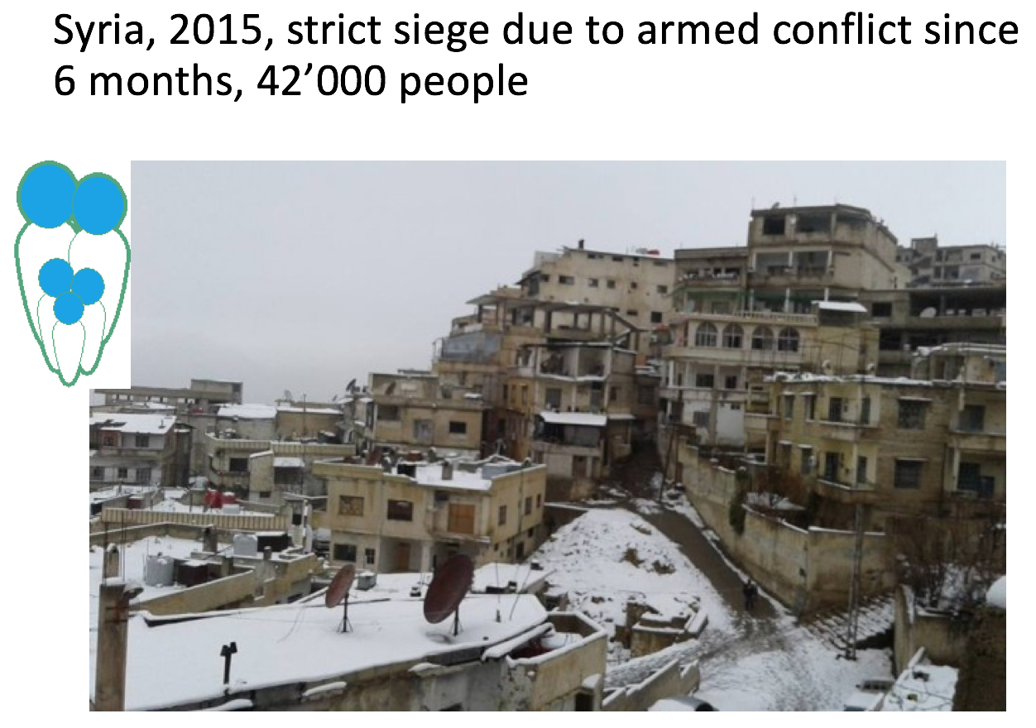
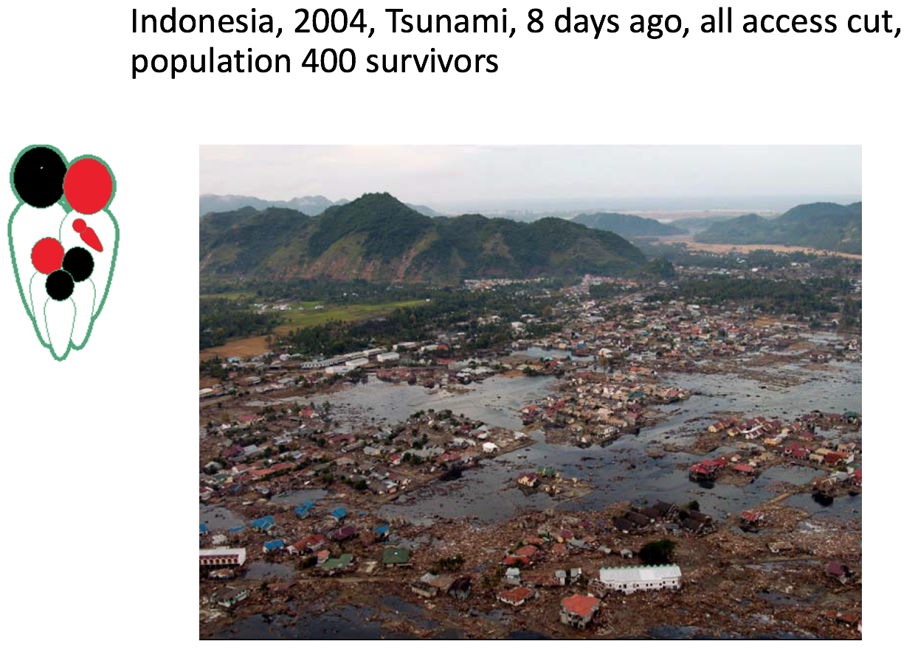
Group work What could be the Purpose and Objectives of a nutrition assessment in this place with regard to nutrition and livelihood 10 min
H.E.L.P. course
Notes:
Imagine that you work for a large multidisciplinary NGO. One sentence
Haiti : To confirm the existence of nutritional crisis situation and to understand the causes of current nutritional crisis situation as well as existing resilience mechanism and expected evolution of crisis.
Syria: Providing quantitative assessment of malnutrition situation in under five and in general population and main causes for design of emergency assistance response in support to that population and support advocacy actions.
Indonesia: Identify the vulnerable groups and priority needs of surviving population related to nutritional risk factors.

Slide 18
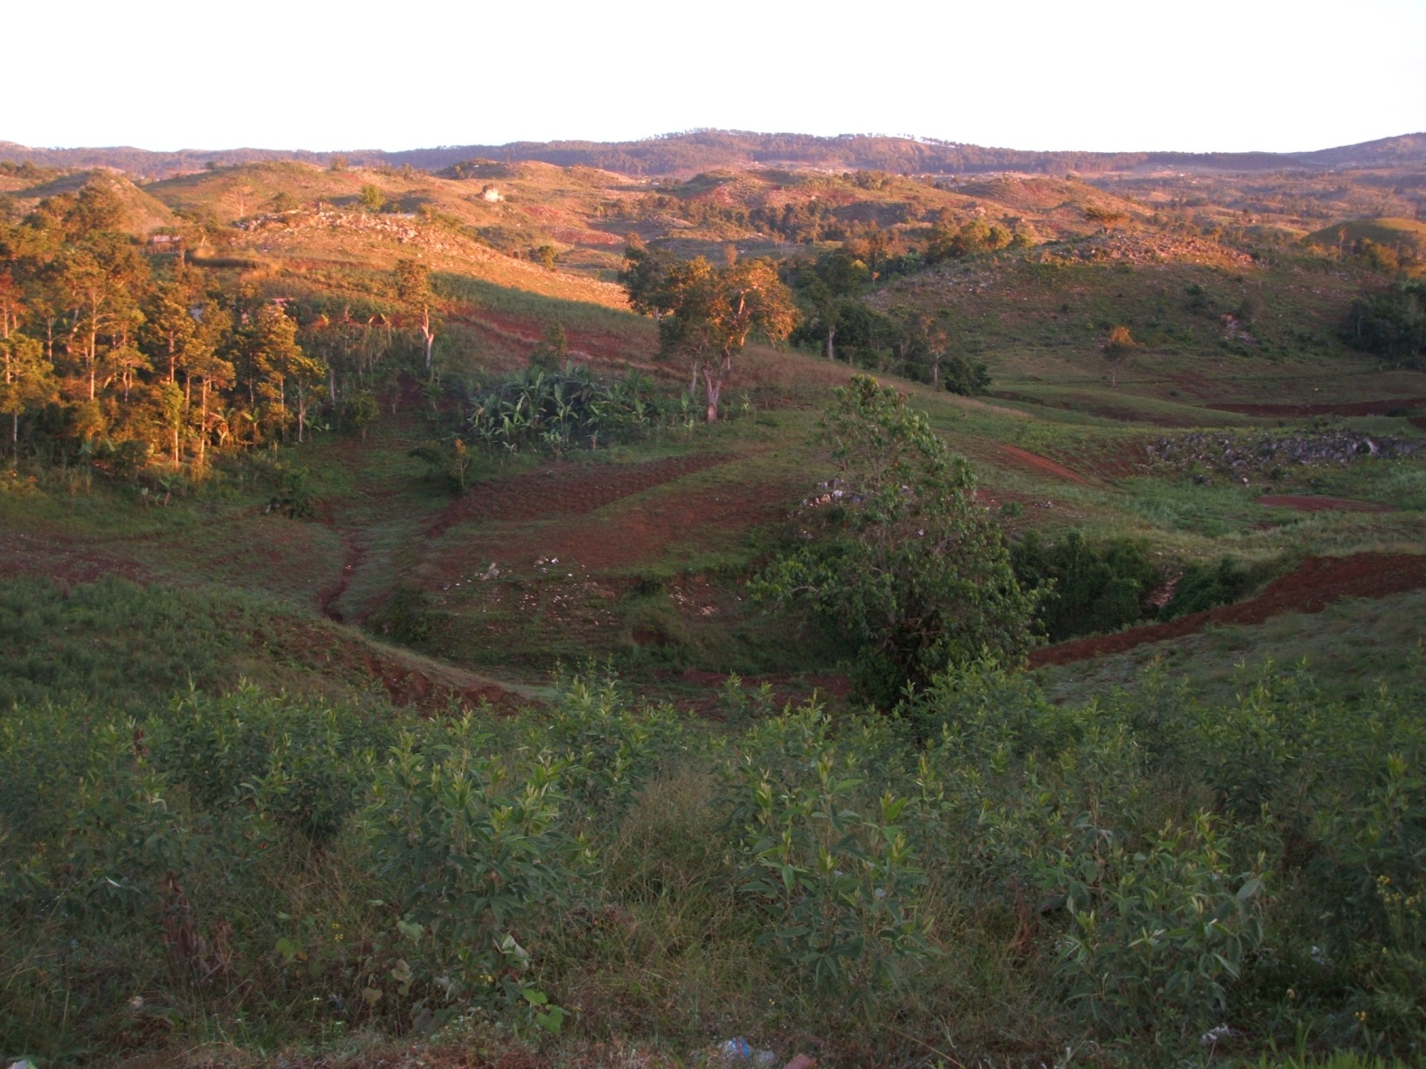
Haiti, 2009, Cyclone 3 months ago, access to the main city blocked until recently, 8’000 people
H.E.L.P. course
H.E.L.P. course
Notes:
Haiti : To confirm the existence of nutritionnal crisis situation and to understand the causes of current nutritionnal crisis situation as well as existing resilience mechanism and expected evolution of crisis.

Slide 19
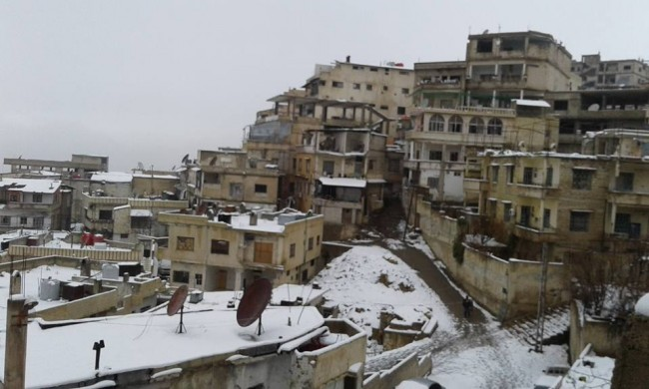
Syria, 2015, strict siege due to armed conflict since 6 months, 42’000 people
H.E.L.P. course
H.E.L.P. course
Notes:
Syria: Providing quantitative assessment of malnutrition situation in under five and in general population and main causes for design of emergency assistance response in support to that population and support advocacy actions.

Slide 20
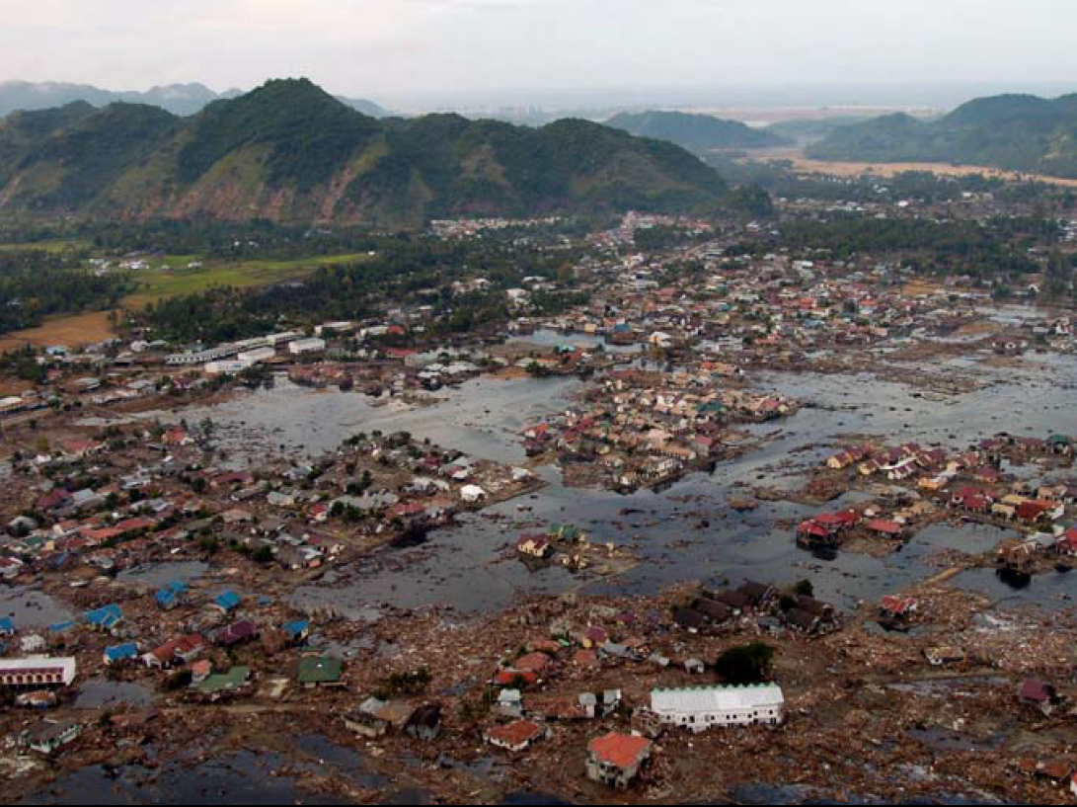
Indonesia, 2004, Tsunami, 8 days ago, all access cut, population 400 survivors
H.E.L.P. course
Notes:
Indonesia: Identify the vulnerable groups and priority needs of surviving population related to nutritionnal risk factors.

Slide 21
Questionnaire content for a nutritional survey
Introduction and Consent
Identifier Variables
Anthropometric Variables
Additional Variables (limited number!!)
Translate and contra-translate the content when needed
H.E.L.P. course
Notes:
Intro and consent:
Introduce team and organization.
Explain the survey objective(s) and selection process.
Inform what will be done/measured and the expected time in the household.
Manage expectations of aid or incentives (results of the survey will not directly affect relief allocation).
Inform about confidentiality and sharing/use of data.
State that there is no penalty for refusal
Ask for verbal consent of respondent
Identifier variables:
Survey date.
Cluster number.
Household number.
Team number
Anthropometric variables:
Age, Sex, Height, Weight, MUAC, Edema.
Additional variables, e.g.
Vaccination status, mortality (overall, U5), Water & sanitation
NB. Keep the number limited!!

Slide 22
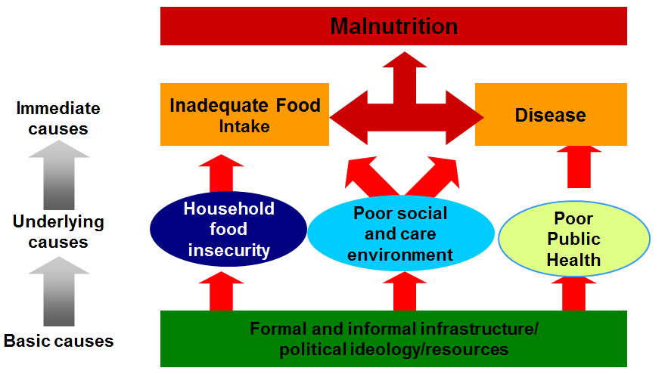
Keep in mind the malnutrition framework for additional variables
H.E.L.P. course

Slide 23
6. Exhaustive survey or Sampling
H.E.L.P. course
H.E.L.P. course
Notes:
Probability sampling whereby each population unit (person, household, etc.) has a known, non-zero chance of inclusion in the sample. Cluster sampling used for e.g. mortality-, nutritional -, vaccination coverage surveys -> looked into more in depth in Nutrition and Livelihood Support Sessions
NB. Making the invisible people visible.

Slide 24
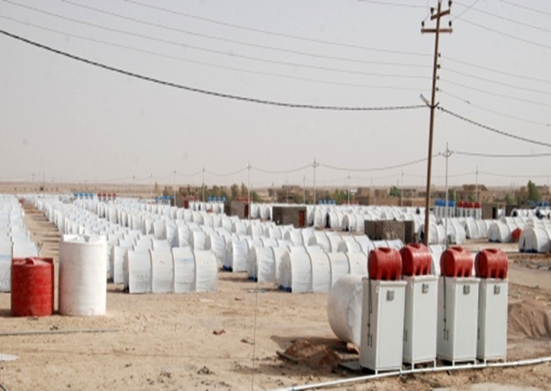
Exhaustive surveys
Exhaustive
Everybody in the population is included -> you get the exact picture of e.g. nutritional status or mortality rate
Only in geographically concentrated populations of a small number
Rare
H.E.L.P. course
H.E.L.P. course
Syrian Refugee Camp, Qiam, Iraq - 2012
Notes:
For instance: There are only 1500 households -> all households are included in the mortality survey + all children aged 6 – 59 month are measured (W/H, MUAC)

Slide 25
Sampling Methods for Probability Sampling
Whole population from which the sample is drawn
1st: Clusters selected from whole population.
I. Simple random
II. Systematic
random
1. Simple
III. Cluster
3. Cluster
IIIa. Simple
random
IIIb. Systematic
random
Simple
Systematic
HH selected directly from whole population
H.E.L.P. course
2nd: HH selected from within selected clusters (municipalities) (using simple or systematic sampling).
2nd: HH selected from within selected clusters (municipalities) (
Notes:
You need a representative sample of children from a selected population to be measured, to get a statistically reliable estimate of the prevalence of acute malnutrition
For the survey to be representative, each child in the population of interest must have an equal chance of being selected for the survey -> probability sample
Cluster sampling when:
1.You do not have a complete and updated list of basic sampling units, or
2. Even if you have a list, but it is impractical to carry out systematic or simple random sampling because the survey population is geographically dispersed.

Slide 26
Systematic Random Sampling
A village is composed of 3400 HH numbered sequentially from 1 to 3400. You need a sample of 250 HH.
?? What will be your sampling interval?
The sampling interval (SI) = 3400 = 13.6
250
You ask someone to randomly choose a number between one and 13 and (s)he chooses 11. This number is the equivalent of the 1st household of the survey.
H.E.L.P. course

Slide 27
Sample size calculation for Simple Random Sampling
Estimate of prevalence sought; when in doubt, take 50% (0.5), which will make the sample as large as possible
N = Z² x ---------
D²
PQ
Q = 1 – p
Size of the sample
Tolerated margin of error (degree of accuracy sought)
H.E.L.P. course
Z = 1.96 for a 95% level of confidence
Can be used for cluster sampling too but then the result (N) must be multiplied by 2
Notes:
Remember: this result for the sample size must be multiplied by 2 for cluster sampling

Slide 28
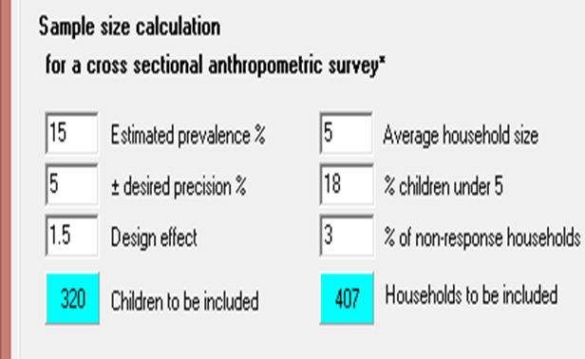
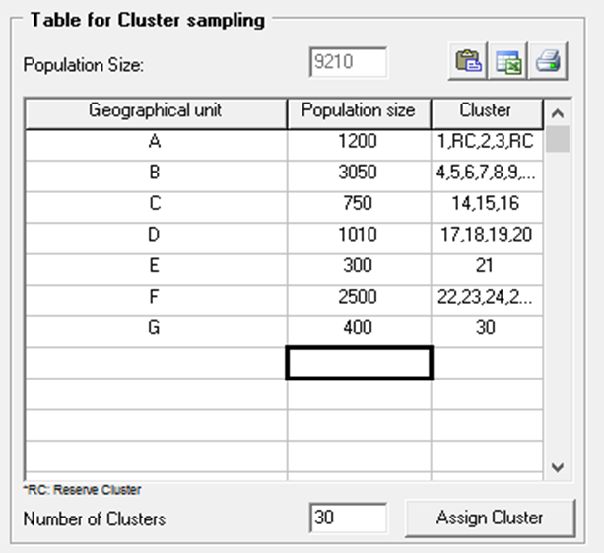
Preparing for cluster sampling
Determine the sample size
Determine the number of clusters: There should be at least 30
Determine the size of each cluster by dividing the total size of the sample by the number of clusters
Determine the location of each cluster
H.E.L.P. course
Notes:
Nb. Ways to help finding sample size: Make the calculation yourself or by using a programme that does the calculation (e.g. excel, EPI-Info, or other programme), look it up somewhere, ask a statistician
You can use the formula for simple random sampling but must for cluster sampling mulitply the result (N) by 2 PQ
N = Z² x ---------
D²
N = size of the sample; Z = 1.96 for a 95% level of confidence; P = Estimate of prevalence sought; when in doubt, take 50%, which will make the sample as large as possible; Q = 1 – p; D = Tolerated margin of error (degree of accuracy sought)

Slide 29
Limitations of a nutritional survey
Cross-sectional survey: A snapshot at a moment in time (no trends)
Provide insufficient information to do a cause-effect analysis
The survey data must be complemented by other contextual information, e.g. food security information through focus group discussions
H.E.L.P. course
H.E.L.P. course

Slide 30
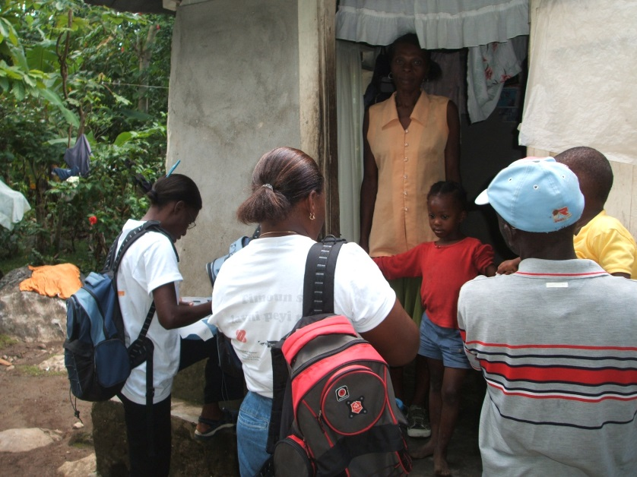
Qualitative data collection methods
Focus groups –using different techniques
Problem tree
Calendar
...
Observation +++
Household visits
Fields, cattle, water source visits
…
Participatory approaches
H.E.L.P. course
Notes:
Screening Syria: screening teams set up for ongoing follow up of the situation, and setup of community based approach for refferal.
Take picture of relevant things, documents,… (uppon autorisation) helps remember, enables further analysis later,…

Slide 31
Observation
Environment
Condition of crops / livestock
People’s activities
Condition of the people and differences
Condition in people’s homes and presence of family members
People preparing meals?
Children with caretakers?
Health services functional? Staffed?
Insecurity, etc…….
H.E.L.P. course
Notes:
Some examples
Environment
Is there a lot of garbage? Are people burning it? Can you see any dead people or animals? Are people collecting the bodies?
Are there many flooded areas? Is the water stagnant? Can you see many insects, such as locusts? Can you see many fresh graves?
Are there many trees? Are they alive or are many cut down?
Condition of livestock, crops
People’s activities
What are people doing? Are they working? If so, where and at what? Are there many people doing nothing?
Can you see many ill or wounded people? Are many people queuing? What are they queuing for? Can you see many people moving with their families and belongings?
Condition of the people and differences
How do people look physically? Do they seem malnourished, dirty, wounded or ill? How well dressed are they? Are people stressed, aggressive or afraid? Are there mainly men, women or children?
Condition in people’s homes and presence of family members
Are people preparing food? What kind of food? How are they preparing food? What fuel are they using? Can you see food and fuel stores?
What kind of assets to people have in and around their homes? Are there many family members at home? Are they mainly children, the elderly, adults or adolescents? What are they doing? Are they growing food around their homes? Are there animals in and around their
homes?

Slide 32
Group work:
List your observations based on the following pictures
7 min
H.E.L.P. course

Slide 33
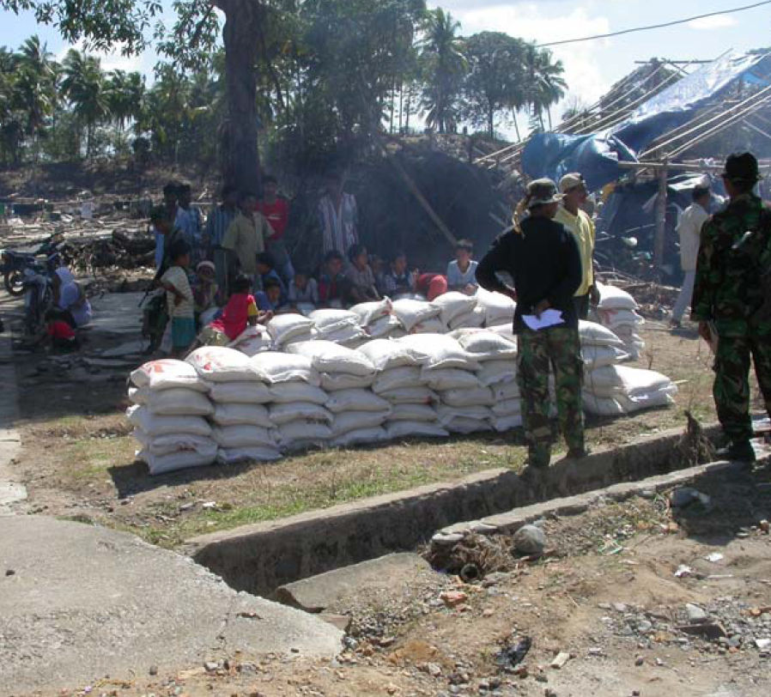
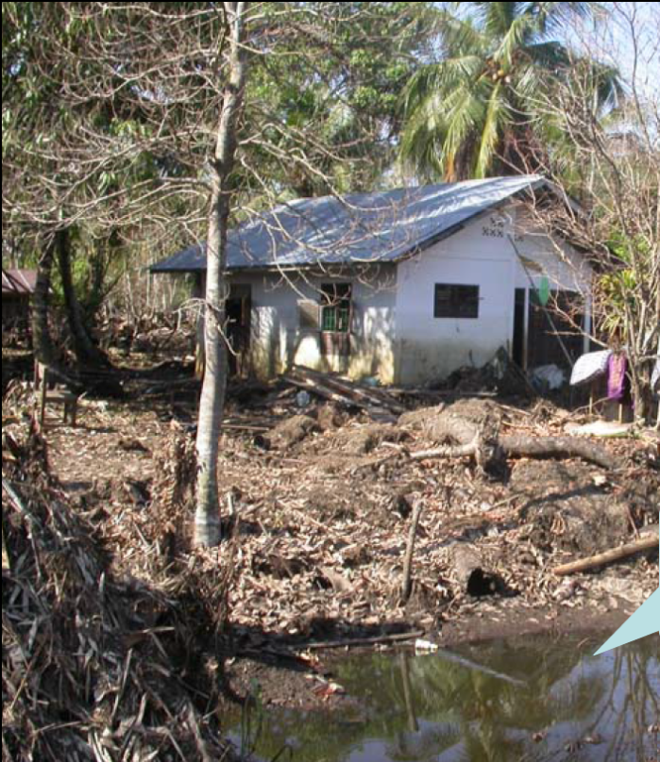
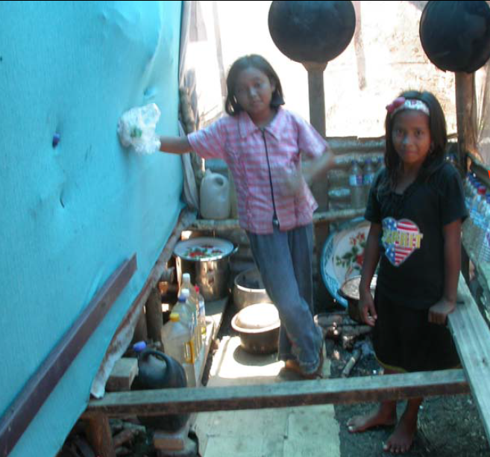
Indonesia, 2004
H.E.L.P. course
Notes:
Ajouter photo des stocks de nourritures gardés par les soldats
Water, salted or not? If salted there is no moskito breeding place but not possible to cultivate.
Cocking items existing, calm people and adaptative strategies in place
Solid and well built (protected from soil) temporary shelter. Drying matresses. Intention to stay
Use of plastic sheeting distributed to collect rain water
Existing food stock, who has the control over the food and other ressources?

Slide 34
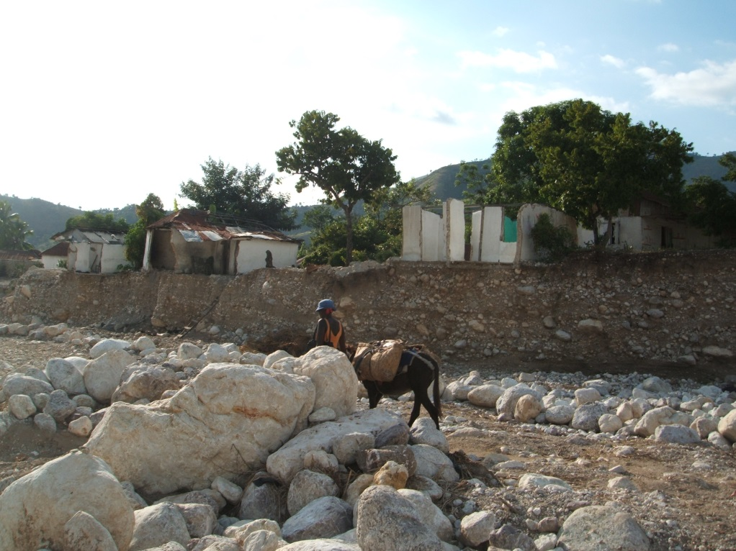
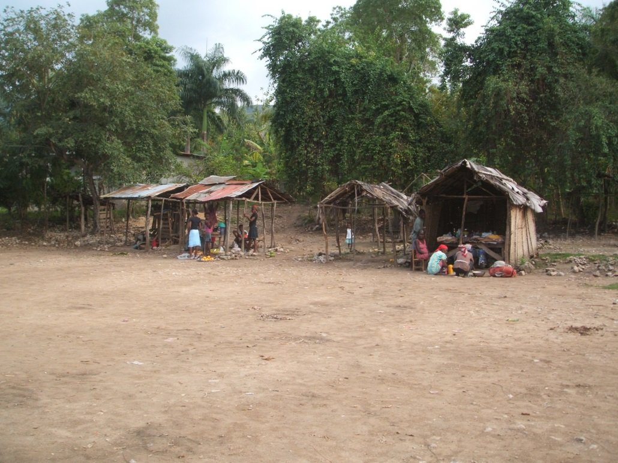
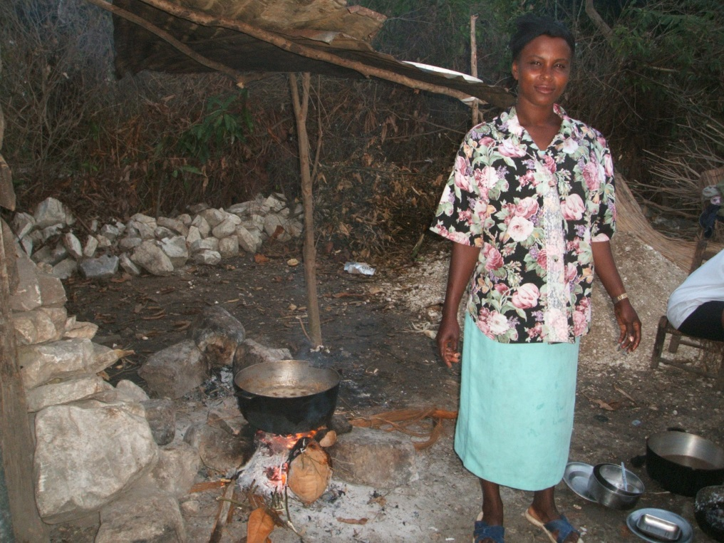
Haiti, 2009
H.E.L.P. course
Notes:
Very little activity in the market (empty),
Movement is possible again,
Agricultural food production restart,
Houses (and roads) literally cut by landslides due to floods
Information about traditional cooking practices and means
Can be much more silent: South east Haiti, a place called Baie d’Orange. We were requested to make an assessment because «there is something wrong there». Cyclone 3 months ago, access to main city of department cut because of damage to road: prevalence of malnutrition

Slide 35
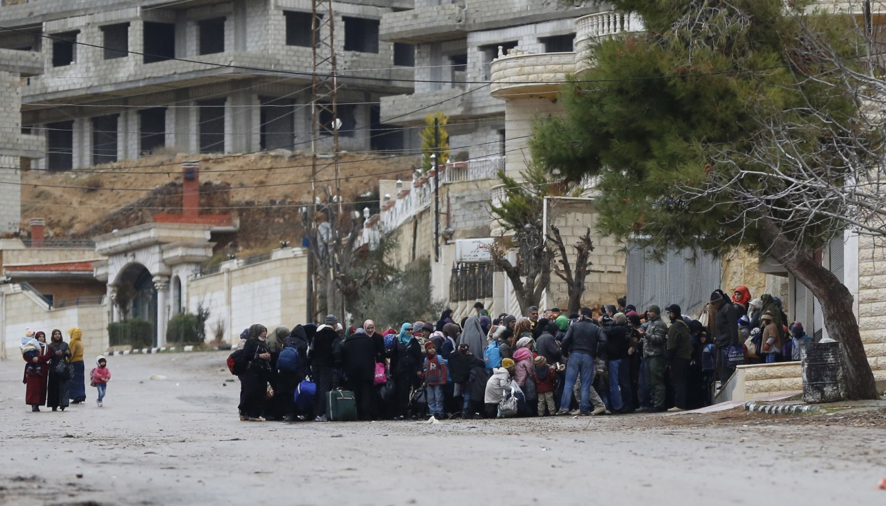
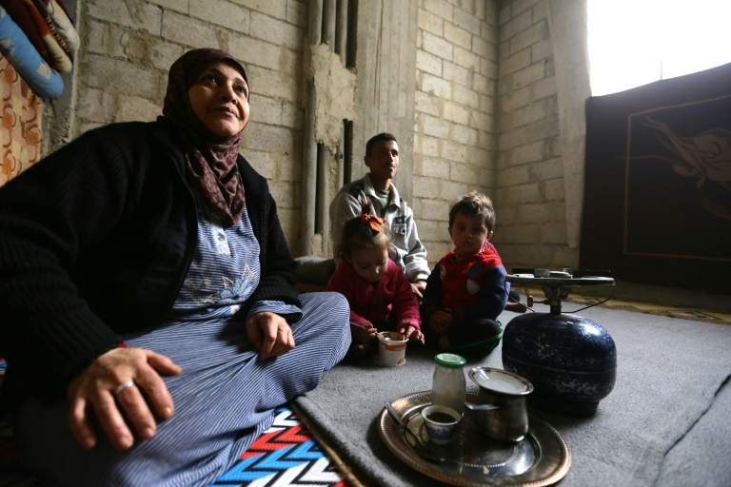
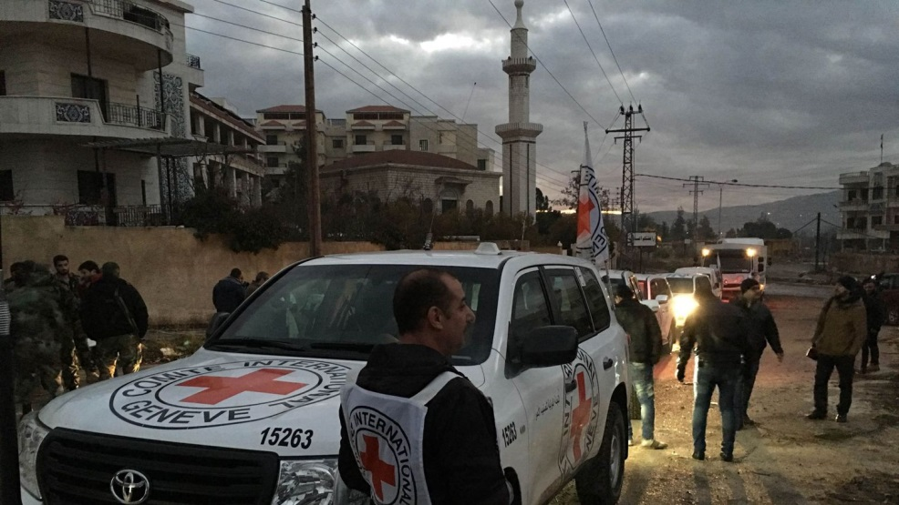
Syria, 2015
H.E.L.P. course
Notes:
Urban area (no agricultural land),
Winter, season with low temperatures and snow
No visible severe damage to houses, but lack of protection against the cold (windows)
Electricity provision in place (is it functioning?) No light in the houses
Gathering of people, mainly women and kids (why?)

Slide 36
Analysis and reporting
Assess the quality of the data
Verify whether you achieved the objectives of your nutritional survey, i.e. are you able to answer all the questions
Report the assessment findings, conclusions & recommendations in a clear and user friendly manner
Ensure that the results are shared with intended users and those who should know
H.E.L.P. course

Slide 37
Now it is time to act and set-up up food and nutrition programmes to support affected people in Haiti, Syria and Indonesia!
H.E.L.P. course

