Slide 1
Introduction to the module on nutrition and livelihood support
Logo organization(s) facilitator(s)
H.E.L.P. course
These learning materials have been developed by:
Rachel Lozano, ICRC, Valérie Belchior-Bellino, ICRC,
Mija Ververs, John Hopkins University/CDC and
Nicole Niederberger, Terre des Hommes
Name and organization facilitator(s)

Slide 2
Objectives
Be able to
discuss the effects of acute and protracted crises on people’s livelihood, food security and nutritional status
explain the conceptual framework of malnutrition and asses people’s nutritional status
initiate and participate in food security and nutrition assessments in acute and protracted crisis situations
identify relevant and appropriate Nutrition-sensitive and Nutrition-specific interventions in a specific crisis situation
H.E.L.P. course

Slide 3
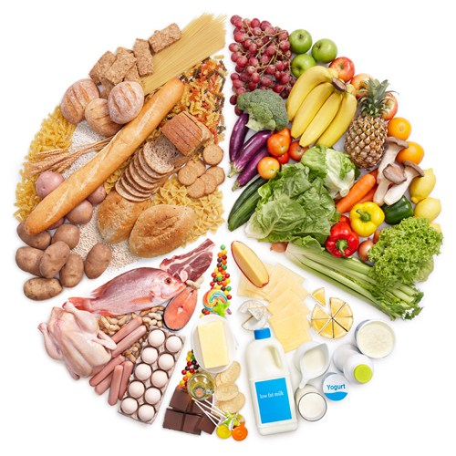
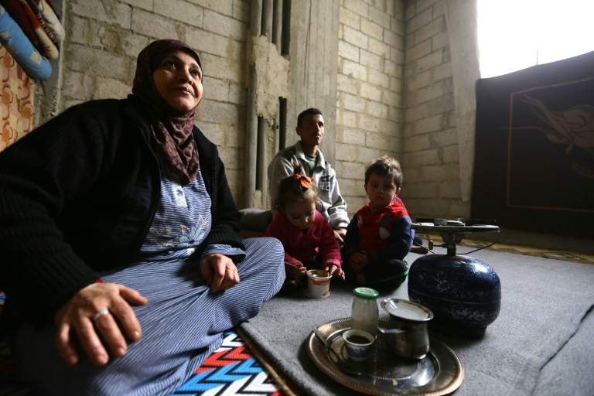
Content Day 1
Basics on
Nutrition and livelihood in stable and acute and protracted crisis contexts
Forms and causes of malnutrition
H.E.L.P. course

Slide 4
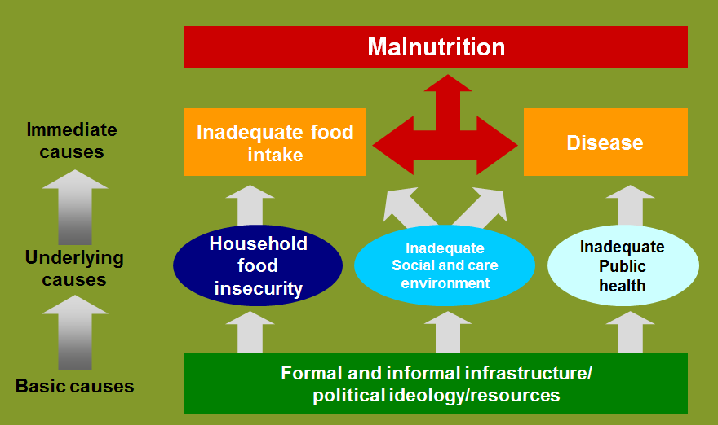
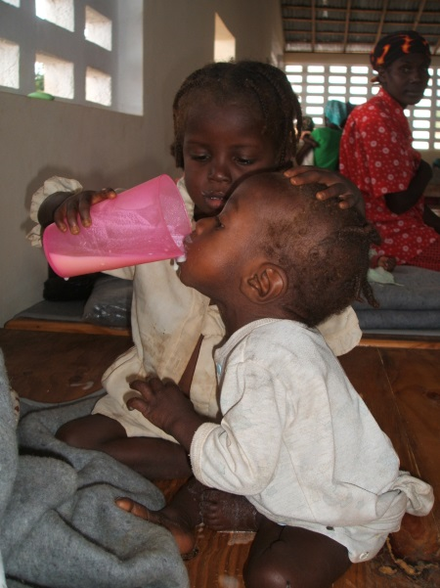
Content Day 2
Basics on
Measuring malnutrition
Assessment of nutrition in crisis situation
Nutrition programming
H.E.L.P. course

Slide 5
How will we work?
Mix of presentations, open questions and exercises/case studies
Requires active participation
??
H.E.L.P. course

