Slide 1
Practical Ethics -
in Humanitarian Action
H.E.L.P. course
Dr. Thomas Wilp, PhD
ICRC – Prehospital Emergency Care & First Aid Coordinator

Slide 2
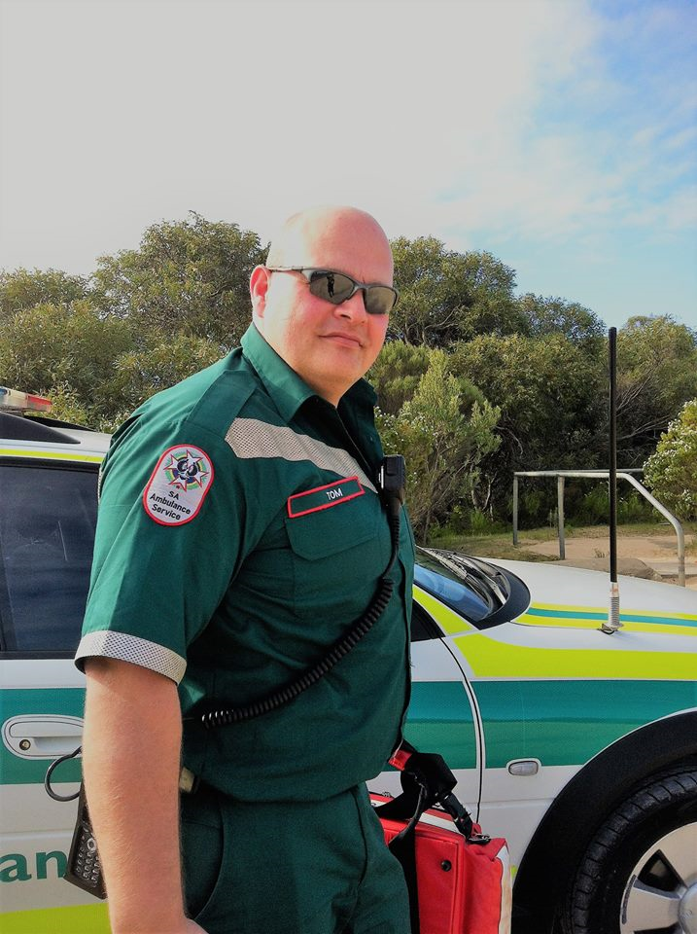
Wilko…
Thomas…
Prehospital Emergency Care Associate
H.E.L.P. course
Prehospital Emergency Care & First Aid Coordinator

Slide 3
What is Ethics…
...and what is Moral?
…and how do they differ?
??
H.E.L.P. course

Slide 4
A purpose for our actions
To act with humanity…
To live a good life, with and for others…
A set of norms and rules: Moral
Humanitarian principles, social ethics, law ethics, journalism ethics, medical ethics, morality, cultural, religious or traditional guidance…
A practical question - practical ethics
How shall we live?
The work which I perform with others, in order to reduce the gap between our values and our practice…
A philosophical research -
A rational reflection on what is morally good or bad, just or unjust, obligatory or forbidden, admirable or despicable…
H.E.L.P. course

Slide 5
Why do we need to know something about Practical Ethics, ethical behaviour and ethical decision making?
Making the best decision…
…ethical dilemma…
??
H.E.L.P. course

Slide 6
What is an ethical dilemma?
An ethical dilemma is a conflict between alternatives, where no matter what a person does, some ethical principle will be compromised…
??
H.E.L.P. course

Slide 7
Case Study Series: Co-opting of Aid Organizations
Group work
Your team is in charge of this operation, what is your decision?
Time before presenting and discussing your results in plenary is 15 minutes (presenting time 1 minute per group)
H.E.L.P. course

Slide 8
H.E.L.P. course

Slide 9
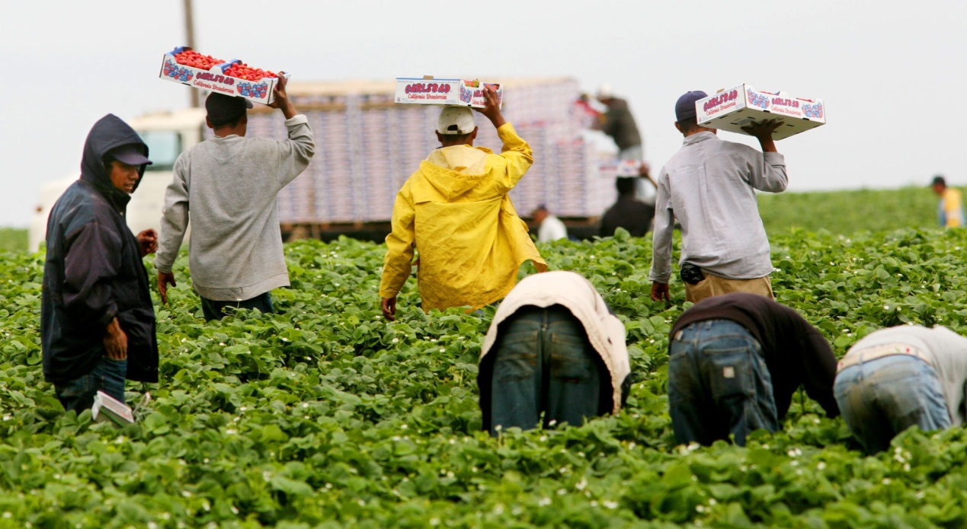
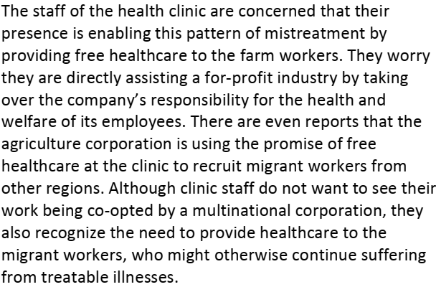
H.E.L.P. course

Slide 10
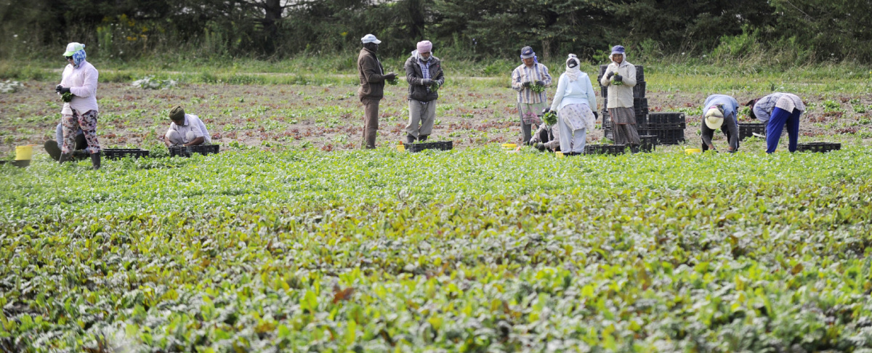
H.E.L.P. course

Slide 11
An ethical dilemma is a conflict between alternatives where, no matter what a person does, some ethical principle will be compromised…
Analyzing the options and their consequences provides the basic elements for ethical decision-making…
H.E.L.P. course

Slide 12
Practical Ethics in Humanitarian Action
1. Guiding principle
Humanity - respect and sympathy
Norms: Laws, Morals, Codes of conduct
Virtues
moral behavior
2. Moral drives and boundaries
H.E.L.P. course

Slide 13
Ethics Resources: What can help us make a decision?
1) Ethics theories
2) Values and principles in humanitarian action
Humanitarian principles
Codes of Conduct for the International RC Movement and NGOs in Disaster Relief
Bioethical principles
Ethical principles of health care in time of armed conflict and other emergencies
H.E.L.P. course

Slide 14
Ethical Theories:
Deontology - or duty-based ethics,
Focus on duties and rules as a basis for ethical action.
A duty is an obligation to always act a certain way, regardless of consequence, because to act in that way is the right thing to do.
Consequentialism
Focuses on consequences and outcomes.
Utilitarianism: we should try to generate the greatest overall good for a group or population; this can be predicted by measuring and calculating the benefits and burdens which result from an action.
H.E.L.P. course

Slide 15
Ethical Theories:
Principlism
Principles are rules or benchmarks.
They inform codes of ethics, international guidelines and codes of conduct.
Virtue Ethics
is less concerned with what we should do, and more concerned with the kind of people we should be.
Virtue is a type of practical wisdom in which good intentions (thought) and the right outcome (action) come together. It is learned from past experience.
H.E.L.P. course

Slide 16
Values and principles, rules and norms
Values
They indicate ideals to follow:
Humanity, dignity, respect for the person
autonomy, life, health, equality, solidarity
Principles
Based on values, give the major orientations to action and attitudes:
Impartiality, auto-determination, respect for life, justice
H.E.L.P. course

Slide 17
Values and principles, rules and norms
Values
They indicate ideals to follow:
Humanity, dignity, respect for the person
autonomy, life, health, equality, solidarity
Principles
Based on values, give the major orientations to action and attitudes:
Impartiality, auto-determination, respect for life, justice
Rules and norms
Determine the action and frame the decision:
Neutrality, informed consent, proportionate means, respect for contracts, equality of access to care, confidentiality
Law; Moral, social norms; Professional ethics, codes of conduct.
H.E.L.P. course

Slide 18
Values and principles in humanitarian ethics: The Fundamental Principles of the Red Cross and Red Crescent Movement
Humanity – Respect people and their dignity
– Act with sympathy towards people
Impartiality – To provide assistance based on need, with no discrimination
Neutrality – To abstain from taking sides
Independence – To act autonomously
H.E.L.P. course
Notes:
Humanitarian Principles Humanity To prevent and alleviate suffering wherever it is found.
Impartiality To provide assistance based on need, with no discrimination based on nationality, race, religious beliefs, class or political opinions.
Neutrality To abstain from taking sides or engage in controversies of a political, racial, religious or ideological nature.
Independence To act autonomously and in accordance with the other core principles

Slide 19
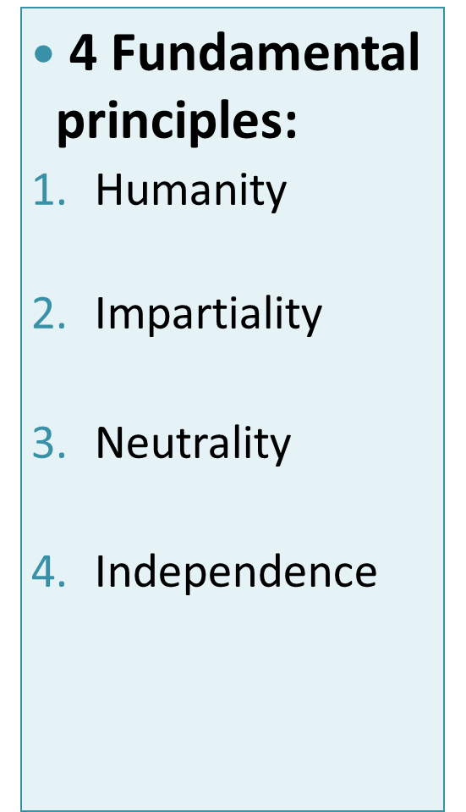
Code of Conduct for the International RC/RC Movement and NGO’s in disaster relief (1994)
6 added principles:
Respect for the cultures and customs
Capacity building
Participation of the concerned persons
Sustainability, and reducing vulnerabilities
Accountability towards the recipients and donors
Information respectful of the persons, their dignity and their image.
H.E.L.P. course

Slide 20
Biomedical Ethics Principles
Autonomy
The right of an individual to make his or her free and informed choice.
Beneficence
The duty to act in the best interest of others.
Non-maleficence
“at least, do no harm”
Justice
Fair and just distribution of resources
H.E.L.P. course

Slide 21
Public Health Ethics
Sustainability
The response should meet the needs of the present without compromising the ability of future generations to meet their own needs.
Precaution
When an activity raises threats of harm to human health or the environment, precautionary measures should be taken even if some cause and effect relationships are not fully established scientifically.
H.E.L.P. course

Slide 22
Public Health Ethics
Solidarity
A social relation in which a group, community, nation or, potentially, global community stands together. It justifies collective action in the face of common threats. It also supports efforts to overcome inequalities that undermine the welfare of minorities and groups that suffer from discrimination.
Vulnerability
Some individuals and groups face heightened susceptibility to harm or injustice during a crisis. Responders should develop plans to address their needs in advance of a crisis and, if a crisis occurs, make reasonable efforts to ensure that these needs are actually met, and should ensure that they are able to contribute to decisions about planning and response.
H.E.L.P. course

Slide 23
Ethical principles of health care in times of armed conflict and other emergencies (1)
“Civilian and military health-care organizations share the common goal of improving the safety of their personnel and other health assets and the delivery of impartial and efficient health care in armed conﬂicts and other emergencies.
Referring to the principles of humanity, whereby human suﬀering shall be prevented and alleviated wherever it may be found and impartiality, whereby health care shall be provided with no discrimination” (…) “Endorse the following ethical principles of health care”
H.E.L.P. course
HCID 2015. Ethical principles of health care in times of armed conflict and other emergencies.

Slide 24
Ethical principles of health care in times of armed conflict and other emergencies (2)
General principles (summary)
Ethical principles of health care are the same as in times of peace.
Health-care personnel shall at all times act in accordance with relevant international and national law, ethical principles of care and their conscience.
Their primary task is to preserve human physical and mental health and to alleviate suffering.
They shall provide the necessary care with humanity, respecting the dignity of the person, with no discrimination of any kind, whether in times of peace or of armed conflict or other emergencies.
Privileges and facilities afforded to health-care personnel … are never to be used for purposes other than for health-care needs.
Health-care personnel never accept acts of torture or any other form of cruel, inhuman or degrading treatment under any circumstances, including armed conflict or other emergencies.
H.E.L.P. course
HCID 2015. Ethical principles of health care in times of armed conflict and other emergencies.

Slide 25
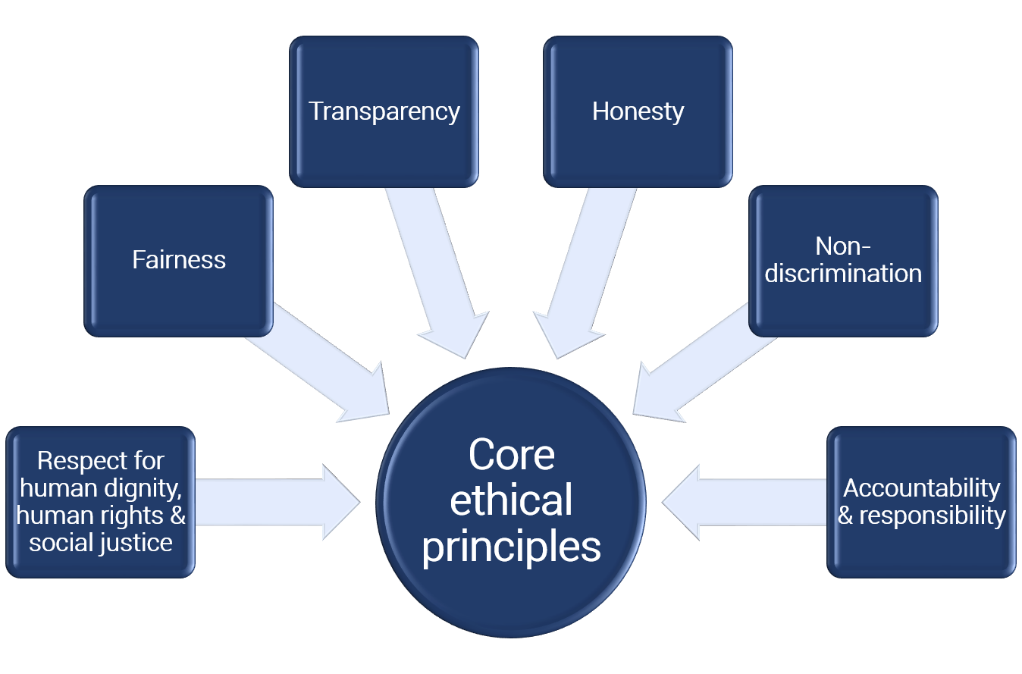
Other Ethical Principles …
H.E.L.P. course

Slide 26
Practical Ethics in Humanitarian Action
1. Guiding principle
Humanity - respect and sympathy
Norms: Laws, Morals, Codes of conduct
Virtues
moral behavior
Consequences
Evidence-based practice
2. Moral drives and boundaries
Discussion
Decision
3. Practical ethics
H.E.L.P. course
Information
Evaluation of results
Context
Particular case

Slide 27
Professional ethics
Medical ethics
Nursing ethics
Public health ethics
Humanitarian ethics
etc.
Consequences
Intended and un-intended results -positive or negative-
for affected people/populations, you, your organization, other stakeholders
Principles
Core Humanitarian principles - Humanity, Impartiality, Neutrality, Independence
Other principles
Bio-ethical principles - Autonomy, Beneficence, Non-maleficence, Justice
Public health principles –Sustainability, Precaution, Solidarity, Vulnerability
Other humanitarian principles – …….
Ethical
Dilemmas in humanitarian action
Moral and ethical values of the context
H.E.L.P. course
Benefits and risks
Constraints

Slide 28
??
How does the decision making process function?
H.E.L.P. course

Slide 29
Is it really an ethical issue?
Problem: In a true ethical dilemma, each potential course of action will violate an important moral principle…
H.E.L.P. course

Slide 30
Identify & confirm the ethical dilemma…
Describe the context…
…Putting the individuum in the centre…
(VISUALIZATION)
H.E.L.P. course

Slide 31
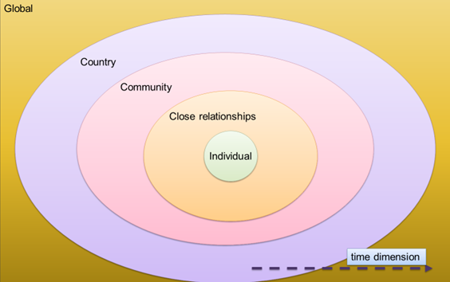
2. Describe the context…
H.E.L.P. course

Slide 32
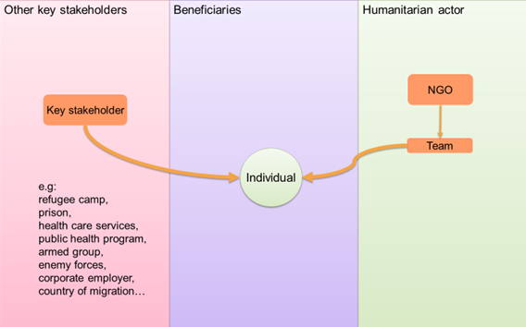
H.E.L.P. course
3. Map key stakeholders and relationships…

Slide 33
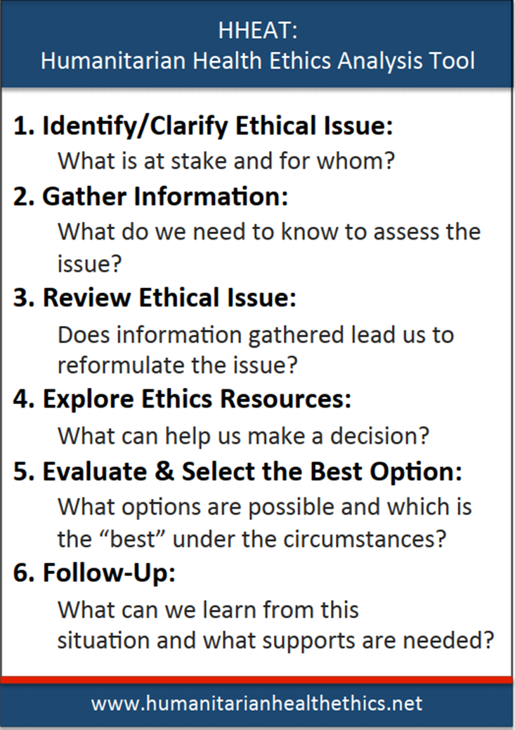
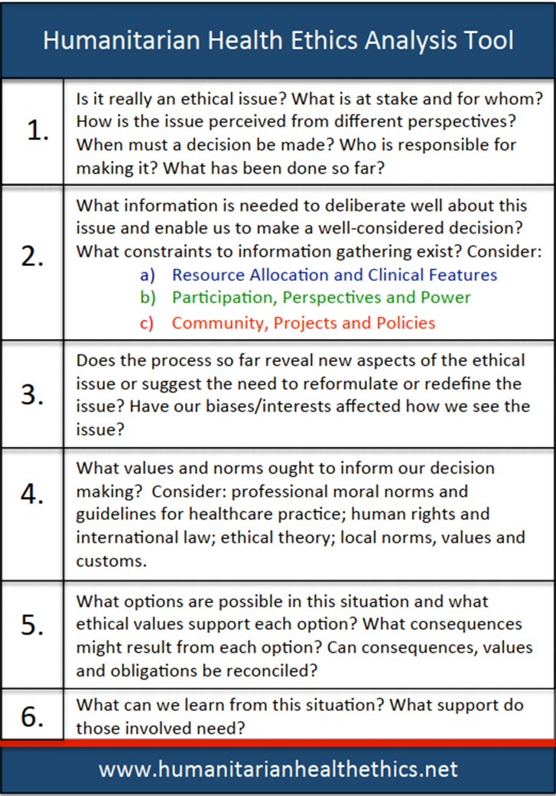
H.E.L.P. course

Slide 34
Ethical decision making…
Start with facts: peoples’ needs in a given context
Clarify facts, gather information
discuss what values, principles and norms are applicable
Discuss possible options, their merits, expected effects, disadvantages
Take a decision and act
valuate: process, results, and adapt action…
H.E.L.P. course

Slide 35
H.E.L.P. course

Slide 36
Consequences of unaddressed ethical issues…
Distress, Frustration, shame, stress and anger in staff involved
Authoritarian or radical decision
-Leading to more frustration, distress, internal crises…
Absence of decision
-Leaving humanitarian needs unaddressed
No accountability to affected people and stakeholders
Scapegoating, blaming and shaming on staff, or on external actors…
H.E.L.P. course

Slide 37
Consequences of an ethically unsound decision…
Disrespectful, ineffective, harmful, unfair actions
Attack on human dignity
Complicity to violence or abuse
Negative perception by the population
-Loss of trust, of access, of acting capacity;
Negative perception by stakeholders
-Public scandal, reputation.
Security threats against the team or the institution.
H.E.L.P. course

Slide 38
Cultural diversity and ethical limits in crises…
Universality of humanitarian and ethical principles
But diversity in balancing one or another: importance of dialogue and people’s participation
Duty to respect cultures and customs
(code of conduct)
Absolute limits
extreme violence, torture, mutilation, hostages, slavery and other cruel, inhuman and degrading treatments.
-IHL, Geneva Conventions…
H.E.L.P. course

Slide 39
What is the best decision ?
The solution which best…
Meets the requirements of humanity
Respects the dignity and autonomy of all the persons concerned,
Agrees with our values and norms,
Brings the better results,
Comes within the scope of sustainability,
and accountability and inclusion
H.E.L.P. course

Slide 41
Case Study Series: Co-opting of Aid Organizations
Group work
Now knowing some tools for ethical decision making, would you change you your decision….
2) Discuss how you (group) would now approach the situation (would you use the tools?)
Time before presenting your results in plenary is - 10 minutes
H.E.L.P. course

Slide 42
Suggested readings…
Humanitarian Health Ethics Analysis Tool Handbook. Fraser, Hunt, Schwartz, de Laat, 2014.
Henry Dunant (1862). A Souvenir of Solferino, ICRC, Geneva.
Hugo Slim (1997). Doing the right Thing. Disasters, 21(3):244-257
World Medical Association (2005). Medical Ethics Manual. http://www.wma.net/
Hugo Slim (2015) Humanitarian Ethics – A Guide to the Morality and Aid in War and Disaster. London: Hurst, 300 pp.
Guidance for Managing Ethical Issues in Infectious Disease Outbreaks, World Health Organization 2016 -www.who.int/ethics/publications/infectious-disease-outbreaks/en/
H.E.L.P. course

