Slide 1

Data/Information Collection,
Analysis and Sharing
H.E.L.P. course
Anne Golaz, CERAH
Antje van Roeden, ICRC

Slide 2
Hans Rosling: The joy of Stats
https://www.youtube.com/watch?v=jbkSRLYSojo
H.E.L.P. course
Notes:
Question: what are key points that come out of this when it comes to data –disaggregration / raw data – vs using data -analyzing

Slide 3
??
Why kind of health data do you use in your work?
H.E.L.P. course
Notes:
Importance of data, Describes a situation, tells how things change, how you interventions /programme progress and whether the interventions have the desired effect.
Intended use: used for decision making, learning and accountability

Slide 4
Belief and Evidence
Belief
Evidence
Opinion
Impression
Judgement
Subjectivity
Emotions
Propaganda
Assumption
Hypothesis
Prejudice
Bias
«Urban legend»
Anecdote
Facts
Proof
Measurement
Quantification
Scientific
Unbiased
Objectivity
H.E.L.P. course

Slide 5
Belief or evidence?
??
The UN cluster approach is NOT working; coordination has not improved since it was introduced in 2005 as part of the UN humanitarian reform.
H.E.L.P. course

Slide 6
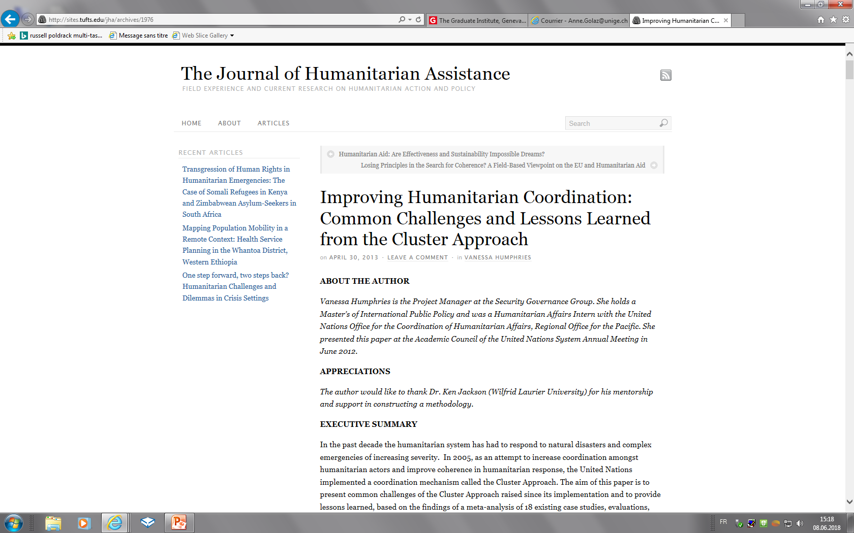
H.E.L.P. course

Slide 7
Improving humanitarian coordination:
Common challenges and lessons learned from the cluster approach¹
Paper: A meta-analysis of 18 existing case studies, evaluations
Results: Overall the cluster approach increased the effectiveness of humanitarian action
Many challenges
  Gaps in predictable leadership (country cluster coordinator: high turnover, insufficient training and experience)
  Barriers to inclusive partnership: failed to create NGO ownership and involvement
  No mechanism to enhance accountability to affected populations
¹ Humphries Vanessa. The Journal of Humanitarian Assistance. April 30, 2013
H.E.L.P. course

Slide 8
A belief
Belief: conviction based on cultural, or personal faith, morality or values
Prejudice: an opinion based on insufficient or unexamined evidence
Evidence
Provides proof
Evidence has to go through the filter of our values and feelings
H.E.L.P. course
Producing evidence: RESEARCH! Studies, surveys, assessments, etc.

Slide 9
Quantitative or qualitative data
Different types of data -1
??
How many people crossed the border?
What types of complications are observed after abdominal surgery?
Why is there an unwillingness to vaccinate pregnant women?
When is the main harvesting season in Colombia, and in Ukraine?
How many of the children go to school? Why not all of them?
H.E.L.P. course

Slide 10
Quantitative & qualitative data
Quantitative data | Qualitative data
How many? How often? How much? How old? How high? How low? How far? | What? How? When? Where? Who? Why?
H.E.L.P. course
Findings can be expressed as
Percentage, rate, ratio, frequency, average, median
Notes:
Discuss different percentage, rate -> needs proportion + , ratio –CFR proportion of people why die of the diseases compared those who had the diseases, frequency, average, median

Slide 11

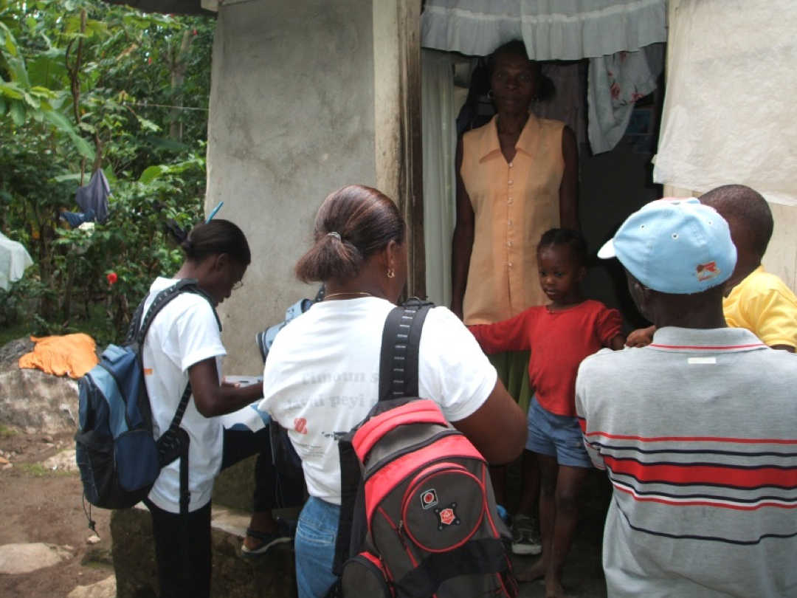
Different types of data -2
??
What is the difference between Secondary data and Primary data
Secondary data
Existing data, gathered by someone else than you or for another purpose
Primary data
Data that you collect specifically for the current purpose
H.E.L.P. course
Notes:
Sources of secondary data: Internet, media, journals, data sharing platforms; authorities; other organizations, Clusters; Archives of your organization

Slide 12
Sources on the World-Wide-Web
As first step for the data gathering for the assessment in South Sudan/Syria your team will look at relevant secondary data available on the internet
Group work:
List the web-sites that you will use for this.
Why these ones?
Time before presenting your results in plenary is
10 minutes
H.E.L.P. course
Notes:
Follow-up from session Setting the Scene (choice of context for the first movies) + Programme Cycle Management (Exercise steps of an Assessment)
10 Minutes -> presenting the results in plenary -> discuss and share the list with (selected) web-sites

Slide 13
Examples of sources on the www
United Nations Agencies
  WHO, UNICEF, UNFPA, WFP, UNWRA, OCHA, IOM, UNDP
International Red Cross and Red Crescent Societies
  ICRC, IFRC, Red Cross & Red Crescent National Societies
Operational NGOs
  MSF, SCF, IMC, HELPAge, ………
Specific information sources -networks, groups, organizations
  ACAPS, Relief web, REACH initiative, Demographic and Health Services Programme (DHS), HumanitarianResponse.info,
  Institute of Health Metrics and Evaluation, Health Cluster, Nutrtition Cluster, WASH Cluster, Situation/Activity reports UN agencies /NGO, ALNAP, …..
Donors
  World Bank, ECHO, PRM, ADB, GTZ, OECD, ……
National Ministries of Health
Media, professional journals
H.E.L.P. course
Notes:
For further information see list with web-sites dsitributed to the learners

Slide 14
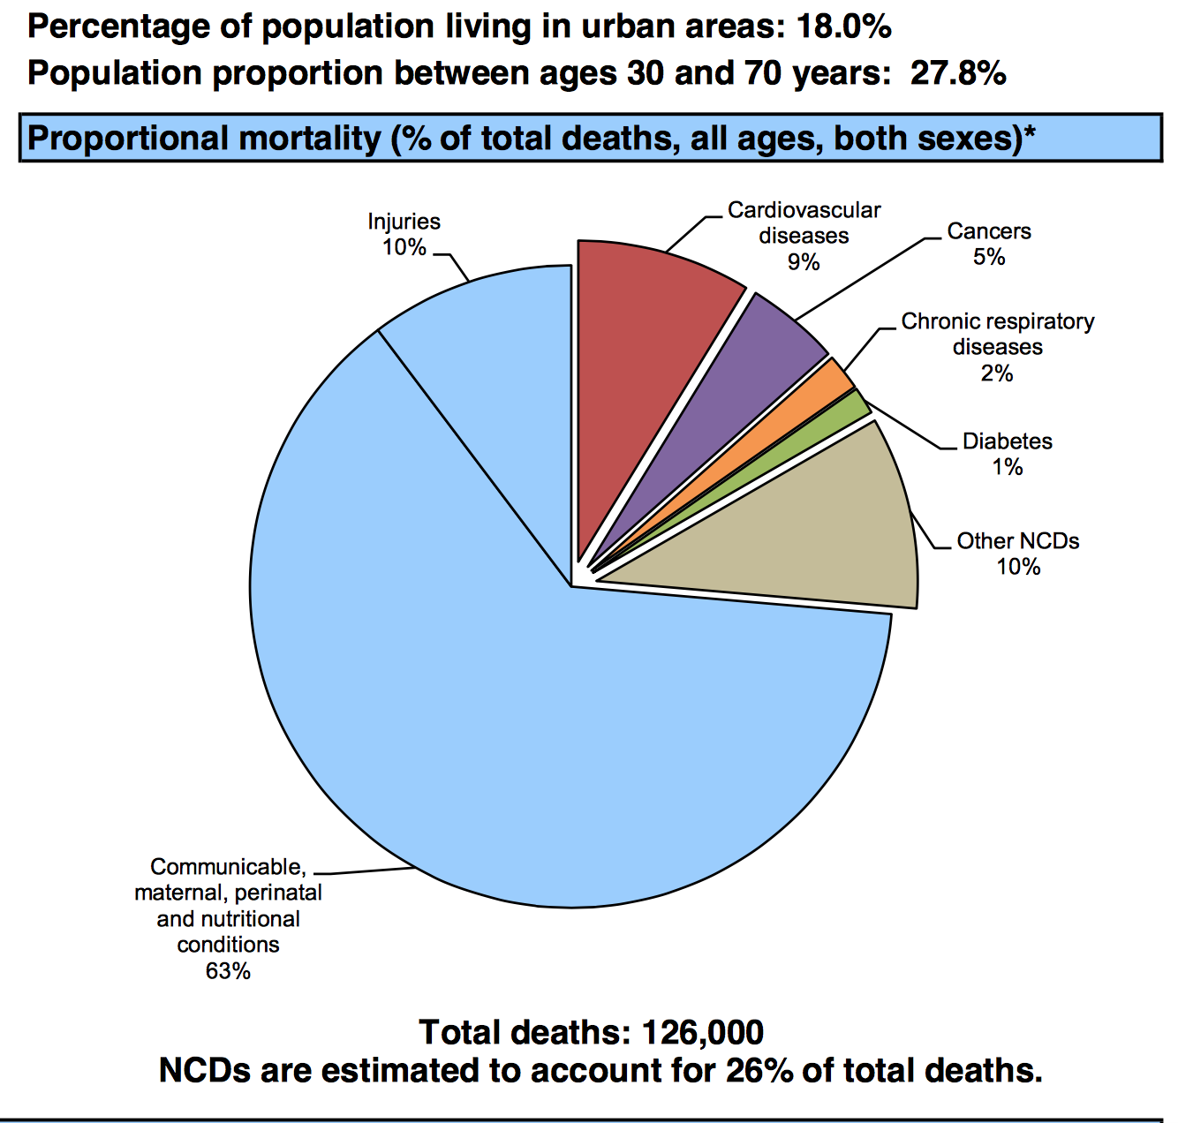
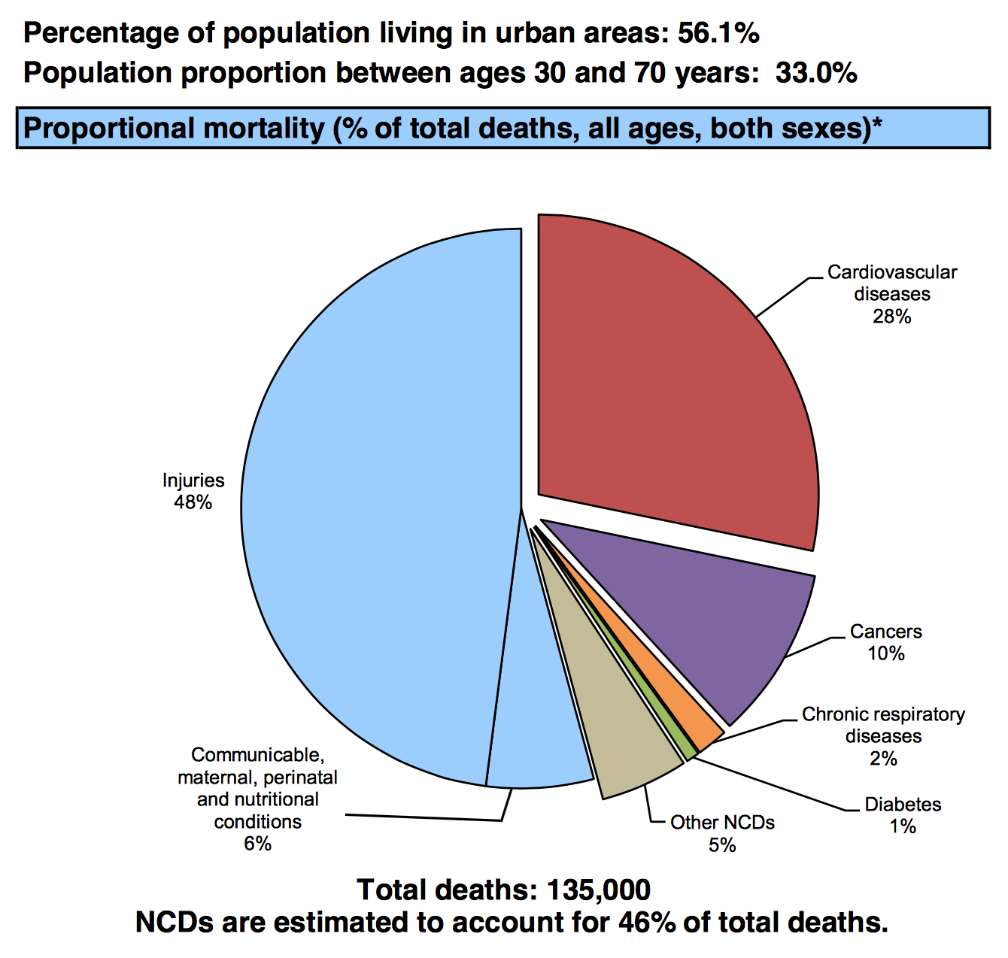
WHO – NCD country profile 2014
South Sudan:
Population 10 838 000
Income group: Low
Syrian Arabic Republic
Population 21 890 000
Income group: Low middle
H.E.L.P. course

Slide 15
Estimating the number of affected people
Examples
Census, Comprehensive count
  Dadaab refugee camp survey, Garissa Region, Kenya
Overflight/areal photography to count households, complemented by other estimates of household size
  Goma 1994
Mapping: Estimate the settlement area in m², complemented by an assessment of population density at different points
Counting people fleeing when they cross the border
  Rohyngia fleeing from Myanmar to Bangladesh, 2018
Count of services: Count N° of services provided to a target population (e.g. N° of vaccinations given to <5y) -> estimate total population using the target population count as percentage
H.E.L.P. course

Slide 16
Exhaustive surveys, sampling, ….
H.E.L.P. course
Notes:
Probability sampling whereby each population unit (person, household, etc.) has a known, non-zero chance of inclusion in the sample. Cluster sampling used for e.g. mortality-, nutritional -, vaccination coverage surveys -> looked into more in depth in Nutrition and Livelihood Support Sessions
NB. Making the invisible people visible.

Slide 17
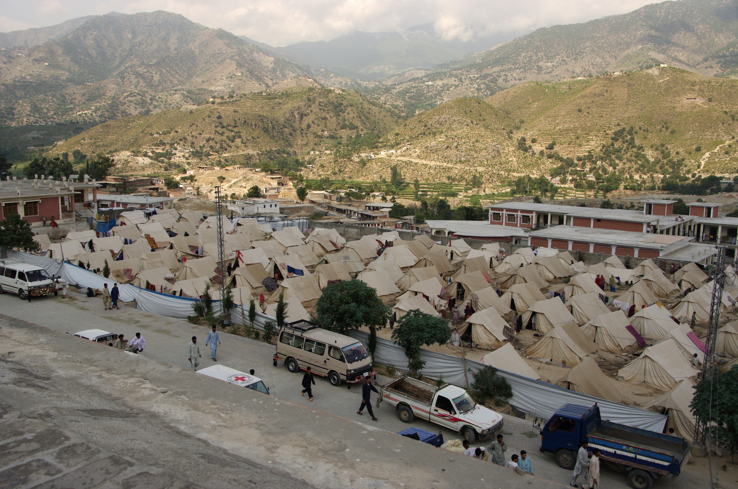
Exhaustive surveys
Everybody in the population is included -> you get the exact picture of e.g. nutritional status
Only in geographically concentrated populations of a small number
Rare
H.E.L.P. course
H.E.L.P. course
Philippe Richard, ©ICRC
Notes:
Photo: Pakistan, North West Frontier Province, District of Dir, Timergara Region, Wari 1 camp
For instance: There are only 1500 households -> all households are included in the mortality survey + all children aged 6 – 59 month are measured (W/H, MUAC)

Slide 18
Non-probability sampling
  Key examples:
  Convenience sampling
    Choosing people arbitrarily and in an unstructured way, e.g. those close to the road
    Does not reflect the wider population from which the sample was drawn
  Purposive sampling
    Requires as a minimum criteria for who will be included
    Can be effective to generate ideas and get feedback
    May be appropriate, e.g. to represent specific age groups or areas historically vulnerable for famine
H.E.L.P. course
Notes:
Also called biased sampling
Rapid assessment that rely on convenience sampling –choosing individuals arbitrarily and in an unstructured way (e.g. taking anyone who is available such as those closest to the road) cannot be assumed to reflect the wider population from which the sample was drawn.

Slide 19
Probability sampling
Key examples:
Simple random sampling
Systematic random sampling
Cluster sampling
  Everybody in the population has an equal chance of being selected
  Gives an estimate of the real situation
  You can generalize the results to the population
  Results are comparable between populations and over time
  May be expensive and time consuming
H.E.L.P. course
Notes:
Probability sampling whereby each population unit (person, household, etc.) has a known, non-zero chance of inclusion in the sample. Cluster sampling used for e.g. mortality-, nutritional -, vaccination coverage surveys -> looked into more in depth in Nutrition and Livelihood Support Sessions
NB. Making the invisible people visible.
Definition: any methods of sampling that uses random selection.
Cluster sampling generally used for mortality surveys, vaccination coverage surveys and nutritional surveys
Cluster sampling is also the method that is frequently used in crisis situations

Slide 20
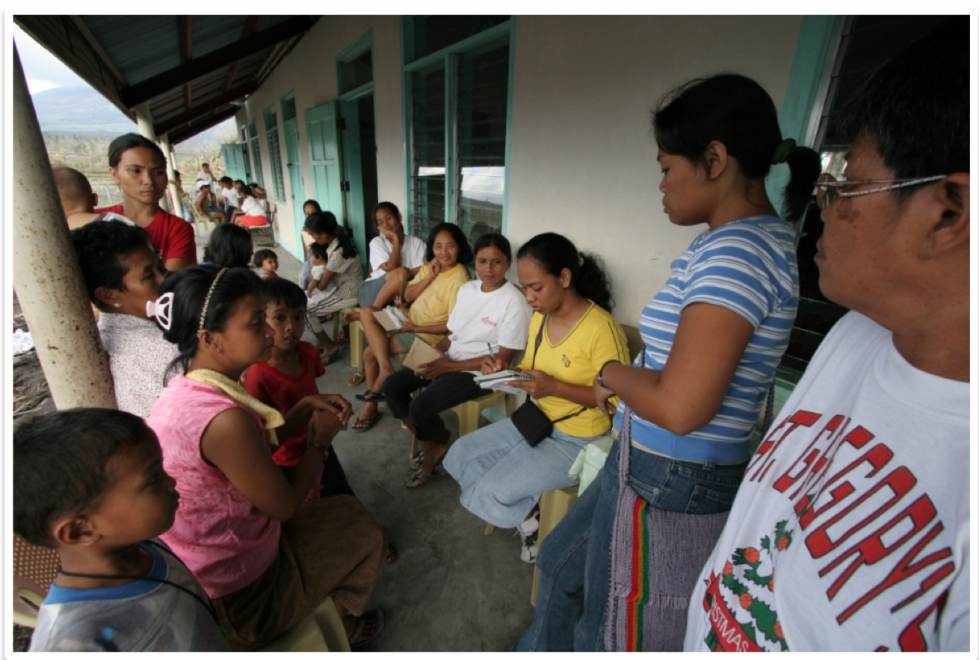
??
Random or biased sample…..
A survey of child malnutrition is conducted by measuring the children of women who were advised over the radio to bring their <5s to the health clinic on Tuesday morning.
H.E.L.P. course
H.E.L.P. course

Slide 21
Sampling Methods for Probability Sampling
Whole population from which the sample is drawn
1st: Clusters selected from whole population.
I. Simple random
II. Systematic
random
1. Simple
III. Cluster
3. Cluster
IIIa. Simple
random
IIIb. Systematic
random
Simple
Systematic
HH selected directly from whole population
H.E.L.P. course
2nd: HH selected from within selected clusters (municipalities) (using simple or systematic sampling).
2nd: HH selected from within selected clusters (municipalities) (
Notes:
You need a representative sample of children from a selected population to be measured, to get a statistically reliable estimate of the prevalence of acute malnutrition
For the survey to be representative, each child in the population of interest must have an equal chance of being selected for the survey -> probability sample
Cluster sampling when:
1.You do not have a complete and updated list of basic sampling units, or
2. Even if you have a list, but it is impractical to carry out systematic or simple random sampling because the survey population is geographically dispersed.

Slide 22
Systematic Random Sampling
A village is composed of 3400 households numbered sequentially from 1 to 3400. You need a sample of 250 households
?? What will be your sampling interval?
The sampling interval (SI) = 3400 = 13.6
250
You ask someone to randomly choose a number between one and 13 and (s)he chooses 11. This number is the equivalent of the 1st household of the survey.
H.E.L.P. course

Slide 23
Sample size calculation for Simple Random Sampling
Estimate of prevalence sought; when in doubt, take 50% (0.5), which will make the sample as large as possible
N = Z² x ---------
D²
PQ
Q = 1 – p
Size of the sample
Tolerated margin of error (degree of accuracy sought)
H.E.L.P. course
Z = 1.96 for a 95% level of confidence
Can be used for cluster sampling too but then the result (N) must be multiplied by 2
Notes:
Remember: this result for the sample size must be multiplied by 2 for cluster sampling

Slide 24





Data collection methods
Observation – Use all your senses
H.E.L.P. course
Notes:
Ears, eyes, taste, touch, smell

Slide 25
Data collection methods
Counting
Interviews –Two ways to classify
  Type of interviewee(s):
    Individuals, (focus) groups, experts, non-experts, etc.
  Extent to which the interview is structured:
    Structured/questionnaire, semi-structured/ check-list, non-structured /spontaneous
H.E.L.P. course
Images -On the spot, areal images (overflying, drones, satellites)
Keeping a medical register, Crowd sourcing, ….
Notes:
GIS = Geographic Information System
Crowdsourcing is the practice of engaging a group of people for a common goal. It is the idea of gathering information with the help of a “crowd” that is later used for a business-related task.
Crowdsourcing has its place in the humanitarian world. Gathering and sharing information via crowdsourcing can be of use in crisis situations where the response is based on timely data coming from different types of sources.

Slide 26

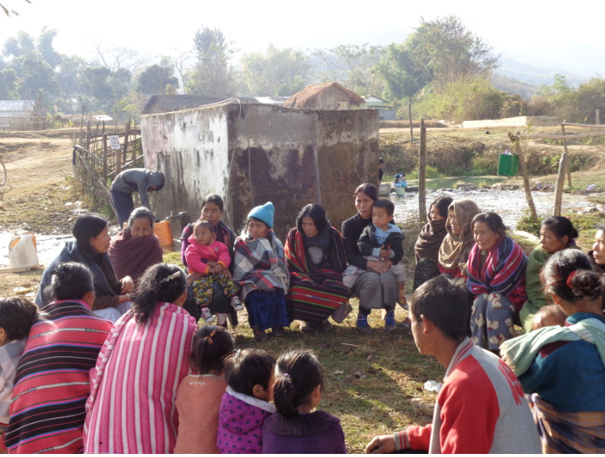
Individual interviews vs focus group discussion
In-depth interviews are one-on-one discussions designed to provide a detailed picture of an individual’s views about the area of interest
Focus group discussions are group intended to identify the beliefs and opinions of a selected group of people on a specific topic
H.E.L.P. course
Notes:
Checklists should not be treated as a questionnaire. They are intended as a memory aid. Remain open to new information that emergencies from the interviews.
If the local society is very hierarchical there will be limits to the diversity that you can achieve in a group. If people will not be able to speak freely, or if participation may cause problems for them or for others, it is better to convene separate groups in which the status is more balanced

Slide 27
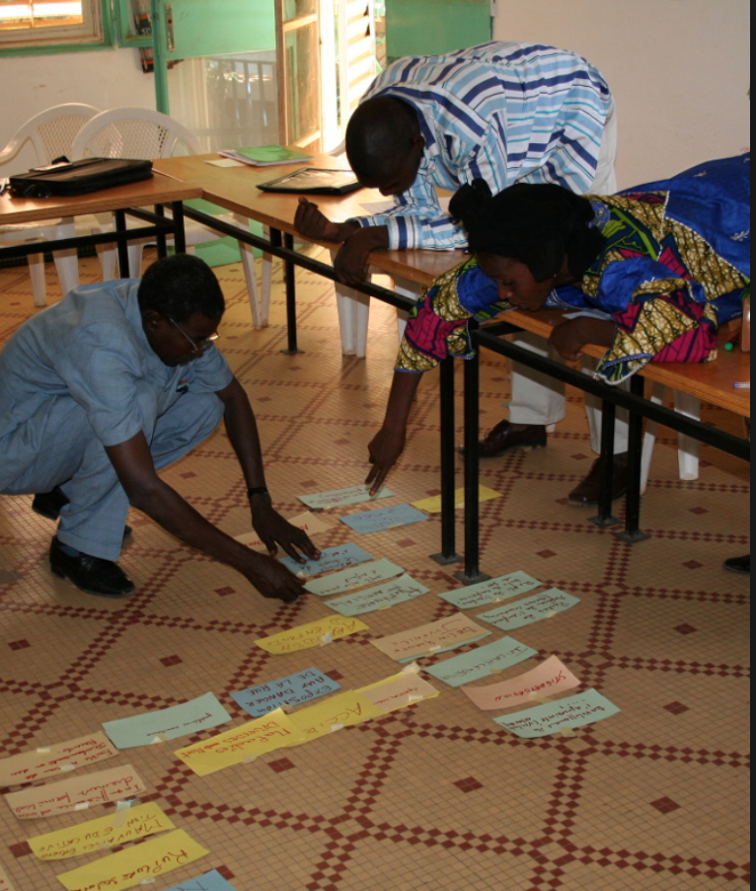
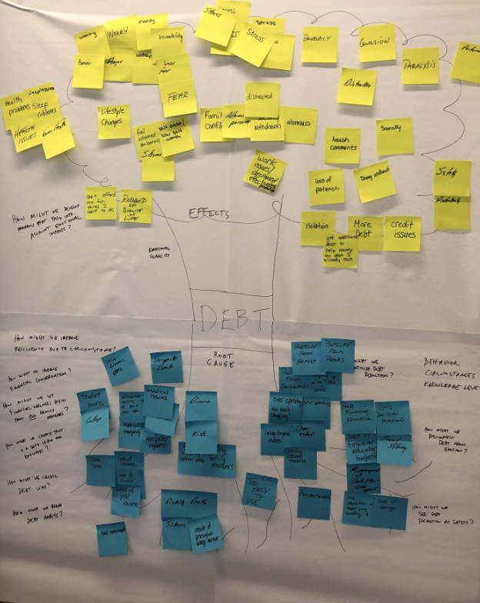
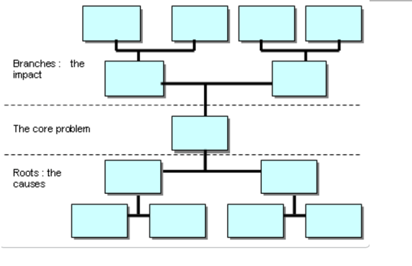
Problem tree
H.E.L.P. course
Notes:
We have foreseen that later in the course you will work on this in your groups

Slide 28
Data collection methods -Digital technologies
Since mid-2000 a proliferation of digital mobile communications technologies, the rise of social media, and access to vast quantities of all kinds of data (digital text, SMS, tweets; satellites, unmanned areal vehicles/UAV imagery).
These play an increasingly important role in responding to humanitarian crises
H.E.L.P. course
Notes:
Keep in mind that not all people are connected: availability, affordability, usability.
E-legislation
Definition digital transformation: The changes associated with digital technology application and integration in all aspects of human life and society. It is the move from the physical to the digital (Source: www.technopedia.com).

Slide 29
H.E.L.P. course

Slide 30
‘’Digital humanitarians’’
Volume and speed of digital information generated during crisis
Can be as paralyzing to humanitarian response as the lack of information
This inundation of information is referred to as Big (Crisis) Data
Starting point digital communities during Asia tsunami in 2004
Surge since the Haiti earthquake in 2014
  Digital Volunteers/’digital humanitarians’ and technical communities (VTCs) aim to make sense the data of and identify needs or stories from user-generated content (UGC)
  Create updated maps, datasets and information products, e.g. >7500 volunteers contributed to improve OpenStreetMap after Nepal earthquake
H.E.L.P. course 2019

Slide 31
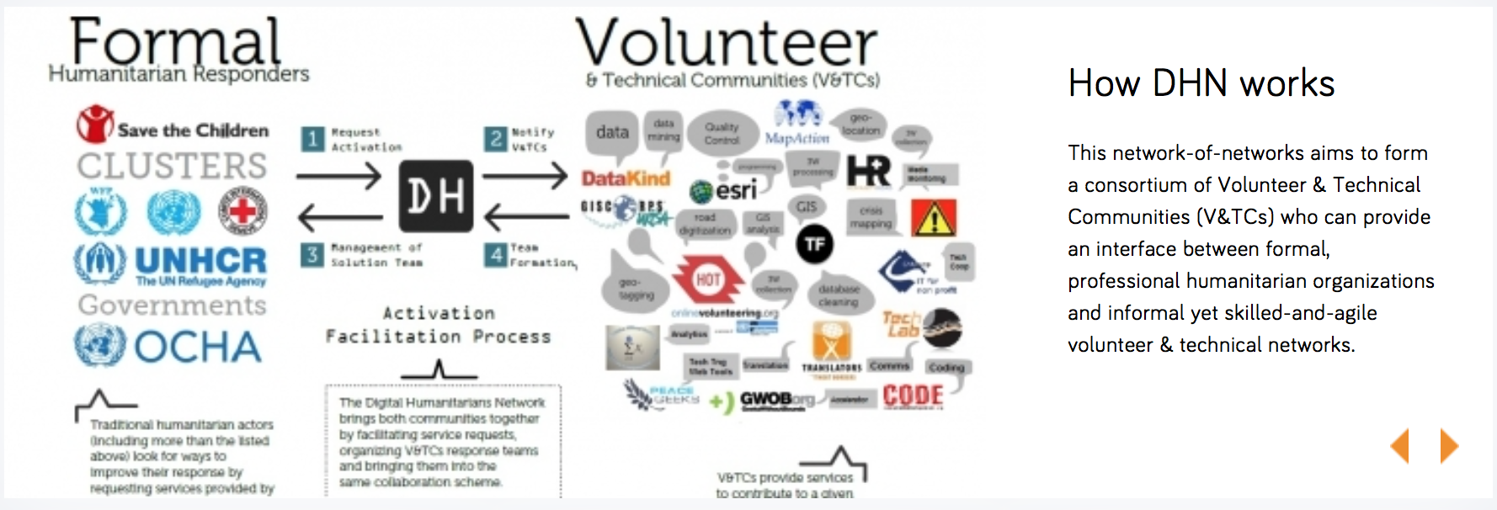
Leveraging networks for humanitarian response
H.E.L.P. course
Source: https://www.digitalhumanitarians.com
Notes:
The Digital Humanitarian Network-of-networks aims to provide and internface between formal humnaitarian organizations and informal yet skiled-and-agile volunteers and technical networks by facilitating service requests, organizing V&TCs response teams and bringing them together in the same collaboration scheme

Slide 32
From data to decision making
          Data /Indicators
          Sources
          Measure (Methods)
          Processing
          Analysis –disaggregation of data!
          Interpretation
          Conclusions
          Decision making
H.E.L.P. course

Slide 33
Triangulation
Interviews,
Focus group discussion
Information cross-check and synthesis
Photos, Films, Satellite images, GIS
Crowd sourcing, User generated content
H.E.L.P. course
Direct observation
Review existing information

Slide 34
??
How can you assess the quality of
data / information?
What questions should you have about data?
??
H.E.L.P. course

Slide 35
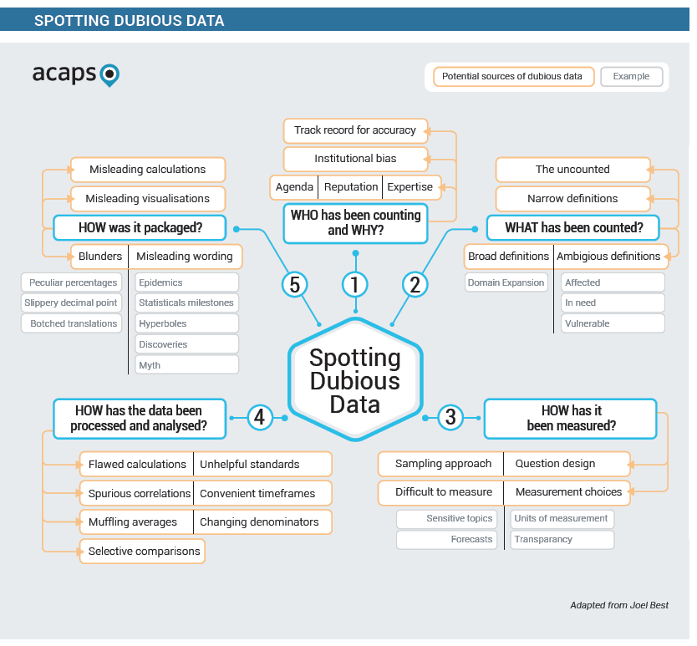
H.E.L.P. course

Slide 36
Who has been counting and why
Daily mail, 14 September 2015
“Two in every 100 Syrian migrants are ISIS fighters, UK PM is warned: Lebanese minister tells Cameron jihadists are coming 'under cover' to attack the West”
H.E.L.P. course
Notes:
Unlikely that the Lebanese Minister of Education has the data at hand to estimate the ratio of ISIS fighters to individuals fleeing Syria.
Likely that the Daily Mail, by some described as a sensationalist newspaper, did not check this fact before publication.
ACAPS

Slide 37
Who has been counting and why?
Keep in mind:
Why was the data collected? What is the agenda of the source? Could it be biased?
What is the expertise of those who have collected, reproduced and disseminated the data?
Is there a strong track record of producing accurate information?
H.E.L.P. course

Slide 38
WHAT has been counted?
Example: Numbers of IDPs and country ranking
2014: 38.2 million IDPs worldwide
Countries with the largest IDP populations:
Syria 7.6 million
Colombia 6.0
Iraq 3.6
DRC 2.8
SSudan 2.2
4 "UNHCR – Global Trends –Forced Displacement in 2014". UNHCR. 18 June 2015.
H.E.L.P. course

Slide 39
What has been counted?
Keep in mind:
Look out for concepts widely used within the humanitarian community, but lack a common definition such as in need, vulnerable, household, urban, resilience
Have the concepts been defined too narrow or too broad, has someone or something been excluded?
Have definitions remained the same at the different points in time?
H.E.L.P. course

Slide 40
How was it counted, measured?
«6.5 million people have been internally displaced in Syria as of October 2015» Source: UN
H.E.L.P. course
Notes:
Data gathering in Syria is severely hampered by the active conflict and lack of access to parts of the country. Statistics regarding the Syria conflict are broad guesstimates, computed in a politically charged context.
Data gathering in Syria is severely hampered by the active conflict and lack of access to parts of the country. Statistics regarding the Syria conflict are broad guesstimates, computed in a politically charged context.

Slide 41
How was it counted, measured?
Keep in mind:
Does the data consist of numbers that seem hard to produce; how could anyone calculate that? Closely scrutinize information on sensitive topics
Numbers presented without sufficient information about measurements choices or assessment tools
Unusual unit of analysis, ex: extended families instead of households
H.E.L.P. course

Slide 42
How has the data been processed or analyzed?
Example: 7.4 million people in need in Afghanistan, 2014, OXFAM
H.E.L.P. course
Notes:
Double-counting the number of people in need is common.
The number of people in need per sector combined to total 7.4 million.
However the unit of analysis are not mutually exclusive categories: some people who are severely food insecure affected as well by natural disasters too.

Slide 43
How has the data been processed and analysed?
Keep in mind:
Could the calculations be flawed?
Are there any misleading comparisons, timeframes, comparison groups, or standards used?
Are there any stated relationships between two variables? Look out for reports claiming to have identify the key cause of complex problems
H.E.L.P. course

Slide 44
How was it packaged?
«Of more than 80 million people estimated to have been in need of humanitarian assistance in 2014, 75% were women and children»
«UN says most of the Syrians arriving in Greece are students»
H.E.L.P. course
Notes:
75% of all people in high fertility countries are women and children
The results of a survey indicate that 16 % of the respondents reported that they were students

Slide 45
How was it packaged?
Keep in mind:
Question dramatic statements that take the form of statistical claims, such as «the best», «the most», «new discovery»
Words that imply causation such as leads to, caused by, etc. Difficult to determine causality
Unhelpful denominators (x per hour) used for shock purpose
H.E.L.P. course

Slide 46
Spotting dubious data (ACAPS)
5 key questions to remember!
1. Who has been counting and why?
2. What has been counted?
3. How has it been counted, measured?
4. How has the data been processed and analysed?
5. How was it packaged?
H.E.L.P. course

Slide 47
‘’Data dilemma’’
On the hand: Data collection and sharing supports the understanding of a crisis and the ways people are affected and able to cope. This is important for the management of humanitarian interventions.
On the other hand: Data collection and sharing may draw attention to the effects of crisis situations on people’s lives and well-being. This may cause harm.
H.E.L.P. course

Slide 48
Data dilemma
Give examples of potentially sensitive data/information that may cause the so called ‘’data dilemma’’ –both for data collection and sharing.
How may people / organizations be affected when the consequences of collecting and sharing sensitive data is not considered?
??
H.E.L.P. course
-> Benefits & risks need to be considered
Notes:
Always consider if it is safe to collect / share data

Slide 49
Guidance in case of ‘’data dilemma’’
Do not put yourself or others in danger
Do not talk to the media/via social media about data unless you are absolutely sure there is no danger to you or others
Ensure data gathering and sharing is done in line with the relevant values, principles and standards
If photographs of people are taken or shared, informed consent is needed. You should not be able to identify patients or establish their affiliation
In the most difficult and precarious situation, it may be best not to gather data at all
H.E.L.P. course
Source: Health Care in Danger, The responsibilities of health-care personnel working in armed conflicts, ICRC, 2013

