Slide 1
Logo organization(s) facilitator(s)
Programme Cycle Management
H.E.L.P. course
Facilitator’s name(s) + organization(s)
These learning materials have been developed by
Antje van Roeden (ICRC) and Eirini Karanisa (ICRC)

Slide 2
Objectives
Be able to
Explain the programme cycle management (PCM) approach and integrate relevant elements of it in the work
H.E.L.P. course

Slide 3
Mission, mandate and principles
Assess
& Analyze
Institutional management priorities
Affected Populations & Context
Evaluate
& Learn
Formulate& Plan
Monitor
Implement
& Monitor
H.E.L.P. course
Notes:
Keep the affected people / population at the centre
The cycle is not completed until findings / results are shared with those responsible for follow-up and others ‘’who need to know’’

Slide 4
Assessment
Gaining an understanding of the situation in order to identify problems, their sources and their consequences, the capacities and responses by the concerned persons and other stakeholders, and the potential for your institution’s intervention.
H.E.L.P. course
Analyse -> decide if there is a need to intervene and if yes, whether you will do so
Notes:
The thinking behind it is that you do an assessment and from there on decision about interventions are taken rather than coming with a pre-set idea of what you are going to do.
There may also be reasons not to carry out an assessment, e.g.
Access to the affected area is impossible
Existing information is adequate for decision making
Many agencies are already doing an assessment in the affected area, and you are confident that they will cover the needs adequately and in a timely manner (NB. assessment fatigue)
A decision not to intervene has already been taken

Slide 5
Types of assessment
Rapid assessment
Country/organization/sector specific formats, MIRA, ACAPS template…
In-depth assessment
Ongoing assessment
H.E.L.P. course
Situation monitoring /surveillance, e.g. HeRAMS, market prices, …
Notes:
Rapid assessment formats, e.g. Country/organization specific ones, Multi-cluster/Sector Initial Rapid Assessment (MIRA); NB MIRA is controversial in certain contexts, ACAPS initial rapid assessment template
Ongoing Assessment = Situation monitoring / Surveillance, e.g. WHO's Health Resources Availability Monitoring System = HeRAMS, market prices, epidemic prone diseases present in the area

Slide 6
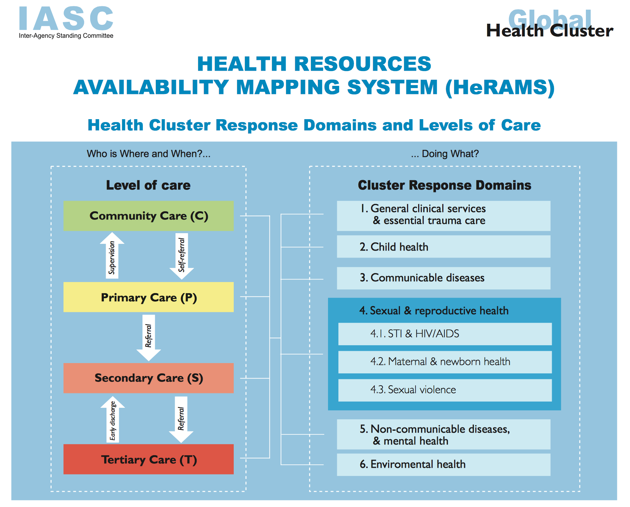

H.E.L.P. course
Notes:
Showing some more information about the HeRAMS

Slide 7
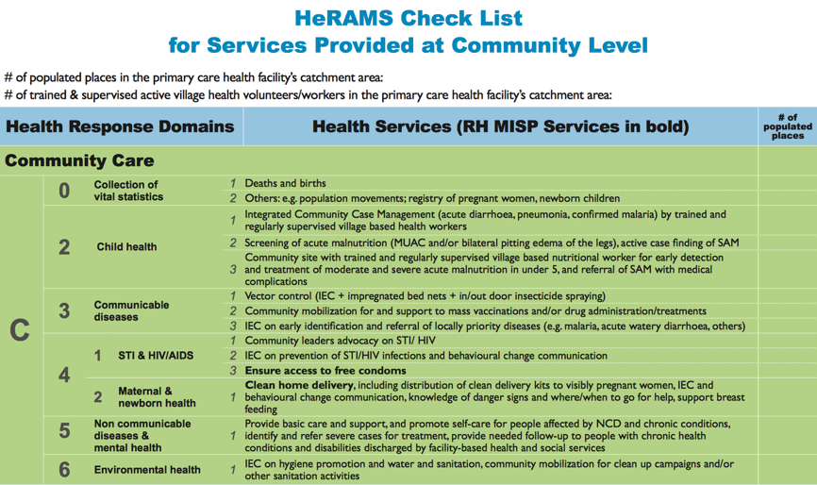
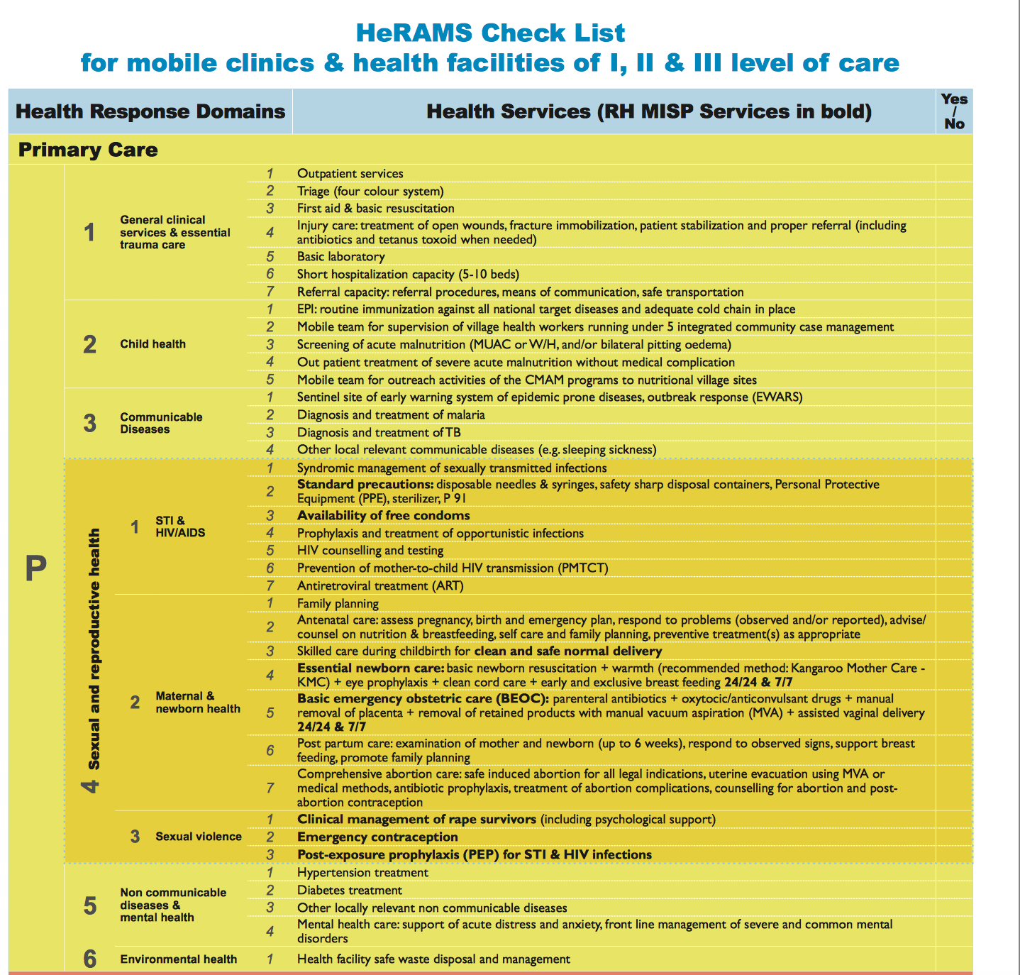
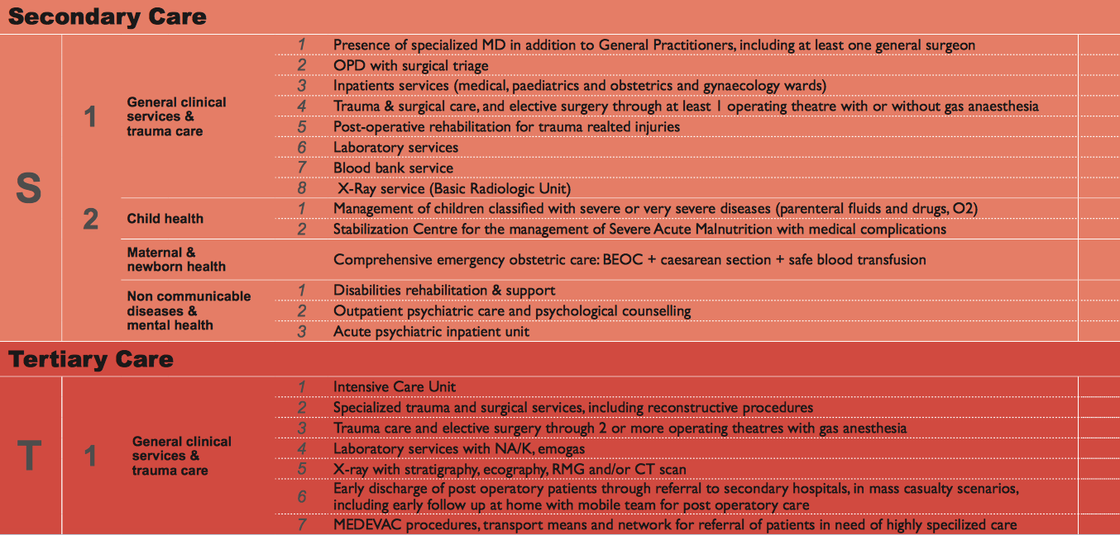
H.E.L.P. course
Notes:
Additional information about the HeRAMS (Hidden slide)

Slide 8
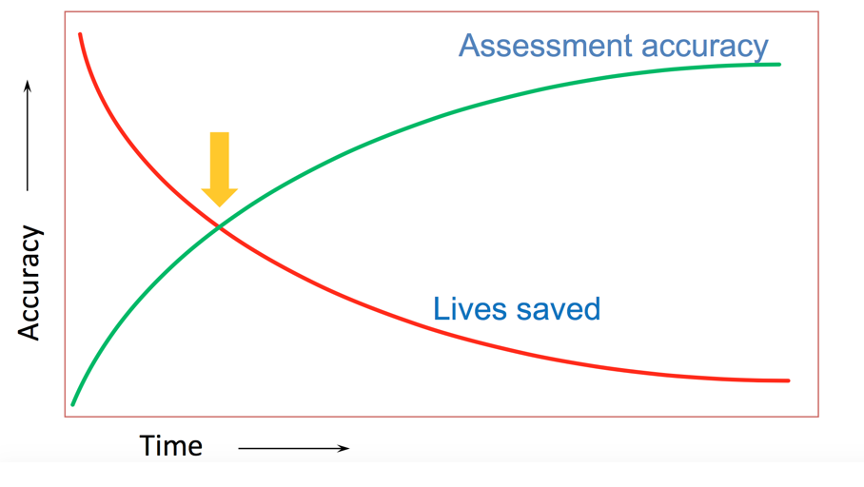
Acute crisis: Accuracy and timeliness
H.E.L.P. course
Notes:
This example is for instance the case during the acute phase after an earthquake.
Good information is needed to act on now while time and options to do so may be very limited.

Slide 9
Acute crisis: Accuracy and timeliness
‘It is better to be vaguely right than precisely wrong’
John Maynard
‘It is better to be vaguely right and on time than precisely right and late’
Accuracy and timeliness are key features of good information in a crisis, together with relevance
H.E.L.P. course
Notes:
Good information is needed to act on …as soon as possible

Slide 10
Carrying out an assessment
You work at the headquarters of an international NGO that is active in the area of health care and you have been asked to lead a team that will carry out an assessment in South Sudan /Syria.
The request for this has come from the board which wishes to know whether a health programme should be started.
The time allocated for the assessment is 15 days and you are preparing the first meeting with the team.
H.E.L.P. course

Slide 11
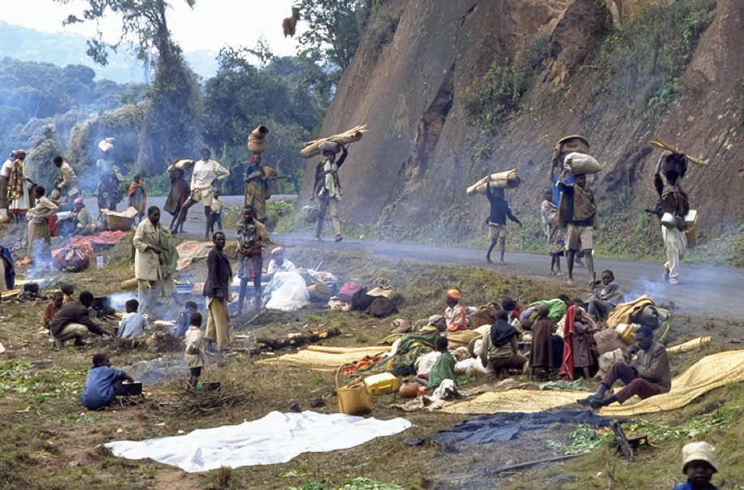
Carrying out an assessment
How do you go about it?
What are the steps?
??
H.E.L.P. course
Notes:
Discussion in plenary

Slide 12
Assessment steps
Clarify purpose, audiences and intended use of the assessment
Formulate scope + focus (questions you seek to answer)
Decide about information that is needed
Assign tasks & responsibilities
Prepare for data collection
Carry out data collection
Process data, analyse and interpret
Report on the assessment findings, conclusions and recommendations
H.E.L.P. course
Notes:
Questions you seek to answer.
Decide about information needed: Gather/analyse secondary data -> gap analysis; Primary data to be collected; Often need for a multidisciplinary team

Slide 13
What kind of information do you look for?
Group work
You are meeting with the assessment team to prepare your assessment in South Sudan / Syria
What kind of information will you need for this assessment?
Can you distinguish different categories of information?
10 minutes
H.E.L.P. course
Notes:
Follow-up from session Setting the Scene (choice of context for the first movies) +

Slide 14
Grouping information
Situation analysis
Problem analysis
  Plus sources and consequences
  Expectations over time
Imbalance needs <-> capacities /services
Stakeholder analysis
Potential and constraints for intervention
H.E.L.P. course
Notes:
Keep the definition of 'assessment' in mind
Situation analysis:
Where are we -overall context -socio-economic, political, military, geographic, environmental....; what is happening (type, scale and duration of crisis); population structure, population health status; water and sanitation services, food availability, availability of health facilities and services, access; disease pattern in the area, …..

Slide 15
Making the invisible people visible
Who could this be in your situation?
How to ensure that not immediately visible people / population groups become visible?
??
H.E.L.P. course

Slide 16
Consider different groups
Disaggregate data:
Age and gender
  Men, women, boys and girls, elderly
Different population groups
  Residents, displaced, …..
  Race, tribe, caste, religion
  Rural, urban, geographic areas
  Income level, poverty /wealth
  Physically disabled, mentally disabled
  Detainees
  ……..
Ensure not immediately visible people are included in your assessment
H.E.L.P. course

Slide 17
Stakeholder analysis
Is an integral part of an assessment
H.E.L.P. course
Notes:
During the module ‘’setting the scene’’ we have listed different types /groups of stakeholders -> refer to this here
We will look later during the module about actors in humanitarian crisis /coordination in more detail two frameworks that can be used to carry out a stakeholder analysis (= the next two slides -> are kept here as hidden slide / as information for the facilitator –in case of a panel discussion, these slides are discussed during the 45 minutes at the end of the day two days before the panel -> taks for the groups to look up certain organizations/institutions)

Slide 18
Stakeholder analysis
Mission
Expertise & Resources
Mandate
Actor
Policies
&
Procedures
Legal framework
Principles for action
Strategies
H.E.L.P. course
NB: Affected populations are a stakeholder
Notes:
This framework is useful when you look at governmental institutions, organizations but also for instance arms carriers, the private sector and communities, etc.

Slide 19

Stakeholder analysis
This map is developed for:
What does (s)he Think and feel?
What really counts
Major pre-occupations
Worries, aspirations
What does (s)he See ?
Environment
Friend
What the market offers
What does (s)he Hear ?
What influences her/him
What does (s)he Say ?
Attitude in public
Appearance
What does (s)he Know ?
Technically
Health system, security situation
Authorities, Red Cross, NGOs
Community
What does (s)he Do ?
Behaviour towards others
Affected populations
Health authorities and system
NGOs, Red Croos
What does (s)he Want ?
Priority needs
Previous achievements
H.E.L.P. course
Pain
Fears
Frustrations
Obstacles
Strengths
Expertise, experience
Successes
Lessons learnt
Gain
Wants / needs
Dreams / hopes
Notes:
This is another way of mapping stakeholders / people you work with and will help you to get a more in-depth understanding.

Slide 20
Field visits for data collection
Step 1 Plan each day carefully
Step 2 Talk to the local authorities (+others) at arrival
Step 3 Use observation techniques
Step 4 Interview people (individual, focus groups,….)
Step 5 Organize team meetings
Step 6 Organize a ‘community meeting’ at the end
It is vital that all people involved in the assessment participate in the organization of the field trips.
H.E.L.P. course
Ensure that nationals staff members are comfortable with the idea of going to selected sites. E.g. they may be from a group that is not well perceived in some areas.
Notes:
Step 1 :Which location(s) will be visited, checklist of main info needed, how information will be collected, who will do what
Step 2: Explain who you are, reason for your visit, how you are going about collecting information
Step 3: (informal) walk around the area accompanied by local people. Continue to observe everything around you.
Step 4 Identify groups or individuals to talk to in order to gather the required information
Step 5 All team members to meet at given moments during the day: sharing ideas, amendments of the schedule
Step 6: Whenever possible, meeting with ‘community’ representatives when field assessment has been completed: Explain what you’ve done, do not make commitments regarding assistance

Slide 21
Some of the problems identified
Measles cases reported
Part of staff health centres fled
Number IDPs in region increases rapidly
Hunger season started
Lack of safe drinking water
Lack of sanitation facilities
Women are afraid to travel to the clinic
Overcrowding in collective centers displaced
Elderly women staying behind
Watery diarrhea cases in the area
Displaced moving from highlands to lower areas
EPI programme not functional since 2 years
Flooding during rainy season
H.E.L.P. course
Medical stock health centres very low
Many health staff left the area
No fuel for the ambulance
Disappearences
Sexual violence reported
Notes:
In crisis situations the reality is that you will be able to identify many different problems

Slide 22
With all the problems we have a problem…
Some order is needed; We have to set
PRIORITIES
H.E.L.P. course
Notes:
Setting priorities is essential and at the same time one of the most difficult things to do. Therefore, let’s look more in detail at how you can go about it.

Slide 23
How to set priorities?
Group work
On what basis would you prioritize?
Propose criteria for a coherent approach to setting priorities?
10 minutes
H.E.L.P. course

Slide 24
Criteria for setting priorities
Type(s) of problems
Scale of the problem
  Number of people affected / at risk
Severity of the problem
  Mortality, morbidity, disability
Likelihood of deterioration in the future
Imbalance between needs and capacities /services
Feasibility for action
    Solution exists, benefits & risks, constraints, competence, capacity, obligation/acceptability to intervene, e.g. mandate, principles, policy
H.E.L.P. course
Notes:
Obligation/acceptability to intervene, e.g. mandate, values, principles, policies -> will be looked into further during the session Practical Ethics
Benefits & Risks: Expected outcomes/impact for affected population, those who intervene, environment, …
Constraints –internal + external -> examples (NB internal constraints may be big but are not always acknowleged)

Slide 25
Severity ranking table
Type of problem | Scale of problem | Severity of problem | Risk of Deterio-ration | Capacities vs Needs | Feasibility for action
Main problem
Main problem
Main problem
Main problem
H.E.L.P. course
Red | Severe situation
Orange | Situation of concern
Yellow | Lack of/unreliable data
Green | Relative normal situation
Notes:
The severity ranking table is a tool that is often used for setting priorities in crisis situations.
The mandate and mission of the organization that you work for will also influence whether you will intervene

Slide 26
SWOC analysis
Strengths
Weaknesses
The resulting SWOC analysis provides the basis for enhancing strengths, investigating opportunities, resolving, where possible weaknesses and constraints are, and explaining the inevitability of some of the latter
Opportunities
Constraints
H.E.L.P. course
Notes:
Constraints can for instance be due to Geography, Politics, Resources (human/expertise, financial), Logistics (formalities, availability of supplies, delays in shipping supplies, warehousing, communication),
Constraints can be internal and external

Slide 27
Analyse -> Decision
H.E.L.P. course
We will intervene….
Notes:
And, you have decided to intervene….. Which brings us to the next step in the programme management cycle, i.e. formulate and plan (see next slide)

Slide 28
Mission, mandate and principles
Assess
& Analyze
Institutional management priorities
Affected Populations & Context
Evaluate
& Learn
Formulate& Plan
Monitor
Implement
& Monitor
H.E.L.P. course

Slide 29
Formulate & plan
Formulate clear and measurable objectives = intended results (changes in the lives of intended beneficiaries)
Formulate & plan a strategy, activities and resources needed to achieve the objectives
Formulate & plan how you will check progress towards reaching the intended results (monitoring & evaluation)
H.E.L.P. course
Notes:
It it important at this stage to also formulate how you will go about monitoring and evaluation.

Slide 30
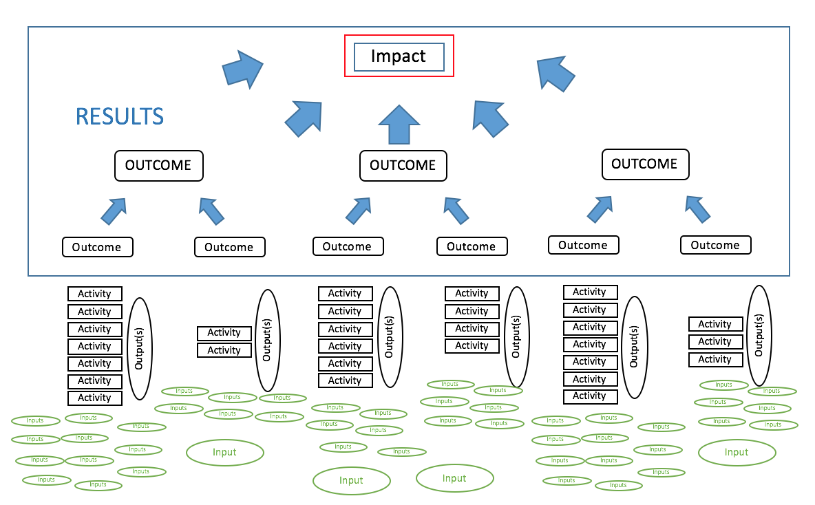
Results chain
input/
resources
activity
output
short term
outcome
medium term
outcome
impact
results
H.E.L.P. course
Notes:
The results chain is commonly used for interventions in crisis situations and goes from inputs to activities, output and than outcome and impact, where in most cases you will carry out a whole lot of activities to reach a certain outcome, while all of the different outcomes contribute to the final impact. It is at the level of outcomes and impact that we speak about results, i.e. changes that happen in the lives of the people that we work with and for.
This may sound all very theoretical and let’s therefore look at what the results chain means in reality -> the chicken in the next slide explains this well

Slide 31
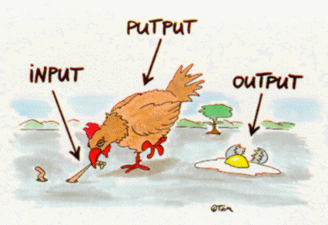
H.E.L.P. course
from http://www.learn-line.nrw.de/angebote/selma/foyer/projekte/hammproj3/in_out/vgrgra.htm
©TOM Jochen Enterprises, Möckernstr.78 10965 Berlin
Notes:
The chicken eats (input) after which there will be a lot of activity going on in its belly (putput /activity) and look, the chicken lays an egg. Is this a result? …….-> Get for answers from the group.
It certainly is a major achievement, but it is not yet a result in the sense of an outcome/impact). The result depends on what happens with the egg: Will it be a new little chicken, your omelet tomorrow morning or does it go to waste as it looks in this picture.
Let’s now look at some examples of activities and results linked to health interventions -> next slide

Slide 32
Activities vs Results
VS
Activities
Results
Carrying out a measles vaccination campaign in X
Supporting the water board in YY with chemicals and training
Rehabilitating / constructing 47’000 latrines in city Z and supporting night soil collectors with repairs of donkey cards
Promoting the use of weight and BP checks in pregnant women
In 2019 there has not been a measles outbreak in X
XX residents in YY have access to sufficient water of adequate quality to cover their household needs
Families in Z use latrines; the incidence of diarrhea has decreased by 20%
Midwifes do blood pressure checks in pregnant women and refer in line with guidelines.
H.E.L.P. course

Slide 33

Results are the effects produced by an intervention at the outcome and impact level
Planned or unplanned
Positive or negative
H.E.L.P. course
Direct or indirect
Notes:
As we just discussed, results are the effects at the outcome and impact level and these can be:
Planned or unplanned
Direct or indirect
Positive are negative
-> Give some examples

Slide 34
S.M.A.R.T.
Acronym for objectives :
S Specific
M Measurable
A Achievable (or Attainable or Acceptable or Applicable or Appropriate or Agreed)
R Relevant (or Realistic or Reliable)
T Time-based (or Timed or Timely or Time-bound)
H.E.L.P. course

Slide 35
Formulating objectives
Objectives are intended results
Production intervention –Micro-economic initiative (MEI)
1500 vulnerable HHs in conflict affected areas in province Delta, including 150 people with a disability, have started or re-started their income-generating activities. By the end of 2020, at least 70% of the beneficiaries are earning an income to cover 30% of the HH needs in a sustainable manner
H.E.L.P. course
Notes:
This slide shows an example of a SMART objective
Formulating SMART objectives leads to the defining a strategy and concrete activities to carry out to reach the objectives

Slide 36
Formulating objectives
Impact
  The mortality rate of children <5 year in the displaced camp in XX has decreased by YY % by end 2019
General objective
  The incidence of diarrheal diseases in the < 5y has decreased to X /by Y%
  The CFR of diarrheal diseases in the < 5 y has reduced to X /by Y%
Specific objective
  1.1. The quantity of water for domestic use exceeds 15 liter per person/day by XX
  1.2. The IDPs have access to a latrine at less than 50 m from their dwelling
  1.3. Children wash their hands after using the toilet and before eating
  1.4. ………….
H.E.L.P. course
Notes:
Formulating SMART objectives leads to the formulation of concrete activities that have to be carried out to attain these objectives

Slide 37
Response strategies
Strategy: A high-level plan to achieve one or more objectives
Possibility to use different modes of action, such as:
Persuasion of authorities to meet their obligations
Support existing capacities
Mobilization of third parties
Substitution /direct provision –setting up own services
Denunciation
H.E.L.P. course
Notes:
Explore alternative response options. Focus on what is feasible and appropriate. Consider the longer-term. Review and revise over time. Suitability may be very short lived during acute crisis situations
Substitution/direct provision of services (decision depends on the urgency and gravity (i.e. severity, scale + risk of aggravation) of the problem. May be considered when
Needs are great and the responsible authorities are unable or unwilling to meet them or no such authorities exist;
Security conditions and/or risk that in-direct assistance misused or ill received;
The assistance will help protect affected people

Slide 38
An integrated approach
Sharing tasks and responsibilities between different departments of your organization or with other actors
Sector or field of activity (e.g. health care, water and sanitation, food)
Geography (responsibility divided on where people live or are located)
Category of affected people (e.g. IDPs, wounded, disabled persons)
H.E.L.P. course
This required coordination, e.g. Within organizations, Cluster
Notes:
No organization will be able to meet all the needs on its own and there is a need for sharing tasks and responsibilities. Good coordination is key for this

Slide 39
Activity and resource plan
Planning activities and resources ROUGHLY
Objective # | Activities /processes | Timing | Outputs | Inputs /Resources | Cost of inputs
H.E.L.P. course
Notes:
After the strategy about how to achieve the intended results has been defined, it is the moment to look at what activities will be carried out linked to this and what resources are needed to do so.
Resources are directly linked to activities and tasks. Examples of resources included staff (type, number, quality), infra-structure (buildings –health posts, hospitals, offices, warehouse,…., essential services such as water & sanitation, energy), equipment/ materials (water pumps, lab equipment, drugs, food, blankets, chlorine, fuel….), transport (land-cruisers, trucks, planes,…), money

Slide 40
Resources
Are directly linked to activities and tasks
Examples:
MONEY
STAFF
  DOCTORS, NURSES, NUTRITIONISTS, ENGINEERS, ADMISTRATORS, DRIVERS, LABOURERS, ……
  INFRASTRUCTURE
  BUILDINGS, ESSENTIAL SERVICES such as WATER, SANITATION, ENERGY; HEALTH POST, HOSPITAL, OFFICES, WAREHOUSES, …..
EQUIPMENT/MATERIALS
  WATER PUMPS, FUEL, LAB EQUIPMENT, DRUGS, FOOD, …
TRANSPORT
  LAND CRUISERS, TRUCKS, PLANES,...
H.E.L.P. course

Slide 41
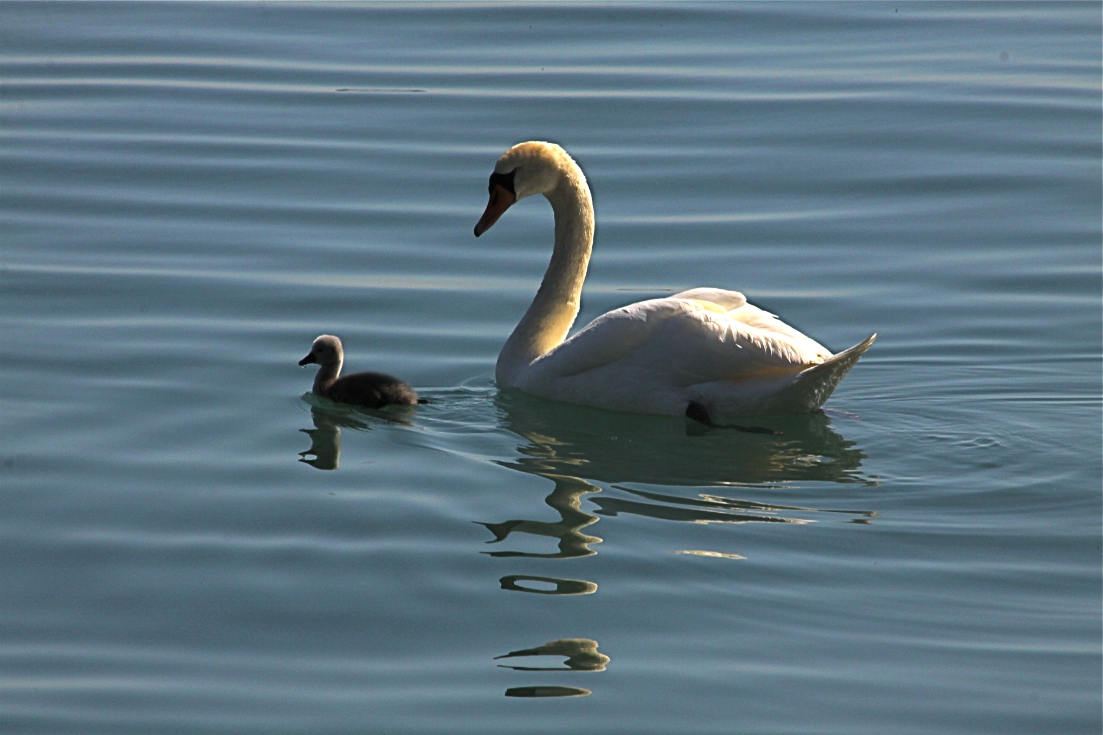
Monitoring and Evaluation
H.E.L.P. course
Notes:
Why this photo? This swan carefully monitors what is happening with her little one.
Monitoring is a continuous and systematic process of collecting, measuring, recording, analysing and communicating information intended to aid management

Slide 42
Monitoring
A continuous and systematic process of collecting, measuring, recording, analysing and communicating information intended to aid management.
H.E.L.P. course

Slide 43
EVALUATION
The independent, objective and systematic examination of the design, implementation and results of a programme/ operation/ policy intended to draw lessons to improve policy and practice and enhance accountability. An evaluation assesses the programme/…. against recognised criteria and articulates findings, draws conclusions and makes recommendations
H.E.L.P. course

Slide 44
VS
Evaluation
Monitoring
A continuous process
To provide information for day-to-day decision making (adjustments or not)
Is carried out by the people who implement the programme
At a moment in time
To provide findings, conclusions & recommendations for strategic decision-making processes
Generally by people who have not been involved in the design or implementation of the prgramme
H.E.L.P. course
Used for managing the operations, to support learning and to assist internal and external reporting (e.g. for accountability, mobilizing other stakeholder, ongoing funding, ….)
Notes:
Let’s now explore what the difference is between monitoring and evaluation
Evaluation: the independent, objective and systematic examination of the design, implementation and results of a programme /operation /policy intended to draw lessons to improve policy and practice and enhance accountability. An evaluation assesses the programme /…. Against recognised criteria and articulates findings, draws conclusion and makes recommendations.
M&E is used for management of operation (inform decision making), to support learning and to support internal and external reporting (e.g. for accountability, mobilizing other stakeholder, funding)
A baseline and target are need to be able to monitor / evaluate whether you interventions progress towards the intended result

Slide 45
Types of monitoring
Situation monitoring /Ongoing assessment /Surveillance
Activity monitoring / Process monitoring
Result monitoring
H.E.L.P. course
Other, e.g. financial monitoring, …..
Notes:
Rapid assessment formats, e.g. Country/organization specific ones, Multi-cluster/Sector Initial Rapid Assessment (MIRA); NB MIRA is controversial in certain contexts, ACAPS initial rapid assessment template
Ongoing Assessment = Situation monitoring / Surveillance, e.g. WHO's Health Resources Availability Monitoring System = HeRAMS, market prices, epidemic prone diseases present in the area

Slide 46
Evaluation criteria
Commonly used criteria for humanitarian action
Relevance
Effectiveness
Efficiency
Impact
Coherence
Connectedness
Coordination
Coverage
Commonly used criteria in health evaluations
Acceptability
Cost-effectiveness
Equity
Other, e.g.
Coordination
H.E.L.P. course
ALNAP - https://www.alnap.org
Notes:
The commonly used evaluation criteria for humanitarian action are based on the OECD/DAC evaluation criteria. For more details about these, you can look at the ALNAP website where you find guidelines on how to use these criteria, a library of evaluations and lots of other useful materials
(ALNAP: Active learning network for accountability and performance in humanitarian action)

Slide 47
Monitoring and Evaluation require formulation and planning
H.E.L.P. course
Notes:
Remember that it is necessary tp formulate and plan how you will monitor and evaluate your interventions. When this is not done,

Slide 48
Indicators
Help to demonstrate change in conditions or results linked to specific interventions
Provide evidence of progress towards the attainment of outputs and desired results
are a critical component of M & E
H.E.L.P. course
  Indicators are developed in-house /with counterparts or derived from internationally accepted standards (e.g. WHO, SPHERE; Global Health Cluster has a suggested set of core indicators and benchmarks)
Notes:
Example: During the war in Former Yugoslavia in the 1990s one of the proxy indicators was whether people in a household smoked. It was a situation where most people smoked -> not smoking anymore meant that the financial situation of the family was bad.

Slide 49
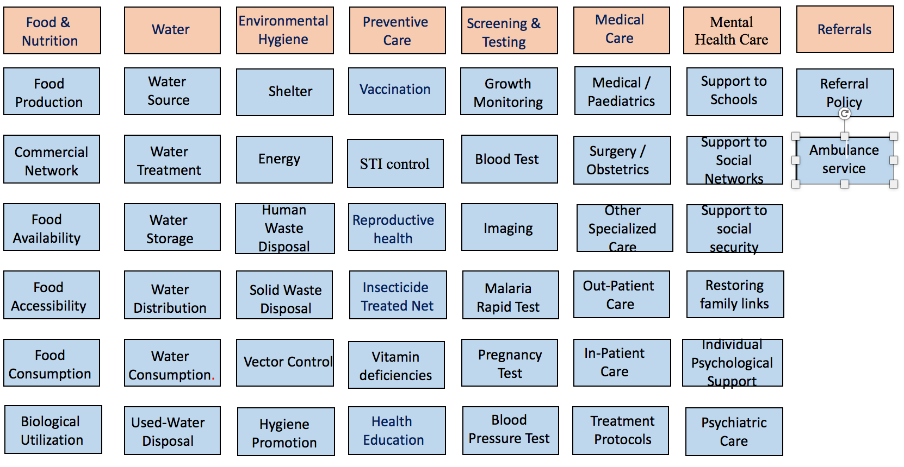
Indicators
Nbr of persons/latrine
Vaccination coverage
Nbr of deliveries
Food prices
Food stock
Nbr of patients fitted w prosthesis
Proportion tests ++
Food ration
Length of hospital stay
Access to health care
H.E.L.P. course
Morbidity
Malnutrition
Mortality
Census
Disability
Notes:
There is a large variety of indicators that can be used, both where it comes to different areas of interest and at different levels of the results chain. This slide gives some examples of this.
Examples: incidence and prevalence, coverage indicators (e.g. measles vaccination coverage), access rates (e.g. % of people with access to sufficient water)

Slide 50
Selection of Indicators
Guided by overall situation and programme objectives
Relevance -> utility
Sensitivity
Limited number
Focus on key indicators which are simple to follow
Direct <-> indirect /proxy indicators
Quantitative and qualitative
  Baseline and target
  Examples: incidence and prevalence, coverage indicators (e.g. measles vaccination coverage), utilization rate, access rate
H.E.L.P. course

Slide 51
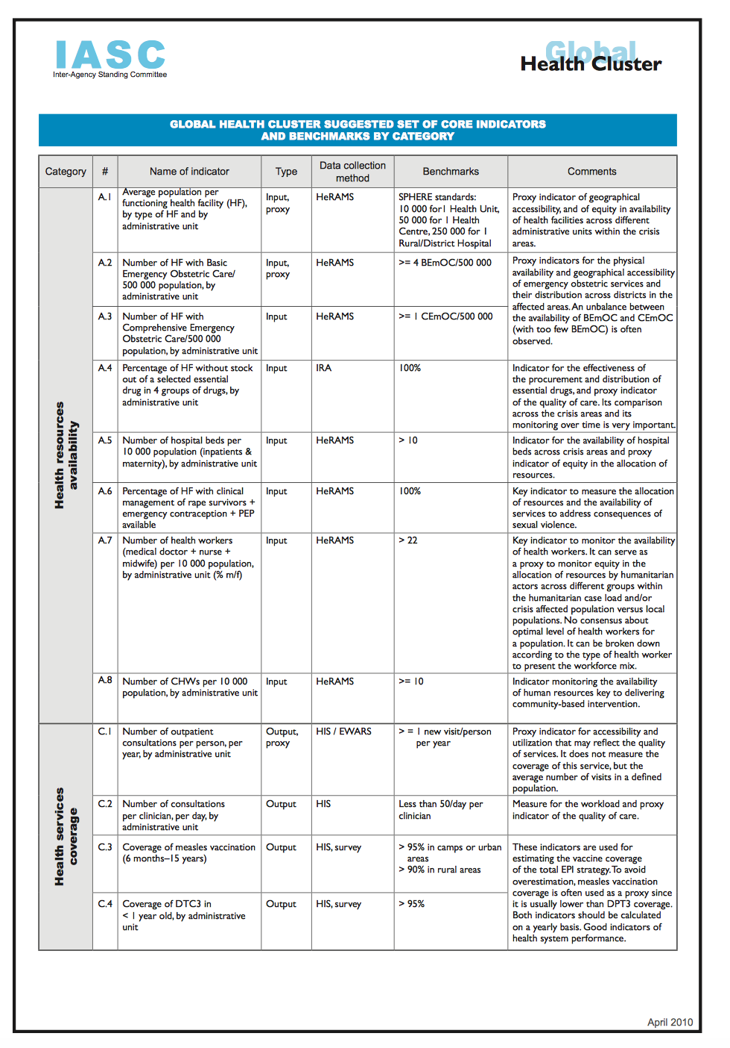
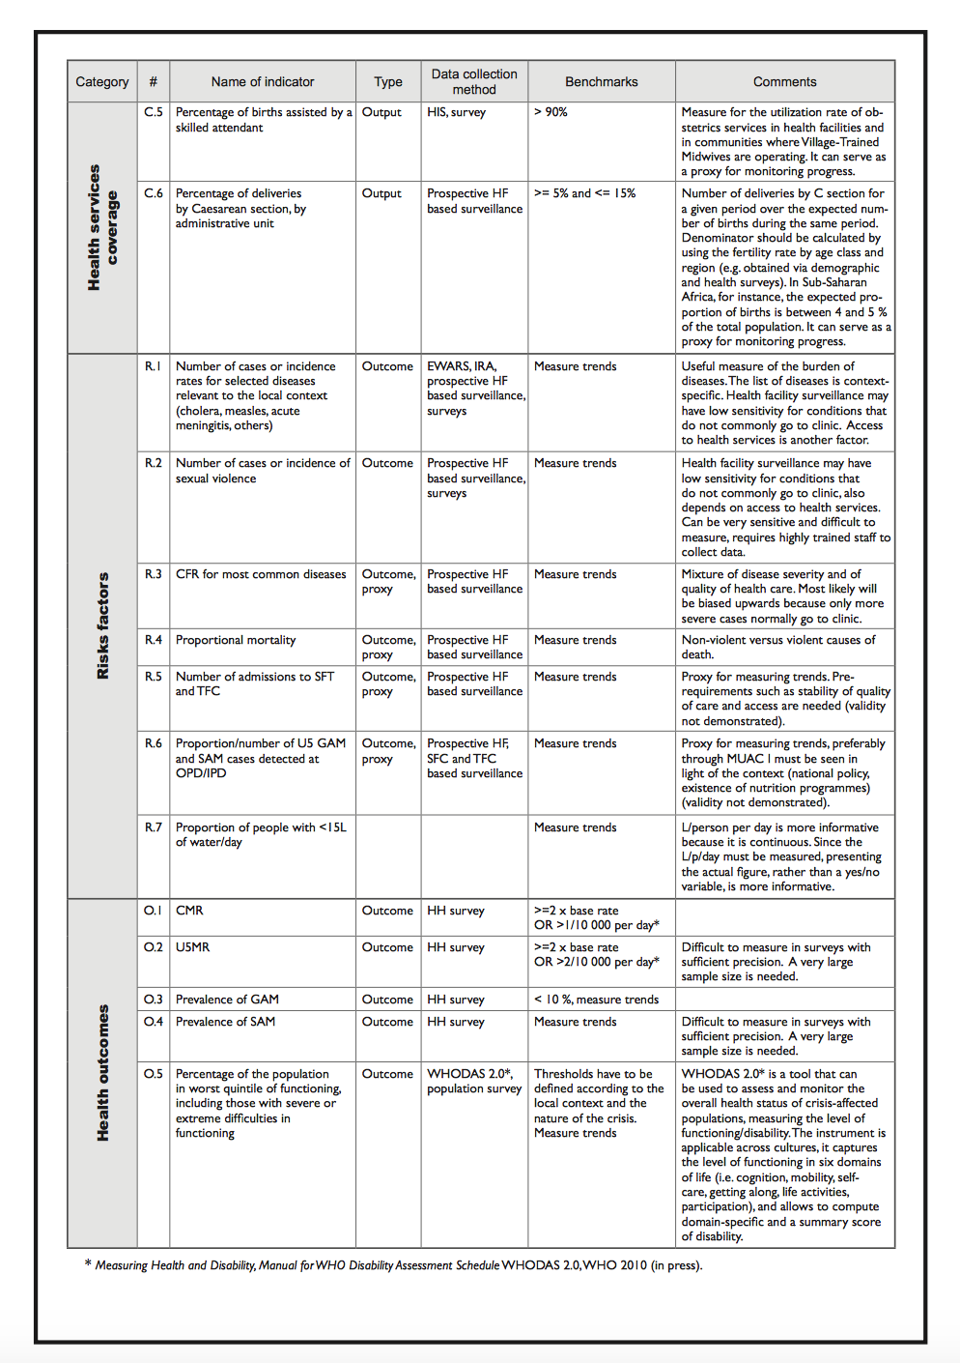
H.E.L.P. course
Notes:
And a last example, i.e. the IASC /Health Cluster list with proposed indicators and bench marks for a number of categories, i.e. health resources availability, health services coverage, risk factors and health outcomes

Slide 52

Questions?
H.E.L.P. course

