Slide 1
Health Emergencies in Large Populations
H.E.L.P. Course Geneva 2019

Slide 2
Aim of the H.E.L.P. course
Enhance professionalism in the response during health emergencies in large populations due to armed conflict, natural disasters and disease outbreaks, with an emphasis on decision making in acute and protracted crises. This by putting the affected people in their context at the centre and using a public health approach, fostering multidisciplinary responses and bringing out challenges, dilemmas, norms and standards
Bring together practitioners with a range of backgrounds in order to allow them to benefit from each other’s knowledge and experience.

Slide 3
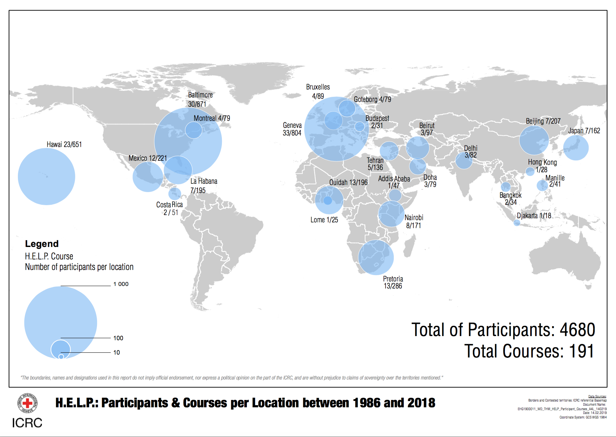

Slide 4
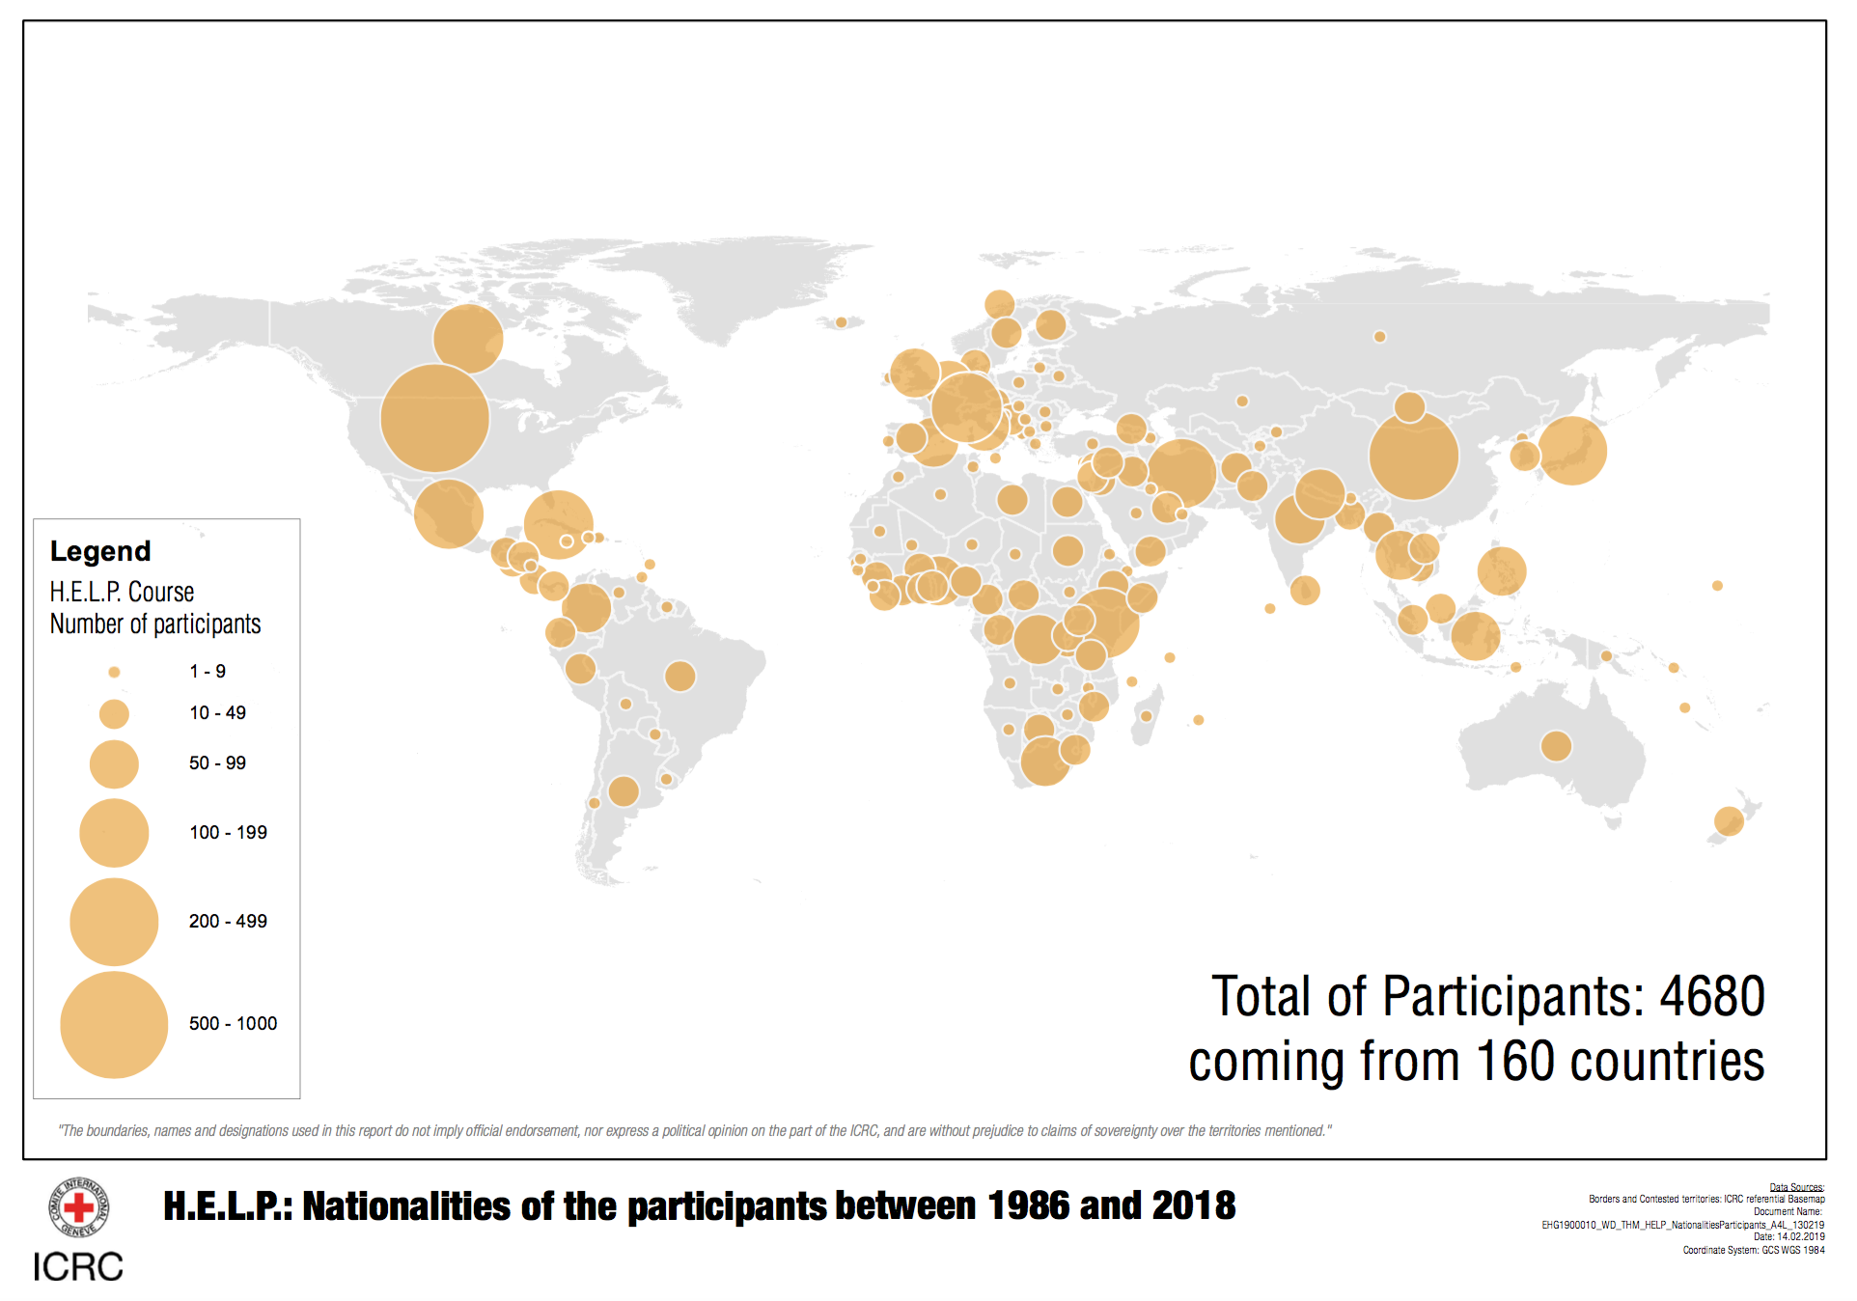

Slide 5
10 H.E.L.P. courses active in 2019
 | Country | City | Language | Since
1 | Switzerland | Geneva | English | 1986
2 | USA | Baltimore | English | 1995
3 | USA | Baltimore 2 | English | 2011
4 | USA | Honolulu | English | 1995
5 | Benin | Ouida | French | 2003
6 | Japan | Fukuoka | English | 2003
7 | Cuba | Habana | Spanish | 2012
8 | Iran | Teheran | English | 2014
9 | India | Delhi | English | 2015
10 | Lebanon | Beirut | English | 2017

Slide 6
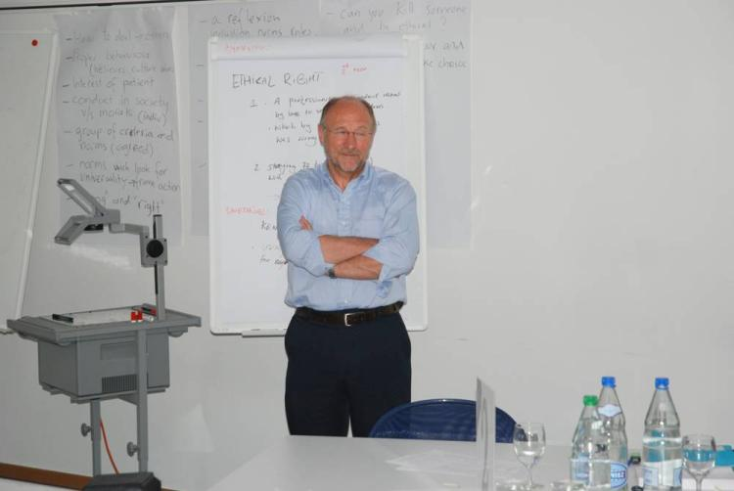
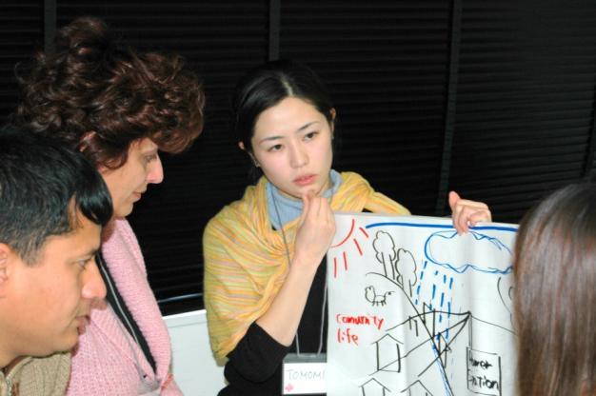
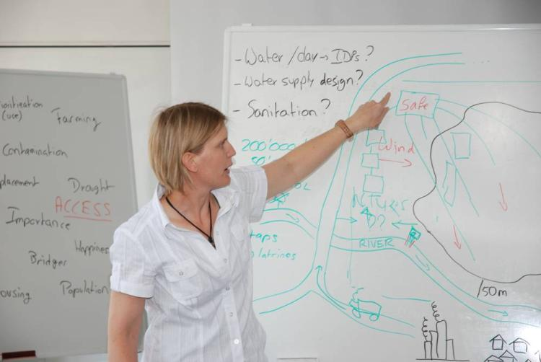
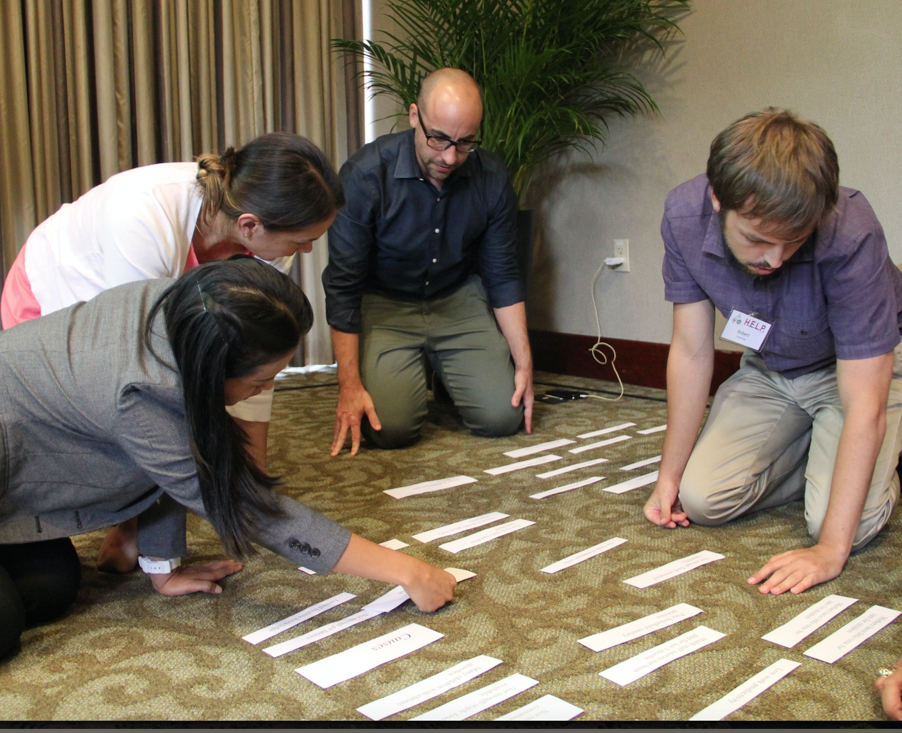
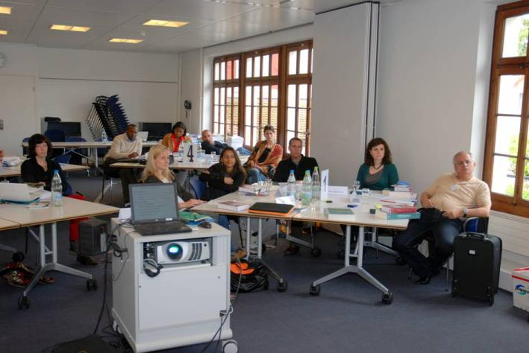
Educational methods
Group work, problem solving
Discussions
Presentations

Slide 7
WEEK 1 – H.E.L.P. course Geneva 2019
Sessions: Morning 08:30-10:30 / 11:00-12:30 afternoon 13:30-15:00 / 15:15-16:45 (16:45 – 17:30)
 | 17.06.2019 | 18.06.2019 | 19.06.2019 | 20.06.2019 | 21.06.2019
08:30 | Arrival | Daily reflection | Daily reflection | Daily reflection | Daily reflection
09:00 | Welcome ICRC, WHO, CERAH | Data collection analysis and sharing Anne Golaz (CERAH Antje van Roeden (ICRC) | Nutrition & livelihood support (3) Valérie Captier & Rachel Lozano (ICRC) | Public health engineering (2) Marco Albertini & Dikolela Kalubi(ICRC) | Health services Dirk Horemans) Antje Van Roeden (ICRC)
10:30 | Coffee break | Coffee break | Coffee break | Coffee break | Coffee break
11:00 | Setting the scene (1) Antje van Roeden & Stéphane du Mortier (ICRC) | Humanitarian ethics Thomas Wilp (ICRC) | Nutrition & livelihood support (4) Valérie Captier & Rachel Lozano (ICRC) | Public health engineering (3) Marco Albertini & Dikolela Kalubi(ICRC) | Health services Dirk Horemans & Benjamin Lane (WHO) Antje Van Roeden (ICRC)
12:30 | Lunch break | Lunch break | Lunch break | Lunch break | Lunch break
13:30 | Setting the scene (2) Antje van Roeden & Stéphane du Mortier(ICRC) | Nutrition & livelihood support (1) Valérie Captier & Rachel Lozano (ICRC) | Nutrition & livelihood support (5) Valérie Captier & Rachel Lozano (ICRC) | Public health engineering (4) Marco Albertini & Dikolela Kalubi(ICRC) | Communication with the media & through social media Pascal Jecquier (ICRC) Richelle Esguerra (ICRC)
15:00 | Coffee break | Coffee break | Coffee break | Coffee break | Coffee break
15:15 | Programme cycle management Antje van Roeden (ICRC) | Nutrition & livelihood support (2) Valérie Captier & Rachel Lozano (ICRC) | Public health engineering (1) Marco Albertini & Dikolela Kalubi(ICRC) | Public health engineering (5) Marco Albertini & Dikolela Kalubi(ICRC) | Actors in humanitarian interventions / coordination Panel discussion
16:45 -17:30 | Topics of specific interest, pre-session activities, presentations | Topics of specific interest, pre-session activities, presentations | Actors in humanitarian interventions / coordination Antje van Roeden (ICRC) | Protecting the medical mission Stéphane du Mortier (ICRC) | Topics of specific interest, pre-session activities, presentations

Slide 8
WEEK 2 – H.E.L.P. course Geneva 2019
Sessions: Morning 08:30-10:30 / 11:00-12:30 afternoon 13:30-15:00 / 15:15-16:45 (16:45 – 17:30)
 | 17.06.2019 | 18.06.2019 | 19.06.2019 | 20.06.2019 | 21.06.2019
08:30 | Daily reflection | Daily reflection | Daily reflection | Daily reflection | Daily reflection
09:00 | Field epidemiology in crisis settings Anne Golaz (UNIGE) | Communicable diseases Vaccine preventable diseases Rodolfo Rossi (ICRC) Gabriel Alcoba (HUG) | Non-communicable diseases Hyo-Jeong Kim (WHO) Sigirya Aebischer (ICRC) | Legal framework Alexandra Ortiz (ICRC) | Summary exercise
10:30 | Coffee break | Coffee break | Coffee break | Coffee break | Coffee break
11:00 | Epidemiology Surveillance and early warning systems Anne Golaz (UNIGE) | Communicable diseases Vector borne diseases Raman Velayudhan (WHO) | Non-communicable diseases Hyo-Jeong Kim (WHO) Sigirya Aebischer (ICRC) | Humanitarian protection Caridad Castilla (ICRC) | Summary exercise
12:30 | Lunch break | Lunch break | Lunch break | Lunch break | Lunch break
13:30 | Communicable diseases Challenges in the world/in crisis situations Anne Perrocheau (WHO) | Communicable diseases Diarrhoeal diseases; Cholera Kate Alberti (WHO) | Sexual and reproductive health Nadine Cornier (UNFPA) | Transversal approaches to violence: Sexual violence Sophie Sutrich (ICRC) | Summary exercise Presentation group work + discussion
15:00 | Coffee break | Coffee break | Coffee break | Coffee break | Coffee break
15:15 | Communicable diseases Outbreak investigation and control Anne Perrocheau (WHO) | Mass casualty management Thomas Wilp (ICRC) | Mental health and psychosocial support Senop Tschakarjan (ICRC) | Staff security Roman Machover (ICRC) | Course evaluation
 |  |  |  |  | 16h00 Closing ceremony
16:45 -17:30 | Topics of specific interest, pre-session activities, presentations | Topics of specific interest, pre-session activities, presentations | Remote management | Summary exercise Antje van Roeden (ICRC)

Slide 9
Rules of the course
Certificate of attendance:
Regular attendance
Active participation to group work
Active participation in summary exercise
Rules
Please limit use of phone, laptop or tablet to the sessions
Listen, respect opinions, share experiences
You may share with others outside the course
With discretion regarding personal experiences shared
Notes:
The Chatham House Rule: When a meeting, or part thereof, is held under the Chatham House Rule, participants are free to use the information received, but neither the identity nor the affiliation of the speaker(s), nor that of any other participant, may be revealed.

Slide 10
Group work guidance
All ideas should be shared and considered
Have respect for each other
Effective communication
Divide the roles in the group
Time management
Open to compromise
Everyone should contribute
Be happy in the group you are

Slide 11
We wish you a very good course !

