Slide 1
Protection
Cours H.E.L.P. 2022
Notes:
Pre-learning material for the session:
Enhancing protection for civilians in armed conflict and other situations of violence. Introduction: Understanding Protection (p.9 – 10)
Professional standards for protection work. Chapter 1: Overarching principles in protection work (p.21-32) and Chapter 5: Promoting complementarity (p.91-101)
Notes for facilitators:
F2F session roll-out: 90 mins.
Presentation of objectives and methodology 5’
Concept of protection 10’
Identification of protection concerns and addressing protection needs – case study: work in groups 20’ + restitution 10’ + feedback and exchange 30’
Ways in which protection and health interventions are intertwined – 15’

Slide 2
Objectifs
Les apprenants sont en mesure
d’expliquer le concept de protection et d’identifier quelques-uns des principaux problèmes de protection rencontrés par les populations touchées par un conflit ou une autre situation de violence
d’identifier des actions visant à répondre aux besoins en matière de protection
de décrire en quoi les interventions en matière de protection et de santé se recoupent
Cours H.E.L.P.
Notes:
Every actor sees protection from a particular perspective depending on their mandate. In this session we’ll talk about protection in the ICRC in settings of armed conflict and OSV
To reach protection outcomes we need a multidisciplinary approach, which includes the health perspective

Slide 3
Qu’est-ce que la protection ?
Des activités visant à garantir le respect des droits individuels conformément aux branches du droit concernées (droit international humanitaire, normes relatives aux droits humains, droit des réfugiés, etc.)
Réduction des risques, notamment en diminuant la vulnérabilité des personnes et en renforçant leurs capacités
Notes:
Harm resulting from the actions of an authoriy or weapon-bearer, in violation of the applicable laws
Responsibility of State authorities and non-State actors where relevant to protect people by ensuring their safety, well-being and dignity.
E.g. violence attacks against medical personnel, ill-treatment, being forced to participate in conflict, depriving access to health care and other essential services, access to humanitarian aid, etc. Beyond health related issues, family separation, disappearance, forced displacement, attacks against civilians and civilian objects, etc
To address protection needs: to influence the behavior of those responsible, together with reducing the risks of affected people.
Prot activities addressed to authorities and weapon bearers + activities addressed to communities and persons at risk

Slide 4
Étude de cas
Les forces rebelles ont conquis une large partie du territoire et y imposent un régime cruel depuis plus de dix ans. Récemment, dans le cadre d’une guerre féroce ayant causé d’immenses souffrances des deux côtés, le gouvernement a réussi à reprendre ce territoire.
De nombreuses personnes soupçonnées de soutenir le régime rebelle sont aux mains du gouvernement, dont elles dépendent pour répondre à tous leurs besoins essentiels (habitat, nourriture, santé, éducation, etc.).
Les hommes en âge de combattre sont privés de leur liberté et, en conséquence, de tout contact avec leurs proches. Le reste de la population, principalement des femmes et des enfants, vit dans des camps de personnes déplacées dans des conditions extrêmement difficiles, et le gouvernement les empêche de retourner dans leur communauté d’origine. À supposer que ces personnes soient libres de rentrer dans leur foyer, cela leur serait impossible, car les communautés n’accepteraient en aucun cas de reprendre ces femmes, perçues comme ayant collaboré avec l’ennemi, ou leurs enfants.
Des fosses communes ont récemment été découvertes dans la zone à proximité des communautés d’origine...
Cours H.E.L.P.

Slide 5
Travail de groupe
Sélectionnez au moins quatre problèmes et risques en matière de protection, auxquels la population est susceptible d’être confrontée dans ces circonstances.
Notez autant d’actions que possible permettant de traiter ces problèmes de protection.
Discussion de 20 minutes
Désigner un porte-parole

Slide 6
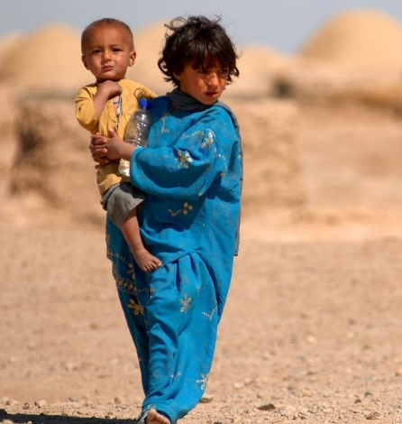
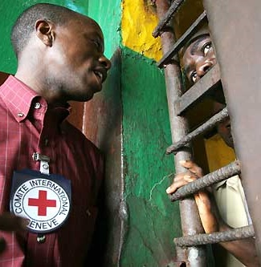
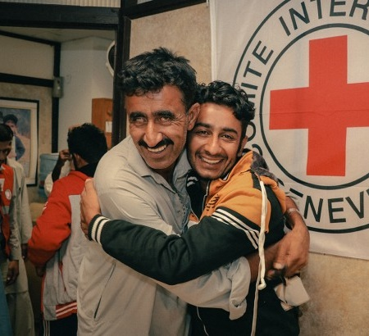
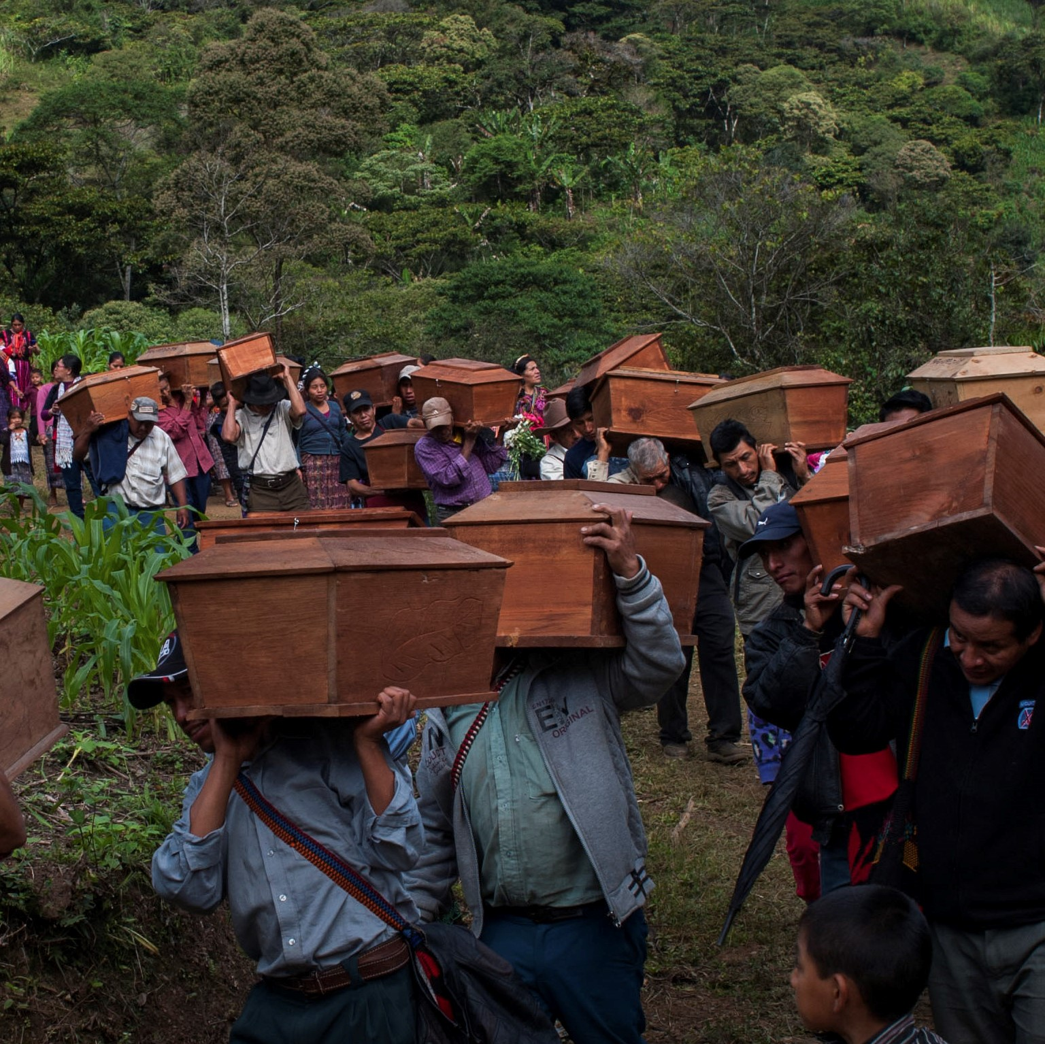
Qui sont les personnes touchées ?
Des civils et d’autres personnes qui ne participent pas ou plus aux hostilités
Des personnes privées de liberté
PROTECTION DE LA POPULATION CIVILE
DÉTENTION
Des personnes séparées de leur famille ou portées disparues en raison du conflit, d’autres situations de violence, de catastrophes naturelles ou d’autres situations générant des besoins humanitaires
Les personnes décédées
PROTECTION DES LIENS FAMILIAUX
FORENSIQUE
Notes:
Objectives:
Persons deprived of their liberty - improving the life and dignity of detainees while ensuring judicial guarantees
Protection of civilians - reducing human suffering caused by the treatment by authorities / weapon bearers, and the manner is which the force is used during the conduct of hostilities or law enforcement operations
Protection of family links – to prevent separation and disappearance, clarify what happened to people who went missing, restore and maintain contact between family members, and reunite families. Support to families
Protection of the dead – ensuring adequate policy and regulations, best forensic practices, improved local capacities for a proper management and identification of the dead

Slide 7
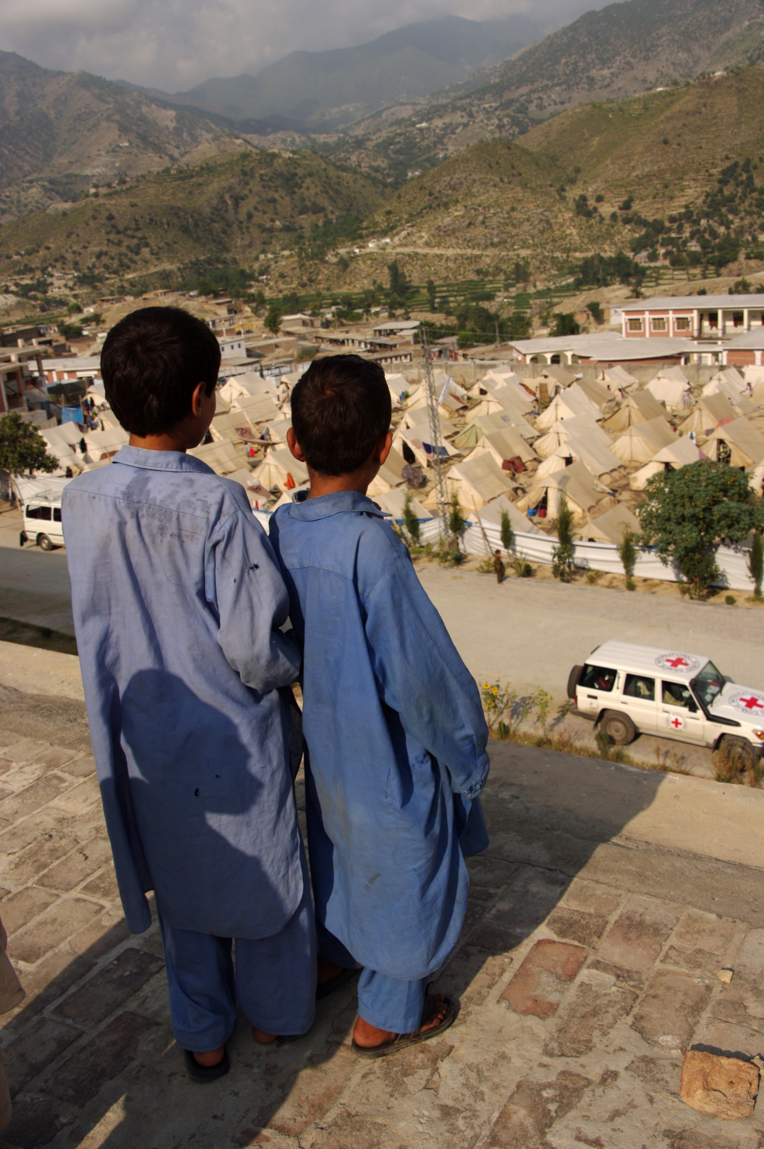
Répondre aux besoins en matière de protection
Cours H.E.L.P.
Notes:
To plan possible interventions, see actors with a responsibility to protect and other stakeholders who may have an influence on the behaviour or in the reduction of the risks.
Individuals and populations at risk are also actors of their own protection (agency). It is essential to understand concerns from their perspective and engage with them for the identification of needs and solutions.
Regarding legal responsibilities, different bodies of law set the specific responsibilities of authorities and other actors. Authorities at all levels of government are primary duty bearers: Authorities (State, non-State) have the primary responsibility to protect and uphold the rights of people within their territory or control. [Link to module on Legal framework].
Given the variety of protection actors involved, efforts should be made to ensure that methods and approaches are complementary to obtain protection outcomes. The roles, activities and capacities of others must be taken into account for building synergies. (Link to module Setting the scene and actors in humanitarian interventions/coordination)

Slide 8
Exemples d’interventions en matière de protection
Normes internationales intégrées dans la législation nationale
Campagnes publiques sur les besoins
Soutien ou création de systèmes afin de faciliter les contacts familiaux
Accès aux victimes / personnes survivantes en vue de leur fournir un soutien
Sensibilisation dans les communautés d’origine
Renforcement
de l’environnement
Action sur le milieu
Garanties judiciaires
Rapports publics (hors CICR)
Action
réactive
Action
réactive
Mobilisation d’autres acteurs
Action
corrective
Action
corrective
Cours H.E.L.P.
Violation
Abus
Violation
Abus
Renforcer la résilience des personnes à risque
Dialogue confidentiel
Élucider le sort des personnes disparues et soutenir les familles
Notes:
Possibilities in the case study:
Stakeholders: Government forces, Rebels, community leaders, religious leaders, Embassies, NGO and Civil society organizations, UNHCR, OHCHR, the ICRC, Red Cross/Red Crescent National Society, etc. (To be complemented by participants based on their own experiences)
Only a few examples:
Responsive action: Activity undertaken to prevent abuse, put a stop to it, and/or alleviate its immediate effects.
Potential examples case study:
Men deprived of their liberty: ICRC engages in a confidential dialogue with Government authorities re. arbitrary deprivation of liberty, torture and other forms of ill-treatment, enforced disappearance, contact with families, conditions of detention, etc); HRW publish a report on the treatment of detainees and their living conditions; activities to restore family links; etc
Women and children in the camps: ICRC engages in a confidential dialogue with Government authorities regarding protection from acts of vengeance and exploitation, discrimination, denial of access to basic services, sexual violence, lack of education for children, registration, lack of freedom of movement…; supporting authorities capacity to register affected people; mobilization of other actors to address urgent gaps; provide assistance to cover essential needs; providing information about existing or potential resources to women and support the exchange of information among them; access to health and psychosocial support for survivors of sexual violence, etc
Remedial action: Action taken to restore people’s dignity and to ensure adequate living conditions after a pattern of abuse.
Eg case study:
Men deprived of their liberty: supporting authorities through rehabilitation to improve conditions in places of detention; mobilize other actors to support authorities on judicial guarantees; help creating a system to facilitate contact of detainees with their families; supporting the families who have no news on the fate and whereabout of their loved ones and collect individual cases to be searched in the prison system, etc
Women and children in the camps: supporting authorites through donations and rehabilitations to resume services without discrimination (water supply, shelter, healthcare, education…); capacity building on relevant standards for camp authorities, protocols and guidelines for an effective protection; Red Cross restore the family links with the outside world; support referral systems, etc
Environment building: Efforts to foster a political, social, cultural, institutional and legislative environment that enables or encourages the authorities to respect their obligations and the rights of individuals.
Eg case study:
Men deprived of their liberty: integration of international standards in national legislation (Mandela’s rules…), etc
Women and children in the camps: raise awareness among communities of origin and other potential communities of the situation of these families through campaigns, etc; humanitarian mediation with communities of origin; influencing community leaders to accept their members; etc
Be aware of humanitarian environment and how the role and working modalities of different actors (authorities and others) complement each other in the protection of people.

Slide 9
Quel serait votre rôle dans la protection des personnes
et
en quoi les activités de protection améliorent-elles la santé ?
Cours H.E.L.P.
Notes:
In which ways health interventions may contribute in protection outcomes and how protection interventions can improve health objectives?

Slide 10
Ressources du CICR en matière de protection
Notes:
Key resources on Protection in www.icrc.org
ICRC Doctrine on Protection
Enhancing protection for civilians in armed conflict and other situations of violence.
Professional standards for protection work.
International Review of the Red Cross

Slide 11
MERCI !

