Slide 1

Santé mentale et soutien psychosocial pour les populations touchées par une crise
Cours H.E.L.P.
Insérer le nom des intervenants

Slide 2
Objectifs
Être capable de
Expliquer en quoi il est important de répondre aux besoins des populations touchées en matière de santé mentale et de soutien psychosocial en situation de crise aigüe et/ou prolongée
Décrire les éléments d’une évaluation SMSPS
D’examiner une réponse programmatique appropriée, axée sur la prévention, le traitement et les soins apportés aux personnes ayant besoin de soins en santé mentale et d’un soutien psychosocial pendant des crises aigües et/ou prolongées
Cours H.E.L.P.
Notes:
In this session we expect to be able to:
explain the importance of addressing mental health and psychosocial needs of affected populations during acute and protracted crises
describe the elements of a MHPSS assessment
discuss an appropriate programmatic response with focus on prevention, treatment and care for people with mental health and psychosocial needs during an acute and/or protracted crisis

Slide 3
Définition de la santé mentale établie par l’OMS
État de bien-être qui nous permet d’affronter les sources de stress de la vie, de réaliser notre potentiel, de bien apprendre et de bien travailler, et de contribuer à la vie de la communauté
Cours H.E.L.P.
Il n'y a pas de santé sans santé mentale
Notes:
The definition of Mental Health, as described by the WHO, consists of an state of well-being in which every individual realizes his or her own potential, can cope with the normal stresses of life, can work productively and fruitfully, and is able to make a contribution to her or his community.
In the Mental Health community, accepting that Mental Health is an integral part of any person’s general health and well being, we categorically say: “There is No Health without Mental Health”

Slide 4
Fardeau mondial des maladies (2004)
% d’AVCI pour les troubles mentaux et liés à l’abus de substances psychoactives
À travers le monde : 14%
Région de la Méditerranée orientale : 12%
% d’AVI 19%
  Handicap sévère : 2,9%
  Handicap modéré : 12,4%
Personnes atteintes d’un handicap modéré et sévère :
  Enfants 0-14 ans 5%
  Adultes 15-59 ans 15%
  Personnes âgées > 60 ans 46%
Cours H.E.L.P.
Notes:
The burden of mental disorders in global populations has been described for many different health diseases and conditions. The “burden” takes into consideration early/premature mortality due to a specific disease or risk factor as well as the amount of years that a health condition or risk factor makes a person live with disability. It is important to mention here that different diseases impact different on a person’s level of disability. And it is important to remember too that mental disorders tend to cause a very high level of functional impairment and disability.
When those burden measures are calculated as DALYS (Disability adjusted life years) and YLD (years lived with disability), we observe that a great proportion of the disease burden is caused by mental and substance use disorders. We know that globally, 1/5 of the burden of diseases is due to mental and substance abuse disorders. Depression is the leading cause of disability worldwide.
So, coming back to populations affected by crisis situations, we already know that there will be a pre-existing burden of mental health conditions on them and the crisis (acute or protracted) will bring an added load of stressors to that burden!

Slide 5
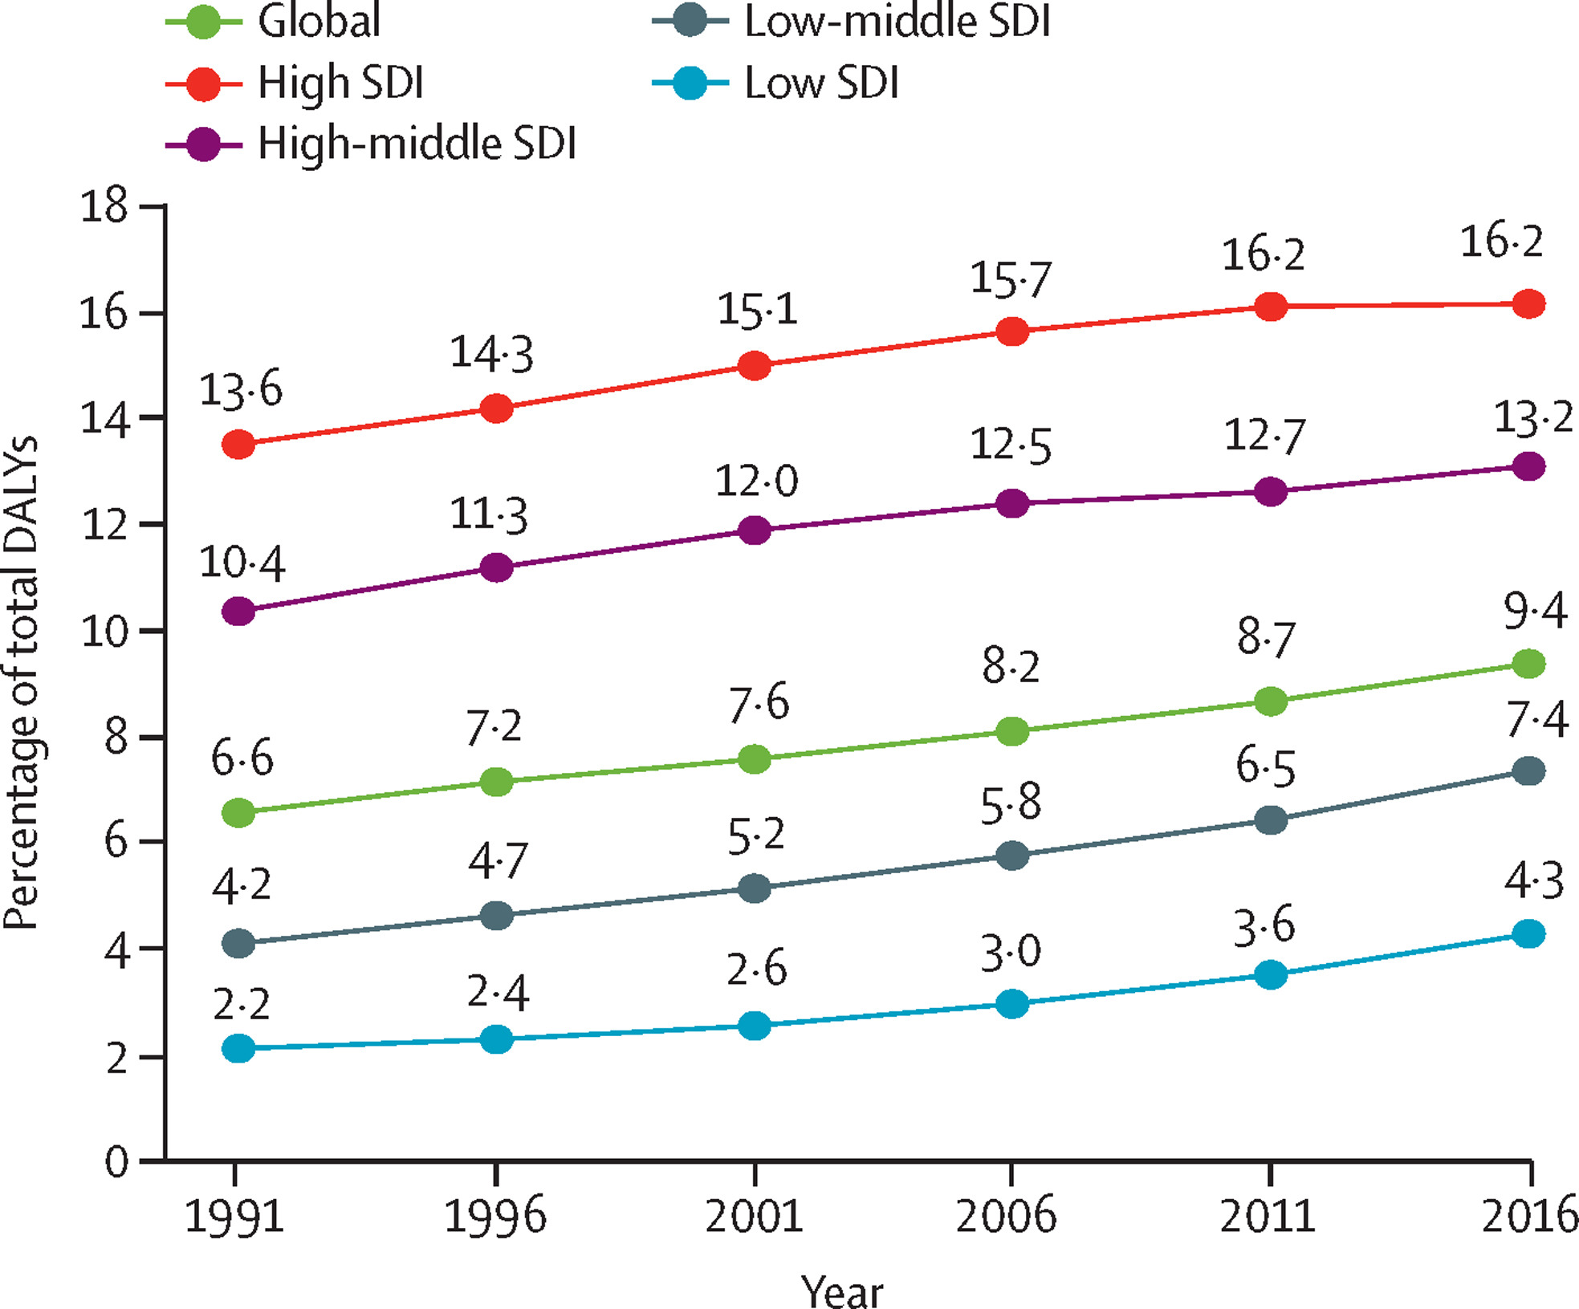
2018, Rising Burden of MH, Substance Use Disorders, Suicide, Alzheimer’s and other dementias by Sociodemographic Development (SDI)
The Lancet
Volume 392, édition 10157, pages 1553-1598 (octobre 2018)
Notes:
Lower SDI have more communicable diseases and lower life expectancy, thus burden of Alzheimer’s and dementia which usually happens later in life, is lower. However interesting to note is the steady rise of MH burden (disability and premature mortality) globally

Slide 6
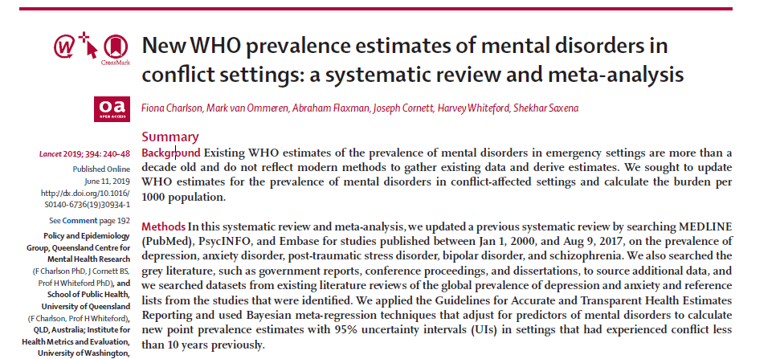
Cours H.E.L.P.
Notes:
This slide and the next show you the most recent prevalence estimates from WHO on key mental disorders in conflict settings. They are a systematic review of all the available studies and update a previous systematic review on the same topic.

Slide 7
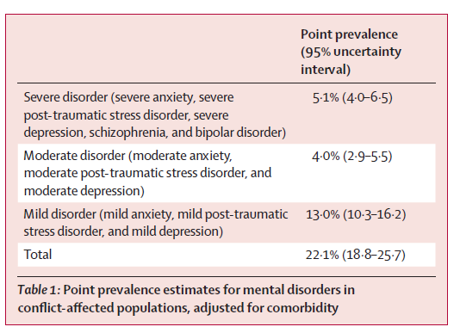
La prévalence des troubles mentaux est à tout moment de 22,1% au sein des populations affectées par un conflit qui ont été évaluées.
Cours H.E.L.P.
Charlson F., et al. New WHO prevalence estimates of mental disorders in conflict settings: a systematic review and meta-analysis. Lancet. Juin 2019.
Notes:
As you can see here, it is estimated that 1 in 5 people present a mental disorder in an area affected by a conflict. This can be due to pre-existing conditions or conditions induced or influenced by stressors caused by the conflict. It is also important to highlight that it is estimated that 5% present with a severe mental disorder which severely impacts functionality and leads to very high levels of disability.
When we put together moderated and severe mental disorders, we can observe that around 1 in 10 people will present them.
Anxiety disorders (including PTSD) encompass the majority of mental disorders (some studies put it at a prevalence of 21.7%. Depression has a prevalence of around 10%, with 3% of those accounting for moderate and severe depression.
Here it is important to highlight the importance of understanding the presence and prevalence of different mental health conditions, and to take this into consideration when developing MHPSS programs, and especially when coordinating action with different actors in the humanitarian response.

Slide 8
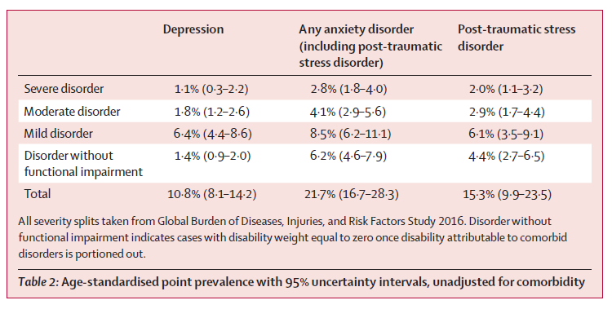
Cours H.E.L.P.
Charlson F., et al. New WHO prevalence estimates of mental disorders in conflict settings: a systematic review and meta-analysis. Lancet. Juin 2019.
Notes:
The table here also show that any anxiety disorders have a prevalence of 21.7% which includes 15.3% prevalence of people with PTSD. Depression has a prevalence of around 10%, with 3% of those accounting for moderate and severe depression.
Here it is important to highlight the importance of understanding the presence and prevalence of different mental health conditions, and to take this into consideration when developing MHPSS programs, and especially when coordinating action with different actors in the humanitarian response.

Slide 9
Prévalence de la santé mentale en détention
 | Population générale | Lieux de détention
Anxiété | 15% | 16-76%
Dépression | 11% | 10–72%
Schizophrénie | 0,5% | 3–20%
Drogues | 5% | 30–76%
Total | 10% modéré 2–3% sévère | 55–90%
Cours H.E.L.P.
Conclusion : peu de personnes détenues ne souffrent PAS de problèmes mentaux.
(Pays : Belgique, États-Unis, Royaume-Uni, Brésil, Chili, Mexique, Chine, Iran, Nigéria)
Notes:
It is many times forgotten, but here it is important to bring to your attention the needs of a specific group of the population that have in general a higher than expected prevalence of mental disorders and tend to be neglected in the humanitarian response. Different studies have shown the increased prevalence of mental disorders of people in places of detention. This is due to many factors, that we do not have time to further discuss here. Unfortunatelly, mental health care for those populations tend to be insufficient in areas of low resources.

Slide 10
Besoins en situation de crise
Problèmes préexistants
  Problèmes sociaux
  Problèmes psychologiques (y compris psychiatriques)
Problèmes induits par la crise
  Problèmes sociaux
  Problèmes psychologiques (y compris psychiatriques)
    Les problèmes psychologiques peuvent impliquer des appréciations réalistes (absence de trouble mental) ou des distorsions de la réalité (possible trouble mental)
Cours H.E.L.P.
Notes:
The MHPSS needs in populations affected by crisis tend to be composed by an accumulation of factors.
Populations affected bring their pre-existing social, psychological and psychiatric problems as for example poverty, social conflicts as well as the pre existing levels of distress and mental disorders.
The crisis increases the number and magnitude of stressors as it is common to have violence, loss, disappearances and other situations that can cause a huge burden on people’s mental health and psychosocial well being.

Slide 11
Classification des troubles mentaux et comportementaux (CIM-10) -> 300 !!!
0. Troubles psychiatriques dus à des raisons biologiques (démence, etc.)
Toxicomanie et dépendance
Schizophrénie
Troubles affectifs (dépression, troubles bipolaires)
Troubles neurotiques, traumatiques, psychosomatiques (anxiété, trouble obsessionnel compulsif, TSPT, etc.)
Problèmes dus à un trouble somatique (troubles du comportement alimentaire, du sommeil, etc.)
Troubles de la personnalité et du comportement
Déficience intellectuelle
Troubles du développement (autisme)
Troubles spécifiques chez l’enfant et l’adolescent (TDAH, etc.)
Cours H.E.L.P.
Notes:
The international classification of mental disorders has a description of many mental health conditions that can affect the health of people and that can impair their functionality and capacity to live fulfilling lives. In crisis situations, priorities need to be made on key conditions to be address where health staff can be trained to diagnose and treat with psychological and psychopharmachological approaches combined.

Slide 12
Symptômes les plus courants
  Symptômes psychosomatiques
  Troubles du sommeil
  Troubles de l’appétit
  Problèmes émotionnels : dépression, pensées suicidaires, anxiété, etc.
  Pensées répétitives
  Abus de substances psychoactives
  Symptômes de TSPT (flashbacks, évitement)
  Chez l’enfant (énurésie, agressivité, peur)
Cours H.E.L.P.
Notes:
Psychosomatic Symptoms
Sleep-related problems
Appetite-related problems
Emotional problems: Depression, desire to die, anxiety, etc.
Repetitive thoughts
Substance Misuse
PTSD
These are the most common symptoms of distress that people experience after experience violent events. Depending on the frequency and magnitude they appear, functionality can be impaired and people will benefit from psychological support.
With children be aware signs and symptoms may be different from adults

Slide 13
Quelles sont les conséquences des problèmes de santé mentale ?
??
Répercussions sur la vie sociale et familiale
Répercussions de la stigmatisation sur l’accès aux services
Fardeau économique : direct/indirect
Cours H.E.L.P.
Notes:
Mental health and psychosocial problems impact goes beyond personal. People affected produce less and might spend more to reach care.
Other affected are afraid to disclose their problems and feel recognized or ostracized. That blocks their access to effective treatment and care.
Without treatment, the family and even communities can be affected as isolation, anger, lack of communication can affect the social capital of entire communities.

Slide 14
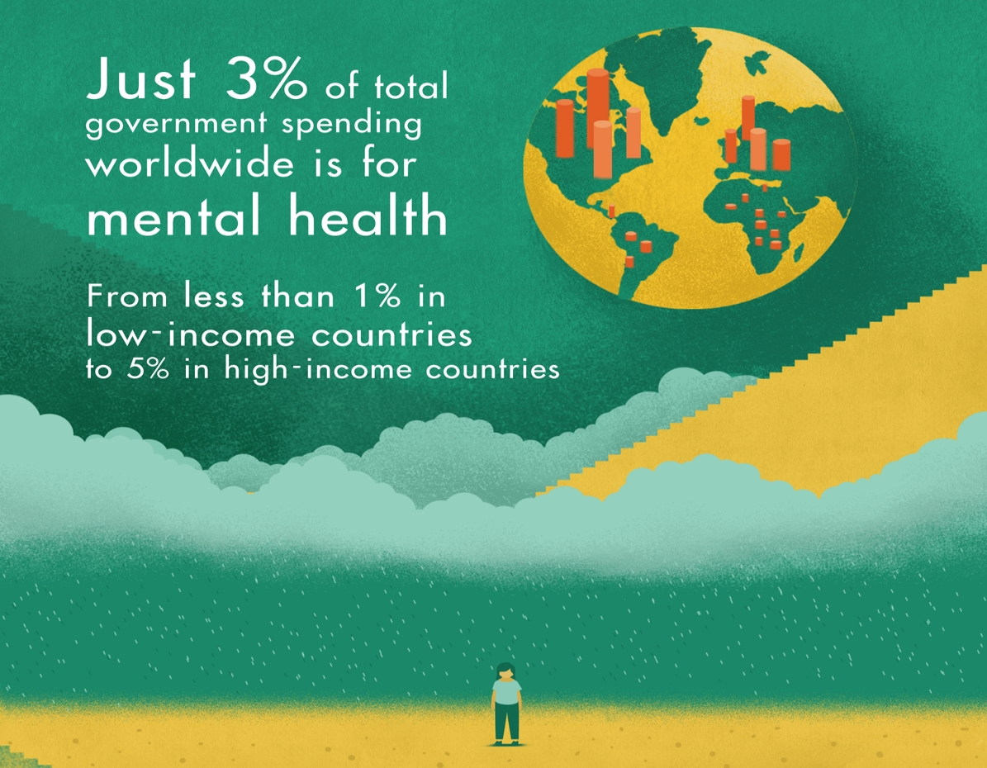
Cours H.E.L.P.
Notes:
Mental health is one of the most neglected areas of Public Health
40% of countries have no MH policy
> 30% of countries no MH programmes
> 50% of MH legislations drafted over 20 years ago and do not incorporate recent developments on human rights for people with psychosocial disabilities
Eventually costs for not treating MH disorders are higher than treatment

Slide 15
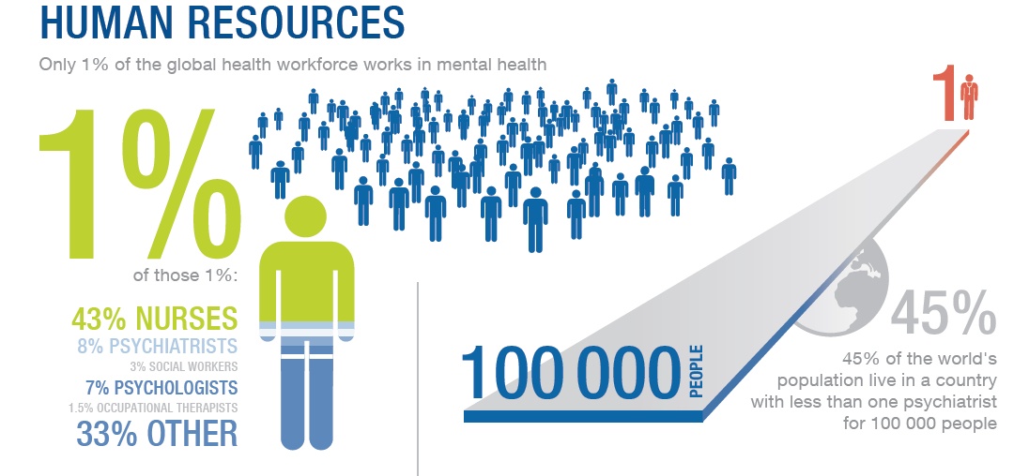
Cours H.E.L.P.
Notes:
There is scarcity of specialized human resources and that is why the ICRC asks for the strengthening of the MHPSS workforce in areas affected by armed conflicts. 45% of the countries have less than 1 psychiatrist for 100,000 people. The existing workforce is insufficient to address the MH burden and in areas affected by crisis, generally, the few professionals that exist, also leave in order to protect themselves and their families. It is necessary to train and continuously supervise non MHPSS specialists to take over classical MH roles.

Slide 16

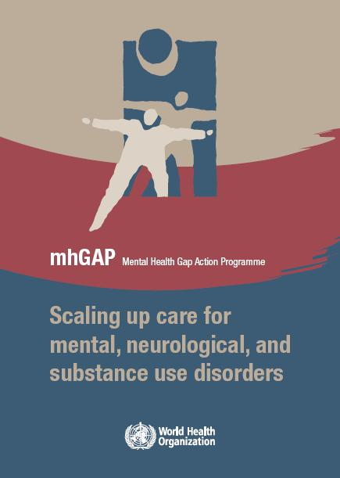
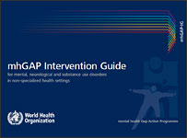
Programme mhGAP
Cours H.E.L.P.
2001
2010
Notes:
The MhGap program is a WHO package on scaling up MH care for priority MH conditions in non specialised settings. It is composed of different guidelines that address psychological and psychopharmacological approaches by non specialists. A specific version for humanitarian settings has been developed.
Components of mhGAP Package are:
Operations to scale up by district managers
Manualized psychological interventions
Building capacity of non-specialists
Clinical decision making tools for non-specialists

Slide 17
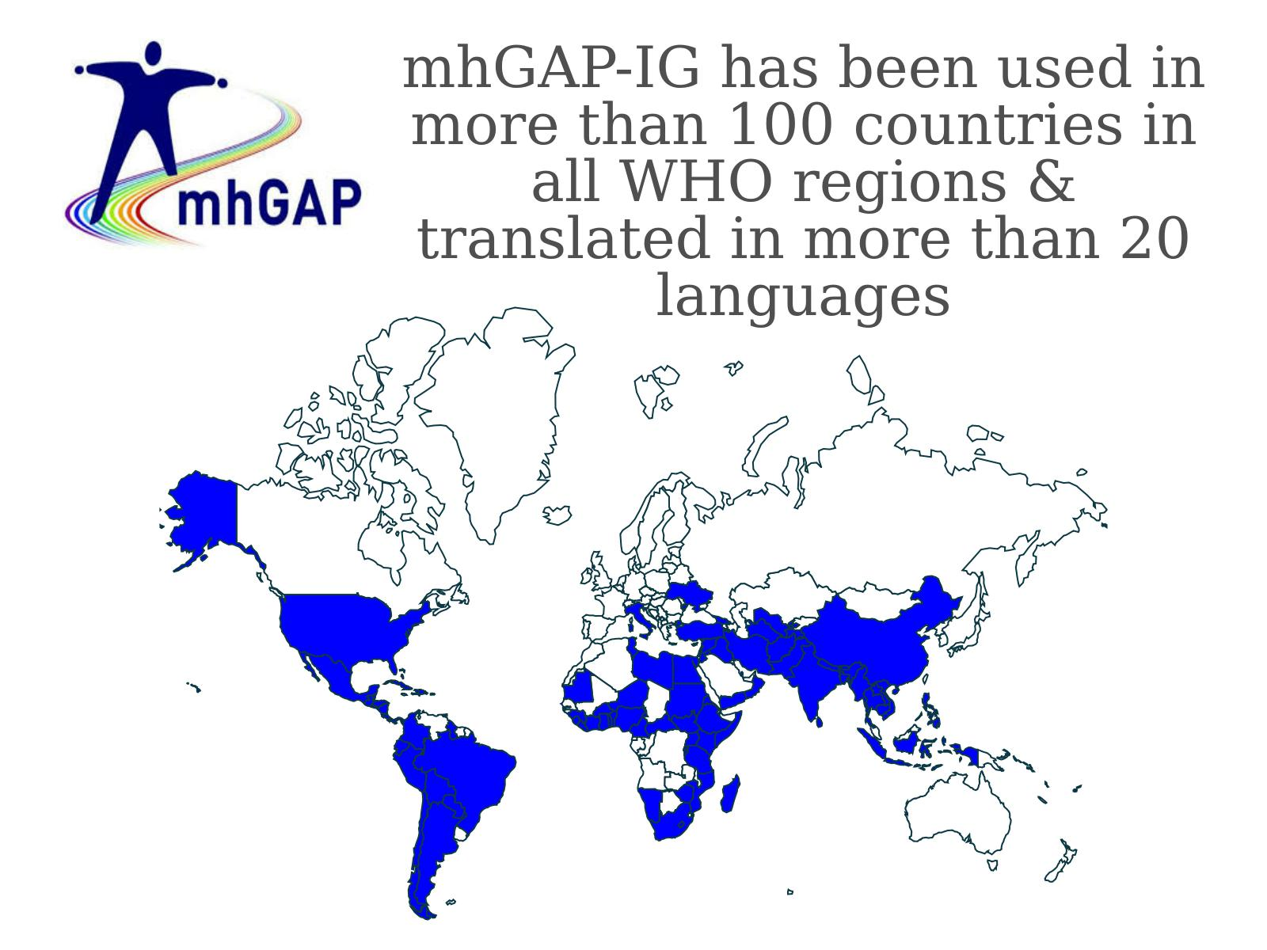
Notes:
The MhGap has been used in more than 100 countries in all Regions of the world. It has been adapted to many different languages.

Slide 18
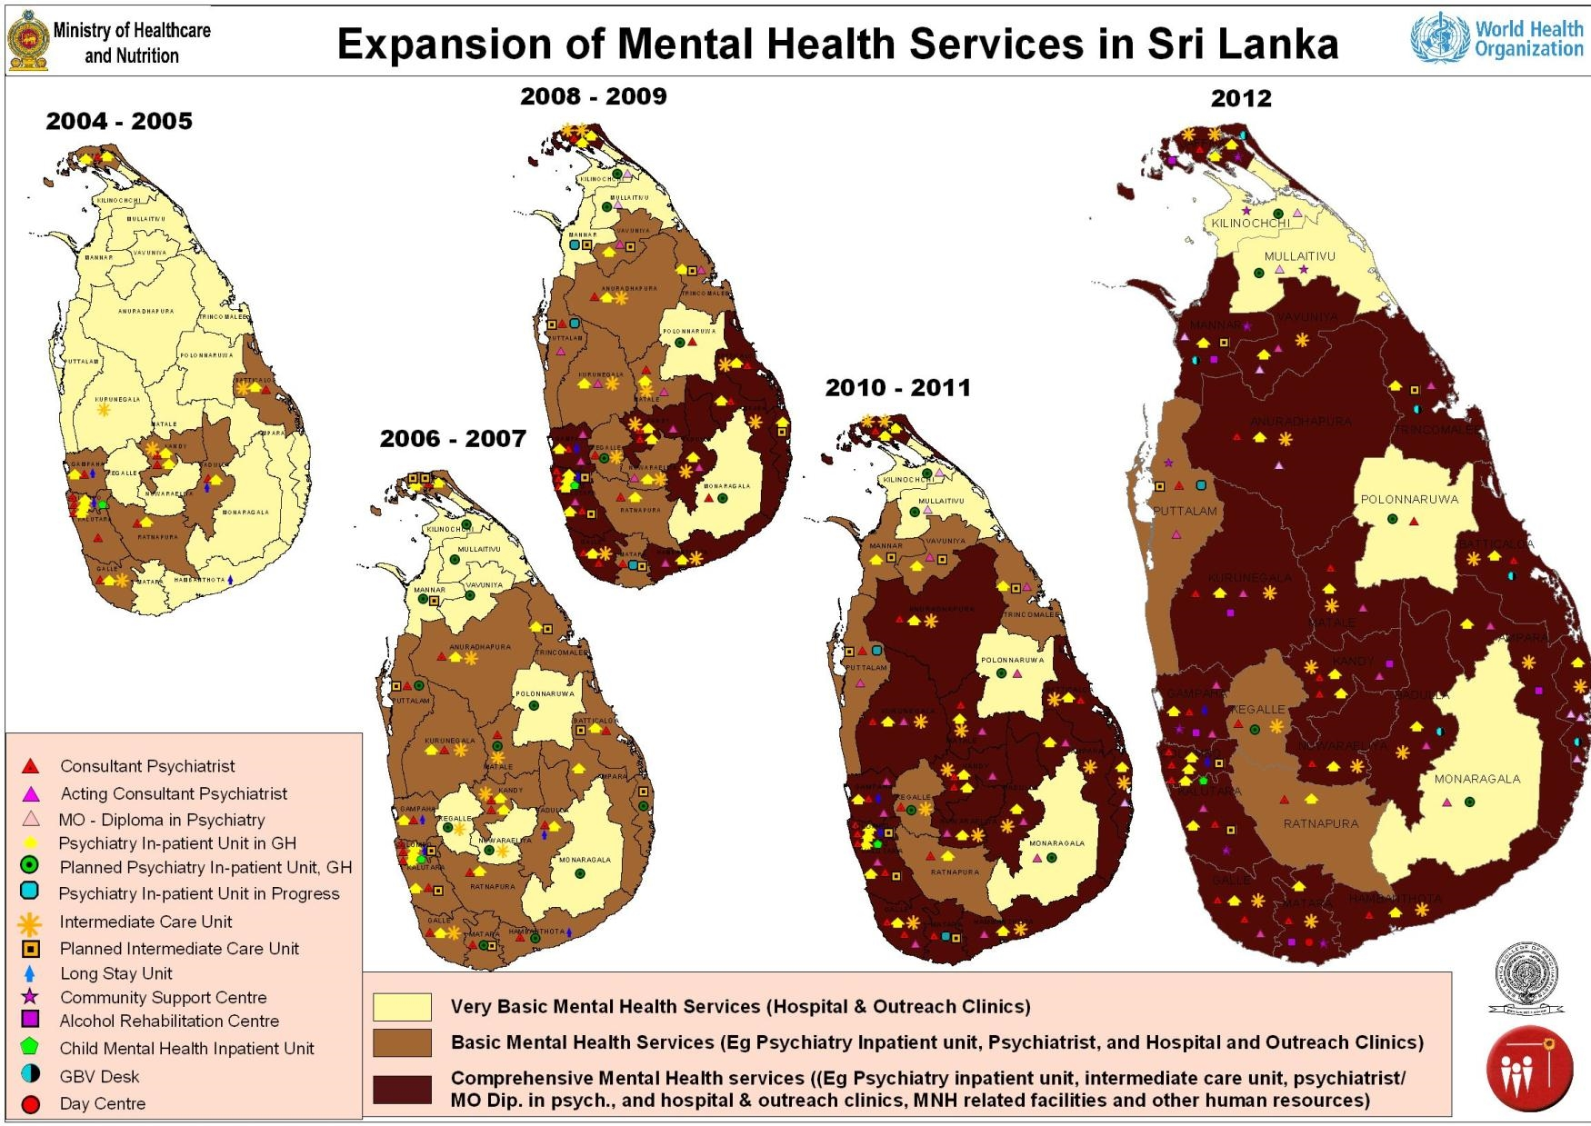
Notes:
Sri Lanka has made significant strides towards the development of efficient, comprehensive, and integrated community-based mental health services.
As of 2011, 20 out of 26 health districts (77%) had functioning acute inpatient units within general hospital settings, compared with 10 out of 26 (38%) before the tsunami.
In addition, the country had 16 fully functional intermediate stay rehabilitation units, compared with five units in 2004.
Nearly 30 community support centres have been established, promoting community involvement and education.

Slide 19
Plan d’action 2013–2020 de l’OMS en matière de santé mentale
Renforcer le leadership et la gouvernance dans le domaine de la santé mentale
Fournir des services de santé mentale et d’aide sociale complets, intégrés et adaptés aux besoins dans un cadre communautaire
Mettre en œuvre des stratégies de promotion et de prévention dans le domaine de la santé mentale
Renforcer les systèmes d’information, les bases factuelles et la recherche dans le domaine de la santé mentale
Cours H.E.L.P.
Notes:
The 2013-2020 WHO MH Plan of action has now been extended up to 2030. The priorities are:
Strengthen effective leadership and governance for mental health
Provide comprehensive, integrated and responsive mental health and social care services in community-based settings
Implement strategies for promotion and prevention in mental health
Strengthen information systems, evidence and research for mental health
Priorities have attached indicators and targets.

Slide 20
Pyramide d’intervention (adaptation de la pyramide de l’IASC de 2007)
Exemples :
Soins cliniques de santé mentale (par le personnel du centre de SSP ou par des professionnels de la santé mentale)
Services
cliniques
Appui concret et émotionnel de base
fourni à des individus ou des familles sélectionnés
Soutien psychosocial spécialisé
Activation des réseaux sociaux
Espaces auxiliaires adaptés aux enfants
Soutien communautaire et de la famille
Renforcement des soutiens communautaires et familiaux
Cours H.E.L.P.
Sensibilisation aux bonnes pratiques humanitaires : services essentiels sûrs, appropriés sur le plan social
et protégeant la dignité
Services essentiels et sécurité
Aspects sociaux des services essentiels et de la sécurité
Notes:
20
This slide is adapted with permission from the IASC Guidelines on Mental Health and Psychosocial Support (IASC, 2007).
The pyramid provides a description of the different levels of support that need to be provided to populations in crisis situations.
At the base we have social considerations that are transdisciplinary and if well addressed can prevent that further MHPSS problems appear. As an example here we have the construction of toilets in places that do not expose people to risk of further violence (e.g. women to sexual violence)
One level higher, we have activities that aim to promote social support and cohesion, that activate social networks and that bring a sense of normalcy. As an example we have child friendly spaces where children can have the opportunity to distract, play, interect and stay in a protected environment.
One level higher we have activities that provide basic emotional support by addressing people’s key psychological or psychosocial necessities. As an example here we have psychological first aid or basic psychological support provided to immediate victims of violence.
And on the highest level, meaning, the smallest part of the affected population will be in need of it, we have clinical services that aim to diagnose and treat psychological or mental health conditions. That can be done by specialists or trained and supervised generalists as nurses, doctors or clinical officers.
The different levels of the pyramid reflect the different amount of the population that would need those services.
Having said that, all levels have the same importance and are complementary.
No organization can provide all.
Partnerships and complementarity is needed in order to provide comprehensive care that can address comprehensively the different levels.

Slide 21
Lignes directrices de l’IASC = cadre inclusif couvrant à la fois la santé mentale et le soutien psychosocial
Définition composite
protection ou promotion du bien-être psychosocial
et/ou
prévention ou traitement d’un trouble mental.
SM SPS
Cours H.E.L.P.
Notes:
As described before, the IASC guidelines provides a comprehensive framework where protecting or promoting psychosocial well-being
and/or preventing or treating mental disorder is included in complementary ways.

Slide 22
Traditional usage of the term psychosocial support varies with sector
Health sector staff: non-biological interventions for people with mental disorder (e.g. CBT)
Protection, social & community services: any non-clinical support for any person with/without disorder (e.g. child friendly spaces)
Lack of common language confusion
H.E.L.P. course
Notes:
Traditional usage of the term psychosocial support varies with sector.
In the Health sector staff: non-biological interventions for people with mental disorder (e.g. CBT)
Protection, social & community services: any non-clinical support for any person with/without disorder (e.g. child friendly spaces)
Therefore, it is important to describe what one means when using such terminology in order to avoid confusion.
More important than that is to clearly describe the observed needs and what activities will be implemented in order to respond to the observed needs.

Slide 23
Santé mentale et soutien psychosocial – CICR
La notion de « santé mentale » est utilisée pour désigner le bien-être psychologique. Les activités de santé mentale visent à renforcer le bien-être psychologique des bénéficiaires en atténuant leurs souffrances psychiques, en améliorant leur fonctionnement quotidien et en les aidant à mettre en œuvre des stratégies d'adaptation (coping) efficaces.
Le terme psychosocial renvoie au lien entre l’individu (c’est-à-dire la « psyché » d’une personne) et son environnement, son entourage direct, sa communauté et/ou sa culture (c’est-à-dire le contexte social dans lequel il évolue). Le soutien psychosocial est essentiel à l’entretien d'une bonne santé physique et mentale, et il constitue, pour les personnes confrontées à des situations difficiles, un mécanisme d'adaptation de premier plan.
Cours H.E.L.P.
Pas de langue commune Confusion
Notes:
Traditional usage of the term psychosocial support varies with sector.
In the Health sector staff: non-biological interventions for people with mental disorder (e.g. CBT)
Protection, social & community services: any non-clinical support for any person with/without disorder (e.g. child friendly spaces)
Therefore, it is important to describe what one means when using such terminology in order to avoid confusion.
More important than that is to clearly describe the observed needs and what activities will be implemented in order to respond to the observed needs.
In the ICRC, as an example:
Mental health is used to denote psychological well-being. Mental health interventions aim to improve psychological well-being by reducing levels of psychological distress, improving daily functioning and ensuring effective coping strategies.
Psychosocial is used to describe the interconnection between the individual (i.e. a person’s ‘psyche’) and their environment, interpersonal relationships, community and/or culture (i.e. their social context). Psychosocial support is essential for maintaining good physical and mental health and provides an important coping mechanism for people during difficult times.
As mentioned before, those are always complementary approaches.

Slide 24
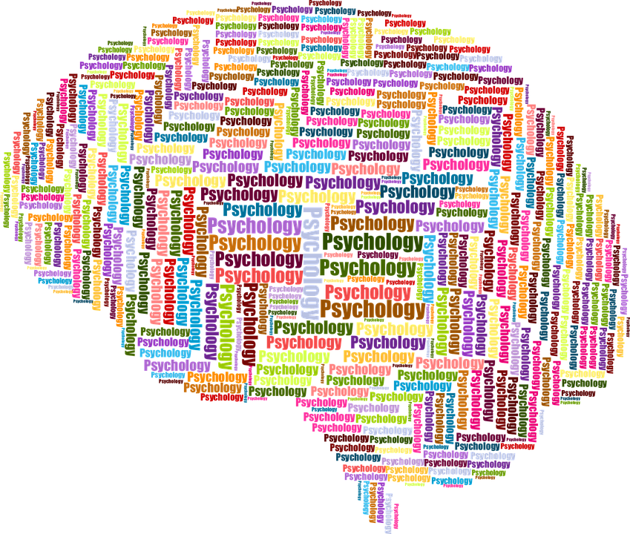

Indicateurs de SMSPS du CICR
Fonctionnalité
Réduction de la détresse (questionnaires)
Capacité d’adaptation (coping)
Cours H.E.L.P.
Notes:
In the ICRC, MHPSS activities prioritize the improvement of individuals affected by violence in the different types of MHPSS programs.
In order to regularly monitor the improvement, measures as functionality, distress and coping are used in the follow up of patients under psychological support. That allows clinicians and program manages to make the necessary adaptations and draw lessons learned for programmatic improvement.

Slide 25
Programmes de SMSPS du CICR
SMSPS pour les victimes de violence
SMSPS pour les familles de personnes portées disparues
SMSPS pour les aidants
SMSPS pour les personnes privées de liberté et qui ont été incarcérées par le passé
SMSPS pour les patients hospitalisés après une blessure par arme et pour les personnes handicapées
SMSPS en situation d’urgence
Cours H.E.L.P.
Notes:
The ICRC MHPSS types of activities are divided according to the support provided to specific target populations.
MHPSS for victims of violence (at community or health centers) and it can include children and victims of sexual violence
MHPSS for families of missing persons
MHPSS for helpers
MHPSS for people deprived of liberty and former detainees
MHPSS for the hospitalized weapon wounded and people with physical disabilities
MHPSS in Emergencies

Slide 26
Quelques interventions de SMSPS
Formation
Orientation de patients
Psychoéducation
Interventions de soutien collectif
Interventions de soutien aux familles
Interventions de soutien aux écoles
Premiers secours psychologiques
Séances de sensibilisation
Cours H.E.L.P.
Notes:
Psychosocial interventions constitute the backbone of any MHPSS response and include a range of social activities designed to foster psychological improvement, such as sharing experiences, fostering social support, awareness-raising and psychoeducation.

Slide 27
Activités de SMSPS
  Sensibilisation des communautés et séances de soutien
  Séances de soutien collectives et individuelles
  Consultations psychologiques et psychiatriques
Cours H.E.L.P.
Notes:
The MHPSS activities are developed in order to cover gaps on MHPSS care that are identified after needs based assessments. Those assessments and the programs that result of it are done in partnership with community and local organizations after the authorization provided by local and/or national authorities.
The MHPSS activities can be implemented as:
MHPSS Community awareness and support sessions (being this PS)
MHPSS Individual and group support sessions (being this PS)
Psychological and Psychiatric consultations (these being MH interventions)

Slide 28
Premiers secours psychologiques
Assistance sous forme de soutien humain et concret, fournie aux personnes ayant récemment été exposées à d’importants facteurs de stress. Cela implique :
  une prise en charge et un soutien pratiques non intrusifs
  l’évaluation des besoins et des préoccupations
  aider les personnes à satisfaire leurs besoins essentiels (nourriture, eau)
  écouter les personnes sans les pousser à s’exprimer
  réconforter les personnes et les aider à se sentir plus calmes
  aider les personnes à accéder à des informations, des services et un soutien social
  protéger les personnes contre tout préjudice supplémentaire
Notes:
What is Psychological First Aid?
Humane, supportive and practical assistance to fellow human beings who recently suffered exposure to serious stressors, and involves:
Non-intrusive, practical care and support
Assessing needs and concerns
Helping people to address basic needs (food, water)
Listening, but not pressuring people to talk
Comforting people and helping them to feel calm
Helping people connect to information, services and social supports
Protecting people from further harm

Slide 29
Premiers secours psychologiques : ce qu’ils NE SONT PAS
Ce n’est PAS une chose réservée aux professionnels
Ce n’est PAS une séance de thérapie professionnelle
Ce n’est PAS un « débriefing psychologique »
  Ce n’est pas une discussion approfondie sur l’événement traumatisant
Il ne s’agit PAS de demander aux personnes d’analyser ce qui s’est passé ou de rétablir la chronologie des événements
Si les premiers secours psychologiques impliquent d’être à l’écoute des personnes, il ne s’agit PAS de les pousser à dire ce qu’elles ont ressenti ou comment elles ont réagi face à l’événement
Cours H.E.L.P.
Notes:
-In contrast to psychological debriefing: PFA does NOT necessarily involve a detailed discussion of the event that caused the distress.
It is known that Psychological debriefing can be potentially harmful and has to be avoided!

Slide 30
Recommandations pour la mise en œuvre
Évaluation des besoins
  Évaluer les besoins des patients
  Évaluer les capacités du personnel médical
  Évaluer les besoins et les capacités RH (personnel SMSPS national et international, psychologues)
  Évaluer les aspects culturels
Suivi et évaluation
  Questionnaires :
    Échelle d’impact des événements
    Center for Epidemiologic Studies – Depression Scale (échelle CES-D pour l’identification d’une dépression majeure)
    Échelle d’évaluation fonctionnelle PSFS, etc.
Cours H.E.L.P.
Notes:
The needs assessment is the starting point for any MHPSS activity which includes a comprehensive situational analysis.
The key points of the needs assessment are:
Assess the existing knowledge via collection of data and information already available
Assess needs of beneficiaries
Assess the capacities of health personnel
Assess HR needs and capacities (MHPSS national, international staff and MHPSS professionals if available. )
Assess the local cultural aspects
Programs also need to include monitoring and evaluation mechanisms:
Questionnaires can be used to monitor the improvement of beneficiaries under care or the improvement of the capacities of professionals trained in MHPSS service delivery.
Local adaptation and validation of questionnaires is a MUST!

Slide 31
ÉVALUATION
Cours H.E.L.P.
Participative et coordonnée
Notes:
And here you have examples of international guidelines produced by international organizations that can guide you in performing assessments of MHPSS needs and resources in crisis situations.

Slide 32
Coordination des soins de santé mentale et du soutien psychosocial (SMSPS) – système de groupes thématiques (clusters)
Dirigeant politique / Coordonnateur de l’action humanitaire des Nations Unies
Groupe de coordination intersectorielle
Groupe Santé
Groupe Protection
(avec sous-groupe
pour la protection de l’enfant)
Groupe Éducation et autres
groupes sectoriels
Groupe de travail technique intersectoriel sur la SMSPS (avec personnes de contact dans chaque secteur, et
redevabilité par secteur). Actions de SMSPS entreprises dans le cadre des groupes sectoriels incluses le cas échéant dans les chapitres de documents d’appel dans les sections dédiées à
la santé, la protection et l’éducation, plutôt que traitées dans un chapitre séparé de l’appel
Notes:
It is important to be aware and involved of existing coordinating mechanisms on MHPSS in crisis situations. The local WHO or UN office will be able to provide the necessary directions.
There is in general a MHPSS working group and MHPSS participates in other groups as Health, Protection and Education.

Slide 33

Les situations de crise comme opportunités pour le développement de la santé mentale
Intérêt des médias
Intérêt des décisionnaires (p. ex. tête de gouvernement, responsables d’agences humanitaires)
Volonté des dirigeants d’envisager des options permettant de dépasser le statu quo
Notes:
While the challenges related to mental health care are considerable, emergencies also present unique opportunities for better care of all people with mental health needs.
Following disasters, the media often focus on the plight of surviving people, including their psychological responses to the stressors they face.
In some countries, government leaders and heads of nongovernmental organizations express – for the first time – serious concern about their nation’s mental health.
Within this context, decision-makers often become willing to allocate resources towards mental health and to consider options beyond the status quo.
Collectively, these factors create the possibility of introducing and implementing more sustainable mental health services that can help people during the emergency and continue to help them in the long term.

Slide 34

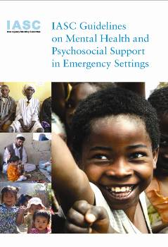
IASC (2007, 2010) Sphère (version de 2018) Guide des premiers secours psychologiques (2011)
Quelques lignes directrices actuelles
Cours H.E.L.P.
Notes:
Here the IASC guidelines, mentioned before:
a multi-sectoral, inter-agency (UN-NGO) framework
that enables coordination,
that identifies useful practices,
that flags harmful practices
that clarifies how different approaches to mental health and psychosocial support complement one another.
The Sphere handbook with key intervention on MHPSS also included.
And the guidelines on Psychological First Aid.

Slide 35

Atlas de la santé mentale de l’OMS
Ressource complète contenant des informations générales sur la santé mentale et un outil important pour la mise au point et la planification de services de santé mentale au sein de pays et de régions.
Les ressources spécifiques à un pays comprennent :
les politiques,
les plans,
les financements,
la prestation de soins,
les effectifs,
les médicaments, et
les systèmes d’information...
en matière de santé mentale
Cours H.E.L.P.
Notes:
The WHO also regularly produces a compilation of MH information and indicators on UN Member States. Please check for information on existing resources.

Slide 36


Projet EQUIP
Le projet EQUIP vise à garantir la qualité et l’efficacité de brèves interventions psychologiques menées par des personnes qui ne sont pas spécialistes de la santé mentale, et à étendre la mise en œuvre de telles interventions aux communautés qui en ont besoin à travers le monde.
Lien vers la vidéo :
https://www.youtube.com/watch?v=bMiVP_YKBpI&feature=youtu.be
Notes:
The EQUIP Project, from the WHO aims to ensure the quality and effectiveness of brief psychological interventions that are delivered by people who are not mental health specialists and the expansion of the use of these interventions in communities who need them around the world. Please check the WHO website for more information. There is an increased amount of psychological interventions that can be delivered by trained and supervised non MHPSS specialists. Those can be helpful to help people overcome the high levels of distress they face in situations of crisis. The evidence for their effectiveness is well documented in the scientific literature.

Slide 37
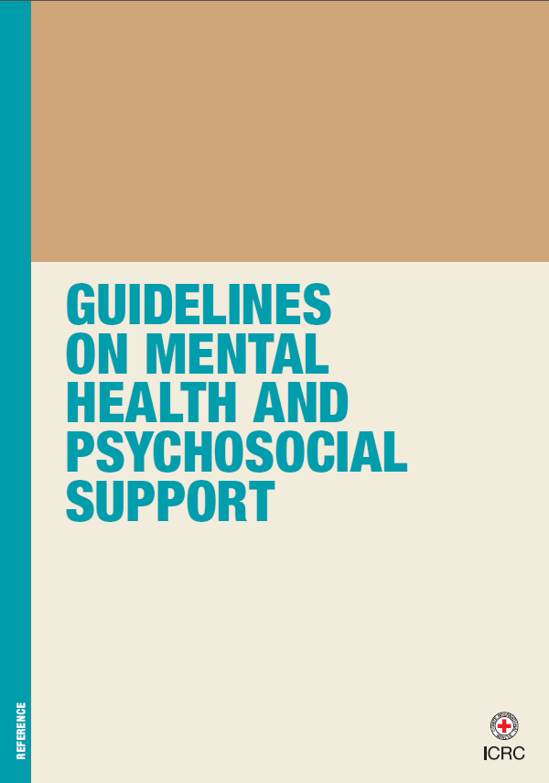
L’action du CICR en matière de SMSPS ne suit pas nécessairement les diagnostics de troubles mentaux, mais se concentre plutôt sur l’atténuation des symptômes et sur la fonctionnalité (aptitude à faire face au quotidien et renforcement de la capacité d’adaptation).
Cours H.E.L.P.
Notes:
The ICRC MHPSS guidelines provide guidance on assessing the needs, developing programs, monitoring and evaluating MHPSS programs for populations affected by armed conflicts and other situations of violence.
The ICRC’s MHPSS response does not necessarily follows standard diagnostic approaches but instead is led by and focuses on symptoms and functionality. More information can also be acquired in the ICRC website at www.icrc.org

Slide 38

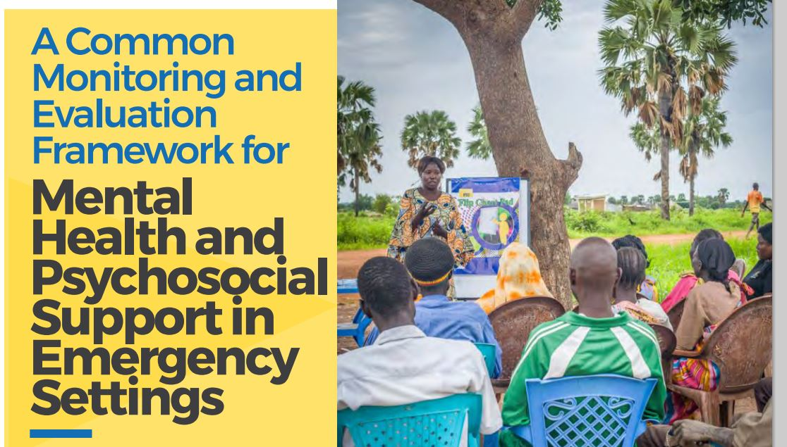
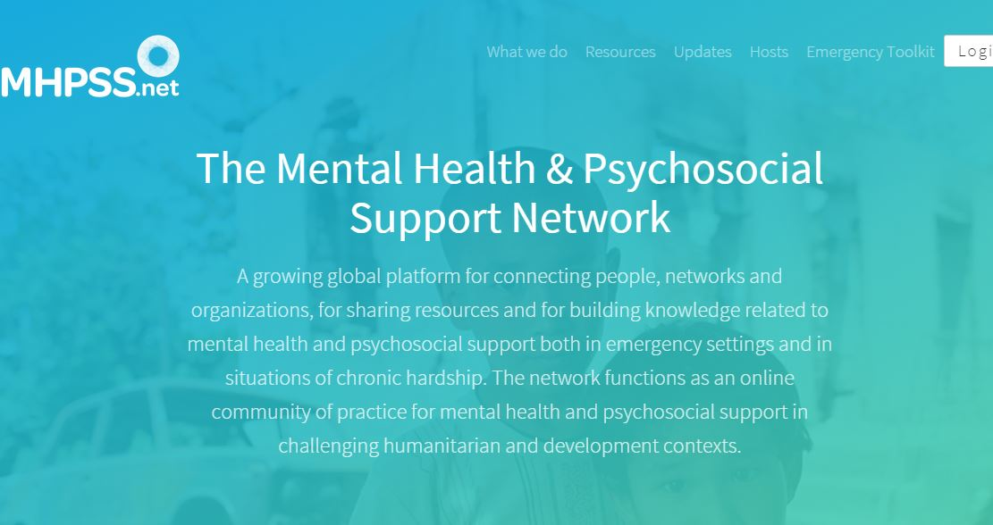
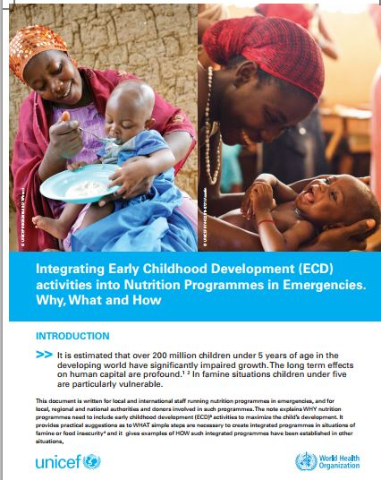

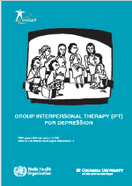
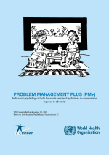
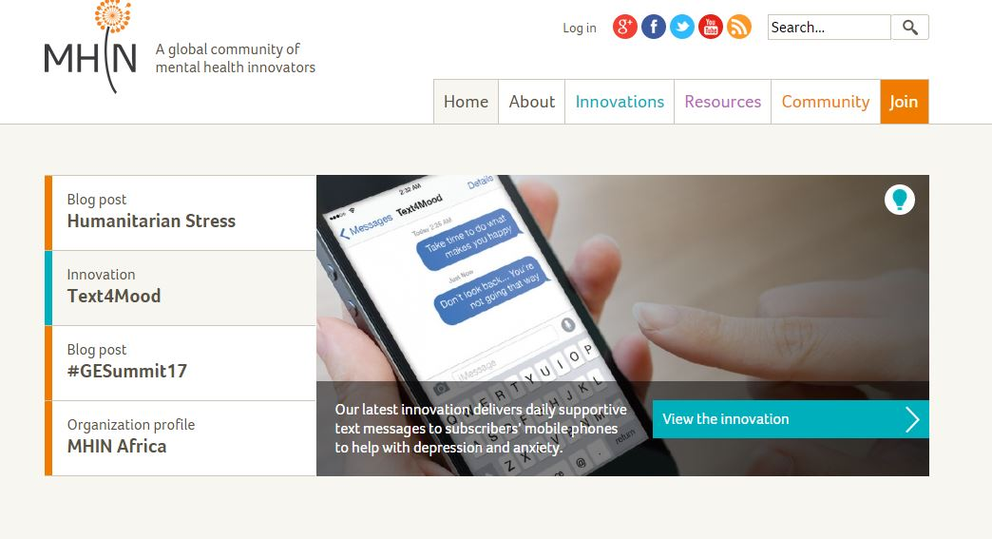
Autres ressources...
Cours H.E.L.P.
…………………..
Notes:
There is more and more material that can be of help in developing MHPSS approaches and programs in crisis situations. Please consult the UN agencies or the ICRC in the place where you work.

Slide 39
Merci de votre attention !
Cours H.E.L.P.

Slide 40
Travail de groupe
Lisez les informations sur le contexte
Sur cette base, définissez des questions d’évaluation
Identifiez de possibles interventions de SMSPS
Cours H.E.L.P.
Cours H.E.L.P.
Notes:
Each groups discusses one of these three crises

