Slide 1
Introduction à la prise en charge d’un grand nombre de victimes...
Cours H.E.L.P.
William Clucas, coordonnateur du programme Premiers secours et soins préhospitaliers d’urgence
Les présents supports de formation ont été élaborés avec l’aide de Thomas Wilp, d’Earl Hernandez, des équipes FA & PHEC et MCIT du CICR, et de MSF

Slide 2
Objectifs
Être capable de
d’expliquer la nécessité et les atouts d’une approche systématique, structurée et pré-établie face à des situations à multiples victimes (SMV)
de décrire les principes généraux de la prise en charge d’un grand nombre de victimes, notamment les principes relatifs au triage et les obstacles potentiels à surmonter
Cours H.E.L.P.

Slide 3



Prise en charge d’un grand nombre de victimes (MCM)
Que signifie la notion de « multiples victimes » ?
Qu’est-ce qu’une situation à multiples victimes (SMV) ?
Qu’est-ce que la prise en charge d’un grand nombre de victimes ?
Cours H.E.L.P.
Notes:
Discuss what a Mass Casualty (any incident in which emergency medical services resources, such as personnel and equipment, are overwhelmed by the number and severity of casualties) is and what the differences between a Mass Casualty Incident (MCI) and a Mass Casualty Management approach are….
It has to include more than one patient, and in many jurisdictions, it is generally defined as at least three
MCI = (WHO) An incident which generates more patients at one time than locally available resources can manage using routine procedures. It requires exceptional emergency arrangements and additional or extraordinary assistance. i.e. imbalance between needs and services
Mass casualty management: (WHO) A coherent and interrelated set of established procedures, policies, and plans that contribute to the shared objectives of optimizing the baseline capacity to deal with patient populations expected in a mass casualty incident, and efﬁciently increasing this capacity during the response to a mass casualty incident.

Slide 4
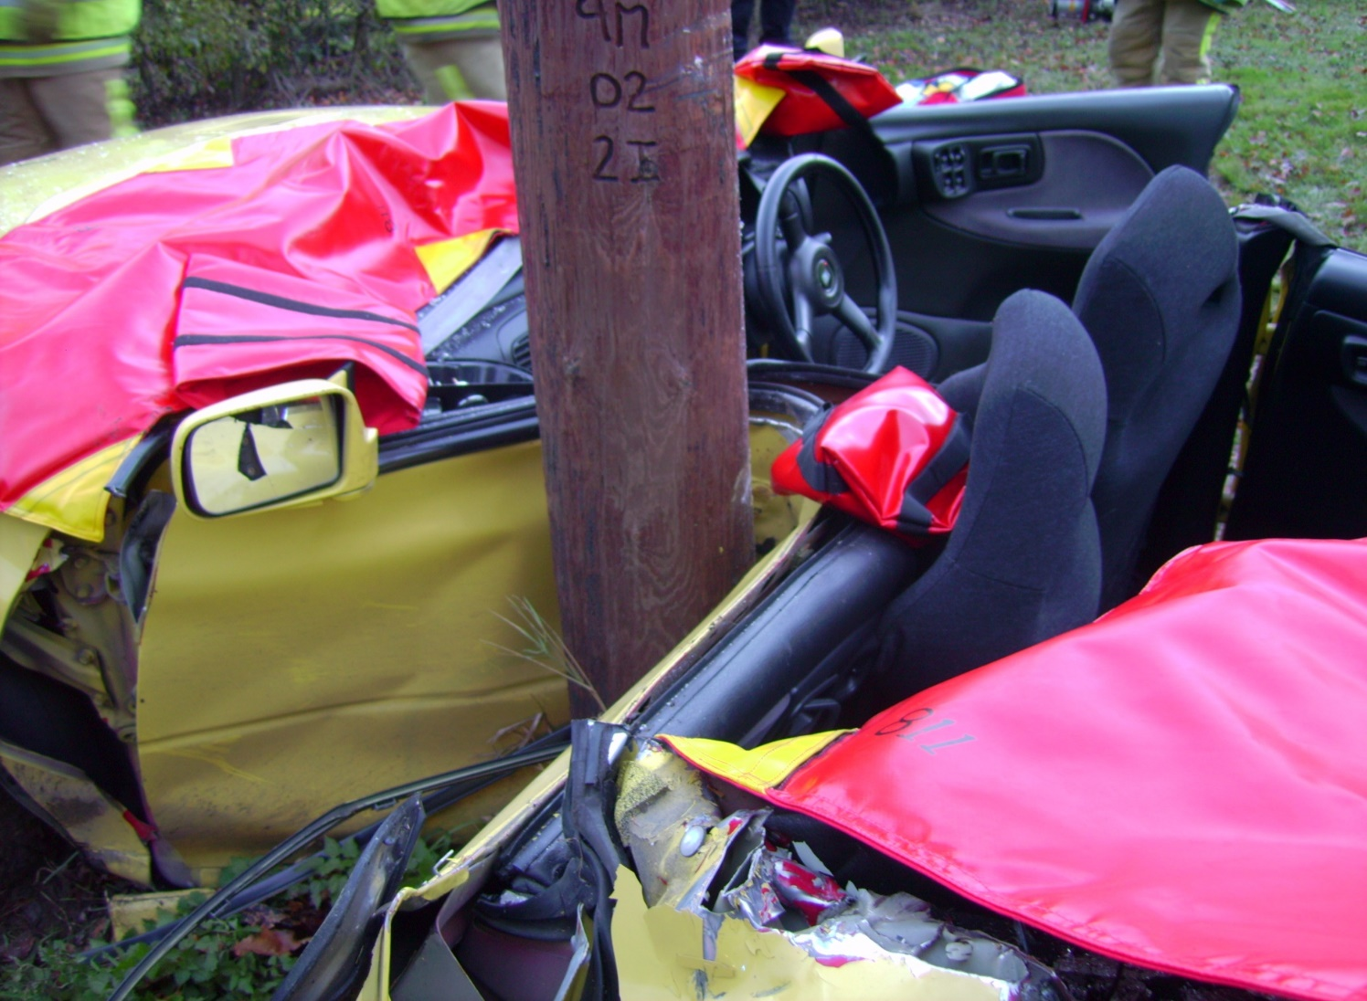
S’agit-il d’une situation à multiples victimes ?
Cours H.E.L.P.
Notes:
Discuss what a Mass Casualty (any incident in which emergency medical services resources, such as personnel and equipment, are overwhelmed by the number and severity of casualties) is and what the differences between a Mass Casualty Incident (MCI) and a Mass Casualty Management approach are….
It has to include more than one patient, and in many jurisdictions, it is generally defined as at least three
MCI = (WHO) An incident which generates more patients at one time than locally available resources can manage using routine procedures. It requires exceptional emergency arrangements and additional or extraordinary assistance. i.e. imbalance between needs and services
Mass casualty management: (WHO) A coherent and interrelated set of established procedures, policies, and plans that contribute to the shared objectives of optimizing the baseline capacity to deal with patient populations expected in a mass casualty incident, and efﬁciently increasing this capacity during the response to a mass casualty incident.

Slide 5
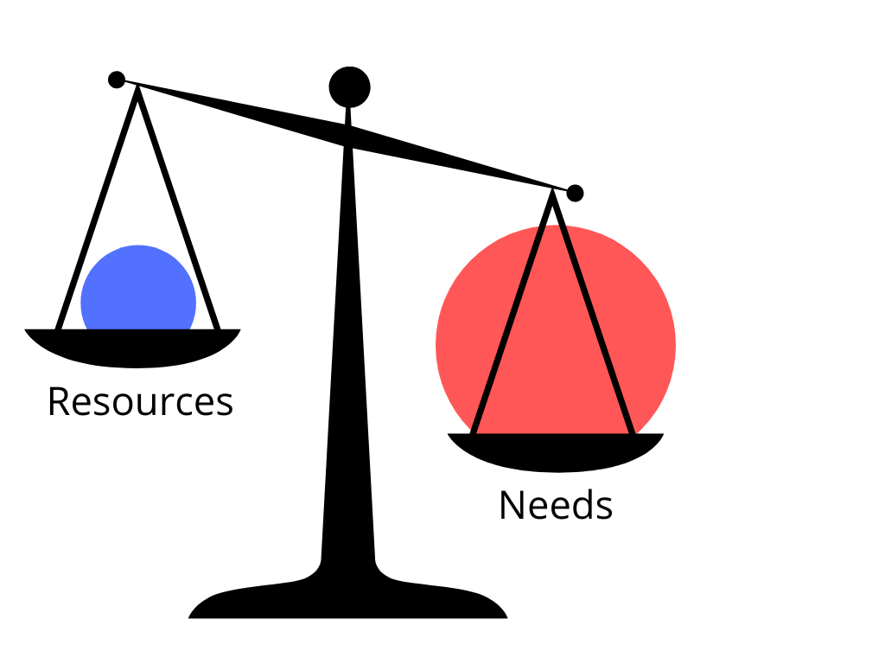
Qu’est-ce qu’une situation à multiples victimes (SMV) ?
Le nombre de patients, la gravité de leur état ou leur type de pathologie dépasse les ressources sanitaires disponibles
Cours H.E.L.P.
Notes:
Discuss what a Mass Casualty (any incident in which emergency medical services resources, such as personnel and equipment, are overwhelmed by the number and severity of casualties) is and what the differences between a Mass Casualty Incident (MCI) and a Mass Casualty Management approach are….
It has to include more than one patient, and in many jurisdictions, it is generally defined as at least three
MCI = (WHO) An incident which generates more patients at one time than locally available resources can manage using routine procedures. It requires exceptional emergency arrangements and additional or extraordinary assistance. i.e. imbalance between needs and services
Mass casualty management: (WHO) A coherent and interrelated set of established procedures, policies, and plans that contribute to the shared objectives of optimizing the baseline capacity to deal with patient populations expected in a mass casualty incident, and efﬁciently increasing this capacity during the response to a mass casualty incident.

Slide 6
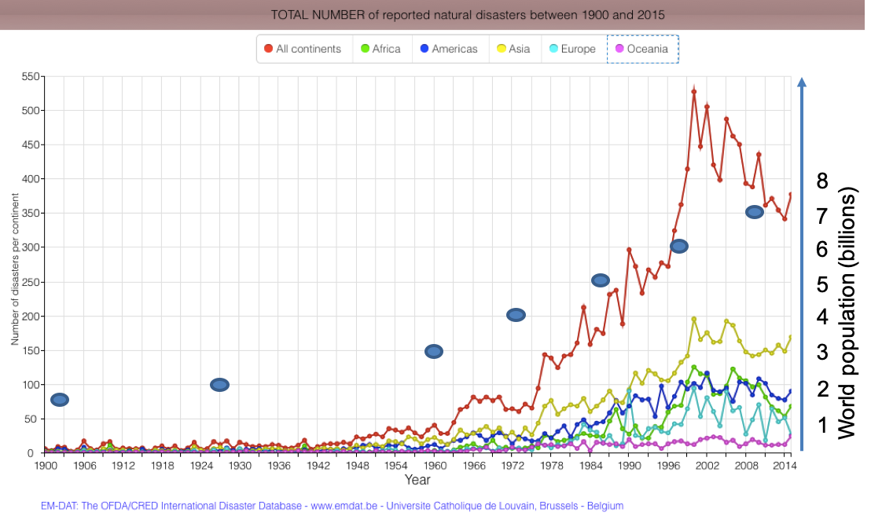
Augmentation de la fréquence des catastrophes et des SMV
Cours H.E.L.P.
Notes:
Discuss what a Mass Casualty (any incident in which emergency medical services resources, such as personnel and equipment, are overwhelmed by the number and severity of casualties) is and what the differences between a Mass Casualty Incident (MCI) and a Mass Casualty Management approach are….
It has to include more than one patient, and in many jurisdictions, it is generally defined as at least three
MCI = (WHO) An incident which generates more patients at one time than locally available resources can manage using routine procedures. It requires exceptional emergency arrangements and additional or extraordinary assistance. i.e. imbalance between needs and services
Mass casualty management: (WHO) A coherent and interrelated set of established procedures, policies, and plans that contribute to the shared objectives of optimizing the baseline capacity to deal with patient populations expected in a mass casualty incident, and efﬁciently increasing this capacity during the response to a mass casualty incident.

Slide 7
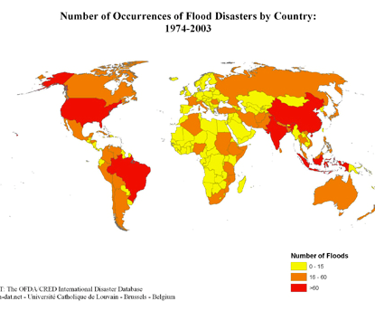
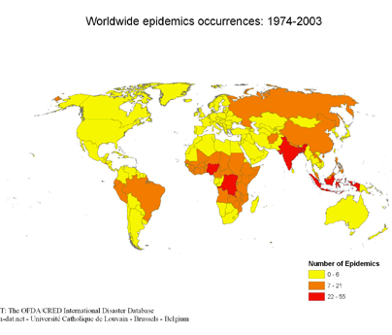
Phénomène mondial
Cours H.E.L.P.
Notes:
Discuss what a Mass Casualty (any incident in which emergency medical services resources, such as personnel and equipment, are overwhelmed by the number and severity of casualties) is and what the differences between a Mass Casualty Incident (MCI) and a Mass Casualty Management approach are….
It has to include more than one patient, and in many jurisdictions, it is generally defined as at least three
MCI = (WHO) An incident which generates more patients at one time than locally available resources can manage using routine procedures. It requires exceptional emergency arrangements and additional or extraordinary assistance. i.e. imbalance between needs and services
Mass casualty management: (WHO) A coherent and interrelated set of established procedures, policies, and plans that contribute to the shared objectives of optimizing the baseline capacity to deal with patient populations expected in a mass casualty incident, and efﬁciently increasing this capacity during the response to a mass casualty incident.

Slide 8
Situations à multiples victimes
Problème – le nombre de victimes, la gravité de leur état ou leur catégorie dépasse les ressources sanitaires disponibles
Objectif – sauver un maximum de vies et de membres ; faire au mieux pour le plus grand nombre possible
Solution – prise en charge d’un grand nombre de victimes selon un plan défini
Cours H.E.L.P.
Notes:
Discuss what a Mass Casualty (any incident in which emergency medical services resources, such as personnel and equipment, are overwhelmed by the number and severity of casualties) is and what the differences between a Mass Casualty Incident (MCI) and a Mass Casualty Management approach are….
It has to include more than one patient, and in many jurisdictions, it is generally defined as at least three
MCI = (WHO) An incident which generates more patients at one time than locally available resources can manage using routine procedures. It requires exceptional emergency arrangements and additional or extraordinary assistance. i.e. imbalance between needs and services
Mass casualty management: (WHO) A coherent and interrelated set of established procedures, policies, and plans that contribute to the shared objectives of optimizing the baseline capacity to deal with patient populations expected in a mass casualty incident, and efﬁciently increasing this capacity during the response to a mass casualty incident.

Slide 9
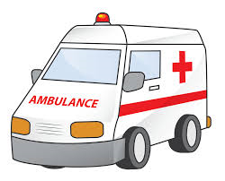


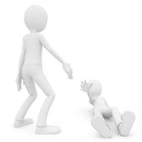
Prise en charge d’un grand nombre de victimes (MCM) : sa raison d’être
La gestion des patients suite à une SMV vise à réduire les pertes au maximum...
Cours H.E.L.P.

Slide 10

Vidéo de MSF
Cours H.E.L.P.

Slide 11


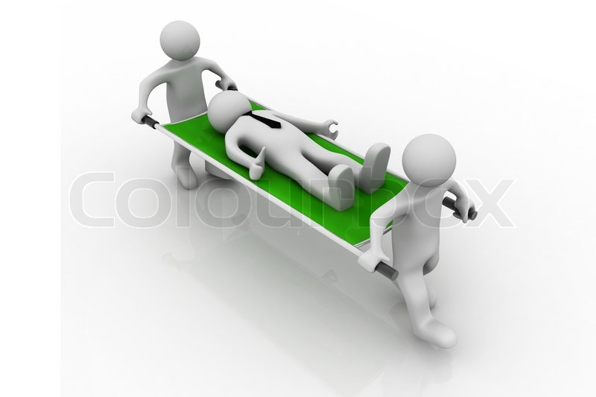
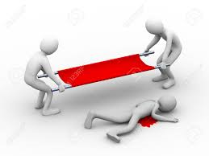
Approche de base
SCOOP (Charger)
and (et)
RUN (Courir)
Cours H.E.L.P.

Slide 12



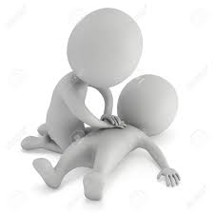
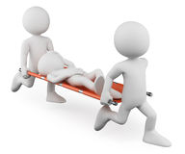
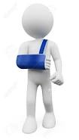


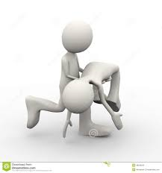
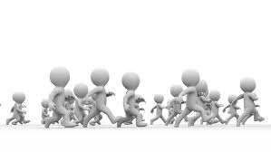
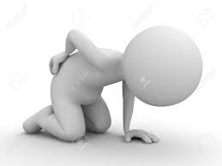





... VOUS NE FEREZ QUE DÉPLACER LE PROBLÈME !
Cours H.E.L.P.
Notes:
In a mass casualty situation this approach will result in the transfer of the problem from the incident site to the hospital, overwhelming and disrupting the care capacity of the health facilities…

Slide 13
Réponse préhospitalière structurée
  C - Commande
  S - Sécurité
  C - Communication
  A - Appréciation (évaluation)
  T - Triage
  T - Traitement
  T - Transport
Cours H.E.L.P.
Notes:
In addition to structuring the response it is also used as a briefing tool

Slide 14
Commande
Or – stratégique : chargée de la gestion d’un incident grave au niveau organisationnel (responsable de l’élaboration d’une stratégie, de l’affectation des ressources et de l’équilibrage entre les exigences découlant de l’incident et celles liées aux opérations habituelles). Hors site
Argent – tactique : chargée des activités globales sur le terrain (responsable de la définition de mesures tactiques venant appuyer la commande stratégique). Contrôle inter-agences de l’incident à proximité du lieu de l’événement
Cours H.E.L.P.
Bronze – opérationnelle : chargée des ressources pour les ambulances (biens et personnels) sur le terrain, au point de contact avec les victimes (responsable du triage, du traitement et du transport des victimes). Il peut y avoir plusieurs niveaux bronze sur plusieurs sites d’activité.
Notes:
The terms gold, silver and bronze may also be substituted with levels 1, 2 or 3
Depending on the context gold and silver may be merged. But emphasise that there needs to be hands off leadership to maintain command and control.
This is the ideal and needs to be contextualized. At first there will just be the first responder on scene and the command structure will build as the incident progresses.

Slide 15
METHANE – SITREP
(M) | Multiples victimes (Mass casualty) | EN ATTENTE ou DÉCLARÉ
E | Endroit exact | Adresse ou coordonnées exactes
T | Type d’incident | Accident de la route, crash aérien, effondrement d’un bâtiment, explosion, bousculade dans un stade
H | (En anglais, Hazard) Dangers | Électriques, chimiques, liés au feu...
A | Accès | Par où approcher
N | Nombre de victimes | Gravité et types de blessures
E | (En anglais, emergency services) Services d’urgence | Police, ambulances, défense civile, armée (ressources déjà sur place et ressources sollicitées)
Cours H.E.L.P.
Questions répétées et régulièrement mises à jour
Notes:
METHANE can be used for interprofessional communication but by asking the right questions can also be obtained from survivors/drivers.

Slide 16
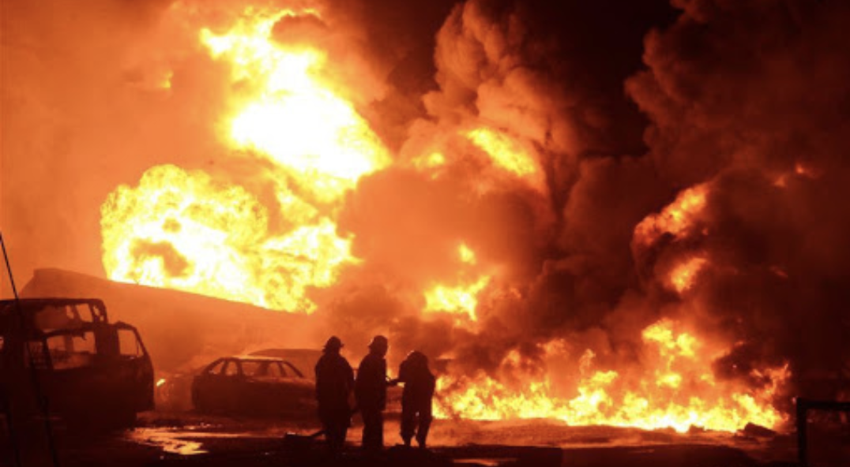
Scénario – Partie A
Cours H.E.L.P.
Voilà ce que vous voyez à travers votre pare-brise...
Notes:
Discuss what a Mass Casualty (any incident in which emergency medical services resources, such as personnel and equipment, are overwhelmed by the number and severity of casualties) is and what the differences between a Mass Casualty Incident (MCI) and a Mass Casualty Management approach are….
It has to include more than one patient, and in many jurisdictions, it is generally defined as at least three
MCI = (WHO) An incident which generates more patients at one time than locally available resources can manage using routine procedures. It requires exceptional emergency arrangements and additional or extraordinary assistance. i.e. imbalance between needs and services
Mass casualty management: (WHO) A coherent and interrelated set of established procedures, policies, and plans that contribute to the shared objectives of optimizing the baseline capacity to deal with patient populations expected in a mass casualty incident, and efﬁciently increasing this capacity during the response to a mass casualty incident.

Slide 17

Scénario – Partie A
0630 signale une explosion au marché à l’heure du petit-déjeuner alors que les commerçants étaient en train de se préparer pour le marché journalier... Habituellement, on dénombre environ 50 stands sur la place principale, certaines familles passant souvent la nuit sur place après être arrivées à pied la veille, depuis leur ferme. Un camion de carburant a explosé, une forte odeur se diffuse dans l’air, de nombreuses personnes sont blessées et beaucoup de bâtiments proches du marché sont détruits, dont une école primaire.
Il n’y a pas d’autre service d’urgence sur les lieux.
Cours H.E.L.P.
Notes:
Discuss what a Mass Casualty (any incident in which emergency medical services resources, such as personnel and equipment, are overwhelmed by the number and severity of casualties) is and what the differences between a Mass Casualty Incident (MCI) and a Mass Casualty Management approach are….
It has to include more than one patient, and in many jurisdictions, it is generally defined as at least three
MCI = (WHO) An incident which generates more patients at one time than locally available resources can manage using routine procedures. It requires exceptional emergency arrangements and additional or extraordinary assistance. i.e. imbalance between needs and services
Mass casualty management: (WHO) A coherent and interrelated set of established procedures, policies, and plans that contribute to the shared objectives of optimizing the baseline capacity to deal with patient populations expected in a mass casualty incident, and efﬁciently increasing this capacity during the response to a mass casualty incident.

Slide 18
Scénario – Partie A
0630 signale une explosion au marché à l’heure du petit-déjeuner alors que les commerçants étaient en train de se préparer pour le marché journalier... Habituellement, on dénombre environ 50 stands sur la place principale, certaines familles passant souvent la nuit sur place après être arrivées à pied la veille, depuis leur ferme. Un camion de carburant a explosé, une forte odeur se diffuse dans l’air, de nombreuses personnes sont blessées et beaucoup de bâtiments proches du marché sont détruits, dont une école primaire.
Il n’y a pas d’autre service d’urgence sur les lieux.
Cours H.E.L.P.
Notes:
Discuss what a Mass Casualty (any incident in which emergency medical services resources, such as personnel and equipment, are overwhelmed by the number and severity of casualties) is and what the differences between a Mass Casualty Incident (MCI) and a Mass Casualty Management approach are….
It has to include more than one patient, and in many jurisdictions, it is generally defined as at least three
MCI = (WHO) An incident which generates more patients at one time than locally available resources can manage using routine procedures. It requires exceptional emergency arrangements and additional or extraordinary assistance. i.e. imbalance between needs and services
Mass casualty management: (WHO) A coherent and interrelated set of established procedures, policies, and plans that contribute to the shared objectives of optimizing the baseline capacity to deal with patient populations expected in a mass casualty incident, and efﬁciently increasing this capacity during the response to a mass casualty incident.

Slide 19
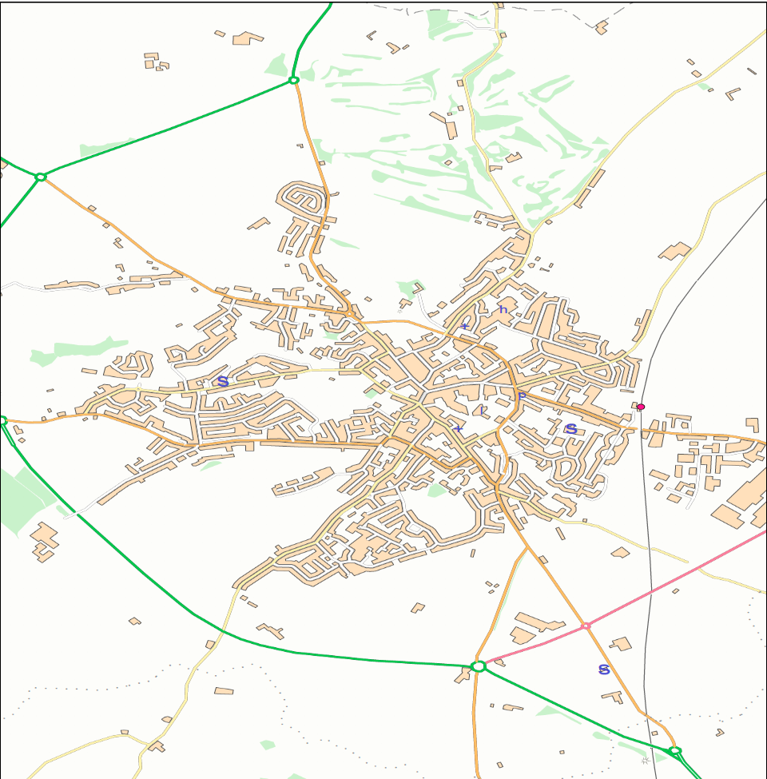
Scénario – Partie A
Marché de Mocktistan
Accès : ancienne voie ferroviaire
Cours H.E.L.P.
Notes:
Discuss what a Mass Casualty (any incident in which emergency medical services resources, such as personnel and equipment, are overwhelmed by the number and severity of casualties) is and what the differences between a Mass Casualty Incident (MCI) and a Mass Casualty Management approach are….
It has to include more than one patient, and in many jurisdictions, it is generally defined as at least three
MCI = (WHO) An incident which generates more patients at one time than locally available resources can manage using routine procedures. It requires exceptional emergency arrangements and additional or extraordinary assistance. i.e. imbalance between needs and services
Mass casualty management: (WHO) A coherent and interrelated set of established procedures, policies, and plans that contribute to the shared objectives of optimizing the baseline capacity to deal with patient populations expected in a mass casualty incident, and efﬁciently increasing this capacity during the response to a mass casualty incident.

Slide 20
METHANE – SITREP
(M) | Multiples victimes | Grave incident déclaré
E | Endroit exact | Marché de Mocktistan
T | Type d’incident | Explosion
H | (En anglais, Hazard) Dangers | Incendie, possible déversement de produits chimiques, effondrement de bâtiment(s)
A | Accès | Ancienne voie ferroviaire
N | Nombre de victimes | Multiples victimes, nombre indéterminé
E | (En anglais, emergency services) Services d’urgence | Pas d’autres services d’urgence sur place. Ressources requises : brigade de pompiers (défense civile), services de sécurité, spécialistes de produits chimiques dangereux, services sociaux et auxiliaires
Cours H.E.L.P.
Questions répétées et régulièrement mises à jour

Slide 21
Triage en cas de SMV
Rapide classification clinique et optimisation de l’orientation des patients vers les établissements de soins de santé
Triage hospitalier
Triage préhospitalier
Cours H.E.L.P.

Slide 22
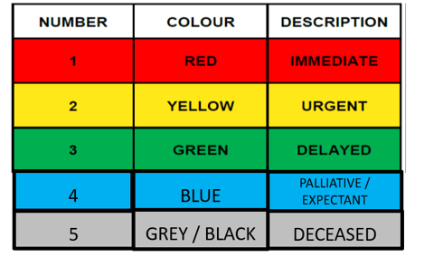
Priorités de triage
Priorité de triage déterminée en fonction des paramètres de triage
  Permets une classification clinique rapide
Cours H.E.L.P.
Notes:
Priority 1 - Immediate
· Casualties who require immediate life saving interventions. These are time critical
casualties. (High priority transport & continuous observation/ monitoring)
Priority 2 – Urgent
· Casualties who are stable, but have significant potential to deteriorate. (Urgent transport & monitor for decompensation)
Priority 3 - Delayed
· Walking (sieve) or stable/minor injuries (sort). (Transport only if needed/when available. Refer to designated low acuity area)
Other colours used are grey for deceased patients and blue for patients who will be treated with palliation – determining patients for palliation is not usually done prehospital.
Emphasise that patients are placed in triage priorities using a triage tool. There are multiple examples and we will look at some of them. Ensure that if the context uses a particular mass casualty triage tool that this is put into the presentation and AFTER showing some of the alternatives then this can be the one that is used for the exercises including the table tops / EMERGO and the full scale simulations.

Slide 23
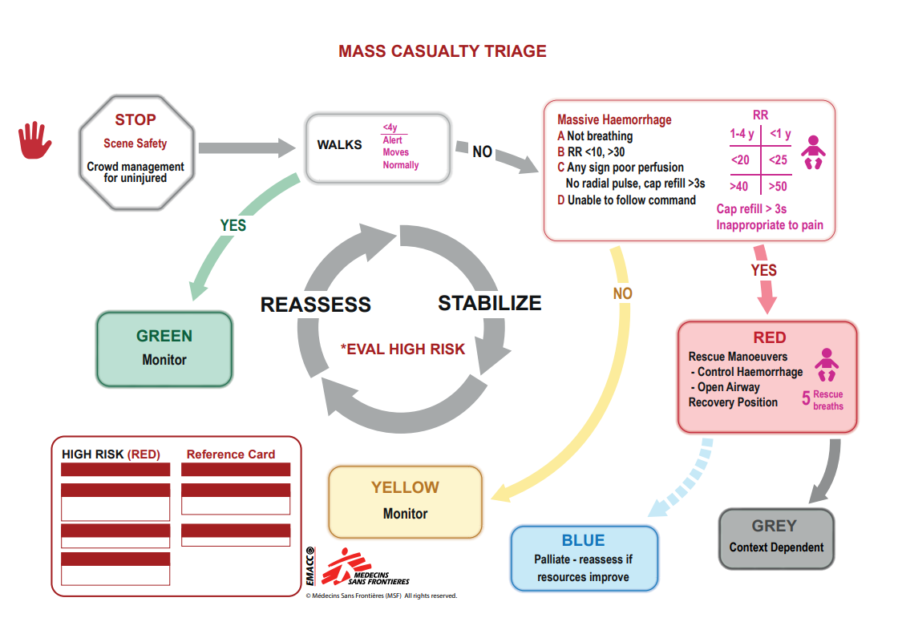
Outils de triage en cas de SMV
Cours H.E.L.P.
Notes:
Emphasise there are different triage systems available. The course should identify what is the agreed tool in their area /country and use that. If they don’t have one then one of the following could be utilised.

Slide 24
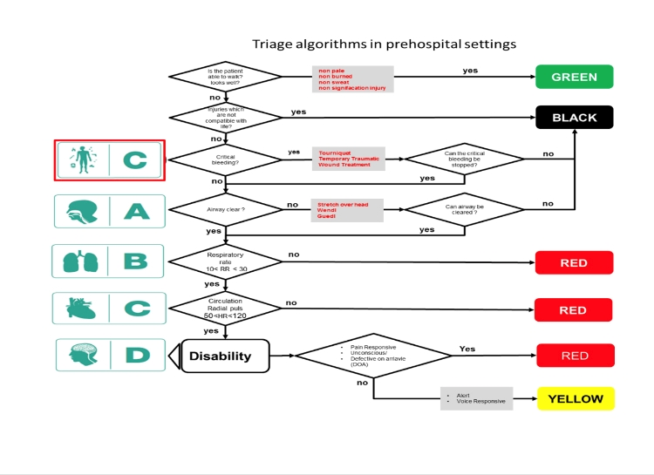
Paramètres de triage en Jordanie, PETRA
Outils de triage en cas de SMV
Cours H.E.L.P.

Slide 25
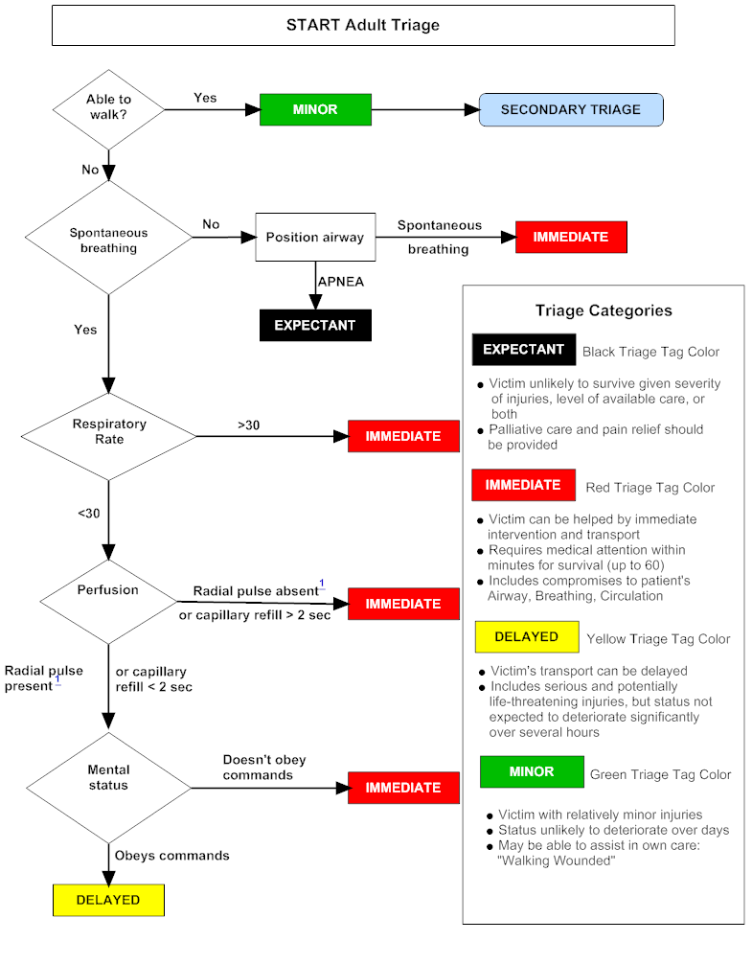
Triage START : exercices pratiques
Cours H.E.L.P.

Slide 26
Exercices pratiques de triage
Personne blessée n^{O} 1
- Amputation traumatique incomplète de la jambe gauche
- Fracture ouverte de l’avant-bras droit
START
Ne se tient pas debout
Respiration : oui
Fréquence respiratoire : 20/min
Pouls radial : non perçu
RÉPONSE
Envisager un garrot
Cours H.E.L.P.

Slide 27
Exercices pratiques de triage
Personne blessée n^{O} 2
Blessure pénétrante à l’abdomen
Hémorragie externe +
START
Ne se tient pas debout
Respiration : oui
Fréquence respiratoire : 26/min
Pouls radial : non perçu
RÉPONSE
Cours H.E.L.P.

Slide 28
Exercices pratiques de triage
Personne blessée n^{O} 3
Fracture ouverte du fémur droit
Blessure au crâne
START
Ne se tient pas debout
Respiration : oui
Fréquence respiratoire : 16/min
Pouls radial : perçu
État de conscience : répond aux commandes
RÉPONSE
Cours H.E.L.P.

Slide 29
Exercices pratiques de triage
Personne blessée n^{O} 4
Blessure à la tête
START
Ne se tient pas debout
Respiration : ne respire pas
Positionnement des voies respiratoires : apnée
RÉPONSE
Code noir
Cours H.E.L.P.

Slide 30
Exercices pratiques de triage
Personne blessée n^{O} 5
Contusion au poignet gauche
Plusieurs écorchures au visage et au torse avec hémorragie externe modérée
START
Patient debout
RÉPONSE
Cours H.E.L.P.

Slide 31
Exercices pratiques de triage
Personne blessée n^{O} 6
- Blessure abdominale, avec éviscération (anses intestinales sorties)
START
Ne se tient pas debout
Respiration : oui
Fréquence respiratoire : 20/min
Pouls radial : perçu
État de conscience : répond aux commandes
RÉPONSE
Ayez à l’esprit que, en temps normal, il s’agit d’un patient rouge.
Cours H.E.L.P.

Slide 32
Exercices pratiques de triage
Personne blessée n^{O} 6
- Blessure abdominale, avec éviscération (anses intestinales sorties)
START
Ne se tient pas debout
Respiration : oui
Fréquence respiratoire : 20/min
Pouls radial : perçu
État de conscience : répond aux commandes
RÉPONSE
Ayez à l’esprit que, en temps normal, il s’agit d’un patient rouge.
Cours H.E.L.P.

Slide 33
Exercices pratiques de triage
Personne blessée n^{O} 7
Blessures thoraciques suite à un accident de la route
START
Ne se tient pas debout
Respiration : 35/min
RÉPONSE
Cours H.E.L.P.

Slide 34
Exercices pratiques de triage
Personne blessée n^{O} 8
Blessure importante à la joue gauche, avec perte de peau et déchirure musculaire
Faible hémorragie
START
Ne se tient pas debout
Respiration : 18/min
Pouls radial : perçu
État de conscience : répond aux commandes
RÉPONSE
Cours H.E.L.P.

Slide 35
Exercices pratiques de triage
Personne blessée n^{O} 9
Aucune blessure apparente suite à un accident de la route
START
Ne se tient pas debout
Respiration : 20/min
Pouls radial : perçu
État de conscience : ne répond pas aux commandes
RÉPONSE
Cours H.E.L.P.

Slide 36
Exercices pratiques de triage
Personne blessée n^{O} 10
Blessure à la tête
START
Ne se tient pas debout
Respiration : ne respire pas
Repositionnement des voies respiratoires : respiration
RÉPONSE
Cours H.E.L.P.

Slide 37
Divers acteurs dans le domaine médical préhospitalier...
  Témoins...
  Proches, amis...
  Collègues...
  Membres de la communauté…
  Premiers intervenants, secouristes...
  Armée... Ou autres groupes armés...
  Police... Ou autres forces de sécurité...
  Pompiers... Ou équivalent communautaire...
  Défense civile... Ou « services » communautaires...
  Services d’ambulances...
  Autres (transport ferroviaire, aérien, etc.)
Cours H.E.L.P.

Slide 38
Composantes d’un plan d’urgence en cas de situation à multiples victimes
Approche interinstitutionnelle
Rôles et responsabilités (prise de décision, responsable du triage, liaison avec d’autres instances)
Système de communication et coordination pré-établi
Mobilisation des ressources
Équipement et fournitures
Protocoles de triage afin de permettre en priorité aux patients qui peuvent guérir de recevoir et de rationner les ressources
Réseau relationnel de l’hôpital ; coopération entre services civils et militaires
Gestion des foules (éléments culturels : souvent difficile)
Médias
Sécurité et bien-être du personnel
Formation et répétition du plan d’urgence en cas de SMV
Cours H.E.L.P.
Notes:
There must be a pre-established communication system between the emergency services and pre-hospital services but also the community and hospital. Keep in mind that prehospital services can vary from well-staffed and equipped teams to First Aid volunteers
Triage: Do the best for the most

Slide 39

Questions
Cours H.E.L.P.

