Slide 1
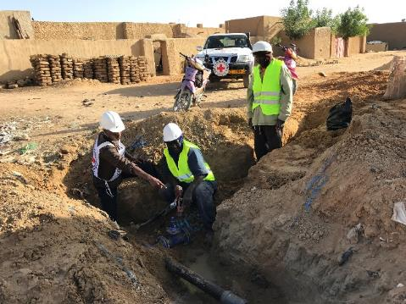
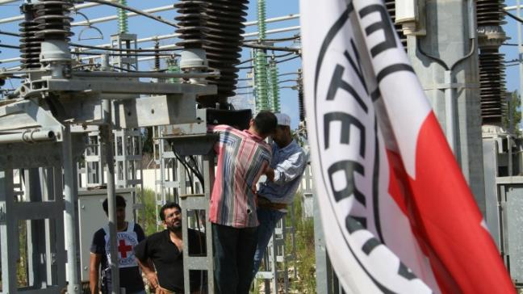
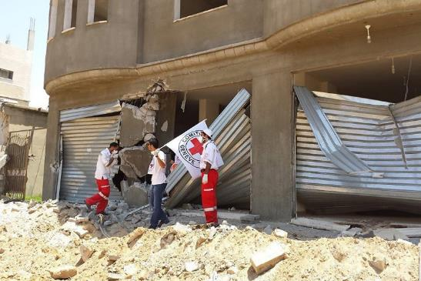
Logo de l’organisation de l’intervenant·e
Ingénierie de la santé publique en milieu urbain
Ces supports pédagogiques ont été créés par les collègues de l’équipe Eau et habitat
Nom(s) de l’intervenant·e + organisation(s)

Slide 2
Objectifs
Savoir
expliquer la portée et l’amplitude de l’urbanisation, ainsi que les caractéristiques et vulnérabilités des services essentiels en milieu urbain
discuter des difficultés liées aux interventions humanitaires en milieu urbain
présenter une réponse adaptée à la perturbation des services essentiels dans un contexte donné et la justifier

Slide 3
Ingénierie de la santé publique en milieu urbain
Définitions
Le défi urbain
Services publics essentiels
Conséquences d’une crise prolongée
Une approche en évolution

Slide 4
Le défi urbain
?
Quelles sont les spécificités des conflits en milieu urbain ?

Slide 5
Le défi urbain
Touchent de vastes populations
Touchent des infrastructures complexes et importantes
Nature prolongée de ces conflits
Dégradation des services publics
Réponse humanitaire inadaptée aux contextes urbains
Notes:
The world is getting more urban and the conflicts also. Some 50 million people worldwide are affected by armed conflicts in urban areas. In addition, it is also estimated than 80% of displaced people find refugee in urban areas. On top of that, there is a sharp increase of protracted conflicts all around the world resulting in an unprecedented level of humanitarian needs.
Protracted conflicts in urban area is a challenge for humanitarian response. Indeed, humanitarian approach has been mainly designed to address needs in camps or rural contexts. There is a lack of expertise and knowledge for urban settings. In addition, current funding mechanisms and programming, both mainly on yearly basis, are not adapted to respond to humanitarian crisis due to protracted armed conflicts.

Slide 6
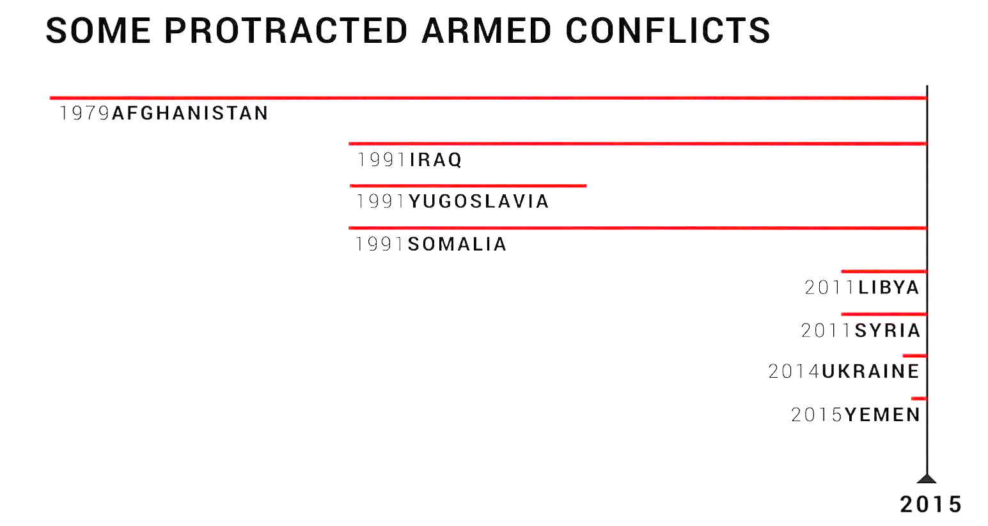
Le défi urbain : durée prolongée
Notes:
The average length of time the ICRC has been present in the countries hosting its ten largest operations is more than 36 years.

Slide 7
Le défi urbain : définition
Définition humanitaire du milieu urbain :
« Zone dans laquelle résident des personnes civiles vulnérables aux dérèglements des services essentiels et le réseau d’éléments nécessaires à ces services. »
Notes:
Urban areas are undoubtedly complex and so is its definition… Tokyo and a village of 2’000 people in Angola are officially classified as “urban”
There is clearly no agreed definition of the term. Definitions of “urban” are normally based on population density and/or a geographic area defined by municipal authorities.
→ In this course, we adopt a different approach, we propose that for humanitarian action, Urban context should be defined as the area within which civilians vulnerable to disruptions in essential services reside and the network of components supporting those services.

Slide 8
Le défi urbain
Vidéo :
Facing urban Challenges
(Faire face aux défis urbains)
(en anglais, 6 min 21 s)
https://www.icrc.org/en/document/water-and-habitat-facing-urban-challenges
Notes:
Humanitarian response in urban areas is major challenge of today’s humanitarian crisis. In order summarize this introduction on urban contexts, let’s watch the following animation that summarize key messages of this video and introduce you the topics of the next ones.

Slide 9
Services essentiels : les principaux éléments
?
Quels sont les trois éléments principaux nécessaires au fonctionnement des services essentiels ?

Slide 10
Services essentiels : les principaux éléments
La prestation de services ne se résume pas à l’infrastructure !
Notes:
Essential urban services are understood to be those services that are vital to ensure the subsistence of the civilian population, including electricity, health, water, wastewater treatment and solid waste disposal. All urban services require three elements in order to function: people (i.e. service provider staff, private-sector contractors and entrepreneurs), hardware (e.g. infrastructure, equipment, heavy machinery) and consumables (e.g. fuel, chlorine, medicines).
Disruption to an essential service occurs when the functions of any of the critical people, hardware or consumables are compromised. Short-term disruption to a service may not have a major impact on the survival of the civilian population, while its deterioration over the long term pose greater risks.
→ Challenge the understanding of the audience by demonstrating that humanitarian action (for a few humanitarian organizations at least) not only deals with the traditional emergency response, but also in parallel a medium to long term more structured support to municipal service providers.

Slide 11
Services interconnectés
Notes:
As shown this figure, critical components of essential services (e.g. electrical power plants, supply routes, water and wastewater treatment plants) are often located outside the city limits. Very distant active combat can thus have a dramatic effect on urban dwellers.

Slide 12
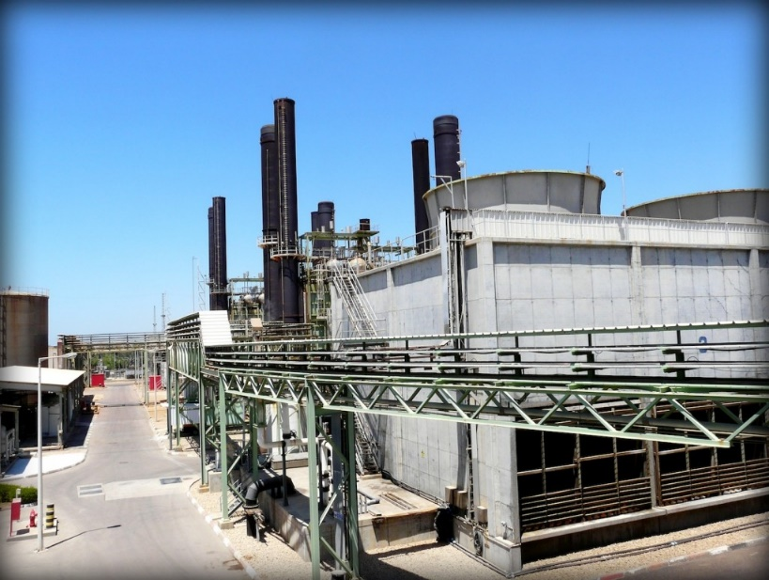
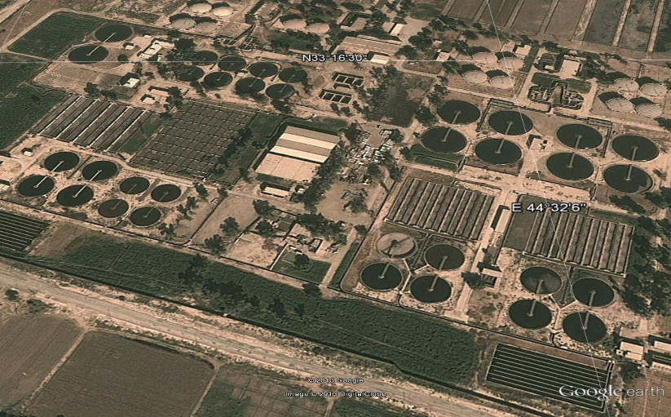
Vulnérabilités en milieu urbain
Dépendance élevée de la population aux services essentiels
Les services essentiels en zone urbaine sont de plus en plus vulnérables, pour plusieurs raisons :
sophistication et complexité
centralisation et chaînes d’approvisionnement longues et exposées
interconnectivité des services essentiels
Les systèmes de service à grande échelle impliquent de lourdes conséquences en cas d’interruption
Densité et diversité des communautés et structures de gouvernance (autorités locales)
Centrale thermique, Gaza
Usine de traitement des eaux
usées de Rustamiyah, Bagdad
Notes:
Urban areas are very complex entities characterized by a number of features which result in their residents being particularly exposed and vulnerable to armed conflicts:
The main vulnerability of people in urban contexts is their reliance on essential services. The services are beyond the technical capacity and the direct physical control of the residents. It affect the resilience of the inhabitants
These essential services consist of sophisticated, often centralized, large scale infrastructure which rely on the availability of specialist expertise, potentially fragile governance structures and complex logistic.
Many essential services depend on others to function. For example, the quality of health services is dependent on potable water and a reliable power supply, for example. Groundwater can also be contaminated by improperly maintained landfill sites. Most services also depend on electricity supply and the associated resources.
Another factor affecting the vulnerability is the scale. Because of the relatively large spatial scale of urban contexts, disruption to an essential service can have a large-scale impact. The destruction of a single power line can result in an electricity blackout across an entire neighborhood (comprising 200,000 people, for example).
Finally, densly populated urban areas are not only at greater risk from epidemics, the diversity of communities can also result in clashes along opposing political, sectarian or tribal lines or across municipal political borders as well as with authorities.

Slide 13
Conflits armés en milieu urbain : impact
Animation vidéo :
Explosive weapons in populated areas: the consequences for civilians
(Armes explosives en zone habitée : conséquences pour les populations civiles)
(en anglais 1 min 49 s)
https://www.icrc.org/en/document/explosive-weapons-populated-areas-consequences-civilians
Notes:
Humanitarian response in urban areas is major challenge of today’s humanitarian crisis. In order summarize this introduction on urban contexts, let’s watch the following animation that summarize key messages of this video and introduce you the topics of the next ones.

Slide 14
Services essentiels : types d’impacts
?
Quels sont les types d’impacts liés à la perturbation des services essentiels ?

Slide 15
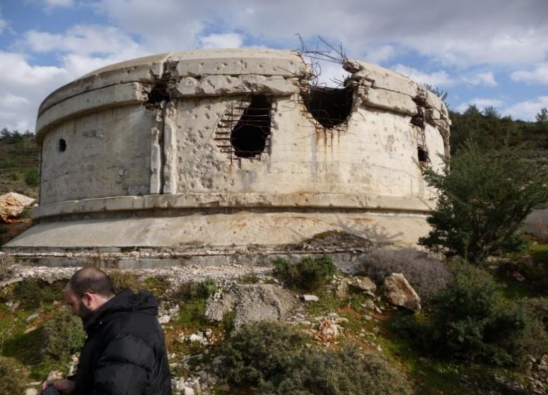
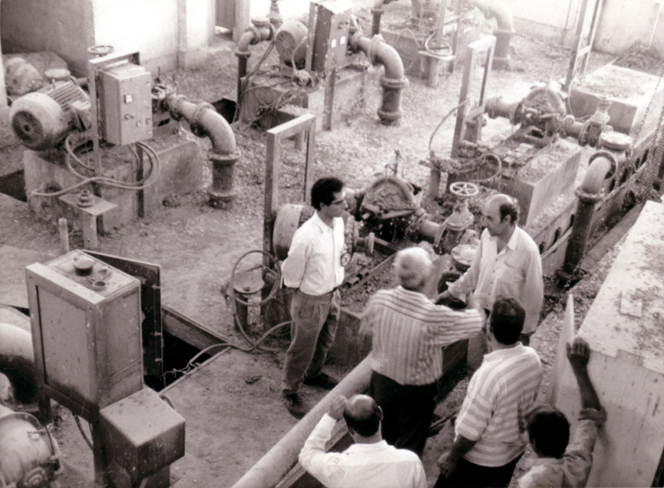
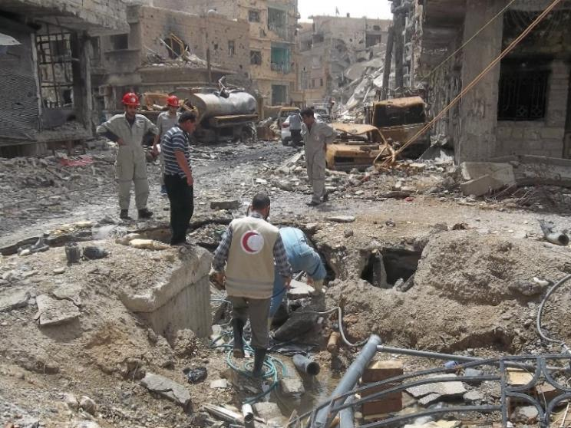
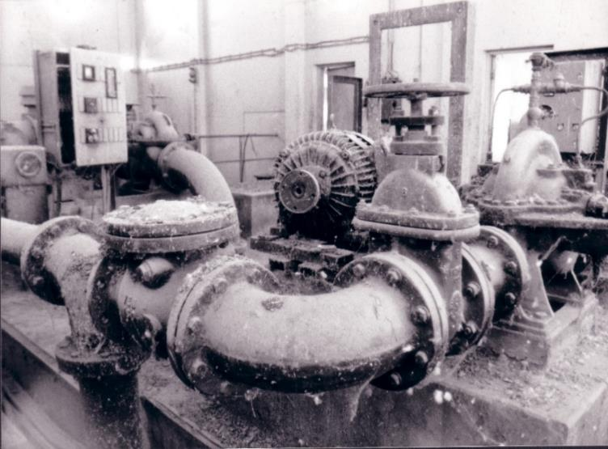
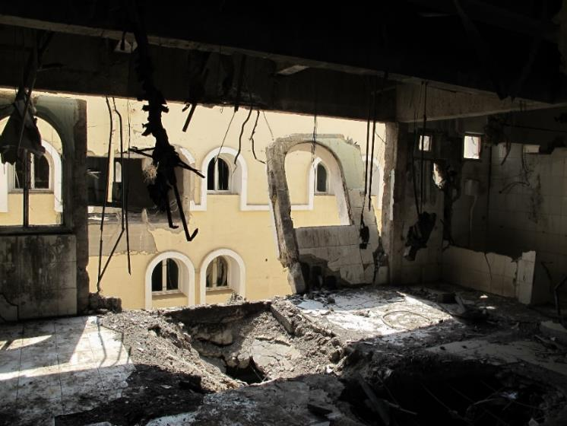
Types d’impacts
IMPACT DIRECT
IMPACT INDIRECT
Impact direct
Impact indirect
Effets cumulatifs
La combinaison d’impacts directs et indirects entraîne des effets cumulatifs.
Notes:
Protracted conflicts have different types of impacts on urban essential services:
The direct impact which is the immediate and physical impact caused directly by armed conflict, such as damages to essential urban infrastructure,
And the indirect impact which derives from direct impact, affecting an associated component of a system, usually in the short to medium term. An example is the “brain drain” that occurs following attacks on staff.
→ These impacts can accumulate over time, resulting in cumulative impact, for example, in a lack of maintenance planning due to insufficient long-term staffing.
Let’s see more into details how theses different types of impacts affect the three critical elements of essential services

Slide 16
Impact sur le matériel
Notes:
Destruction of or damage to infrastructure and equipment is an example of direct impact on hardware. However this pictures does not illustrate a direct impact, but an indirect one. Indeed, this pipe is leaking not because of explosive munitions, but due to the coping mechanisms of people affected. The inhabitants were no longer supplied by the main network and they made holes in the nearest pipes in order to have access to water. Sometimes coping mechanisms from inhabitants can result in negative effect on public health.

Slide 17
Impact sur le matériel
Notes:
Another example of indirect impact on critical hardware is this water pumping station In that case, functional equipment were removed gradually by water utility staff to a more crucial part of the system to respond to an emergency. As a result, this water pumping was rendered completely inoperable. We call this phenomena cannibalization of critical hardware components.

Slide 18
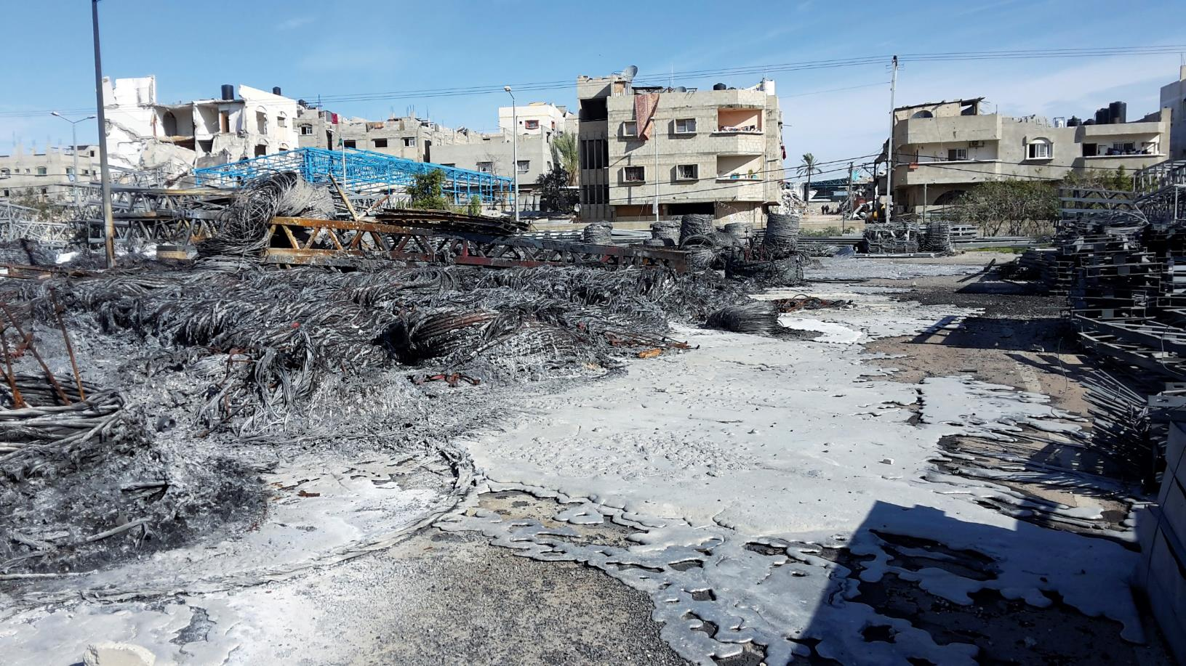
Impact sur les consommables
Notes:
Direct impact on critical consumables is related primarily to their destruction such as in the picture of the destruction of a warehouse of an electrical utility following a bombing. As a result, the electrical company lost its capacity to react to breakdowns

Slide 19
Impact sur les consommables
Notes:
Looting of water or electricity providers’ warehouses is a classic example of indirect impact on critical consumables as we can see here in the picture of a looted water treatment plant.

Slide 20
Impact sur les gens
Notes:
One of the obvious direct impact on people is the casualties among essential staff due to the conflicts. As a result, there are fewer staff reporting to work and fewer staff willing to go the field to conduct routine operation and maintenance work.
Another direct impact on people is the poor or complete lack of access to a service component. Here an example of ICRC providing secured access to municipal workers in order to perform emergency repairs.
An indirect impact of on critical people occurs when armed conflict and sanctions (or embargoes) begin to affect a country’s economy. It often results in staff salaries being reduced or delayed. As a consequence, staff services then resign or loose motivation reducing the likelihood of routine operation and maintenance from being carried out

Slide 21
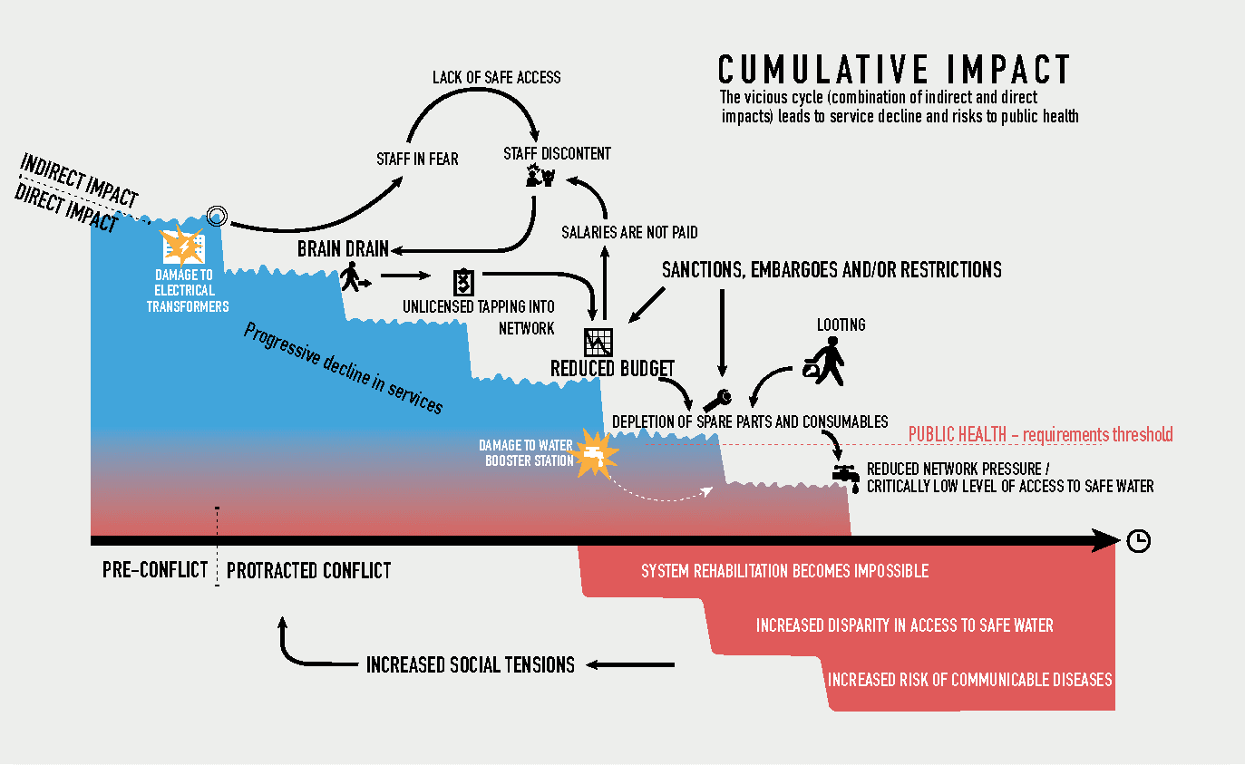
Effets cumulatifs
Notes:
Cumulative impact is the long-term deterioration in the performance of essential services through
incremental direct and indirect impacts on one or more of the critical components of essential services
Cumulative impact on essential services can be seen as a vicious cycle influenced by direct and indirect impacts. The accumulation ultimately affects public health and may contribute to the very conflict which created it. The cycle of impacts therefore lies within the cycles of conflict that characterize complex emergencies.

Slide 22
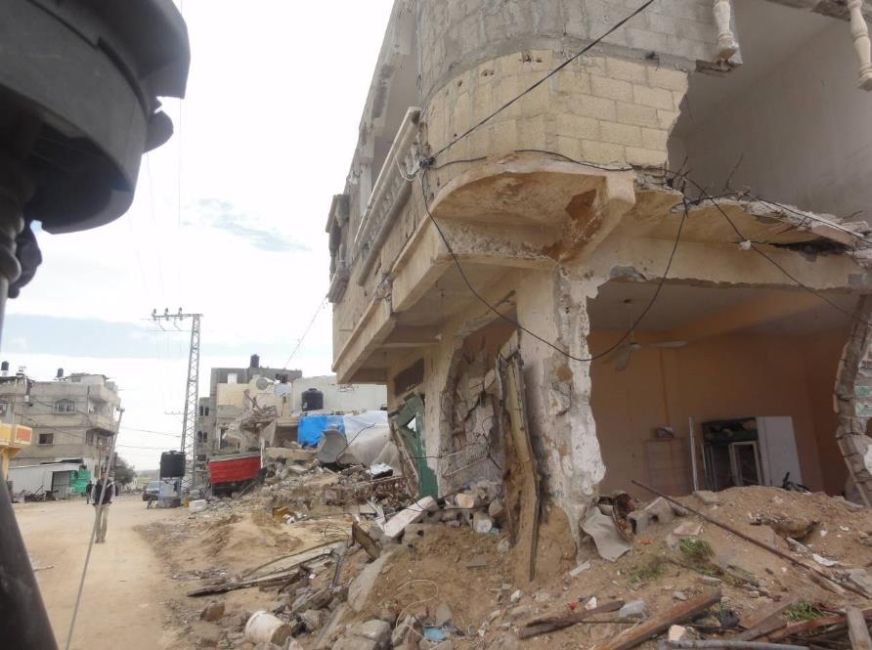
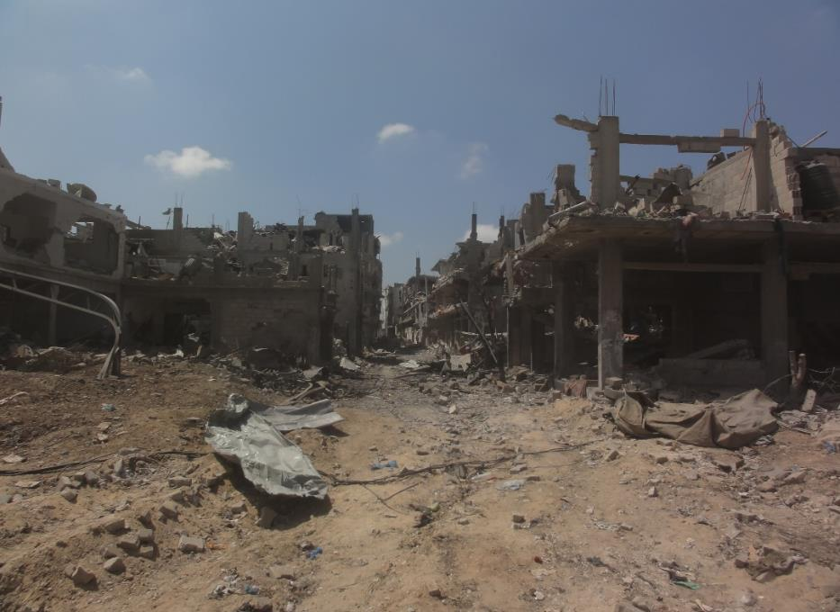
Conséquences humanitaires : déplacement
La destruction des zones résidentielles et l’érosion des services publics peut entraîner des déplacements de populations qui exacerbent à leur tour les tensions sur les services urbains et les ressources naturelles ailleurs.
Échelle de destruction :
au niveau du foyer
Échelle de destruction :
au niveau du quartier

Slide 23
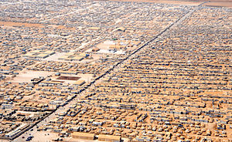
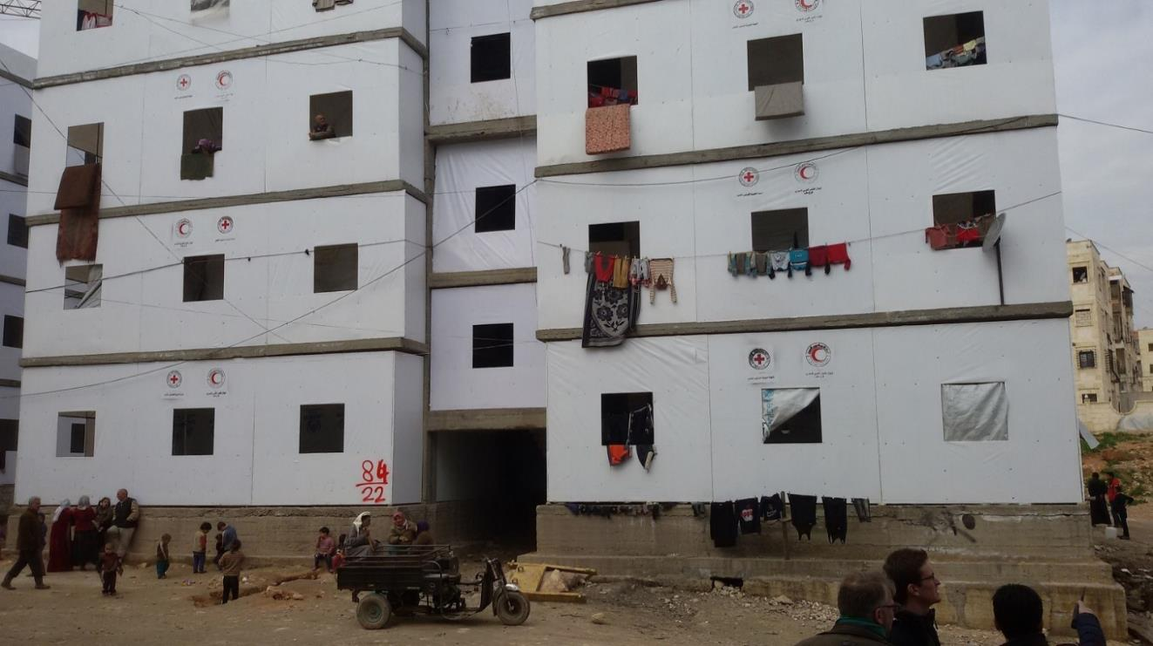
Conséquences humanitaires : déplacement
Déplacement – vers des communautés hôtes
Déplacement – vers des installations communautaires
Déplacement – vers des camps
Notes:
The cumulative impact of protracted urban crises and the associated erosion of public services, often lead to displacement, be it to host communities, communal facilities or camps.

Slide 24
Conséquences humanitaires : santé publique
Notes:
The cumulative impact of protracted armed conflict on public health is much more difficult to track than its impact on the quality of coverage of any essential service.
Even a short disruption to the drinking water supply (as might be expected at the start of the hostilities) can greatly increase the probability of infection from diseases already present in the environment if the quality of the service was originally reliable.
As people’s immunity builds up with repeated disruptions to the water service, it is difficult to generalize the impact that any disruption would have on general health of the population.
However, the risk of a sustained increase in the incidence of endemics diseases is enhanced as the conflict drives more people and strains of illness into the city, particularly when the movements of people are coupled with poor general treatment of water and wastewater and incomplete immunization campaigns.

Slide 25
Conséquences humanitaires
Animation vidéo :
From ruins to rebuilding_Helping Syrians regain hope for their future
(Des ruines à la reconstruction_Aider la population syrienne à retrouver l’espoir pour l’avenir)
(en anglais, 1 min 08 s)
https://www.icrc.org/en/document/ruins-syria-war-fighting-rebuild
Notes:
Humanitarian response in urban areas is major challenge of today’s humanitarian crisis. In order summarize this introduction on urban contexts, let’s watch the following animation that summarize key messages of this video and introduce you the topics of the next ones.
(SARC Homs Branch WATSAN Video)

Slide 26
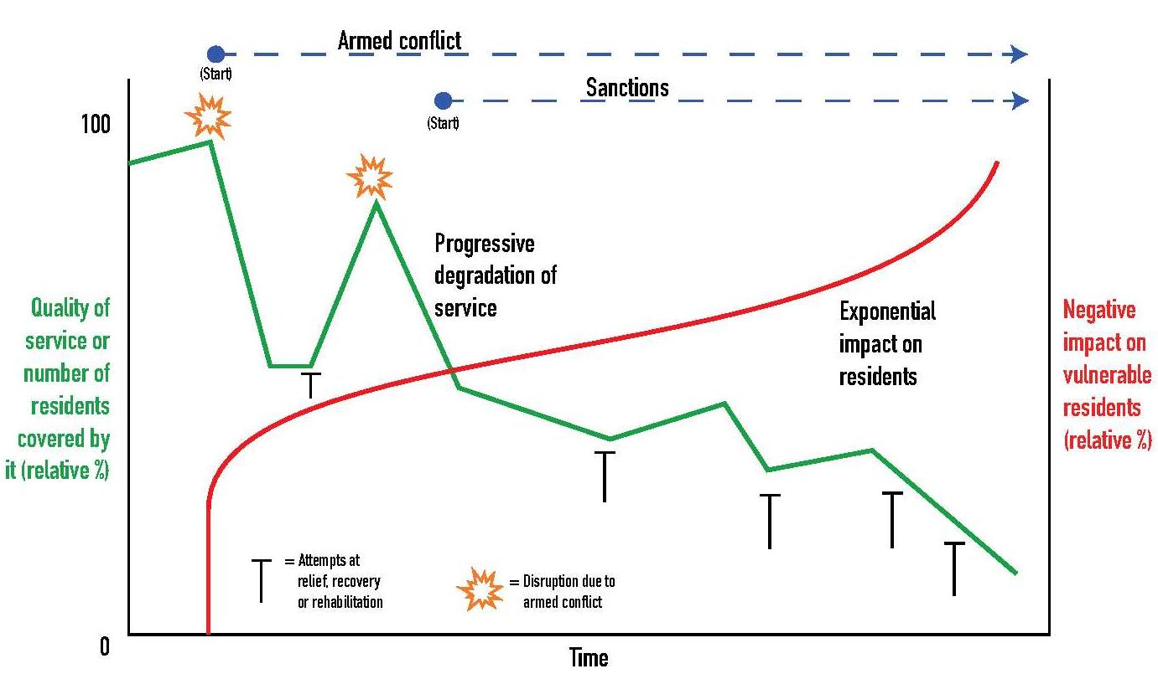
Conséquences humanitaires
Notes:
The challenge of maintaining essential services in urban contexts subject to protracted armed conflict is conceptualized here.
While the quality of the service decreases cumulatively over time, as a result of direct and indirect impacts, the impact on residents increases exponentially.
Unfortunately, the humanitarian approach is traditionally geared towards “simple” short-term interventions (fire-fighting approach), like e.g. water trucking, rather than sustainable rehabilitation. Reparation of large scale systems is often too costly and complex for humanitarian agencies and municipalities, especially if the systems have been eroded over time, through cumulative impacts.

Slide 27
Élaborer une approche plus efficace
?
Comment modifier l’approche pour mieux répondre aux difficultés spécifiques aux conflits urbains ?
Notes:
We have seen the extent and nature of the impact of the deprivation of urban services during times of armed conflict. It is clear that there is need for a move from traditional assistance paradigms to one that takes into account of the longer-term realities and needs in urban areas affected by ongoing armed conflict.
→ How would you suggest a way forward to best meet the challenges and to ensure the right response in the right place at the right time. So the main objective is to discuss the relevance of humanitarian response to essential urban services disruption in protracted conflicts.

Slide 28
Services urbains lors de conflits armés :
une approche en évolution
1.) Passer d’une pratique humanitaire réactive à une pratique proactive :
introduire des programmes et financements pluriannuels
renforcer la collaboration et le soutien structurels à long terme avec les acteurs locaux et la population locale (action humanitaire neutre, indépendante et impartiale, NIIHA)
2.) Renforcer la capacité de réponse :
capacité et compétences techniques (p. ex. alimentation électrique, eaux usées, etc.)
renforcer la capacité logistique (contrats inclus).
3.) S’attaquer aux causes profondes ainsi qu’aux conséquences :
promouvoir le respect du DIH afin d’empêcher l’utilisation d’armes de destruction massive en milieu urbain (protection des infrastructures)
4.) Revoir le paradigme du spectre urgence-réhabilitation-développement :
collaboration et échange de savoir-faire entre les protagonistes humanitaires et de développement
Notes:
Donors should reconsider their funding schemes to ensure that they match the scale and duration of the challenge. Relief, rehabilitation and development efforts will be much more expensive and take far longer if humanitarian agencies in coordination with local service providers are unable to mitigate the consequences of indirect and cumulative effects. Twelve-month funding designed for disaster relief or very short conflicts are not adequate to stabilize or restore essential urban services in protracted armed conflicts. To appropriately address the complexity of essential urban services during protracted armed conflicts, larger budgets that cover a longer period are needed
Essential services rely on three critical components (people, hardware and consumables,). Experience tends to show that, of all the components of an essential service, “people” may be the most crucial. Effective partnerships with local authorities and service providers become indispensable in complex urban environments, much more than for rural areas where people can organize themselves around less sophisticated services.
It is widely accepted that including beneficiaries in the conception, implementation and management is vital to the effectiveness, as well as to the sustainability, of any intervention. However, “community involvement” in urban areas is very different from the common understanding based on rural experience. Working with local people to repair or rehabilitate essential services in urban contexts also poses some particular challenges. Humanitarian assistance should not focus only community based approach assistance. It is arguably more beneficial to restore water to an entire neighborhood (by repairing the transmission line), for example, than to assist household-level coping mechanisms.
International humanitarian law (IHL) offers a degree of protection. However, while IHL protects all service components from the direct impact of armed conflict, there are specific challenges arising from its interpretation and application in urban warfare, in particular the extent to which IHL provides protection against the indirect or cumulative impact of hostilities on essential services. The ICRC is actively seeking to address some of these challenges, in particular through its work on the use of explosive weapons in populated areas.
The distinctions between the stages of relief-rehabilitation-development response are not necessarily relevant in urban context. Multiple types of programme may be required simultaneously in the same city. For instance, in 2010 in Bagdad, ICRC interventions covered the full spectrum; for example, large hospital and wastewater infrastructure rehabilitation projects were established to support the government’s long-term development plans, alongside basic maintenance of existing health and water facilities (which could be labelled “reconstruction”) and water-trucking programmes to informal settlements of IDPs – typical “relief” activity.

Slide 29
Conclusion : ingénierie de la santé publique en milieu urbain
Pour fonctionner correctement, les services urbains nécessitent du matériel, des consommables et des personnes.
Les services urbains sont de plus en plus vulnérables en raison de leur centralisation, sophistication et interconnectivité.
Puisque les populations urbaines sont souvent nombreuses et que les habitants et habitantes sont particulièrement dépendants des services publics, toute perturbation peut rapidement entraîner des besoins à grande échelle.
Les conflits prolongés en milieu urbain ont des impacts directs et indirects. Les effets cumulatifs de ces conflits provoquent souvent l’érosion progressive et parfois irréversible des services publics.
Parmi les conséquences humanitaires qui en découlent figurent la détérioration de la santé publique et le déplacement de vastes populations.
Afin de répondre aux défis spécifiques soulevés par les conflits urbains prolongés, l’approche humanitaire doit devenir plus proactive et s’orienter sur le long-terme. Il faut également promouvoir le DIH et la collaboration avec les acteurs du développement.

Slide 30
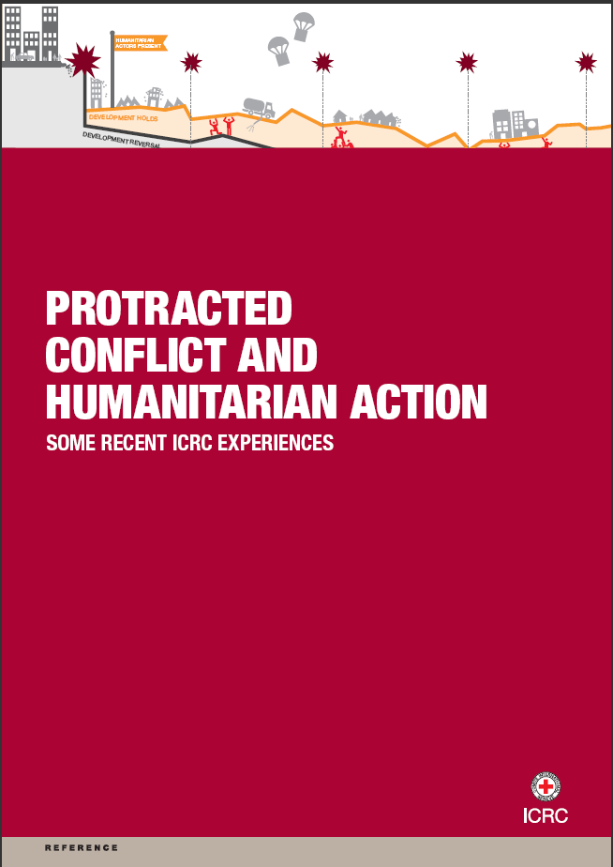
Documents de référence
Il est nécessaire d’approfondir les recherches.
Quelques exemples :
Mesurer l'impact
Études épidémiologiques
Notes:
Finally, more research need to be conducted on the impact of disruptions to urban services on people’s lives over time. One priority area is the need to gain an understanding of how disruptions to services affect people’s livelihoods, food security, human security and health. Many humanitarian agencies have programmes targeting the direct impact of these disruptions but not the indirect or cumulative impact on the broader nexus of interrelated humanitarian issues of concern.

