Slide 1
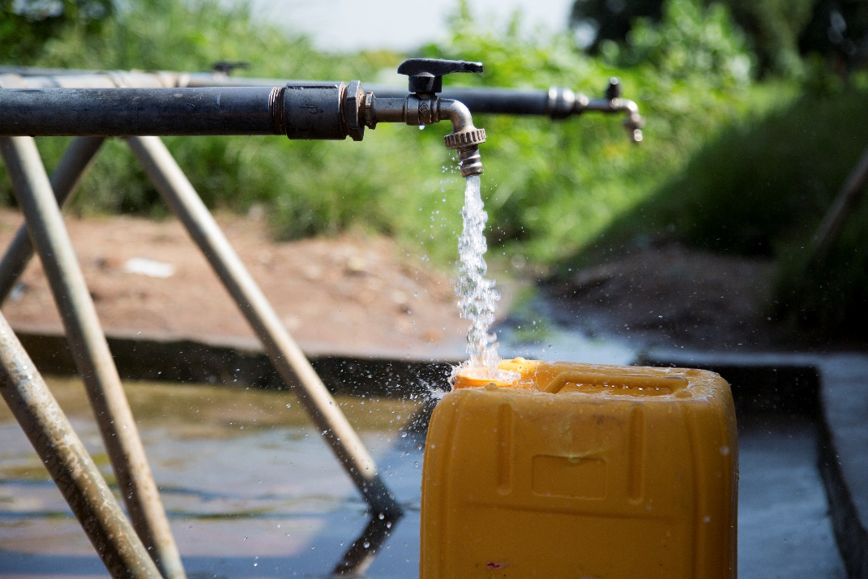
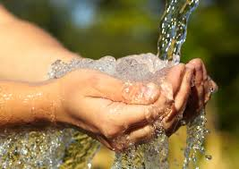
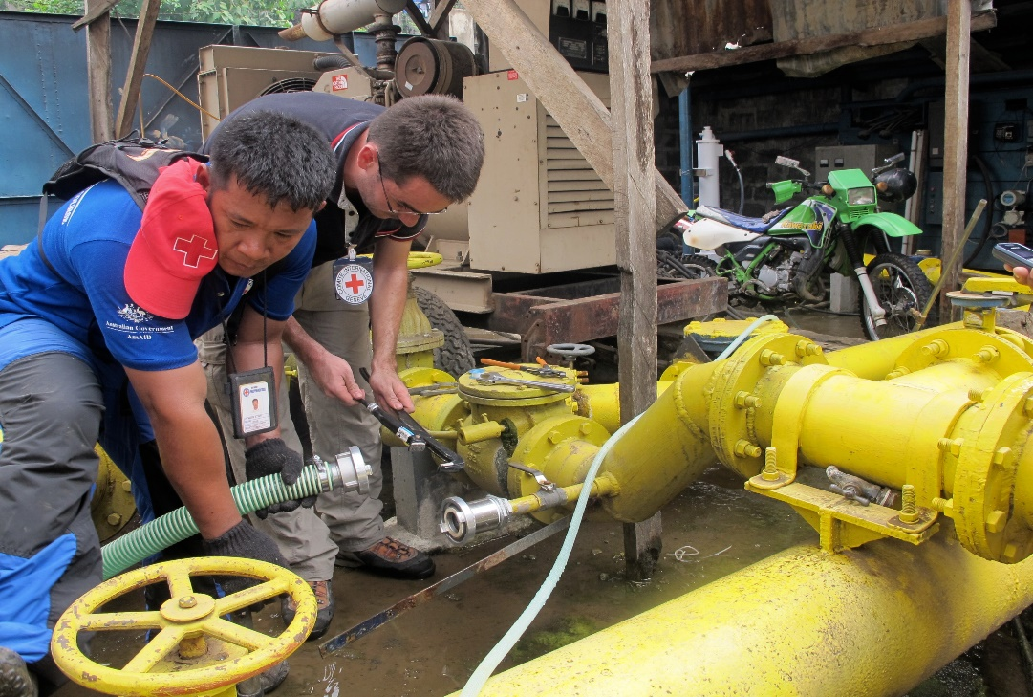
Logo de l’organisation de l’intervenant·e
Eau et santé
Cours H.E.L.P.
Nom(s) de l’intervenant·e + organisation(s)
Ces supports pédagogiques ont été créés par les collègues de l’équipe Eau et habitat
Notes:
During this session, we will introduce you to the topic of public health engineering and see how engineers can have a significant impact to reduce the mortality and morbidity encountered in many humanitarian contexts. You will learn about the link between health and Water, Sanitation and Hygiene, so-called WASH activities.
Engineers in humanitarian assistance should have a good understanding on how communicable diseases are transmitted. This is why you will be introduced to different environmental transmission pathways of diseases and you see some measures to be taken to prevent the spread of some diseases.

Slide 2
Objectifs
Savoir
expliquer les exigences en matière de quantité et de qualité de l’eau
comparer différentes sources d’eau et risques de contamination
recommander un processus de traitement de l’eau fondé sur les indicateurs de qualité de l’eau
analyser les différentes étapes depuis l’approvisionnement en eau jusqu’à la distribution

Slide 3
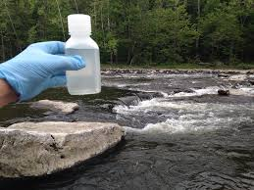
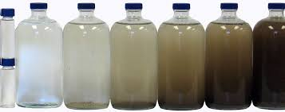
Critères liés à la qualité de l’eau
La qualité microbiologique de l’eau est une préoccupation majeure dans les contextes humanitaires.
→E. Coli/100 ml = 0
Certaines substances chimiques peuvent également être nocives en cas d’exposition prolongée ou immédiate.
→ nitrate, arsenic, fluorure, etc.
Les critères organoleptiques jouent un rôle important dans l’acceptation de l’eau.
→ turbidité ≤ 5NTU
Notes:
Three main criteria are used in WHO guidelines to assess if water is fit for human consumption:
the microbiological quality. It is usually the primary concern in humanitarian contexts, because the presence of some pathogens can cause an acute effect on a large number of people in short term. Therefore, a bad microbial quality represents a high risk of epidemic.
There are thousands of different pathogens, so in order to assess the microbiological quality, we use an indicator of the presence of fecal contamination, the Escherichia coli (E-coli). Iit does not demonstrate the presence of pathogenic organism, although there is a strong suspicion.
Some chemical components occurring in the water supply can also be harmful, they are usually a health concern after a long exposure. The principal exception is nitrate. Chemical contamination can be man-made due to industrial or agricultural activities for instance, but some contaminants can also naturally occurred in the ground. At a global scale, fluoride and arsenic are the most significant chemicals, each affecting perhaps millions of people. However, many other chemicals can be important contaminants of drinking-water under specific local conditions.
Organoleptic criteria are related on how water looked, smell and taste. It is not necessarily because a glass of water is not fully transparent or smell or taste slightly that water is harmful, but organoleptic criteria play an important in the acceptance of the product by the consumer. In a emergency, if people do not trust water quality, they may change to alternative sources which are less safe.
but organoleptic criteria play an important in the acceptance of the product by the consumer. In a emergency, if people do not trust water quality, they may change to alternative sources which are less safe

Slide 4
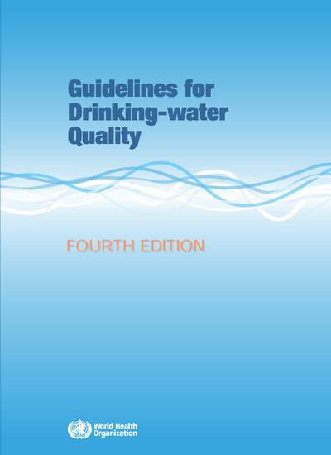
Normes de qualité de l’eau
L’OMS crée des normes internationales sur la qualité de l’eau et la santé humaine sous la forme de lignes directrices utilisées comme base pour les réglementations et l’établissement de normes dans le monde entier
https://www.who.int/water_sanitation_health/publications/drinking-water-quality-guidelines-4-including-1st-addendum/en/
Notes:
In any cases, you must ensure that the quality of water supplied complies with national water quality regulations in the country where you are working. In the absences of recognised national standards, you can refer to the values and recommendations contained in WHO Water Quality Guidelines. These guidelines are available for free in the Internet

Slide 5
??
Quelles sont les limites des tests de qualité de l’eau ?

Slide 6
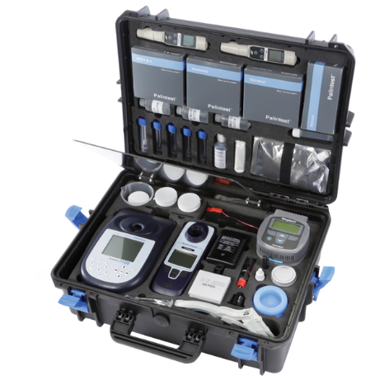
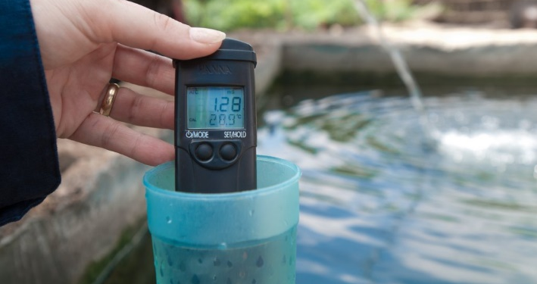
Limites de l’analyse de la qualité de l’eau
C’est une indication qui reflète un instant T
Tous les paramètres ne sont pas faciles à mesurer
Fiabilité des laboratoires
→ Nécessité de procéder à d’autres tests
http://www.who.int/wsportal/wsp/en/
Laboratoire mobile d’analyse
de la qualité de l’eau
Notes:
However be careful with water analysis:
It is only a snapshot which gives single results at a given time and given location. Some parameters can vary strongly: for instance in some contexts turbidity & fecal pollution occurs more often in rainy season
• Some microbial and chemical parameters can be easily measured in the field with specifically designed portable laboratory and equipment, however not all the parameters can be measured like that. Some analysis require specific equipment in laboratory. Also, laboratories are not always reliable.
This is why Complementary investigations are requiered. Local knowledge, including medical information is very valuable. As well as a Good understanding of water resources, through hydrogeological studies for instance
– Finally, sanitary survey and assessment of rsik of contamination are needed.
For further information, you can refer to WHO Water Safety Plans (WSP) which are quite comprehensive

Slide 7
??
Du point de vue de la santé publique,
quelles sont les principales utilisations de l’eau ?

Slide 8
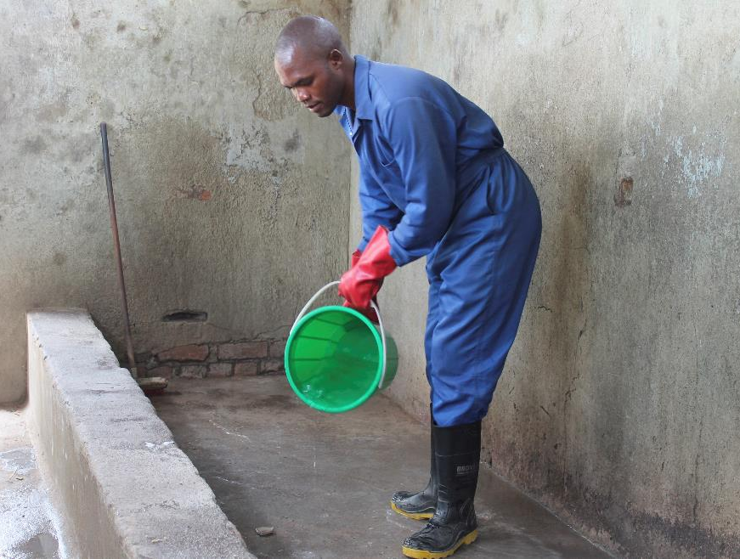
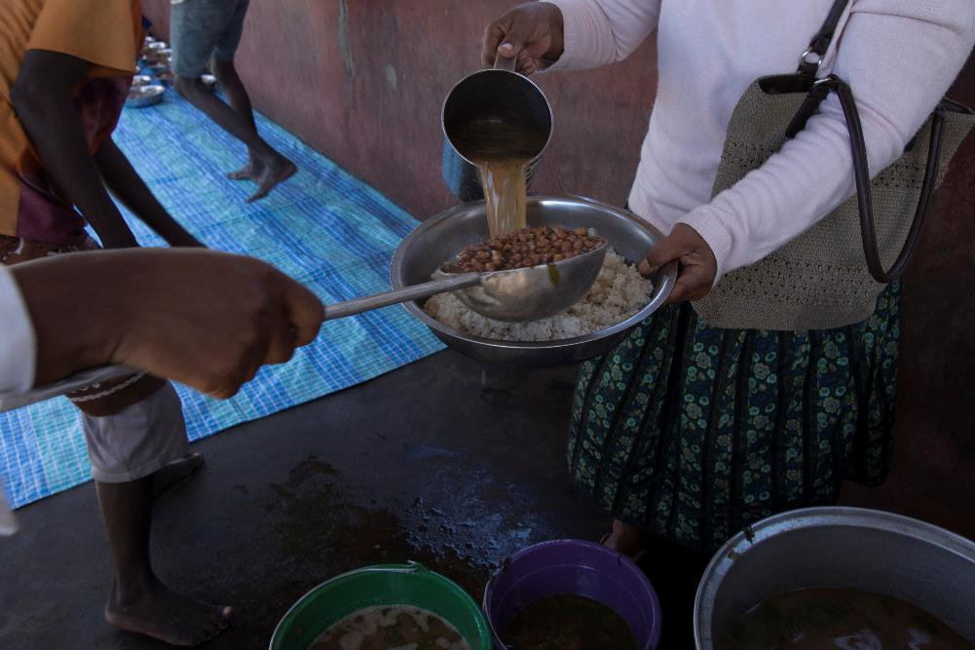
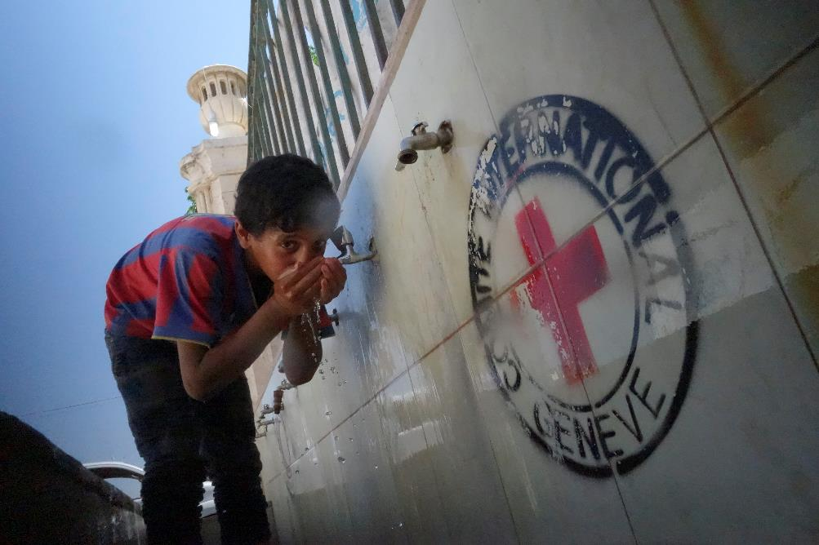
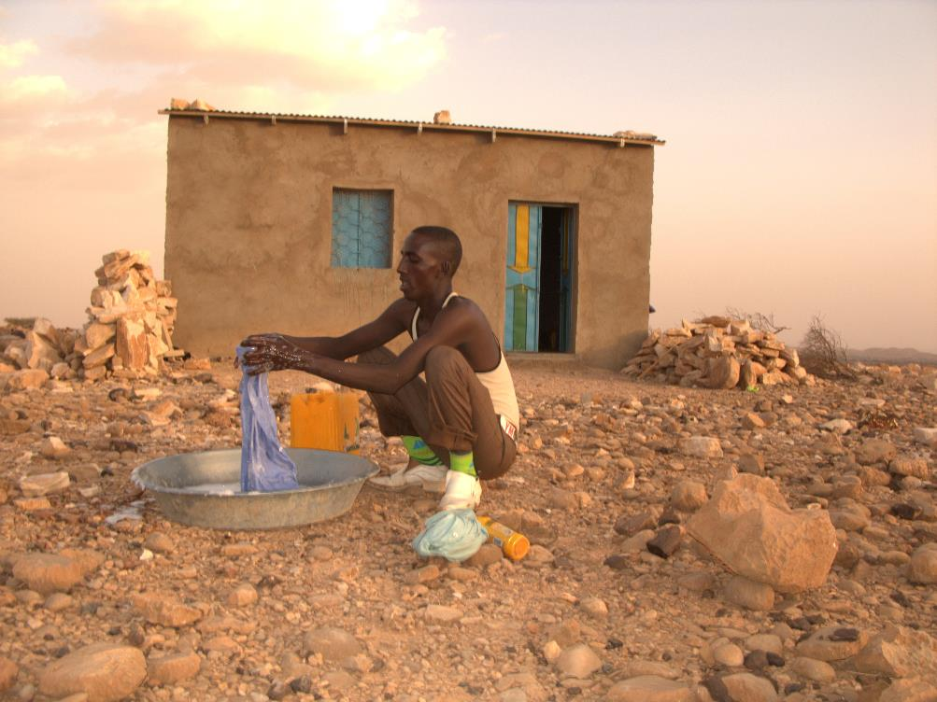
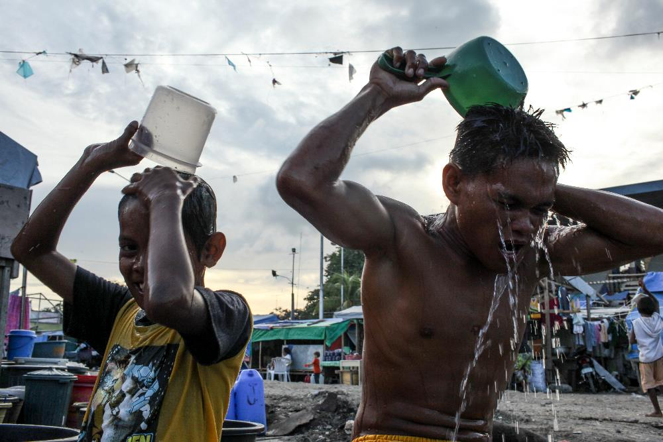
Différentes utilisations de l’eau
Cuisiner
Nettoyer
Boire
Laver son linge
Se doucher
Notes:
If we focus on public health aspects, water is needed for:
Drinking
Cooking
Washing clothes
Cleaning building
Waste disposal (sanitation)
Personal washing

Slide 9
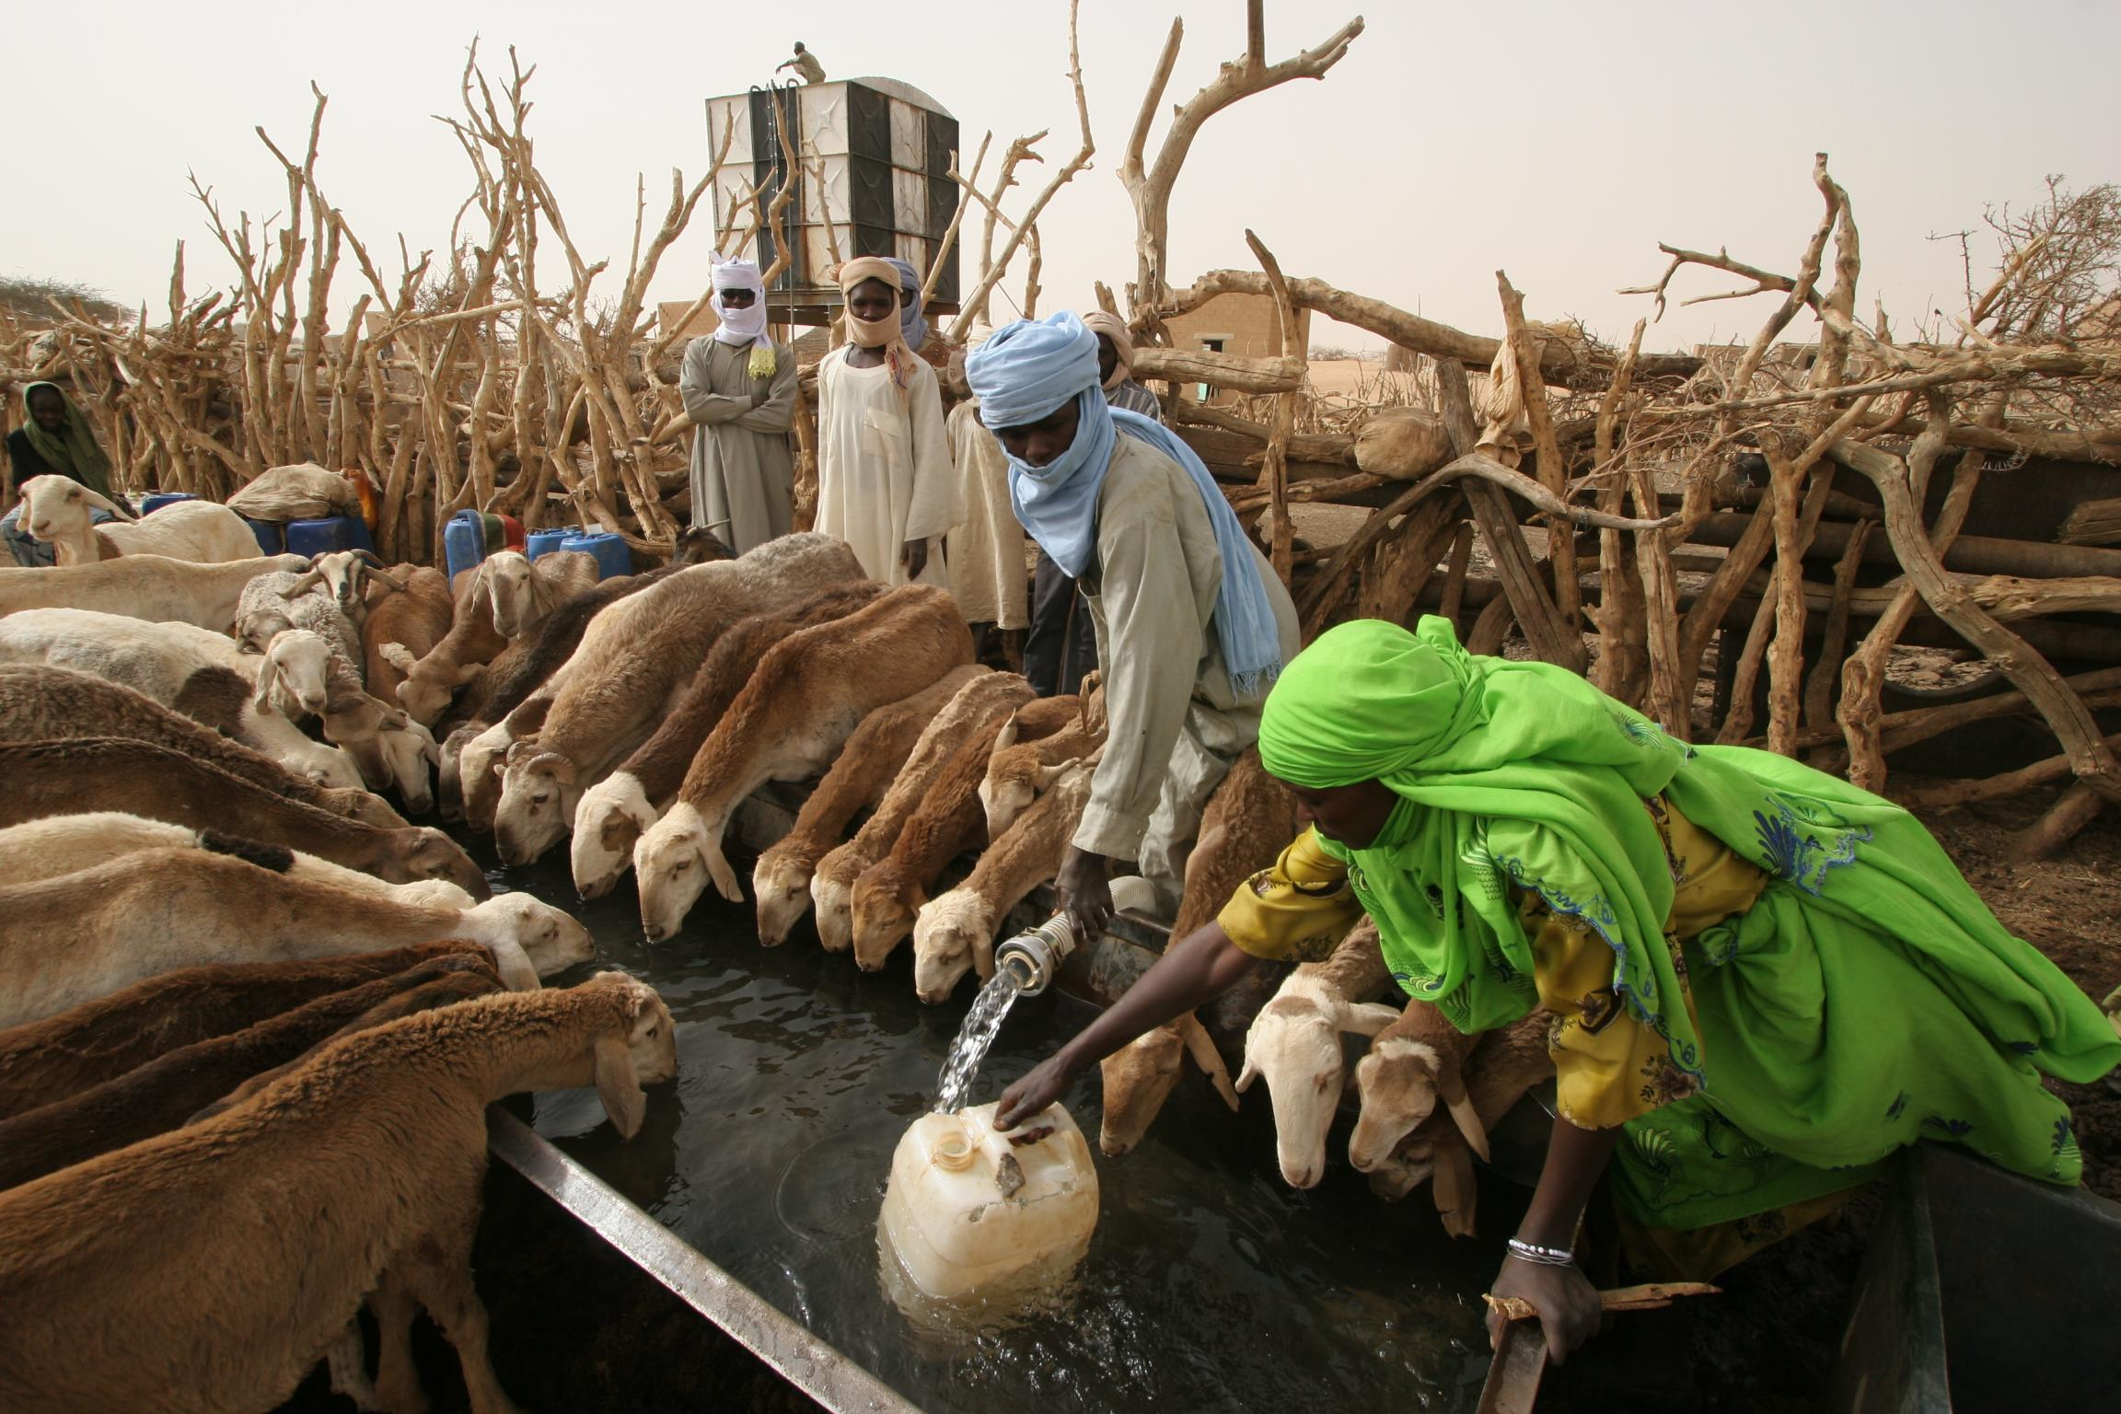
Autres utilisations de l’eau
Notes:
Water is also needed for many other purposes:
Adequate quantity of water can also be crucial to ensure livelihood. Providing water to livestock (as here in Darfur, Sudan) or irrigating plantations allows many people to earn their livelihood and supplies food to the population
Availability of water is also vital for some cultural and religious practices
The list of water uses can be very long and competition for water between these different uses and users exist. It should be taken into account in the assessment of water needs.

Slide 10
??
Quelles sont les normes minimales en matière de quantité d’eau ?

Slide 11
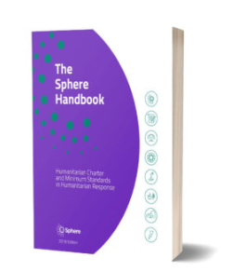
Normes minimales en matière de quantité d’eau
Besoins de survie : consommation d’eau (boisson et nourriture) | 2,5-3 litres/jour | Dépend du climat et de la physiologie de chaque personne
Mesures élémentaires d’hygiène | 2-6 litres/jour | Dépend des normes sociales et culturelles
Besoins élémentaires pour cuisiner | 3-6 litres/jour | Dépend du type de nourriture et des normes socioculturelles
Standards Sphère, 2018
https://handbook.spherestandards.org/en/sphere/#ch006
Notes:
The Sphere movement was started in 1997 by a group of humanitarian professionals aiming to improve the quality of humanitarian work during disaster response.
Initially developed by non-governmental organizations, along with the Red Cross and Red Crescent Movement, the Sphere standards have become a primary reference tool for national and international NGOs, volunteers, UN agencies, governments, donors, the private sector, and many others
*/ According to the Sphere project standards, in humanitarian assistance at least 15 ldp is required for basic survival water needs. It includes:
3 lpd for drinking
6 lpd for basic hygiene practices
6 lpd for cooking
BE CAREFUL! These figures should be considered as a minimum for survival during a very acute emergency and not as a satisfactory situation.

Slide 12
Impact de la quantité d’eau sur la santé
Niveau de service | Satisfaction des besoins | Niveau de préoccupation sanitaire
Aucun accès (< 5 l/pers./j) | Consommation : ne peut pas être assurée Hygiène : presque impossible | Très élevé
Accès élémentaire (< 20 l/pers./j) | Consommation : devrait être assurée Hygiène : possibilité de se laver les mains et d’assurer une hygiène alimentaire de base ; lessive et douche difficiles | Élevé
Accès intermédiaire (env. 50 l/pers./j) | Consommation : assurée Hygiène : lavage des mains et hygiène alimentaire assurés ; lessive et douche normalement possibles | Faible
Accès optimal (> 100 l/pers./j) | Consommation : tous les besoins sont couverts Hygiène : tous les besoins devraient être couverts | Très faible
Notes:
*/ Indeed, priority should be given to quantity while respecting quality in order to tackle water washed diseases that are due to the lack of water for hygiene purposes.
If you look at the figures from the WHO, we see that with 20l/c/d, you should be able to assure drinking, cooking and very basic hygiene needs. However, it would be difficult to ensure laundry and bathing and other hygiene needs. As such, the level of health concern remains high due to the risk of spread of infectious diseases.
In order to lower this risk to less concerning levels, at lest 50 l/c/d would be needed according to WHO

Slide 13
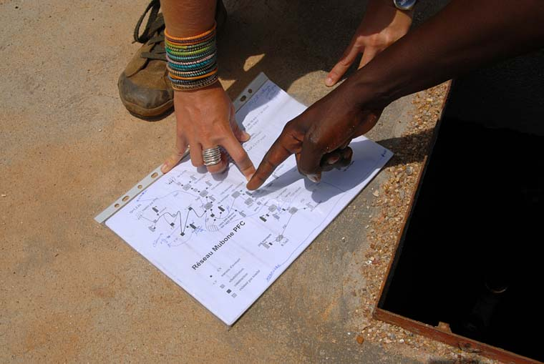
Accès à l’eau
Aspects à prendre en compte :
sécurité
éléments sociaux et culturels
questions d’ordre physique
questions d’ordre économique
temps nécessaire / distance
Notes:
*/ Providing adequate quantity of water at a water point does not guarantee that people will have access to it.
As part of the assessment of water needs, we have also to look at the various obstacles to this access,
- Is it safe to access to it, can we access freely at any time
Does everyone have access to it? Especially the most vulnerable. Is the water point accessible to everyone. For instance, does a disable person can access to it
Is it affordable the poorest
Finally, time to get to the water point is also very important

Slide 14
??
Comment évaluer le temps nécessaire pour aller chercher de l’eau ?

Slide 15
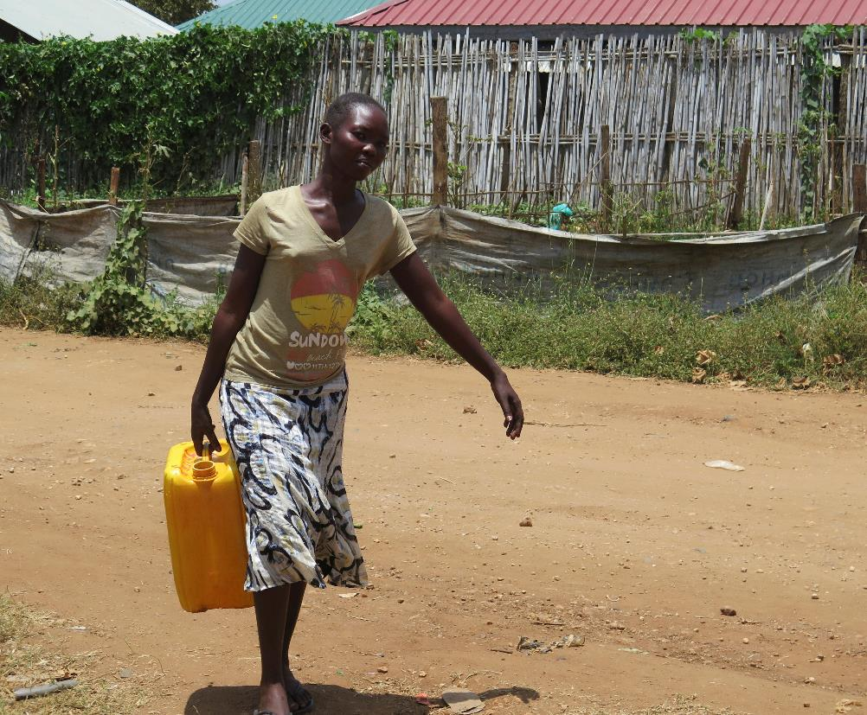
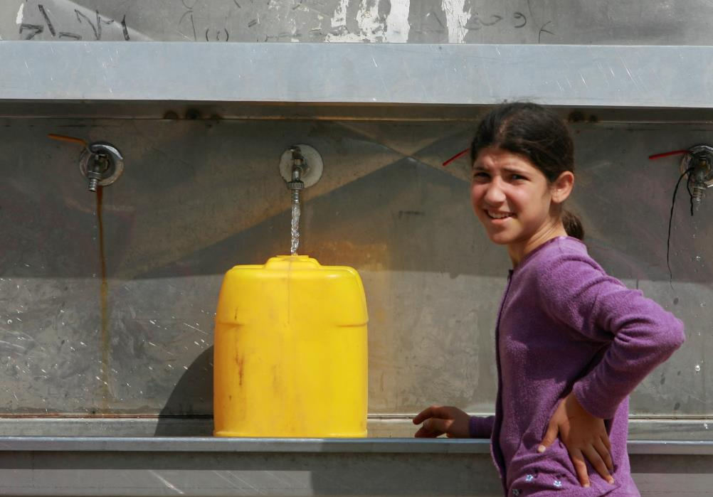
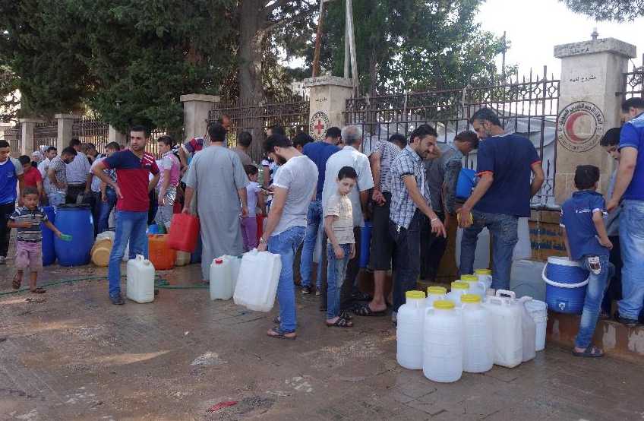
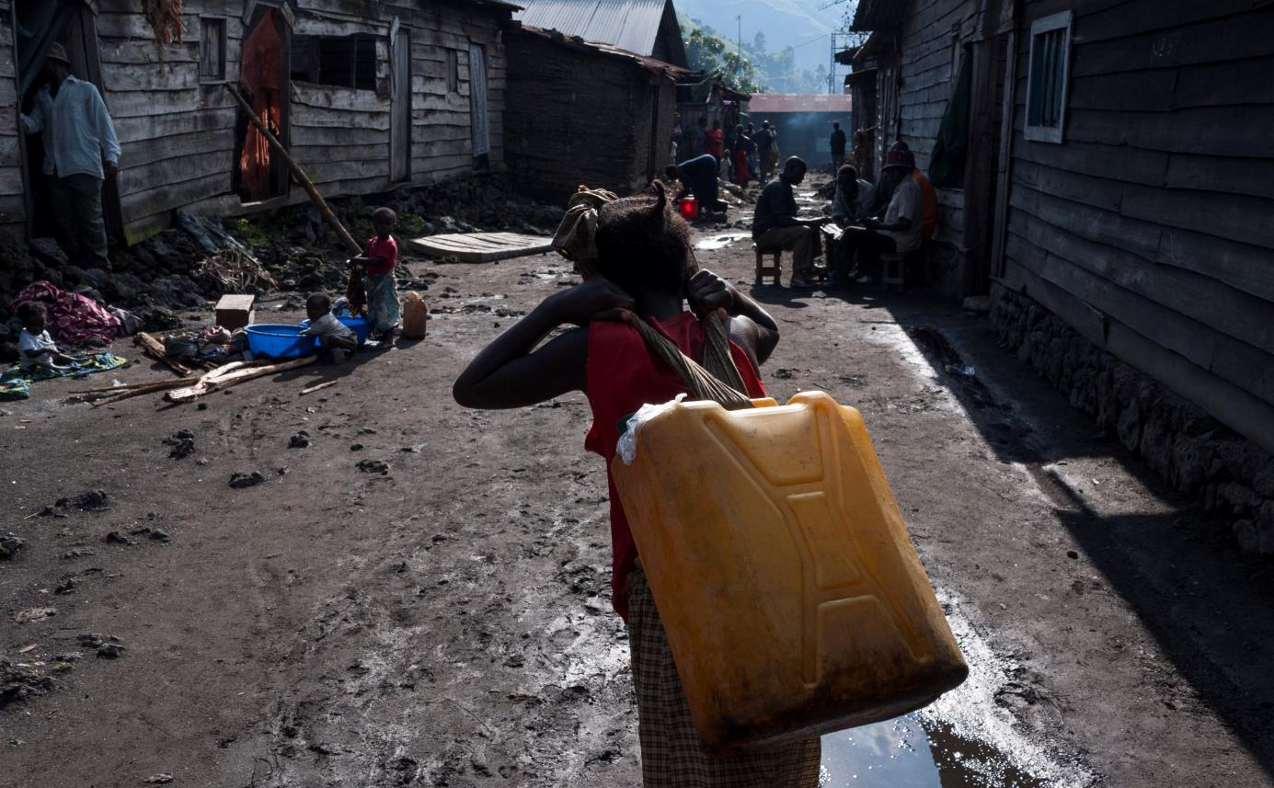
Le temps nécessaire à la collecte d’eau dépend des éléments suivants :
Distance
Débit
Queue
Contenant
Notes:
*/ Time to collect water depends on:
Time to get to the water point and back which mainly depends on the distance
Time to wait at the water point which can be very long when there is not enough water points and people have to queue
The size and type of the container. Some are easier to carry than others.
The flow-rate of the water point can make the water collection a lengthy expedition

Slide 16
Rapport entre temps de collecte de l’eau et consommation
Distance aller-retour à pied | Fourchette de consommation (l/pers./j)
> 1000 m | 5–10
De 500 à 1000 m | 10–15
Borne fontaine < 250 m | 20–50
Robinet de cour | 20–80
Robinet individuel | 30–60
Plusieurs robinets | 70–250
SMET and WIJK (WEDC, 2002)
Notes:
*/ As shown in this graph, there is a relationship between the distance of the water point and the water consumption. However, the relationship is not linear!
People who have easy access to water at home (e.g. via multiple taps) were shown to consume large quantities of water (usually >100 l/c/d).
If water can be collected from a water point that is less than 100m from home within less than 5min, consumption is still relatively high (e.g. 50l/c/d)
However, if people have to walk 100 to 1000m to the water point or it takes you between 5 to 30 min, the water consumption has show to drop to about 15-20l/c/d. Interestingly, that quantity doesn’t change much within that range of time and distance. This quantity is still not optimal to maintain a good hygiene and has shown to have a negative impact on health.
When people have to walk longer time than 30min (in total) or distances above 500m (one-way), the quantity of water drops below acceptable levels. Personal hygiene is hardly possible anymore which results in a serious risk to health.

Slide 17
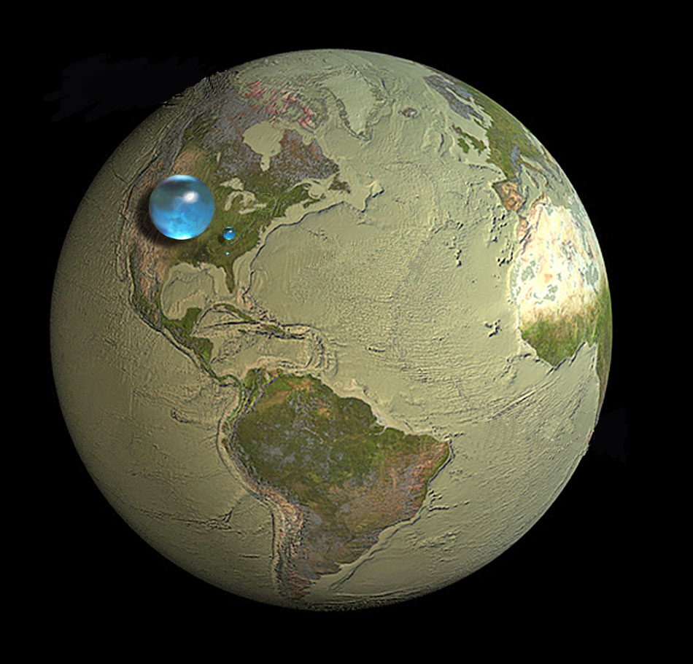
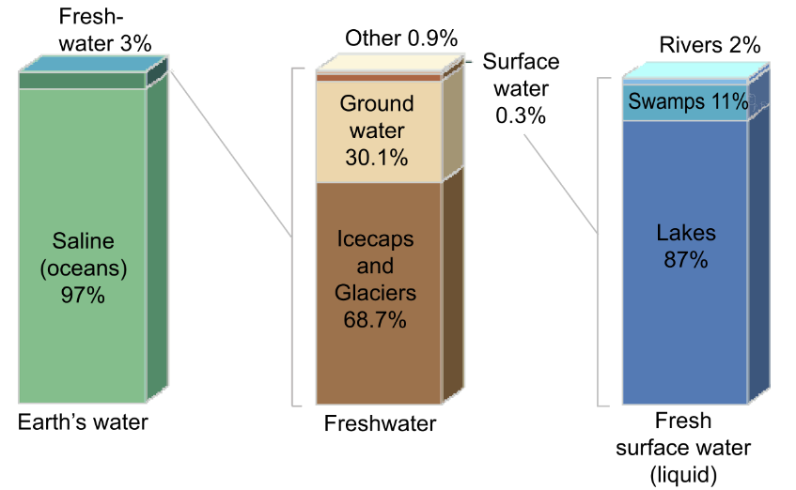
Ressources mondiales en eau
Notes:
Fresh water is a tiny part of world water (middle sphere), but most of it is not accessible to living things (ice, underground)
Easily accessible water is found in lakes, ponds, rivers : small sphere of 60 km of diameter. Water for 7.5 billion human beings (drinking water, irrigation, animals, industries) + all other living organisms !
Oceans cover 71% of Earth's surface and contain 97.2% of the volume of water of our planet.
97.2% salt water and 2.8% freshwater.
Nearly 70% of that fresh water is frozen in the icecaps of Antarctica and Greenland; most of the remainder is present as soil moisture, or lies in deep underground aquifers as groundwater not accessible to human use.
< 1% of the world's fresh water (~0.007% of all water on earth) is accessible for direct human uses

Slide 18
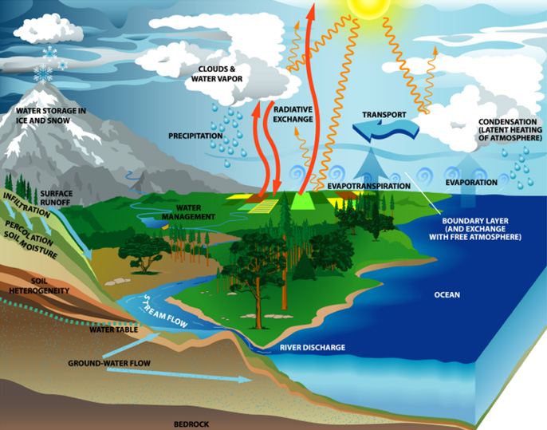
Le cycle de l’eau
Le cycle de l’eau décrit le mouvement continu de l’eau
  sur
  au-dessus de
  sous
la surface de la Terre
(http://www.usgcrp.gov/usgcrp/images/ocp2003/ocpfy2003-fig5-1.htm)
Notes:
Water also exists in different forms: including mineralized (salt-) water, “sweet” water, snow, ice, vapour etc.
The different forms of water can be “transformed” into others

Slide 19
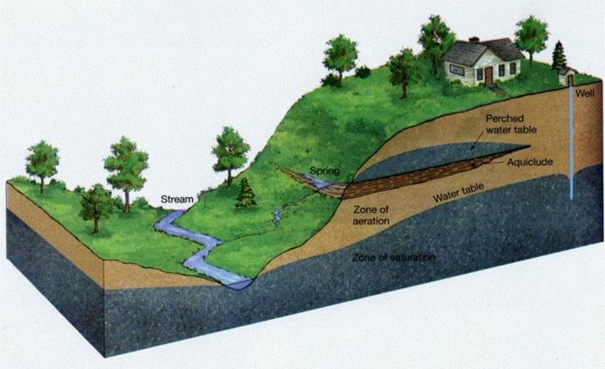
Différentes sources d’eau :
→ Eau de surface :
  rivière, lac, mer
→ Eau souterraine :
source
puits peu profond
eau de forage
Eau de pluie

Slide 20
Travail de groupe
Quels sont les avantages et les inconvénients
des différentes sources d’eau ?
(p. ex. eau de pluie, eau de surface, eau salée,
source naturelle, puits peu profond et eau de forage)
Durée de l’exercice : 10 minutes
Notes:
Rainwater: often cheap solution, as little infrastructure needed. However treatment of water is needed. Depends on rain availability, quantity and pattern (seasonal)
surface water (lake, rivers): needs always treatment. Requires pumping, stockage and distribution.
salt water: requires desalination of water which is very power consuming and costly. Rarely a viable option.
natural spring: good option if available. Requires initial investment into spring catchment, pipeline and storage, but has low running costs (no pumps or electricity needed thanks to gravity flow).
Open shallow well: relatively cheap and simple, but water is usually contaminated and thus not really safe for consumption. Household treatment needed.
Borehole: requires pumping but is usually safe for consumptions (no treatment unless for large populations). High initial investment i.e. if deep borehole.

Slide 21
Critères de sélection d’une source d’eau
Quantité d’eau
      Capacité immédiate
      Fiabilité dans le temps
Qualité de l’eau
      Qualité de l’eau actuelle
      Risque de contamination
Faisabilité technique et financière
      Critères de développement et d’installation d’une solution technologique
      Critères de fonctionnement et de maintenance
Accessibilité et acceptation
      Accès physique et sécurité
      Dimension socioculturelle
Notes:
How do we select a water source? First check which sources are available at all. Then, for each available source, we consider four major criteria:
Water quantity – what is the yield of the water source and how does it relate to the demand? Is the source intermittent or strongly affected by seasonality? The minimum yield of the water source should still be greater than the demand. If this is not the case, combination of several sources cover demand should be considered. Sufficient storage capacity might help to improve reliability of supply.
Water Quality: is the water likely to be contaminated? What type of contamination (biological, chemical, physical)? Some parameters, i.e. turbidity, taste, color can be easily tested on site. Chemical and biological require a laboratory. The treatment of water requires both initial and running costs, especially if there is a specific chemical contaminant (e.g. iron). Therefore sources that don’t require treatment, like springs and deep boreholes are often an interesting option.
Technical and financial feasibility: Some sources might be available but are not viable for practical or financial reasons. E.g. distance of spring is far and would require a huge initial investment. The same is the case if the ground-water is very deep and a borehole would be costly to drill and operate. Sometimes the lack of grid-electricity or lack of competence can also render a project unrealistic.
The Accessibility and Acceptance: If for example a borehole is in an insecure area, it will be difficult to operate and maintain it.

Slide 22
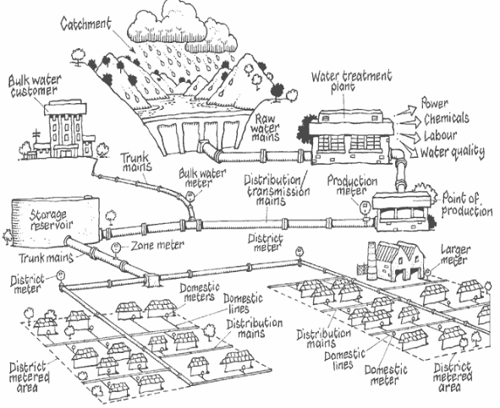
Systèmes d’approvisionnement en eau :
Références Queensland Environmental Protection Agency and Wide Bay Water Corporation (2004): Managing and Reducing Losses from Water Distribution

Slide 23
Travail de groupe
Comment assurer l’approvisionnement de ces différents camps en eau ?
Quelles seraient les solutions possibles ?
Durée de l’exercice : 10 minutes

Slide 24
Source
dans les montagnes
Rivière
Aquifère
Aquifère
Notes:
A village in the mountains
A city and a village in the plains
A village next to the river
The plain has a deep aquifer while in proximity to the river there is a shallow alluvial aquifer

Slide 25
Point de captage de la source, réservoir et canalisations
Réservoir
Réservoir
Station d’épuration
Puits creusé à la main / Collecte d’eau de pluie, stockage et traitement par les ménages
Puits,
pompe manuelle et
jerrycans
Rivière
Aquifère
Aquifère
Aquifère
Notes:
What could be possible water supply system providing these four settlements? (discussing possibilities, just for the exercise!)
Lets see – there is a pure spring in the mountains. We protect the spring, and deliver water by gravity to the village nearby (distance reasonable, so limited costs).
We build an intake on the river down in the valley, pump water up to the drinking water treatment plant (WTP). Treated water is pumped further and stored at the tank, from where it is further distributed to the town through a distribution system.
In the village further down the valley, people collect water at the protected well with a handpump. They carry water in jerry cans home.
A local NGO has distributed the household filters to treat water at home in this village next to the river. Few households also collect rainwater from their roofs and store it in rainwater tanks.
All these different types of water supply systems have different scale. However, they have all the same steps:
Water source – spring, well, surface or groundwater,
water intake structure – be it either a protected river intake, spring catchment, dugwell or rainwater gutter
abstraction technology – such as hand pump or motorized pump
water treatment – if it is required
water transport – either through a network or with jerry cans
and water storage (rainwater tanks) or treatment (HWTS) at the user level.
Most water supply systems can be structured along these 6 functional groups.

Slide 26
Source
Prélèvement
Extraction
Traitement
Distribution et transport
Sécurité
Collecte sur le toit
Élucidation
Méthodes de filtration
Coagulation / Sédimentation
Jerrycans
Stockage
Stockage sûr
< 1000 l
> 1000 l
Eau de pluie
Gravité
Récupération d’eau de pluie
Fournisseurs
Source
Pompes manuelles
Traitement de l’eau par les ménages
Céramique
Membranes
Chloration
Bouillir
Biosable
UV
Procédé Sodis
Barrage réservoir souterrain
Désinfection
Chloration
UV
Ozone
Filtre à sable lent
Ultrafiltration
Pasteurisation
Kiosques
Eau souterraine
Collecte à la source protégée
Pompes motorisées
Réseaux de distribution
Eau de surface
Puits protégé
Produits chimiques
Sulf. d'ammonium et de fer
Réservoirs de stockage
Eau saumâtre et eau de mer
Eau de forage
Charbon actif granulé (GAC)
NF/Osmose inv.
Produits chimiques
Filtres F
Filtres AS
Prélèvement d’eau de rivière
Mer
Osmose inverse
Distill. membran.
Prélèvement d’eau de mer
Notes:
The technologies from each functional group perform specific tasks of the water supply system and can be linked between each other to show possible combinations. It is not always necessary that water passes through all functional groups to reach the consumer. In some systems treatment is excluded due to high quality of source water, or water is supplied by gravity and no pumping is needed. However, water always moves from left to right through the functional groups or from top down within the group.

Slide 27
Source
Prélèvement
Extraction
Traitement
Distribution et transport
Sécurité
Élucidation
Méthodes de filtration
Coagulation/sédimentation
Collecte sur le toit
Élucidation
Méthodes de filtration
Coagulation/sédimentation
Jerrycans
Stockage
Stockage sûr
< 1000 l
> 1000 l
Eau de pluie
Gravité
Récupération d’eau de pluie
Fournisseurs
Source
Pompes manuelles
Traitement de l’eau par les ménages
Céramique
Membranes
Chloration
Bouillir
Biosable
UV
Procédé Sodis
Barrage réservoir souterrain
Désinfection
Chloration
UV
Ozone
Filtre à sable lent
Ultrafiltration
Pasteurisation
Kiosques
Eau souterraine
Collecte à la source protégée
Pompes motorisées
Réseaux de distribution
Eau de surface
Puits protégé
Produits chimiques
Sulf. d'ammon. et de fer
Réservoirs de stockage
Eau saumâtre et eau de mer
Eau de forage
GAC
NF/Osmose inv.
Produits chimiques
Filtres F
Filtres AS
Prélèvement d’eau de rivière
Mer
Osmose inverse
Distill. membran.
Prélèvement d’eau de mer
Notes:
Here you see an example for a centralized or a semi-centralized system supplying and treating surface water. Surface water is collected at a protected or unprotected river or lake intake, is delivered with means of gravity or motorized pumping to the tretament plant. There it is clarified and disinfected and either is being sold at a water kiosk or fed into the distribution network. Safe water storage at home might be needed to cover for interruptions.

Slide 28
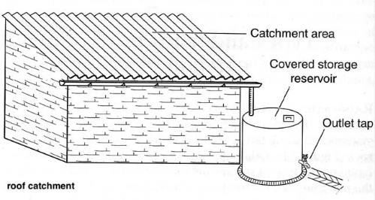
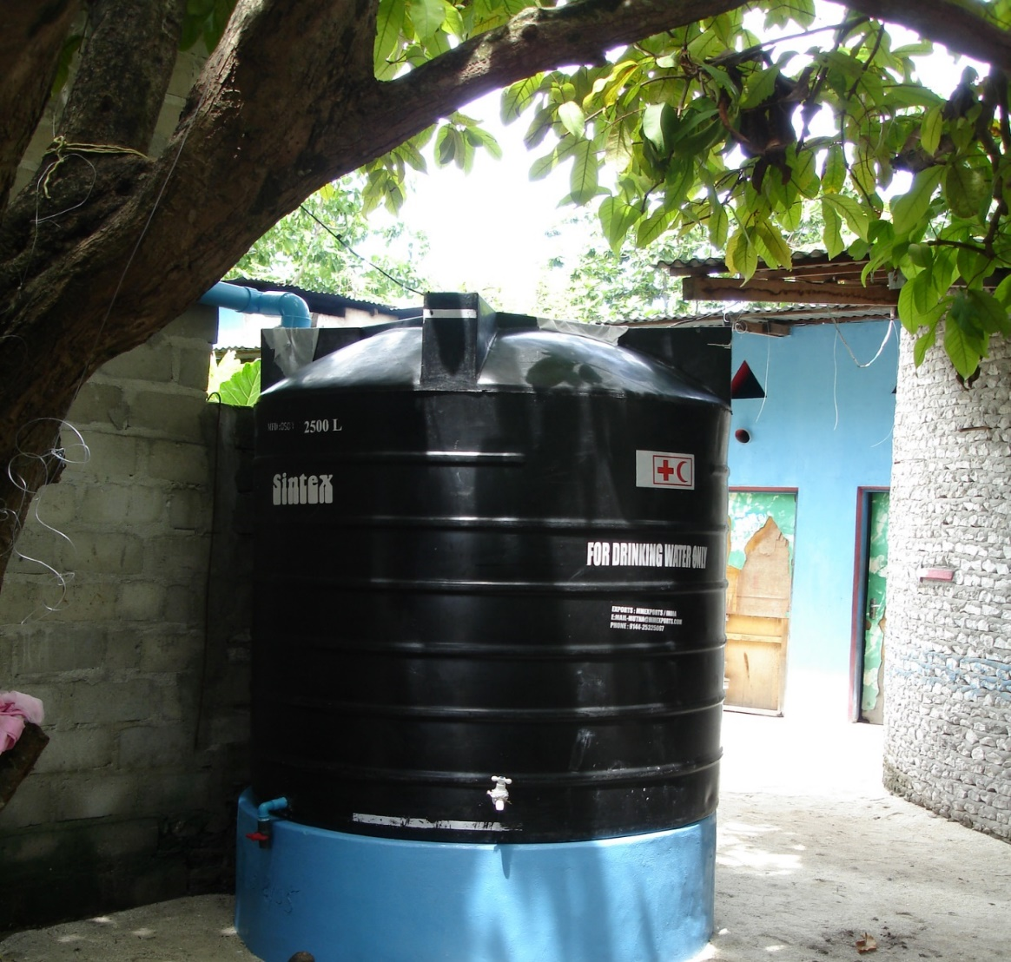
Collecte des eaux de pluie
Utilisée en majorité par les ménages
Pas adaptée à l’approvisionnement en eau à grande
échelle
Nécessite en principe une source complémentaire
Caractéristiques :
Bonne qualité (en fonction du stockage)
Installation adaptée
Limitée aux quantités disponibles
Dépend des conditions météorologiques
Entretien important

Slide 29
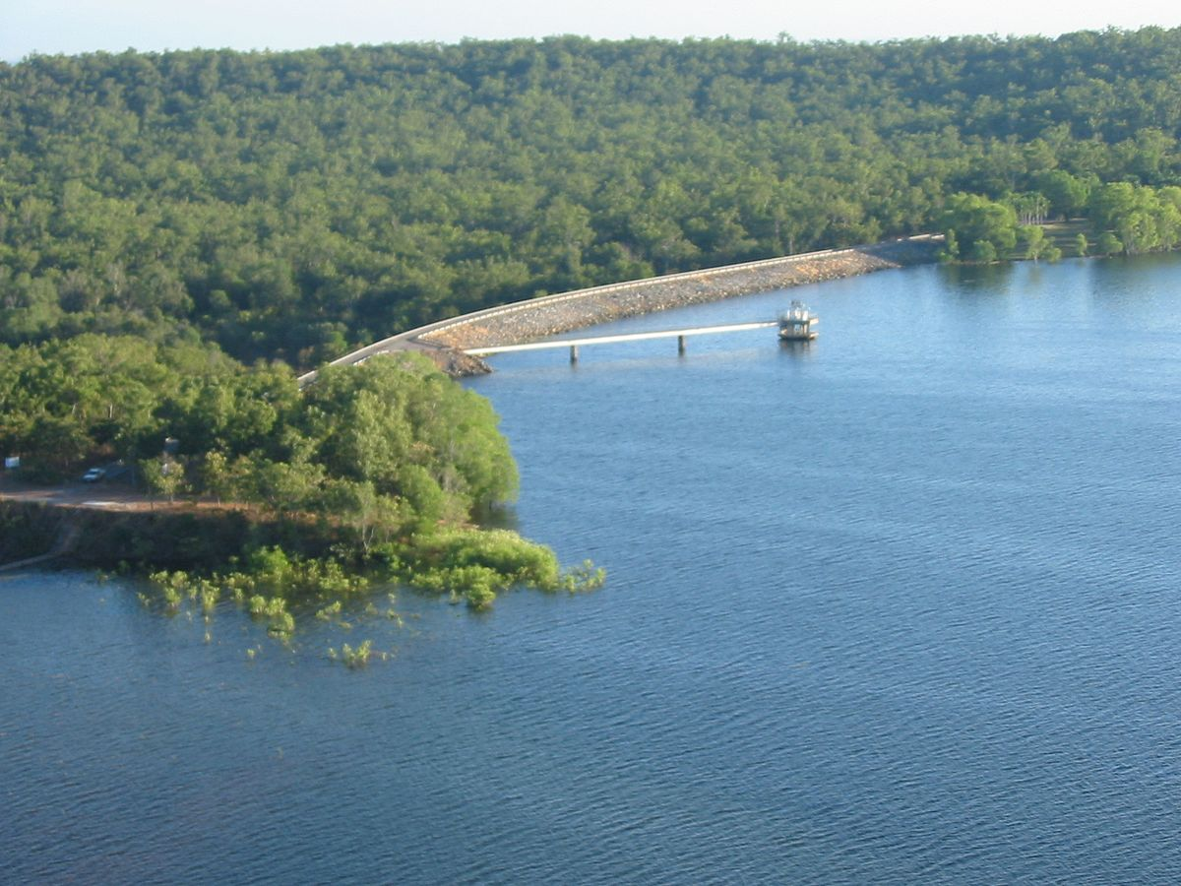
Eau de surface
Rivières, cours d’eau
Lacs, lagons, barrages
Caractéristiques :
Traitement systématique
Grands volumes disponibles
Notes:
Surface water is often a good option, as usually large quantities can be extracted. However, the water requires treatment and pumping, which comes with running costs.
Sea water (mineralized/salty) is also a surface water but is rarely a reasonable option as a source of water. Desalination is too costly and only used if there is no alternative.

Slide 30
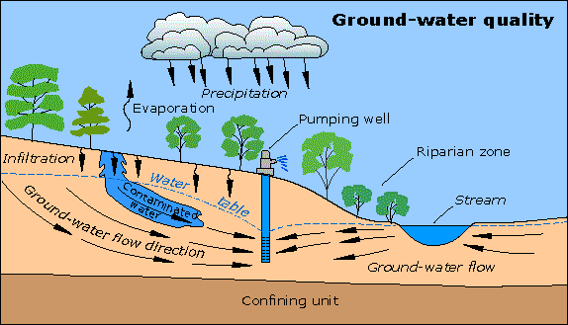
Eau souterraine
Eau souterraine :
Points de captage d’eau de source
Puits peu profond : puits creusé à la main
Puits profond : eau de forage
Caractéristiques :
Excellente qualité (en général)
Extraction potentiellement très coûteuse
Possibilité de contamination (p. ex. par des toilettes à proximité)
Risque d’introduction d’eau de mer si près de la côte
Notes:
If there is no contamination, ground water does not require treatment, which reduces costs. The deeper the borehole or well the more costly the investment and running costs.
It important to test the groundwater for contamination, which can come from many sources, as for example from nearby latrines or septic tanks but also from leaking well apron. Saltwater intrusion is a common phenomenon in proximity to sea-costs. Open hand-dug-wells have to be considered contaminated and unsafe.

Slide 31
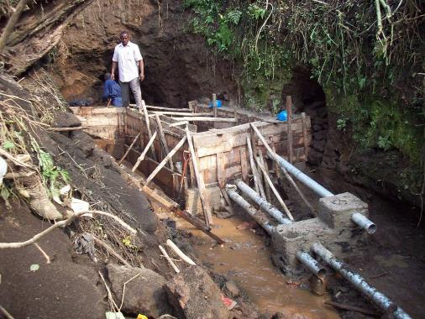
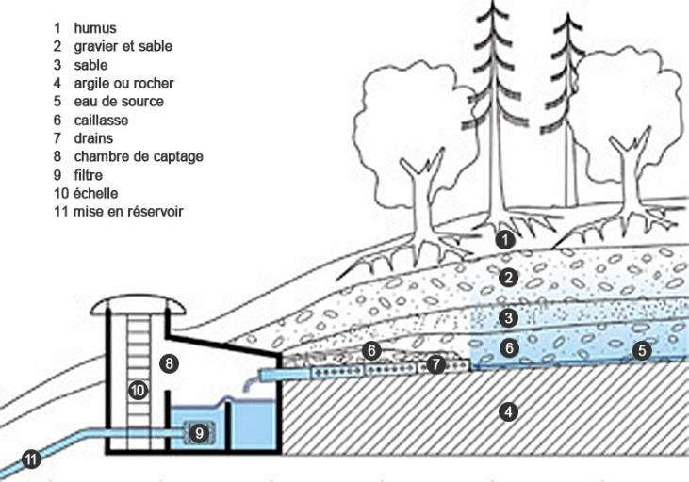
Point de captage d’eau de source
Caractéristiques :
Excellente qualité (en général). Investissement initial uniquement, faibles coûts d’entretien
Notes:
Using natural spring water is a good option if available.
It requires an initial investment for the spring catchment (to prevent contamination
of intake), pipeline and storage, but then has low running costs
(no pumps or electricity needed thanks to gravity flow). Usually, no treatment is required.

Slide 32
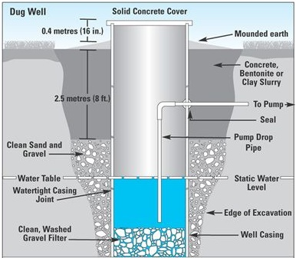
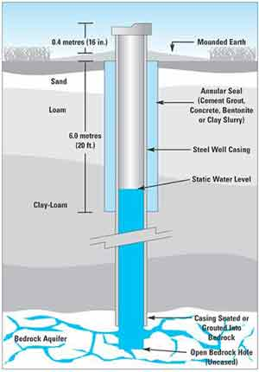
Puits
Puits creusé
Eau de forage
Notes:
The two methods to extract water from an underground aquifer is by digging a well or by drilling a borehole. Dug-wells are usually limited to max. 40-50m depth, while boreholes can reach much deeper (hundreds of meters). However, the deeper the borehole the costlier.

Slide 33
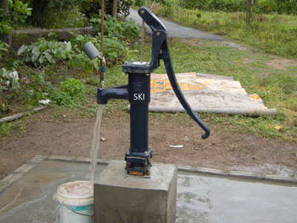
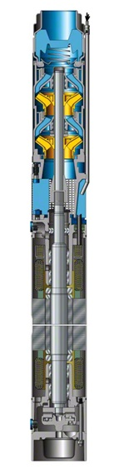
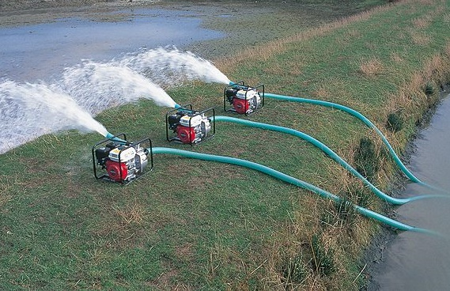
Systèmes de pompes
Pompe manuelle
  Profondeur de l’eau (max. 50 m en général)
  Productivité faible : max. 250 bénéficiaires (sphères)
  Utilisation et réparation faciles, mais besoin de maintenance et supervision
Pompe motorisée
  Possibilité de forte productivité
  Besoin en combustible/énergie donc coûts opérationnels plus élevés et dépendance en équipements
  Compétences accrues requises pour la maintenance
  Disponibilité des pièces détachées ?

Slide 34
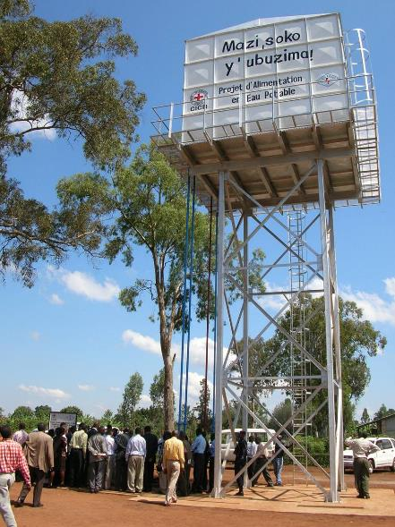
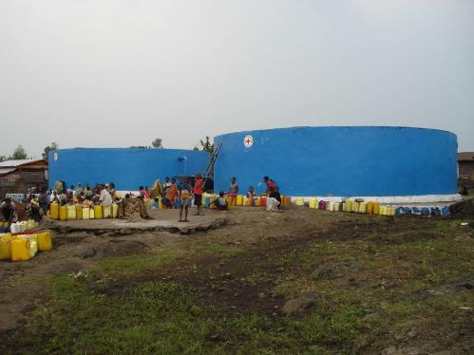
Stockage de l’eau
Réservoirs d’eau sur le sol
Réservoir d’eau surélevé

Slide 35
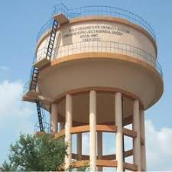
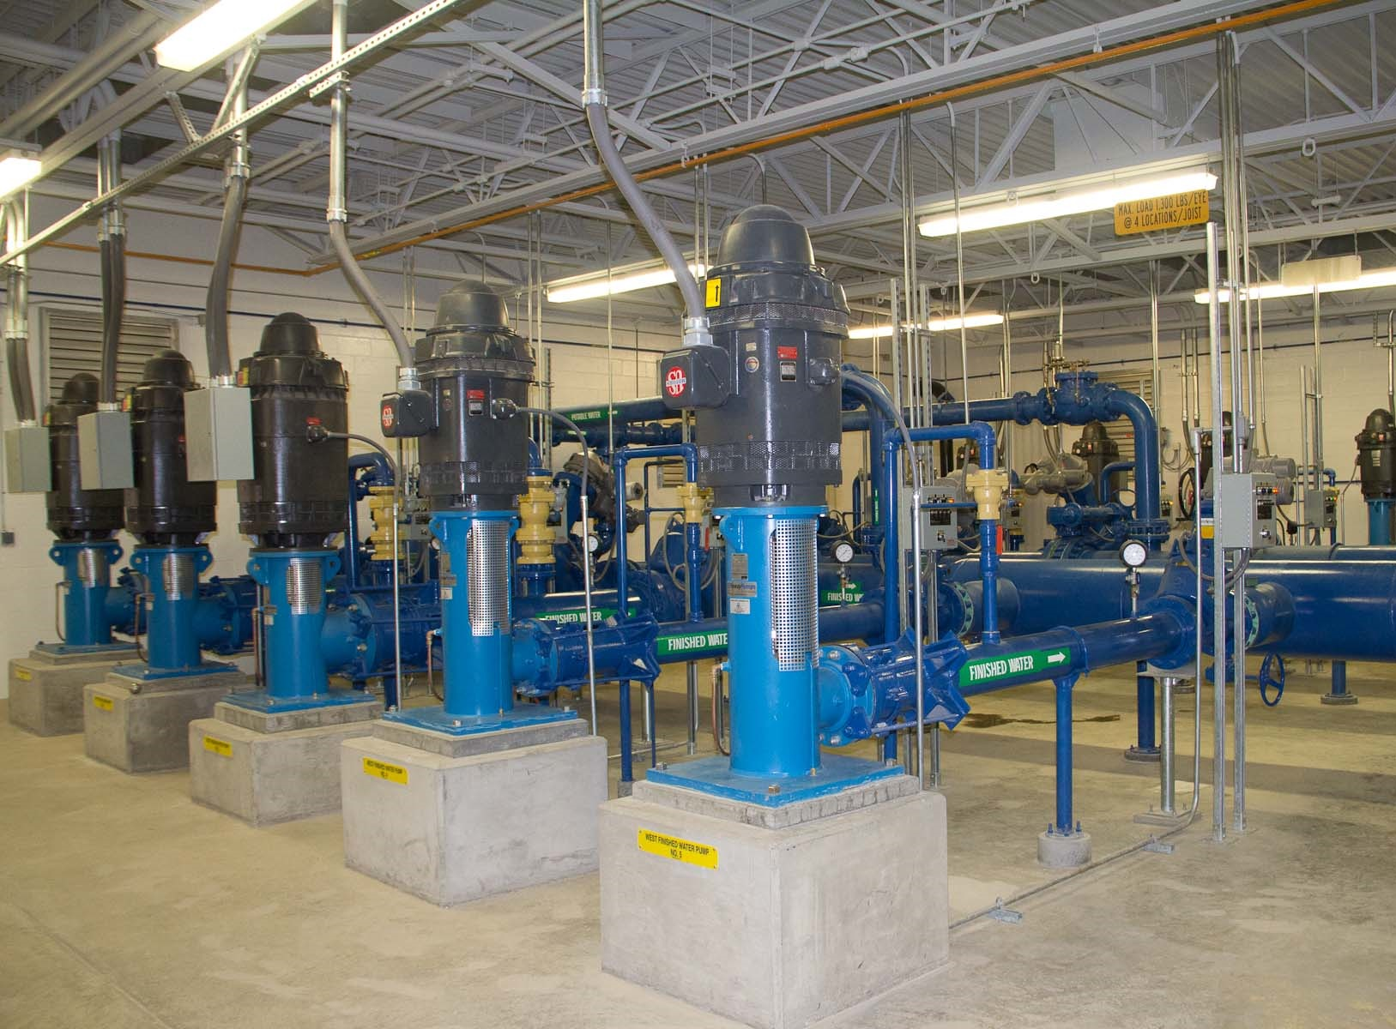
Distribution d’eau
Par la gravité
Par des pompes à haut débit

Slide 36
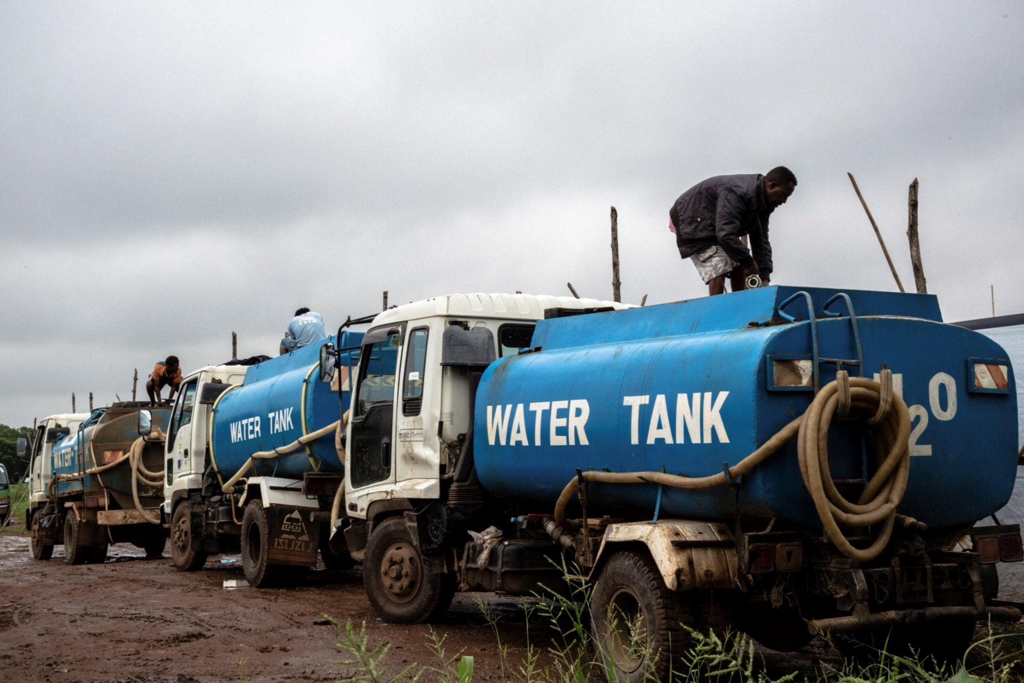
Transport d’eau par camions
Coûts élevés
Grands efforts d’organisation
Choix du moyen de transport le plus adapté
Risque de recontamination
  → Chloration choc des réservoirs et chloration de l’eau
Utiliser les camions uniquement pour transporter l’eau, pas pour la distribuer !
→ Si possible, éviter le transport d’eau par camions !
Notes:
Water tankering is still used in remote rural settings without access to adequate water sources, urban and peri-urban areas wihout distribution networks or as an emergency water supply when other adequate water sources are not available. In all cases – it is expensive, not easy to organize and should be avoided whenever possible. If water is not chlorinated, water quality is likely to deteriorate during transport. And tankering of water from contamined water sources can support spreading of deseases in large areas within a very short time. Thus chlorination of tankered water as well as shock chlorination of the tankers, especially in times of disease outbreaks is highly recommended. Since the tank volume and the type of water source are known and the water is well mixed during transport, chlorination of tankered water is rather easy.

Slide 37
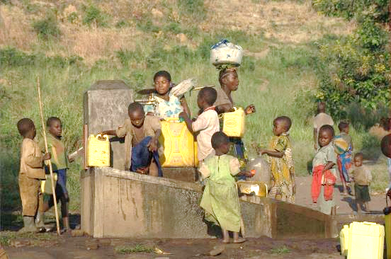
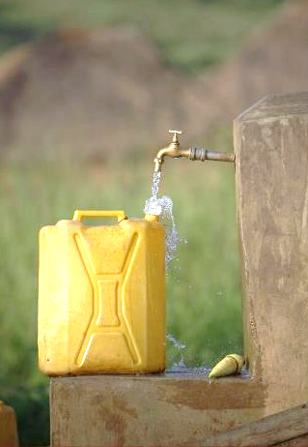
Points de distribution et stockage au niveau des ménages
Notes:
Transport of water in jerry cans is a reality for many rural and urban families. Depending on the location of the water source, it requires often a lot of time which can be used for other activities. In areas where water sources are located at longer distances, other water distribution options should be considered first. Transport of jerry cans filled with safe water to home by water kiosk providers can be costly but in general adequate option in case water and jerry cans are disinfected and safely sealed. Usually this is not the case and deterioration of water quality can be expected during transport and use. Chlorination of jerry cans at the point of water collection can be an option to improve the situation.

Slide 38
??
Quelles sont les étapes types du traitement de l’eau ?

Slide 39
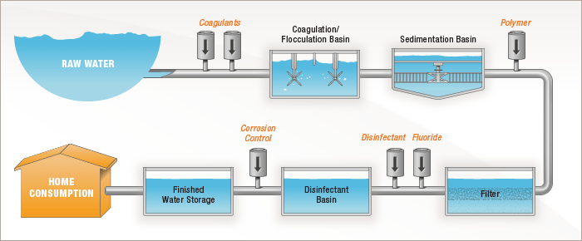
Étapes principales du traitement de l’eau
Prétraitement
Clarification
Désinfection
Filtration
Notes:
Pre-tretament: e.g. Screen, gritting, greases traps, ventillation (to remove iron)
Clarification: The purpose of clarification is to remove as much as possible
particulate material. The conventional treatment sytsems usually apply
coagulation/flucclation combined with sedimentation or filtration.
Filtration: Rapid sand filtration without coagulation is used as well on large
centrazied drinking water tretament plants or community supplies.
In community supplies, roughing filtration has been used successfully as
efficient and low maintenance pre-treatment.
Disinfection: Usually via chlorine or ozon

Slide 40
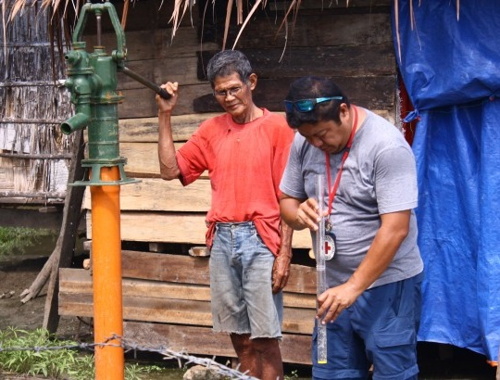
Turbidité de l’eau
La turbidité fait référence à une eau trouble causée par des particules en suspension (résidus organiques, argile, organismes microscopiques, etc.).
Sphère recommande une turbidité inférieure à 5 NTU (unité de turbidité néphélométrique) pour garantir une chloration efficace.
Pour réduire la turbidité de l’eau, il est nécessaire de procéder à une clarification par coagulation ou floculation.

Slide 41
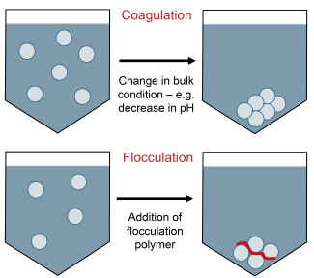
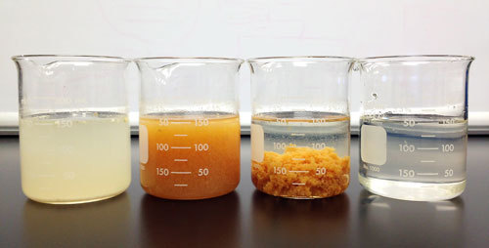
Étape de clarification
Coagulation :
Le coagulant le plus utilisé est le sulfate d’aluminium en poudre, qui, même s’il n’est pas un coagulant puissant, a l’avantage de pouvoir être transporté facilement par voie aérienne et d’être largement disponible dans différentes parties du monde.
Floculation :
L’ajout de polymères peut être efficace. En revanche, cela fonctionne uniquement sur une plage de pH restreinte, avec une efficacité optimale entre 6,5 et 7,5 de pH. En dehors de cette fourchette, son efficacité chute et il faut en augmenter la quantité pour compenser.

Slide 42
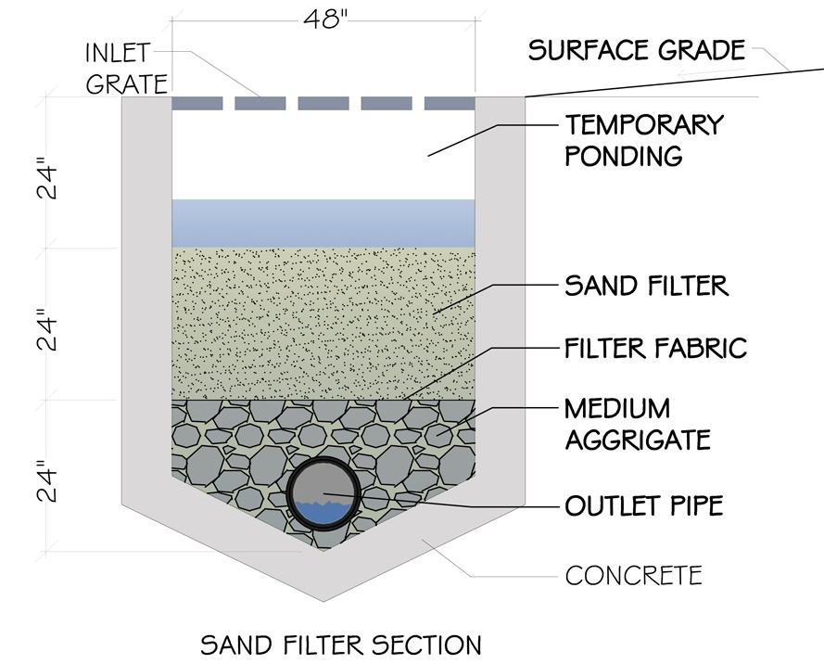
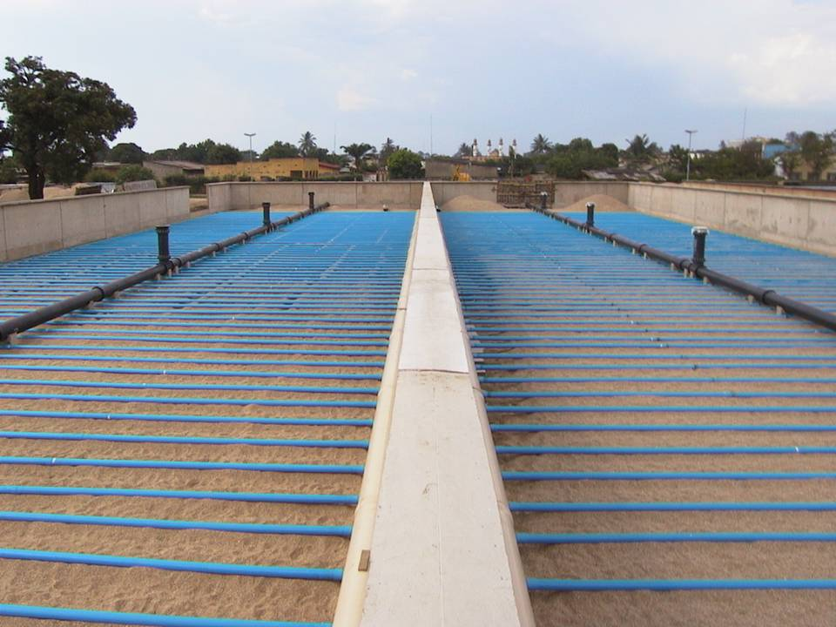
Étape de filtration
Le processus de filtration implique le passage de l’eau à travers un lit de graviers, composé de sable ou autres matières adaptées, le tout à un faible débit. La matière retient la plupart des particules solides tout en laissant passer l’eau.

Slide 43
Étape de filtration
Microns (μm)
(échelle logarithmique)
0,001
0,01
0,1
1,0
10
100
1000
Techniques
de visualisation
Microscope
électronique
à balayage
Microscope
optique
Visible à
l’œil nu
Taille des entités
Hémo-
globine
Bactéries
Sels
Pseudomonas
diminuta
Virus de la polio
Pollens
Virus
E. coli
Globules
rouges
Anti-
biotiques
Cheveux
humains
Plasma humain
Processus de séparation
Nanofiltration
Microfiltration
Osmose inverse
Ultrafiltration
Filtre à sable

Slide 44
??
Quelles sont les différentes méthodes de désinfection de l’eau ?

Slide 45
Méthodes de désinfection de l’eau
Bouillir
Désinfection chimique (p. ex. chlore, ozone)
Rayonnement UV (par le soleil ou une lampe)
Ultra ou microfiltration (filtres céramiques)
En situation d’urgence, le chlore est souvent l’option la plus pratique.
Notes:
Boiling: A simple and effective method, but it’s very expensive and not efficient for large quantities. Used mainly at household level
Chemical Disinfection (i.e. chlorine, ozone): Relatively cheap and effective method, also for large quantities.
UV-radiation (via sun or lamp): possible method but needs good management. Often used in combination with other methods.
Micro-filtration (Ceramic filters): Also a simple method but relatiely slow. Filters have to be cleaned. Used mainly at household level. [Formally, filtration is not considered a disinfection, as it only removes, but doesn’t kill off the pathogens. It is still listed here as an alternative]
→ Chlorine is easy to use, generally available, cheap and quite effective. (pros and cons of chlorine are discussed in the following)

Slide 46
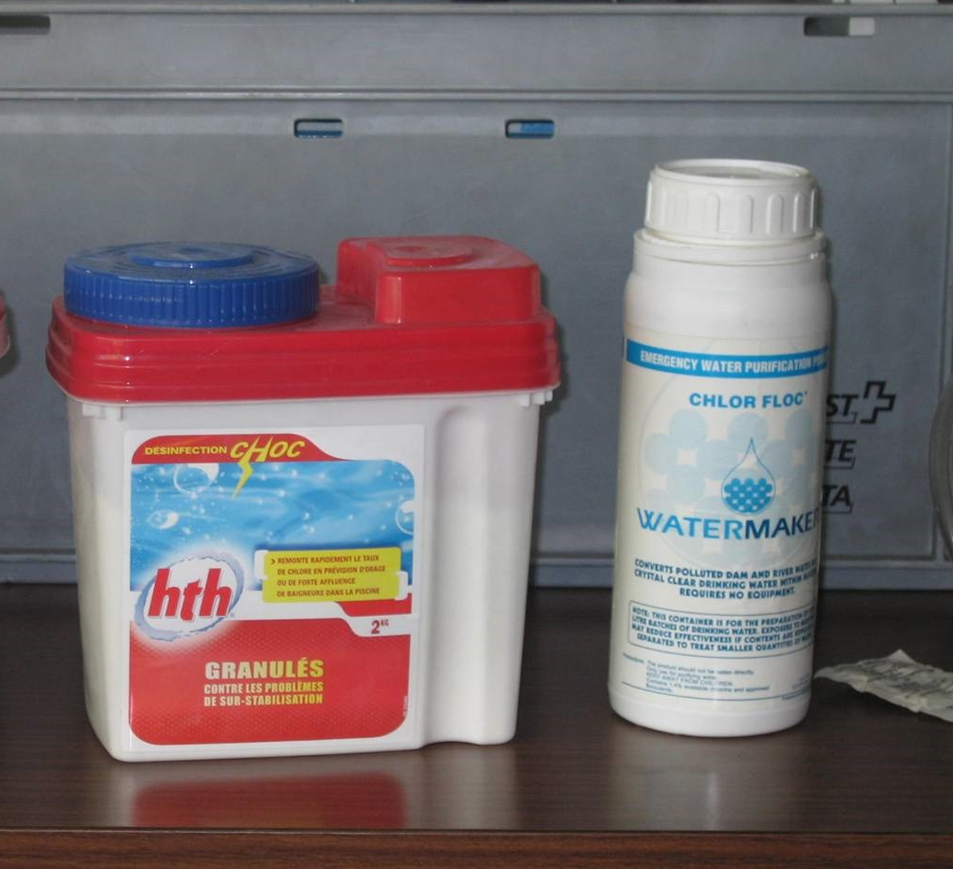
Les différentes formes de chlores
 | Teneur en chlore | Forme du produit
Chlore gazeux | 99% | Gaz liquide ou pressurisé
Ca(ClO)2 (= HTH) | 60–70 | Poudre blanche, granulés ou tablettes
NaClO (javel) | 15% max. | Solution liquide
Notes:
Chlorine gas is only used for large scale water treatment as it requires complex
and expensive equipment.
Calcium hypochlorite (HTH) powder is the most commonly used type for bulk water
disinfection. High concentrated but still easy to use.
Sodium hypochlorite is often used for pools or for water disinfection at household level.
Widely available and less dangerous than HTH. But less concentrated, thus more quantity
needed.

Slide 47
Le chlore comme désinfectant
Avantages :
généralement très disponible et relativement abordable
se dissout facilement
le chlore résiduel qui se trouverait dans l’eau traitée apporte une protection contre toute contamination ultérieure
efficace contre un large éventail d’agents pathogènes (bactéries et virus inclus)
possibilité de production locale
Inconvénients :
agent oxydant puissant qui doit être manipulé avec prudence – ne pas inhaler les vapeurs de Cl2
ne pénètre pas efficacement dans les particules
peut donner un goût désagréable en cas de surdosage, ce qui peut dissuader la population de boire de l’eau salubre
pour être efficace contre certains agents pathogènes (kystes, œufs, virus), il faut une concentration plus élevée en chlore et un contact prolongé

Slide 48


Kit d’analyse
du chlore résiduel
Désinfection au chlore
Lorsqu’on ajoute du chlore dans une source d’eau, il purifie l’eau en réagissant avec les matières organiques, dont les bactéries et virus. La dose de chlore nécessaire à cette réaction s’appelle la demande en chlore de l’eau.
Une fois la demande satisfaite, tout excès de chlore (quantité au-dessus du niveau nécessaire pour satisfaire la demande en chlore) restera dans l’eau sous la forme de chlore résiduel.
Le chlore résiduel d’une solution peut être facilement mesuré à l’aide d’un kit d’analyse du chlore résiduel.
La quantité de chlore à ajouter est déterminée en mesurant le chlore résiduel d’un échantillon à l’aide de différentes doses de chlore.
La quantité de chlore résiduel recommandée 30 minutes après le traitement se situe entre 0,2 et 0,5 mg/l.
Notes:
The jar-test is a series of test on

Slide 49




Traitement de l’eau en urgence
Notes:
In Emergencies, we often use coagulation/flocculation combined with
sedimentation or filtration. Then the water is disinfected with chlorine.
Mobile equipment is often the most practical solution, as for example:
Mobile water treatment system (LMS), mounted on a trailer. Available
in 4-10 m3/h.
Flexible onion tanks (e.g. for coagulation and sedimentation) and flexible
bladder tanks or Oxfam tanks for storage.
Mobile water test kit for water analysis and to adjust the water
treatment methods.

Slide 50
Conclusion : eau et santé
L’eau peut être contaminée par des agents biologiques, chimiques ou physiques. En l’absence de standards nationaux de qualité de l’eau, il est possible d’utiliser les normes de l’OMS comme références.
La quantité minimale d’eau ne doit pas tomber en dessous de 15 l/pers./j, même en situation d’urgence. Le temps passé à aller chercher de l’eau ne doit pas dépasser 30 minutes.
Il existe différentes sources d’eau : la pluie, l’eau de surface et l’eau souterraine. Il faut évaluer divers facteurs comme la qualité, la quantité, la faisabilité technique, les coûts, l’accessibilité et l’acceptation pour sélectionner la source d’eau la plus appropriée.
La chloration est la méthode de désinfection la plus appropriée en situation d’urgence. Si la turbidité excède 5 NTU, l’eau doit être clarifiée par coagulation ou floculation avant la chloration.

