Slide 1
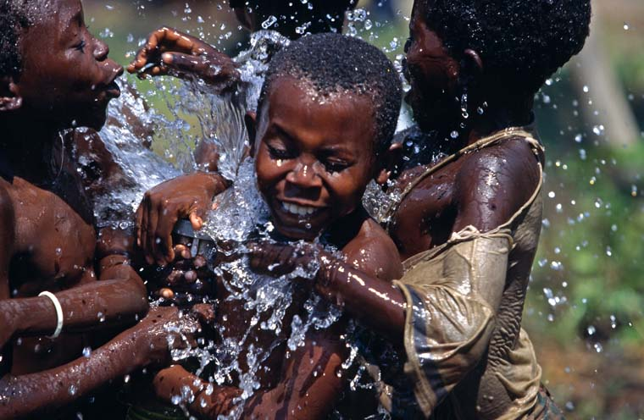
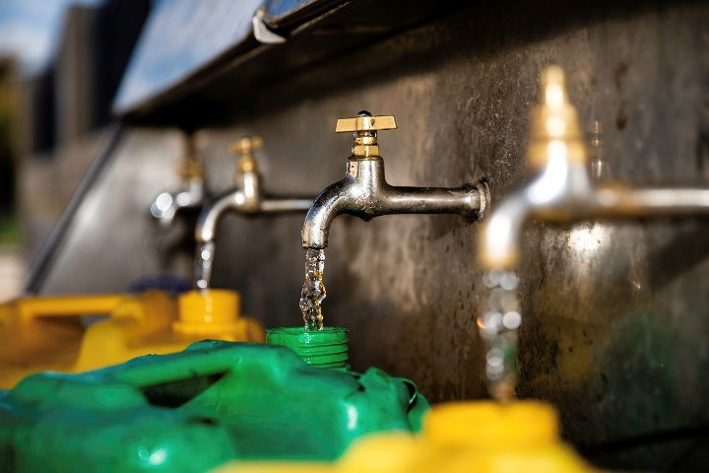
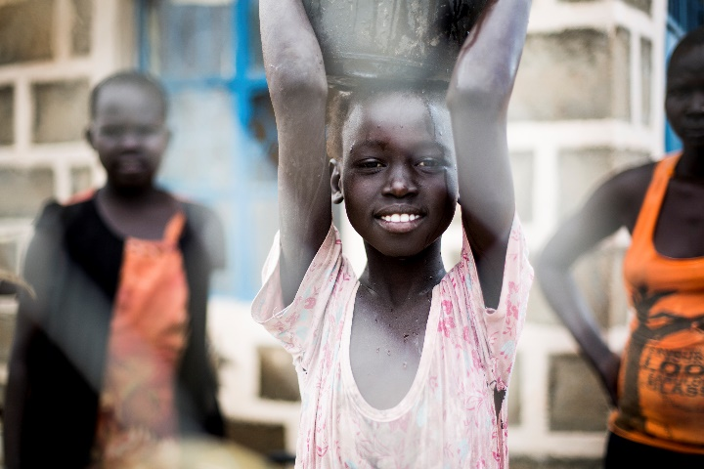
Logo de l’organisation de l’intervenant·e
Ingénierie de la santé publique
Ces supports pédagogiques ont été créés par les collègues de l’équipe Eau et habitat
Nom(s) de l’intervenant·e + organisation(s)
Notes:
During this session, we will introduce you to the topic of public health engineering and see how engineers can have a significant impact to reduce the mortality and morbidity encountered in many humanitarian contexts. You will learn about the link between Public Health and Water, Sanitation and Hygiene, so-called WASH activities.
Engineers in humanitarian assistance should have a good understanding on how communicable diseases are transmitted. This is why you will be introduced to different environmental transmission pathways of diseases and you see some measures to be taken to prevent the spread of some diseases.

Slide 2
Objectifs
Savoir
décrire l’interaction entre la population, l’environnement et la santé
inscrire les activités relatives à l’ingénierie de la santé publique dans le système de santé au sens plus large
décrire les niveaux d’intervention dans le domaine de l’eau et de l’habitat pour lutter contre les maladies transmissibles

Slide 3
Pyramide sanitaire
Soins de santé curatifs
Soins de santé préventifs
Nutrition et sécurité alimentaire
Eau, assainissement,
hygiène et environnement
Sécurité
Cours H.E.L.P.
Notes:
At the foundation of the pyramid there are two key building blocks: nutrition and public health engineering which usually in humanitarian contexts aim to provide an adequate drinking water supply, a proper excreta management, run off and waste water disposal, collection and disposal of refuse and medical waster and effective vector control interventions.
The idea behind the pyramid of health is that it makes no sense to manage health issues of vulnerable people only from the top– with “medical curative care” – if their immediate environment is the cause of their unhealthy state. Tackling the root of the problem, particularly for communicable disease, rather than only treating patients is more effective to reach out a large of population.
This approach was implemented in the eighties and well documented researches have shown that the provision of adequate food, clean water, sanitation and shelter activities were more effective than most medical programmes to tackle diarrhea and vector-borne diseases,
This is why this model advocates for public health engineering and nutrition activities to be done in close collaboration with medical activities in order to achieve a public health objective

Slide 4
Interaction entre la population et l’environnement
Population
Environnement
Notes:
In order to understand the role of the public health engineer, we have to look at the interaction between a population and its environment which can be schematized as a diagram showing,
*/ on one side, waste that a population discharges into the environment
*/and on the one side, the elements originating in the environment which are necessary to maintain a population’s life and health

Slide 5
Quels sont les déchets que rejette la population dans l’environnement ? Quels éléments de l’environnement sont nécessaires au maintien de la santé et de la vie de la population ?
??

Slide 6
Interaction entre la population et l’environnement
Déchets humains
Ordures
Déchets liquides
Population
Environnement
Eau
Énergie
Nourriture
Équipements / Logement
Vecteurs
Notes:
*/ waste that a population discharges into the environment (in the form of human excreta, garbage, and liquid waste).
*/ the elements originating in the environment which are necessary to maintain a population’s life and health (water, food, energy, raw materials for work, materials for building shelter) and also vector of diseases (such as rats or mosquitoes)

Slide 7
En quoi les interactions des populations avec leur environnement évoluent-elles lors de situations de crise et de déplacement ? Quelles sont les conséquences en matière de santé publique ?
??

Slide 8
Cercle vicieux
Production de
déchets humains
Population
Environnement
Cercle vicieux
Agents pathogènes
Notes:
During many situations of displacement:
Populations away from their familiar habitat have difficulties to maintain their hygiene practices
Overcrowding increases the risk of disease transmission
The stress on public services is increased and can result in shortages or break-down of services (water systems, health centers, latrines, waste-water systems etc)
Waste products (e.g. faeces or solid waste) are no longer disposed off properly resulting in a contamination of the environment
Displaced populations don’t have the means to keep their environment clean and are exposed to pathogens
Malnutrition and inappropriate housing increases the vulnerability of displaced populations
Between these two poles a vicious circle may be created. Infectious diseases can be transmitted by direct contact within the population,
but also through the environment.
For example, if human waste are disposed inadequately in the environment, it can lead to a proliferation of pathogens contains in the faeces in the water for instance.
As a result, it might lead to an increase of incidence of diarrheal diseases within the population, which leads to an increase of the contamination of the environment and an increase number of pathogens and so on….. A vicious circle !

Slide 9
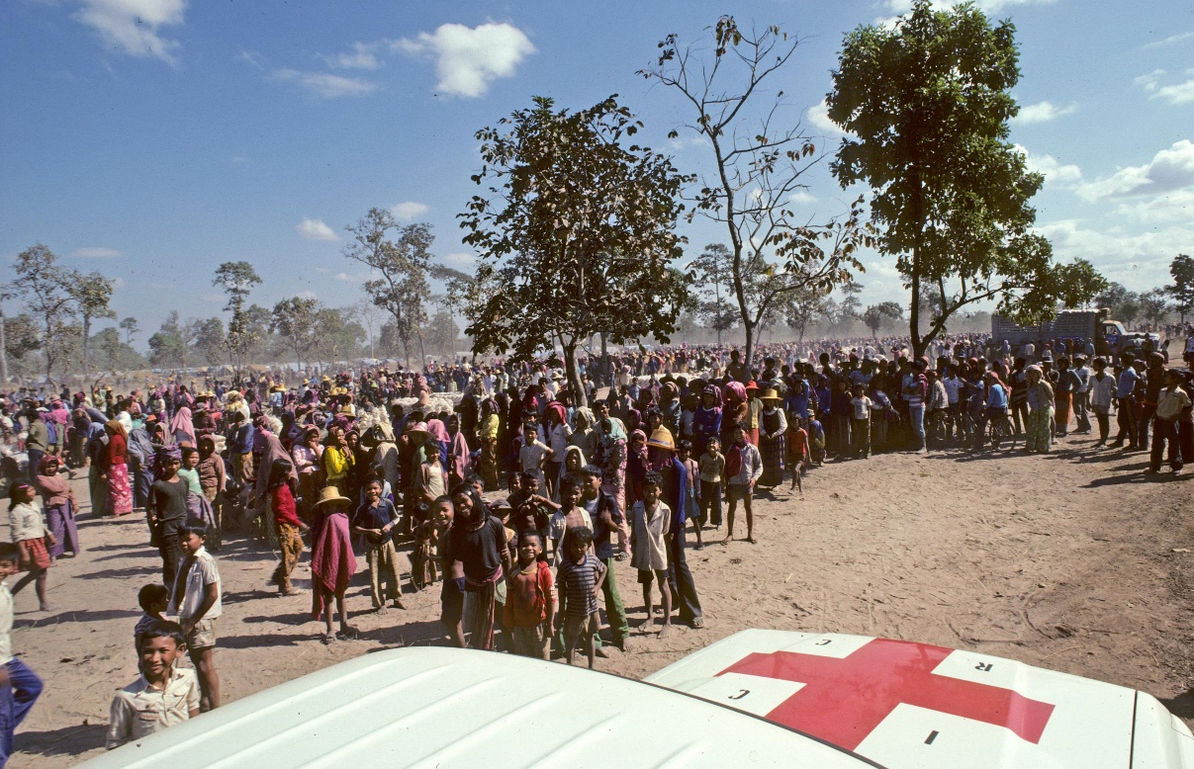
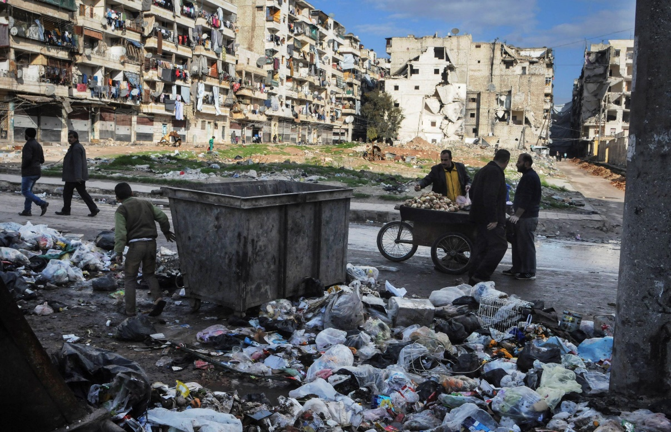
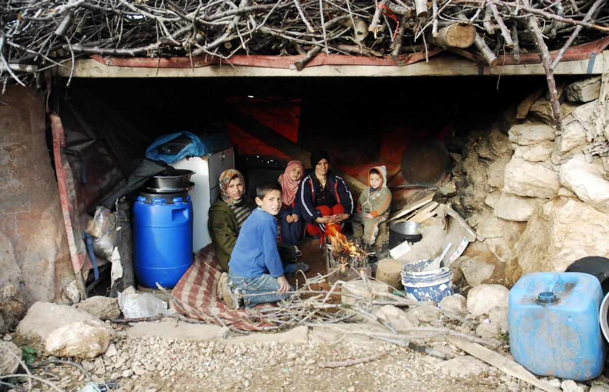
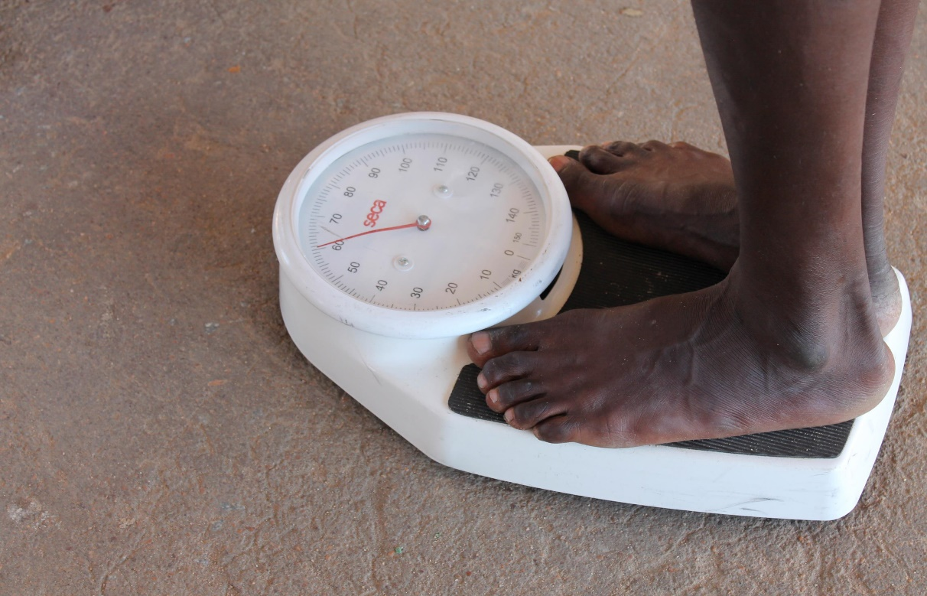
SURPOPULATION
MANQUE DE SERVICES
ALIMENTATION
INSUFFISANTE
LOGEMENTS INSALUBRES
Notes:
In a humanitarian context, the role of the public health engineer is crucial because population are particularly at risk of this vicious cycle.
Various factors aggravate the vulnerability of the population to infectious diseases:
\* Overcrowding
\* Deterioration of essential services and infrastructure, such as health care, water and sanitation systems, garbage collection.
\* Poor housing conditions in temporary settlement or damaged structures
\* Lower immunity due to malnutrition or lack of health care
.

Slide 10
Principes d’ingénierie de la santé publique
Connaître le cycle de transmission de maladies permet d’élaborer une réponse adaptée
→ Prévention
Création de dangers
Transport de matières dangereuses
Exposition aux dangers
→ Introduction de plusieurs barrières
Notes:
Public health engineering relies on this concept that certain hazards (infectious pathogens or chemicals) move through the environment and cause harms to human. Therefore, public health engineering measures focus on preventing the creation of hazards, its transport and the people from being exposed to it once encountered.
In the case of human waste mentioned early, we cannot avoid its creation, but the public engineer can reduce the spread of human waste in the environment by setting a proper sanitation system. He can also treat water and promote proper food hygiene practices to the reduce the exposure of people to faces contained in contaminated food or water.
Therefore, the role of the engineers is to put barriers at the creation, transport and exposure to hazards to improve health. Because one barrier rarely function at 100%, public health engineer should put multiple barriers.
In order to know where and when to put the barrier to stop the vicious cycle of the transmission of a disease, the public health engineer should have a good understanding of the transmission cycle of this disease
Depending on the organizations, this public health engineer is called, environmental health specialist, WASH specialist or Water & habitat, such as the ICRC.

Slide 11
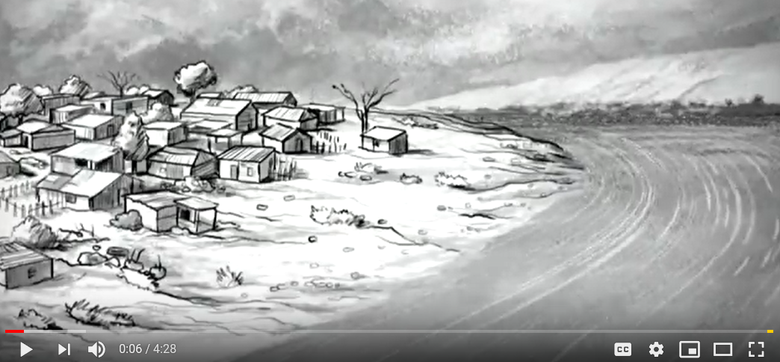
Vidéo
L’HISTOIRE DU CHOLÉRA (en anglais)
https://www.youtube.com/watch?v=jG1VNSCsP5Q
Notes:
Water-borne diseases are infections which can be transmitted through drinking water which contains the pathogen
Water-borne diseases include diarrheal diseases which is the second leading cause of death in children under five years old, and is responsible for killing more than half million of children every year. It also includes infectious hepatitis or polio. All these diseases are part of the so-called faecal-oral diseases. That is to say that Infection occuring when pathogens from the faeces of a sick person are ingested by somebody else. There are many different pathways, some direct and some indirect, for the faeces containing the pathogen to gain entry into the mouth..
The water-borne class is, for many, the most intuitive and comprises those diseases caused by the ingestion of pathogens in water. It is fundamentally concerned with water quality and safety. Chapter 4 of this volume provides an overview of the diverse viral, bacterial, protozoal and helminthic causes of water-borne disease. While water-borne disease can be manifest as, sometimes large, outbreaks, the ability of public health surveillance systems to detect such events, even in countries with advanced health information systems, is very low and in fact the majority of water-borne disease is not associated with identified outbreaks.

Slide 12
Système de classification des maladies
Classification de Bradley des dangers liés à l’eau, en fonction de leur voie de transmission :
Maladies transmises par l’eau
Maladies dues au manque d’eau (c.-à-d. d’hygiène)
Maladies d’origine aquatique (ou à support hydrique)
Maladies transmises par des vecteurs liés à l’eau
Notes:
Unlike the conventional biological taxonomy which classifies diseases according to the nature of their pathogens, in Public health engineering, we prefer to classify infectious disease according to their environmental transmission pathways
In public health engineering, we often used the so-called Bradley classification to distinct fours types of water-related routes by which a diseases may be transmitted from one person to another.
Water-related disease’ is a diverse assemblage. The hazards or agents that are the direct cause of damage include bacteria, viruses, protozoa, helminthes, chemicals and personal physical factors. They may originate from human or animal excreta, industrial operations or be parts of natural or disturbed ecosystems. The sites of entry include ingestion but also inhalation/aspiration, wounds and perforation of mucous membranes and intact skin. The sites of damage – whether by pathogens or chemical toxins – include every organ of the body. The symptoms are diverse ranging from the acute (self-limiting diarrhoea) to the chronic (cancers, blindness and life-long infections) and recurring (malaria); and are both direct (caused by a pathogen or chemical) and indirect (such as an existing condition aggravated by the physiological effects of the water-related disease or through an intermediate state such as such as malnutrition caused or aggravated by water-related disease). Finally, epidemiological investigation identifies numerous underlying associated factors such as poverty, education, climate, demography, housing and use of basic services. Some of these may be judged to be ‘causal’ whereas others may be associated through a series of co-factors, and distinguishing among these is complex.

Slide 13
Maladies transmises par l’eau
Cette catégorie comprend les maladies causées par l’ingestion d’agents pathogènes présents dans l’eau.
Elle concerne la qualité et la sécurité de l’eau.
Exemples :
Maladies diarrhéiques
Choléra, dysenteries
Hépatite infectieuse
Poliomyélite
Notes:
Water-borne diseases are infections which can be transmitted through drinking water which contains the pathogen
Water-borne diseases include diarrheal diseases which is the second leading cause of death in children under five years old, and is responsible for killing more than half million of children every year. It also includes infectious hepatitis or polio. All these diseases are part of the so-called faecal-oral diseases. That is to say that Infection occuring when pathogens from the faeces of a sick person are ingested by somebody else. There are many different pathways, some direct and some indirect, for the faeces containing the pathogen to gain entry into the mouth..
The water-borne class is, for many, the most intuitive and comprises those diseases caused by the ingestion of pathogens in water. It is fundamentally concerned with water quality and safety. Chapter 4 of this volume provides an overview of the diverse viral, bacterial, protozoal and helminthic causes of water-borne disease. While water-borne disease can be manifest as, sometimes large, outbreaks, the ability of public health surveillance systems to detect such events, even in countries with advanced health information systems, is very low and in fact the majority of water-borne disease is not associated with identified outbreaks.

Slide 14
Schéma des F
Fluids (liquides)
Fingers (doigts)
Feces (selles)
Food (nourriture)
Nouvel hôte
Flies (mouches)
Field (terrain)
https://www.youtube.com/watch?v=A5zgzLA8YaE
Notes:
The F-Driagram illustrates these main pathways. They are easily memorized as they all begin with the letter ‘f’: fluids
(such as drinking water), fingers. flies, fields (crops and soil) and food
The great majority of the agents of water-borne disease can also be transmitted by other means, all leading to ingestion. As such it overlaps with the concept of faecal–oral disease transmission

Slide 15
Schéma des F
Fluids (liquides)
Fingers (doigts)
Feces (selles)
Food (nourriture)
Nouvel hôte
Flies (mouches)
Assainissement
Field (terrain)
Principales barrières
Notes:
Various sanitation measures represent primary barriers, as they prevent feces from entering the environment in a uncontrolled manner.
Examples: appropriate latrines and waste water systems

Slide 16
Schéma des F
Fluids (liquides)
Fingers (doigts)
Feces (selles)
Food (nourriture)
Nouvel hôte
Flies (mouches)
Barrières secondaires
Principales barrières
Field (terrain)
Assainissement
Qualité de l’eau
Notes:
Water quality represents a secondary barrier, as it prevents contaminated environment (water) from contaminating food or infecting the host.
Examples: water treatment methods (like chlorination)

Slide 17
Schéma des F
Fluids (liquides)
Fingers (doigts)
Feces (selles)
Food (nourriture)
Nouvel hôte
Flies (mouches)
Barrières secondaires
Principales barrières
Field (terrain)
Assainissement
Qualité de l’eau
Hygiène
Notes:
Good Hygiene represent can both be a primary or secondary barrier.
Examples as primary barrier: stop open defecation and promote correct use latrines, washing hands after defecation
Examples as secondary barrier: washing hands before eating, store water correctly to avoid recontamination, protect food from flies etc.

Slide 18
Maladies dues au manque d’eau (c.-à-d. d’hygiène)
Résulte d’une hygiène insuffisante en raison du manque d’eau
Trois modes de transmission de la maladie
Exemples :
maladies associées à la voie oro-fécale (p. ex. l’ascaridiose)
infections de la peau ou des yeux (p. ex. le trachome)
infections causées par les poux (p. ex. le typhus)
Notes:
this class as comprising ‘infections that decrease as a result of increasing the volume of available water’ and also provide a formal operational definition: ‘water washed infections are those whose incidence or severity can be reduced by augmenting the availability of water without improving its quality’ (p162).
The second type of water-related diseases are water-washed diseases. Infections that are caused by pathogens whose transmission can be prevented by improving availability and quantity of water.
Good personal hygiene requires the availability and use of water for bathing, clothes washing and utensil washing. Therefore, the transmission mechanism is related to the quantity of water rather than water quality. There are three types of water-washed diseases:
The ones associated with the faecal-route with similar diseases to water-borne diseases
Infections of skin or eyes that are not related to the faecal oral routes, but also due to poor hygiene such as trachoma which is the leading infectious cause of blindness worldwide And infections carried by lice and which may be reduced by improving personal hygiene, such as typhus

Slide 19
Diminution des maladies diarrhéiques
Effets des différents types d’intervention :
La quantité d’eau disponible a un impact important sur l’hygiène personnelle et peut réduire le risque de transmission des maladies.
Intervention | Diminution
Qualité de l’eau | 15%
Quantité d’eau | 20%
Hygiène | 33%
Assainissement | 55%
Le manque d’eau est directement associé aux maladies vectorielles, transmises par l’eau et dues au manque d’hygiène.
Source : www.lboro.ac.uk/well/...briefs/52-water-quality-or-quantity.pdf
Notes:
Providing sufficient quantities of water is at least as important as providing good quality of water. The reason is that to maintain a good personal hygiene sufficient water is essential and that good hygiene has show to reduce the transmission of most water-associated diseases.

Slide 20
Maladies d’origine aquatique
Causées par des vers parasites qui vivent une partie de leur cycle de vie dans l’eau
Transmission par ingestion ou pénétration dans la peau
Exemples : schistosomiase, ver de Guinée
Notes:
The water-based disease class is concerned with those agents of disease that pass an obligatory part of their life cycle in water. Infection may be through ingestion – as is the case with dracunculiasis – which therefore overlaps with the water-borne class; or may be across the intact or damaged (abraded, wounded) skin (percutaneous) – as is the case with schistosomiasis and leptospirosis. These are normally disease agents with more-or-less complex life cycles. Chapter 5 describes the cause, transmission and prevention of schistosomiasis.
The third type of water related diseases is called water based. Here the pathogen spends part of its lifecycle in the water usually in a snail or another aquatic animal.
Pathogens usually enter the water from faeces and urine of infected persons. The pathogen is transmitted by ingestion or by penetration of the skin
The water-based diseases are all caused by parasitic worms. Not all parasitic worms are water-based but two of the most significant are: the Guinea worm and shistosomaisis

Slide 21
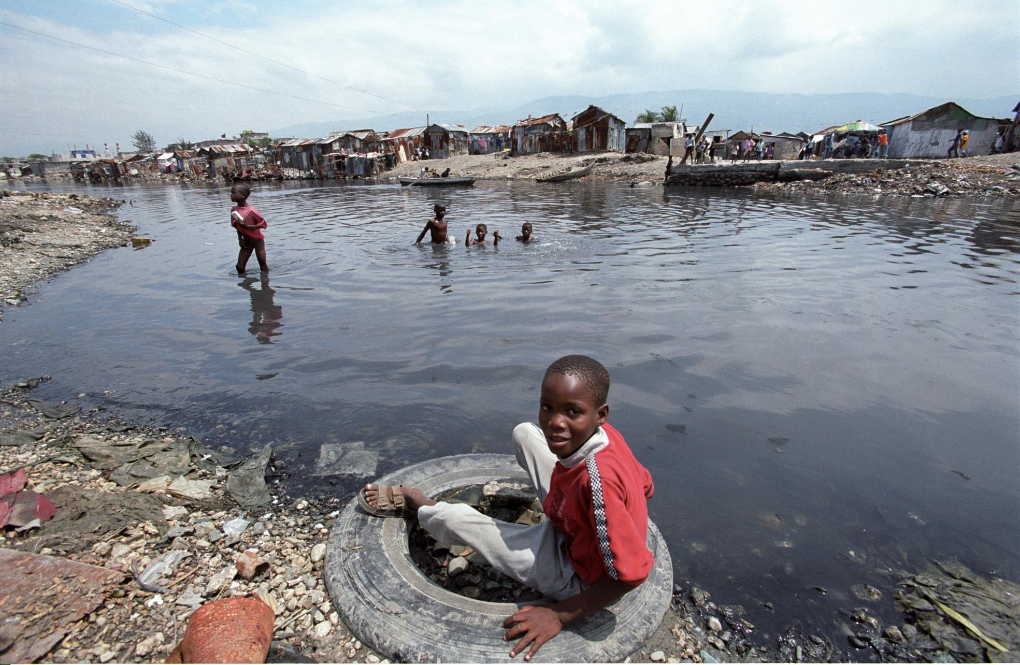
https://www.youtube.com/watch?v=lo1cRLdqKq4
Notes:
Schistosomiasis affects millions of people each year . People become infected when larval forms of the parasite – released by freshwater snails – penetrate the skin during contact with infested water (usually stagnant water). Play habits of school-aged children such as swimming or fishing in infested water make them especially vulnerable to infection.

Slide 22
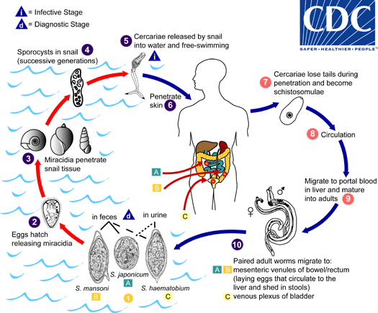

Slide 23
Maladies vectorielles liées à l’eau
Causées par des insectes (vecteurs) qui se reproduisent dans l’eau ou à proximité
Exemples : paludisme, fièvre jaune, dengue, etc.
Notes:
Finally, the fourth route are diseases spread by insects which breed in water or bite near water.
Malaria, yellow fever and dengue are diseases transmitted by this transmission mechanism
The title of this class is largely self-explanatory. The disease agent itself may have no relationship itself with water; rather its insect vector either breeds in or bites near water bodies. The relationship to water is determined by the insect vector, with some preferring stagnant polluted waters and others preferring clean, fast moving waters. Globally malaria is the most important of this class, which also includes Bancroftian filariasis, onchocerciasis, dengue, yellow fever and other arboviral infections all of which are transmitted by insects with aquatic larvae. Tsetse flies, which transmit Gambian sleeping sickness, are found near rivers but do not breed in water. Chapter 6 of this volume describes the cause, transmission and prevention of some vector-borne diseases.

Slide 24
Travail de groupe
Dressez la liste des interventions clés permettant de réduire la propagation des maladies en fonction des voies de transmission.
Temps de réflexion avant la présentation des résultats en plénière :
15 minutes
Cours H.E.L.P.

Slide 25
Interventions techniques
Notes:
Knowing the transmission routes for diseases help to identify key interventions to be done to reduce the spread of diseases.
For instance, to tackle water borne diseases, we need to improve water quality by treating water or preventing its contamination
For water-washed disease, we have to increase access and availability of water to ensure better hygiene
For water-based, it is difficult to treat infected water surface bodies, but we can prevent people from getting into contact with them.
For water related insect vector, we can apply some vector control measures that we will see further into details during this wekk.

Slide 26
Conclusion : ingénierie de la santé publique
Dans les situations d’urgence, les pratiques d’hygiène personnelle sont délaissées et les services publics sont souvent interrompus, ce qui peut entraîner la propagation de certaines maladies : un cercle vicieux.
Le travail des ingénieurs de la santé publique consiste à introduire plusieurs barrières afin de bloquer la transmission de la maladie. Il s’agit de sensibiliser le public et de fournir les infrastructures et services adéquats. Les barrières les plus importantes sont liées à : l’approvisionnement en eau, l’assainissement et la promotion de l’hygiène.
Pour mettre en place des barrières efficaces, il est nécessaire de connaître les schémas de transmission des agents pathogènes, que ce soit les maladies transmises par l’eau, celles dues au manque d’hygiène, ou encore les maladies d’origine aquatique et vectorielles.
Un approvisionnement suffisant en eau est essentiel au maintien d’une bonne hygiène. Il a été montré qu’une bonne hygiène personnelle permet de réduire le risque de contracter la plupart des maladies liées à l’eau.

