Slide 1
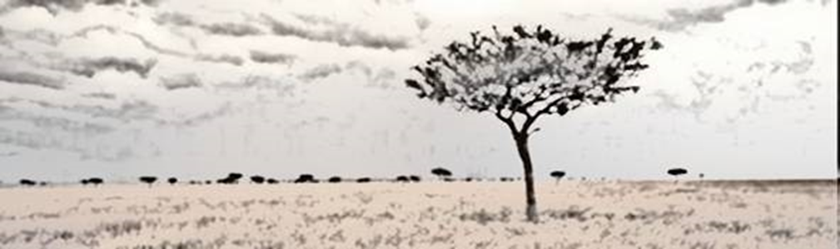
Nutrition et moyens de subsistance dans les situations de crise humanitaire
Logo de l’organisation de l’intervenant·e
Cours H.E.L.P.
Ces supports pédagogiques ont été créés par :
Rachel Lozano, CICR, Valérie Belchior-Bellino, CICR,
Mija Ververs, John Hopkins University/CDC et
Nicole Niederberger, Terre des Hommes
Nom(s) de l’intervenant·e + organisation(s)

Slide 2
Objectifs
Être en mesure
d’identifier des groupes de population présentant de hauts risques de malnutrition et leurs besoins spécifiques
de décrire les étapes d’une crise et les différentes situations de crise
Cours H.E.L.P.

Slide 3
Mécanisme d’adaptation
Instruction
PHYSIQUES
FINANCIERS
Dépenses indispensables
Revenus
NATURELS
HUMAINS
STRATÉGIES DE
SUBSISTANCE
Conditions de vie
Santé
Production alimentaire
POLITIQUES
SOCIAUX
Consommation alimentaire
Nutrition
Cours H.E.L.P.
Notes:
The assets and strategies will lead to livelihood outcomes
Nutritional status
The nutritional status is a key indicator for a person’s physical condition that will be discussed in a later section. It is a very useful outcome to monitor because it reflects directly people’s health and / or food consumption and it informs on people’s ability to work.
Health
A person’s health is closely linked to their food intake, nutritional status and basic living conditions as well as to their behaviour (awareness, attitude, practices) and their access to quality health care. Good health in turn is essential for performing livelihood activities and achieving positive outcomes.
Education & capacities
People’s capacities are crucial. If someone is uneducated and has poor skills, there is a strong risk that the person will only achieve poor livelihood outcomes.
The economic security core components
Those that are directly relevant for economic security at HH level:
Food consumption
Food production
Income support; and
Basic living conditions.
It has been demonstrated that the poorer the household, the more of its resources are spent on food.

Slide 4
Processus de crise
Phase préliminaire
Phase de récupération
Phase aigüe ou crise
Adaptation
Utilisation des réserves et des défenses
Consolidation
Dégradation fonctionnelle
Récupération
Cours H.E.L.P.
Décompensation
Réanimation
Mort du système concerné
Notes:
This process can take a few minutes (tsunami) or a much longer period (political crisis, drought) .

Slide 5
Les mécanismes d’adaptation
Exemples de mécanismes d’adaptation :
Réduction des repas
Recours aux emprunts
Cueillette de nourriture sauvage
Obligation de travailler pour certains membres de la famille
Vente d’outils de production
Vente de terres agricoles
Prostitution
Ce sont des mesures prises par des personnes pour traverser des périodes difficiles causées par des événements affectant leurs moyens d’existence et leur mode de vie
Ils peuvent être identifiés au niveau de la communauté, du ménage et au niveau individuel
Ils peuvent être néfastes en compromettant en permanence la santé ou la sécurité alimentaire du ménage, ou être évolutifs et réversibles
Cours H.E.L.P.
Notes:
Are coping strategies always ‘abnormal’ or damaging?
There are different stages of coping. Early coping strategies are not necessarily abnormal: They are reversible and cause no lasting damage. These may include collecting wild foods, selling nonessential assets or sending a family member to work elsewhere.
More drastic strategies may permanently undermine a household’s future food security. These may involve the sale of land, distress migration on the part of whole families, or intensive use of wood leading to deforestation.
Some coping strategies employed by women and girls, such as prostitution/commercial sex work, tend to expose them to sexual violence, physical harm and higher risk of HIV and other sexual transmitted diseases infection. Migration generally increases the risk of HIV transmission.
Coping strategies may also affect the environment, for example through over-exploitation of commonly-owned natural resources. It is important to protect and support food security before people begin using more damaging strategies, having exhausted all other means of coping.

Slide 6



Voici nos familles
Cours H.E.L.P.

Slide 7
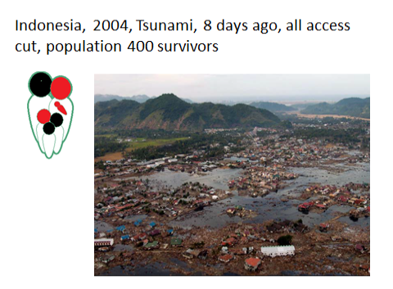
Cours H.E.L.P.
Notes:
Situation: Earthquake of a magnitude of 9.2 on the Richter scale followed by one of the deadliest tsunami of history. Affected several countries and millions of people.
Few contacts with survivors per radio communication, visual assessment of the whole coast using a helicopter, slow decrease of water level, assumption of very high number of deaths.
Were middle class inhabitants of a big village close to the sea
Father and two kids died during the events, the baby was born in between.

Slide 8
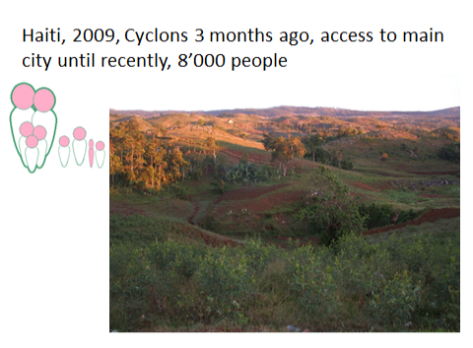
Cours H.E.L.P.
Notes:
Situation: South east Haiti, a place called Baie d’Orange. We were requested to make an assessment because «there is something wrong there». Cyclons 3 months ago (Fay, Gustave and Hannah)
access to main city of department cut because of road damage: «much more» cases of acute malnutition than usually.

Slide 9
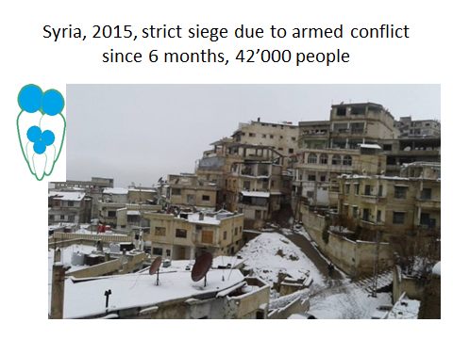
Cours H.E.L.P.
Notes:
Severe conflict situation since more than 4 years in a lower middle income country. Previously health and education system were functionning. Siege used as a warefare technique. No access possible since 5-6 months (no good nor people movement possible). Most information received through media and social media, few contact with healthcare providers, non quantified but alarming feedback on nutritional situation. Time available on site possibly very short.
Father was outside the area for his work when city was besieged and has no possibility to join them.

Slide 10
La survenue d’une crise humanitaire
dépend de :
la vulnérabilité et des capacités, mais aussi du type et de l’ampleur du danger
(DANGER + VULNÉRABILITÉ)
----------------------------------------- = gravité de la CRISE
CAPACITÉS / RESSOURCES
Cours H.E.L.P.
Notes:
A disaster is a sudden or slow, calamitous event that seriously disrupts the functioning of a community or society and causes human, material, and economic or environmental losses that exceed the community’s or society’s ability to cope using its own resources. Though often caused by nature, disasters can have human origins
Means available to mitigate the effect of the haZard

Slide 11
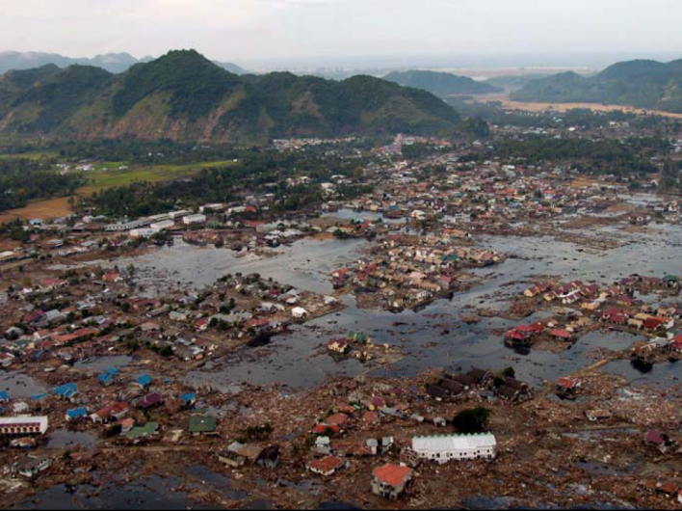

Indonésie, 2004, tsunami, 400 survivants
DANGER + VULNÉRABILITÉ
----------------------------------------- = gravité de la CRISE
CAPACITÉS / RESSOURCES
Énorme danger, zone côtière exposée
Pays à revenu intermédiaire
Capital humain et biens matériels importants avant la catastrophe
Aucune préparation
Aide disponible partagée entre des millions de personnes de plusieurs pays
Cours H.E.L.P.

Slide 12
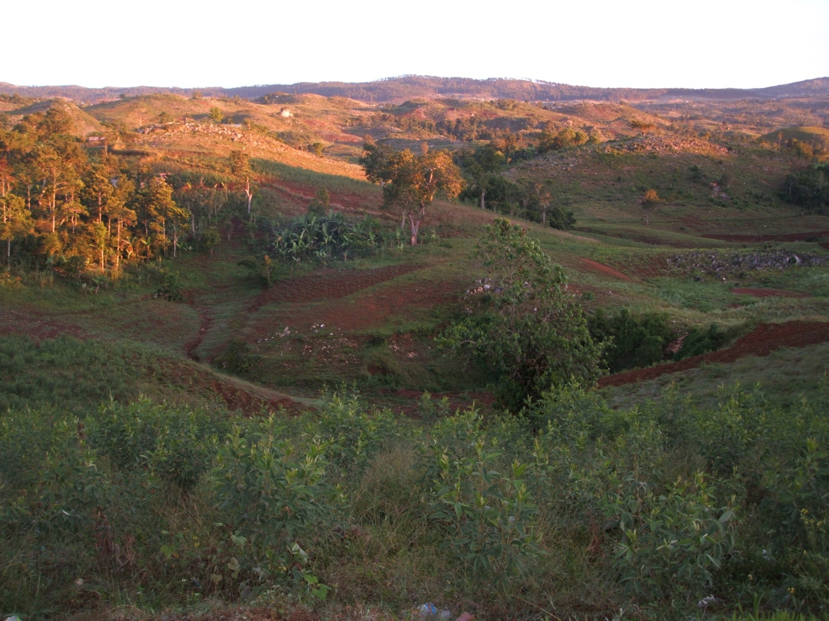
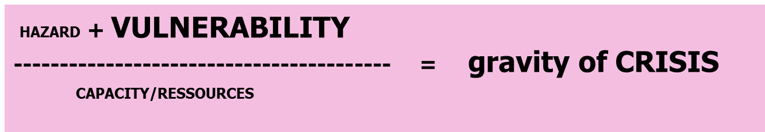

Haïti, 2009, cyclone 3 mois auparavant, aucun accès à la ville principale jusqu’à récemment, 8000 personnes
Danger de moyenne portée
Pays à faible revenu
Familles pauvres, sécurité alimentaire limite
Aucune préparation aux catastrophes
Pas de stocks de nourriture
Très peu, voire aucune aide fournie
Cours H.E.L.P.

Slide 13
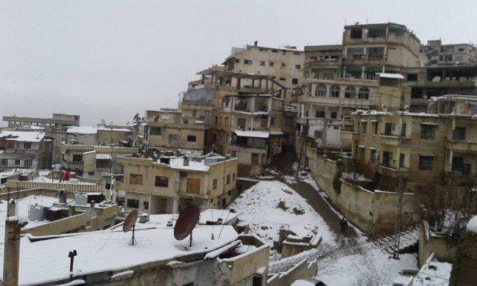
Syrie, 2015, ville assiégée depuis 6 mois à la suite d’un conflit armé, 42 000 personnes
DANGER + VULNÉRABILITÉ
---------------------------------------- = gravité de la CRISE
CAPACITÉS / RESSOURCES
Pays à revenu intermédiaire
Solide régime de gouvernance, bon système de santé, bon système éducatif
Préparation limitée
Perte de capital humain essentiel en tant que stratégie au conflit
Cours H.E.L.P.

Slide 14
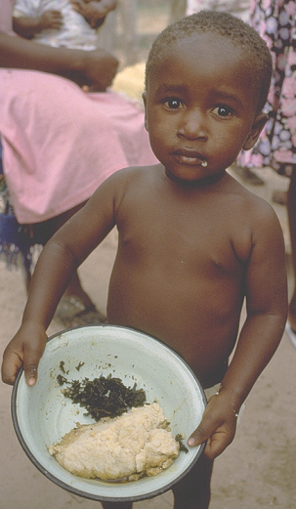
Situations de crise engendrant une insécurité alimentaire et économique
Nourriture en quantité et qualité insuffisantes
Exposition supplémentaire à d’autres facteurs de risques nutritionnels
Risque de malnutrition
Cours H.E.L.P.
Notes:
Crisis often lead to worsening of the food consumption
What’s wrong with this ration?
Monotonous
Limited food groups: 4 or 5
Incomplete range of micronutrients
Often lacking adequate proteins
Causes of malnutirtion will be detailed duirng one of the next sessions

Slide 15
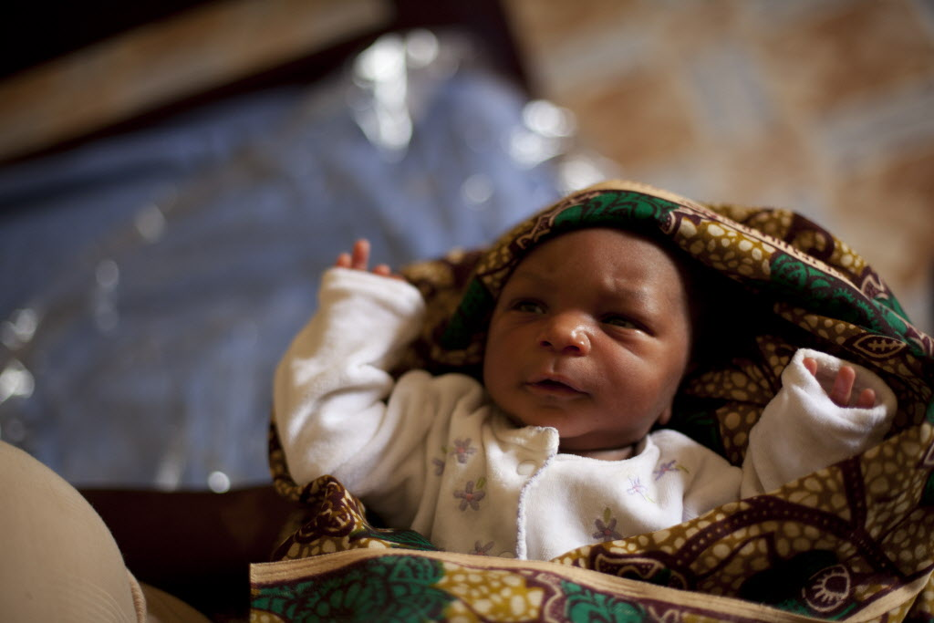
Le cas particulier des nourrissons et des enfants en bas âge
Cours H.E.L.P.
Notes:
Published in 3 Lancet series in 2008, 2013 and 2016
Access is needed for as long as the child needs it, meaning minimum 6 months to one year.
Example: Syria: no access of the household and no availability on the market in besieged area.

Slide 16
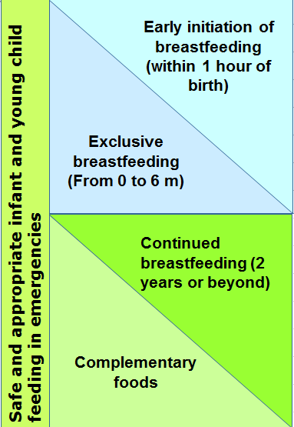
Recommandations pour les enfants de moins de 2 ans
Rôle crucial pour les systèmes de soins de santé, les organisations humanitaires, la communauté et le gouvernement concernant les choix individuels et les pratiques des mères
Code international de commercialisation des substituts du lait maternel adopté en 1981 Rarement appliqué dans les faits
Cours H.E.L.P.
Notes:
What are optimal IYCF recommendations?
Safe and appropriate IYCF practices are optimal practices to minimise morbidity and mortality:
Optimal IYCF recommendations are:
Early initiation of exclusive breastfeeding (EBF) – this means breastfeeding within 1 hour of birth
EBF for 6 months – exclusive breastfeeding means an infant receives only breastmilk, no other liquids or solids, not even water, with the exception of necessary vitamins, mineral supplements or medicines.
Continued breastfeeding to 2 years or beyond.
Complementary feeding encompasses continued breastfeeding, the introduction of complementary foods, and how that is done in the nutritional and developmental interests of the child.
BMS industry represents 44 billion yearly worldwide, increasing of 10% in some countries (China). And puts enormous means in marketing (10X more than breastfeeding promotion programs in UK 2012)

Slide 17
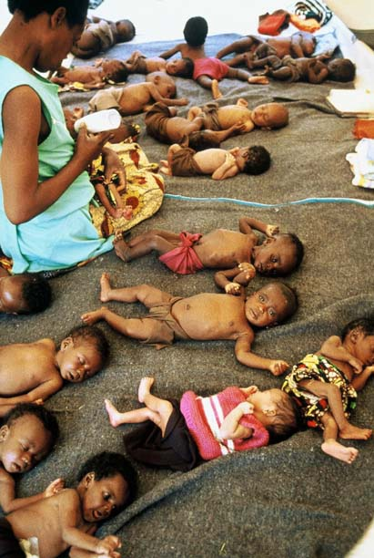
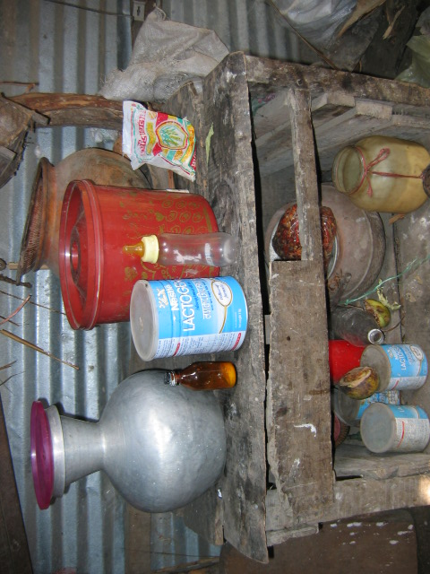
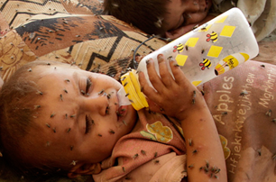
Quels sont les problèmes rencontrés lors des situations de crise ?
Alors que les enfants allaités de moins de six mois sont bien protégés, les enfants nourris au lait artificiel sont très vulnérables
PAS d’eau potable
PAS de moyens de préparation sûrs
PAS d'accès au lait maternisé
Cours H.E.L.P.
Notes:
Published in 3 lancet series 2008, 2013 and 2016
Access is needed for as long as the child needs it, meaning minimum 6 months to one year.
Example: Syria: no access of the household and no availability on the market in besieged areas.

Slide 18
Le cas particulier des nourrissons et des enfants en bas âge
La diversification de 6 à 23 mois peut également être problématique
PAS de nourriture de consistance et de qualité adéquates
PAS de fréquence des repas adaptée
PAS d’eau potable
PAS de moyens de préparation sûrs
Maladies fréquentes (dues à l’environnement et liées au développement de l’enfant)
Risque accru de malnutrition et de mortalité infantile
Cours H.E.L.P.
Notes:
Published in 3 lancet series 2008, 2013 and 2016
Children >6 months need sufficient nutritious food – Breast milk is no longer enough
Frequency (Ex. Chad refugee camp: 2 meals/day….)
Consistency
Quality – lack of nutritious foods; need for calcium, protein food products, etc. (transition BF-food problems)
Quantity – sharing… Inappropriate feeding: full grains (staple)
Not hygienically prepared or consume
Frequent illnesses (normal childhood diseases but also new ones due to disaster setting; >1 year: age of walking with more exposure to unhygienic environment)
Access is needed for as long as the child needs it, meaning minimum 6 months to one year.
Example: Syria: no access of the household and no availability on the market in besieged area.

Slide 19
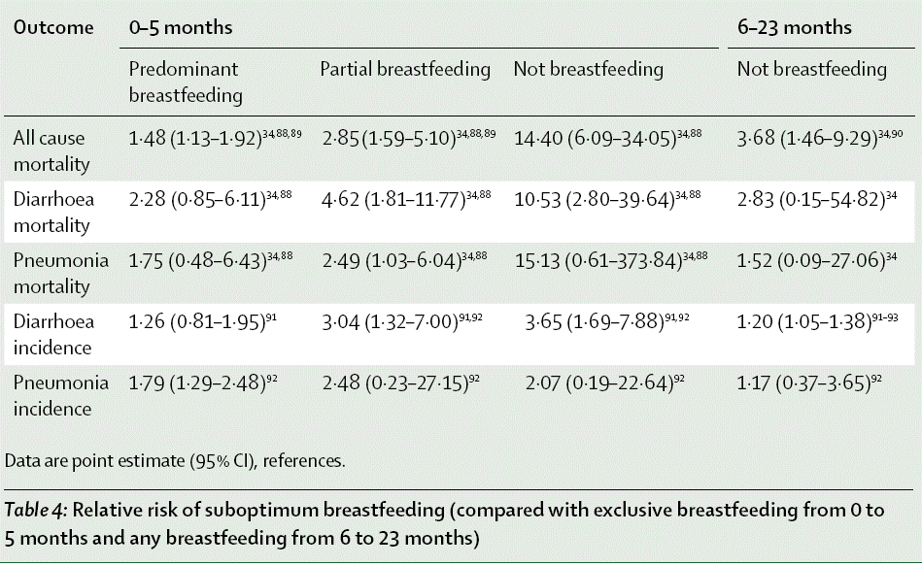
Perte des bénéfices de l’allaitement maternel (du point de vue immunologique, nutritionnel, psychoaffectif...)
Et risques additionnels dus à l’absence d’allaitement maternel (hygiène, achats, qualité,...)
Cours H.E.L.P.
Notes:
Black lancet

Slide 20
Quel peut être l’impact d’une crise sur la consommation alimentaire de ces familles ?
Cours H.E.L.P.
Notes:
In plenary:
Remember : hazard + vulnerability/ capacity
Coping mechanisms? Consequences at short term for those families?

Slide 21
Lors de la prochaine séance, nous étudierons les causes de la malnutrition
Cours H.E.L.P.

