Slide 1
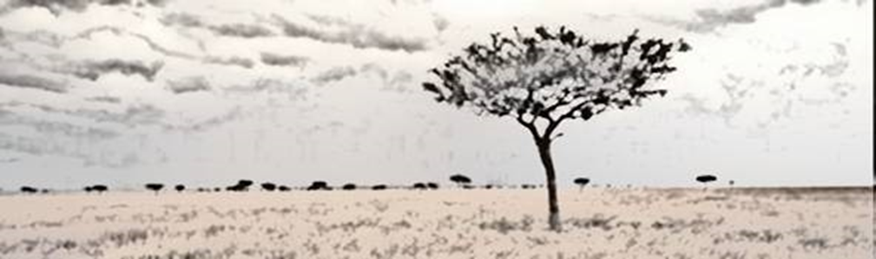
Nutrition et moyens de subsistance : concepts
Logo de l’organisation de l’intervenant·e
Cours H.E.L.P.
Nom(s) de l’intervenant·e + organisation(s)
Ces supports pédagogiques ont été créés par :
Rachel Lozano, CICR, Valérie Belchior-Bellino, CICR,
Mija Ververs, John Hopkins University/CDC et
Nicole Niederberger, Terre des Hommes

Slide 2
Objectifs
Être en mesure
de décrire les concepts relatifs à la nutrition et à la sécurité alimentaire
de décrire différentes stratégies de subsistance basées sur les actifs des ménages
de décrire les bases d’une alimentation adéquate pour les individus et les populations
Cours H.E.L.P.

Slide 3
Imaginons trois familles.
Elles vont nous accompagner pendant ces deux jours de formation
Cours H.E.L.P.
Notes:
Each group gets one family
We’ll follow these families during the nutrition and livelihood module
See Hand out

Slide 4
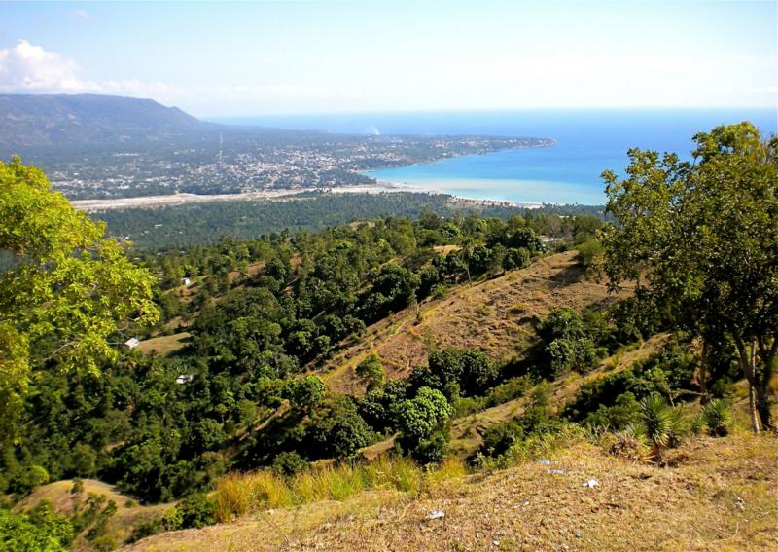




Haïti, 2008, zone rurale dans le sud :
la famille Rose
Cours H.E.L.P.
Notes:
Low income country, modest farmer family. Parents and 7 children.

Slide 5

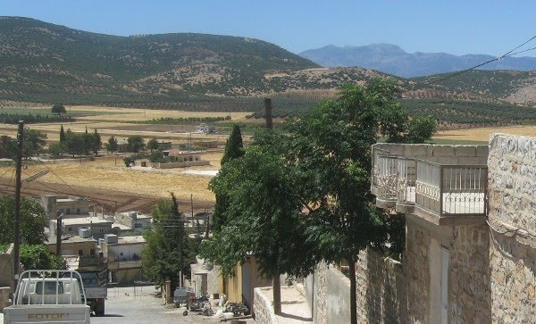
Syrie, 2009, petite ville touristique :
la famille Bleu
Cours H.E.L.P.
Notes:
Lower middle income country,
Follow a family with parents, grand mother (missing in the drawing), and 3 children (1, 2 and 4 years old). Father is a civil servant and works in a nearby place. They own an apartment.

Slide 6

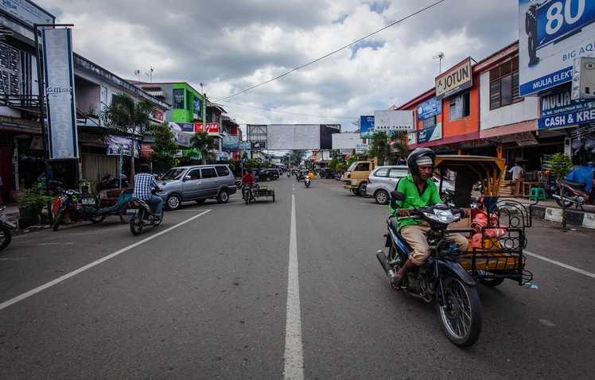
Indonésie, 2003, ville côtière :
la famille Rouge
Cours H.E.L.P.
Notes:
Lower middle income country, Costal area in the south of Banda Aceh, in Indonesia.
Family with 3 children, mother is pregnant, parents have a little house close to the sea and work occasionally in a small food store in the neighborhood.

Slide 7
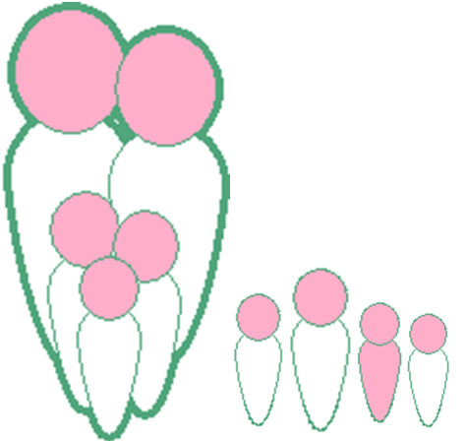
??
De quoi ces familles et la population en général ont-elles besoin pour vivre ?
Cours H.E.L.P.
Notes:
Based on the responses. How can we detail those needs? (question-answer in plenary or in small groups -3 min)
Food
Education
Social life and network
Water and sanitation
Security
Health
Shelter and furniture

Slide 8
Ce dont elles ont besoin :
Nourriture
Habitat et
mobilier
Instruction
Soins de santé
Vie sociale
et amis
Cours H.E.L.P.
Sécurité
Eau et
installations sanitaires
Notes:
The three families are all three represented by the family here.
Whatever context you live in, these basic needs are the same.

Slide 9
Ce dont elles ont besoin :
Il s’agit des besoins essentiels
Nourriture
Habitat et
mobilier
Instruction
Soins de santé
Vie sociale
et amis
Sécurité
Cours H.E.L.P.
Eau et
installations sanitaires
Notes:
Link with family needs

Slide 10
Ce dont elles ont besoin :
Nourriture
Habitat et
mobilier
Instruction
Soins de santé
Vie sociale
et amis
Sécurité
Cours H.E.L.P.
Eau et
installations sanitaires
Notes:
Let’s deepen our insight in one of these needs: food

Slide 11
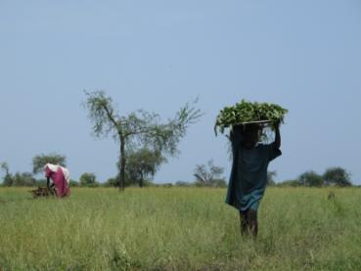
Nourriture
En quantité appropriée
et de qualité adéquate
Cours H.E.L.P.
Soudan du Sud, août 2013
Notes:
Everybody needs food
in adapted quantity → a child is eating less than an adult
In adapted quality → children needs animal source food to grow, women a good source of iron…

Slide 12
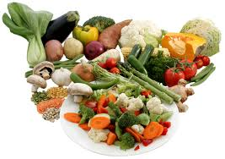
Quantité
Appelée énergie
Mesurée en kilocalories (kcal)
Varie en fonction de l’âge, de la taille, du poids, de la grossesse ou de l’allaitement, de l’activité physique, du climat, des maladies, etc.
Cours H.E.L.P.
Notes:
Energy provided to the body per amount of nutrient
Food needs vary. Those variations are due to:
Age: an infant is eating less than his father nutrients to grow before 2 / 3 years
Body shape: large people eat more than the tin ones
Season: people eat more in cold environment or season the in hot ones → 100 kcal / degree
Activity level: farmers eat more when going to cultivate than office employee
Status: a pregnant women needs 285 Kcal more per day (in average), a lactating 500 kcal
Health: a sick child may refuse to eat. Some illness or injury increase the need for food (HIV, TB, Burns)

Slide 13
Besoins énergétiques quotidiens
Groupe
Hommes
Femmes
Moyenne
d’âge
(kcal/jour)
(kcal/jour)
(kcal/jour)
% de pop.
0-4 ans
1320
1250
1290
12,37%
5-9
ans
1980
1730
1860
11,69%
10-14
ans
2370
2040
2210
10,53%
15-19
ans
2700
2120
2420
9,54%
20-59
ans
2460
1990
2230
48,63%
+ de 60
ans
2010
1780
1890
7,24%
Femmes enceintes
285
(en plus)
2,4%
Femmes allaitantes
500
(en plus)
2,6%
BESOINS QUOTIDIENS MOYENS :
2100 kcal/personne/jour
Cours H.E.L.P.
Basé sur le rapport technique de l’OMS n° 724 et sur les estimations de population des Nations Unies, mi-1995
Notes:
PREGNANCY: 285 kcal extra is based on:
Food and Nutrition Needs in Emergencies, UNHCR, UNICEF, WFP and WHO, 2004.
And other articles.1st trim no extra needs in kcal, 2nd 350 and 3rd 500 kcal, average throughout pregnancy 285 kcal
The ICRC ration of 2’400 kcal / person / day is based on WHO 1: a male of 65 kg, a female of 55 kg with a moderate activity
The WFP ration of 2’100 Kcal / person / day is based on WHO 2: a male of 60 kg, a female of 52 Kg with light activity… may be the type of population in camps??

Slide 14
Macronutriments
Micronutriments
Protéines
Minéraux
Oligo-
éléments
Glucides
Vitamines
Lipides
Indispensables au
fonctionnement des cellules
Cours H.E.L.P.
Fournissent de l’énergie
EAU
Notes:
Nutrients are divided in 2 types of nutrients
MACRONUTRIENTS**
MICRONUTRIENTS
Vitamins and minerals

Slide 15
Micronutriments
Minéraux
VITAMINES SOLUBLES DANS L’EAU
Calcium
Soufre
Magnésium
Fer
Vit. B-1 (thiamine)
Sodium
Phosphore
Acide pantothénique
Vit. B-2 (riboflavine)
Potassium
Acide folique
Vit. B-12
Vit. B6
B3 niacine
Vit. C
OLIGOÉLÉMENTS
Molybdène
Bore
VITAMINES LIPOSOLUBLES
Fluorure
Sélénium
Cobalt
Cours H.E.L.P.
Vitamine A
Iode
Zinc
Vitamine D
Cuivre
Vitamine E
Chrome
Manganèse
Vitamine K
Silicium
Notes:
Those marked as Red are of a big public health concern worldwide.
Red bold are those most often seen in emergencies on large scale, often difficult to get sufficient in a diet in even ‘normal’ diets in developing countries.

Slide 16
Macronutriments
Protéines → 4 kcal par gramme
Lipides → 9 kcal par gramme
Glucides → 4 kcal par gramme
Alcool → 7 kcal par gramme
Énergie (kcal)
Cours H.E.L.P.
Notes:
PROTEINS 10 - 15 %
FAT 15 – 30 %
CARBODHYDRATES 55 – 75 % ; have as well specific roles and metabolism
They all provide energy but

Slide 17
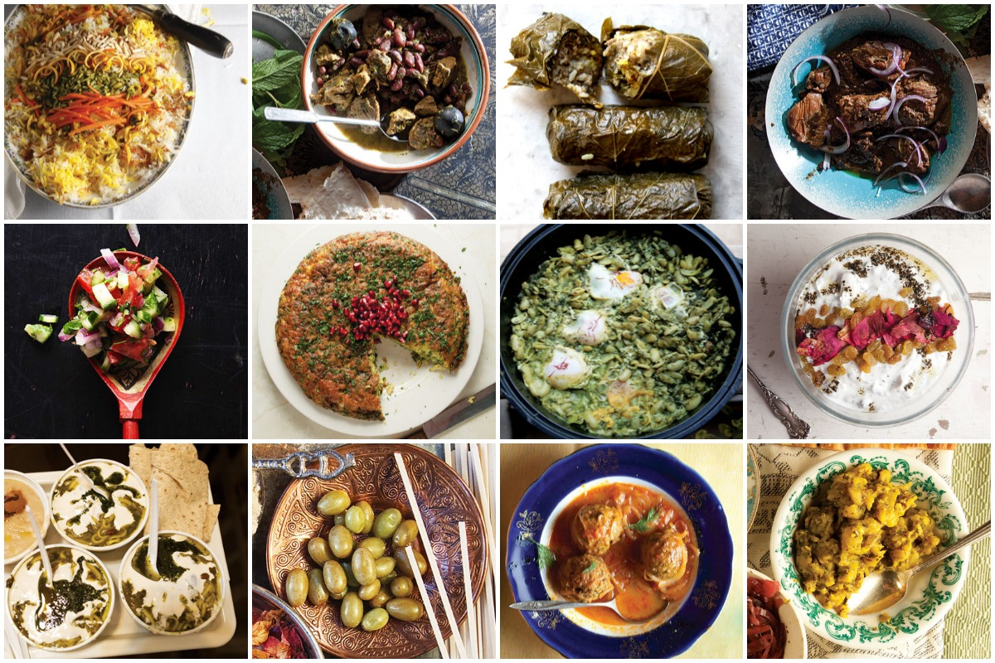
Comme tous les êtres humains, nos familles n’ont pas besoin de nutriments, de kcal ou de pourcentages,
mais d’une alimentation diversifiée.
N’oubliez pas...
Cours H.E.L.P.
Notes:
Depending on many, social, environnemental and cultural factors

Slide 18
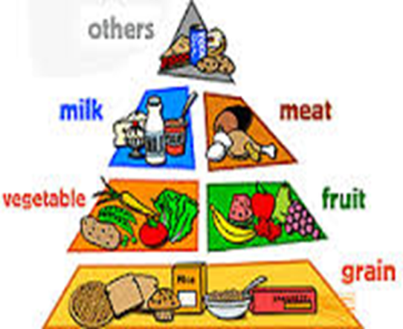
  Lipides
  Protéines
  Vitamines et minéraux
  Glucides
Cours H.E.L.P.
Notes:
To have a balanced intake, Our requirement should be met with a diversified range of foods
The food diversity has been classified in 4 groups in a pyramid:
At the base: carbohydrates it’s what we need in biggest quantities
1st floor: fruits and vegetables
2nd floor: meat, milk, fish eggs
3rd floor: What we need in smaller quantity like oil

Slide 19
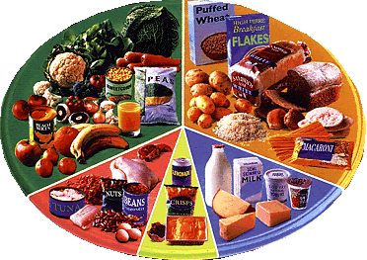
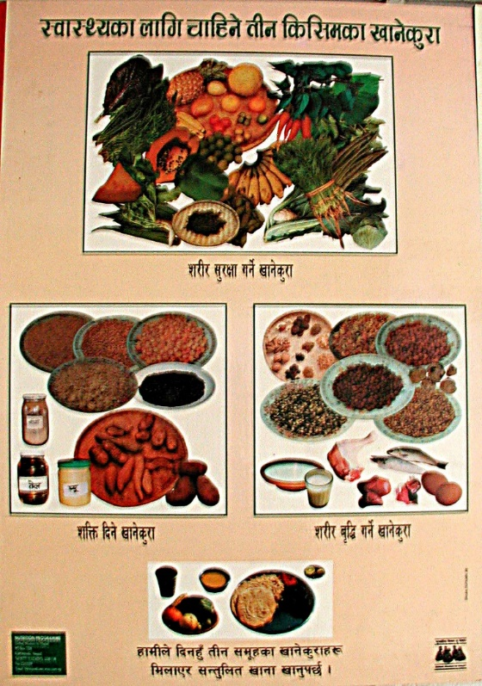
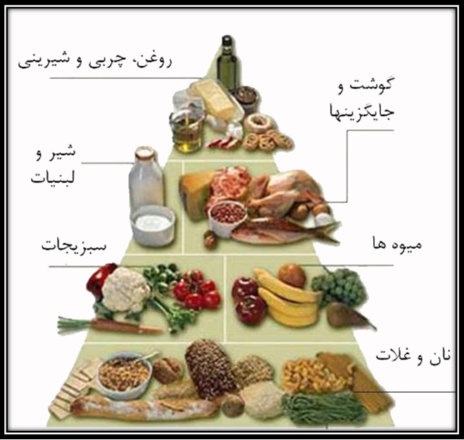
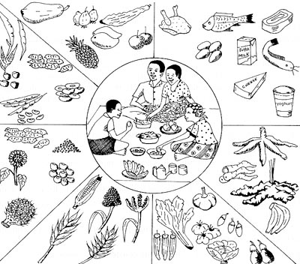
Cours H.E.L.P.
Notes:
This can be presented in many different ways, and adapted locally. A more boring, written one is proposed to you as a hard copy (hand out).
When we have access to the whole range of nutrients on a regular basis and in good quantities, this will contribute to a good nutritional status (we will see later that food alone is not sufficient to ensure a good nutritional status.

Slide 20
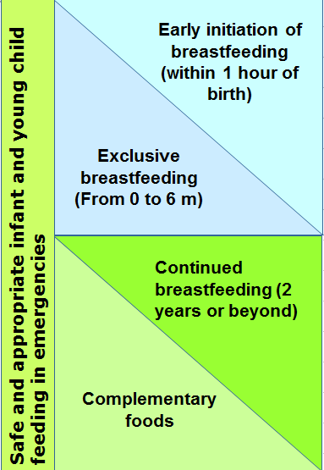
Recommandations pour les enfants de moins de 2 ans
Rôle crucial pour les systèmes de soins de santé, les organisations humanitaires, la communauté et le gouvernement concernant les choix individuels et les pratiques des mères
Code international de commercialisation des substituts du lait maternel adopté en 1981 Rarement appliqué dans les faits
Cours H.E.L.P.
Notes:
What are optimal IYCF recommendations?
Safe and appropriate IYCF practices are optimal practices to minimize morbidity and mortality:
Optimal IYCF recommendations are:
Early initiation of exclusive breastfeeding (EBF) – this means breastfeeding within 1 hour of birth
EBF for 6 months – exclusive breastfeeding means an infant receives only breastmilk, no other liquids or solids, not even water, with the exception of necessary vitamins, mineral supplements or medicines.
Continued breastfeeding to 2 years or beyond.
Complementary feeding encompasses continued breastfeeding, the introduction of complementary foods, and how that is done in the nutritional and developmental interests of the child.
BMS industry represents 44 billion US yearly worldwide, increasing 10% in some countries (e.g. China). And puts enormous means into marketing (10x more than breastfeeding promotion programmes in UK in 2012)

Slide 21
Un bon état nutritionnel est
un état dans lequel les fonctions physiques d’une personne lui permettent de maintenir les processus de performance corporelle adéquate – croissance, grossesse, allaitement ou travail physique –, de résister à la maladie et de recouvrer la santé
Cours H.E.L.P.

Slide 22
Pour pourvoir à ses besoins essentiels, notre ménage dispose de moyens de subsistance.
Moyens de subsistance
Capacités, actifs, revenu et activités nécessaires pour gagner sa vie
Cours H.E.L.P.
Notes:
They have needs, but they also have assets

Slide 23
Moyens de subsistance
PHYSIQUES
FINANCIERS
NATURELS
HUMAINS
Cours H.E.L.P.
POLITIQUES
SOCIAUX
Notes:
On a flip chart: Bring out the assets of this family, i.e.
Human assets
Physical condition: Health & nutritional status, ability to work, ability to move
Capacities: Skills & education
The human assets of a HH describe the people themselves, their condition and capacities.
HH’s human assets can be seen as the balance of productive human assets (labour force, good education, developed professional skills) on one side, versus the HH’s liabilities on the other side (poor physical condition, illiteracy, high number of dependents, chronically ill family member needing care etc.)
Key message: The impact of the human assets on a HHs livelihood can hardly be overestimated! Naturally, the human assets vary strongly between different HHs.
Social assets
Solidarity networks like the extended family, kinship structures, neighbours, religious groups as well as benefits through prestige and influence.
The social assets comprise solidarity mechanisms available to a HH that are beyond the HH (core family) but that remain at an informal (non-government) level. Such networks are particularly important after HHs face a shock.
Example: In many cases, displaced populations seek refuge in areas where they can expect solidarity from relatives or members of their ethnic group.
Political assets
Rights through citizenship, relations with the authorities
The political assets describe people’s relationship to political power structures and decision makers. Typical examples of this are favouritism and marginalization. In addition, there are the basic rights that come with citizenship – or the absence of these if people are for example refugees.
Natural assets
Natural resources like (public) land, water, wildlife, biodiversity, the atmosphere, solar energy etc.
These comprise the natural environment that is not privately owned and that, in principle, is accessible to everyone. The preservation and exploitation of these resources is usually regulated by formal or customary laws (regulations to protect water quality, the exploitation of timber, hunting etc.).
Physical assets
Basic goods and infrastructure at HH level. They are mostly related to living conditions and means of production
Physical assets can be divided into the following categories:
Basic (HH level) infrastructure related to: water, sanitation, transport, communication and energy
Housing / shelter
Non-food items: cooking, clothing, bedding etc.
Means of production: Livestock, tools and devices used for livelihood activities as well as privately owned land
HHs’ living conditions and capacity to produce food often depend on physical assets.
Financial assets
Savings, gold & jewellery, remittances, credit, scholarships, pensions
These are HHs direct “reserves” of cash. Income and salaries are not included in this because they are realized through livelihood activities and fall under the livelihood outcomes.
The financial assets are crucial because they provide flexibility as they can be easily converted into other assets.
For example, money can buy physical assets, it can develop the human assets through education or it can enhance the political capital through paying bribes.
A HH’s dependency ratio is the number of individuals aged under 15 or over 64 years, divided by the number of individuals aged 15 to 64 years. The higher the value, the heavier the burden for the HH.
The initial version of the SLF contained only five assets, the political assets were integrated at a later stage.
Infrastructure at HH level includes means of communication, transport, water etc.
Depending on the situation, livestock can be used either as means of production, savings or a social asset (for status & dowry)
Some versions of the SLF place privately owned agricultural land under “natural assets”. However, here the assumption is that this is a private means of production. The benefit of its use or the impact due to its loss will essentially affect the owners. For this reason, privately owned land is grouped together with the other means of production.

Slide 24
??
Quels sont les moyens de subsistance de votre famille ?
Cours H.E.L.P.
Notes:
Q/A in plenary: Each group proposes 3 possible livelihood assets for their family (taken from the description given earlier or imagined). Guide so that the examples cover all the categories of the livelihood assets.

Slide 25
Stratégies de subsistance
Basées sur leurs choix personnels :
les enfants iront-ils à l’école et à l’université ?
pour quelles améliorations en matière d’habitat vont-elles opter ?
quelles sont leurs habitudes alimentaires ?
quelles seront leurs dépenses prioritaires ?
…
PHYSIQUES
FINANCIERS
STRATÉGIES DE
SUBSISTANCE
NATURELS
HUMAINS
POLITIQUES
SOCIAUX
Cours H.E.L.P.
Notes:
Livelihood strategies – What people do for a living
The livelihood strategies of a household comprise the range of economic and social activities undertaken by its members. Often, members of a HH pursue several activities that can vary considerably throughout the year. Consequently, livelihood strategies are often complex and multifaceted. While diversified livelihood strategies have the advantage of making the best use of the available capacities to earn income or to produce food, this diversity also makes HHs less vulnerable to shocks.
In order to choose the right strategies, it is crucial that HHs dispose of complete and up-to date information on the economic context they are living in. Key message: Livelihood strategies are, in principle, based on people’s own choices.
EXAMPLE: Likely, farming has been for generations the main livelihood of our family of farmers. Distance from the capital has prevented family members to study in relatively better schools and to choose other paths (or to do farming by following improved practices). 2/3 of the yield (cassava and groundnuts) are used for self-consumption, 1/3 is sold. Cash will be used to by other food items, clothes, medicine etc. During the lean period, when the HH cannot count anymore on their harvest for self-consumption, other activities complement the main livelihood, such as collecting savage foods, ignam, firewood to be sold to get cash etc. Hunting and/or fishing might be more relevant during this period.

Slide 26
Résultats des stratégies de subsistance
PHYSIQUES
FINANCIERS
Instruction
Dépenses indispensables
Revenus
NATURELS
HUMAINS
STRATÉGIES DE
SUBSISTANCE
Conditions de vie
Santé
Production alimentaire
POLITIQUES
SOCIAUX
Consommation alimentaire
Nutrition
Cours H.E.L.P.
Notes:
The assets and strategies will lead to livelihood outcomes
Nutritional status
The nutritional status is a key indicator for a person’s physical condition that will be discussed in a later section. It is a very useful outcome to monitor because it reflects directly people’s health and / or food consumption and it informs on
people’s ability to work.
Health
A person’s health is closely linked to their food intake, nutritional status and basic living conditions as well as to their behaviour (awareness, attitude, practices) and their access to quality health care. Good health in turn is essential for performing livelihood activities and achieving positive outcomes
Education & capacities
People’s capacities are crucial. If someone is uneducated and has poor skills, there is a strong risk that the person will only achieve poor livelihood outcomes.
The EcoSec core components
Those that are directly relevant for the economic security at HH level:
Food consumption
Food production
Income support; and
Basic living conditions.
It has been demonstrated that the poorer the household, the more of its resources are spent on food.

Slide 27
??
Selon les moyens dont elles disposent, nos familles vont déterminer des stratégies de subsistance
Quelles pourraient être ces stratégies concernant votre famille ?
Cours H.E.L.P.
Notes:
Q/A in plenary. Each group to propose 3 potential livelihood strategies for their family (imagined; covering the different strategies)

Slide 28
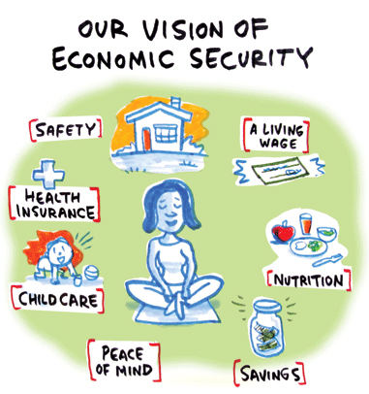
Grâce à leurs moyens et stratégies de subsistance, nos familles connaissent une situation de sécurité économique...
Dès lors qu’un ménage ou une communauté :
est autonome sur le plan économique
peut pourvoir aux besoins essentiels
Cours H.E.L.P.

Slide 29
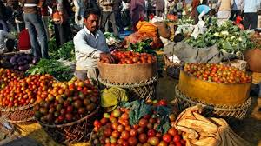
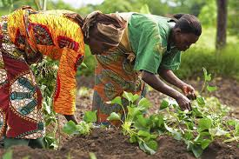
…et de sécurité alimentaire
La sécurité alimentaire existe lorsque tous les êtres humains ont, à tout moment, un accès physique et économique à une nourriture suffisante, saine et nutritive leur permettant de couvrir leurs besoins et leurs préférences alimentaires afin de mener une vie saine et active.
Sommet mondial de l’alimentation, 1996
Cours H.E.L.P.
Notes:
At the level of a HH, of a community or of a state

Slide 30
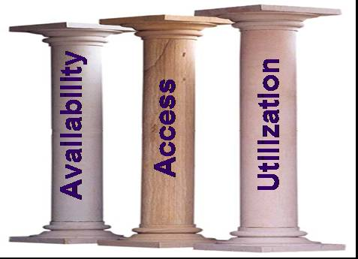
Les trois piliers de la sécurité alimentaire
Disponibilité de la nourriture
Production alimentaire, importations alimentaires, etc.
Accès à la nourriture
Production et réserves alimentaires des ménages, revenu des ménages, mécanismes de solidarité, troc, etc.
Utilisation de la nourriture
État de santé (diarrhée, paludisme, SIDA), stockage de la nourriture et pratiques culinaires, combustible, besoins liés à l’âge, etc.
Cours H.E.L.P.
Notes:
Availability: Sufficient quantities of appropriate food are physically available.
Access - Income or other resources are adequate to obtain sufficient and appropriate food. The main focus here is on the economic access of households to food. Often forgotten but also relevant is access to preparation facilities: i.e. fuel, cooking utensils, etc. (for example: in flooded areas fuel to cook might be needed)
Utilization - Food is properly used (food processing and storage practices, adequate knowledge and application of nutrition and child care principles, and adequate health and sanitation services). Also includes biological use, which is linked to a person’s health.

Slide 31
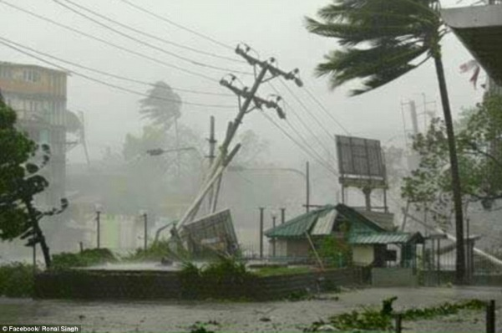
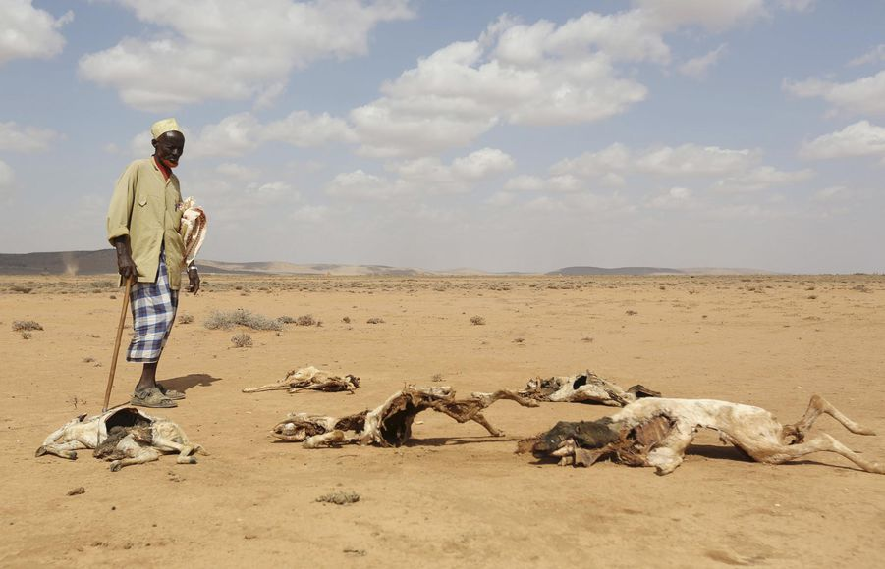
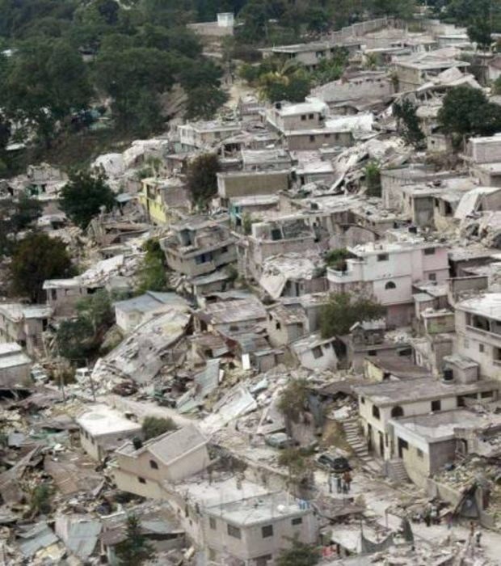
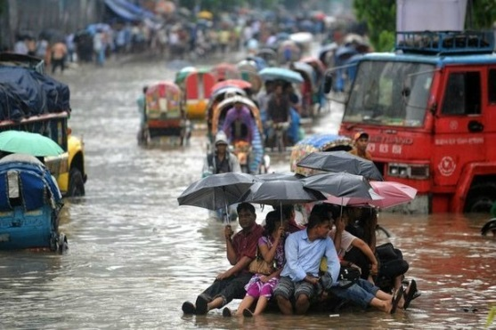
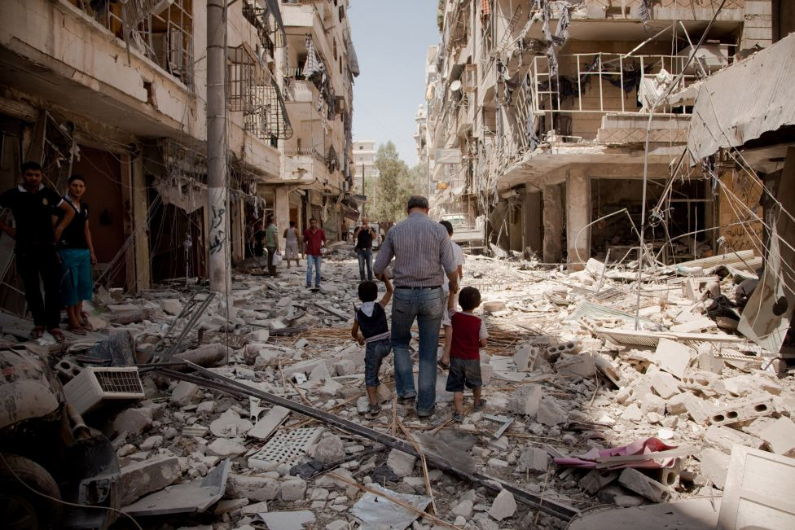
Mais ensuite… les choses ont changé…
Cours H.E.L.P.
Notes:
This crisis may be of sudden onset or more gradual, may occur in a previously stable context or in a more vulnerable context. There may as well be several crises hitting the same population. This will affect economic and food security and nutrition determinants. Let’s see how.

