Slide 1
Professional Standards in (ICRC) Physiotherapy
How to make them work

Slide 2
Good to know:
ICRC Physiotherapy Standards (PTS) are built around this cycle
PTS consist of 23 Standards
User/patient related: respect, informed consent, confidentiality
Therapist (service provider) related: communication, lifelong learning, professional conduct, quality improvement
Procedures (rehab cycle) related: assessment, treatment planning, implementation, evaluation, discharge
Service provision related: data management, safety & security, HR
PTS are implemented using tools (documents)
Assess and Analyse
Formulate and Plan
Implement and Monitor
Evaluate and Learn

Slide 3
You are not familiar with project cycle or results-based management (RBM)?
Check this out:
Wikipedia on RBM
Detailed guidelines on RBM by the ICRC’s Economic Security Unit:
The RBM approach
Measuring Results
Think of your approach with a patient or user: 1) assessment, 2) goal-setting and treatment planning, 3) treatment implementation, 4) re-assessment.
Now replace the rehabilitation user with the rehabilitation service. You want to address a gap in the service. Your approach here follows the same principle as when treating a patient: watch this video

Slide 4
PTS: Project & Rehab Cycle
Project cycle: Focus = project (service, team, training, etc.)
Rehab cycle: Focus = individual (rehabilitation service user)
Assess and Analyse
Formulate and Plan
Implement and Monitor
Evaluate and Learn
Assessment
Assignment
Intervention
Evaluation
Service
User

Slide 5
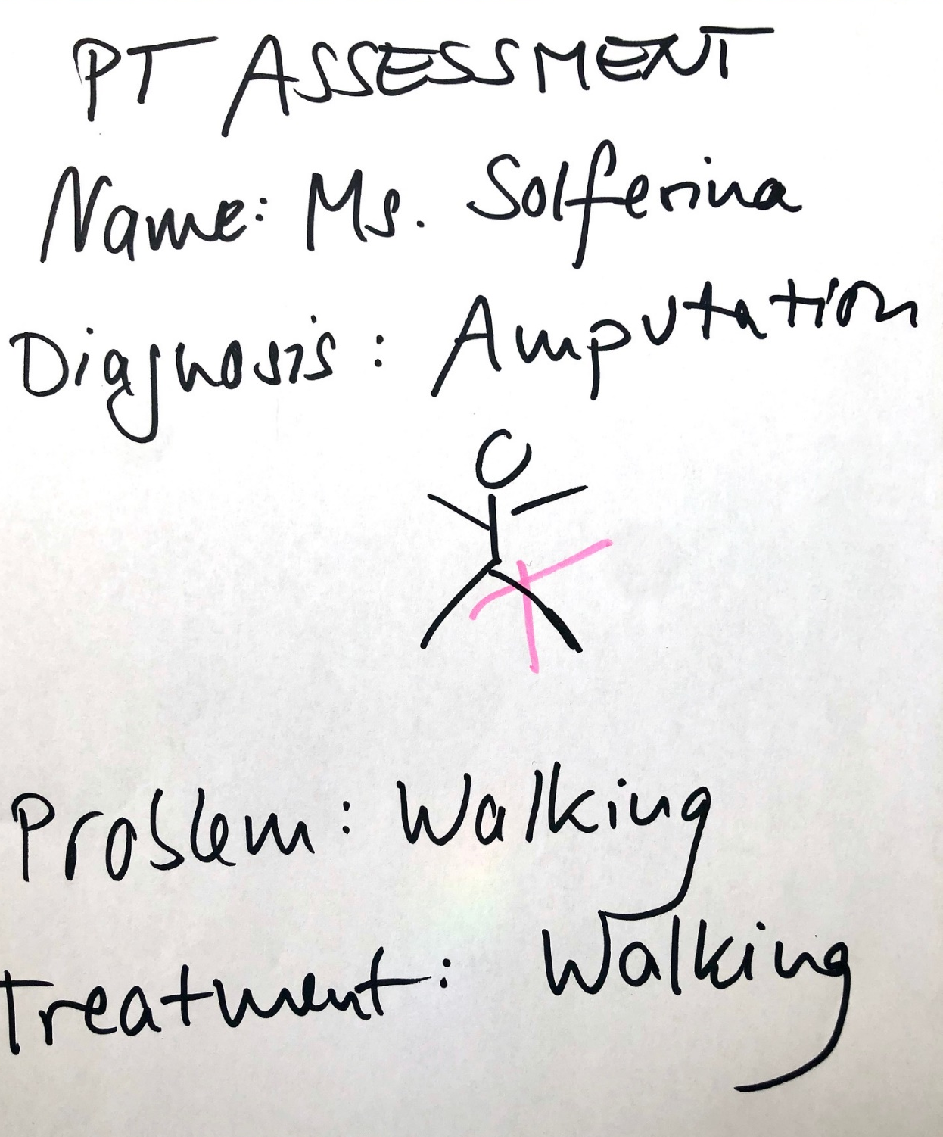
Let’s suppose the gap analysis reveals that the physiotherapy team uses an incomplete assessment form:
The form is not aligned to the assessment and treatment guidance which is part of the ICRC PT Standards
In addition, the PT team does not use outcome measures as part of their assessment

Slide 6
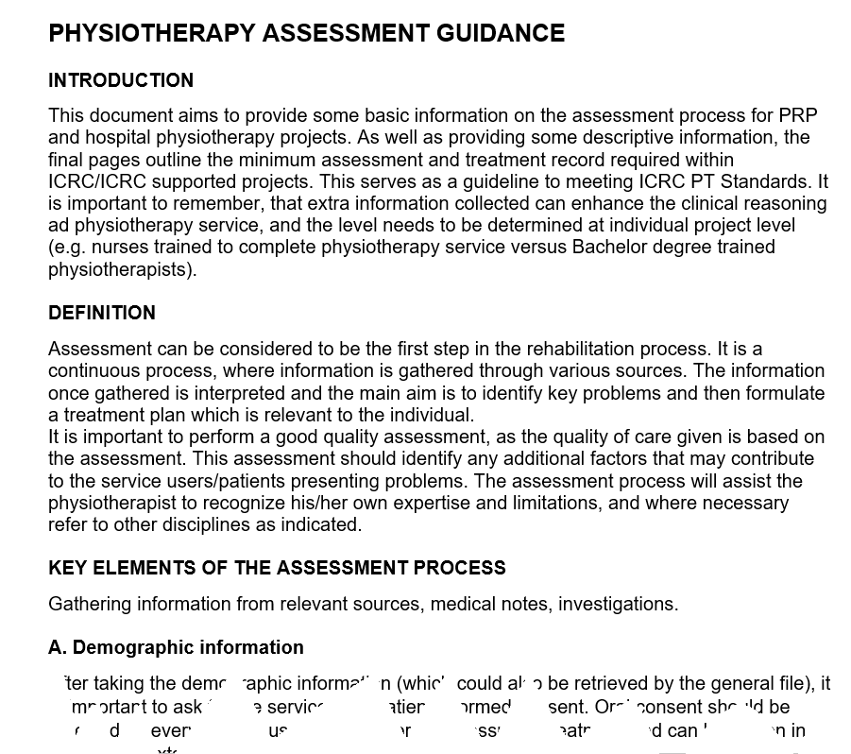
Adressing 1 gap on 2 cycles
You have detected a gap that needs addressing on both levels: project cycle and rehab cycle.
Why? The user in the centre of the rehab cycle needs a proper assessment and outcome measures in order to receive quality treatment.
To introduce this change you will work in a project cycle. You design an action plan to design a user assessment form following the assessment guidance.
For this you need resources: members of the physiotherapy team, time and space for meetings, access to a printer, etc.

Slide 7
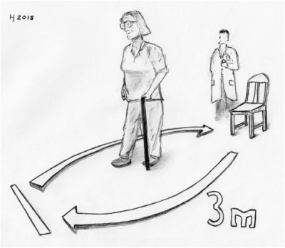
‘’Outcome measures zone’’
To address the gap in outcome measurement you want to create an ‘’outcome measures zone’’ in your treatment hall.
Outcome measurement should become routine practice for every user as part of the patient flow.
Also this activity will enter the action plan of the project cycle.

Slide 8
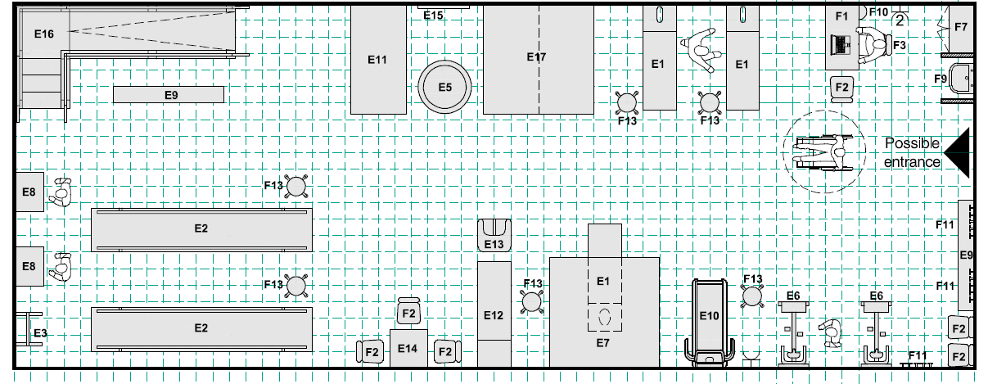
Here’s a graph from the ICRC architectural handbook for rehabilitation centres showing an exercise room full of equipment, but no space for outcome measurement. You might consider with your team to create an outcome measurement corner where the user enters the room.

Slide 9
Theory of change
Assess and Analyse
Formulate and Plan
Implement and Monitor
Evaluate and Learn
These changes require considerable effort, negotiations, convincing and resources such as money, time, skills, human resources. The key to this is called change management.
But let’s go back to the cycle. You have introduced the outcome measure area. That’s it! All gaps addressed?
You get the idea: the cycle is never finished! Whilst a project/rehab cycle is time-limited, re-assessment may launch a new cycle. It is acually a spiral. The purpose is increasing quality over time.

Slide 10
THE JOURNEY –
It is actually a spiral ☺
Re-Assess, start again ...
Evaluate & Learn
Q
U
A
L
I
T
Y
Implement & Monitor
Formulate & Plan
Assess & Analyse

Slide 11
PTS implementation within the Project Cycle
Start with a Situation Analysis (SA)
Discuss with line manager at which stage of the project cycle the project is and if a SA at this stage is practicable
Discuss with line manager or predecessor if a SA was done that you should build on rather than repeating the exercise
Internationals on mission should in any case start their post by doing a SA to get an overview, this SA will be part of the documents produced during mission (not necessarily part of the overall project cycle)
Do a Gap Analysis (GA) (points as above)
Formulate an Action Plan (AP) (points as above)
In addition to above points : discuss the AP with your line manager as you will need ressources (HR, budget, etc.) and time

Slide 12
Standard not met
Relevant*?
Yes
Achievable**?
No
Address later
Yes
Address now
No
Address later
Action plan***
Create risk assessment schedule
Design informed consent form
Choose guide for communication rules
Improve patient assessment form
Schedule monthly journal club meetings
Order material
Decision-making guide after a gap analysis has revealed unmet standards
*
1) now
2) in this context
3) for providing acceptable quality
**
1) now
2) in this context
3) with the given resources
*** examples

Slide 13
PTS implementation within the Rehab Cycle
Start with an Assessment (Ax) (you and your team)
If no ax form exists in the project, create one based on the ax guidance*)
If an ax form exists, compare it to the ax guidance and adjust if necessary*)
Assess the patient/user
Do the suggested outcome measures
Select other suitable outcome measures if applicable
Formulate a Treatment Plan (Tx plan) for and with the patient/user
Implement the Treatment Plan, etc. (see rehab cycle)
Refer to the PTS and gap analysis for any stage of the cycle and work with your team on meeting PTS as far as possible
*) this activity could already be part of a mini project formulated in the action plan

Slide 14
SITUATION & GAP ANALYSIS
SITUATION ANALYSIS (SA) : findings from one project documented in a standardized form; each project is unique and individual, SAs are not necessarily comparable
GAP ANALYSIS (GA): 23 ICRC PT standards (aligned to international professional standards); if administered in standardized way = comparable (time 1 time 2, project 1  project 2)
BUT: reliability, validity and responsiveness of the gap analysis have not been tested! Be aware of these limitations when considering comparison of projects across different contexts

Slide 15
ASSESSMENT & OUTCOME MEASURES
USER ASSESSMENT (ax) are findings from one user in a standardized form; this usually differs from service to service; findings are individual, not necessarily comparable
OUTCOME MEASURES (ocm) are internationally published validated test to be administered acc to instructions and always in the same way = comparable (time 1  time 2; user 1  user 2)
An assessment contains outcome measures that are
Obligatory (eg. service procedures require a WHODAS for each user)
Suggested (eg. service procedures suggest a TUG for each user with LL/ mobility limitations)
Selected (by therapist following findings from individual user’s assessment)

Slide 16
assess&analyse Assessment formulate&plan Assignment implement&monitor Intervention
Project cycle
Rehab cycle
Ax
OCM
Tx plan
GA
SA
Action plan
Patient progress monitoring
Project progress monitoring

Slide 17
Tools ... Tools ... Tools
Rehab Cycle Tools | Cycle Stage | Project Cycle Tools
Assessment & treatment guidance, outcome measures | <<Assessment Assess & analyse>> | Situation analysis, gap analysis, PT competency checklist
Assessment & treatment guidance; SMART goal setting; tx protocols | <<Assignment Formulate & plan>> | Action plan; SMART goal setting
Applied EIP/EBP; progress diary; phone app; exercise tracker (watch) | <<Intervention Implement & monitor>> | Action plan and other monitoring tools (reporting tools, database ..)
Same assessment and outcome measures, user feedback | <<Evaluation Evaluate & learn>> | Same assessment tools (SA, GA, competency checklist), action plan (verify indicators)
All tools are on this webpage for download 

Slide 18
Every workplace is different ...
As a mobile (international) physio you might arrive in a new project or in an already running project
You will initiate, lead, integrate into and/or follow a project cycle according to context
You should in any case do your own analysis using project cycle documents
You can always suggest/initiate a project within a bigger one, eg. a training cycle
As a resident or partner (national) physio you might work in a context that is managed in project cycles
You may initiate, lead, integrate into and/or follow a project cycle according to context
If not, you should still regularly do your own analysis using project cycle documents (eg. each year in January)
In any case the project cycle documents will help you to organise your work & stimulate change

Slide 19
Types of cycles
The choice of tools and documents depends on what’s in the centre of the cycle
Missing elements of the rehab cycle could become part of a project: eg. a training on outcome measures
Every cycle to be successful is part of a bigger project: eg. gaps in a patient rehab cycle often reflect gaps in service organisation and should be adressed on both levels
Also the success of your own professional development will be better if you organise it in cycles
service
patient
team
department
user
yourself
training
part of bigger project

Slide 20
Confused?
Just work your way through the module and the different tools
Read this presentation again at the end
It will be much clearer then!

