Slide 1
Change management
©ICRC PTS project 2019

Slide 2
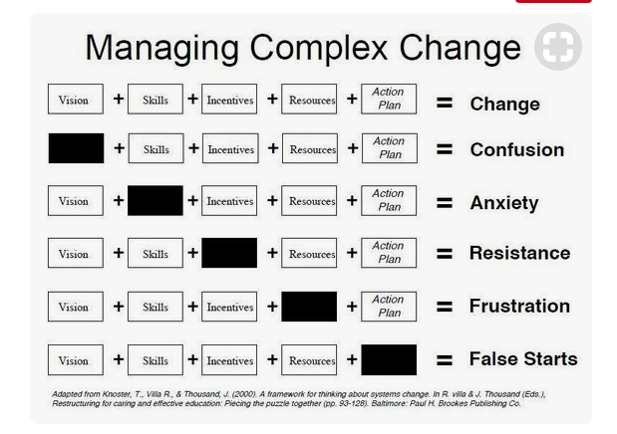
©ICRC PTS project 2019

Slide 3
Change Management
What comes to mind?
©ICRC PTS project 2019

Slide 4
Principles
Human side – confront reality and respect culture
Leaders must start the change and be role models
3. Break barriers
4. Mobilise people and stimulate ownership
©ICRC PTS project 2019

Slide 5
How to do it
Communicate the vision/opportunity
Design and plan
Implement: prepare for the unexpected!
Empower action
Expect to encounter resistance and see why
Support, reward, training, TOOLS
©ICRC PTS project 2019

Slide 6
We don’t need heroic and charismatic people to lead us
©ICRC PTS project 2019

Slide 7
A Change Champion Is
On front line, dispels anxieties
Leader
Ambassador
Role Model
Enthusiast
©ICRC PTS project 2019

